Slide 1
Retrieval of Ocean Surface Wind Speed for Future Passive Microwave Imager: MWI
Sisma Samuel, Anton Verhoef, Ad Stoffelen
IOVWST, 28-05-2024

Slide 2
Outline
Passive Microwave Remote Sensing: Introduction
Microwave Imager onboard Metop-SG
1D-Var Retrieval of wind speed
Comparison of
Simulated vs Observed Brightness Temperature
Retrieved Wind speed vs model wind speed

Slide 3
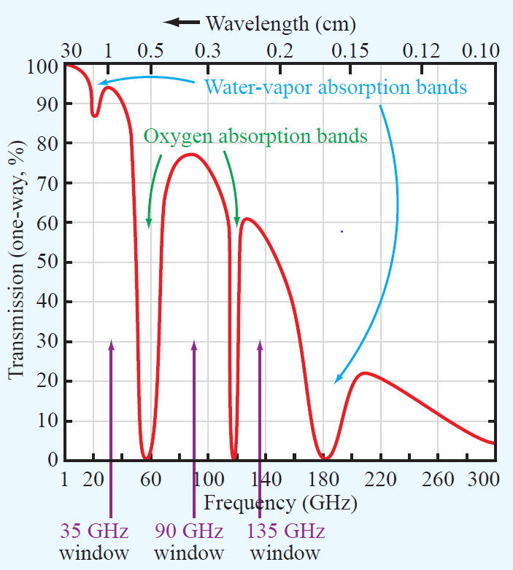
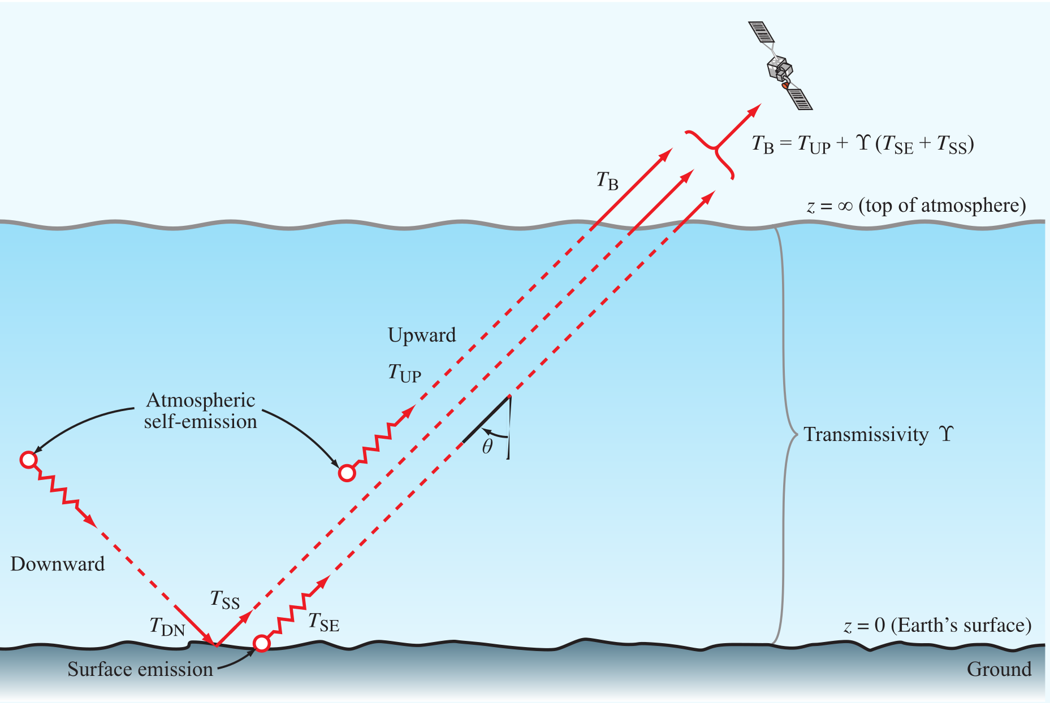
Passive Microwave Remote Sensing: Introduction
Observes the thermal emissions- Brightness temperature
22 GHz
T_{SE}- Surface emitted
T_{UP}- Radiation upward by atmosphere
T_{SS}- Surface scattered
183.3 GHz
©Ulaby et al. 2014
The longer wavelength of microwaves enables it to penetrate through clouds, haze, and dust

Slide 4
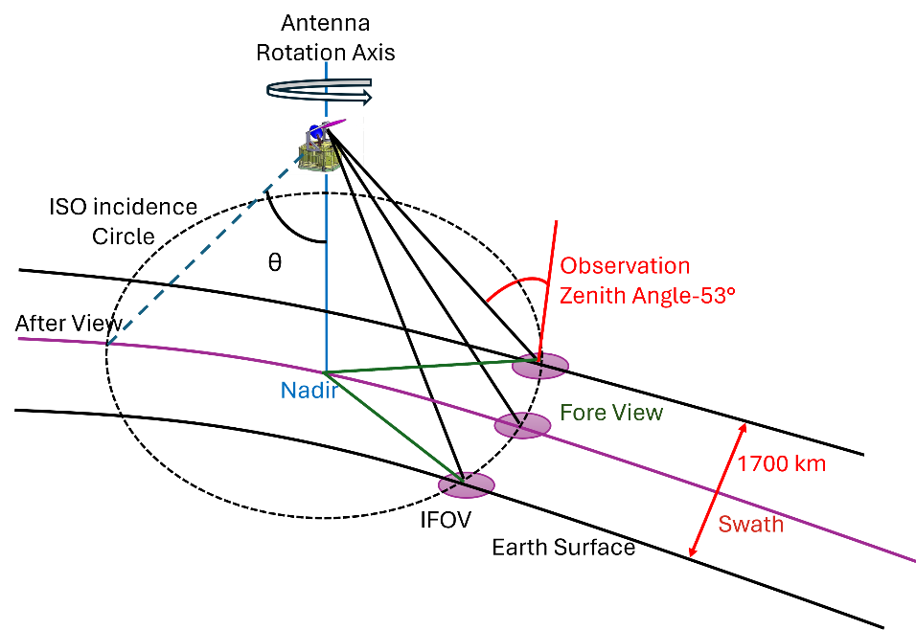
Microwave Imager
Microwave Imager (MWI) is a conically scanning Radiometer onboard Metop-SG
18 frequencies, 26 channels
Constant Zenith Angle ~ 53°
Swath 1700 km, 40 scans/min = 10 km/scan
No | Central frequency (GHz) | Bandwidth (MHz) | Polarisations | IFOV
1 | 18.7 | 200 | V, H | 50 km
2 | 23.8 | 400 | V, H | 50 km
3 | 31.4 | 200 | V, H | 30 km
4 | 50.3 | 180 | V, H | 30 km
5 | 52.8 | 400 | V, H | 30 km
6 | 53.24 | 400 | V, H | 30 km
7 | 53.75 | 400 | V, H | 30 km
8 | 89.0 | 400 | V, H | 10 km
9 | 118.7503±3.2 | 1000 | V | 10 km
10 | 118.7503±2.1 | 800 | V | 10 km
11 | 118.7503±1.4 | 800 | V | 10 km
12 | 118.7503±1.2 | 800 | V | 10 km
13 | 165.5±0.725 | 2700 | V | 10 km
14 | 183.31±7.0 | 4000 | V | 10 km
15 | 183.31±6.1 | 3000 | V | 10 km
16 | 183.31±4.9 | 3000 | V | 10 km
17 | 183.31±3.4 | 3000 | V | 10 km
18 | 183.31±2.0 | 3000 | V | 10 km

Slide 5
Microwave Imager
Microwave Imager (MWI) is a conically scanning Radiometer onboard Metop-SG
18 frequencies, 26 channels
Constant Zenith Angle ~ 53°
Swath 1700 km, 40 scans/min = 10 km/scan
Channel No | Central frequency (GHz) | Bandwidth (MHz) | Polarisation | IFOV
12 | 19.35 | 355 | H | 25
13 | 19.35 | 365 | V | 25
14 | 22.235 | 407 | V | 25
15 | 37 | 1615 | H | 25
16 | 37 | 1545 | V | 25
Currently we make use of Special Sensor Microwave Imager/Sounder (SSMIS) for wind retrieval

Slide 6
1D-Var Retrieval of wind speed
1D-Var requires a background profile to derive first guess of atmospheric state- NWPSAF & ERA5 profiles
Input profile
Select matching profiles
Matching profile is selected based on SST and windspeed
No
Compute Brightness Temperature
RTTOV calculates T_{B} for each wavelength.
SURFEM model: for ocean surface emissivity
Estimate optimal solution by minimizing cost function
T_{B} filtering to avoid larger mismatch
Run 1D-Var
1D-Var
Converged
?
If yes, written to output.

Slide 7
Simulated vs Observed Brightness Temperature-All sky Condition
19H
19V
22V
RTTOV calculates the T_{B} for each channel based on the background atmospheric profiles
37H
37V
NWPSAF Profile

Slide 8
Simulated vs Observed Brightness Temperature-All sky Condition
19H
19V
22V
RTTOV calculates the T_{B} for each channel based on the background atmospheric profiles
37H
37V
ERA5 Profile

Slide 9
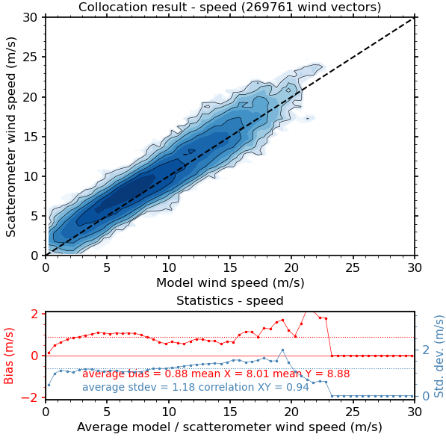
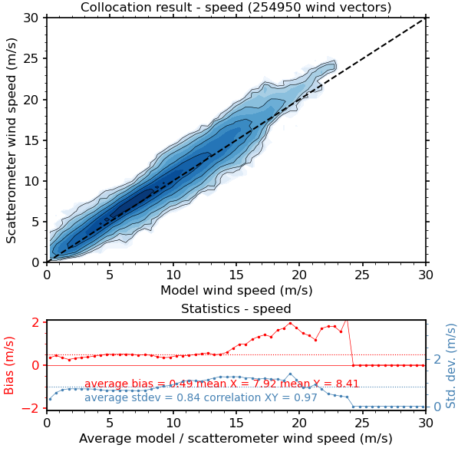
Comparison of retrieved Wind speed to model windspeed
NWPSAF Profile
ERA5 Profile
Radiometer wind speed (m/s)
Radiometer wind speed (m/s)
Wind speed was estimated by minimizing the cost function

Slide 10
Comparison of retrieved Wind speed: After Bias correction
NWPSAF Profile
ERA5 Profile
Radiometer wind speed (m/s)
Radiometer wind speed (m/s)
Average bias and Std Dev reduces after bias correction

Slide 11
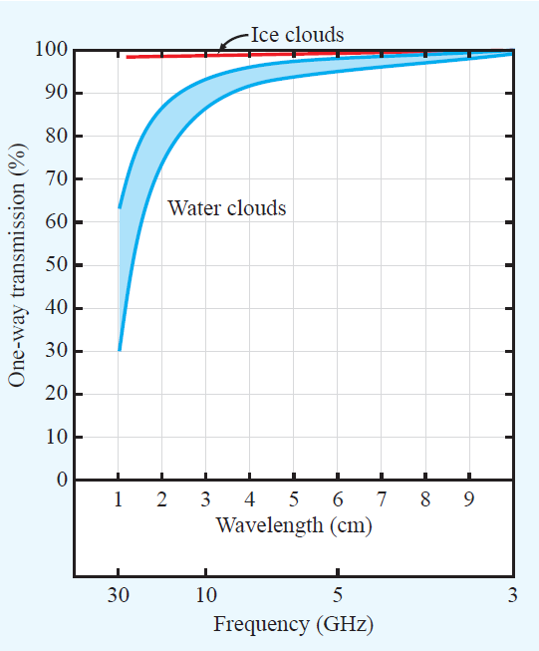
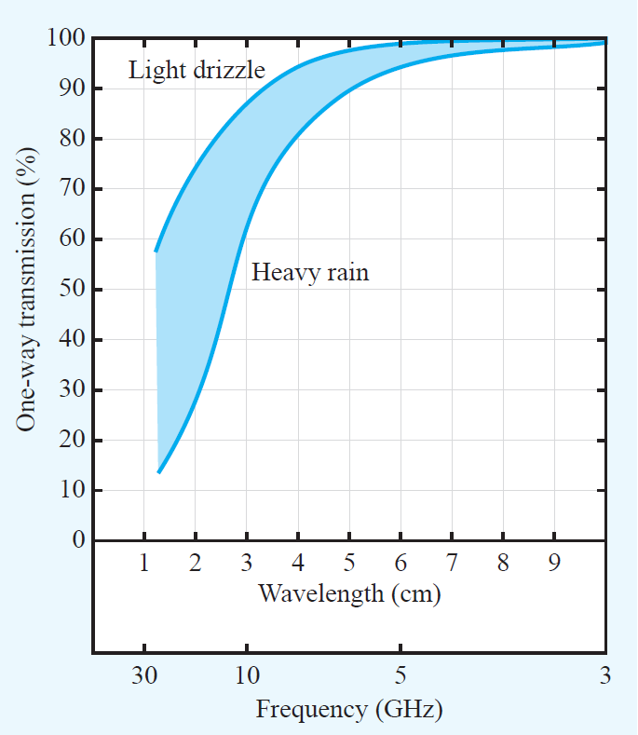
Attenuation effect of rain
Rain Flag:
T_{B} (37V)-T_{B}(37H)<50K
T_{B} (19H)>165K
Goodberlet et al., 1989
Connor and Chang, 2000

Slide 12
Simulated vs Observed Brightness Temperature: Rain Flag
19H
19V
22V
RTTOV calculates the T_{B} for each channel based on the background atmospheric profiles.
~18% of points are removed after applying rain flag
37H
37V
NWPSAF Profile

Slide 13
Simulated vs Observed Brightness Temperature: Rain Flag
19H
19V
22V
RTTOV calculates the T_{B} for each channel based on the background atmospheric profiles.
~20% of points are removed after applying rain flag
37H
37V
ERA5 Profile

Slide 14
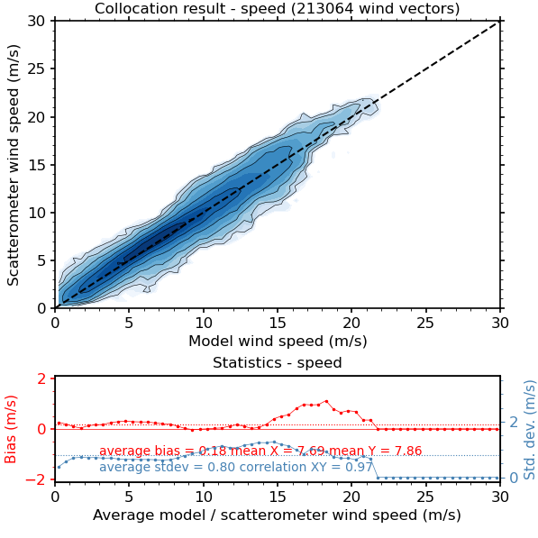
Comparison of retrieved Wind speed: After bias correction
NWPSAF Profile
ERA5 Profile
NWPSAF
ERA5
Radiometer wind speed (m/s)
Radiometer wind speed (m/s)
Average bias and Std Dev reduces after bias correction for rain flag cases

Slide 15
Conclusion
Currently, we make use of the SSMIS onboard DMSP to prepare for future MWI retrievals.
The NWP SAF 1-Dimensional Variational Technique and Radiative transfer model (RTTOV) is used for the retrieval of near surface wind speed.
All-sky condition |  |  |  | Rain Flag
Before Bias Correction |  | After Bias Correction |  | After Bias Correction
Bias | Std Dev | Bias | Std Dev | Bias | Std Dev
0.49 | 0.84 | 0.21 | 0.82 | 0.18 | 0.80
0.88 | 1.18 | 0.62 | 1.16 | 0.63 | 1.10
ERA5
NWPSAF
Thank you

