Slide 1
Coastal Wind Observations with HF Radar: Status and Validation
Brian Emery¹ and Anthony Kirincich²
¹University of California Santa Barbara
²Woods Hole Oceanographic Institution
Notes:
We join a long history of attempts at this …
problem, why it’s important, what we’ve achieved, what follows

Slide 2
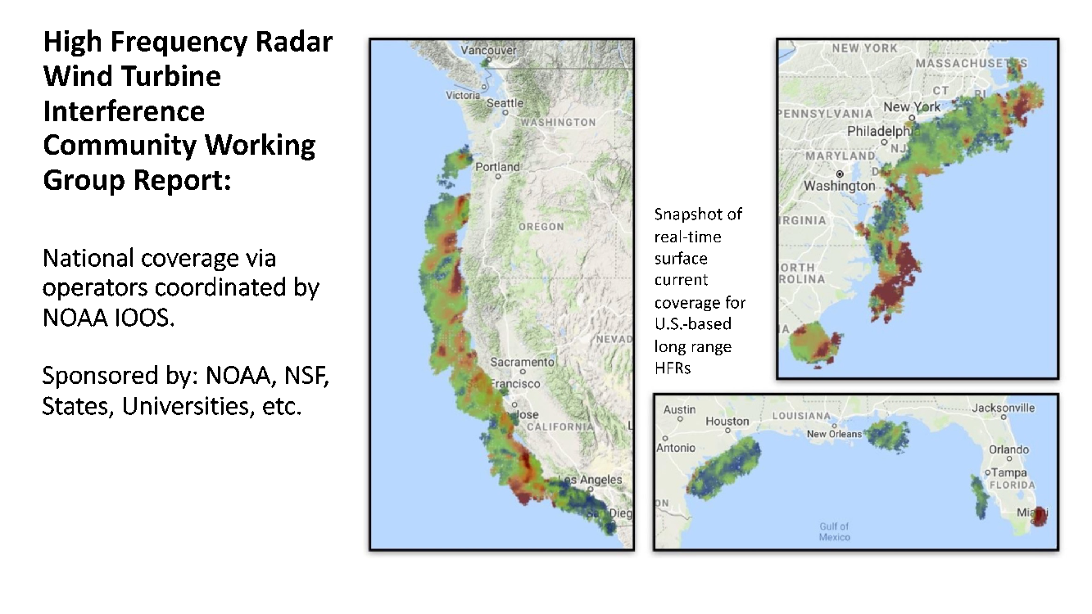
165 Radars
Hourly Currents
2 km grid
12 m waves
… wind?
Notes:
WHY THIS IS IMPORTANT
Coastal coincident Winds and currents
… 12 meter ocean waves

Slide 3
Radar Equation/Radar Cross Section
Attenuation
Bragg wave spectral power
Constants
Area of scattering patch

Slide 4
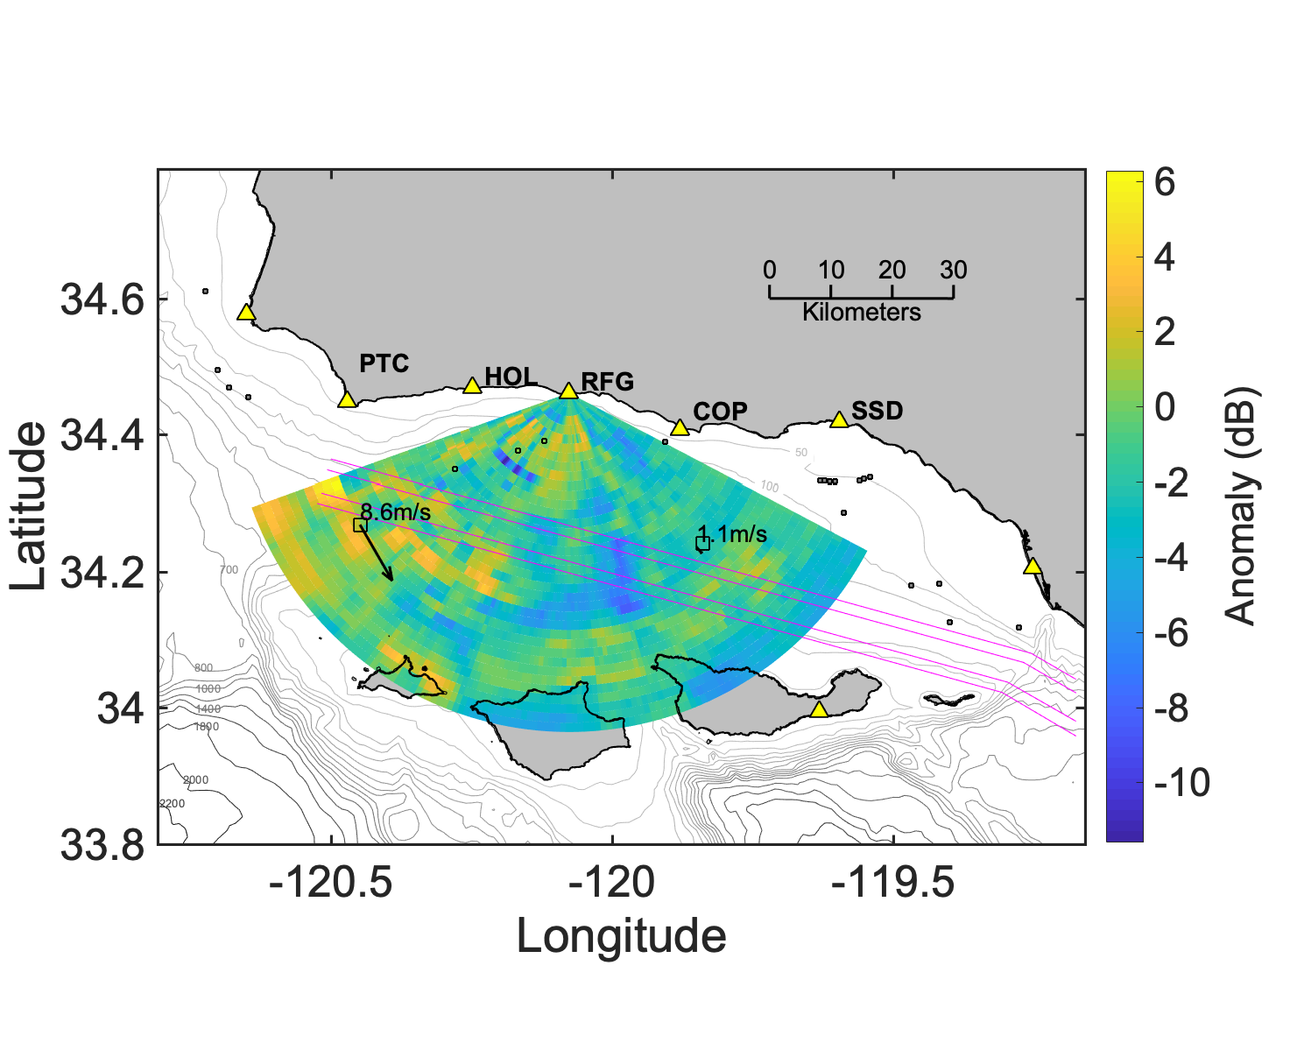
Signal Power Anomaly
46054
46053
Notes:
Number of radars in this region
NDBC buoys
What each radar measures (FIRST ORDER POWER) (currents from Doppler shift)
Make point of wind variation

Slide 5
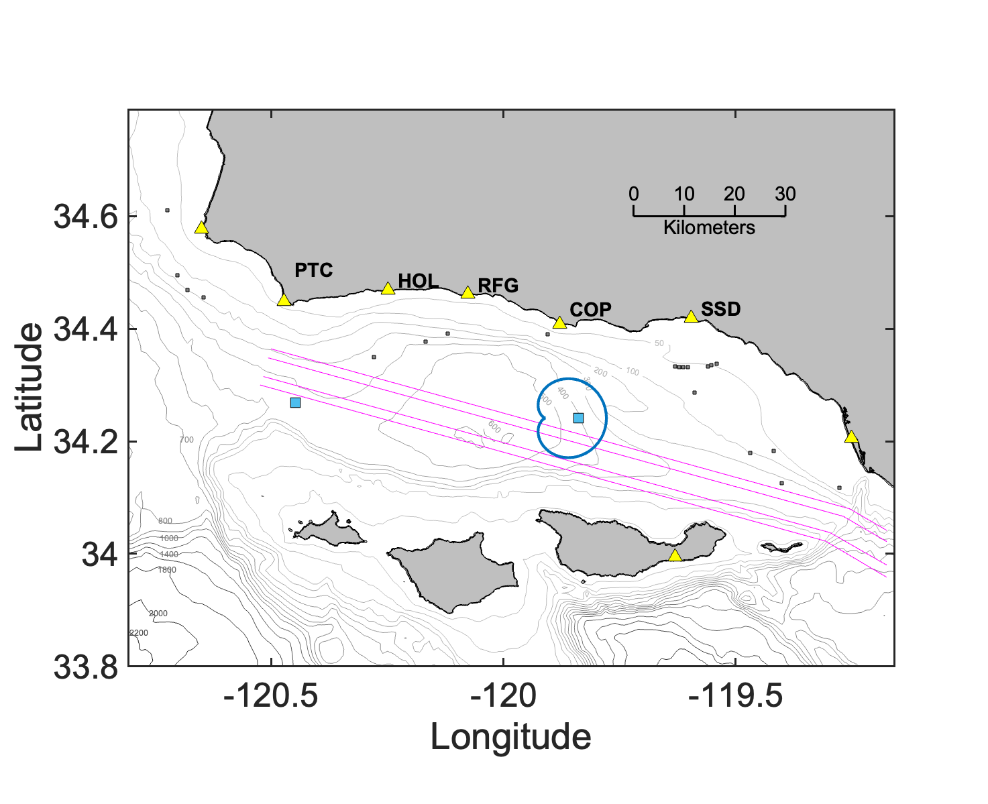
Notes:
… combine data from multiple sites …
… approach and receding waves
sampling the wind-wave distribution

Slide 6
Notes:
… combine data from multiple sites …
ADD GMF
… approach
sampling the wind-wave distribution

Slide 7
Notes:
… combine data from multiple sites …
ADD GMF
… approach
sampling the wind-wave distribution

Slide 8
Notes:
… combine data from multiple sites …
ADD GMF
… approach
sampling the wind-wave distribution

Slide 9
“GMF”
Wave Growth
Decay
Kirincich, 2016
Notes:
… combine data from multiple sites …
… approach
sampling the wind-wave distribution

Slide 10
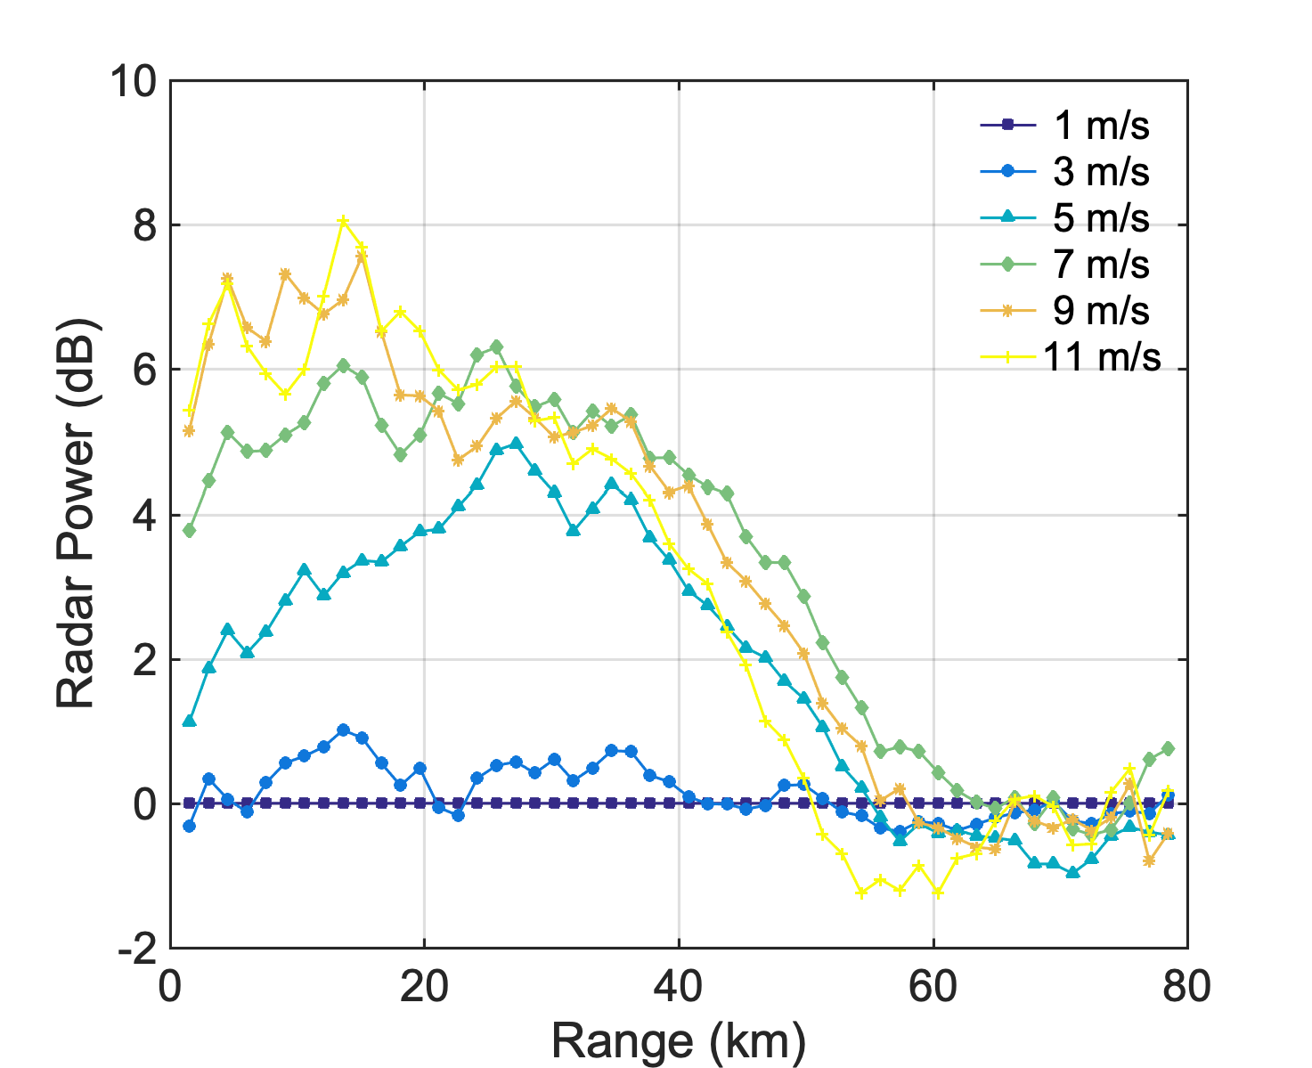
Notes:
Add anomaly conditioned on wind speed

Slide 11
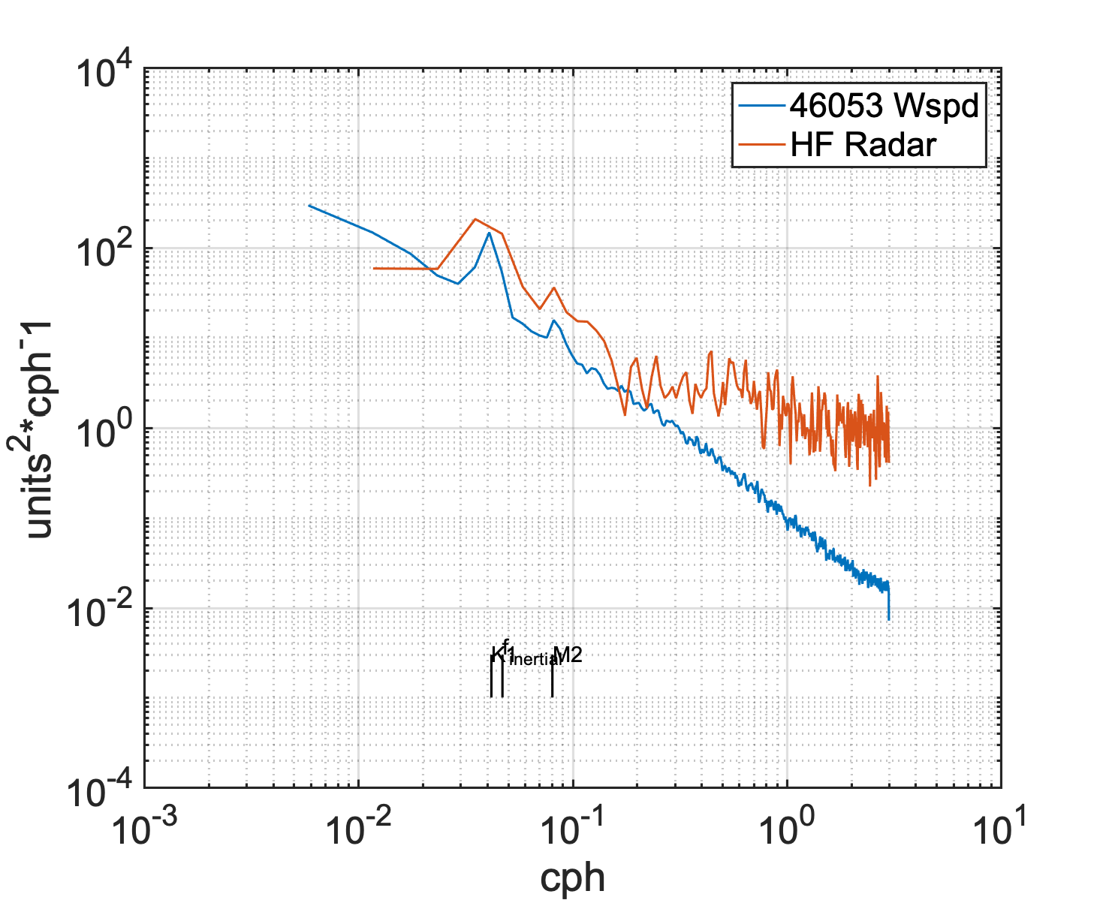
Notes:
… a lot of noise
Minimize DOA error
EOF filling Gaps
UKF smoothing with simple data model

Slide 12
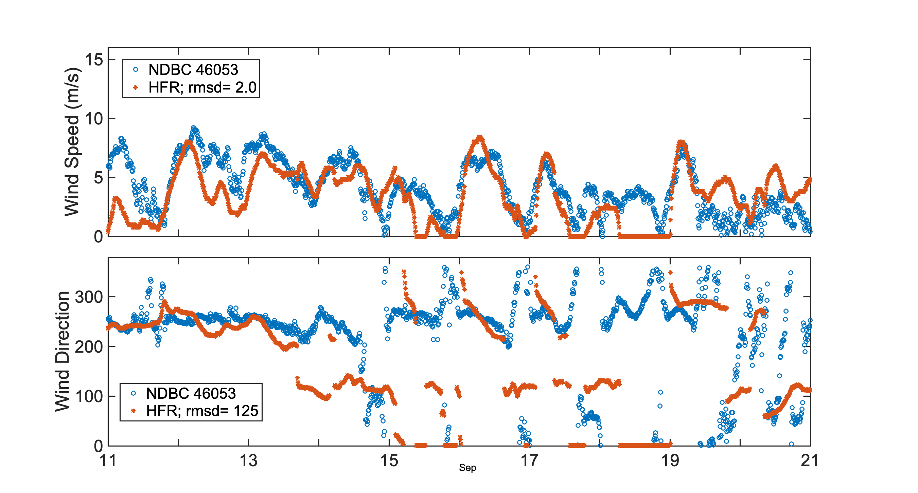
September 2021

Slide 13
Coastal Wind Observations with HF Radar: Status and Validation
Status:
- 2 m/s RMSD; comparable with others
Ongoing:
wave glider data
Better UKF model
Use of variational methods
Better attenuation accounting

Slide 14
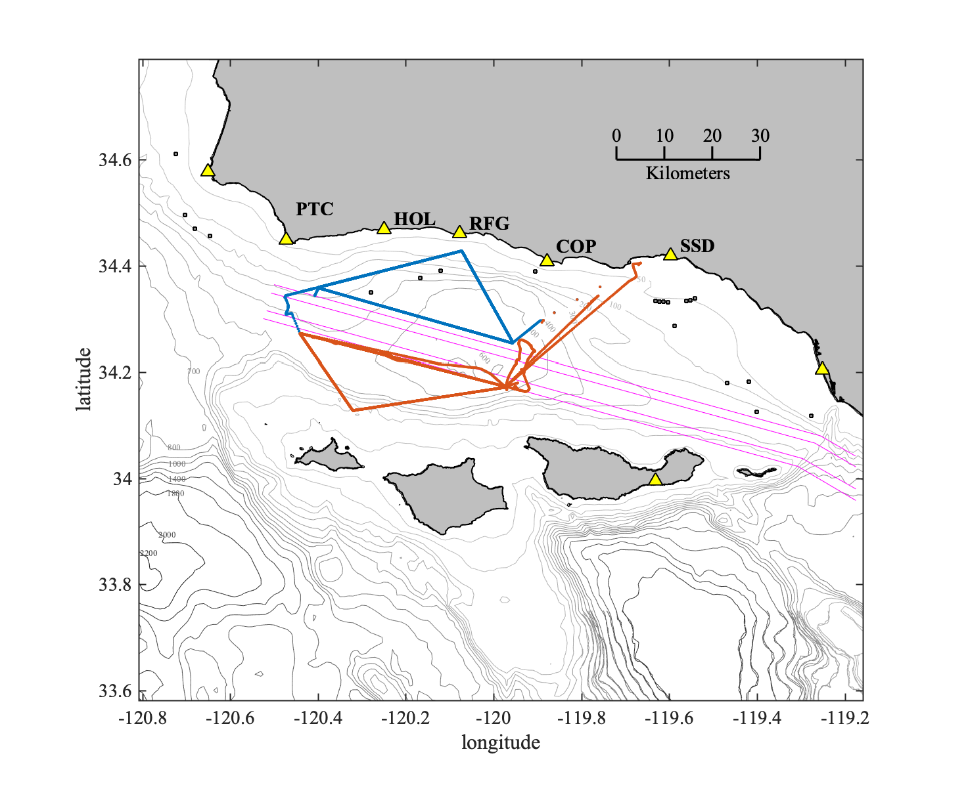
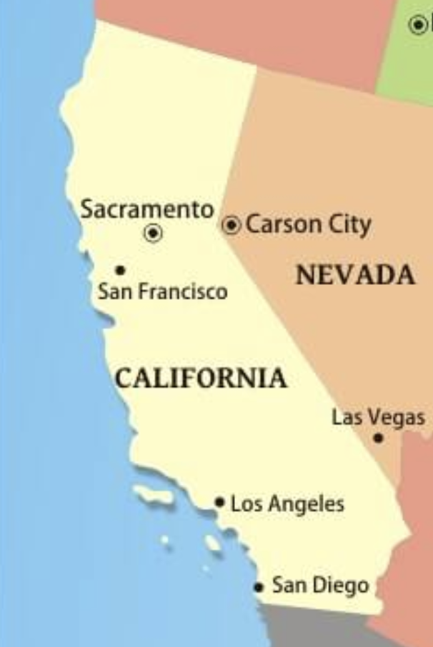
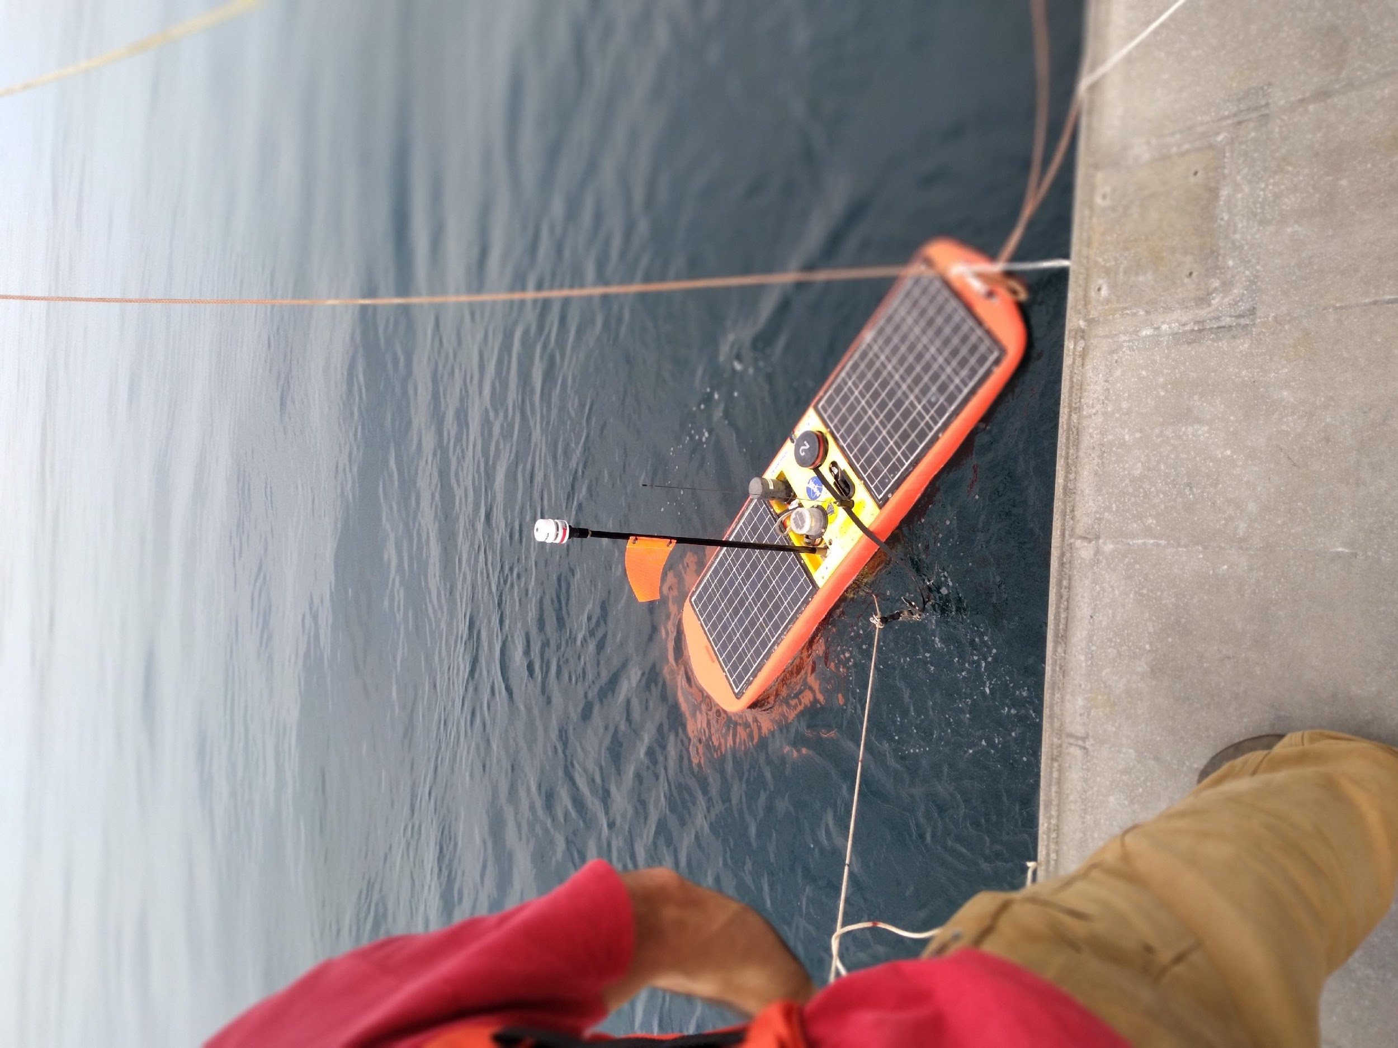
Spatial Wind Observations
… off Martha’s Vineyard too
Notes:
Wave glider map spatial winds
Time/Space Measurements of surface winds .. several HF radars
Main ‘Calibration’ data set

Slide 15
Coastal Wind Observations with HF Radar: Status and Validation
Status:
- 2 m/s RMSD; comparable with others
Ongoing:
wave glider data
Better UKF model
Use of variational methods
Better attenuation accounting
Thanks
brian.emery@ucsb.edu

Slide 16
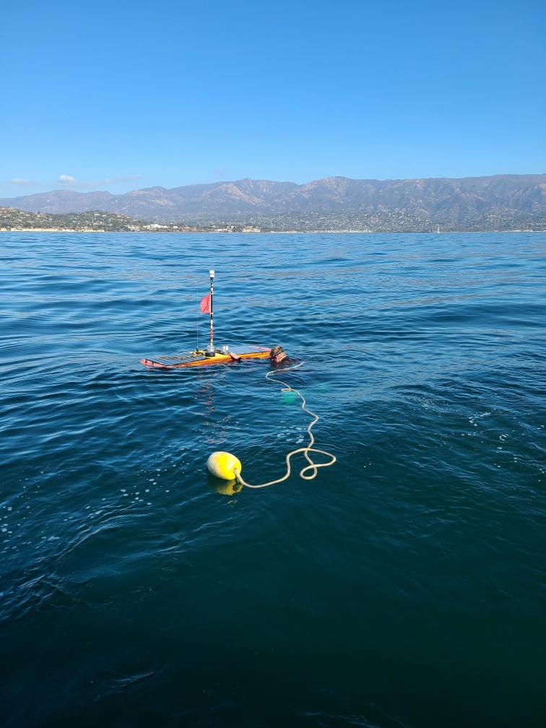
Thanks
brian.emery@ucsb.edu
Notes:
Wishing you skepticism and wonder

Slide 17
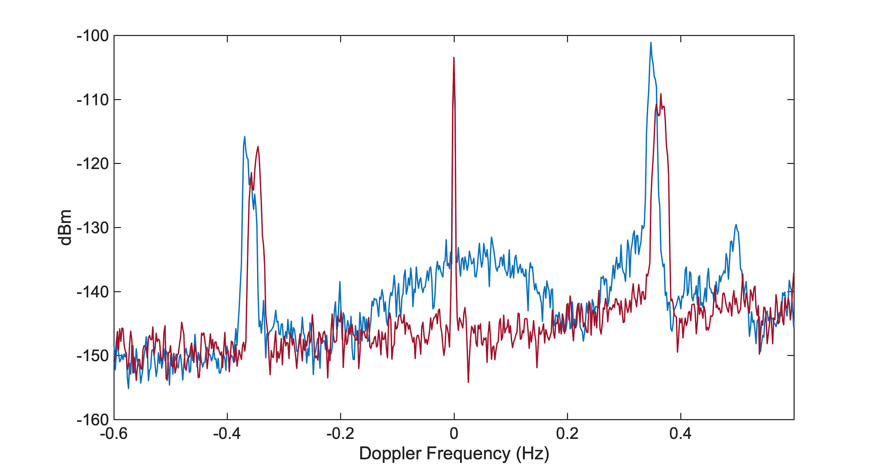
First Order Bragg Scatter
~10 dB
Notes:
… others use 2nd order

Slide 18
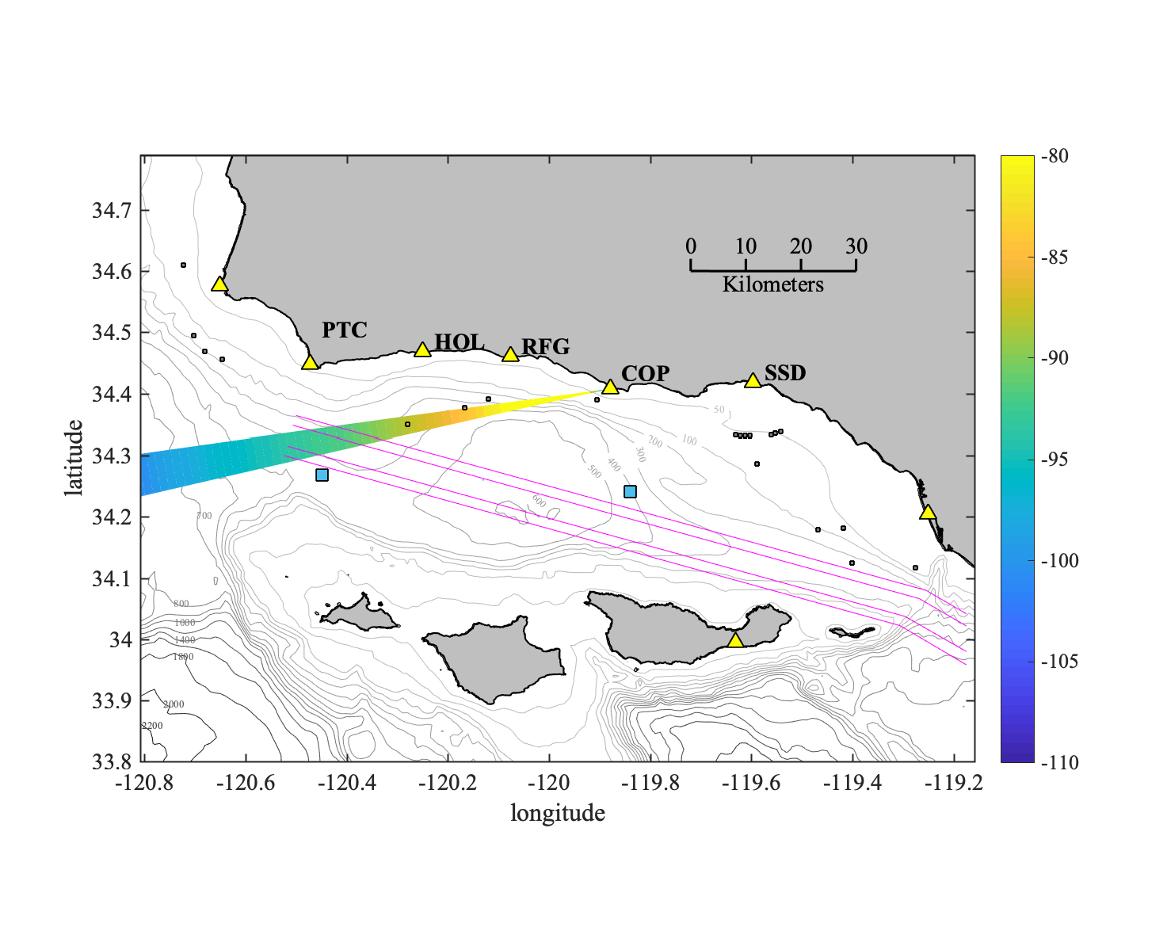
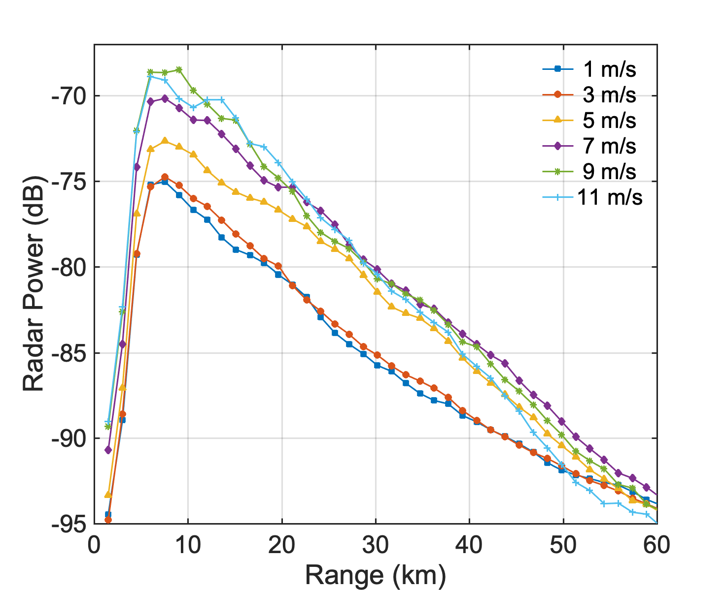
conditional average by wind speed
Notes:
Blanking
First part, wind speed and power linear … decreasing with range
2nd part roughness becomes important

Slide 19
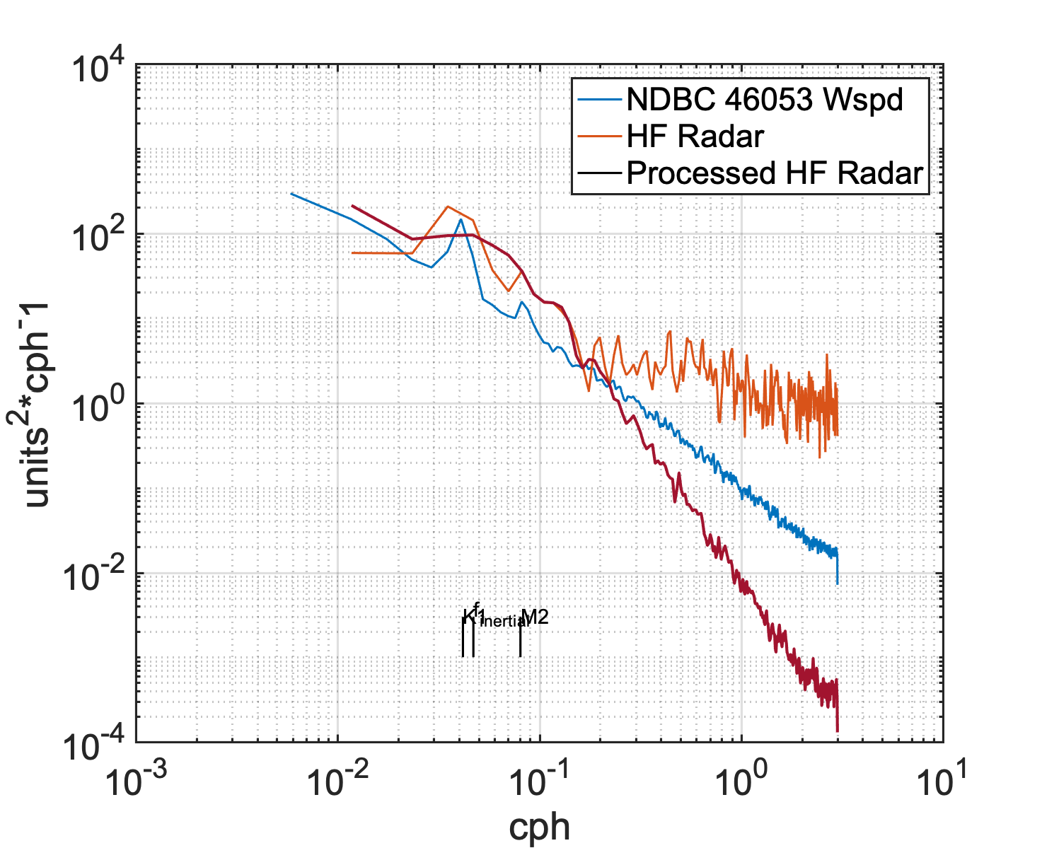

Slide 20
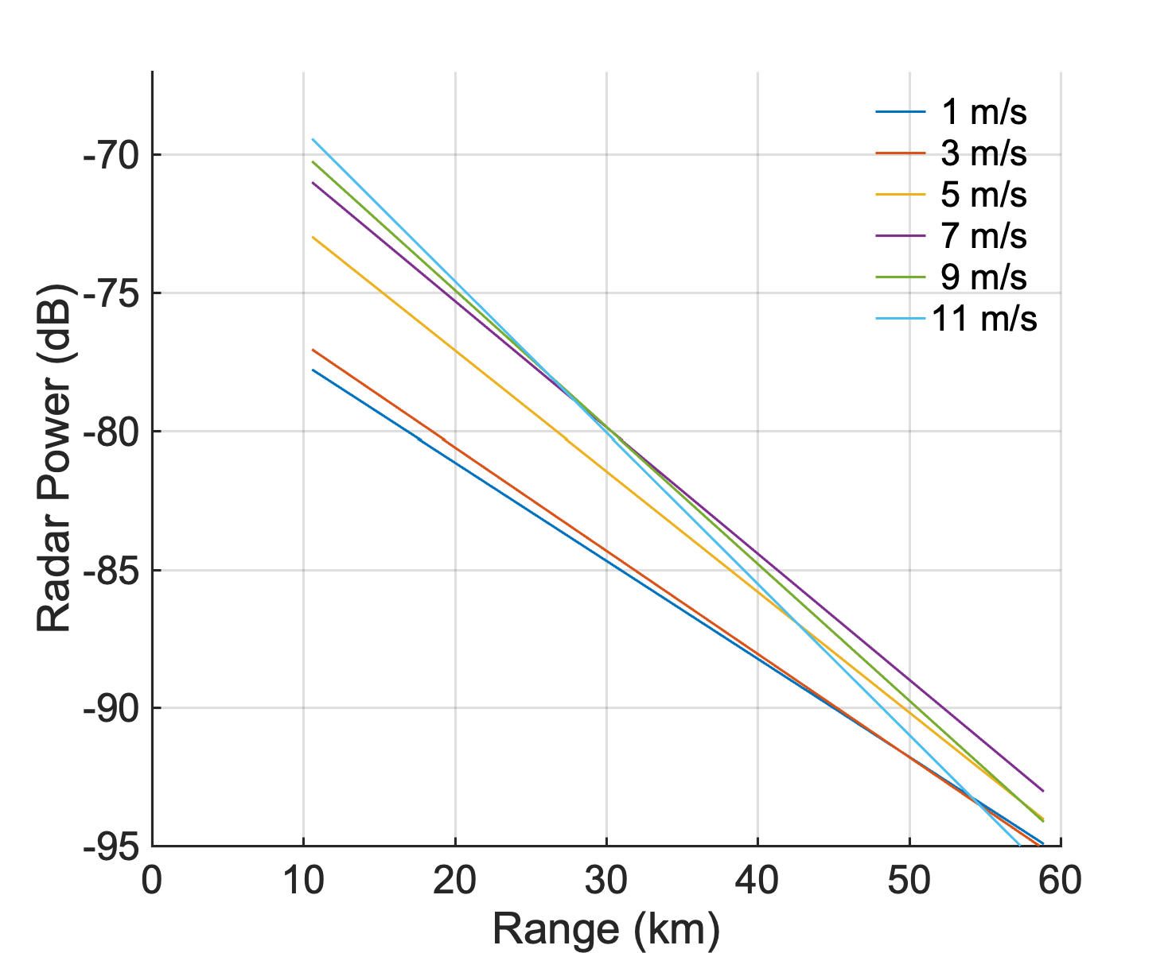
conditional average by wind speed
Notes:
Higher winds, more attenuation along path

Slide 21
“GMF”
Directionality
Observed Power
Wave Growth
Attenuation at high wind speeds
From Kirincich (2016)
Notes:
Typical GMF relates to the RCS which is part of the P term
We are working to account for other factors affecting P
From: Kirincich, A. (2016) Remote Sensing of the Surface Wind Field over the Coast Ocean via Direct Calibration
of HF Radar Backscatter Power. J. Atmos. Ocean. Technol. 33:1377–1392.

Slide 22
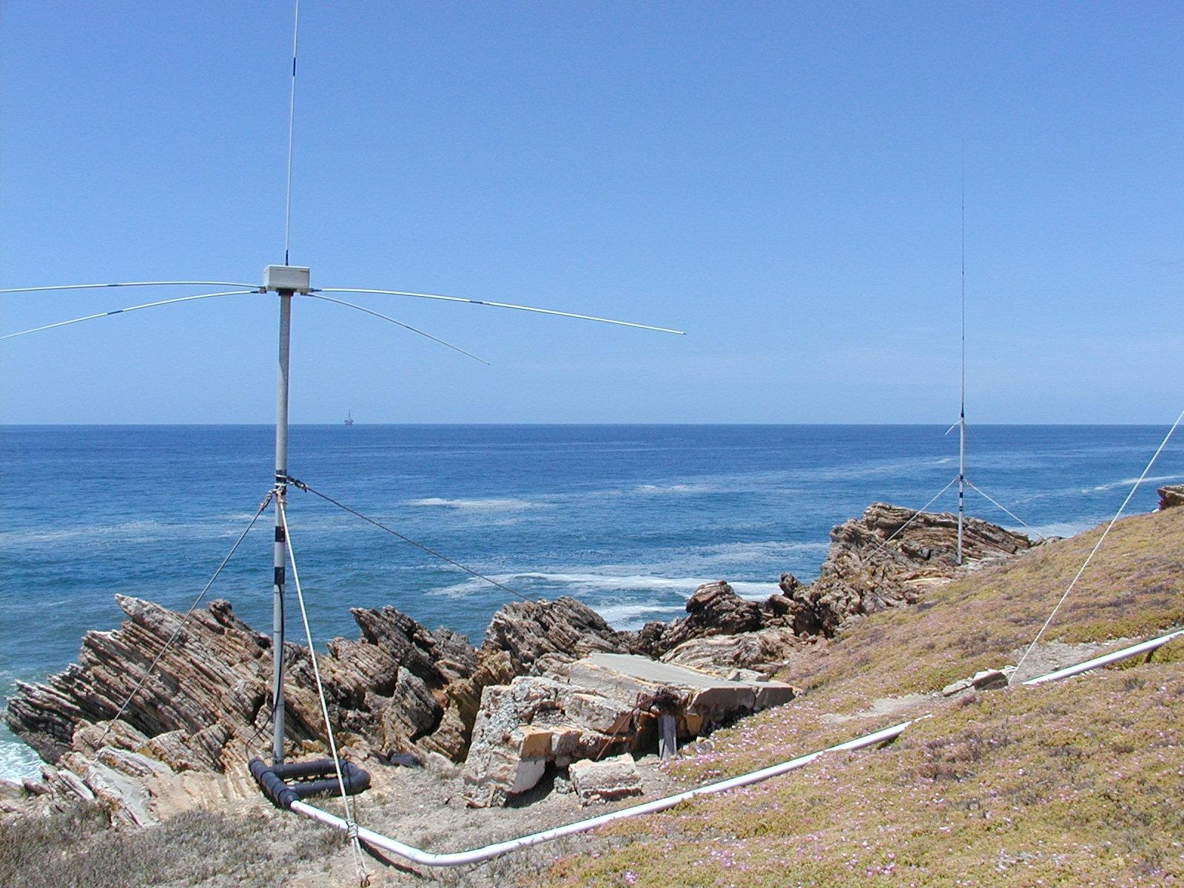
SeaSonde (3 receive antennas)
Univ. of Hawaii (8 receive antennas)
UH HFR receive antenna installed on Nantucket Island, MA.
Notes:
Radiowaves ~20m long, ocean waves about 10 m (or x period)
Ground wave propagation
Bragg scattering

Slide 23
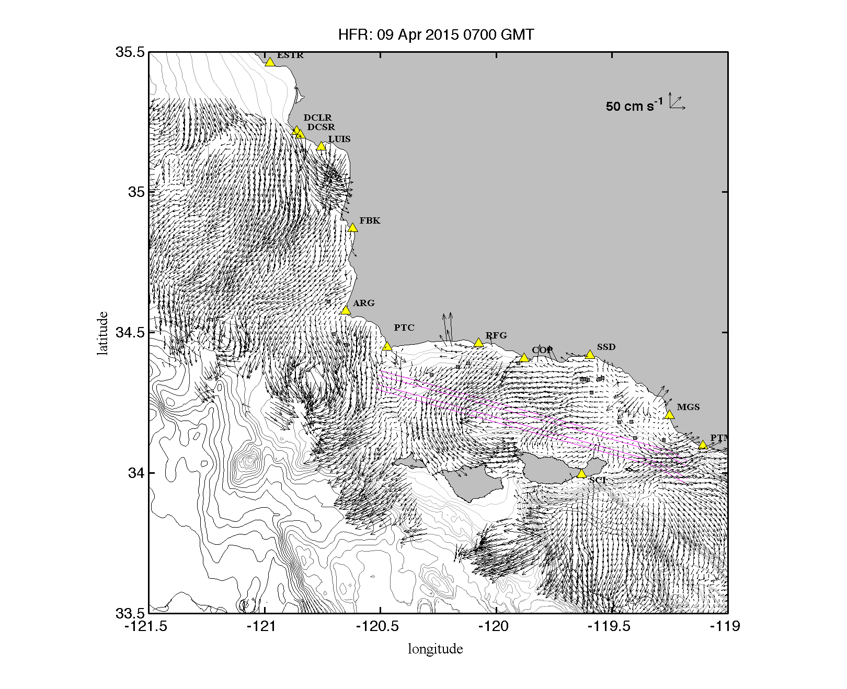
Notes:
Building an HFR Network
And a network of operators! … ROWG starting during this time …

Slide 25
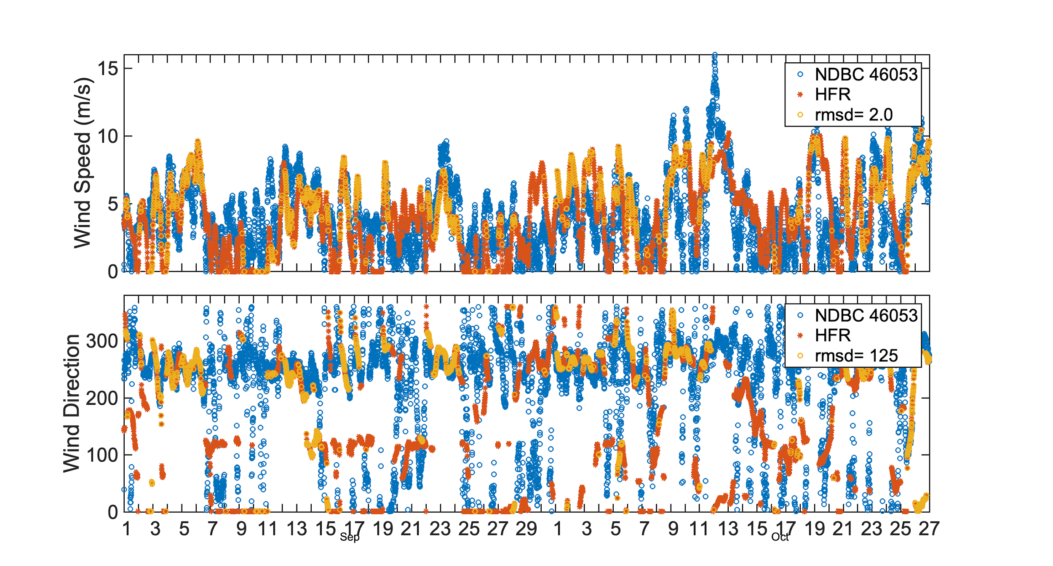
Notes:
2.4 for whole timeseries
stats_noNaN(B53.WSPD) has stdev of 2.5 m/s (2.2 for what is shown here)

Slide 26
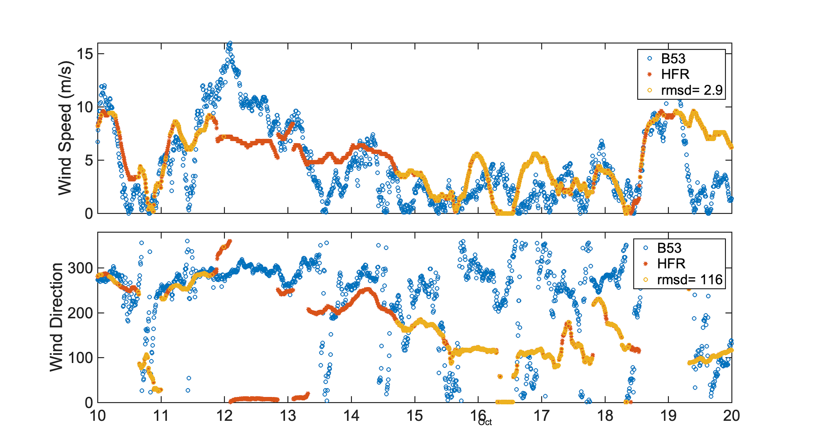

Slide 27
