Slide 1
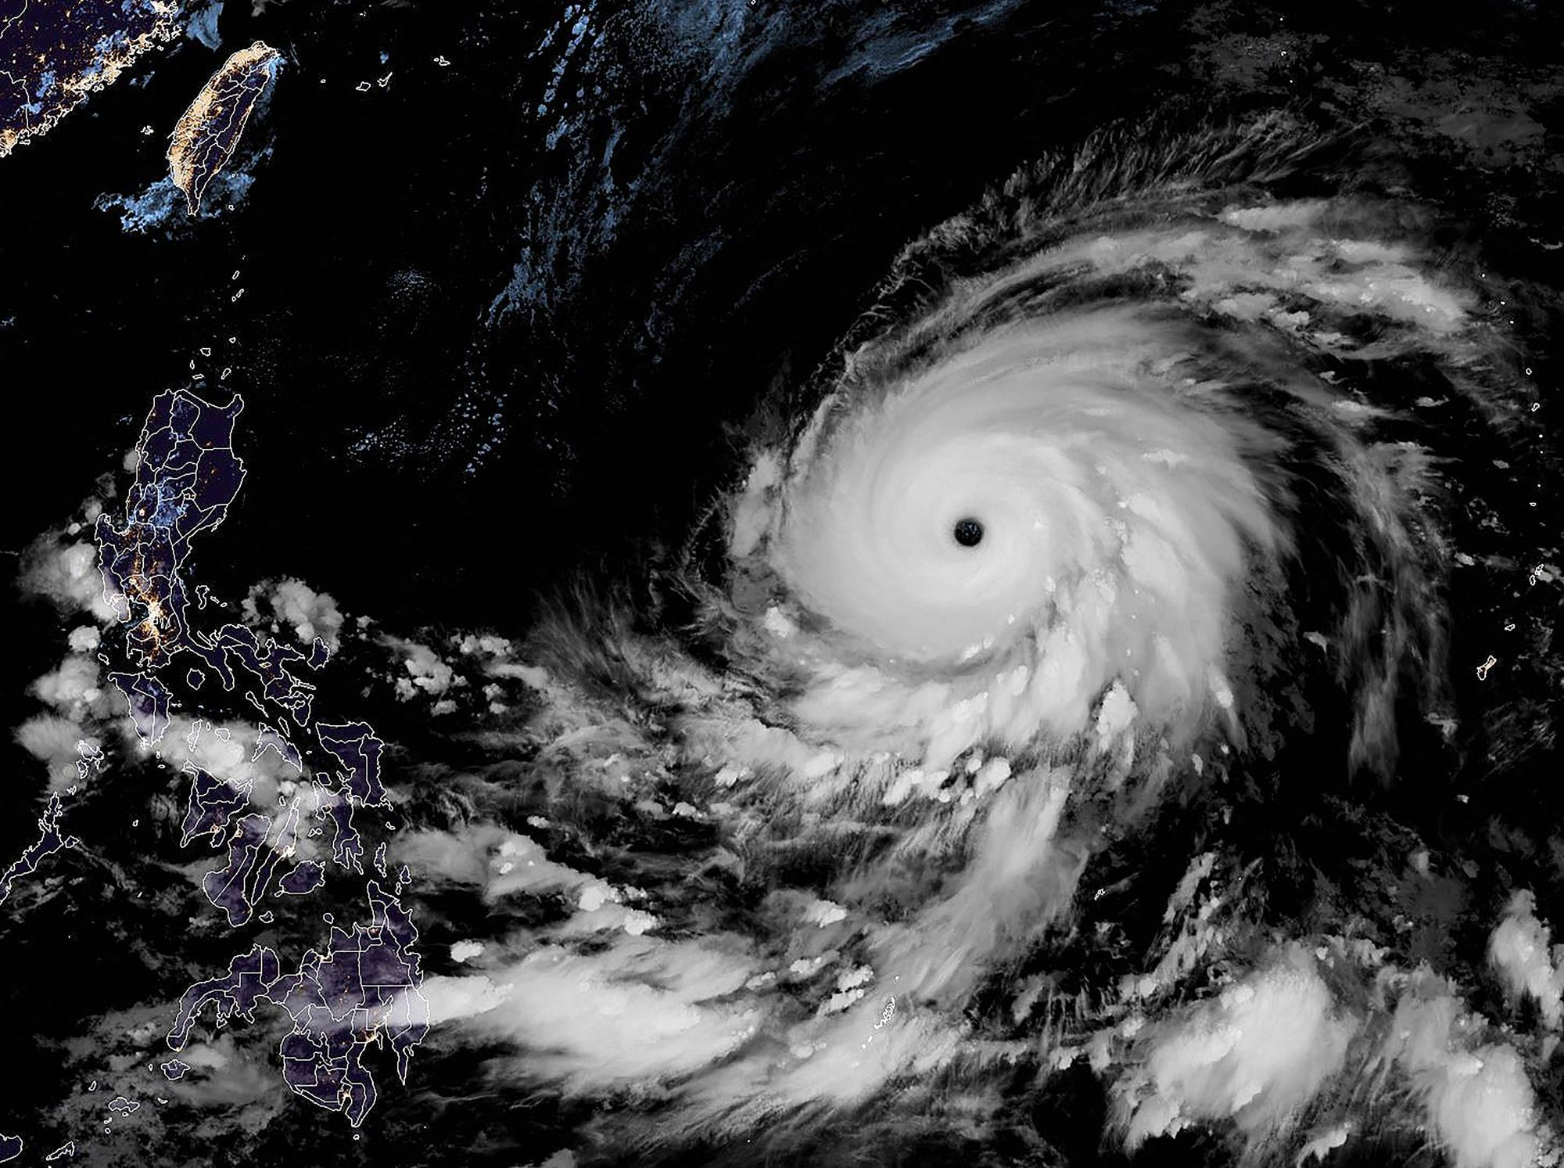
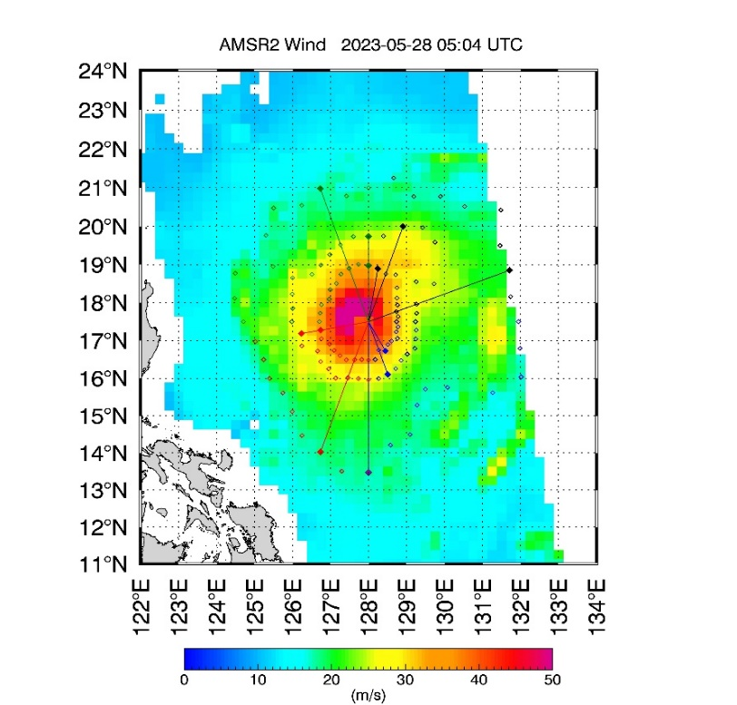
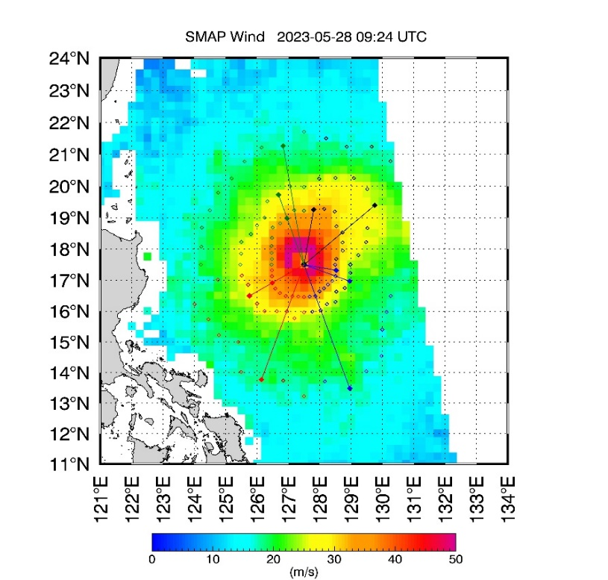
Updates on extreme wind measurements with satellite microwave radiometers
Lucrezia Ricciardulli, Thomas Meissner, Andrew Manaster
Remote Sensing Systems, Santa Rosa, CA, USA
MAWAR WP02 2023-05-28
AMSR2 05:04 UTC
SMAP 09:24 UTC
These studies are supported by NASA OVWST and USPI
IOVWST meeting, May 29-31, 2024, Salt Lake City

Slide 2
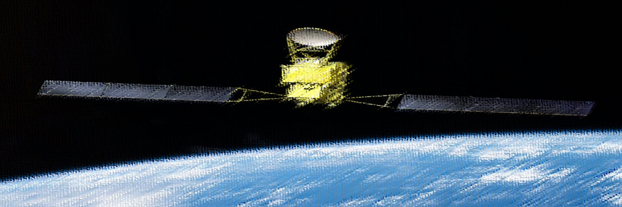
TC Radiometer Winds: Features and Best Use
TC-winds: Gridded Asc/Desc maps (0.25º) and fixes (radii, intensity) in NRT
https://www.remss.com/tropical-cyclones/tc-winds/
SMAP (6 pm/am; 2015-present): L-band (1.4 GHz); sensitive to high winds 10-70 m/s, no rain impact (Meissner et al, BAMS 2017)
AMSR2 (1:30 am/pm; 2012-present ): 6-89 GHz, current TC-trained algorithm uses C/X-band (6/10 GHz; Meissner et al, 2021)
Archived: WindSat (2003-2020); AMSR-E (2002-2011)
Temporal/Spatial scales
10-minute sustained winds, 40 km; large swaths, can see full storm
Best use of radiometer extreme winds
Remote locations
Consistency over time: Monitoring storm intensity evolution
Identify Rapid Intensification (RI)
Determining the radii, and monitor their evolution
Disadvantages of radiometer winds
Low resolution: cannot see real small-scale peak intensity (1-min) or detect Radius of Maximum Wind (RMW)
Residual rain contamination in AMSR2 TC-winds (addressed in next slides).

Slide 3
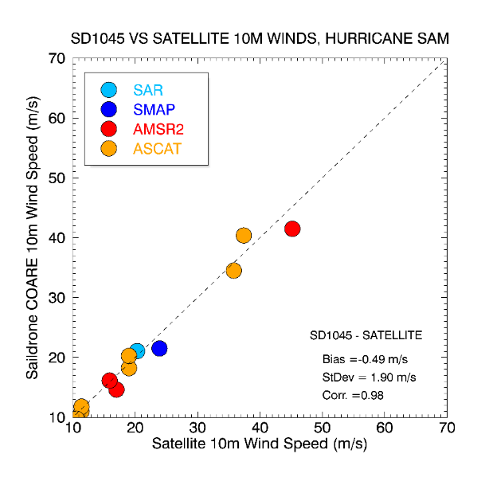
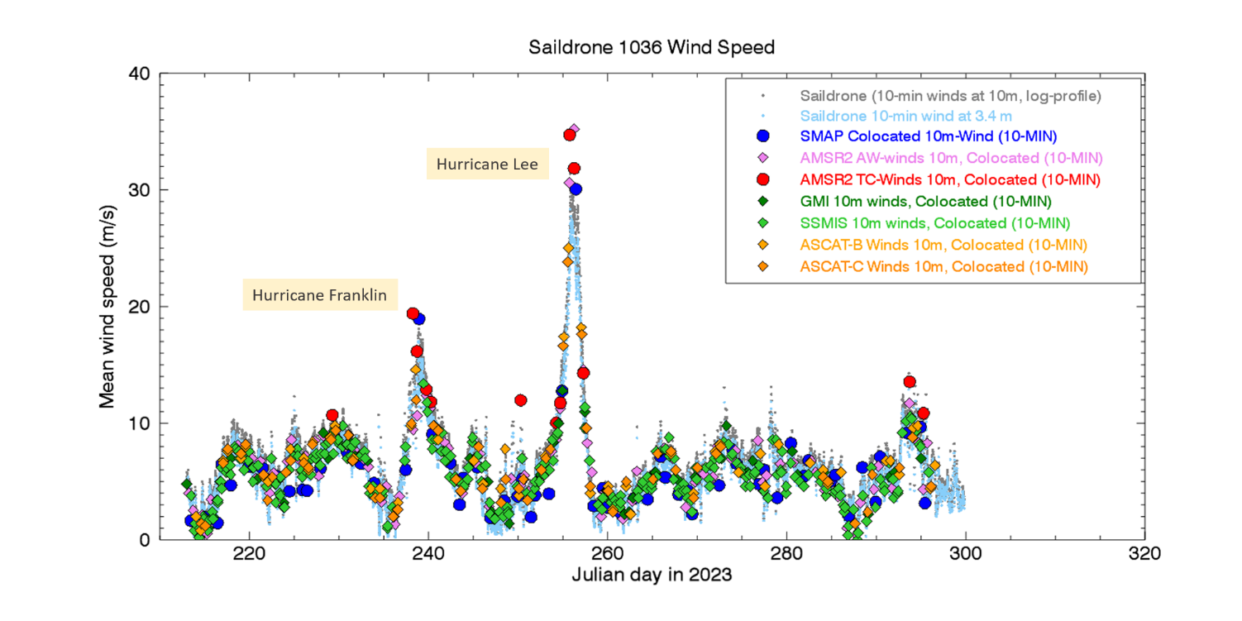
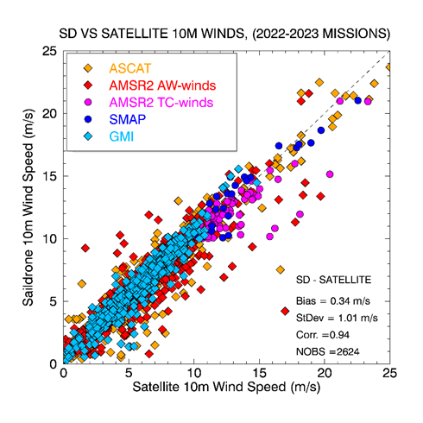
In-situ Validation using Saildrones (SD)
NOAA/SD Hurricane project (2021,2022,2023) deployed several SD in areas with high probabilities of storms to monitor Tropical Atlantic/Caribbean
Validation extreme winds: Hurricane SAM (2021)
Ricciardulli, Foltz et al (2022)
Foltz, et al (EOS, 2022); Zhang, Foltz et al (BAMS, 2023)
Saildrone SD-1036 (2023 mission)
Validation 0-25 m/s

Slide 4
MW Channel Utilization in Surface Wind Retrievals
Primary Channels and Source of Emission
Band (GHz) | 1.4 (SMAP) | 6-7 | 10 | 18 | 23 | 37 | 89
SST
Wind | No rain impact/ Sensitivity to high winds
Water Vapor
Rain/Cloud
Ice/Scatter.
Surface
Atmosphere
Current AMSR2 TC-winds algorithm for w>20 m/s, SST>20ºC
(and AMSR2 rain retrievals from 37GHz)

Slide 5
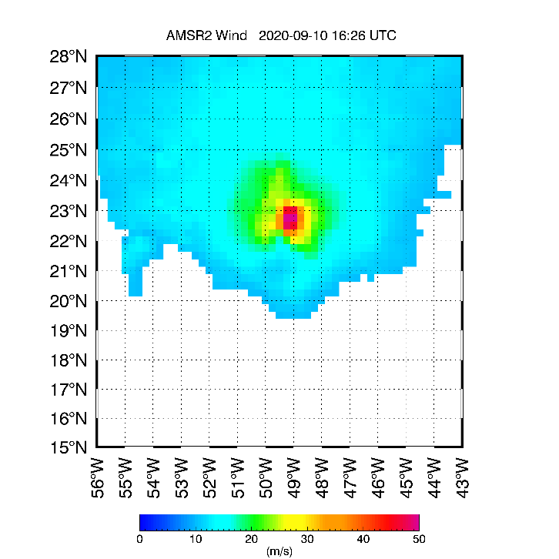
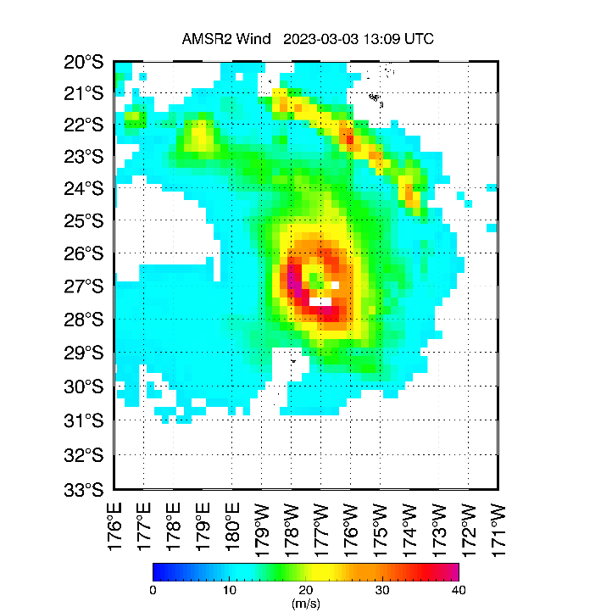
What are the major issues in MW TC winds?
AMSR2 UNRELIABLE → wrong fix (intensity and/or radii)
1. Core winds occasional strong bias due to
Residual spurious rain signal
Areas with unusually cold 89 GHz
Ice clouds/overshooting cloud tops?
More common in storm’s early stage and below 30 m/s
Algorithm not sufficiently trained for these conditions
2. Rain bands in wind field
Residual rain signal contamination.
Could affect radii, occasionally the max wind too
Easy to visually detect, hard to remove from automated fix
Same problems in old WindSat retrievals (similar algorithm)
PAULETTE (AL17, 2020)
JUDY (SH15, 2023)
AMSR2: 52m/s
HWRF : 22 m/s
BT : 23 m/s
Rain spurious signal

Slide 6
Other issues: Radio Frequency Interference (RFI)
3. Recent persistent RFI in SMAP
New L-band (1.4 GHz) RFI in Bay of Bengal
Since Dec 2023, both asc/desc → land/ship based
Very large positive bias
Additional occasional RFI near Taiwan and Mediterranean
→Develop automated detection (flag) or mask region
RFI
4. Occasional RFI in AMSR2
New RFI source in C-band (6-7 GHz) and (10 GHz) in Bay of Bengal
Descending passes (1:30 am)
Other RFI over global coastal waters at 10 GHz is filtered
Location changes over time, frequent updates in RFI filter

Slide 7
Possible Solutions for AMSR2 TC-winds Algorithm
Three main approaches to address significant occasional bias in the AMSR2 TC winds, due to residual rain, deep clouds
Patch: Find a Flag that works and just apply it to current winds
Develop New regression algorithm for AMSR2 winds in TC using all channels
PROS: complete view of TC core, no holes; responds to different environmental conditions; Fix intensity/radii more reliable;
CONS: Developing multi-year training dataset for wide range of environmental conditions is time consuming; not fail-proof (residual biases might need to be flagged)
With the new training dataset, develop a Machine Learning algorithm
Algorithm’s success depends on comprehensive and accurate training dataset

Slide 8
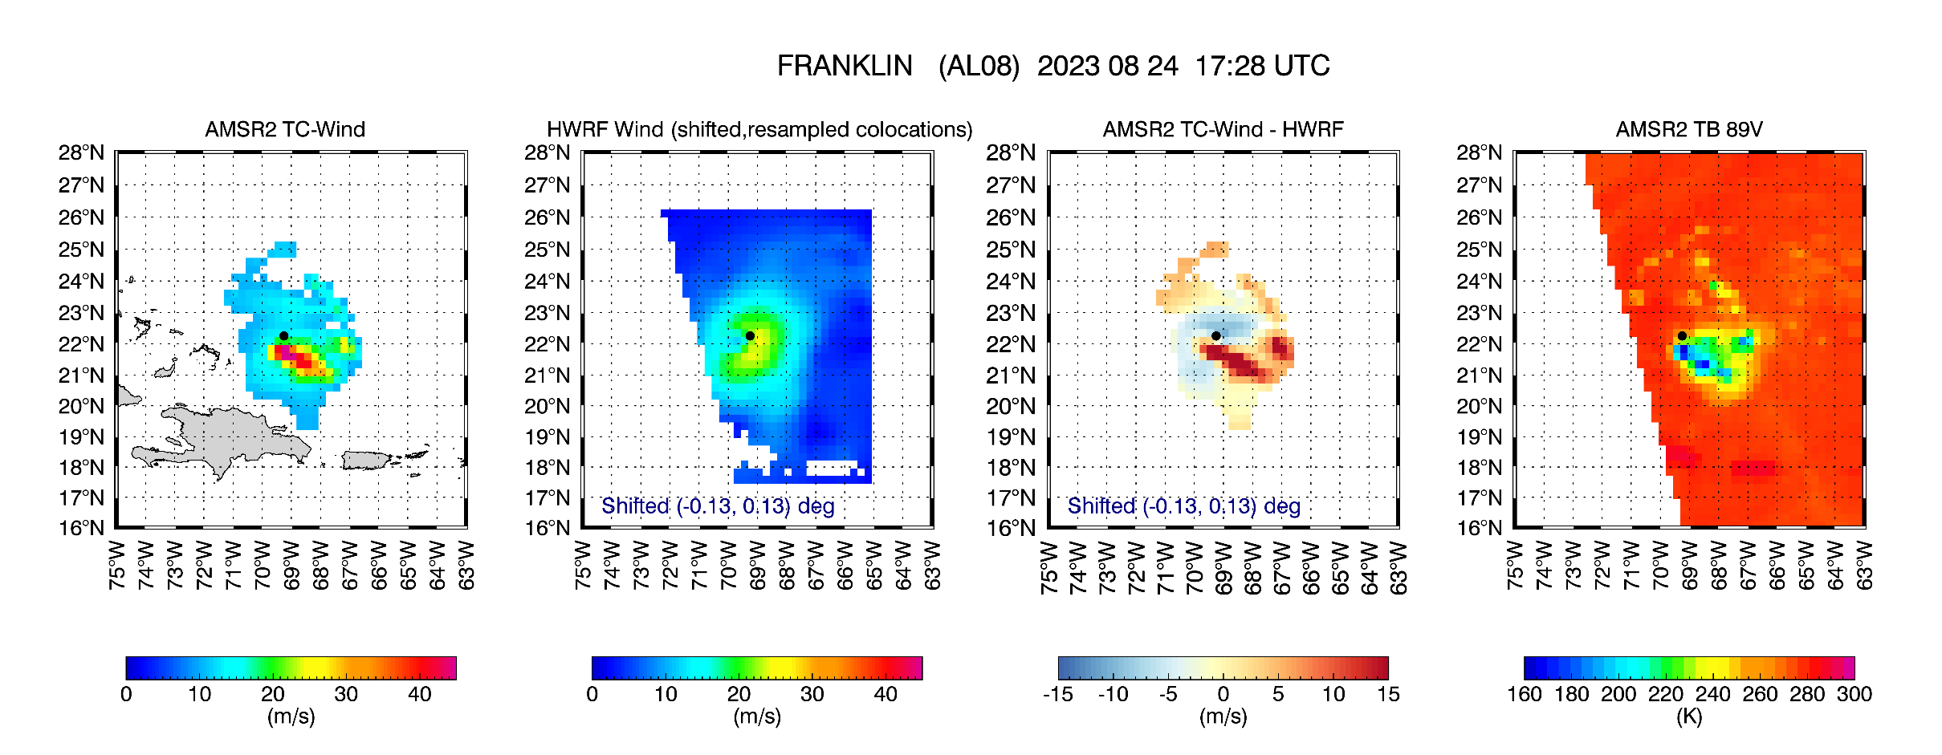
Building a New Training Dataset Using HWRF
AMSR2 (1:30 am/pm) doesn’t colocate well with SMAP (6 pm/am), so we decided to use HWRF data as ground truth
Colocate AMSR2 TBs (gridded at 25x25 km) for all channels (6-89 GHz, V/H pol) with HWRF
HWRF is 6-hourly and high resolution: resampled the 6 hourly at 25 km, using storm-center coordinate and interpolate these at the AMSR2 time and shift it to match the AMSR2 storm center
Training dataset : 18 TCs in 2018-2022 (102 scenes; 70,000+ colocations)
Testing dataset: 20 TCs in 2023
AMSR2: 48m/s
HWRF : 24 m/s
BT : 26 m/s

Slide 9
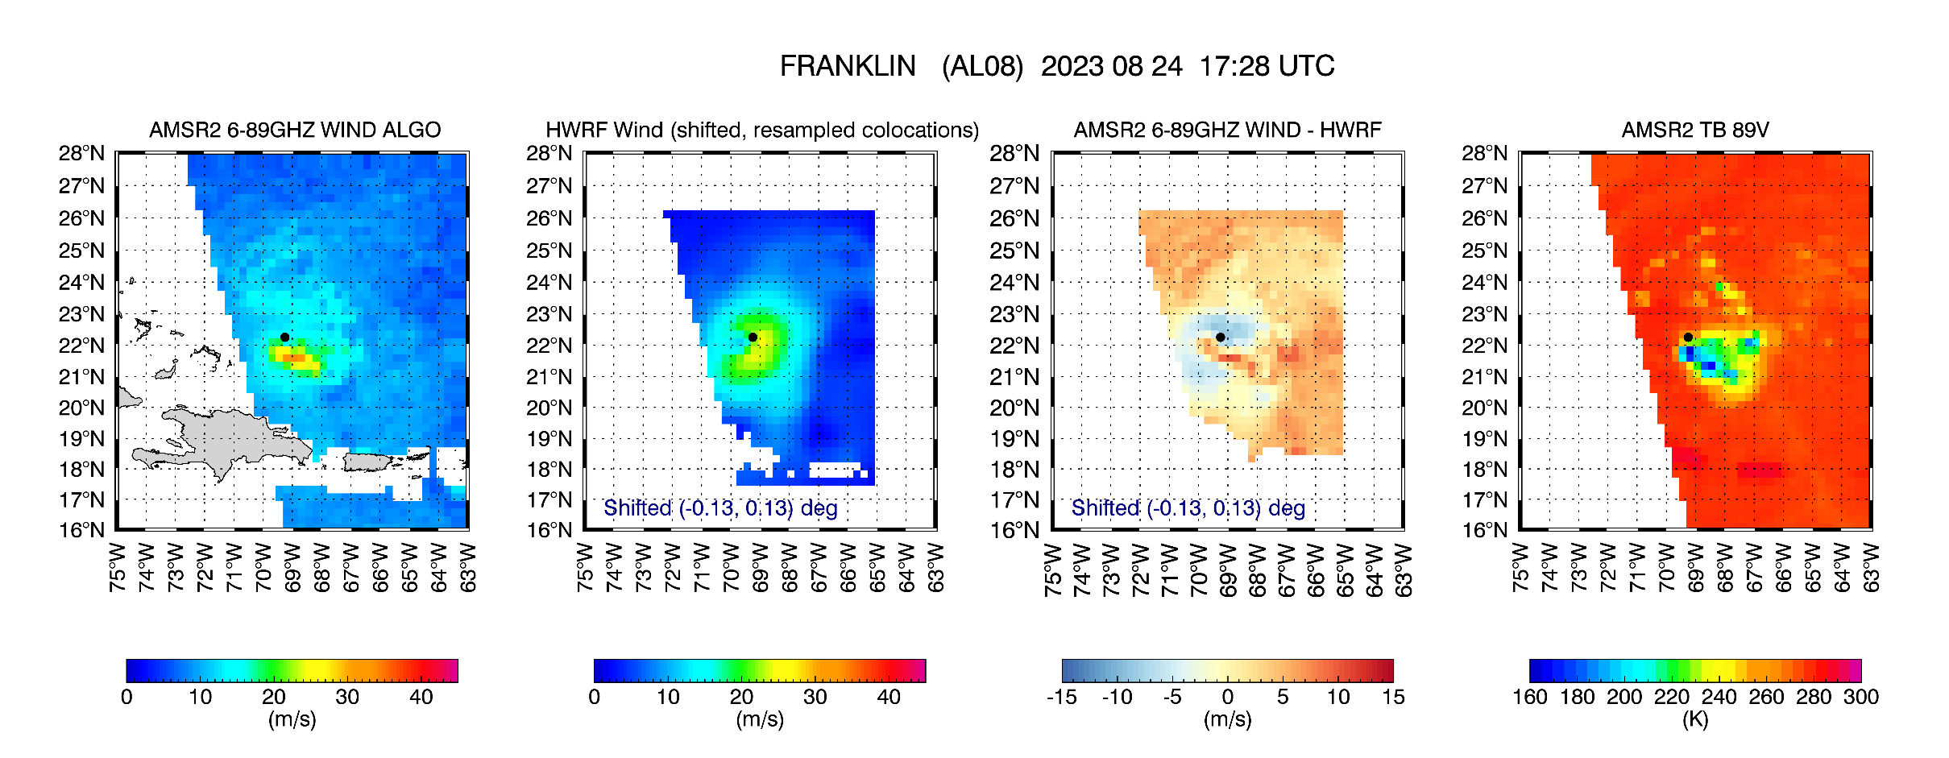
New Linear Regression Algorithm Using All Channels 6-89 GHz
$$Wreg=a0+ \sum_{iVpol=1,7}{biVpol ×TBiVpol} + \sum_{iHpol=1,7}{ciHpol ×TBiHpol }$$
iVpol = 6.9V, 7.3V, 10.7V, 18.7V, 23.8V, 37.5V, 89V
iHpol = 6.9H, 7.3H, 10.7H, 18.7H, 23.8H, 37.5H, 89H
AMSR2: 34 m/s
HWRF : 24 m/s
BT : 26 m/s

Slide 10
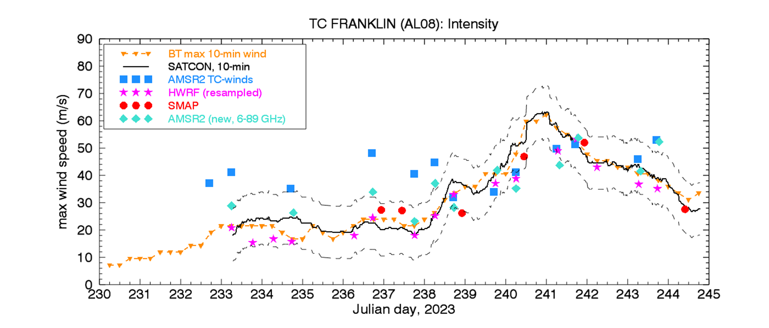
New algorithm (6-89GHz) vs Old (6-10GHz): FRANKLIN
Sample case in previous slide

Slide 11
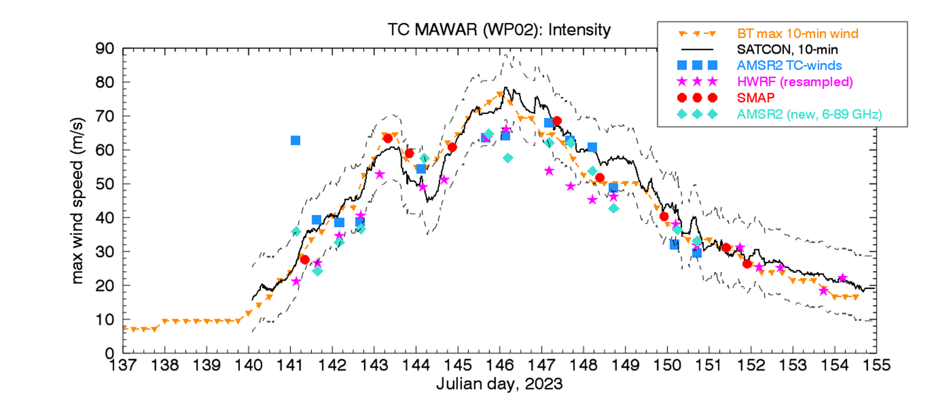
New algorithm (6-89GHz) vs Old (6-10GHz): MAWAR
Very bad outlier
Cover slide
example

Slide 12
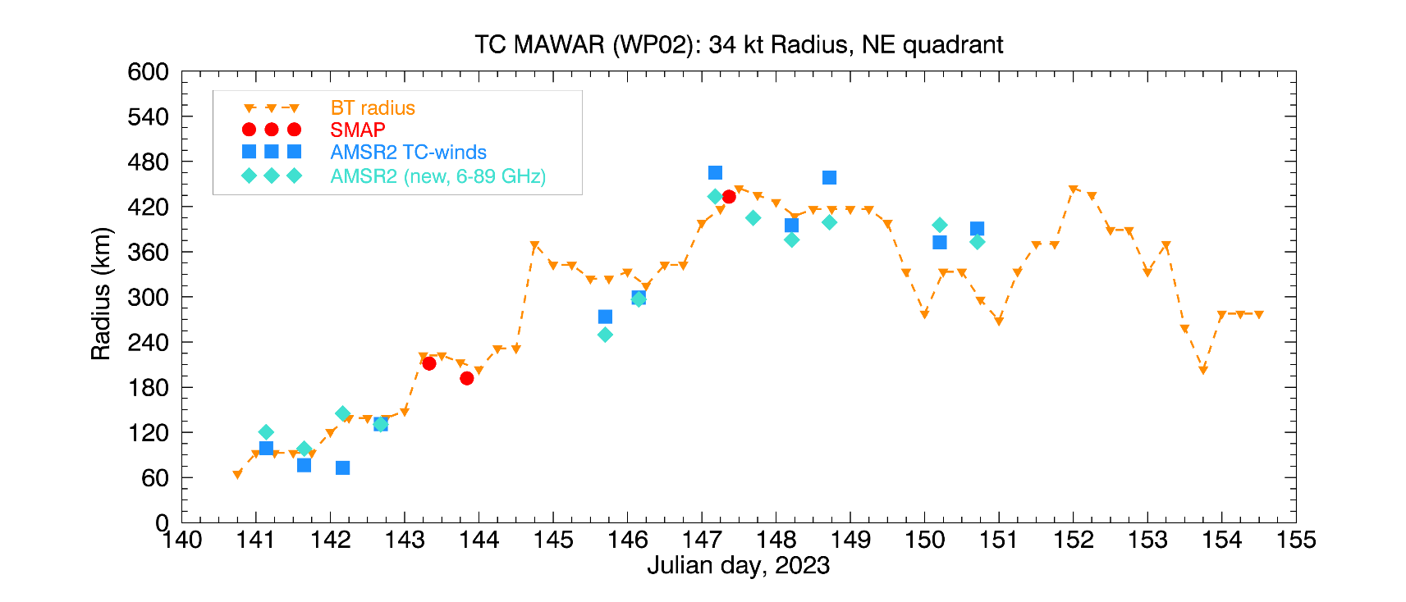
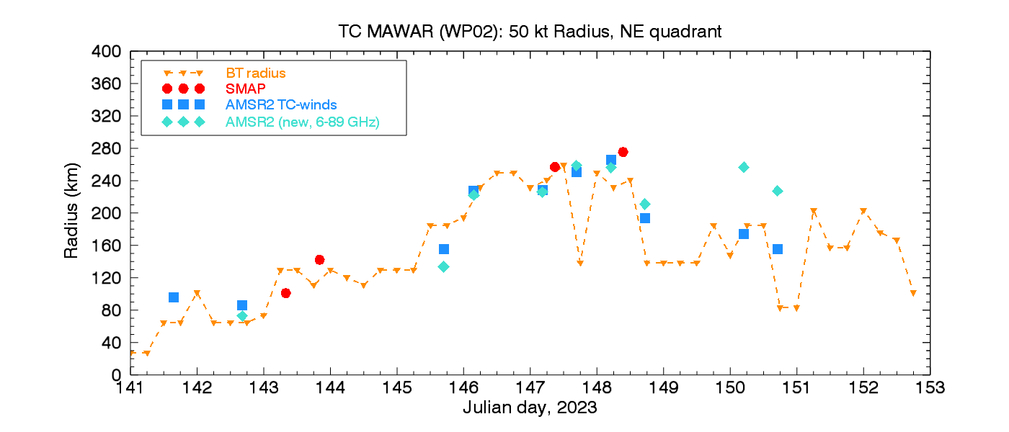
Radii Timeseries: MAWAR
34 kt
50 kt

Slide 13
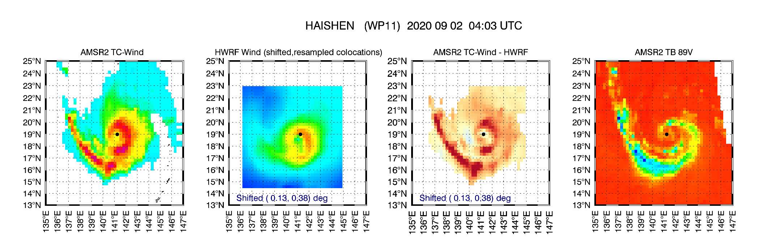
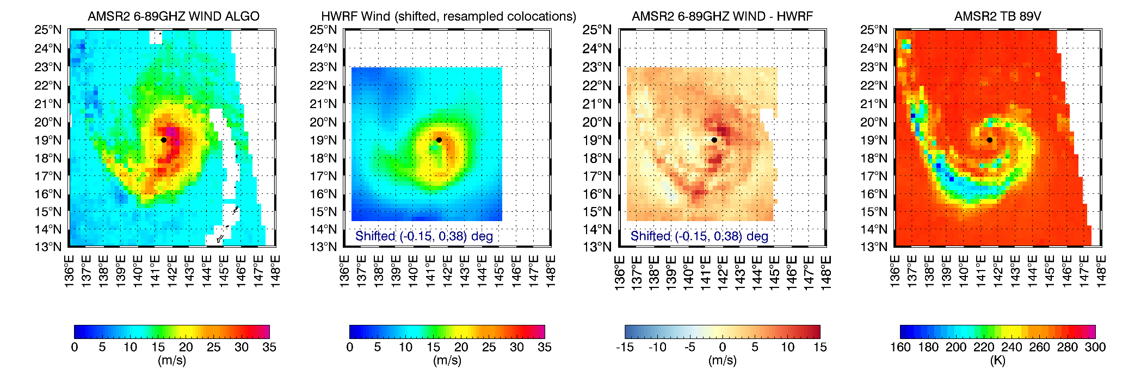
Algorithm comparison: HAISHEN (WP11)
Current C/X-band
TC-algorithm
AMSR2: 35 m/s
HWRF : 33 m/s
BT : 37 m/s
Large rain band bias
Max SE
Max
Max
New 6-89 GHz
Linear regression
TC-algorithm
AMSR2: 37 m/s

Slide 14
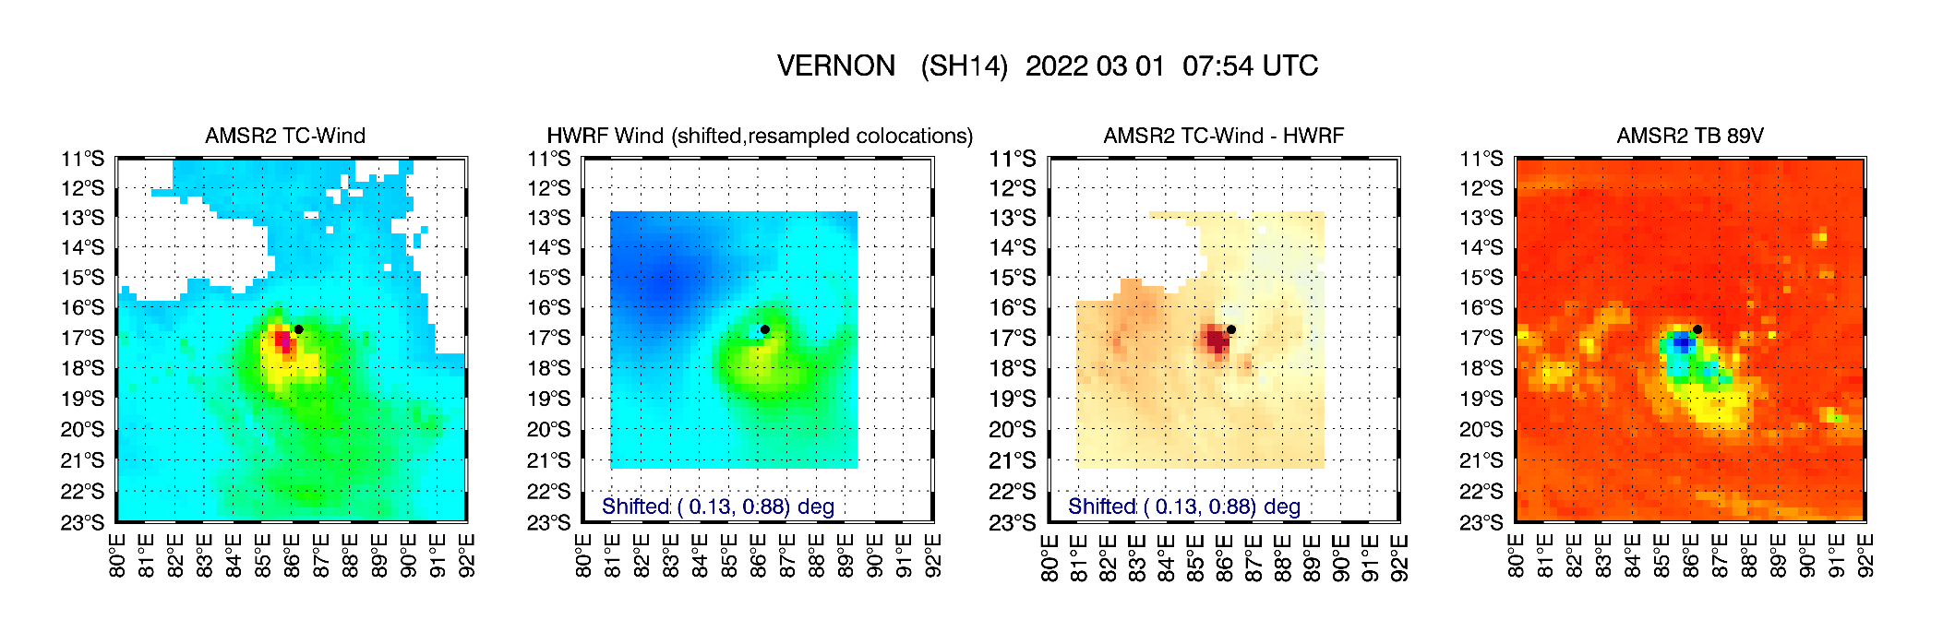
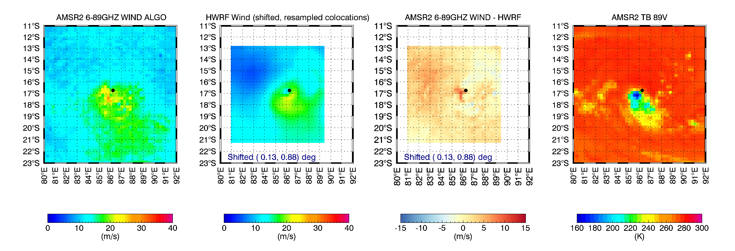
VERNON (SH14)
Large bias in the core
(cold 89GHz)
AMSR2: 45 m/s
HWRF : 21 m/s
BT : 23 m/s
AMSR2: 29 m/s

Slide 15
New MW sensors, coming soon
MWI (DoD, successfully launched 11 April 2024):
MW Imager (MWI) by US Department of Defense, Weather System Follow-on (WSF), similar to WindSat, 6 pm/am orbit
Includes 10-89 GHz channels, but will not have the lower frequency (C-band 6 GHZ) channel.
It will provide wind speed and direction but wind retrievals in TC without the 6 GHz channel might be challenging
There is some potential for winds in light rain using other channels 10-89 GHz.
NISAR (NASA/ISRO, ~October 2024):
L-band SAR in 6pm/am orbit (mainly for land/ice mission)
NASA added planned acquisitions 650 km offshore US coastal waters (include Hawaii, Caribbean) for wind retrievals in hurricane regions
Potential L-band high resolution SAR winds in TC, no rain effect, high sensitivity at high winds, NRT.
AMSR-3 (JAXA, early 2025):
Similar to AMSR-2. It will include 11 frequencies between 6.9 and 183 GHz (new channel); In 1:30 am/pm orbit.
RSS will provide TC-winds using algorithm similar to the new one developed now for AMSR-2.
Additional observations: Rain, Water Vapor, SST.

Slide 16
SUMMARY
SMAP and AMSR2 continue to operate well and provide estimates of TC intensity and radii in NRT
AMSR2 displayed significant biases in rain/icy clouds
RSS is developing new algorithm to mitigate these biases
A preliminary version of this algorithm is very promising. The new algorithm will be finalized in the coming weeks/months after retraining it with more extensive training dataset
Additional flag could be applied when new algorithm displays residual spurious biases
New RFI in Bay of Bengal, both L-band (SMAP) and C-X band (AMSR2)
Thank you!
Recent Publications
Ricciardulli, L., Howell, B., Jackson, et al, (2023): Remote Sensing and Analysis of Tropical Cyclones: Current and Emerging Satellite Sensors. TCRR, Vol 12(4).

Slide 17
Extra slides

Slide 18
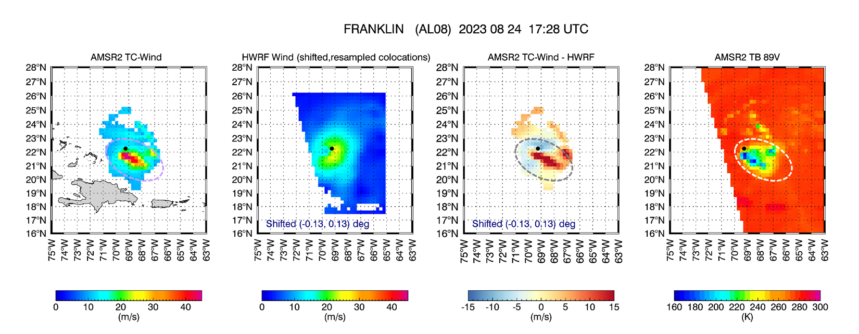
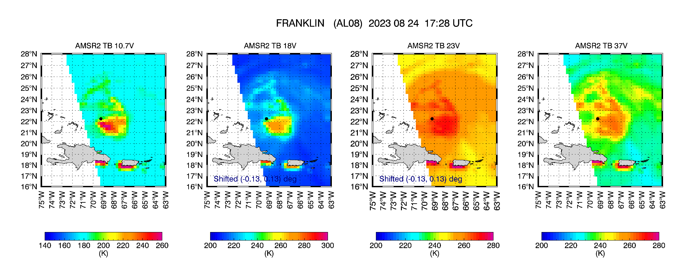
AMSR2
89 GHZ
AMSR2
Wind
AMSR2
37 GHz

Slide 19
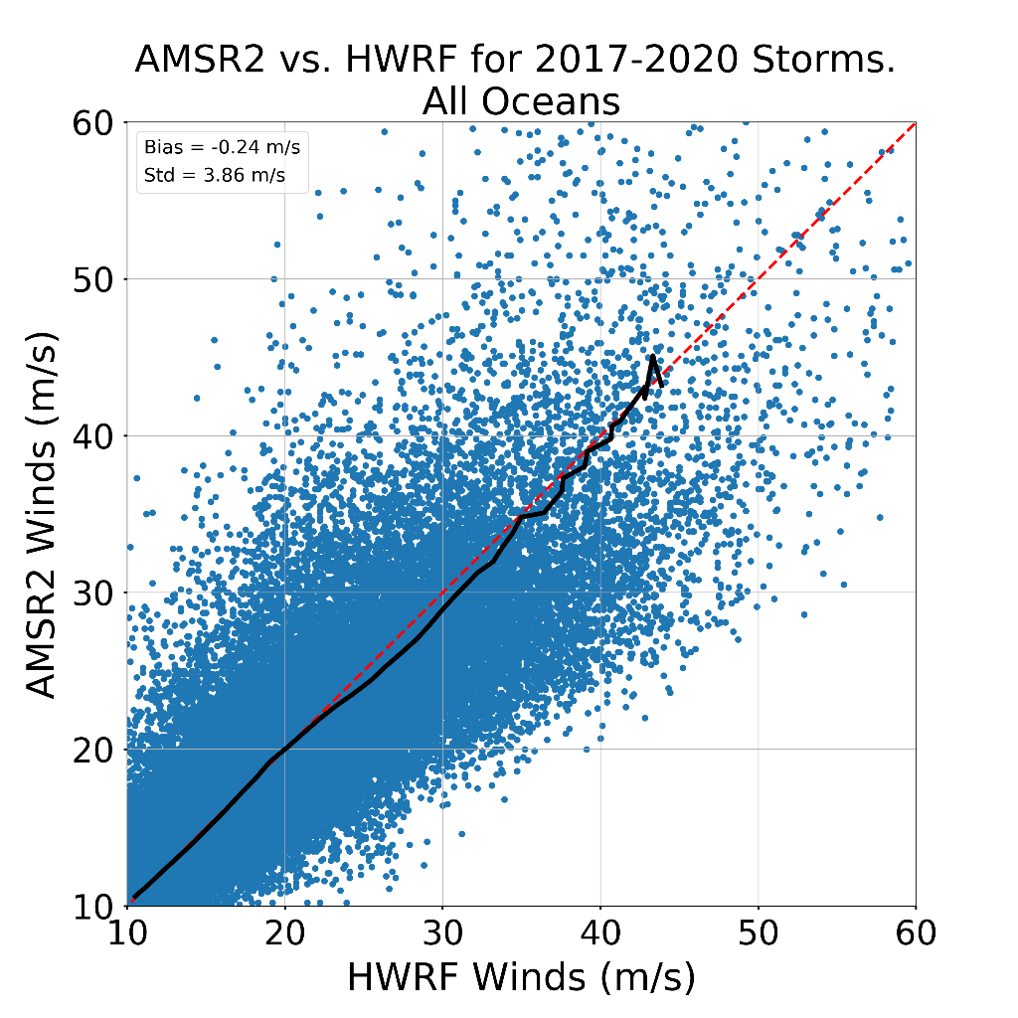
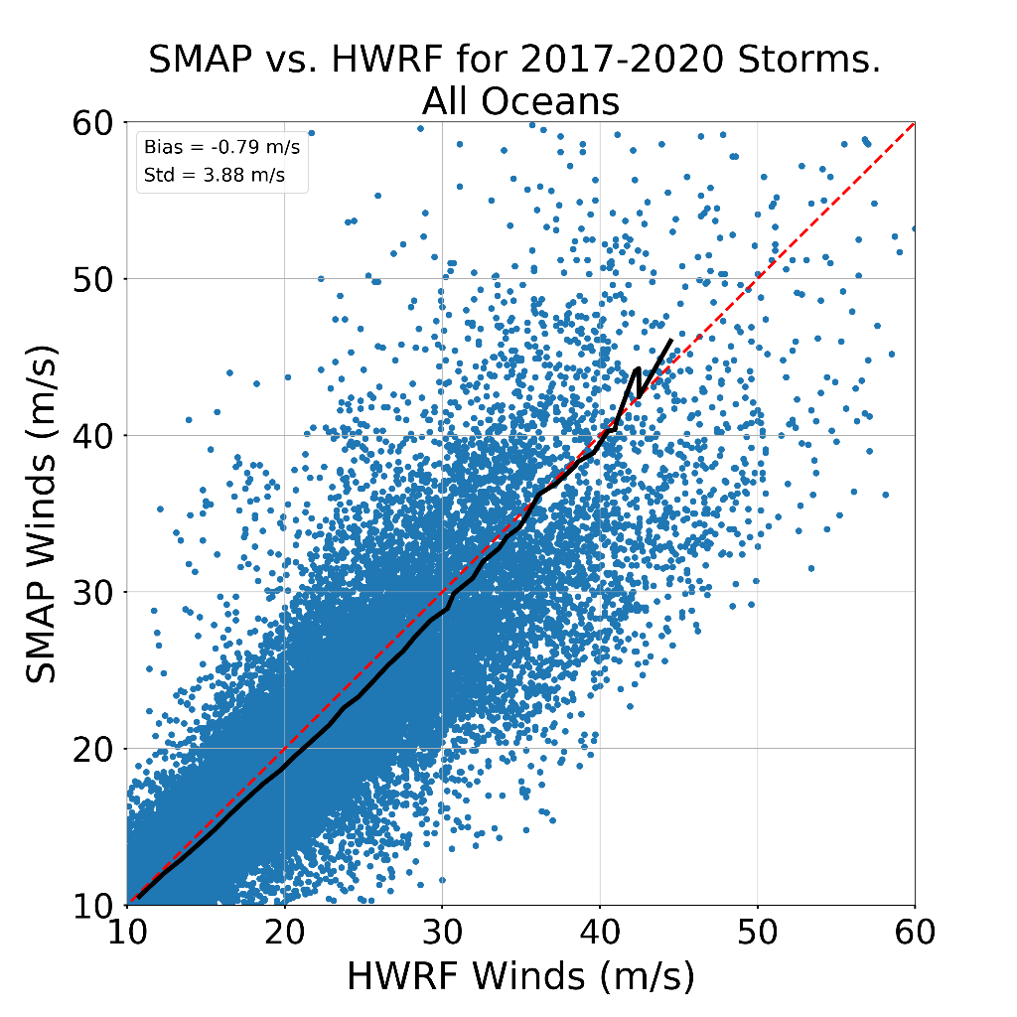
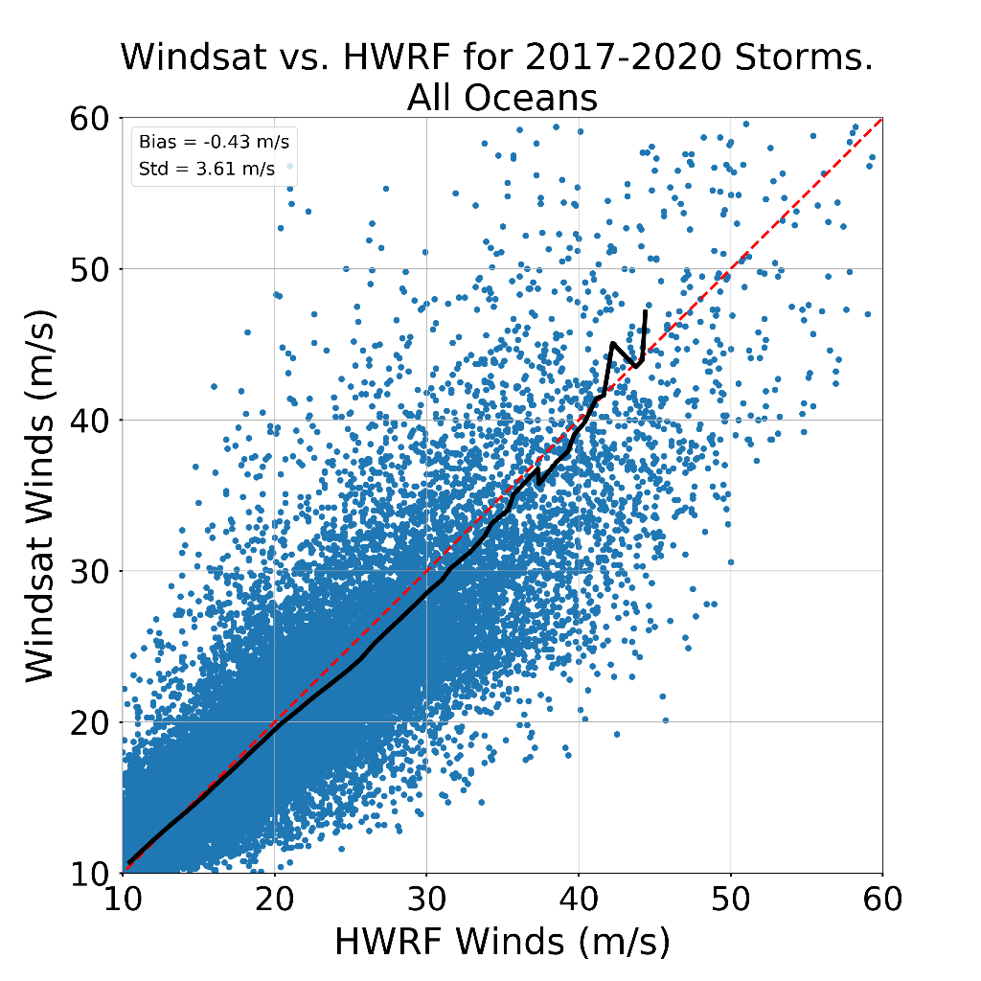
Statistical Results (2017-2020)
AMSR2
SMAP
WindSat
Bias = -0.24 m/s
Std = 3.86 m/s
CC = 0.85
Bias = -0.79 m/s
Std = 3.88 m/s
CC = 0.87
Bias = -0.43 m/s
Std = 3.61 m/s
CC = 0.87
Good agreement between HWRF and the satellites in terms of bias, standard deviation, and correlation coefficient for winds between 10-60 m/s for 19 storms analyzed between 2017-2020.
19

Slide 20
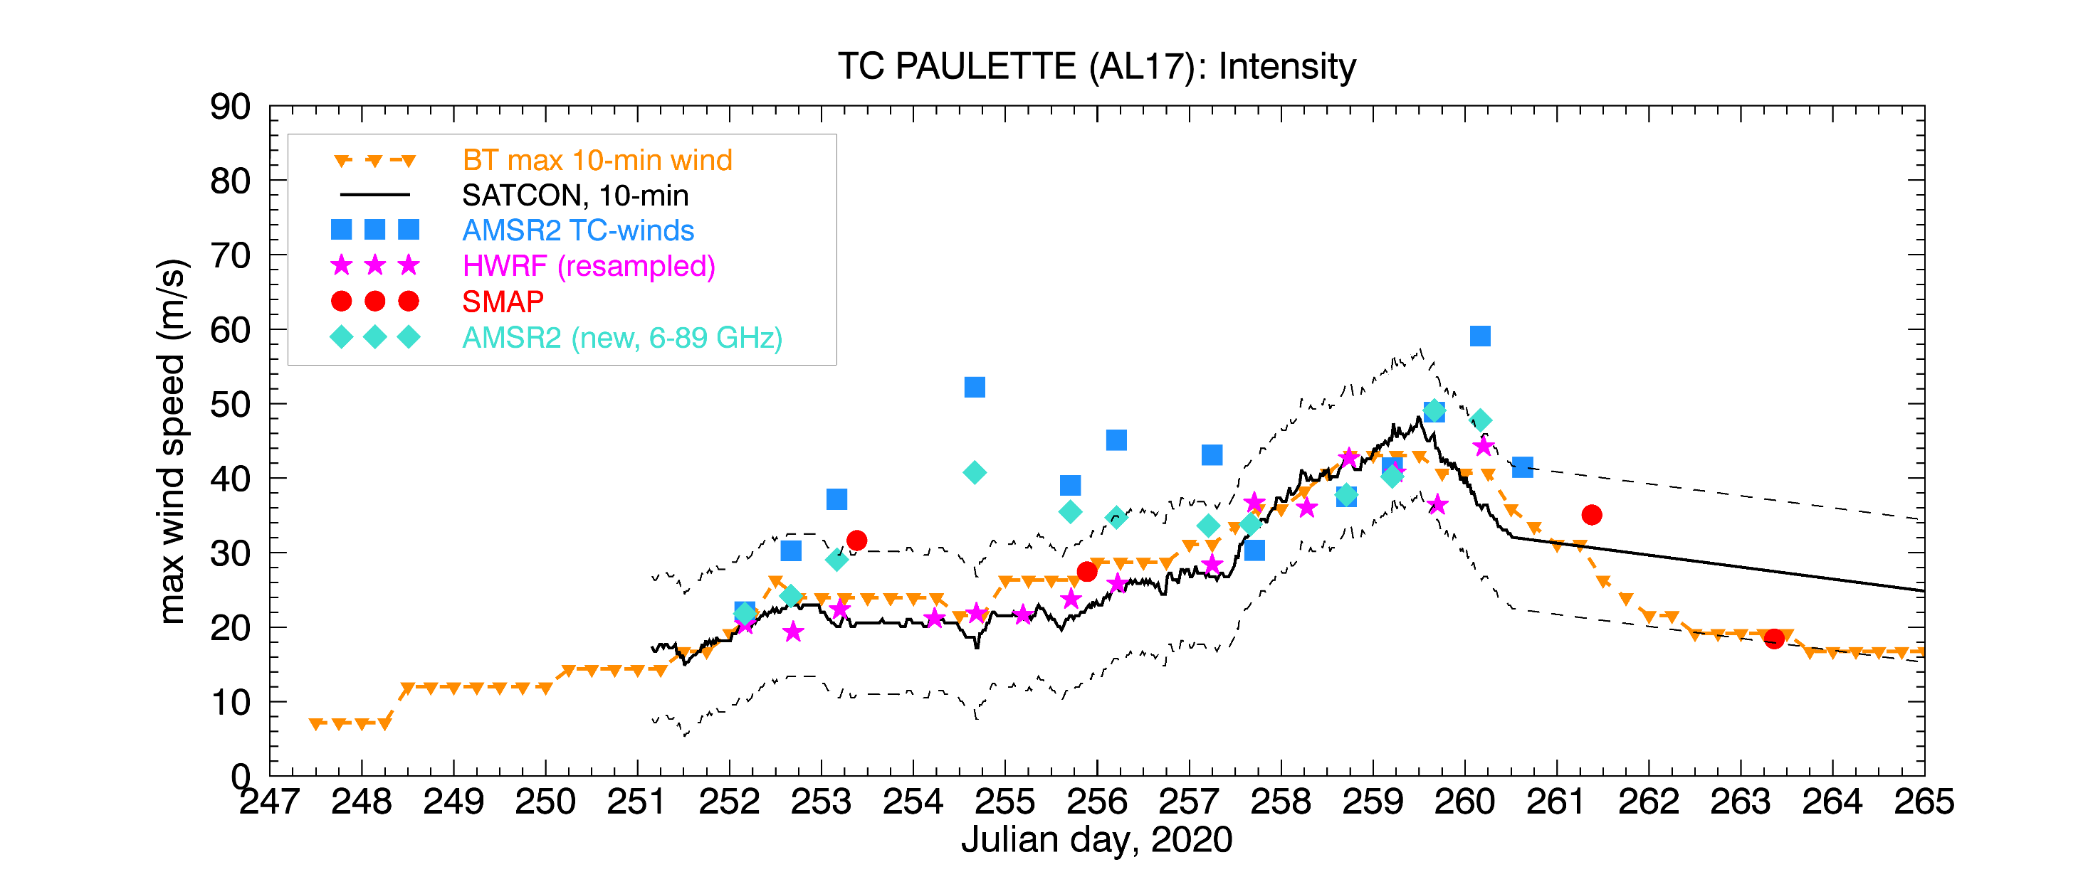
New algorithm (6-89GHz) vs Old (6-10GHz): PAULETTE
Sample biased case in slides 4, 14
Room for improvement

Slide 21
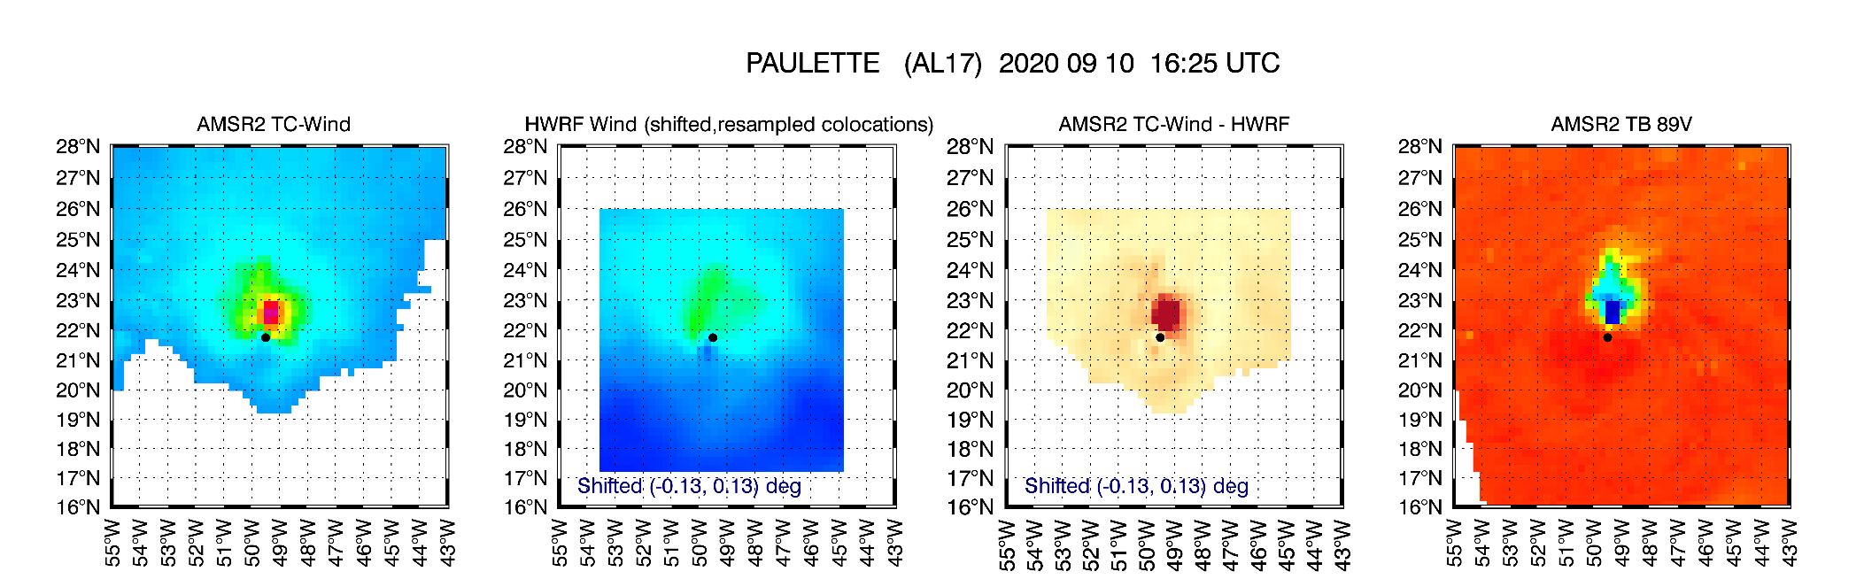
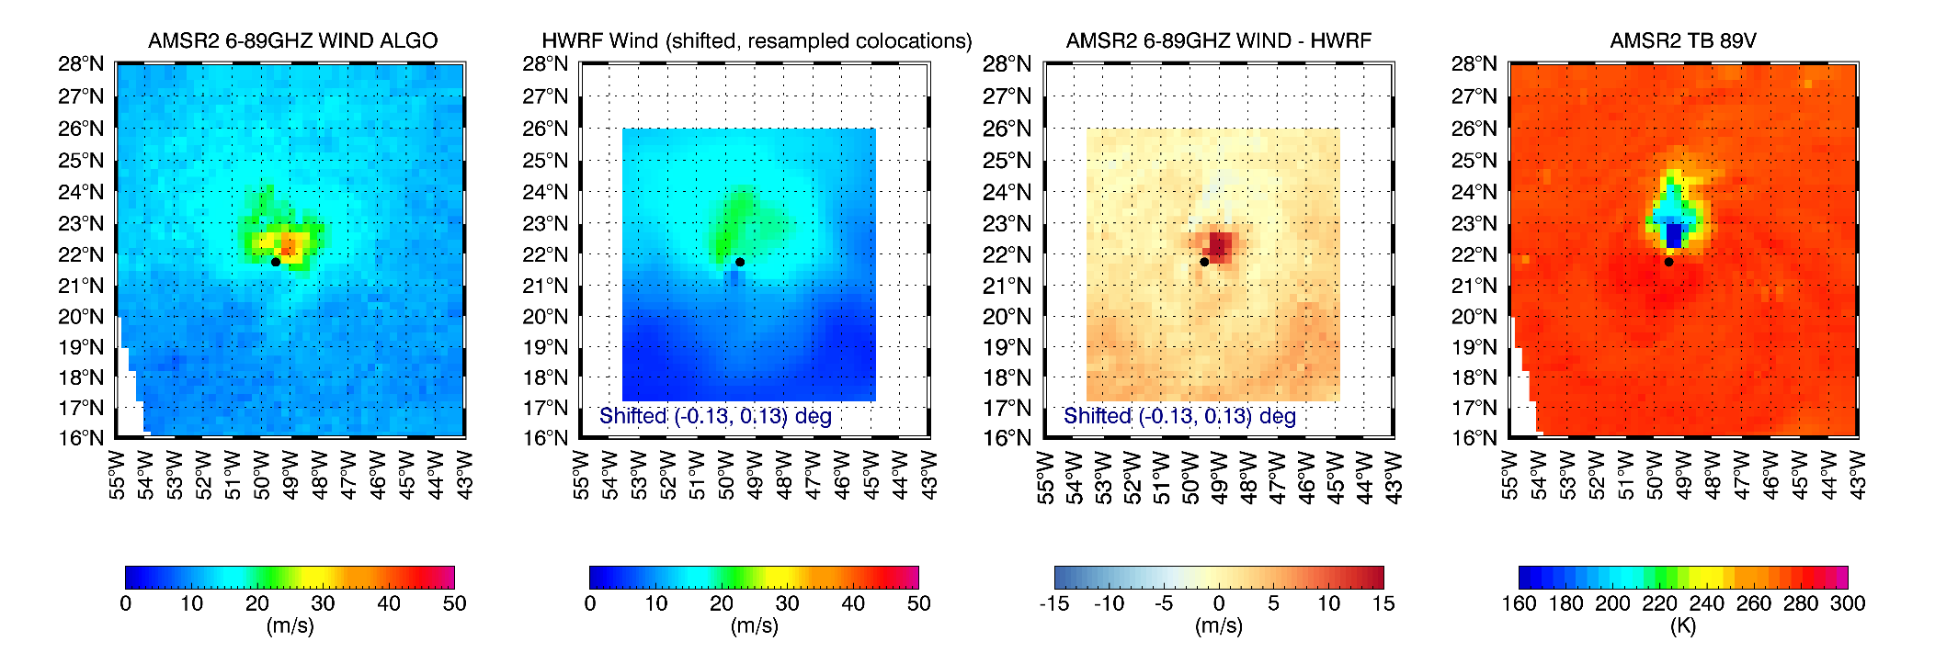
PAULETTE (AL17, 2020)
This was one of the worst case of bias with very cold 89GHz
AMSR2: 52 m/s
HWRF : 23 m/s
BT : 22 m/s
Improved but still strongly biased
AMSR2: 41 m/s

Slide 22
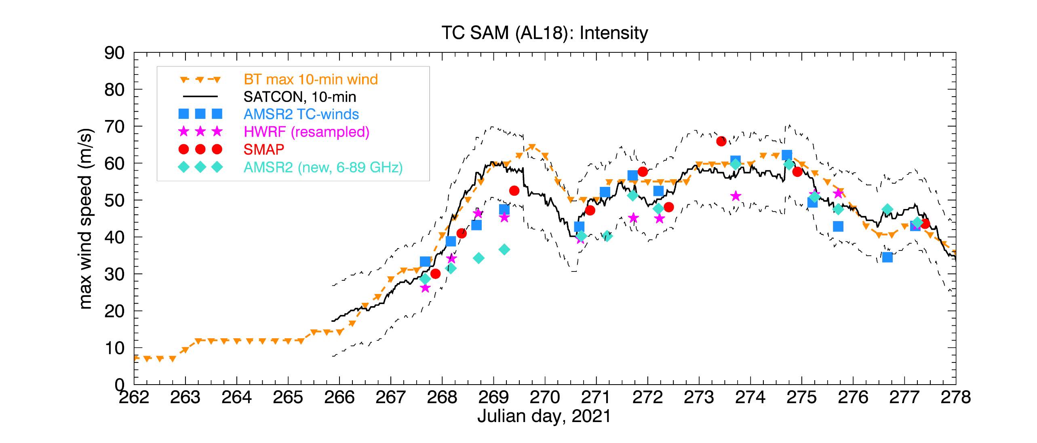
New algorithm (6-89GHz) vs Old (6-10GHz): SAM
AMSR2 pass
Compared to SD

Slide 23
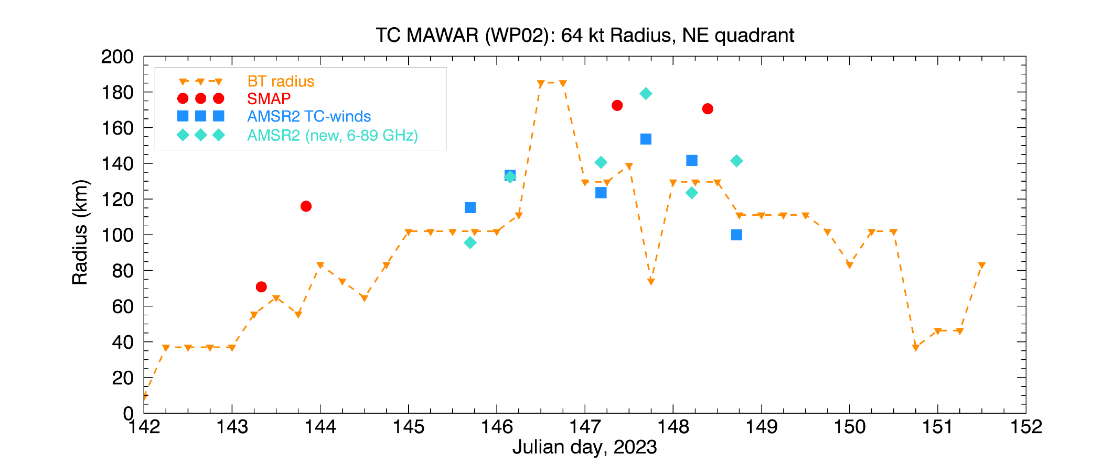
64 kt Radii Timeseries: MAWAR
64 kt

Slide 24
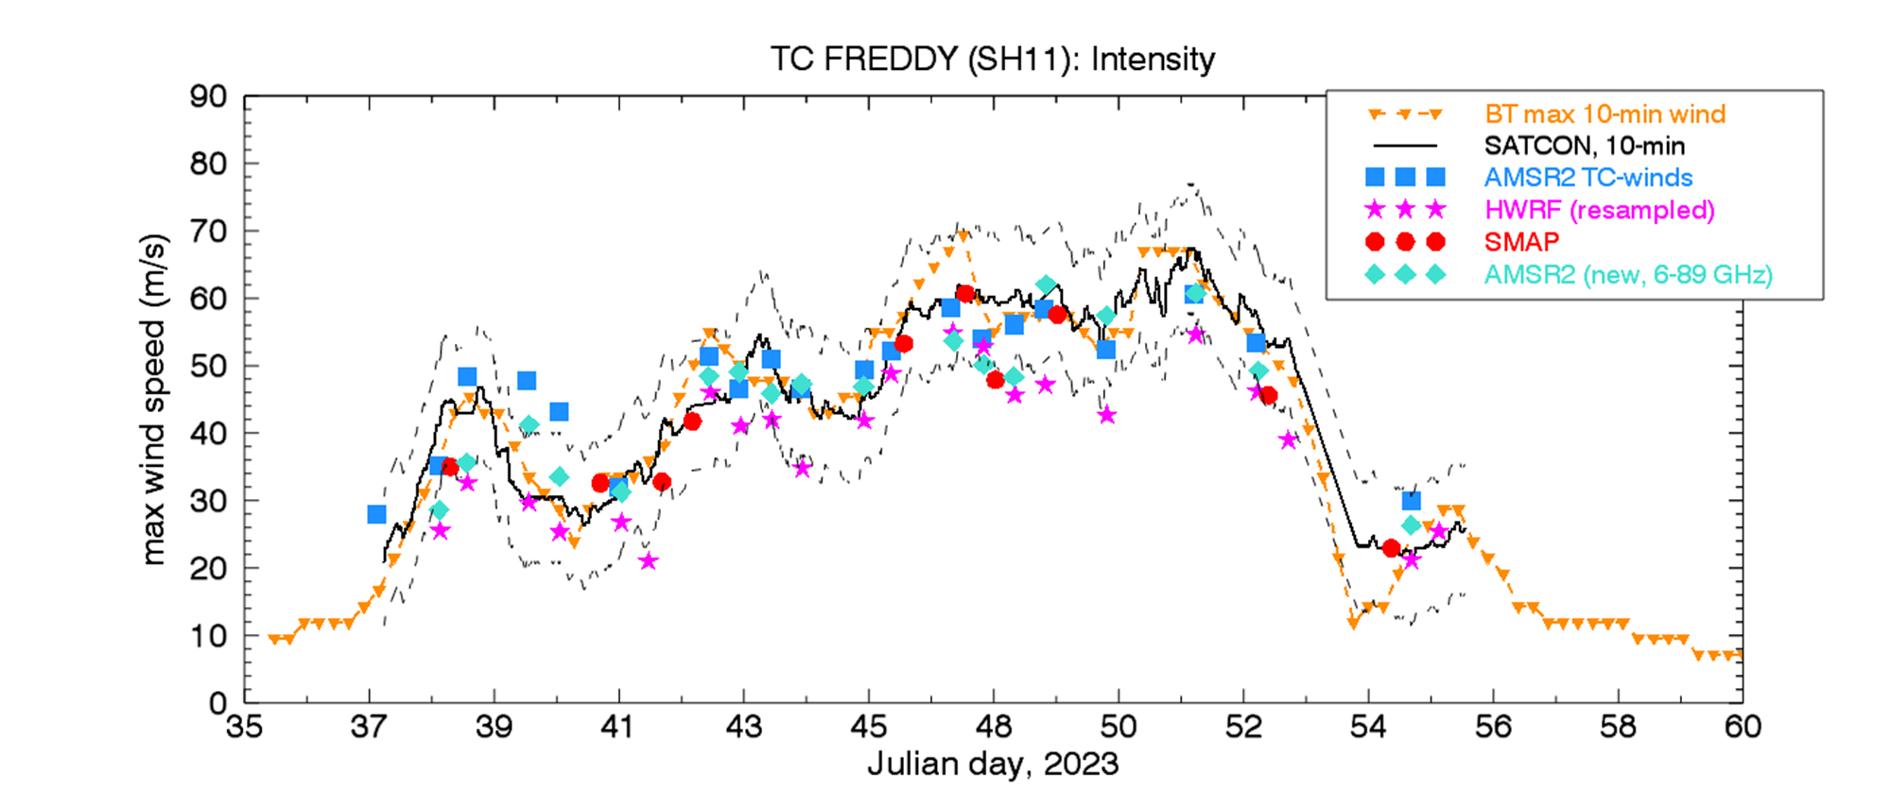
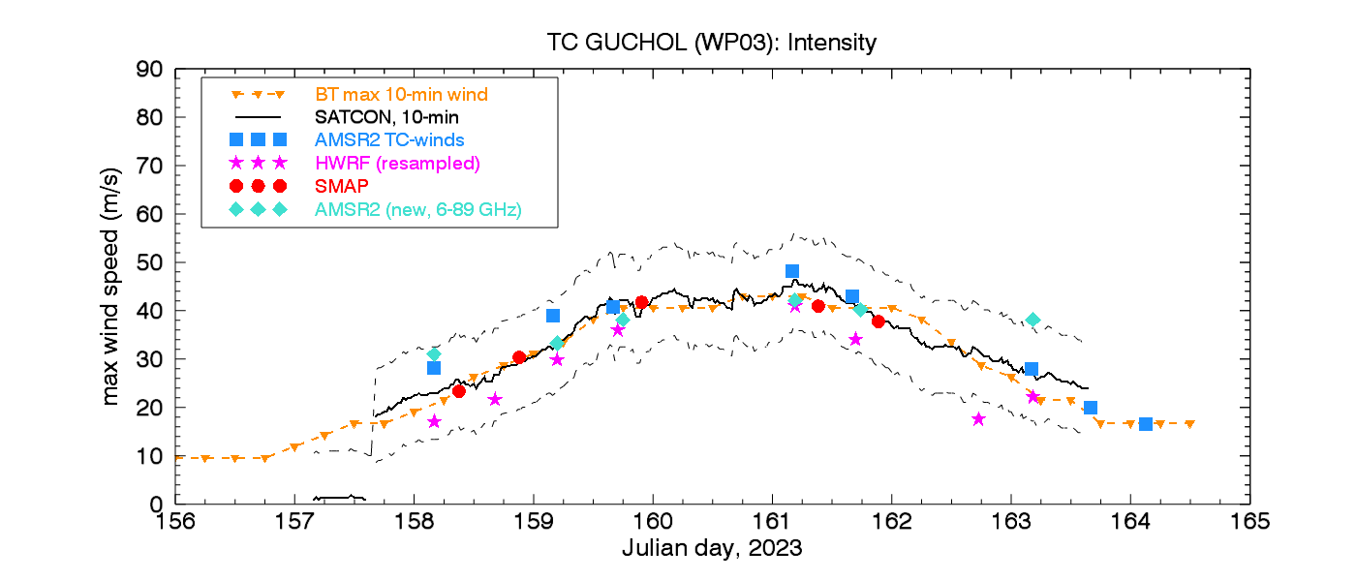
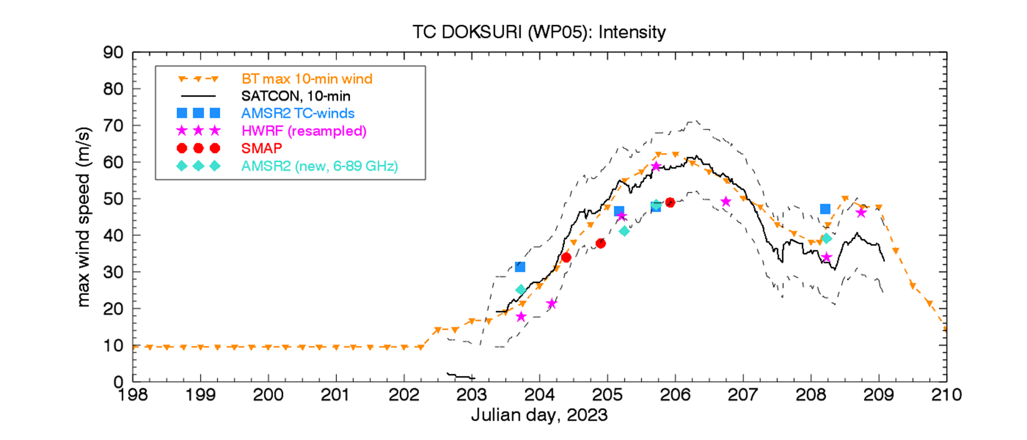
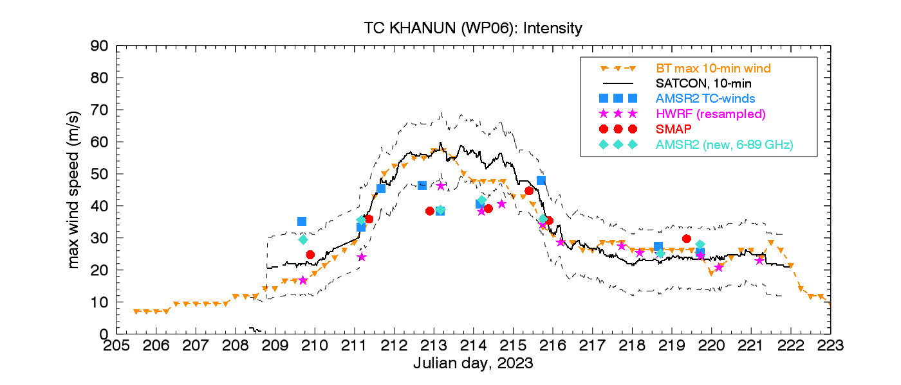
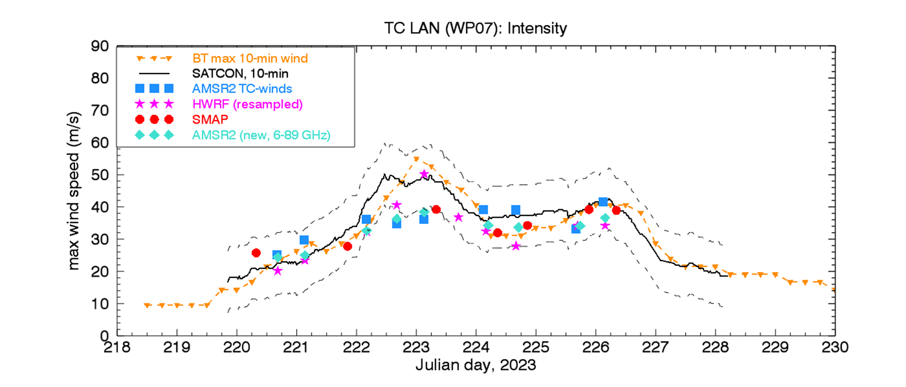
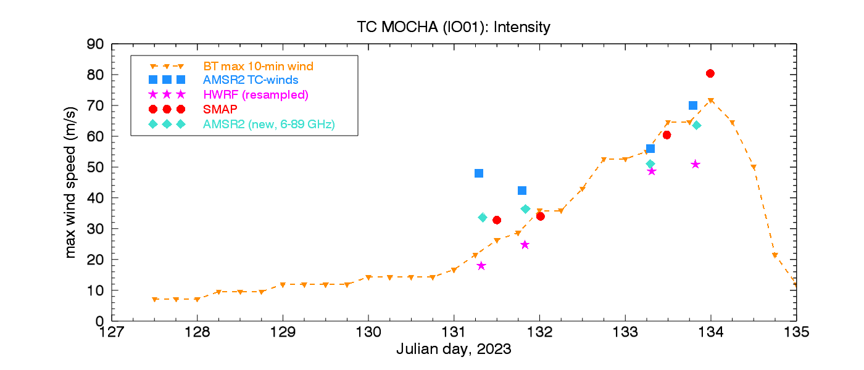
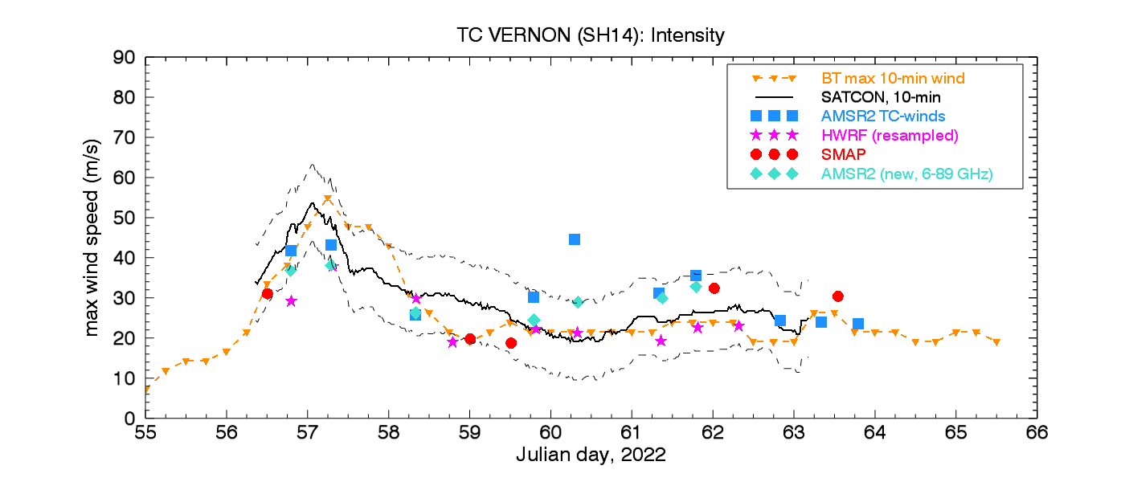
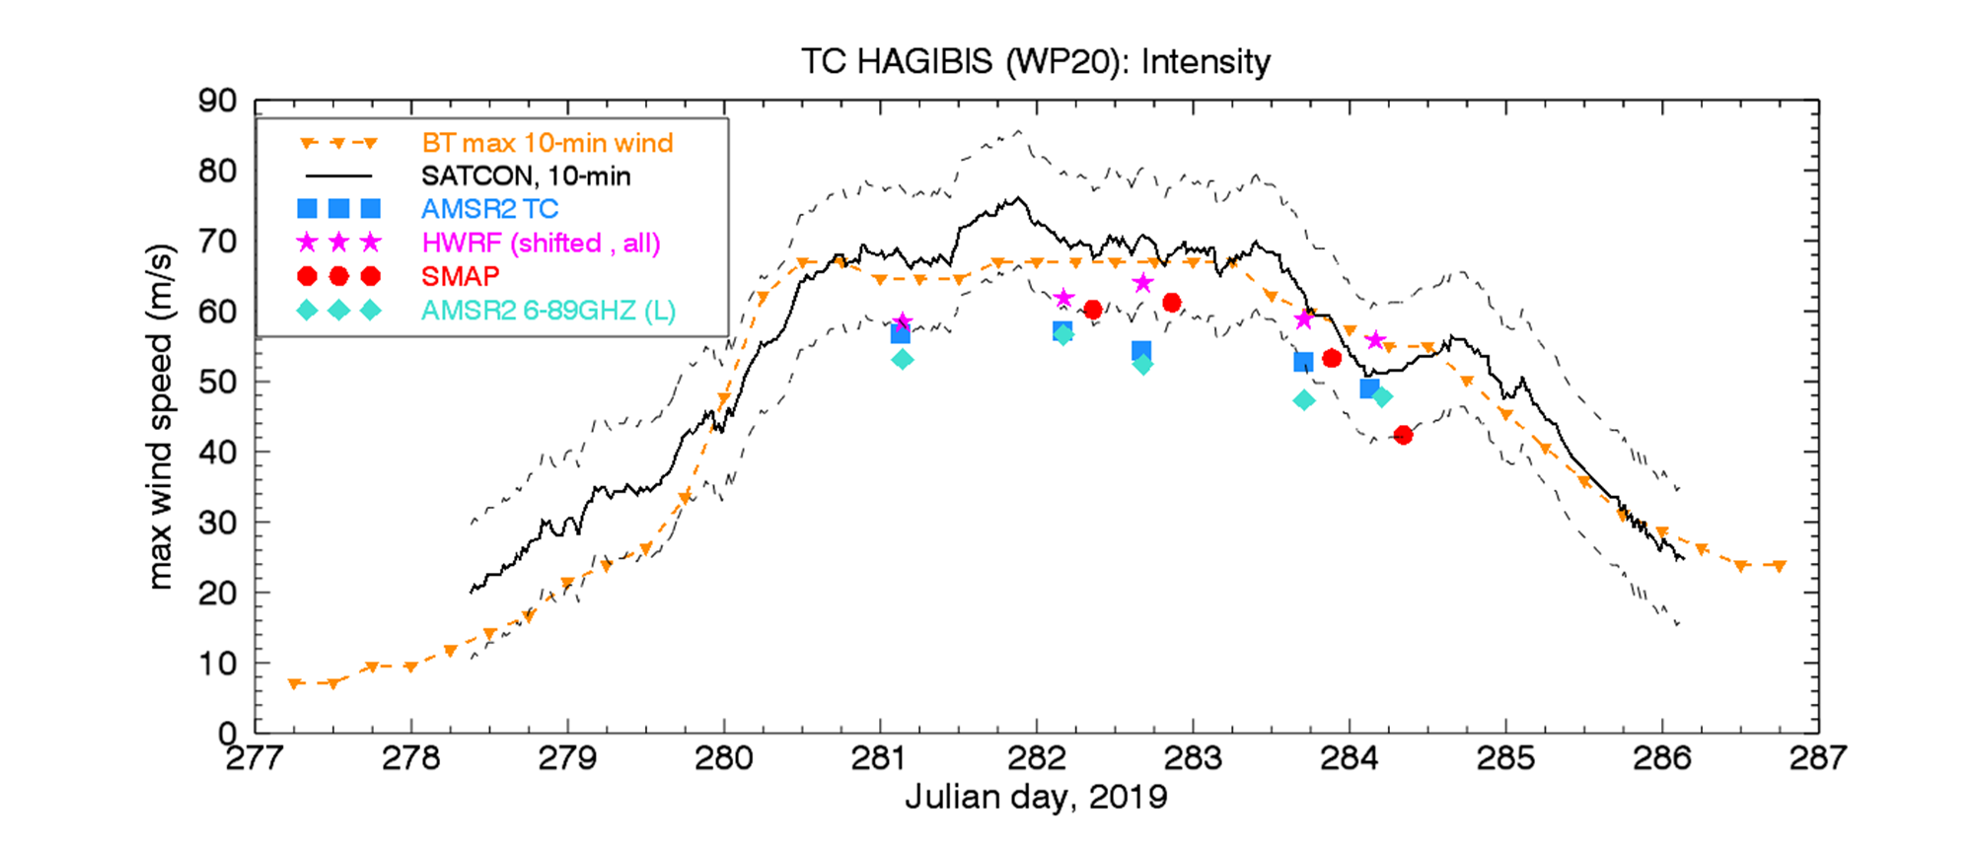
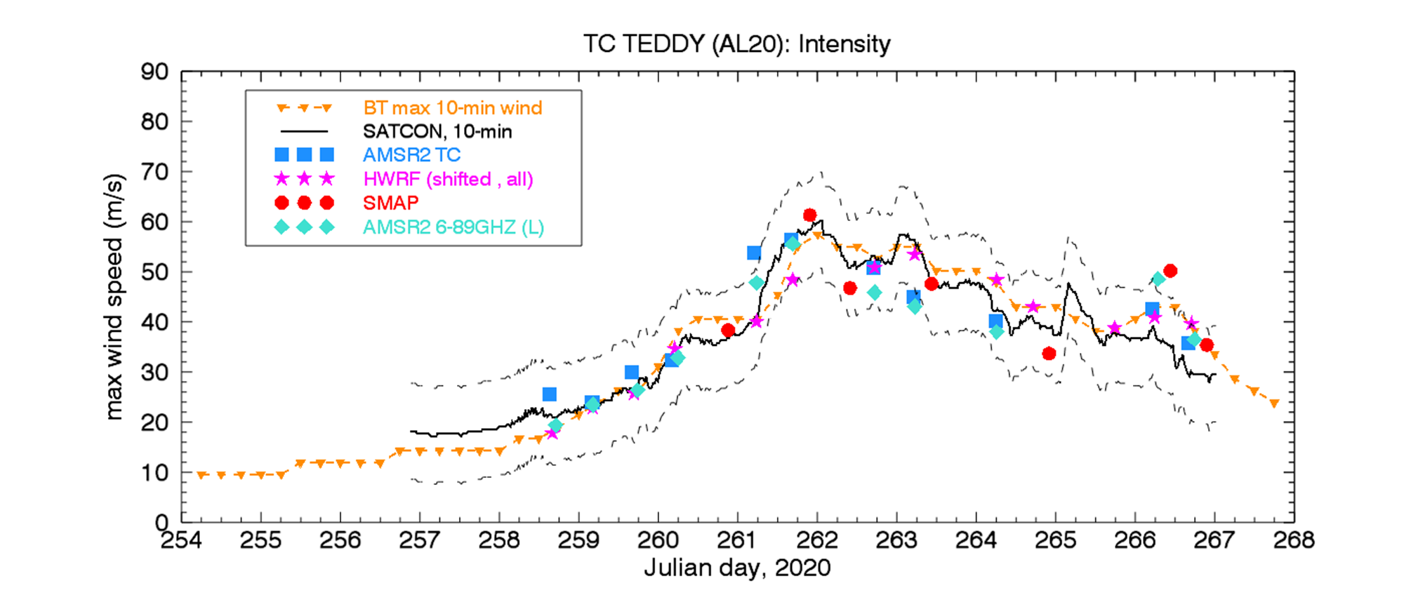
TC archive for post-storm analyses: How often does it happen?

Slide 25
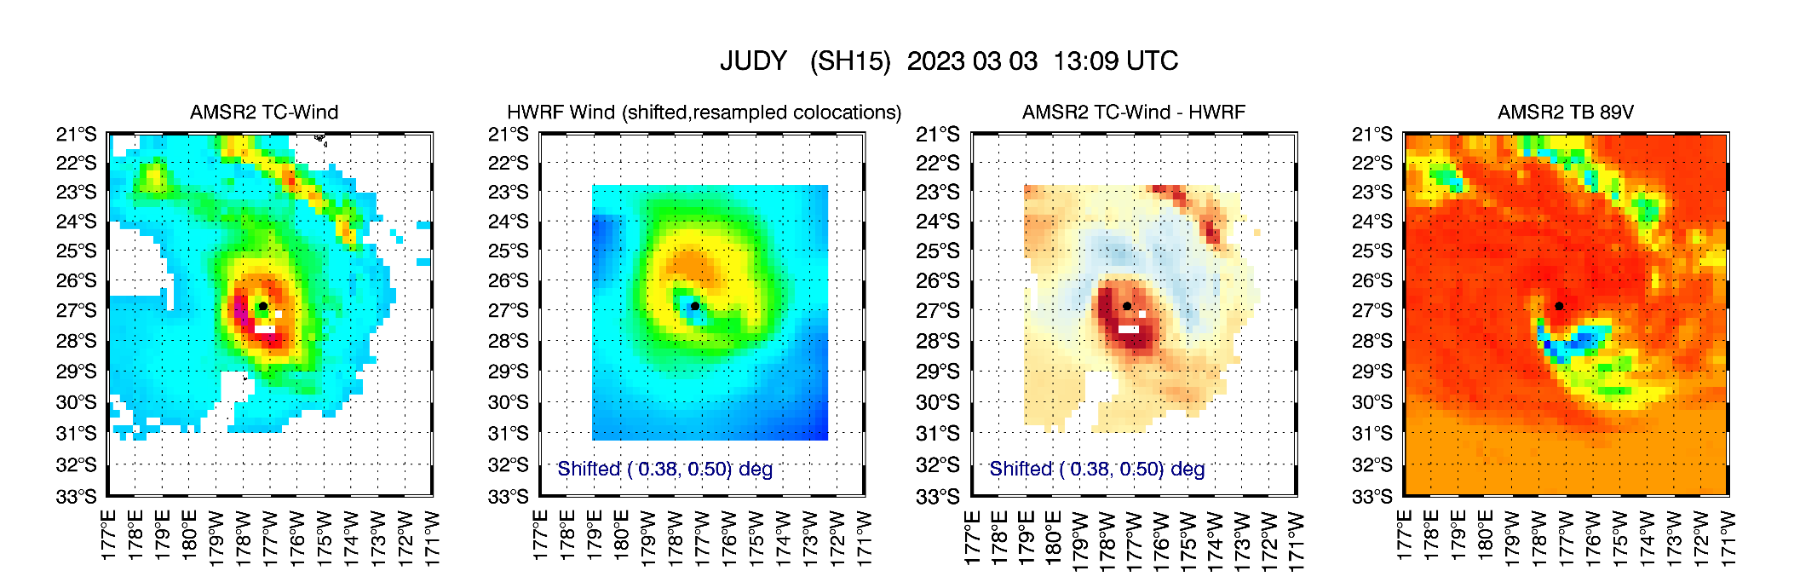
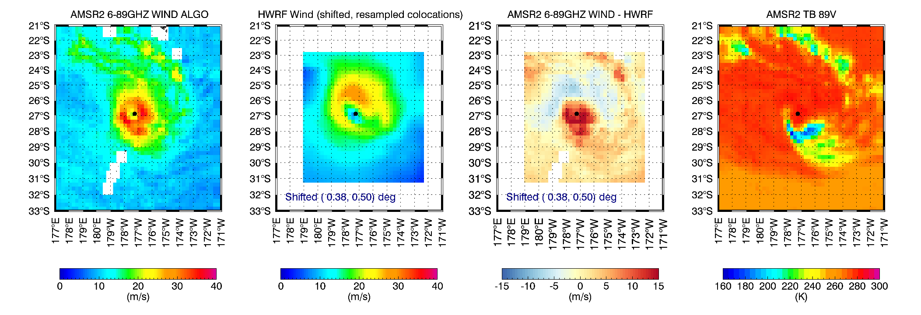
JUDY (SH15)
Large bias in the core and rain band
AMSR2: 43 m/s
HWRF : 29 m/s
BT : 36 m/s
Rainband bias reduced
AMSR2: 37 m/s

Slide 26
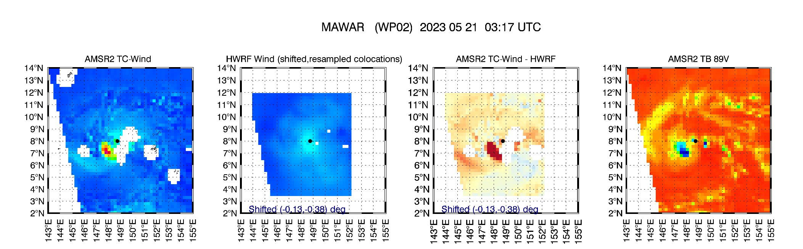
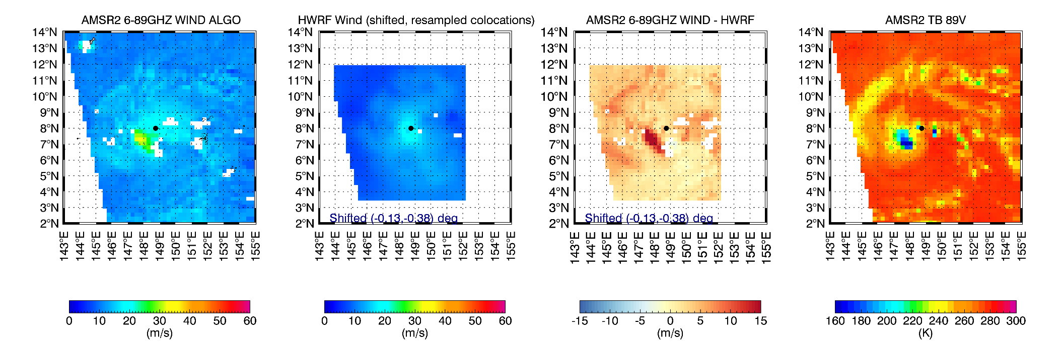
MAWAR (WP02)
Very large bias in cold 89GHZ core (early stage)
AMSR2: 62 m/s
HWRF : 21 m/s
BT : 28 m/s
Improved but still some bias
AMSR2: 36 m/s

Slide 27
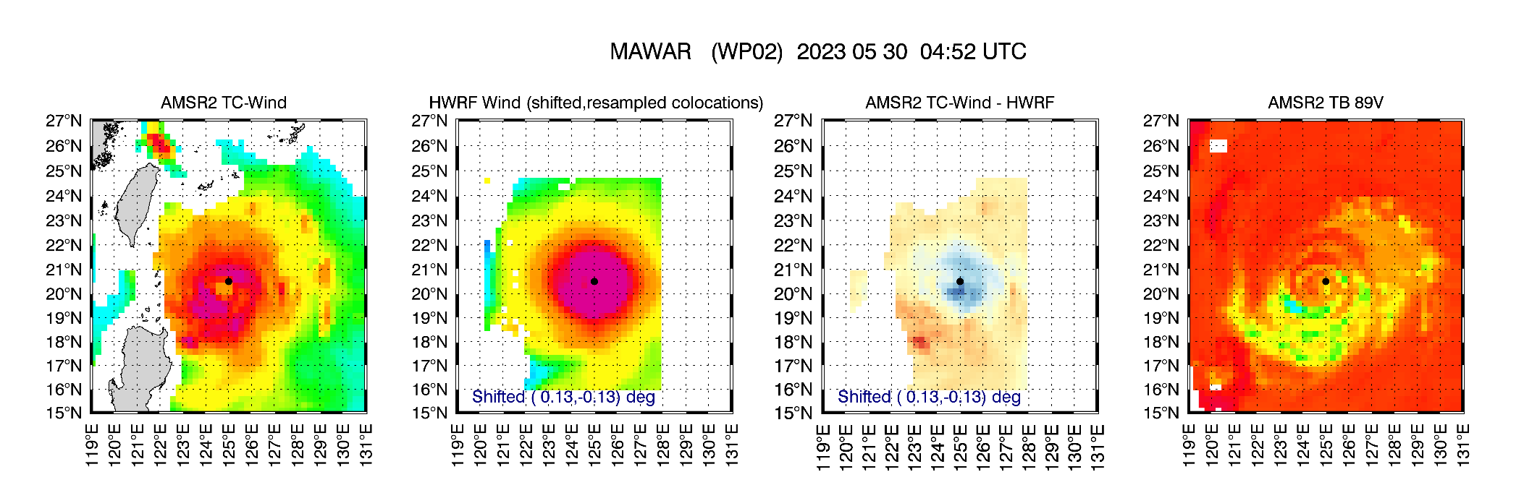
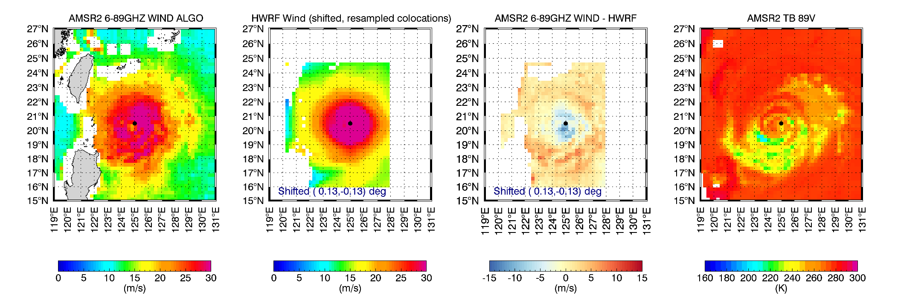
MAWAR (WP02)
This MAWAR case is interesting because is one of the few cases where the new algorithm increases the winds
AMSR2: 32 m/s
HWRF : 38 m/s
BT : 38 m/s
The new wind field looks more similar to HWRF. Note that this storm was NOT used for training the new algorithm
AMSR2: 36 m/s

Slide 28
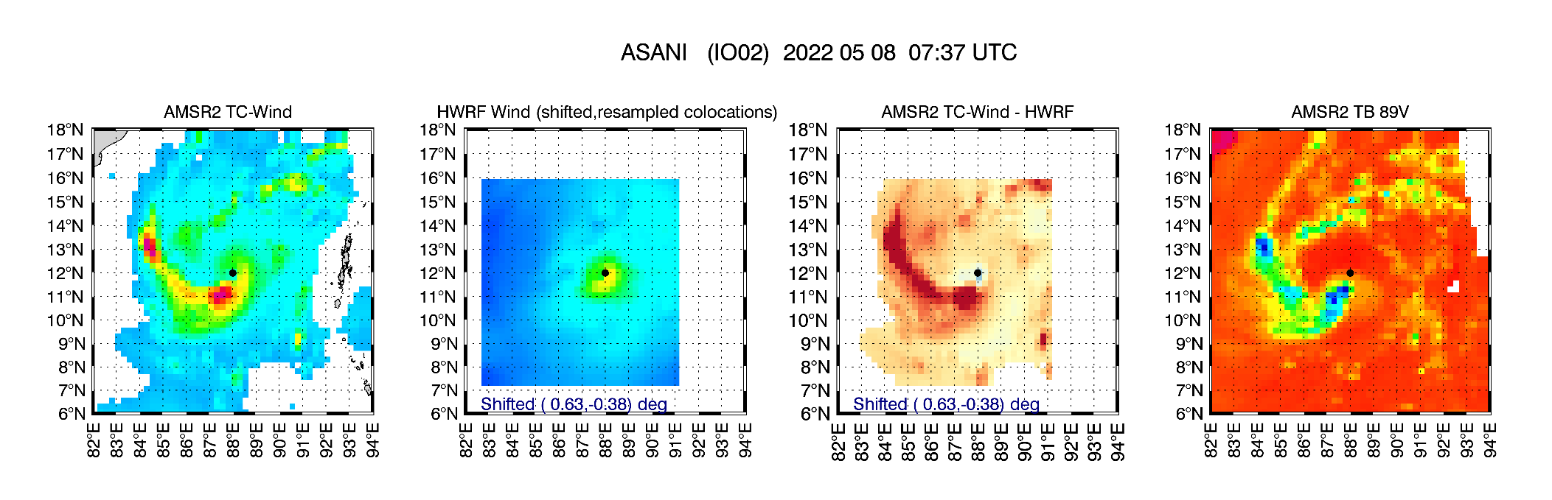
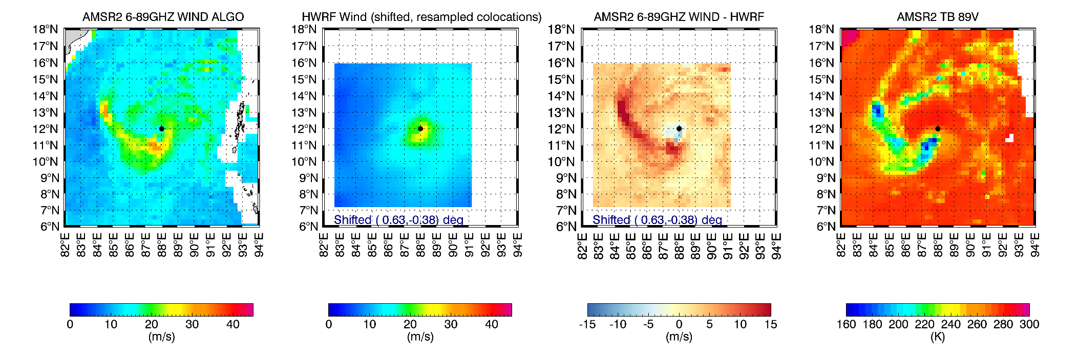
ASANI (IO02, 2022)
Large bias in the core and rain band
AMSR2: 48 m/s
HWRF : 26 m/s
BT : 33 m/s
AMSR2: 32 m/s

Slide 29
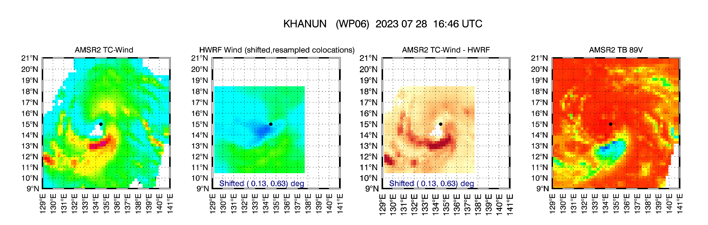
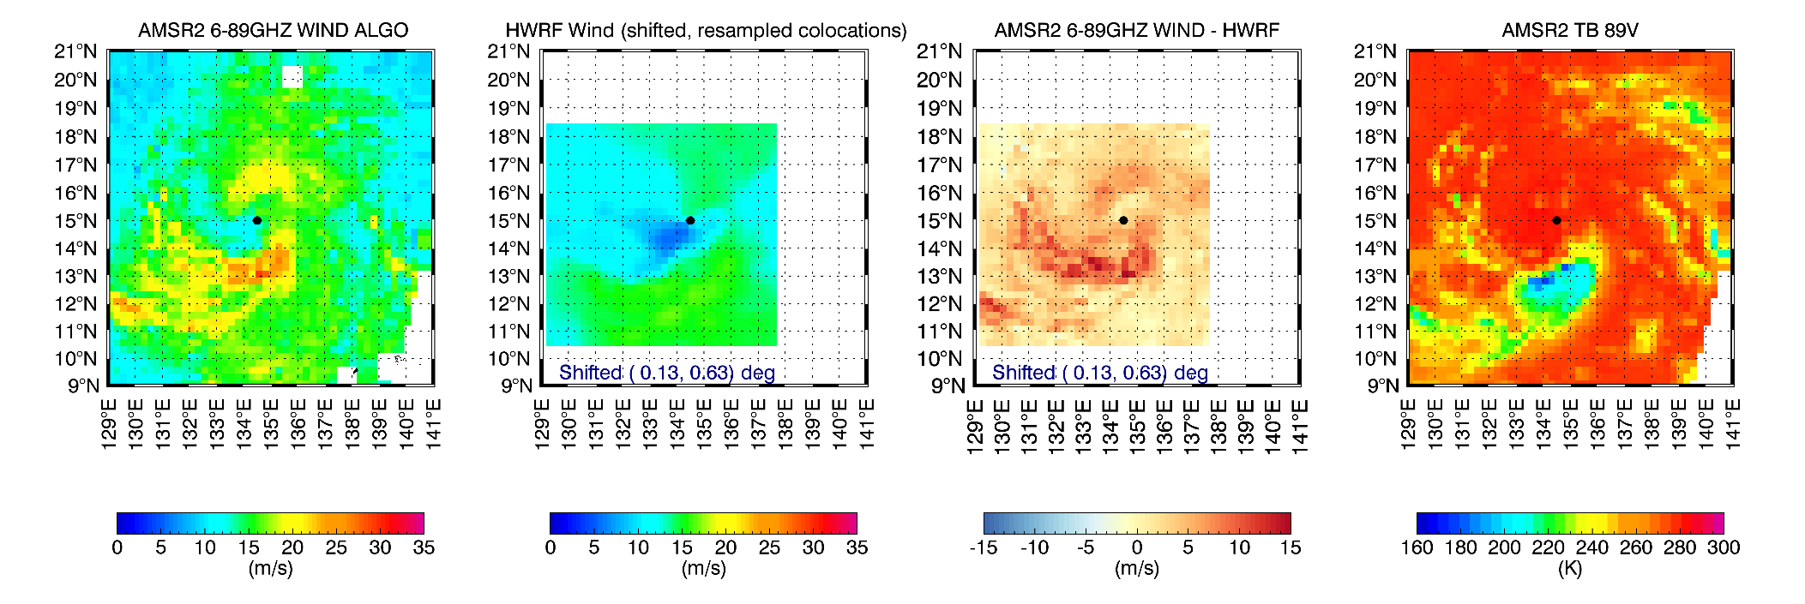
KHANUN (WP06)
Large bias in the core and rain band
AMSR2: 35 m/s
HWRF : 17 m/s
BT : 18 m/s
AMSR2: 29 m/s

Slide 30
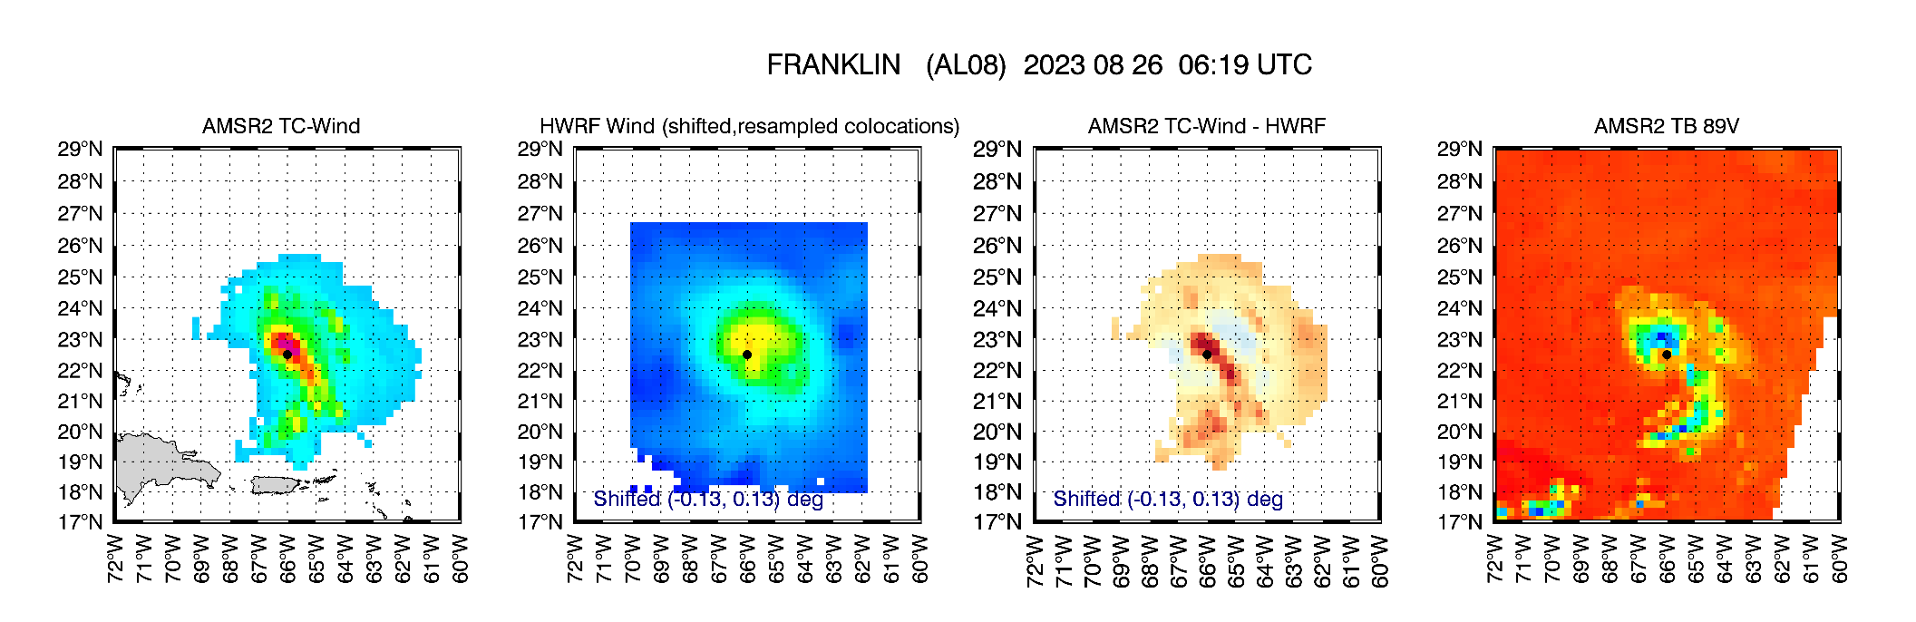
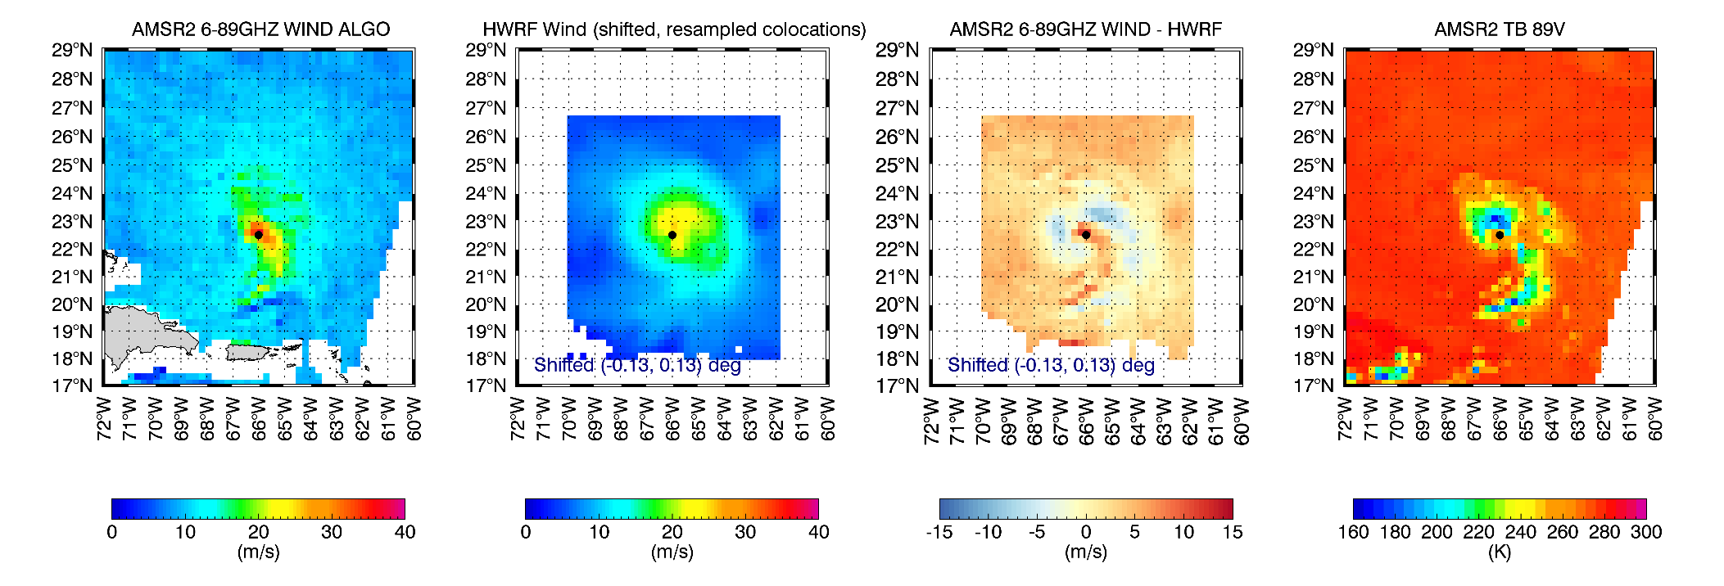
FRANKLIN (AL08)
Franklin had many bad cases: Environmental conditions with many cases of 89GHz < 200K
AMSR2: 45 m/s
HWRF : 25 m/s
BT : 28 m/s
AMSR2: 37 m/s

Slide 31
BIPARJOY
Large bias in the core and RFI
RFI
AMSR2: 70 m/s
HWRF : 27 m/s
BT : 36 m/s
AMSR2: 33 m/s

