Slide 1




Exploiting many scatterometers
EUMETSAT OSI SAF,
Ida land-fall news story
Ad.Stoffelen@knmi.nl, fellow IEEE
Leader active sensing
R&D satellites (RDSW), KNMI,
the Netherlands

Slide 2
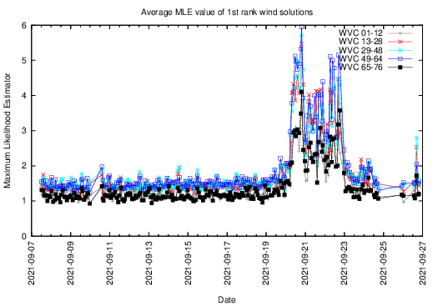
Today’s status of KNMI wind processing
ASCAT-A, MetOp-A : 2007- Nov 2021 9:30 LST
ASCAT-B, MetOp-B : 2012- healthy 9:30 LST
ASCAT-C, MetOp-C : 2018- healthy 9:30 LST, Excellent for wind changes in convection
OSCAT-2, ScatSat-1 : 2017- Feb 2021 8:45 LST, Excellent for Ku/C intercalibration
OSCAT-3, OceanSat3 : Q2 2022 12:00 LST, Good quality, high NRCS
HSCAT-B, HY2B : 2018- healthy 6:00 LST
HSCAT-C, HY2C : 2020- healthy Not sun-synchronous, regresses
HSCAT-D, HY2D : 2021- healthy Regresses, commissioning
CSCAT, CFOSAT : 2019- 2022 Stability issues
WindRad, FY3E : 5/7/’21- now 5:30 LST, commissioning, C-band?
scatterometer.knmi.nl/proc_status/
Vector wind CDRs for ERS (1991-1999), QuikScat (1999-2009),
ASCAT (2007-), OSCAT (2014+), needed to monitor re-analyses
Reanalyses are subject to changing inputs
scatterometer.knmi.nl/archived_prod/
EU Copernicus Marine Service Wind TAC
HY2D
https://scatterometer.knmi.nl/hy2d_25_prod/index.php?cmd=monitoring&period=week&day=0&flag=yes

Slide 3
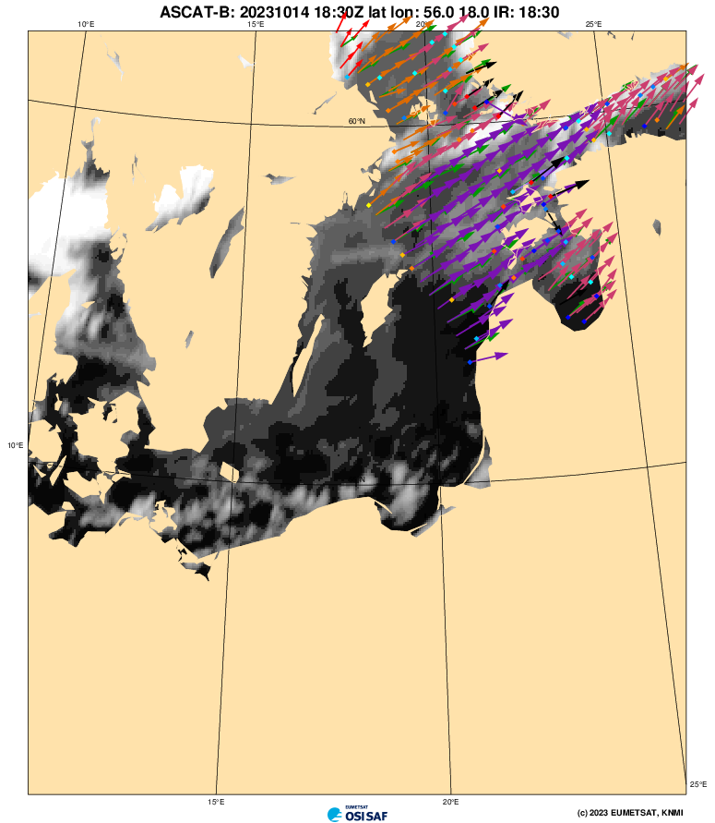
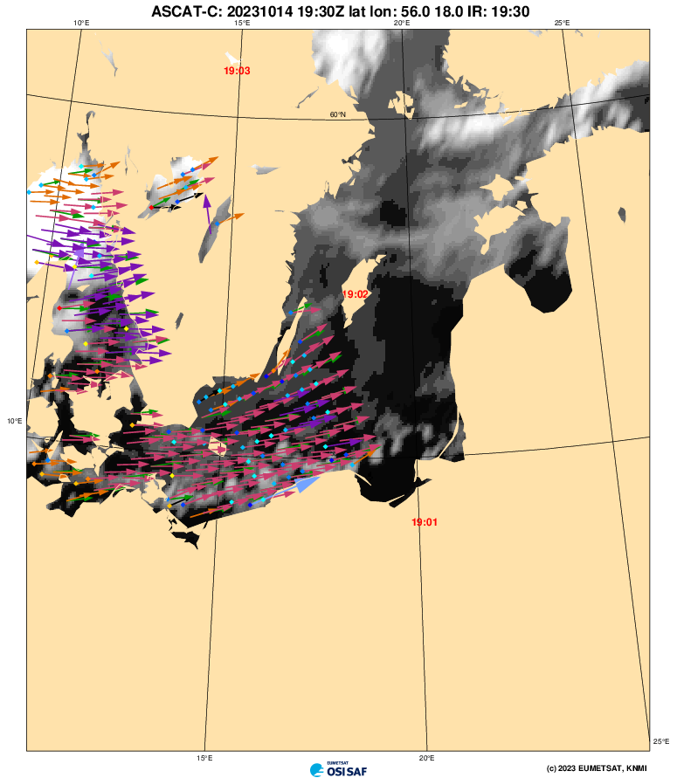
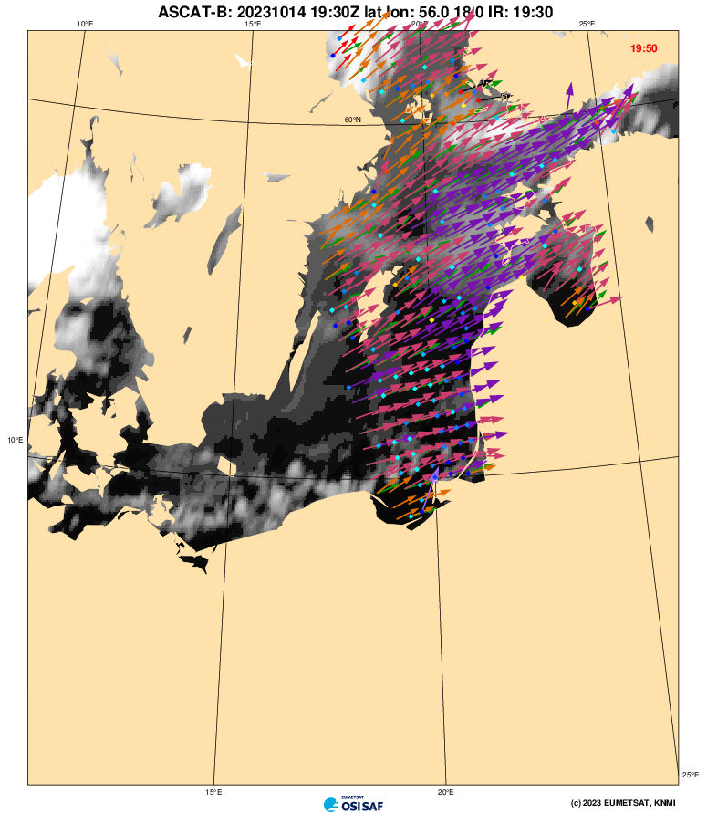
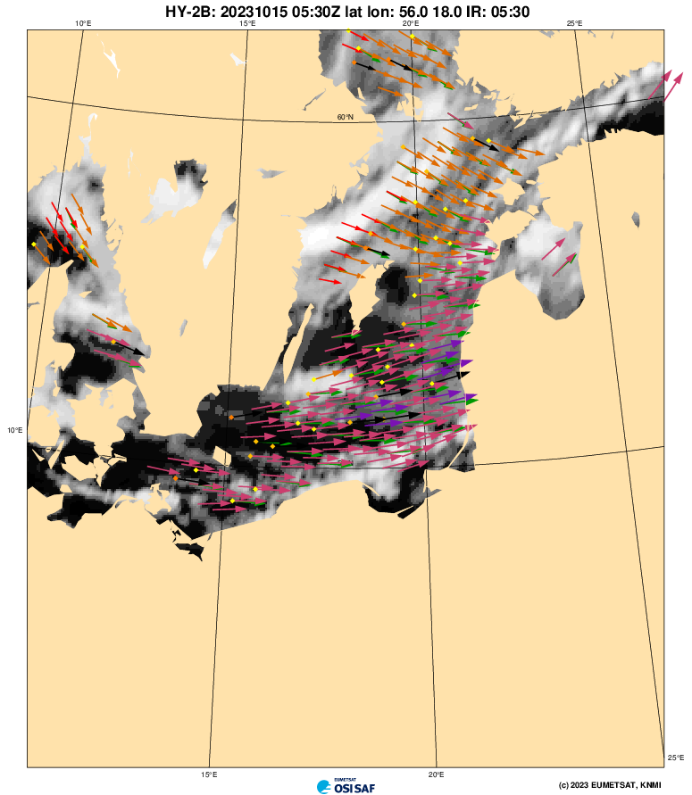
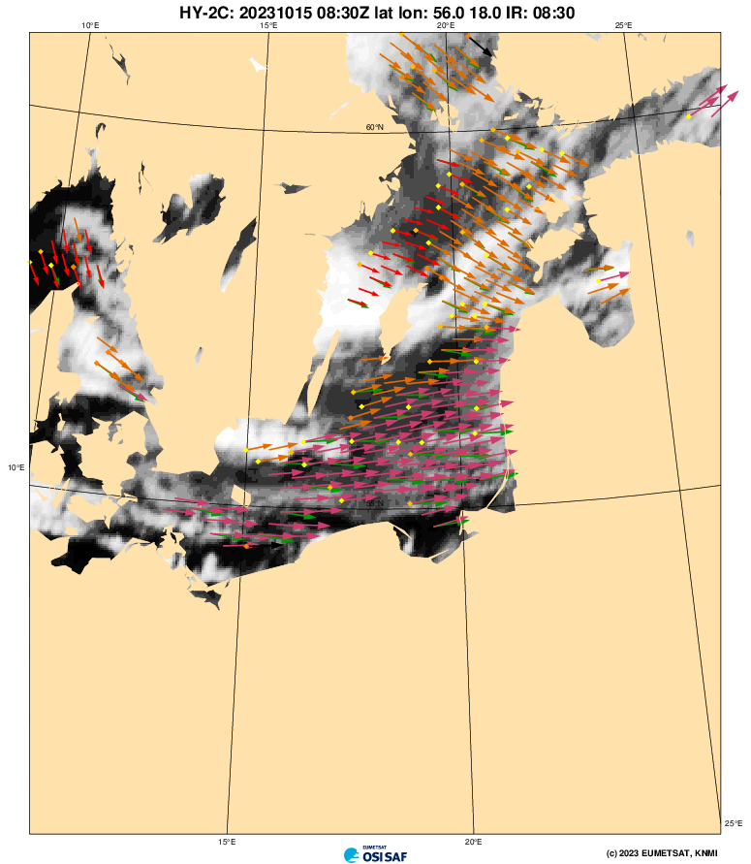
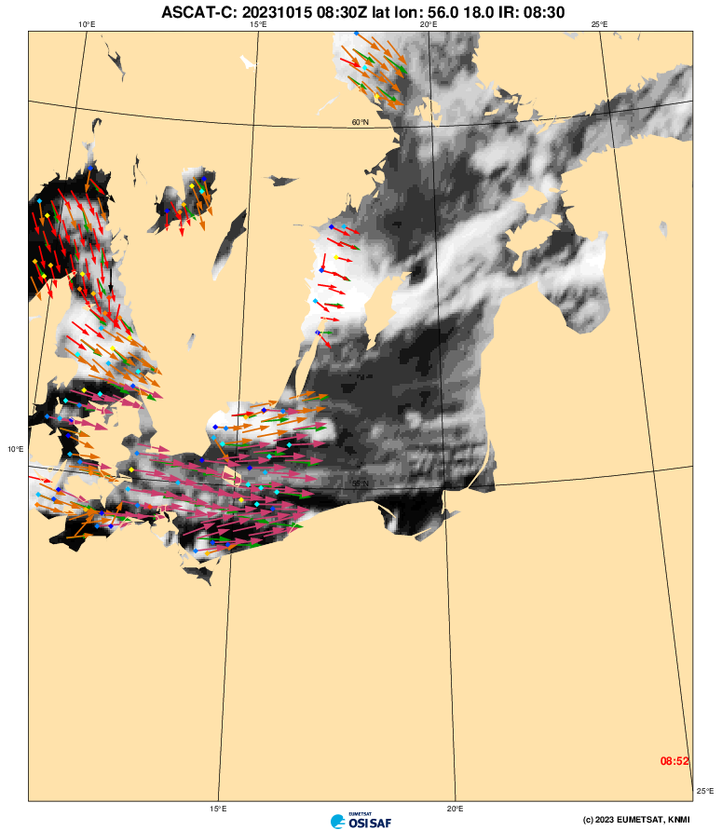
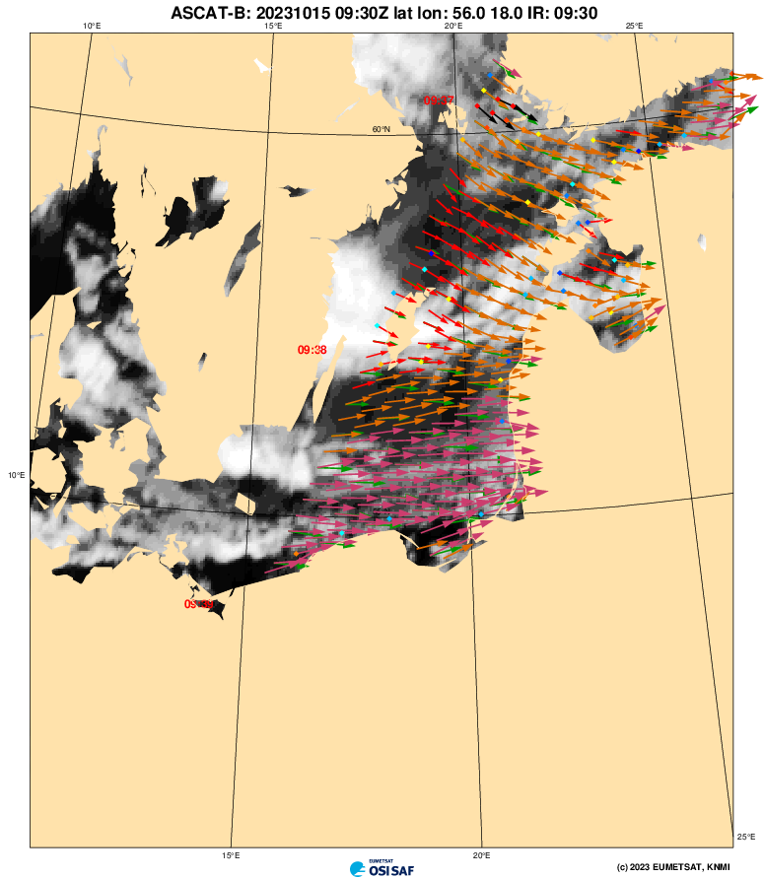
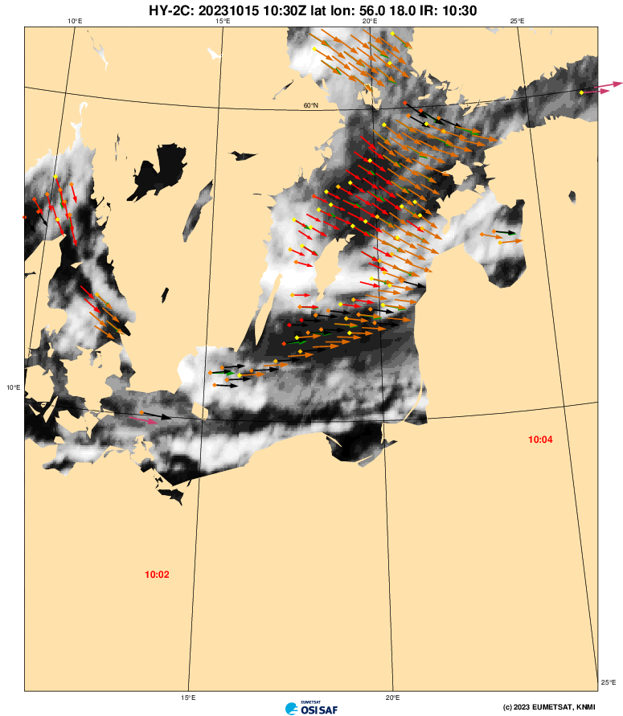
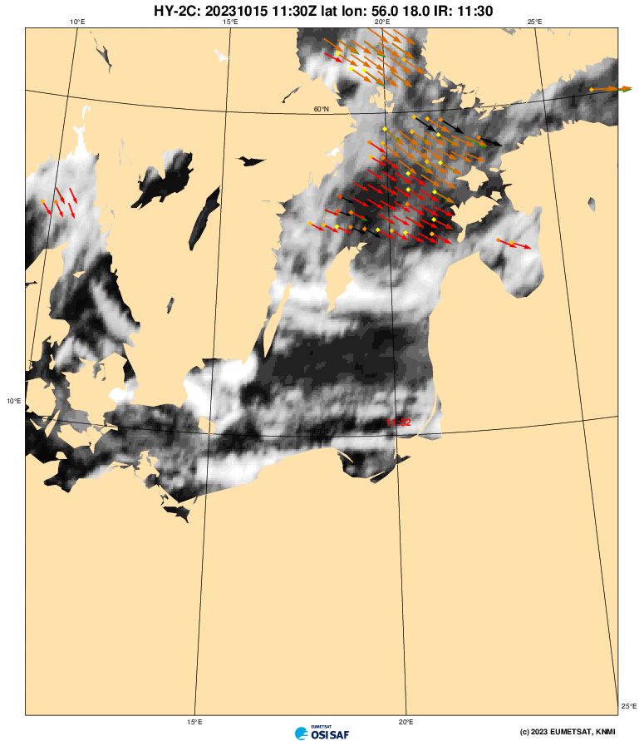
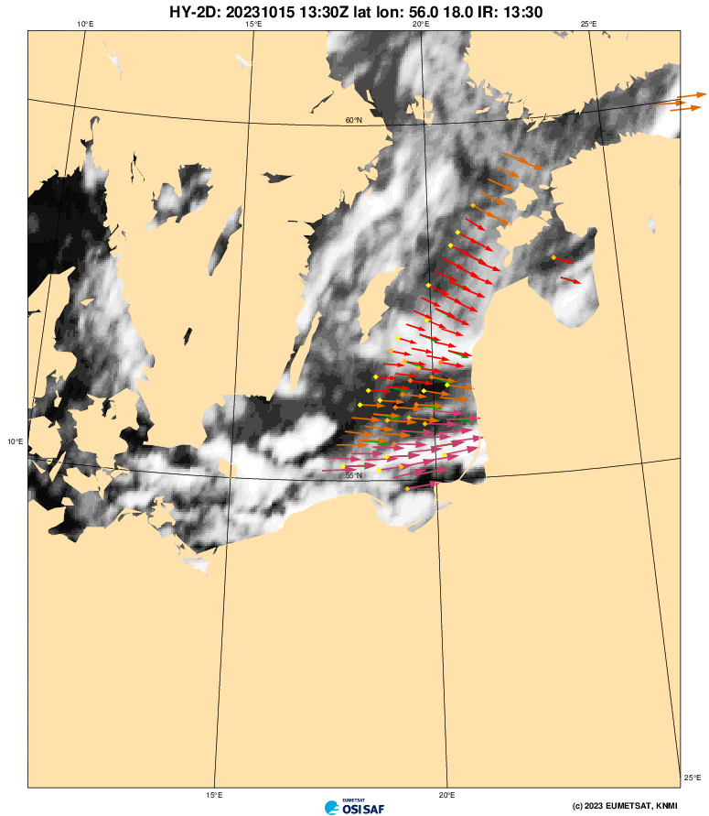
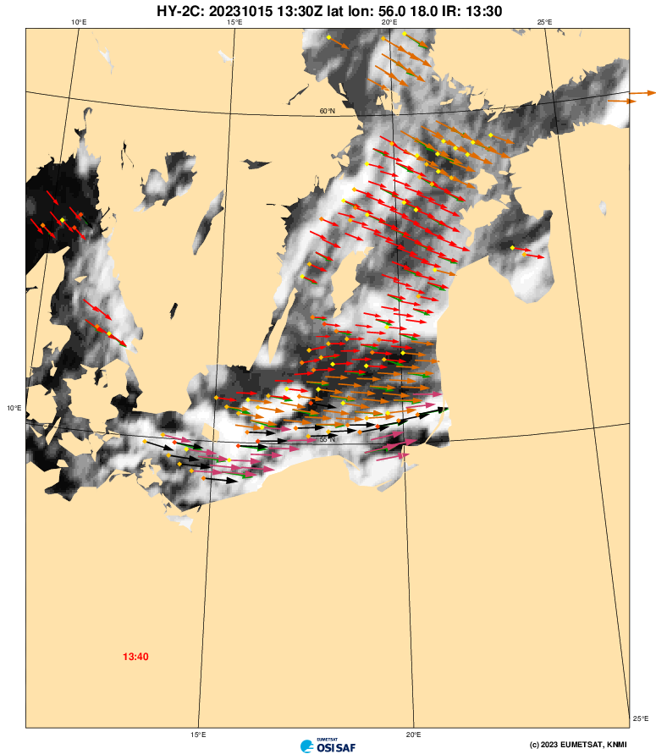
ASCAT-B
ASCAT-C
ASCAT-B
HY2-B
HY2-C
ASCAT-C
ASCAT-B
HY2-C
22 hrs over the Baltic
from 5 scatterometers
HY2-C
HY2-D
HY2-C

Slide 4
Scatterometers are very stable
ASCAT-A beams stay within a few hundreds of a dB (eq. to m/s)
Measurement space cone position variation due to seasonal wind variability
Reference for climate research (to check reanalyses)
Maria Belmonte Rivas et al., 2017

Slide 5
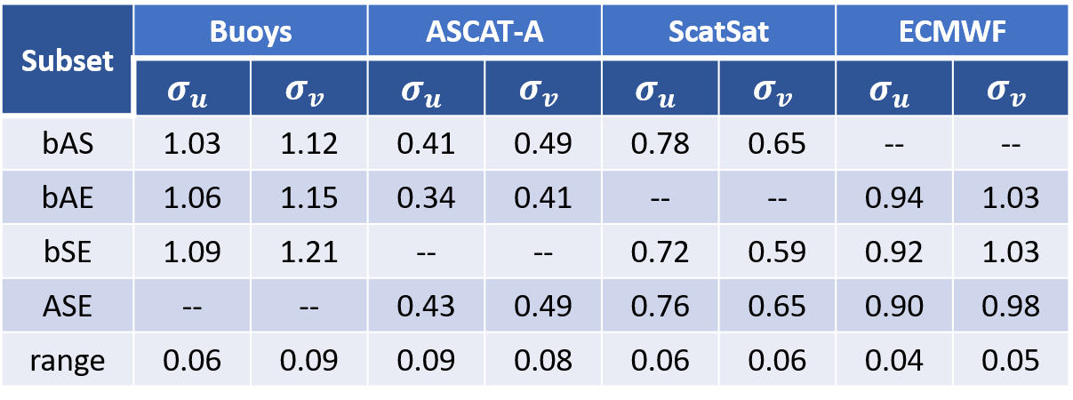
Scatterometer winds are excellent quality
Scatterometers winds and stresses are unbiased with respect to moored buoys and have the smallest random error among in-situ and NWP winds
Consolidated several methodologies to solve multiple collocation error equations
Added better ability to approximate the errors of the errors
Confirms the excellent accuracy of scatterometer winds
Stress-equivalent 10-m buoy and ECMWF winds
Jur Vogelzang and Ad Stoffelen, 2022a, 2022b, 2021

Slide 6
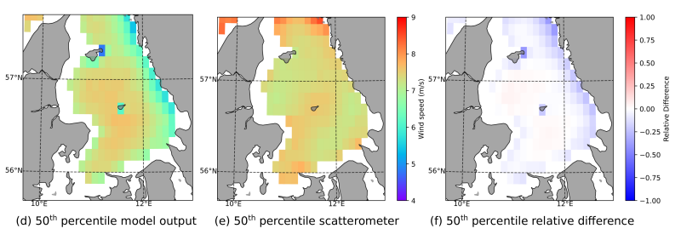
Coastal winds from ASCAT and NWP
COSMO NWP wind ASCAT wind Relative difference
New ASCAT land contribution flag to get 50% closer to the coast (~5 km)
Also in development for other scatterometers for coastal wind monitoring
Use more sporadic SAR for local variability studies, e.g., S-1, RadarSat
Mesoscale and global NWP models are degraded in coastal regions
Neirynck et al., in review

Slide 7
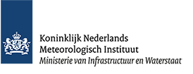

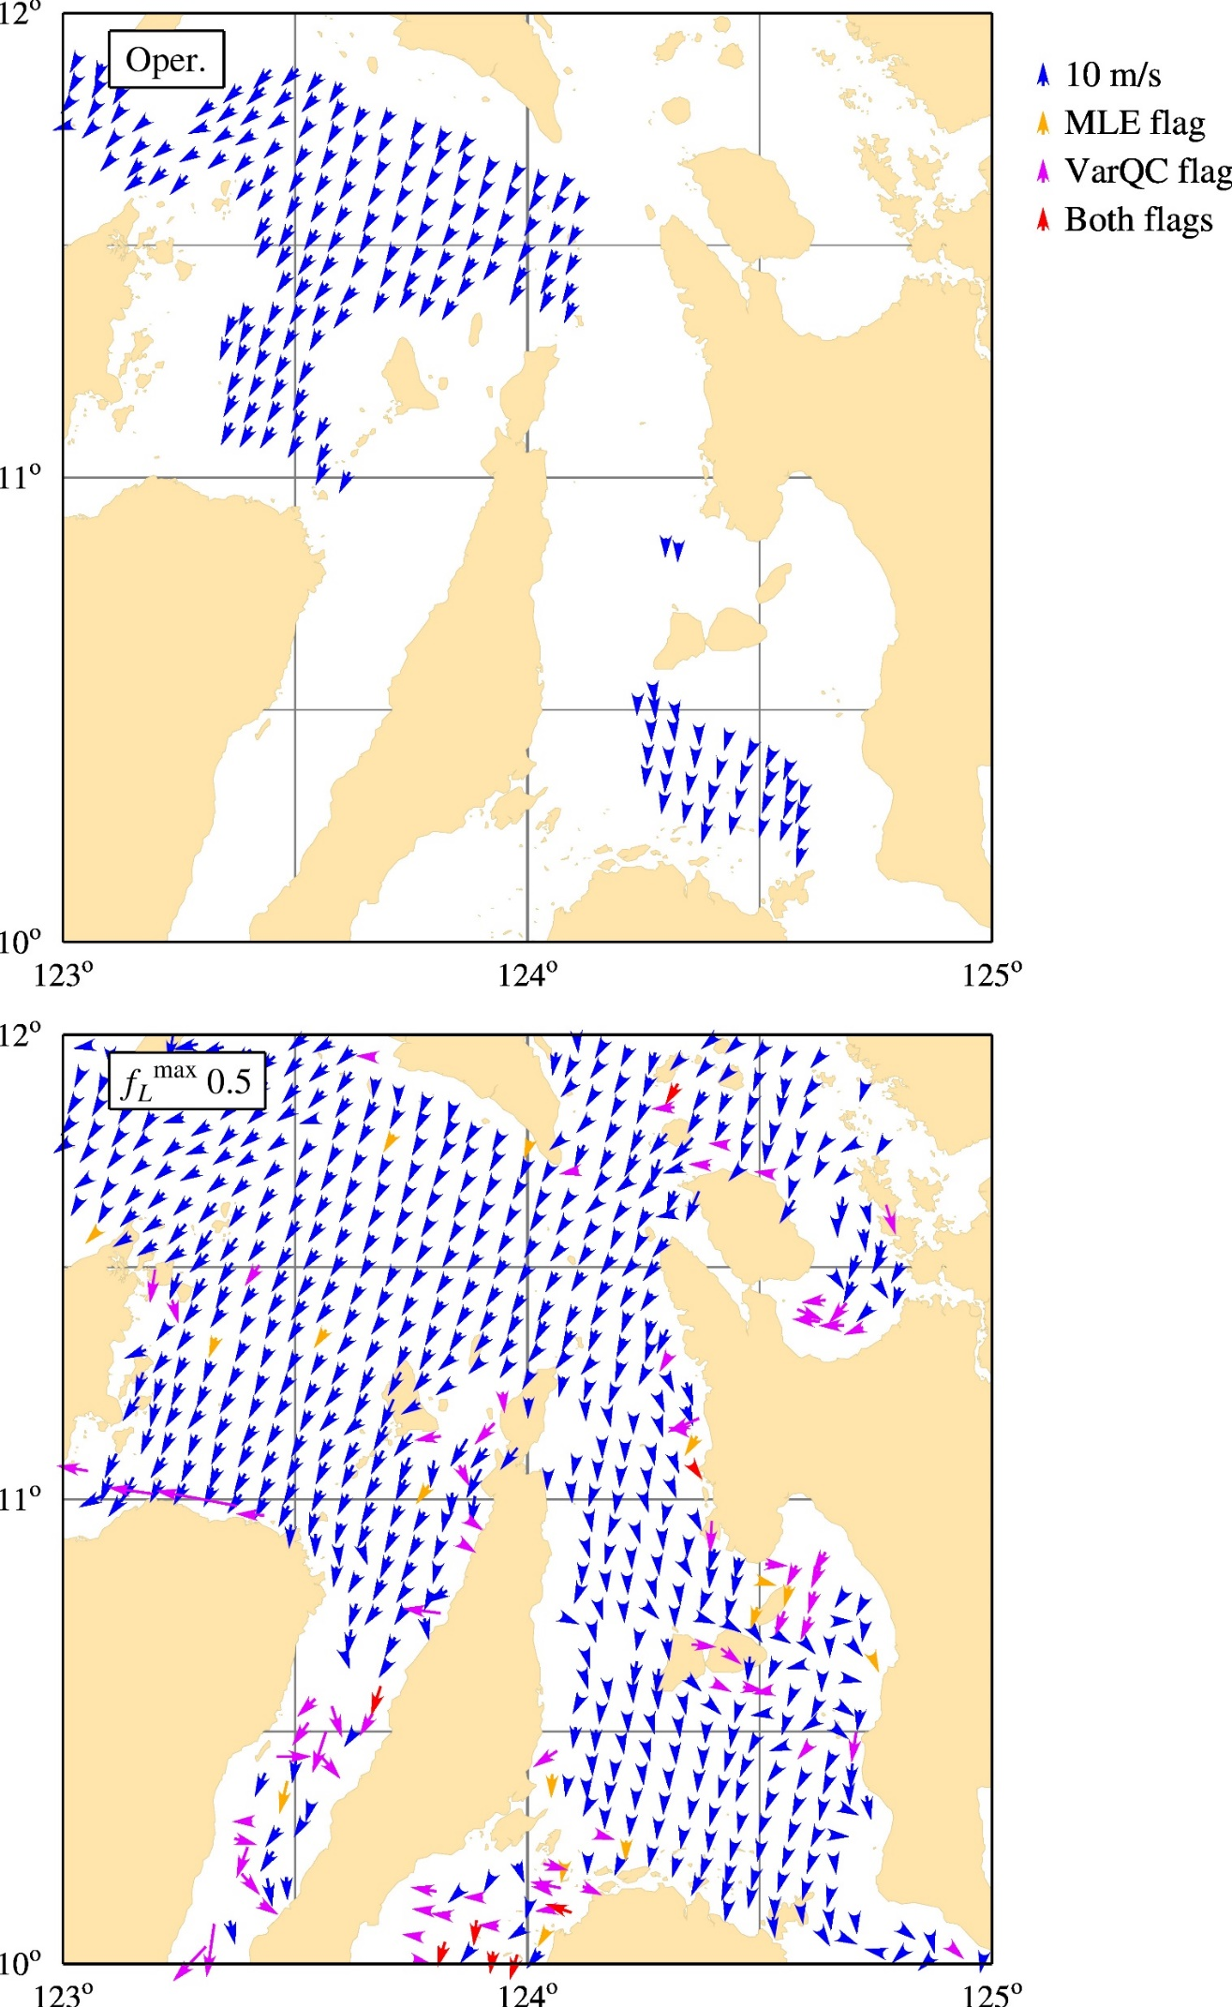
First result at 6.25 km grid size
Vogelzang & Stoffelen, 2022, in review

Slide 8
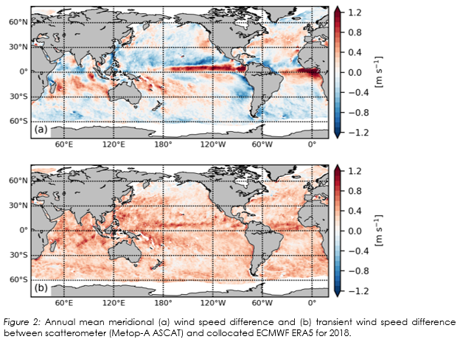

Higher level ocean vector wind services
Air-sea interaction has major errors in forcing and fluxes, affecting NWP and climate research using models
Correct NWP model wind biases by exploiting the virtual scatterometer constellation:
Vector wind / variability
Stress vector / variability
Divergence
Curl
Fluxes

Slide 9

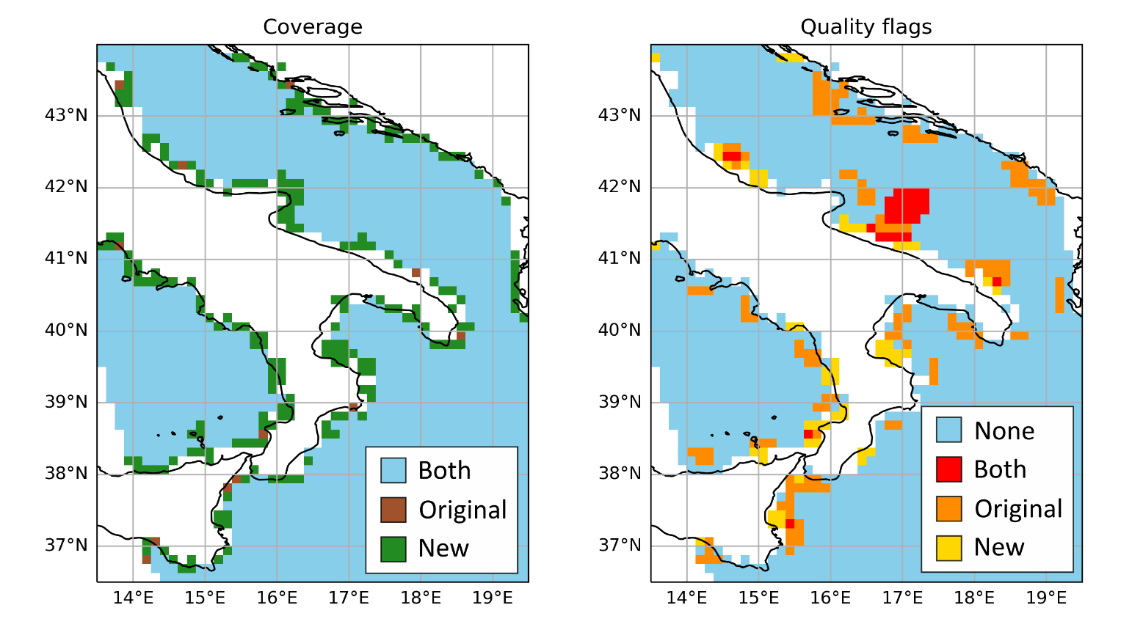
Winds/stress service evolution
Service Evolution continues L3/L4 winds
A (new) SAR winds project has just started
Snapshots of higher resolution winds by SAR
  Use for coastal scatterometer product validation and enhancement
  Besides ASCAT and SCA, extend to Ku-band scatterometers
  Improve SAR stress-equivalent wind vectors in coastal regions (complement with scatterometer wind direction information)
Exploit quality-controlled in-situ TAC wind, stress and air stability information
  Needed for coastal wind and stress validation

Slide 10
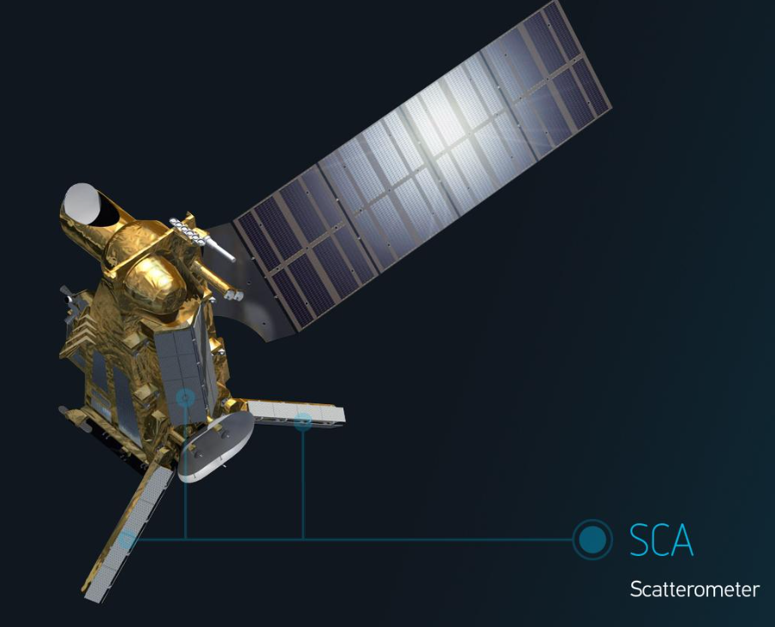
New scatterometers, Passive microwaves and SAR
SAR services are being developed in the Copernicus Marine Service to add value to scatterometer wind products, in particular for extremes
and coastal winds assessment
Satellite B of MetOp-SG (2025) has SCA and will provide
  10% more swath than ASCAT
  Double spatial resolution w.r.t. ASCAT
  Better extremes, due to a VH channel
  Continuous calibration by transponders
Satellite B of MetOp-SG (2025) has a microwave radiometer MWI complementing SCA
  “Day-2” SCA-intercalibrated MWI stress-equivalent winds
  “Day-3” synergetic SCA and MWI stress-equivalent winds
Copernicus Imaging Microwave Radiometer, CIMR (2025+), will provide ice and sea products, among which stress-equivalent wind speed/vector
  Intercalibrate with virtual scatterometer constellation (cf. Dinnat et al., 2023)

Slide 11



Extreme Wind Trends in Climate Data Records
Ad Stoffelen, Alexandre Payez, Rianne Giessen
Wind trends in extremes are difficult to measure due to irregular sampling by in-situ observations
Re-analyses sample regularly and in a fixed model setting, but suffer from varying observational data set inputs over time, probably affecting trends
We have stable scatterometer instruments over several decades to detect trends in extremes
Analyzing trends by scatterometer instrument is reliable due to its constant sampling characteristics over time (see example plots)
Combining several overlapping instruments in a row may produce long-term reliable trends
PDF interpolation could further reduce sampling errors and allow determination of 99.9 wind speed percentiles over larger areas, e.g., basin
This is being shown in the ESA MAXSS project
Figure 2.1.2. ASCAT-A 99th wind speed percentile (a) annual anomaly for 2020 and (b) annual trend (2007–2020). Areas with trends significant above the 90% confidence level are outlined in black.
Giessen et al., 2022

Slide 12
Summary
Winds determine weather, hurricanes, ocean waves and surges, electricity, ocean forcing, motion, heat and carbon budget, sea ice decline, climate change, …
Are used by marine forecasters, in NWP, by oceanographers, wind engineers, off-shore industry, safety authorities, climate scientists, . . .
Golden age of scatterometry to benefit these applications
Scatterometer winds are generally stable and accurate, even in the most extreme conditions
Opportunities for multiple collocations, NRCS intercalibration, QC improvements, GMF estimation, improved wind retrieval, rain correction, coastal winds development, …
Allows standardized user products, which are easy to use for the global user communities
Model biases in mean wind vector, variability and wind derivatives should be corrected for data assimilation, coupled modelling or forecasting applications (ML) to the benefit of more realistic earth system dynamics
In-situ wind references need consolidation for satellite instrument calibration and model applications, in particular at the extremes
New missions measuring ocean motion will complement scatterometry and can exploit the high SRL in wind scatterometry

Slide 13
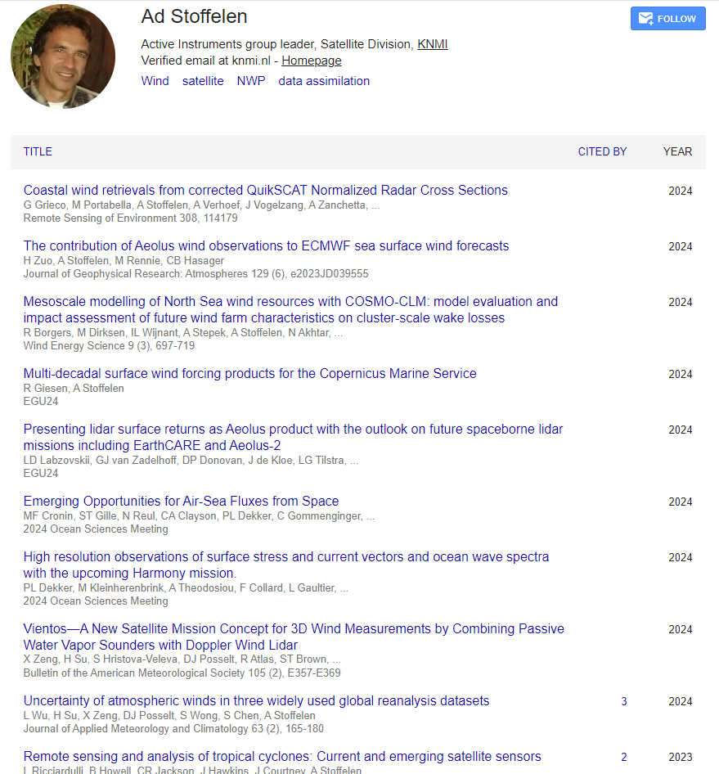
Further information . .
Services:
scatterometer.knmi.nl
training material
osi-saf.eumetsat.int marine.copernicus.eu

Slide 14
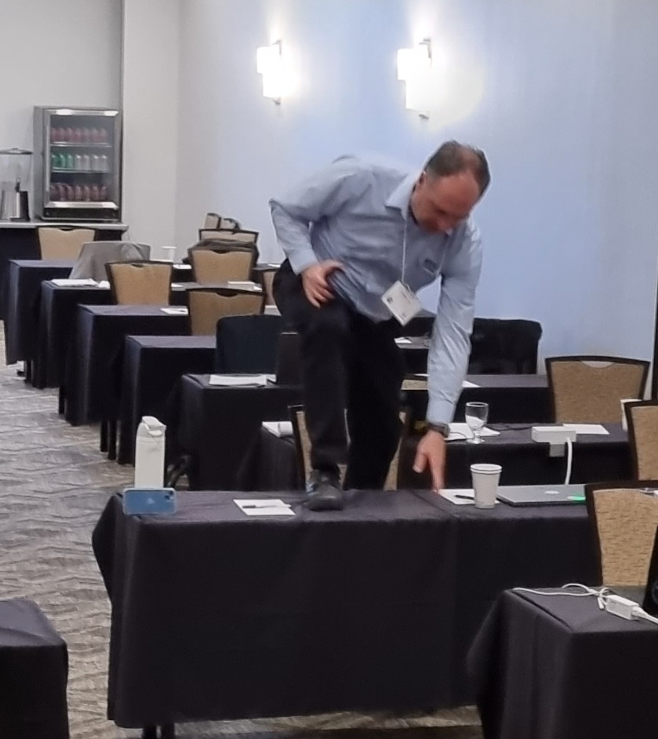
Our host did really everything to make this
meeting a success ☺
Many thanks to all organizers and staff !

Slide 15
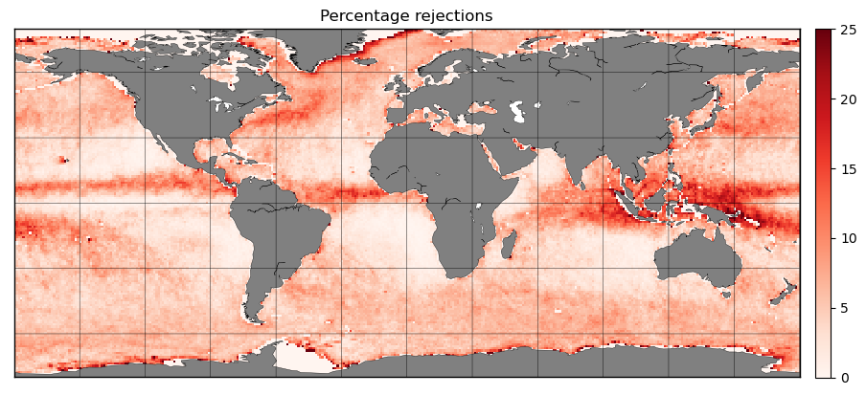
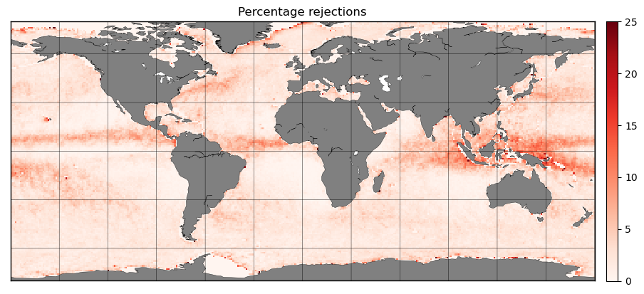


Quality Control and ocean winds
% rejections Ku-band
We continuously collaborate to improve quality control (QC)
For Ku-band scatterometers we need to control rain (=>)
Develop algorithms to correct for remaining observational sampling biases
We compare geographical biases between rain-insentitive (ASCAT) and rain-sensitive (Ku-band) scatterometers and collocated ECMWF winds
Using ECMWF allows correction of satellite sampling biases
It allows to estimate the bias due to the systematic removal of at maximum ~10% of the Ku-band winds in moist convection
We work on Ku-band rain correction methods using Bayesian estimation
Zhao et al., 2023 (2x)
King et al., 2022
Xu and Stoffelen, 2021, 2019
Trindade et al., 2020, 2023
Belmonte and Stoffelen, 2019
Old
New

Slide 16
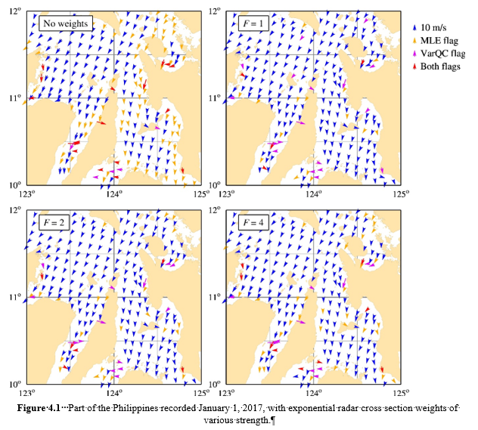
Coastal ASCAT and wind quality
Accurate wind vectors
Close to the coast
SCA improves resolution
SCA improves accuracy
Vogelzang et al, 2021

Slide 17

Higher level ocean vector wind services
Hourly gridded L3/L4 wind and stress
Corrects NWP errors

Slide 18
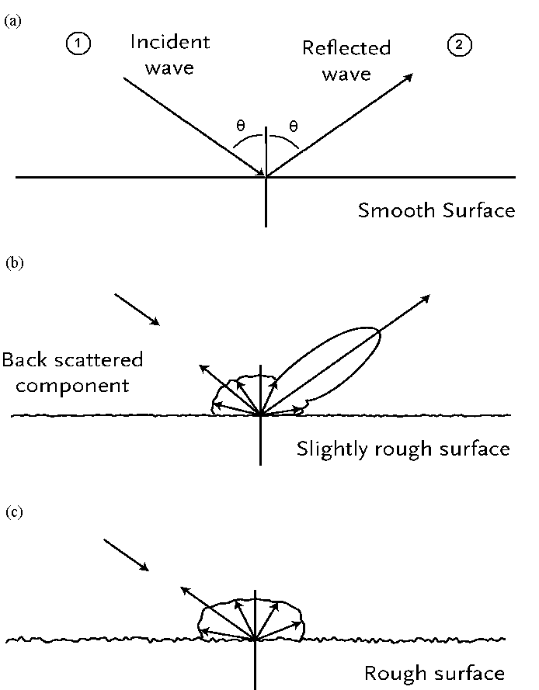
Scatterometer?
Radar
beam
Reflection
Flat
Vlak
Interference with cm-waves (Bragg)
The more wind, the more μgolf scattering
Also depending on wind direction
Back-scattering
Rippled
Rough

Slide 19
Scatterometer research, partners KNMI abroad
Marcos Portabella, Ku-band scatterometry, 8 years at KNMI, now ICM in Barcelona, Spain
Wenming Lin, 7 years at ICM, wind variability/rain; now at NUIST on CFOSAT, . . .
2023 PhD’s: Weicheng Ni (NUDT) on hurricanes, Ke Zhoa (Qingdao) on rain, Haichen Zuo (DTU) on Aeolus and ASCAT, Ana Trindade (ICM) on ERA*
Giuseppe Grieco, 3 years at KNMI on GNSS-R, 1 year at ICM, now CNR in Italy on coastal PenWP
Federico Cossu, EUMETSAT wind fellow at ICM, Spain
Zhixiong Wang, Ku GMF with SST correction, product comparison Ku/C, now prepared data for ECMWF data assimilation experiments and WindRad, NUIST
Xingou Xu at NSSC, Scatterometry, Machine Learning, Beijing, now at KNMI
Paul Chang, NOAA hurricane hunters, USA
Bertrand Chapron/Alexis Mouche, MAXSS, GlobCurrent, SAR winds, IFREMER
Sean Healy, data assimilation, ECMWF
Scatterometer Cal/Val: EUMETSAT, NASA, ESA, ISRO, NSOAS, CMA, CNES
Paco Lopez Dekker, Doppler for EPS-SG SCA (2026), ESA EE Harmony PI, TU Delft, Netherlands
CGMS Ocean Surface Winds Task Group, IOVWST, . . .
ESA Earth Explorer MAG member for Harmony and SeaStar

Slide 20
Motivation / Potential OSW TG
Scatterometer winds were introduced and represented at the IWWG meetings since 1996 (Ascona meeting)
OSW side meetings were held at several IWWG meetings with representatives of the NWP community
Several topics need further attention beyond CEOS and IOVWST, such as:
  Intercalibration of wind products for Climate Data Records and operational user convenience
  An in-situ wind speed reference for high and extreme winds
  Methods for the elimination of model biases in NWP data assimilation (local VARBC)
  Improved spatial NWP wind assimilation methods; assimilate unique products
  QC optimization for NWP, Ku-band rain
  Open high-level wind services and both local and global timeliness of the virtual constellation
  Open data comparisons and open software to share in the community
  Exploit scatterometer wind stress measurements for improved atmosphere-ocean coupling
  Development of coastal winds for all scatterometers
The OSW TG facilitates an open and shared environment to address above points for the general benefit of the meteorological/ocean community

Slide 21
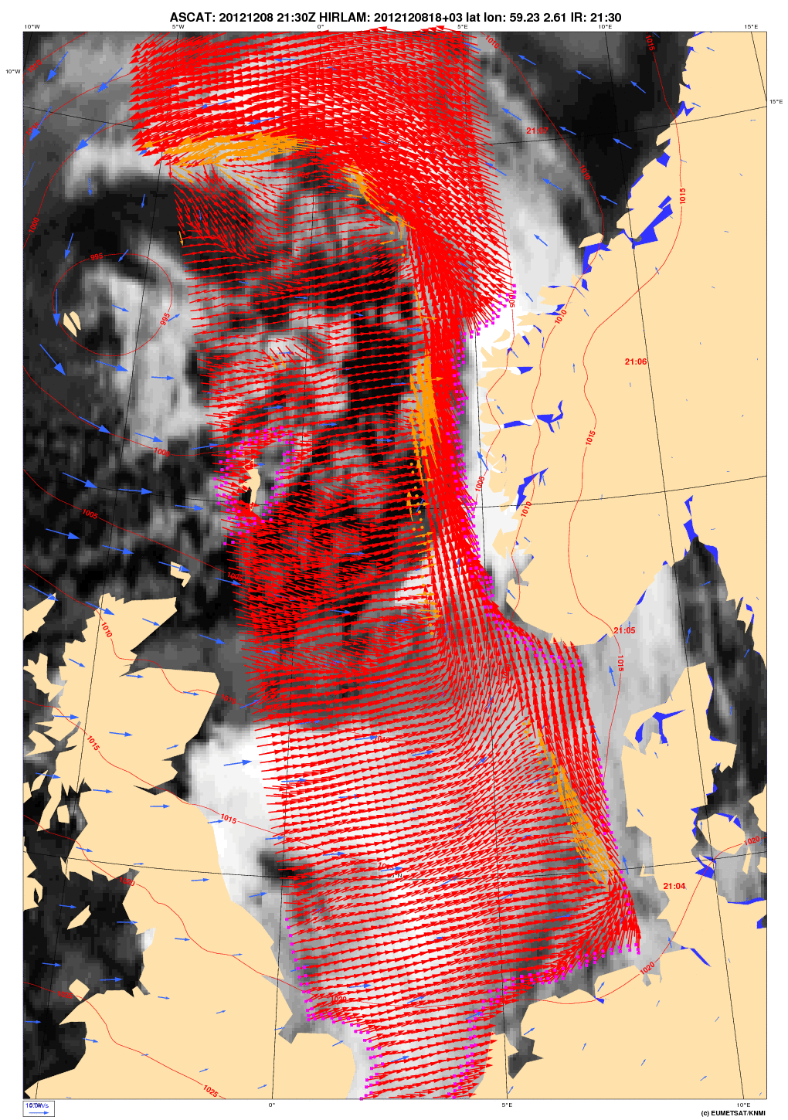



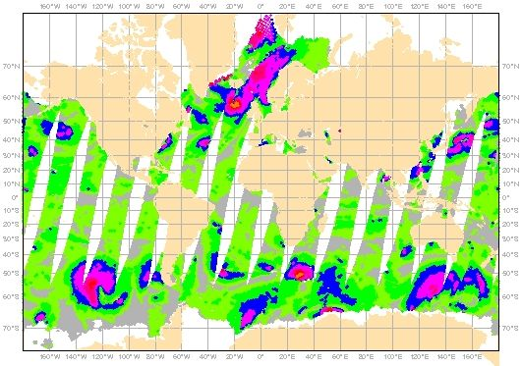
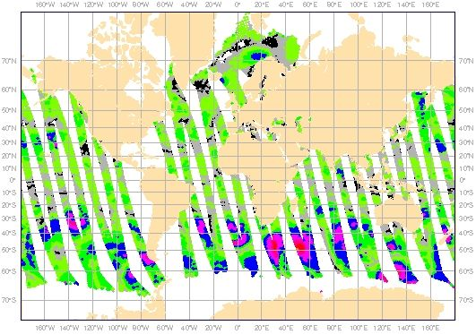
KNMI Satellite Wind Services
24/7 Global Wind services (OSI SAF)
  Constellation of satellites
  High quality winds, QC
  Timeliness 30 min. – 2 hours
  Service messages
  QA, monitoring
Software services (NWP SAF)
  Portable Wind Processors
  Weather model comparison
Organisations involved:
KNMI, EUMETSAT, EU, ESA, NASA, NOAA, ISRO, SOA, WMO, CEOS, ..
Users: NHC, JTWC, ECMWF, NOAA, NASA, NRL, BoM, UK MetO, M.France, DWD, CMA, JMA, CPTEC, NCAR, NL, . . .
More information:
www.knmi.nl/scatterometer
Wind Scatterometer Help Desk
Email: scat@knmi.nl
USA
Africa
S.America
China
Russia
Asia
India
Europe

Slide 22
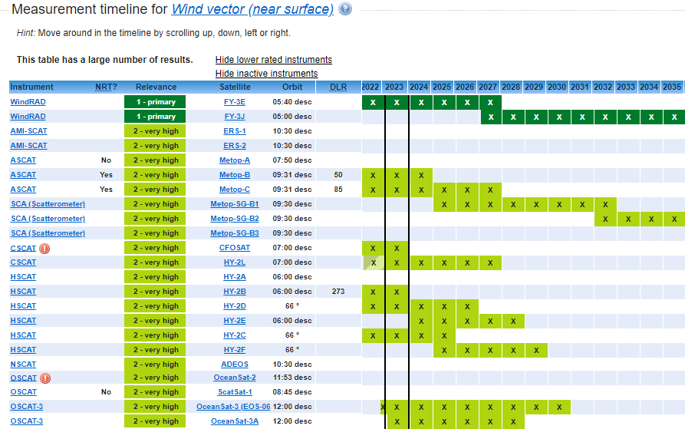
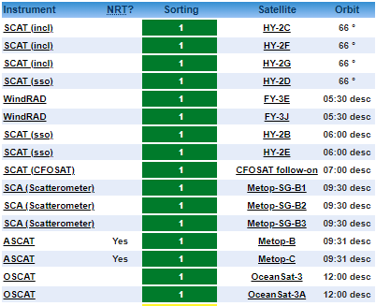
Golden age of Scatterometry (WMO OSCAR)
Source: https://space.oscar.wmo.int/gapanalyses?mission=12
Past C-band missions : Past Ku-band missions :
ERS-1,2/ESCAT 10:30 desc. 1992-1996, 1995-2000 SeaWinds/QuikScat 6:00 desc. 1999-2009
MetOp-A/ASCAT 9:30 desc. 2007-2021 RapidScat/ISS 52 * 2014-2016
OceanSat-2/OSCAT-1 0:00 desc. 2009-2014
ScatSat-1/OSCAT-2 8:45 desc. 2016-2021
Prepare ourselves for many scatterometers ☺
Exploit for weather, ocean and climate applications

