Slide 1
Comparison of ASCAT and SWOT Wind Speeds Near Sea Ice
Bryan W. Stiles, Alexander Fore, Alexander Wineteer, and Benjamin Holt
Jet Propulsion Laboratory, California Institute of Technology
International Ocean Vector Wind Science Team Meeting
Salt Lake City Utah
May 29-31, 2024

Slide 2
Sponsor Acknowledgment
The research described here was carried out at the Jet Propulsion Laboratory, California Institute of Technology, under a contract with the National Aeronautics and Space Administration.

Slide 3
Plan: Develop a multi-decadal multi-sensor ocean surface wind climate data record near the sea ice edge
Step 1: Retrieve 2-km resolution wind speeds and ice concentration map from SWOT.
Step 2: Compare SWOT winds and QC to ASCAT data and use to improve ASCAT QC and wind accuracy near ice edge.
Step 3: Compare ASCAT winds and QC to QuikSCAT and ScatSAT data and use to improve QuikSCAT and ScatSAT quality control near ice edge

Slide 4
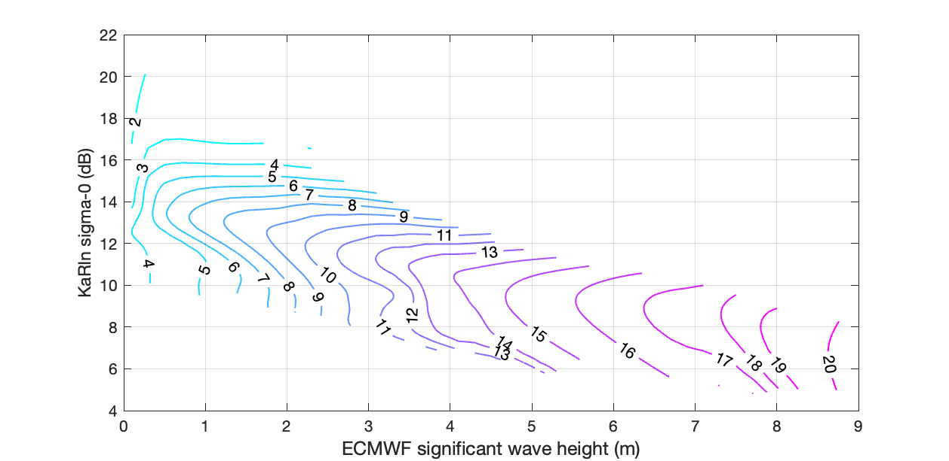
Developed SWOT KaRIn wind retrieval using ASCAT and ECMWF as ground truth
Inputs to wind retrieval are
sigma-0,
incidence angle
SWH (ECMWF)
Plot is a cut of the 3-D model function at incidence angle = 2.5 degrees.
GMF is a lookup table produced using an empirical function approximation method using ECMWF winds as training output.

Slide 5
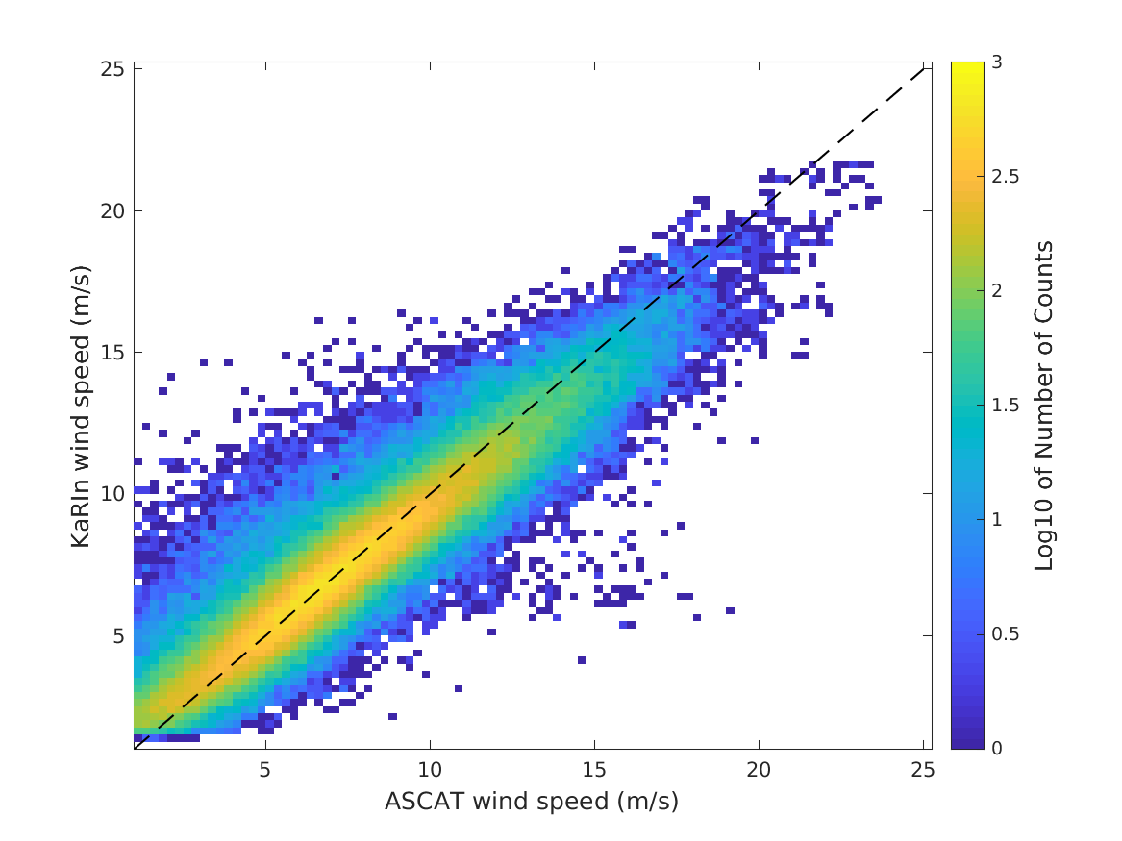
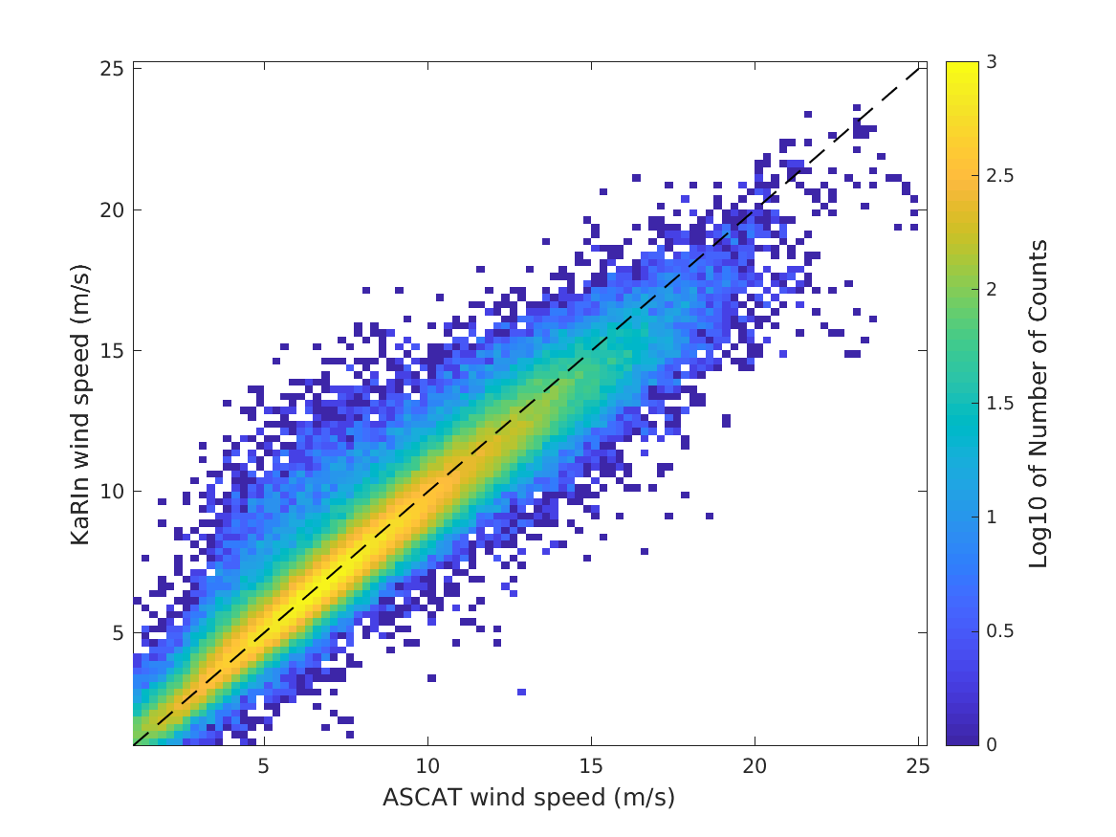
Developed SWOT KaRIn wind retrieval using ASCAT and ECMWF as ground truth
Current GMF, ASCAT within 30 min, GOOD SSHA2
Retrained GMF, ASCAT within 30 min, GOOD SSHA2
RMSE=1.28 m/s
RMSE=1.01 m/s

Slide 6
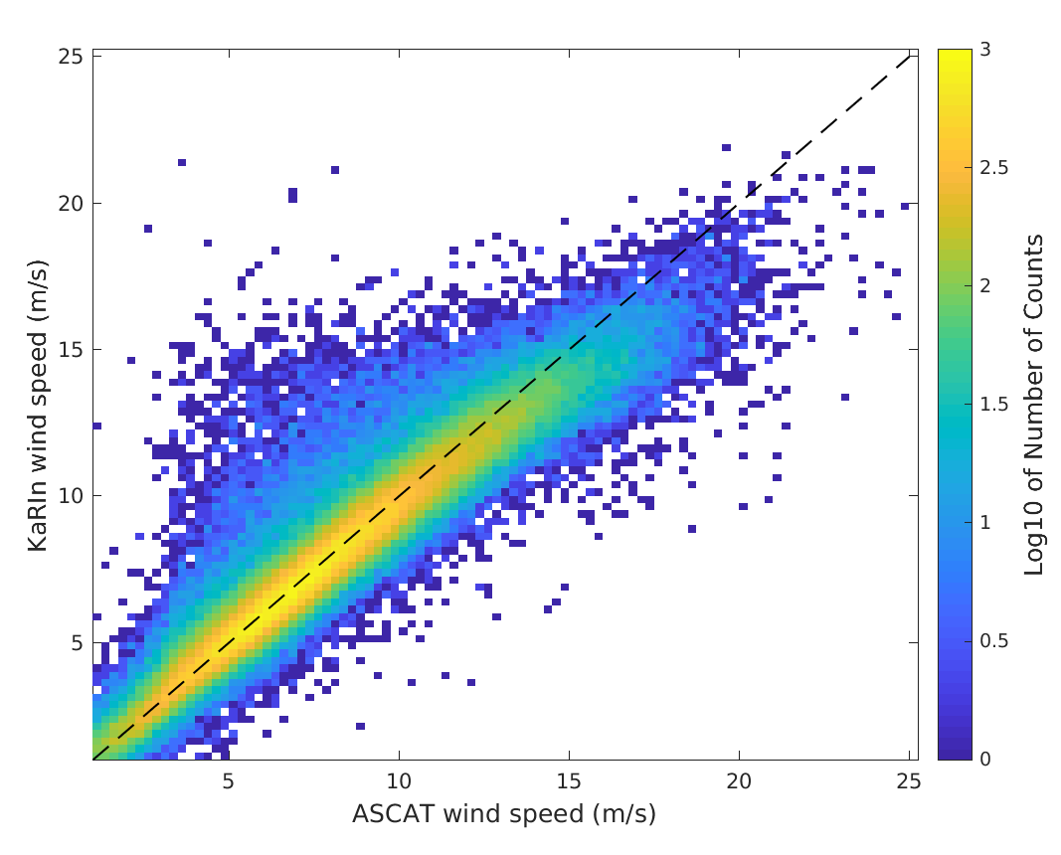
Developed SWOT KaRIn wind retrieval using ASCAT as ground truth, volumetric correlation instead of model SWH
swh_model input
volumetric correlation input
RMSE=1.01 m/s
RMSE=1.12 m/s

Slide 7
A note on SWOT KaRIn coregistered images
All geographic images in this presentation are in SWOT swath coordinates with the y-axis being along track and the x-axis across track.
SWOT InSAR data is missing in the middle of the x-axis (nadir) for this reason.
To give a general idea where the data is on the ground
Y-axis is labeled with median latitude for each along track position
X-axis is labeled with median longitude for each cross track position
Along track extent of each image was determined bycentered a 200-km window on the southernmost valid co-registered ASCAT wind pixel.

Slide 8
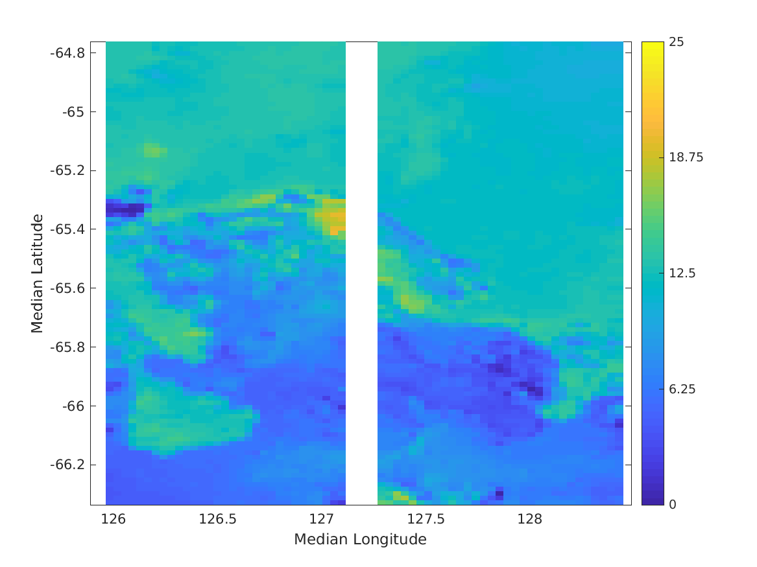
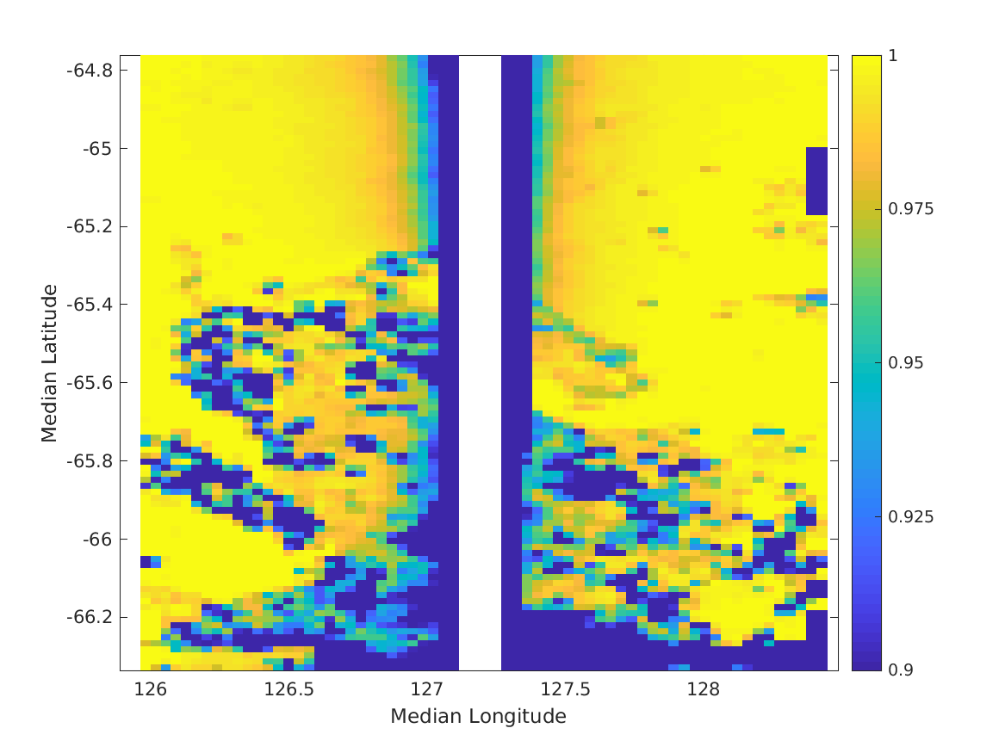
SWOT KaRIn backscatter and volumetric correlation near ice Cycle 479, Pass 019, April 3, 2023
Backscatter in dB
Volumetric Correlation

Slide 9
SWOT KaRIn 2 x2 km sea ice concentration estimate RMS diff from ECMWF is 12.42 %
Trained a neural network to map
From:
Volumetric correlation
Sigma-0
Incidence angle
3x3 variance of volumetric correlation
3x3 variance of sigma-0
To:
ECMWF ice concentration (much lower resolution)

Slide 10
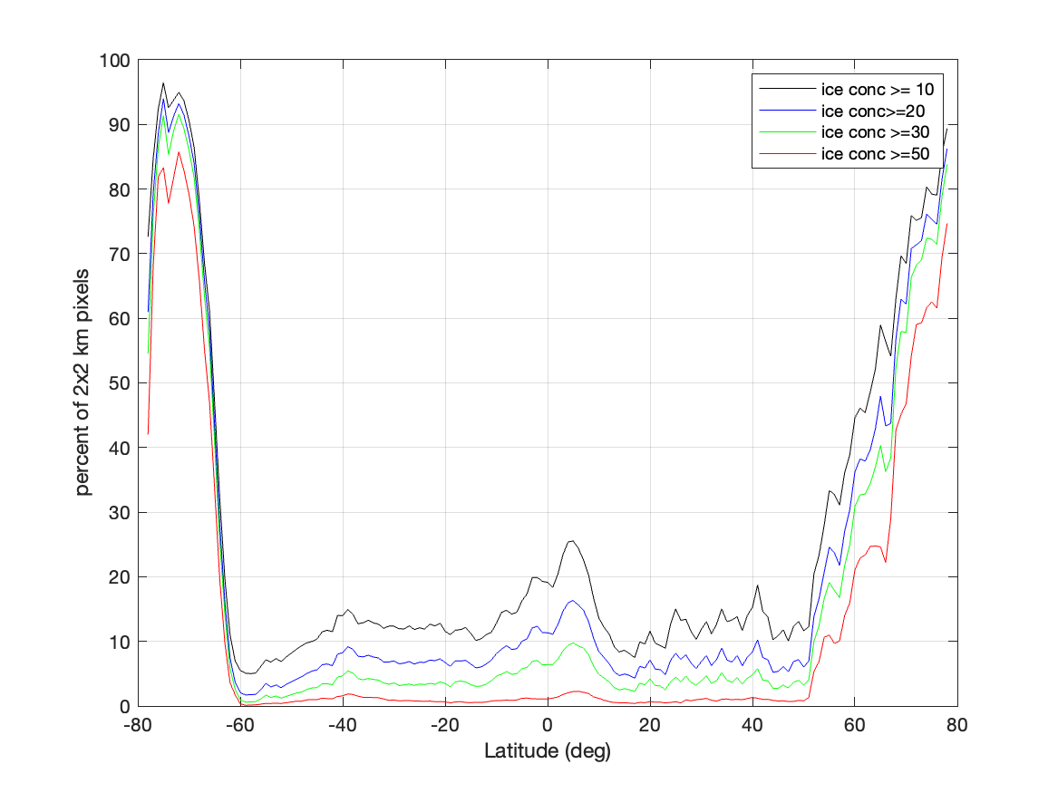
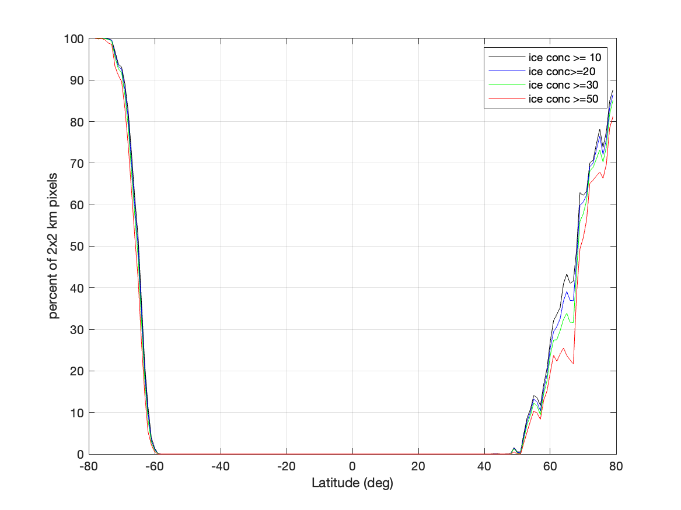
Compare SWOT and ECMWF KaRIn sea ice concentration by latitude to determine of flagging threshold
SWOT
ECMWF
A 10% ice conc flag threshold has a false alarm rate < 20% and a misdetection rate ~ 5%.

Slide 11
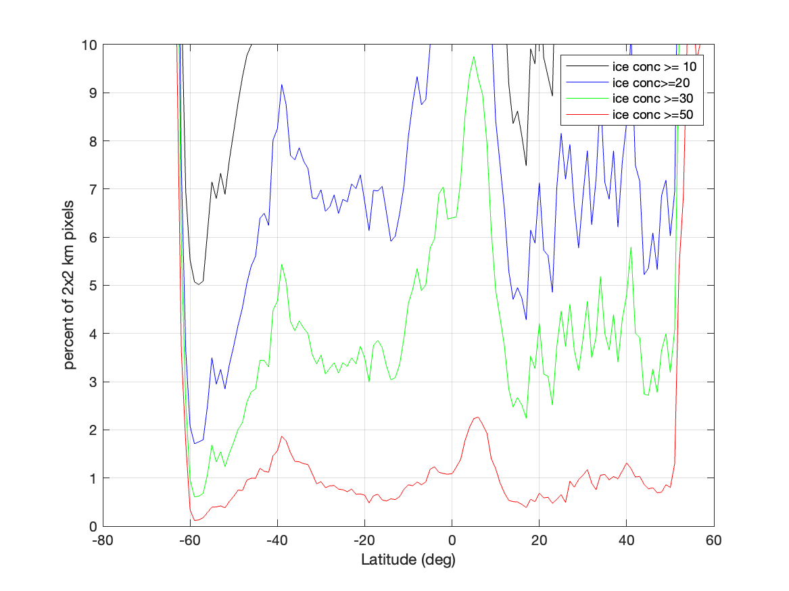
Compare SWOT and ECMWF KaRIn sea ice concentration by latitude to determine of flagging threshold
Percentage flagged vs latitude
Zoomed in to show false alarm rate for 50% threshold
A 50 % ice conc flag threshold has a false alarm rate < 2% and a misdetection rate ~20%.

Slide 12
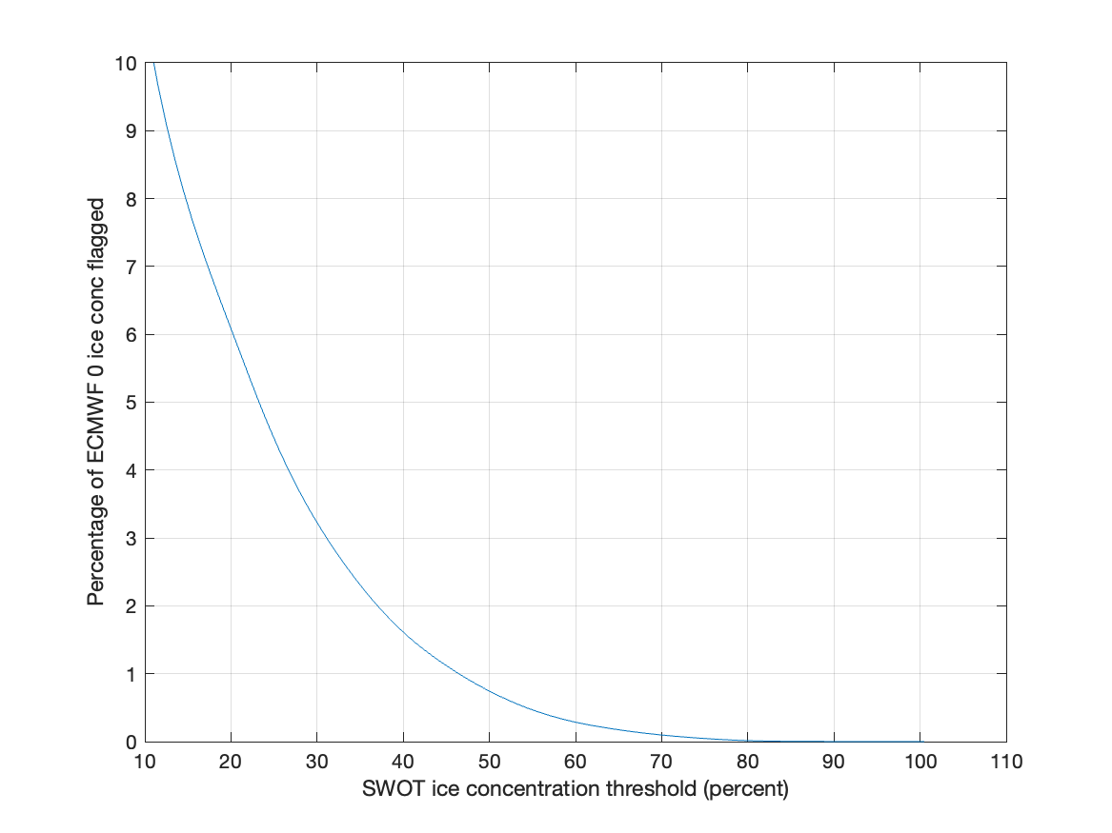
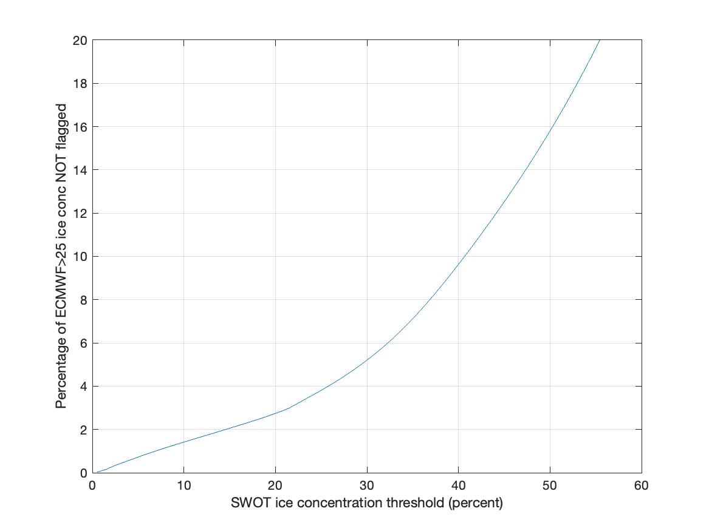
Alternative way to compute false alarm and missed detection rate: FA=Percentage of ECMWF ice conc=0 data flagged MD=Percentage of ECMWF ice conc > 25% not flagged
False alarm vs SWOT ice conc threshold
Missed detection vs SWOT ice conc threshold

Slide 13
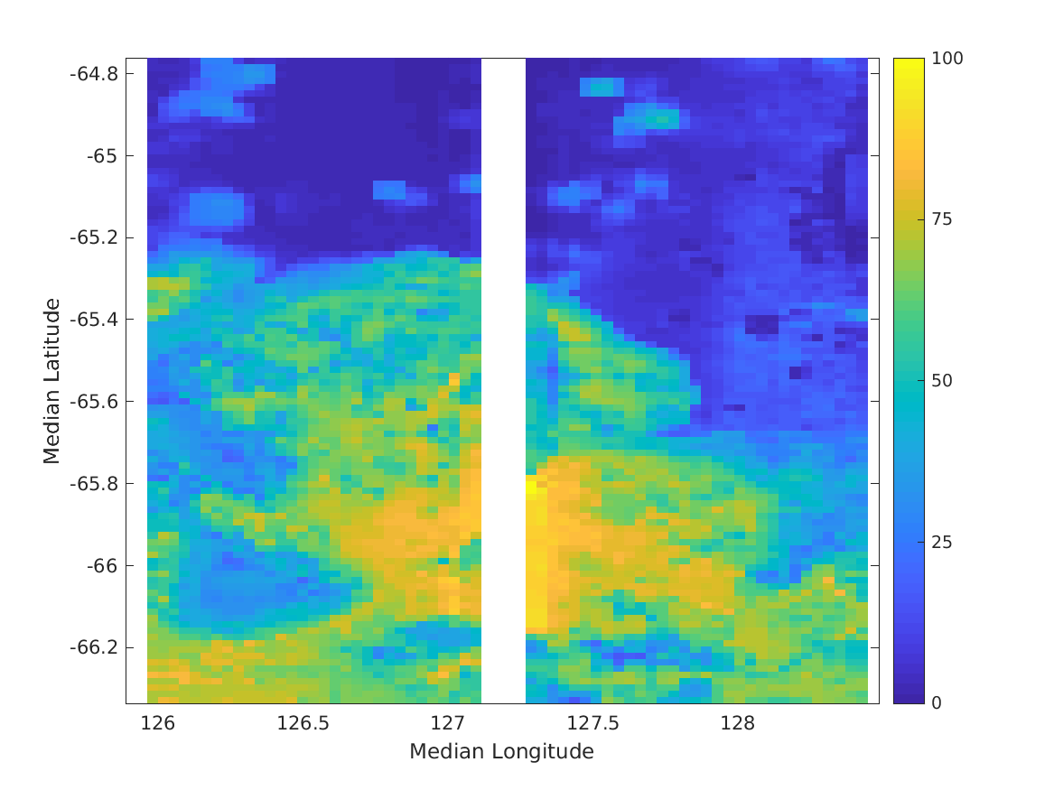
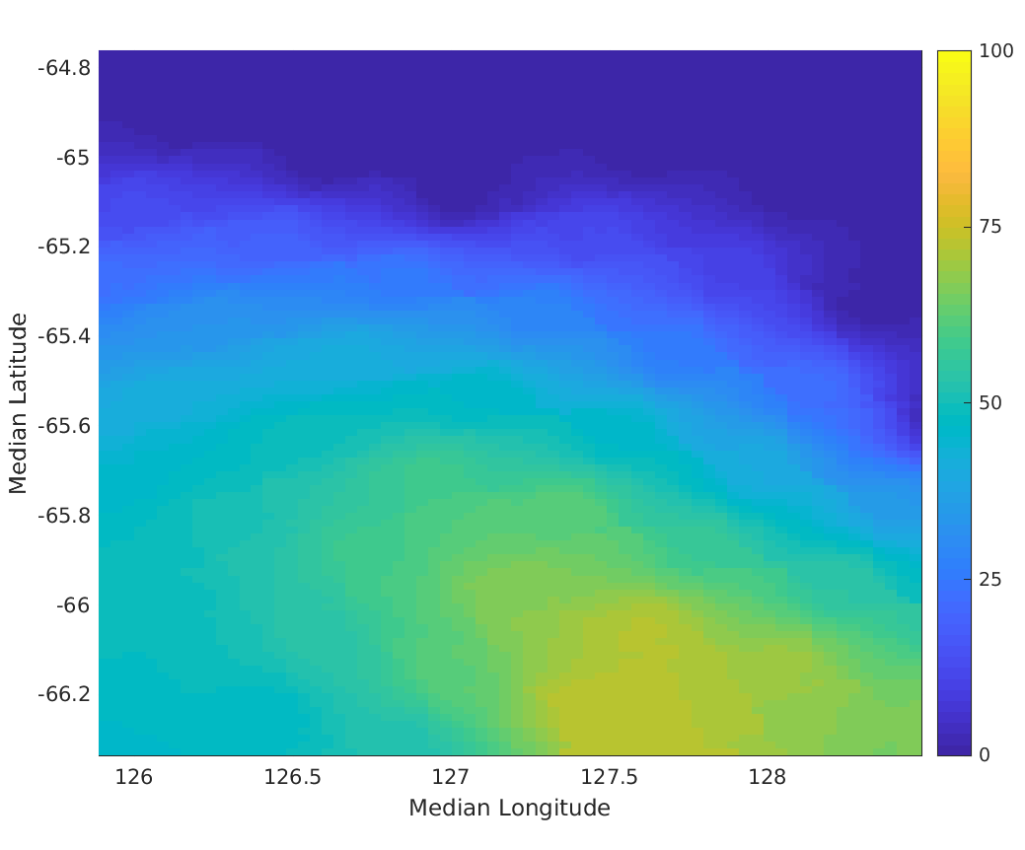
SWOT KaRIn and ECMWF Ice concentration Cycle 479, Pass 019, April 3, 2023
SWOT
ECMWF

Slide 14
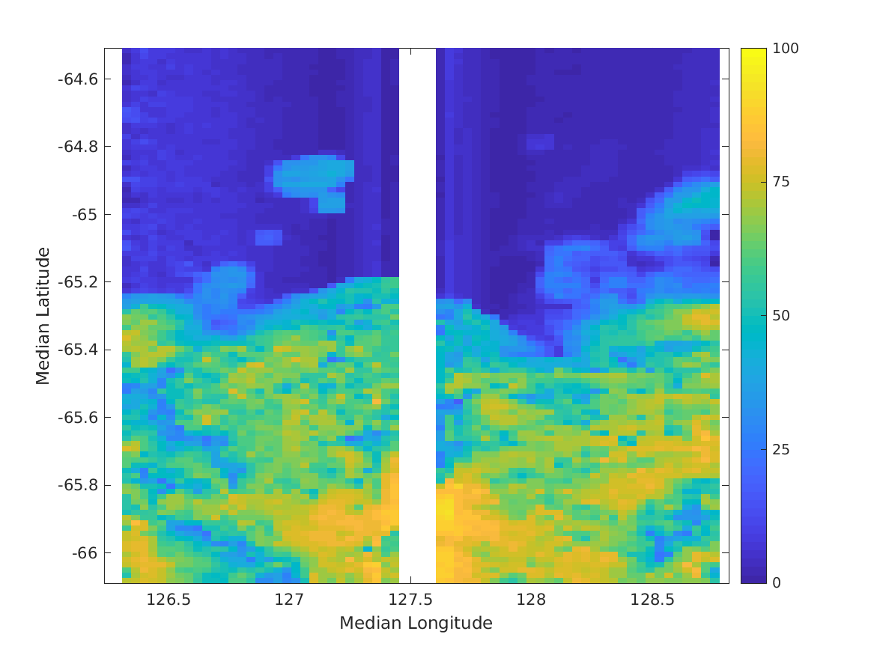
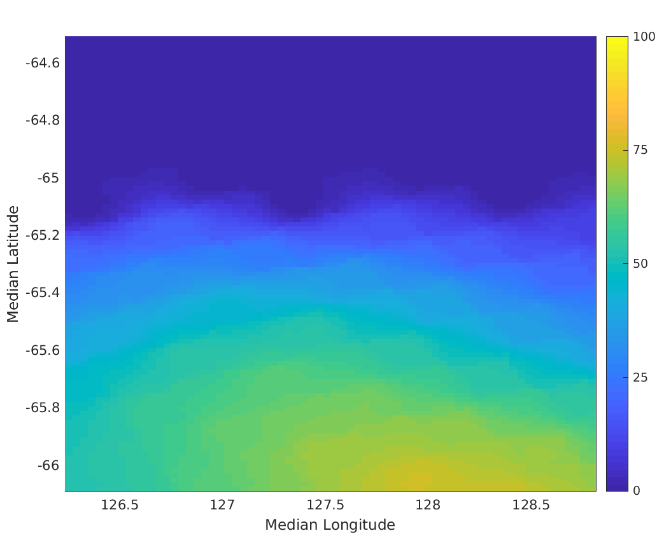
SWOT KaRIn and ECMWF Ice concentration Cycle 480, Pass 019, April 4, 2023
SWOT
ECMWF

Slide 15
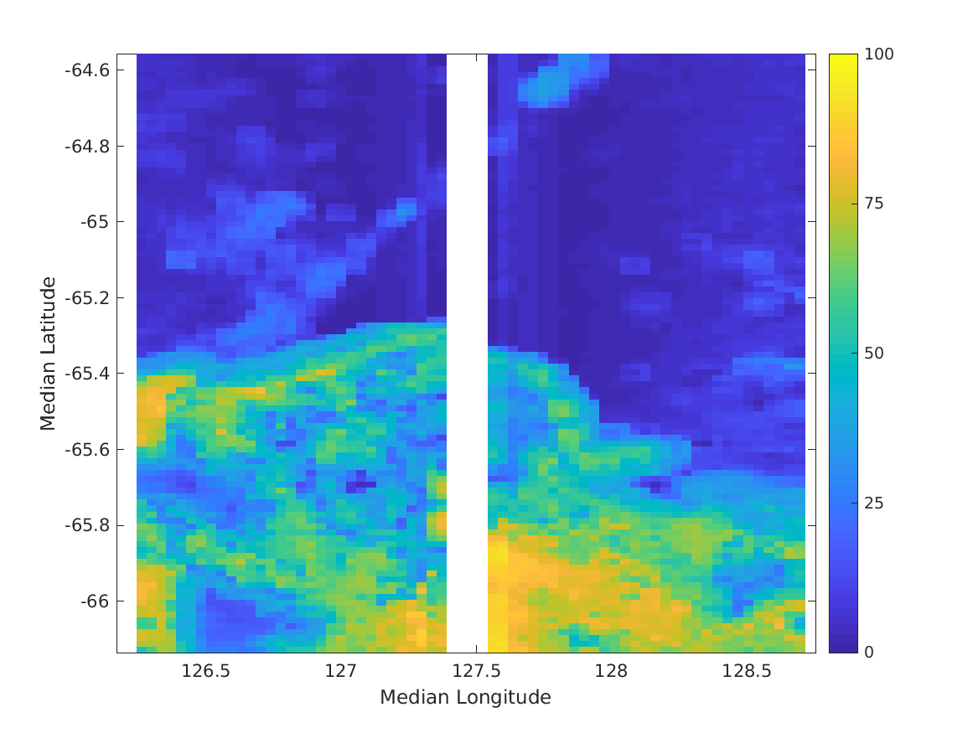
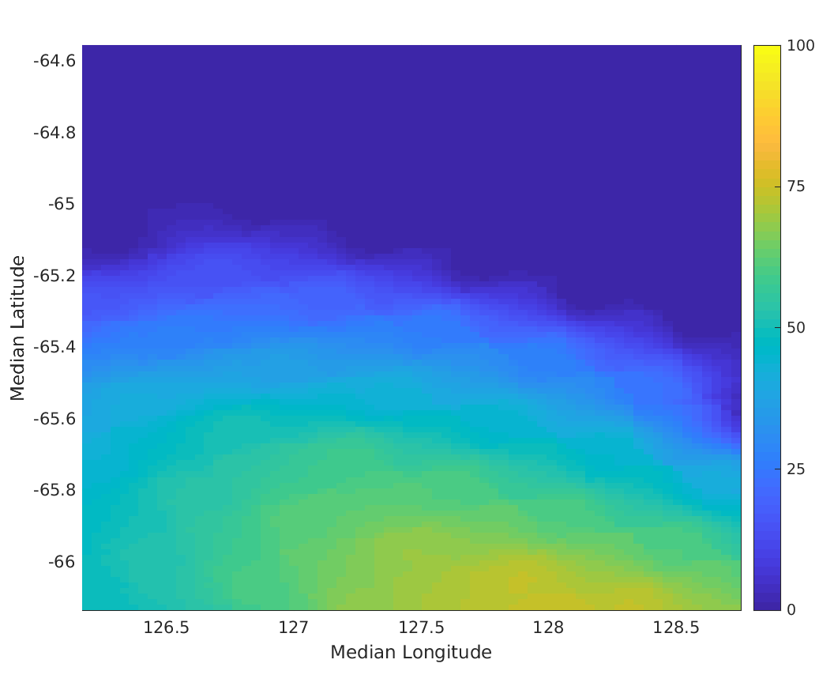
SWOT KaRIn and ECMWF Ice concentration Cycle 481, Pass 019, April 5, 2023
SWOT
ECMWF

Slide 16
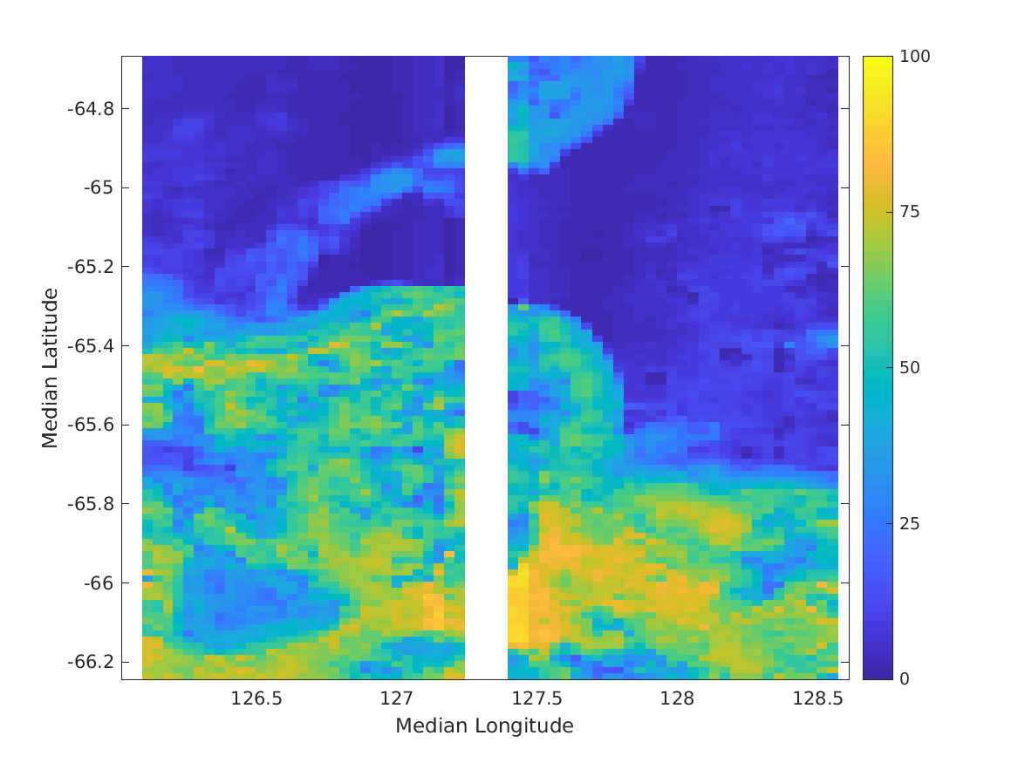
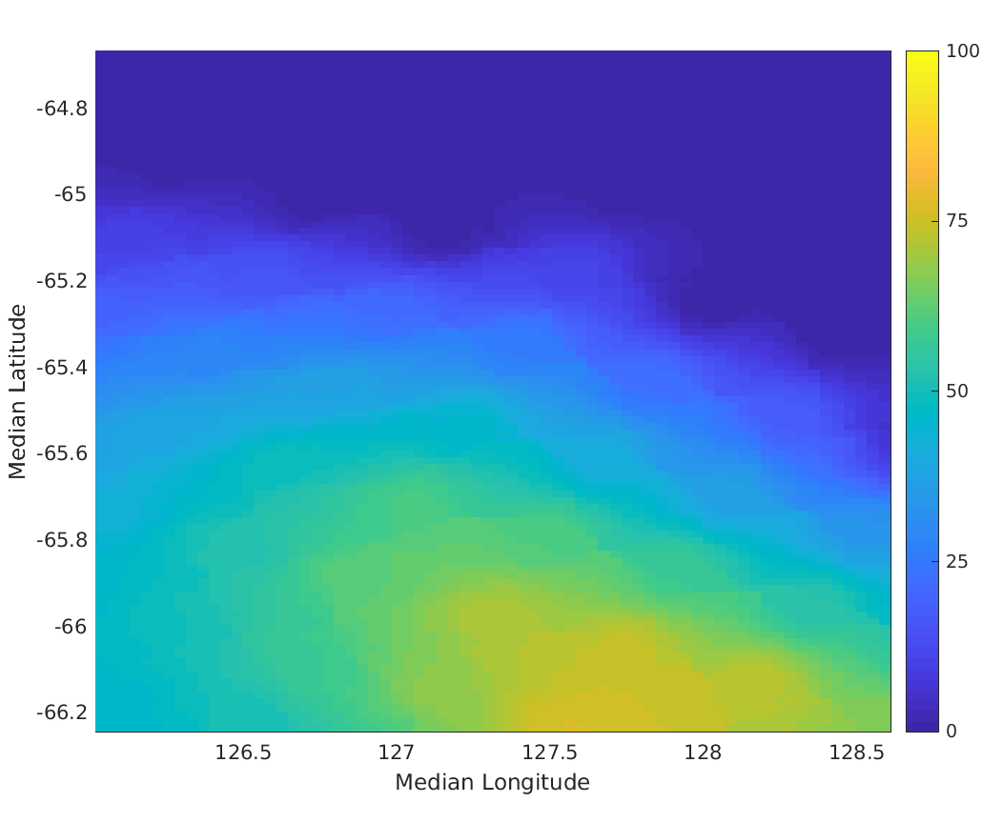
SWOT KaRIn and ECMWF Ice concentration Cycle 482, Pass 019, April 6, 2023
SWOT
ECMWF

Slide 17
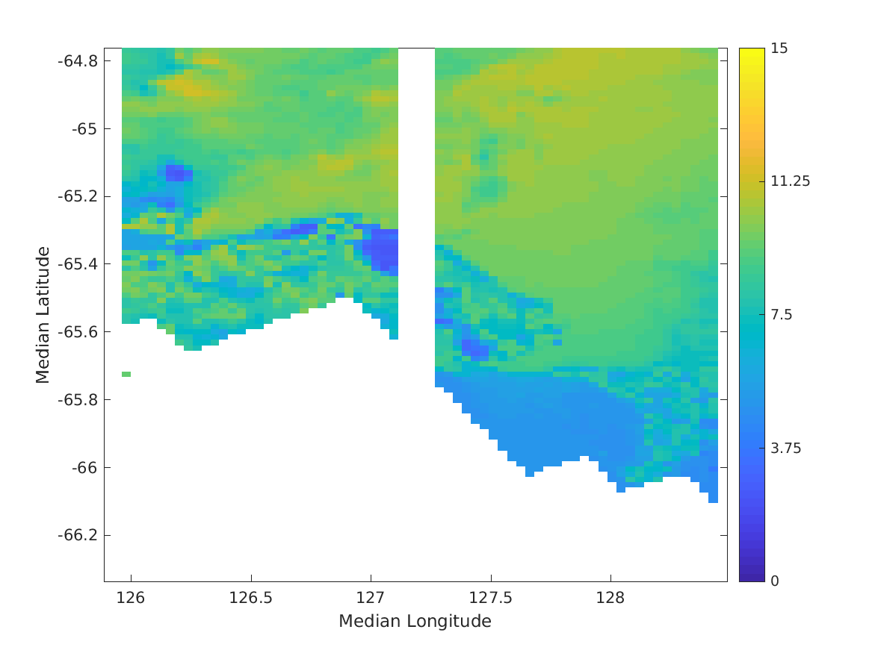
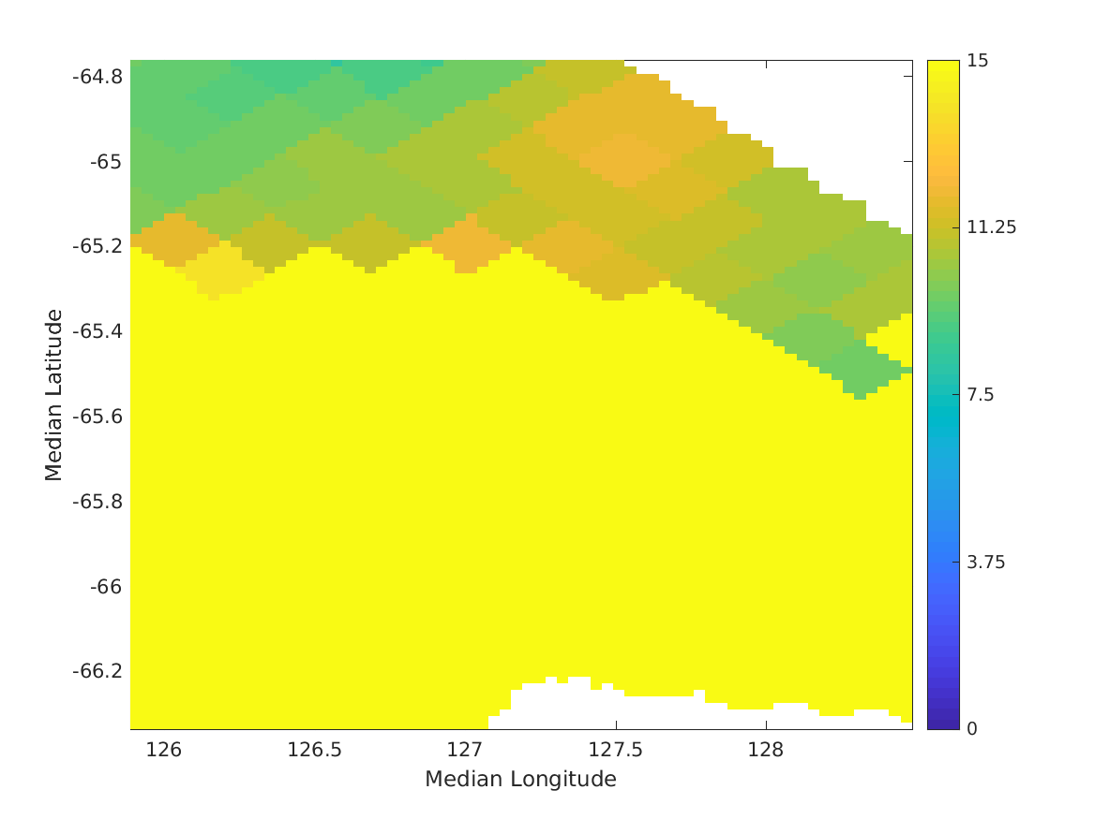
SWOT KaRIn and ASCAT Wind Speed (m/s) Cycle 479, Pass 019, April 3, 2023
SWOT
ASCAT

Slide 18
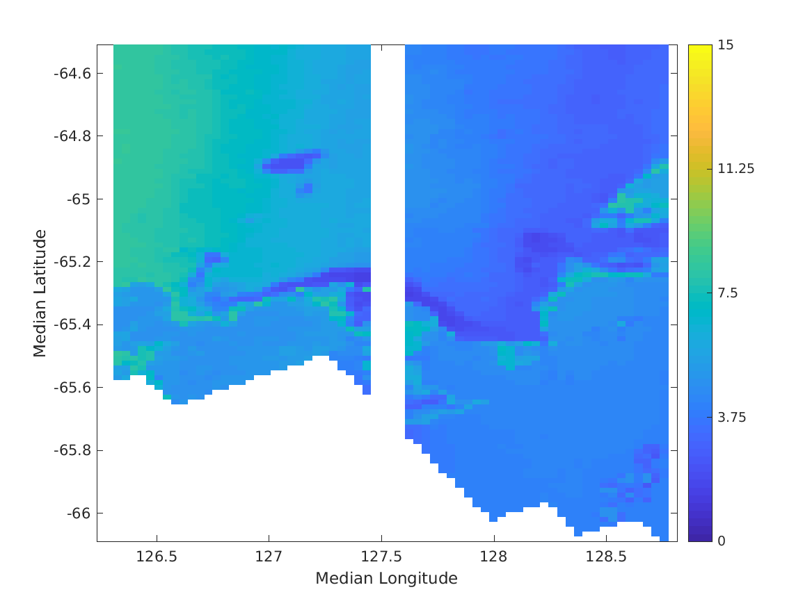
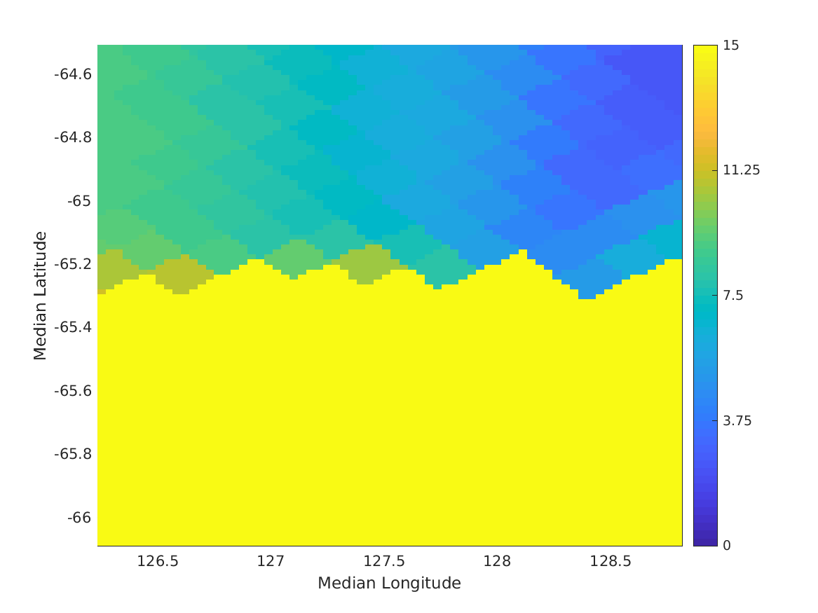
SWOT KaRIn and ASCAT Wind Speed (m/s) Cycle 480, Pass 019, April 4, 2023
SWOT
ASCAT

Slide 19
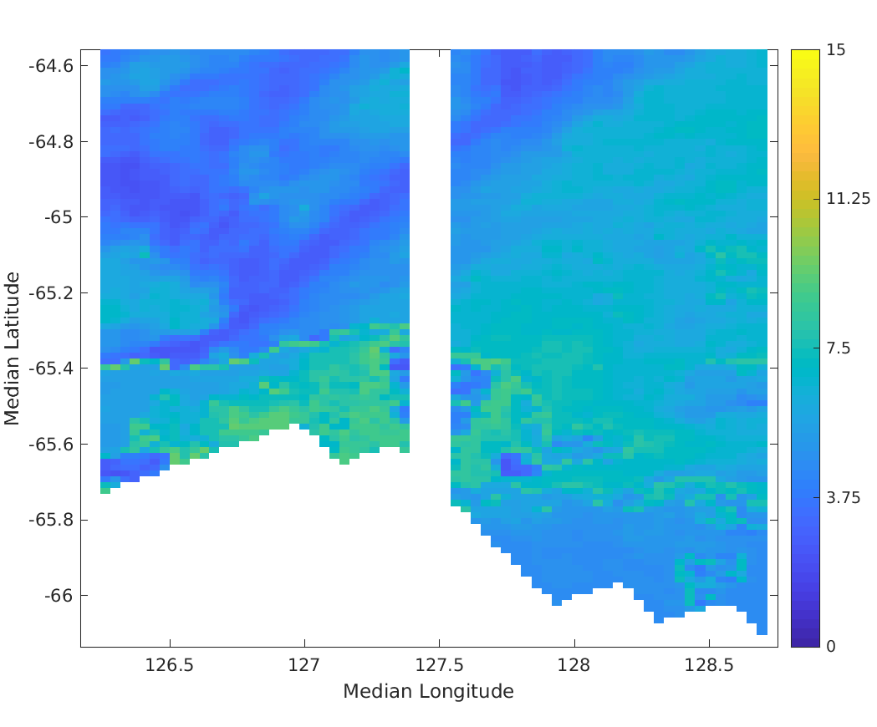
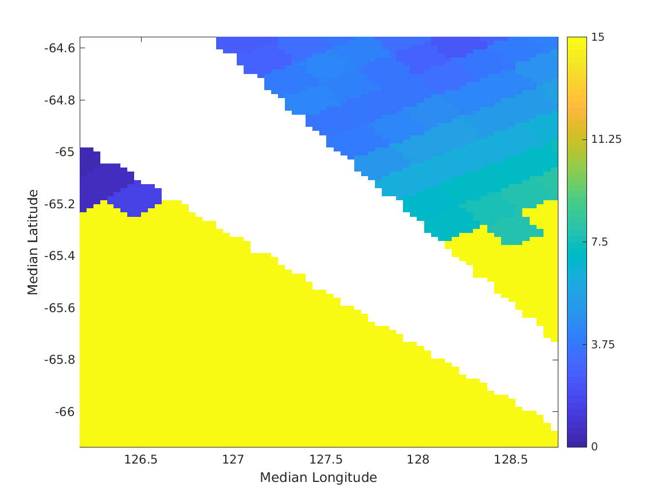
SWOT KaRIn and ASCAT Wind Speed Cycle 481, Pass 019, April 5, 2023
SWOT
ASCAT

Slide 20
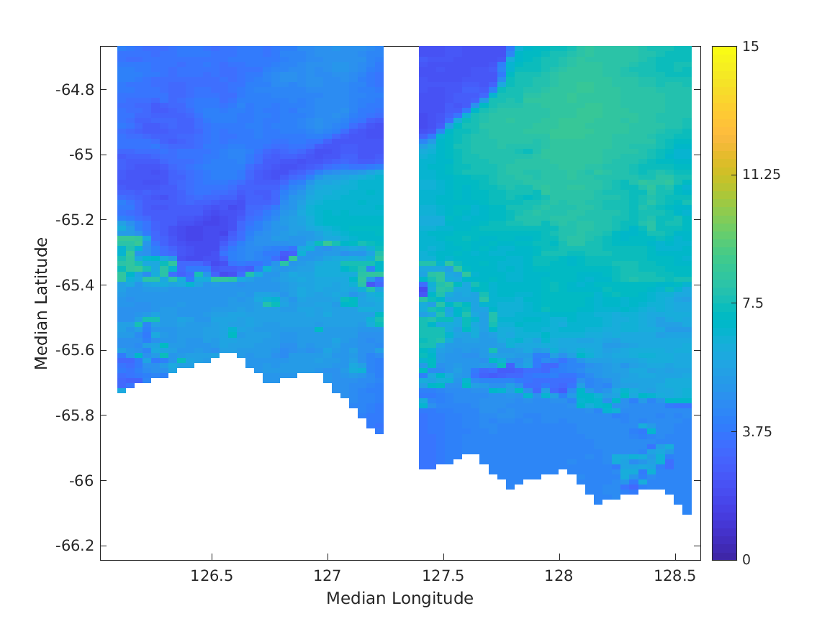
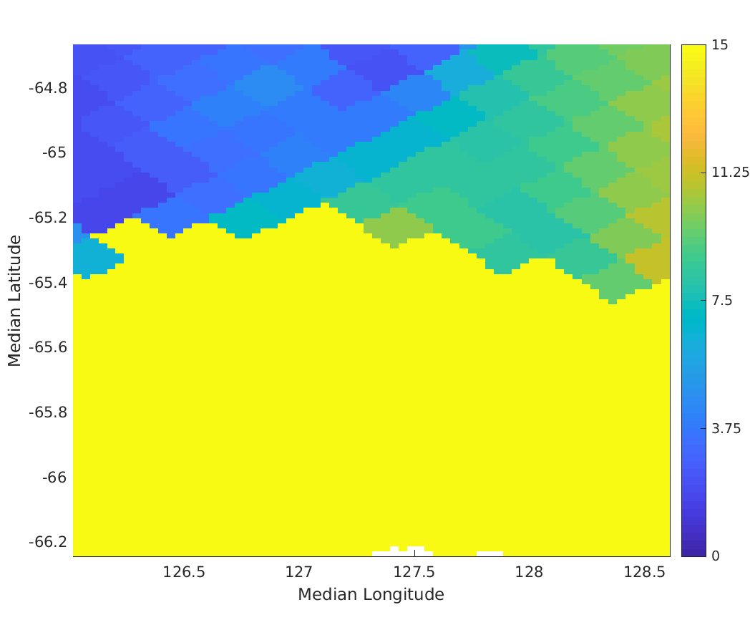
SWOT KaRIn and ASCAT Wind Speed Cycle 482, Pass 019, April 6, 2023
SWOT
ASCAT

Slide 21
Conclusions and future work
Developed a 2-km ice flag from SWOT data
Definite sea-ice (SWOT ice conc> 50%, ~1% false alarm rate),
Possible sea-ice (SWOT ice conc 10-50%)
Definite ice-free (SWOT ice conc < 10%), missed detection rate = ~ 1.5%.
Next steps are:
Develop SWOT near sea-ice winds products using newly developed flag as quality control.
Compare SWOT winds and QC to ASCAT data and use to improve ASCAT QC and wind accuracy near ice edge.
Compare ASCAT winds and QC to QuikSCAT and ScatSAT data and use to improve QuikSCAT and ScatSAT quality control near ice edge

Slide 22
Backup Slides

Slide 23
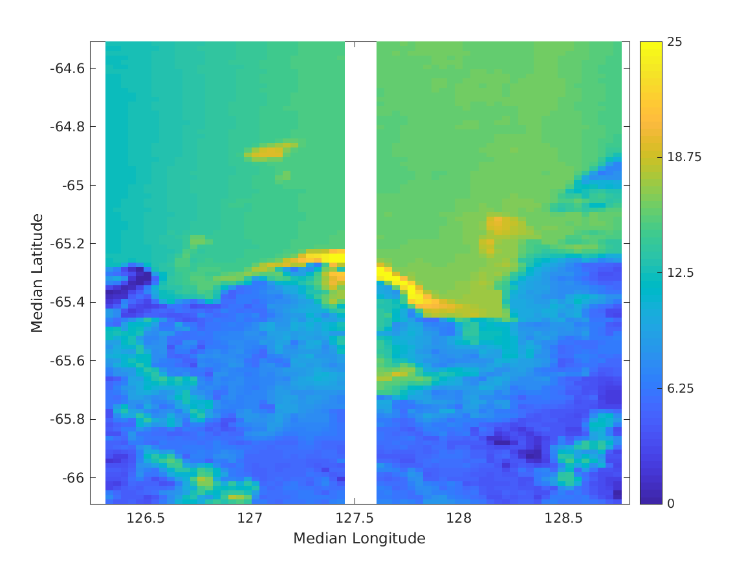
SWOT Wind Speed (m/s) and Sigma-0 (dB) Cycle 480, Pass 019, April 4, 2023
Wind Speed (m/s)
Sigma-0 (dB)

Slide 24
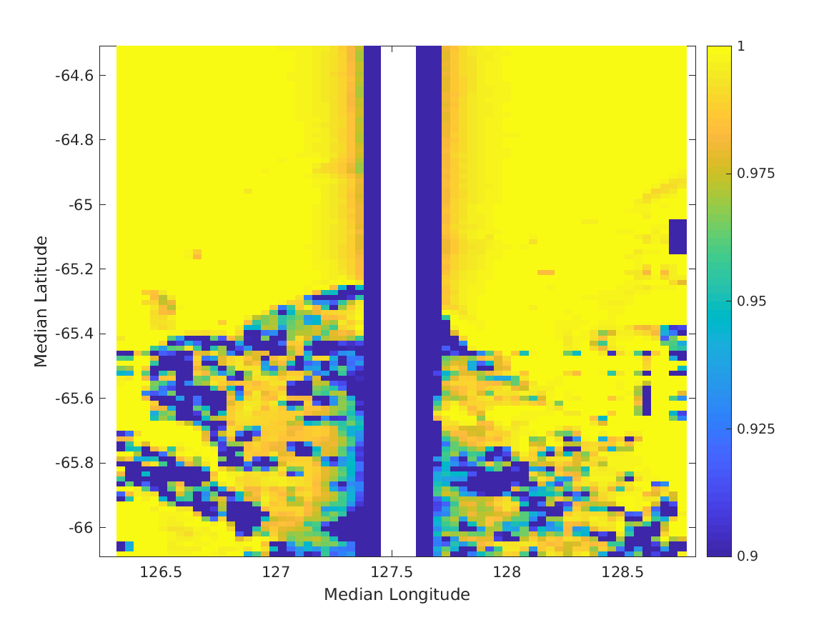
SWOT Wind Speed (m/s) and Volumetric Correlation Cycle 480, Pass 019, April 4, 2023
Wind Speed (m/s)
Volumetric Correlation

