Slide 1
Hourly Surface Wind Forcing Products from ERS in the 1990’s
Ad.Stoffelen@knmi.nl, Rianne Giesen, Jeroen Verspeek
and colleagues from KNMI, ICM (Barcelona) and NUIST (Nanjing)

Slide 2
Scatterometer time line
KNMI et al. provide intercalibrated products for all scatterometers at L2, L3 and L4
Provides a wind vector series since last century with unprecedented accuracy
Cone metrics intercalibration ERS and ASCAT
C-band
Ku-band

Slide 3
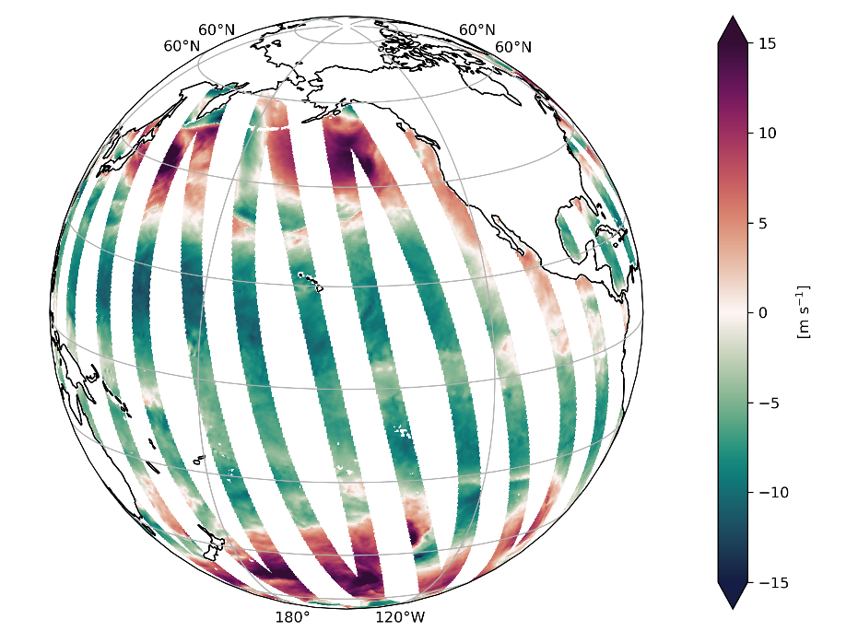
L3 wind products
Zonal wind Metop-A ASCAT ASC
Scatterometer observations for one satellite instrument
Provided variables: surface wind and stress vector components, divergence and curl
Include ECMWF model wind and stress fields collocated at L2
Intercalibrated L2 provided by EUMETSAT OSI SAF
Product | ECMWF forecasts | Number of instruments | Horizontal grid | Period | Update
NRT daily | Operational | 7 | 0.125º 0.25º 0.50º | 2016 - -1 day | Daily
MY daily | ERA5 | 6 | 0.125º 0.25º 0.50º | 1991 - -4 months | Monthly

Slide 4
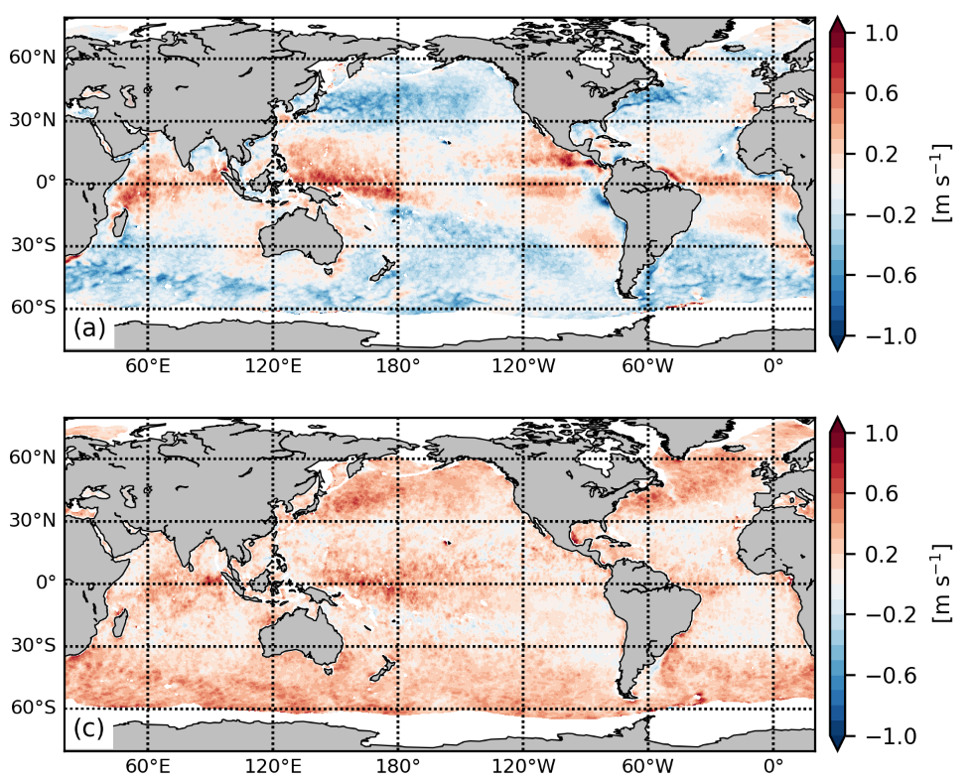
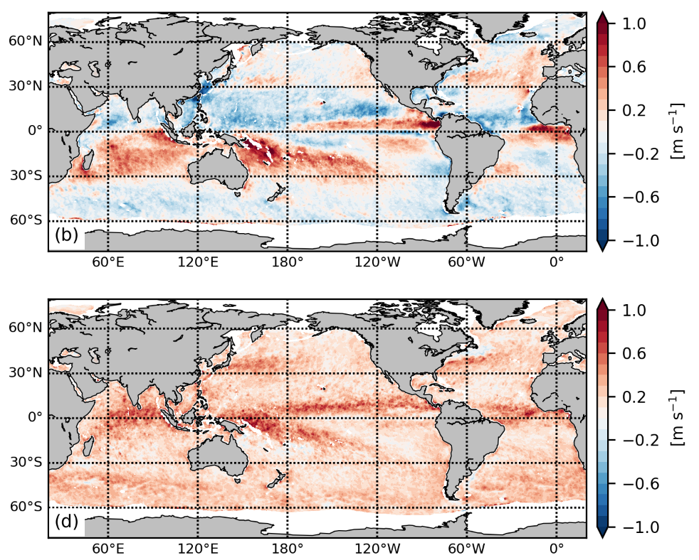
NWP model biases
Gridded L3 averages over 20+ days tell us:
Persistent biases between scatterometer observations and ECMWF model winds, called SC
Lack of small-scale variability in ECMWF model winds, lack of div and curl
Metop-A ASCAT – ECMWF ERA5 [2019]
Zonal wind
Meridional wind
Mean wind
Transient wind
Belmonte Rivas, M. and A. Stoffelen (2019): Characterizing ERA-Interim and ERA5 surface wind biases using ASCAT, Ocean Sci., 15, 831–852, doi: 10.5194/os-15-831-2019.

Slide 5
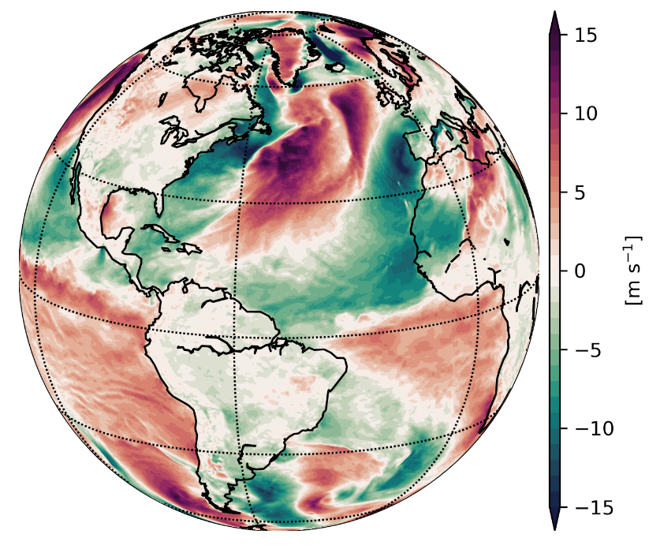
L4 wind products
Meridional wind
Bias-corrected ECMWF model fields by adding SC
Provided variables: surface wind and stress vector components, divergence and curl
Statistical variables: bias, standard deviation of differences, difference of variances, number of observations
Available from Copernicus Marine Service, ERS added in June ‘24 from 1994 and later
Product | Released | ECMWF forecasts | Averaging window | Horizontal grid | Period | Update
NRT hourly | July 2022 | Operational | 20 days (backward) | 0.125º | -2 years - -1 day | Daily
MY hourly | November 2022 | ERA5 | 20 days (centered) | 0.125º (ASCAT) 0.25º (other) | 1999 - -4 months | Monthly
MY monthly | November 2022 | ERA5 | Full month (centered) | 0.25º | 1999 - -4 months | Monthly

Slide 6
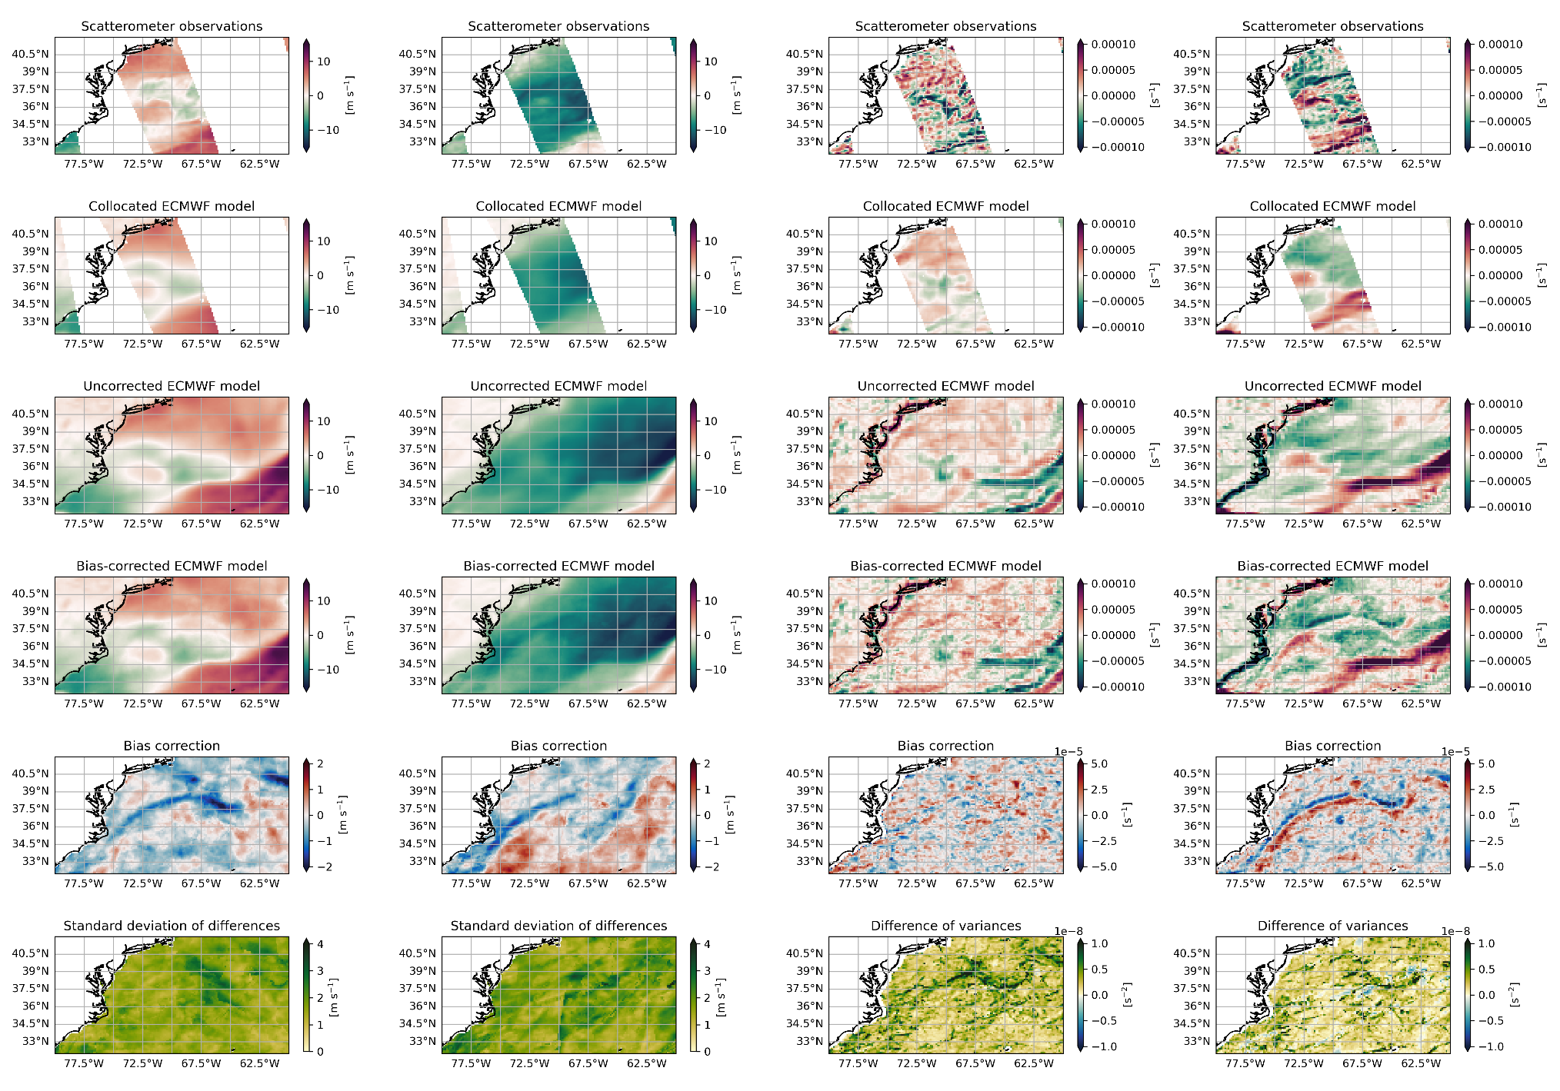
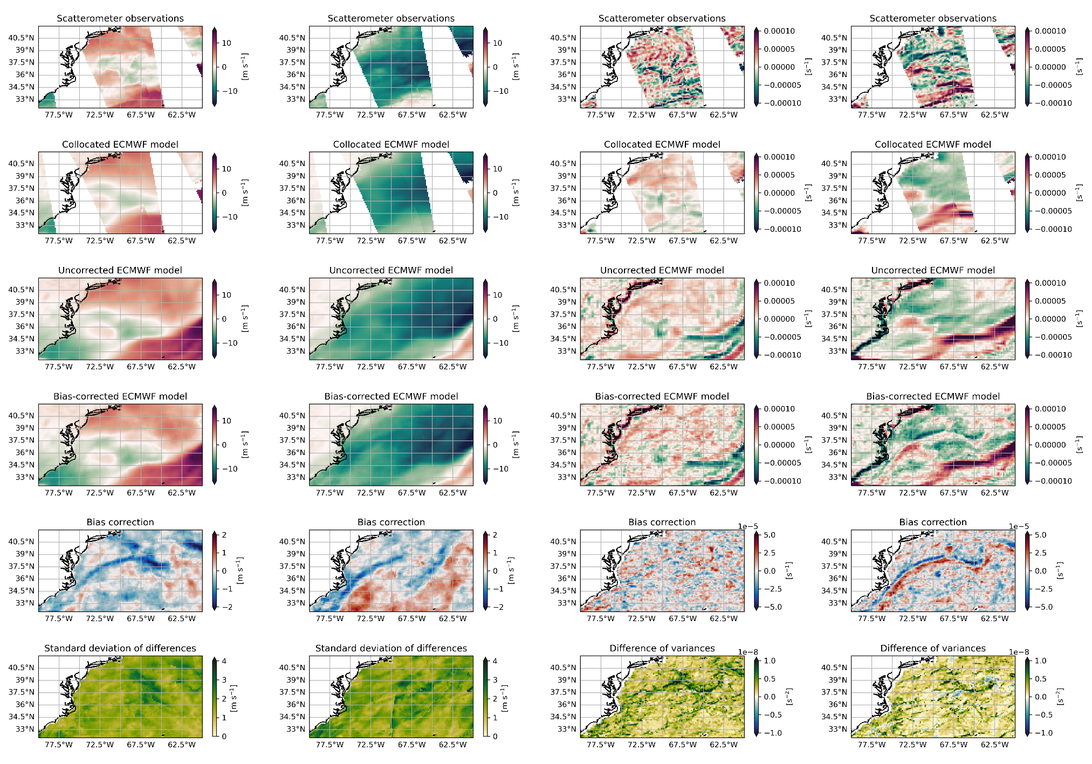
L3 and L4 variables
Zonal wind component
Meridional wind component
Wind divergence
Wind rotation
Gulfstream region
2 February 2023
SC: Metop-B/C ASCAT
ECMWF ERA5

Slide 7
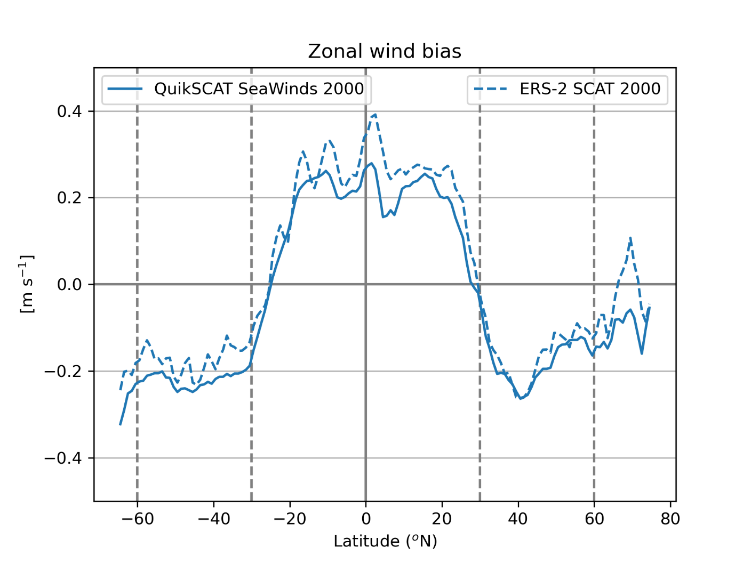
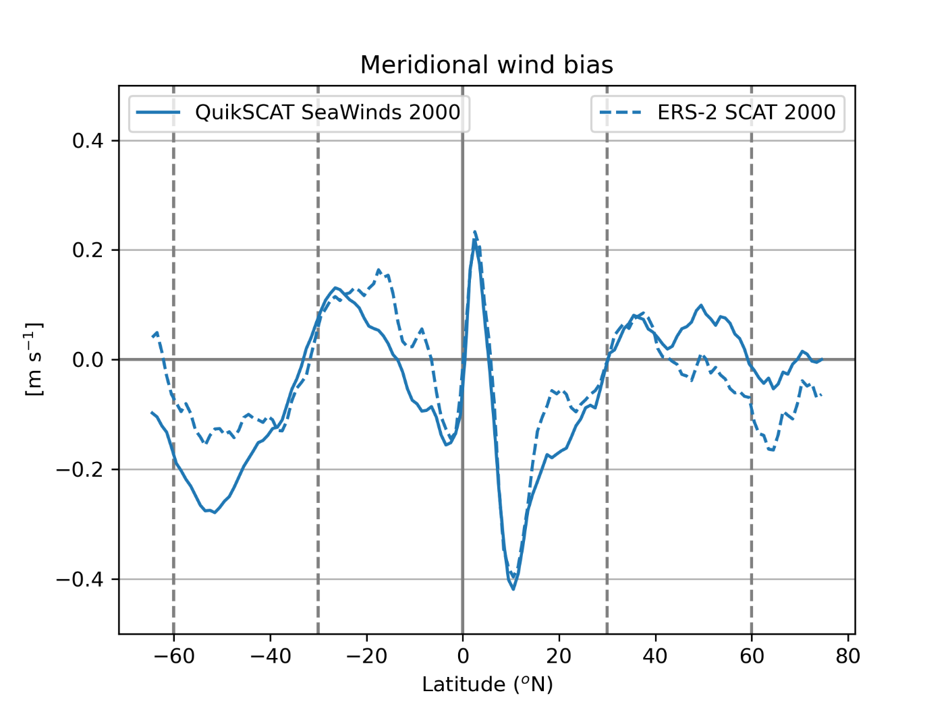
Bias comparison between QuikSCAT and ERS-2

Slide 8
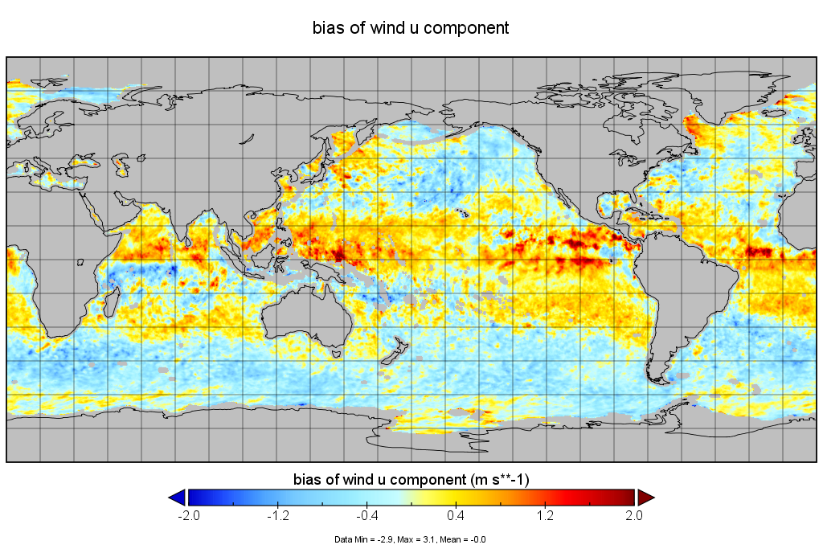
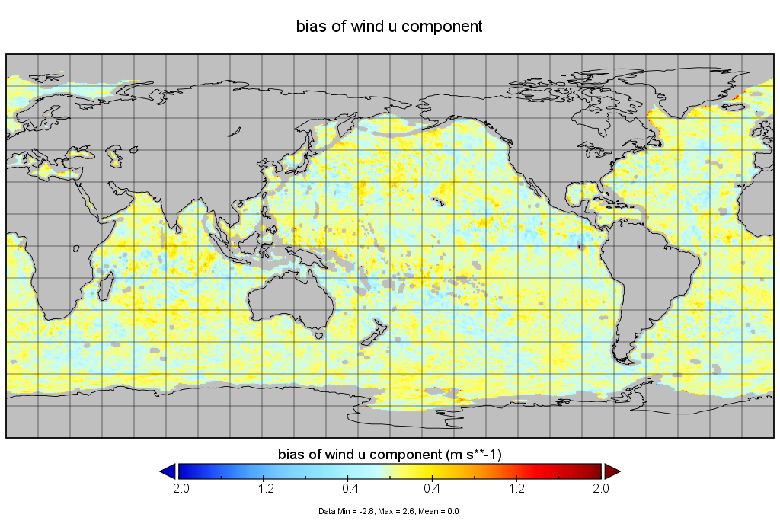
Applications
Improved wind forcing/fluxes for physical ocean models, SC sensitivity studies > Copernicus Marine Service
Link with physical processes to improve model parameterizations > ICM NN, EUMETSAT fellow, KNMI/ECMWF
Use bias-adjusted scatterometer observations in data assimilation > tests at ECMWF by De Chiara et al.
Validation of new scatterometers with improved background winds > Zhen Li
MetOp-B/C

Slide 9
Summary
Significant persistent NWP model biases with scatterometer observations
20+ day temporally-averaged differences can be used to produce bias-corrected NWP model fields
Seasonal cycle in biases is stronger than interannual variability
Gradual changes in bias correction magnitude over multi-annual periods
Generally very good correspondence between scatterometer instruments, differences in model bias are due to calibration, MSS processing or QC
Backward extension with ERS-1 and ERS-2 is possible using longer averaging windows
1991-1994 needs to deal with a few periods with a 3-day repeat cycle and is work in progress

Slide 10
Backup slides

Slide 11
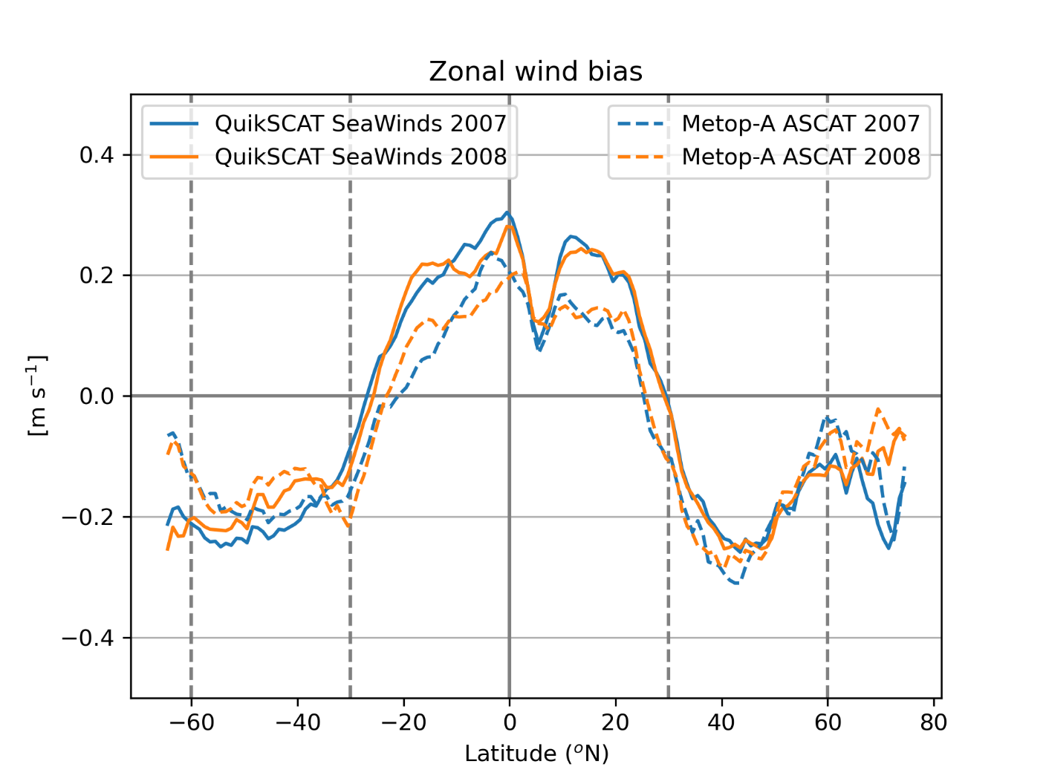
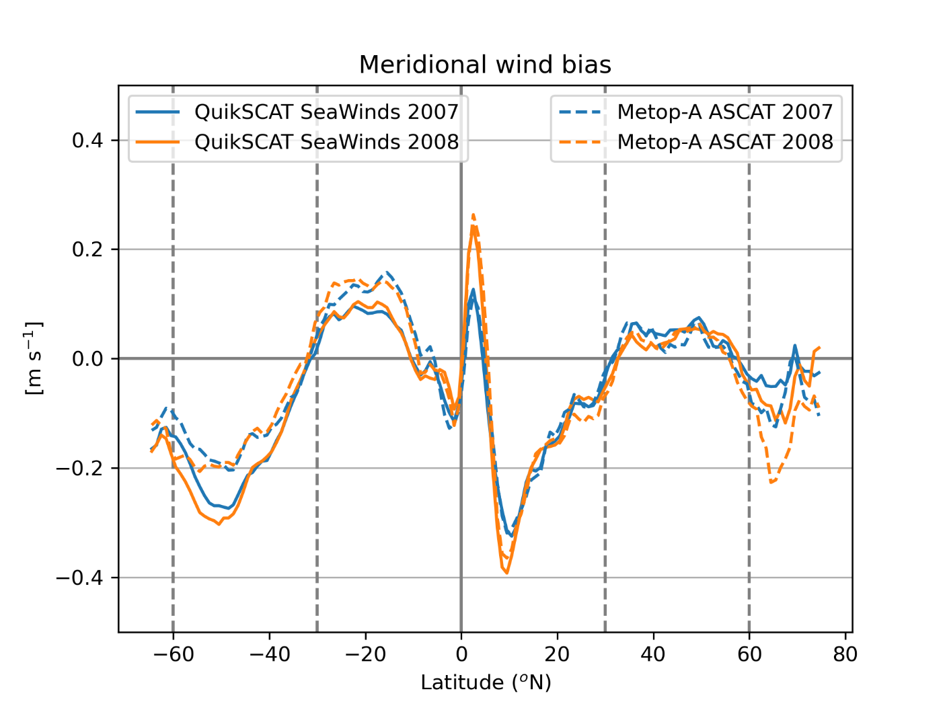
Bias comparison between QuikSCAT and Metop-A

Slide 12
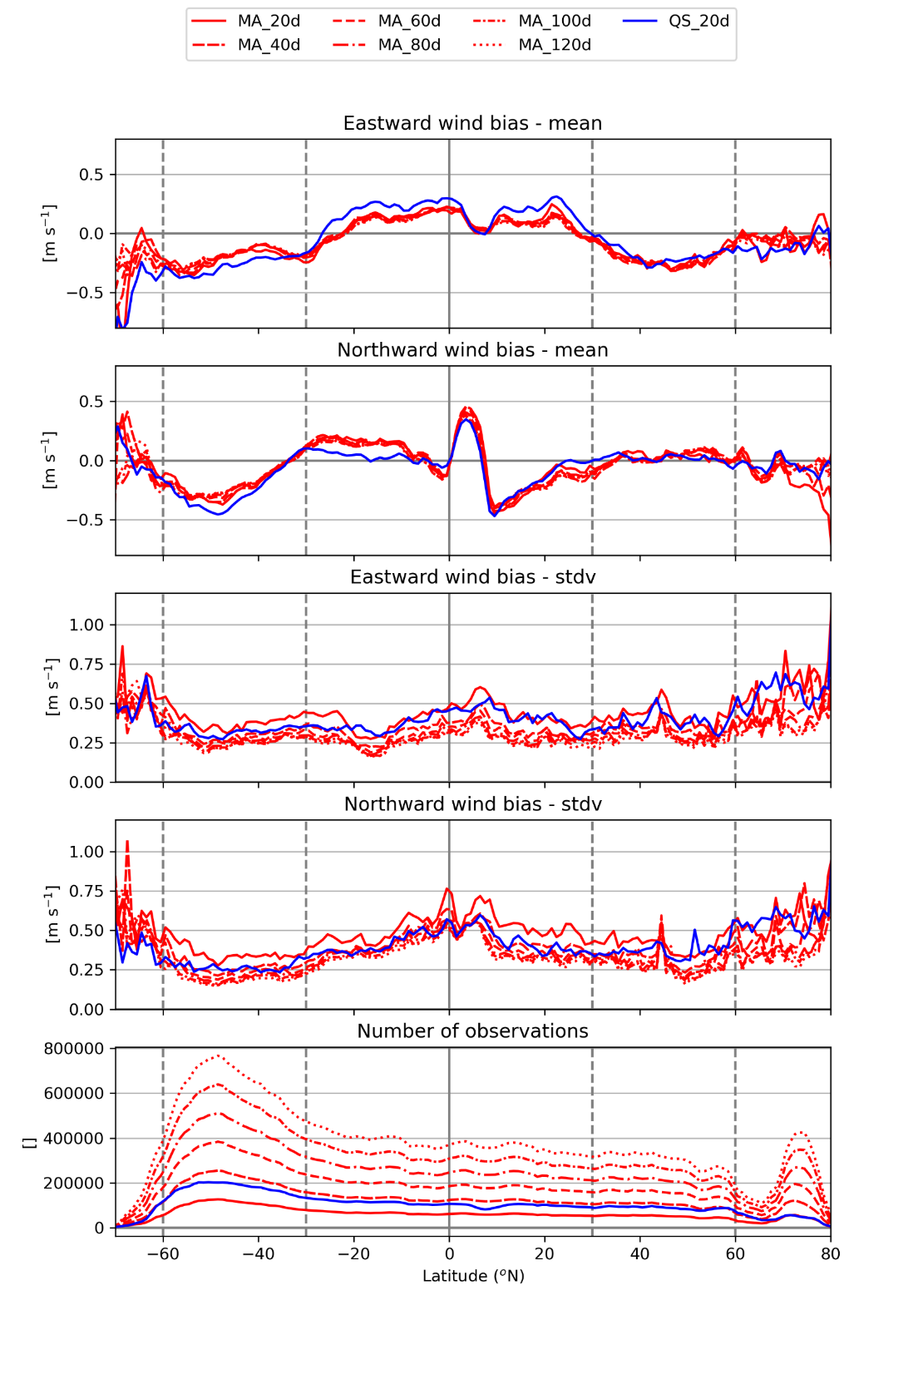
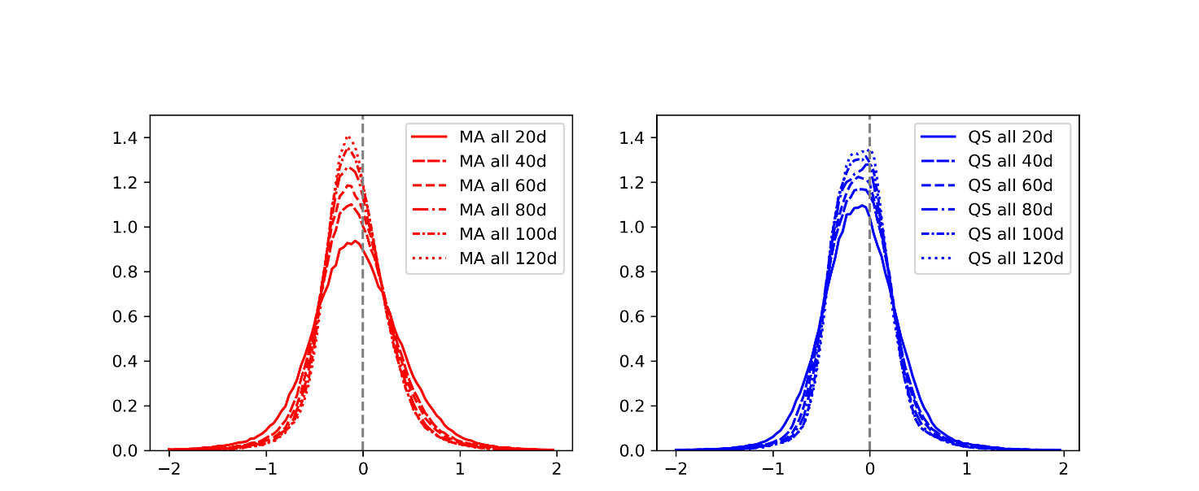
Bias comparison between QuikSCAT and Metop-A
Metop-A
Zonal wind bias
QuikSCAT
Meridional wind bias

Slide 13
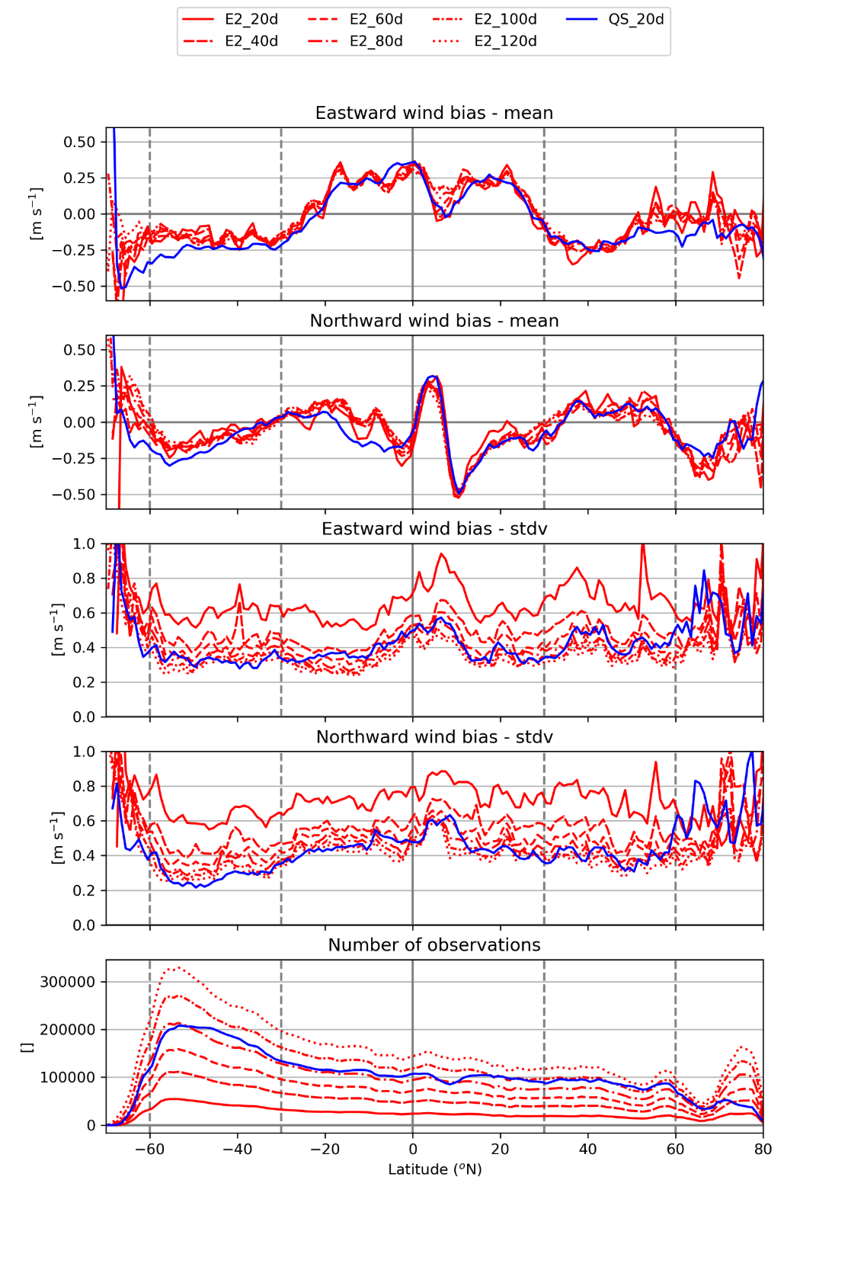
Bias comparison between QuikSCAT and ERS-2
ERS-2
Zonal wind bias
QuikSCAT
Meridional wind bias

Slide 14
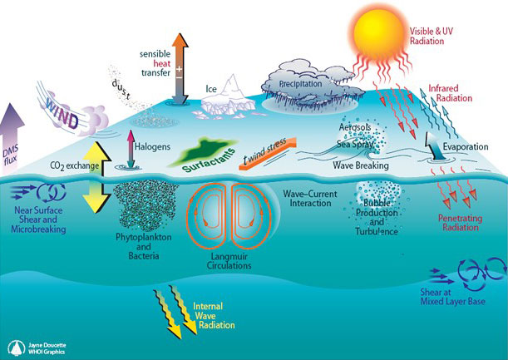
Context
Many processes at the marine boundary layer are dependent on the surface wind:
Ocean circulation
Wave generation and storm surges
Coastal sediment transport
Momentum, heat and mass exchange
To accurately represent these processes in physical ocean models, global fields with high spatial and temporal resolution are needed
Source: Woods Hole Oceanographic Institution
Notes:
Various processes take place at the marine boundary layer and many of these processes are dependent on the wind at the ocean surface:
Winds drive the circulation in the upper ocean layers
Winds generate waves and in more extreme cases cause storm surges
Winds affect the near-shore currents and thereby coastal sediment transport
Last but not least, winds are an important player in the exchange of momentum, heat and mass between the atmosphere and the ocean. For instance, the sensible and latent heat fluxes are linear functions of the wind speed, while gas exchange rates functions have a higher-order dependency on wind speed.
The challenge with winds is that they are highly variable in time and space. Frequent and high-resolution observations are needed for a realistic representation of winds in ocean models. As the temporal coverage of remotely sensed winds is generally too low, wind fields from numerical weather prediction models are generally used as input to ocean models.

Slide 15
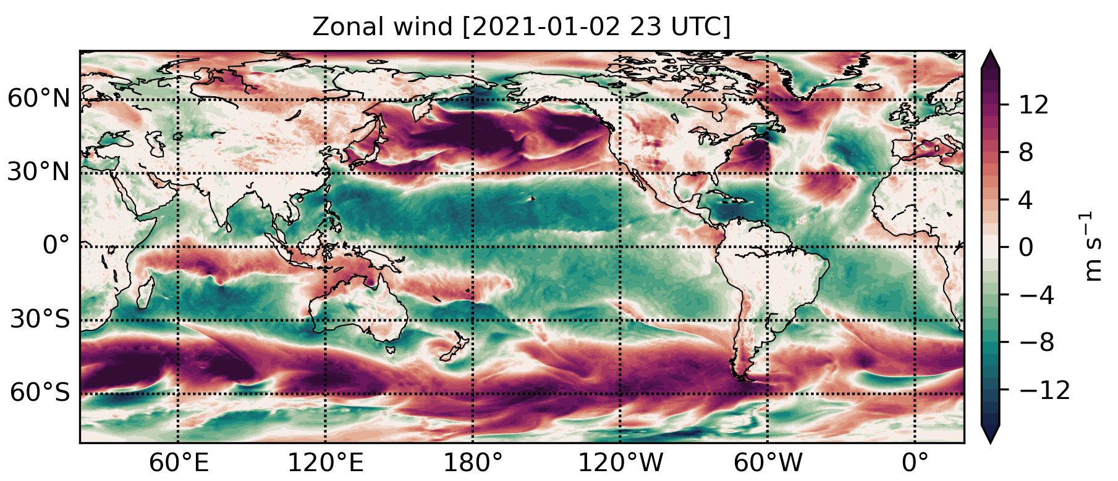
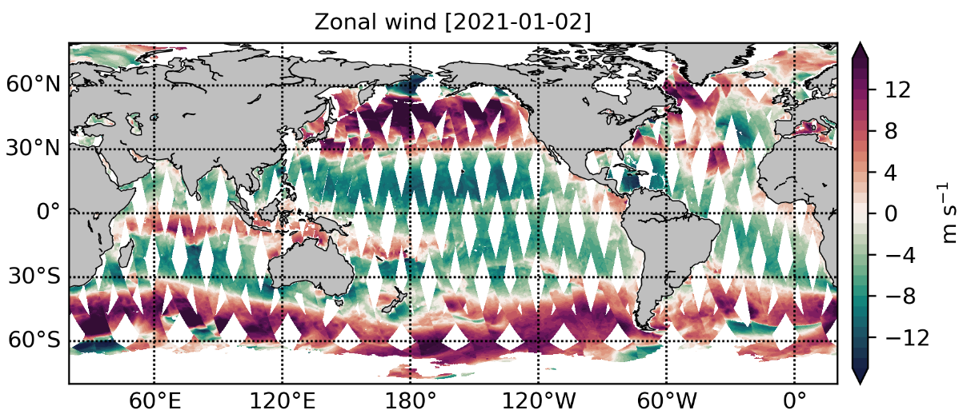
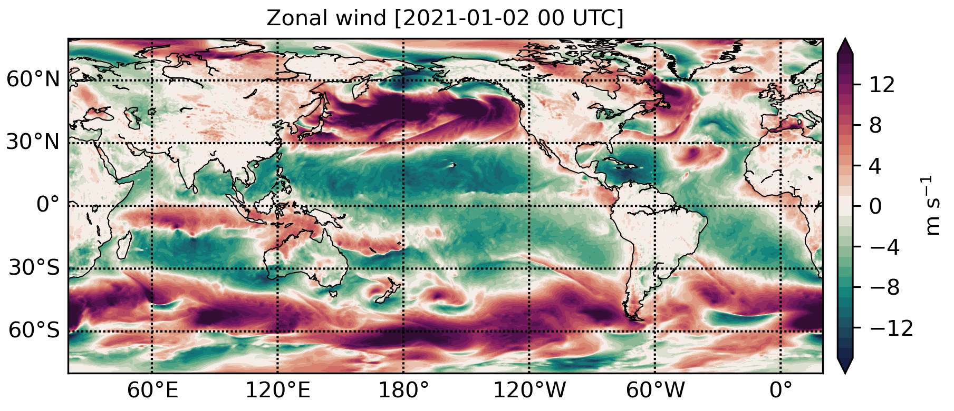
Wind field spatial and temporal coverage
Remotely sensed surface winds have limited spatial and temporal coverage
Numerical weather prediction (NWP) models provide global coverage at an hourly frequency
Ocean models are generally forced with NWP model winds
However, NWP model winds are not perfect…
24x
Scatterometer daily coverage (Metop-B ASCAT)
NWP model daily coverage (ECMWF ERA5)
Notes:
Various processes take place at the marine boundary layer and many of these processes are dependent on the wind at the ocean surface:
Winds drive the circulation in the upper ocean layers
Winds generate waves and in more extreme cases cause storm surges
Winds affect the near-shore currents and thereby coastal sediment transport
Last but not least, winds are an important player in the exchange of momentum, heat and mass between the atmosphere and the ocean. For instance, the sensible and latent heat fluxes are linear functions of the wind speed, while gas exchange rates functions have a higher-order dependency on wind speed.
The challenge with winds is that they are highly variable in time and space. Frequent and high-resolution observations are needed for a realistic representation of winds in ocean models. As the temporal coverage of remotely sensed winds is generally too low, wind fields from numerical weather prediction models are generally used as input to ocean models.

Slide 16
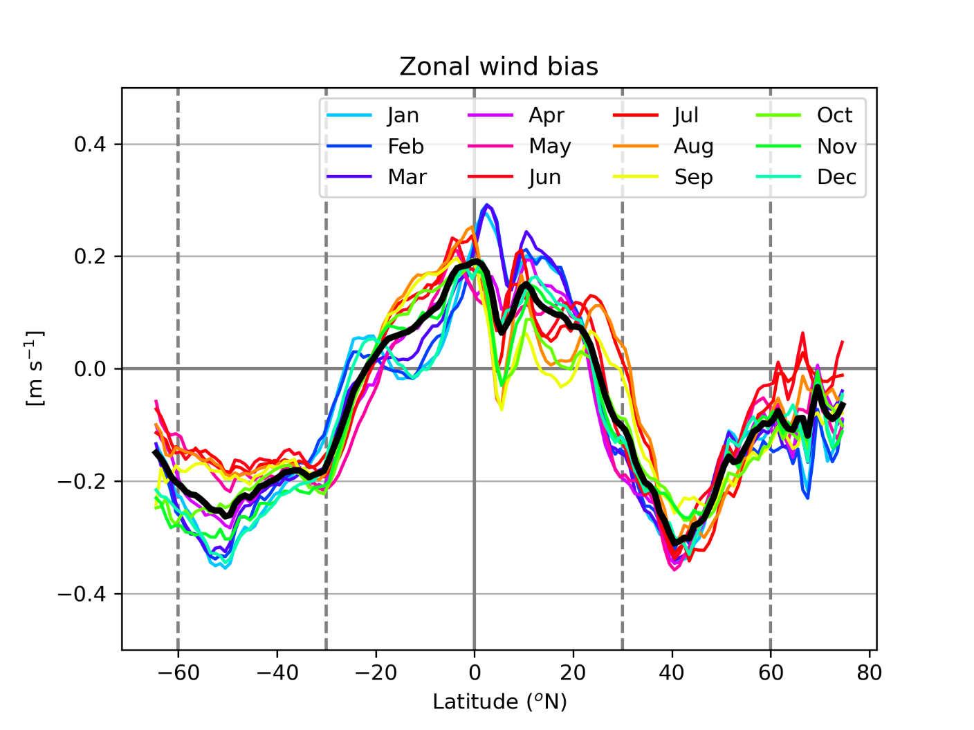
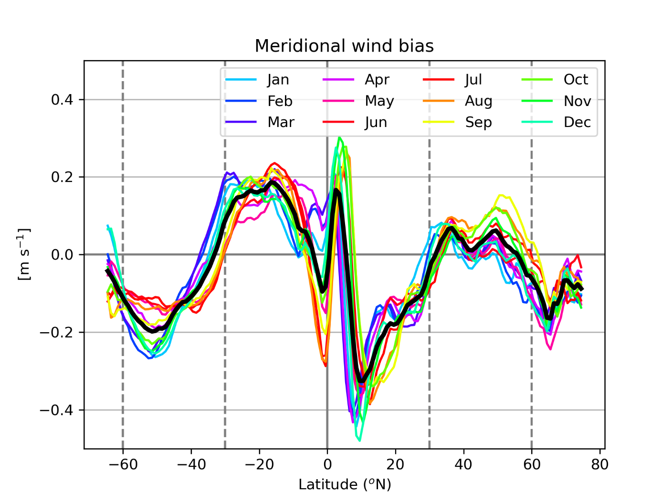
Seasonal bias changes
Zonal wind biases are positive in the tropics and negative at higher latitudes
Strong latitudinal gradients in the meridional wind biases in the tropics
Changes in magnitude and location of maxima/minima
SC: Metop-A/B/C ASCAT
ECMWF ERA5
2007-2022

Slide 17
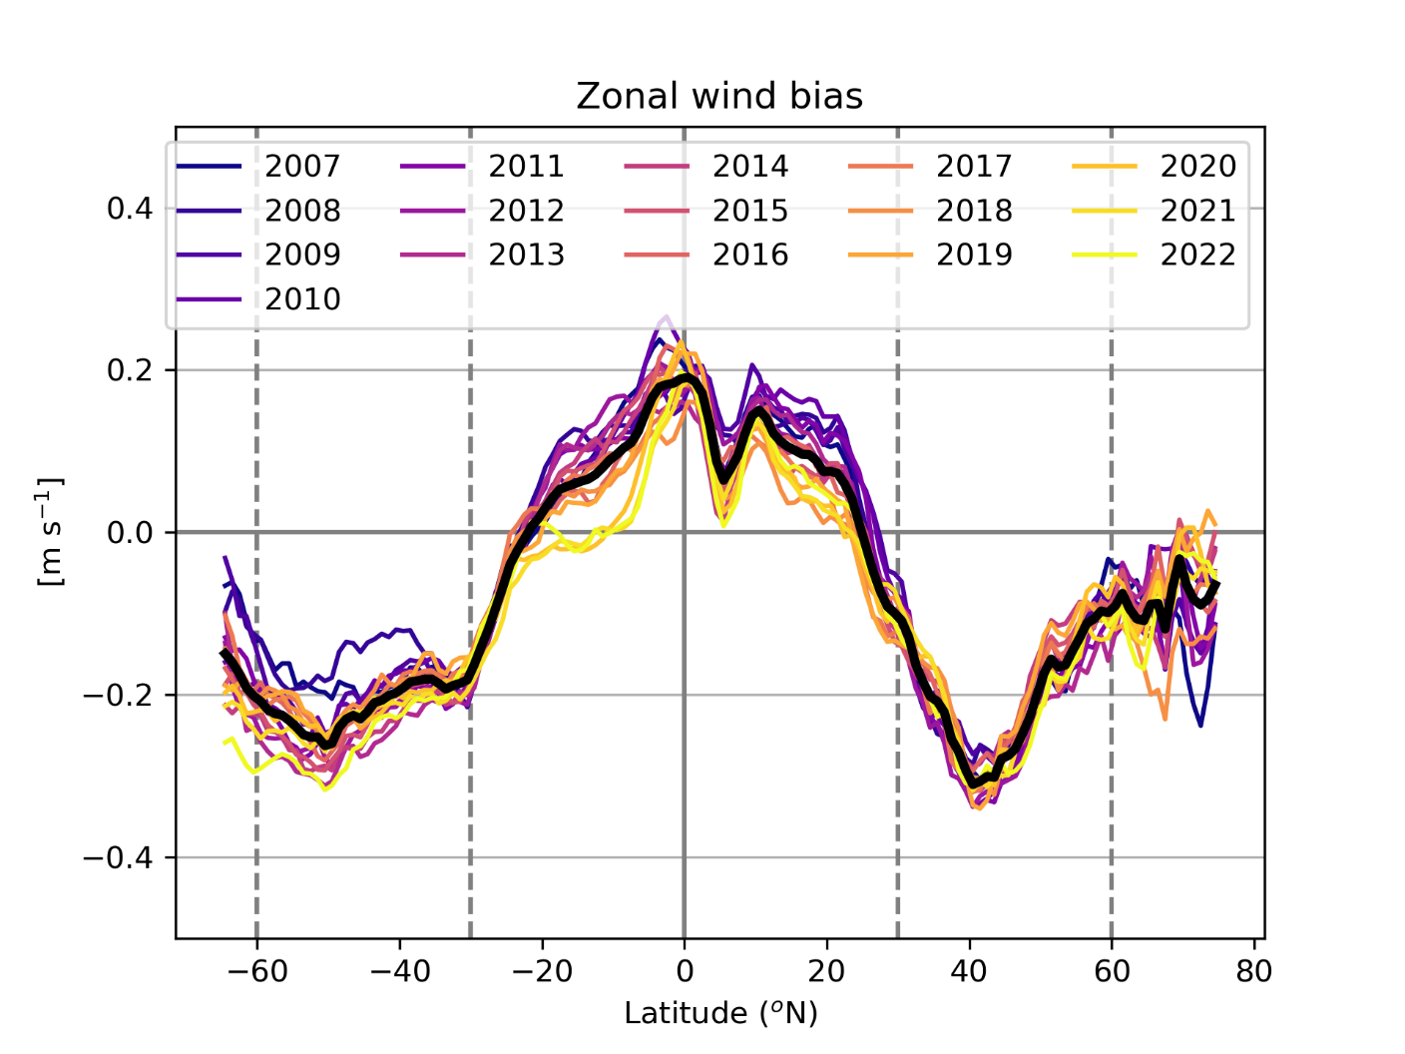
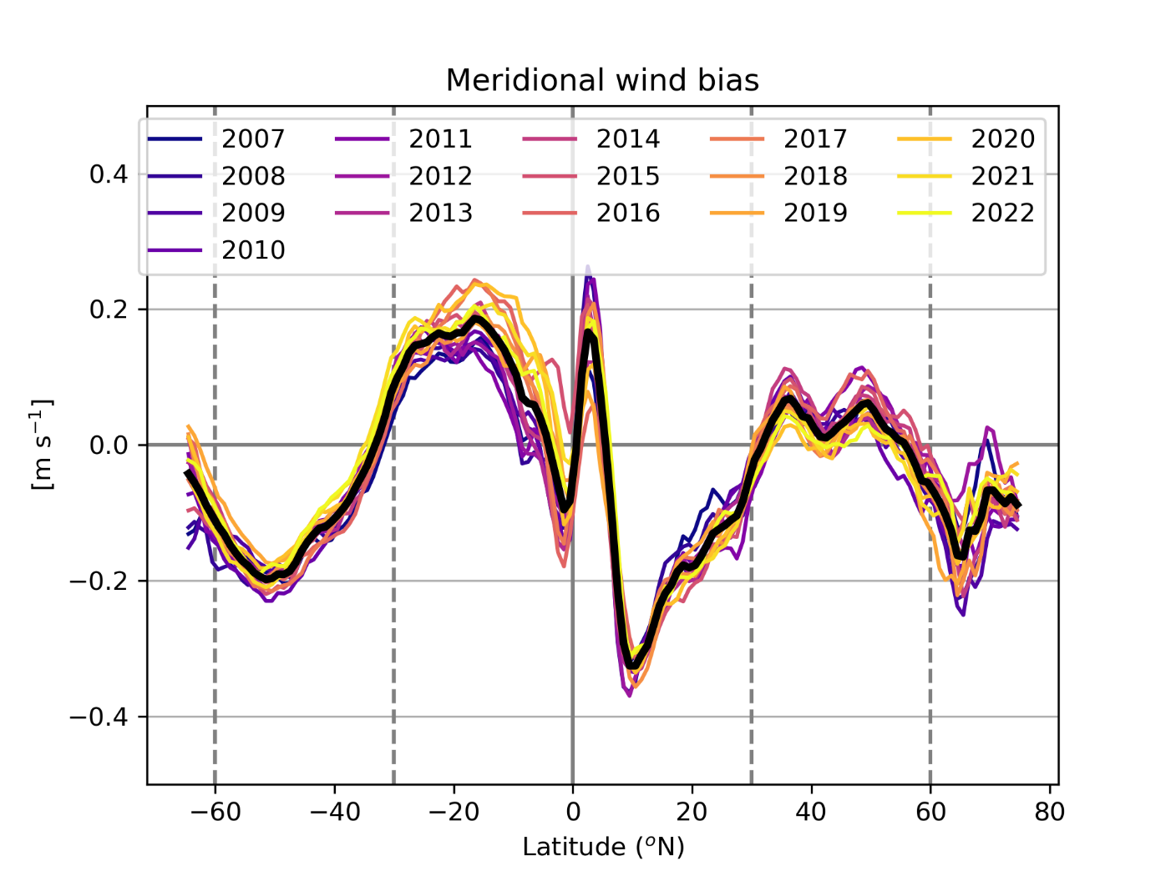
Interannual variability
Interannual variability in scatterometer corrections is smaller than seasonal variability
Gradual shift in latitudinal patterns over the years: to be investigated

Slide 18
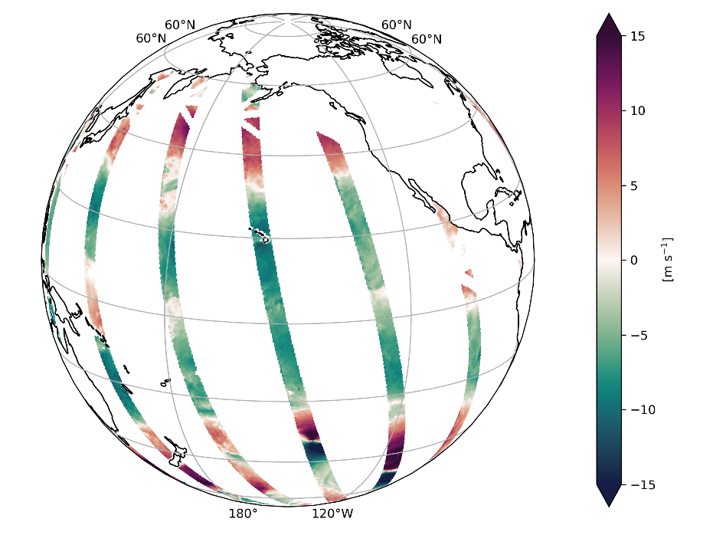
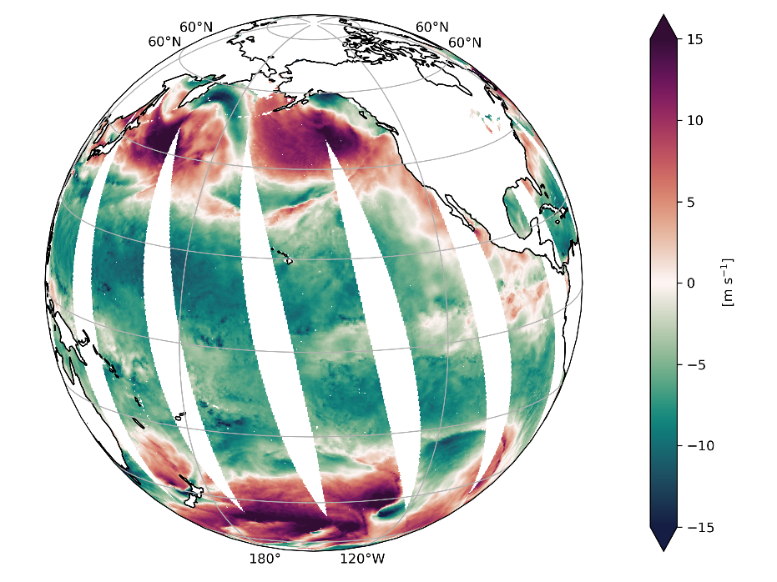
Scatterometer spatial coverage
Zonal wind ERS-2
Zonal wind QuikSCAT
Zonal wind Metop-A

Slide 19
Bias comparison between QuikSCAT and Metop-A
Zhixiong’s slide !
Metop-A ASCAT
QuikSCAT Seawinds
Metop-A - QuikSCAT
Zonal wind bias
Meridional wind bias

Slide 20
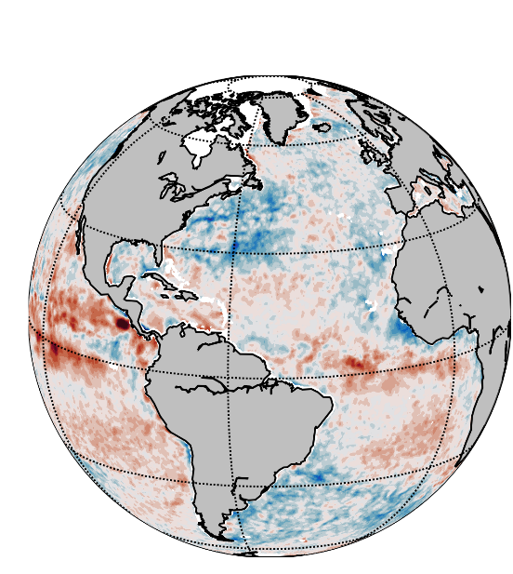
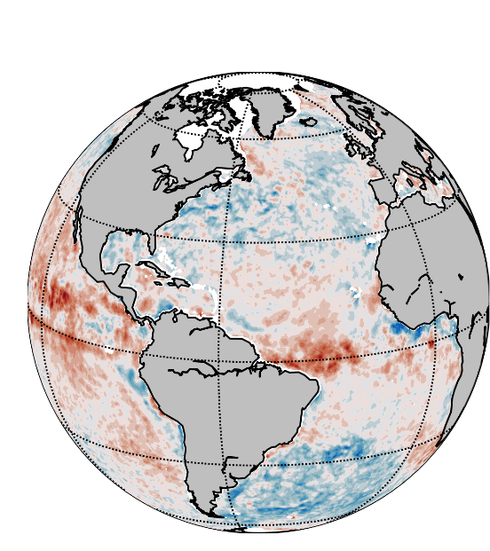
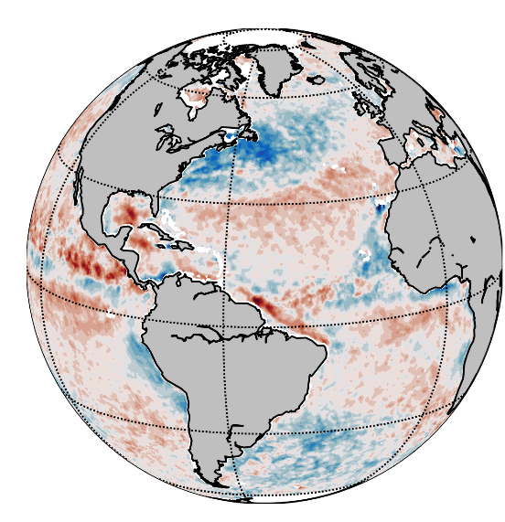
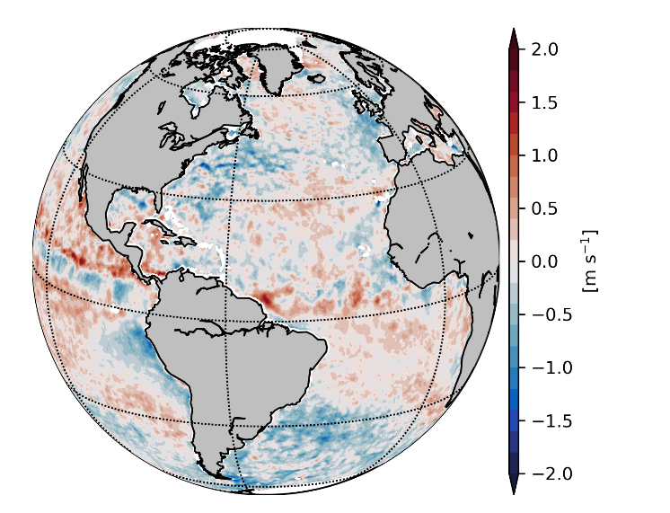
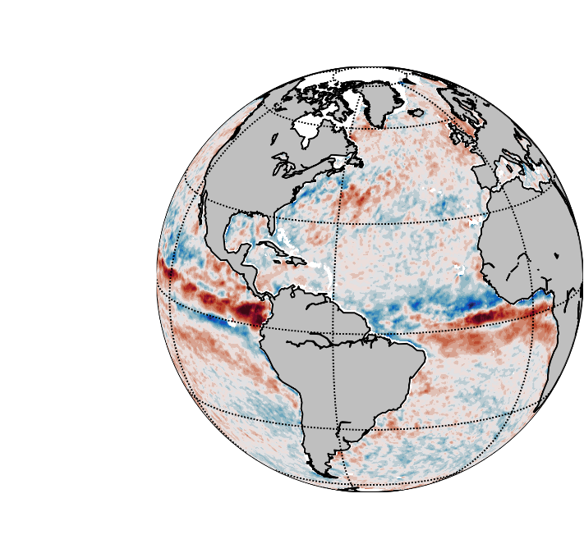
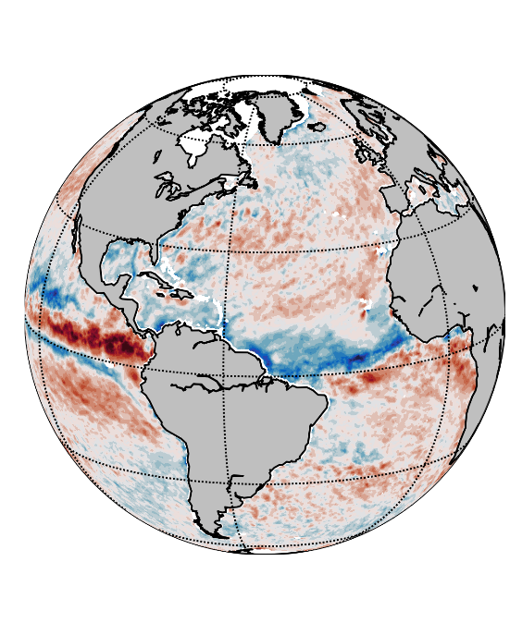
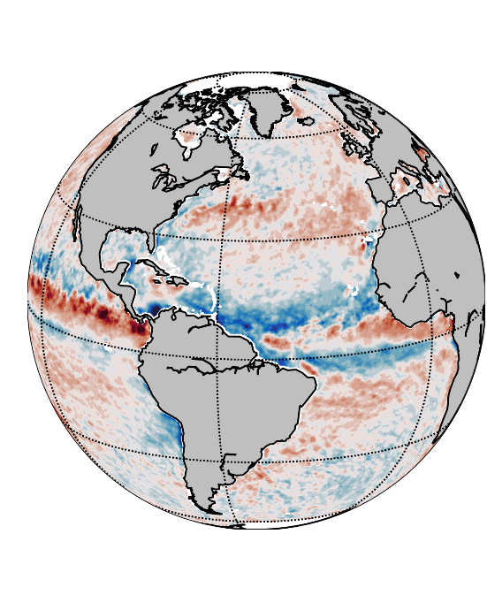
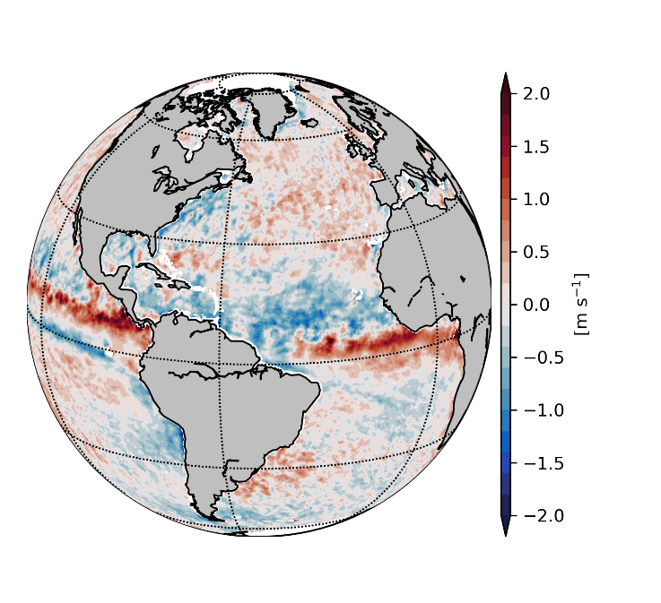
Seasonal bias changes
SC: Metop-B/C ASCAT
ECMWF ERA5
January 2022
April 2022
July 2022
October 2022
Zonal wind bias
Meridional wind bias

Slide 21
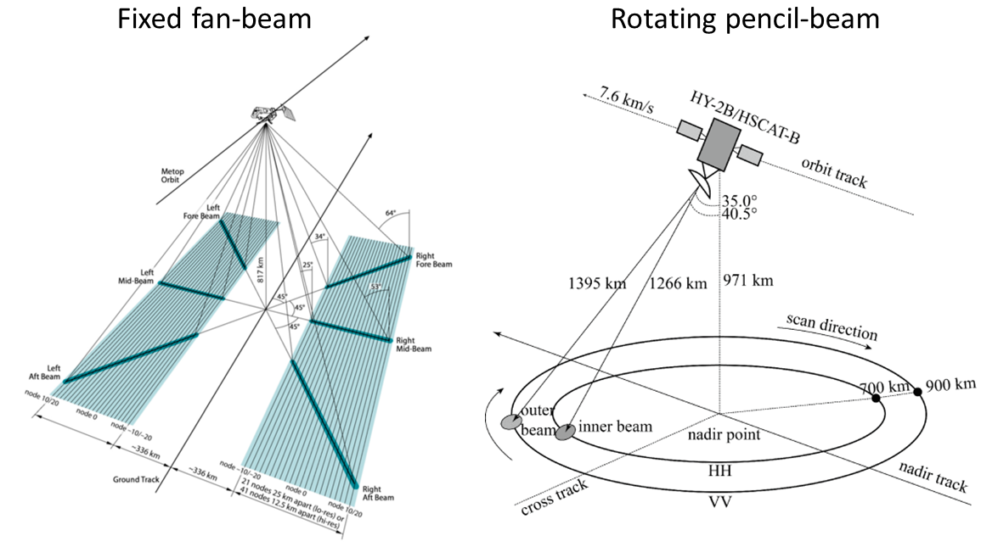
Scatterometer wind observations
Active microwave instrument
Backscatter of the signal increases with increased ocean surface roughness
Wind speed and direction are derived from the backscatter using a geophysical model function
Notes:
Various processes take place at the marine boundary layer and many of these processes are dependent on the wind at the ocean surface:
Winds drive the circulation in the upper ocean layers
Winds generate waves and in more extreme cases cause storm surges
Winds affect the near-shore currents and thereby coastal sediment transport
Last but not least, winds are an important player in the exchange of momentum, heat and mass between the atmosphere and the ocean. For instance, the sensible and latent heat fluxes are linear functions of the wind speed, while gas exchange rates functions have a higher-order dependency on wind speed.
The challenge with winds is that they are highly variable in time and space. Frequent and high-resolution observations are needed for a realistic representation of winds in ocean models. As the temporal coverage of remotely sensed winds is generally too low, wind fields from numerical weather prediction models are generally used as input to ocean models.

Slide 22
Scatterometer correction
$$SC\left(i,j,t_{f}\right)=\frac{1}{M}\sum_{t=1}^{M}{u_{10s}^{scat}\left(i,j,t\right)−u_{10s}^{NWP}\left(i,j,t\right)}$$
SC Scatterometer-based correction
(i,j) Grid point spatial coordinates
t_{f} NWP model forecast time
M Number of scatterometer observations at (i,j) in time window of N days
t Observation time
$u_{10s}^{scat}$ stress-equivalent wind variable from scatterometer
$u_{10s}^{NWP}$ stress-equivalent wind variable from NWP model interpolated to (i,j,t)
Trindade, A., M. Portabella, A. Stoffelen, W. Lin and A. Verhoef (2020), ERAstar: A High-Resolution Ocean Forcing Product, IEEE Trans. Geosci. Remote Sens., 1-11, doi: 10.1109/TGRS.2019.2946019.

Slide 23
Bias-corrected ECMWF fields
$u_{10s}^{NWP∗}\left(i,j,t_{f}\right)=$ $u_{10s}^{NWP}\left(i,j,t_{f}\right)$+SC $\left(i,j,t_{f}\right)$
Meridional wind
ERA5
Bias-corrected ERA5
Bias correction (20 days)

