Slide 1




SAR-learned Scatterometer Resolution Enhancement of Tropical Cyclones
Ad.Stoffelen@knmi.nl, Weicheng Ni,
Jur Vogelzang, Xingou Xu, Ke Zhao
Active Remote Sensing Group
Satellite Observations, KNMI
EUMETSAT OSI SAF
EU Copernicus Marine Services

Slide 2
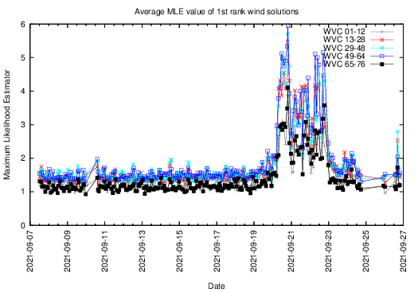
A constellation to track hurricanes
ASCAT-A, MetOp-A : 2007- 2021 9:30 LST, End-of-service November 2021
ASCAT-B, MetOp-B : 2012- healthy 9:30 LST
ASCAT-C, MetOp-C : 2018- healthy 9:30 LST, Excellent for wind changes in convection
OSCAT-2, ScatSat-1 : 2017- Feb 2021 8:45 LST, Excellent for Ku/C intercalibration
OSCAT-3, OceanSat3 : Nov 2022 . . . 12:00 LST, in commissioning
HSCAT-B, HY2B : 2018- healthy 6:00 LST
HSCAT-C, HY2C : 2020- healthy Not sun-synchronous, regresses
HSCAT-D, HY2D : 2021- healthy Regresses, development status
CSCAT, CFOSAT : 2019- demo Stability issues, nadir issues
WindRad, FY3E : 5/7/’21- healthy 5:30 LST, commissioning
https://scatterometer.knmi.nl/proc_status/
Vector wind CDRs for ERS (1991-1999), QuikScat (1999-2009),
ASCAT (2007-), OSCAT (2014+), needed to monitor re-analyses
Reanalyses are subject to changing inputs
https://scatterometer.knmi.nl/archived_prod/
HY2D
https://scatterometer.knmi.nl/hy2d_25_prod/index.php?cmd=monitoring&period=week&day=0&flag=yes

Slide 3
Need for accurate extreme winds
Nowcasting, where dropsondes are the adopted wind speed reference; if the wind speed reference would change, hurricane categories change too, as everything relies on dropsonde wind speed calibration (SFMR, Dvorak, passive satellite ocean winds, .. )
NWP, to formulate drag and air-sea interaction stresses
Oceanography, to determine ocean mixing depth in hurricanes (see deep cold water track behind hurricane)
Climate monitoring, to determine climate change at the
extremes, i.e., recalibrate past records
Climate prediction, to well describe complex extra-tropical and tropical coupled ocean-atmosphere dynamics (CO₂, heat, H₂O, … )
Improved description of hurricane dynamics
Satellite ocean surface wind speed calibration for active and passive microwave remote sensing
Coupled
Uncoupled
Polverari et al., 2021

Slide 4


5 scatterometers capture landfall of Ida
Strength consistent with NHC advisories, but . .
Hurricane in-situ wind speed scale differs from moored buoys, our in-situ speed reference
www.eumetsat.int/CHEFS, Polverari et al., ‘21
The in-situ reference wind speed scale also determines ocean drag and fluxes, NWP u10
Scatterometer winds do not need long waves
SCA has VH and higher resolution, hopefully DopSCA
EUMETSAT OSI SAF, Ida land-fall news story
EU Copernicus Marine Core Services
Ni et al., 2021

Slide 5
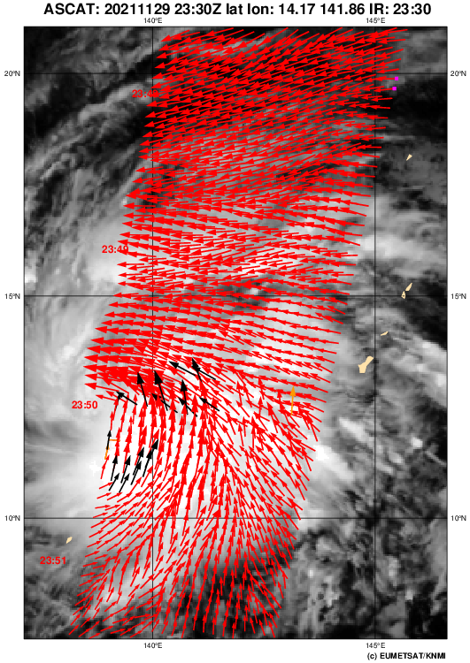
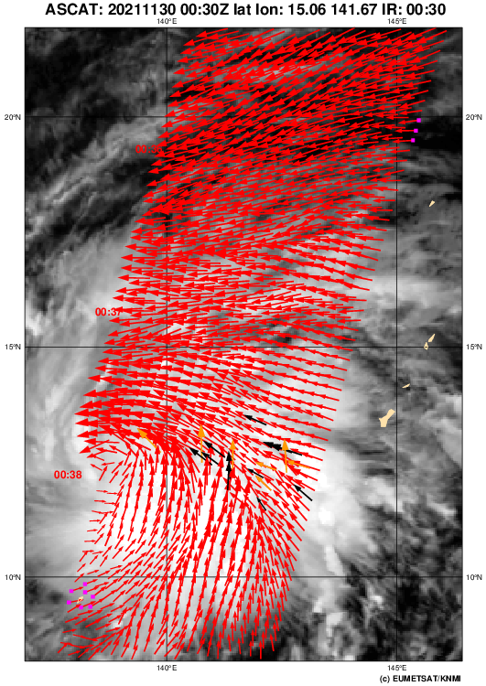
In only 50 minutes
Nyatoh
ASCAT-B
ASCAT-C

Slide 6
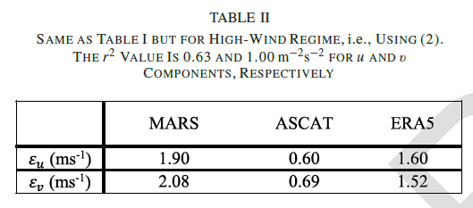
An In-situ Controversy at the Extremes
250
240
230
220
210
200
190
180
170
160
[m/s]
150
> 12 m/s apply for x=V(ASCAT): V’(ASCAT)=0.0095x²+1.52x-7.6
Dropsondes are used in the operational community as reference
SFMR, Dvorak, SMAP, SMOS, .. ,
depend on dropsonde speed reference
Use CHEFS method for spatial scaling
to satellite footprints, collocation, ..
We normally use stress-equivalent 10-m ECMWF and buoy winds up to 25 m/s (at sufficient sampling) for cal/val
Triple collocation (see table)
Dropsondes and buoys are different =>
CMOD7 physically credible, CMOD7D ?
CMOD7D follows SFMR speeds @25km footprint
140
130
Dropsonde
1:1
120
SFMR speed
110
100
90
Cat.:
V
IV
III
II
I
80
70
60
50
40
30
20
10
0
0
10
20
30
40
50
60
70
80
90
[m/s]
CMOD7 speed [m/s]
CMOD7 ASCAT speed
Polverari et al., 2022 Stoffelen et al., 2021

Slide 7
ESA MAXSS work at KNMI
Exploiting the SAR data base
  Hurricane morphology
  Improve SAR wind direction (as verified by ASCAT)
  Use SAR to train scatterometer resolution enhancement
  Sustained wind representation 1-min (SAR) versus 10-min (Scat)
  Wind calibration/adjustment at extremes (with ICM)
Decadal analysis (Alexandre Payez)
L4 validation

Slide 8
Grey gradient method for SAR
Ni et al. 2021 Hurricane eye morphology extraction from SAR images by texture analysis (MAXSS)

Slide 9
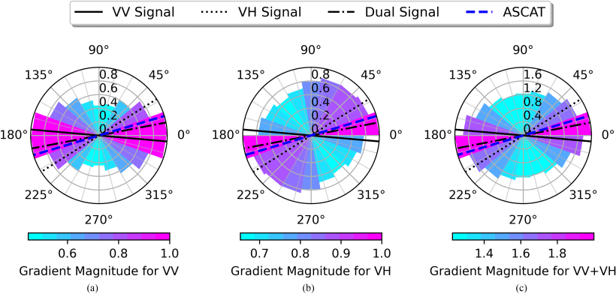
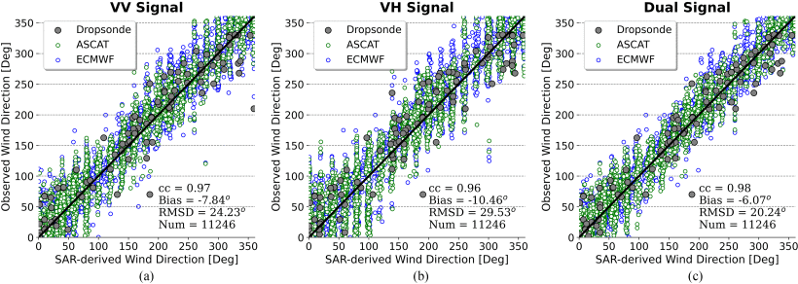
Improved SAR wind direction
Gradient method
Compare SAR
VV, VH
and both
Dropsondes
ASCAT
ECMWF
Ni et al., 2023
Tropical Cyclone Wind Direction Retrieval From Dual-Polarized SAR Imagery Using Histogram of Oriented Gradients and Hann Window Function (MAXSS)

Slide 10
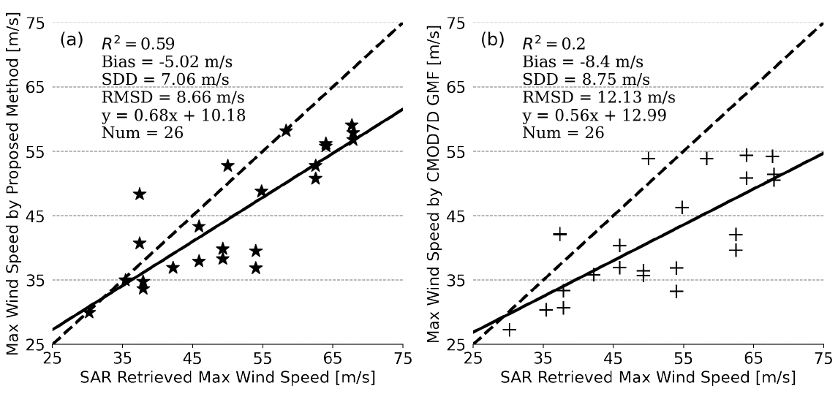
1-min. maximum sustained winds
Standard for hurricane category advisories
Based on dropsonde wind speed scale – CMOD7D GMF for ASCAT
Scatterometers blur the maximum eyewall winds (~10-min. value)
Develop guidance for 1-minute maximum sustained winds for ASCAT
Fit simple Rankine vortex to ASCAT winds:
New
CMOD7D
Ni et al., 2022 Tropical Cyclone Intensity Estimation From Spaceborne Microwave Scatterometry and Parametric Wind Models (MAXSS)

Slide 11
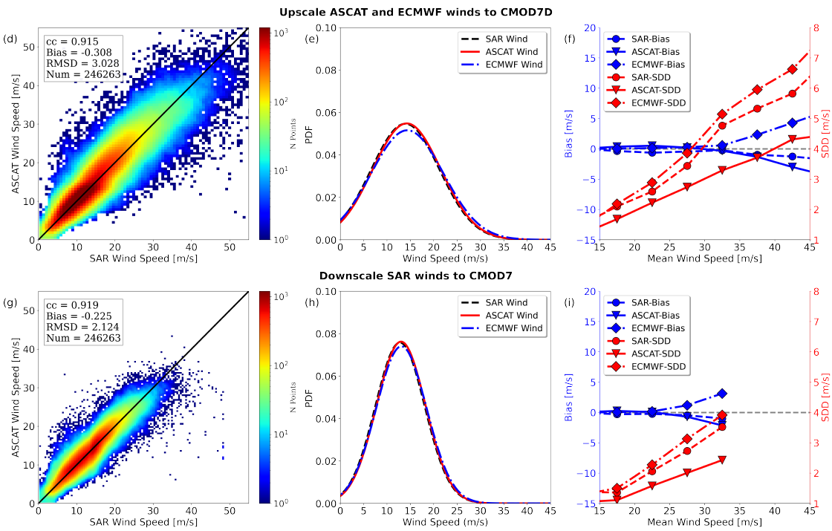
ASCAT, ECMWF and SAR speed scale
Triple speed collocation ASCAT, SAR, ECMWF for matching
Ni et al., 2022 : SAR and ASCAT Tropical Cyclone Wind Speed Reconciliation (MAXSS)

Slide 12
ASCAT, ECMWF and SAR speed scale
Triple speed collocation ASCAT, SAR, ECMWF for matching
Mean wind speed is reference for accurate binning
Biases are small after scaling
ASCAT error smallest at ~10%
SAR has more speed structure
ECMWF is smooth
Ni et al., 2022 : SAR and ASCAT Tropical Cyclone Wind Speed Reconciliation (MAXSS)

Slide 13
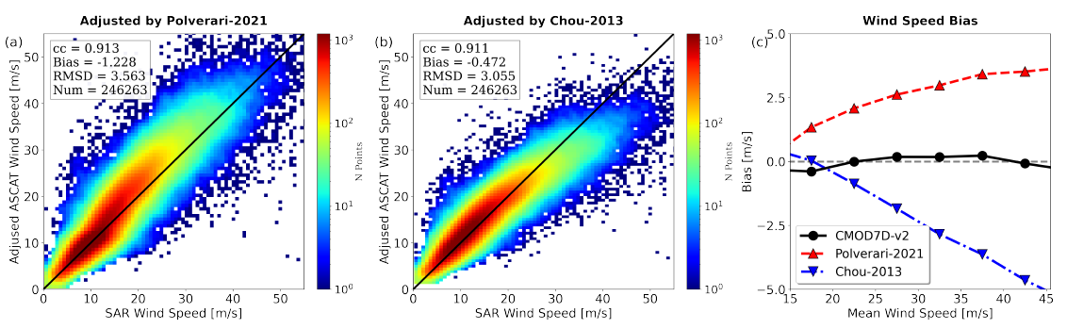
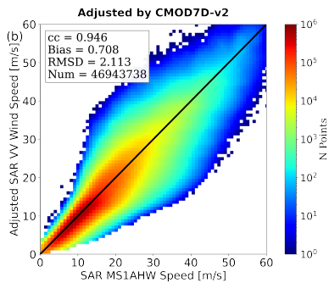
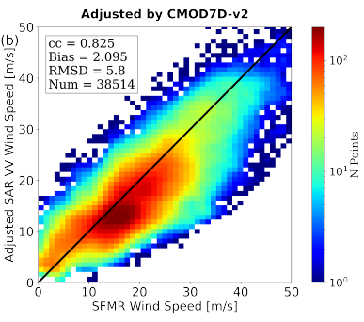
Comparing to SFMR/dropsondes
Chou et al. adjusted to dropsondes
Polverari et al. matched SFMR
SAR VV and ASCAT match well with the same GMF after spatial matching
SFMR and SAR spread substantially with RMSD of 5.8 m/s
SFMR appears difficult to calibrate
Ni et al., 2022 : SAR and ASCAT Tropical Cyclone Wind Speed Reconciliation (MAXSS)

Slide 14
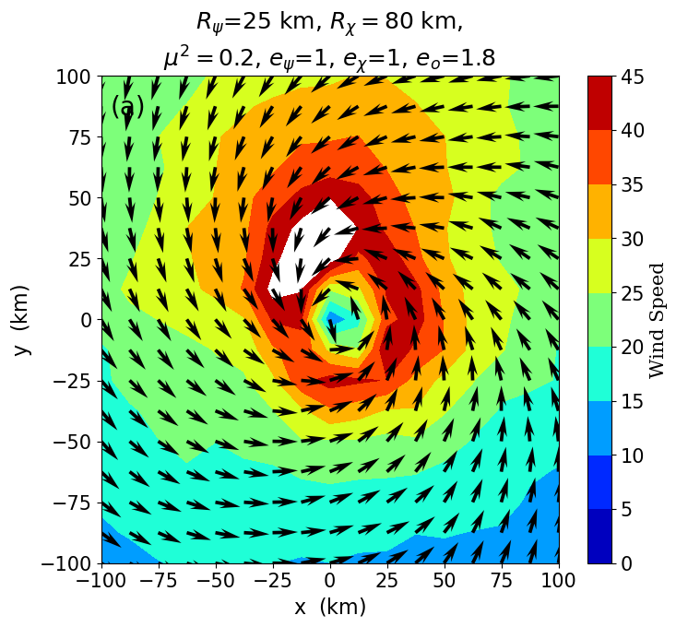
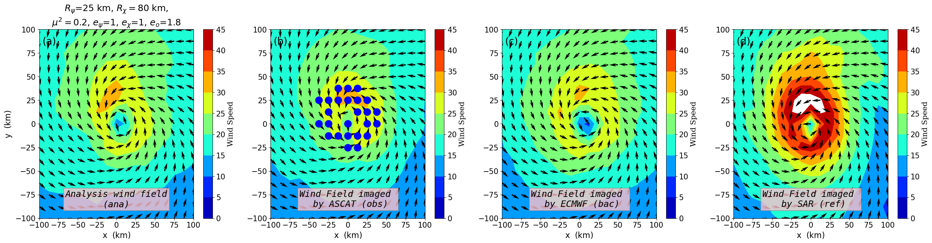
2DVAR resolution enhancement
In development
Storm-centered background (max. R² centre)
Empiricial “hurricane” spatial B error structure functions, depending on category
Sensitivity tests for varying radii and rot/div ratio
Now 12.5 km product, later 5.6 km
Wind speed scaling is last step
Enhanced ASCAT
Ni et al., in preparation

Slide 15
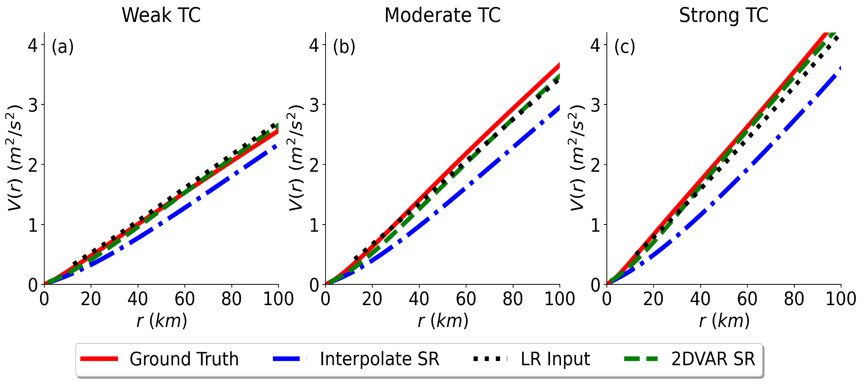
2DVAR resolution enhancement
Spatial variance in hurricane eye area well represented by 2DVAR
ASCAT has SAR variance at low resolution (LR), but is sampled low
Bi-linear interpolation reduces variance as expected
Enhanced ASCAT
SAR
Ni et al., in preparation

Slide 16
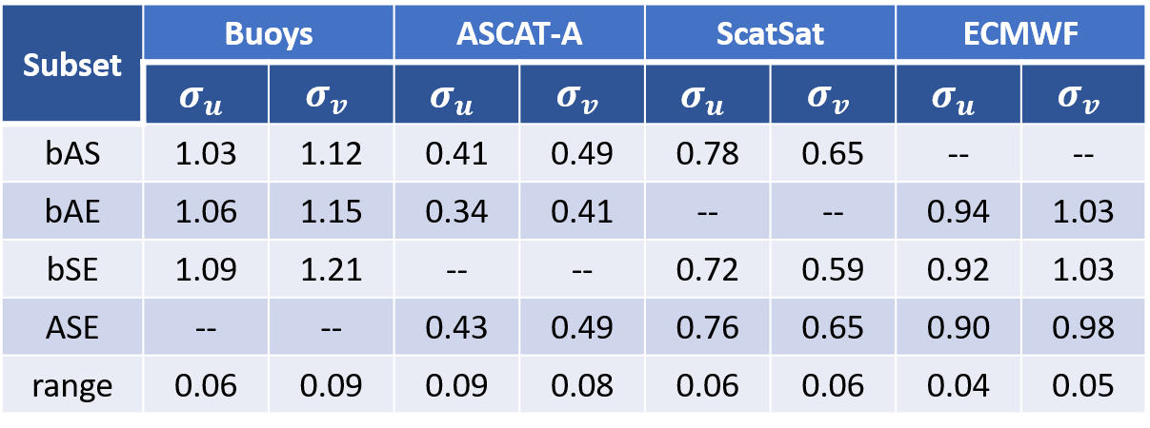
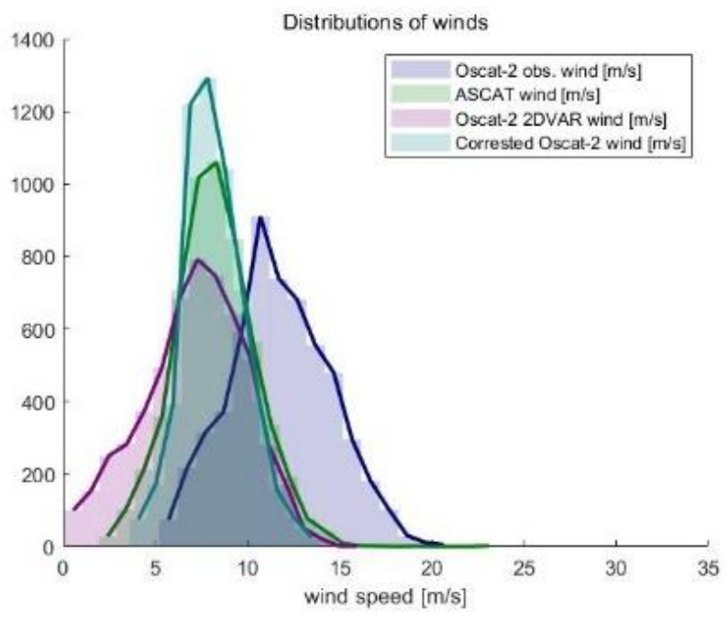
Well Characterized Wind Quality
Quadruple/Quintuple Collocation Analysis of
In-Situ, Scatterometer,
and NWP Winds
Jur Vogelzang & Ad Stoffelen,
https://doi.org/10.1029/2021JC017189
https://doi.org/10.3390/rs14184552
Support vector machine tropical wind speed retrieval in the presence of rain for Ku-band wind scatterometry
Xingou Xu & Ad Stoffelen
https://doi.org/10.5194/amt-2021-200

Slide 17
Ku-band rain
Rain points can be separated from wind points in 4D measurement space for most WVCs
The wind distribution is contained in the wind GMF
Construct a VV and HH rain GMF
Use Bayesian inference to get rain probability / rain area
Use probability threshold for flagging
Use probability for rain correction to retrieve corrected winds (assuming rain area for P)
Could be promising for tropical hurricanes
Combine with 2DVAR resolution enhancement, now developed for ASCAT in MAXSS with SAR
Zhoa et al., 2023, 2x accepted

Slide 18
L3/L4 uncertainty analysis
MetOp-B and C spatially overlap
B and C are separated by 50 minutes
Divergence changes substantially in 50 minutes
Large divergence associates with large SST gradients
Global model does not show this variability (too fast to track)
Miguel Fernández et al., in preparation

Slide 19
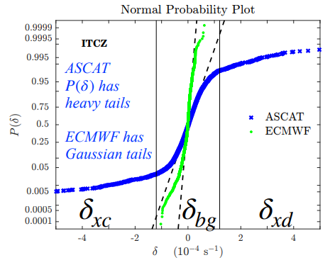
L3/L4 product uncertainty analysis
King et al. showed association of extreme ASCAT convergence and divergence to heavy rain
ECMWF div. is close to Gaussian (straight line)
Pencil-beam winds also show extremes, but particularly less extreme (small-scale) convergence
How to deal with this in Copernicus L4 products?
What about the MAXSS L4 winds?
King et al, 2022
Miguel Fernández et al., in preparation

Slide 20
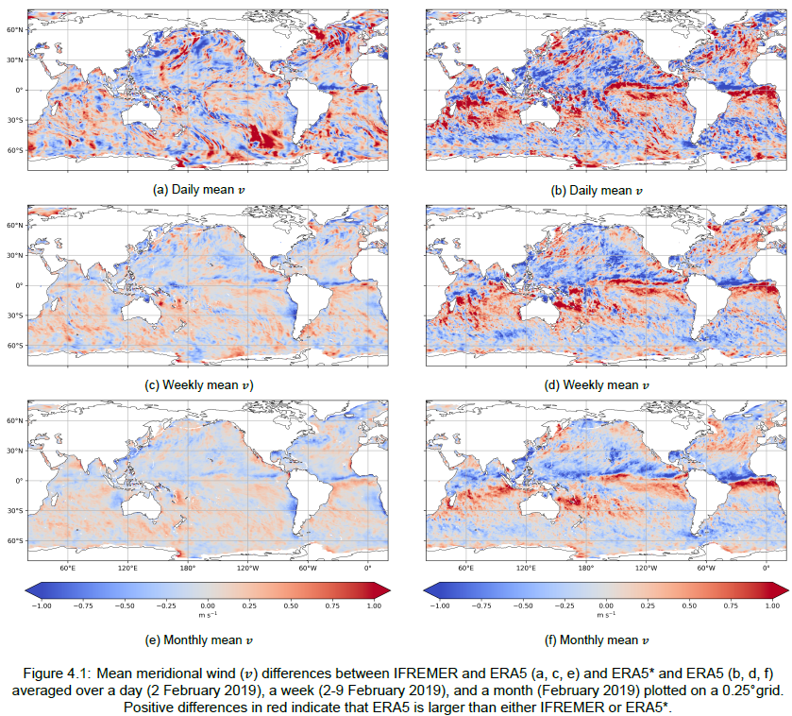
L3/L4 product uncertainty analysis
IFREMER L4 – ERA5
ERA5*– ERA5
Scatterometers show substantial model biases
Both in mean and variance
How to make L4 products that maintain observed spatial characteristics?
Ex.: IFREMER L4 product copied ERA5 model bias over time (see right)
Verify MAXSS L4 product?
Liselotte van Cranenburgh, MSc Thesis

Slide 21
Conclusions and Outlook
We have many scatterometers capturing tropical cyclones, showing fast changes due to moist convection
Good science in the ESA MAXSS project on SAR and ASCAT comparisons, exploiting the SAR (thanks to ESA SHOC, CYCLOBS) to improve scatterometer winds
Resolution enhancement ASCAT progressing well
Resolution enhancement Ku-band scatterometers, probably after implementation rain correction
How strong is the wind in a hurricane? (Tuesday afternoon)
Coupled
Uncoupled

Slide 22


Slide 23
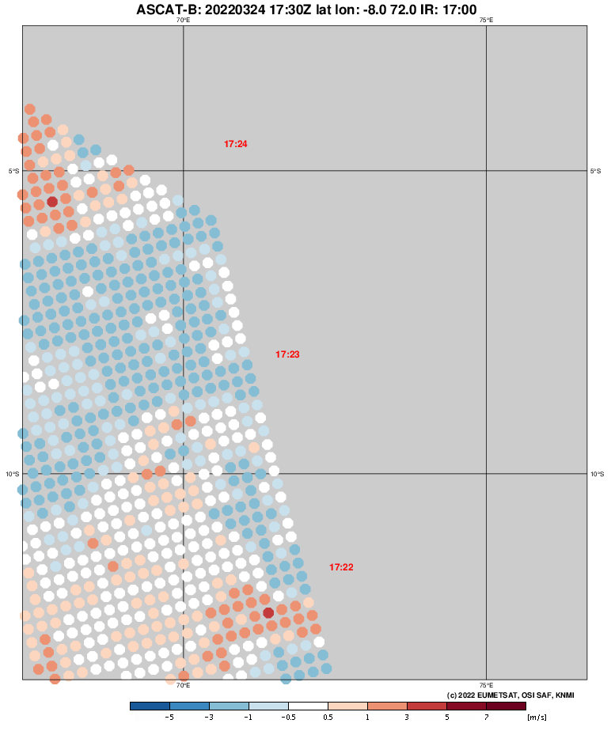
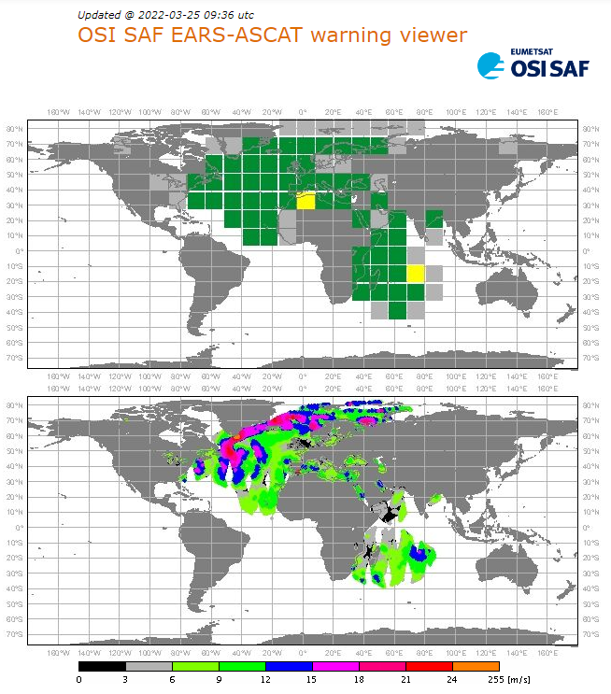
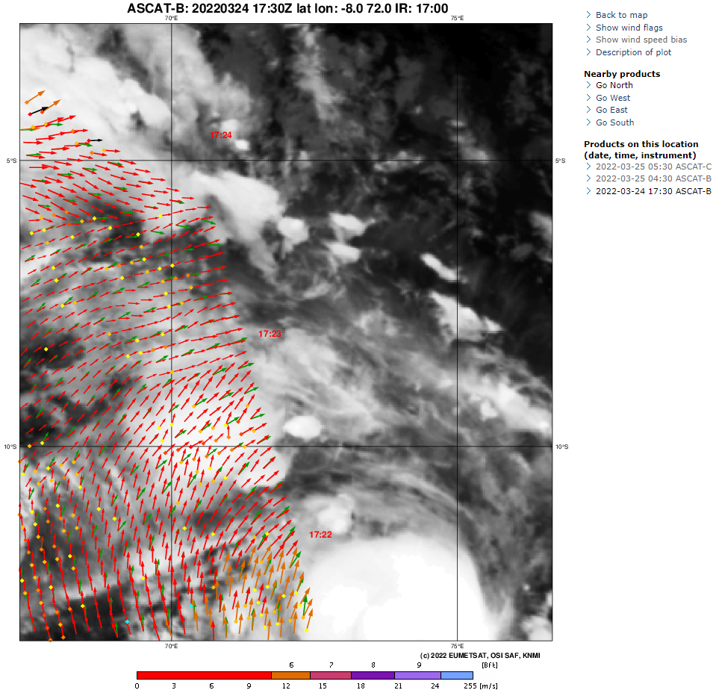
KNMI cyclone visualization and EARS Early Warning
scatterometer.knmi.nl/2ewc_prod/
Warns fast in case of climatologically large deviation between ECMWF and ASCAT

Slide 24
Grey gradient method for SAR
Ni et al. 2021 Hurricane eye morphology extraction from SAR images by texture analysis (ESA MAXSS project)

Slide 25
In only 50 minutes . . .
Nyatoh
ASCAT-B
ASCAT-C

Slide 26
ASCAT, ECMWF and SAR speed scale
Triple speed collocation ASCAT, SAR, ECMWF for matching
Ni et al., 2022 : SAR and ASCAT Tropical Cyclone Wind Speed Reconciliation (MAXSS)

Slide 27
ASCAT, ECMWF and SAR speed scale
Triple speed collocation ASCAT, SAR, ECMWF for matching
Mean wind speed is reference for accurate binning
Biases are small after scaling
ASCAT error smallest at ~10%
SAR has more speed structure
ECMWF is smooth
Ni et al., 2022 : SAR and ASCAT Tropical Cyclone Wind Speed Reconciliation (MAXSS)

Slide 28
2DVAR resolution enhancement
PhD Weicheng Ni (NUDT)
Storm-centered background (max. R² centre)
Empiricial “hurricane” spatial B error structure functions, depending on category
Sensitivity tests for varying radii and rot/div ratio
Now 12.5 km product, later 5.6 km
Wind speed scaling is last step
Enhanced ASCAT
Ni et al., in preparation

Slide 29
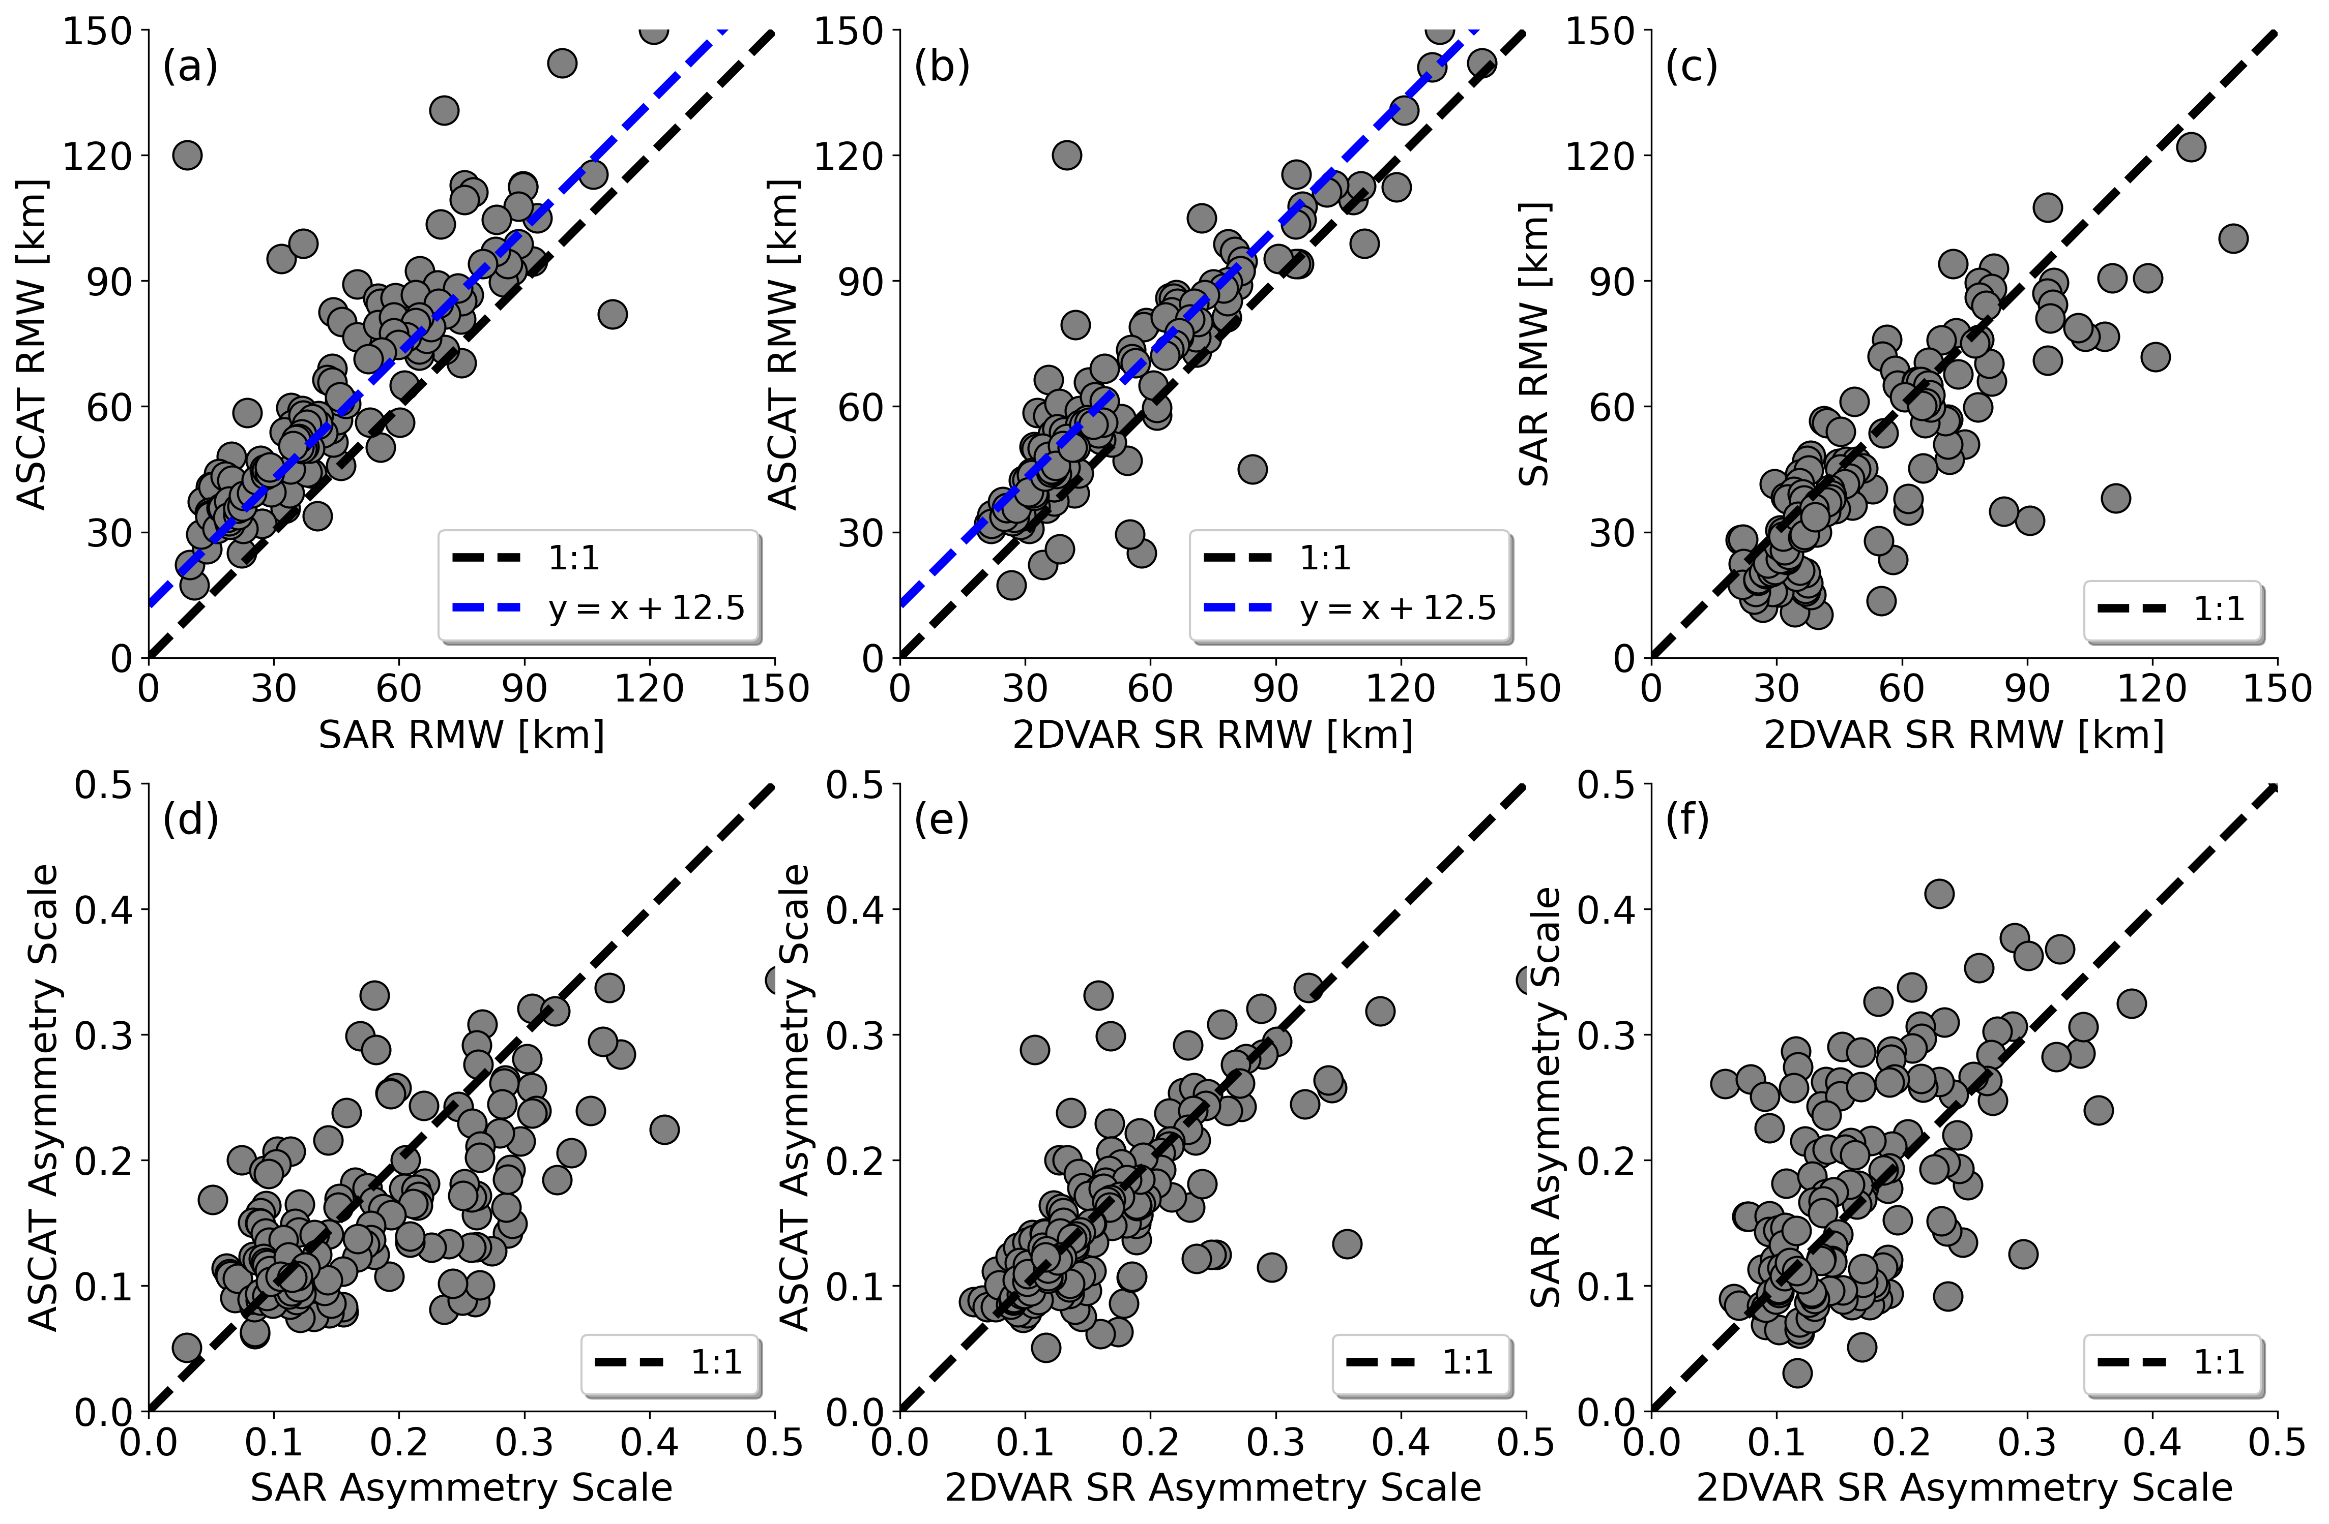
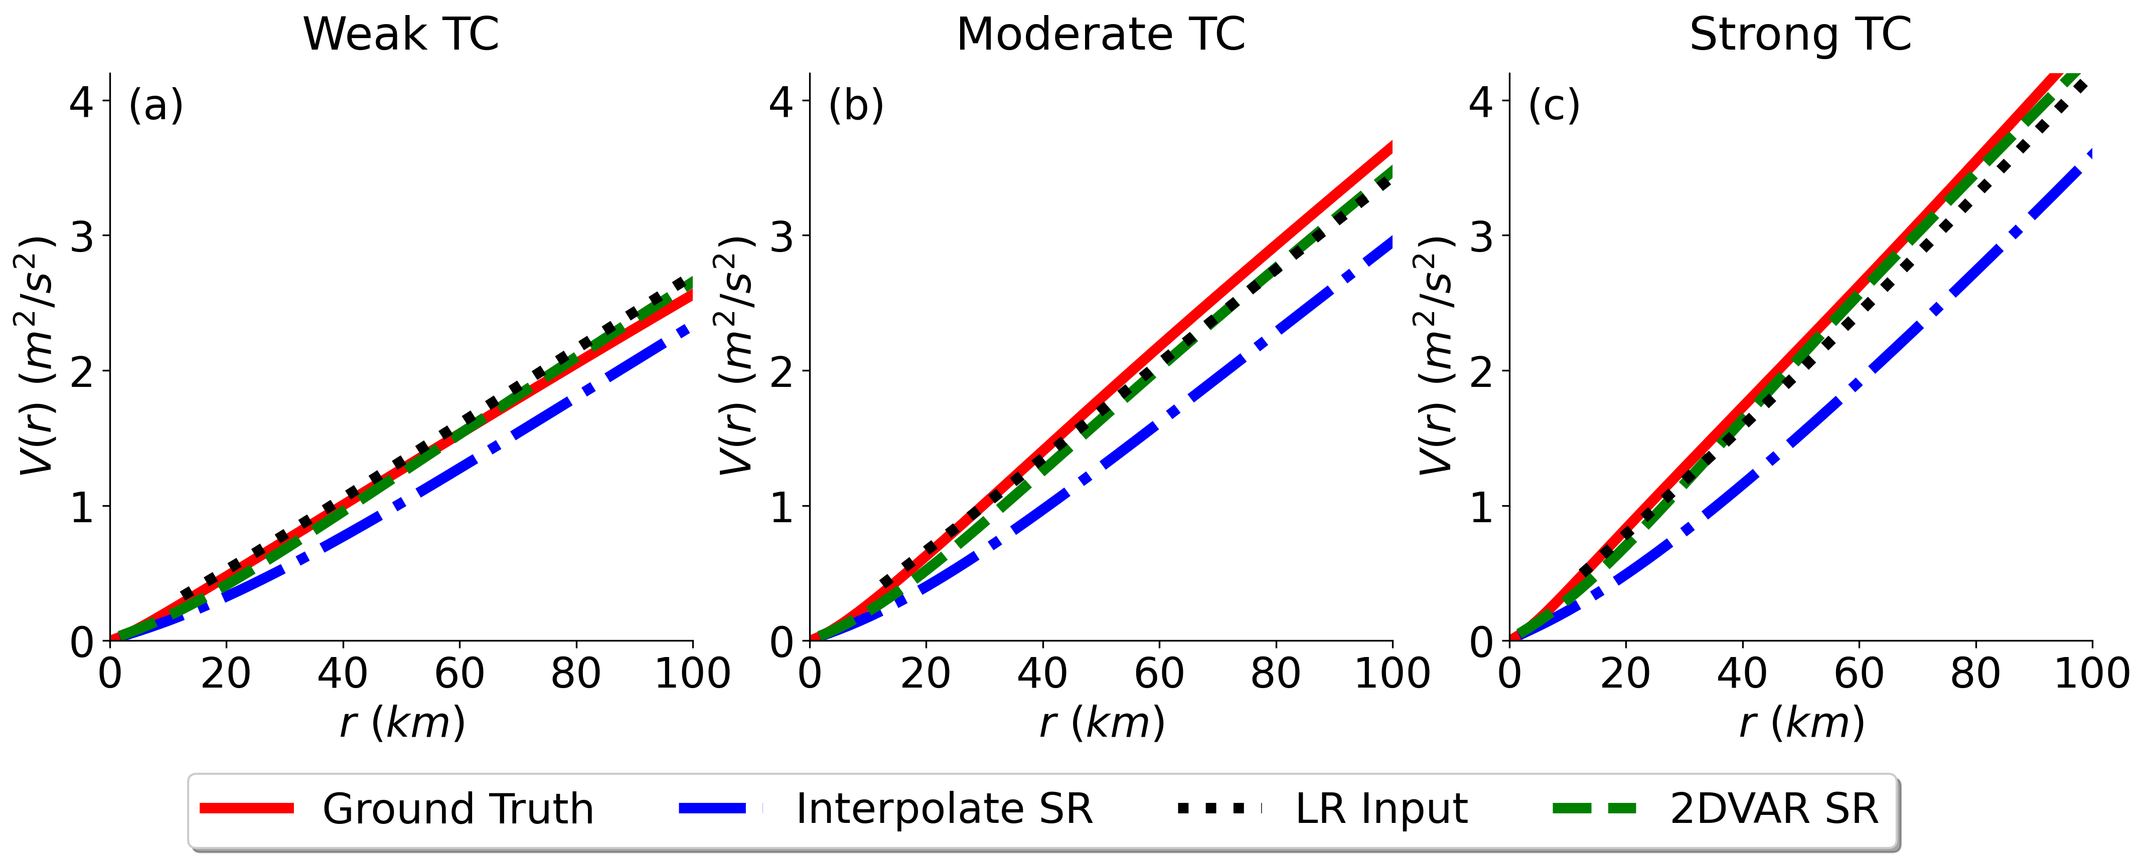
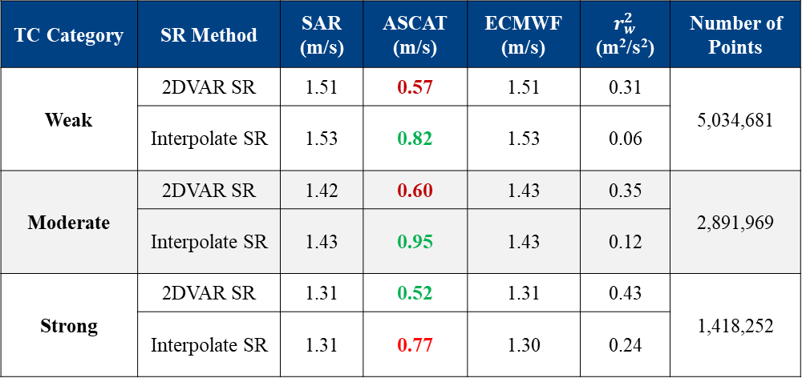
Tropical Cyclone Resolution Enhancement for ASCAT Winds
Morphological Analysis
The proposed SR method is capable of preserving consistency at large scales with original ASCAT winds while compensating for the ASCAT footprint blurring effect of the small-scale information and enhancing TC vortex structures in a physically meaningful manner, regardless of TC strength category.
The obtained SR products possess the correct small-scale properties of TC inner-core structures, such as Radius of Maximum Wind, TC asymmetry and wind variability.
Quality Evaluation by Triple Collocation Analysis
TC Category | SR Method | SAR (m/s) | ASCAT (m/s) | ECMWF (m/s) | $r_{w}^{2}$ (m²/s²) | Number of Points
Weak | 2DVAR SR | 1.51 | 0.57 | 1.51 | 0.31 | 5,034,681
 | Interpolate SR | 1.53 | 0.82 | 1.53 | 0.06
Moderate | 2DVAR SR | 1.42 | 0.60 | 1.43 | 0.35 | 2,891,969
 | Interpolate SR | 1.43 | 0.95 | 1.43 | 0.12
Strong | 2DVAR SR | 1.31 | 0.52 | 1.31 | 0.43 | 1,418,252
 | Interpolate SR | 1.31 | 0.77 | 1.30 | 0.24
Spatial Variance Estimates

Slide 30
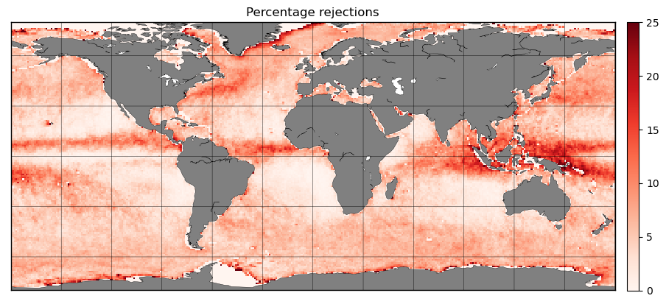
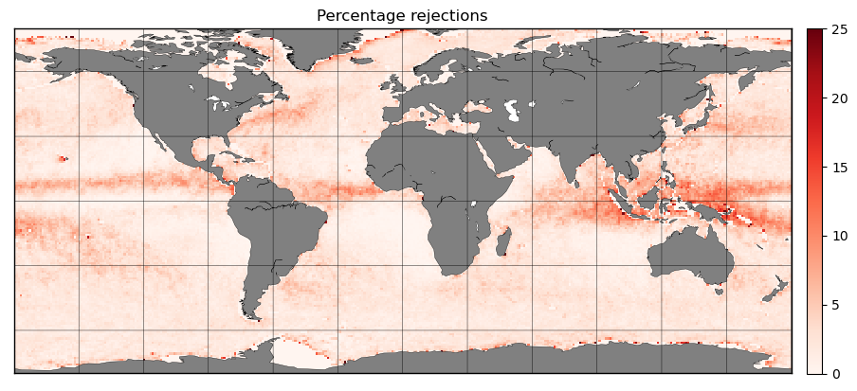


Ku-band Quality Control and ocean winds
We continuously collaborate to improve quality control (QC)
For Ku-band scatterometers we need to control rain (=>)
Develop algorithms to correct for remaining observational sampling biases
We compare geographical biases between rain-insentitive (ASCAT) and rain-sensitive (Ku-band) scatterometers and collocated ECMWF winds
Using ECMWF allows correction of satellite sampling biases
It allows to estimate the bias due to the systematic removal of at maximum ~10% of the Ku-band winds in moist convection
We work on Ku-band rain correction methods using Bayesian estimation
Zhao et al., 2023 (2x)
King et al., 2022
Xu and Stoffelen, 2021, 2019
Trindade et al., 2020, 2023
Belmonte and Stoffelen, 2019
% rejections Ku-band
Old
New

Slide 31
Bayesian rain estimation
Rain points can be separated from wind points in 4D measurement space for most WVCs
The wind distribution is contained in the wind GMF
Construct a VV and HH rain GMF
Use Bayesian inference to get rain probability / rain area
Use probability threshold for flagging
Use probability for rain correction to retrieve corrected winds (assuming rain area for P)
Could be promising for tropical hurricanes
Combine with 2DVAR resolution enhancement,
now developed for ASCAT in MAXSS with SAR
Zhao et al., 2023, 2x accepted

Slide 32

New scatterometers, Passive microwaves and SAR
SAR services are being developed in the Copernicus Marine Service to add value to scatterometer wind products, in particular for extremes and coastal
Satellite B of MetOp-SG (2025) has SCA and will provide
  10% more swath than ASCAT
  Double spatial resolution w.r.t. ASCAT
  Better extremes, due to a VH channel
  Continuous calibration by transponders
Satellite B of MetOp-SG (2025) has a microwave radiometer MWI complementing SCA
  “Day-2” SCA-intercalibrated MWI stress-equivalent winds
  “Day-3” synergetic SCA and MWI stress-equivalent winds
Copernicus Imaging Microwave Radiometer, CIMR (2025+), will provide ice and sea products, among which stress-equivalent wind speed
  Intercalibrate with virtual scatterometer constellation
Enhanced ASCAT
Ni et al., 2023

Slide 33
1-min. maximum sustained winds
Standard for hurricane category advisories
Based on dropsonde wind speed scale – CMOD7D GMF for ASCAT
Scatterometers blur the maximum eyewall winds (~10-min. value)
Develop guidance for 1-minute maximum sustained winds for ASCAT
Fit simple Rankine vortex to ASCAT winds:
New
CMOD7D
Ni et al., 2022 Tropical Cyclone Intensity Estimation From Spaceborne Microwave Scatterometry and Parametric Wind Models (MAXSS)

Slide 34
Comparing to SFMR/dropsondes
Chou et al. adjusted to dropsondes
Polverari et al. matched SFMR
SAR VV and ASCAT match well with the same GMF after spatial matching
SFMR and SAR spread substantially with RMSD of 5.8 m/s
SFMR appears difficult to calibrate
Ni et al., 2022 : SAR and ASCAT Tropical Cyclone Wind Speed Reconciliation (MAXSS)

Slide 35
Improved SAR wind direction
Gradient method
Compare SAR
VV, VH
and both
Dropsondes
ASCAT
ECMWF
Ni et al., 2023
Tropical Cyclone Wind Direction Retrieval From Dual-Polarized SAR Imagery Using Histogram of Oriented Gradients and Hann Window Function (MAXSS)

