Slide 1
NOAA’s Ultra High Resolution ASCAT Tropical Cyclone Wind Products
Seubson (Golf) Soisuvarn^{1,2}, Suleiman Alsweiss^{1,3}, Zorana Jelenak^{1,2}, Paul S. Chang¹, Qi Zhu^{1,3}, Faozi Said^{1,3},
Joseph Sapp^{1,3} and Christopher Jackson¹
¹NOAA/NESDIS/STAR
²UCAR
³Global Science & Technology, Inc.
IOVWST – May 29-31, 2024
The views, opinions, and findings in this report are those of the authors and should not be construed as an official NOAA or U.S. government position or policy.

Slide 2
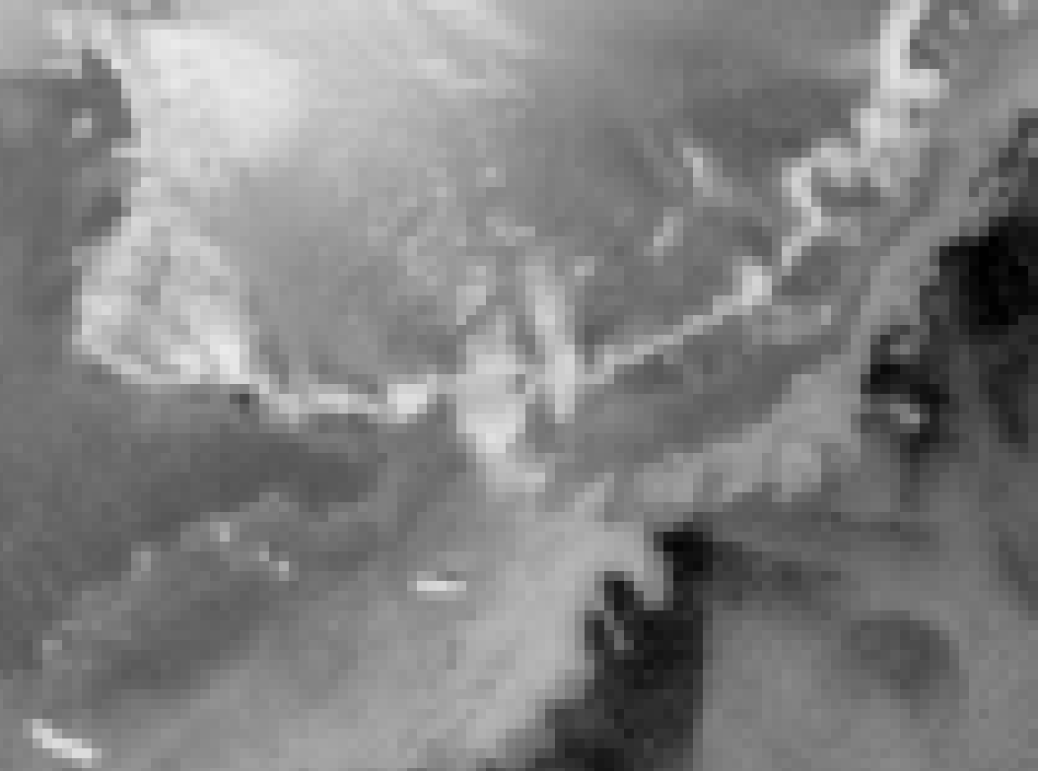
Scatterometer Spatial Resolution Enhancement (BYU David Long)
AVE (2.225 km pixels)
25 km gridded (grd)

Slide 3
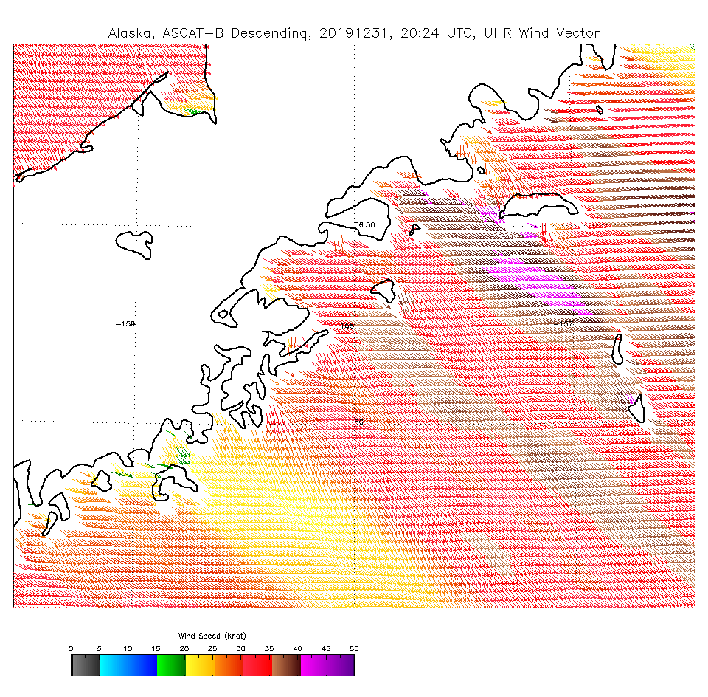
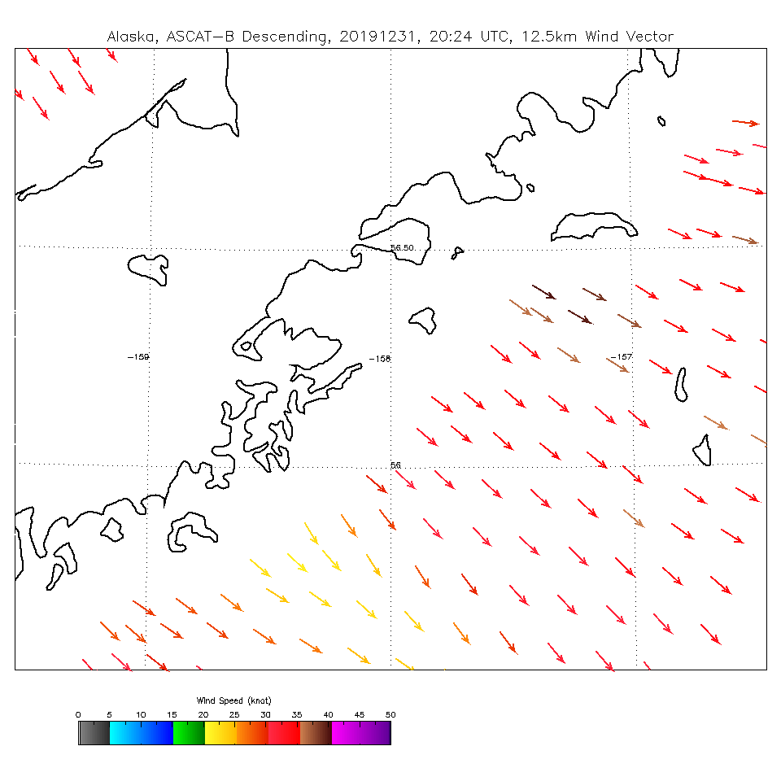
Motivation – Scandies Rose sinking 2019
X
X
Scandies Rose sinking
The National Transportation Safety Board said the vessel’s inaccurate stability instructions combined with heavy lopsided ice accumulation due to wind and sea conditions, which were more extreme than forecasted during the voyage, caused the vessel to sink near Sutwik Island.
Notes:
“Commercial fishing in 2019 was not just one of the most deadly occupations in America, it was the most deadly occupation in America,” said NTSB Chairman Robert Sumwalt during Tuesday morning’s video conference meeting. “Commercial fishing had a fatality rate of 145 fatalities per 100,000 full-time employees. Compare that to the average of all workers, which is 3.5 fatalities per 100,000.”

Slide 4
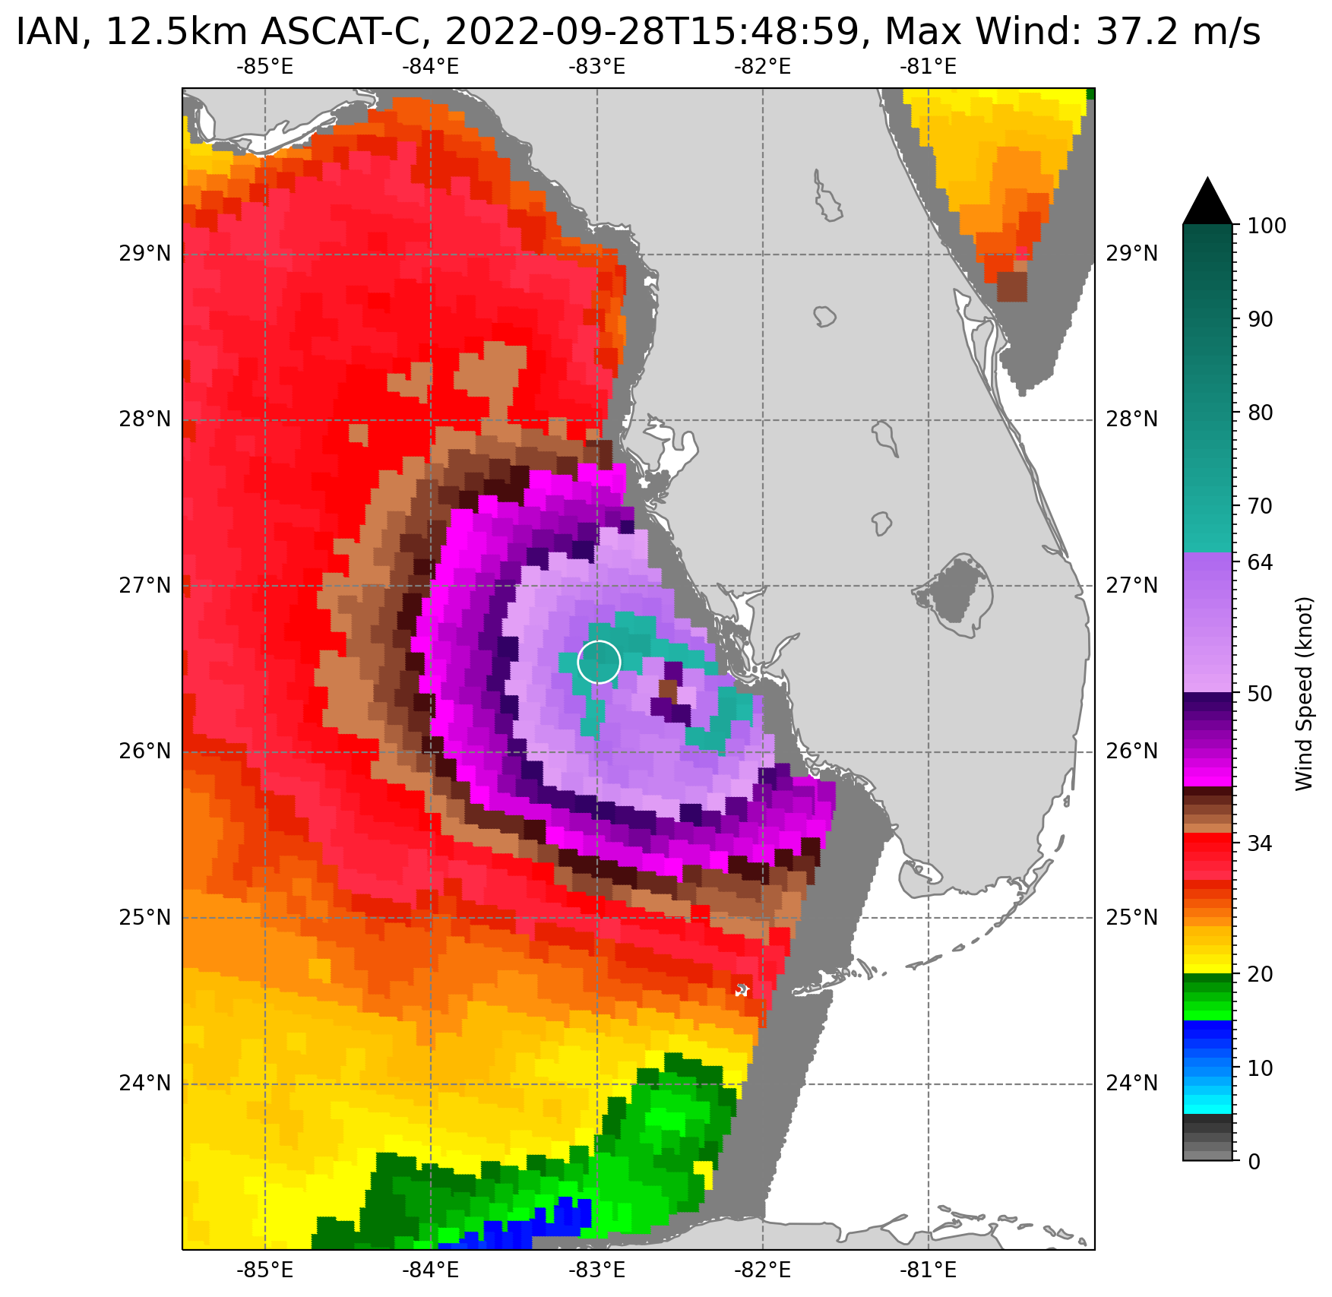
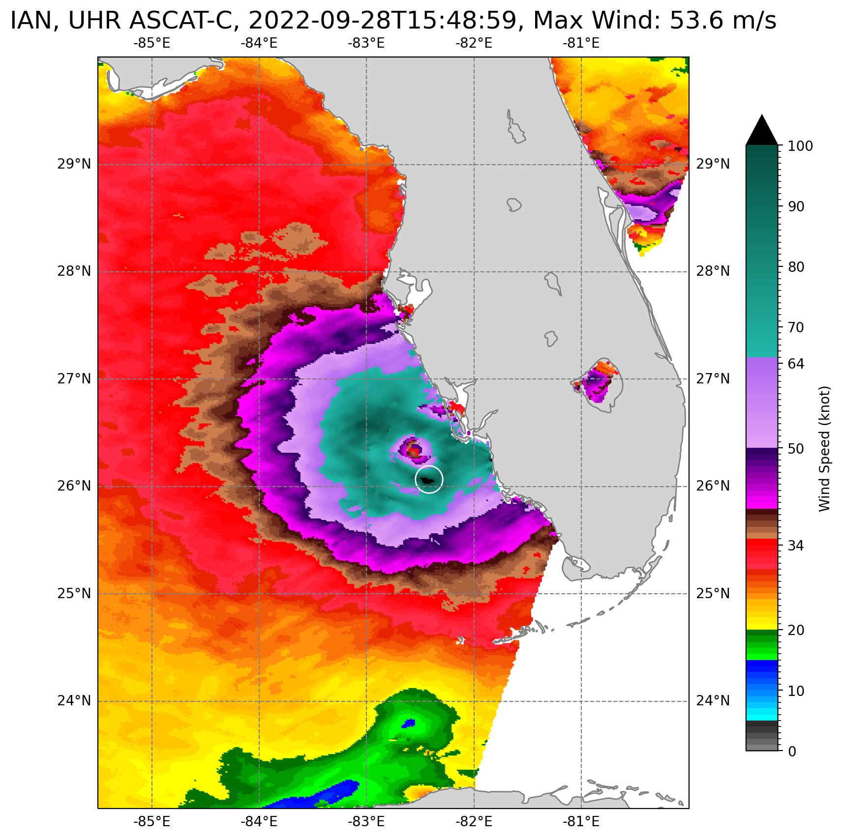
12.5km Standard ASCAT vs. UHR ASCAT
UHR outer swath extended for 75 km wider than the standard product swath
UHR wind reported every 1.5 km grid spacing
UHR winds up to 1 km of the coast vs 5-30 km for the 12.5 km product
UHR high wind retrievals rescaled utilizing SFMR measurements
UHR wind direction ambiguity removal initialized by utilizing the 12.5 km directions
Reveals finer details in wind field but noisier than the original 12.5 km wind product

Slide 5
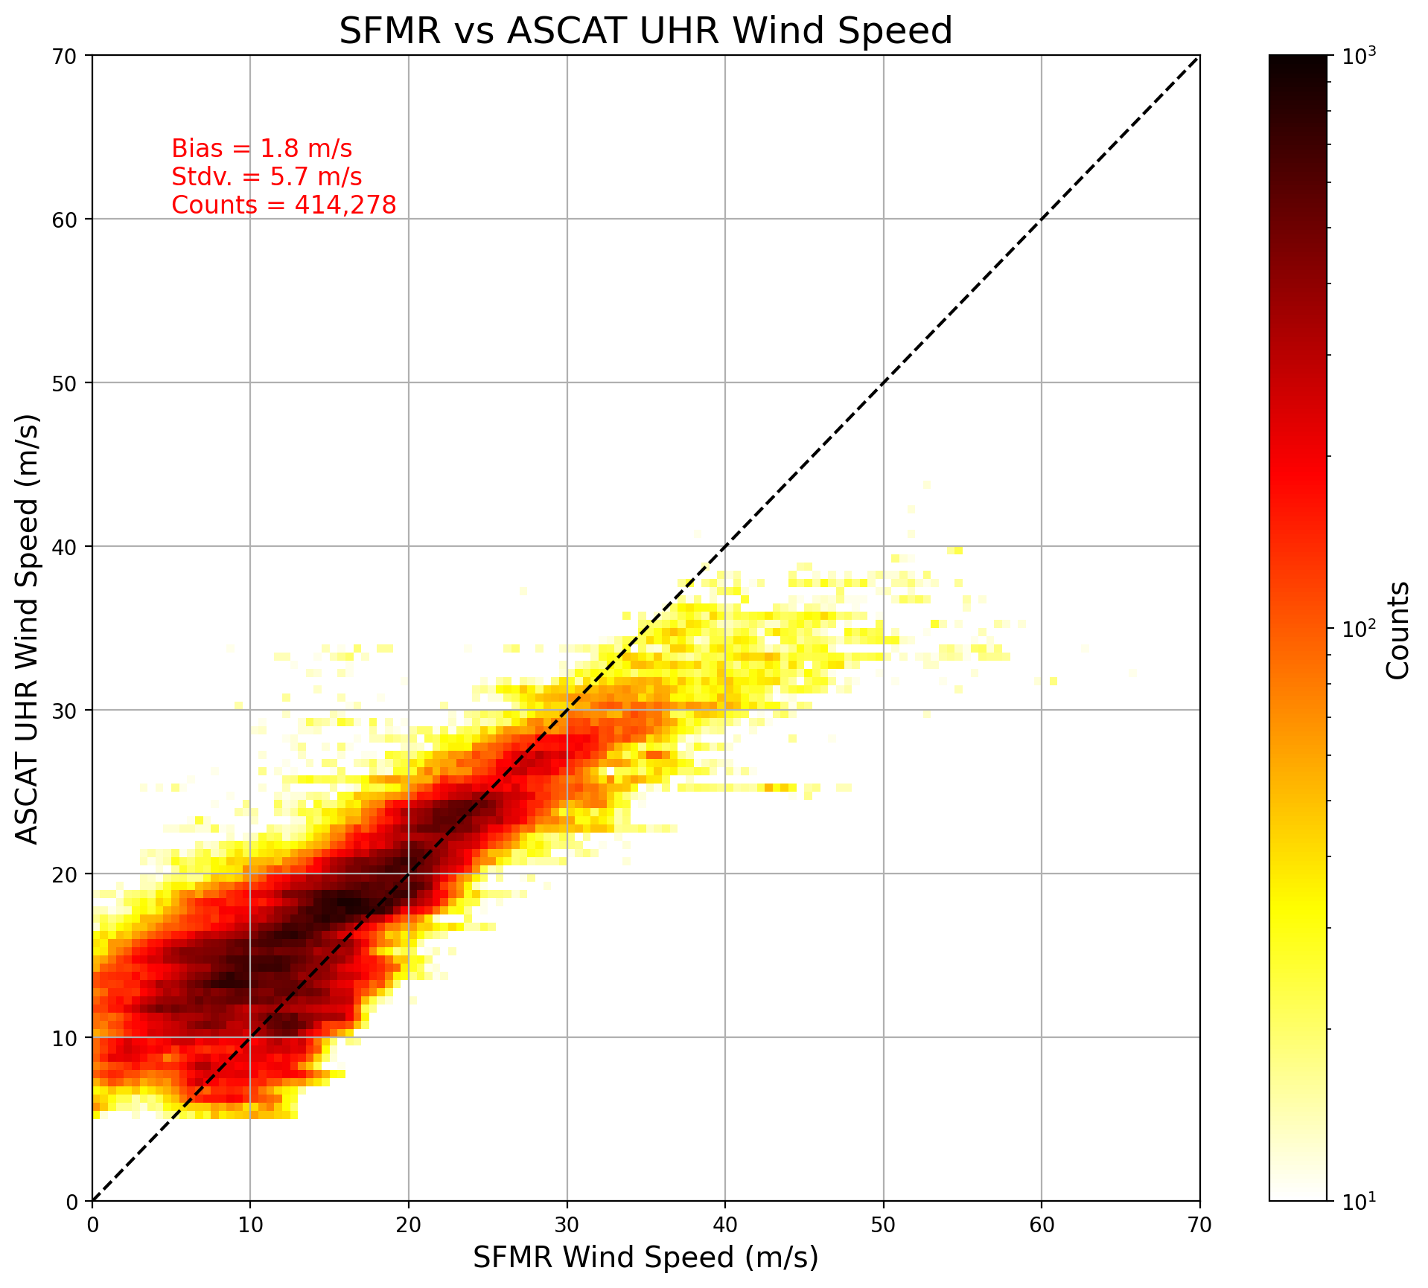
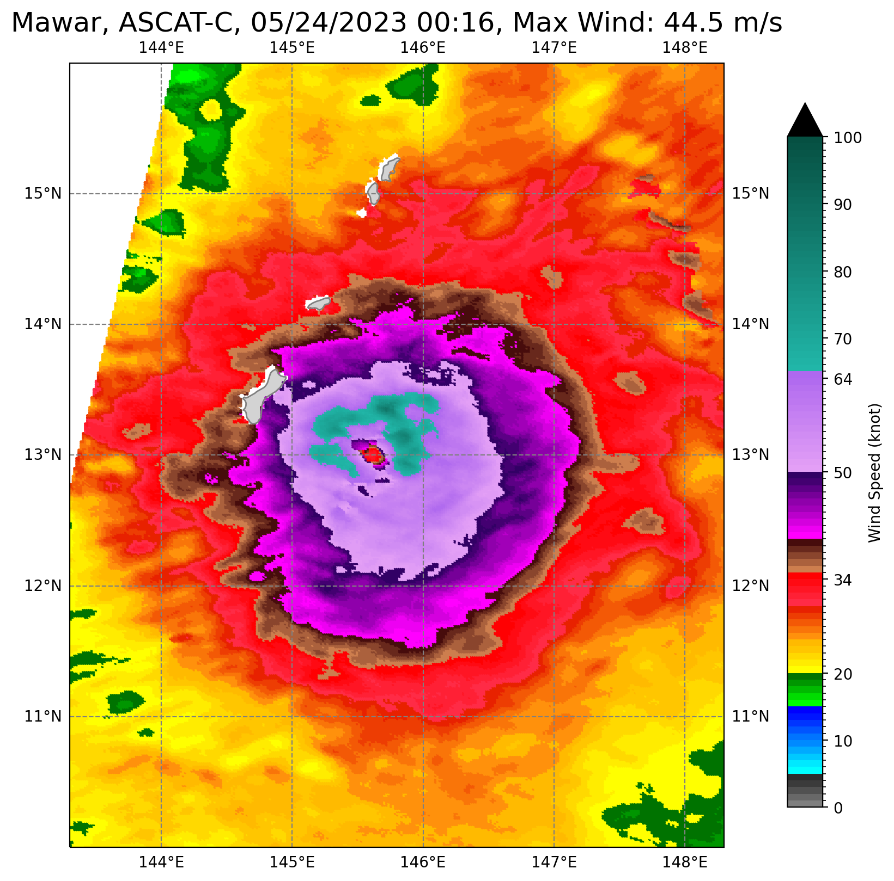

Slide 6
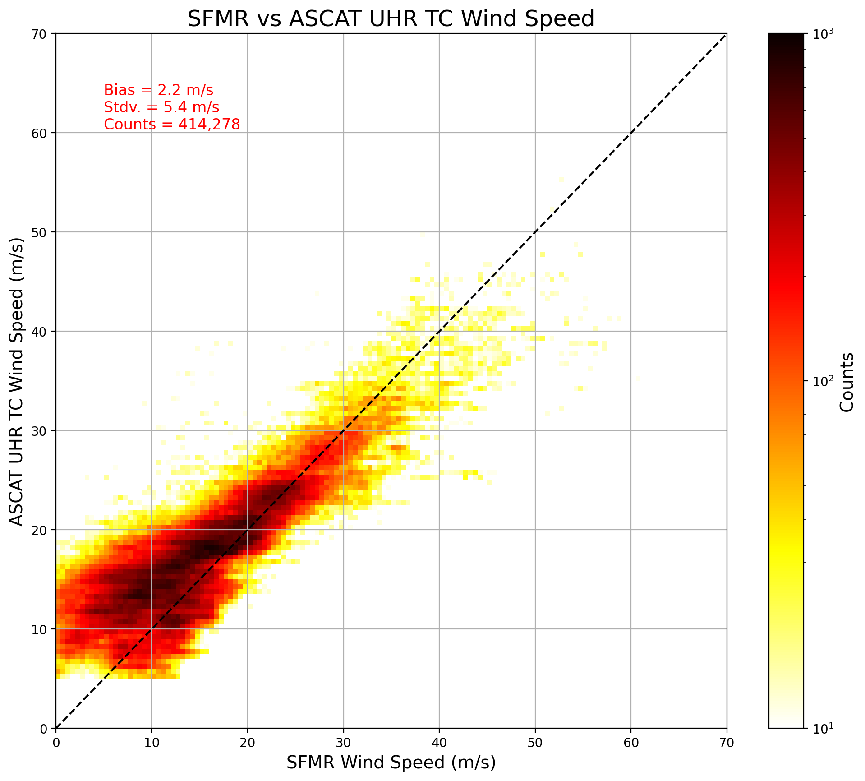
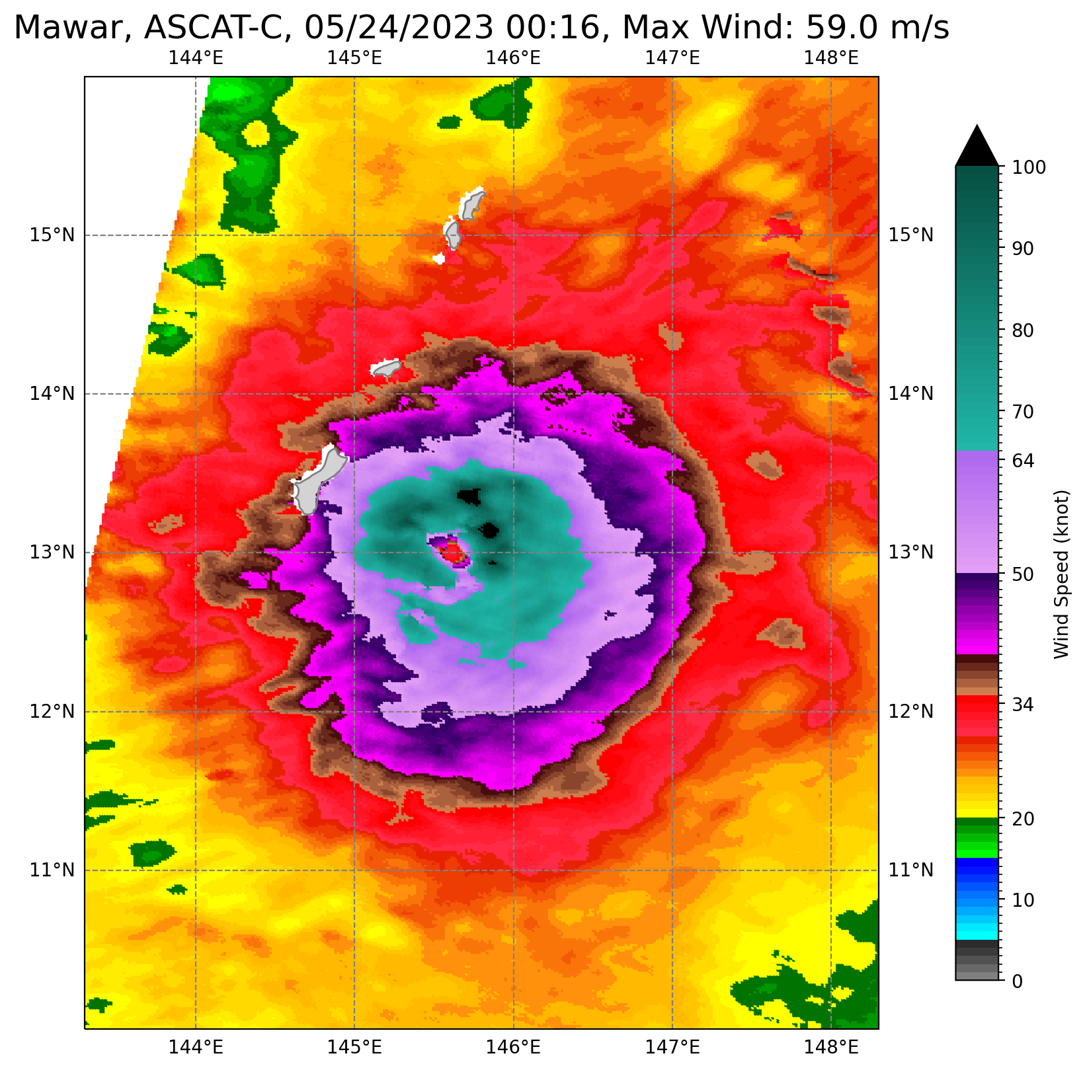
34-knot radii remain unchanged

Slide 7
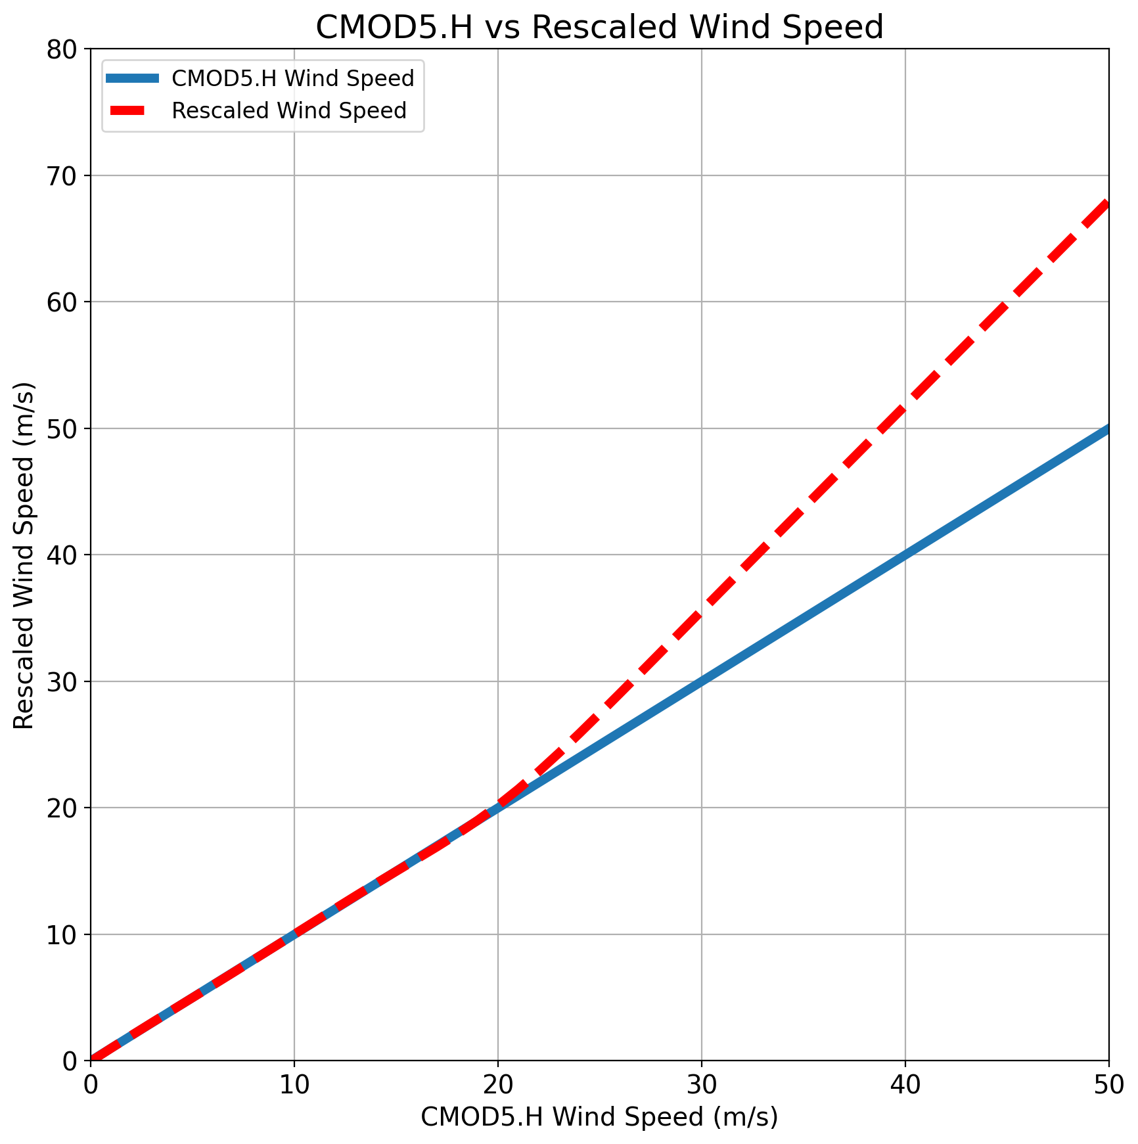

Slide 8
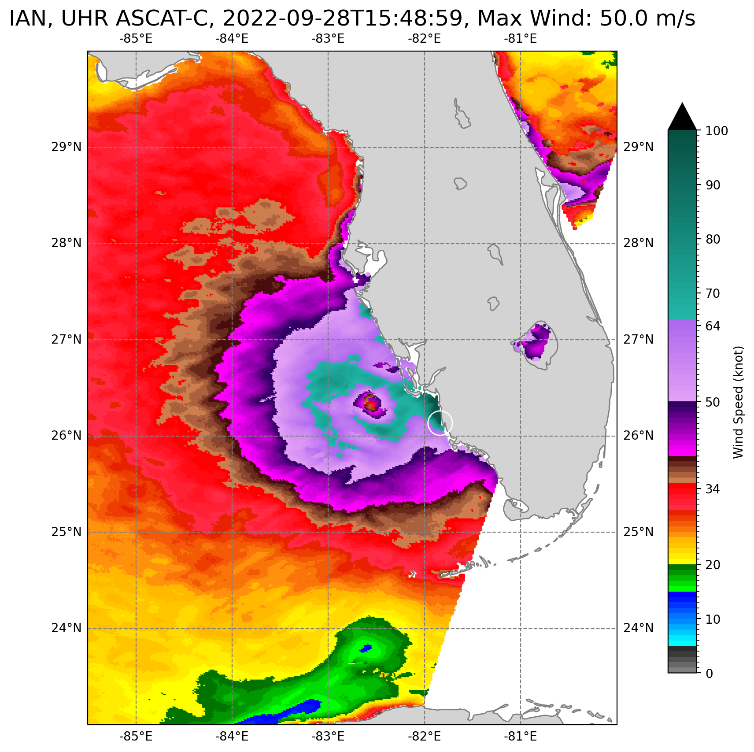
UHR Processing Without Coastal Correction
Maximum Wind 50 m/s

Slide 9
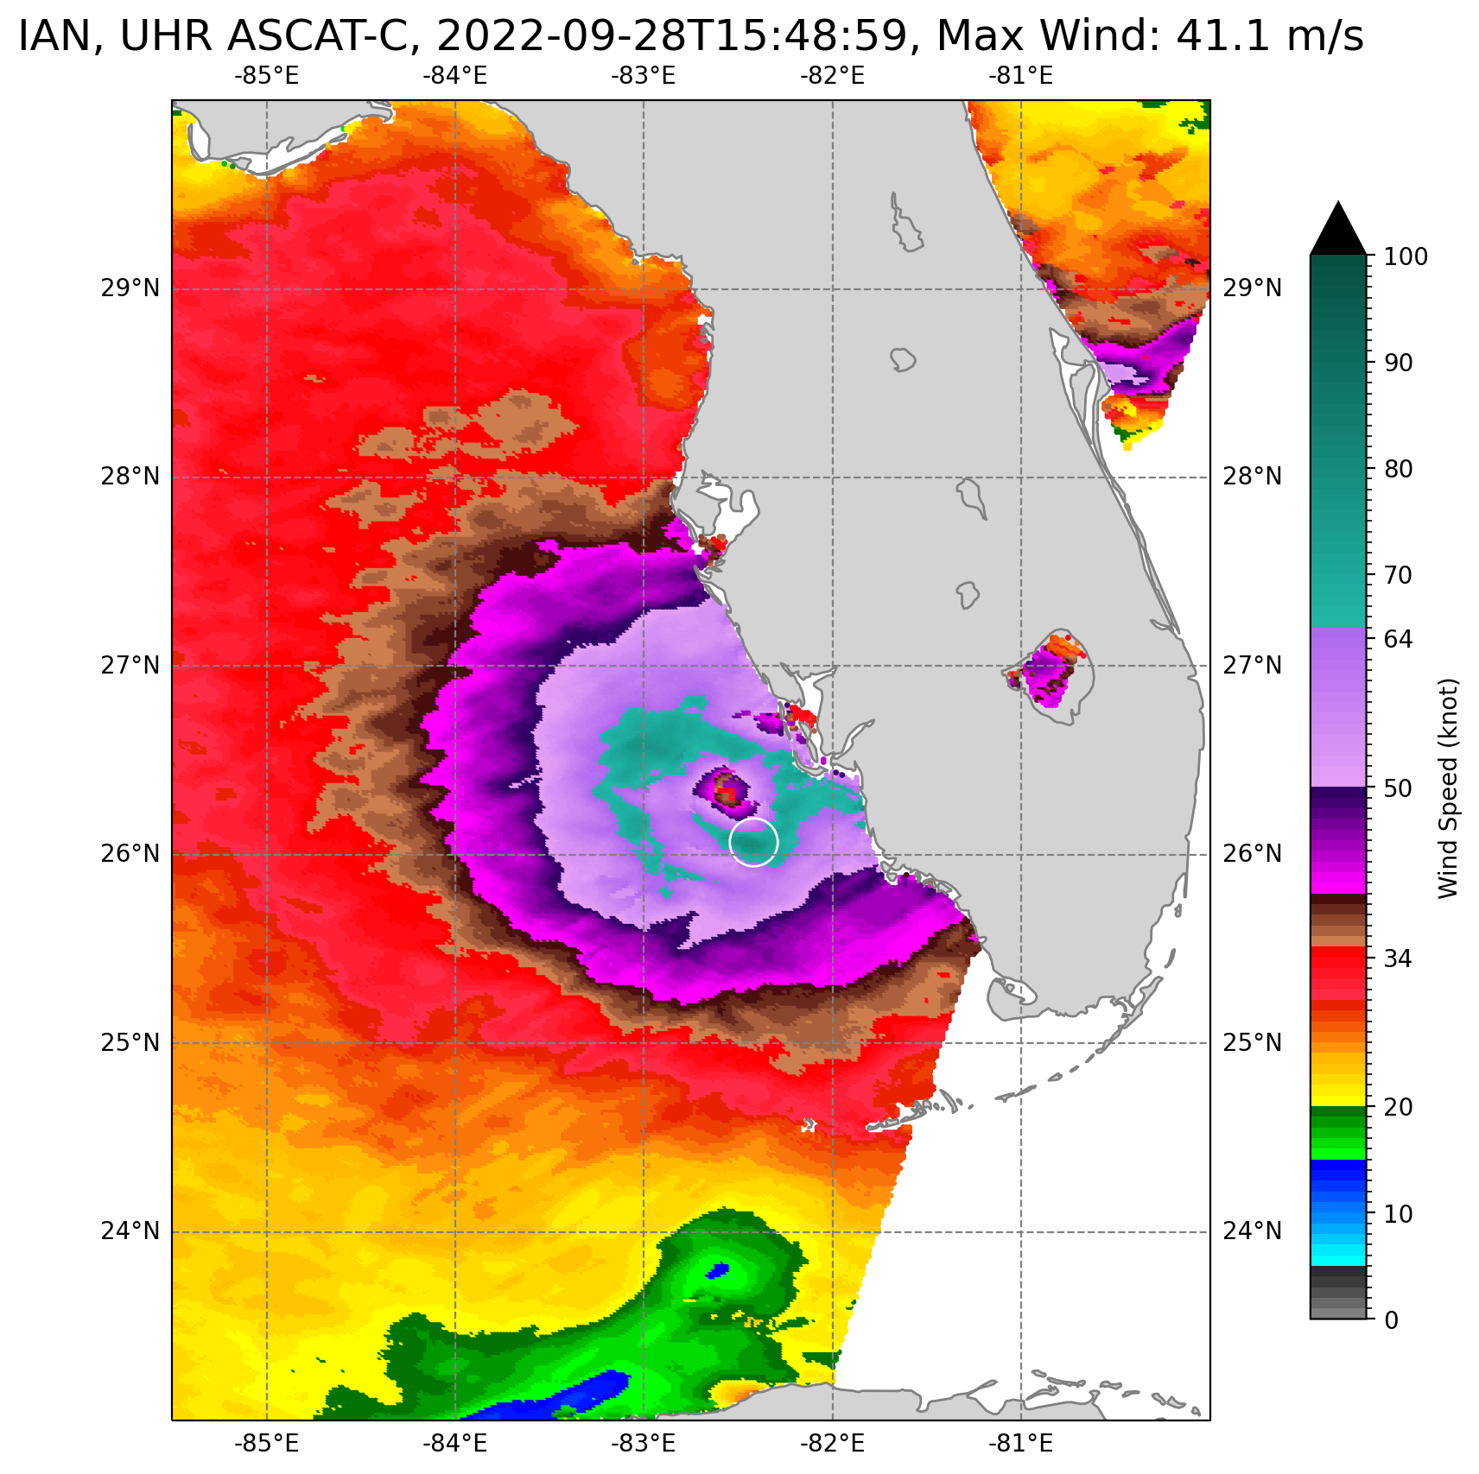
UHR Processing With Coastal Correction
Maximum Wind 41.1 m/s

Slide 10
UHR Processing With Coastal Correction and High Wind GMF
Maximum Wind 53.6 m/s

Slide 11
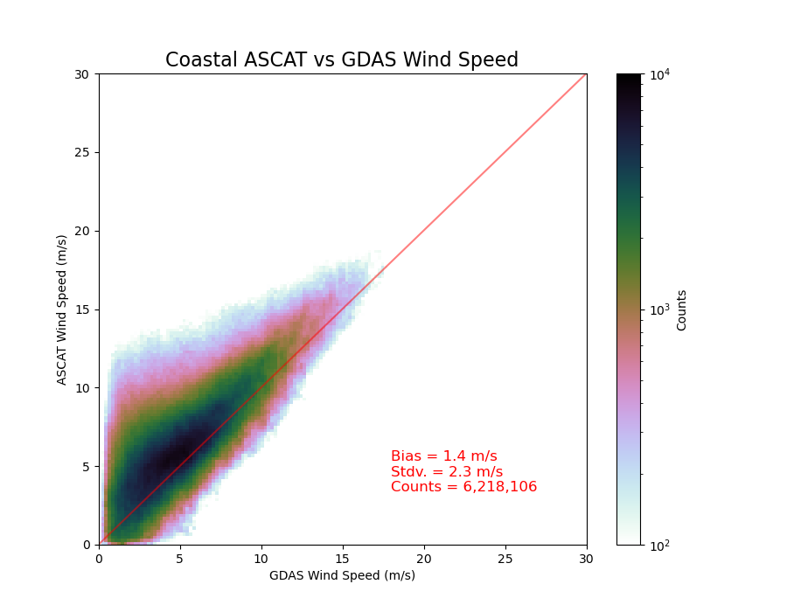
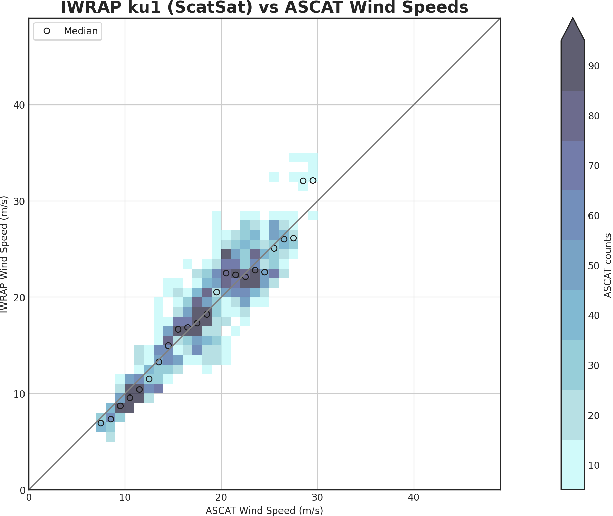
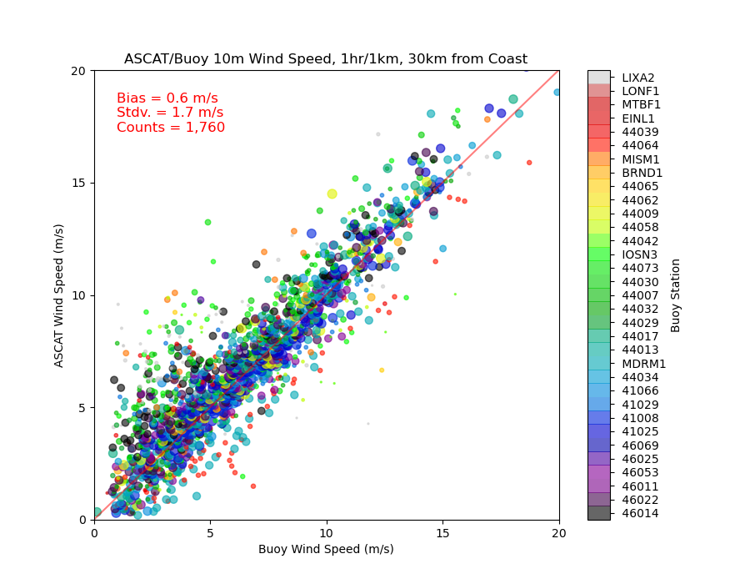
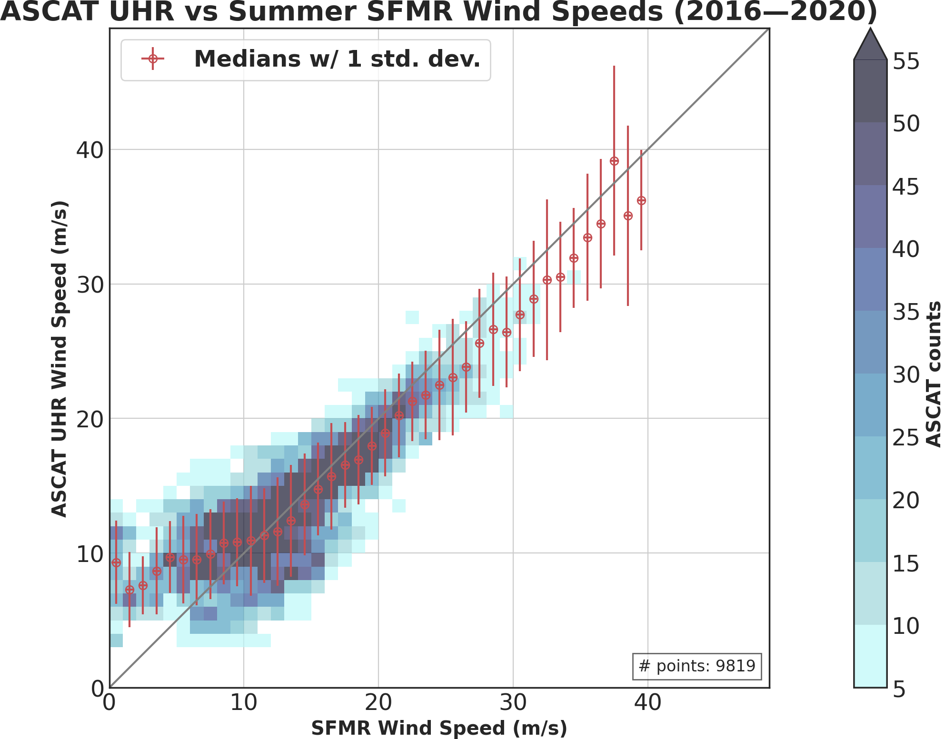
Validation: Model, Buoys, IWRAP, SFMR
NWP
IWRAP
Buoys
SFMR
S. Soisuvarn, Z. Jelenak, P. S. Chang, Q. Zhu and C. G. Shoup, "High-Resolution Coastal Winds From the NOAA Near Real-Time ASCAT Processor," in IEEE Transactions on Geoscience and Remote Sensing, vol. 61, pp. 1-12, 2023, Art no. 5208612, doi: 10.1109/TGRS.2023.3279764

Slide 12
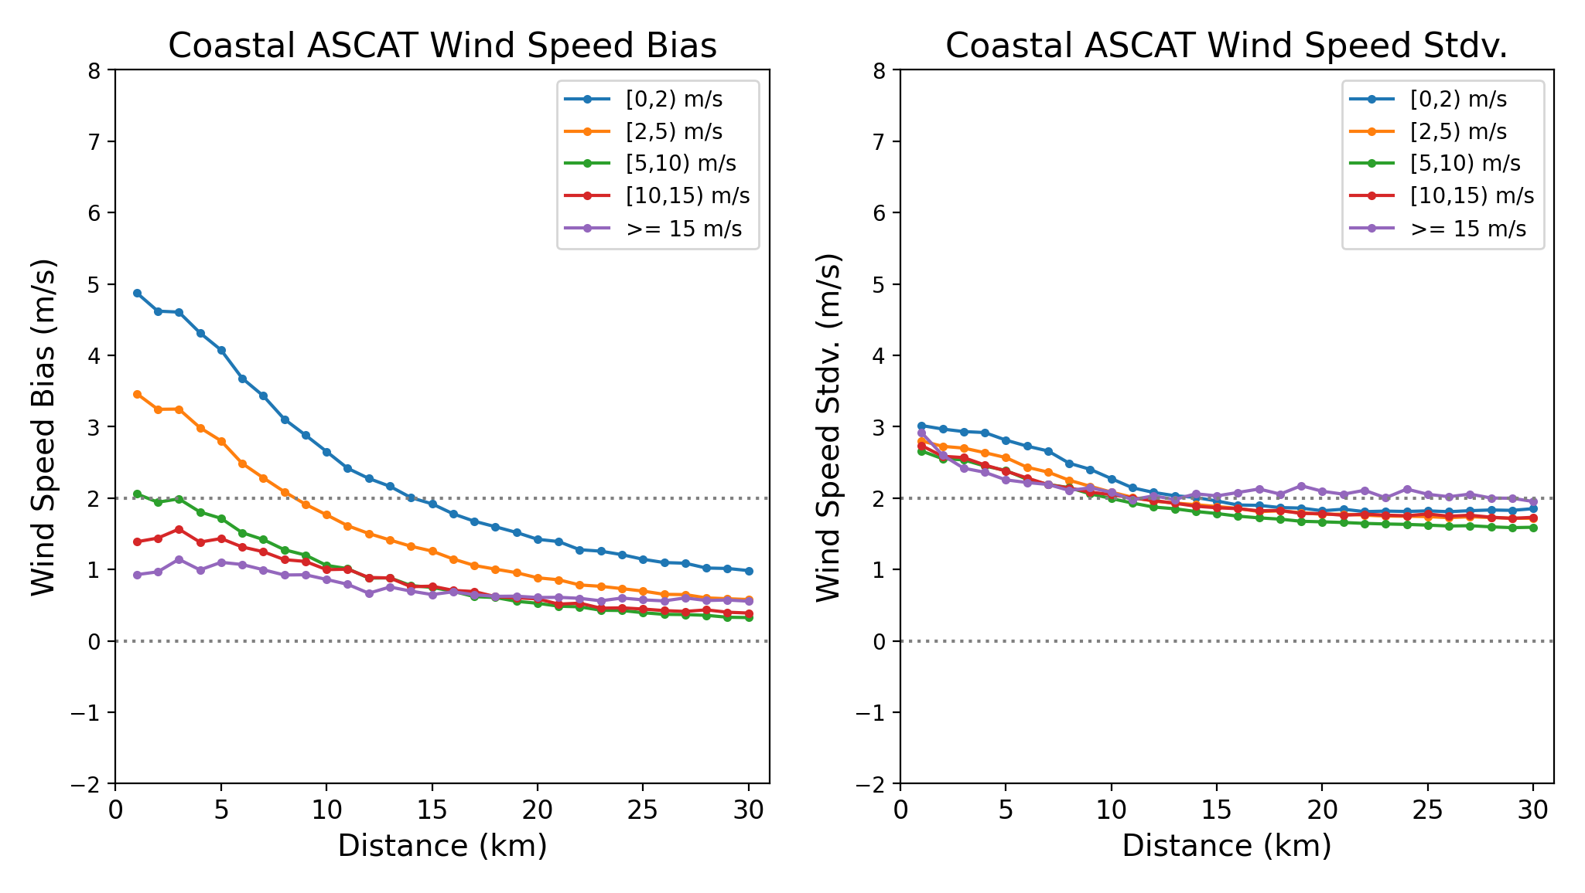
Coastal Winds Performance

Slide 13
Center Fixes

Slide 14
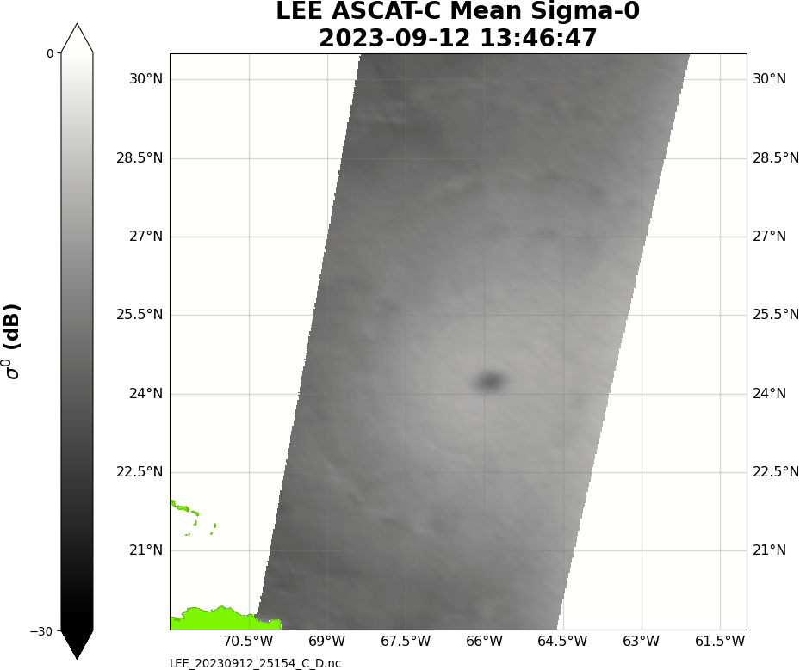
Storm Circulation and Center Determination
Left swath
Right swath
45°
90°
135°
550 km
550 km

Slide 15
Example: Hurricane Lee 09/09/2023 – cont.
Forward Look Sigma0
Aft Look
Sigma0
_
=
The intersection of the two red lines is the storm center

Slide 16
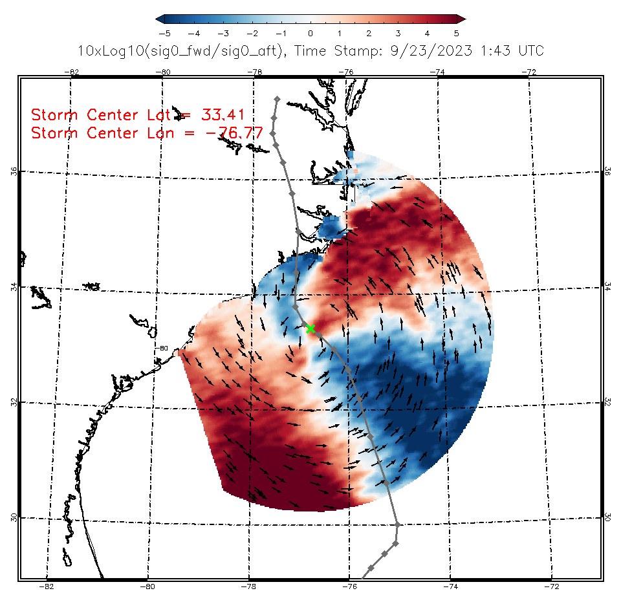
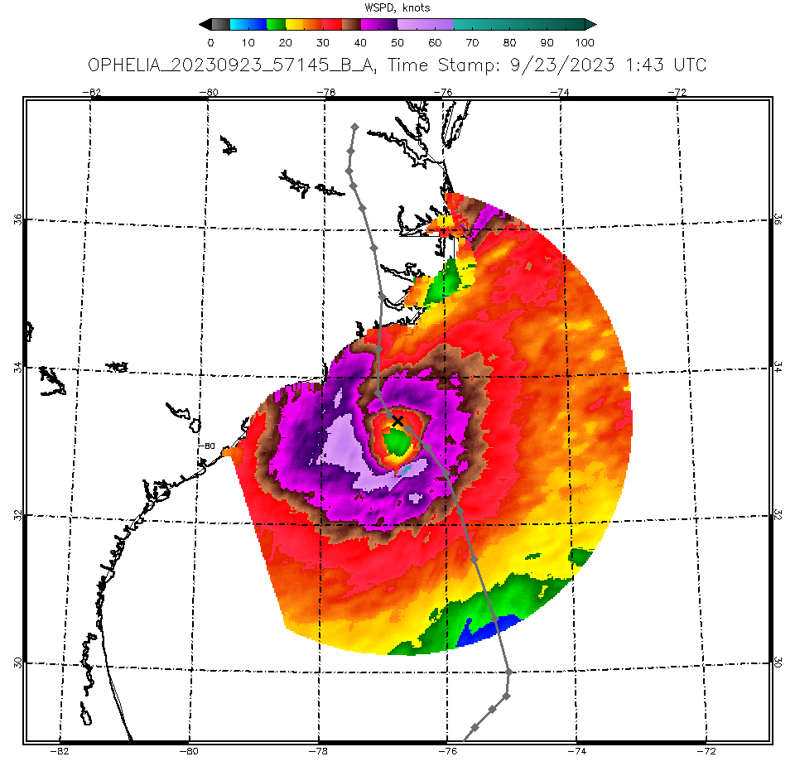
Ophelia

Slide 17
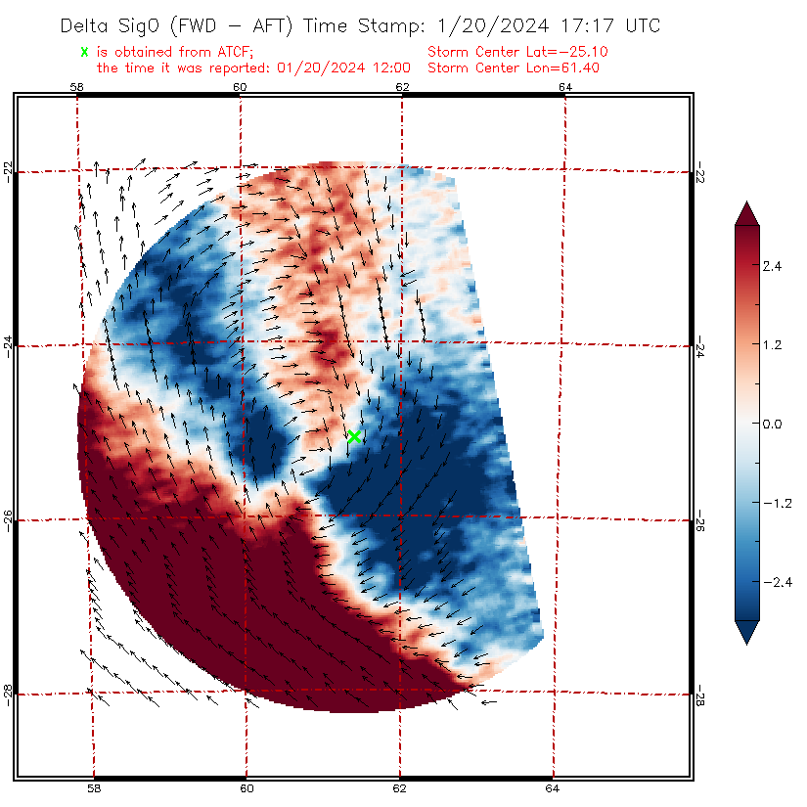
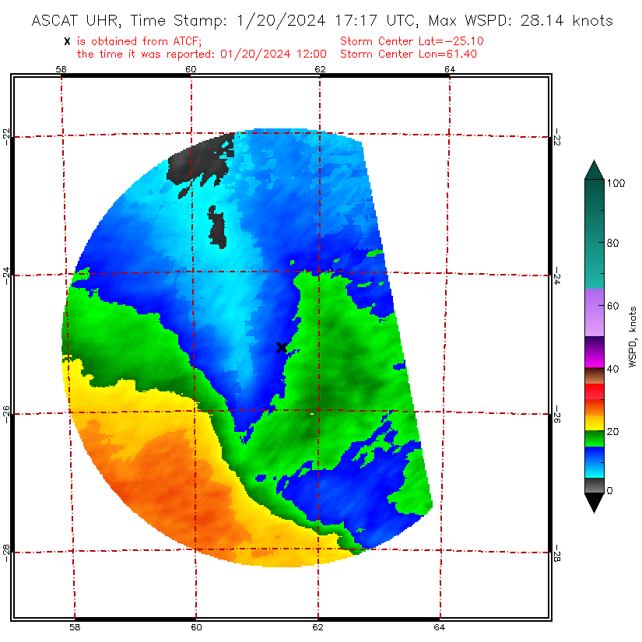
Belal

Slide 18
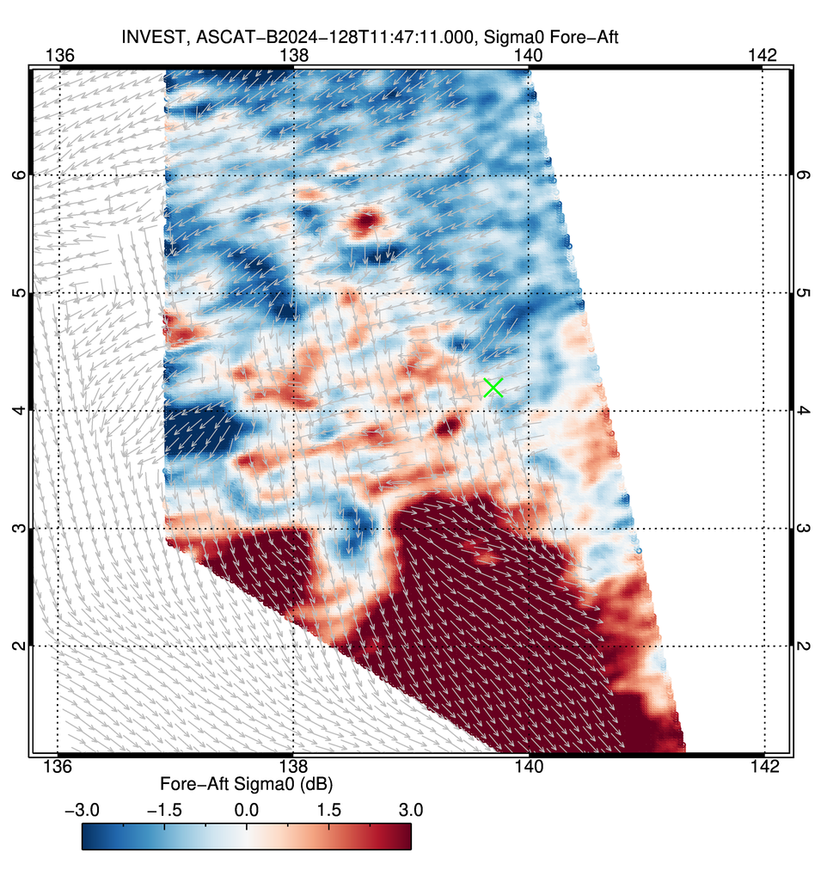
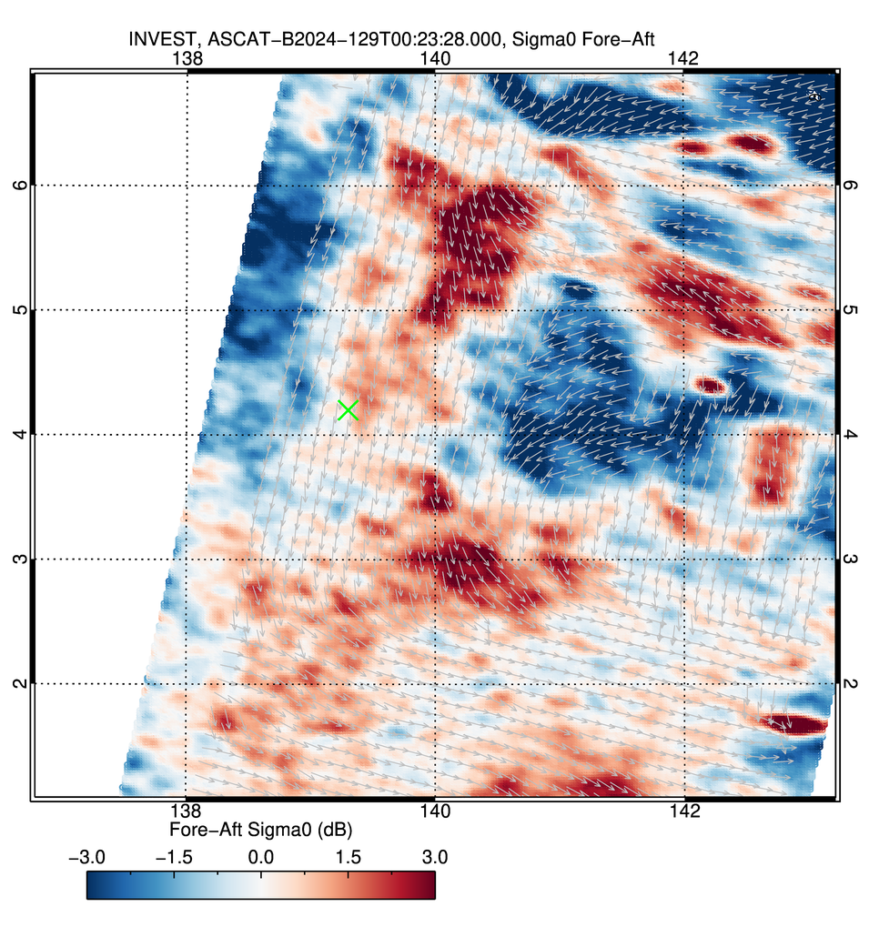
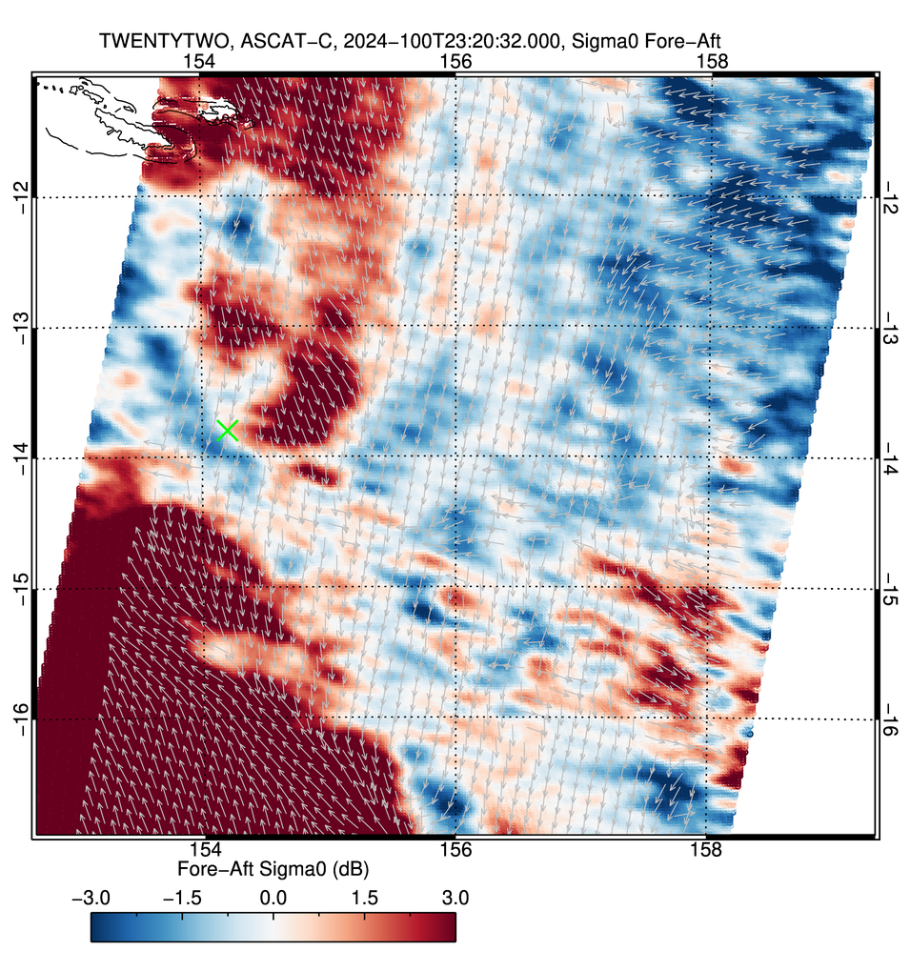
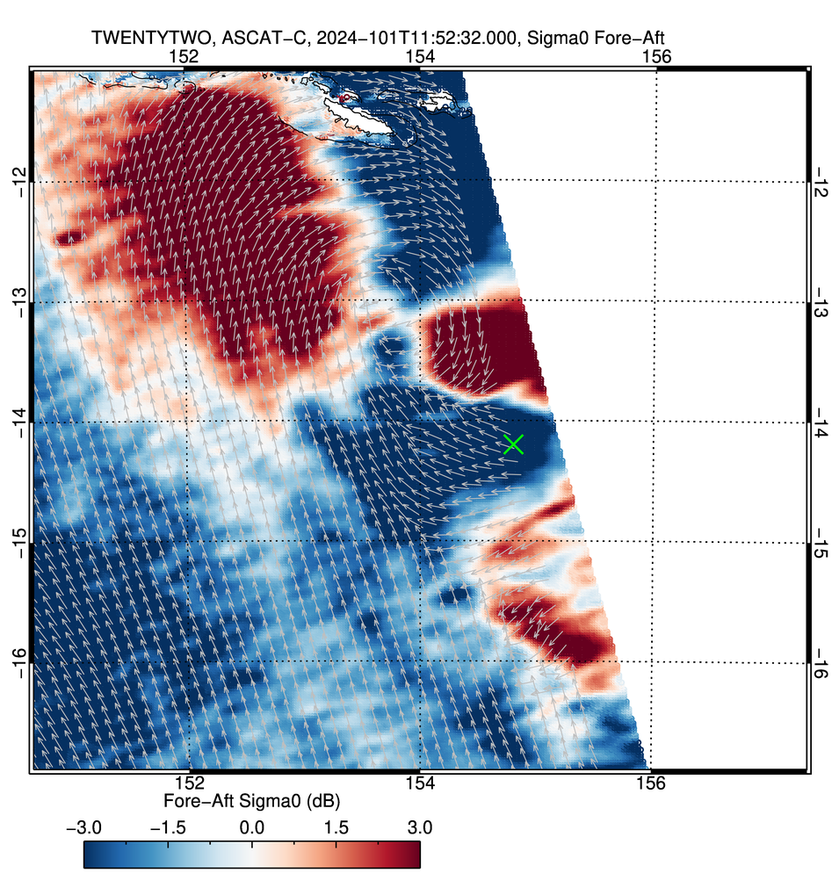
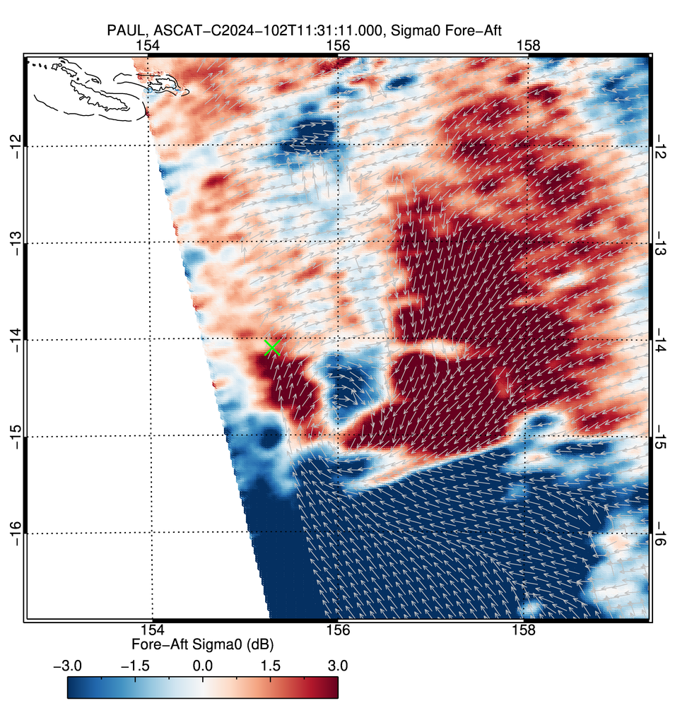
x
x
x
No circulation
but more organized system
No circulation
Still no closed circulation
Even more organized
Distorted closed circulation
x
x
Closed circulation

Slide 19
Max Wind Determination

Slide 20
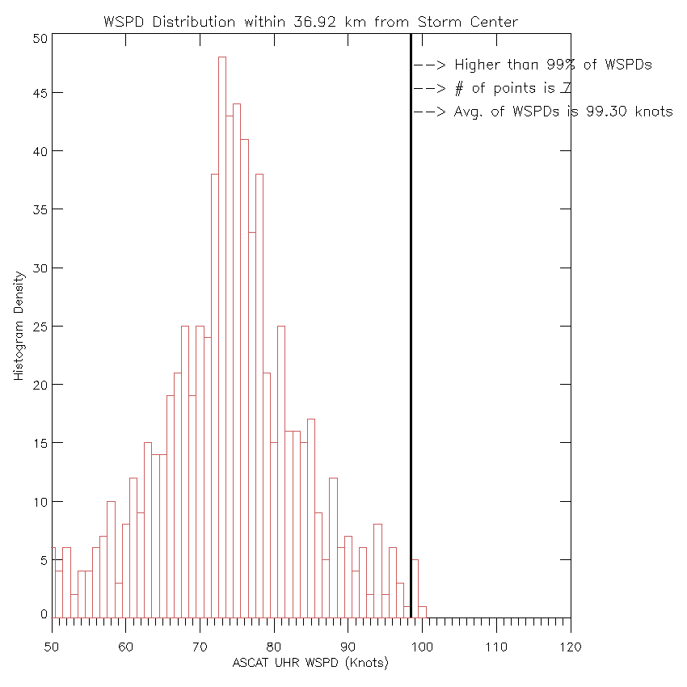
MAX Wind Determination
Determine radius on max winds in all 4 quadrants
Determine wind speed distribution within the largest radius
Determine winds within 85, 90, 95 and 99 percentile of the distribution
Check for consistencies
Check location within swath
99%
85%
90%
95%

Slide 21
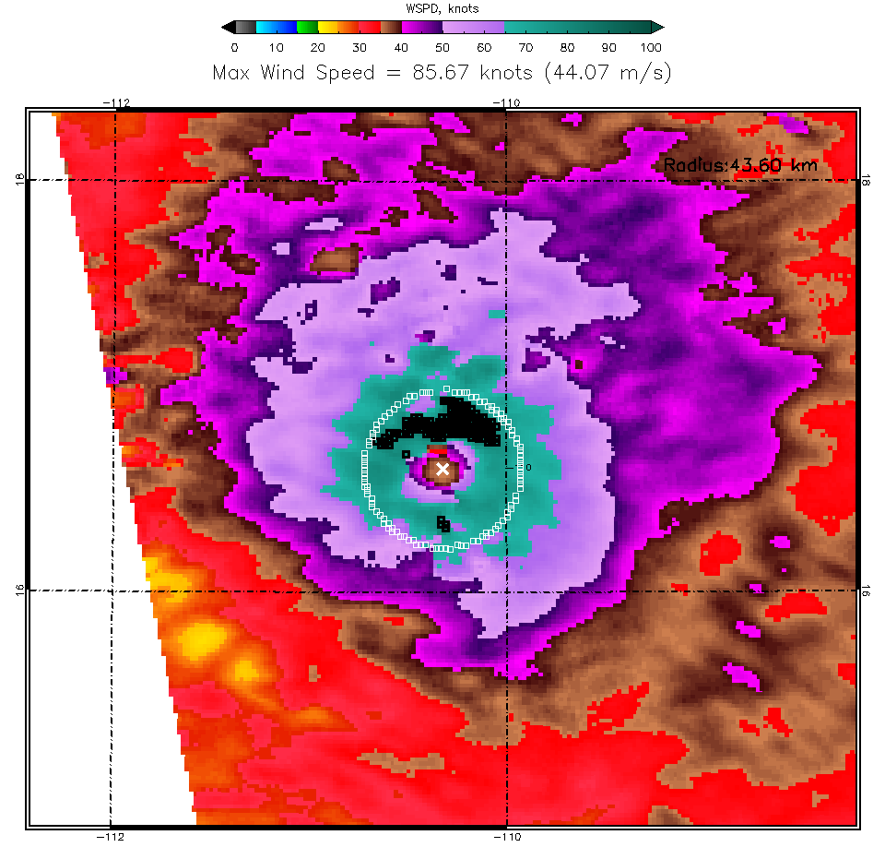
85%
Black pixels represent WVCs from which the mean max wind was calculated
90%
95%
99%

Slide 22
Maximum Wind
Maximum wind was calculated as mean of the 85, 90, 95 and 99 percentile of winds within maximum of RMW within four quadrants
Using 95% or higher yields cat 3 winds
Using lower % results in cat 2 winds
Use in combination with other data to determine max
 | 85% [kts] | 90% [kts] | 95% [kts] | 99% [kts] # number of WVC
ASCAT-B 4:05Z | 88.2 | 90 | 95 | 98.89 #7
ASCAT-C 4:58Z | 86 | 90 | 94 | 99.25 #7
ASCAT-B 16:36Z | 81 | 83 | 85.6 | 88.25 #12
ASCAT-C 17:28Z | 86 | 90 | 94.4 | 98.75 #15

Slide 23
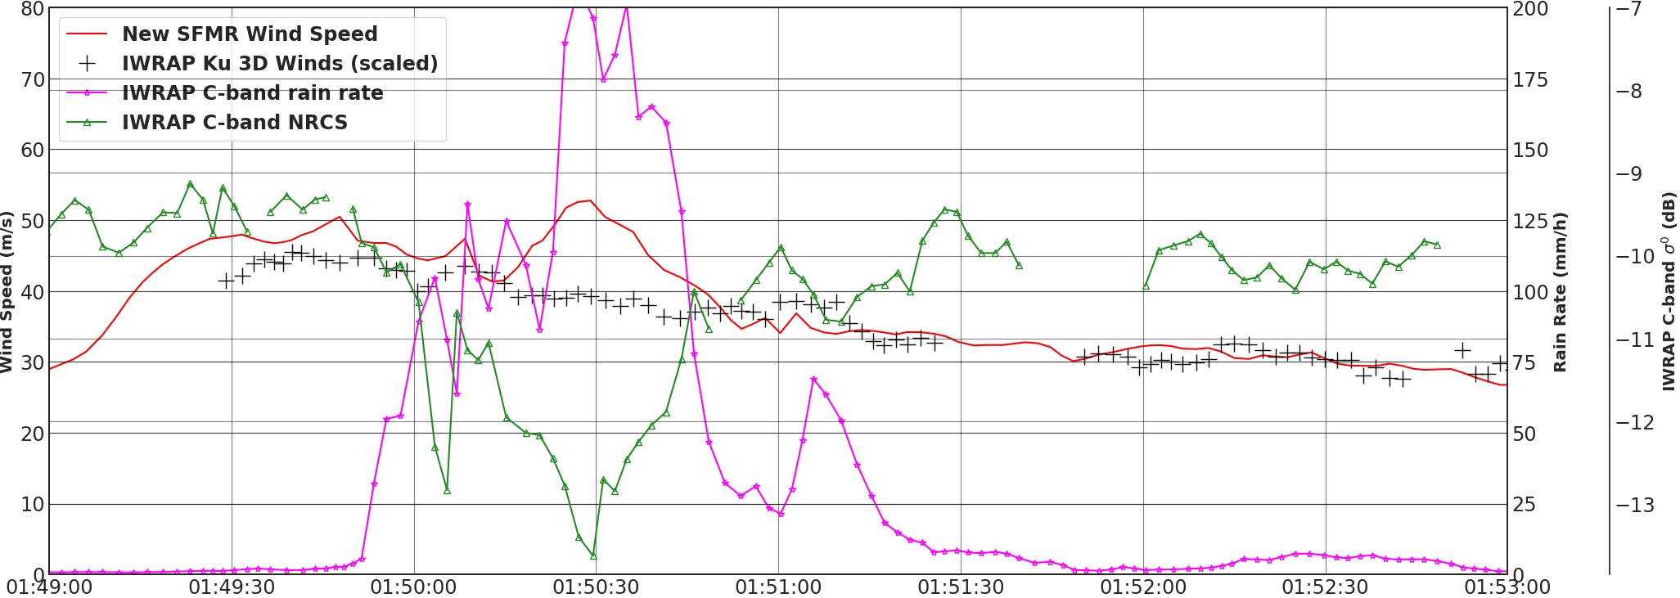
Important to Remember: C-band is Attenuated in Rain

Slide 24
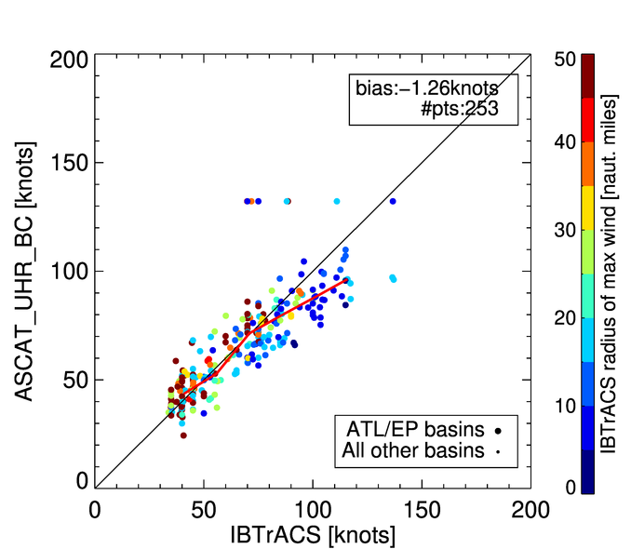
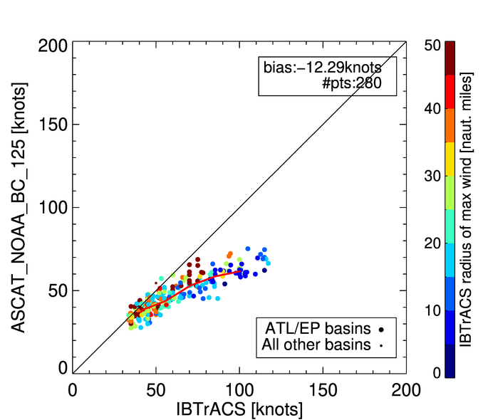
Max Wind Determination (95%) vs Best Track
ASCAT UHR
ASCAT NOAA 12.5

Slide 25
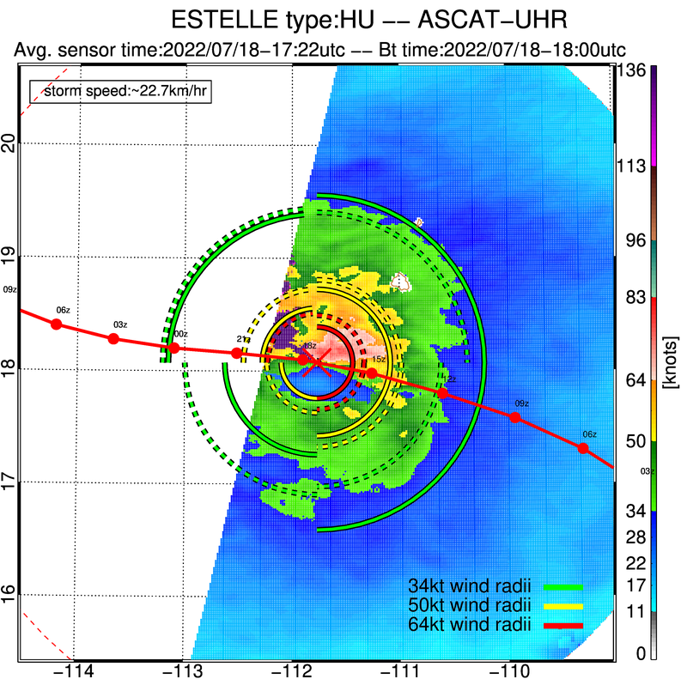

Slide 26
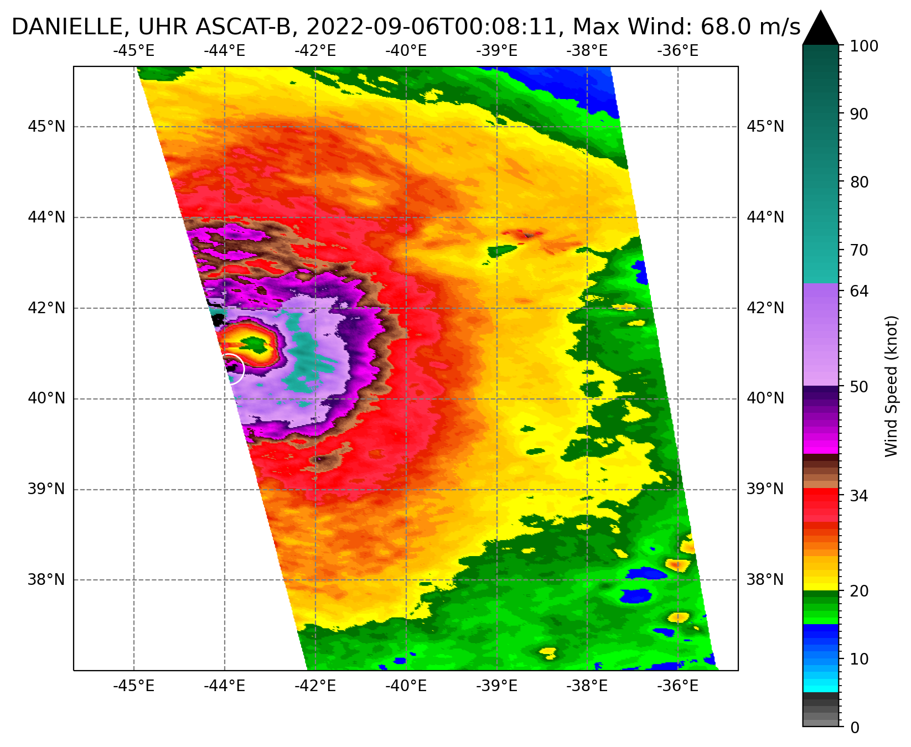
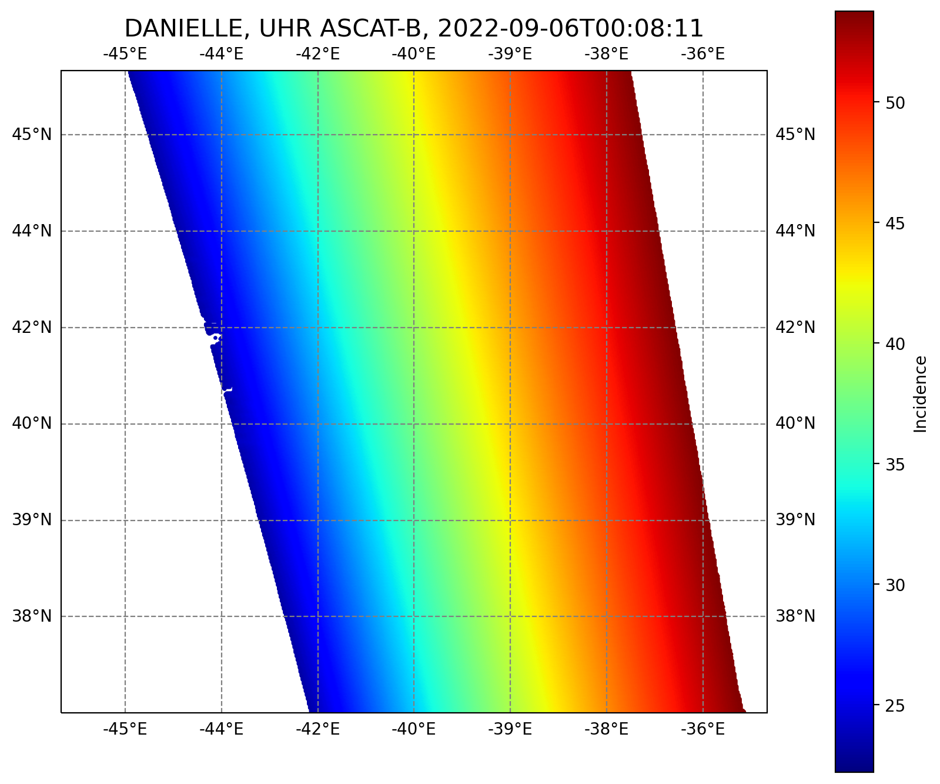
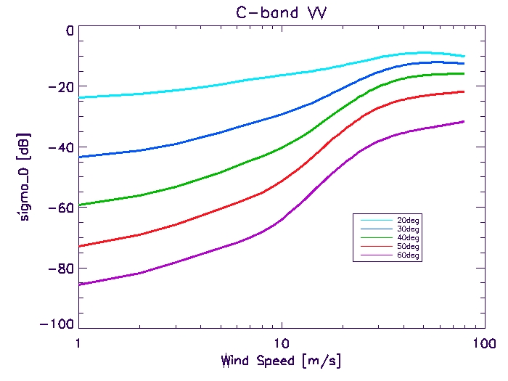
Edge Issues

Slide 27
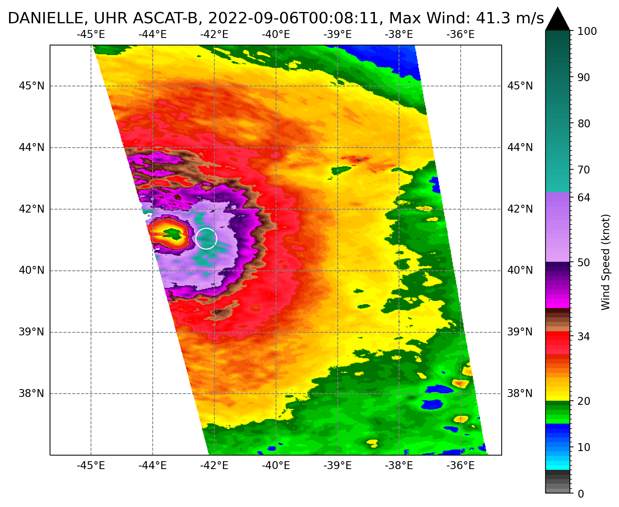
All winds above 30m/s with Mid Beam Incidence angle <25° should be omitted from Max Wind and Wind Radii Estimations
Left swath
Right swath
45°
90°
135°
550 km
550 km

Slide 28
Wind Radii Determination

Slide 29
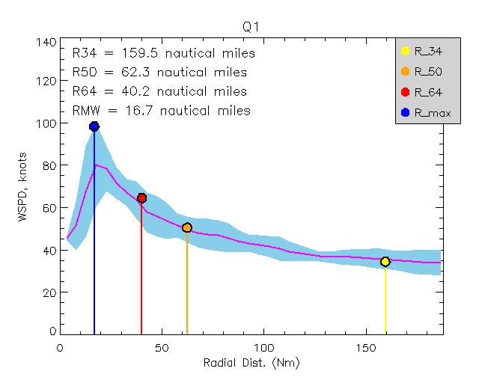
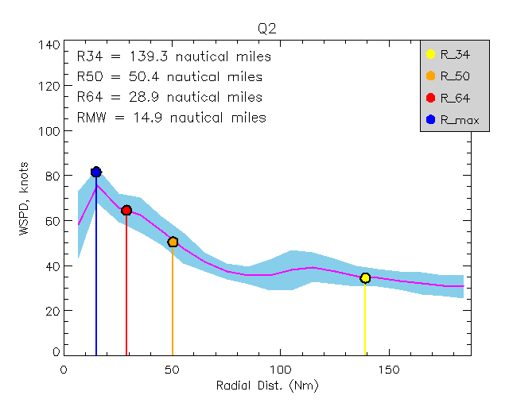
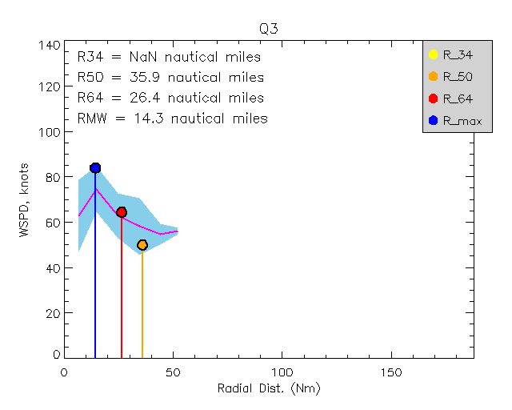
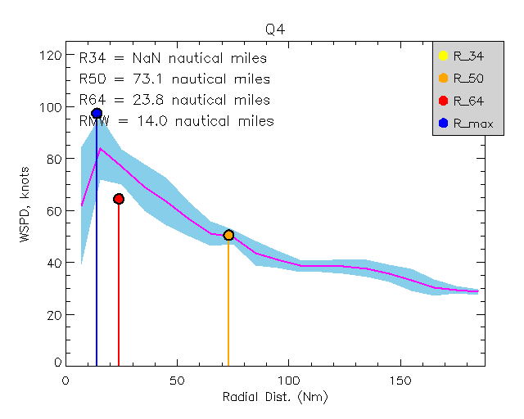
Analyzed Wind Radii @4:05z 08/18/2023
New UHR Products – In Testing/Validation Phase

Slide 30
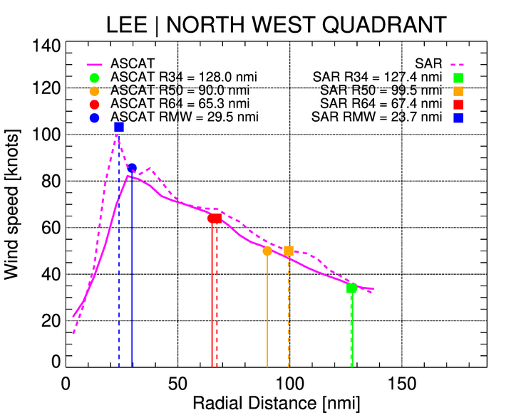
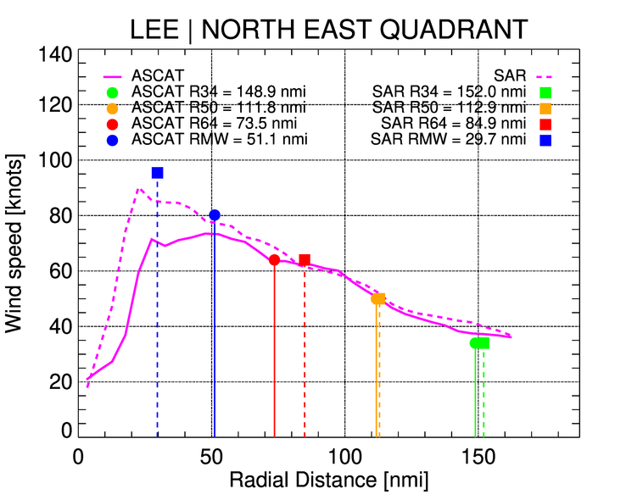
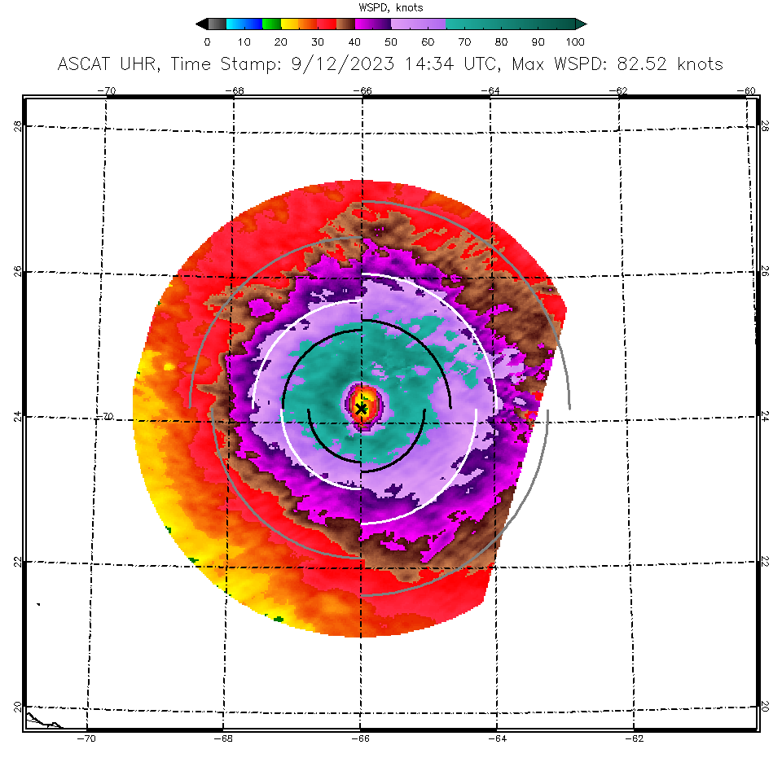
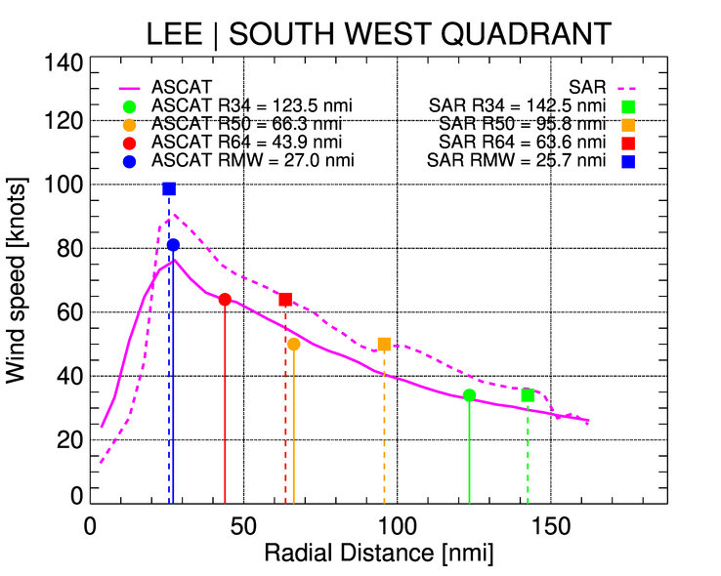
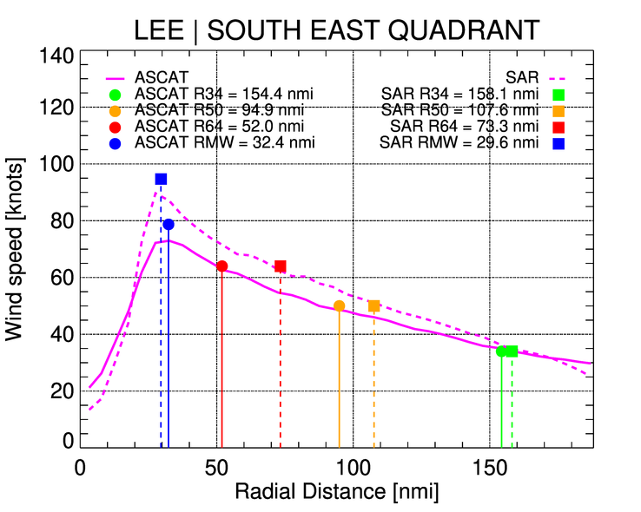
LEE case study
SAR time:2023/09/12-10:13 | ASCAT time:2023/09/12-14:34 (4hr+ time diff.)

Slide 31
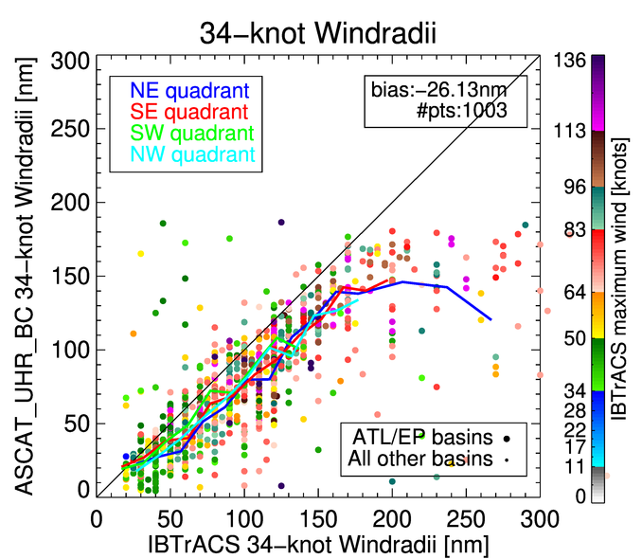
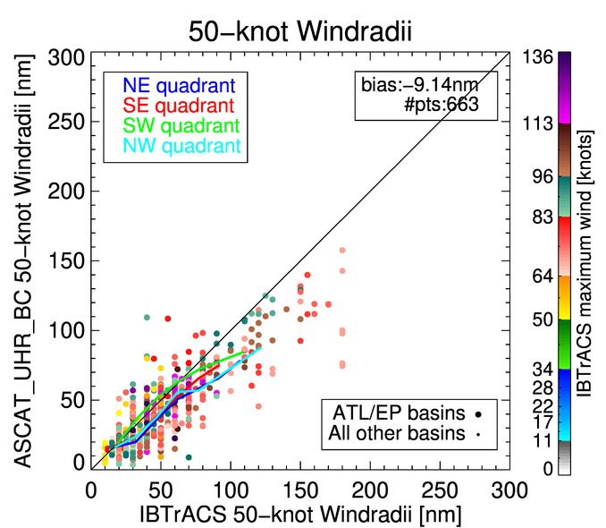
34kts
50kts
64kts

Slide 32
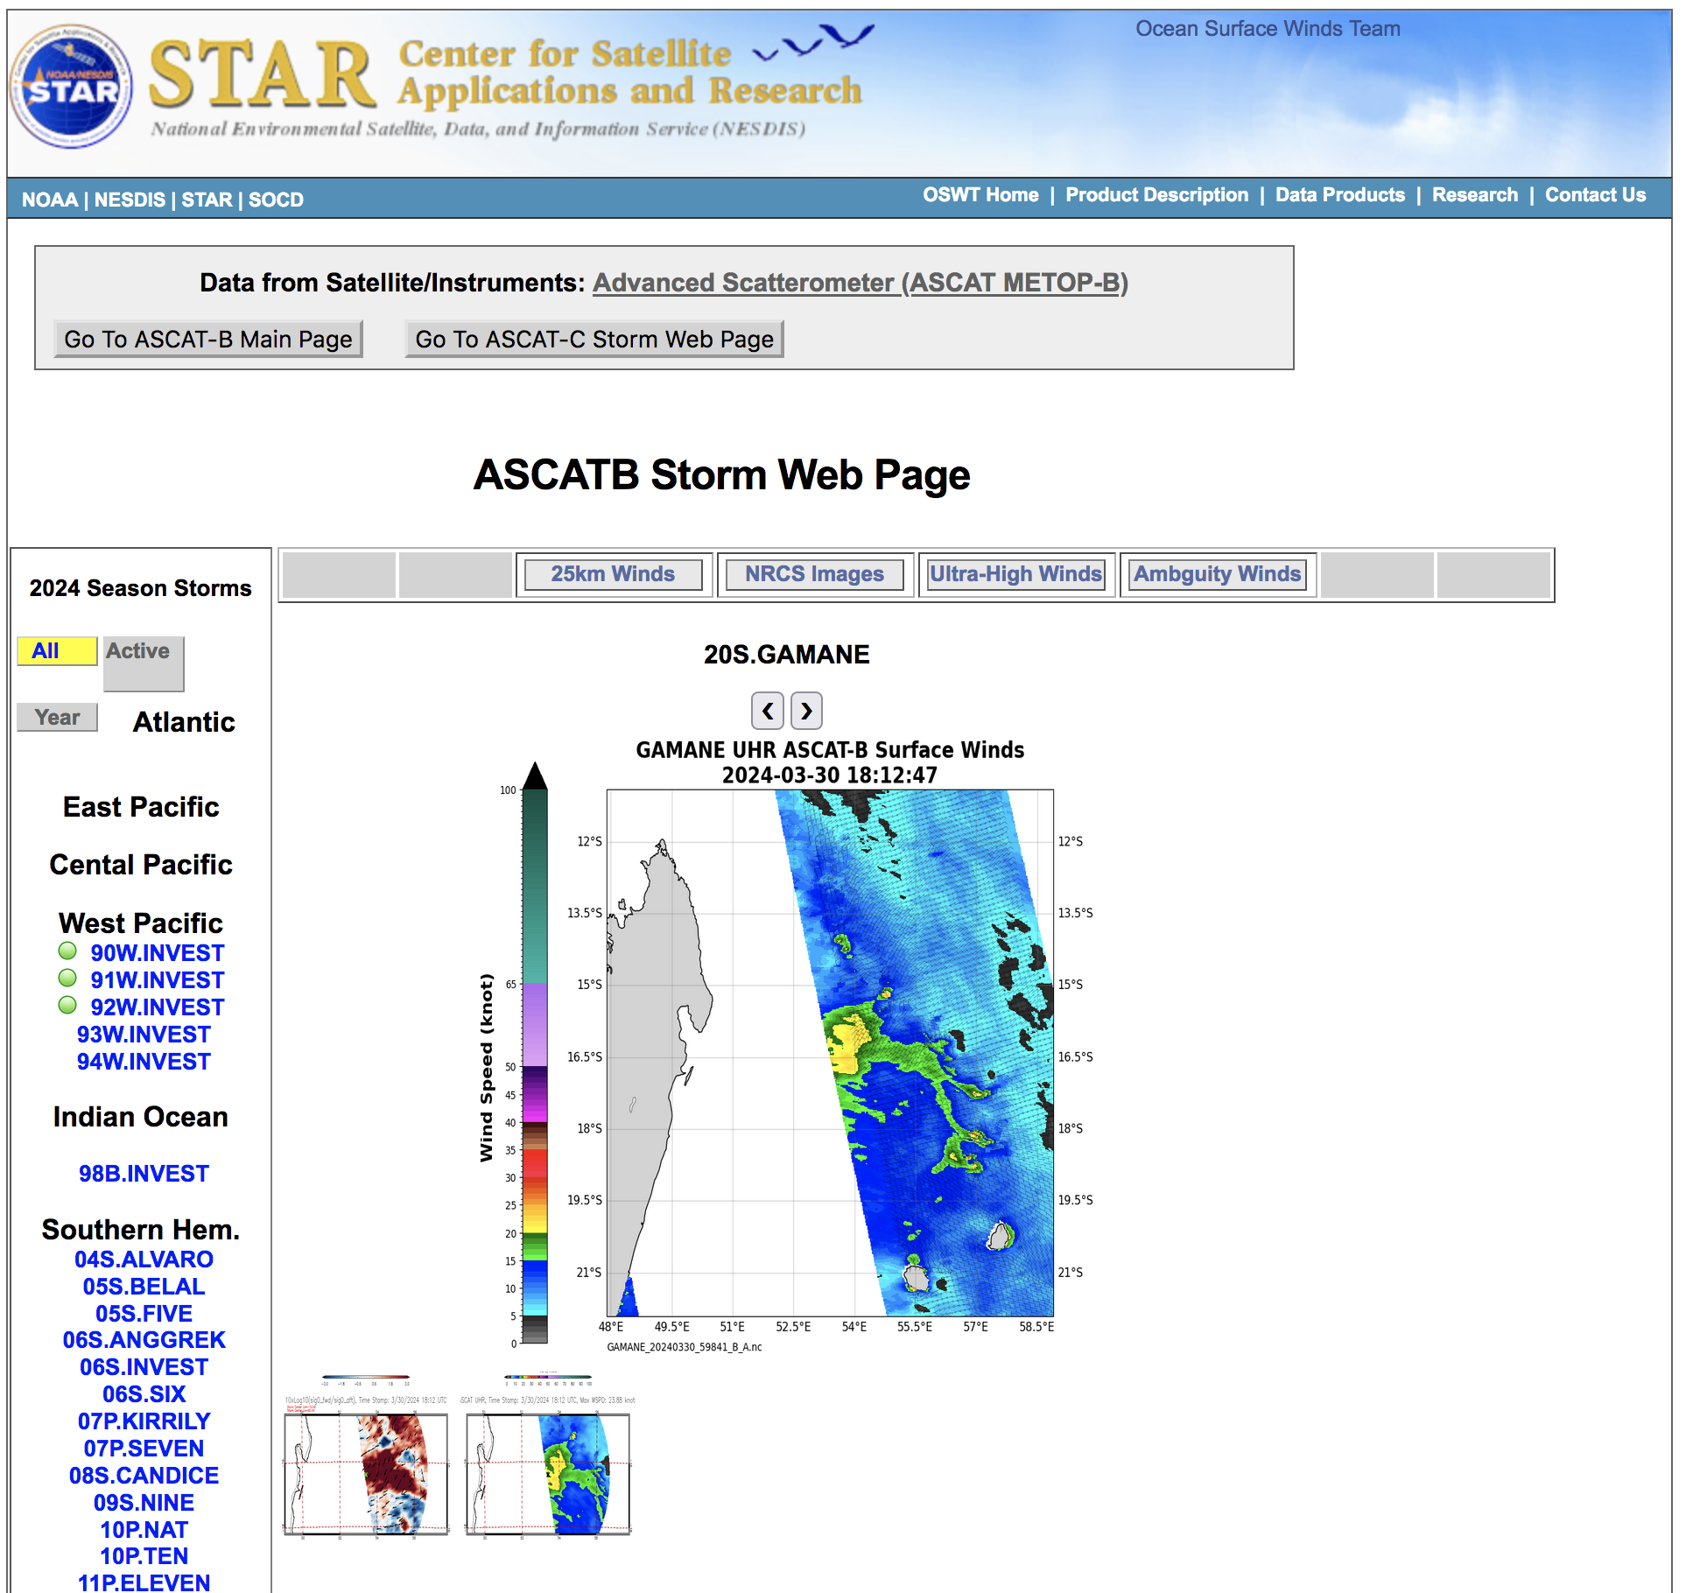
ASCAT UHR Data Availability
Data available in NRT
https://manati.star.nesdis.noaa.gov/UHR_ASCAT/
Images
https://manati.star.nesdis.noaa.gov/datasets/ASCATCStorm.php

Slide 33
UHR ASCAT Summary
UHR winds reveal finer spatial structures and higher wind speeds
UHR ASCAT = “coarse resolution SAR”
High wind performance with respect to IWRAP Ku and C-band measurements valid up to 45 m/s
Validation with SFMR shows a correlation of 0.9 and a 2.67 m/s low bias (We believe this is a SFMR problem not ASCAT)
For closed circulation and storm center detection Fore-Aft Sigma0 imagery should be considered
UHR wind direction too noisy
UHR ASCAT maximum wind should be considered together with ASCAT 12.5km wind directions and rain flag
Capable of retrieving 34, 50 and 64 knot wind radii

Slide 34
Backup slides

Slide 35
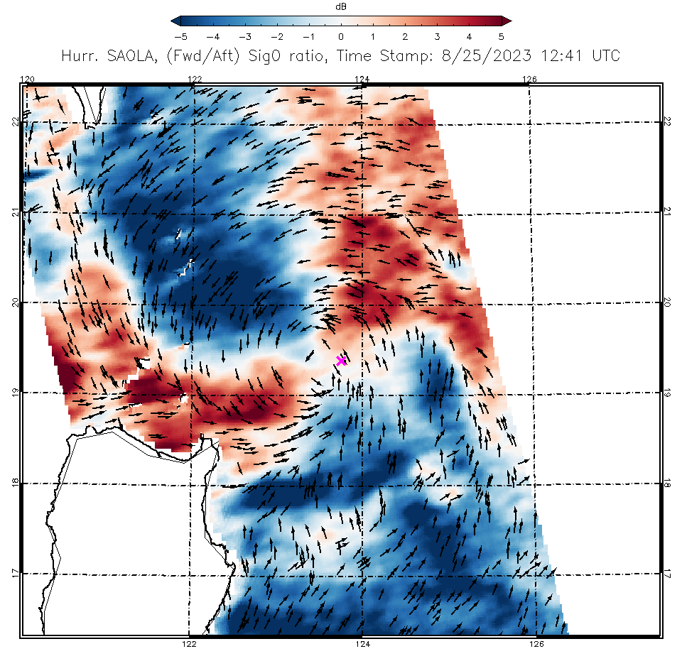
Forward Look Sigma0
Aft Look
Sigma0
_
=

Slide 36
Saola

Slide 37
Anggrek

Slide 38
Tammy

Slide 39
Belal

Slide 40
Saola

