Slide 1
Wind profile characterization from scatterometry products and sea state parameters
Alberto S. Rabaneda IOVWST 2024

Slide 2
Motivation
Study the wind-wave interaction, especially the effect of different wave conditions on the wind profile above the wave field.
Test the capability of the logarithmical law to determine the wind profile in offshore locations.
Find a non-empirical parameterization of the sea surface roughness length.
Produce an added-value product with 3D winds from scatterometers, radiometers, adn SAR for the wind industry

Slide 3
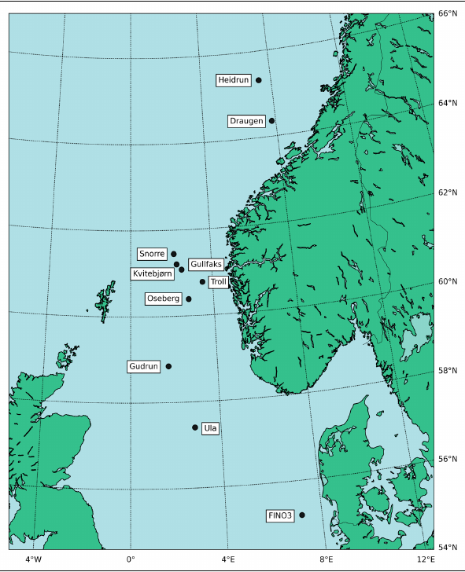
Locations and datasets
Met mast
Sea and atmospheric sensors at different heights/depths
Oil platforms
Only wind vectors,
complemented with ERA5

Slide 4
Locations and datasets
 |  | Egmond aan Zee (EZ) | Oil platforms
Data sources | Wind vectors | Cup & sonic anemometers | Cup anemometers
 | Atmospheric parameters | In situ | ERA5
 | Sea state parameters | In situ | ERA5
Considerations | Stability | Only neutral | All
 | Time resolution | 1h | 1h
 | Period | 2005 - 2008 | 2022 onwards

Slide 5
Theory recap
Lettau’s equation
C_{d} : Drag coefficient
h* : effective obstacle height
s : silhouette or cross-section area
n : number of obstacles
A : area of the domain
θ : angle between wind and wave direction
L_{p}: Wavelength
H_{s}: Significant wave height
Onshore
Assuming deep seas in absence of white capping and breaking waves
Offshore
New formulation still agrees with the direct proportionality between z₀ and u* found by Charnock in 1952

Slide 6
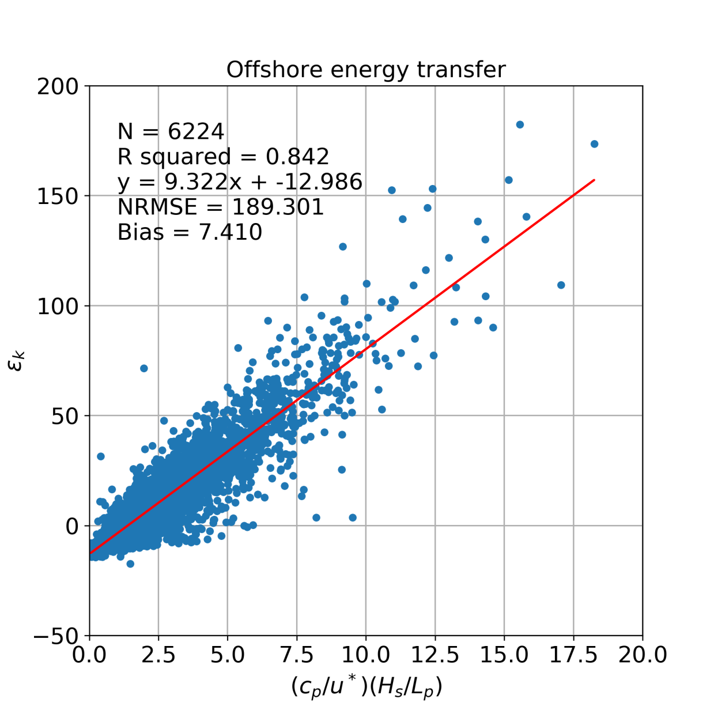
Theory recap
z₀ : aerodynamically consistent
z₀ : wave age dependant
At 21m!!!!

Slide 7
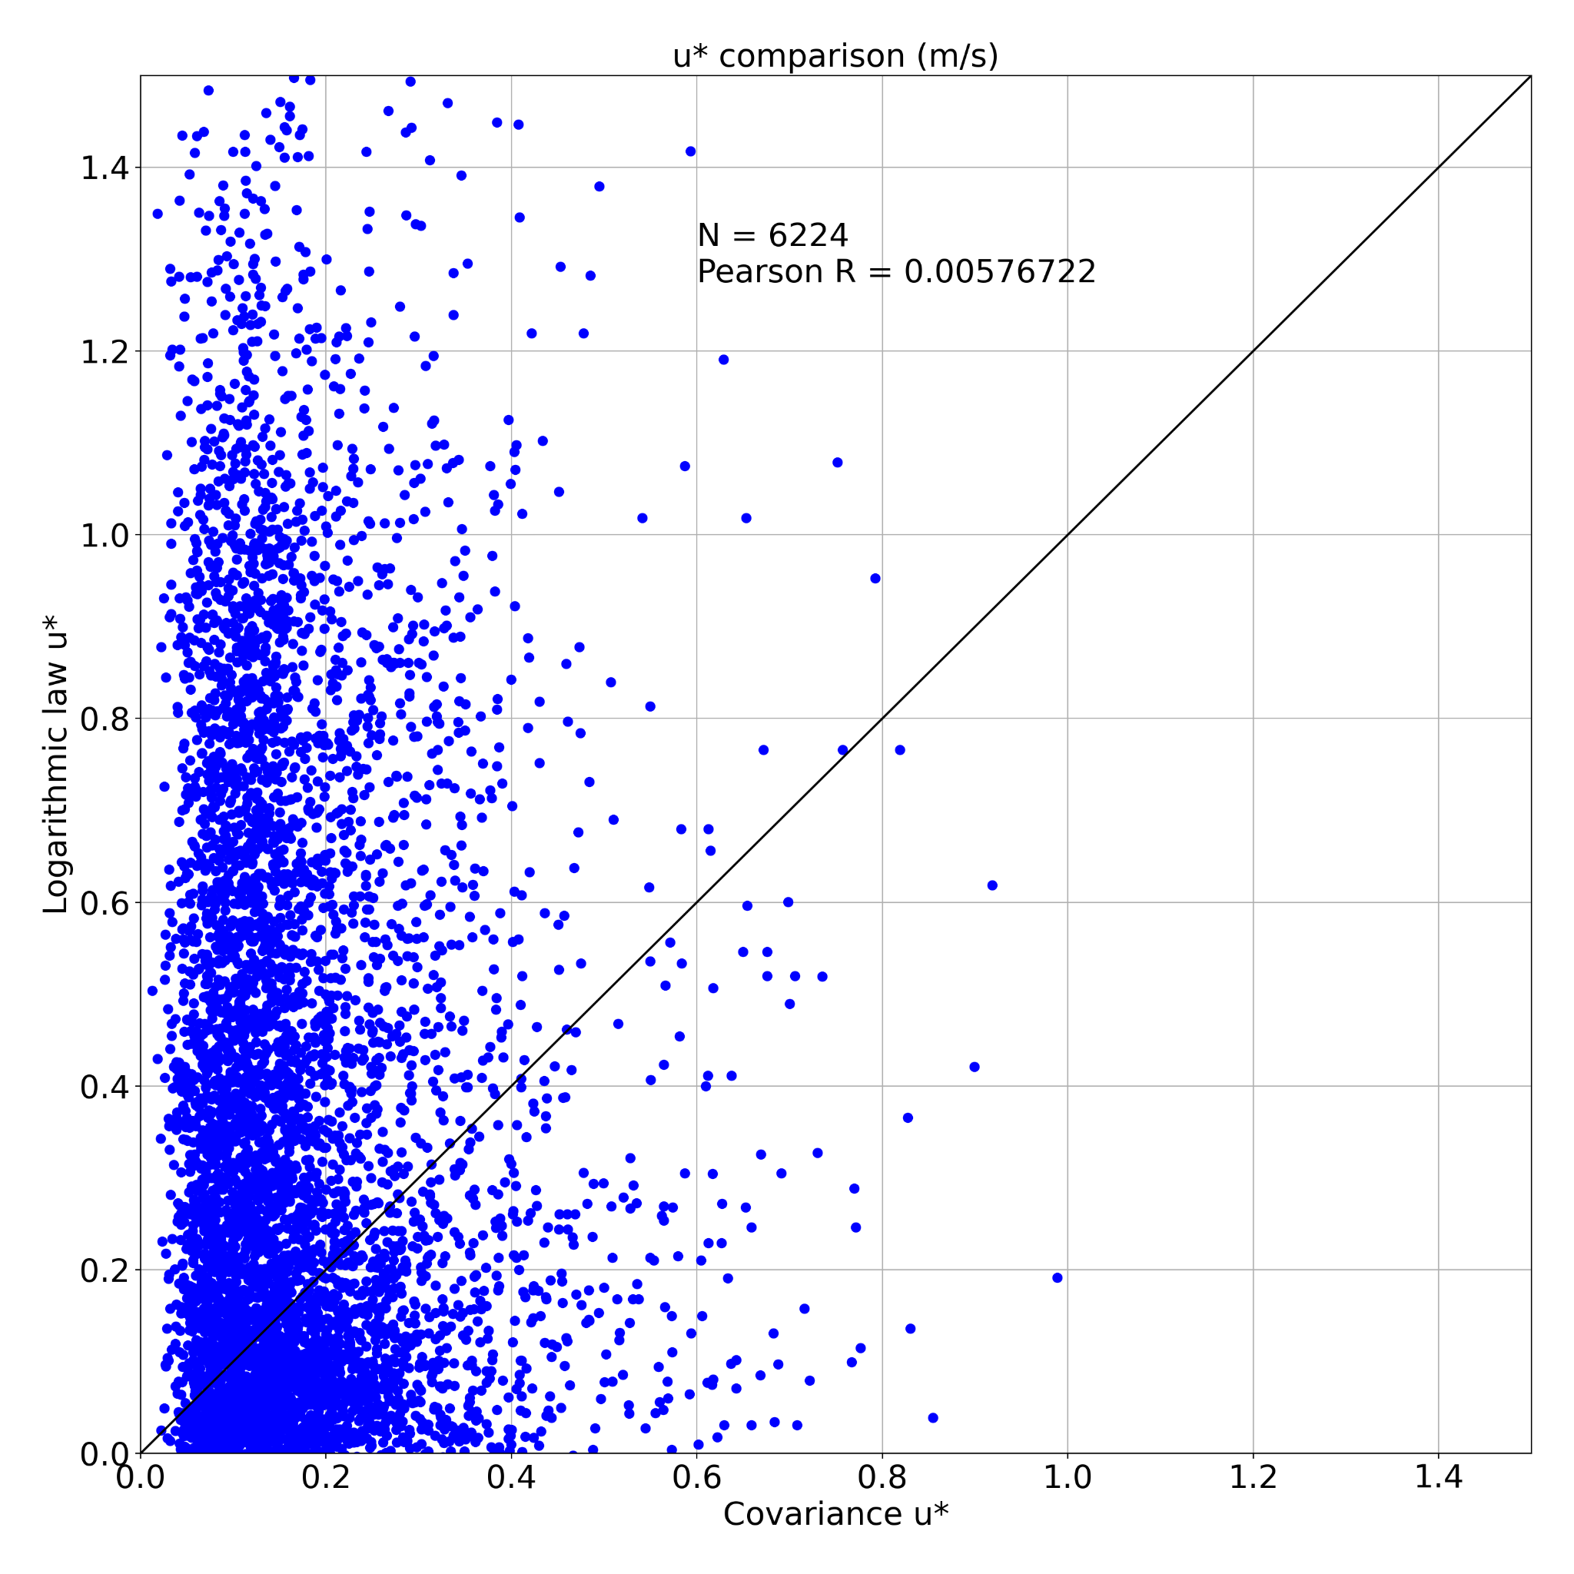
Theory recap
z₀ : wave age dependant
If neutral stability
z₂ > z₁

Slide 8
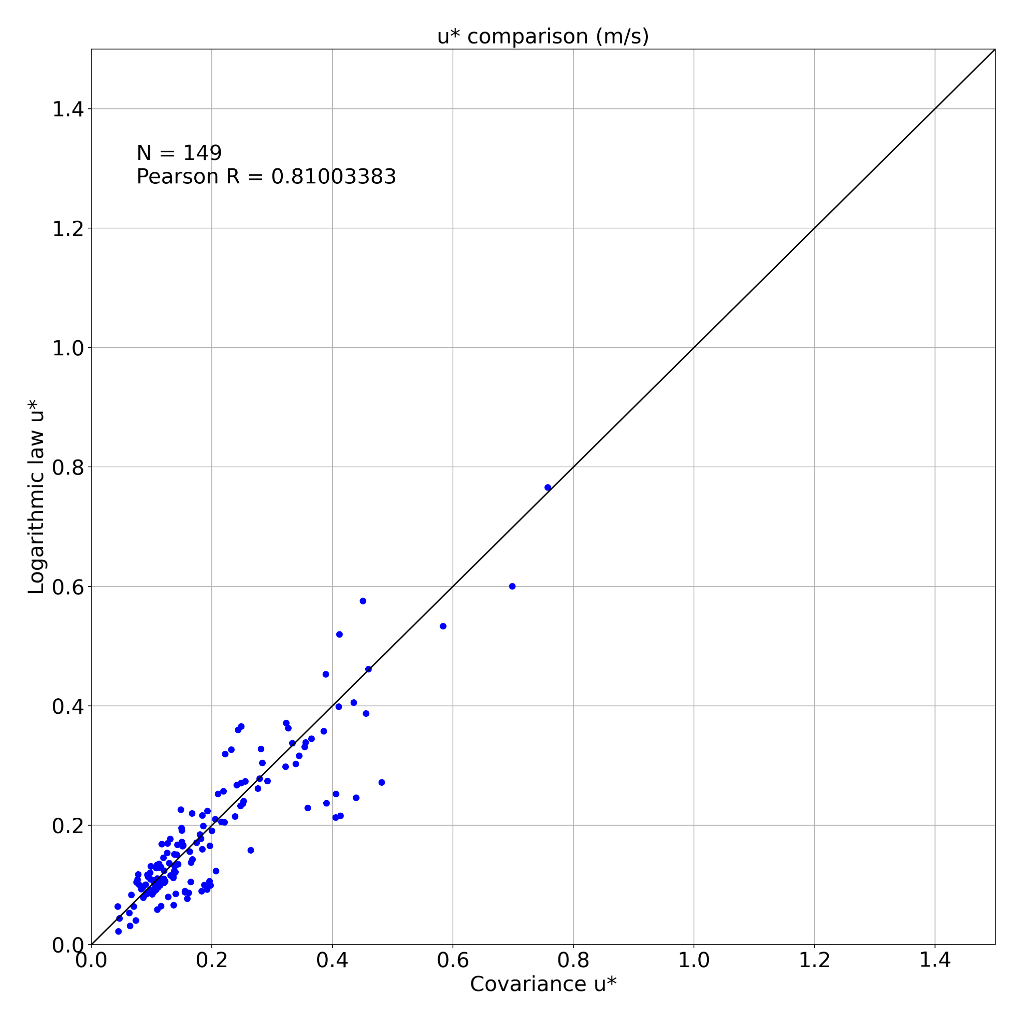
Theory recap
z₀ : aerodynamically consistent
If neutral stability and
ε_{k} at z₁ = ε_{k} at z₂
ε_{k} is z dependant
z₂ > z₁

Slide 9
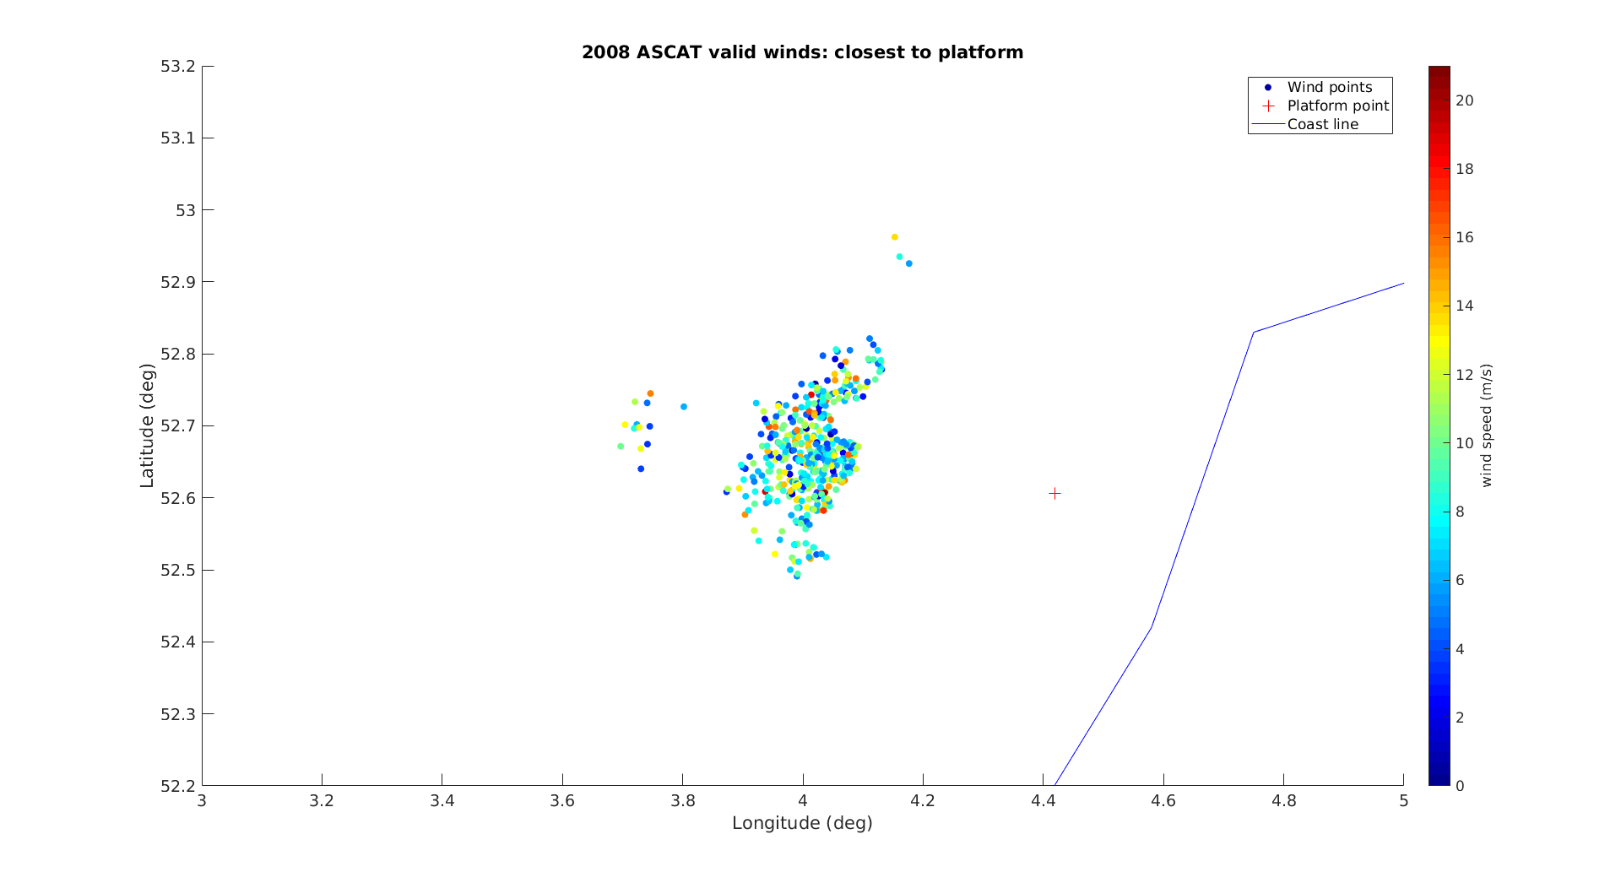
Theory recap
Following formulation in previous slide, C_{Dz} is solved by iteration:
2. u* solved with C_{D10} and U_{10S} CMOD7:
Closest measurements to EZ by the dispersometer ASCAT in 2008.
Acknowledgements to Dr. Federica Polverari and Dr. Marcos Portabella for the reprocessed ASCAT data.
Now, the new OLL can be applied to determine the wind profile at different heights.

Slide 10
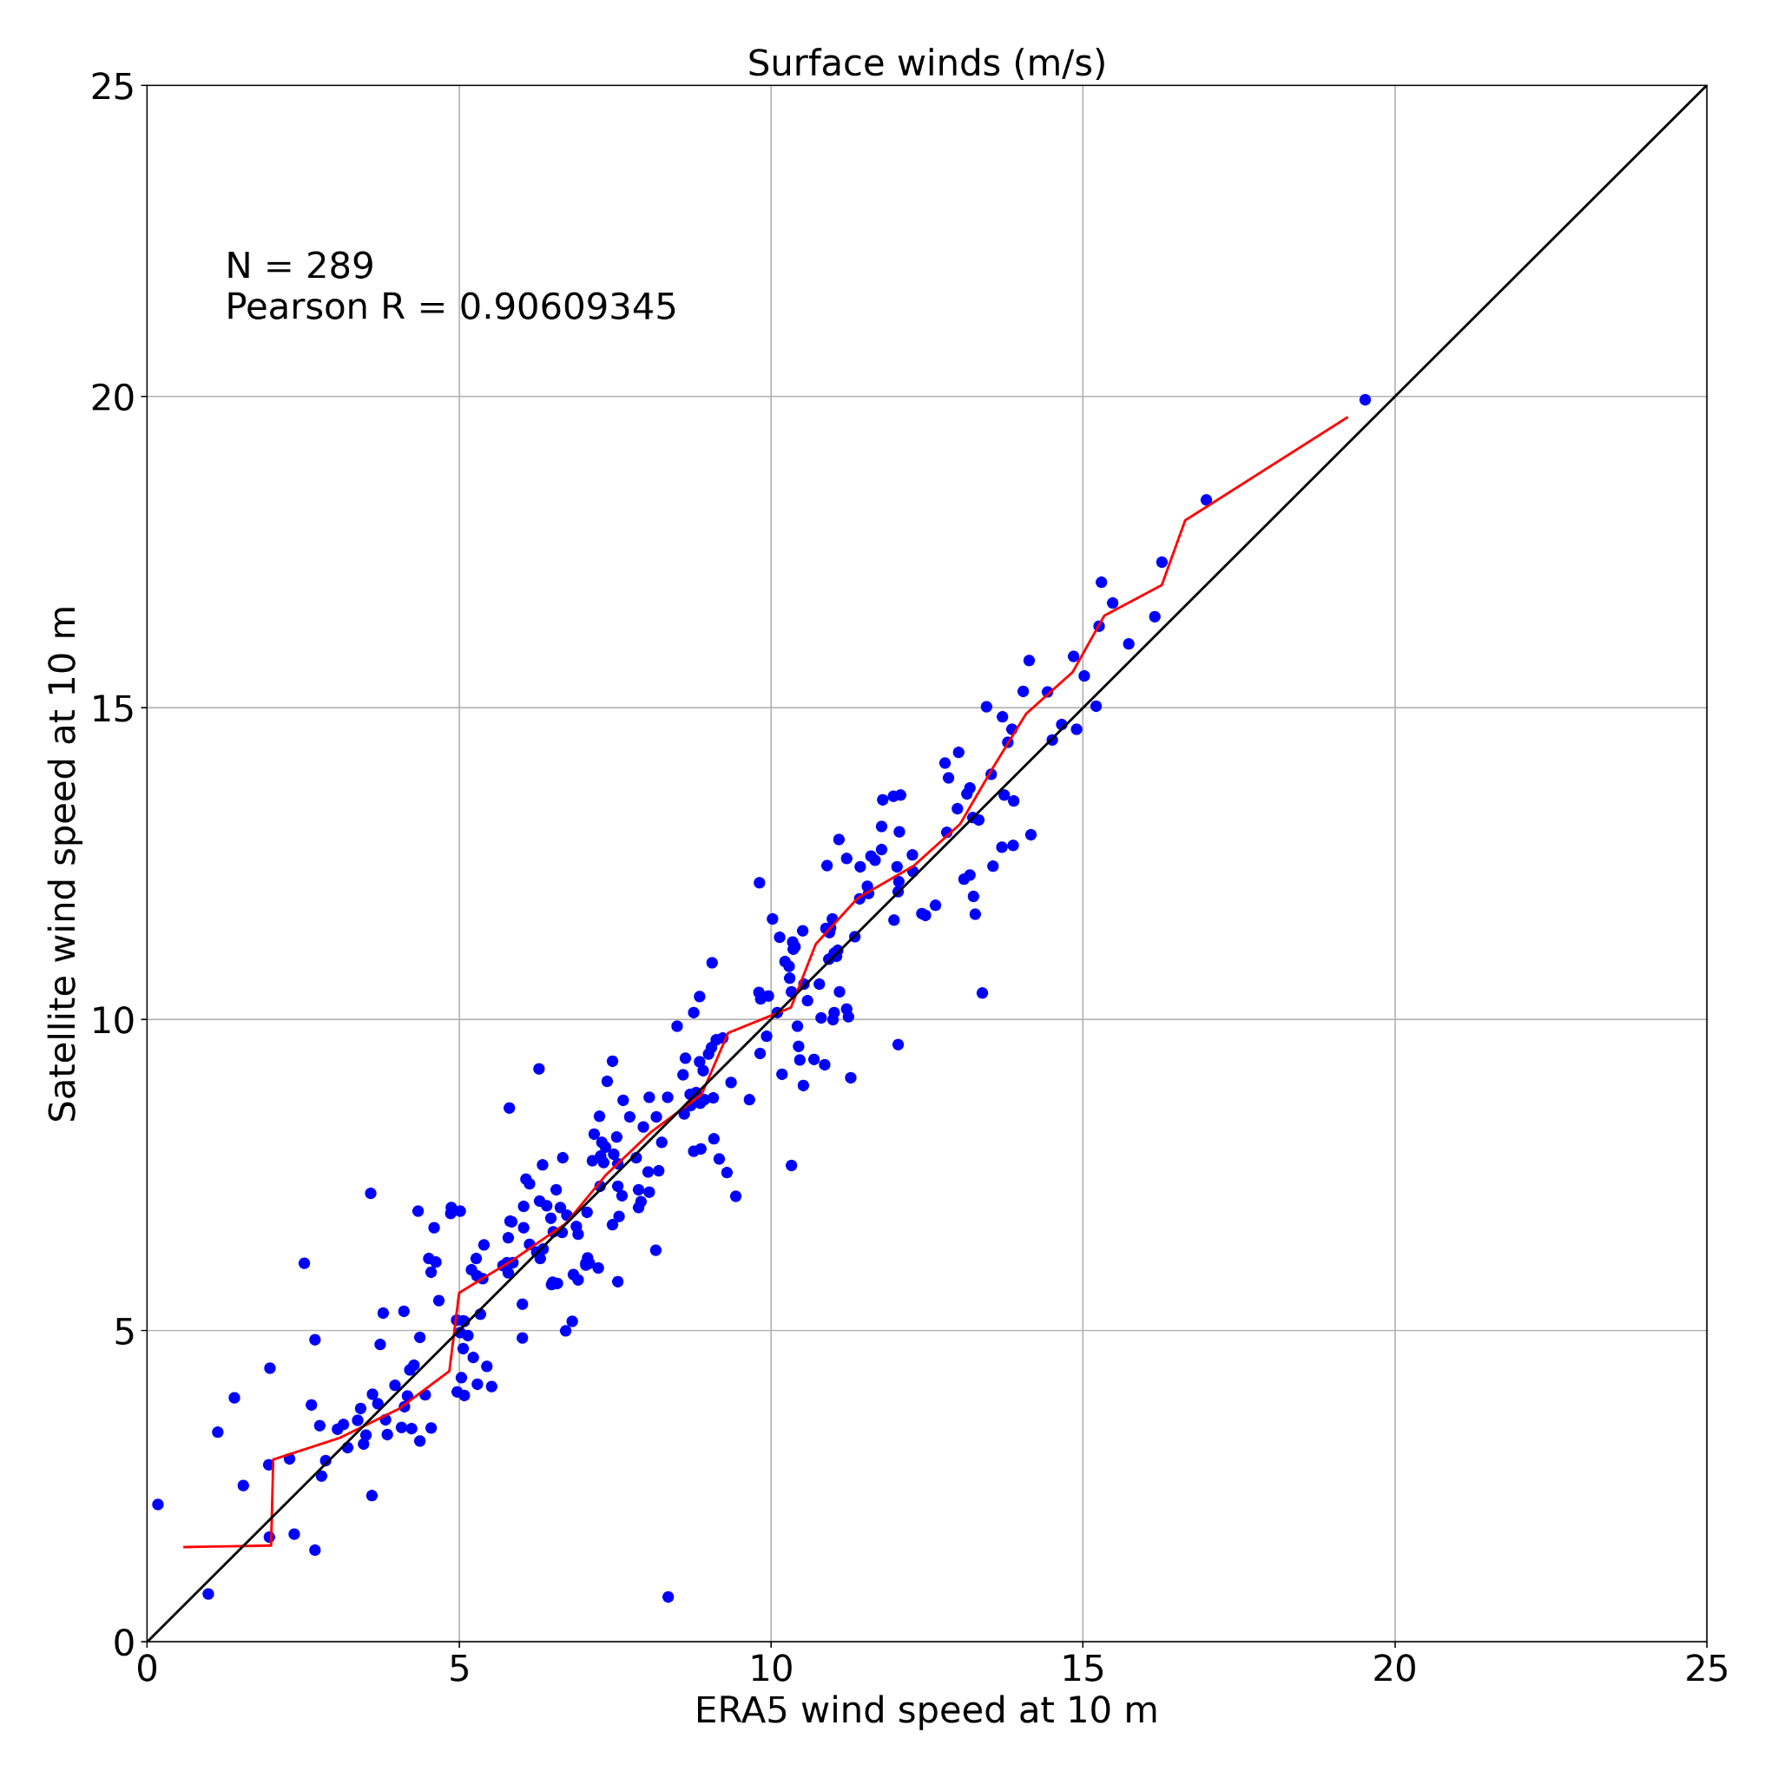
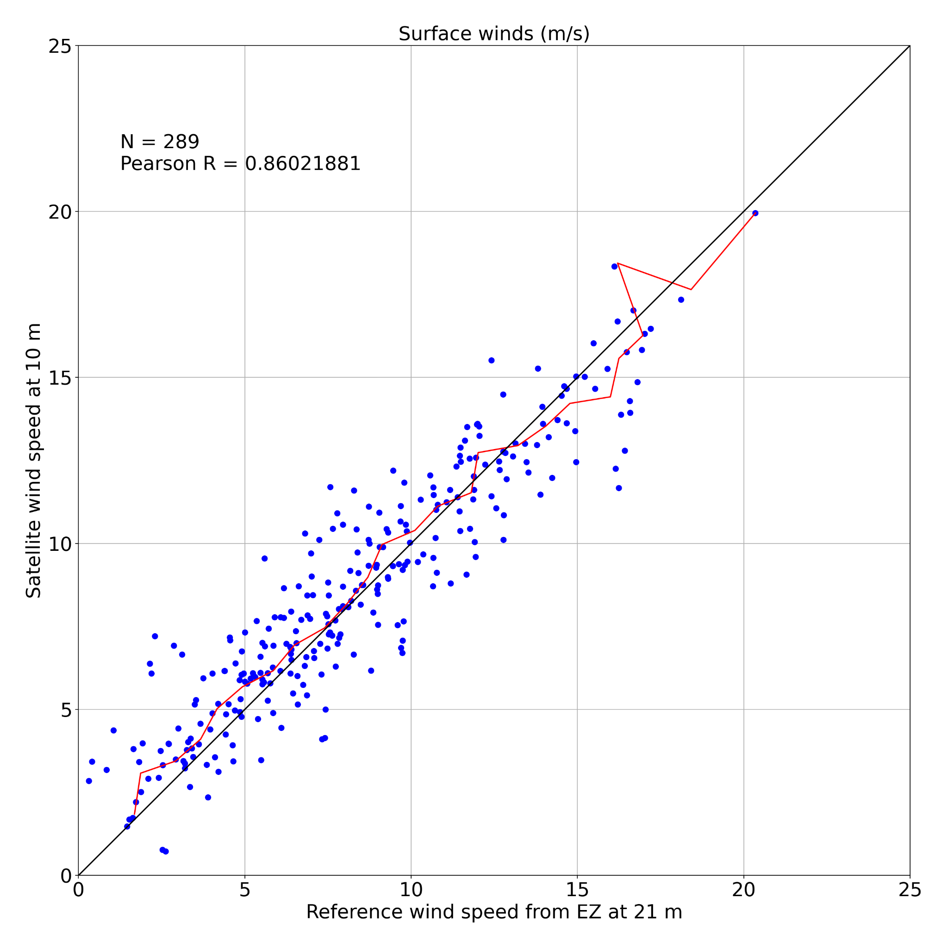
EZ mast - neutral surface winds

Slide 11
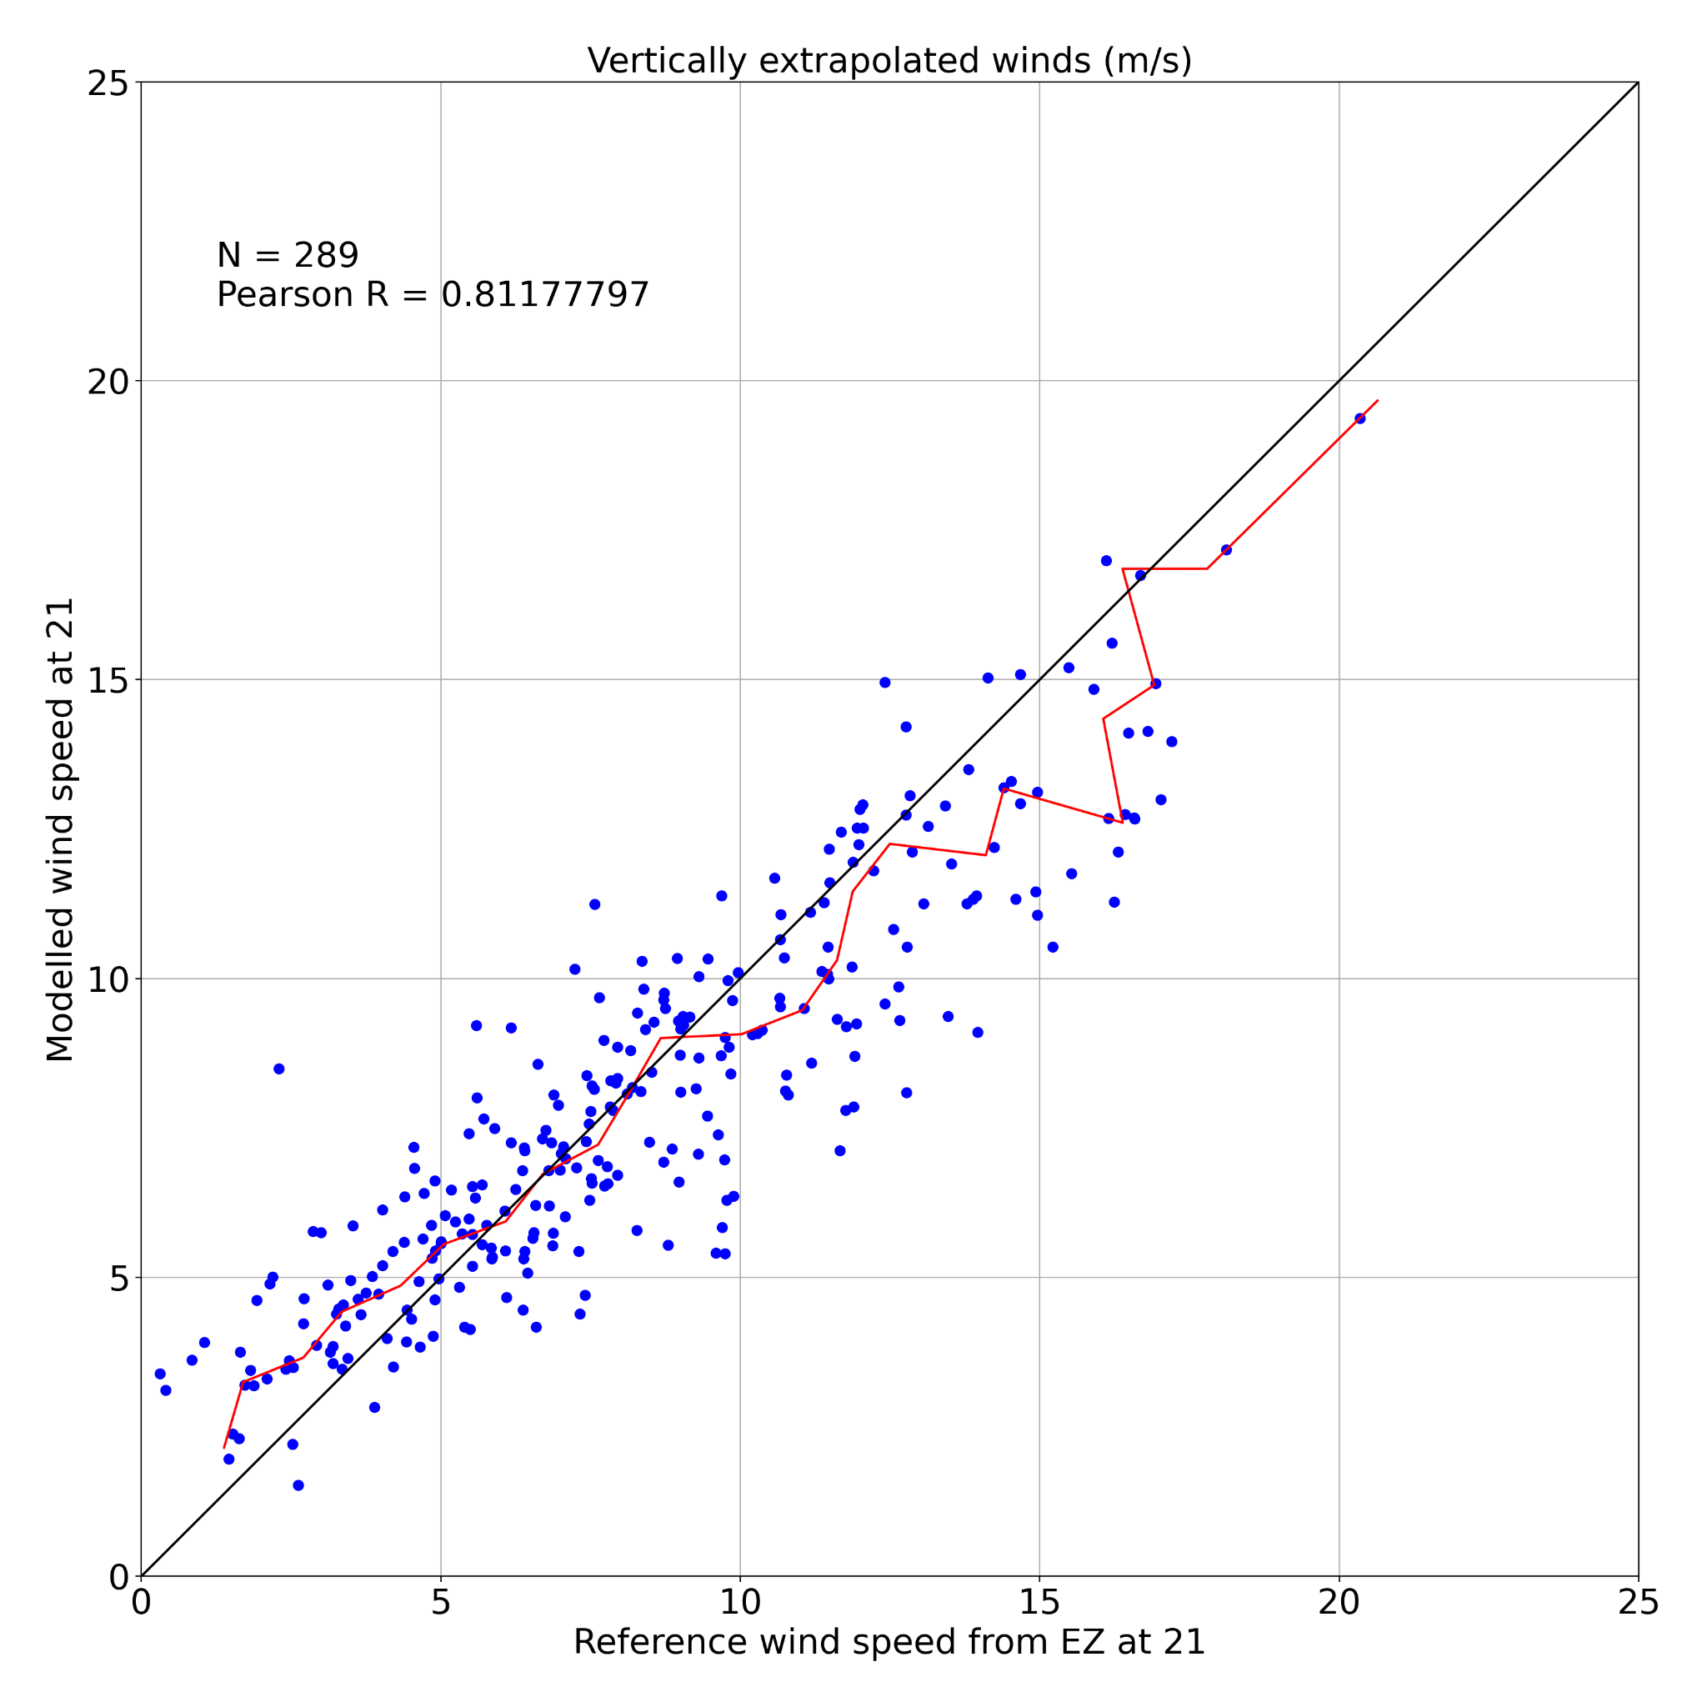
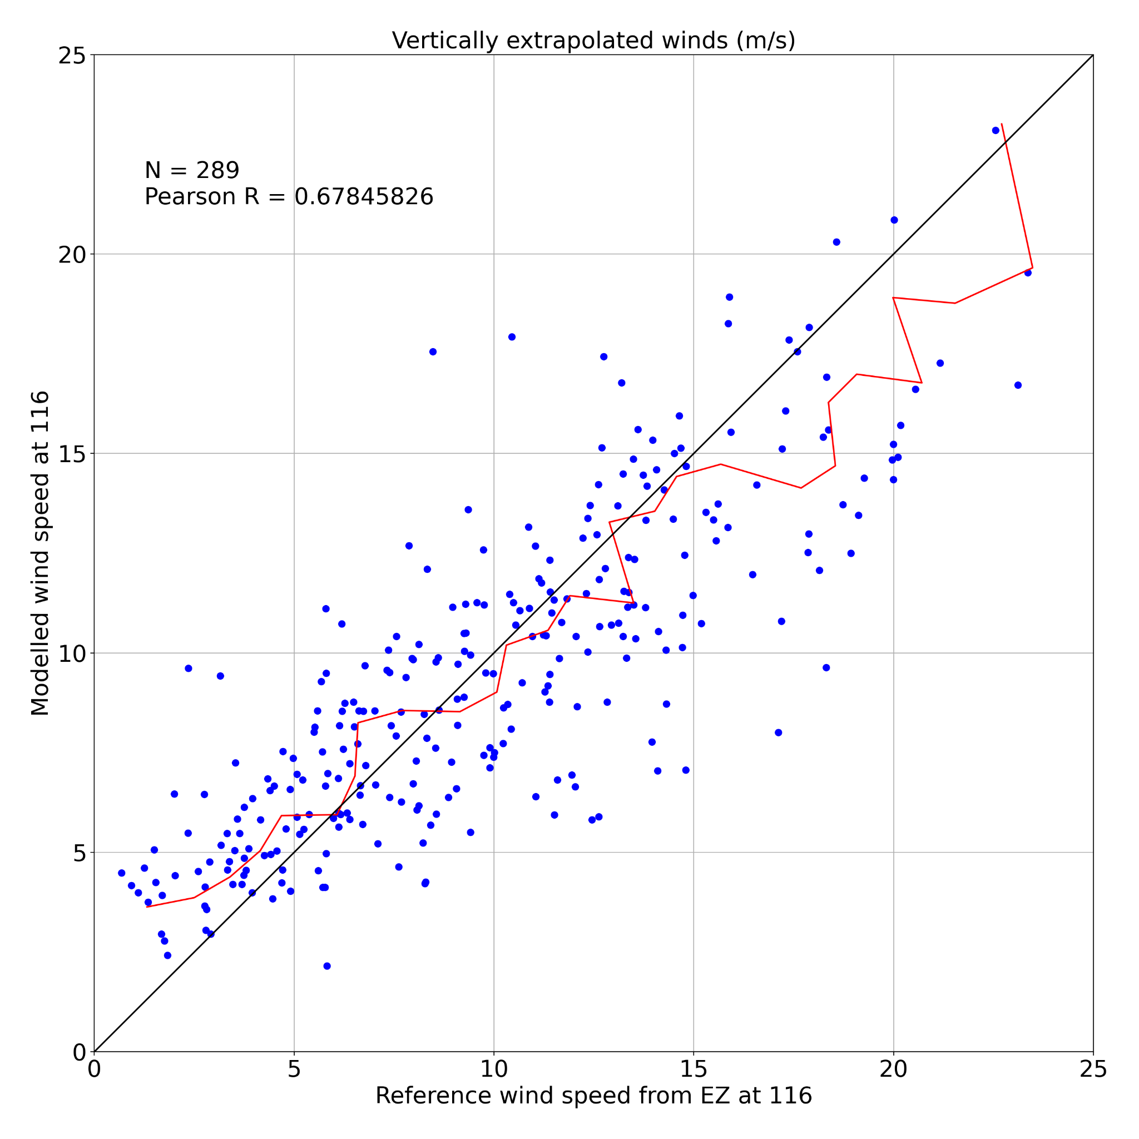
EZ - neutral extrapolated winds

Slide 12
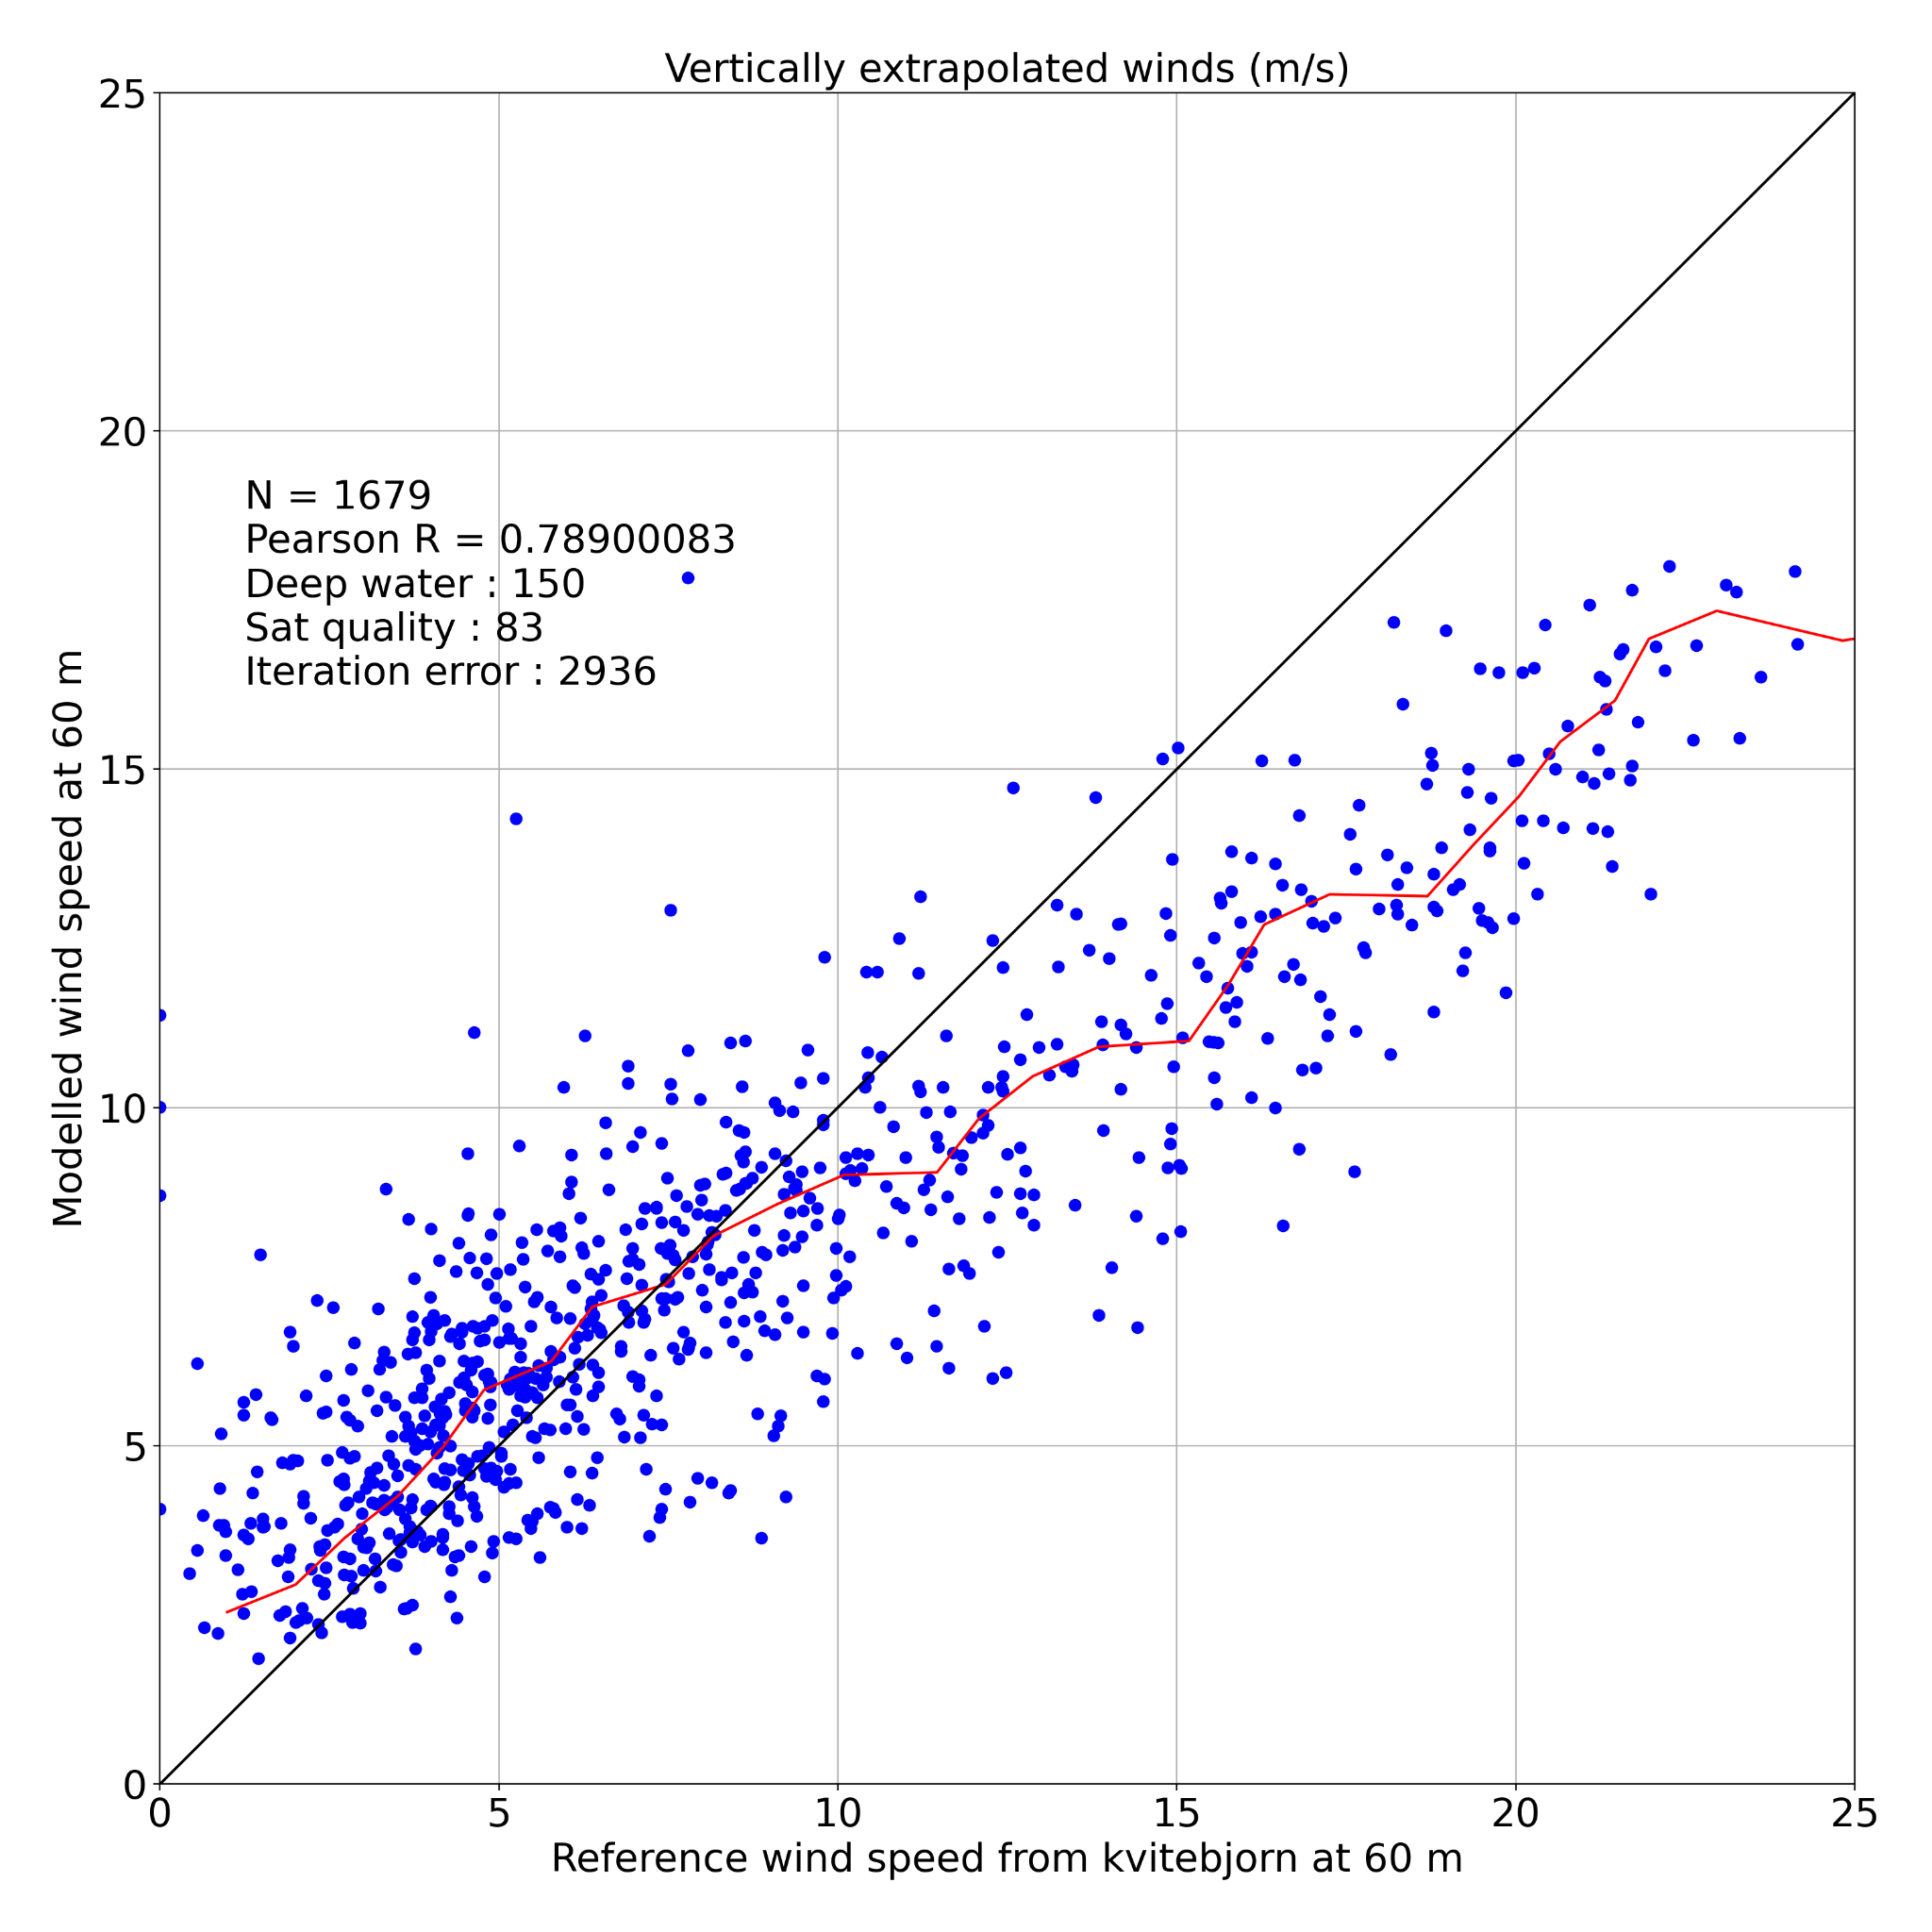
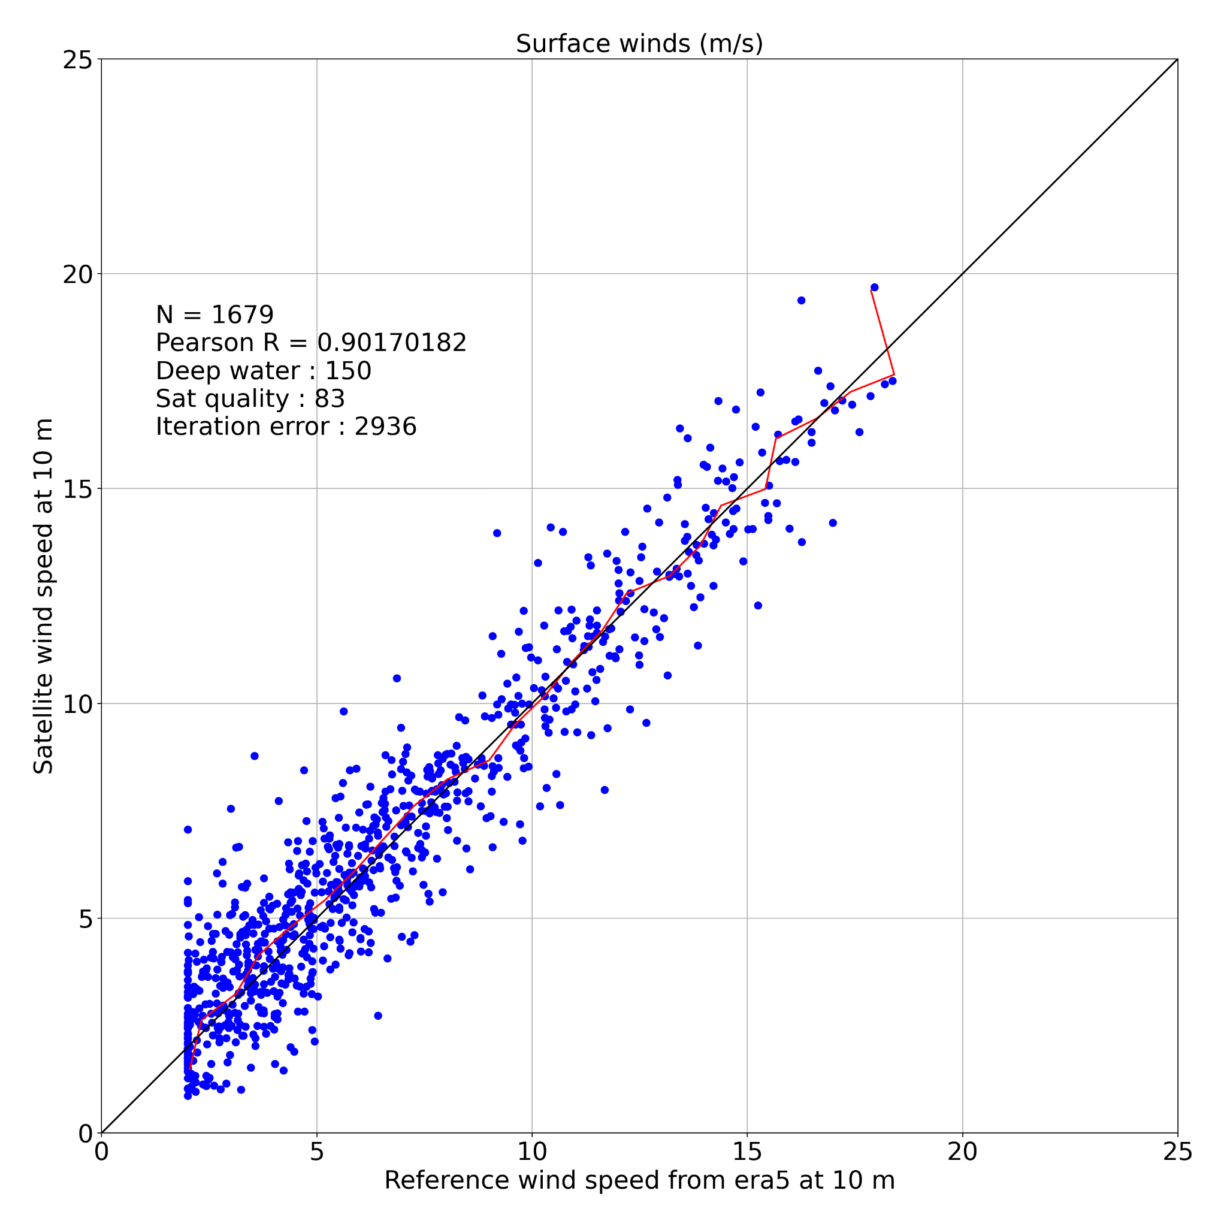
Results - Oil platform - Kvitebjorn (60m)

Slide 13
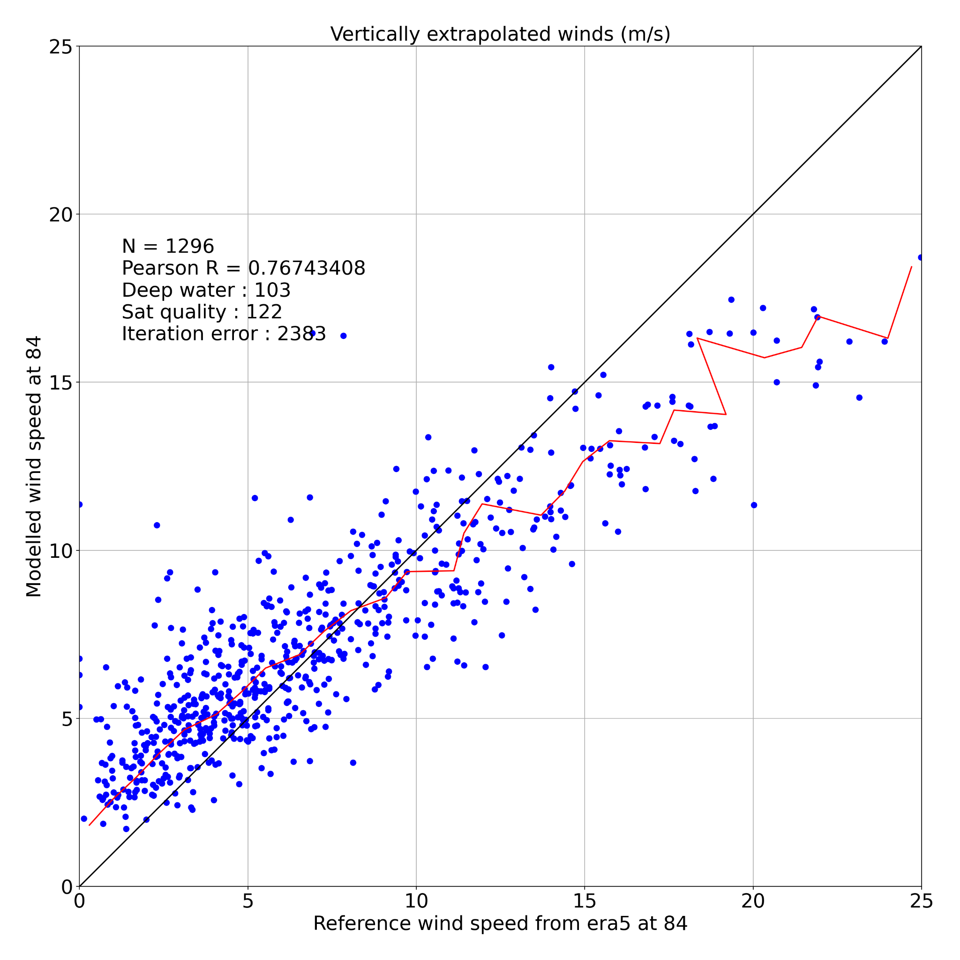
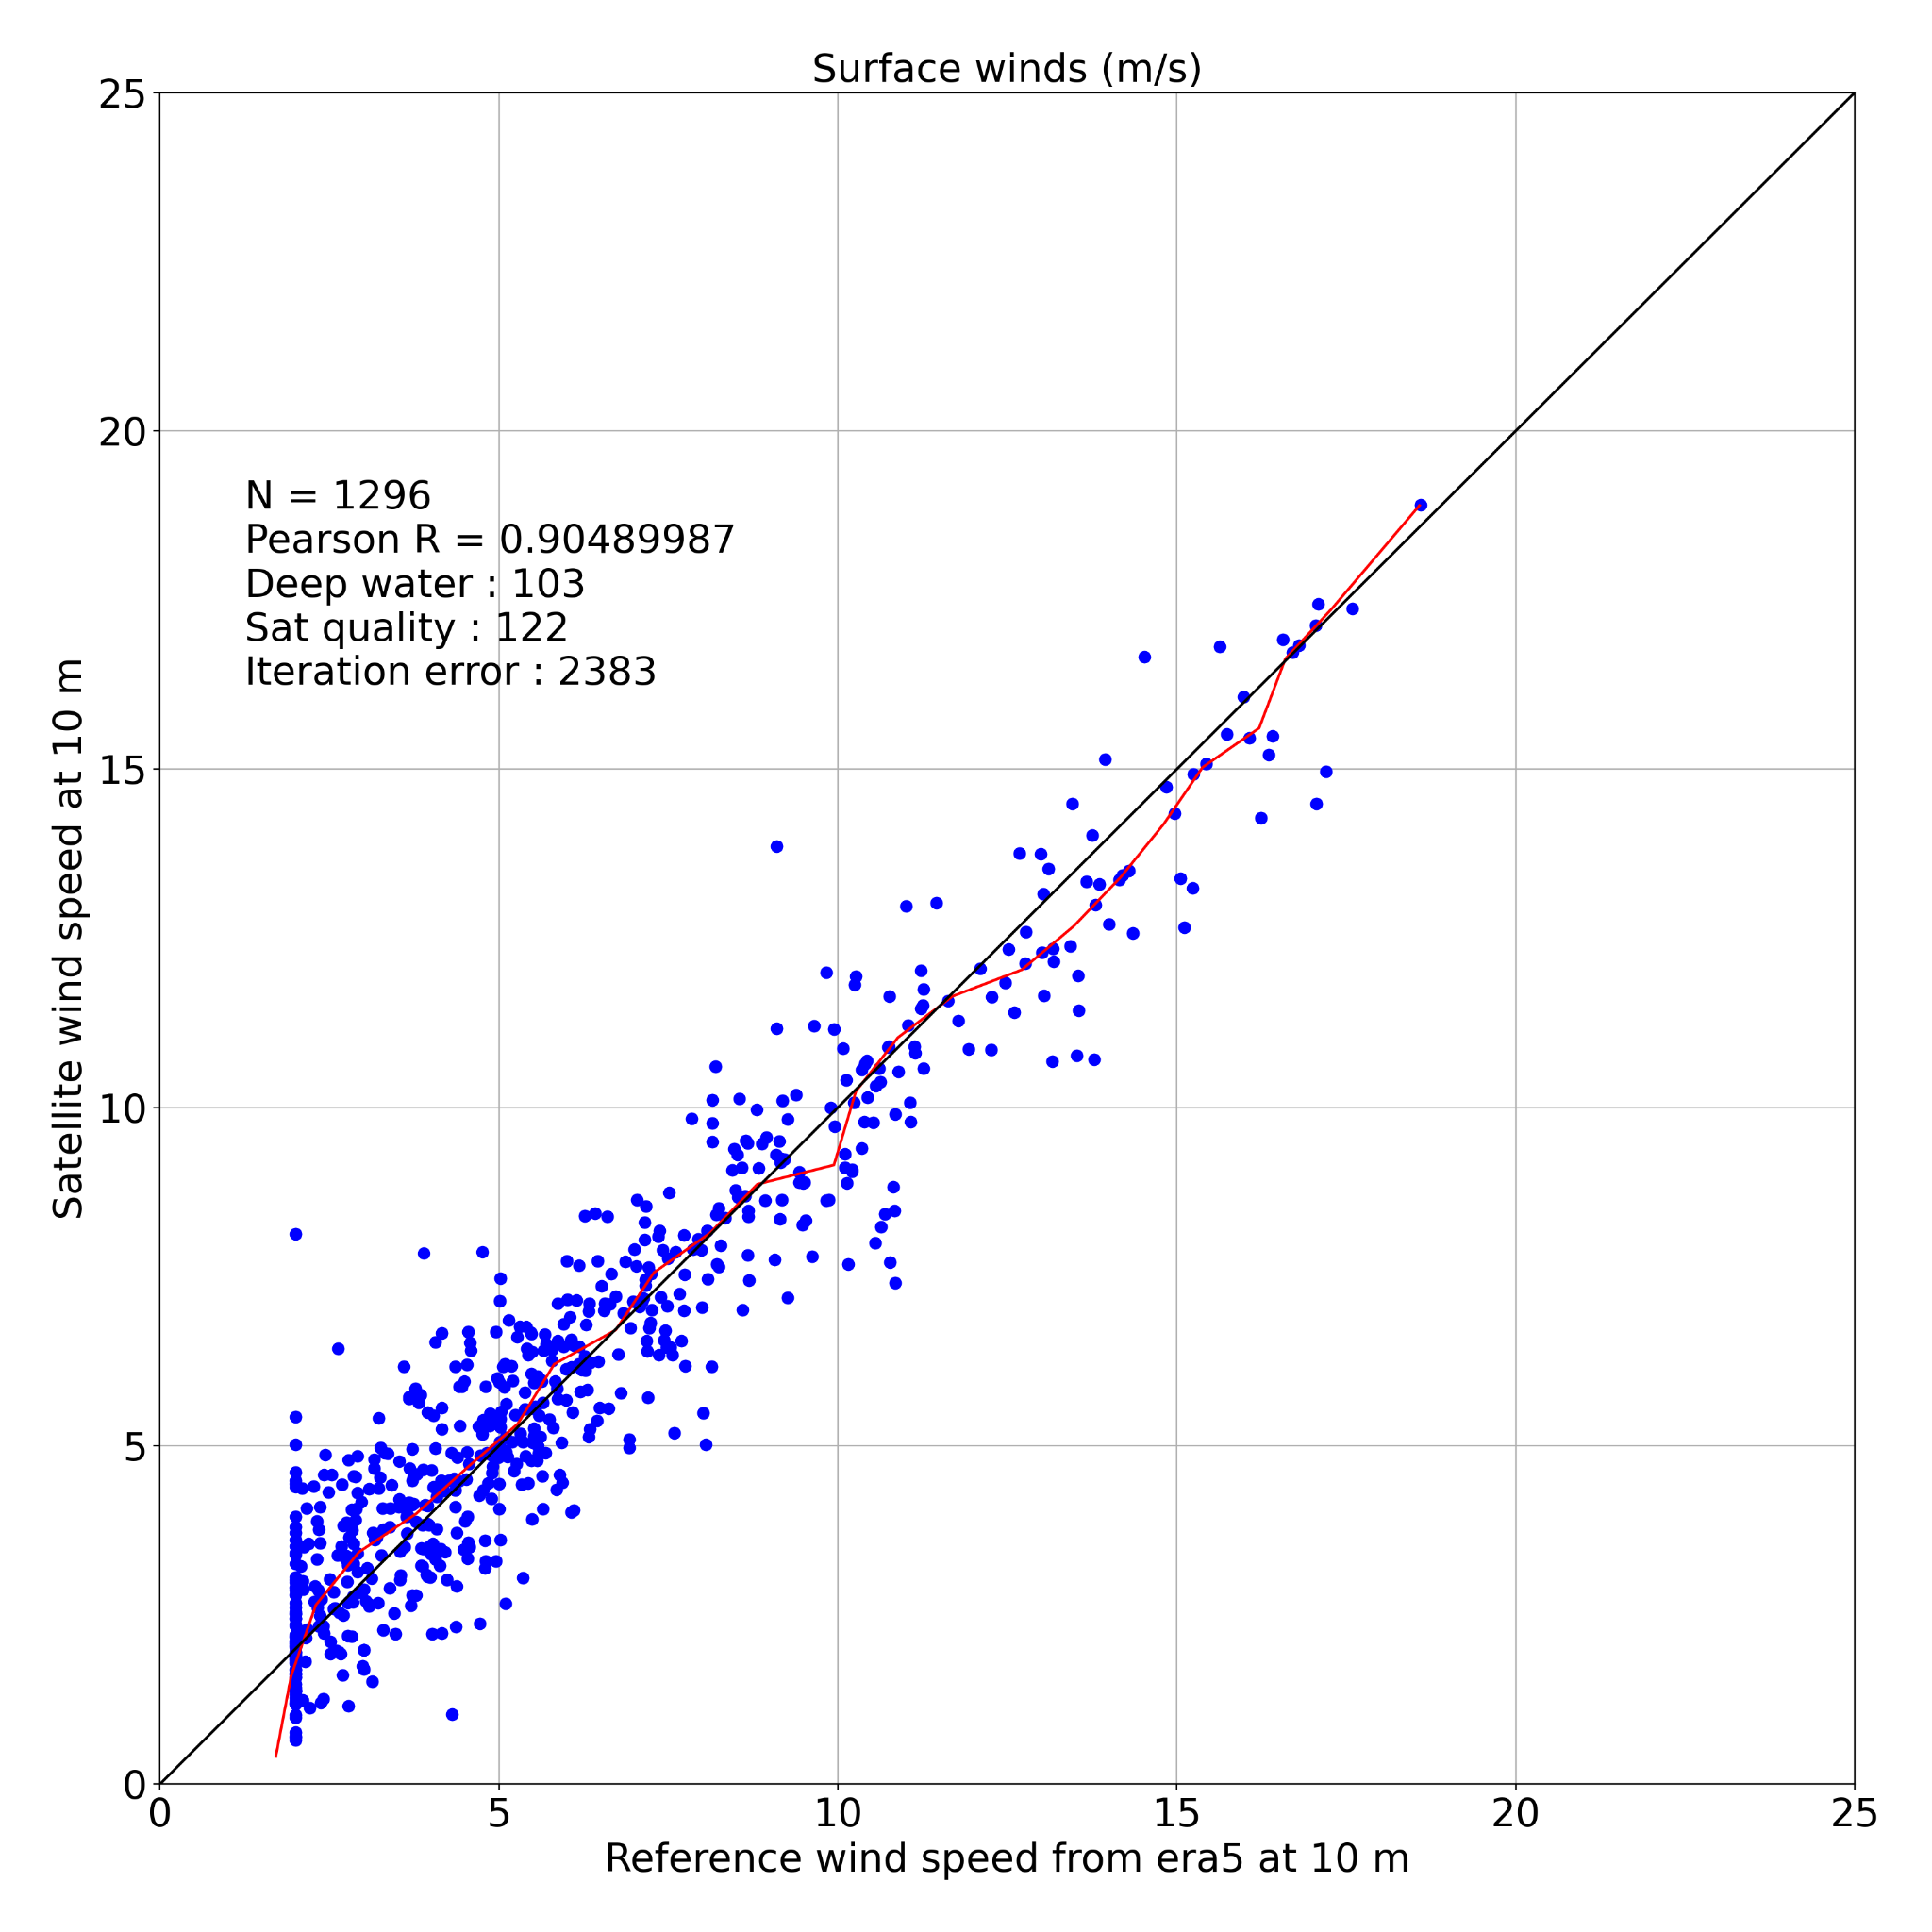
Results - Oil platforms - Troll (84m)

Slide 14
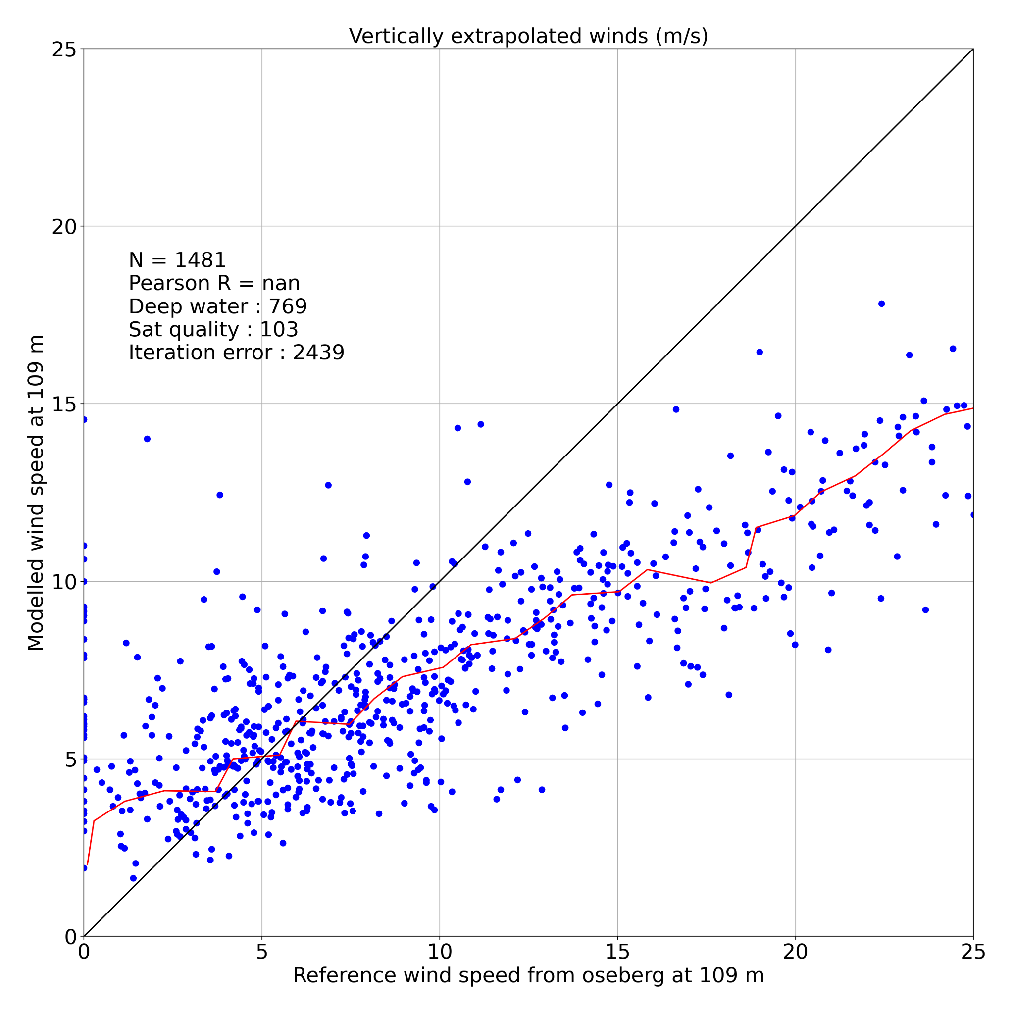
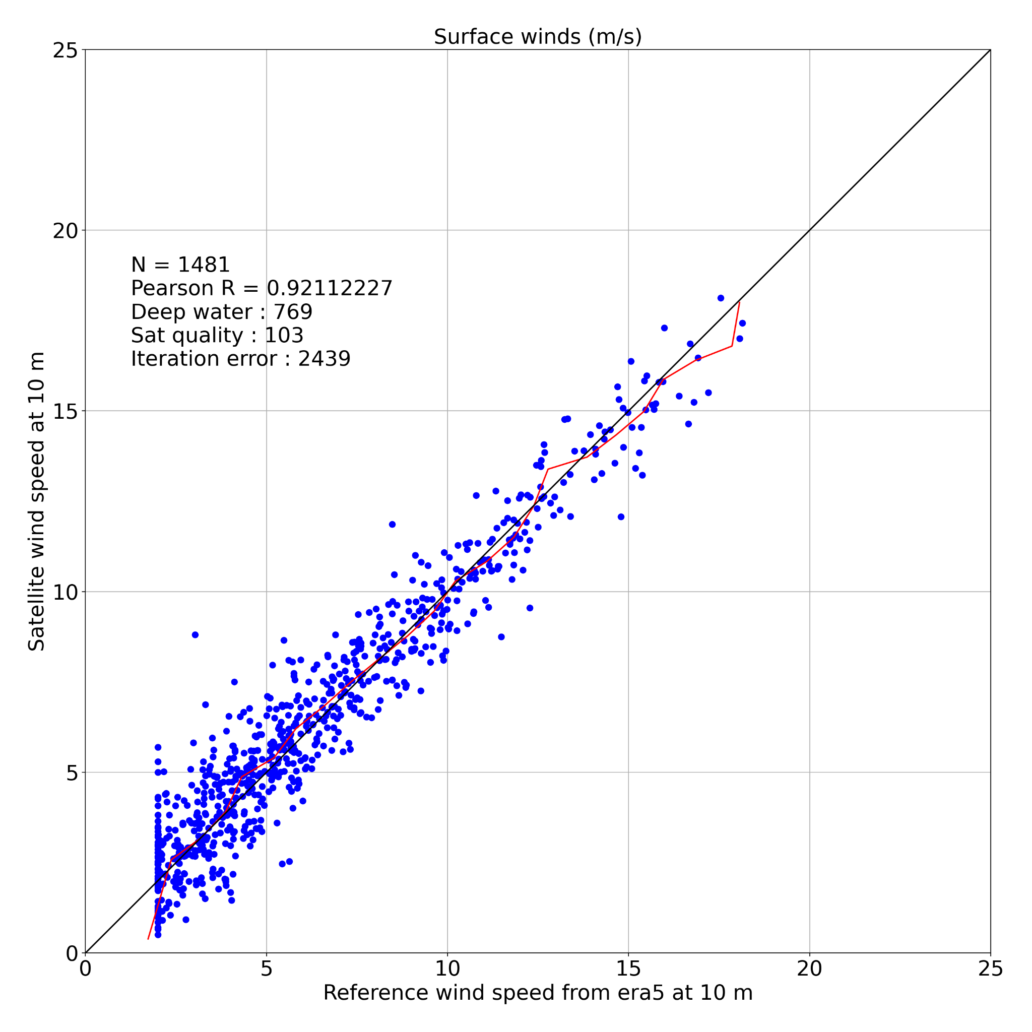
Results - Oil platform - Oseberg (109m)
*re-interpolated winds

Slide 15
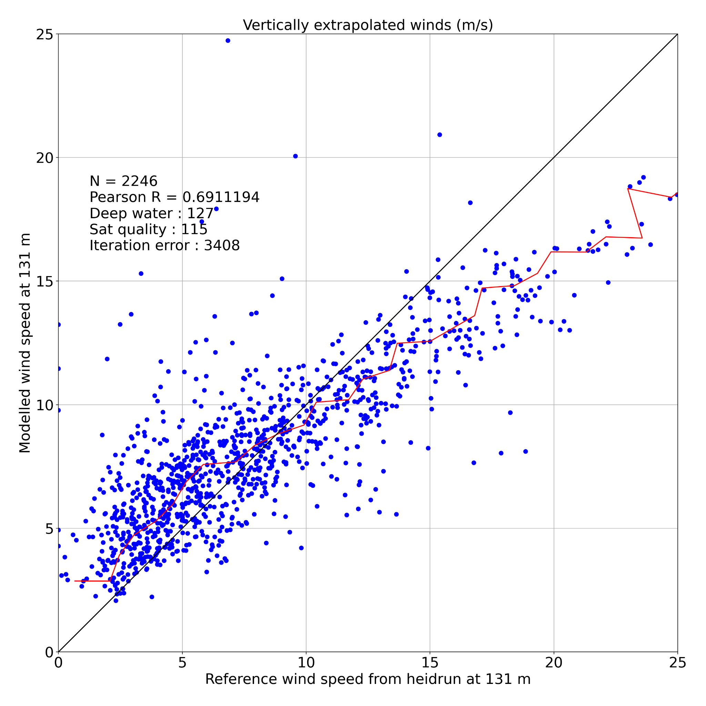
Results - Oil platforms - Heidrun (131m)

Slide 16
Summary
Lessons learned
When applying the log law (or COARE):
The lower the level the smaller the error
A under/overestimated z₀ is compensated with an over/underestimated u*
Good validation: calculate surface parameters and extrapolate vertically
Ideal validation: modelled u* against a u* sonic anemometer, but at what height??
Future steps
Is ε_{k} really dependant on z ??
If yes, find the relationship
If not, recalculate ε_{k} empirical parameters for an z-independent ε_{k}
Use insitu sea state measurements instead of model for sea state input
Perhaps, apply readjustment to scatterometers high winds ??
Extent the study to radiometers and SAR

Slide 17
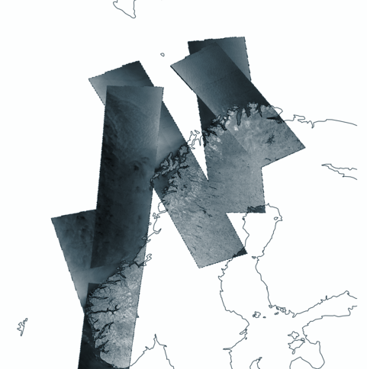
Questions?

Slide 18
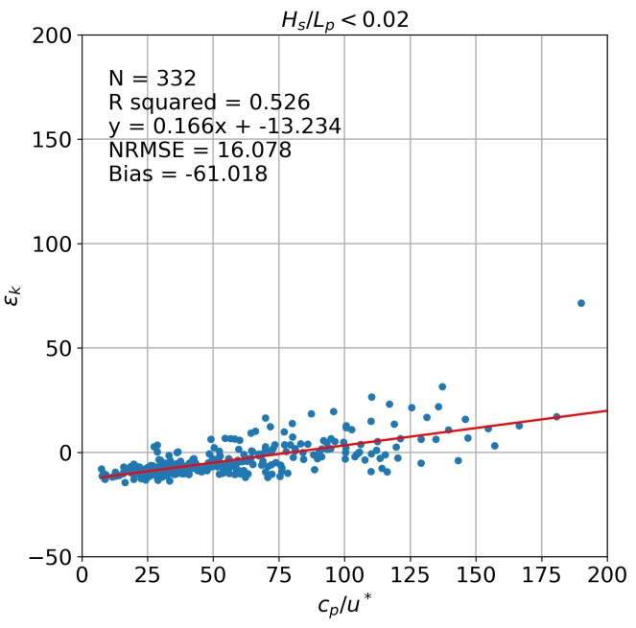
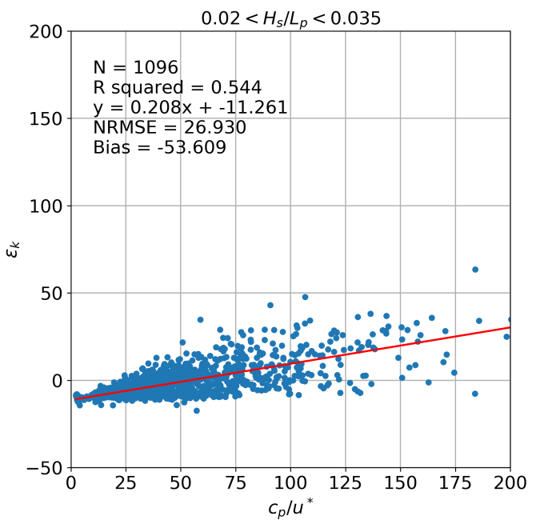
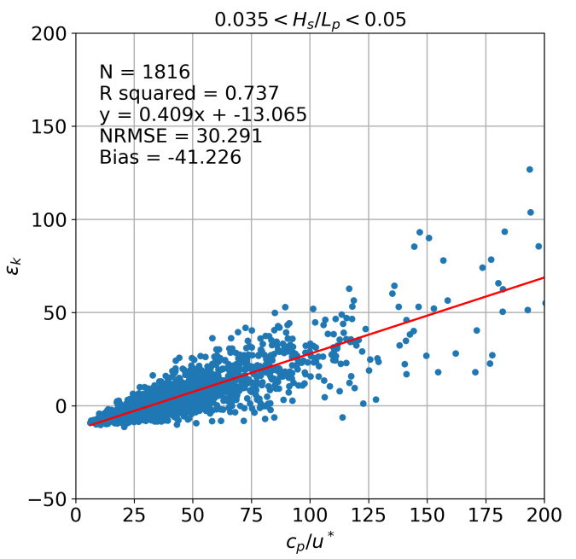
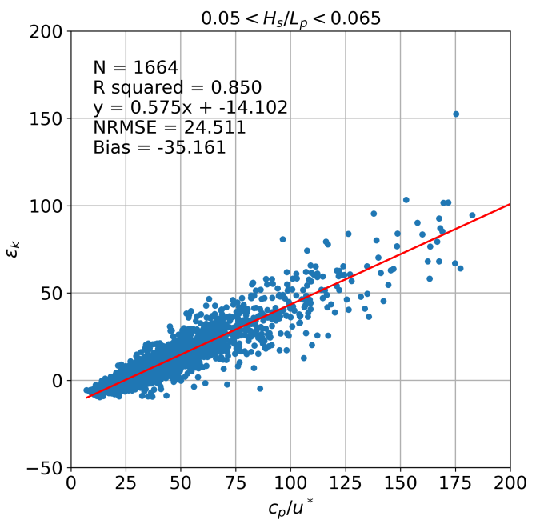
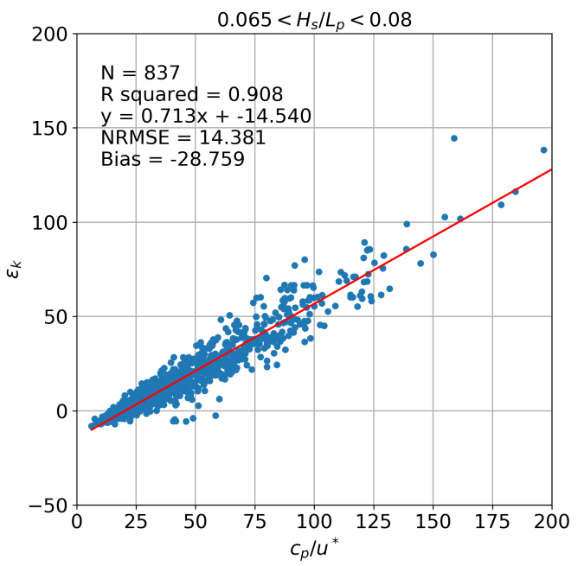
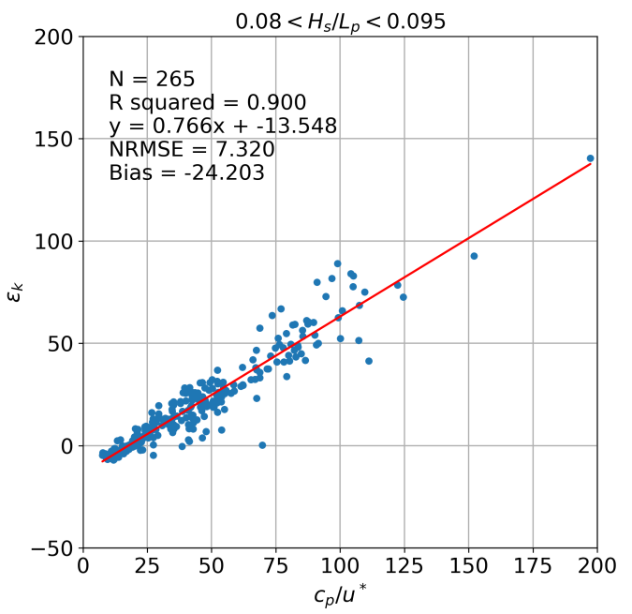
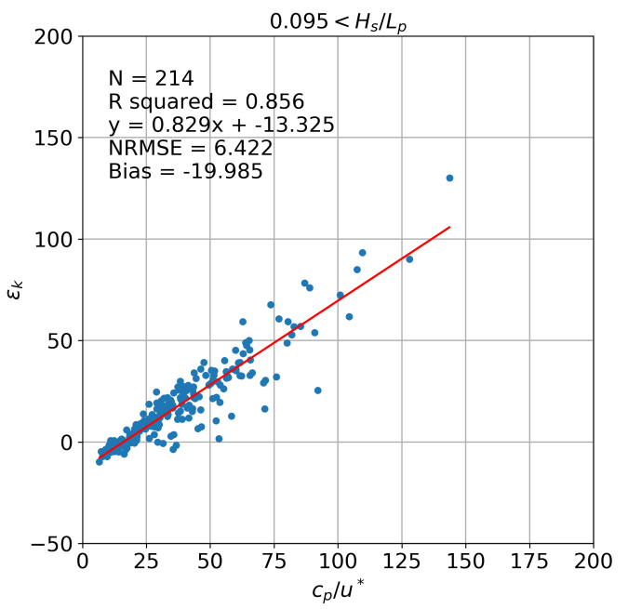
Bonus slide

