Slide 1
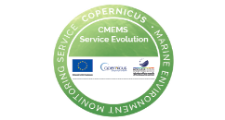
The Virtual Scatterometer Constellation and its Exploitation in User Applications
Ad.Stoffelen@knmi.nl, fellow IEEE
Leader active sensing, R&D satellites (RDSW), KNMI, the Netherlands
EUMETSAT Ocean and Sea Ice SAF
EU Copernicus Marine Service Wind TAC
with
contributions from many . . .

Slide 2
Golden age of Scatterometry (WMO OSCAR)
Source: https://space.oscar.wmo.int/gapanalyses?mission=12
Past C-band missions : Past Ku-band missions :
ERS-1,2/ESCAT 10:30 desc. 1992-1996, 1995-2000 SeaWinds/QuikScat 6:00 desc. 1999-2009
MetOp-A/ASCAT 9:30 desc. 2007-2021 RapidScat/ISS 52 * 2014-2016
OceanSat-2/OSCAT-1 0:00 desc. 2009-2014
ScatSat-1/OSCAT-2 8:45 desc. 2016-2021
Prepare ourselves for many scatterometers ☺
Exploit for weather, ocean and climate applications

Slide 3
Motivation / Potential
Scatterometer winds were introduced and represented at the IWWG meetings since 1996 (Ascona meeting)
OSW side meetings were held at several IWWG meetings with representatives of the NWP community
Several topics need further attention beyond CEOS and IOVWST, such as:
Intercalibration of wind products for Climate Data Records and operational user convenience
An in-situ wind speed reference for high and extreme winds
Methods for the elimination of model biases in NWP data assimilation (local VARBC)
Improved spatial NWP wind assimilation methods; assimilate unique wind products
QC optimization for NWP, Ku-band rain
Open high-level wind services and global timeliness of the virtual constellation
Open data comparisons and open software to share in the community
Exploit scatterometer wind stress measurements for improved atmosphere-ocean coupling
Development of coastal winds for all scatterometers
The OSW TG facilitates an open and shared environment to address above points for the general benefit of the meteorological/ocean community

Slide 4
To be considered by CGMS from OSW TG
For improved satellite wind speed calibration, collaboration on WMO level with in-situ experts and with dropsonde providers is recommended in order to better comprehend in-situ measurement data and their accuracy in extreme conditions, which is of large societal relevance;
Encouragement and support from satellite agencies would accelerate the effective use of the OSW that they produce in NWP with potentially large effect on forecast quality of the extending virtual scatterometer constellation;
To define an official international operational framework to ensure timely and valuable high-resolution SAR acquisitions of Tropical Cyclones (cf. WMO IWTC-10).

Slide 5
F2F IOVWST
Overview of the constellation
Combining scatterometers to improve (inter)calibration and QC
Improvements in spatial processing at extremes, coastal
Scatterometer data assimilation
Ocean forcing using scatterometers
Novel missions and science
https://osi-saf.eumetsat.int/community/stories/international-ocean-vector-winds-science-team-meeting-2023

Slide 6
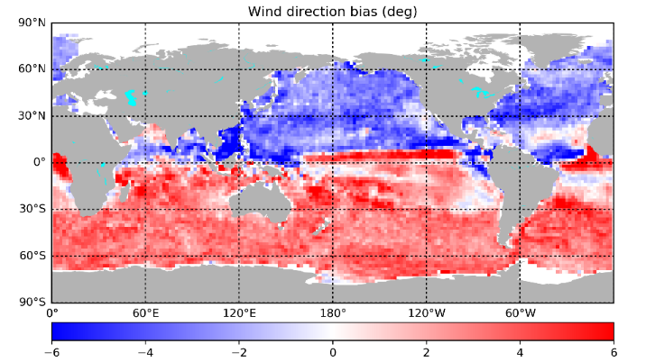
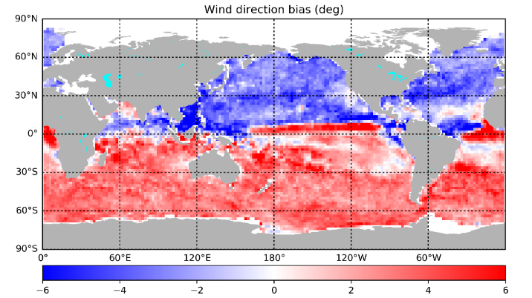
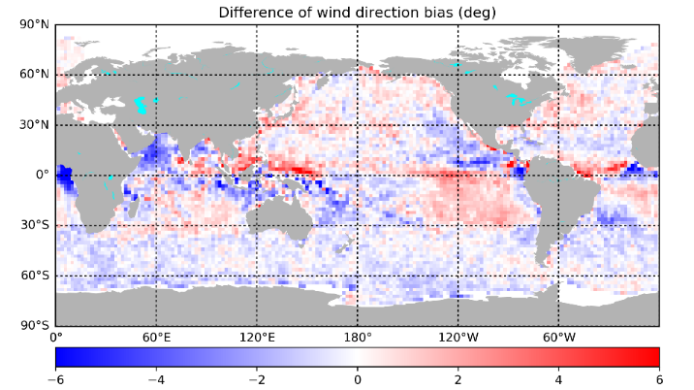
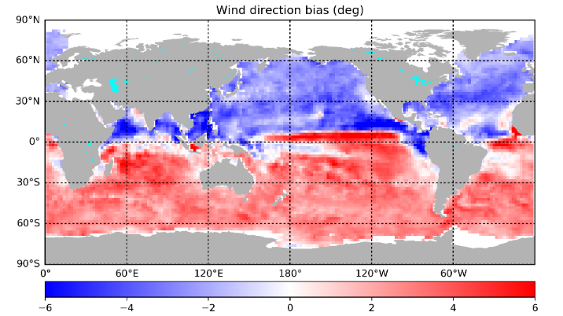
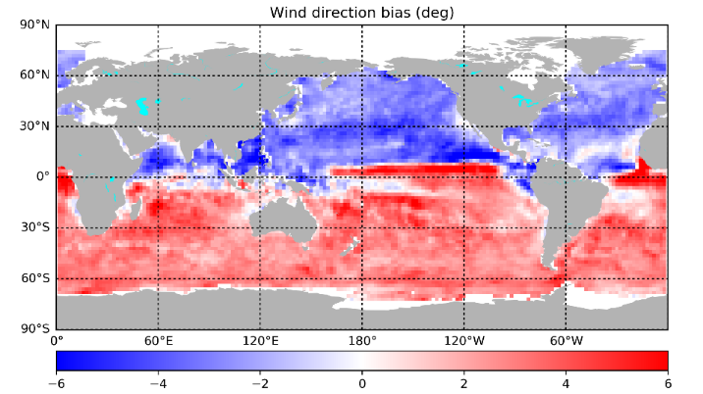
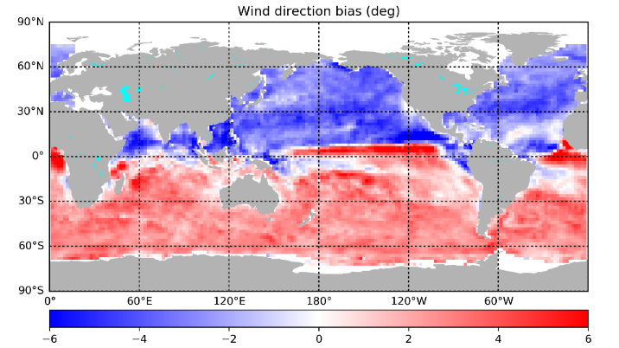
Wind direction biases of SCA - NWP
From 5 different scatterometers:
Pattern could be diurnal cycle error
ASCAT-B NRT
ASCAT-C NRT
ASCAT-B/NRT – HSCAT-B/Rep02
HSCAT-B Rep02
HSCAT-C Rep02
HSCAT-D Rep02
What happens when you push ocean water in the wrong direction in digital Earth models ?
Thanks to Zhixiong Wang, NUIST
6

Slide 7
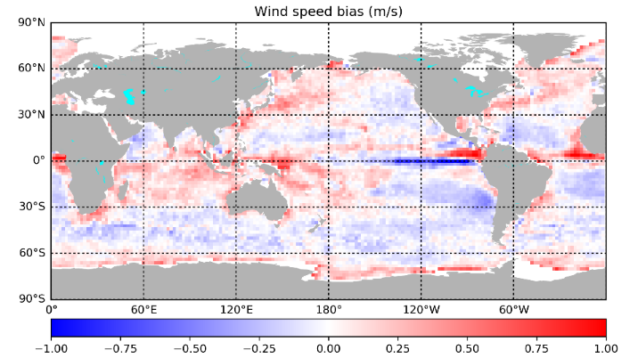
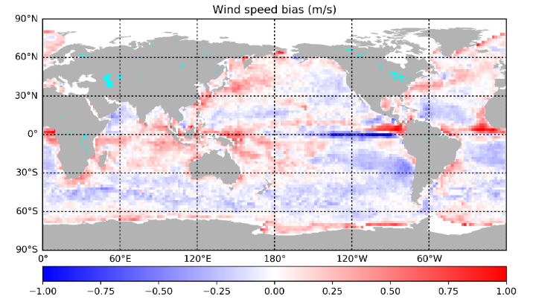
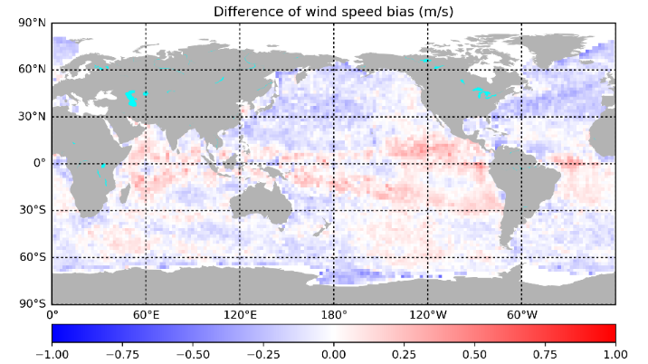
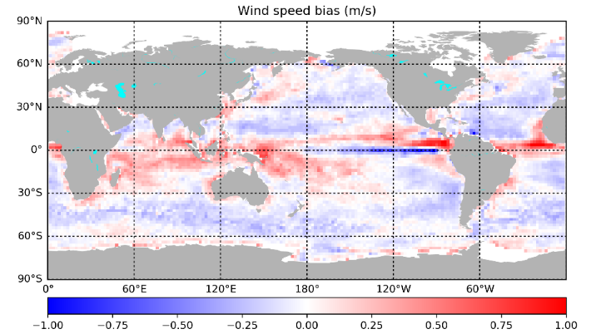
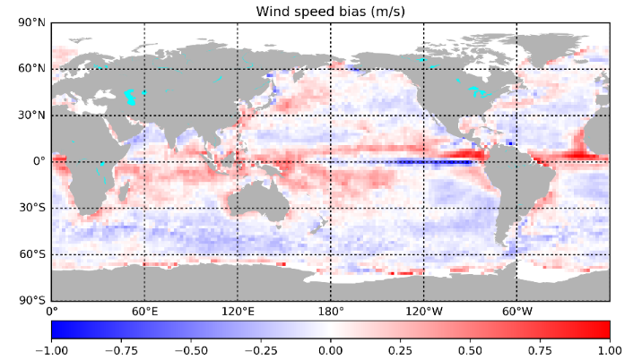
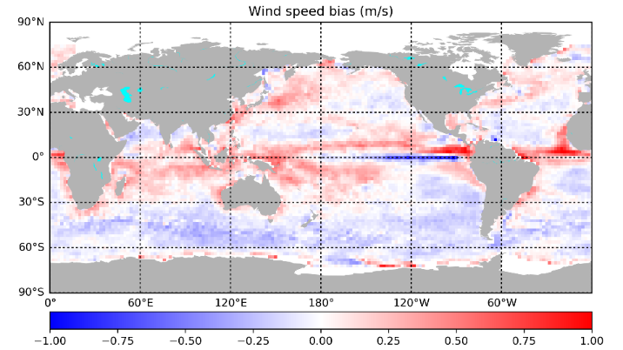
Wind speed biases of SCA - NWP
From 5 different scatterometers:
Pattern could be diurnal cycle error
ASCAT-B NRT
ASCAT-C NRT
ASCAT-B/NRT – HSCAT-B/Rep02
HSCAT-B Rep02
HSCAT-C Rep02
HSCAT-D Rep02
What happens when you push ocean water wrongly in digital Earth models ?
Thanks to Zhixiong Wang, NUIST
7

Slide 8
Background information

Slide 9
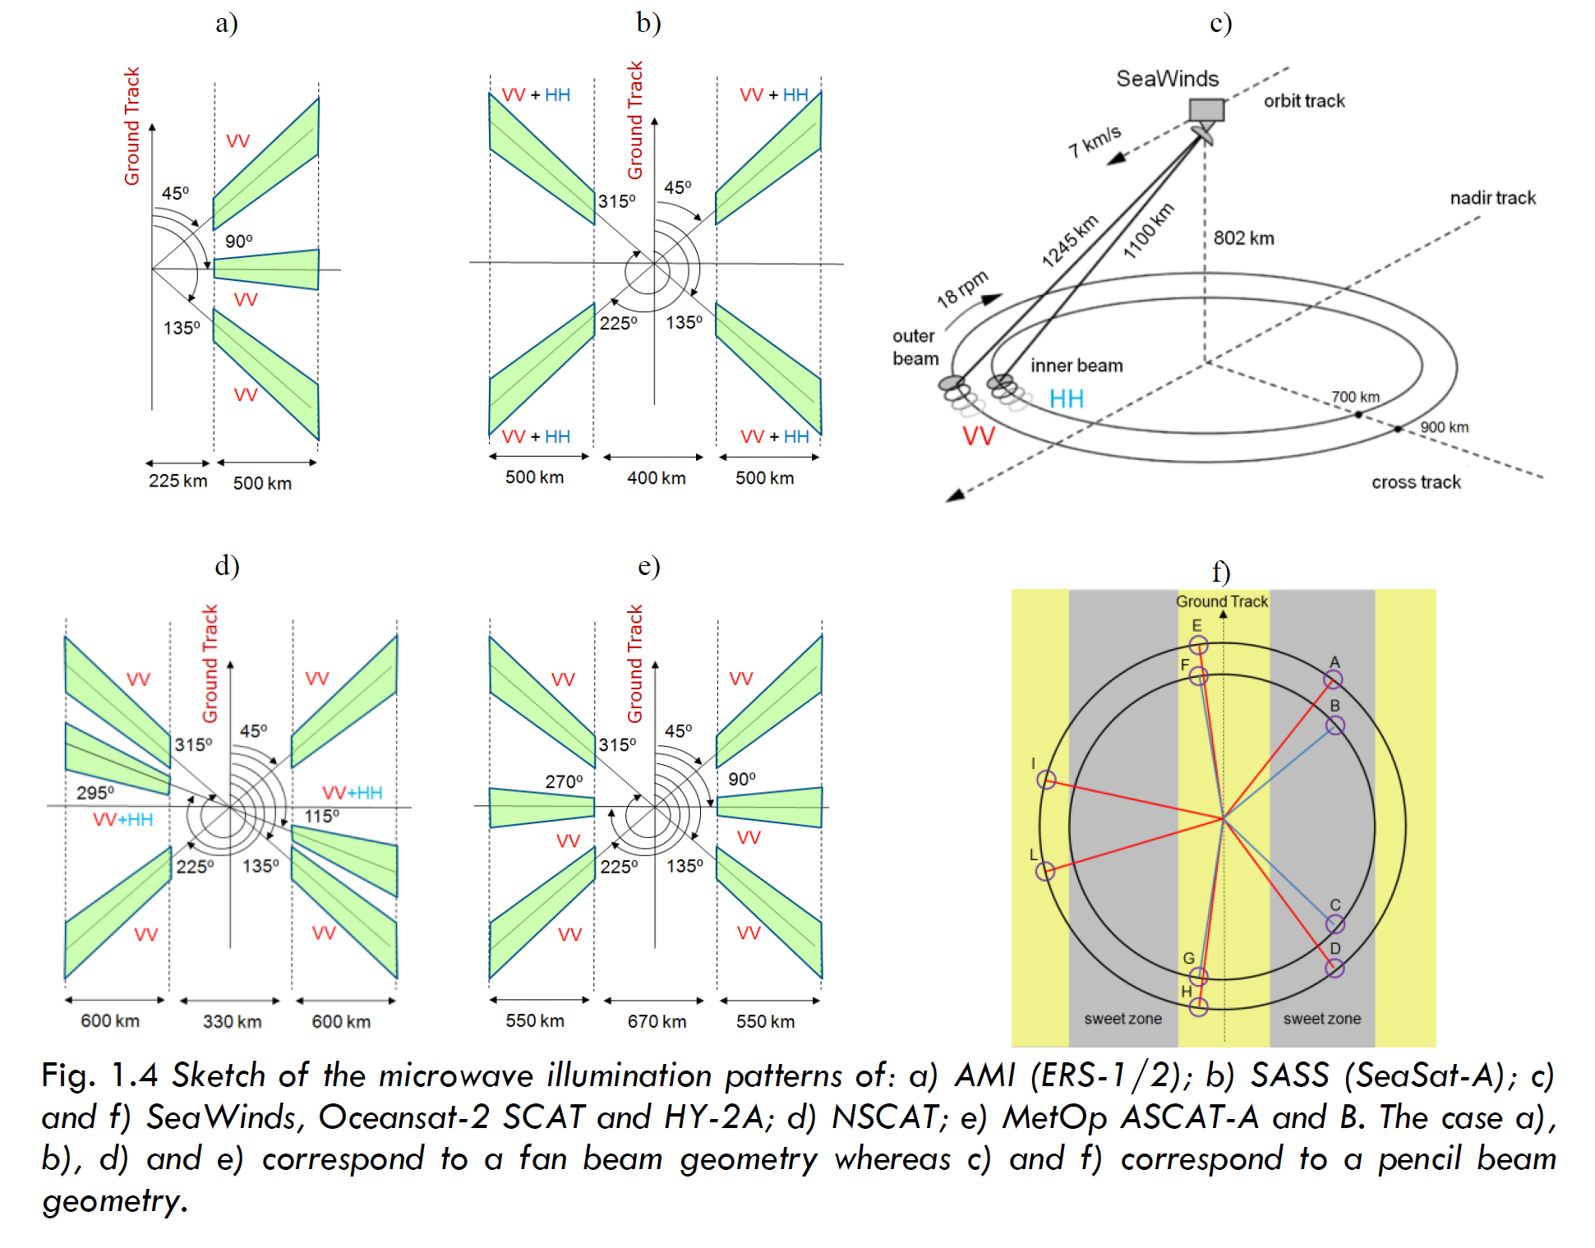
Ku
C
Ku
Ku
Ku
C
Franco Fois, PhD thesis, 2015

Slide 10
Stress-equivalent wind
Radiometers/scatterometers measure ocean roughness
Ocean roughness consists in small (cm) waves generated by air impact and subsequent wave breaking processes; depends on gravity, water mass density, surface tension s, and e.m. sea properties (assumed constant)
Air-sea momentum exchange is described by τ = ρ_{air} u* u* , the stress vector; depends on air mass density ρ_{air} , friction velocity vector u*
Surface layer winds (e.g., u₁₀) depend on u* , atmospheric stability, surface roughness and the presence of ocean currents
Equivalent neutral winds, u_{10N} , depend only on u* , surface roughness and the presence of ocean currents and is currently used for backscatter geophysical model functions (GMFs)
u_{10S} = √ρ_{air} . u_{10N}/√ρ₀ is now used to be a better input for backscatter GMFs (stress-equivalent wind)
This prevents regional biases against local wind references
Jos de Kloe et al., 2017

Slide 11
Current CGMS OSW Task Group
Ad Stoffelen (KNMI, lead)
Fangli Du (CMA)
Jian Shang(CMA)
Régis Borde(EUMETSAT, IWWG)
Stefanie Linow (EUMETSAT)
Mark Bourassa (FSU, IOVWST)
Dave Halpern (IOC)
Raj Kumar (ISRO, ret.)
Ernesto Rodriguez (NASA)
Svetla Hristova (NASA)
Paul S Chang (NOAA, CEOS VC)
Juhong Zou (NSOAS)
Dong Xiaolong (NSSC, CEOS WGCV MSSG)
Steve Wanzong (UW-Madison/SSEC/CIMSS, IWWG)
Heikki Pohjola (WMO)
Instruments
WindRad (CMA)
HY2-B/C/D (NSOAS)
ASCAT-A/B/C (EUMETSAT)
CFOSAT (NSOAS/CNES)
OceanSat-2/3, ScatSat (ISRO)
NSCAT, QuikScat, RapidSCAT (NASA)
ERS-1/2 (ESA)
WindSat, SSMI, AMSR, MWI
SAR (ERS, Envisat, S-1, RadarSat, . . . )
(GNSS-R)
(Altimeters)

Slide 12
Actionable CGMS members
CMA | China Meteorological Administration | 1989
CNES | Centre National d’Etudes Spatiales | 2004
CNSA | China National Space Administration | 2006
ESA | The European Space Agency | 2003
EUMETSAT | EUMETSAT | 1987
IMD | India Meteorological Department | 1979
IOC-UNESCO | Intergovernmental Oceanographic Commission - UNESCO | 2001
ISRO | Indian Space Research Organisation | 2015
JAXA | Japan Aerospace Exploration Agency | 2003
JMA | Japan Meteorological Agency | 1972
KMA | Korea Meteorological Administration | 2005
NASA | National Aeronautics and Space Administration | 2003
NOAA | National Oceanic and Atmospheric Administration | 1972
ROSCOSMOS | Russian Federal Space Agency | 2003
ROSHYDROMET | Russian Federal Service for Hydrometeorology and Environmental Monitoring | 1973
WMO | World Meteorological Organization | 1973
Current and prospective developers and operators of meteorological satellites
WMO, because of its unique role as representative of the world meteorological data user community, and other programmes jointly supported by WMO and other international agencies
Space agencies operating R&D satellites contributing to WMO programmes
Observers
CSA | Canada Space Agency
ENV CAN | Environment Canada
GCOS | Global Climate Observing System
KARI | Korea Aerospace Research Institute
KIOST | Korea Ocean Research & Development Institute
SOA | State Oceanic Administration (National Satellite Ocean Application Service, NSOAS, under the Ministry of Natural Resources, MNR)

