Slide 1
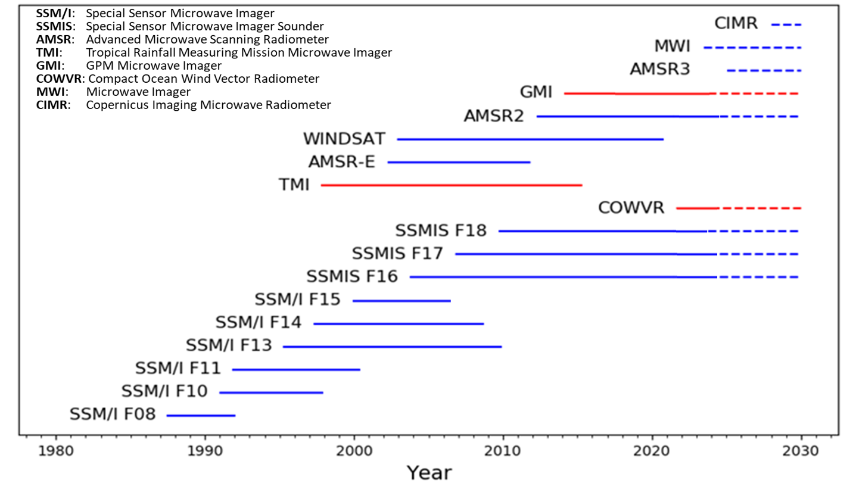
MW Radiometer Missions with Wind Retrieval Capability
SMAP: Soil Moisture Active Passive
SMOS: Soil Moisture and Ocean Salinity
SMAP
SMOS
L-band only
Non-sun-synchronous
Fully Polarimetric (wind vector)

Slide 2
MW Channel Utilization in Surface Wind Retrievals
Primary Channels and Source of Emission
Band (GHz) | 1.4 L-band only | 6-7 | 10 | 18-19 | 22-23 | 34-37 | 85-91
Sensors | SMAP, SMOS | AMSR, WSAT | TMI, GMI, MWI, AMSR, WSAT | ALL (incl. COWVR) | ALL (+COWVR) | ALL (+COWVR) | TMI, GMI, MWI SSMIS, AMSR
SST
Wind | No rain impact/ Sensitivity to high winds
Water Vapor
Rain/Cloud
Ice/Scatter.
SFMR
Surface
Atmosphere

Slide 3
RADIOMETERS WINDS: PROS/CONS
Advantages
Long legacy (continuous, since 1988), overlapping and cross-calibrated sensors
Allowing Climate Data Records
Diurnal sampling: variety of fixed orbit times + non-sun-synchronous (TMI, GMI, COWVR)
Simultaneous observations of several environmental parameters:
wind, rain, water vapor, SST, cloud
Capability of wind vector retrievals with polarimetric channels
L-band very sensitive to high winds and insensitive to rain (winds in TCs)
Potential for downscaling to lower cost small satellites (i.e. COWVR)
Fully polarimetric + fore/aft observing mitigates wind direction ambiguities in retrievals
Disadvantages
Lower resolution (25-50 km) than scatterometers
Rain impact on wind retrievals (can be mitigated with 6 GHz channel)
Radio Frequency Interference (RFI) is a growing problem (requiring more agile sensors)
Most of climate record is scalar winds (fully polarimetric generally not required for
most MW missions i.e. precip)

Slide 4
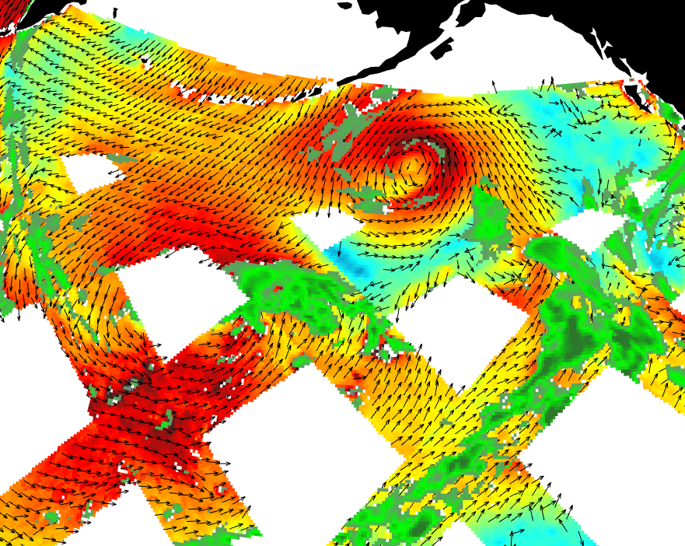
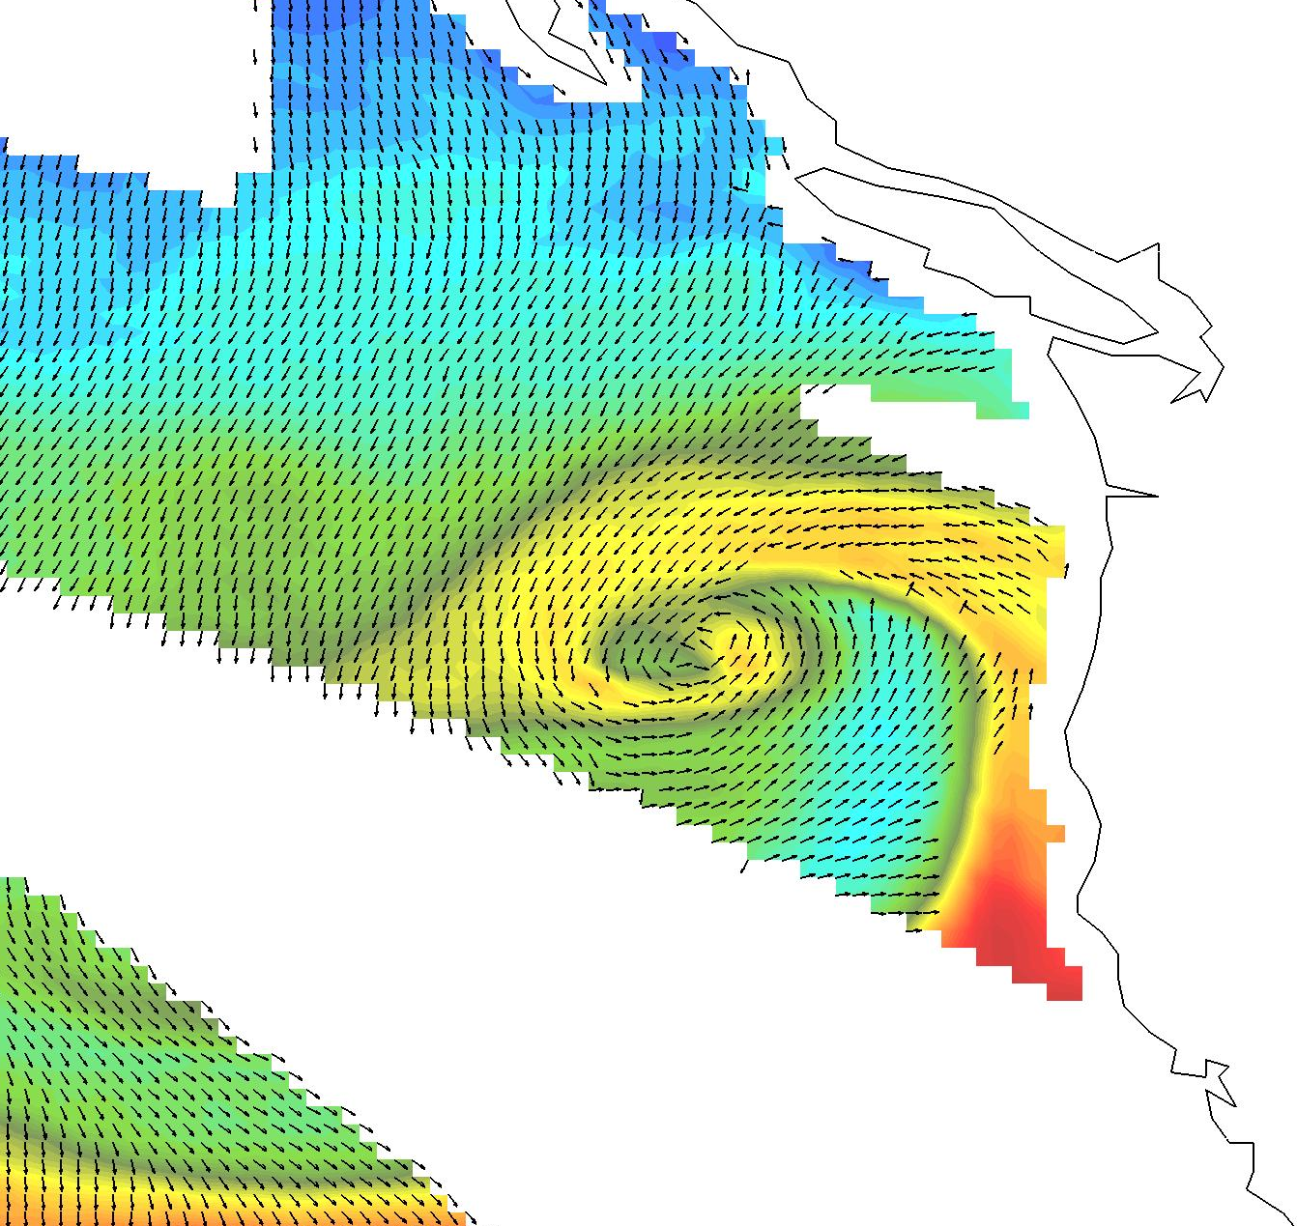
Radiometer capabilities:
Wind vector and other parameters
Surface Wind Vector and Rain
Surface Wind Vector and Water Vapor
Microwave Radiometers have added benefit of co-located observations of water vapor, clouds, rain, SST

Slide 5
Backup

Slide 6
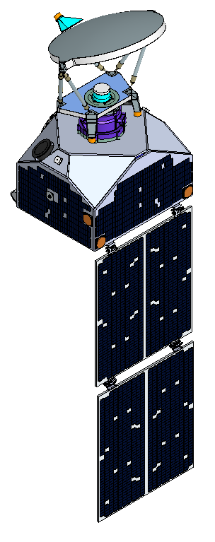
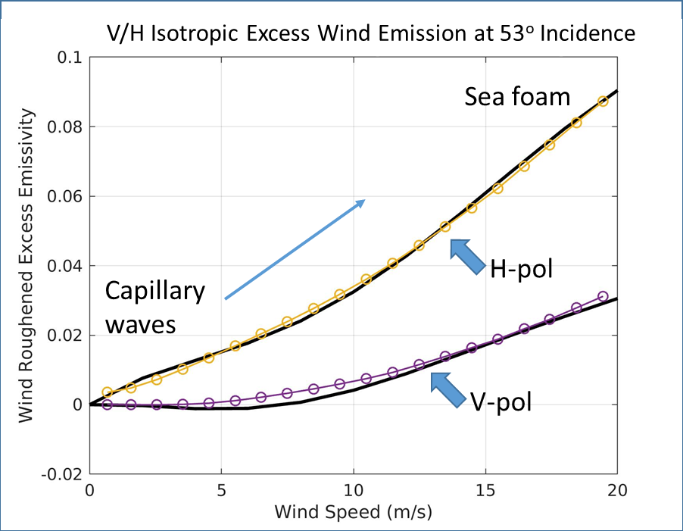
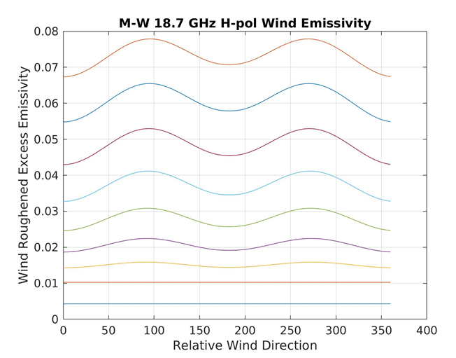

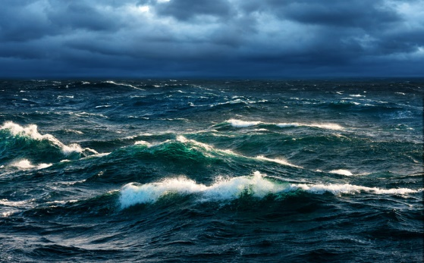
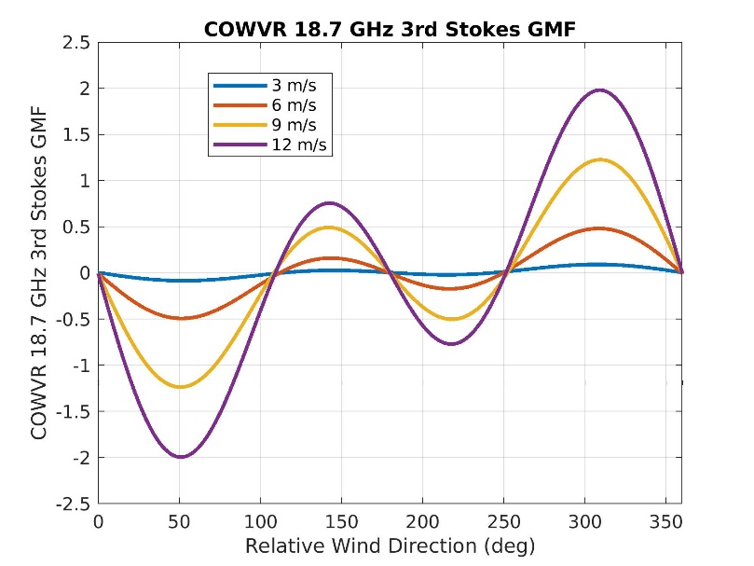
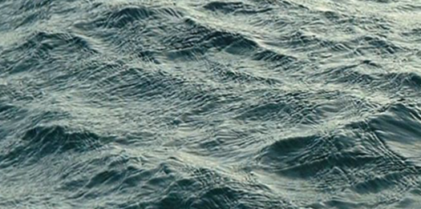
Polarization Stokes Vector
Ocean Emissivity Model Function
$ε_{V/H}=a_{0}+a_{1}\cos{φ_{rel}}+a_{2}$ $\cos{{2φ}_{rel}}$
Dual-pol radiometer
$ε_{3/4}=b_{1}\sin{φ_{rel}}+b_{2}$ $\sin{{2φ}_{rel}}$
Fully polarimetric
a₀

Slide 7
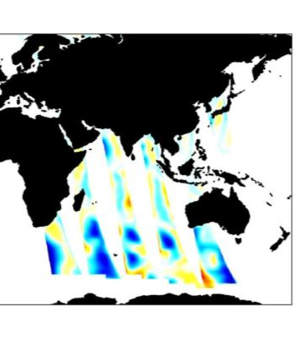
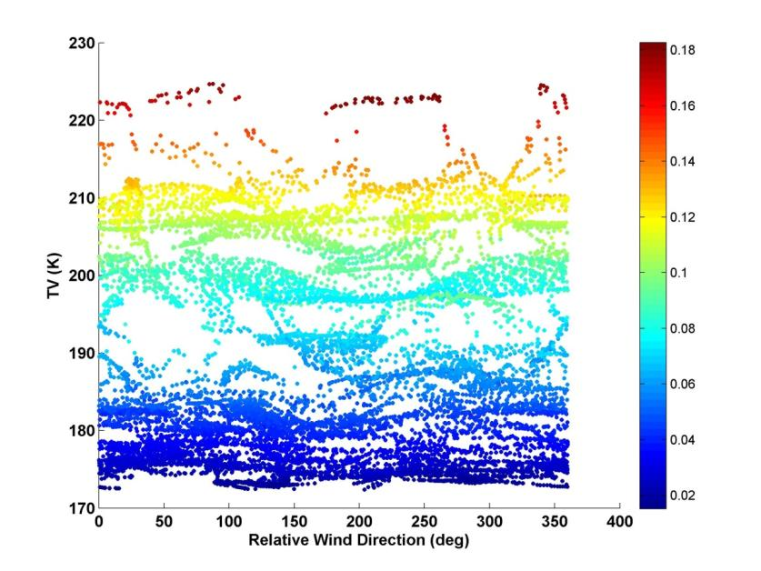
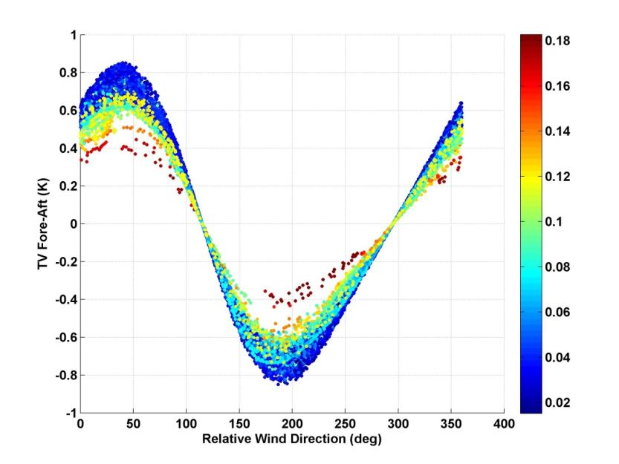
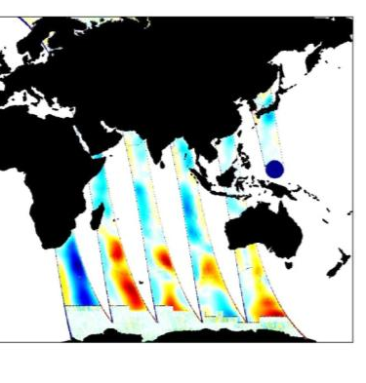
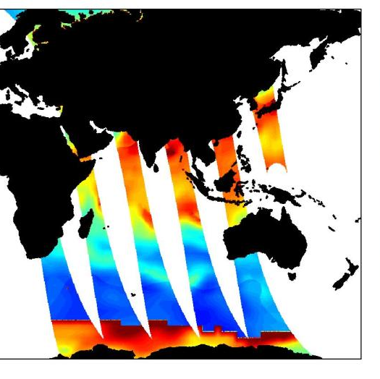
2-Look Passive Microwave Radiometry
V/H-pol channels have orthogonal wind direction signal from 3rd/4th, but the small signal at the ocean surface is swamped by the atmospheric contribution
Taking the fore/aft difference largely cancels out atmosphere, similar to 3rd and 4th stokes channels
3rd Stokes Top-of-Atmosphere
V-pol Fore-Aft Top-of-Atmosphere
from simulation

