Slide 1
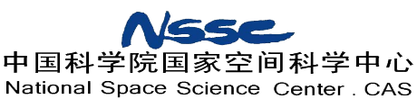


Calibration and inversion of the backscatter data from the Chinese OSCOM Doppler Scatterometer airborne prototype
Shilei Wang, Marcos Portabella, Xiaolong Dong, Wenming Lin, Qingliu Bao

Slide 2
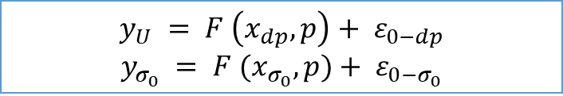
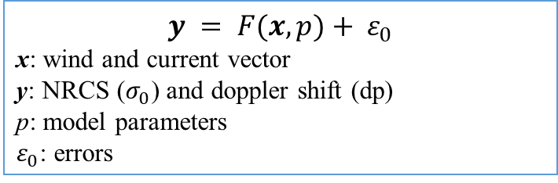
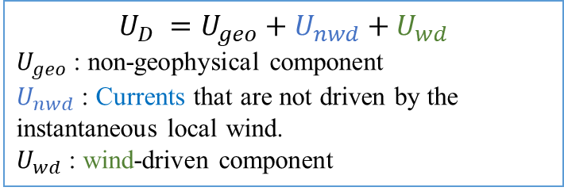
Simultaneous wind and current retrievals from Doppler scatterometer data:
2 methods:
Backscatter and doppler observations are combined in the cost function. Thus winds and currents are inversed at the same time.
Backscatter and doppler observations are combined in the cost function. Thus winds and currents are inversed at the same time.
Winds and currents are retrieved separately. Winds are inversed using the backscatter, and currents are retrieved using the doppler shift.
$$y_{U} = F \left(x_{dp}, p\right)+ ε_{0−dp}$$
$$y_{σ_{0}} = F (x_{σ_{0}}, p)+ ε_{0−σ_{0}}$$
$$y = F(x, p)+ ε_{0}$$
x: wind and current vector
y: NRCS ($σ_{0}$) and doppler shift (dp)
p: model parameters
$ε_{0}$: errors
$$U_{D} =U_{geo}+U_{nwd}+U_{wd}$$
$U_{geo}$: non-geophysical component
$U_{nwd}$: Currents that are not driven by the instantaneous local wind.
$U_{wd}$: wind-driven component
Reference:
Martin, A., et al. (2018). Simultaneous ocean surface current and wind vectors retrieval with squinted SAR interferometry: Geophysical inversion and performance assessment. Remote Sensing of Environment, 216.
First of all, calibrate measurements.
Instrument instability
Limited dataset
……
Reference:
Elyouncha, A., Eriksson, L. E., Broström, G., Axell, L., & Ulander, L. H. (2021). Joint retrieval of ocean surface wind and current vectors from satellite SAR data using a Bayesian inversion method. Remote Sensing of Environment, 260, 112455.

Slide 3
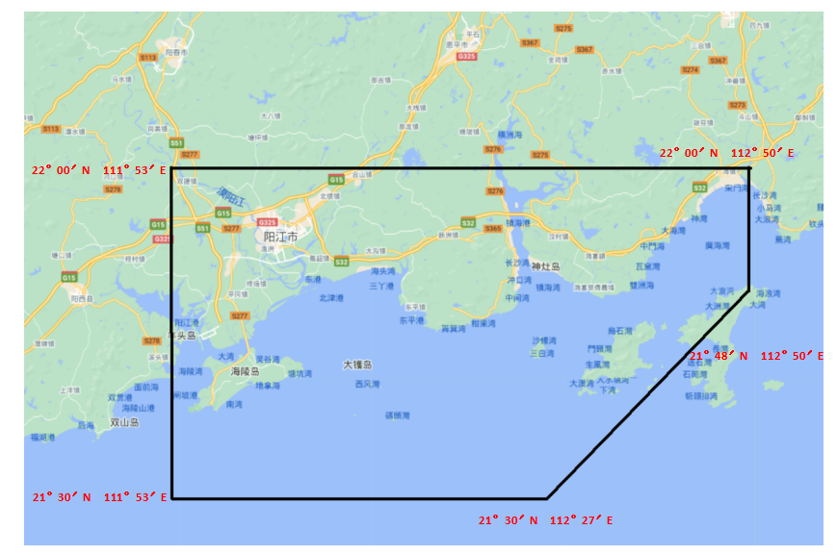
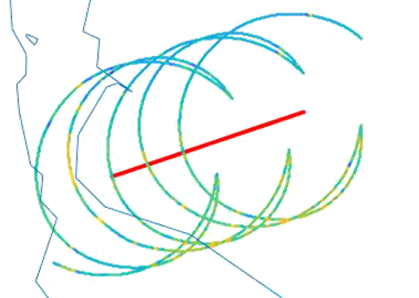
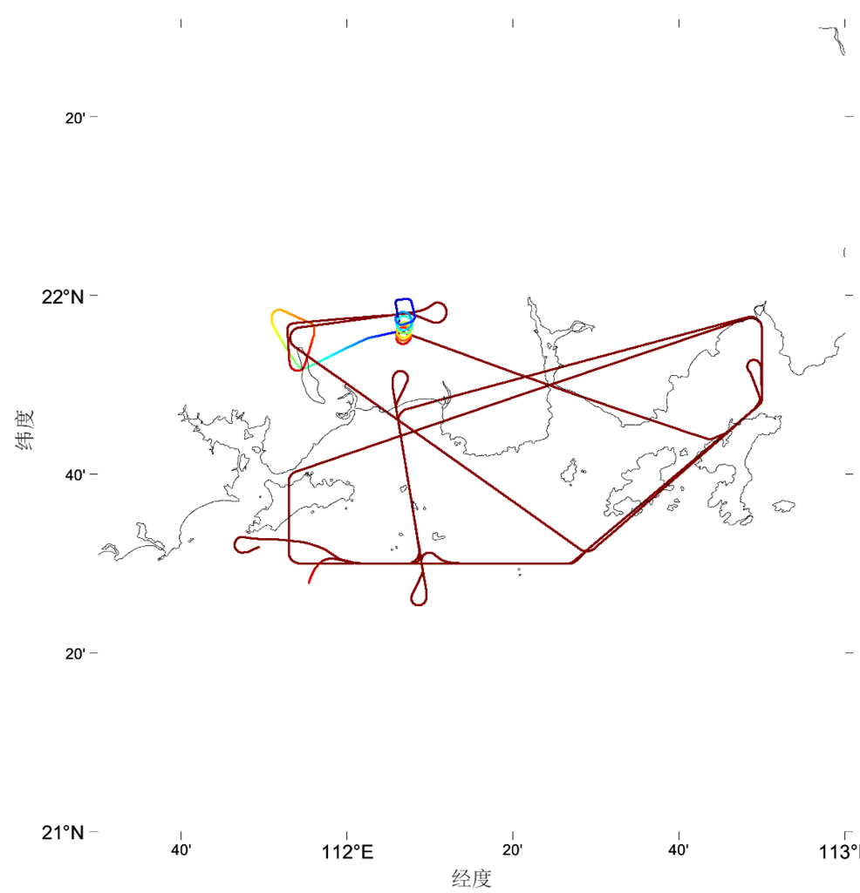
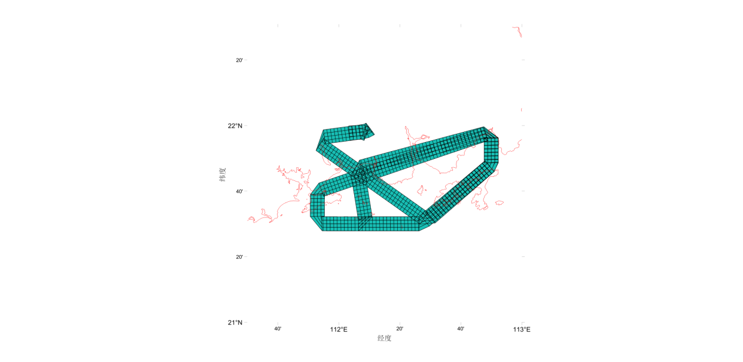
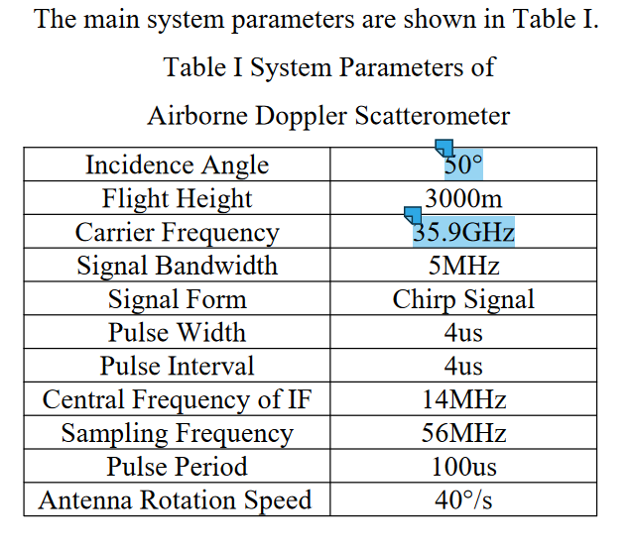
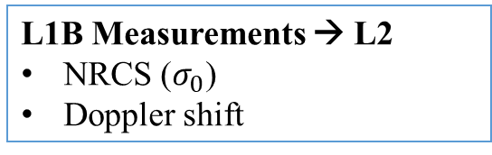
OSCOM campaign:
Rotating pencil-beam airborne doppler scatterometer
Experiment year：2020
August 6 14:30pm-17:30pm
August 11 14:30pm-17:10pm
August 15 14:00pm-18:00pm
Experiment area:
Coastal area in south of Yangjiang River, Guangdong Province, China
Latitude: from 21°30’N to 22°00’N
Longitude: from 111°53’E to 112°50’E
System parameters
Polarization: VV
L1B Measurements → L2
NRCS ($σ_{0}$)
Doppler shift
Cell size: 2 km
Swath width: 8 km

Slide 4
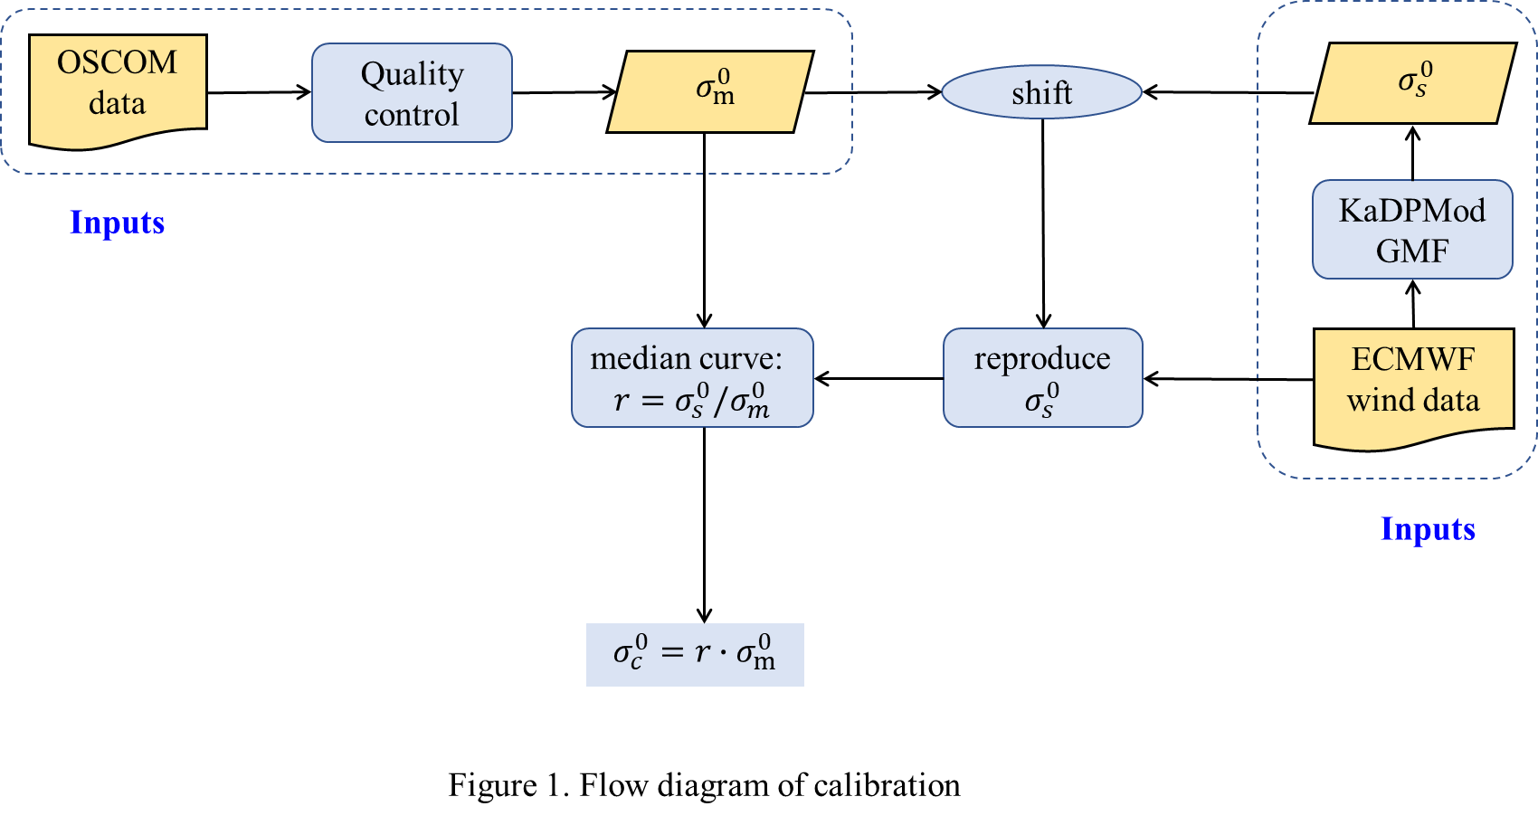
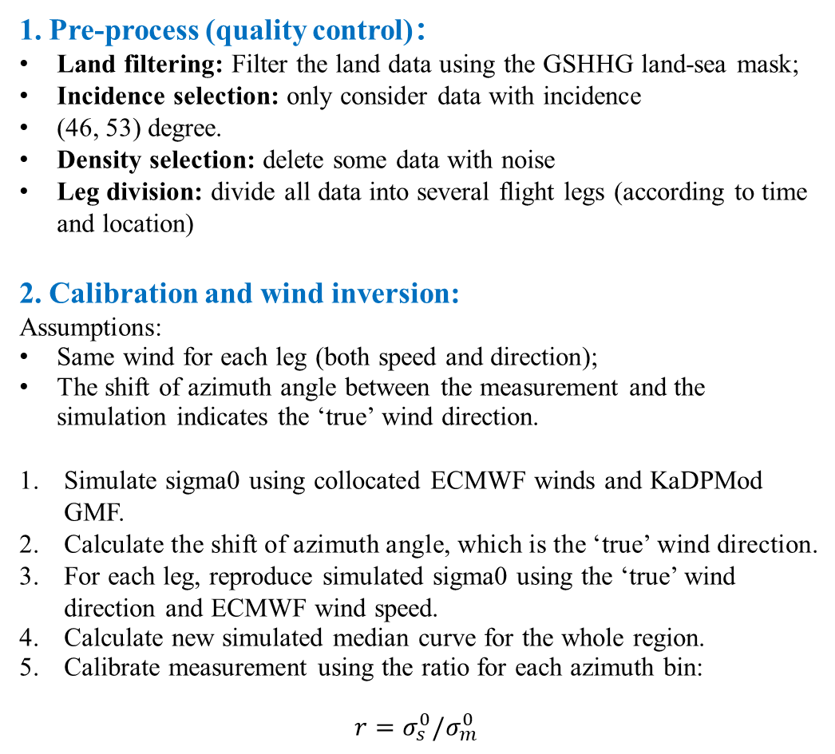
1. Pre-process (quality control)：
Land filtering: Filter the land data using the GSHHG land-sea mask;
Incidence selection: only consider data with incidence
(46, 53) degree.
Density selection: delete some data with noise
Leg division: divide all data into several flight legs (according to time and location)
2. Calibration and wind inversion:
Assumptions:
Same wind for each leg (both speed and direction);
The shift of azimuth angle between the measurement and the simulation indicates the ‘true’ wind direction.
Simulate sigma0 using collocated ECMWF winds and KaDPMod GMF.
Calculate the shift of azimuth angle, which is the ‘true’ wind direction.
For each leg, reproduce simulated sigma0 using the ‘true’ wind direction and ECMWF wind speed.
Calculate new simulated median curve for the whole region.
Calibrate measurement using the ratio for each azimuth bin:
$$r=σ_{s}^{0}/σ_{m}^{0}$$
3. Ongoing work

Slide 5
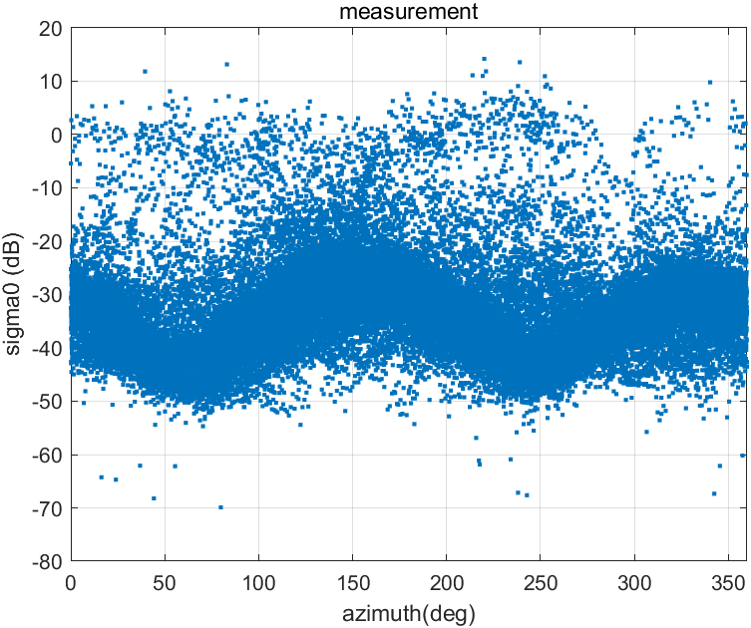
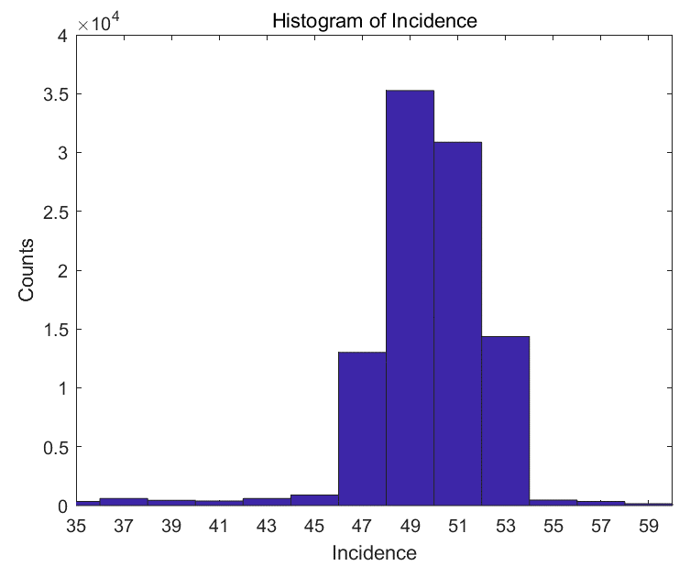
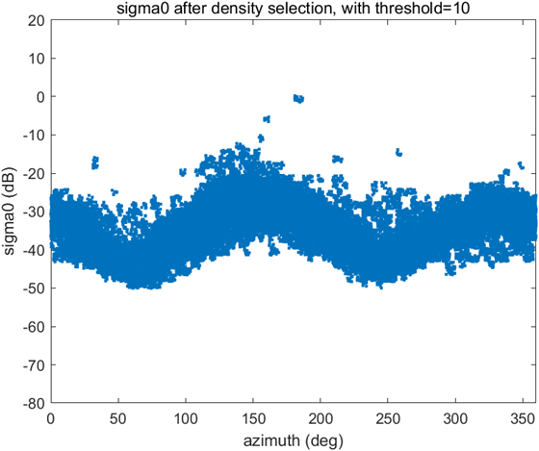
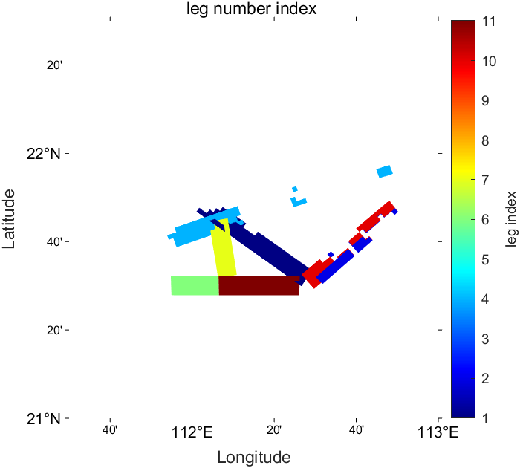
1. Pre-process (quality control)：
Land filtering: Filter the land data using the GSHHG land-sea mask;
Incidence selection: only consider data with incidence
(46, 53) degree.
Density selection: delete some data with noise
Leg division: divide all data into several flight legs (according to time and location), and delete those legs with less data.
Land filtering
Incidence selection
Density selection
Leg division
Kp ≈ 20%

Slide 6
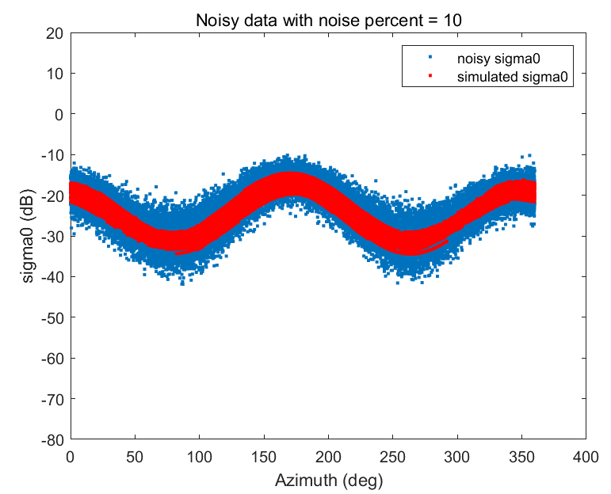
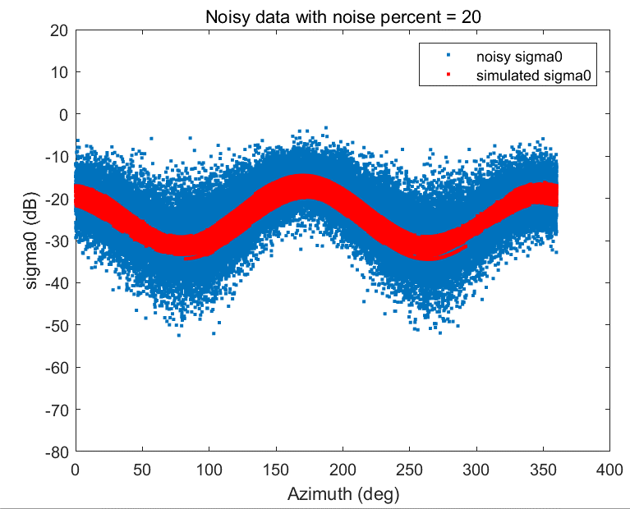
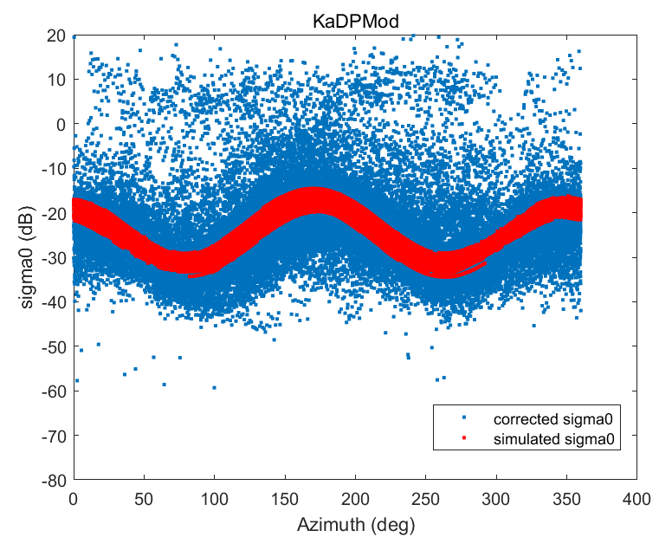
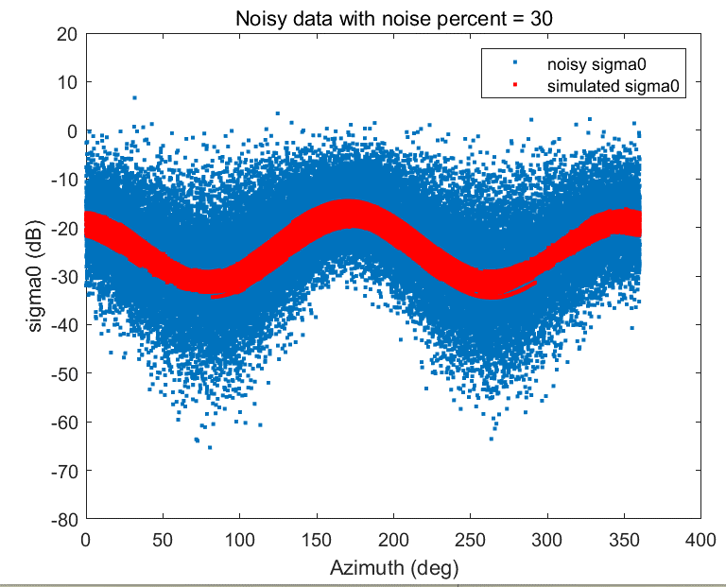
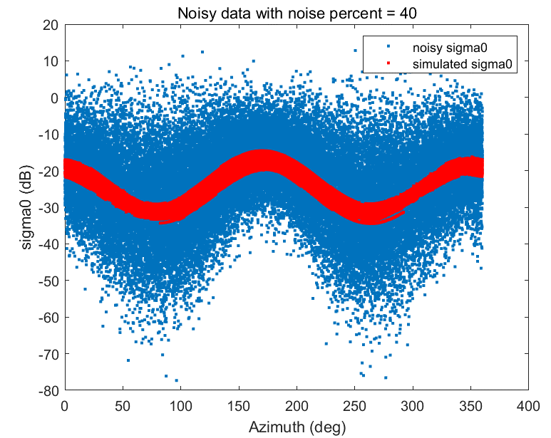
1. 1 Pre-process (quality control): Density selection
Simulate noisy sigma0 with Monte-Carlo method:
normally distributed
centered around the simulation
standard deviation on σ0 is
∆σ0 = Kp × σ0
Kp = 10%
Kp = 20%
Measured sigma0
Closest: Kp = 20%
Kp = 30%
Kp = 40%

Slide 7
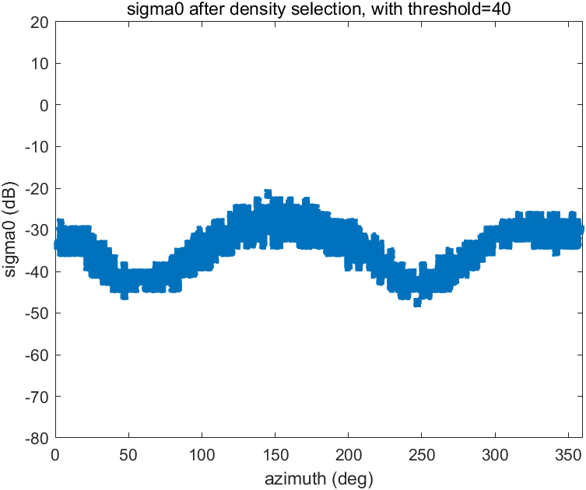
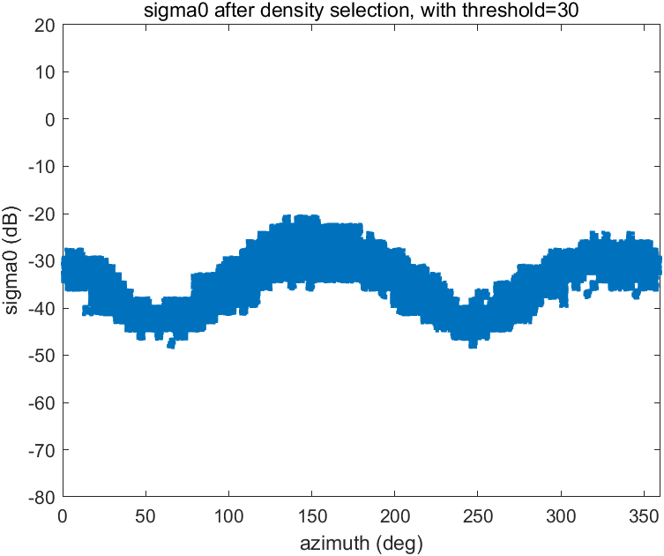
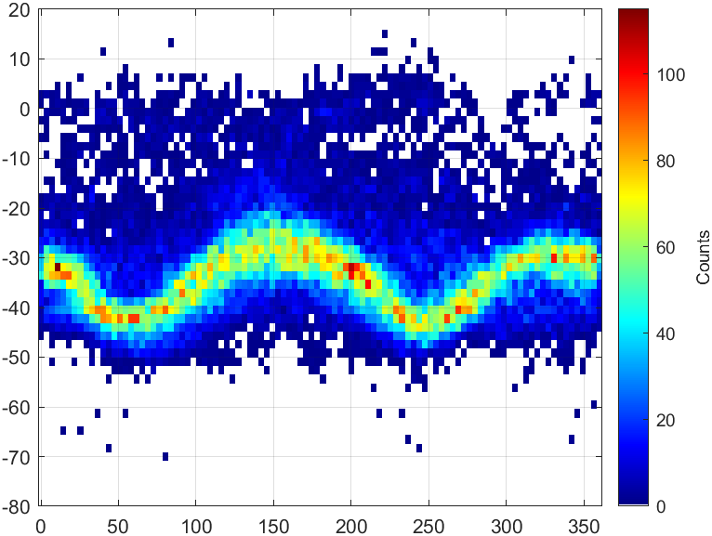
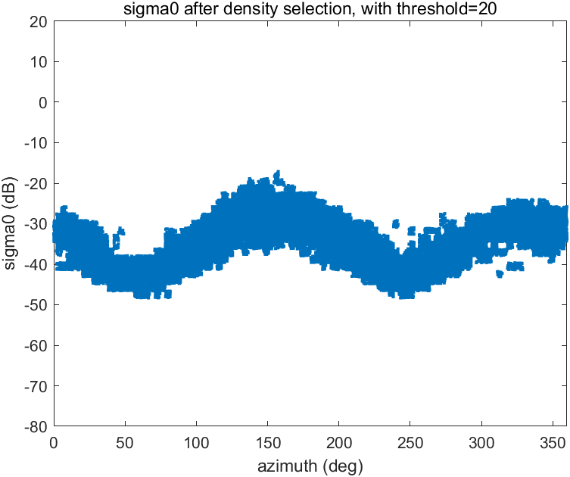

1.1 Pre-process (quality control)：Density selection
Aim：Exclude the noise
Method :
Split the whole range of x and y into several bins
At a certain bin: count how many points are within this bin.
Density > 40
Count: 27797
Density > 30
Count: 32471
Density selection
Threshold=10
2d histogram
Count: 48567
Density > 20
Count: 36755
Density > 10
Count: 42384
Test less constrained noise filtering on both calibration and wind retrieval

Slide 8
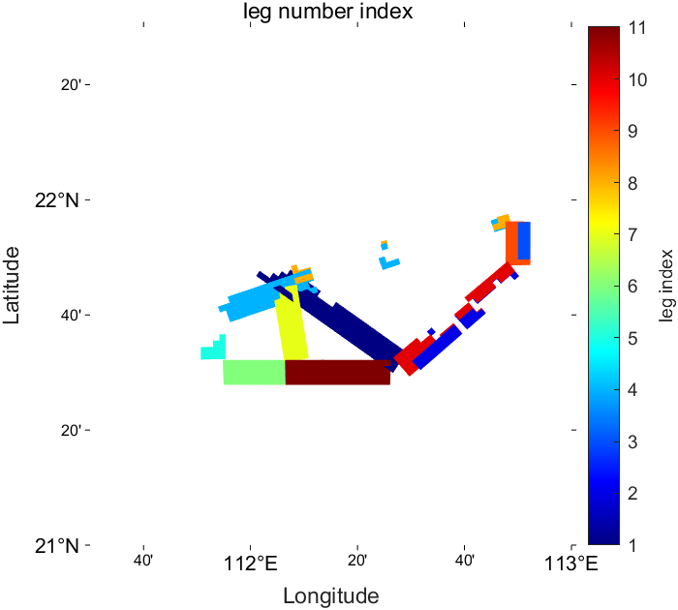
1.2 Pre-process (quality control)： Leg division
Divide all data into several flight legs (according to time and location)
Delete those legs with less data: leg index= 3, 5, 8 & 9
Quality control

Slide 9
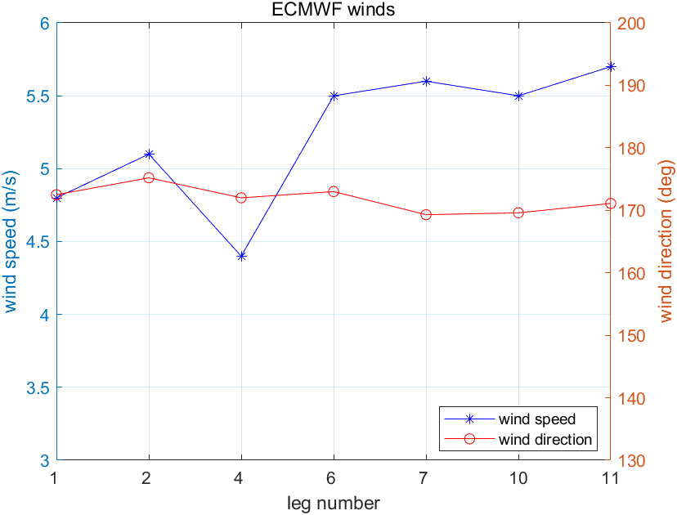
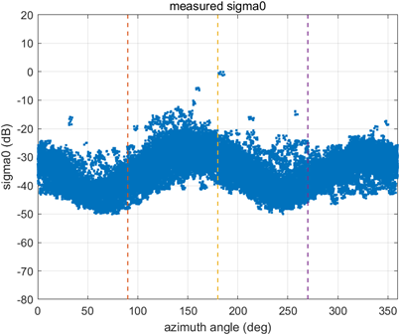
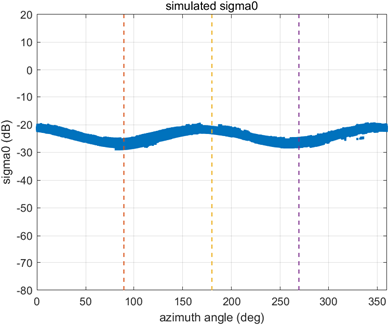

2.1 Calibration: Simulate sigma0
Assumptions:
Same wind for each leg (both speed and direction);
The shift of azimuth angle between the measurement and the simulation indicates the ‘true’ wind direction.
Simulate sigma0 using collocated ECMWF winds and KaDPMod GMF.
Model winds
KaDPMod GMF
Measured sigma0
Simulated sigma0
Reference:
Y. Y. Yurovsky, V. N. Kudryavtsev, S. A. Grodsky and B. Chapron, "Ka-Band Dual Copolarized Empirical Model for the Sea Surface Radar Cross Section," in IEEE Transactions on Geoscience and Remote Sensing, vol. 55, no. 3, pp. 1629-1647, March 2017, doi: 10.1109/TGRS.2016.2628640.
an obvious shift of azimuth angle
Different directional modulation

Slide 10
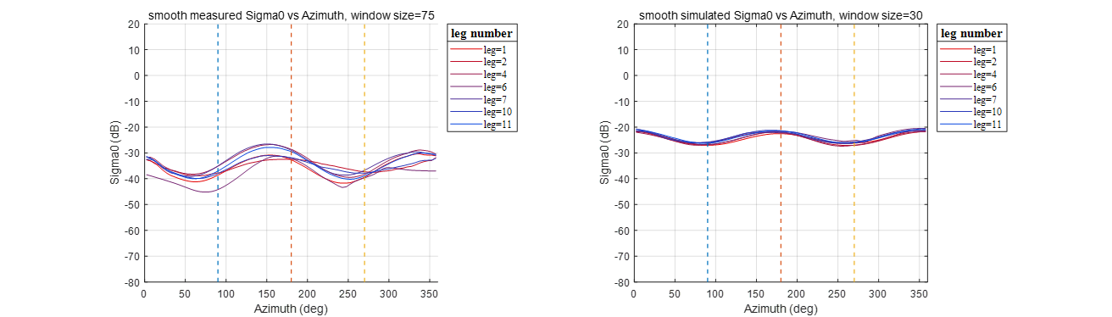
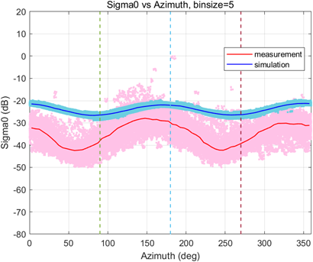
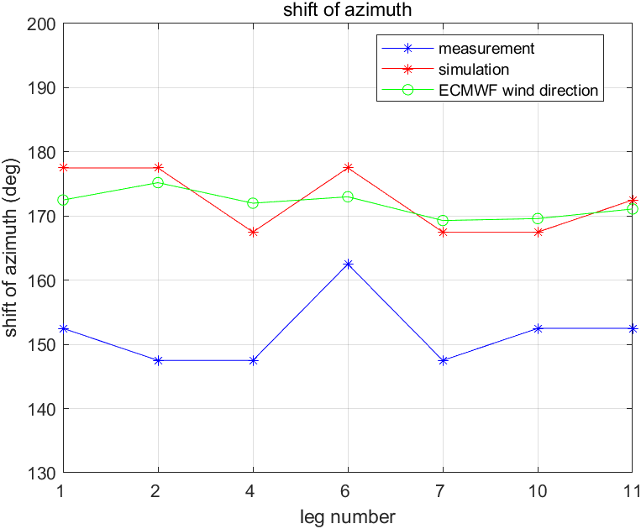
2.2 Calibration: Calculate the shift
Calculate the shift of azimuth angle, which is the ‘true’ wind direction.
1) Calculate and smooth median curves for each leg using low-pass filter
2) Calculate the shift for all legs
Shift: ‘True’ wind direction
measurement = 155°
Simulation = 175°

Slide 11

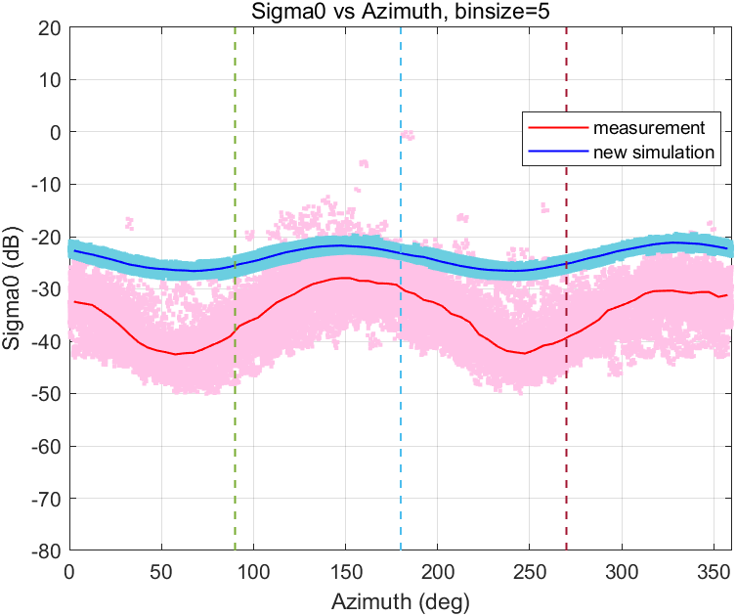
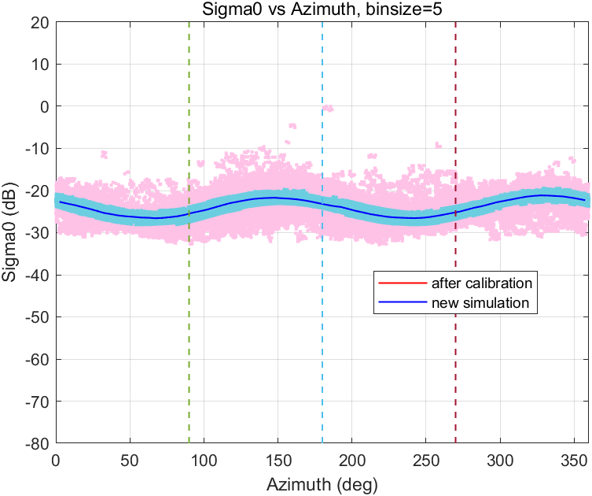

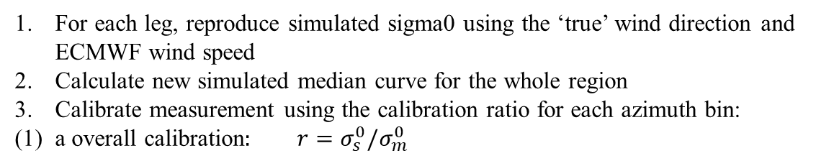



2.3 Calibration: calibrate sigma0 using the shift
For each leg, reproduce simulated sigma0 using the ‘true’ wind direction and ECMWF wind speed
Calculate new simulated median curve for the whole region
Calibrate measurement using the calibration ratio for each azimuth bin:
(1) a overall calibration$: r=σ_{s}^{0}/σ_{m}^{0}$
reproduce $σ_{s}^{0}$
reproduce $σ_{s}^{0}$
$$r=σ_{s}^{0}/σ_{m}^{0}$$
$$σ_{c}^{0}=r∙σ_{m}^{0}$$

Slide 12
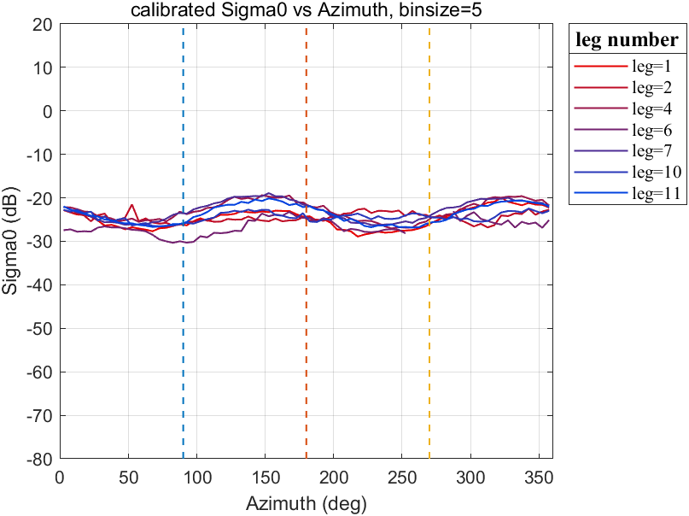
2.3 Calibration: calibrate sigma0 using the shift
For each leg, reproduce simulated sigma0 using the ‘true’ wind direction and ECMWF wind speed
Calculate new simulated median curve for the whole region
Calibrate measurement using the calibration ratio for each azimuth bin:
(1) a overall calibration$: r=σ_{s}^{0}/σ_{m}^{0}$
reproduce $σ_{s}^{0}$
reproduce $σ_{s}^{0}$
$$r=σ_{s}^{0}/σ_{m}^{0}$$
$$σ_{c}^{0}=r∙σ_{m}^{0}$$

Slide 13
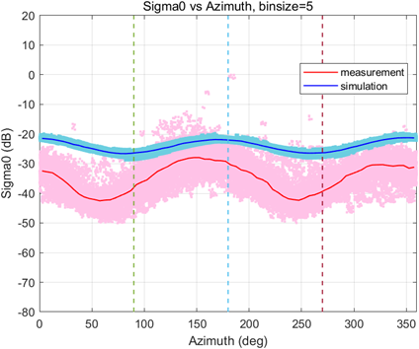
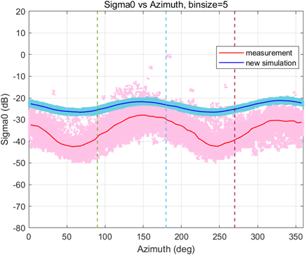
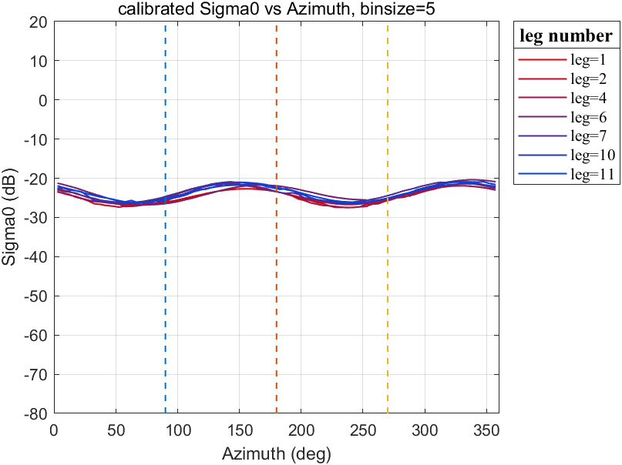
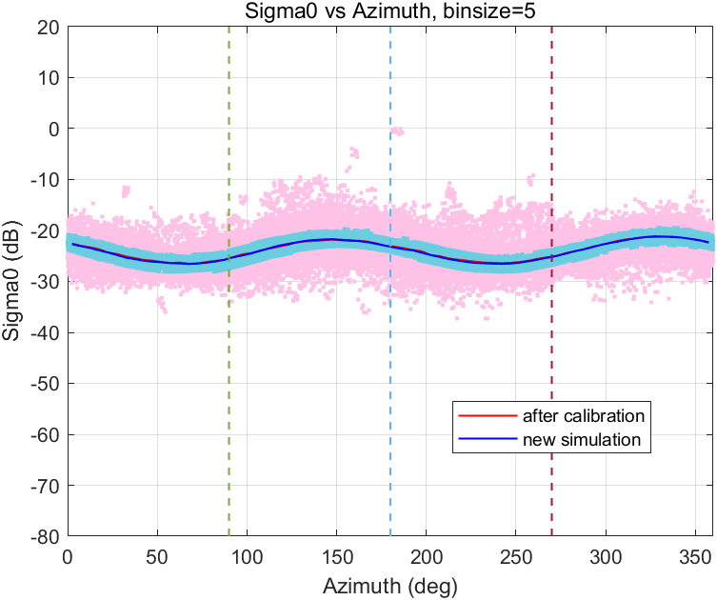

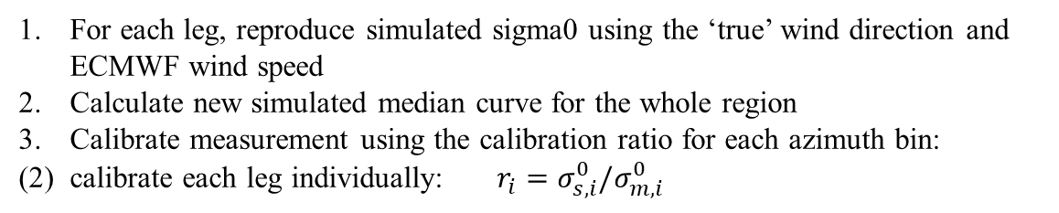

2.3 Calibration: calibrate sigma0 using the shift
For each leg, reproduce simulated sigma0 using the ‘true’ wind direction and ECMWF wind speed
Calculate new simulated median curve for the whole region
Calibrate measurement using the calibration ratio for each azimuth bin:
(2) calibrate each leg individually:$r_{i}=σ_{s,i}^{0}/σ_{m,i}^{0}$
reproduce $σ_{s}^{0}$
reproduce $σ_{s}^{0}$
$$r_{i}=σ_{s,i}^{0}/σ_{m,i}^{0}$$
$$σ_{c}^{0}=r∙σ_{m}^{0}$$

Slide 14
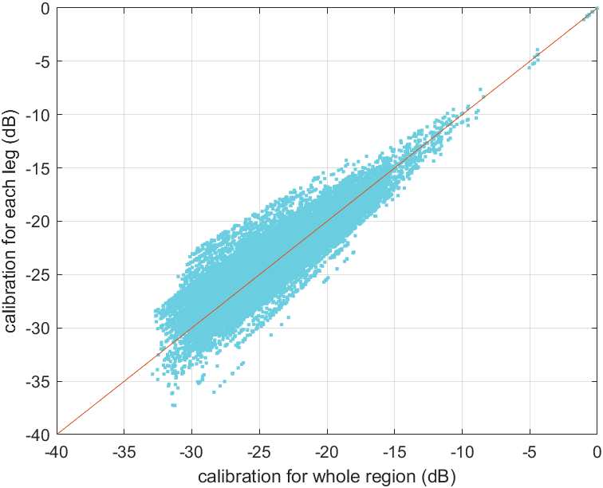
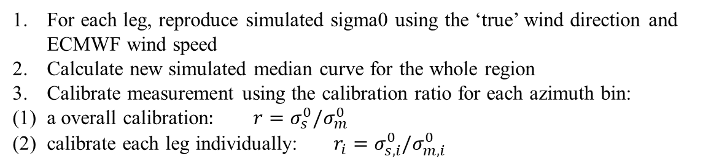

2.3 Calibration: calibrate sigma0 using the shift
For each leg, reproduce simulated sigma0 using the ‘true’ wind direction and ECMWF wind speed
Calculate new simulated median curve for the whole region
Calibrate measurement using the calibration ratio for each azimuth bin:
(1) a overall calibration$: r=σ_{s}^{0}/σ_{m}^{0}$
(2) calibrate each leg individually:$r_{i}=σ_{s,i}^{0}/σ_{m,i}^{0}$
Correlation Coefficient = 0.8966
$R^{2}=0.8002$

Slide 15
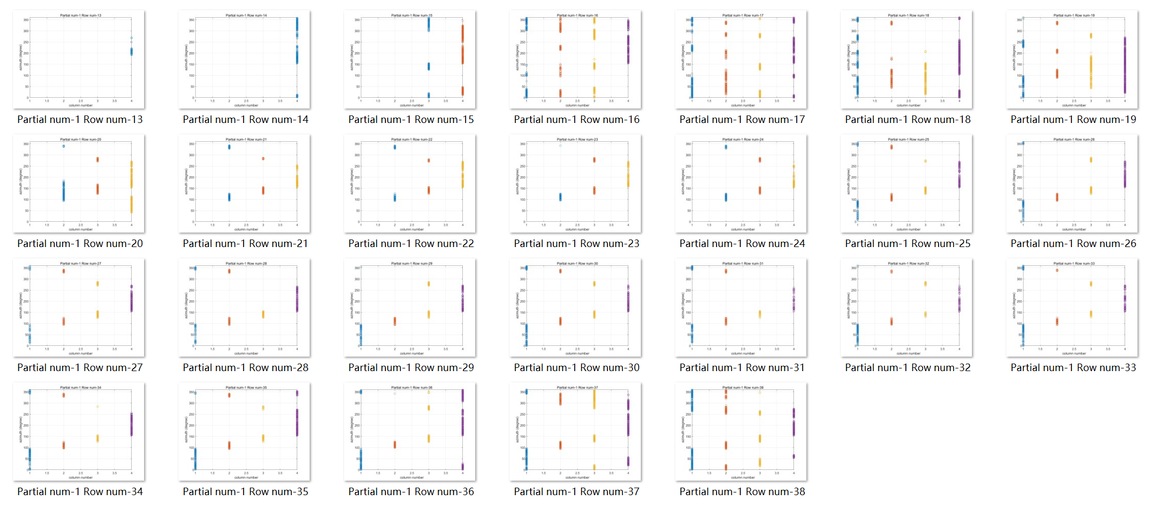
2.4 Wind Inversion: with calibrated sigma0
Azimuth Separation: take leg 1 as an example
Sweet region: Node 2 & 3 which have relatively good azimuth separation between fore and aft views
Outer region: Node 1 & 4 where azimuth separation between fore and aft views is small, but they have continuous azimuth

Slide 16
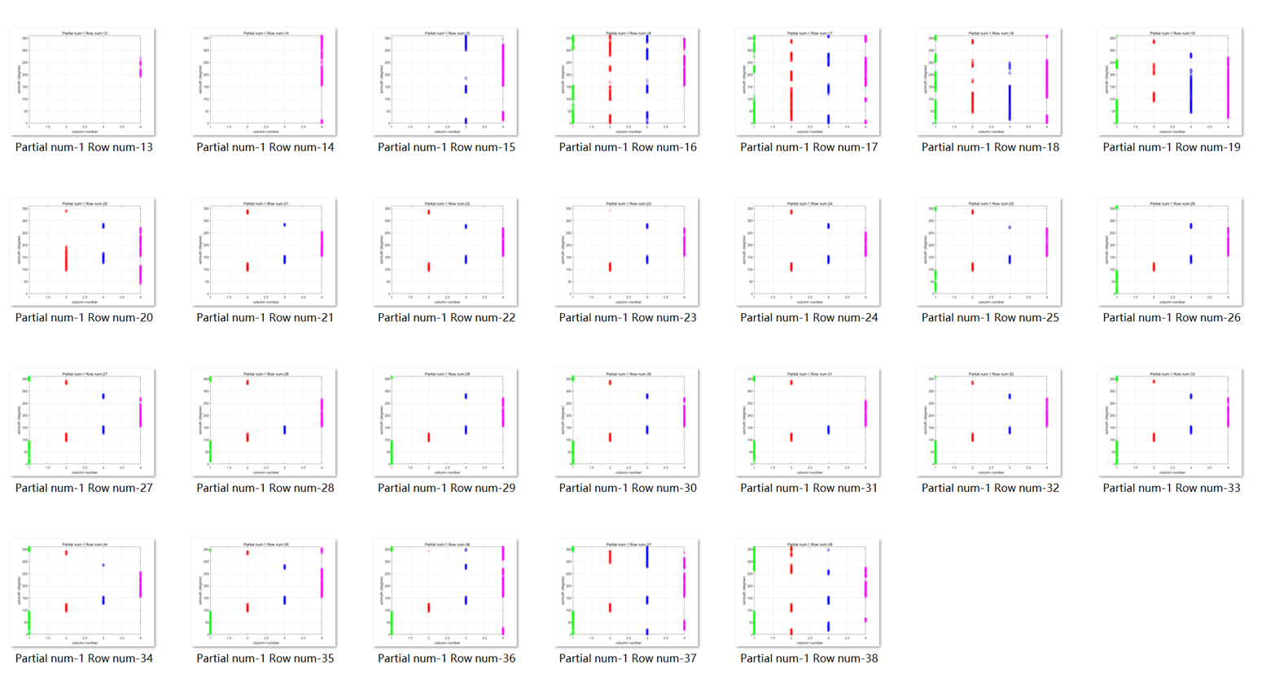
2.4 Wind Inversion: with calibrated sigma0
Azimuth Separation: take leg 1 as an example
Sweet region: Node 2 & 3 which have relatively good azimuth separation between fore and aft views
Outer region: Node 1 & 4 where azimuth separation between fore and aft views is small, but they have continuous azimuth

Slide 17
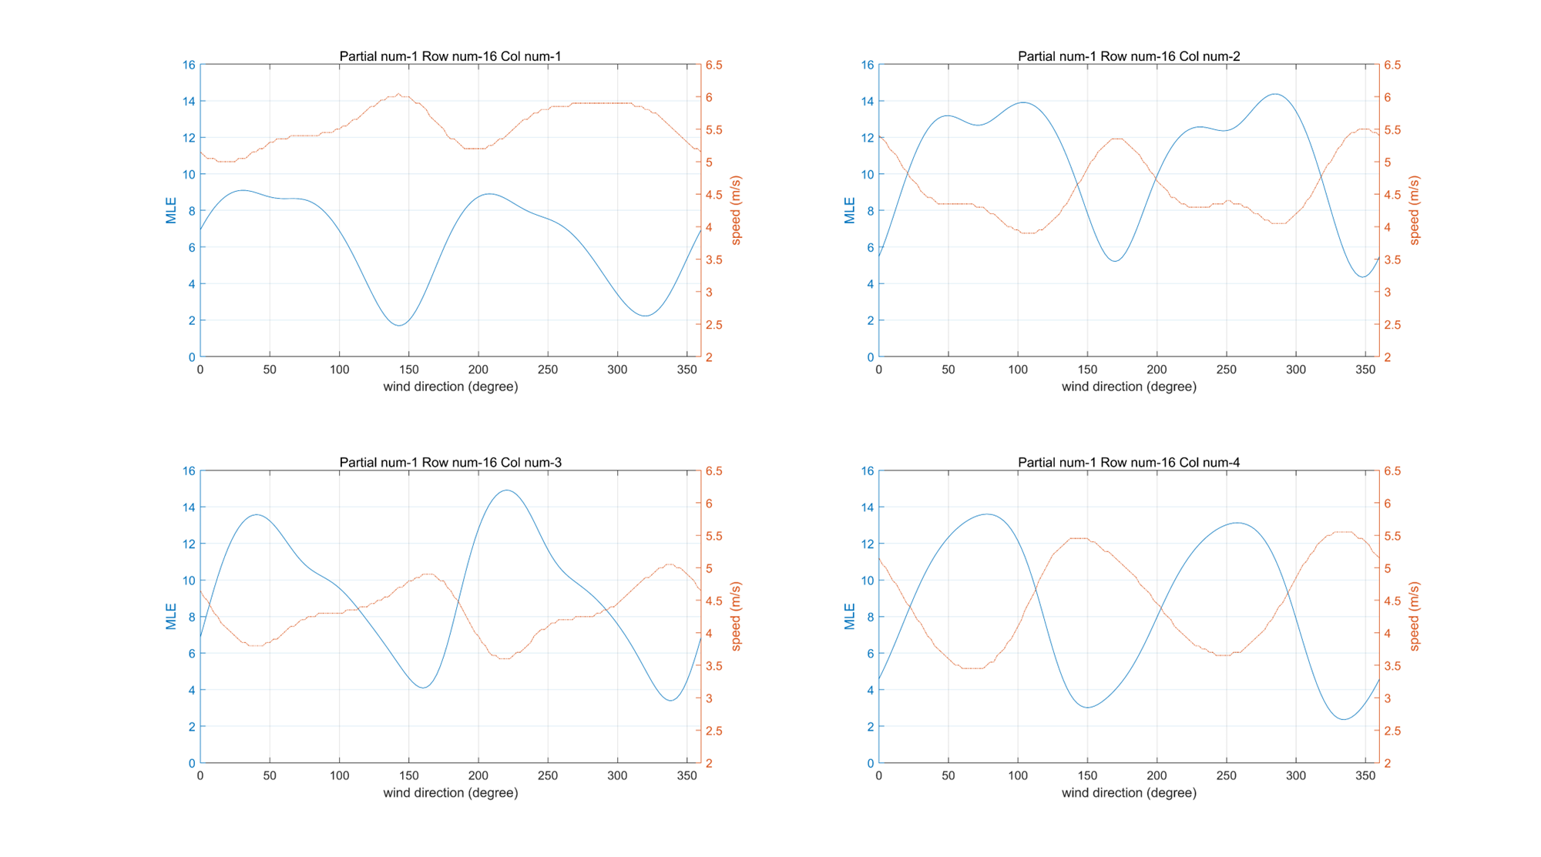
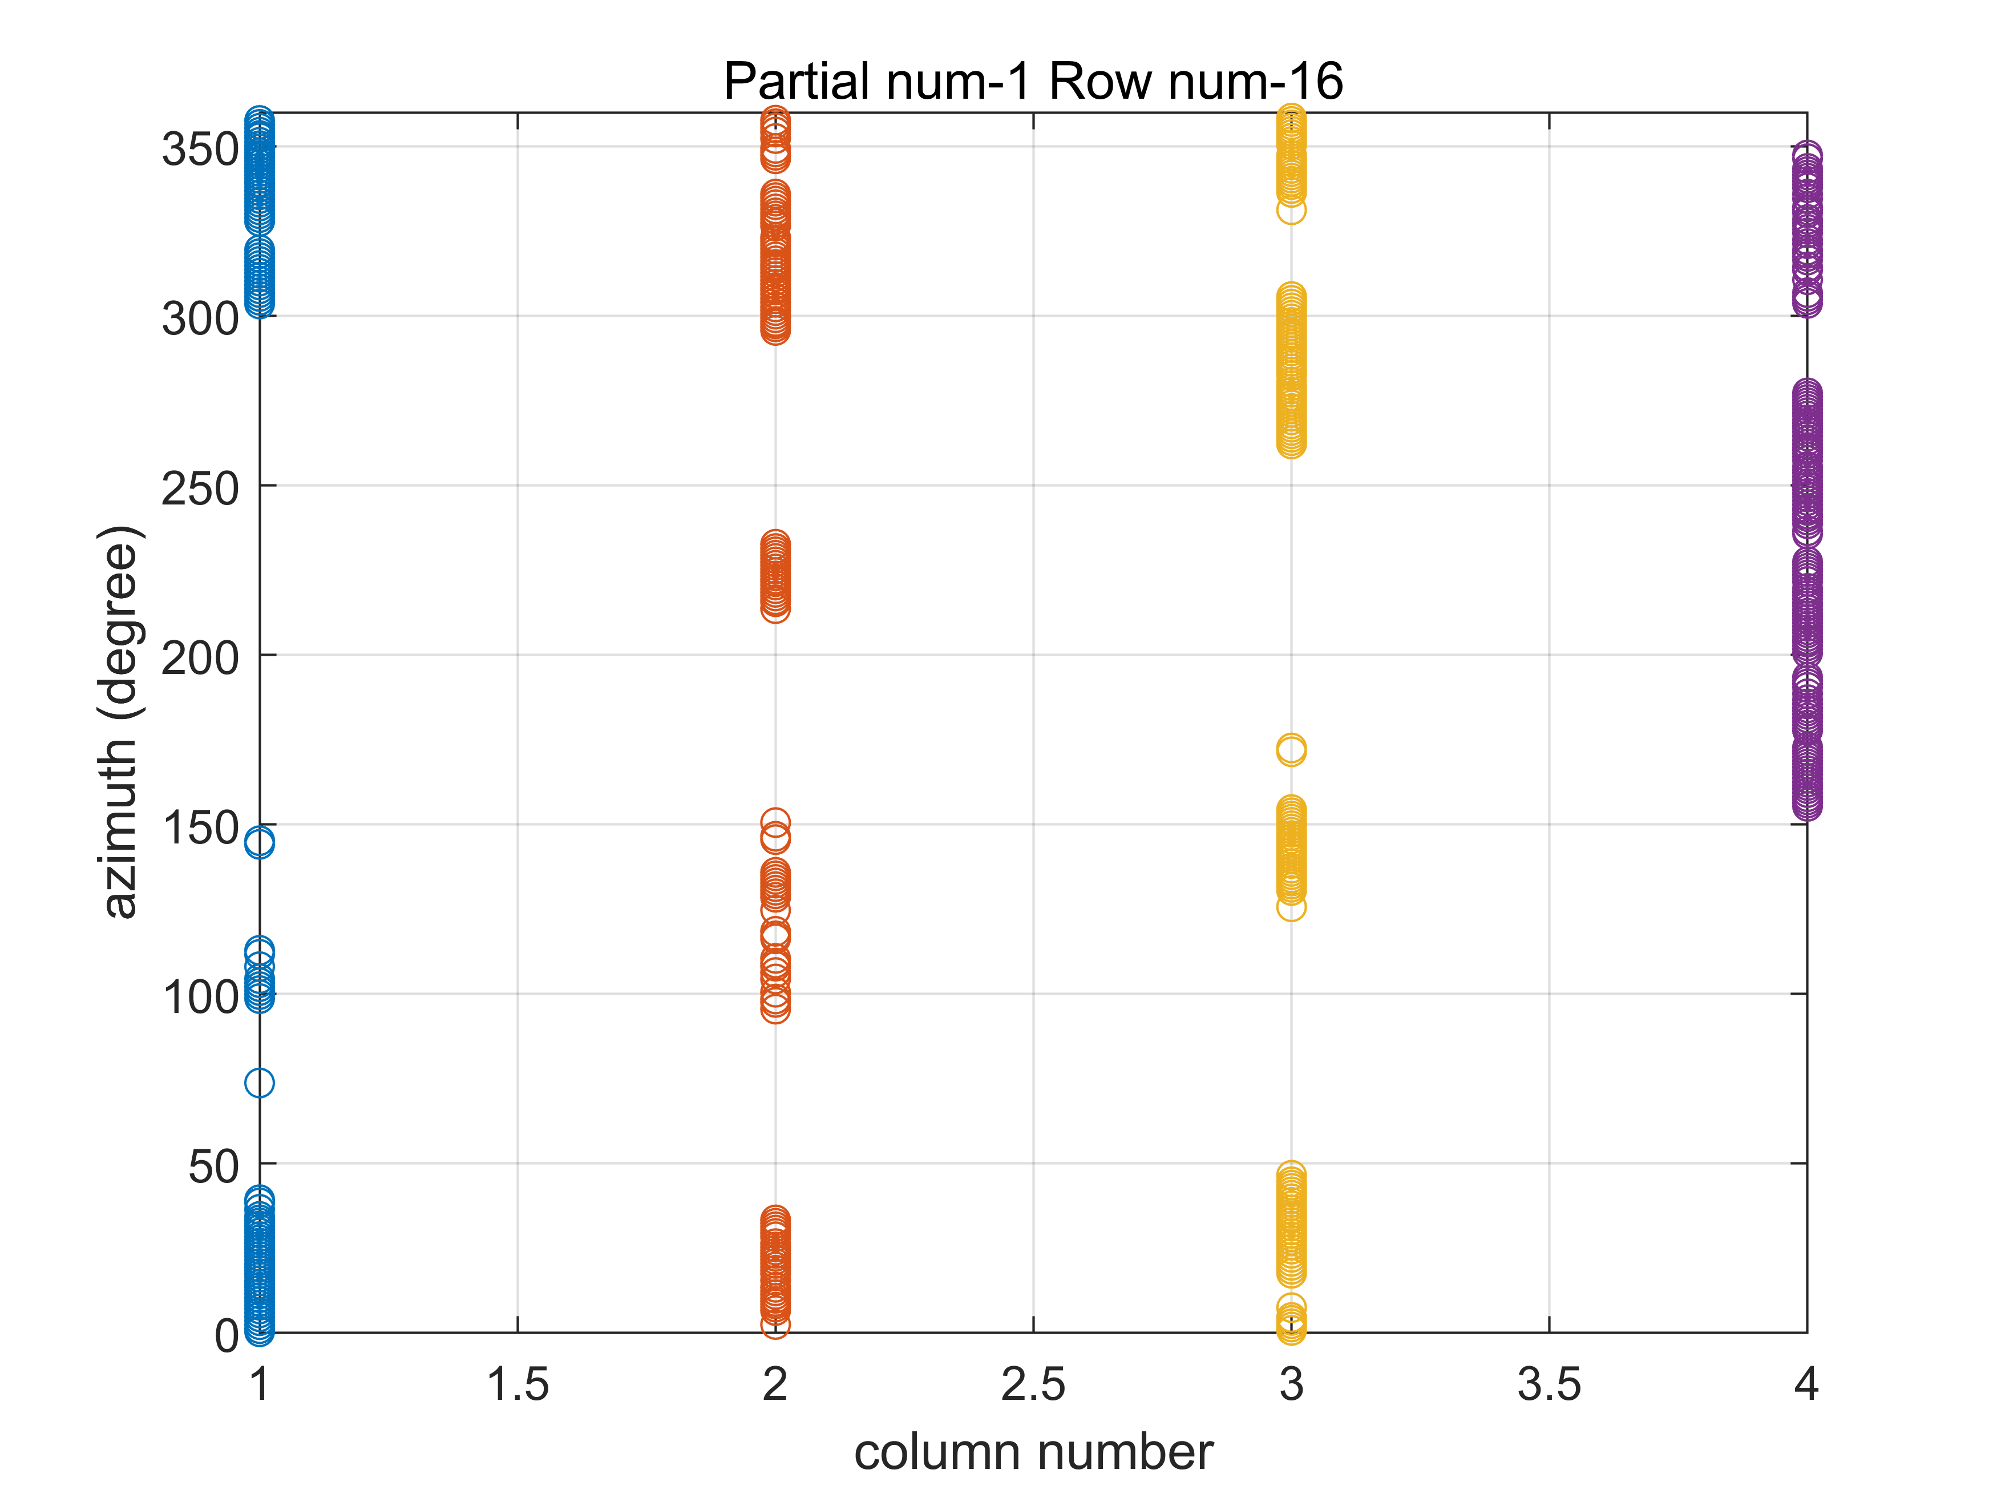
2.4 Wind Inversion: with calibrated sigma0
MLE: take one row in leg 1 as an example
Group data every 10 deg azimuth
Number of ambiguous solutions depends on geometry

Slide 18
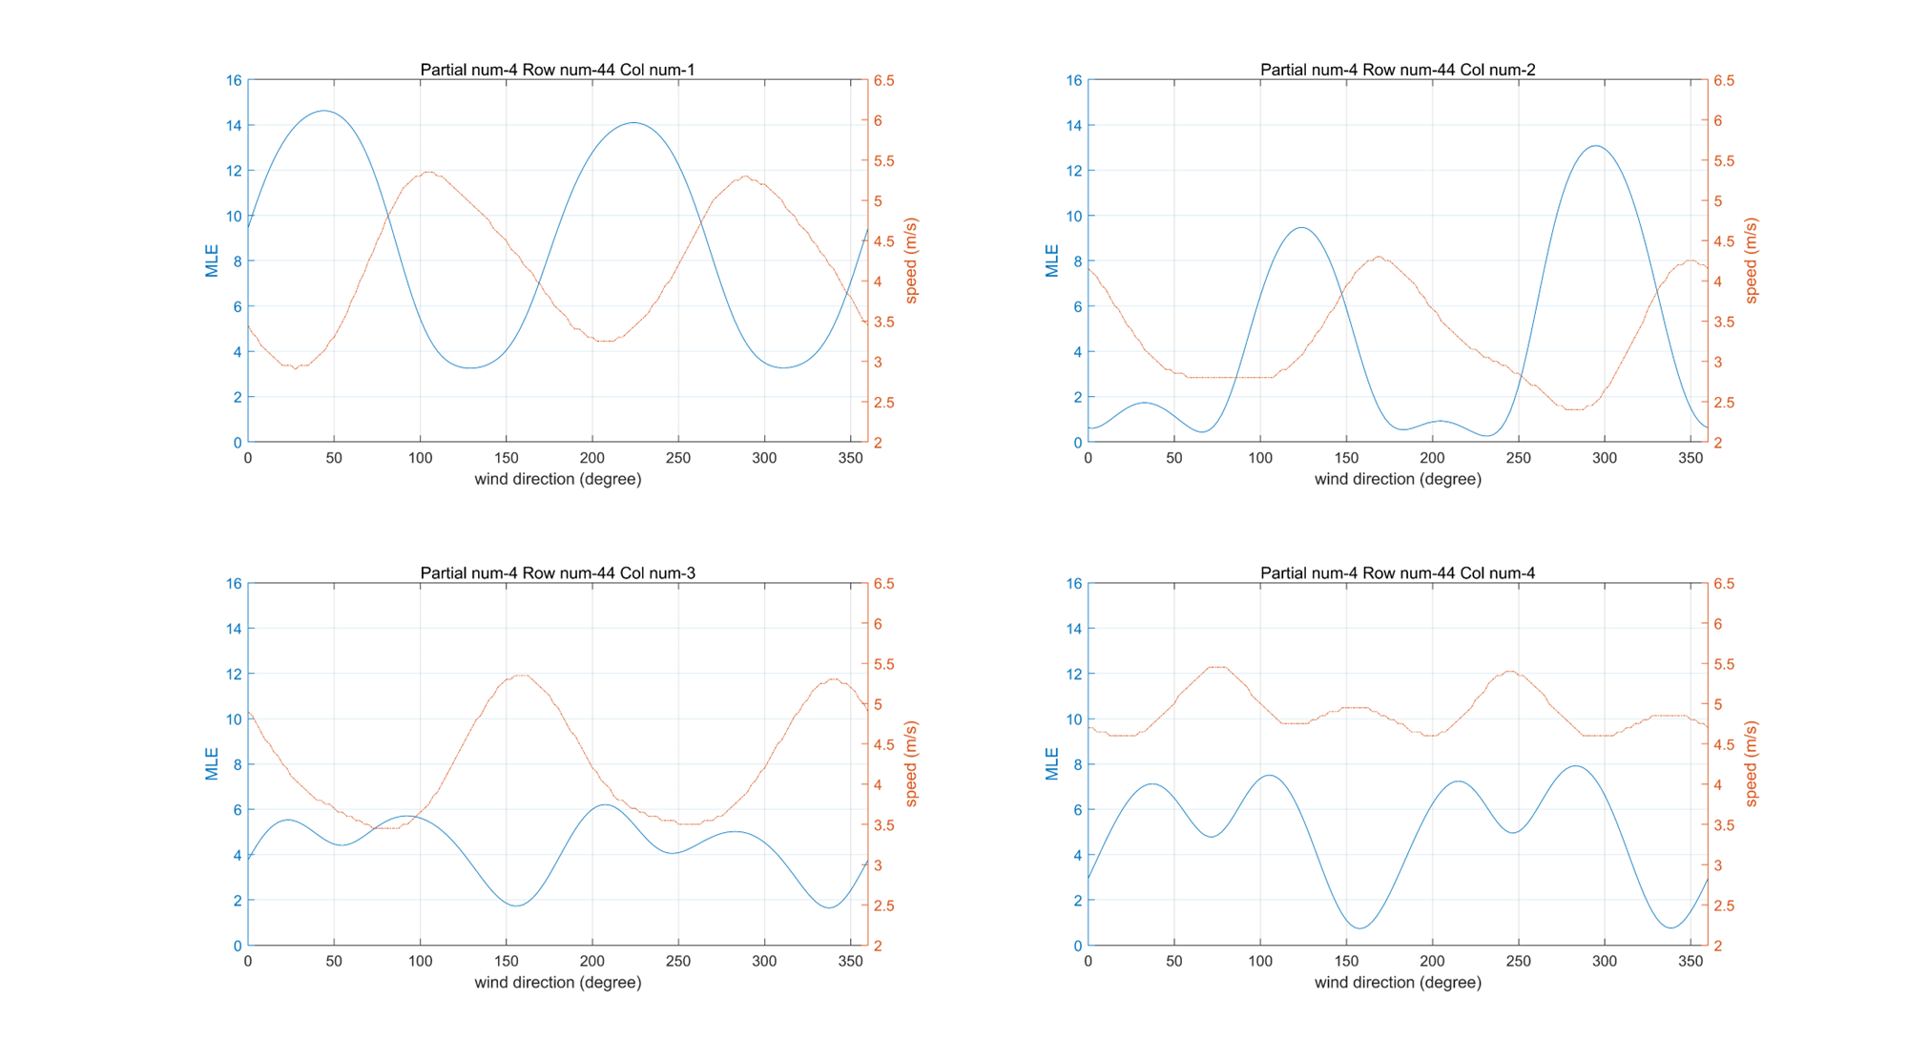
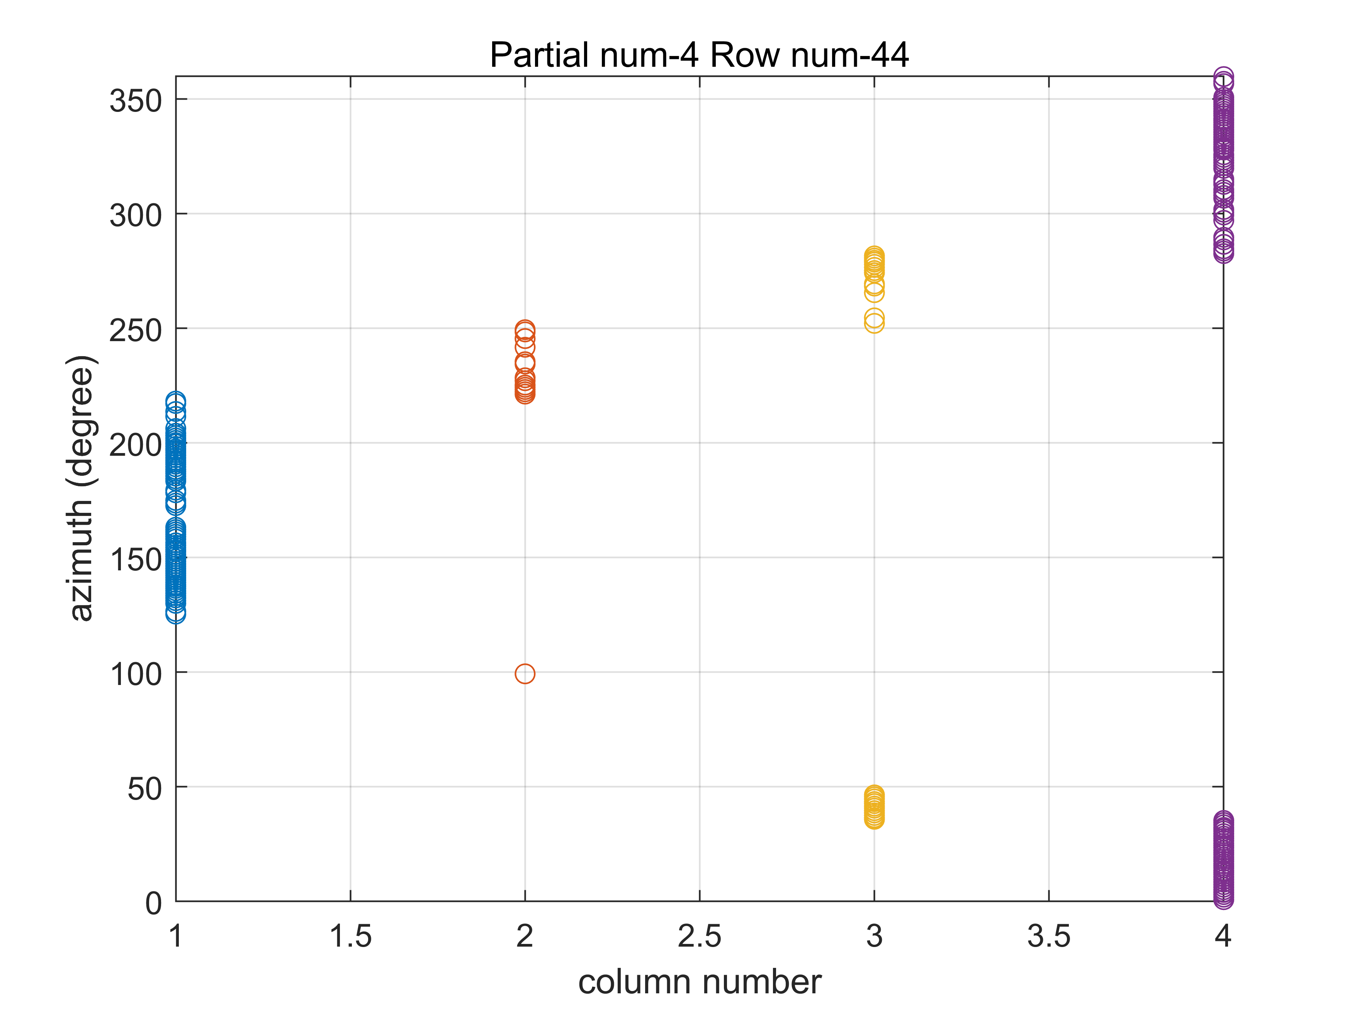
2.4 Wind Inversion: with calibrated sigma0
MLE: take one row in leg 4 as an example
4 ambiguous solutions
Number of ambiguous solutions depends on geometry

Slide 19
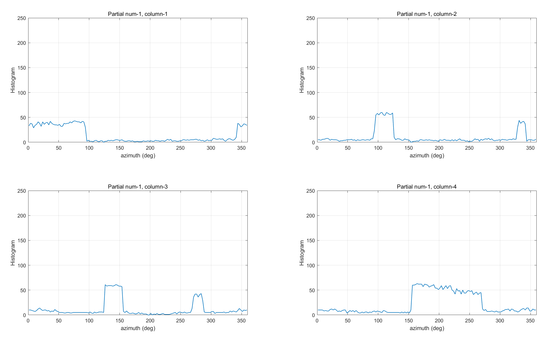



2.4 Wind Inversion: with calibrated sigma0
Sampling issues: OSCOM viewing geometry (platform attitude?)
Relatively high measurement noise; sigma0 averaging in 2.5º bins
filtering
Figure 2.7.1 The Histogram of azimuth for each column before filtering.
Figure 2.7.2 The Histogram of azimuth for each column after filtering.
Figure 2.7.3 The MLE cost function (blue curve) and speed (orange curve) before filtering.
Figure 2.7.4 The MLE cost function (blue curve) and speed (orange curve) after filtering.

Slide 20
2.4 Wind Inversion: with calibrated sigma0
Sampling issues: OSCOM viewing geometry (platform attitude?)
Relatively high measurement noise; sigma0 averaging in 2.5º bins
filtering
Figure 2.7.1 The Histogram of azimuth for each column before filtering.
Figure 2.7.2 The Histogram of azimuth for each column after filtering.
Figure 2.7.3 The MLE cost function (blue curve) and speed (orange curve) before filtering.
Figure 2.7.4 The MLE cost function (blue curve) and speed (orange curve) after filtering.

Slide 21






2.4 Wind Inversion: with calibrated sigma0
(1) a overall calibration$: r=σ_{s}^{0}/σ_{m}^{0}$

Slide 22





2.4 Wind Inversion: with calibrated sigma0
Mean wind for each leg
(1) a overall calibration$: r=σ_{s}^{0}/σ_{m}^{0}$

Slide 23





2.4 Wind Inversion: with calibrated sigma0
(2) calibrate each leg individually:$r_{i}=σ_{s,i}^{0}/σ_{m,i}^{0}$

Slide 24




2.4 Wind Inversion: with calibrated sigma0
Mean wind for each leg
(2) calibrate each leg individually:$r_{i}=σ_{s,i}^{0}/σ_{m,i}^{0}$

Slide 25



2.5 Wind Inversion: with modified GMF
Assumptions:
Same wind for each leg (both speed and direction);
The shift of azimuth angle between the measurement and the simulation indicates the ‘true’ wind direction.
Simulate sigma0 using collocated ECMWF winds and KaDPMod GMF.
Calculate the shift of azimuth angle, which is the ‘true’ wind direction.
For each leg, reproduce simulated sigma0 using the ‘true’ wind direction and ECMWF wind speed.
Calibrate measurement using NOC method.
Modify KaDPMod GMF using mean sigma0 of new simulation and calibration.
Inverse wind field with calibrated sigma0 and modified GMF.
Measured sigma0
Simulated sigma0
an obvious shift of azimuth angle
Different directional modulation

Slide 26







2.5 Wind Inversion: with modified GMF
Modification of KaDPMod GMF
1. Assume two correction coefficient in the model: $\text{a}\text{2_}\text{coef}$ and $\text{a}\text{3_}\text{coef}$.
KaDPMod:
(1)
Modified GMF:
$$log{ σ}_{0}= A_{0} + A_{1}∗\cos{φ}∗\text{a}\text{2_}\text{coef}$$
$$+ A_{2}∗\cos{2φ}∗\text{a}\text{3_}\text{coef}$$
(2)
Fig. 1. mean sigma0
(3)
$$f(x) = a_{1} +a_{2}∗ cos⁡(x+b) +a_{3}∗ cos⁡(2∗x+b))$$
2. Calculate the mean sigma0 as a function of azimuth for both measurement and simulation (as shown in Fig. 1).
3. Fit two curves with equation (3).
4. Calculate $\text{a}\text{2_}\text{coef}$ and $\text{a}\text{3_}\text{coef}$ with equation (4).
5. New GMF is generated.
a2_coef= a2_measurement / a2_GMF
a3_coef= a3_measurement / a3_GMF
(4)

Slide 27




2.5 Wind Inversion: with modified GMF
Assumptions:
Same wind for each leg (both speed and direction);
The shift of azimuth angle between the measurement and the simulation indicates the ‘true’ wind direction.
Simulate sigma0 using collocated ECMWF winds and KaDPMod GMF.
Calculate the shift of azimuth angle, which is the ‘true’ wind direction.
For each leg, reproduce simulated sigma0 using the ‘true’ wind direction and ECMWF wind speed.
Calibrate measurement using NOC method.
Modify KaDPMod GMF using mean sigma0 of new simulation and calibration.
Inverse wind field with calibrated sigma0 and modified GMF.
NWP ocean calibration
(NOC)

Slide 28







2.5 Wind Inversion: with modified GMF
Modification of KaDPMod GMF
Generate new simulation with modified GMF.
$$log{ σ}_{0}= A_{0} + A_{1}∗\cos{φ}∗\text{a}\text{2_}\text{coef} + A_{2}∗\cos{2φ}∗\text{a}\text{3_}\text{coef}$$

Slide 29



2.5 Wind Inversion: with modified GMF
Modification of KaDPMod GMF
a2: Upwind-downwind effect
a3: Upwind-crosswind effect
$$log{ σ}_{0}= A_{0} + A_{1}∗\cos{φ}∗\text{a}\text{2_}\text{coef} + A_{2}∗\cos{2φ}∗\text{a}\text{3_}\text{coef}$$
$$log{ σ}_{0}= A_{0} + A_{1}∗\cos{φ}∗1+ A_{2}∗\cos{2φ}∗\text{a}\text{3_}\text{coef}$$
when speed gets lower, the change of upwind and downwind is different.

Slide 30





2.5 Wind Inversion: with modified GMF

Slide 31





2.5 Wind Inversion: with modified GMF (only a3_coef)

Slide 32




2.5 Wind Inversion: with modified GMF
Mean wind for each leg

Slide 33




2.5 Wind Inversion: with modified GMF (only a3_coef)
Mean wind for each leg

Slide 34





2.6 Comparison
3) Sigma0 as a function of azimuth
Method 1: using azimuth-calibrated sigma0
reproduce $σ_{s}^{0}$
$$σ_{c}^{0}=r∙σ_{m}^{0}$$
Method 2: using modified GMF
$$σ_{c}^{0} after NOC$$
$$σ_{s}^{0} with new GMF$$

Slide 35


2.6 Comparison
1) Retrieved winds
Comparison between winds using 2 methods
2) Comparison against ECMWF:
 | cells | speed bias (m/s) | speed SD (m/s) | direction SD (deg) | U SD (m/s) | V SD (m/s)
with modified GMF | 429 | -0.92 | 1.65 | 17.18 | 1.40 | 1.47
with modified GMF (only a3_coef) | 429 | -0.97 | 1.38 | 17.24 | 1.14 | 1.33
with azimuth calibration (overall ratio) | 429 | -0.42 | 1.02 | 25.91 | 1.82 | 1.39
with azimuth calibration (each leg’s ratio) | 429 | -0.31 | 0.84 | 25.72 | 1.71 | 1.50

Slide 36




When leg=6, measurement has more noise.
$$measurement$$
$$smoothed measurement$$

Slide 37





Comparison between winds using 4 different methods
with azimuth calibration
(overall ratio)
with azimuth calibration
(each leg’s ratio)
with modified GMF
(only a3_coef)
with modified GMF

Slide 38



3. Ongoing work
Simultaneous wind and current retrievals from Doppler scatterometer data:
Winds and currents are retrieved separately. Winds are inversed using the backscatter, and currents are retrieved using the doppler shift.
Backscatter and doppler observations are combined in the cost function. Thus winds and currents are inversed at the same time.
$$y_{U} = F \left(x_{dp}, p\right)+ ε_{0−dp}$$
$$y_{σ_{0}} = F (x_{σ_{0}}, p)+ ε_{0−σ_{0}}$$
$$y = F(x, p)+ ε_{0}$$
x: wind and current vector
y: NRCS ($σ_{0}$) and doppler shift (dp)
p: model parameters
$ε_{0}$: errors
$$U_{D} =U_{geo}+U_{nwd}+U_{wd}$$
$U_{geo}$: non-geophysical component
$U_{nwd}$: Currents that are not driven by the instantaneous local wind.
$U_{wd}$: wind-driven component
Test less constrained noise filtering on both calibration and wind retrieval
Ocean current retrieval
joint wind & current cost function
Use Metop-SG scatterometer simulation study to analyze performance of other DoppScatt potential configurations
…
38

Slide 39






3. Ongoing work
Simultaneous wind and current retrievals from Doppler scatterometer data:
Principal：
Work：
Ocean current retrieval
Inteference Phase $∆φ$ → Horizontion Velocity $v=\frac{∆φ∙λ}{4πmT_{s}}$ → Surface_Velocity → …
(λ: wave length, $mT_{s}$: interference phase interval)
Joint wind & current cost function
Use Metop-SG scatterometer simulation study to analyze performance of other DoppScatt potential configurations
New campaign upcoming (July 2024)!
OSCOM to be launched in 2026
But… CFOSAT follow-on to be launched by the end of 2024 will have DOPSCA capabilities
Winds and currents are retrieved separately. Winds are inversed using the backscatter, and currents are retrieved using the doppler shift.
$$y_{U} = F \left(x_{dp}, p\right)+ ε_{0−dp}$$
$$y_{σ_{0}} = F (x_{σ_{0}}, p)+ ε_{0−σ_{0}}$$
Surface_Velocity
$$U_{D} =U_{geo}+U_{nwd}+U_{wd}$$
$U_{geo}$: non-geophysical component
$U_{nwd}$: Currents that are not driven by the instantaneous local wind.
$U_{wd}$: wind-driven component
Backscatter and doppler observations are combined in the cost function. Thus winds and currents are inversed at the same time.
$$y = F(x, p)+ ε_{0}$$
x: wind and current vector
y: NRCS ($σ_{0}$) and doppler shift (dp)
p: model parameters
$ε_{0}$: errors
39

Slide 40
Thank you!
Simultaneous wind and current retrievals from Doppler scatterometer data: calibration of OSCOM backscatter measurements
Shilei Wang (wangshilei20@mails.ucas.ac.cn)
Marcos Portabella (portabella@icm.csic.es）
Xiaolong Dong (dongxiaolong@mirslab.cn)
Wenming Lin (002853@nuist.edu.cn)
Qingliu Bao (baoqingliu@piesat.cn)

Slide 41




The reason why there is no ‘azimuth gap’ in each of the curves (legs) of the top left plot in slide 10:
When legs are divided, the turning parts are also included.
Take leg 1 as an example:
Leg 1:
straight-line section
turning section
Slice of Leg 1:
only straight-line section
with 40° gap

Slide 42







The impact of the ‘gap’ of azimuth
The trajectory of each leg

Slide 43







The impact of the ‘gap’ of azimuth
Find the ‘gap’: use the histogram

Slide 44







The impact of the ‘gap’ of azimuth
Point out the ‘gap’ in the scatter plot (within the red lines)
the size of the ‘gap’ : 40°
Sometimes there are 2 gaps: due to two flight directions in one leg. The azimuth difference between 2 gaps are 180°.
The noise level of the "turning plane" data is not different from that of the "straight plane" data according to the figures.

Slide 45
According to calculation using L1B raw dataset,
the spatial resolution of L1B data is
In degree scale:
Latitude: 1.0848e-08 deg
Longitude: 8.6062e-10 deg
In meter scale:
Latitude ~ 0.0012 m
Longitude ~ 0.0001 m

Slide 46


2.6 Comparison
3) Sigma0 as a function of azimuth
Method 1: using azimuth-calibrated sigma0
reproduce $σ_{s}^{0}$
$$σ_{c}^{0}=r∙σ_{m}^{0}$$
Method 2: using modified GMF
$$σ_{c}^{0} after NOC$$
$$σ_{s}^{0} with new GMF$$
46

Slide 47

Comparison between winds using 4 different methods
with azimuth calibration
(overall ratio)
with azimuth calibration
(each leg’s ratio)
with modified GMF
(only a3_coef)
with modified GMF

Slide 48


Comparison between winds using 4 different methods
with azimuth calibration
(overall ratio)
with azimuth calibration
(each leg’s ratio)
with modified GMF
(only a3_coef)
with modified GMF

Slide 49



2.6 Comparison
1) Retrieved winds
Comparison between winds using 2 methods
Compare with ECMWF:
 | cells | speed bias (m/s) | speed SD (m/s) | direction SD (deg) | U SD (m/s) | V SD (m/s)
with modified GMF | 429 | -0.92 | 1.65 | 17.18 | 1.40 | 1.47
with modified GMF (only a3_coef) | 429 | -0.97 | 1.38 | 17.24 | 1.14 | 1.33
with azimuth calibration (overall ratio) | 429 | -0.42 | 1.02 | 25.91 | 1.82 | 1.39
with azimuth calibration (each leg’s ratio) | 429 | -0.31 | 0.84 | 25.72 | 1.71 | 1.50
2) Mean winds for each leg
Compare with ECMWF:
 | legs | speed bias (m/s) | speed SD (m/s) | direction SD (deg) | U SD (m/s) | V SD (m/s)
with modified GMF | 7 | -0.80 | 0.84 | 5.86 | 0.58 | 0.70
with modified GMF (only a3_coef) | 7 | -0.84 | 0.76 | 3.67 | 0.36 | 0.70
with azimuth calibration (overall ratio) | 7 | -0.28 | 0.65 | 8.97 | 0.78 | 0.60
with azimuth calibration (each leg’s ratio) | 7 | -0.17 | 0.20 | 4.56 | 0.33 | 0.27

Slide 50


Comparison between winds using azimuth calibration and modified GMF
x axis: modified GMF with only a3_coef
y axis: azimuth calibration (overall ratio)
x axis: modified GMF with only a3_coef
y axis: azimuth calibration (each leg’s ratio)

Slide 51
Comparison between winds using azimuth calibration and modified GMF
x axis: modified GMF with only a3_coef
y axis: azimuth calibration (overall ratio)
x axis: modified GMF with only a3_coef
y axis: azimuth calibration (each leg’s ratio)

Slide 52


Comparison between winds using 2 modified GMF
x axis: only a3_coef
y axis: with a2_coef and a3_coef
low winds

