Slide 1
Swell direction impact to satellite derived sea surface winds
Faozi Said^{1,2} , Zorana Jelenak^{1,3}, Paul S. Chang¹
¹NOAA/NESDIS/STAR
²Global Science & Technology, Inc.
³UCAR
IOVWST 2024 – May 30
The views, opinions, and findings in this report are those of the authors and should not be construed as an official NOAA or U.S. government position or policy.

Slide 2
Motivation
It has been shown that the presence of swell can impact L-band radiometer and GNSS-R signals (e.g. SMAP, CyGNSS)
Above observation mostly focused on significant waveheight impact (from full spectrum)
This time, interested in swell directional impact, including its significant waveheight and peak period properties, to selected radiometer and scatterometer retrieved wind speed

Slide 3
Dataset general information
Dataset | Grid size | Time period
SMAP JPL v5.0 | 25 km | 2017 Jan-2020 Dec
SMAP JPL v5.3.4 | 25 km | 2019 Jan-2020 Dec
SMAP RSS | .25 deg | 2017 Jan-2020 Dec
AMSR 2 NOAA | 10 km | 2017 Jan-2019 Dec
AMSR2 RSS | .25 deg | 2017 Jan-2020 Dec
ASCAT NOAA | 25 km | 2017 Jan-2020 Dec
0.5◦/3 hourly IFREMER implementation of Wavewatch III model bilinearly interpolated to each dataset
‘first swell’ direction
‘first swell’ significant waveheight
‘first swell’ peak period
0.25◦/6 hourly ECMWF forecast* u/v components bilinearly interpolated to each dataset
*used as input wind forcing to IFREMER WW3

Slide 4
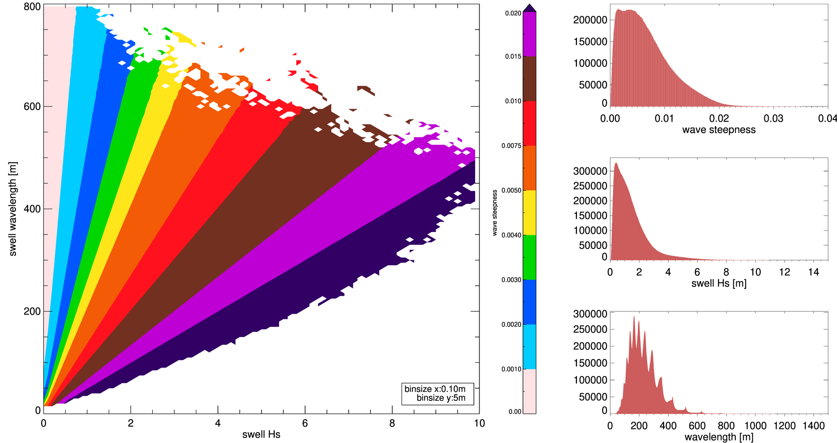
The use of spectral wave steepness
Instead of generating hundreds of plots for different Hs, and peak period, wave steepness parameter can be used as it encompasses these.
$$\frac{Hs}{λp}$$
Source: https://www.ndbc.noaa.gov/education/waves.shtml
IFREMER product does not provide peak wavelength, only peak period.
Used dispersion relation of deep ocean waves to derive peak wavelength
$$\sim \frac{g}{2π}T^{2}$$
$λ$=$\frac{g}{2π}T^{2}\tanh\left(2π\frac{h}{λ}\right)$
$$\sim 1.5T^{2}$$
~1 in deep ocean

Slide 5
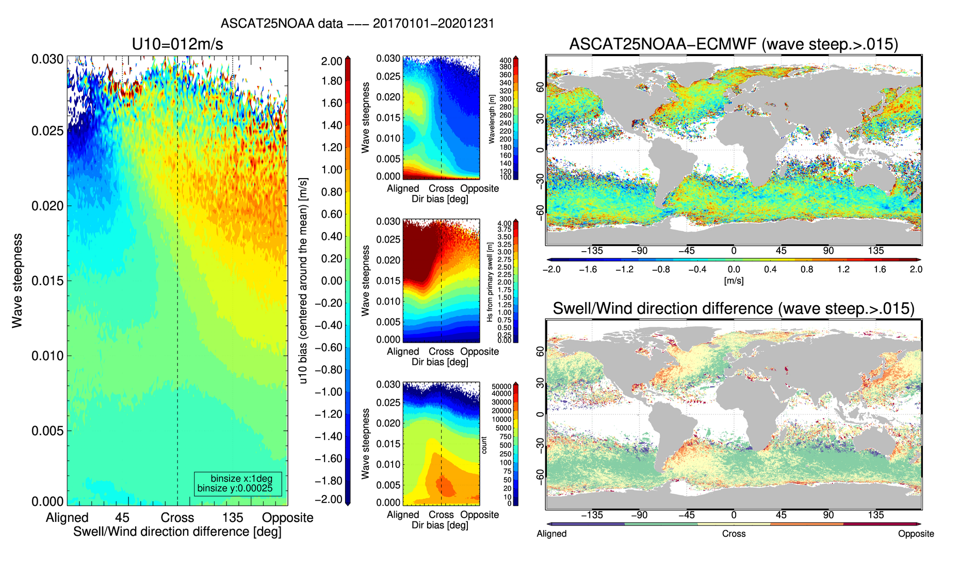
Wind speed bias as a function of wave steepness and swell/wind direction difference
Time period:20170101-20201231 | collocated model wind speed fixed at 12 m/s +/- 1m/s
ASCAT25NOAA

Slide 6
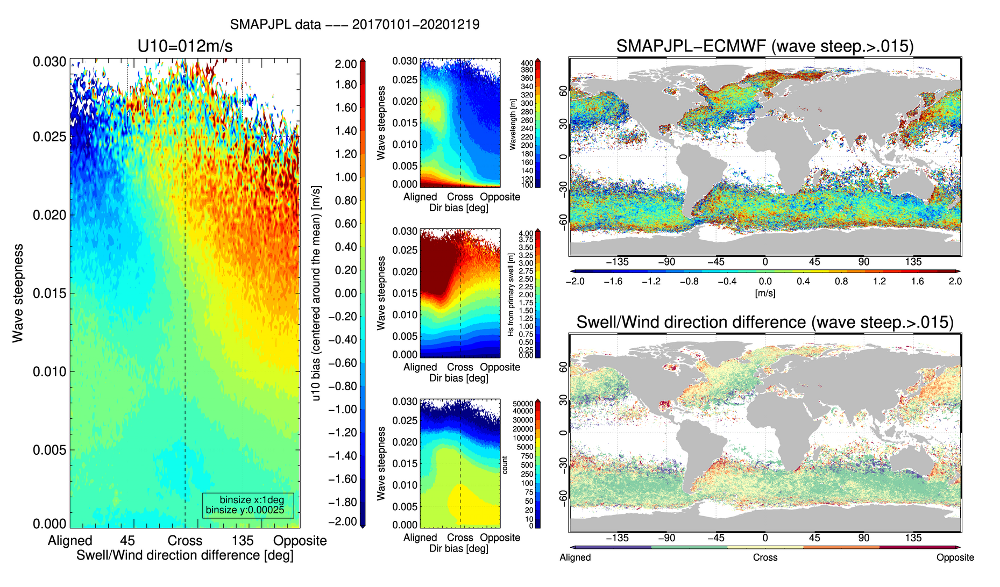
Wind speed bias as a function of wave steepness and swell/wind direction difference
Time period:20170101-20201219 | collocated model wind speed fixed at 12 m/s +/- 1m/s
SMAPJPL

Slide 7
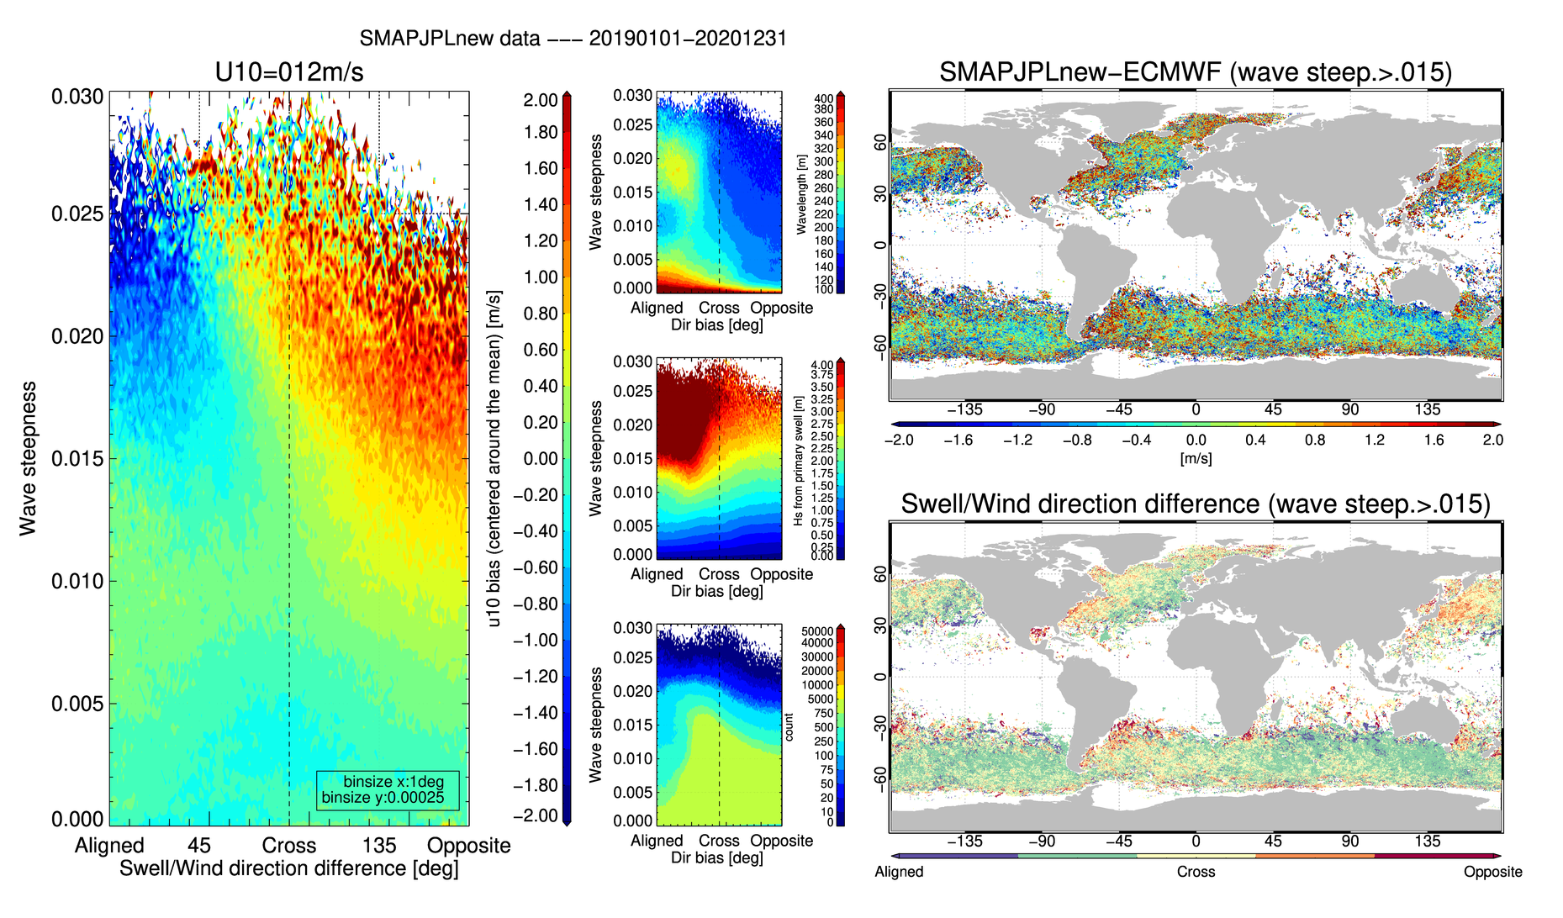
Wind speed bias as a function of wave steepness and swell/wind direction difference
Time period:20190101-20201231 | collocated model wind speed fixed at 12 m/s +/- 1m/s
SMAPJPLnew

Slide 8
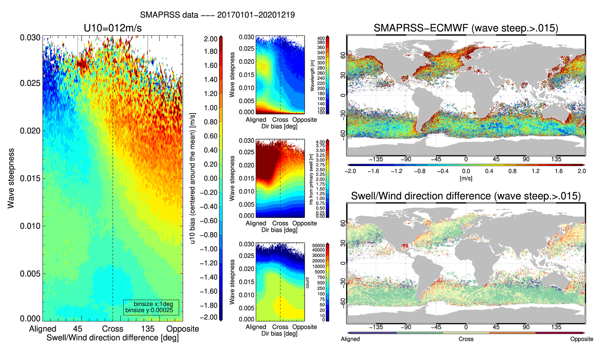
Wind speed bias as a function of wave steepness and swell/wind direction difference
Time period:20170101-20201219 | collocated model wind speed fixed at 12 m/s +/- 1m/s
SMAPRSS

Slide 9
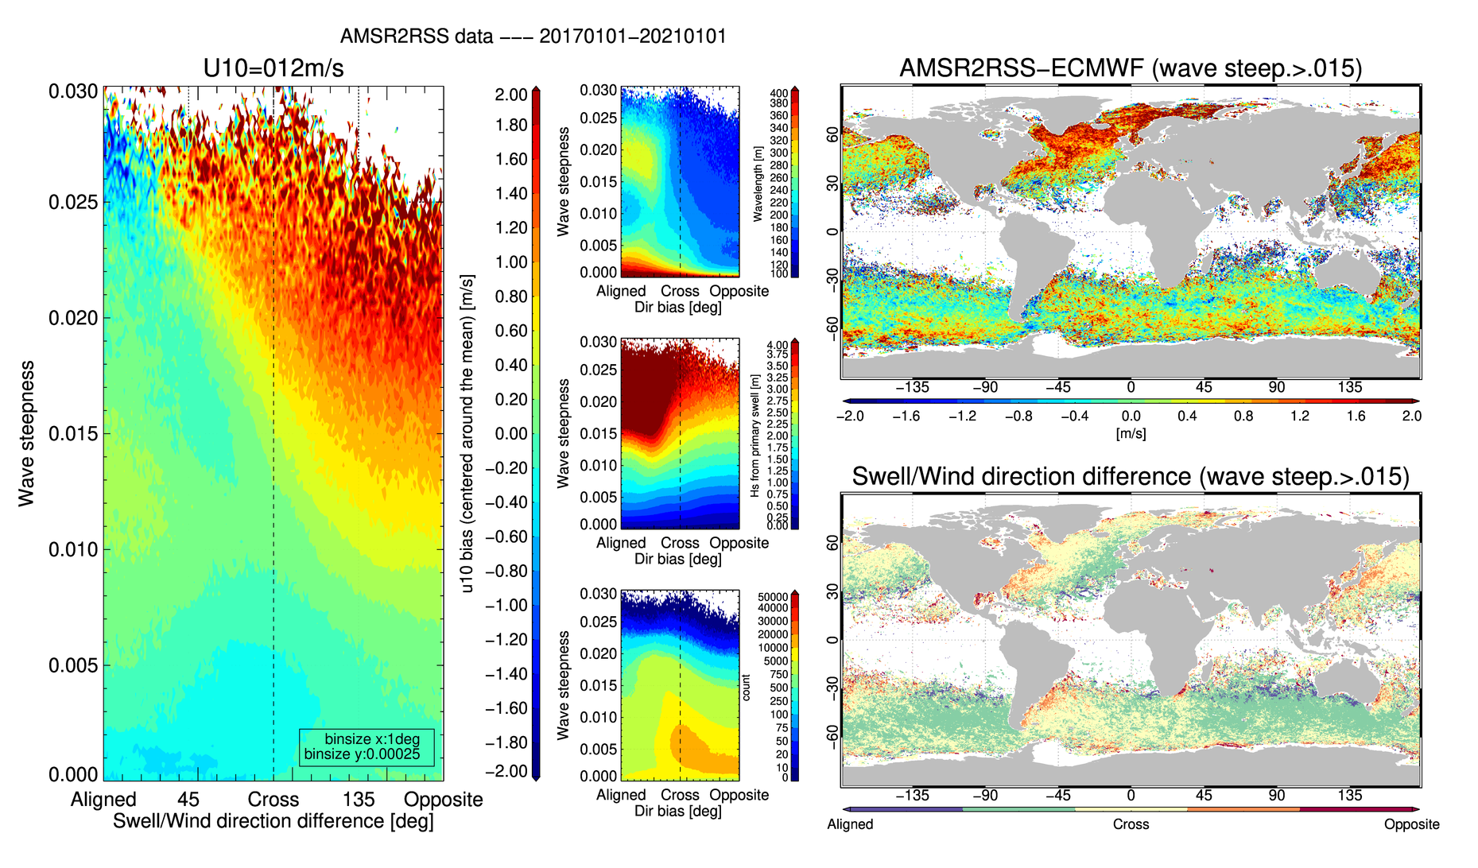
Wind speed bias as a function of wave steepness and swell/wind direction difference
Time period:20170101-20210101 | collocated model wind speed fixed at 12 m/s +/- 1m/s
AMSR2RSS

Slide 10
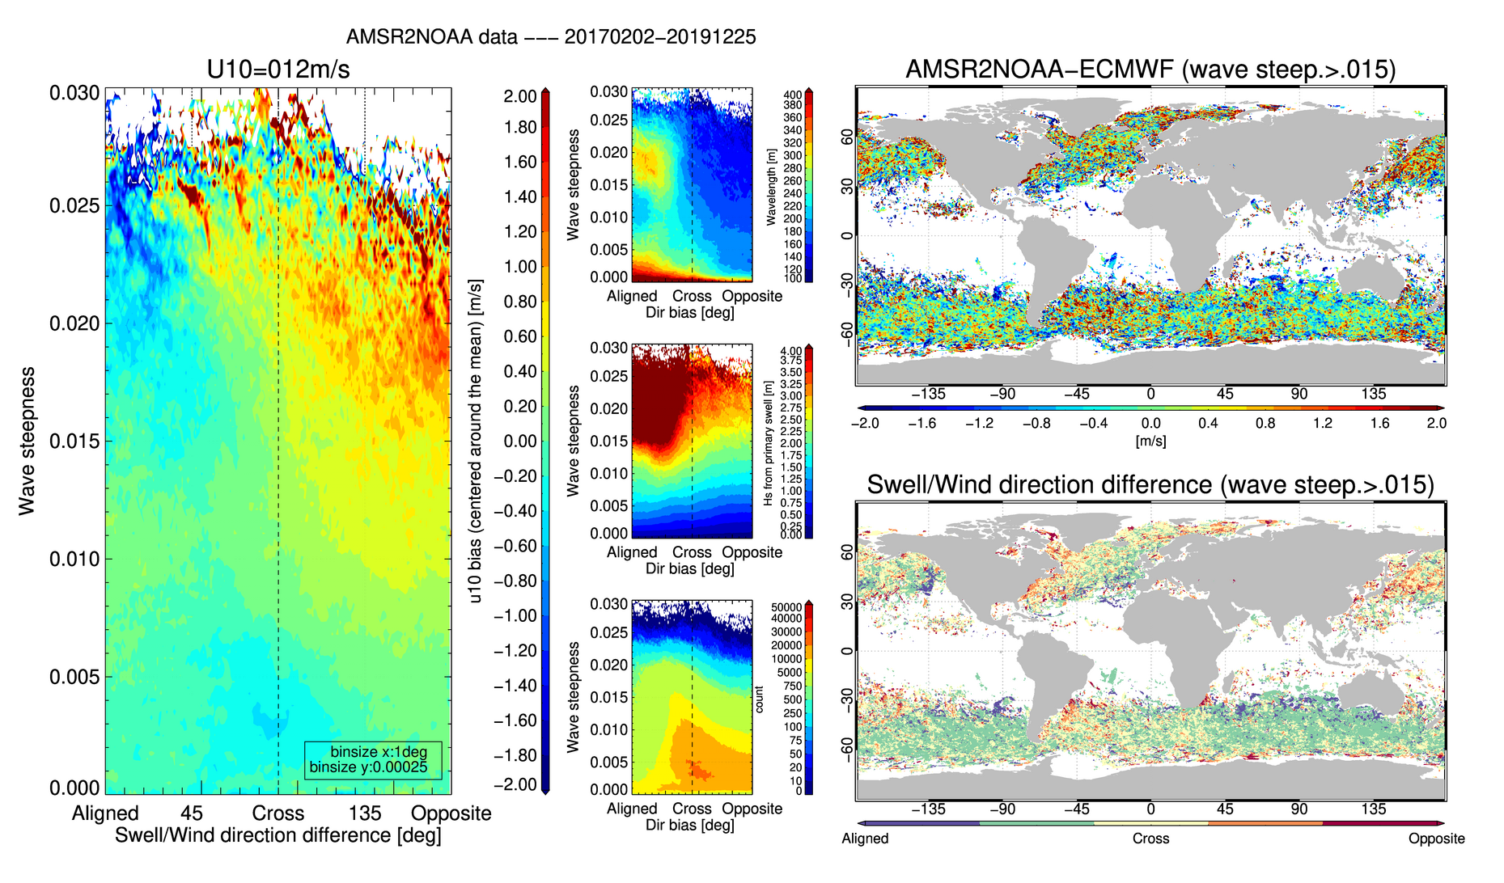
Wind speed bias as a function of wave steepness and swell/wind direction difference
Time period:20170202-20191225 | collocated model wind speed fixed at 12 m/s +/- 1m/s
AMSR2NOAA

Slide 11
SMAPJPL
SMAPJPLnew
SMAPRSS
Model wind speed fixed at 6 m/s +/-1 m/s
ASCAT25NOAA
AMSR2NOAA
AMSR2RSS
Similar wind speed trend for all listed wind speed products

Slide 12
SMAPJPL
SMAPJPLnew
SMAPRSS
Model wind speed fixed at 9 m/s +/-1 m/s
ASCAT25NOAA
AMSR2NOAA
AMSR2RSS

Slide 13
SMAPJPL
SMAPJPLnew
SMAPRSS
Model wind speed fixed at 12 m/s +/-1 m/s
As the fixed model wind speed bin increases, the wind speed bias trend becomes more dynamic (as a function of the swell/wind direction difference)
ASCAT25NOAA
AMSR2NOAA
AMSR2RSS

Slide 14
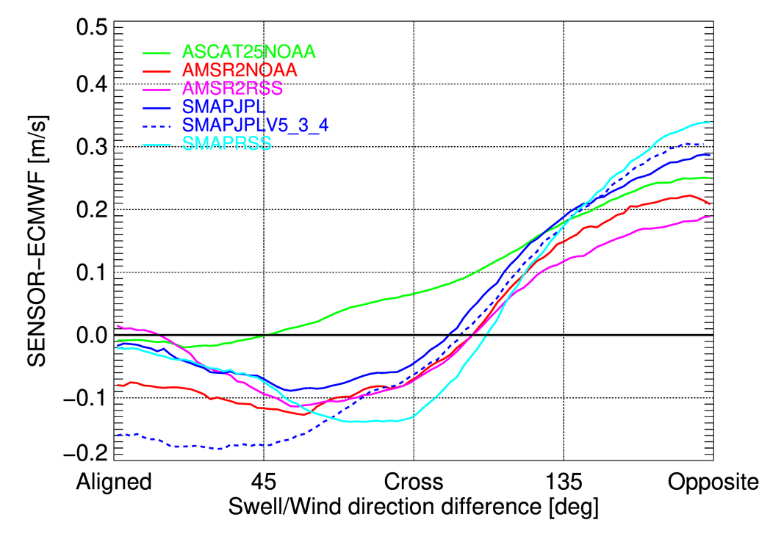
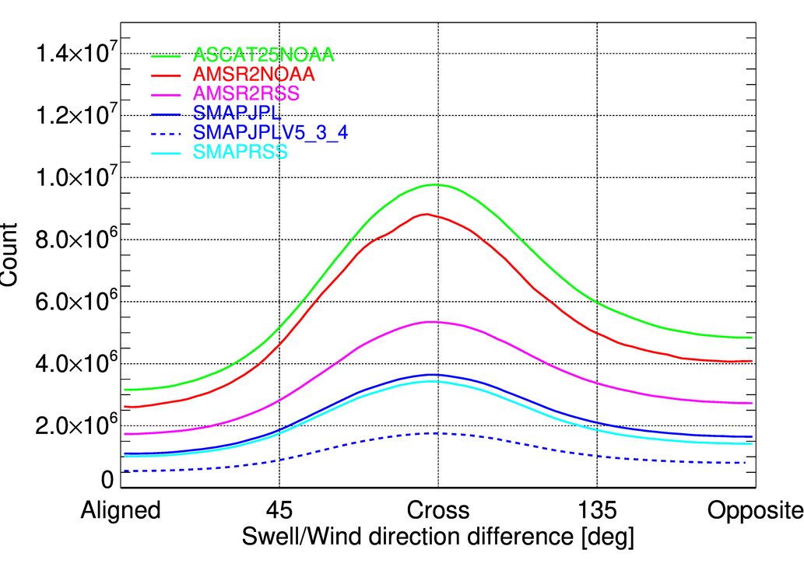
Sensor wind speed bias* as a function of the primary swell/model wind direction difference (given model wind > 8 m/s)
-ASCAT showing least dynamic range
-SMAP RSS shows largest dynamic range between cross and opposition directions
-SMAP JPL V5.3.4 most dynamic range between aligned and opposite directions
*centered around the mean

Slide 15
Summary
Wind speed error (sensor-model) from SMAP, AMSR2, ASCAT increases when the swell direction becomes opposite to the wind direction
This error becomes prevalent as the swell spectral wave steepness parameter increases
Most likely roughness and wave breaking slightly altered (tilt/hydrodynamic modulations perhaps?) with ‘steeper’ swell passing in opposite/cross directions. However, did neglect potential impact of ocean surface current
Respective GMF may need to be revisited to take into account above effect
Possible future work
Use SWIM data and identify measured swell Hs/direction and verify wind speed bias trend using ASCAT data (don’t think AMSR2/SMAP can be used due to very low matchup)
Check potential impact on level 1 data (e.g. ASCAT sigma0, SMAP excess emissivity)
Repeat exercise with CyGNSS data
Include time component
Repeat exercise within tropical cyclone condition
Free advert ☺: upcoming IGARSS talk on “EXPLORING SWELL IMPACT TO RADIOMETER DERIVED FOAM FRACTION AND WIND SPEED” Faozi Said, Zorana Jelenak, Paul S. Chang, Magdalena D. Anguelova, Michael H. Bettenhausen

