Slide 1
Status and recent developments of the EUMETSAT scatterometer missions
S Linow, N Khosravi, C Anderson, S Lupemba, M Cloarec
IOVWST Salt Lake City
29 May 2024

Slide 2
Agenda
EPS-SG
Overview
SCA
Update on the mission status, planned activities
ASCAT
Instrument status and current work

Slide 3
EPS-SG Objectives
Primary mission: further improve observational inputs to Numerical Weather Prediction models.
Continuation and enhancement of service from mid-morning polar orbit in 2025 – 2046 timeframe
Significant contributions to other real time applications: Nowcasting at high latitudes; Marine meteorology and operational oceanography; Operational hydrology; Air quality monitoring.
Climate monitoring: expand by 20+ years the climate data records initiated in 2006 with EPS (first generation).

Slide 4
EPS-SG: Metop-SG satellites and instruments
Sat-A
RO
3MI
IASI-NG
MWS
MWI
Sentinel-5
MetImage
ICI
RO
SCA
Sat-B

Slide 5
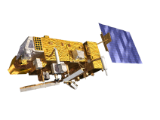
EUMETSAT scatterometer missions
YEAR...
03
04
05
06
07
08
09
10
11
12
13
14
15
16
17
18
19
20
21
22
23
24
25
26
27
28
29
30
31
32
33
34
35
36
37
38
39
40
EUMETSAT POLAR SYSTEM (EPS)
METOP-A
METOP-B
METOP-C
EUMETSAT POLAR SYSTEM SECOND GENERATION (EPS-SG)
METOP-SG A: SOUNDING AND IMAGERY
METOP-SG B: MICROWAVE IMAGERY
YEAR...
03
04
05
06
07
08
09
10
11
12
13
14
15
16
17
18
19
20
21
22
23
24
25
26
27
28
29
30
31
32
33
34
35
36
37
38
39
40
Metop
ASCAT-A (19 October 2006 – 15 November 2021)
ASCAT-B (launched 17 September 2012)
ASCAT-C (launched 07 November 2018)
Metop-SG
Scatterometer instruments (SCA) are on the SAT‐B series
SG-A1 launch planned for Q1/2025
SG-B1 launch planned for Q1/2026
[https://www.eumetsat.int/planned-launches]

Slide 6
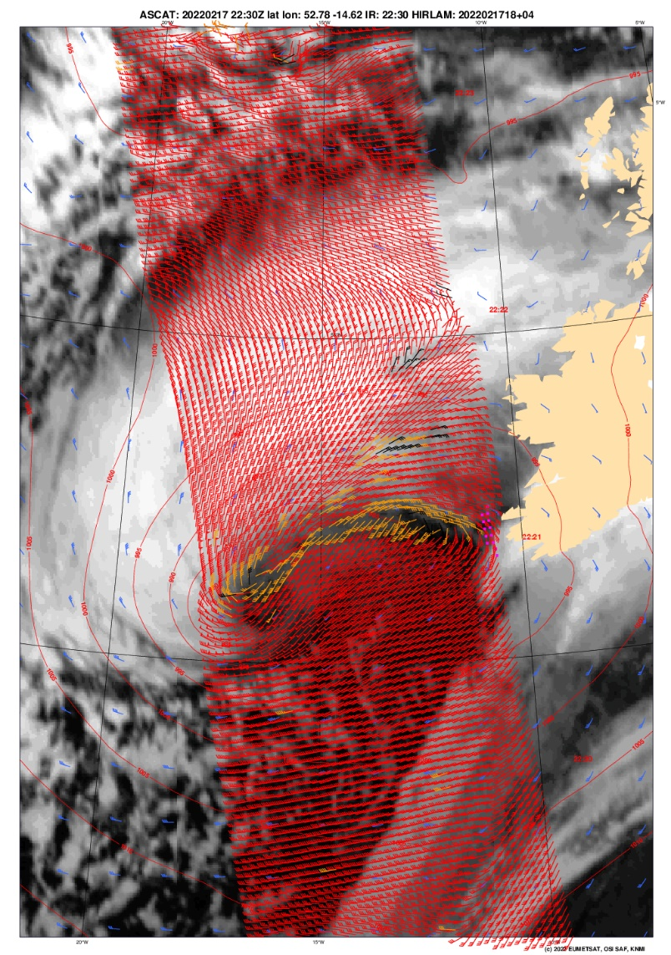
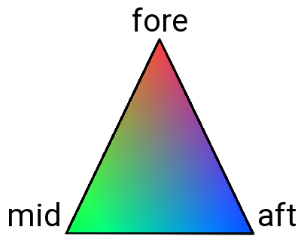
Scatterometer instruments
ASCAT-C Level-1 backscatter triplets
First Generation – ASCAT
Frequency 5.255 GHz (C-band)
Swath width 550 km
Incidence angles
25° to 53° (mid beams)
34° to 65° (side beams)
Polarization: VV
Second Generation – SCA
Frequency 5.355 GHz (C-band)
Swath width ~650 km
Incidence angles
20° to 53.7° (mid beams)
28.4° to 65° (side beams)
Polarizations: VV plus HH + HV + VH on mid-beams for improved high winds retrieval
Level-2 winds
© EUMETSAT / OSI SAF / KNMI
© Airbus
Storm Eunice
18. February 2022, RGB composite.

Slide 7
EPS-SG SCA processing chain and products
EUMETSAT internal products
EUMETSAT HQ
EUMETSAT SAF network:
OSI SAF + H SAF
Level-0
Level-1A
Level-1B full resolution (SZF)
Level-1B resampled (SZR)
Level-2
unprocessed data
radiometric and spectral corrections and calibration factors
telemetry
Radiometrically calibrated backscattering coefficients
Geolocation in the original range location
Quality flags
Radiometrically calibrated backscattering coefficients
Resampled on a swath grid
Quality flags
Soil moisture
Ocean surface wind vectors
Level-3
Sea ice parameters (ice edge, type, low-resolution drift)

Slide 8
L1 product dissemination
Product ID | Global / Regional | EUMETCAST | Others | Destination (Others) | Archive
SCA-1B-SZF | G |  | NetCDF-4 | KNMI | BUFR NetCDF-4
SCA-1B-SZR | G | BUFR NetCDF-4 |  |  | BUFR NetCDF-4
SCA-1B-SZF | R |  | NetCDF-4 | KNMI | BUFR NetCDF-4
SCA-1B-SZR | R | BUFR NetCDF-4 |  |  | BUFR NetCDF-4
Timeliness
Global data: target 70 min
Regional data: target 30 min
Some updates expected.
No dissemination via GTS is currently planned for SCA L1B data.

Slide 9
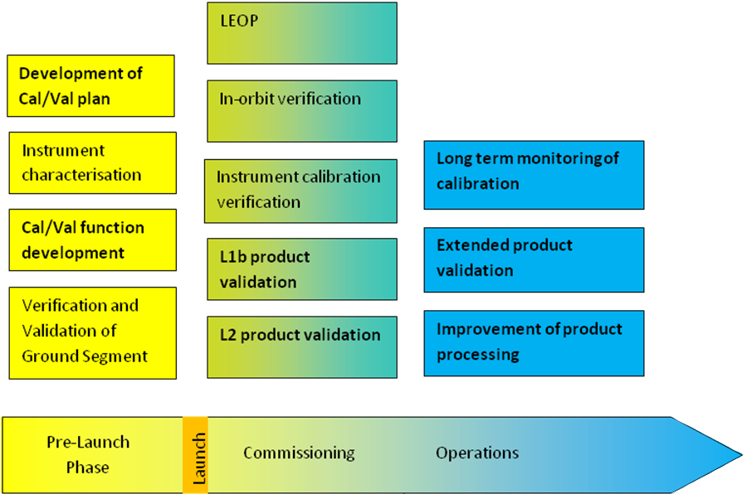
SCA summary and outlook
SCA will ensure continuity of the EUMETSAT scatterometer missions for a period of >> 30 years
Currently preparing cal/val activities and supporting the development of the operational processing facilities
Finished final pre-launch versions of processing specs, test data set and cal/val plan
SCA cal/val will follow the well-established approach used for ASCAT:
Validation using natural targets to assess long-term stability
Ground-based transponders as absolute reference

Slide 10
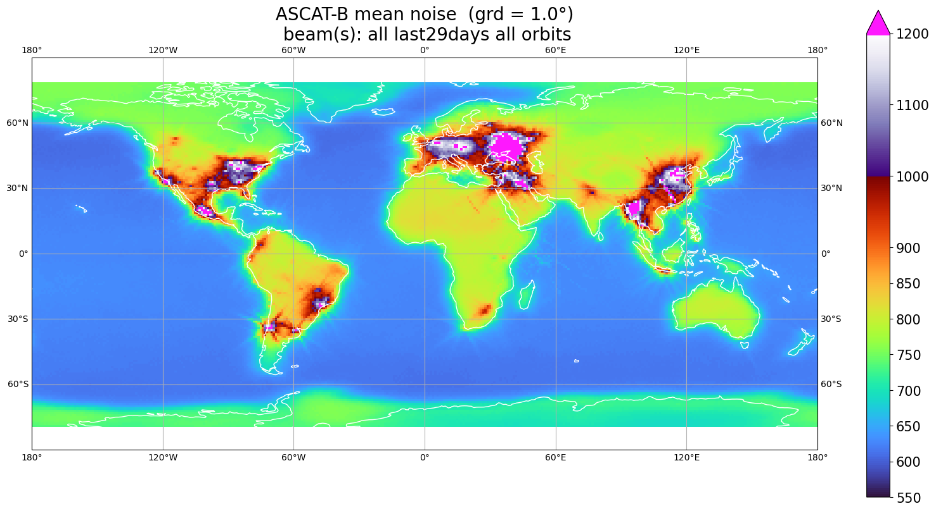
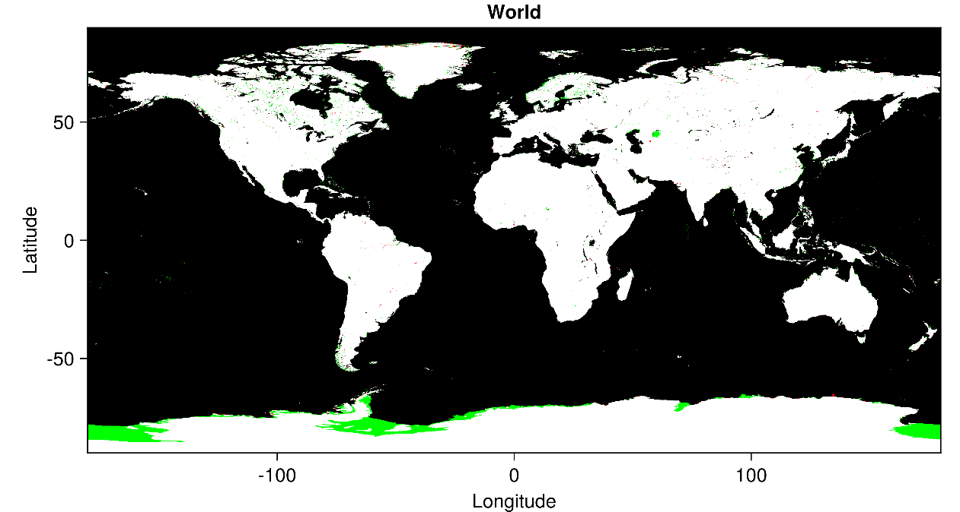
ASCAT status
Ongoing activities
Reprocessing the full ASCAT-A mission to provide a consistent time series of the full mission duration
Small evolution of the L1 processor – introduction of a new land-sea mask (fix known issues with the current one, is now consistent with the one for SCA)
Upcoming
Will continue with ASCAT-B and ASCAT-C long-term behaviour assessment and reprocessing
Investigate noise/RFI evolution – this is highly problematic for land applications
Figure: raw noise powers, unitless

Slide 11
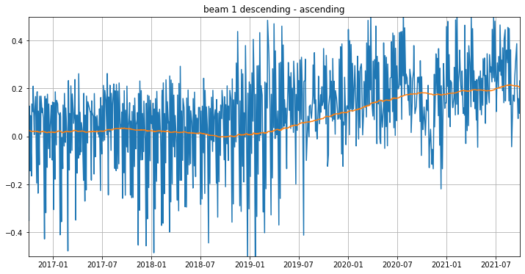
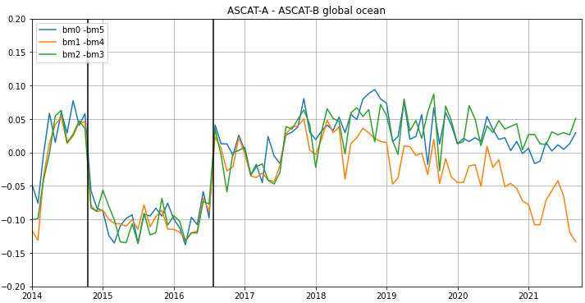
ASCAT-A long-term behaviour
Amazon rainforest
Global ocean
Difference between the Gamma-0 obtained from descending and ascending orbits over the rainforest
Discrepancy between ascending and descending orbits, starting around 2019
Drift documented by Ricciardulli et al.* starts around the same time
Similar trend in the differences between the opposing beams
Also here, different spatial sampling of ASCAT-A and ASCAT-B
* A Stable Satellite Wind Climate Data Record for Climate Variability Studies, Lucrezia Ricciardulli, Andrew Manaster, Thomas Meissner, and Carl Mears, Remote Sensing Systems, Santa Rosa, CA, USA, IOVWST 2023

Slide 12
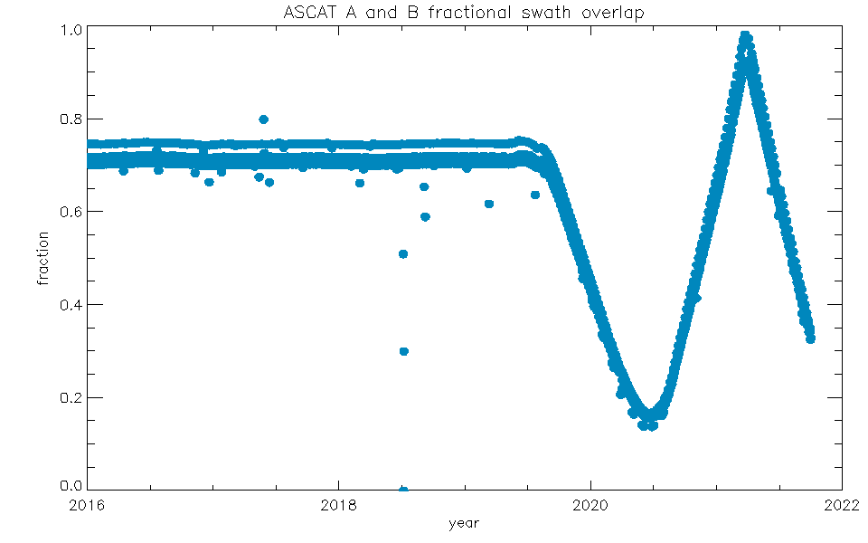
ASCAT-A long-term behaviour
ASCAT-A ground track
The last inclination maintenance of ASCAT-A occurred on 31.08.2016
after that, a slow drift has started leading to the local time of the ascending node to be shifted to about 90 minutes earlier by the end of the mission i.e., ~ 20:00 for ascending and ~08:00 for descending orbits.
ASCAT A and B fractional swath overlap for ascending passes (daily)
Drift observed since 2018 is most likely caused by different spatial sampling due to the drifting ground track of ASCAT-A, and is not a calibration issue

Slide 13
Thank you!
Questions are welcome.

