Slide 1
Momentum and energy fluxes in wind-forced breaking waves
Nicolò Scapin^{1,2}, Jiarong Wu^{1,*}, J. Thomas Farrar³,
Bertrand Chapron⁴, Stéphane Popinet⁵ and Luc Deike^{1,2}
International Ocean Vector Winds Science Team (IOVWST) Meeting Salt Lake City, Utah, USA (May, 29-31th 2024)
Department of Mechanical and Aerospace Engineering (MAE), Princeton University, US.
High Meadows Environmental Institute (HMEI), Princeton University, US.
Woods Hole Oceanographic Institution (WHOI), US.
IFREMER, Univ. Brest, CNRS, IRD, Laboratoire d'Océanographie Physique et Spatiale (LOPS), France.
CNRS, Institut Jean Le Rond d'Alembert - Sorbonne Université, France.
* Current affiliation: Courant Institute of Mathematical Sciences, New York University, US

Slide 2
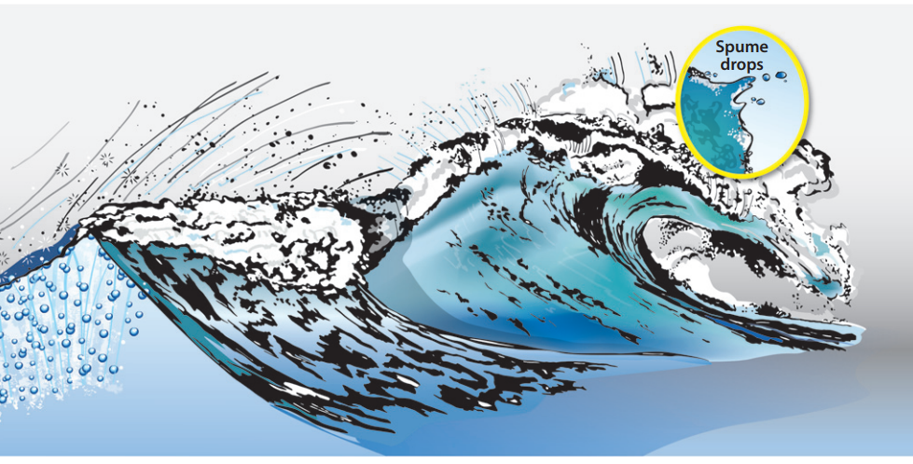
Wind-forced breaking waves
Change in surface topography + spray formation: modulation of mass, momentum and heat transfer
Veron F., Annu. Rev. Fluid Mech., 2015
Wind forcing induces: wave growth, steepening, and eventually wave breaking with energy transfer to the water column.
Waves and wave breaking modulate the exchanges of momentum, energy and mass at the ocean-atmosphere interface.

Slide 3
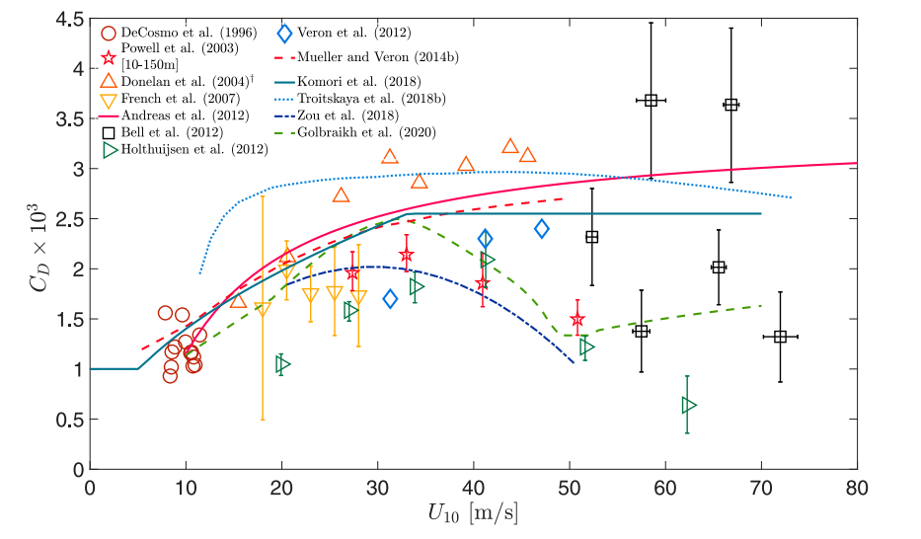
Exchanged fluxes at high wind speeds
Dimensionless momentum flux, $C_{D}$
$$C_{D}= \frac{ρ_{a}u_{∗}^{2}}{ρ_{a}u^{2}(\overline{z}=10 m)}$$
--> Drag coefficient: the imposed stress over velocity U₁₀.
--> Uncertainty in (a) the imposed stress and (b) in the velocity profile leads to a large data scattering.
Energy transfer
--> Modulation of the growth rate by the wind forcing
"A Review of Parameterizations for Enthalpy and Momentum Fluxes from Sea Spray in Tropical Cyclones" by S. Sroka and K. Emanuel
--> Dissipation induced by wave breaking
Objectives: retrieve from first principles the energy and momentum fluxes

Slide 4
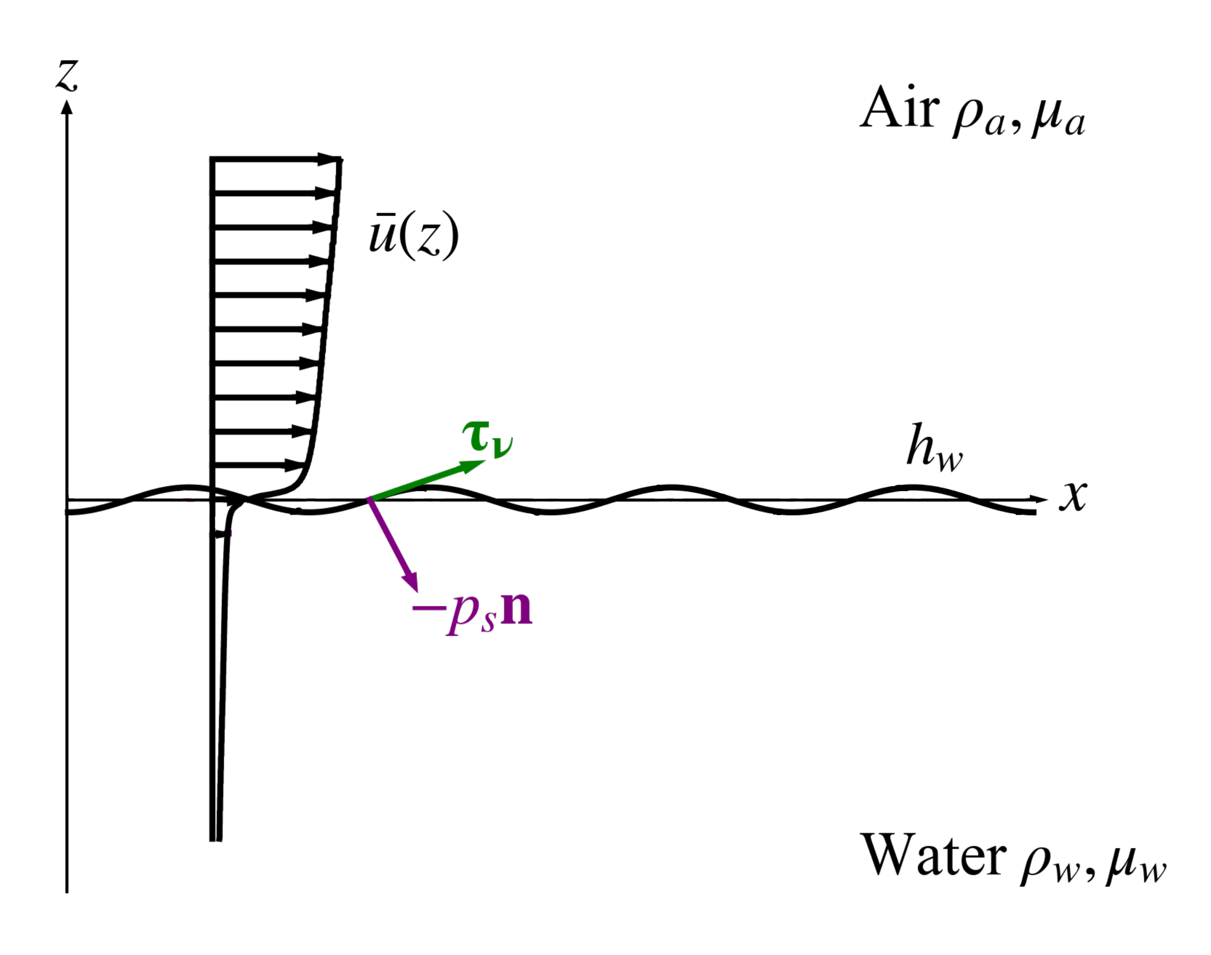
Two-phase turbulent boundary layer (1/2)
Physical dimensionless parameters
Friction Reynolds number: $Re_{τ}=\frac{ρ_{a}u_{∗}H_{a}}{μ_{a}};$
Wave Reynolds number: $Re_{wave}=\frac{ρ_{w}cλ}{μ_{w}};$
Bond number: $Bo=\frac{\left|g\right|\left(ρ_{w}−ρ_{a}\right)λ^{2}}{4π^{2}σ}$;
Initial wave steepness: $a_{0}k$;
Friction velocity over wave speed: $u_{∗}/c$
H_{a}
Airflow
λ
H_{w}
Water currents
Wu et. al., JFM 2022
Direct numerical simulations of the two-phase system by solving the Navier-Stokes equations, i.e continuity and momentum equations with Basilisk solver (http://basilisk.fr/);
Fully-coupled simulations without any model for the wave shape, i.e. waves can grow and break and sub-grid model for turbulence, i.e. all the scales are resolved.

Slide 5
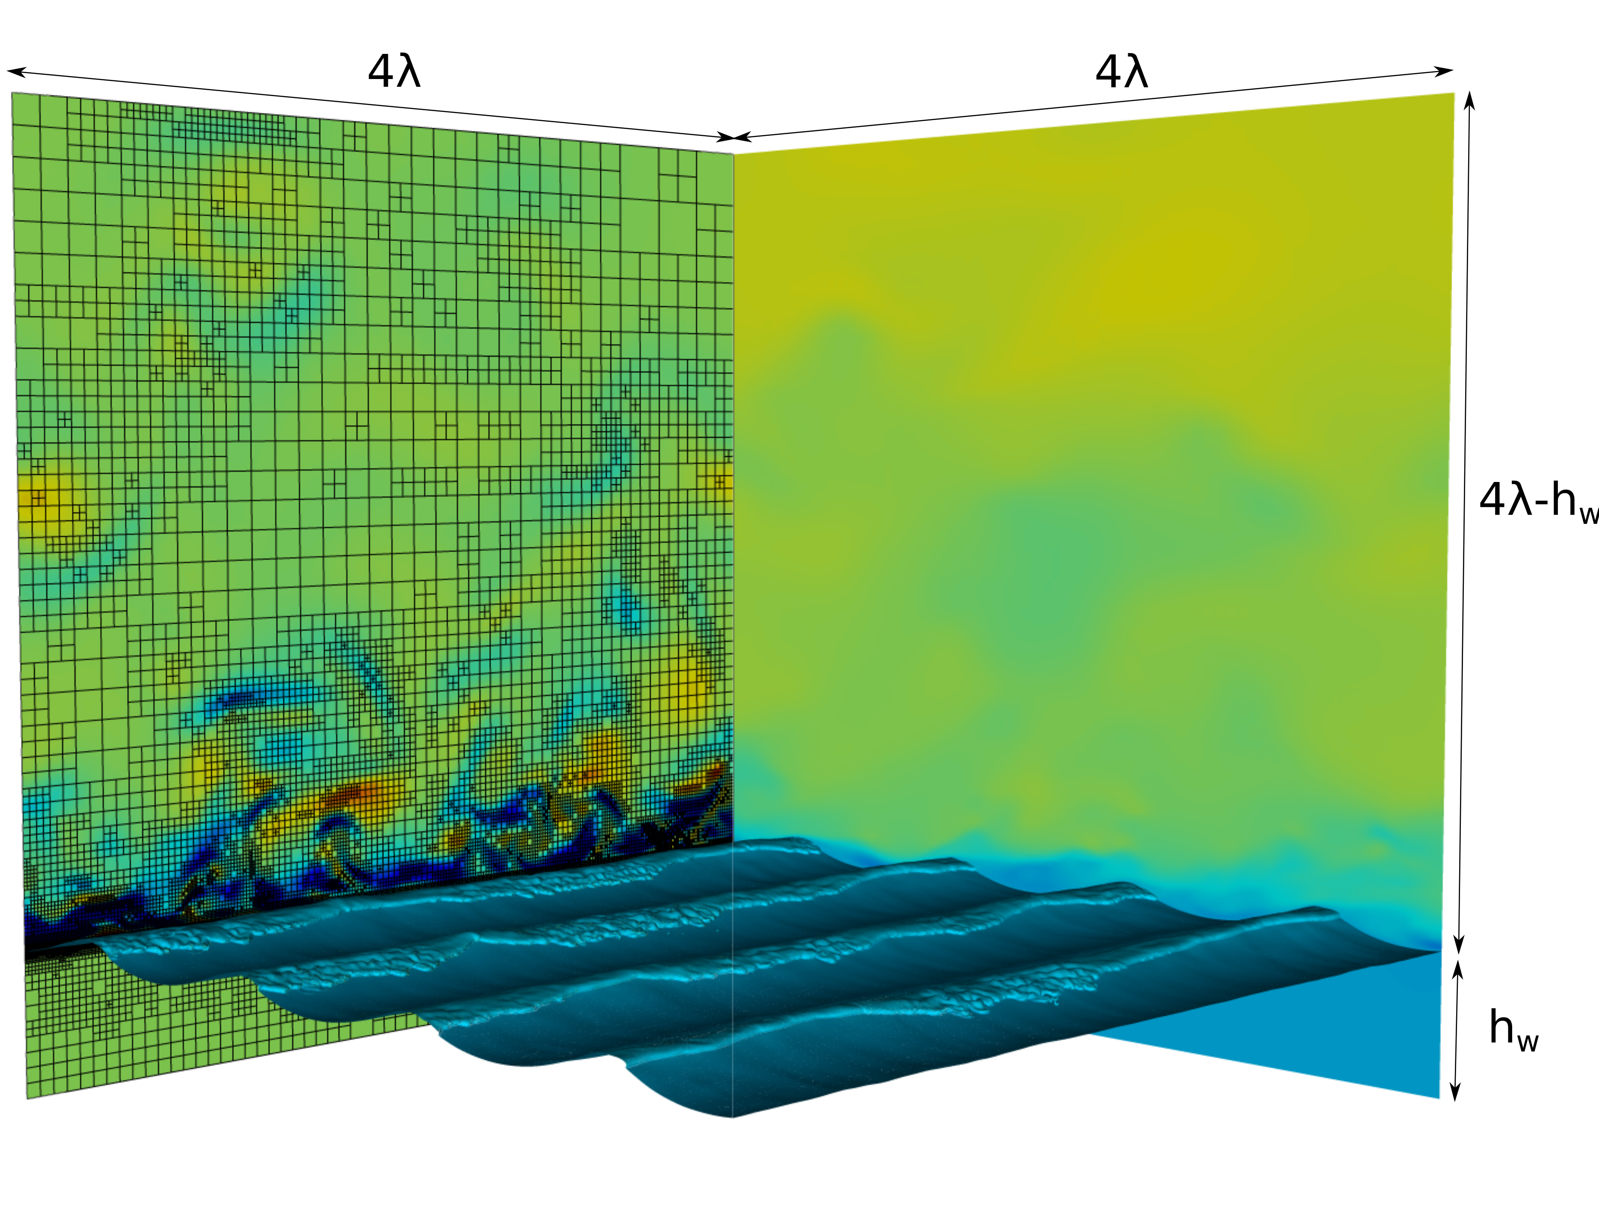
Two-phase turbulent boundary layer (2/2)
Initial condition in Air: fully-developed turbulence (mean velocity independent of time);
Initial condition in Water: potential flow solution of a third-order Stokes wave.
Computational domain:
$4λ ×4λ ×4λ$, $H_{w}≈0.64λ, H_{a}≈3.36λ$
x-y: periodic directions; z: free-slip conditions;
Grid resolution: $L^{10}$ (equivalent ${1024}^{3});$
We fix: $$Re_{τ}=720, Re_{w}=2.5⋅{10}^{4}, Bo=200, a_{0}k=0.3$$
z
We vary (in the high-wind speed regime):
$$\frac{u_{∗}}{c}=0.3−0.4−0.5−0.7−0.9;$$
y
x

Slide 6
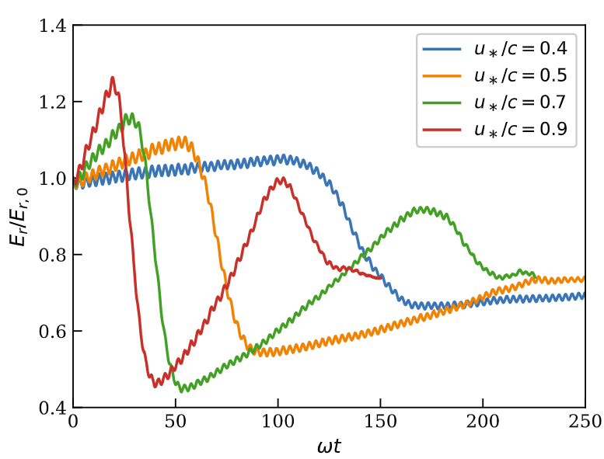
u*/c = 0.9
$$E_{w}\left(t\right)=\frac{1}{2}ρ_{w}\left|g\right|a^{2}(t)$$
$$a^{2}\left(t\right)=\frac{2}{A}\int{{\left(η−\overline{η}\right)}^{2}dA}$$
The instantaneous change in $E_{w}\left(t\right), i.e. change in a(t)k$
(1) Affects the exchanged momentum, i.e. pressure and viscous forces, between air and water;
(2) Modulates the airflow;
(3) Affect the energy transfer to the water column.

Slide 7
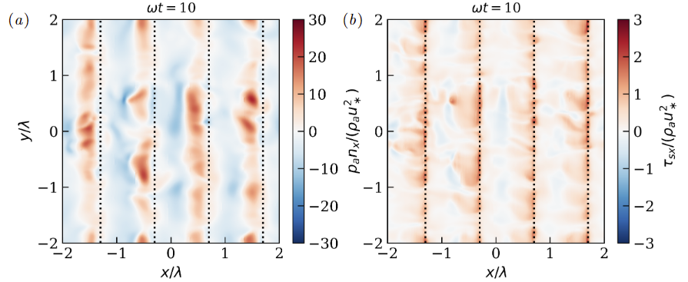
(1) Momentum fluxes/exchanged forces
We decompose the streamwise force in a pressure and viscous contribution $(τ=μ_{a}(∇u+∇u^{T})$)
$$F_{x}=\underset{F_{p,x} − Pressure contribution}{\underbrace{−\int_{Γ}{pn{⋅e}_{x}dA}}}+\underset{F_{τ,x} − Viscous contribution}{\underbrace{\int_{Γ}{(τn)⋅e_{x}dA}}}$$
$n=\left(n_{x}, n_{y}, n_{z}\right)$: normal vector at the interface $Γ$, $e_{x}=\left(1, 0, 0\right)$

Slide 8
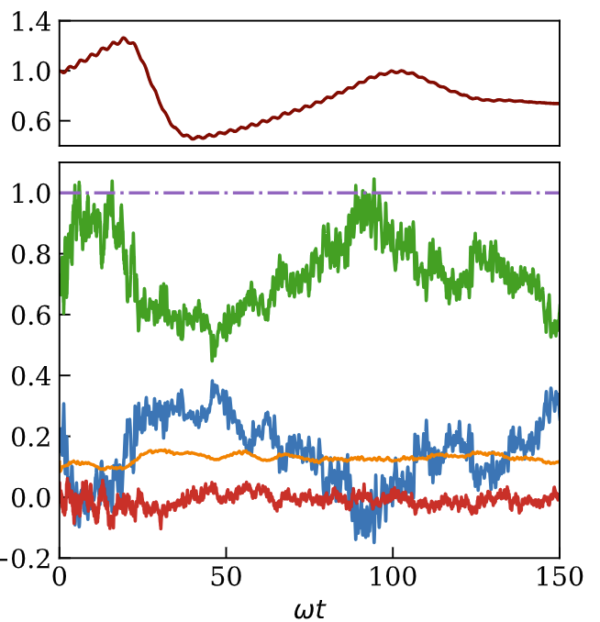
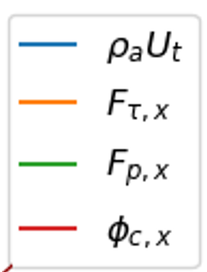
(1a) Momentum fluxes/exchanged forces
$$\frac{E_{w}}{E_{w,0}}$$
Growing stage: increase in the pressure force
Breaking stage: drop in the pressure force
Streamwise momentum budget in the air
$$\frac{F}{ρ_{a}u_{∗}^{2}Γ}$$
the compensation for pressure force comes from the change in the mean flow and partially from the viscous contribution
Airflow modulation

Slide 9
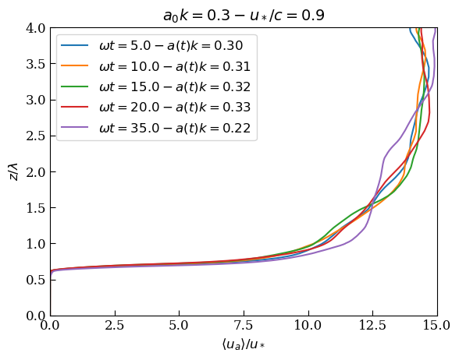
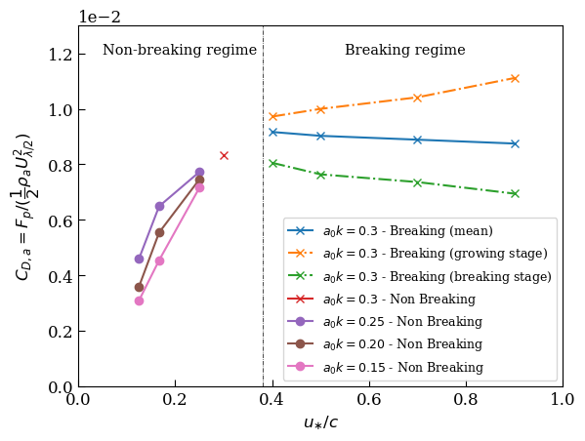
(2) Airflow modulation and drag coefficient (1/2)
$$C_{D,a}= \frac{{\overline{F}}_{p}}{\frac{1}{2}ρ_{a}Γ{\overline{U}}^{2} (z=\frac{λ}{2}) }$$
The flow locally accelerates at the breaking.
Wave breaking is the driver behind $C_{D,a}$ saturation!

Slide 10
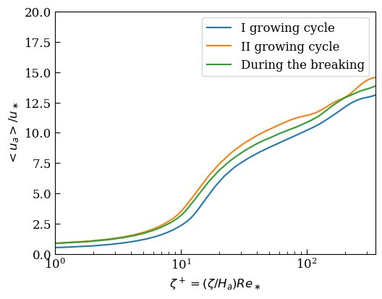
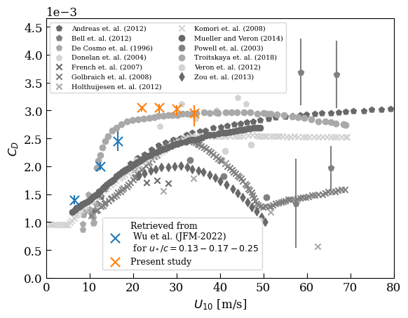
(2) Airflow modulation and drag coefficient (2/2)
$$C_{D}=\frac{κ^{2}}{\log{(\frac{z=10 m}{z_{0}})}}$$
$z_{0}$ computed by fitting a log profile in the log law
the law-of-the wall: streamwise velocity as a function of the vertical wave-following coordinate
→ consistent upshift of the velocity profile
Wave breaking is the driver behind $C_{D}$ saturation!

Slide 11
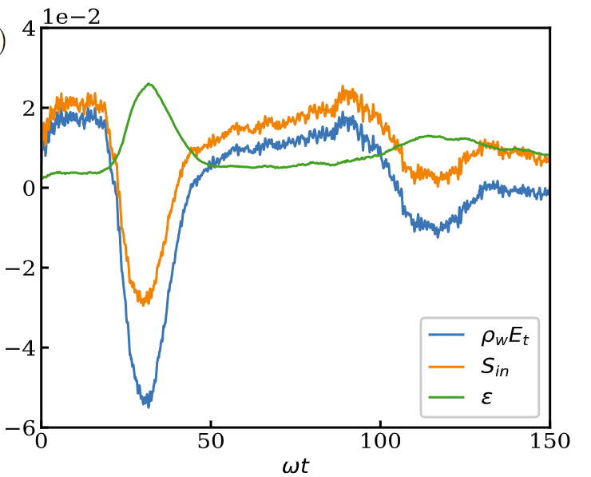
(3) Energy transfer to the water column
$$\frac{I}{ωE_{w,0}}$$
$$\frac{∂e_{w}}{∂t}=S_{in}−ε$$
$e_{w}=\frac{1}{2}{ρ_{w}|g|a}^{2}\left(t\right)$: wave energy
$S_{in}=S_{τ}+S_{p}:input$ (viscous stress and pressure)
$ε$: Dissipation --> $ε=μ_{w}{\left(∂_{i}u_{j}+∂_{j}u_{i}\right)}^{2}$
During the growing stage, the energy input $S_{in}$ is positive
During the breaking stage, the energy input $S_{in}$ not only is much smaller than the dissipation but it turns to become negative

Slide 12
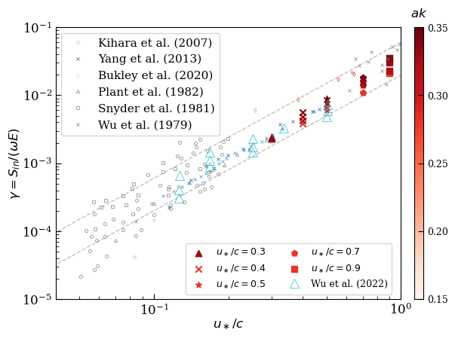
(3a) Wind inputs
From the total energy input, we can estimate the grow rate as
$$γ= \frac{S_{in}}{ωE}=\frac{{2S}_{in}}{ωgρ_{w}a^{2}}$$
Miles scaling: we can approximate $S_{in}≈cF_{p}$, we can derive an expression for $γ$
$$γ= \frac{S_{in}}{ωE}=β\frac{u_{∗}^{2}}{c^{2}}\frac{ρ_{a}}{ρ_{w}}$$
$$β=16−50$$
Good agreement between the DNS and theoretical Miles scaling for different $u_{∗}/c$ and $ak$

Slide 13
(3b) Energy dissipation (1/3)
Dissipation is required for parametrization in operational wave models.
$ε=χ_{0}w_{c}^{3}/l_{c}$ with $w_{c}=\sqrt{2gl_{c}}, l_{c}=h$with $h$ the breaking height, $w_{c}$ is the ballistic velocity (Melville, JFM 1994 and Drazen, JFM 2008).
In JFM-2008, Drazen suggested $\left(\frac{ε}{L_{0}}\right)=ε_{l}=ρ_{w}Aε$ with $A=πh^{2}/4$ (cylindrical cloud turbulence)
$ε_{l}=\frac{{bρ}_{w}c^{5}}{g}$
Breaking parameters: $b=χ_{1}{\left(S−S_{0}\right)}^{2.5} with$ $S=\left(hk\right), χ_{1}=O(1) and S_{0}=0.08.$

Slide 14
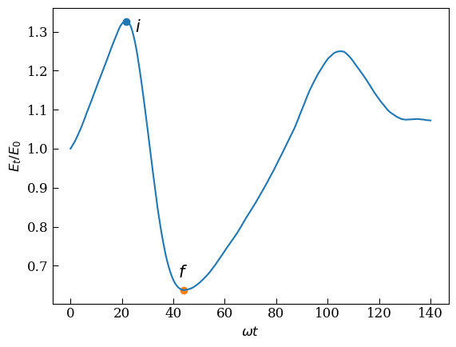
(3b) Energy dissipation (2/3)
This correlation was developed for breaking waves. Is it valid for wind-forced breaking waves?
Procedure:
Define the initial and the final points (i) and (f).
Compute the dissipation per unit of breaking crest $ε_{l};$
Compute b.
Compare the estimated b with the one obtained from the inertial scaling $b=χ_{0}{\left(S−S_{0}\right)}^{2.5}.$
$$ε_{l}L_{0}={(E}_{i}−E_{f})/(t_{i}−t_{f})$$

Slide 15
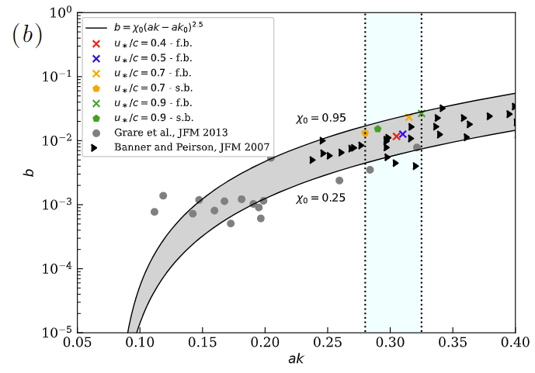
(3b) Energy dissipation (3/3)
Drazen’s inertial scaling: $b=χ_{1}{\left(S−S_{0}\right)}^{2.5}$
$$χ_{1}=O(1) and S_{0}=0.08.$$
breaking interval for our simulations
Interval of $χ_{1}∈[0.25−1]$
Key points:
the breaking event appears to be a universal process, i.e. independent of the cause triggering the breaking;
If choose a proper $w_{c}$ and $l_{c}$, we can predict the breaking-induced dissipation even for wind-forced breaking waves

Slide 16
Conclusions
Direct numerical simulations of wind-forced wave breaking at high wind speed;
Nonmonotonous behaviour of the pressure force which reduces after the breaking stage (even without droplets);
Reduction is linked to the airflow modulation and to the change in the velocity profile;
Growth-rate and energy dissipation consistent with the available scaling laws.
N. Scapin et al., “Momentum and energy fluxes in wind-forced breaking waves” (to be submitted)

Slide 17
Numerical methodology
We solve on an adaptive cartesian grid (1) continuity equation (incompressibility constrain) together with (2) the momentum equation for a two-phase system.
Sharp-interface formulation for the interface advection (geometric VoF);
Momentum consistent formulation to ensure robustness at high density ratio;
Adaptive mesh-refinement (AMR) techniques based on wavelet transformation;
Basilisk: Open-source implementation available at http://basilisk.fr/

Slide 18
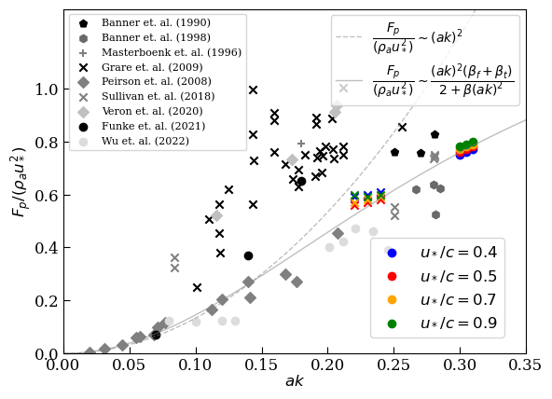
Comparison with the commonly employed scaling laws
Pressure drag vs the instantaneous steepness, before the breaking (circles) and after the breaking (x);
Correction required at larger steepness, i.e. a(t)k>0.15

Slide 19
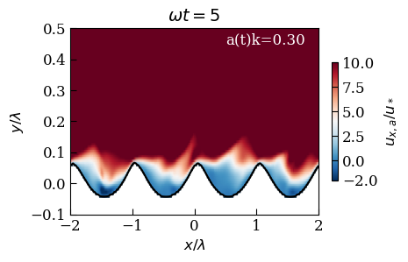
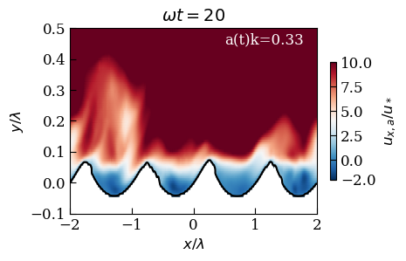
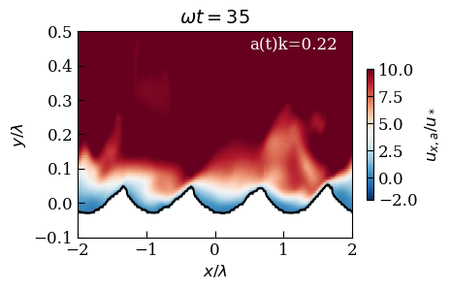
2. Airflow modulation
Pre-breaking stage
Breaking stage
Post-breaking stage

Slide 20
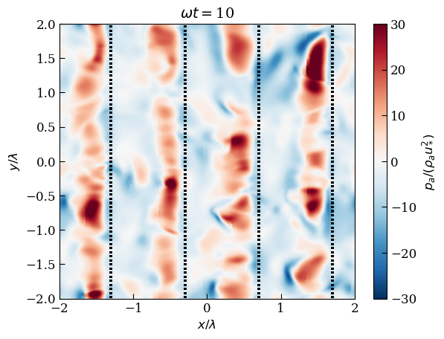
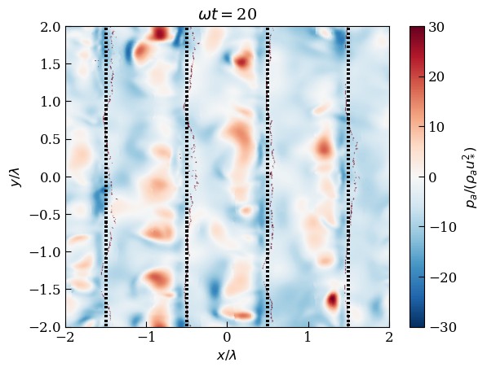
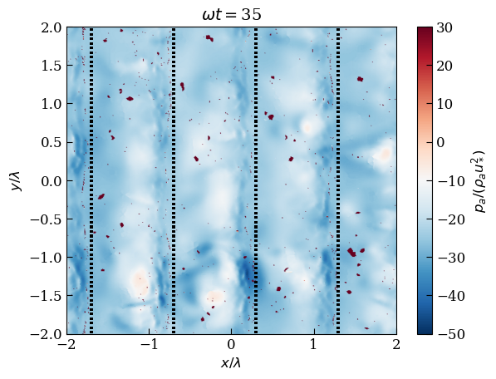
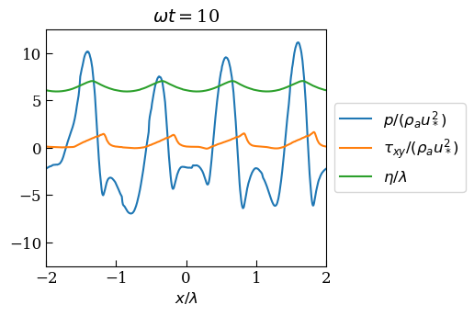
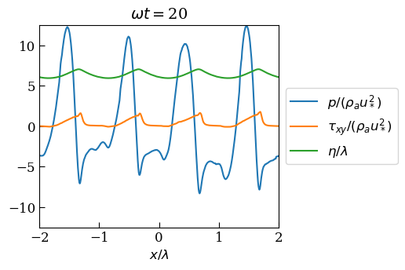
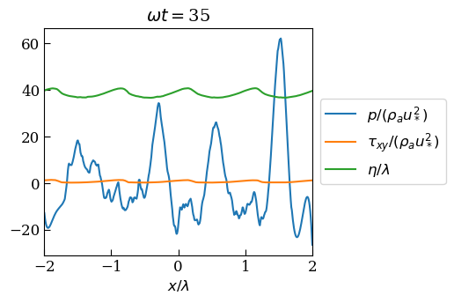
Pressure distribution (a₀k = 0.3 - u*/c = 0.9)
Pre-breaking, a(t)k=0.31
Breaking, a(t)k=0.33
Post-Breaking, a(t)k=0.22

Slide 21
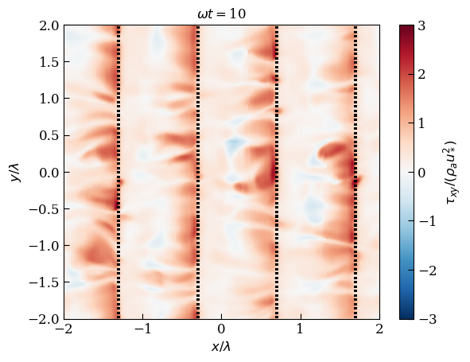
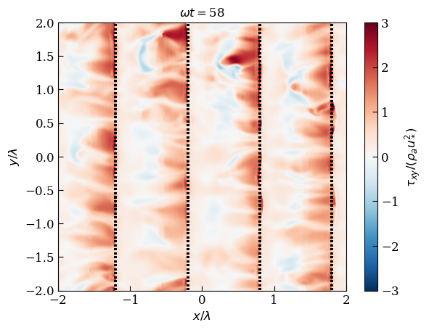
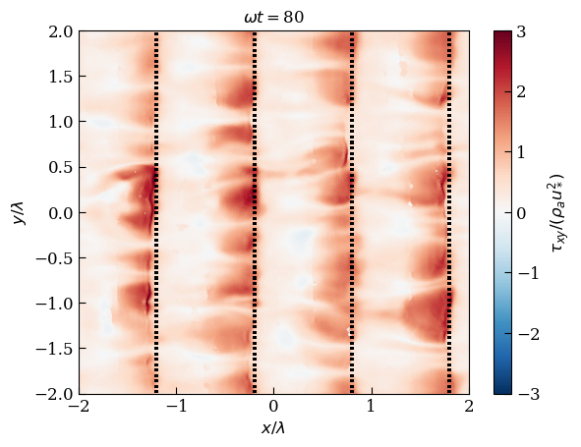
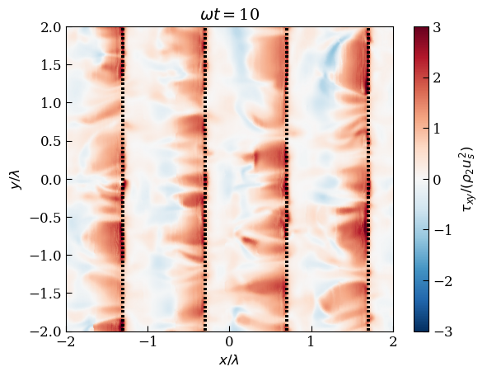
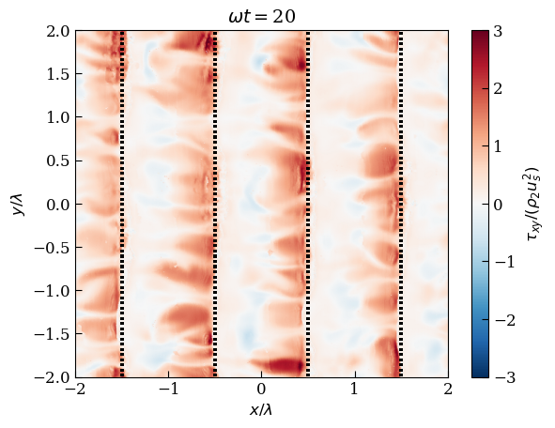
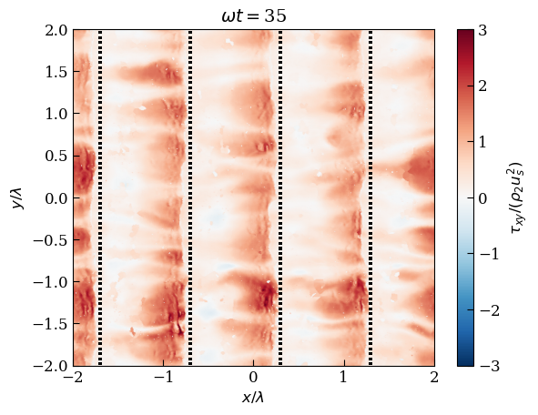
Viscous stress distribution (a0k = 0.3 - u*/c = 0.5-0.9)
u*/c = 0.5
Pre-breaking, a(t)k=0.30
Breaking, a(t)k=0.32
Post-Breaking, a(t)k=0.22
u*/c = 0.9
Pre-breaking, a(t)k=0.305
Breaking, a(t)k=0.33
Post-Breaking, a(t)k=0.21

Slide 22
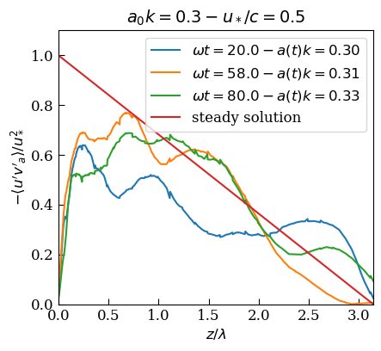
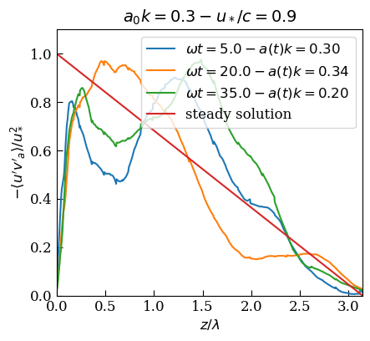
Reynolds stress
Large variation of the Reynolds stress in time with an enhancement at the breaking stage
(which also explain the deviation from the log-law)

