Slide 1
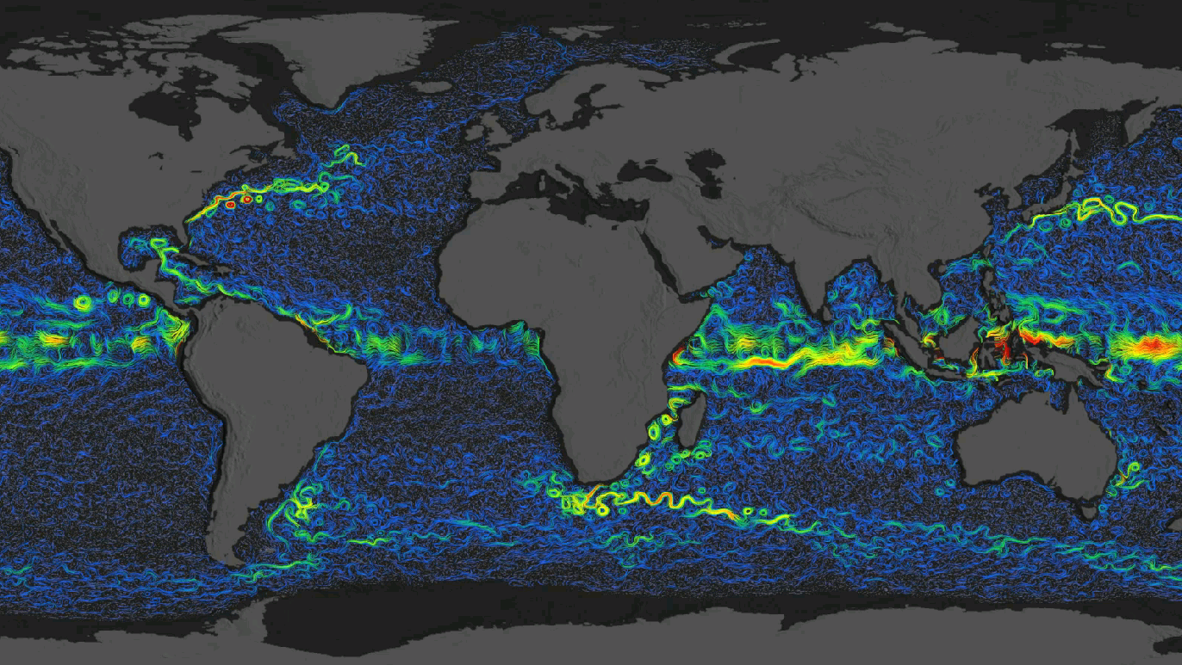
Simultaneous Winds and Surface Currents via the Proposed ODYSEA Doppler Scatterometer
Sarah Gille (SIO/UCSD, sgille@ucsd.edu)
with the ODYSEA team: Tong Lee, Fabrice Ardhuin, Justin Boland, Mark A. Bourassa, Paul Chang, Sophie E. Cravatte, J. Thomas Farrar, Melanie R. Fewings, Fanny Girard-Ardhuin, Gregg A. Jacobs, Zorana Jelenak, Florent Lyard, Jackie C May, Elisabeth D Rémy, Lionel Renault, Ernesto Rodriguez, Clément Ubelmann, Ana Beatriz Villas Bôas, and Alexander G. Wineteer
Earth and Space Research OSCAR Product: https://www.esr.org/research/oscar/additional-information/

Slide 2
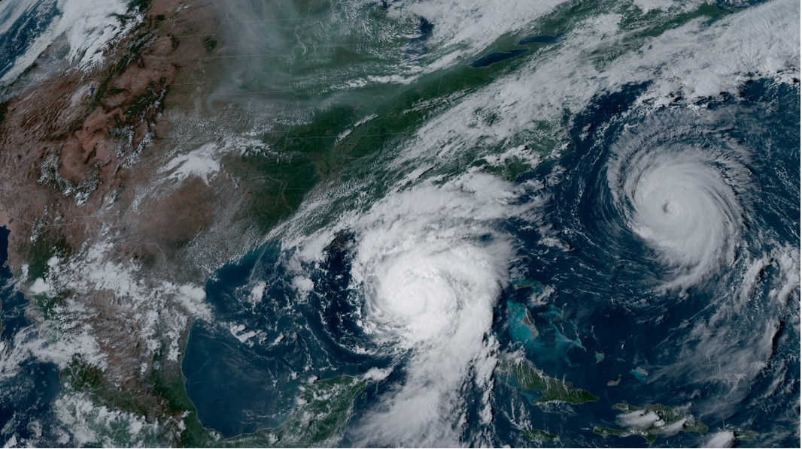
Hurricane Idalia and Hurricane Franklin
August 29, 2023
https://www.noaa.gov/media-advisory/noaa-to-announce-2024-atlantic-hurricane-season-outlook

Slide 3
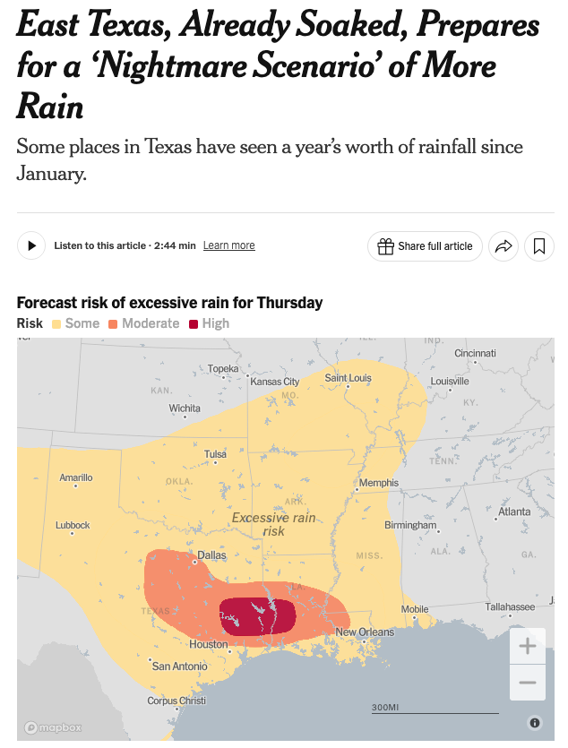
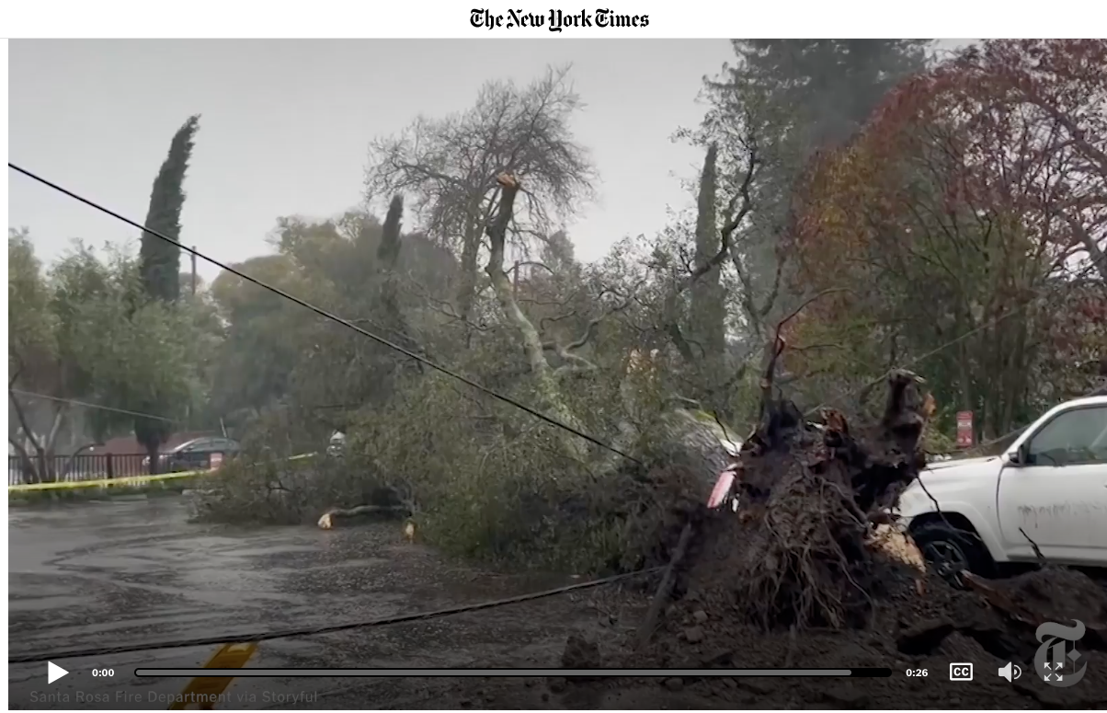
The ocean drives disruptive weather
Feb. 19, 2024
New York Times, May 15, 2024

Slide 4
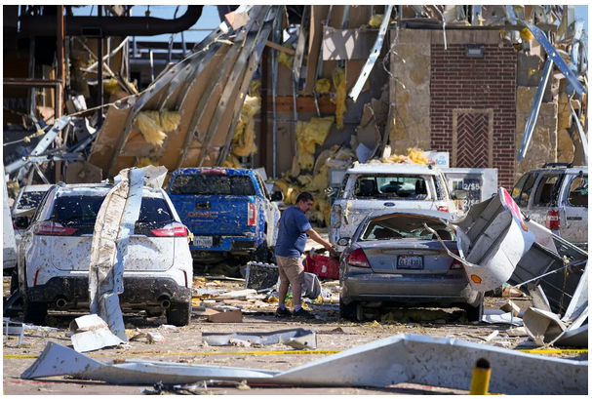
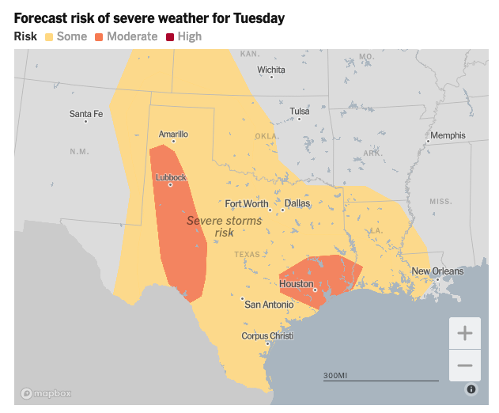
Even tornadoes…..
New York Times, May 28, 2024

Slide 5
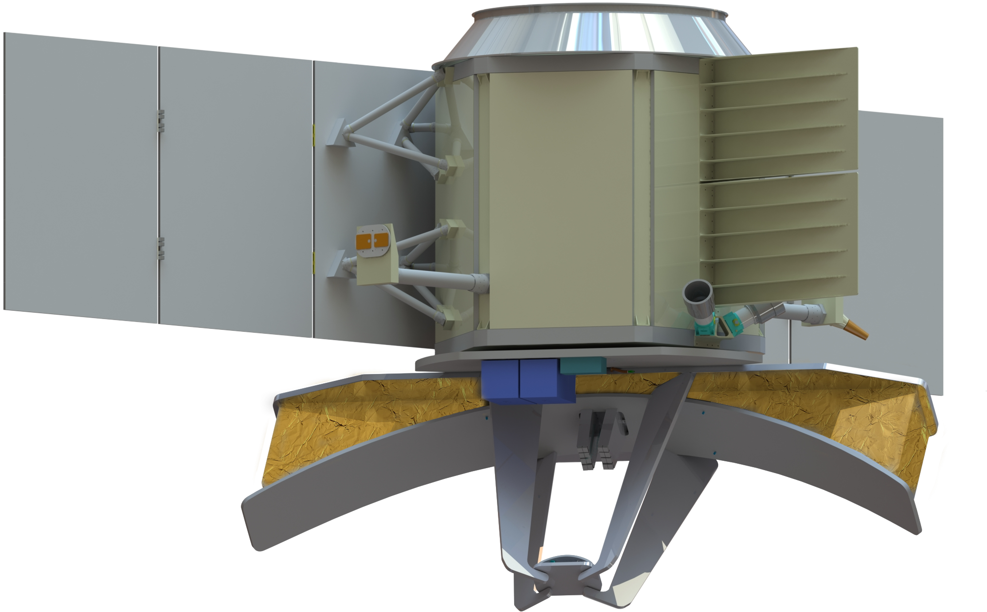
Ocean Dynamics and Surface Exchange with the Atmosphere
Earth System Explorer proposal to measure winds, surface currents, and their interactions
Objectives:
What does ODYSEA measure?
What can we do with ODYSEA’s measurements?
What’s the status? And how can you be involved?

Slide 6
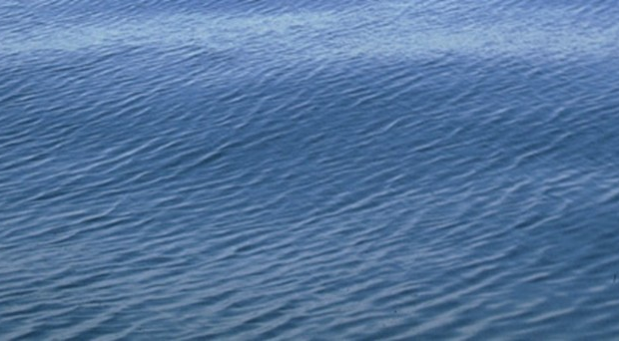
Scatterometers respond to capillary waves
Radar scatters off capillary waves
Scatterometers obtain wind direction through multiple looks at the same patch of ocean
wind
Photo: http://www.eng.usf.edu/~aetejada/ResearchHighlight1.html

Slide 7
In addition to backscatter, measure frequency
Ocean surface

Slide 8
Capillary waves ride on ocean currents
Ocean surface current
Backscattered radar frequency Doppler shifted due to surface currents
With multiple looks, determine current speed and direction

Slide 9
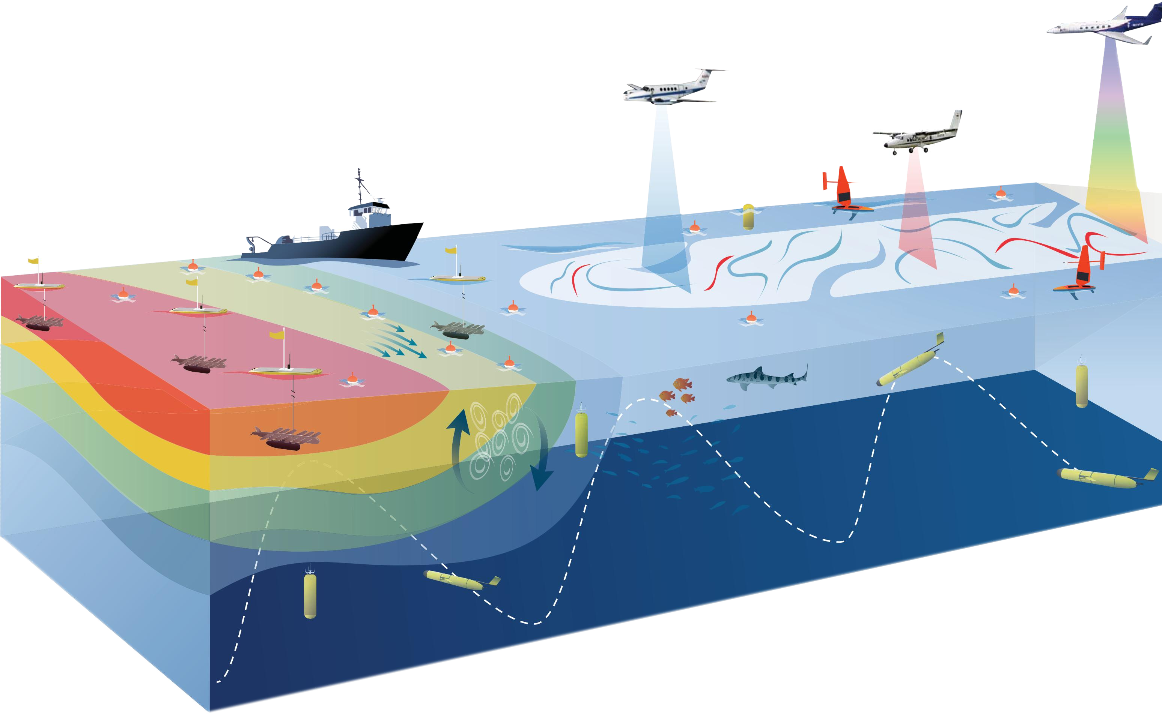
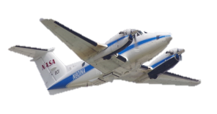
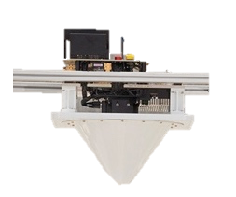
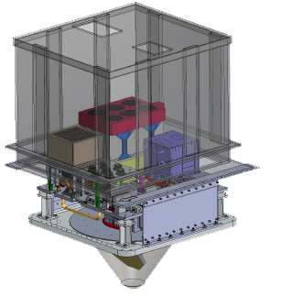
Ocean Dynamics and Surface Exchange with the Atmosphere
DopplerScatt IIP (2014)
ODYSEA ESE (2023)
DopplerScatt AITT (2016)
S-MODE EVS-3 (2019)
DopplerScatt
Concept (2013)

Slide 10
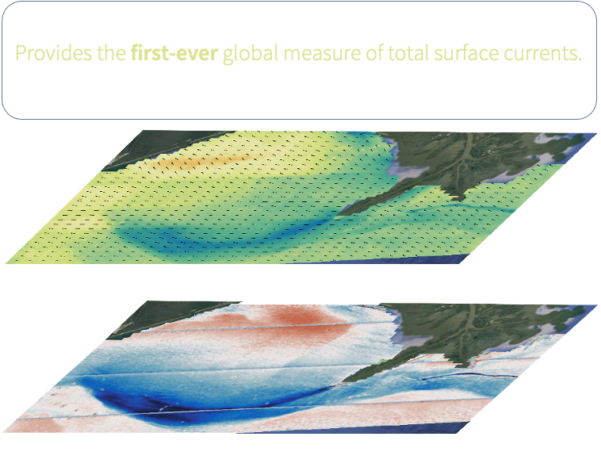
Earth System Explorer proposed to NASA with strong support from CNES (+ US Space Force)
Advanced to next phase!
Web: odysea.ucsd.edu
PI: Sarah Gille sgille@ucsd.edu
Project Scientist: Tong Lee, tlee@jpl.nasa.gov
5 km postings
1700 km swath
Daily coverage, near-real time

Slide 11
ODYSEA will bring small-scale wind gradients into focus

Slide 12
And show us currents and eddies as never seen before

Slide 13
What can we do with winds and currents?
2 science objectives
1 applications objective

Slide 14
Science Objective 1: Competing hypotheses of wind—current coupling

Slide 15
Science Objective 2: Hypothesis: High stratification implies faster surface currents

Slide 16
Or seasonal sub-mesoscale dynamics govern velocity?
Kuroshio Extension submesoscale motions energized in late winter/spring
Available potential energy lower in summer due to stratification.
End of winter
End of summer
Rocha et al, GRL, 2016

Slide 17
Hypothesis: Low stratification means more potential energy storage and ultimately faster currents
Underscores need for more extensive global observations of winds and currents

Slide 18
Meeting operational needs
Near real time winds and currents
Storm evolution, surface waves, maritime safety, debris transport
Support NOAA, Navy, Coast Guard Search and Rescue, Mercator Ocean international

Slide 19
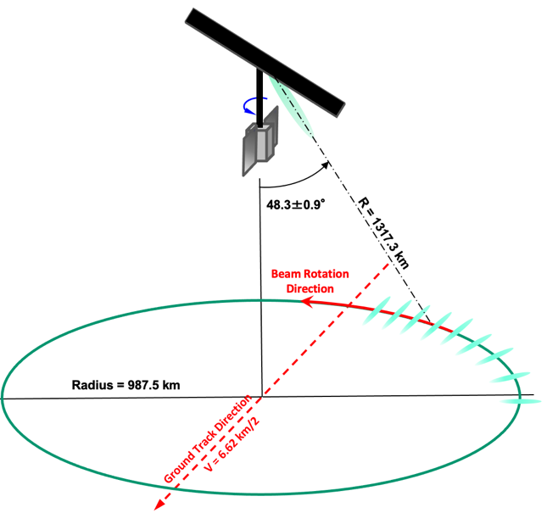
ODYSEA Mission Overview
Science and operational capabilities fill a void
No satellites measure total surface currents
No US scatterometers measure winds, no 5-km postings, no sun synchronous measurements in midnight—6 am time range
90% global coverage < 1 day (2x/day in many places)
~650 km sun-synchronous terminator (4:30 am/4:30 pm) orbit
Capability for near-real time ocean wind and currents data products (<6 hour latency)
One of four Earth System Explorers selected for 9 months of further study
Science has been reviewed; now demonstrate that goals can be achieved on time and on budget
2 missions will be selected for launch in 2030 and 2032

Slide 20
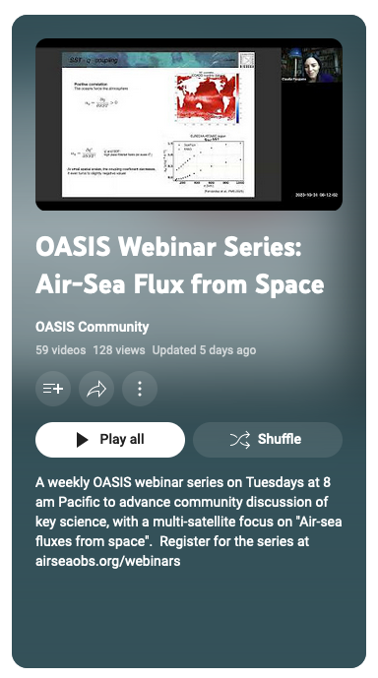
How can you get involved?
1. Test science ideas using the ODYSEA simulator (https://odysea.ucsd.edu)
2. Discuss the science:
OASIS Grand Idea #2: Air-Sea Fluxes from Space
Webinar Tuesdays at 8 am PT, 11 am ET, 5 pm CET
Sign up from the OASIS web site: https://airseaobs.org/
Find previous recordings on youtube
Steering committee:
Mara Freilich, Brown University
Sarah Gille, Scripps Institution of Oceanography, UC San Diego
Christine Gommenginger, National Oceanography Centre
Tony Lee, Jet Propulsion Lab
Paco Lopez-Dekker, Technical University Delft
Claudia Pasquero, Università di Milano - Bicocca
Aneesh Subramanian, University of Colorado
Bia Villas Bôas, Colorado School of Mines

Slide 23
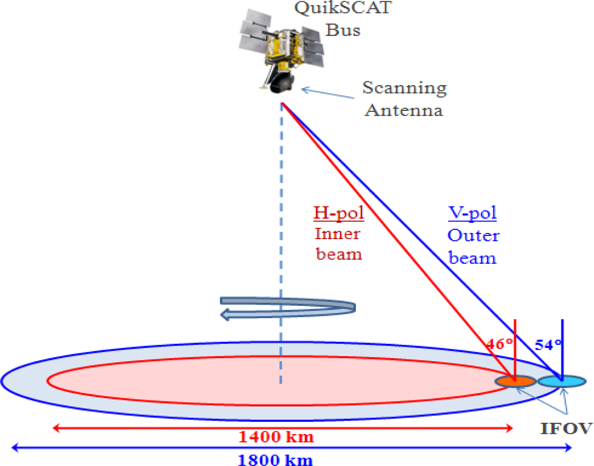
Measuring wind with scatterometry
Multiple looks at each patch of ocean.
Use backscattered radar signal to identify wind speed and direction.
Passive instruments (e.g. COWVR) use emitted radiation

Slide 24
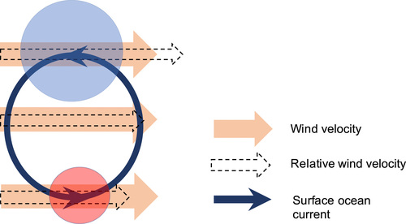
Why relative winds?
Winds counter to currents strengthen the relative wind and exert more stress on the ocean
Winds aligned with currents imply less relative wind and less stress to drive the current.
Rai et al, Science Advances, 2021
Capillary waves measured by satellite depend on wind relative to current, so if satellites were our only means to measure wind, we could ignore relative winds.
But we calibrate to in situ winds and use models without relative effects, so, we need to be able to tease these components apart.

Slide 25
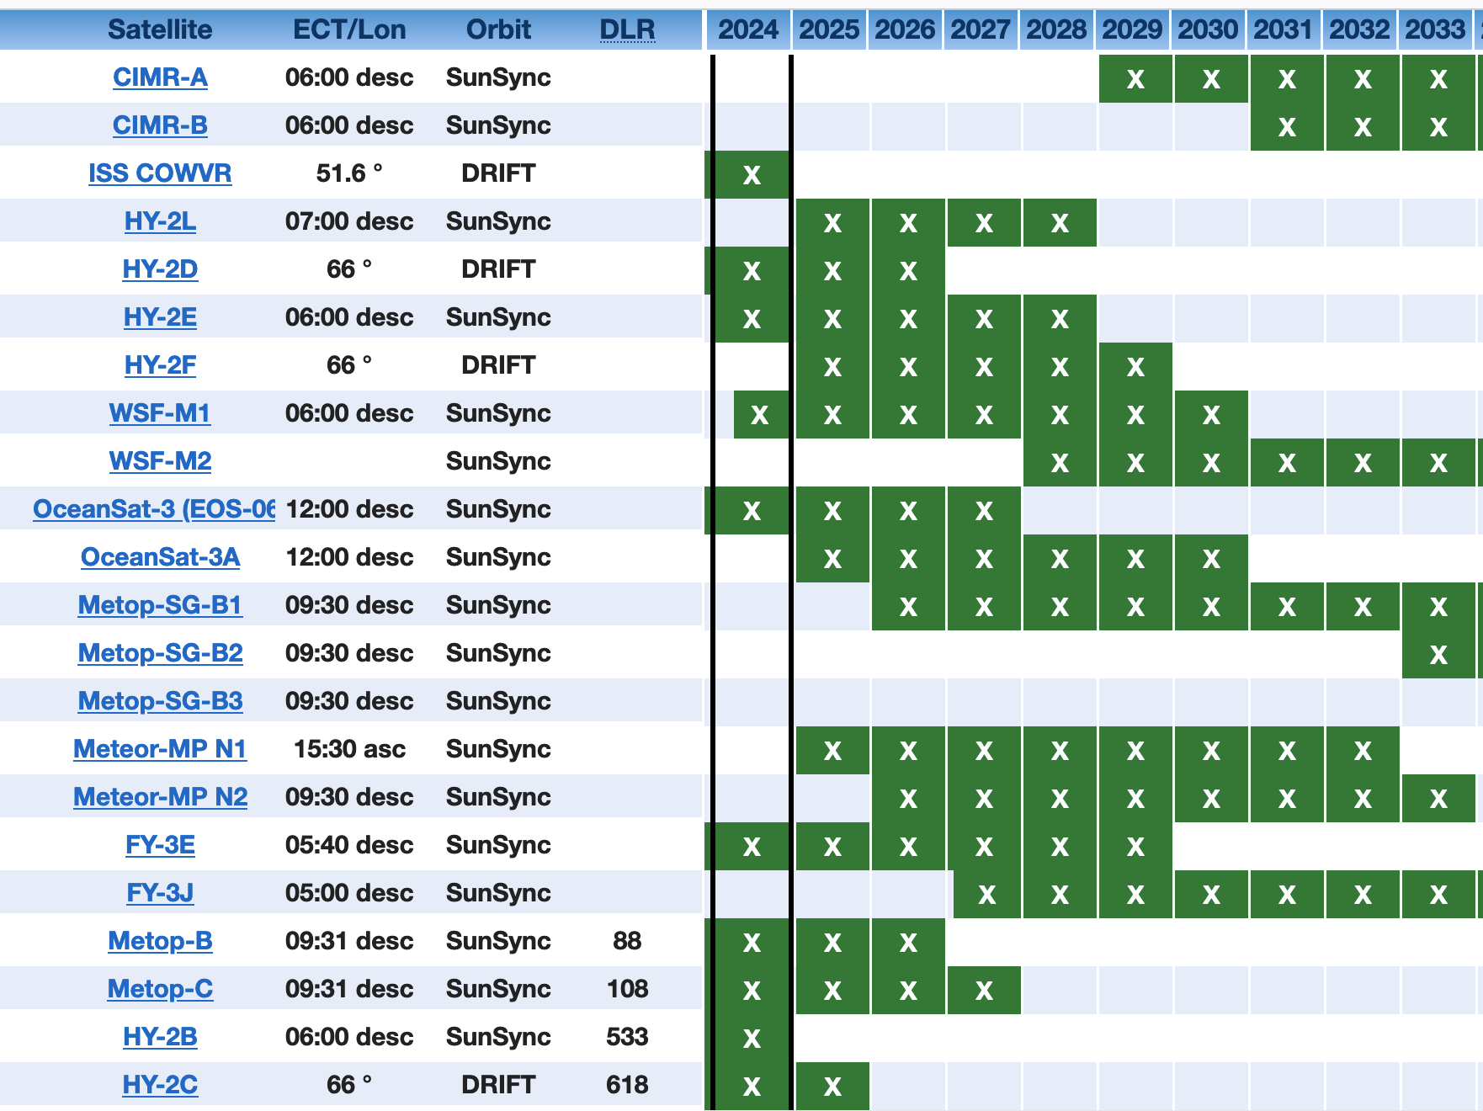
Vector winds: Current and planned
Passive sensors
China
Passive sensors
Russia
China
China
https://space.oscar.wmo.int/gapanalyses?variable=183

Slide 26
How to measure wind from satellite
Capillary waves are cm-scale waves
Waves align consistently relative to wind
By Blue Elf - Own work, CC BY-SA 3.0, https://commons.wikimedia.org/w/index.php?curid=3680068

Slide 27
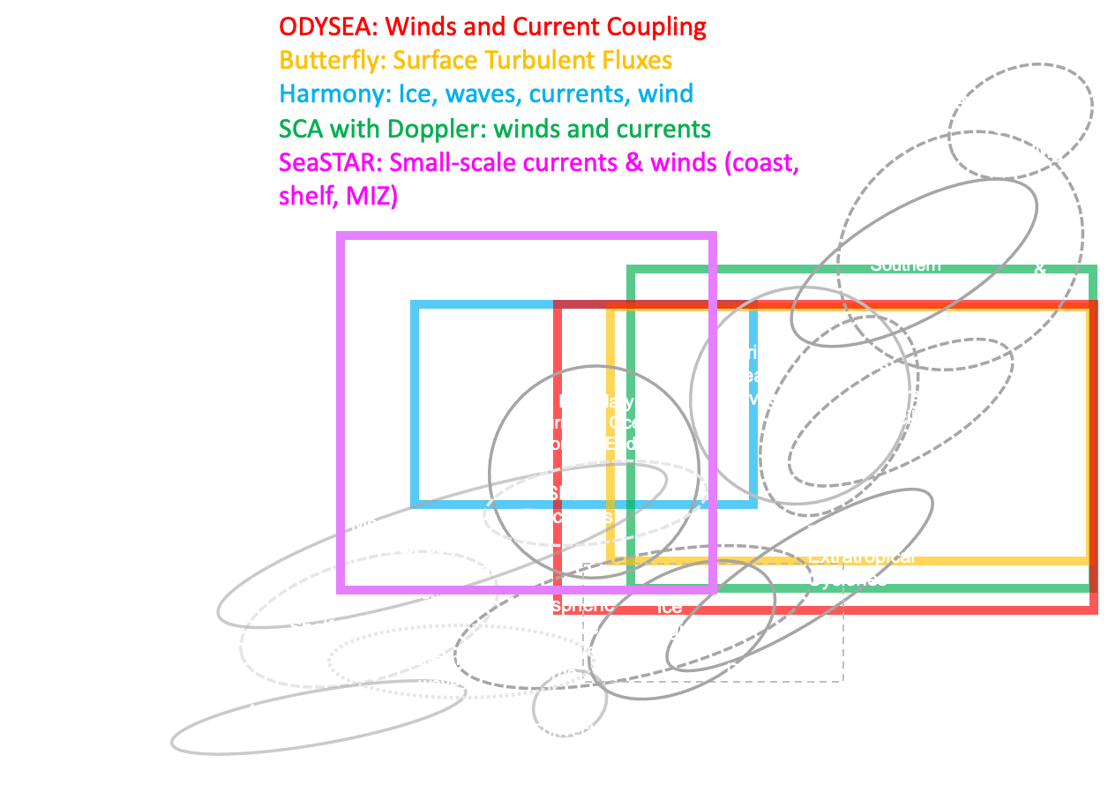

Slide 28
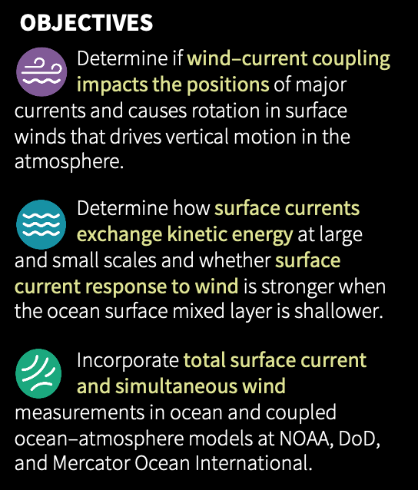
2 science objectives
1 applications objective

