Slide 1
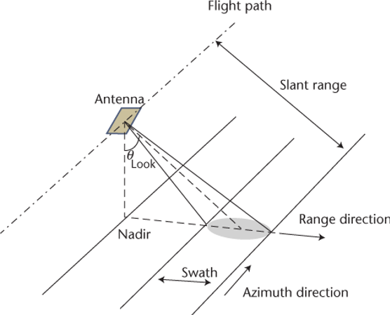
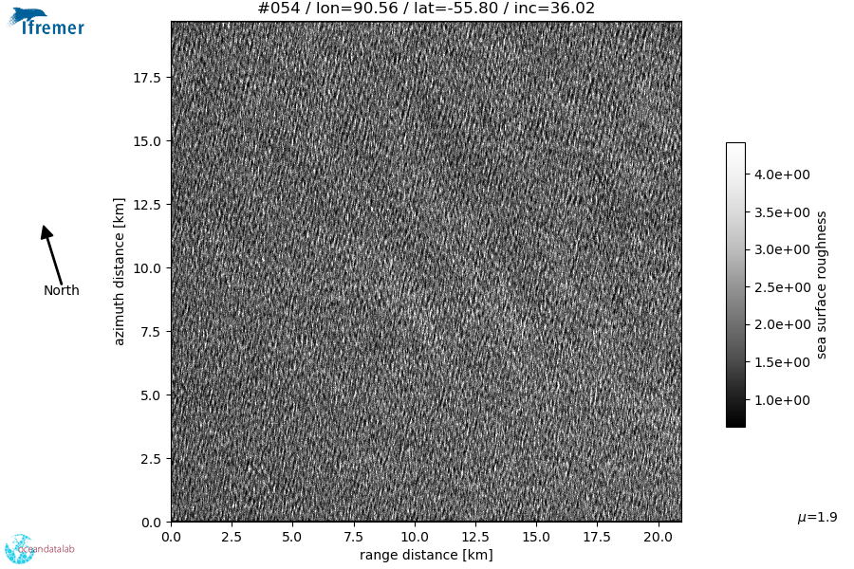
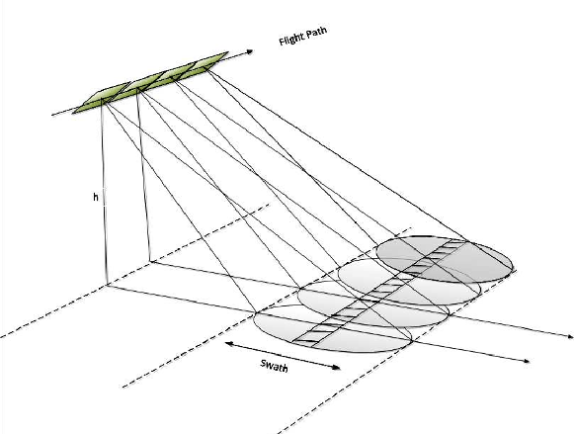
SAR Basics -1
Active instrument, typically uses microwave bands - works in all atmospheric conditions & day/night, measures amplitude and phase
Can achieve fine spatial resolution (<10 m) independent of platform height
Resolution δ = (Z_{platform} 𝜆_{EM}) / L_{antenna}
δ=(850 km)(5 cm)/(10 m)=4.25 km
Simulates a large L_{antenna} by superposition… larger L_{antenna} → finer δ
SAR works well or “easy to interpret” when the target does not move!
Typically ocean image
Looks blurry due to SAR imaging mechanisms

Slide 2
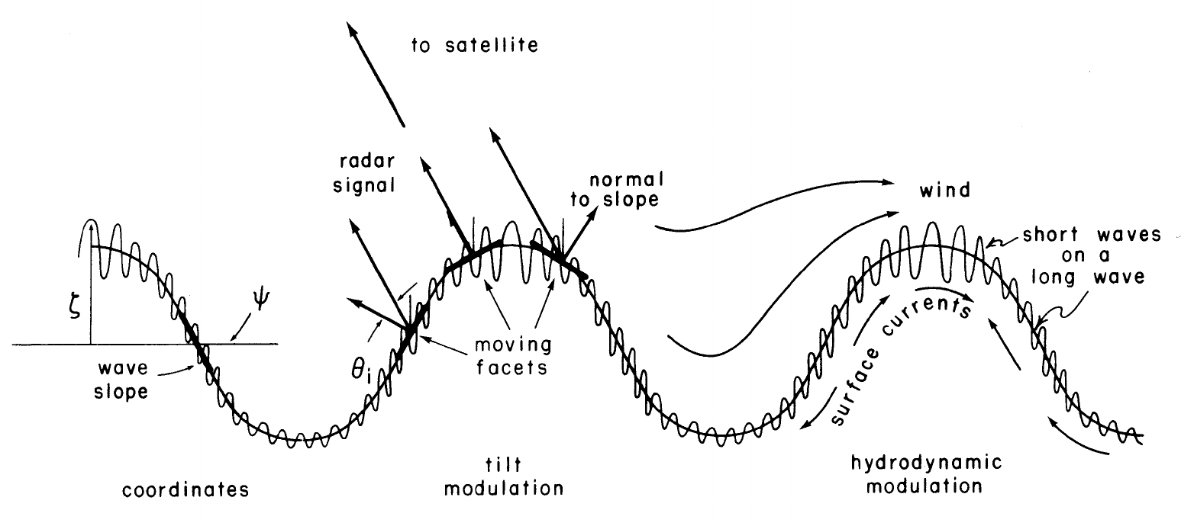
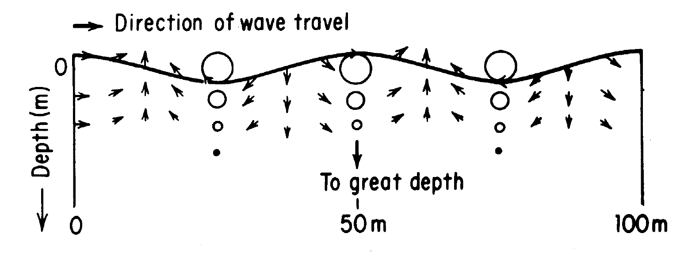
SAR Basics - 2
Ocean signals are difficult to interpret because of
hydrodynamic modulation - ocean waves modulate the amplitude of the shorter waves, and thus the backscatter intensity (theories still lacking)
tilt modulation - ocean waves modulate the local geometry and slopes of the sea surface (important for low incidence)
velocity bunching* - the wave orbital velocities, with surface convergence and divergence, produce modulations in the image as the scatterers moving on the waves are placed according to these induced Doppler velocities (dominant)
Velocity Bunching

Slide 3
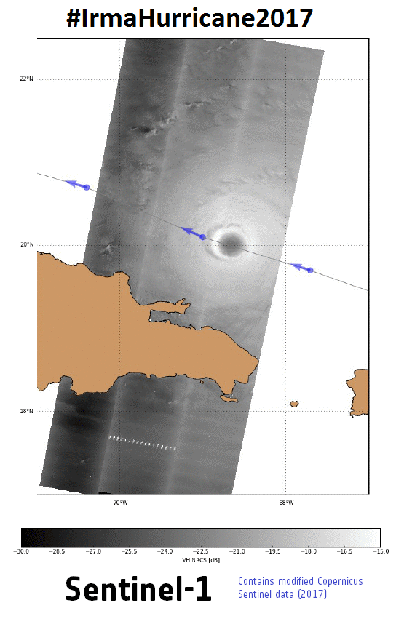
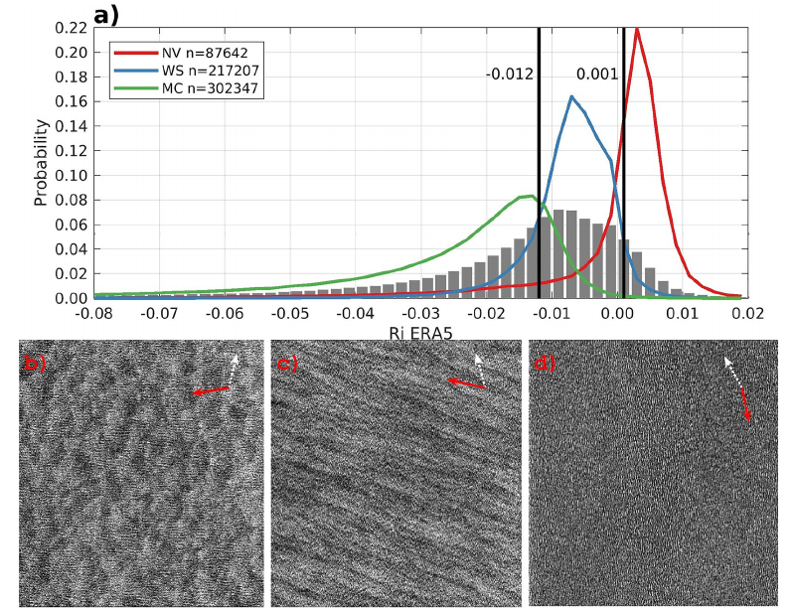
SAR Applications
←SAR gets the extreme wind speeds accurate!
Irma 2017 - Cross-polarization (VH) does not saturate under extreme winds
(A. Mouche, IFREMER)
SAR textures map to atmospheric stratification
→cells ~unstable
→rolls ~near-neutral
→none ~stable
Stopa et al., GRL 2022→

Slide 4
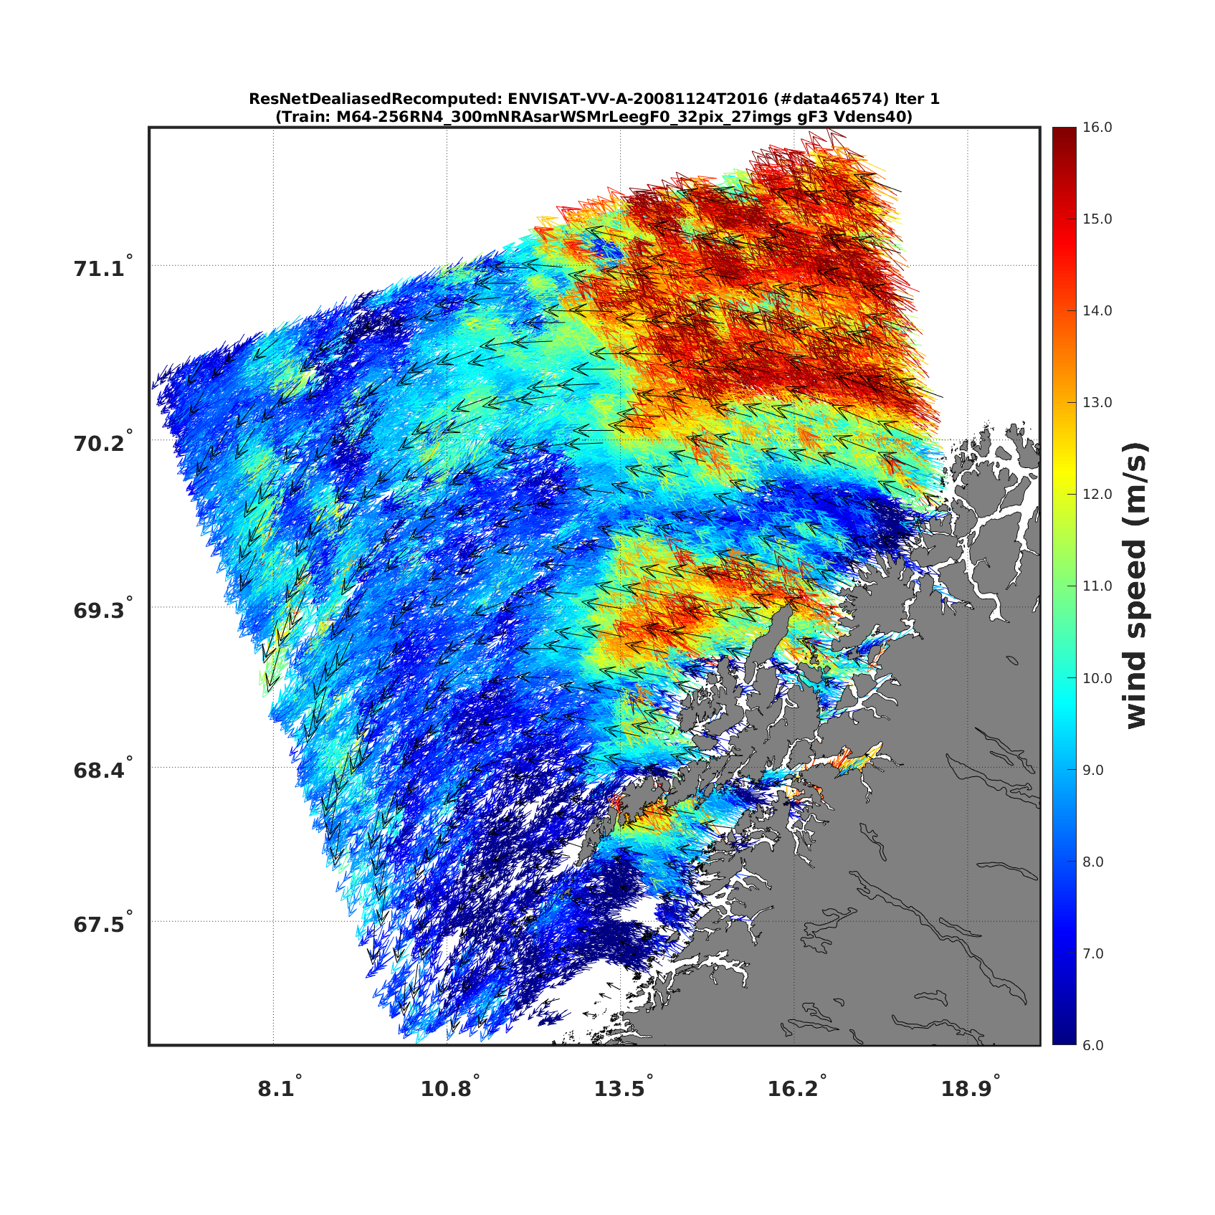
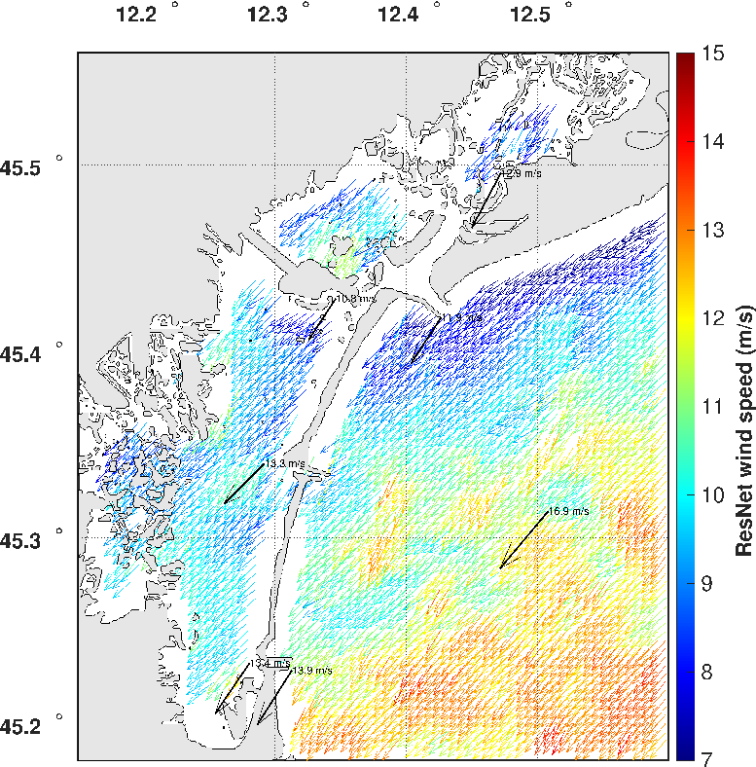
CNN winds (colored) for validation of coastal scatterometer winds (black)
Convolutional Neural Network (CNN) for wind retrieval.
Case of Venice Lagoon

Slide 5
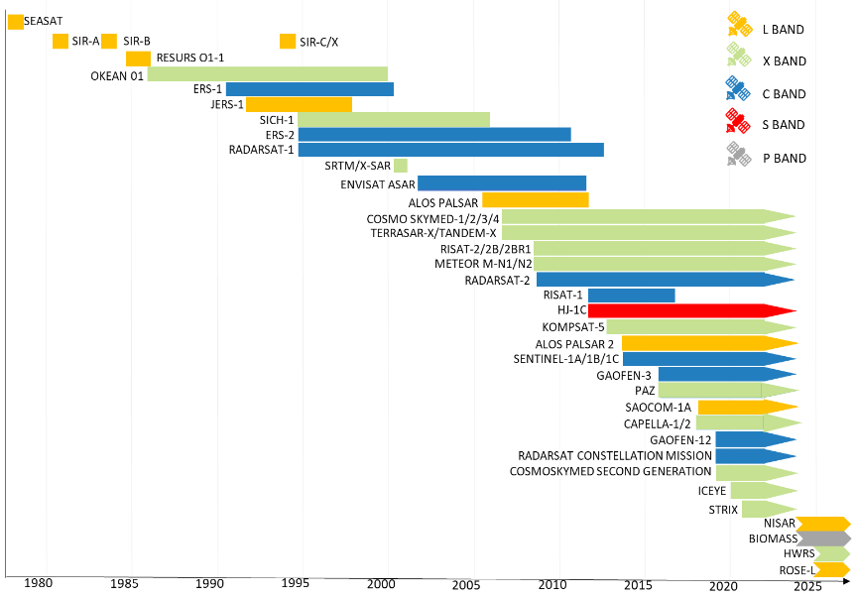
SAR Availability
●X, C, L, P ~ 3, 6, 24, 65 cm
●ESA has an open data policy making Sentinel-1 readily available
●NASA’s NiSAR is in L-band - focus on cryosphere and land - open data
●There are private SAR companies allowing on-demand acquisitions
Image: Alfredo Fernández-Landa

