Slide 1
Zonostrophic Turbulence in Hurricanes
Jun Zhang
NOAA/AOML/Hurricane Research Division & University of Miami/CIMAS
Boris Galperin, Alexander Nickerson, Gregory King,
Semion Sukoriansky
University of South Florida/College of Marine Science
IOVWST Meeting, Salt Lake City, Utah, May 31, 2024

Slide 2
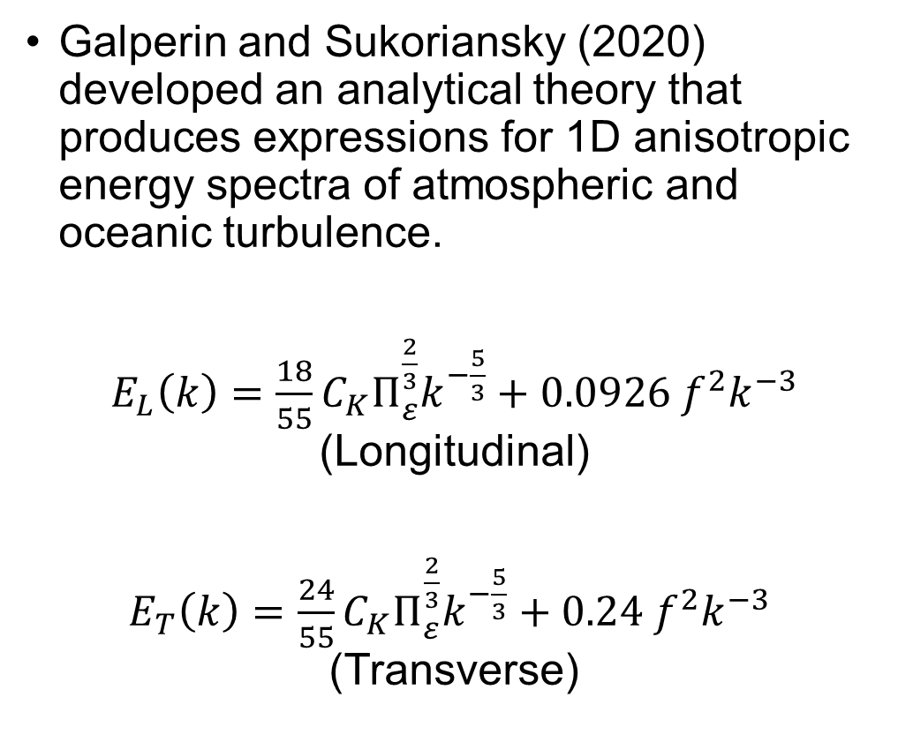
Quasinormal scale elimination (QNSE) theory
Galperin and Sukoriansky (2020) developed an analytical theory that produces expressions for 1D anisotropic energy spectra of atmospheric and oceanic turbulence.
$E_{L}\left(k\right)=\frac{18}{55}C_{K}Π_{ε}^{\frac{2}{3}}k^{−\frac{5}{3}}+0.0926 f^{2}k^{−3}$ (Longitudinal)
$E_{T}\left(k\right)=\frac{24}{55}C_{K}Π_{ε}^{\frac{2}{3}}k^{−\frac{5}{3}}+0.24 f^{2}k^{−3}$ (Transverse)

Slide 3
Can QNSE be applied in hurricane conditions?
Transverse (azimuthal) spectra
Solid lines – aircraft observations
Dashed lines - QNSE
Red dots– NG spectrum of tropospheric and stratospheric turbulence (Nastrom & Gage (1981, 1984, 1986)
Flight-level Data from a total of 655 flights (into 138 storms from 1997 to 2019) were analyzed to study the characteristics of kinetic energy spectra in comparison to theory

Slide 4
Can QNSE be applied in hurricane conditions?
Longitudinal (radial) spectra
Dashed lines - QNSE

Slide 5
Summary of Zonostrophic Turbulence
The QNSE theory of rotating turbulence is capable of reproducing both the amplitudes and slopes of observed turbulence spectra in tropical cyclones (TCs)
Outside the TC vortex (outer core), the TC spectra rebound to NG spectra for weak storms
The affinity of the TC, tropospheric and ocean spectra exposes the unity of physical laws governing a broad variety of geophysical flows

Slide 6
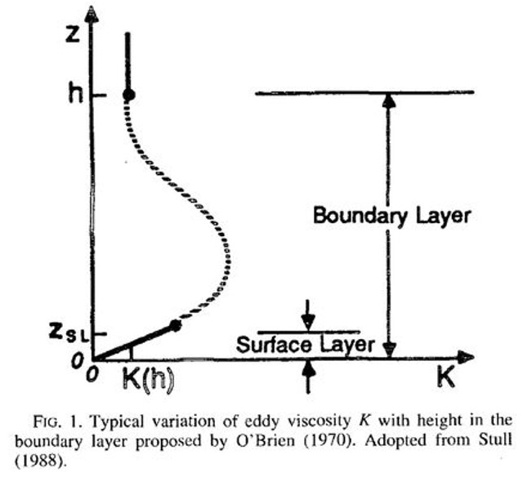
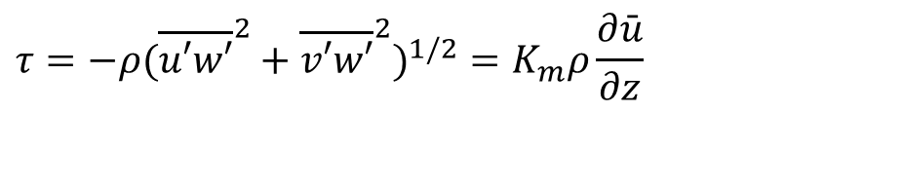

Turbulent flux Parameterization
Vertical eddy diffusivity for momentum transfer (K_{m}):
Momentum flux ($τ)$:
$$τ=−ρ({\overline{u′w′}}^{2}+{\overline{v′w′}}^{2})^{1/2}=K_{m}ρ\frac{∂\bar{u}}{∂z}$$
K_{m} = k (u*/Φ_{m}) z (1 – z/h) ²
k = 0.4
u* : friction velocity
Φ_{m} : stability function ~1
h : PBL height determined by critical Richardson number method
http://www.esrl.noaa.gov/research/themes/pbl/

Slide 7
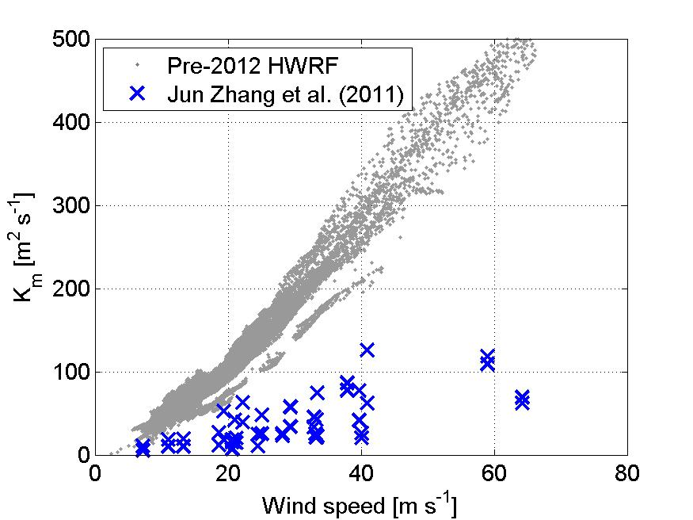
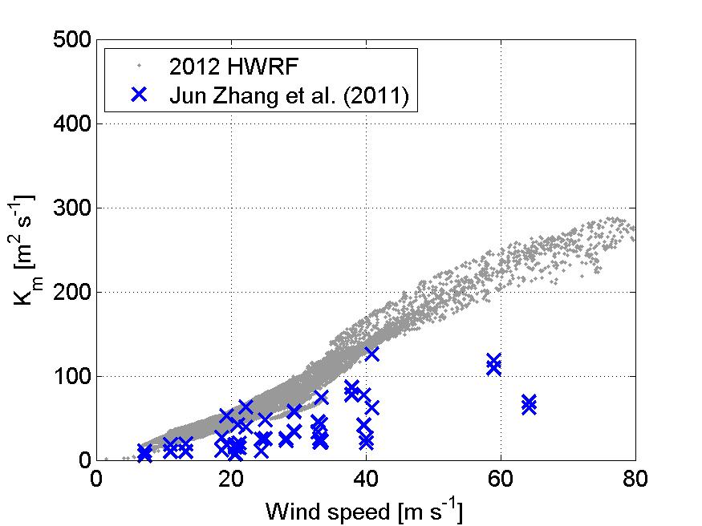
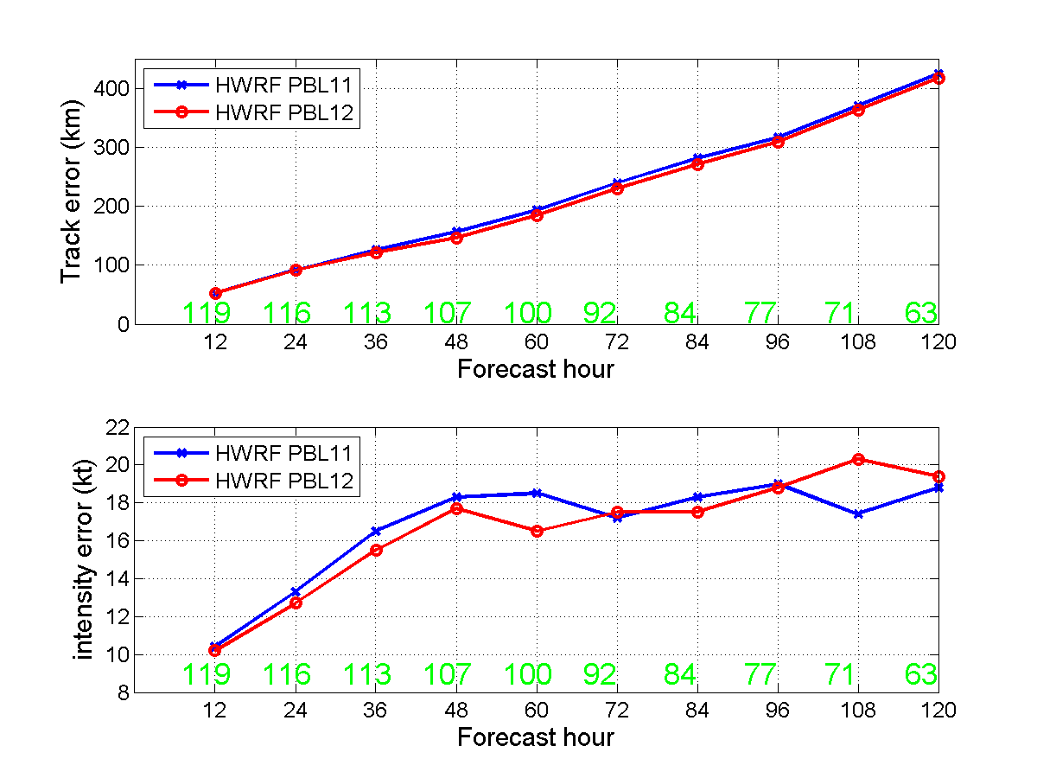
Improving turbulence parameterization in hurricane forecast models
Observations (x) from limited P3 flights in the hurricane boundary layer

Slide 8
Improving turbulence parameterization in hurricane forecast models
Storm size
(RMW)
BL height
SFMR

Slide 9
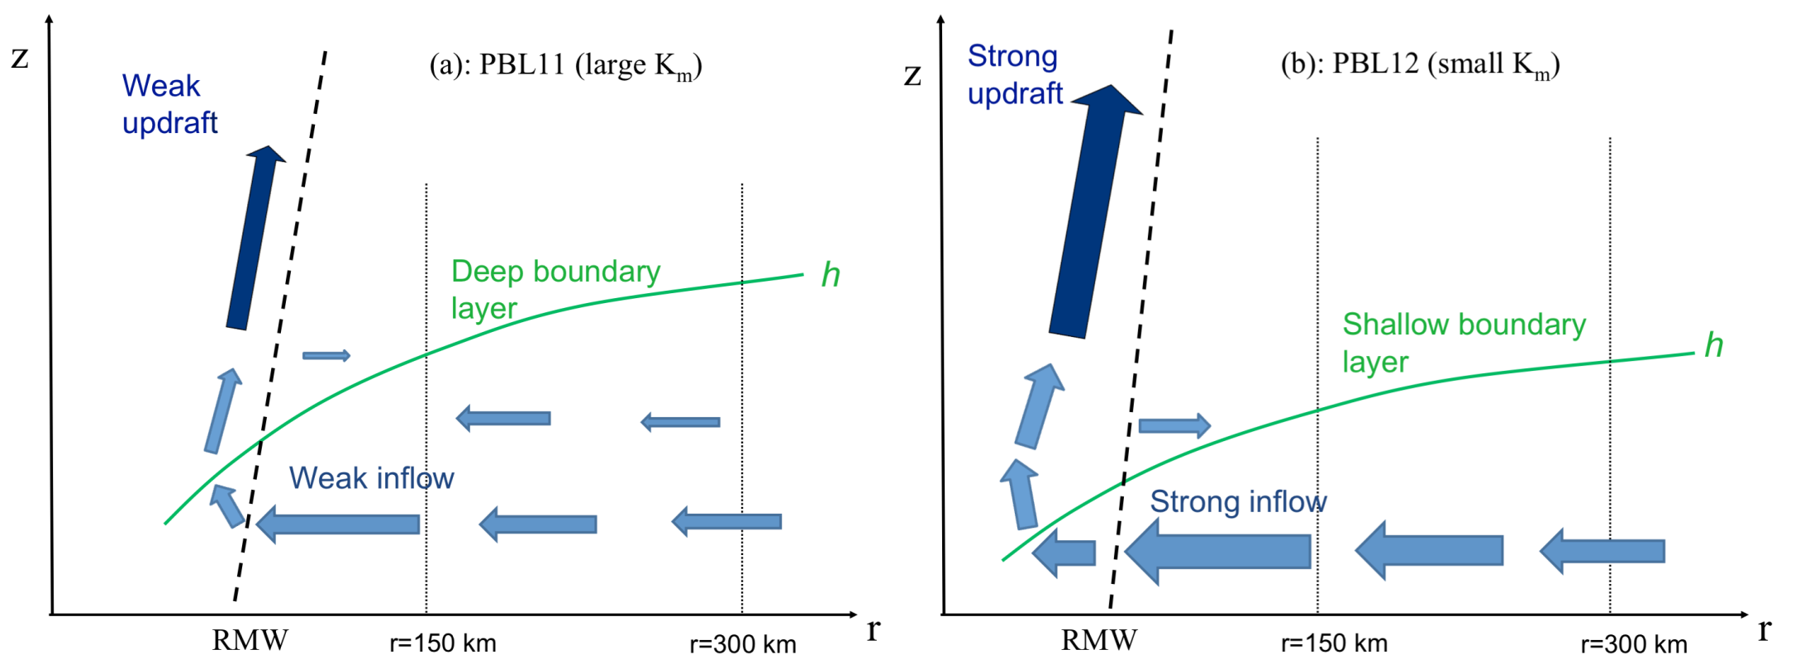
Effects of Turbulent Mixing on Hurricane Structure and Intensity
(J. A. Zhang et al. 2015, 2017)
Large eddy diffusivity
Small eddy diffusivity

Slide 10
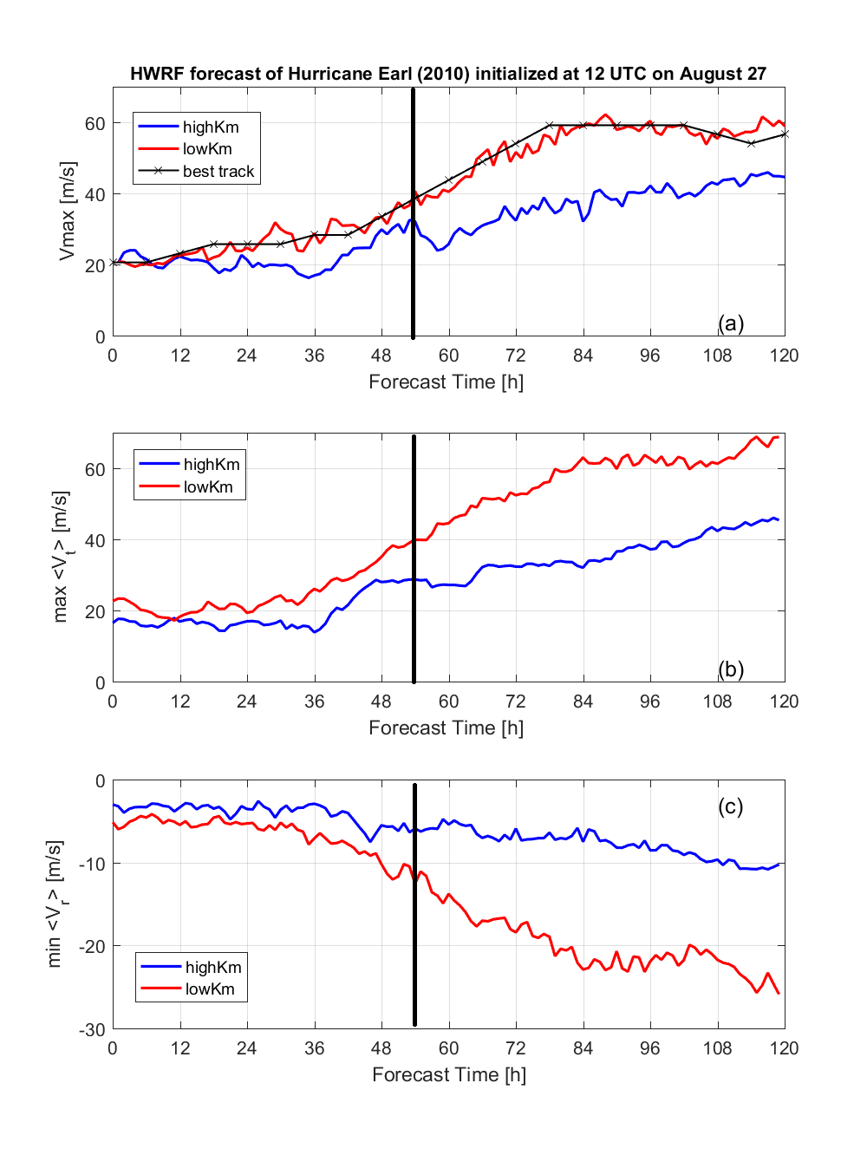
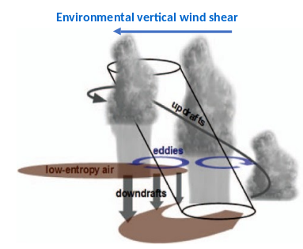
Impacts of PBL scheme on Vortex Tilt

Slide 11
More Conclusions
1. Successful Examples of Research to Operations (R2O) are shown in terms of using observational data to improve boundary-layer parameterization in operational models (e.g., HWRF)
2. Model deficiency can be identified through model diagnostics of TC structures based on observations
3. Observation-based model physics upgrades led to improvements in hurricane intensity and structure forecasts
4. Analyses of retrospective forecasts helped understand how and why changes in the PBL schemes affect hurricane intensity and structure

Slide 12
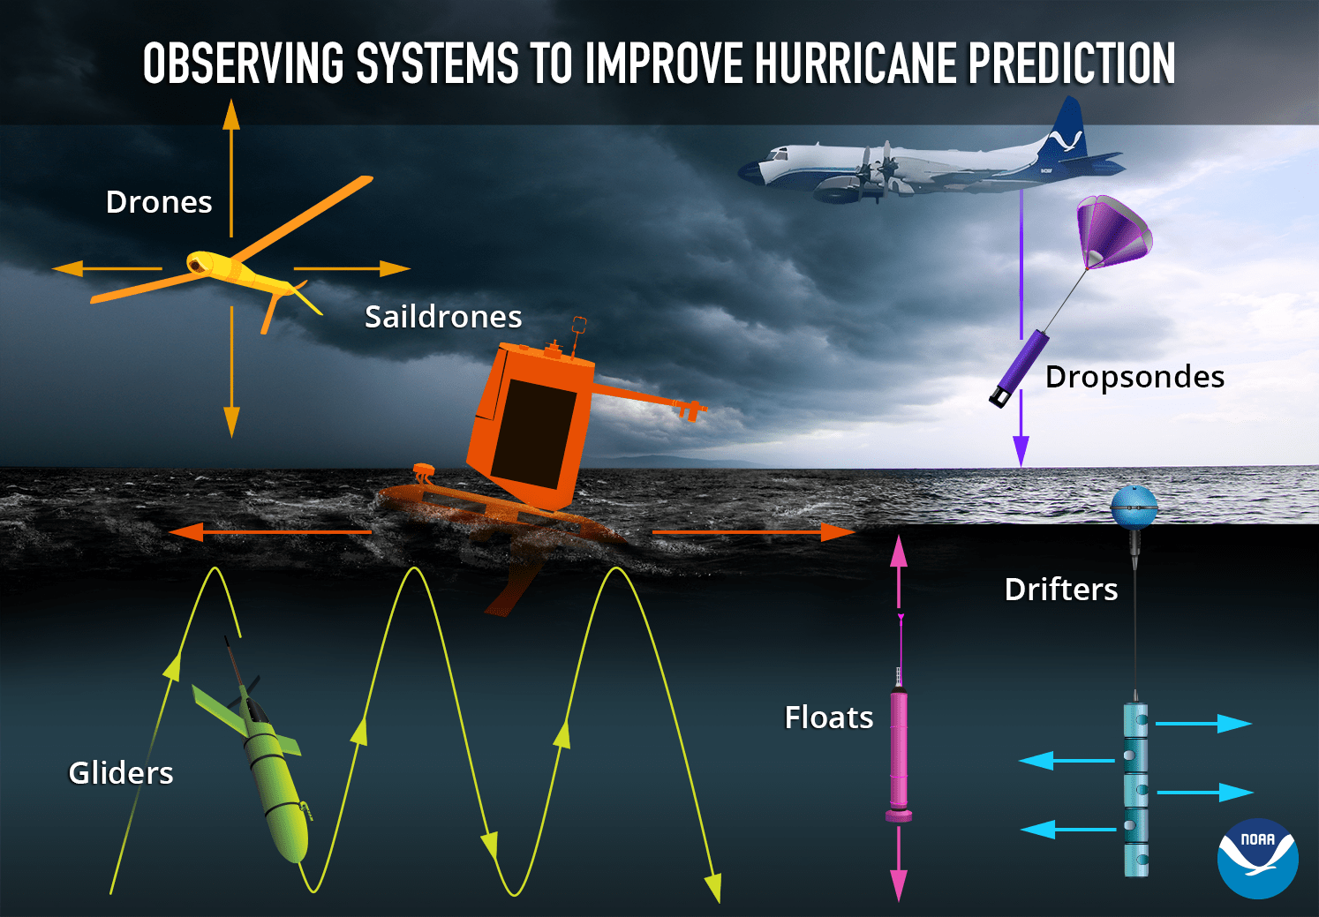
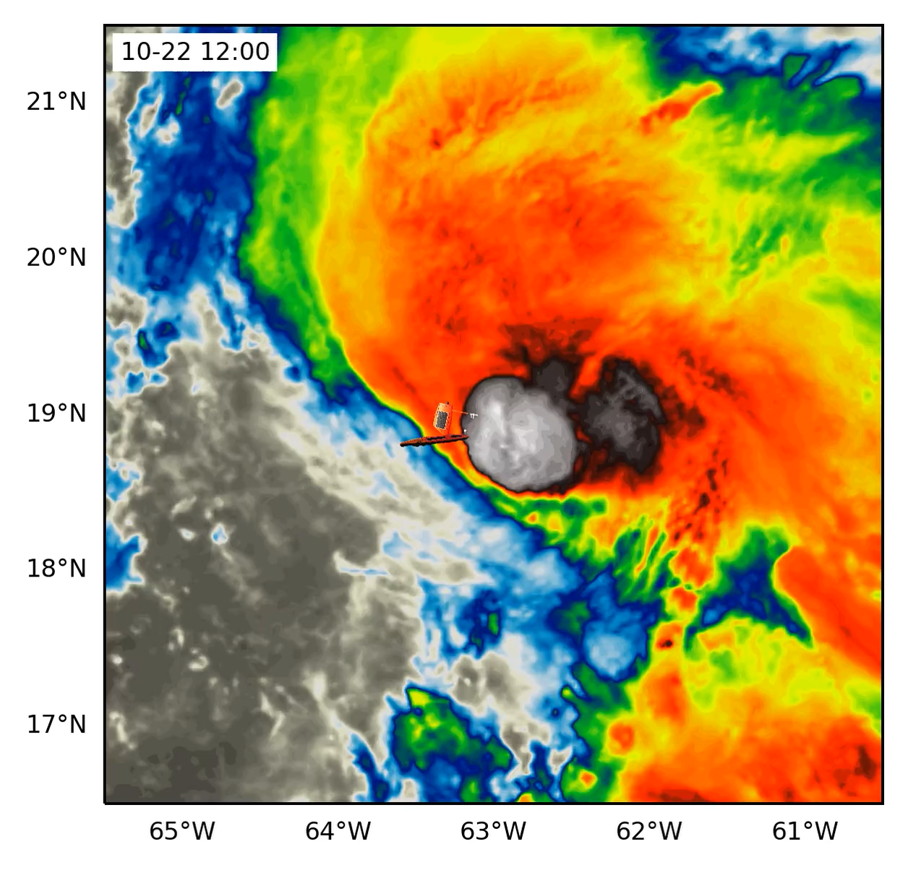
Coordinated Hurricane Atmosphere-Ocean Sampling (CHAOS) Experiment
Hurricane Tammy (2023)
Credit: NOAA PMEL
https://www.aoml.noaa.gov/wp-content/uploads/2024/04/2024HFP_OceanObserving_Science_Description_CHAOS.pdf

Slide 13
Thanks!
Questions?
Contact: jun.zhang@noaa.gov

Slide 14
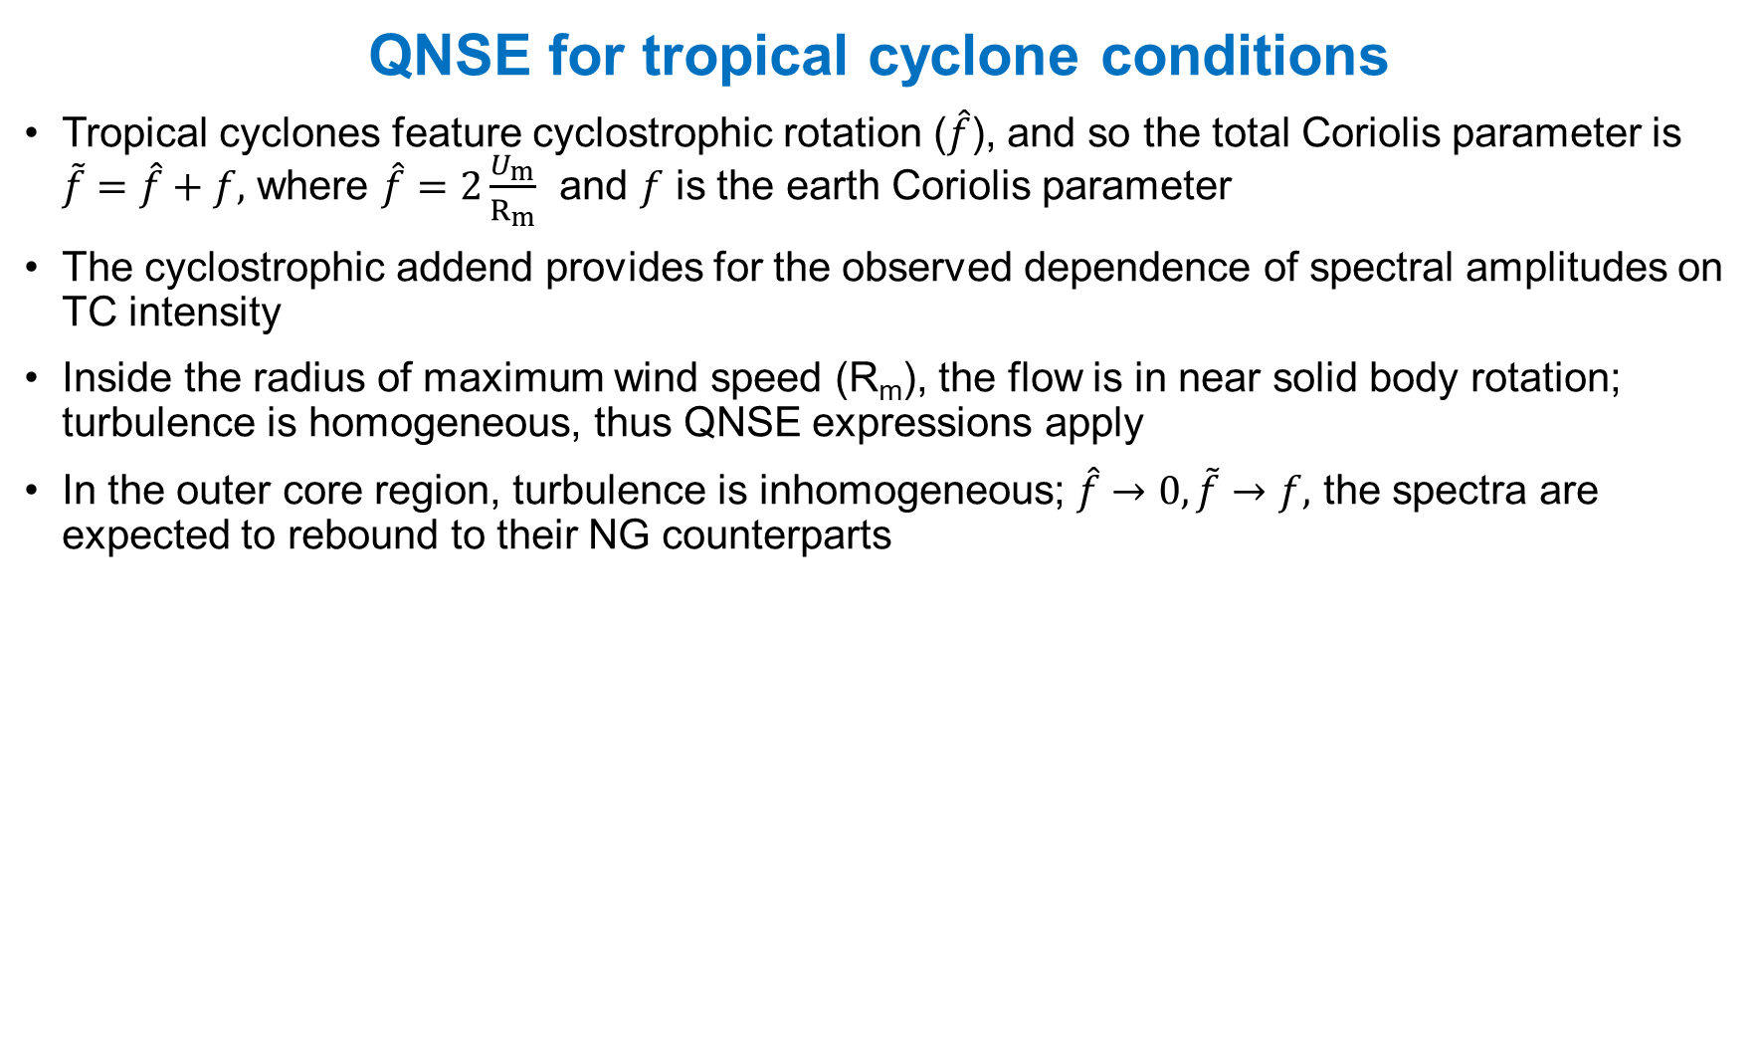
QNSE for tropical cyclone conditions
Tropical cyclones feature cyclostrophic rotation ($\hat{f}$), and so the total Coriolis parameter is $\tilde{f}=\hat{f}+f,$ where $\hat{f}=2\frac{U_{m}}{R_{m}}$ and $f$ is the earth Coriolis parameter
The cyclostrophic addend provides for the observed dependence of spectral amplitudes on TC intensity
Inside the radius of maximum wind speed (R_{m}), the flow is in near solid body rotation; turbulence is homogeneous, thus QNSE expressions apply
In the outer core region, turbulence is inhomogeneous; $\hat{f}→0, \tilde{f}→f,$ the spectra are expected to rebound to their NG counterparts

Slide 15
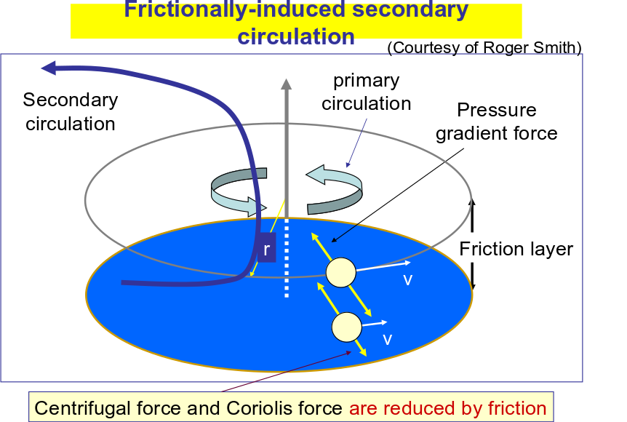
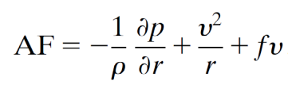
Agradient Force:

Slide 16
Non-TC observations vs. QNSE
Ship observations of ocean current velocity
from Japan to equator (over four regions)
The same QNSE expressions (dashed lines) successfully represent the observed (solid lines) longitudinal (red) and transverse (blue) spectra in the Northwest Pacific ocean in different regions where f varies
Spectral slope can be different for different wavenumbers but the QNSE theory nicely predicted this slope change.
Note that tropospheric observations (e.g., Khatri et al. 2018) also supported the QNSE theory

Slide 17
Can surface enthalpy fluxes recover the θ_{e} deficit?
Green curve shows inflow trajectory
no
yes

Slide 18
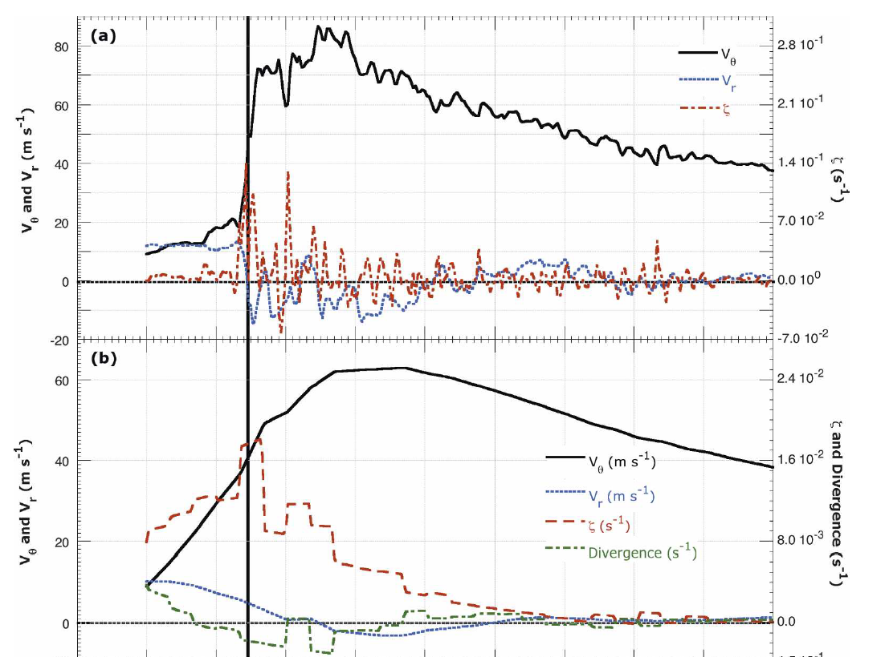
P3 flight into Hurricane Hugo
(Marks et al. 2008)
On 15 September 1989, during observations for Hurricane Hugo, Hunter NOAA42 flew through an eyewall mesovortex.
EVM – Eyewall vorticity maximum

Slide 19
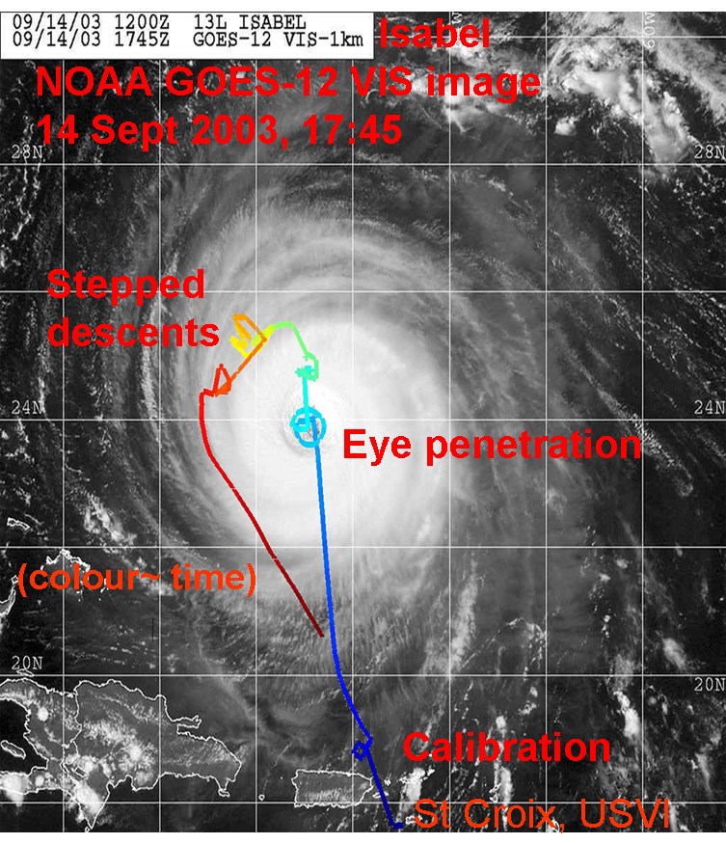
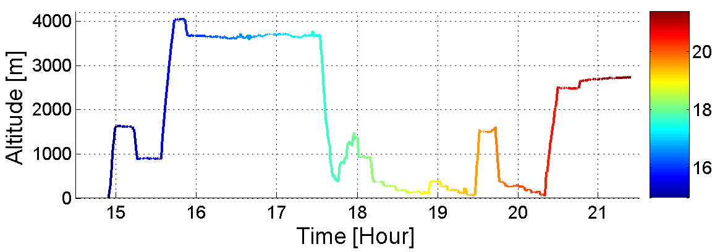
The Coupled Boundary Layer Air-sea Transfer Experiment (CBLAST)

Slide 20
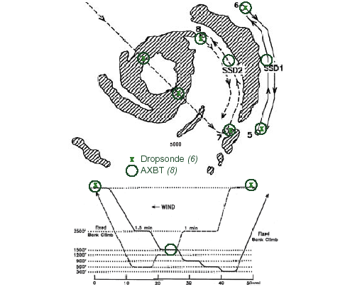
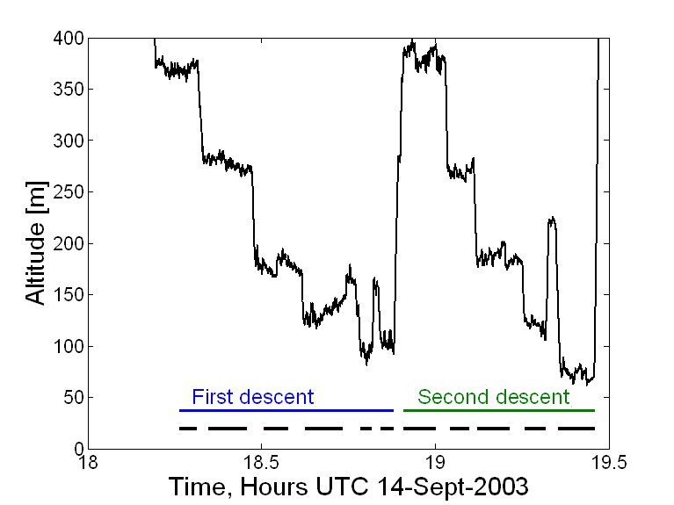
CBLAST STEPPED DESCENTS
Black lines represent the flux runs
Typical length of a flux run is 24 km

Slide 21
1D Energy Spectra
K_{u}^{-5/3}
Wavenumber spectrum of kinetic energy for P3 flight legs at heights of 88m (red) and 194m (blue) in hurricanes. From: Byrne & Zhang (2013), GRL

Slide 22
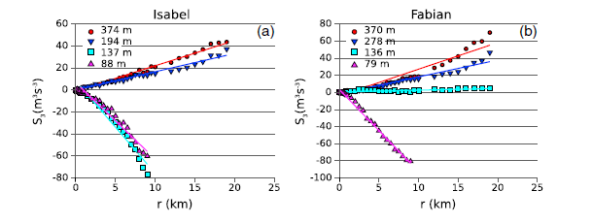

Energy Cascade – 3rd order structure function
The -5/3 slope in the energy spectra generally points to Kolmogorov 3D turbulence and direct cascade
If it is 2D turbulence, then the -5/3 slope $→$ inverse cascade
Byrne & Zhang (2013)

Slide 23
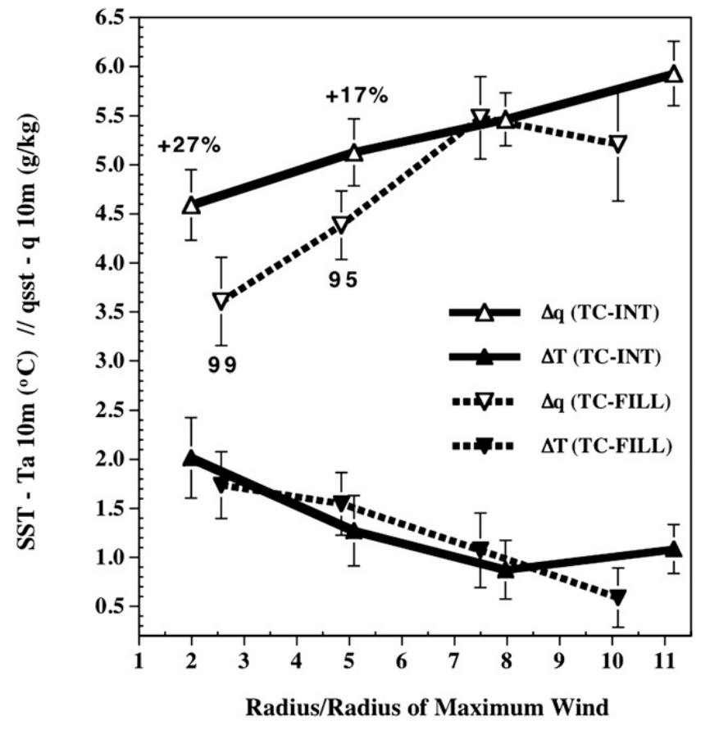
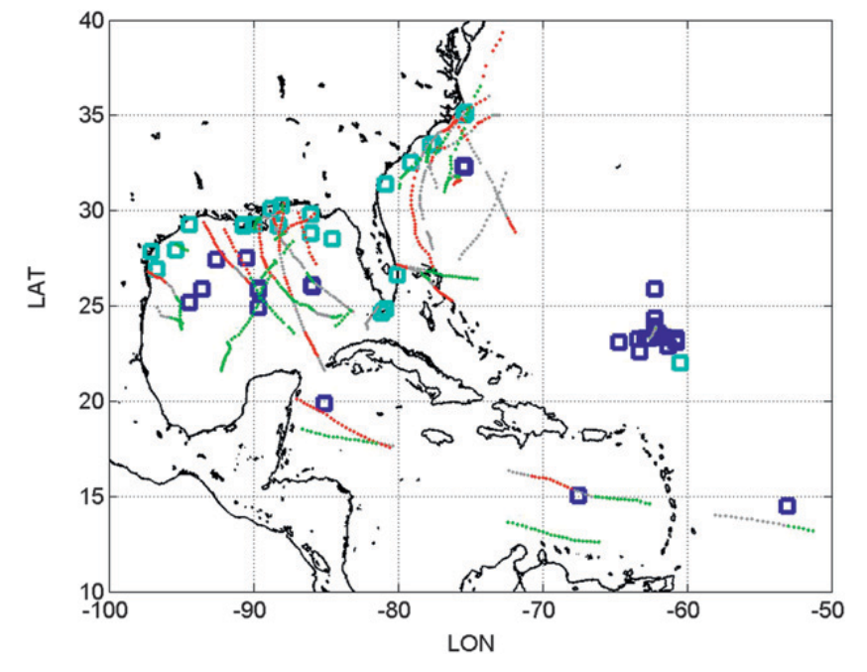
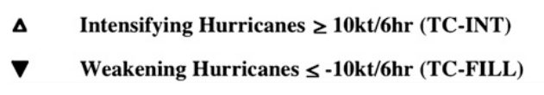
Hurricane Intensity change and Air-sea Interaction
NDBC Buoys

