Slide 1
Aircraft Scatterometer and Radiometer Measurements within Tropical Cyclone Extreme Rain Bands
This material is based in part upon work supported by the Office of Weather and Air Quality Research Program within the NOAA/OAR Weather Program Office under Award NO.NA23OAR4590412-01
Ocean Winds Team:
^{1,3}Zorana Jelenak, ^{1,2}Joe Sapp, ^{1,2}Clayton Bjorland,
¹Paul Chang and ^{1,2}Casey Shoup
¹NOAA/NESDIS/STAR
²Global Science & Technology, Inc.
³UCAR
⁴Tomorrow.io

Slide 2
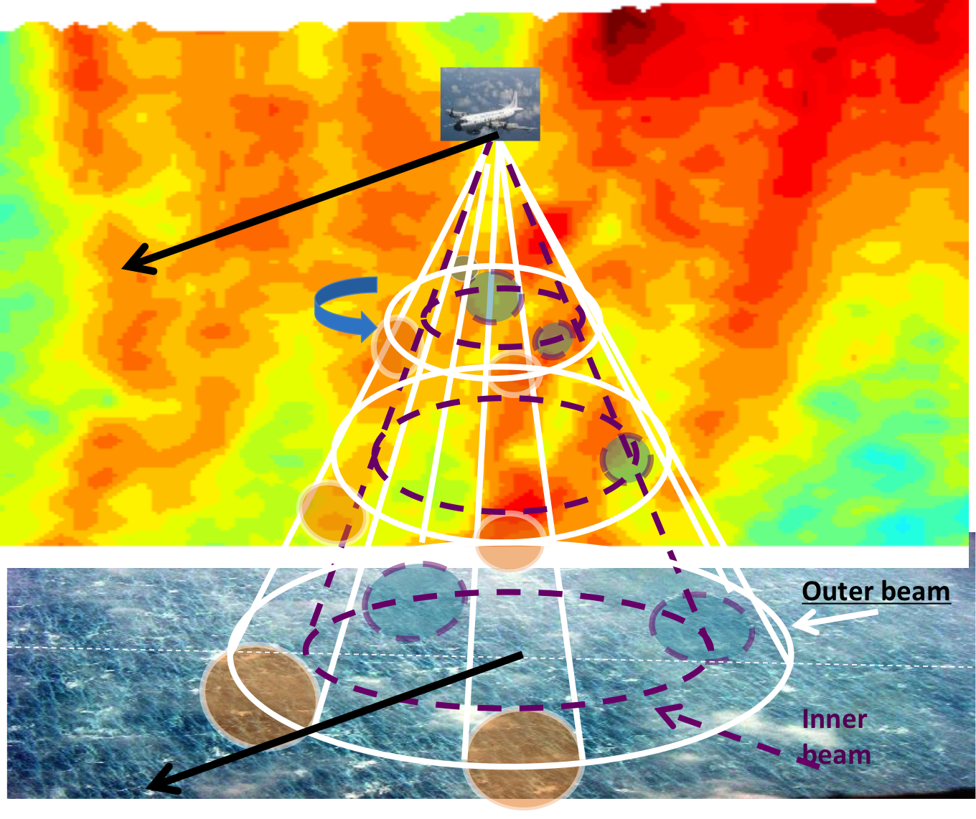
Imaging Wind and Rain Airborne Profiler – IWRAP
2021 Season Configuration
The IWRAP is a downward-pointing, conically scanning, dual-frequency, dual-polarization Doppler radar capable of measuring surface backscatter and intervening volume reflectivity and Doppler velocity at 30 m range resolution.
2021 configuration:
  Conically scanning Ku and C-band radars
  V-pol measurements acquired at 30° and 50° incidence angles
  Outer beam profiles from 1.5km below the aircraft up to 30m from the surface
  Inner beam profiles from 120m below the aircraft up to 30m from the surface
3D wind and reflectivity profiles retrieved along the nadir at 30m vertical and 150m along track resolution
  Maximum possible swath width of ~2–3 km at typical flying altitudes
@50°
@30°
Notes:
The IWRAP is a downward-pointing, conically scanning, dual-frequency, dual-polarization Doppler radar capable of measuring surface backscatter and intervening volume reflectivity and Doppler velocity at 30 m range resolution. During both 2020 and 2021 season iwrap was set up in most optimal configuration for measuring 3d wind and reflectivity profiles
Ku and C-band radars utilized conically scanning antennas and observations were acquired and vertical polarization and two difference incidence angles 30 and 50deg

Slide 3
Unique Characteristics of IWRAP
Traditionally IWRAP wind and reflectivity profiles have been obtained by utilizing the pulse-pair processing algorithm and covariance method widely used in Doppler weather radars
  This allows for accurate retrievals down to 300-500m above the surface
  At lower altitudes precipitation volume backscatter is contaminated by the 1) nadir reflection from the surface backscatter and the 2) surface backscatter at the range gates closer to the ocean.
Most unique aspect of IWRAP radar is in its advanced radar control and data acquisition system
  This allows for spectral processing technique to be employed
2021 NRT processing utilized traditional pulse pair approach
  Post season spectral processor applied on all data collected during 2021 season
Notes:
In the past IWRAP wind and reflectivity profiles were processed utilizing traditional pulse-pair processing algorithm and covariance method widely used in Doppler weather radars. While this provided us with highest resolution 3d profiles due to nadir echo and surface backscatter contamination of the precipitation volume backscatter the retrievals were only possible to within 300m above the ocean surface
The most unique aspect of IWRAP system is its advance radar control and data acquisition system which allows us to collect both in-phase (I) and quadrature (Q) signals for the entire observational profile. This allows for spectral processing technique to be employed and the full spectrum to be derived by utilizing a series of FFTs on every single range gate
An example of power spectrum from Ku2 channel is shown. Shaded rectangular box ~500m and oval surface represent nadir echo and surface backscatter mask that are used to eliminate contamination of the precipitation signal

Slide 4
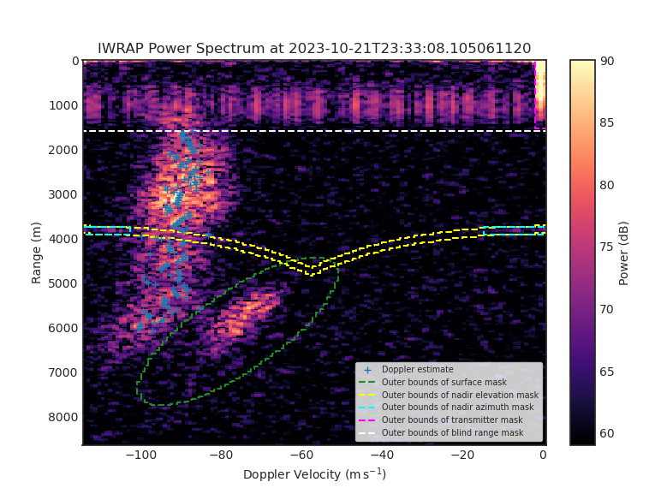
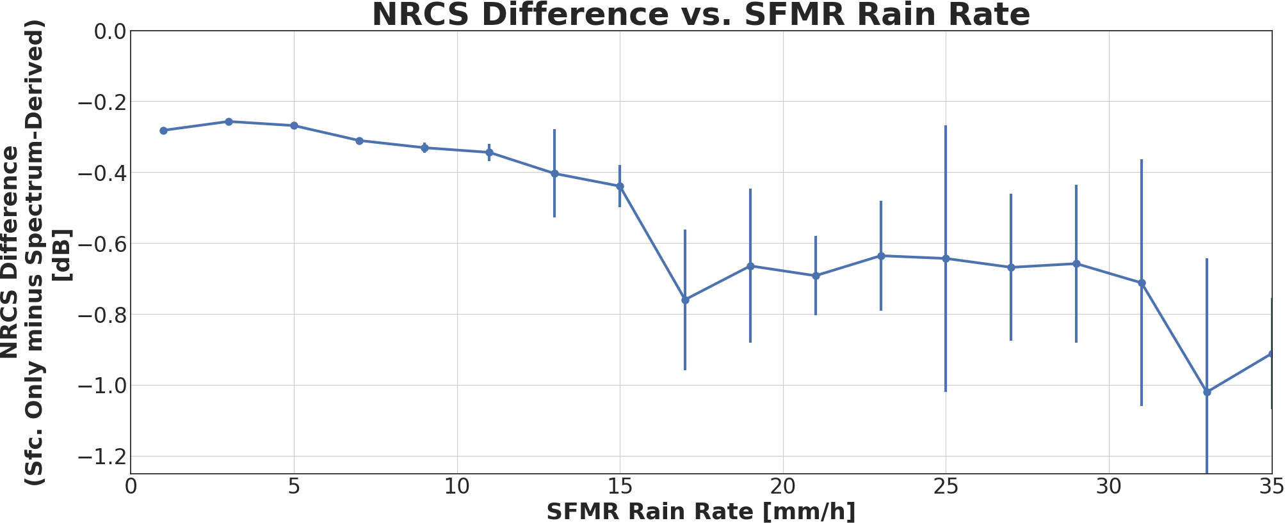
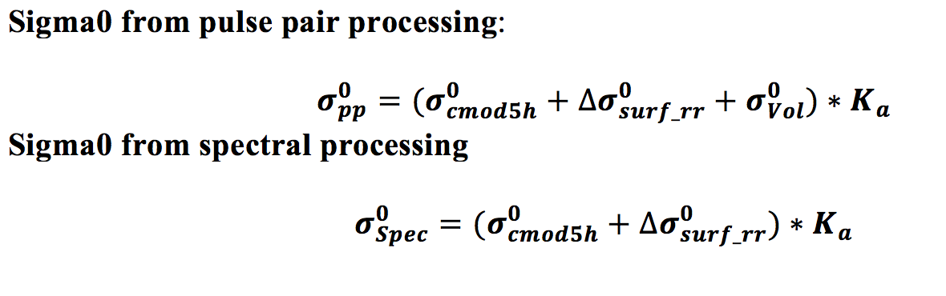
Pulse Pair vs Spectrum Sigma0’s
Ku @50°

Slide 5
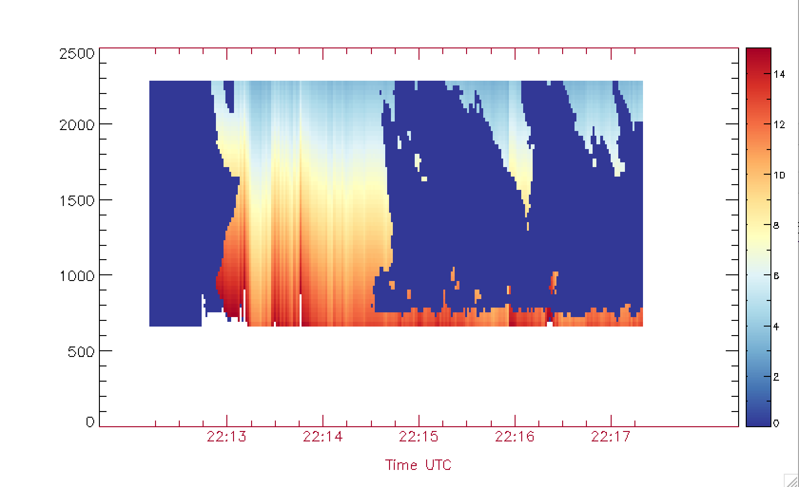
Specific Attenuation from IWRAP C and Ku band Reflectivities
Tammy 10212023H1 Flight
Altitude [m]
Specific Attenuation [dB/km]

Slide 6
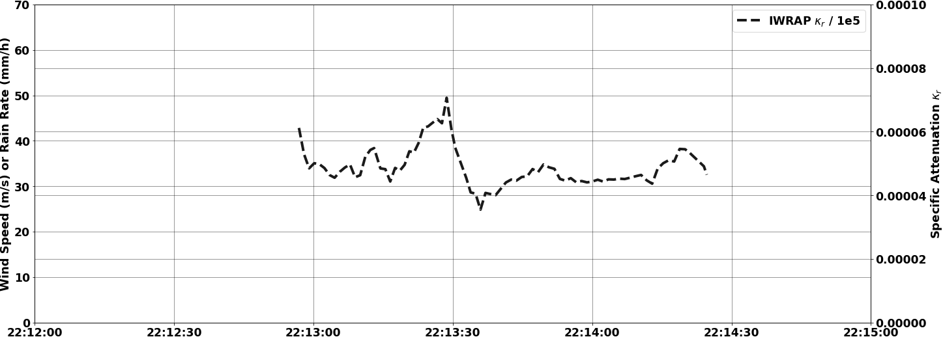
Ku-band Specific Attenuation at 30m Within Rain Band of Interest
Tammy 10212023H1 Flight

Slide 7
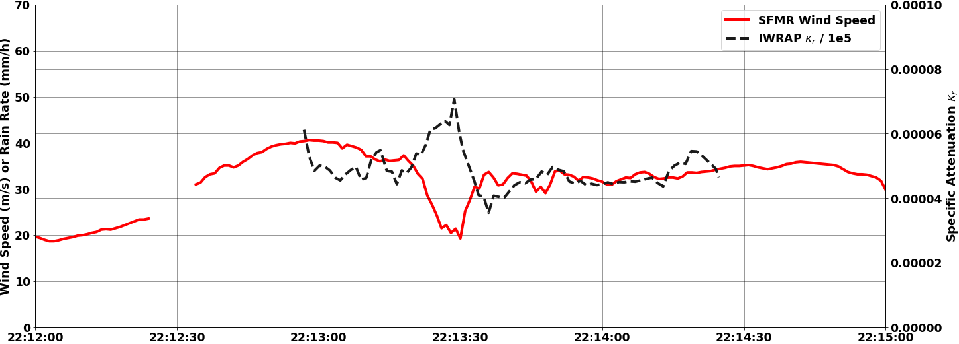
Ku-band Specific Attenuation and
SFMR Wind Speed Within Rain Band of Interest
Tammy 10212023H1 Flight

Slide 8
Hypothesis: Error due to Retrieval Procedure Insufficiencies
SFMR acquires measurements at 6 different channels. How is each channel impacting retrieval
Experiment: Produce ensemble runs utilizing different channel weightings
  Original rain/wind forward model as utilized in the operational algorithm
  Run 57 different combinations

Slide 9
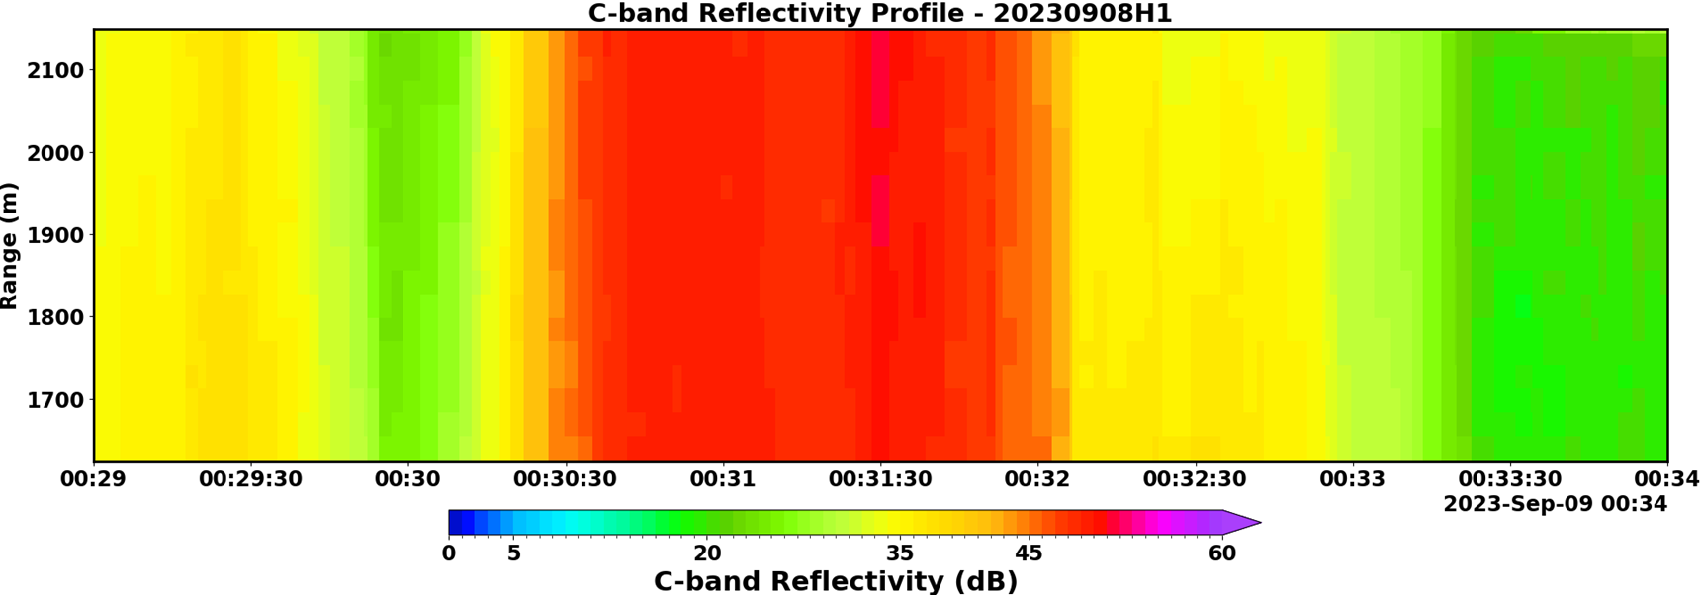
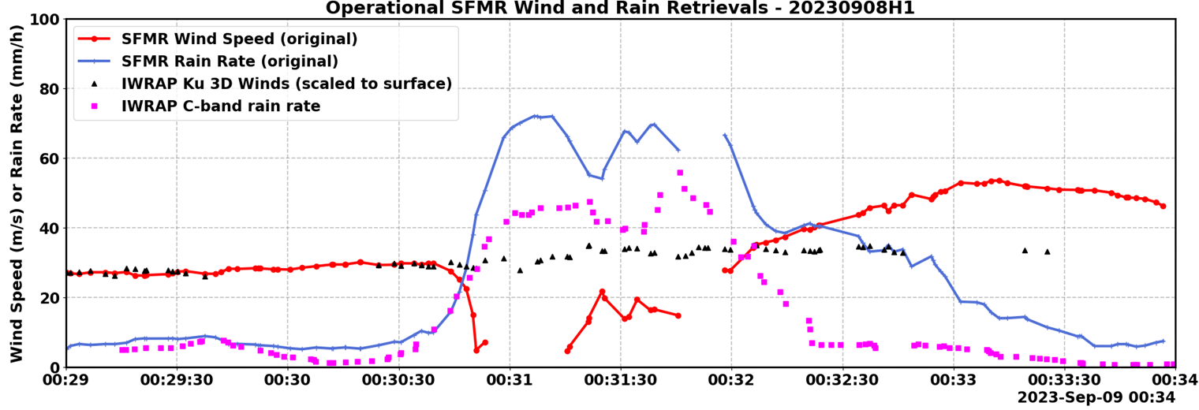
Case of Large Wind Underestimation

Slide 10
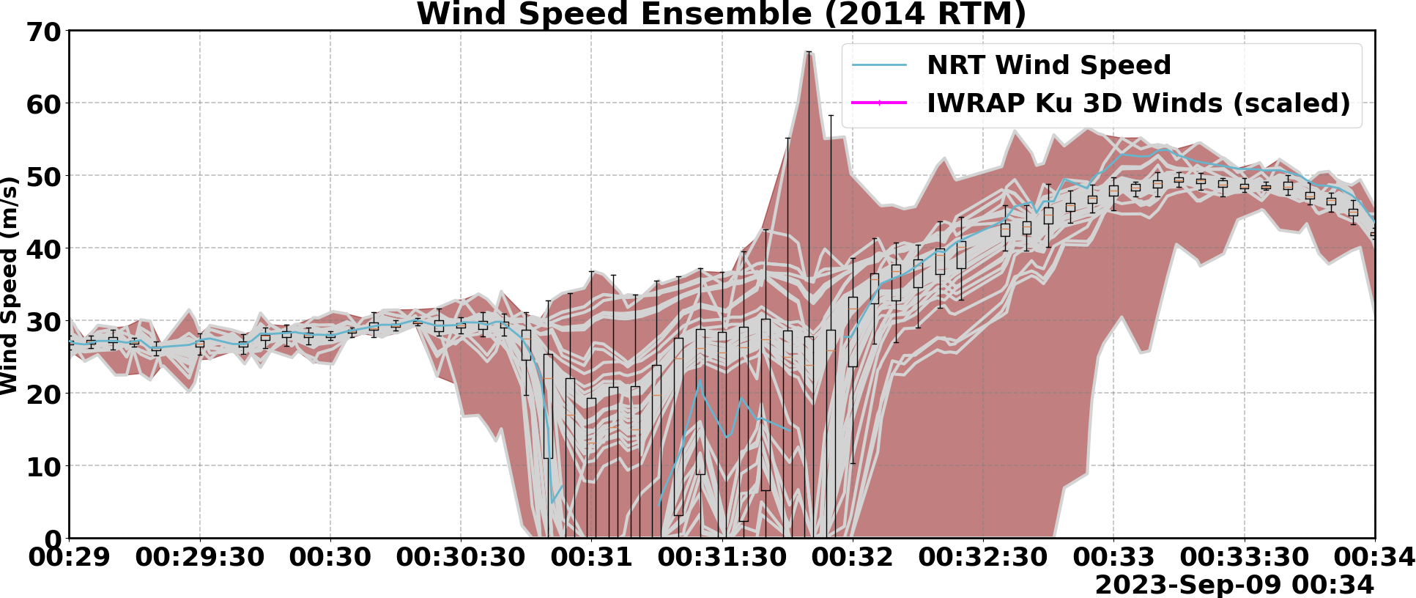
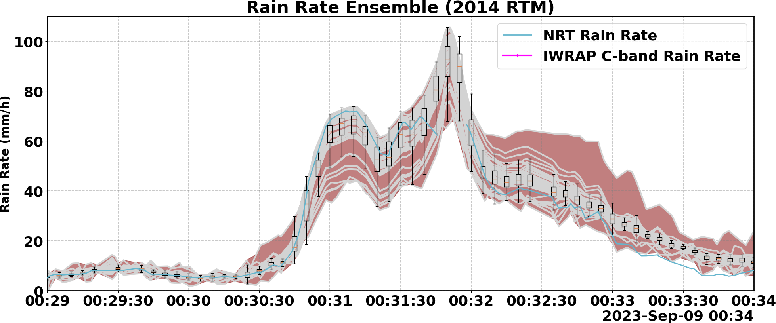
What are these results saying?
NRT algorithm is giving same weight to all channels – worst possible retrieval solution is picked
Large spread among ensembles points to calibration error, model insufficiencies, and instrument insufficiencies (ei stepping through frequencies)

Slide 11
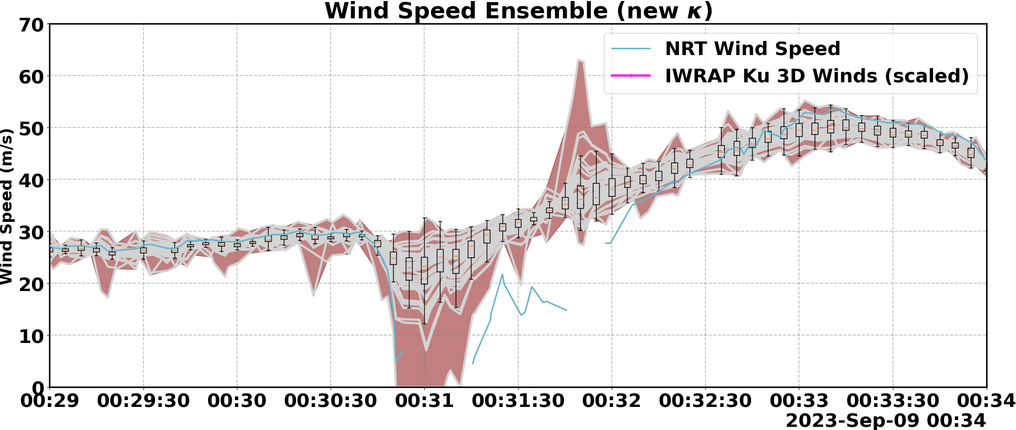
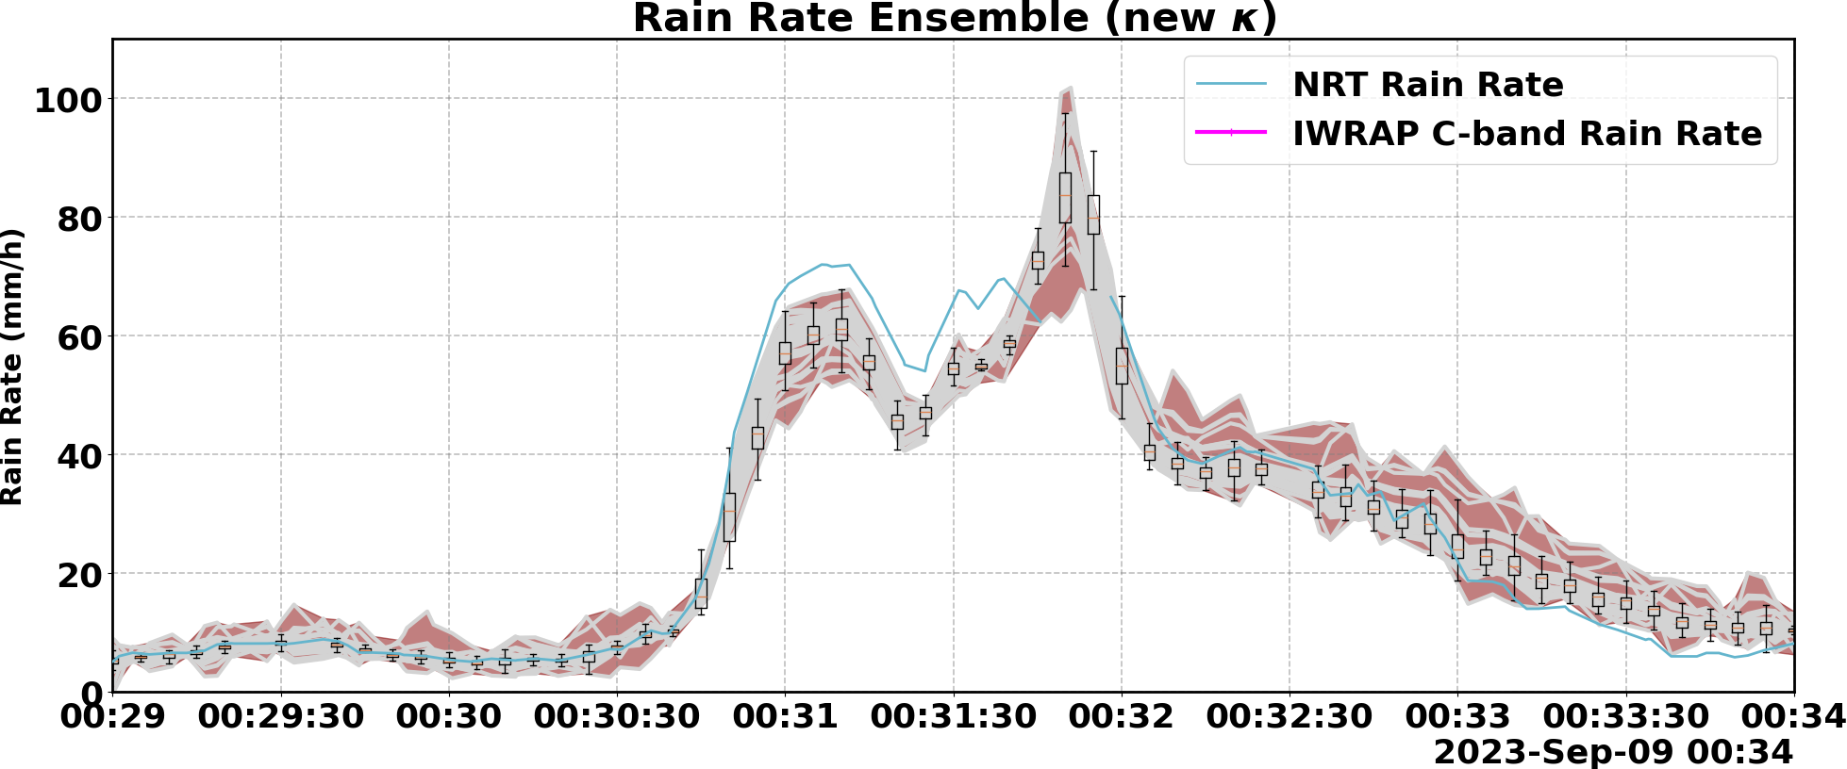
K=a(f,R)R^{b(f,R)}

Slide 13
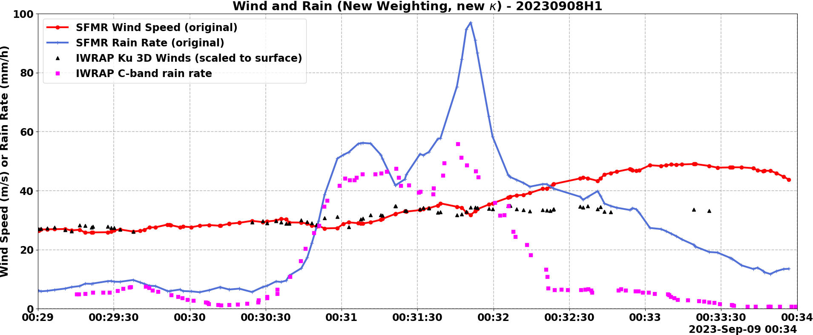
SFMR wind/rain spread due to instrument stepping through frequencies

Slide 14
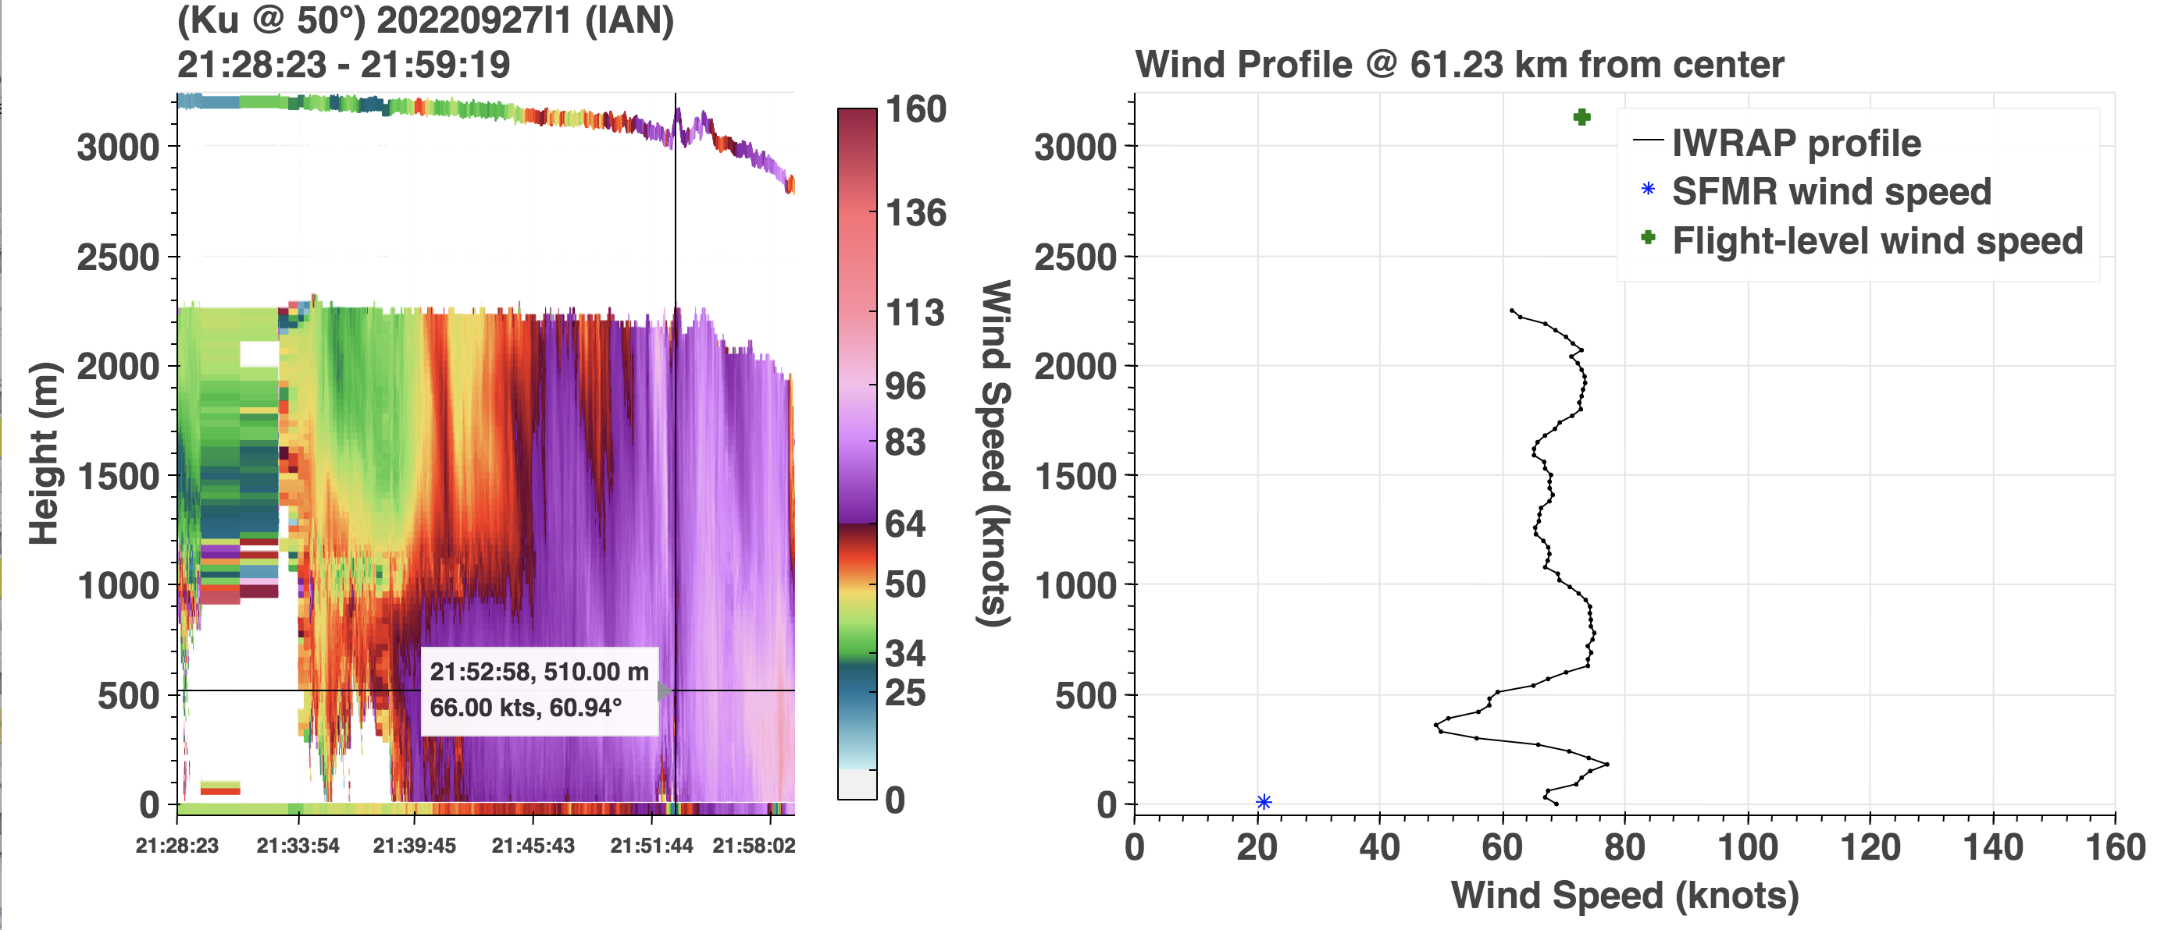
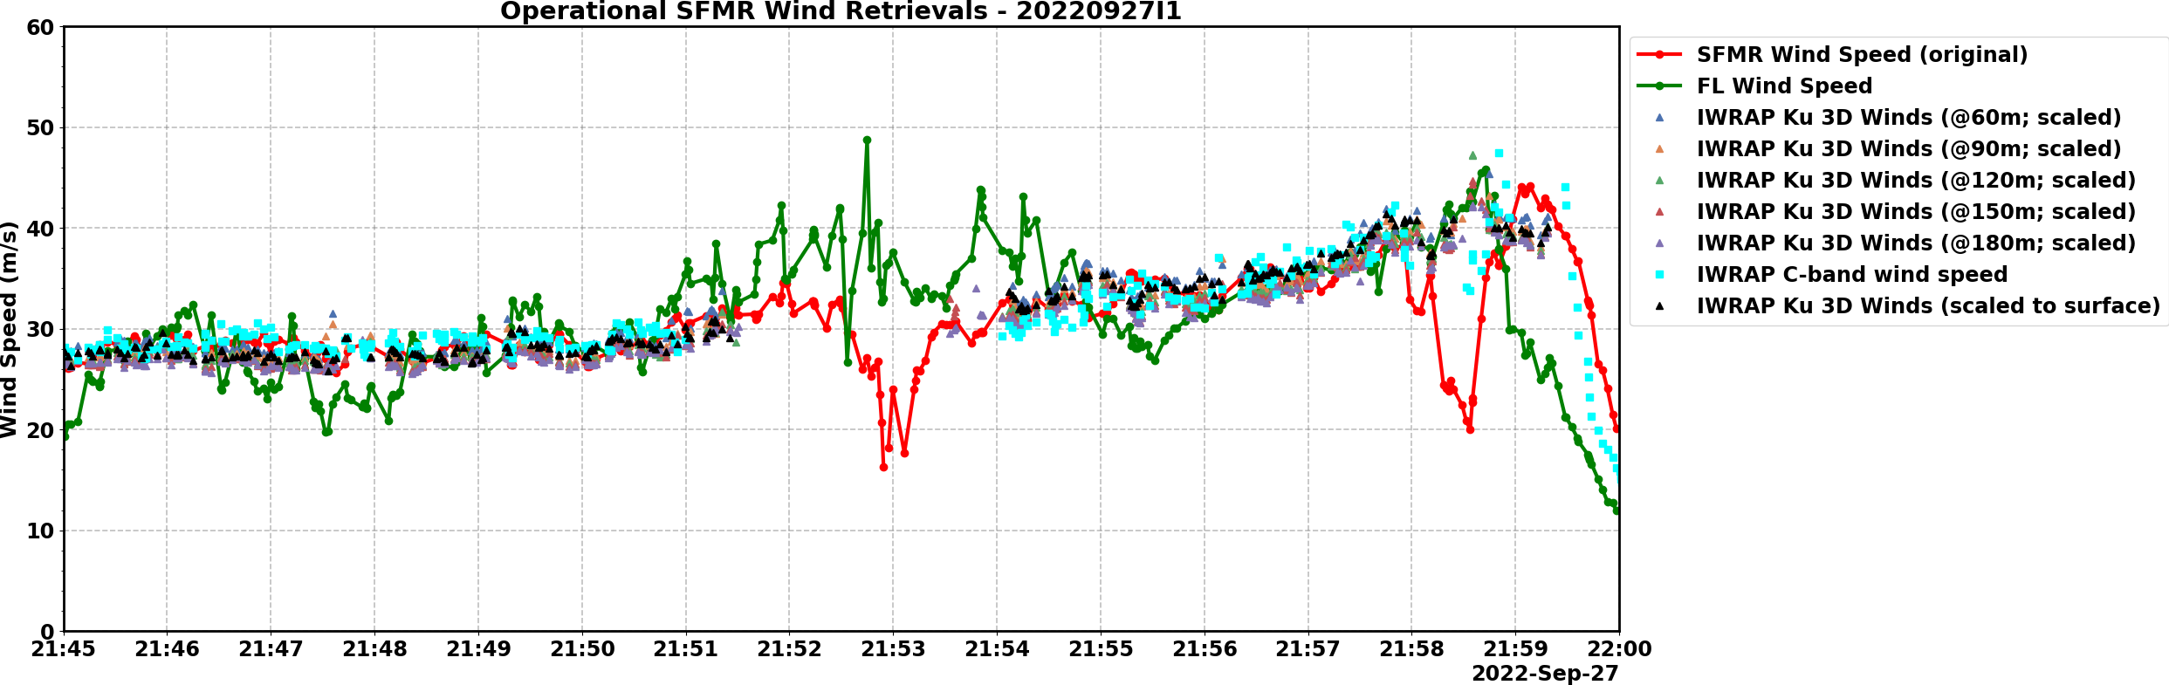
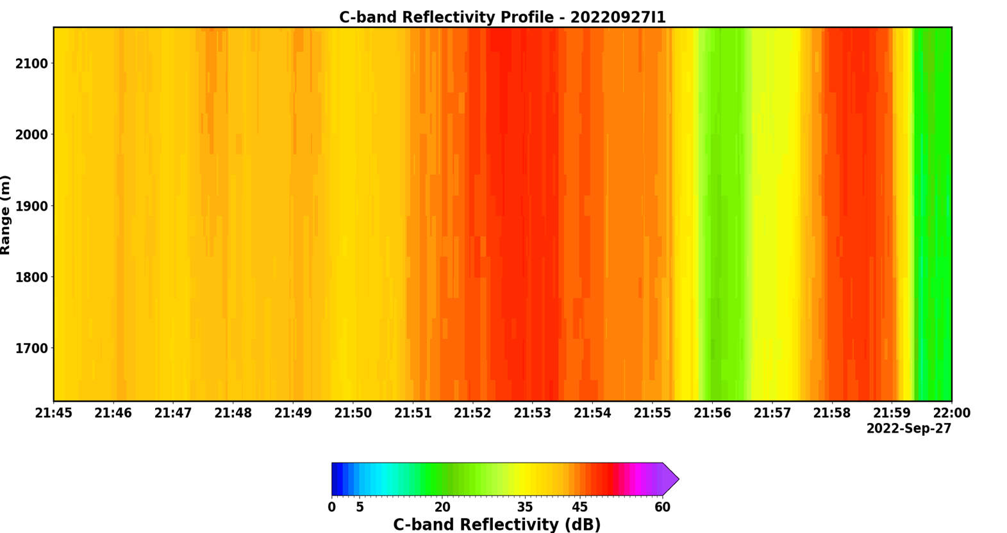
Well calibrated SFMR
Ian flight 09/27/2022

Slide 15
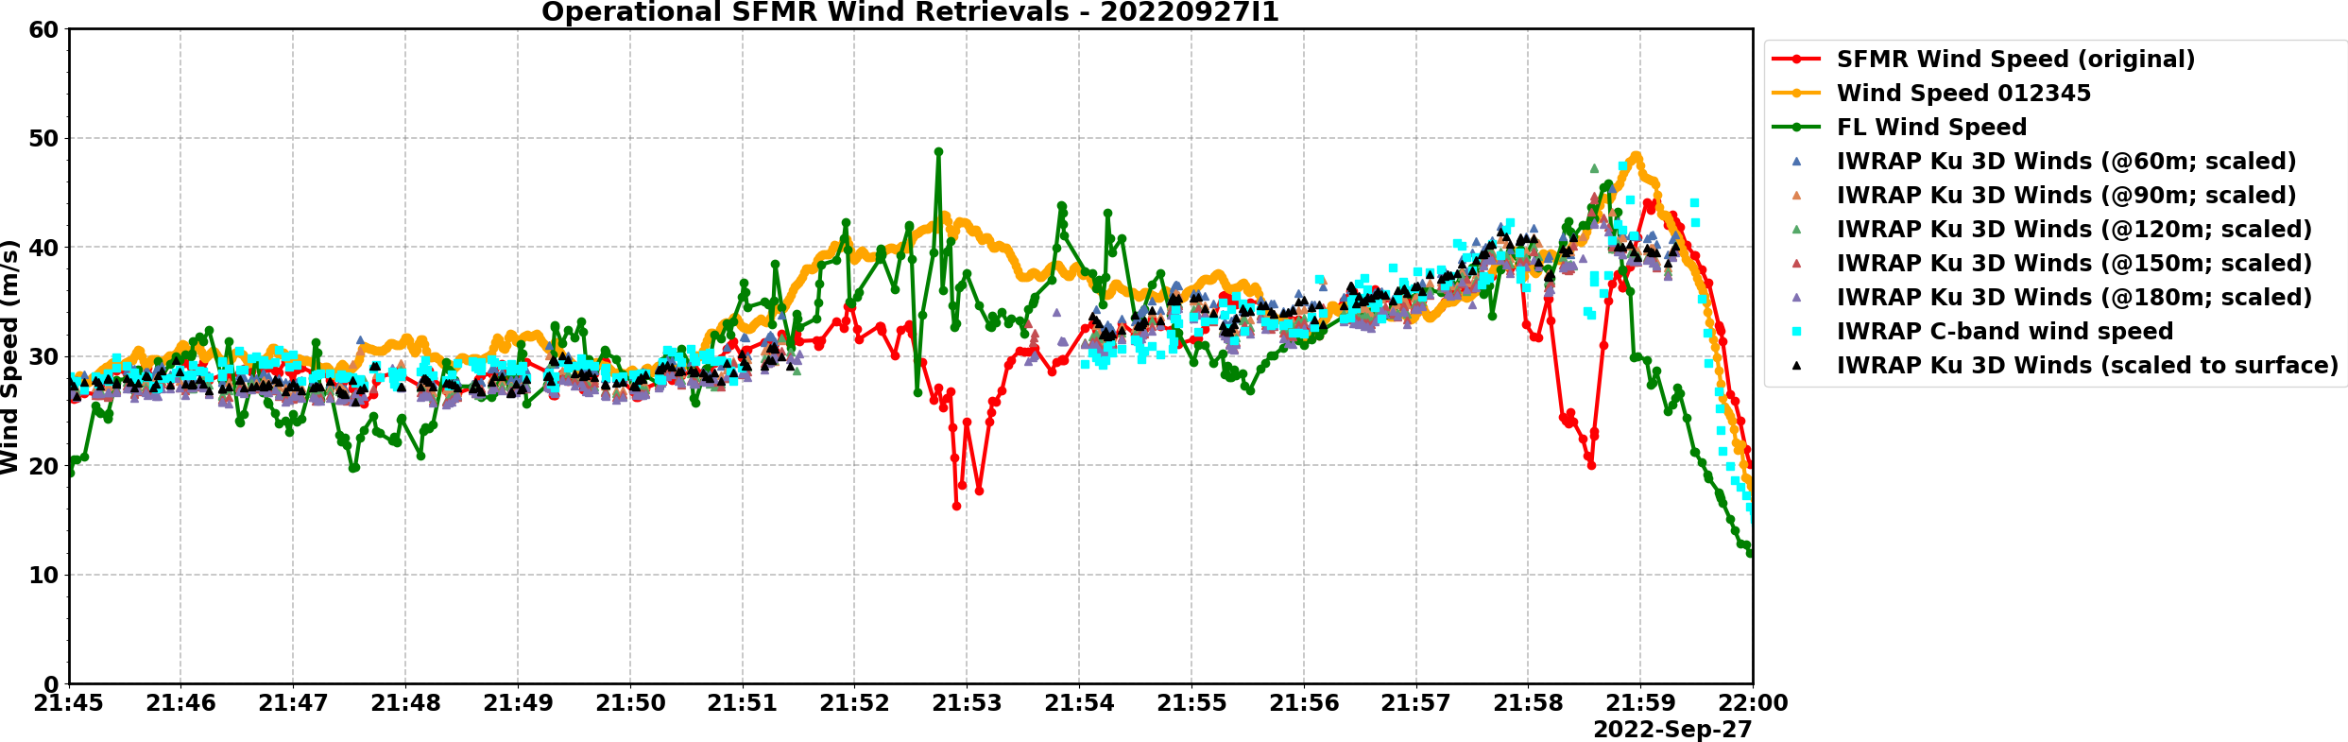
Well calibrated SFMR
New K-model

Slide 16
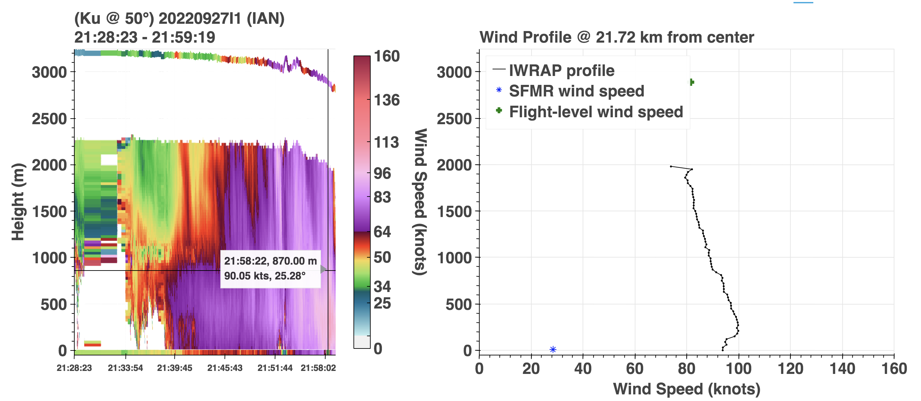
Well calibrated SFMR
Ian flight 09/27/2022

Slide 17
Well calibrated SFMR
Ian flight 09/27/2022

Slide 18
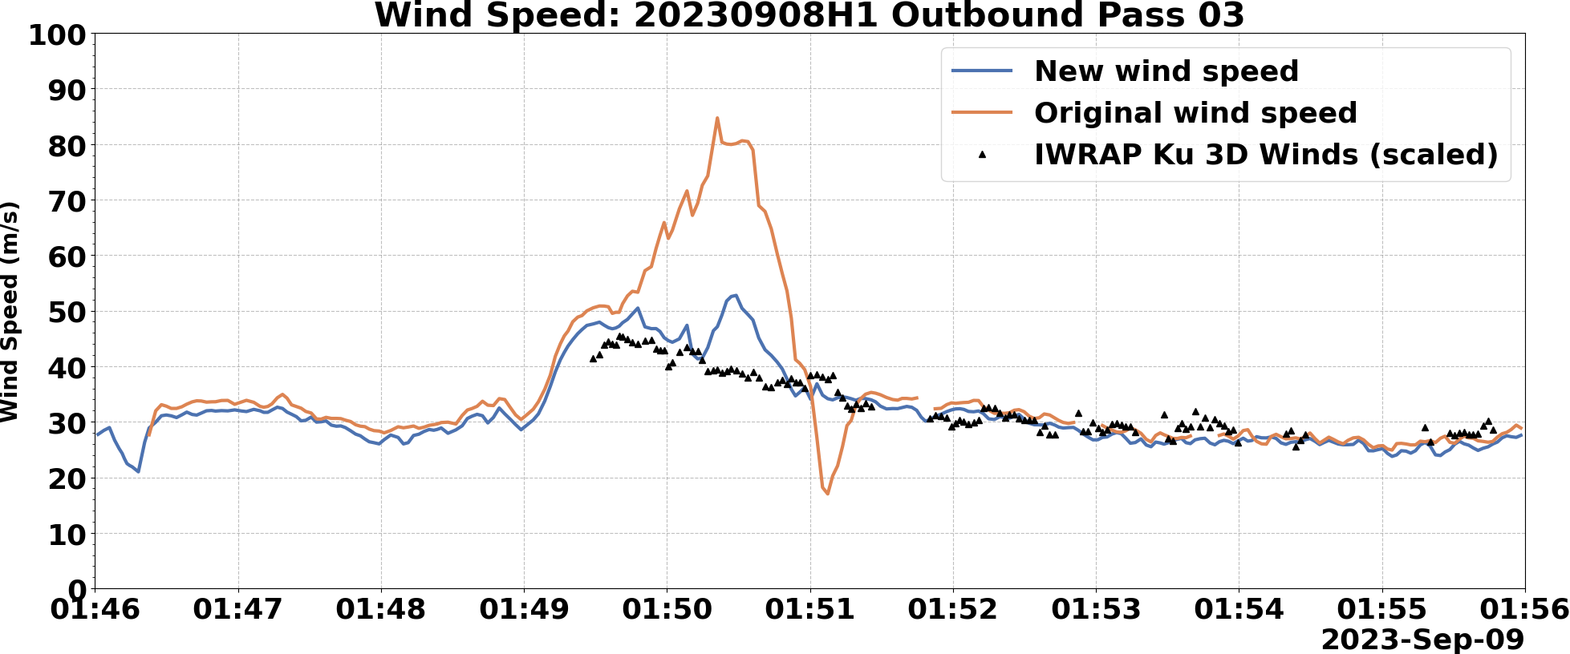
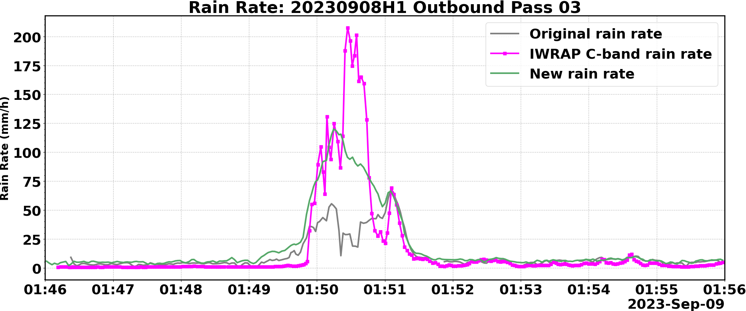
With new SFMR rain attenuation + scattering model

Slide 19
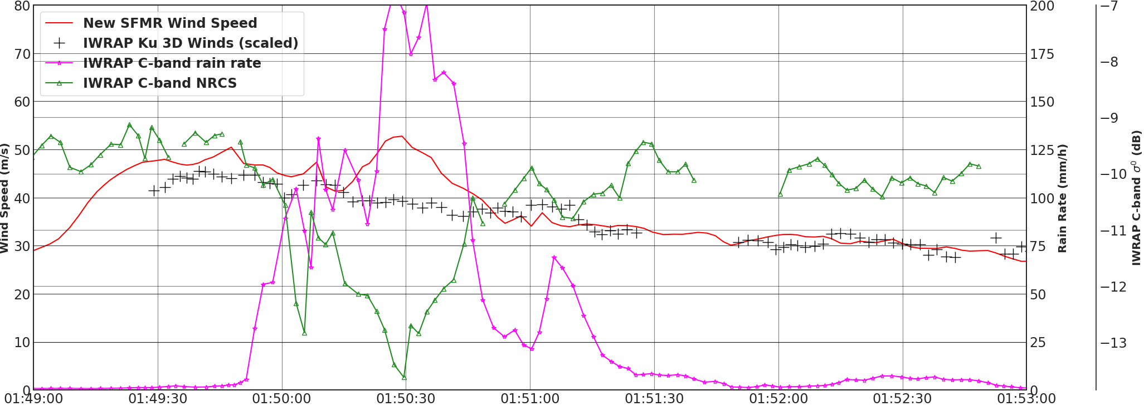
C-band is Impacted by Rain

Slide 20
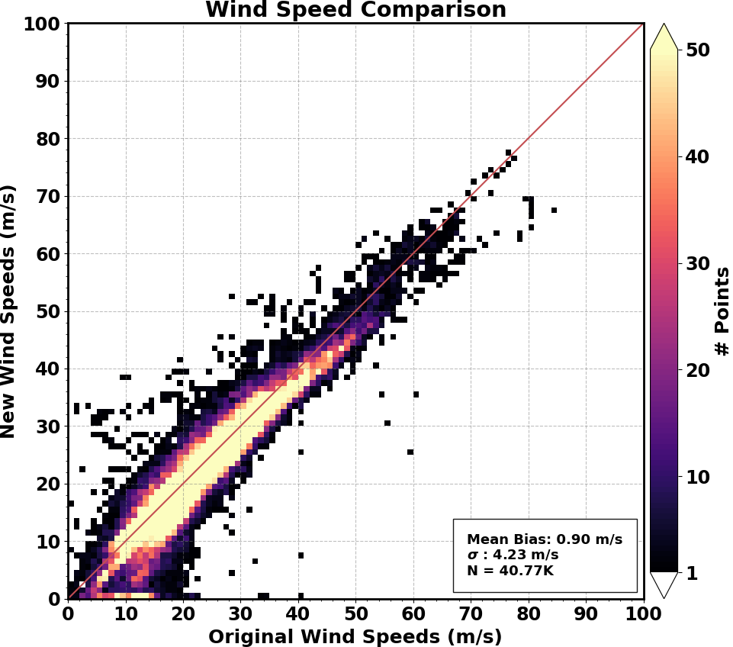

Slide 21
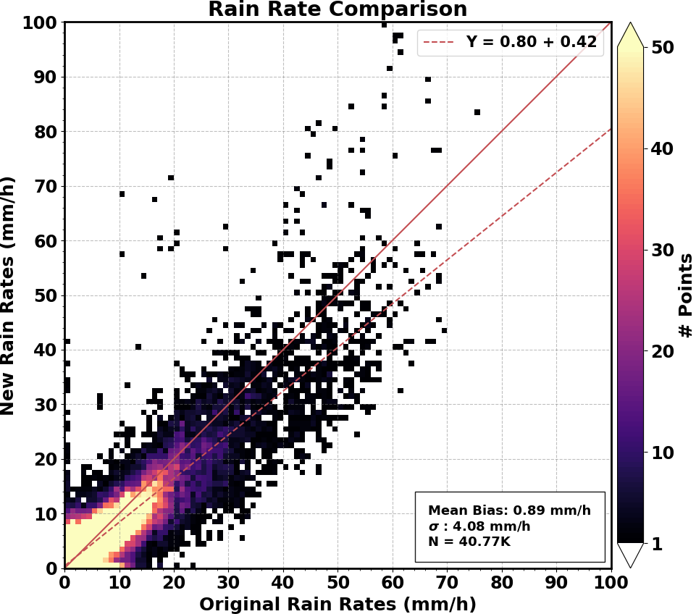

Slide 22
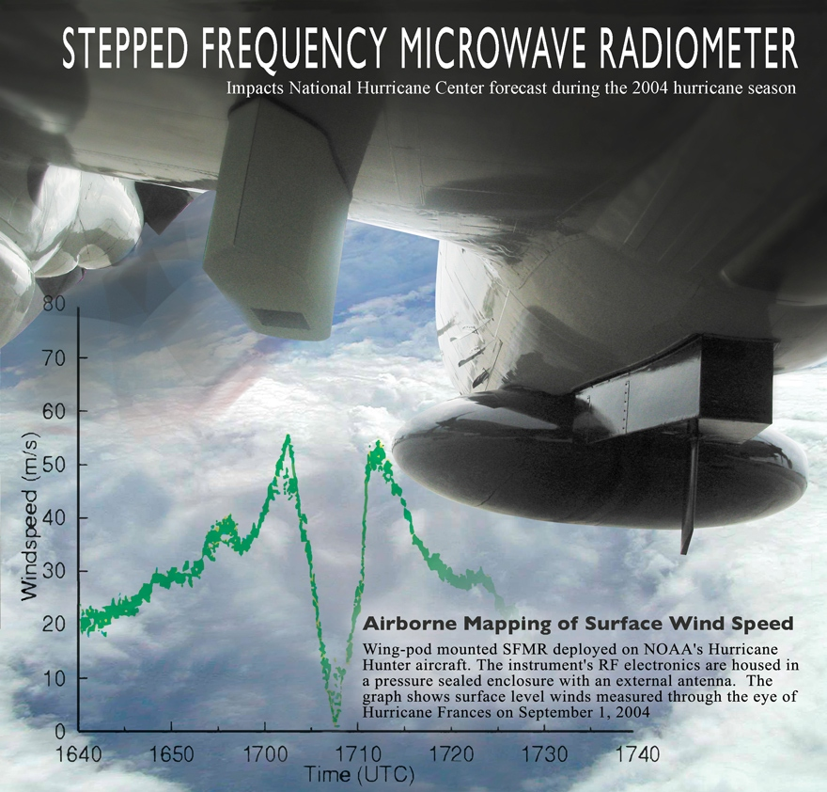
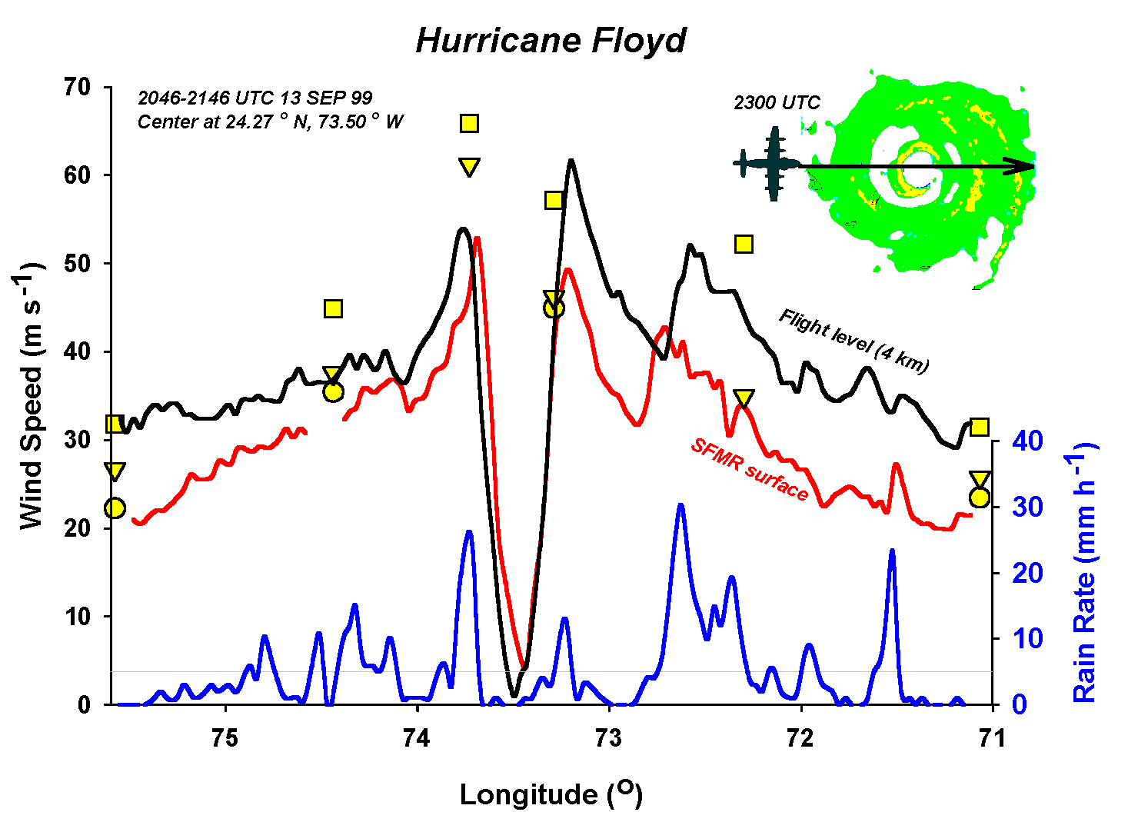
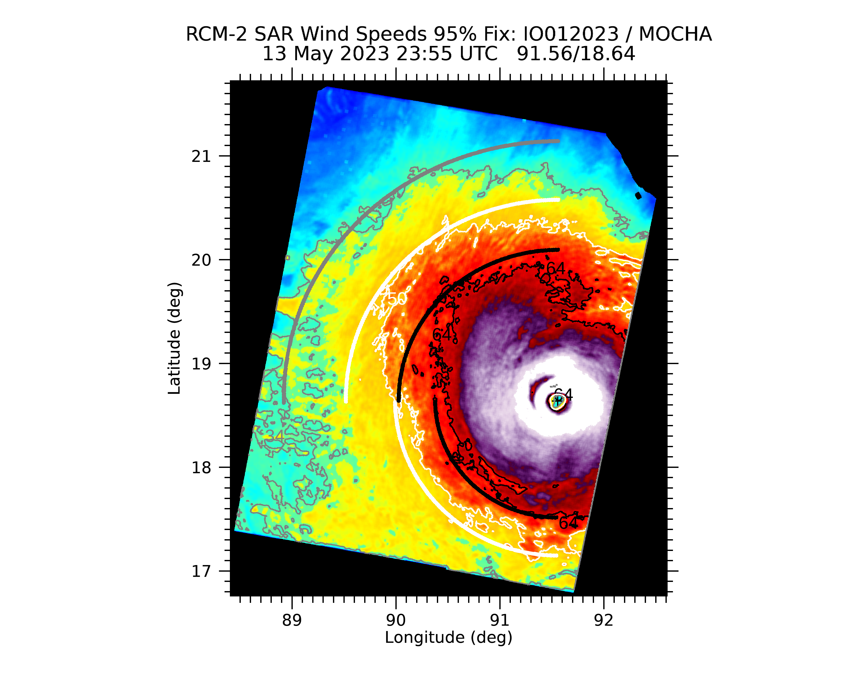
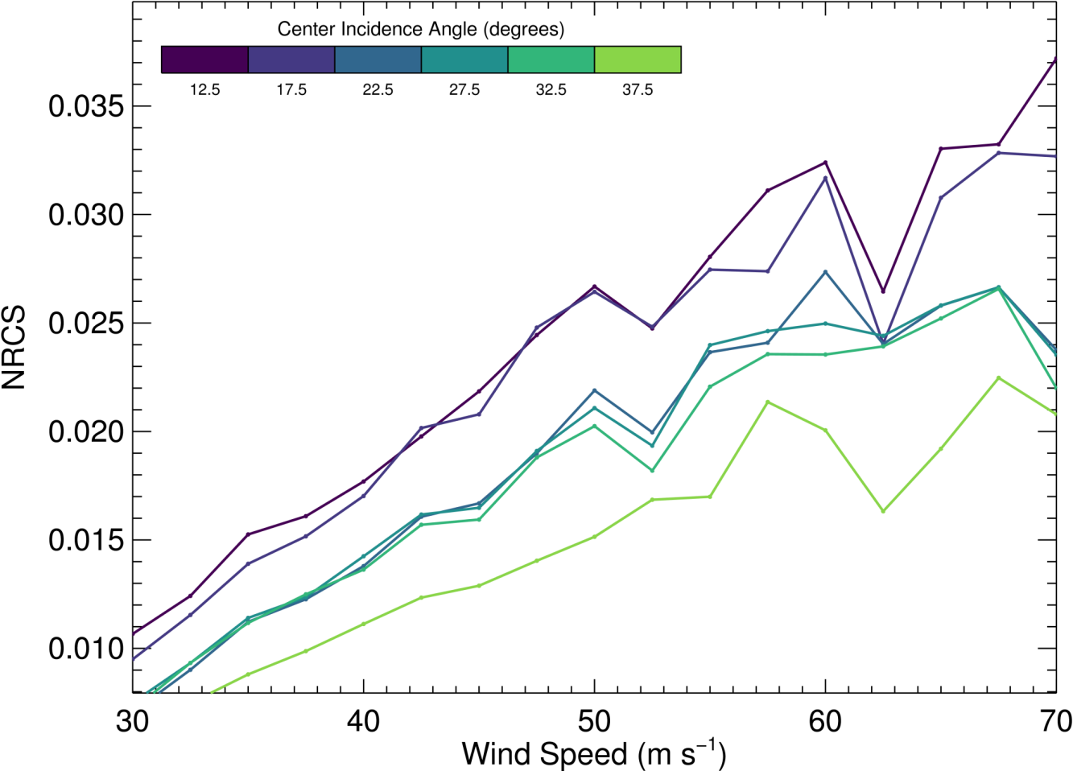
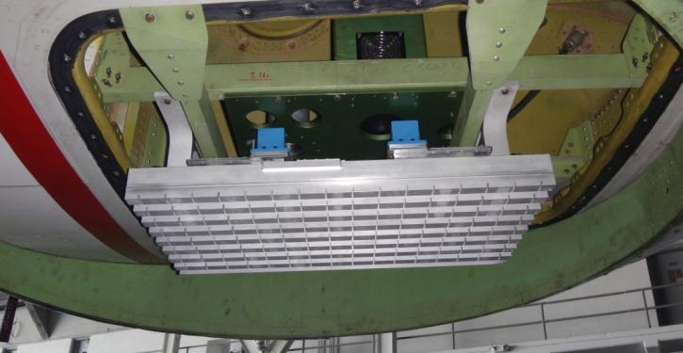
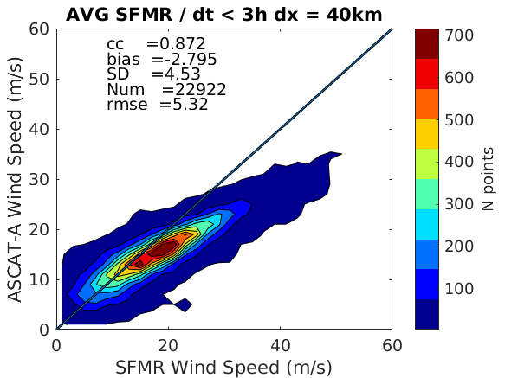
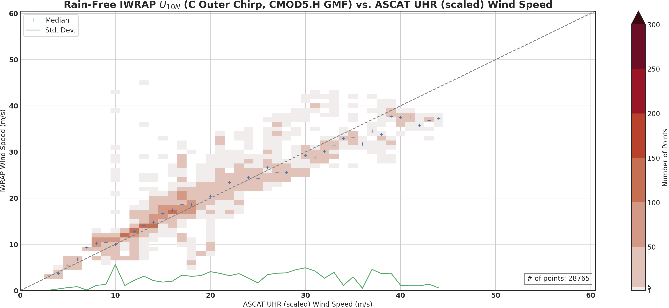
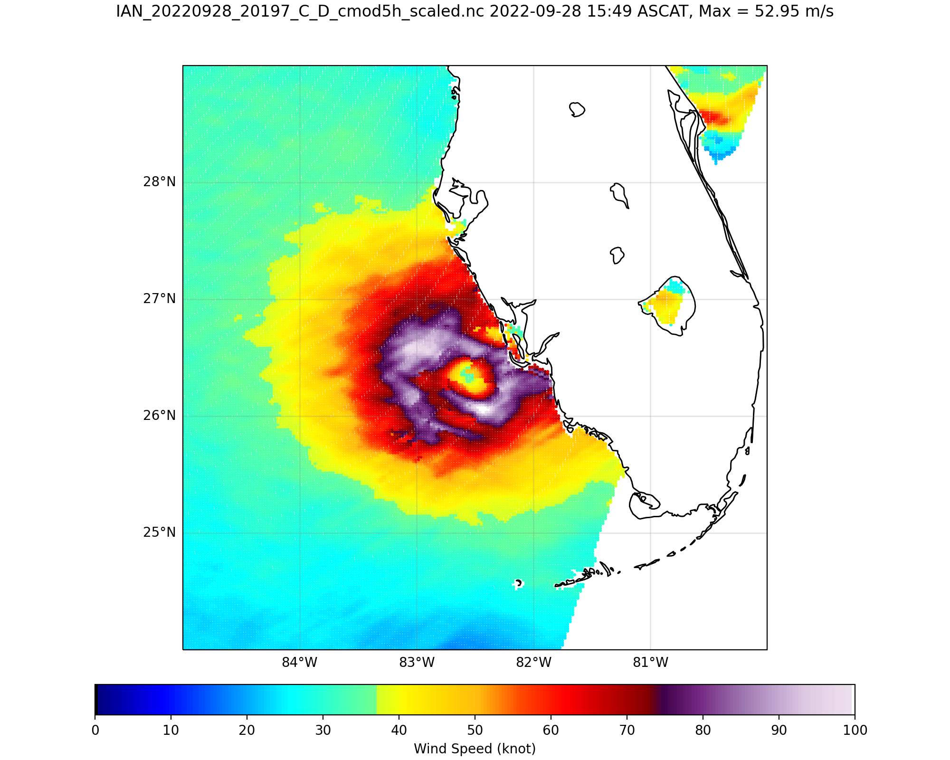
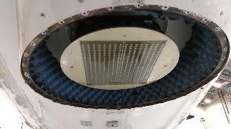
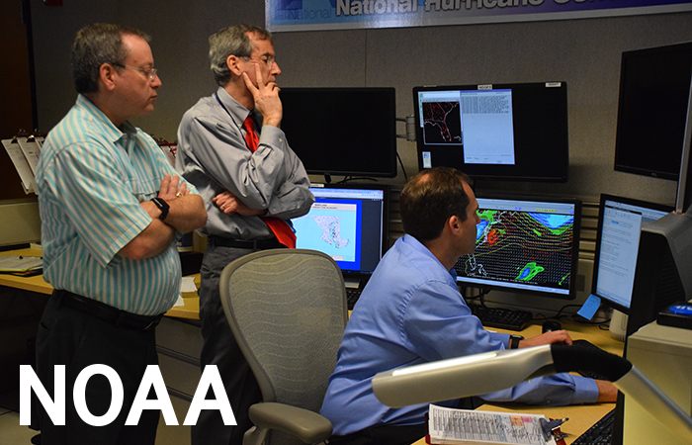
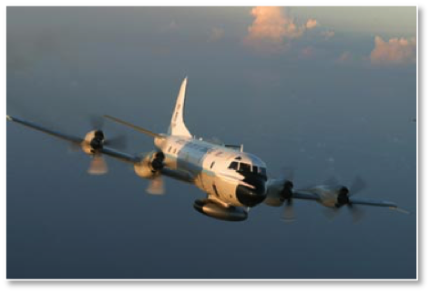
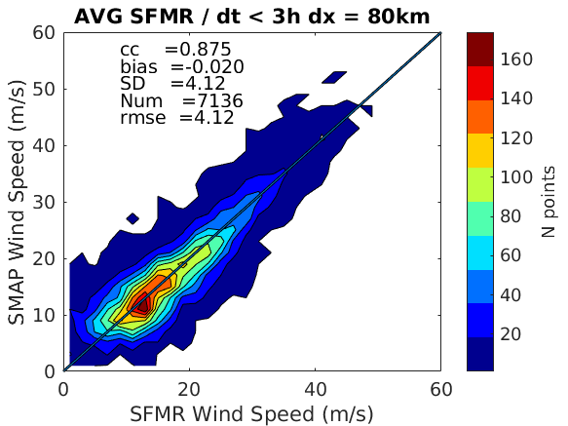
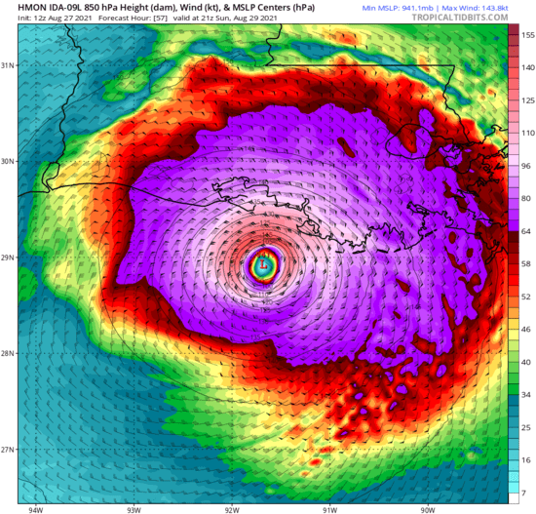
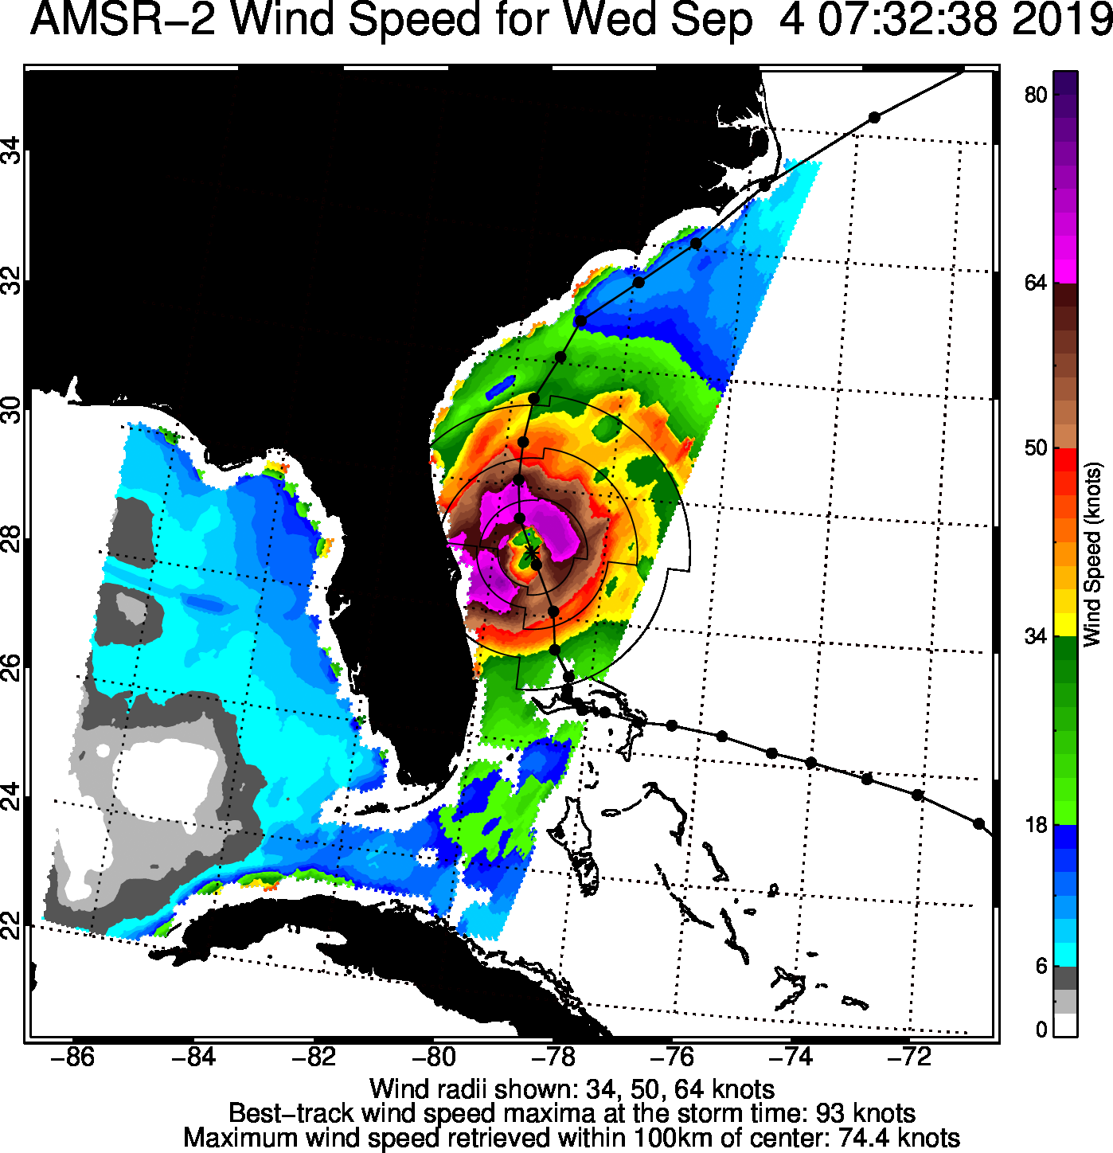
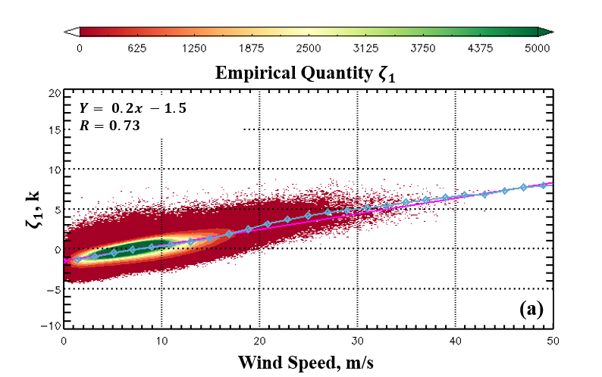
CrossPolination
X-pol Antenna
SAR VH
IWRAP C-band
UHR ASCAT
AMSR2
HWRF
SMAP

Slide 23
Summary
Due to inadequate minimization scheme and rain attenuation and scattering model SFMR wind estimates both overestimate and underestimate winds within tropical cyclones
Utilizing IWRAP measurements new attenuation/scattering model has been developed
Considering SFMR is utilized for calibration and validation of all satellite high wind retrievals as well as for model parametarization and data assimilation we propose modification of the operational algorithm
SFMR rain rate is also utilized for calibration of other aircraft instruments
IWRAP NRCS and rain measurements are providing new insight of precipitation impact on scatterometry c and ku observations

Slide 24
Backup

Slide 25
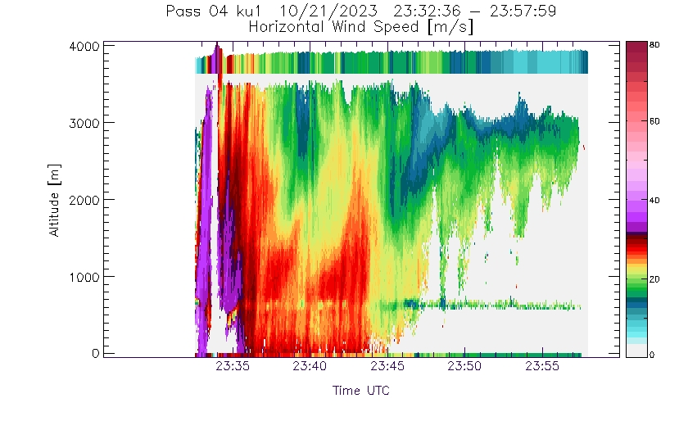
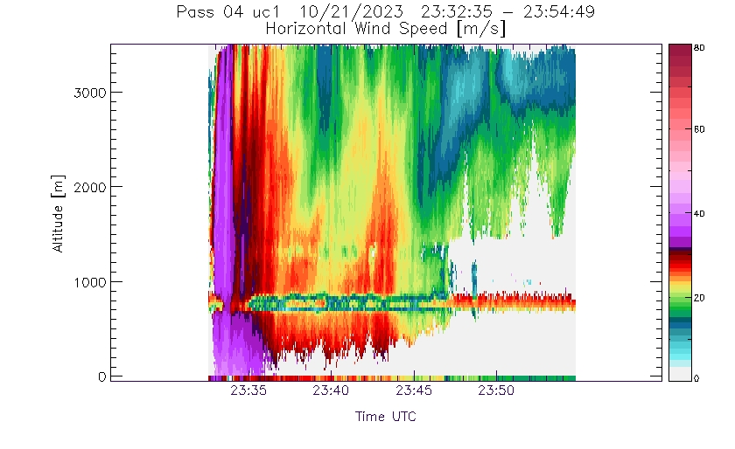
Expanding our Understanding of C and Ku band Observations in Rain
Acquired raw measurements at all 8 channels
Better understanding of Ku and C band sensitivities
C band seems to be more sensitive in rain column in which Ku attenuates
These are the same rain bands within which SFMR wind speed retrievals have large errors

Slide 26
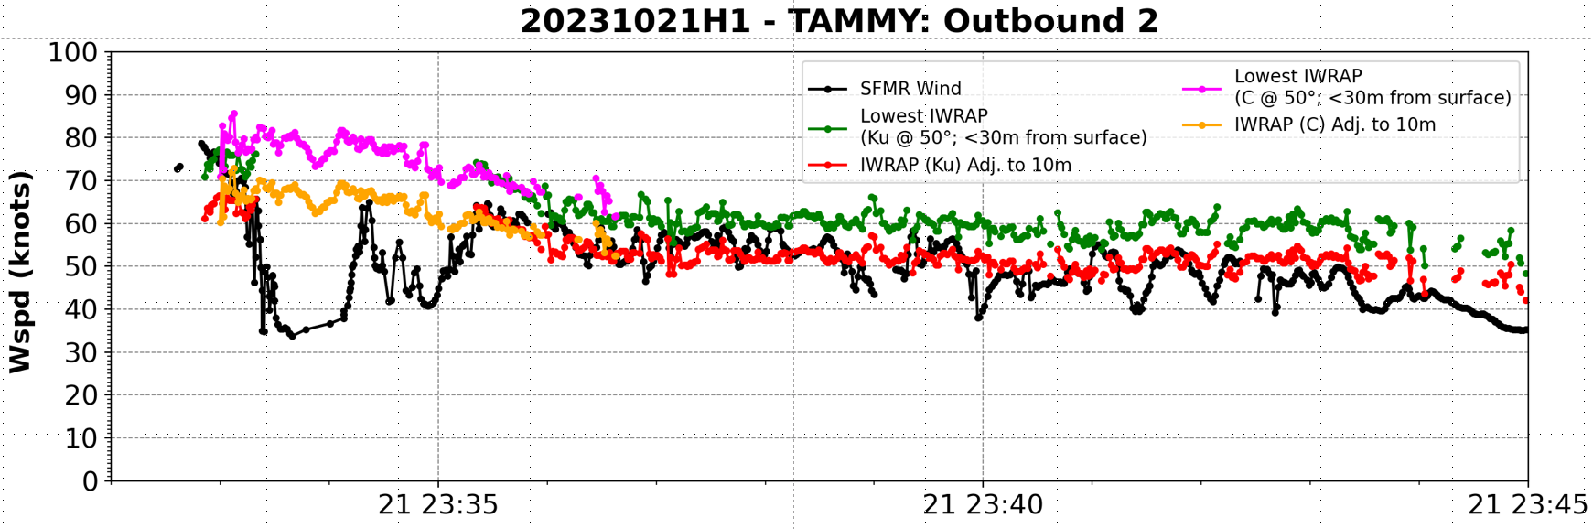
Typical SFMR Wind Speed Drop off within Rain Bands and Coincident IWRAP lowest 3D Horizontal Wind Retrievals

