Slide 1




Sharing Scatterometer Data
Ad.Stoffelen@knmi.nl
& scatterometer team
Active Remote Sensing Group
R&D Satellite Observations, KNMI
EUMETSAT OSI SAF
EUMETSAT NWP SAF
EU Copernicus Marine Core Services

Slide 2
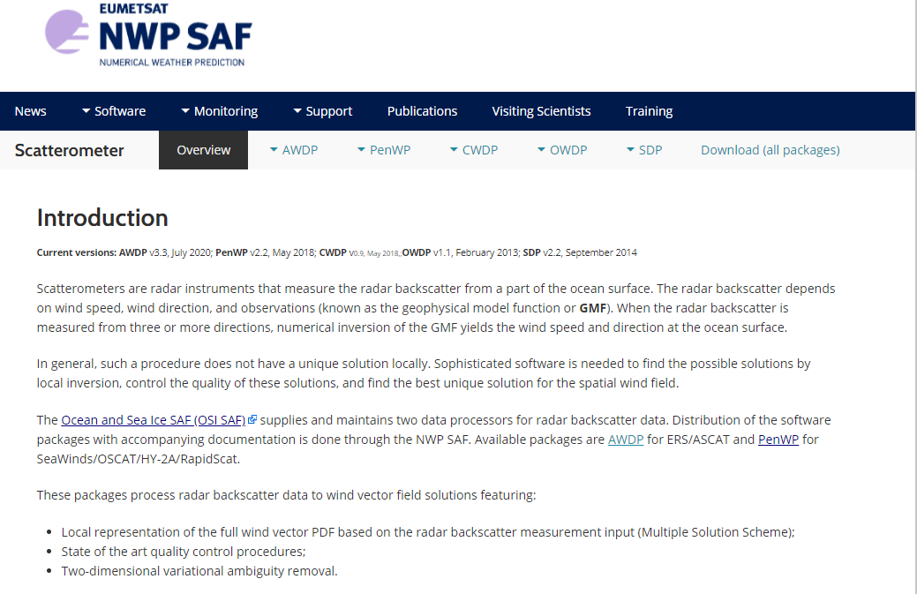
nwp-saf.eumetsat.int/site/software/scatterometer/

Slide 3
Sharing Data
China
Following CGMS, excellent collaboration between Europe and China (MoUs)
Involves data timeliness and L1 provision for EUMETSAT OSI SAF
Processed to L2, L3 and L4 and assimilated at ECMWF
Involves producing useful collocation data of HY2 with OSCAT and ASCAT
Processor developments in NRCS calibration, QC and GMF in collaboration
Limitations
Can the IOVWST be truly international following USA policies?
What are objective reasons to deny information from Chinese scatterometers?
Can we work on them?
For NWP global timeliness is important
Notes:
Supermodding is decribed in Stoffelen et al., 2020: https://nwp-saf.eumetsat.int/site/download/documentation/scatterometer/reports/High_Resolution_Wind_Data_Assimilation_Guide_1.3.pdf

Slide 4
Open Software
Excellent collaboration between Europe and China (MoUs)
BYU and Europe
Within Europe
EUMETSAT OSI SAF software is open, we also share tools
Findable, Accessible, Interoperable and Reusable?
Limitations
Maintenance
Protected software
Diagnostic tools
Resources for collaboration (find time to work on foreign scatterometers)
Notes:
Supermodding is decribed in Stoffelen et al., 2020: https://nwp-saf.eumetsat.int/site/download/documentation/scatterometer/reports/High_Resolution_Wind_Data_Assimilation_Guide_1.3.pdf

Slide 5
Dealing with model bias
Short-term
Apply the bias correction method to the ECMWF ERA5 and OPS dataset > ERA5*, resp. OPS*
Test effect ERA*/OPS* wind (variance) fields in global/regional ocean (coupled) models
Use ERA*/OPS* for KNMI product bias correction before data assimilation
Apply other optimizations, e.g., supermodding, cf. Mile et al., 2021, 4D-var
Long-term
Apply ERA* near-real time and multi-year L4 wind products (CMEMS, fellow)
Correct local biases in ECMWF data assimilation (VARBC) for better initialization
Attribute wind biases and variances to model errors, both in dynamical closure and parameterizations (fluxes, convection, PBL, … ), estimate with ML/AI
Essential for climate dynamics and NWP impact, but difficult to fund (no mission)
It needs close interaction between L2-L4 producers, flux experts and modellers
Notes:
Supermodding is decribed in Stoffelen et al., 2020: https://nwp-saf.eumetsat.int/site/download/documentation/scatterometer/reports/High_Resolution_Wind_Data_Assimilation_Guide_1.3.pdf

Slide 6
Dealing with model bias
  We will continue to learn from the golden age in scatterometry that is commencing
  A scatterometer typically provides more than a few % error reduction and 7 complementary scatterometers hence could provide 15% forecast improvement, if timely available
  Current data assimilation can be improved when model biases are removed in DAS
  Sensor wind bias corrections to the biased model state are needed for BLUE data assimilation, as persistent local model biases can often be larger than the local innovations
  Atmospheric model mesoscales tied to the ocean condition are lacking, while in addition large-scale model errors exist
  Model wind stress error correction is needed before ocean forcing due to large local biases, as available in L4 Copernicus Marine Service wind and stress products
  The model error patterns need investigation as a function of fluxes, drag, convection, … MABL parameterizations, to understand the errors better; dynamical correction may then be considered
  We are working on statistical, NN and parametric model bias corrections for application
  Continued interaction with the user community will be needed to assess priorities and practical ways forward; your input is welcome!
Notes:
See bias correction guide for more information: https://nwp-saf.eumetsat.int/site/download/documentation/scatterometer/Wind_Bias_Correction_Guide_v1.5.pdf
Perhaps it is not appropriate to use the MO turbulent diffusion scheme to compensate for missing mesoscale variability…

Slide 7
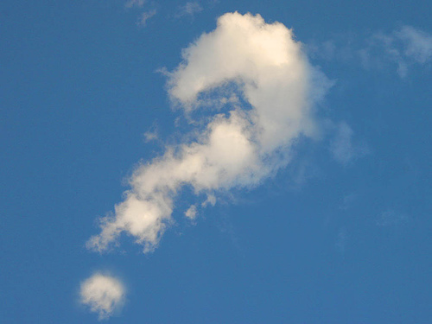

Slide 8
Trainin^{g} / Interaction
Training Course Applications of Satellite Wind and Wave Products for Marine Forecasting
vimeo.com/album/1783188 (video)
Forecasters forum
training.eumetsat.int/mod/forum/view.php?f=264
Xynthia storm case
www.eumetrain.org/data/2/xynthia/index.htm
EUMETrain ocean and sea week
eumetrain.org/events/oceansea_week_2011.html (video)
NWP SAF scatterometer training workshop
nwpsaf.eu/site/software/scatterometer/
Use of Satellite Wind & Wave Products for Marine Forecasting
training.eumetsat.int/course/category.php?id=46 and others
Satellite and ECMWF data vizualisation
eumetrain.org/eport/smhi_12.php?
MeteD/COMET training module www.meted.ucar.edu/EUMETSAT/marine_forecasting/

Slide 9
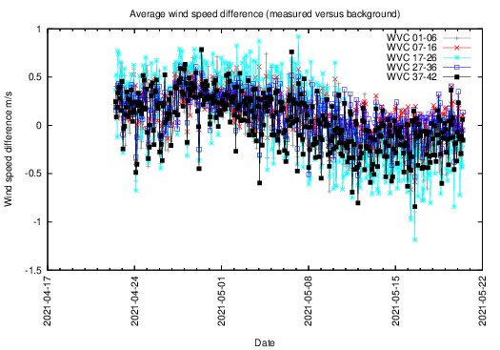
Toda^{y}’s Status
ASCAT-A, MetOp-A : 2007- 2022 9:30 LST, End-of-life maneuver in 2022
ASCAT-B, MetOp-B : 2012- healthy 9:30 LST
ASCAT-C, MetOp-C : 2018- healthy 9:30 LST, Excellent for wind changes in moist convection
OSCAT-2, ScatSat-1 : 2017- 2021 8:45 LST, Excellent for Ku/C intercalibration
OSCAT-3, OceanSat3: October 2021 12:00 LST
HSCAT-B, HY2B : 2018- healthy 6:00 LST
HSCAT-C, HY2C : 2020- healthy Not sun-synchronous, regresses
HSCAT-D, HY2D : 2021- healthy 6:00 LST
CSCAT, CFOSAT : 2019- demo Stability issues, nadir issues
WindRad, FY3E : 5/7/’21- healthy 5:30 LST
https://scatterometer.knmi.nl/proc_status/
Vector wind CDRs for ERS (1991-1999), QuikScat (1999-2009), ASCAT (2007-), OSCAT (2014+),
Wind CDRs for RapidScat, SMAP, SSMI, AMSR, altimeter, . .
https://scatterometer.knmi.nl/archived_prod/
scatterometer.knmi.nl/cfosat_25_prod/
index.php?cmd=monitoring&period=week

Slide 10
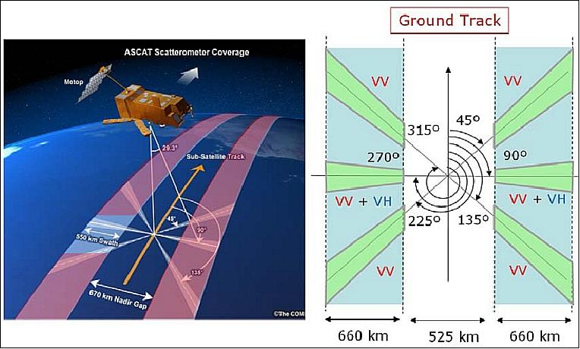
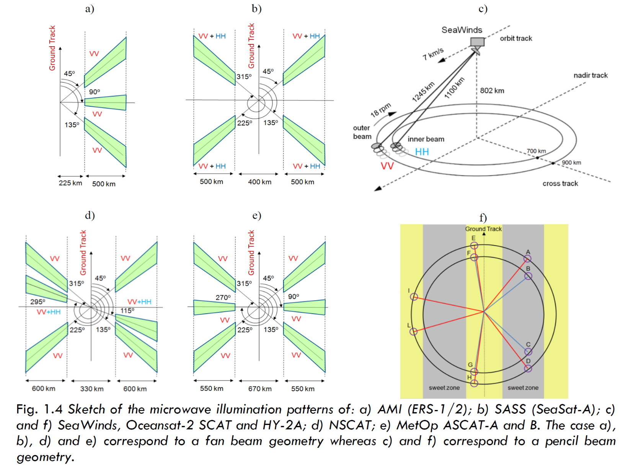
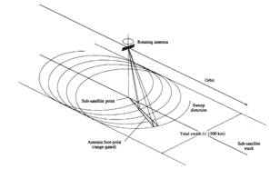
C-band, ERS, ASCAT, SCA
Ku-band, QuikScat, RapidScat
Ku, CSCAT and Ku/C, WindRad
Ku
Ku-band, OSCAT, HSCAT
C

Slide 11
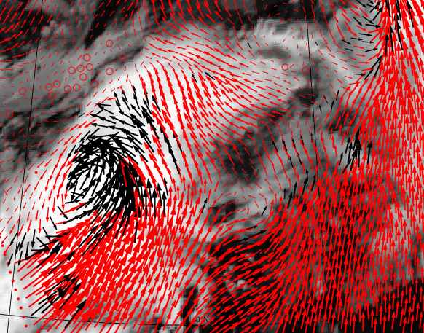
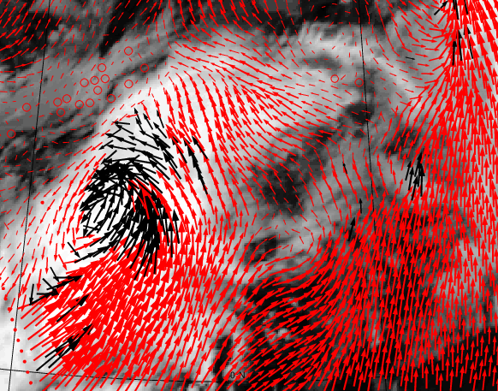
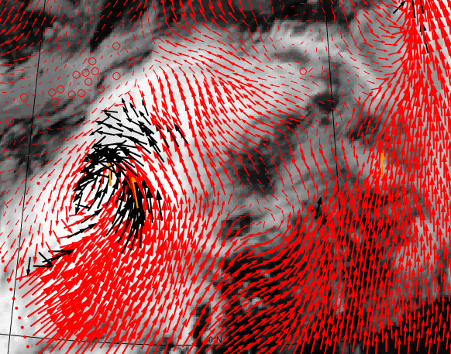
QC development Ku-band
HY2B ~20:00 UTC 29/4/’21
Current MLE QC NWP QC Nowcasting QC
- ASCAT and ScatSat collocations are very helpful to train Ku-band QC near rain to
reduce FAR and enhance POD
- We evaluated dependencies of sorted MLE, SE and Joss on wind speed bias and SD
- “Egg” processing slightly different from “slice” processing
NWP QC rejects less scattered winds and less winds near the front and low
Nowcasting QC rejects even less winds with heavy-rain-affected regions
(north-east of the low) still rejected
Versus ECMWF | MLE | NWP | NWC
Wind speed bias | -0.04 | -0.05 | -0.04
StdevD u | 1.21 | 1.20 | 1.22
StdevD v | 1.21 | 1.20 | 1.22
StdevD wind dir | 9.57 | 9.60 | 9.66
Rejection rate | 5.47 % | 3.16 % | 1.74 %
Anton Verhoef, Xu and Stoffelen, 2020

Slide 12
Stress-equivalent 10-m wind
Radiometers/scatterometers measure ocean roughness
Ocean roughness consists in small (cm) waves generated by air impact and subsequent wave breaking processes; depends on gravity, water mass density, surface tension s, and e.m. sea properties (assumed constant)
Air-sea momentum exchange is described by τ = ρ_{air} u* u* , the stress vector; depends on air mass density ρ_{air} , friction velocity vector u*
Surface layer winds (e.g., u₁₀) depend on u* , atmospheric stability, surface roughness and the presence of ocean currents
Equivalent neutral winds, u_{10N} , depend only on u* , surface roughness and the presence of ocean currents and is currently used for backscatter geophysical model functions (GMFs)
u_{10S} = √ρ_{air} . u_{10N}/√ρ₀ is now used to be a better input for backscatter GMFs (stress-equivalent wind)
This prevents regional biases against local wind references
Jos de Kloe et al., 2017

Slide 13
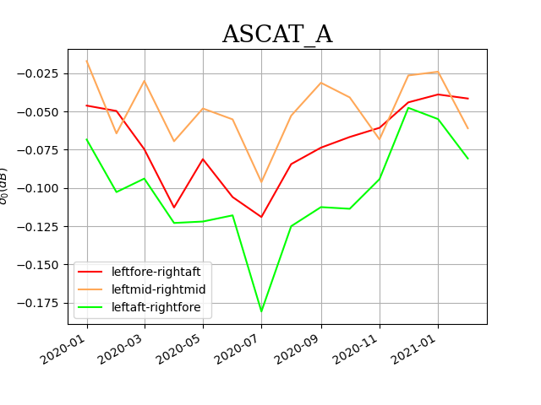
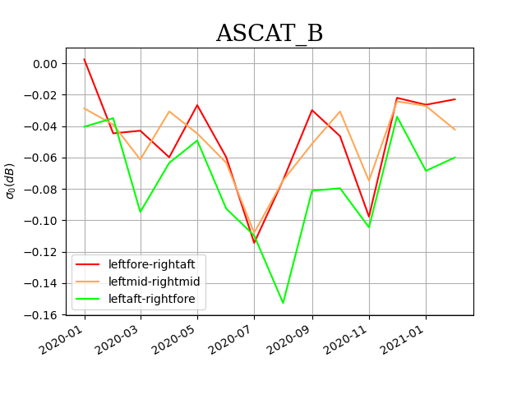
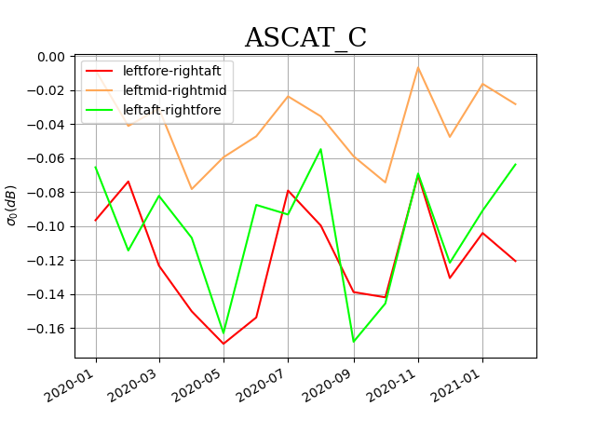
σº intercalibration
Many satellites allow calibration evaluation for almost identical weather sample
Remaining effects are typically 0.1 dB which corresponds to about 0.1 m/s retrieval bias for nominal winds
At 40 m/s, 0.1 dB corresponds to about a 4 m/s error, due to the lower sensitivity of ASCAT σº

Slide 14
Intercalibration and standardization
Our premise is that for given wavelength, polarization and geometry, σ⁰ should be identical in identical geophysical conditions and independent of instrument settings
We develop generic L2 wind processing for calibrated instrument data
Noise properties do however affect σ⁰ diagnostics, so we develop noise models too to better understand our retrievals and diagnostics
KNMI is particularly interested to remove (σ⁰ –dependent) instrument biases as they interfere with Ku-band wind and SST dependencies (Stoffelen et al., 2017; Wang et al., 2017; Belmonte et al., 2017)
Comparison of ScatSat with QSCAT, RSCAT and OSCAT behavior for given Geophysical Model Function GMF and NWP input to obtain consistency
CFOSAT, HY-2 and WindRad scatterometers will follow

Slide 15
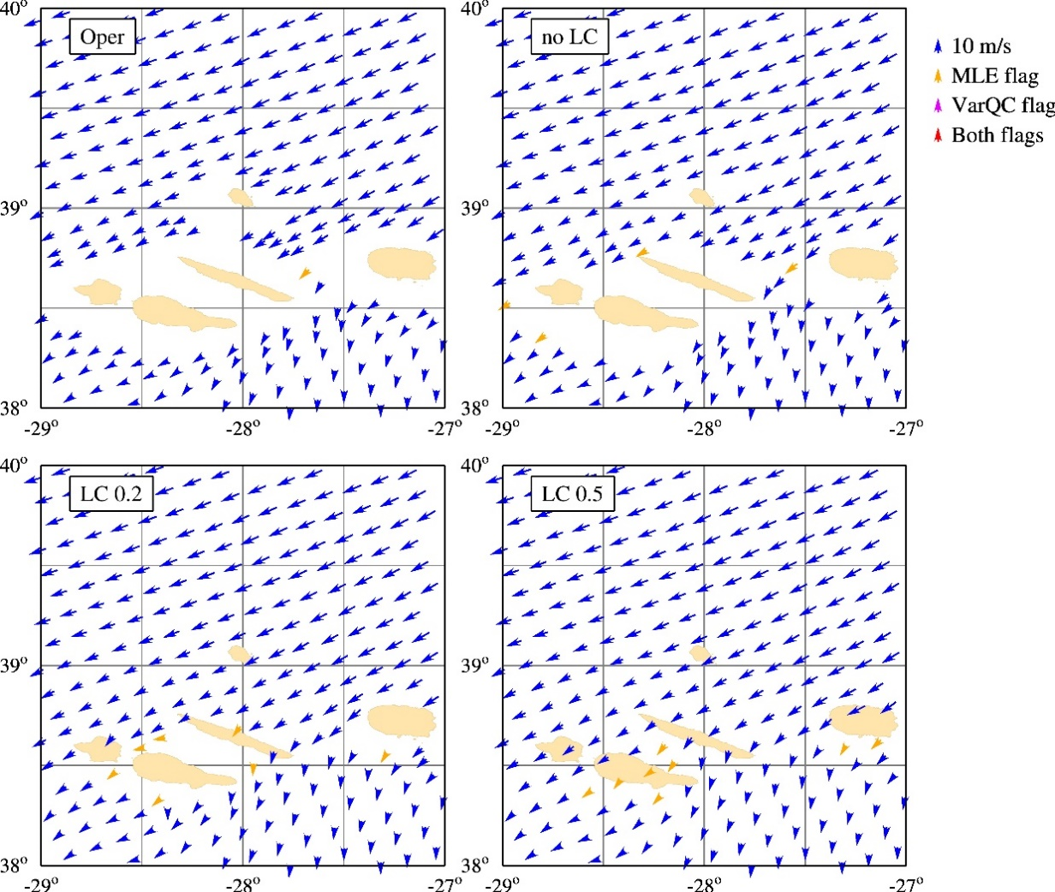
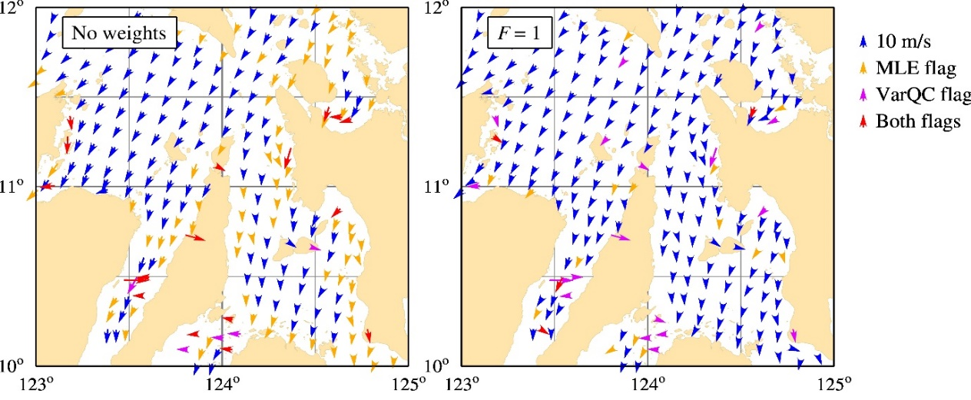
Development coastal winds
Madeira
LCR
EUMETSAT provides Land Contamination Ratio, LCR, for every measurement
For every WVC with land and sea, we determine the land and sea σº by regression of σº versus LCR
We use weights in the regression to avoid detrimental effects from outliers (bottom plots)
Sea σº is used for wind retrieval
Similar development for QuikScat, while more complex noise features
First version for 2021 release

Slide 16
CGMS48 plenary Recommendation
Establish an Ocean Surface Wind Task Group (OSW TG) in the CGMS International Winds Working Group (IWWG) that coordinates its actions and recommendations with GSICS, CEOS and the IOVWST
The OSW TG facilitates an open and shared environment to address key points for the general benefit of the meteorological/ocean community
  Intercalibration of wind products for Climate Data Records and operational user convenience
  An in-situ wind speed reference for high and extreme winds
  Methods for the elimination of model biases in NWP data assimilation (local VARBC)
  Improved spatial NWP wind assimilation methods; assimilate unique products
  QC optimization for NWP
  Open high-level wind services and timeliness of the virtual constellation
  Open data comparisons and open software to share in the community
  Exploit scatterometer wind stress measurements for improved atmosphere-ocean coupling
  Development of coastal winds for all scatterometers

Slide 17
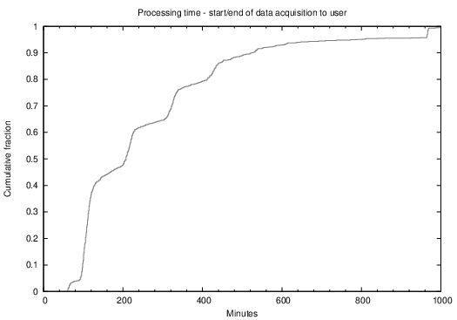
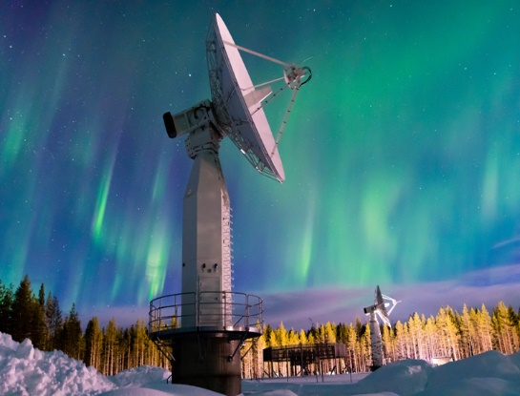
Current CGMS OSW Task Group/IWWG
Ad Stoffelen (KNMI, lead)
Fangli Du (CMA)
Jian Shang(CMA)
Régis Borde(EUMETSAT, IWWG)
Stefanie Linow (EUMETSAT)
Mark Bourassa (FSU, IOVWST)
Dave Halpern (IOC)
Raj Kumar (ISRO)
Ernesto Rodriguez (NASA)
Svetla Hristova (NASA)
Paul S Chang (NOAA, CEOS VC)
Juhong Zou (NSOAS)
Dong Xiaolong (NSSC, CEOS WGCV MSSG)
Steve Wanzong (UW-Madison/SSEC/CIMSS, IWWG)
Heikki Pohjola (WMO)
HY2B/C/D, NSOAS, China
EUMETSAT member states
Sodankylä (FMI-ARC)
OSI SAF winds
WMO OSCAR timeliness

