Slide 1
Impact of Indian Ocean tropical cyclones on the development of the Madden-Julian Oscillation (MJO)
Toshi Shinoda, Suyang Pei
Texas A&M University - Corpus Christi

Slide 2
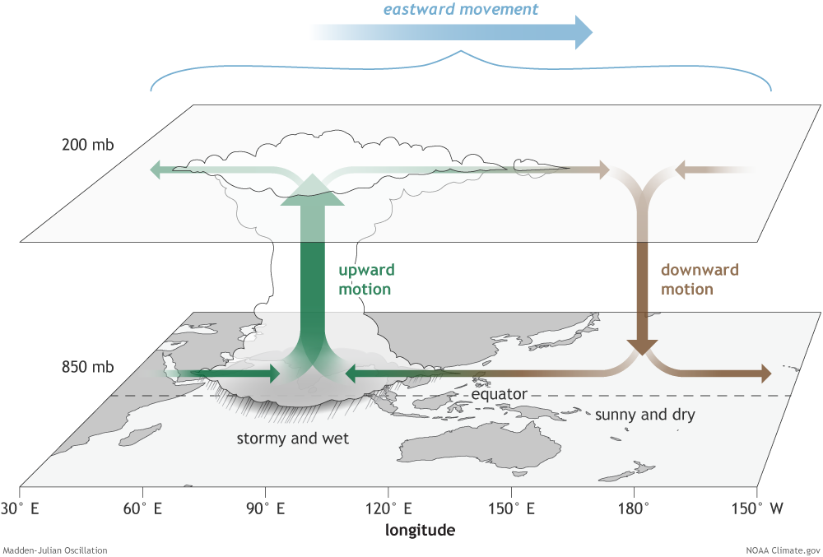
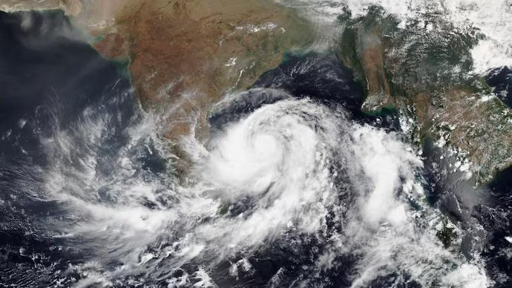
Many previous studies (e.g., Liebmann et al. 1994; Maloney& Hartmann 2000; Sobel & Maloney 2000; Hall et al. 2001; Aiyyer & Molinari 2008; Camargo et al. 2008; Barrett & Leslie 2009, and many others)
MJO
Tropical cyclone
?
Satellite image of Cyclone Fani. (Photo: Twitter/NOAA Satellites)
Through anomalous large scale circulation and convection

Slide 3
Purpose of this study
Investigate the impact of tropical cyclones on the MJO initiation over the Indian Ocean.
Case study: MJO event during DYNAMO, December 2011
Data
CCMP winds
CMORPH precipitation
Circulation and moisture from ERA 5
DYNAMO sounding
SST (OI SSTv2)
TC track from International Best Track Archive for Climate Stewardship (IBTrACS)

Slide 4
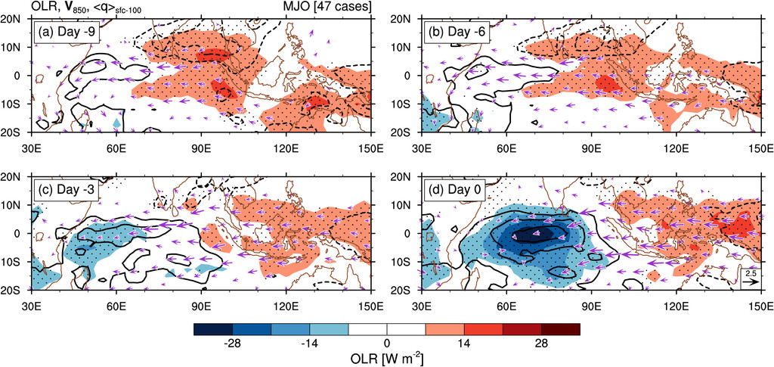
MJO initiation over the Indian Ocean
Takasuka and Satoh (2020)

Slide 5
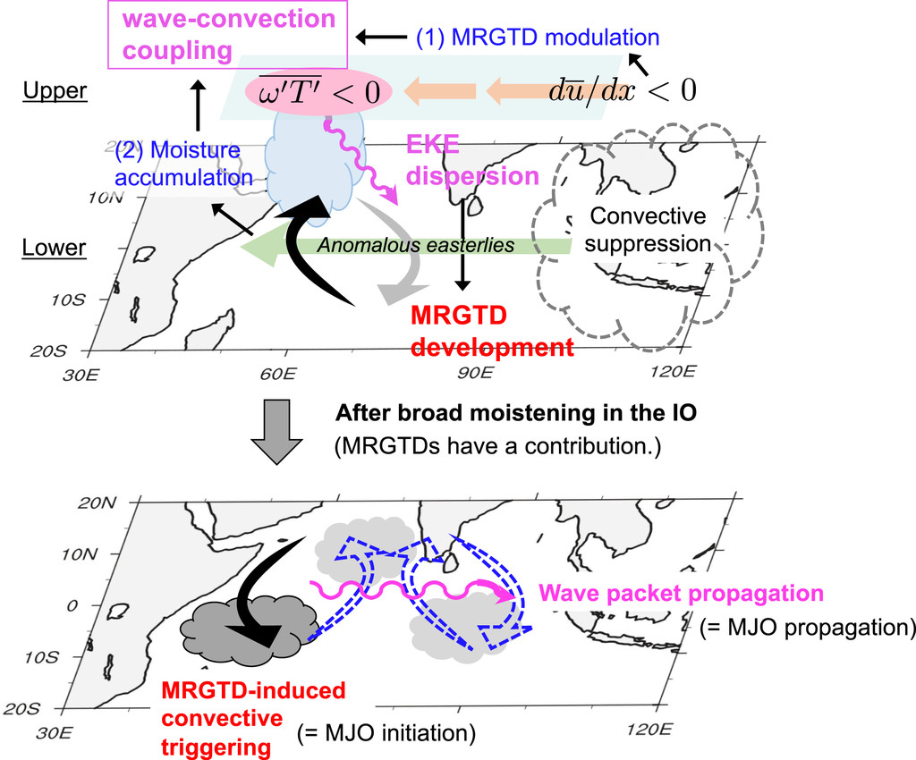
MJO initiation over the Indian Ocean
Takasuka and Satoh (2020)

Slide 6
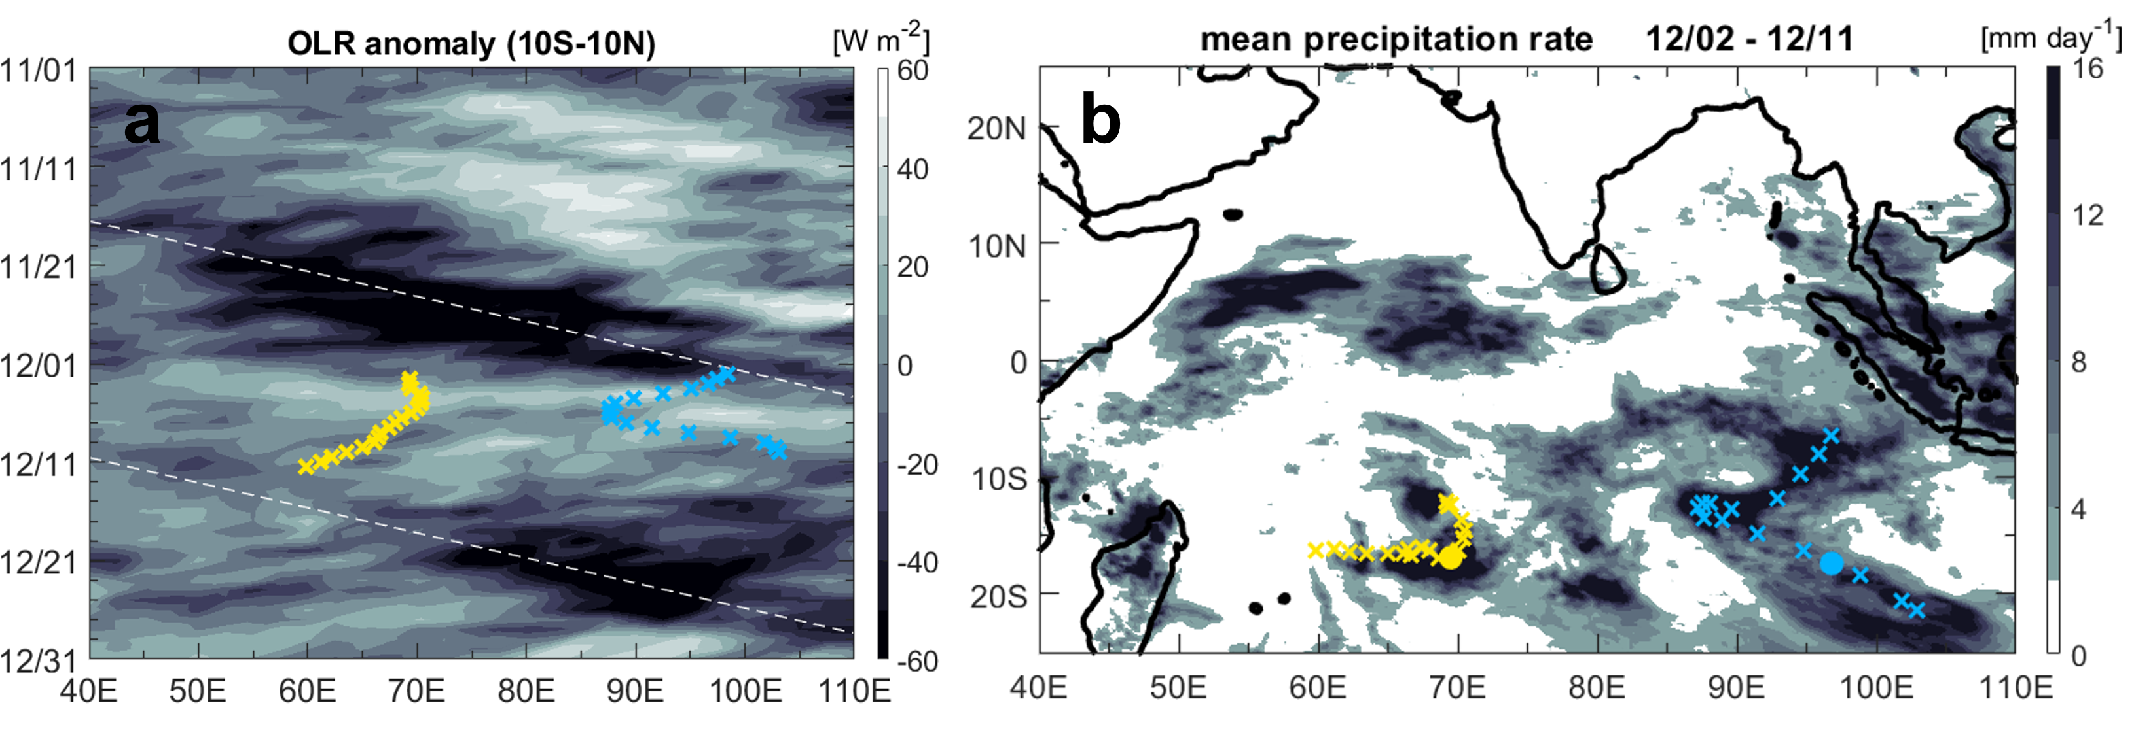
Two tropical cyclones in the south tropical Indian Ocean during the development of MJO event
Time
Convection is initiated in the central Indian Ocean

Slide 7
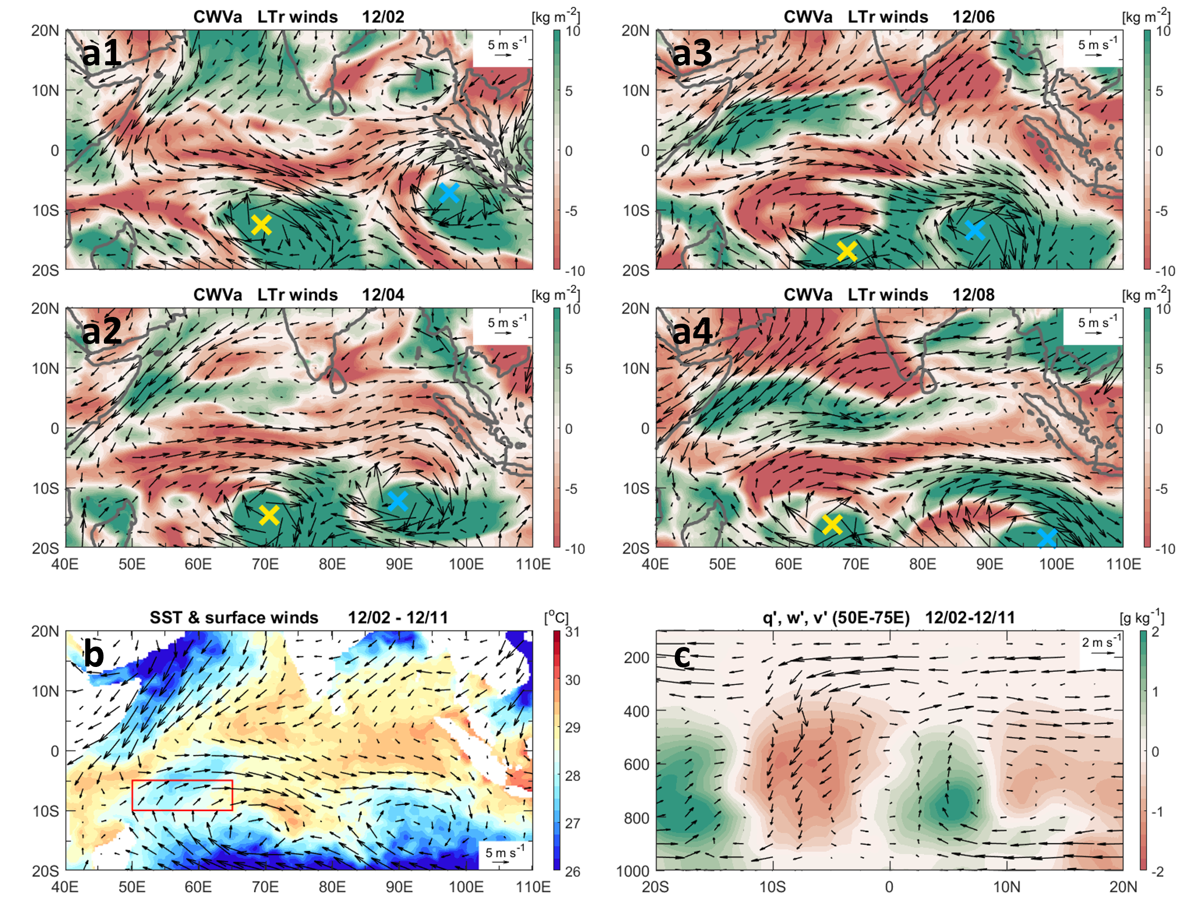
Circulation and moisture associated with TCs
dry air band

Slide 8
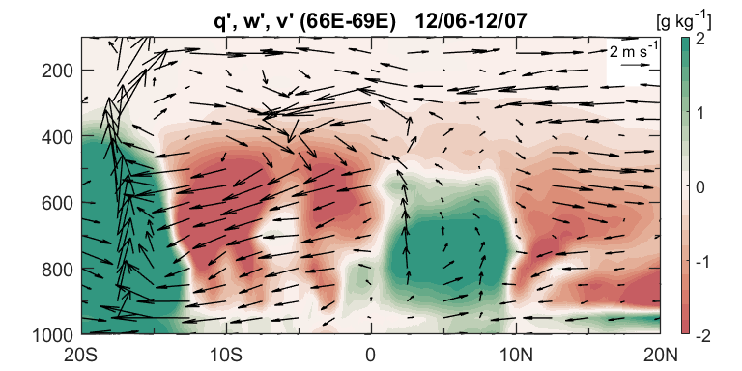
Meridional circulation
SST cooling in the southwest IO

Slide 9
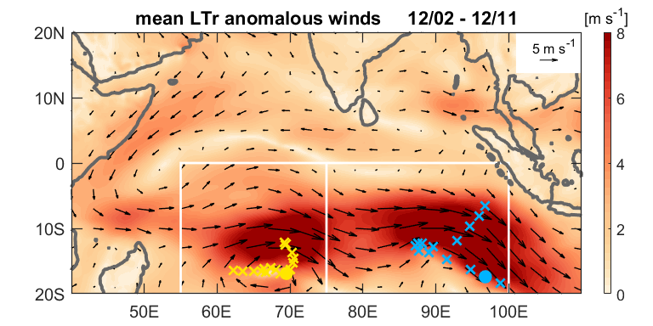
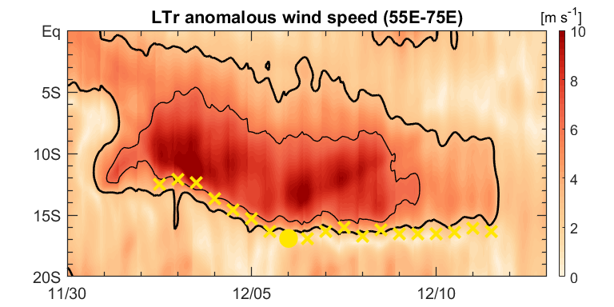
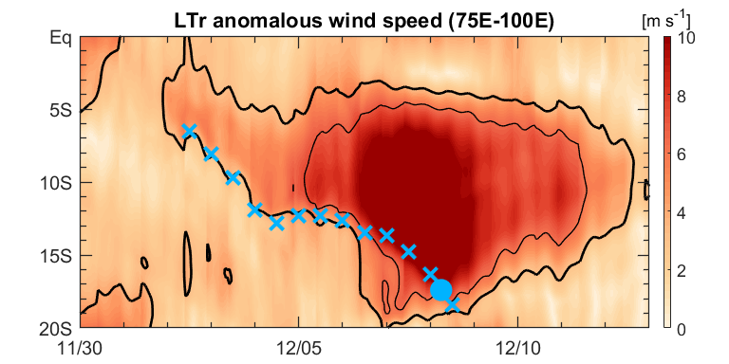
b1
b2
b3

Slide 10
Summary
The 2011 Dec. MJO initiation differs from most other MJOs due to the modulation by two southern Indian Ocean (IO) tropical cyclones (TCs).
TC-induced dry air advection and subsidence along with cold SSTs sustain a dry air band in 10ºS-Eq, inhibiting convection in the southern equatorial IO.
After TCs dissipate, convection develops in 10ºS-Eq. in the central IO and organizes into the MJO.

