Slide 1
Correction of Faraday Rotation Effects in SCA Data
C Anderson, JJW Wilson, S Remus, M Cloarec, S Linow

Slide 2
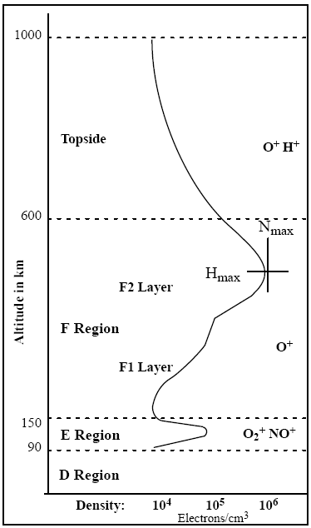
Faraday rotation effect
A scatterometer transmit pulse and its echo pass through the ionosphere
magnetic field and free electrons cause a rotation in the polarization: Faraday rotation
the backscatter arriving on the surface of the Earth differs from the true backscatter sent by the scatterometer
The backscatter measured by a scatterometer differs from the backscatter reflected off the Earth’s surface
Notes:
Electron content of the ionosphere depends on the latitude (higher at the equator) and on solar activity
Two-way effect

Slide 3
Faraday rotation effect
Over the ocean co-pol backscatter is typically much larger than cross-pol
Even a small amount of co-pol rotated into the cross-pol channel can corrupt the cross-pol measurement.
Can the cross-pol data be corrected to reduce or remove the effects of Faraday rotation?
VH
VV
Sentinel-1: TC Megan, 2024-03-17
Notes:
Contrast between cross-and like-pol channels over the ocean:
depends on wind speed and viewing geometry
the ratio between cross- to co-pol is somewhere between -5 and -25 dB
S1 image is scaled gamma-0 and purely illustrative – the default settings show the ocean as mostly black

Slide 4
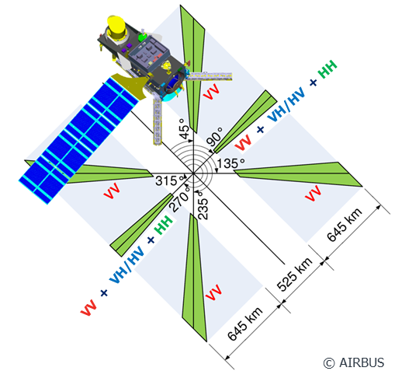
SCA measurements
In addition to the VV measurements, SCA will provide HH and HV/VH polarisation on the mid beams.
The SCA instrument does not measure the complex (amplitude and phase) polarimetric backscatter matrix, as de-correlation of the scene occurs between pulses and the phase is not preserved.
Therefore, SCA itself cannot correct for the ionosphere impact. We need external data.
Notes:
Linear polarisation
We measure complex signals, but the phase coherence is lost.

Slide 5
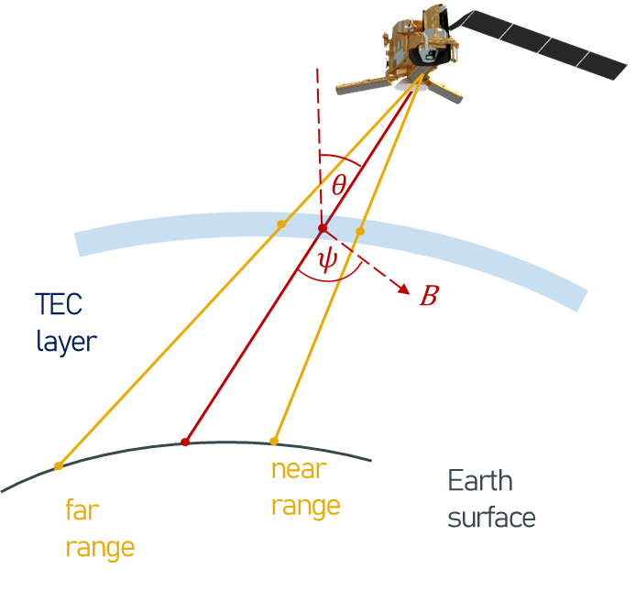
Faraday rotation angle
Models of the Faraday rotation angle Ω are available, e.g. Wright et al (2003) gives
$Ω=\frac{k}{f^{2}}B\cos{ψ\sec{θ}}TEC$
$Ω$ Faraday rotation angle (1-way)
f frequency
B the magnetic field strength
$ψ$ angle with magnetic field
$θ$ incidence angle
TEC total electron content (vertical)
The TEC is mapped to a single layer at 400 km height
Assuming TEC = 150 TECU gives a rotation angle of around 2.5°
Notes:
TEC is the vertically integrated number of free electrons in the ionosphere
1 TECU is 10^16 electrons / m²
The TEC maximum is at around 400 km (see 1st figure)
Approximation: B = const and $ψ$ = const
Theoretically we just need the contribution up to the spacecraft (remove the topside contribution), in practice the topside contribution is difficult to quantify

Slide 6
Effect of Faraday rotation on backscatter
The Freeman and Saatchi (2004) model leads to
Where:
m measured backscatter
σ true backscatter
ρ HH-VV correlation
c = cos Ω
s = sin Ω
Cross-pol backscatter is most strongly affected when ρ = 1
For typical values, the above equations show that the measured cross-pol backscatter can differ from its true value by around 0.15 dB
Notes:
Longepe et al, 2021 paper: 10.1109/TGRS.2021.3055979
Investigated this for SAR data
Found it to be low, with a dependency on wind speed and viewing geometry
Typical daytime values of TEC are expressed on the scale from 0 to 100 TEC units

Slide 7
Retrieving the true backscatter
The Freeman and Saatchi model leads to 3 equations with 5 variables (σ_{hh} , σ_{vv} , σ_{vh} , Ω , ρ)
Given Ω and ρ we can solve for the true backscatter values
Ω can be determined from viewing geometry, Earth magnetic field model and near real time estimates of TEC
ρ is more difficult to establish but we can assume
ρ = 0 : calculate a partial correction, or
ρ = 1: calculate worst case effect, set a flag if it exceeds a threshold
→ Decided to set ρ = 1
Notes:
Correlation coefficient depends on the surface characteristics
Depend on the wind over the ocean and viewing geometry
Depend on number of surface characteristics over land
No universally valid number for ρ

Slide 8
Solving the 3 equations
Setting σ_{hh} = μ² σ_{vv} allows the three equations to be solved and lead to the quadratic
There are some restrictions on the solutions for μ
it must be real and positive (to give physically relevant backscatter)
only one of the two solutions must be real and positive (to give an unambiguous result)

Slide 9
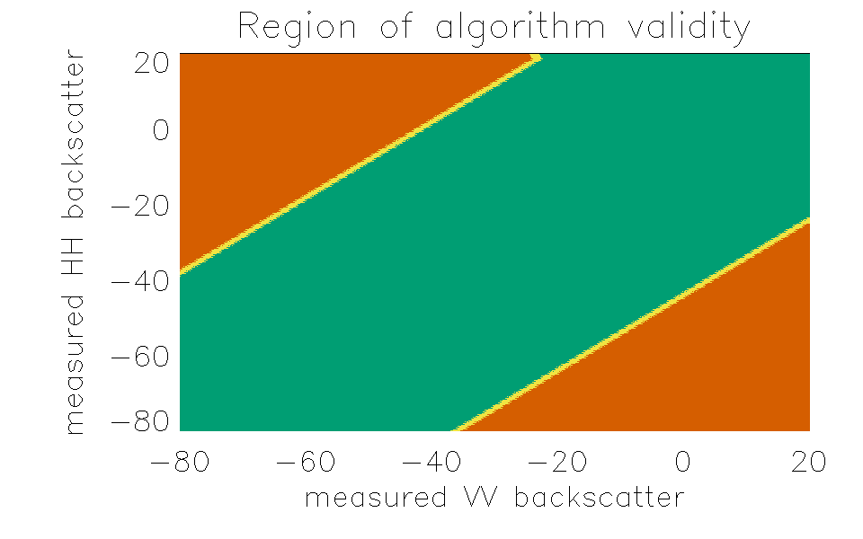
Parameter space investigation
When does μ have a physically relevant solution?
μ depends on measured co-pol backscatter, ρ and Ω
Numerical investigations of this parameter space show that a solution can be found when the measured backscatter values are within 10 to 20 dB of each other (depending on the value of Ω)
Example numerical results when Ω = 2.5° and ρ = 1.
Green shows the region where μ has one unambiguous physically relevant solution

Slide 10
SCA processing
SCA data will be processed at EUMETSAT into two backscatter products:
full resolution (SZF)
spatially averaged (SZR).
The SZR product contains original and corrected cross-pol backscatter
The correction assumes ρ = 1 (worst case Faraday rotation) so the user has the option of examining the difference between original and corrected and rejecting the data if it exceeds a threshold
Notes:
SZF (full-res) is on the footprint geometry, the individual measurements are not co-located
SZR is the gridded product, it will contain backscatter pentuplets (3 x VV from f/m/a + HH + xpol (combined HV and VH))
Equations above show that we need co-located measurements for all polarisations to derive the correction
Corrected backscatter can therefore only be provided for the gridded product

Slide 11
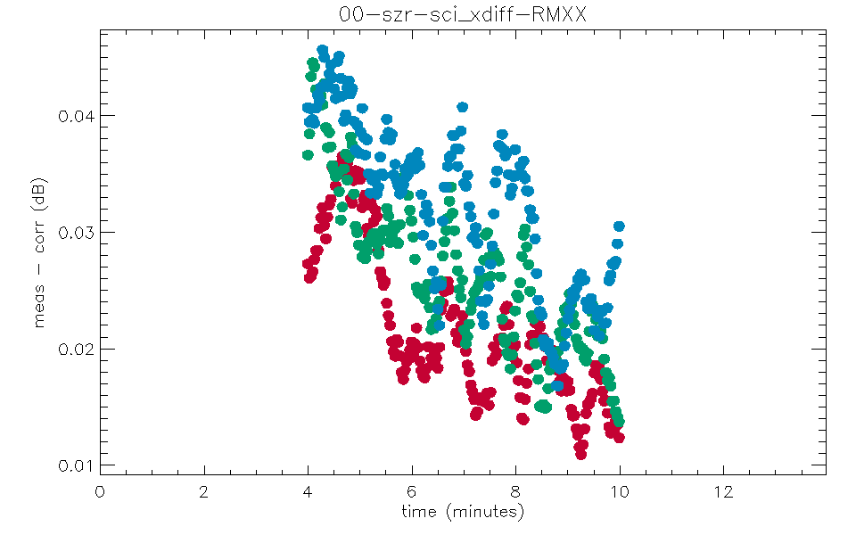
Processor testing
Prototype SCA processors and simulated SCA data are available
Plot shows the difference between measured and corrected cross-pol in SZR product
The difference is small (< 0.05 dB) but the available test data is not representative of real ocean backscatter
Difference in cross-pol backscatter at near, mid and far swath (simulated SCA data around -7 dB, simulated TEC values > 100 TECU)
Notes:
Available test data does not contain geophysical signals
Constant backscatter at around -7 dB and a noise distribution
No contrast between the like-pol and cross-pol channels
→ Needs further research and feedback from users

Slide 12
Summary
The backscatter measured by SCA is affected by Faraday rotation
If the rotation angle and correlation coefficient are known, then the backscatter can be corrected
The SCA processer estimates the rotation angle (using near real time TEC data) and assumes worst case correlation
Original and corrected cross-pol backscatter are provided in the near real time level 1b SZR product

