Slide 1

International Ocean Vector Wind Science Team Meeting
Salt Lake City, UT
29-31 May 2024
Review of GNSS-R Winds
Chris Ruf
University of Michigan

Slide 2
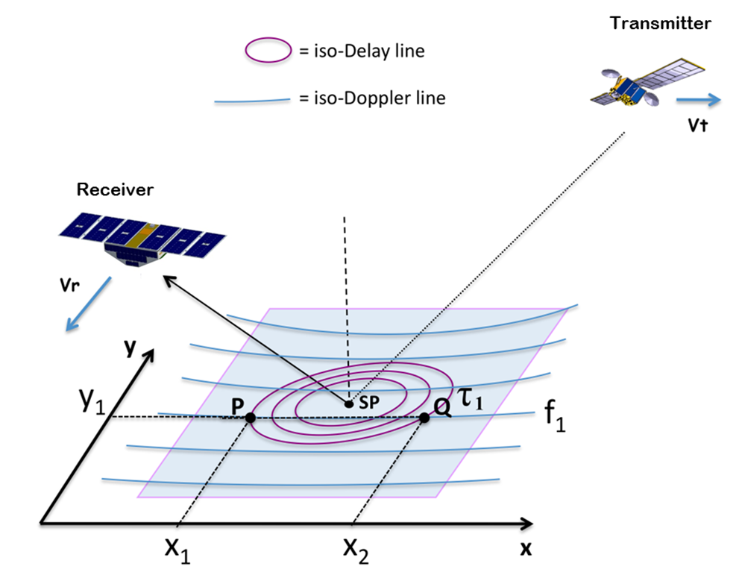
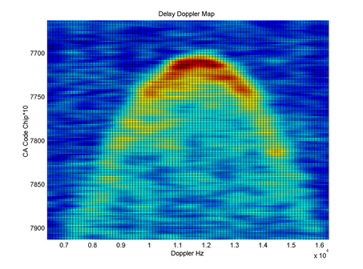
GNSS-R Measurement Methodology
Global Navigation Satellite System (GNSS) is the generic name for GPS, Galileo, BeiDou, … navigation satellites, which operate at L-Band (1.2-1.6 GHz)
GNSS Reflectometry (GNSS-R) is a remote sensing method which measures GNSS signals scattered in the forward (specular) direction from the Earth surface. It is essentially an L-Band bistatic radar.
GNSS-R measurement of the Delay Doppler Map (DDM)

Slide 3
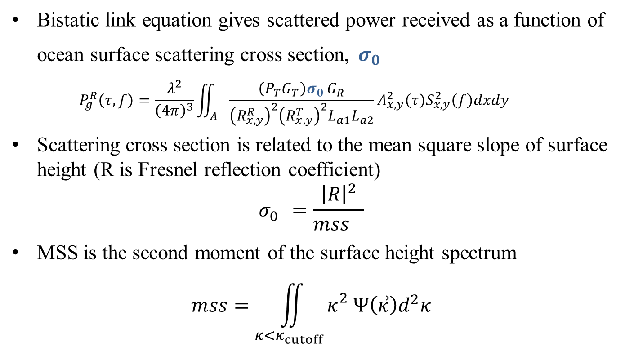
Relationship between GNSS-R Measurement and Ocean Surface Conditions
Bistatic link equation gives scattered power received as a function of ocean surface scattering cross section, $σ_{0 }$
  $$P_{g}^{R}\left(τ,f\right)=\frac{λ^{2}}{{\left(4π\right)}^{3}}\iint_{A}{\frac{\left(P_{T}G_{T}\right)σ_{0 }G_{R}}{{\left(R_{x,y}^{R}\right)}^{2}{\left(R_{x,y}^{T}\right)}^{2}L_{a1}L_{a2}}Λ_{x,y}^{2}\left(τ\right)S_{x,y}^{2}\left(f\right)dxdy}$$
Scattering cross section is related to the mean square slope of surface height (R is Fresnel reflection coefficient)
$$σ_{0}^{}=\frac{{\left|R\right|}^{2}}{{mss}_{}}$$
MSS is the second moment of the surface height spectrum
$$mss=\iint_{κ<κ_{cutoff}}{κ_{}^{2}Ψ\left(\vec{κ}\right)d^{2}κ}$$

Slide 4
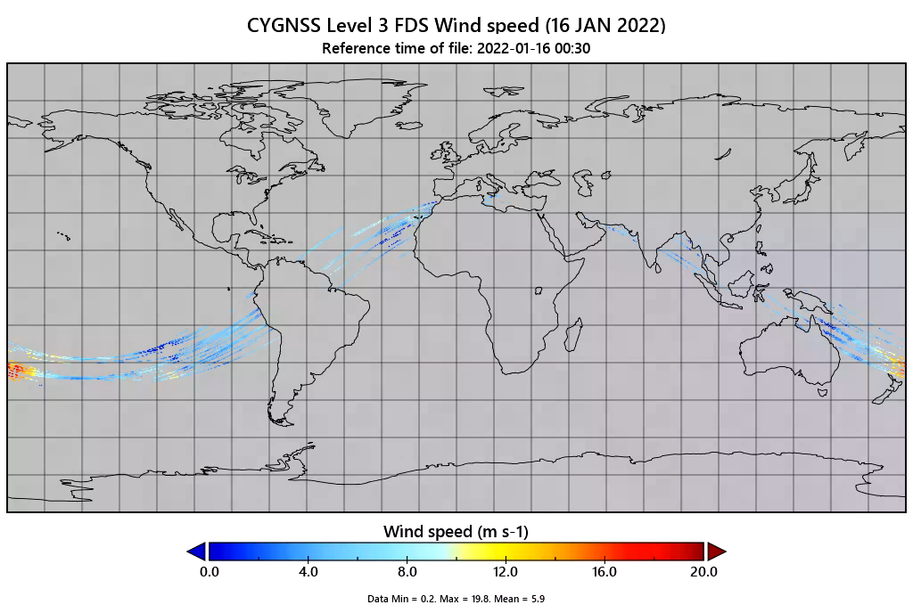
Examples of GNSS-R CYGNSS Wind Speed
Buoy comparison to NOAA v1.2
RMSD = 1.2 m/s, Bias =-0.3 m/s
ERA5 comparison to Project v3.2
RMSD = 1.7 m/s, Bias =-0.2 m/s

Slide 5
Practical GNSS-R Considerations and Differences from Scatterometry
Scatterometers are primarily sensitive to the capillary wave portion of the roughness spectrum at the Bragg resonant wavelength of the backscattered microwave signal. Capillary waves as closely coupled to the local wind speed at the time of the radar observation.
GNSS-R is sensitive to the integrated roughness spectrum over both capillary and longer swell waves
  In fully developed seas, the shorter and longer portions of the roughness spectrum are in equilibrium and both GNSS-R and scatterometers are sensitive to the local wind
  In young (underdeveloped) seas, GNSS-R is sensitive to longer portions of the roughness spectrum that are not forced by the local wind at the time of the observation, and a correction for this sensitivity is necessary (typically using ancillary SWH information from a model)
GNSS-R is very weakly sensitive to wind direction
  Poor ability to detect wind direction
  Little dependence of wind speed error on wind direction

