Slide 1
Upwelling along Complex Coastlines from Remotely Sensed Winds
Steven Morey
Florida A&M University
NOAA Center for Coastal and Marine Ecosystems-II
Portions of this work have been funded by the NASA Ocean Vector Winds Science Team and the NOAA Office of Education/ Educational Partnership Program award (NA16SEC4810009) to the Center for Coastal and Marine Ecosystems-II.

Slide 2
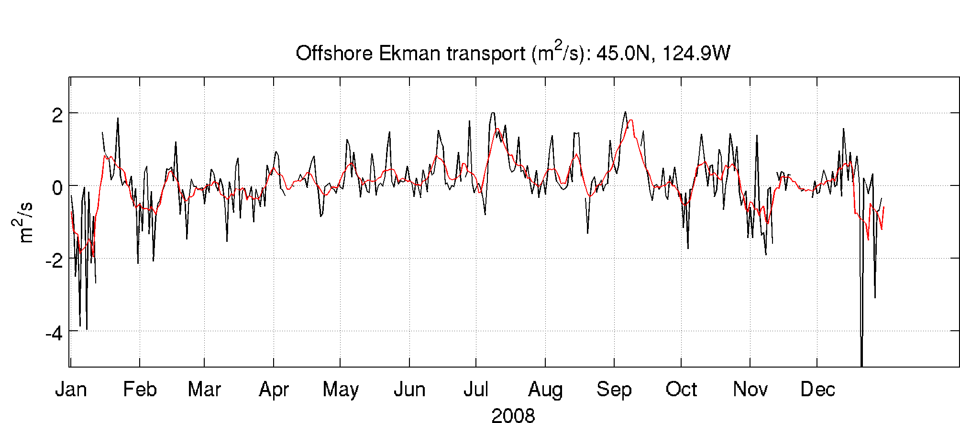
Idealized Coastal Upwelling
The offshore Ekman
transport is
x
S_{x} is used as an upwelling Index
Wind Stress
y
Classic Upwelling Indices from CCMP Winds
Offshore Ekman Transport
Upwelled Onshore Transport
Based on assumption of no variations in the along-coast direction.

Slide 3
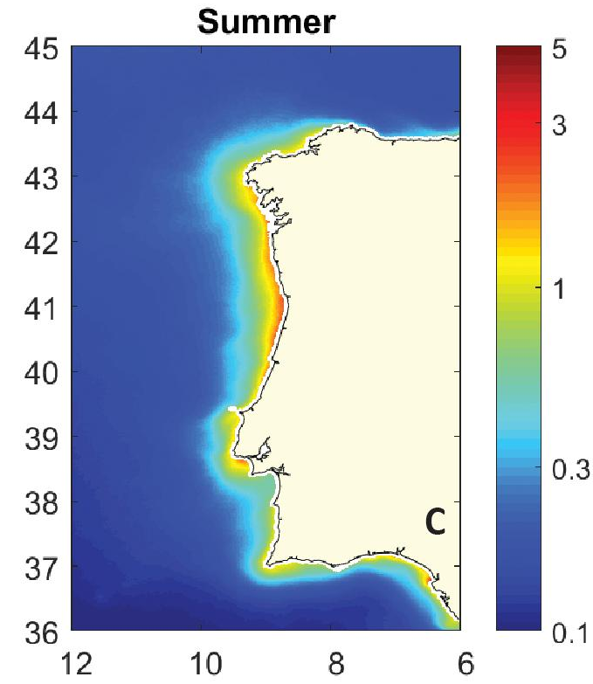
What about irregular coastlines?
CHL a (mg/m³)
Average Summer satellite ocean color-derived chlorophyll-a (Ferreira et al., 2019)

Slide 4
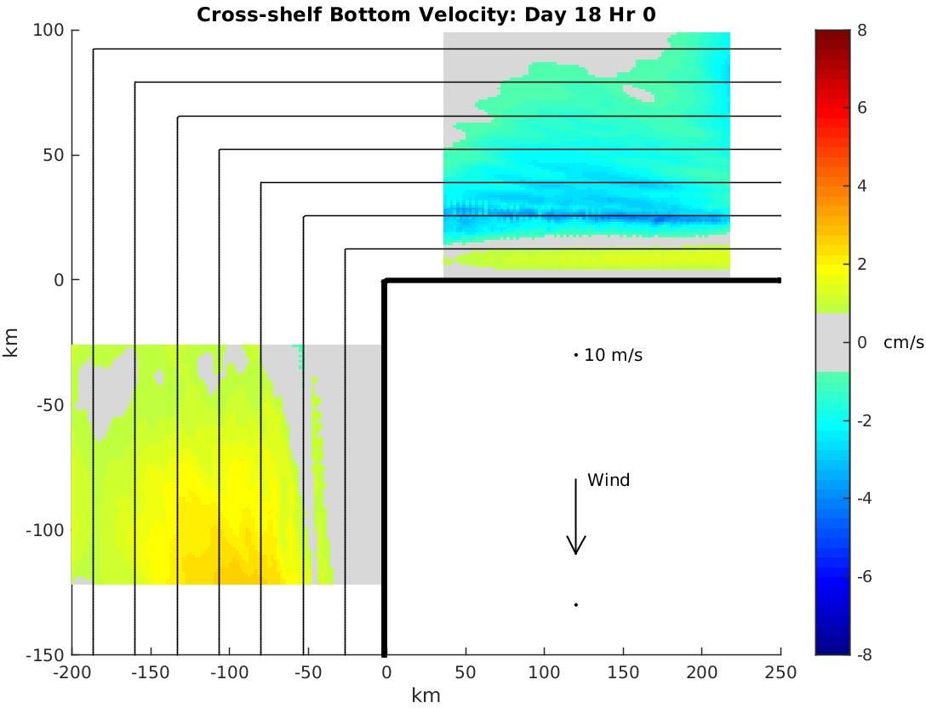
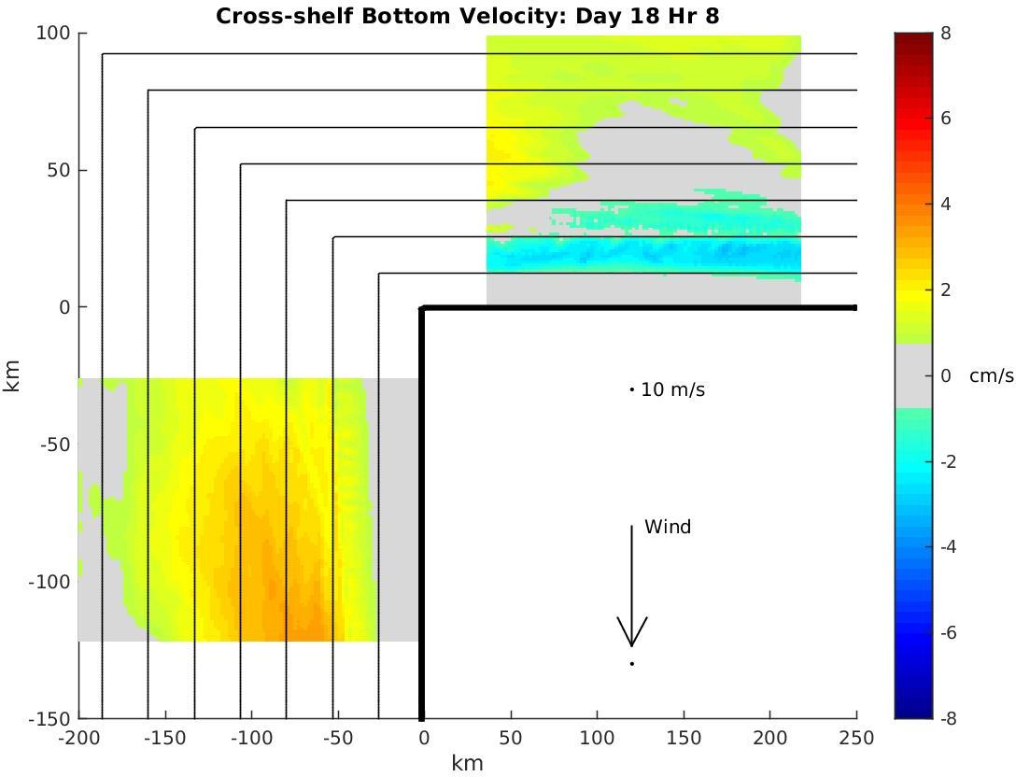
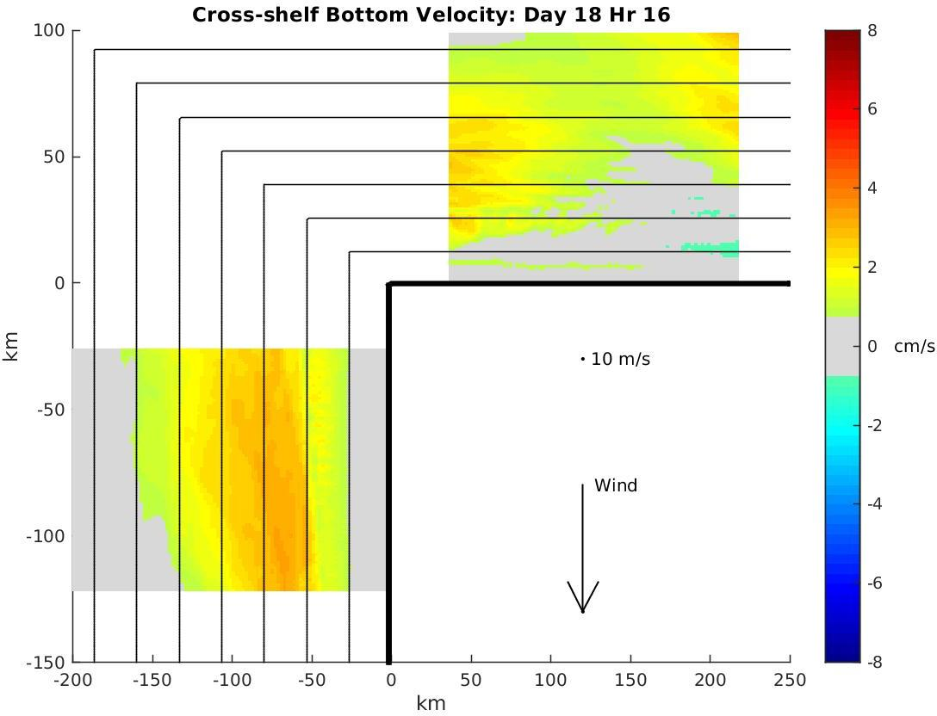
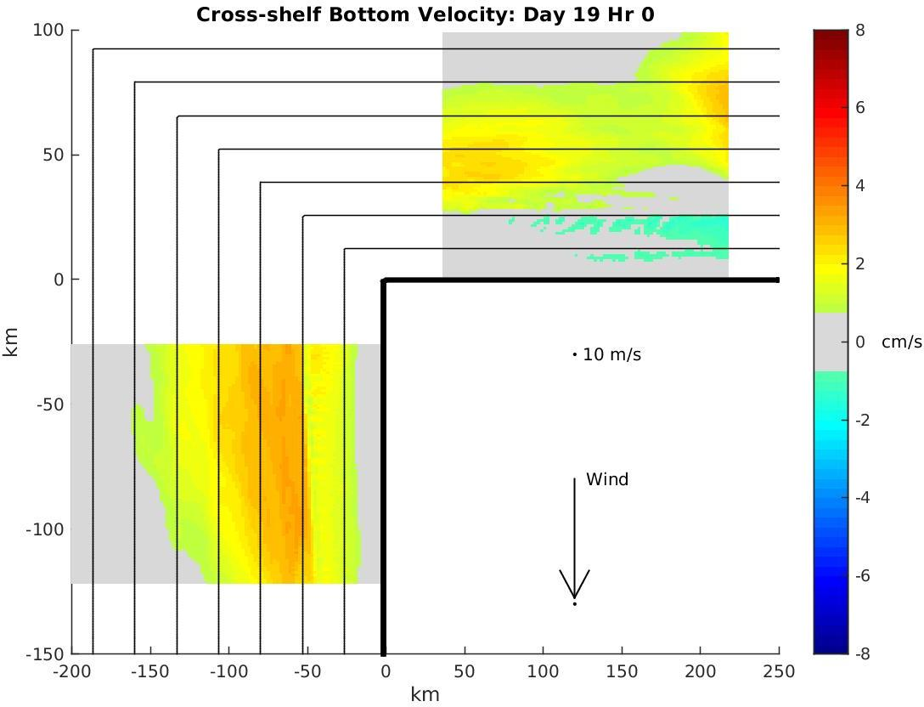
Idealized Shelf Model
Stratified water column
Spatially uniform oscillating winds (5-day period)
Onshore winds (not alongshore) appear to be associated with an upwelling signal.
The downwelling and upwelling motions generated via Ekman transport on the western shelf propagate as a CTW to the northern shelf.

Slide 5
Previous work statistically analyzed time series of upwelling and local winds to determine directions of local winds most associated with upwelling.
This approach does not accurately account for remote impacts.
Here, wind fields over the region are analyzed to identify patterns associated with upwelling along irregular coastlines.
Application of the method to satellite wind measurements can aid studies of upwelling and coastal marine ecosystems in remote or inaccessible regions.

Slide 6
Upwelling has been well studied along west coast of Iberian Peninsula – due to prevalence of northerly winds.
Satellite SST reveals periods of upwelling along northern coast as well.
A machine learning technique, the Self-Organizing Map (SOM), is applied to identify characteristic wind patterns over the region associated with upwelling events on the northern coast of this complex coastline.

Slide 7
Self-organizing maps (SOM):
Unsupervised machine learning technique
Artificial neural network
Reduces the input data (input space) to a lower dimensional representation (map space) by clustering the input vectors based on their similarity toward a set of neurons (nodes)
Neuron that is closest to an input vector (in this case, a daily wind field), is called the Best Matching Unit (BMU).

Slide 8
Input data: CCMP2 daily wind fields (2009-2013)
Wind field grid size: 22 x 46 x 1826 (649 ocean points x 1826 days)
SOM Topology: 24 neurons (6x4)

Slide 9
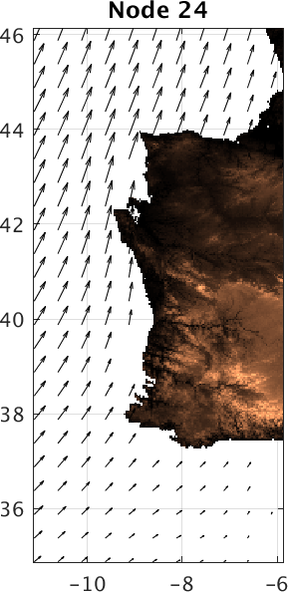
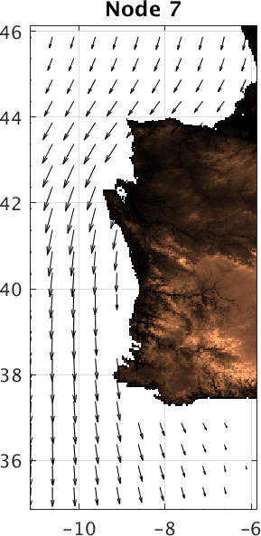
SOM Methodology for wind fields:
Remap 3-dimensional vector input fields (lat x lon x time) into 2-dimensional scalar input array:
{u_{i,j,t}, v_{i,j,t}} →
i=1..n
J=1..m
t=1..nT
Perform SoM Training on input array
Remap neurons to wind fields
Determine BMUs for input wind fields
BMU=24
$$\left[\begin{aligned}u_{1,1,1}, u_{2,1,1}{…u}_{n,m,,1},v_{1,1,1},{…v}_{n,m,1} \\ u_{1,1,2}, u_{2,1,2}{…u}_{n,m,,2},v_{1,1,2},{…v}_{n,m,2} \\ . \\ . \\ . \\ u_{1,1,nT}, u_{2,1,nT}{…u}_{n,m,,nT},v_{1,1,nT},{…v}_{n,m,nT}\end{aligned}\right]$$
BMU=7

Slide 10
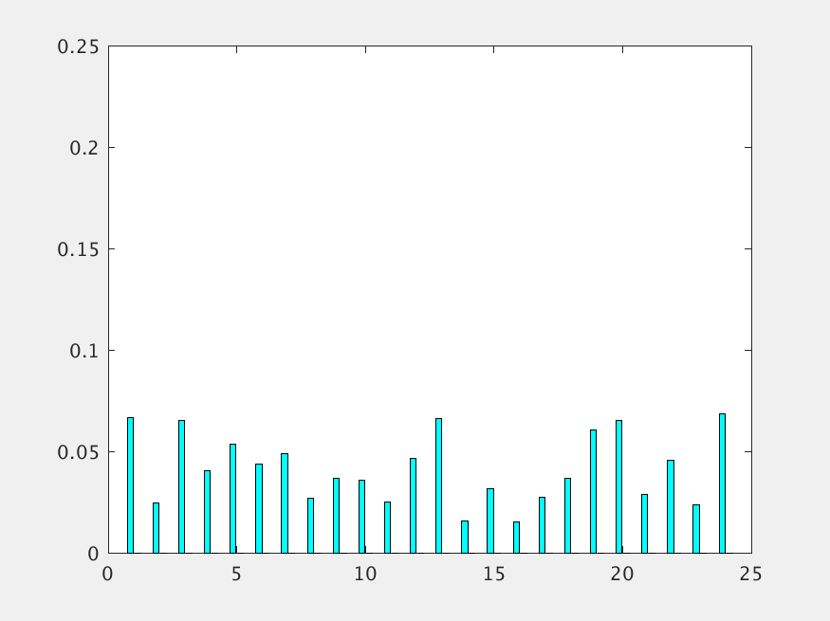
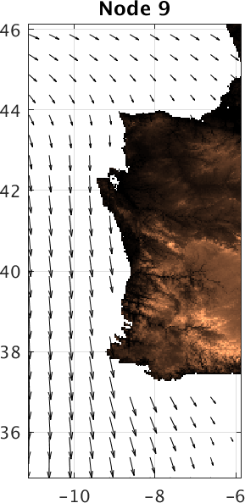
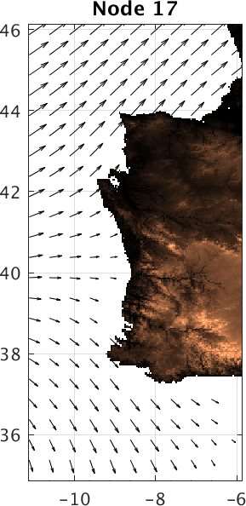
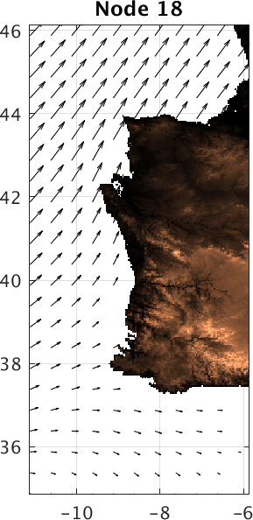
Frequency of Occurrence of each BMU
1,824 daily wind fields are clustered to 24 patterns (neurons or nodes)

Slide 11
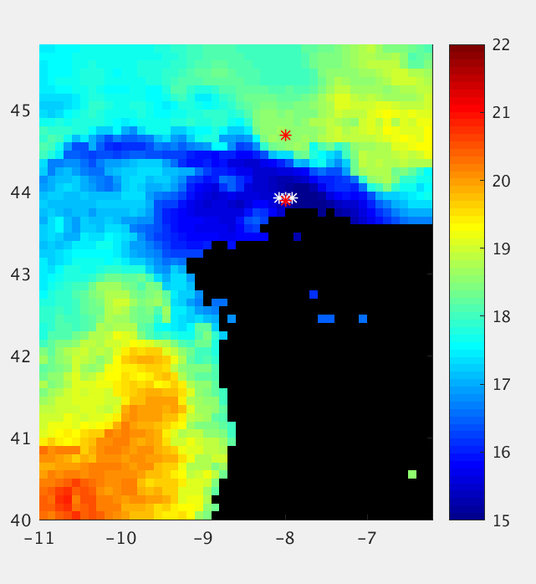
Upwelling proxies:
Direct observations of upwelling are not common
Upwelling evidenced by SST and ocean color signatures
Ocean models can provide information about upwelling, but limited assessment of subsurface variability
Two approaches used here for upwelling along 8W:
Daily change of Nearshore minus Offshore SST difference (GHRSST) – difference at red points
Onshore bottom velocity (HYCOM) – average of white points

Slide 12
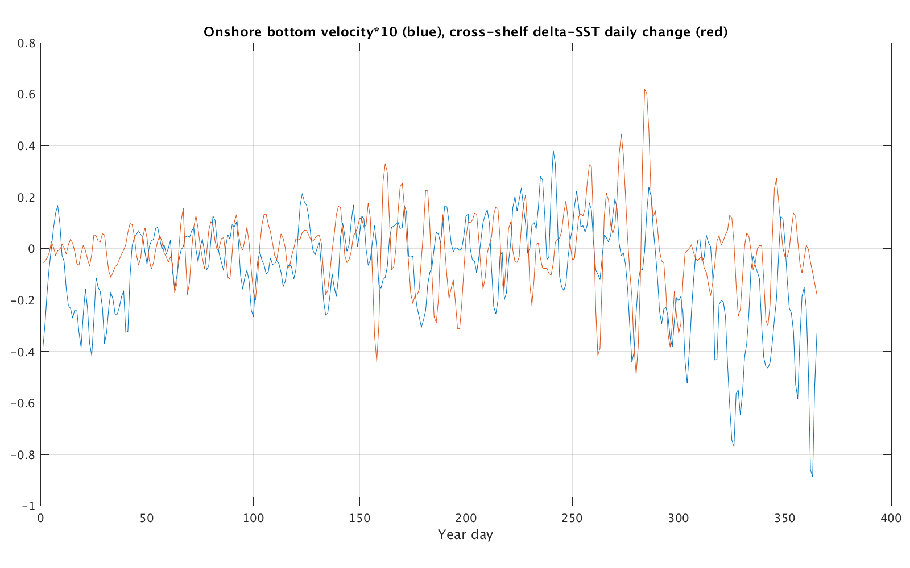
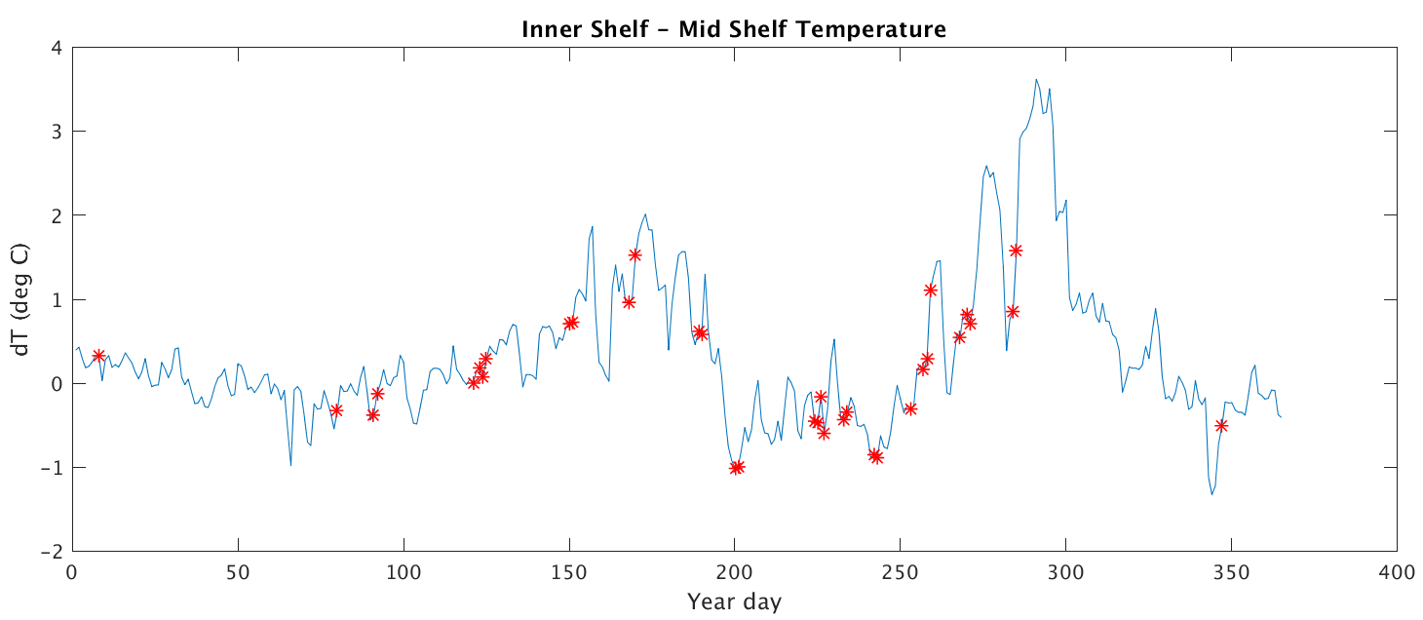
Modest correlation (0.3) between two upwelling proxy time series (delta SST filtered over 5 days)
SST can be influenced by surface thermal fluxes
Uncertainties in near-coastal currents in global model reanalysis
Define an upwelling period when:
Daily averaged onshore bottom velocity > 1 cm/s
and
dSST change > 0.15°C per day
and one day before

Slide 13
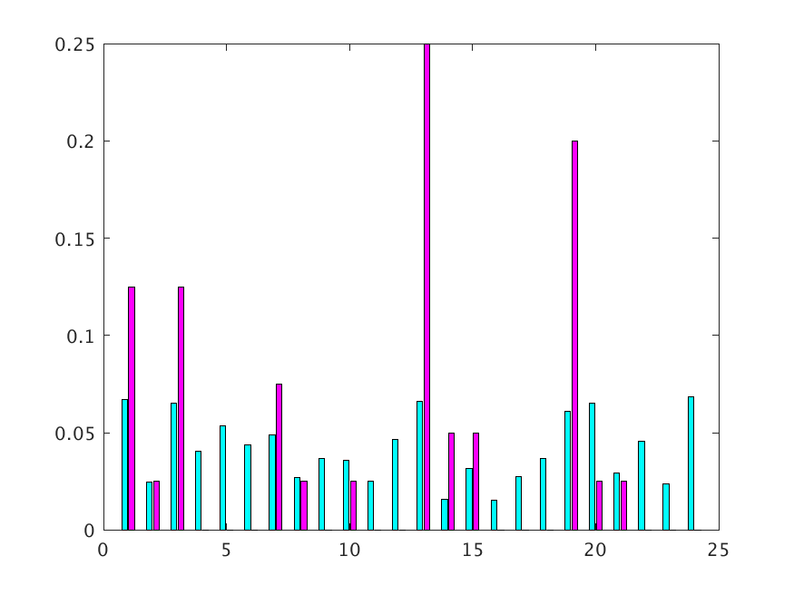
Frequency of Occurrence of each BMU
Comparison of histograms of BMUs for upwelling periods versus all time highlights neurons (characteristic wind fields) that are more likely to occur during upwelling periods

Slide 14
Nodes 1, 3, and 7 show largely onshore winds along northern coast with alongshore upwelling-favorable winds along western coast – consistent with propagation of remote upwelling signal from west to north coast versus local wind-driven upwelling.
Nodes 13, 14, 15, and 19 have winds with along-shore components on both north and west coasts – reinforcement of upwelling signal along propagation pathway. -- This wind pattern is strongly linked with upwelling along the northern coast (nodes 13 and 19).

Slide 15
Summary and Next Steps
The SOM machine learning technique helps highlight spatial patterns in the wind fields that are associated with upwelling along coastlines that don’t match the assumptions for the classic coastal upwelling theory.
Identification of BMUs for satellite-observed winds can aid in predicting or providing indices for coastal upwelling in such regions.
Next steps will include:
Experiments with SOM parameters and topologies
Further development of multivariate upwelling proxies
Applications to other regions
Demonstration of BMU mapping from other wind data sets (e.g., NRT and swath products)

