Slide 1
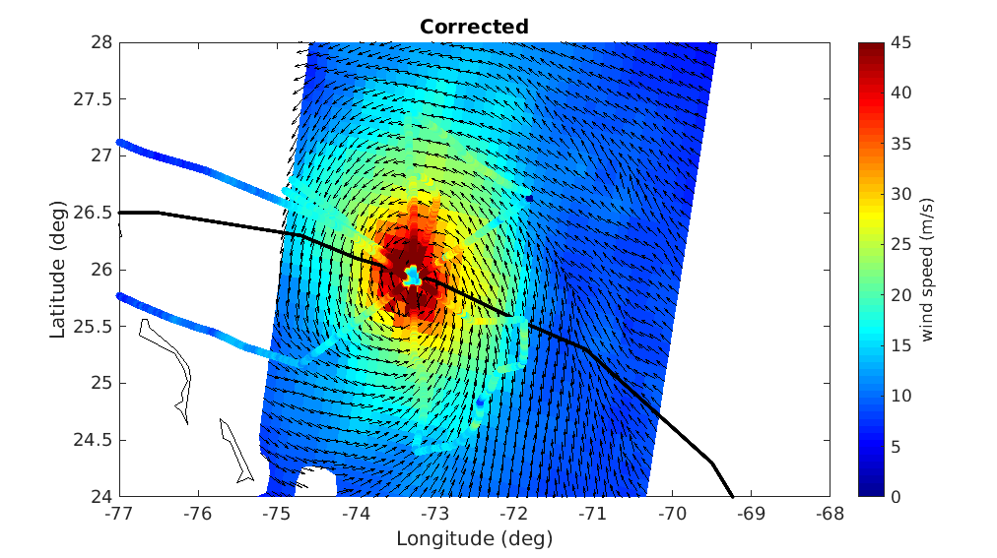








Intercalibration and error characterization of satellite and synergistic sea-surface wind products under tropical cyclone conditions
Federico Cossu (ICM-CSIC)
Evgeniia Makarova (ICM-CSIC)
Albert S. Rabaneda (Met Norway)
Marcos Portabella (ICM-CSIC)
Joe Tenerelli (OceanDataLab)
Nicolas Reul (Ifremer)
Ad Stoffelen (KNMI)
Giuseppe Grieco (ISMAR-CNR)
Joseph Sapp (NOAA-NESDIS)
Zorana Jelenak (NOAA-NESDIS)
Paul Chang (NOAA-NESDIS)
portabella@icm.csic.es
ASCAT operational wind field over Hurricane Dorian using buoy winds as calibration reference
ASCAT adjusted wind field over Hurricane Dorian
using SFMR winds as calibration reference

Slide 2
ESA MAXSS project:
Extreme wind inter-calibration & validation
Aim: To adjust radiometers & scatterometers high & extreme winds using SFMR (2010-2020)
  OSI SAF: ASCAT-A, -B & -C, Rapidscat, OSCAT, OSCAT2, HY-2A & -2B
  REMSS: Windsat (v7), AMSR-2 (v8), SMAP (v1)
  Ifremer: SMOS (v2)
Assess spatial representativeness
  Look for suitable SFMR upscaling for each SCAT & RAD
Analyse QC effects
Assess SFMR calibration
Ensure inter-calibration among all satellite systems

Slide 3
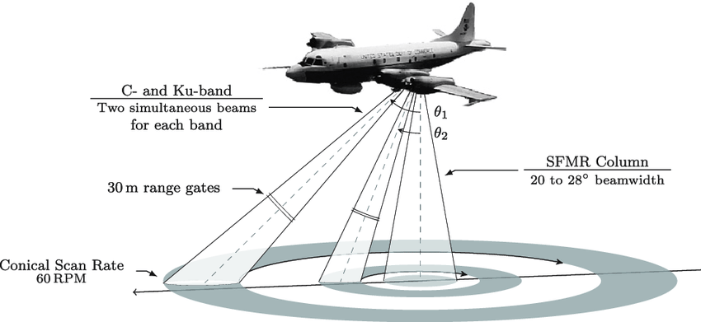
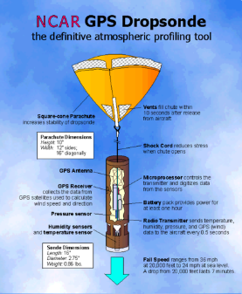
SFMR & GPS Dropsonde
Dropsondes:
They provide the wind profile
The 10m equivalent neutral surface wind speed and direction empirically derived by the WL150 algorithm.
Surface wind value consists in an height-weighted average of the dropsonde readings available within the lowest 150m-layer between 10m and 350m.
SFMR:
Nadir-pointing radiometer at C-band.
The equivalent neutral surface wind speed retrieved by inversion of a Geophysical Model Function.
Surface wind retrieval are provided in 1-sec sampling and the aircraft position is assigned to each wind retrieval.

Slide 4
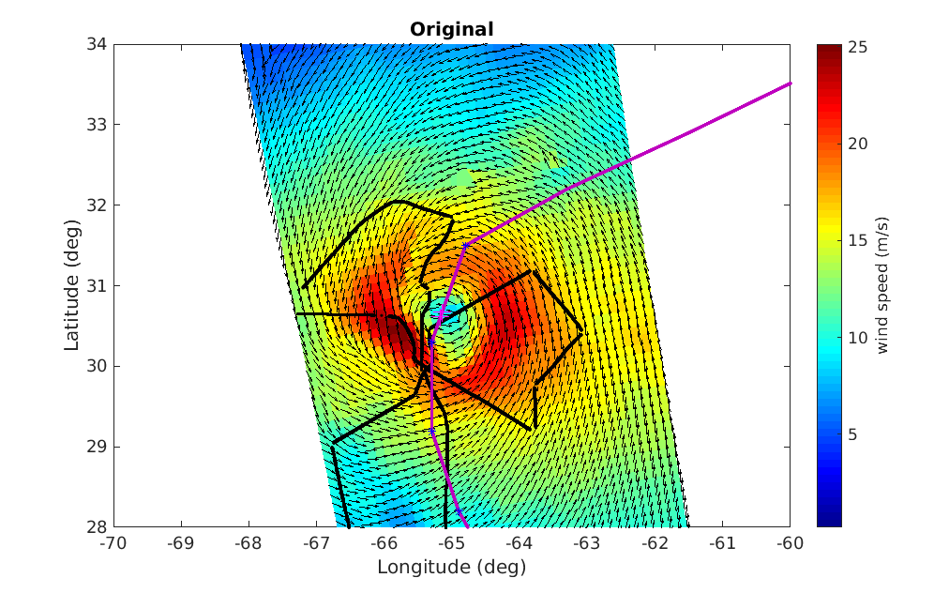
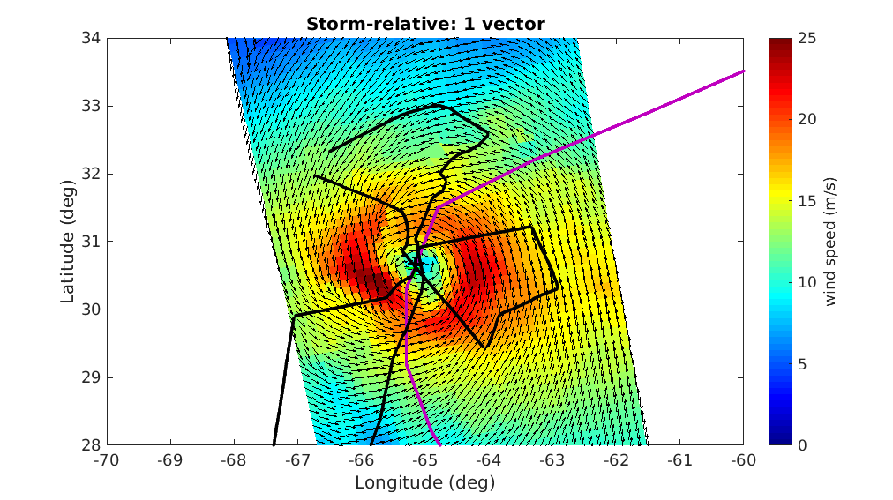
Triple collocations SFMR-SAT-Model
Best track
NOAA flight trajectory
ASCAT wind field over Hurricane Karl on September 23rd, 2016
SFMR collocations in storm-motion centric coordinates
Model (ECMWF/MM) spatially and temporally interpolated to the Satellite wind field

Slide 5
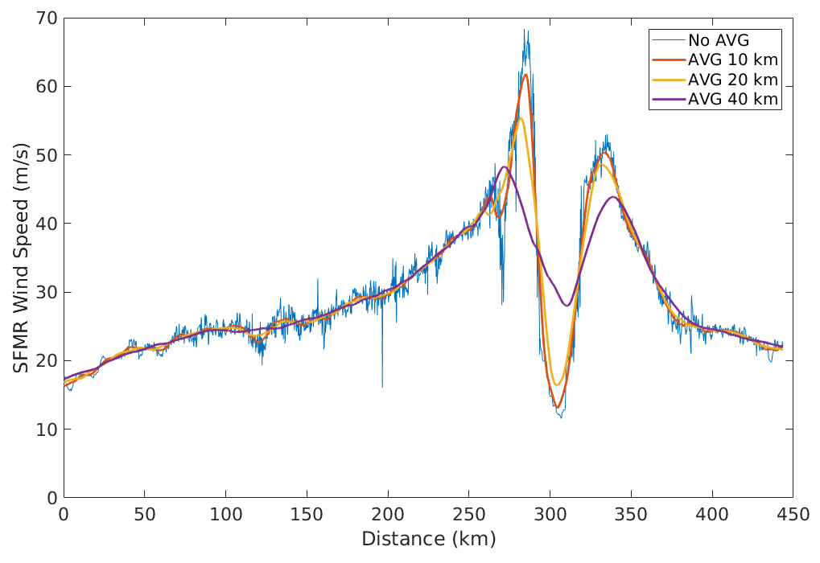
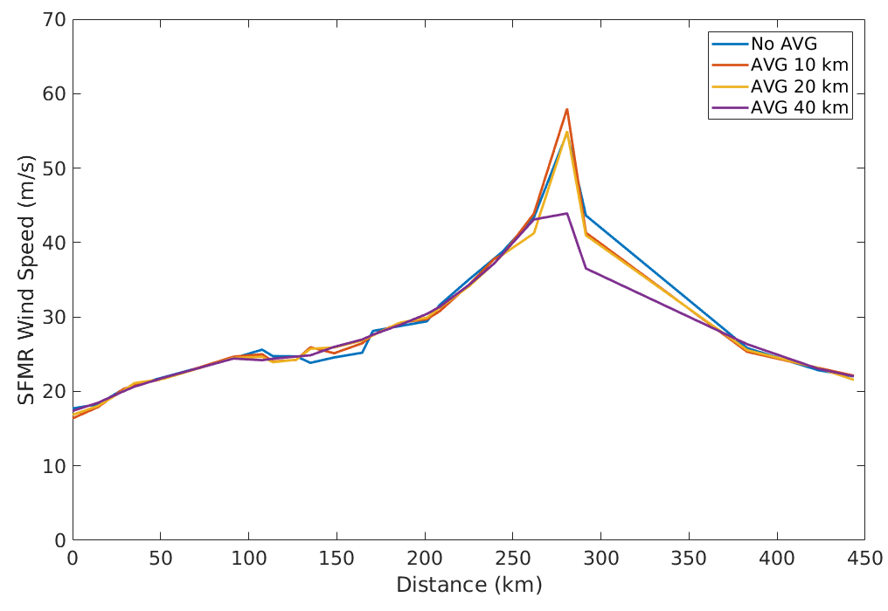
SFMR upscaling effects
SFMR upscaling effects at SFMR 1-sec sampling
SFMR upscaling effects at 12.5 km sampling
SFMR upscaling effects are significantly smaller at 12.5-km (ASCAT-A) sampling

Slide 6
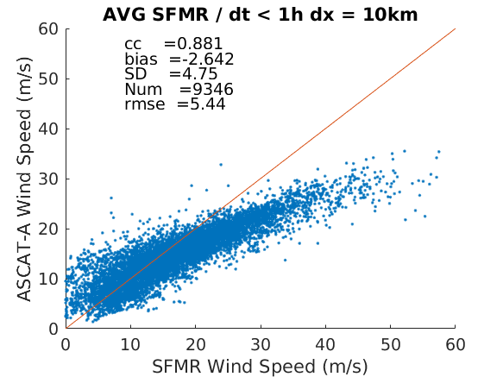

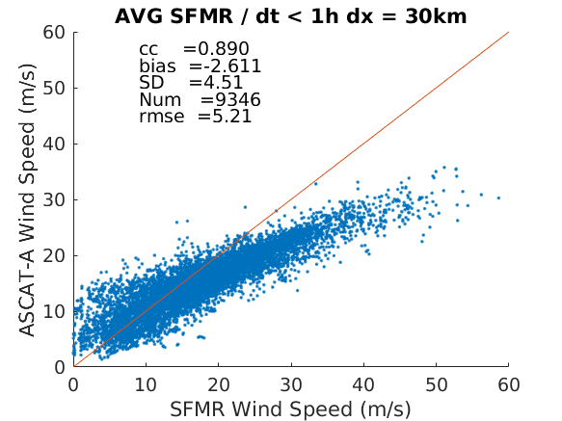

SFMR upscaling effects
SFMR 40-km averaged winds more representative of ASCAT 12.5-km (25-km resolution) winds
SFMR 80-km averaged winds more representative of all other (50-km res) scatts & radiometers

Slide 7
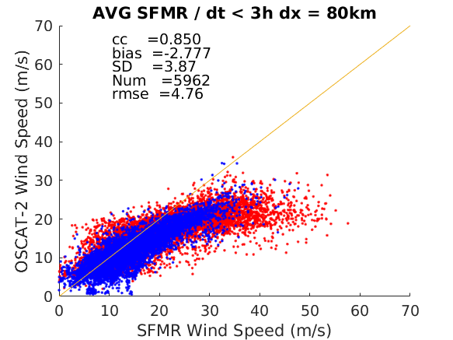
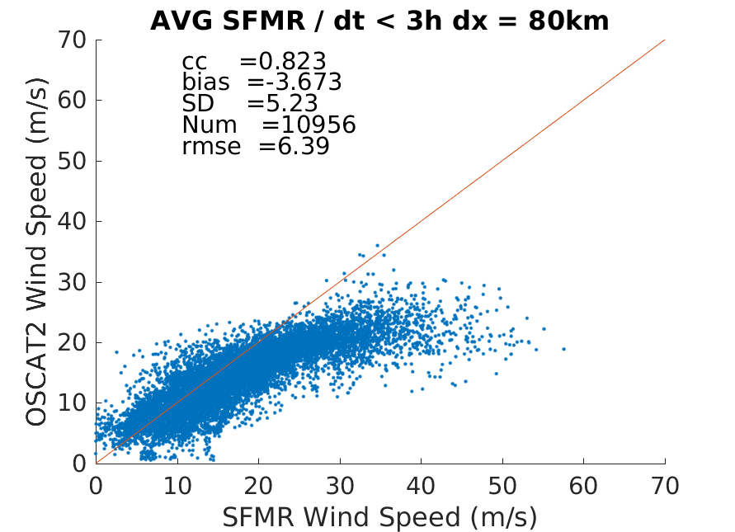
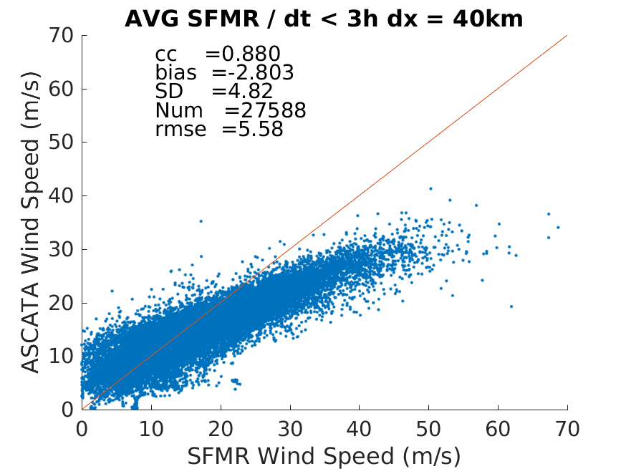
Ku-band QC effects
KNMI_QC
Rain contamination filtered out by KNMI_QC; but then, only few extreme wind points left

Slide 8
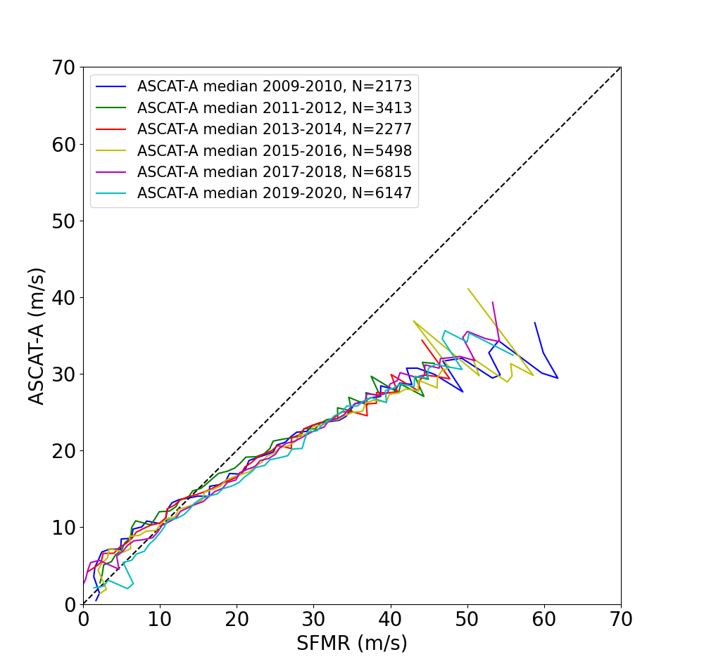
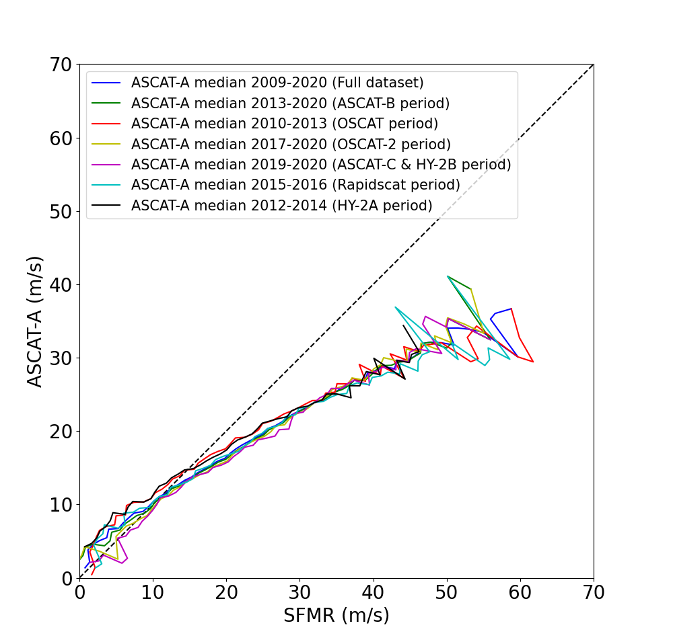
SFMR calibration effects
SFMR calibration variations of up to 2 m/s between the range 15-30 m/s

Slide 9
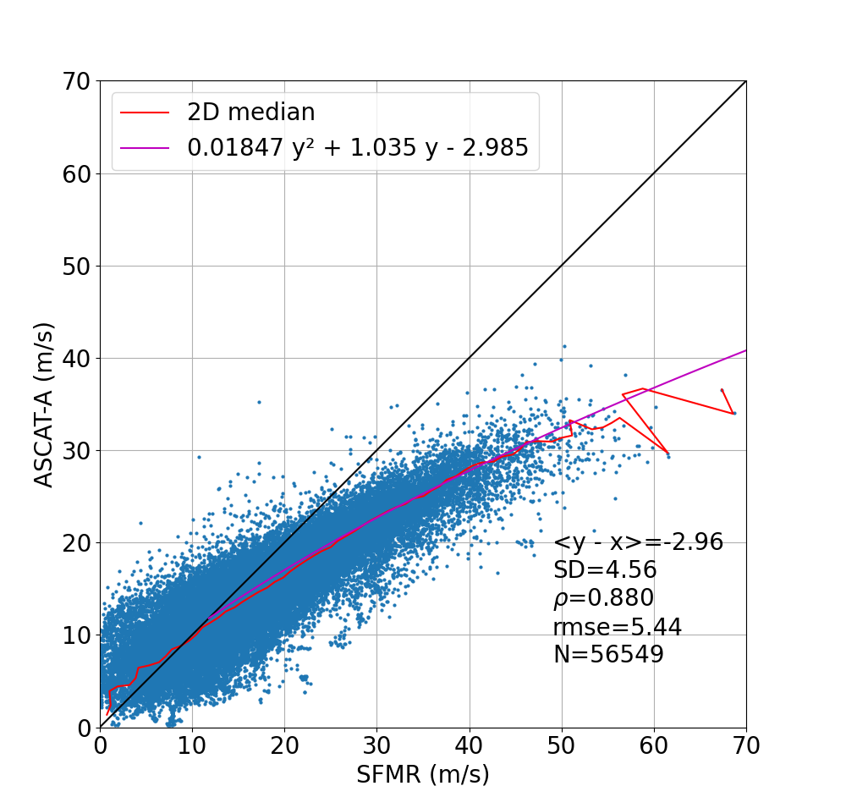
C-band scatterometer extreme wind adjustment
Assume a mean SFMR calibration by using the full 2009-2020 period
Assume all ASCATs well intercalibrated

Slide 10
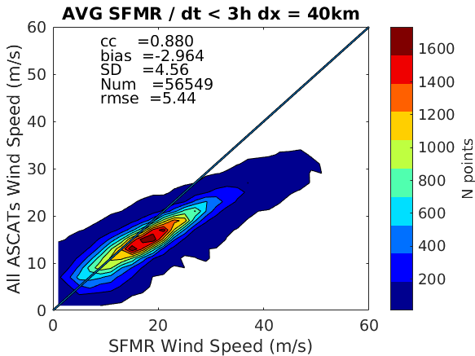
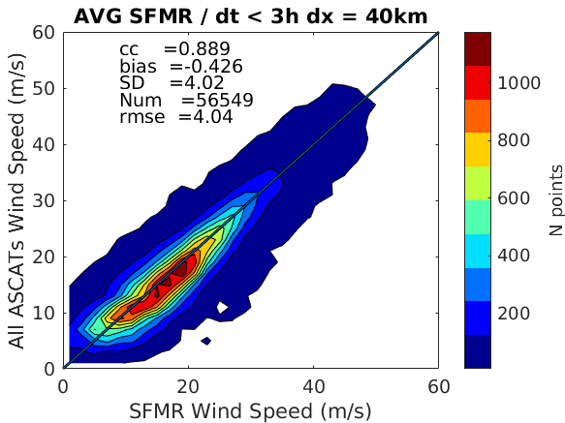
Extreme wind adjustment using SFMR as reference
Original ASCAT winds
Adjusted ASCAT winds
All scatterometer & radiometer winds adjusted using SFMR as reference
A similar exercise is done with ERA5; the MM product is already adjusted by definition

Slide 11
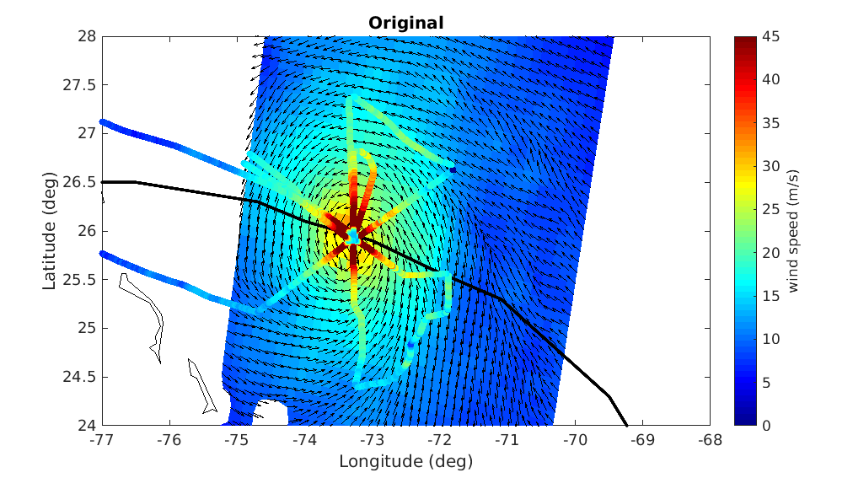
ASCAT extreme wind adjustment
ASCAT operational wind field over Hurricane Dorian using buoy winds as calibration reference
ASCAT adjusted wind field over Hurricane Dorian
using SFMR winds as calibration reference

Slide 12
C-band scatterometer extreme wind adjustment
Assume a mean SFMR calibration by using the full 2009-2020 period
Assume all ASCATs well intercalibrated

Slide 13
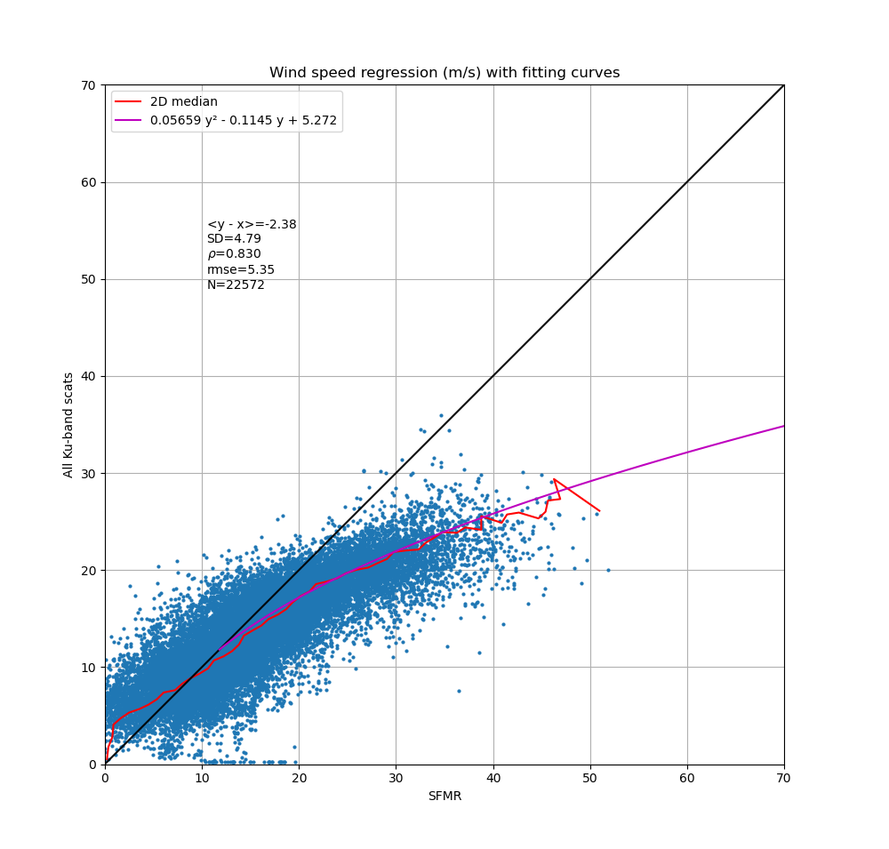
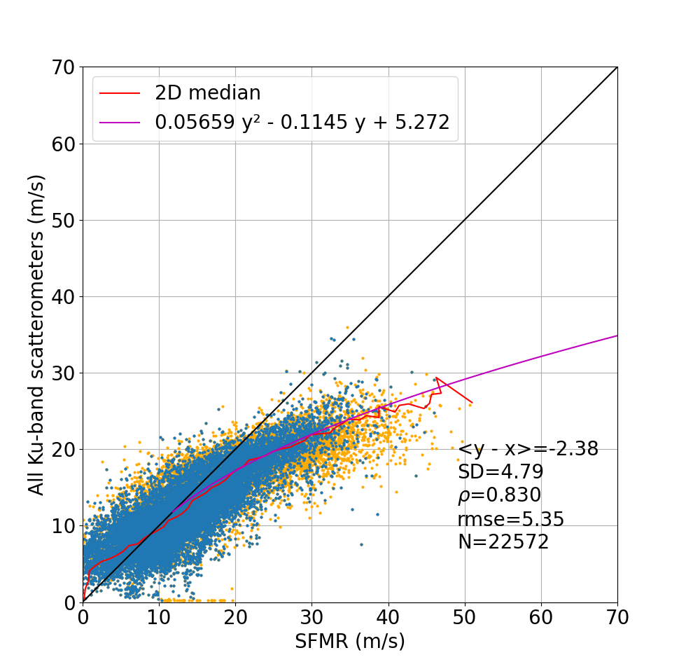
Ku-band scatterometer extreme wind adjustment
Assume a mean SFMR calibration by using the full 2009-2020 period
Assume all Ku-band systems are well intercalibrated
Neglect QC flags (e.g., rain contamination)

Slide 14
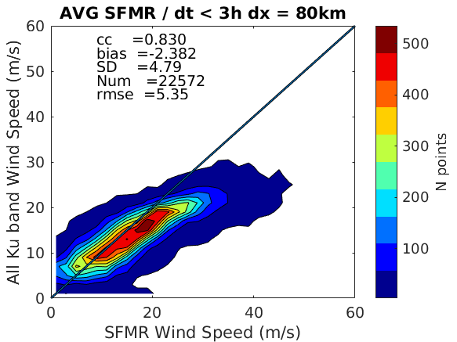
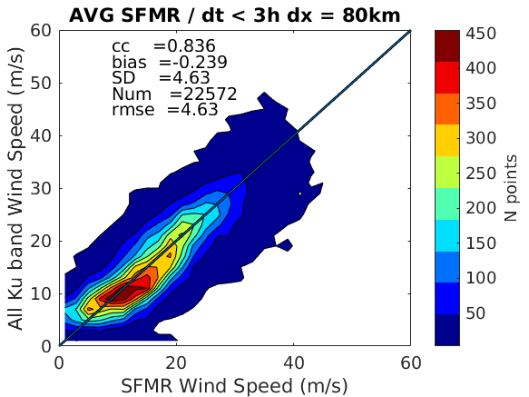
Ku-band scatterometer extreme wind adjustment
Original Ku-band winds
Recalibrated Ku-band winds
Adjusted Ku-band winds consistent with SFMR winds (as expected)

Slide 15
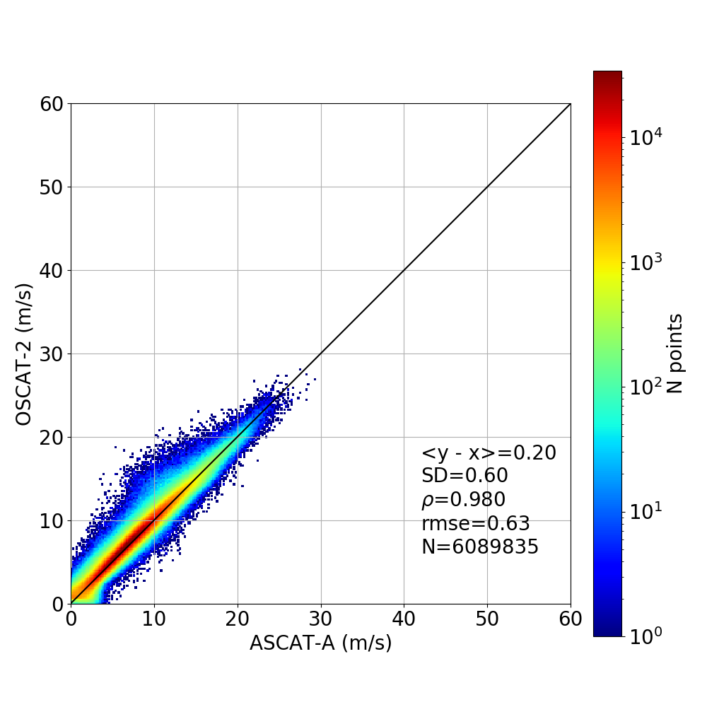
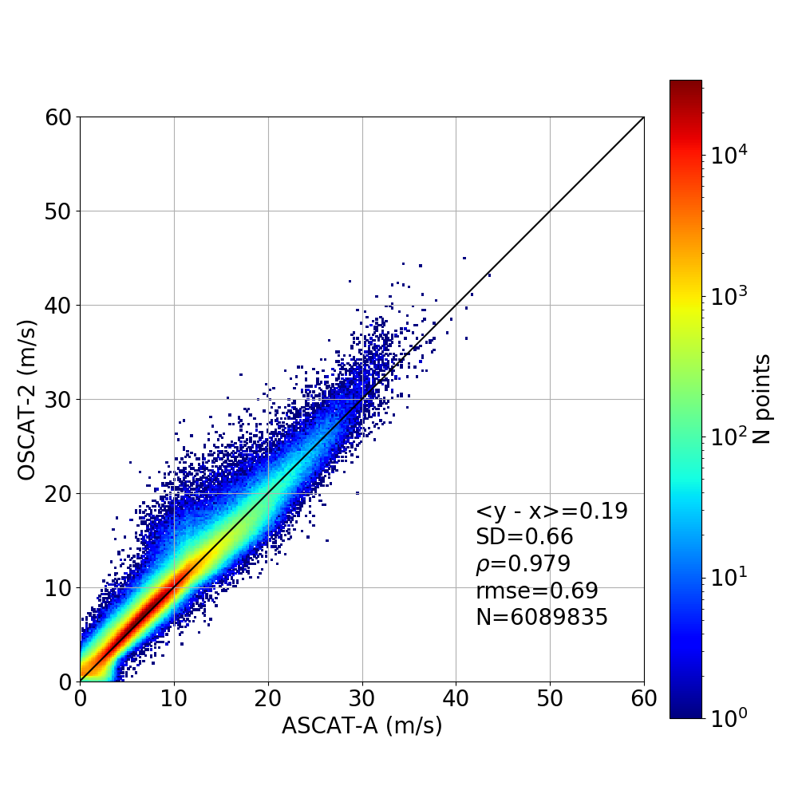
Ku-band scatterometer extreme wind adjustment
Original C- & Ku-band winds
Adjusted C- & Ku-band winds
Adjusted OSCAT-2 high & extreme winds inconsistent with adjusted ASCAT-A winds due to “rain fitting” of the former

Slide 16
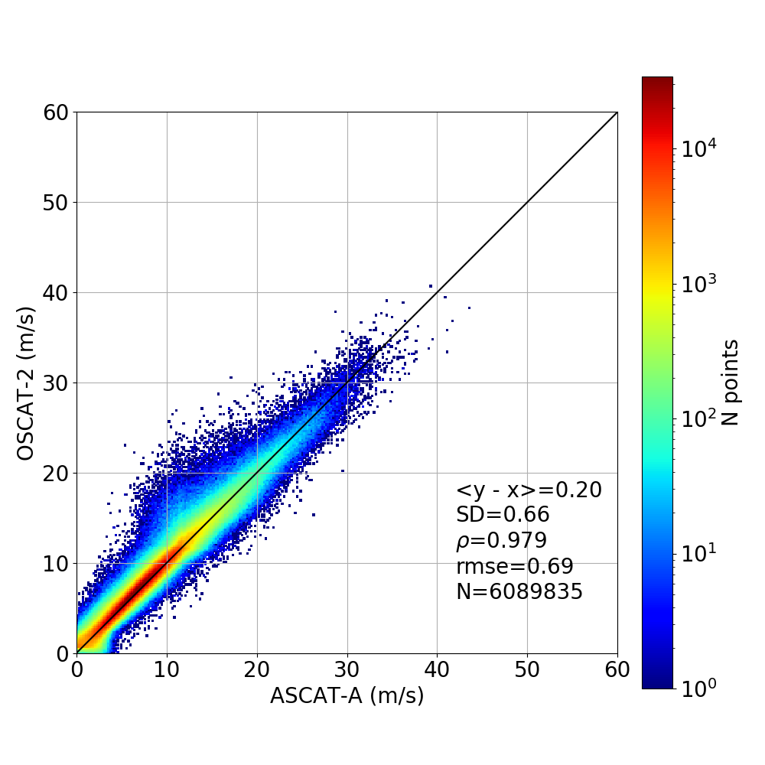
Ku-band scatterometer extreme wind adjustment
Adjusted winds with C- & Ku-band fittings
Adjusted winds with C-band fitting only
Adjusted OSCAT-2 winds with C-band fitting consistent with adjusted ASCAT-A winds

Slide 17
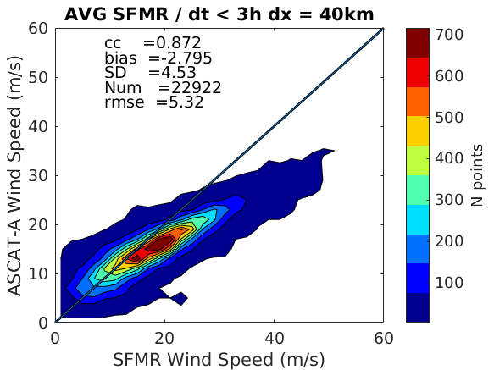
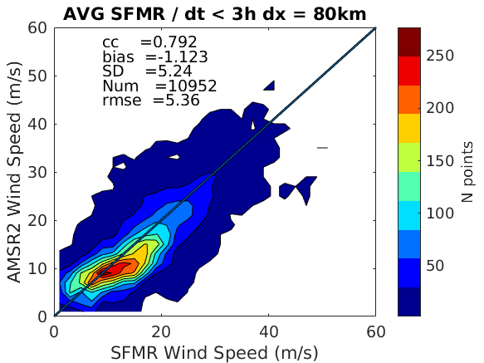
Radiometer extreme wind adjustment
ASCAT-A original winds
REMSS AMSR2 v8 AW winds
ASCAT-A original winds
ASCAT-A & AMSR2 winds inconsistent in the range 10-15 m/s when collocated with SFMR (2012-2020)
AMSR-2 wind retrieval issues under TC conditions?

Slide 18
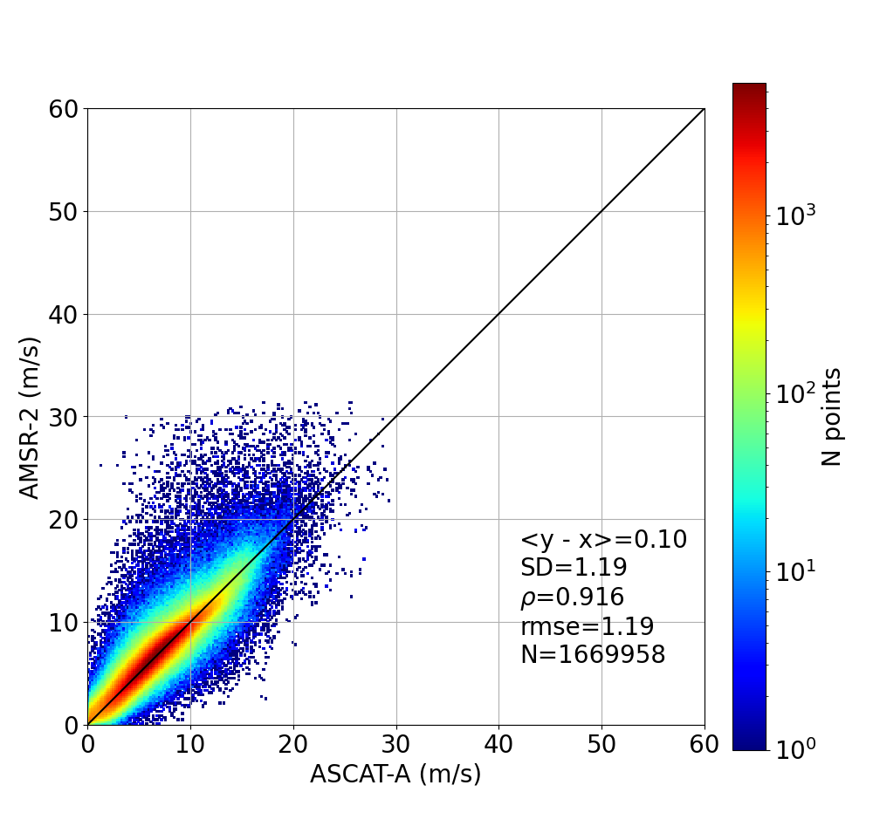
Radiometer extreme wind adjustment
ASCAT-A & AMSR2 winds mostly consistent in the range 10-15 m/s when directly collocated (max. of 3-hour distance)

Slide 19
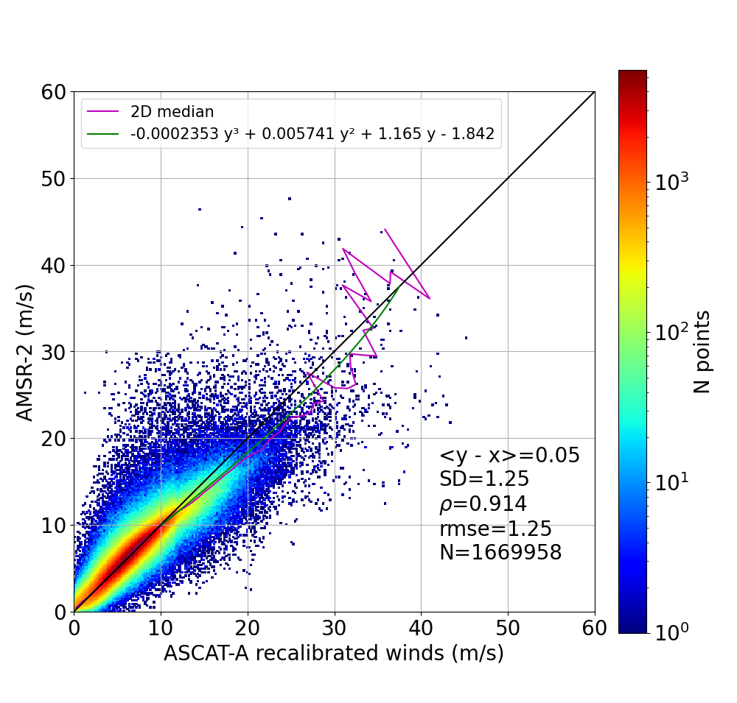
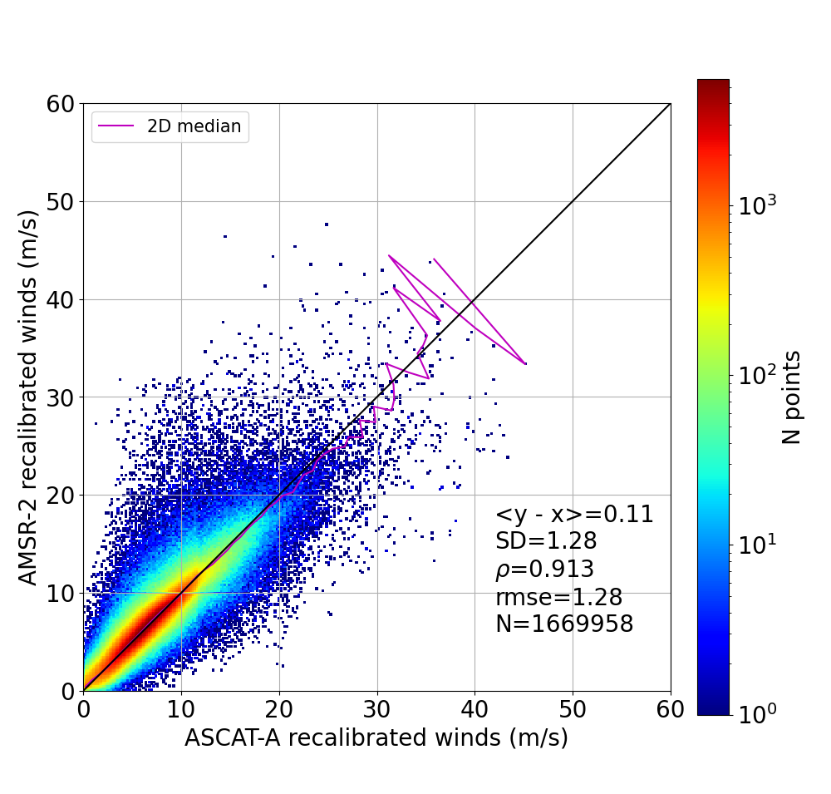
Radiometer extreme wind adjustment
AMSR-2 adjusted winds (m/s)
ASCAT adjusted winds (m/s)
ASCAT-A & SFMR based fitting leads to consistent (adjusted) AMSR-2 & ASCAT-A winds

Slide 20
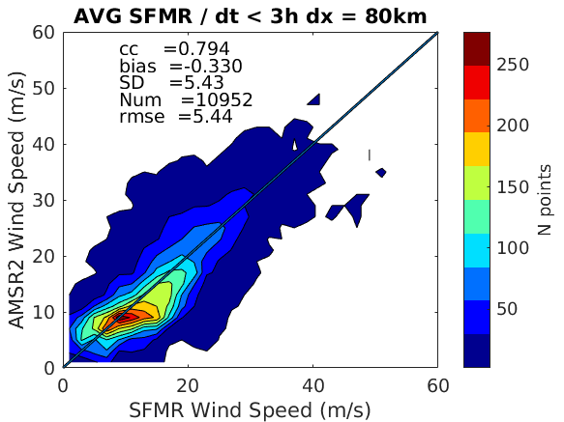
Radiometer extreme wind adjustment
ASCAT-A & SFMR based fitting leads to more consistent (adjusted) AMSR2 & SFMR winds

Slide 21
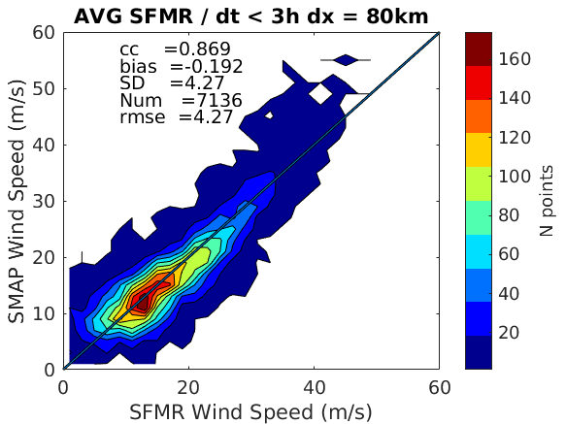
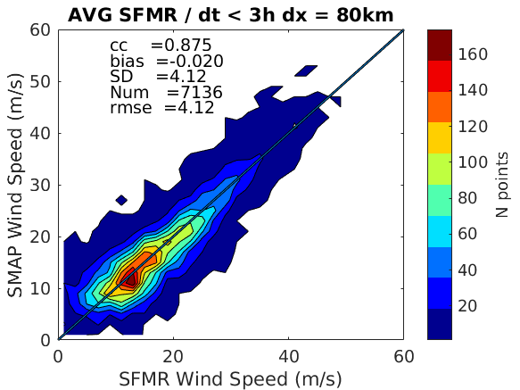
Radiometer extreme wind adjustment
SMAP winds show good correlation although a slight overestimation at extremes w.r.t. SFMR
SFMR based fitting leads to more consistent (adjusted) SMAP winds

Slide 22
ESA MAXSS project:
Extreme wind inter-calibration & validation
Aim: To develop and validate the triple collocation method for extreme wind error characterization of the multi mission (MM) product
Prior to this, to carry out triple collocation analysis to assess the quality of SCAT & RAD extreme wind data used as input to MM
Focus on the tropical region, where triple collocation analysis is possible & wind adjustment is meaningful
RapidSCAT (RSCAT) not used as input to MM in order to verify its quality using SFMR-RSCAT-MM triple collocations
Intercomparison of RSCAT-MM under ETC conditions

Slide 23
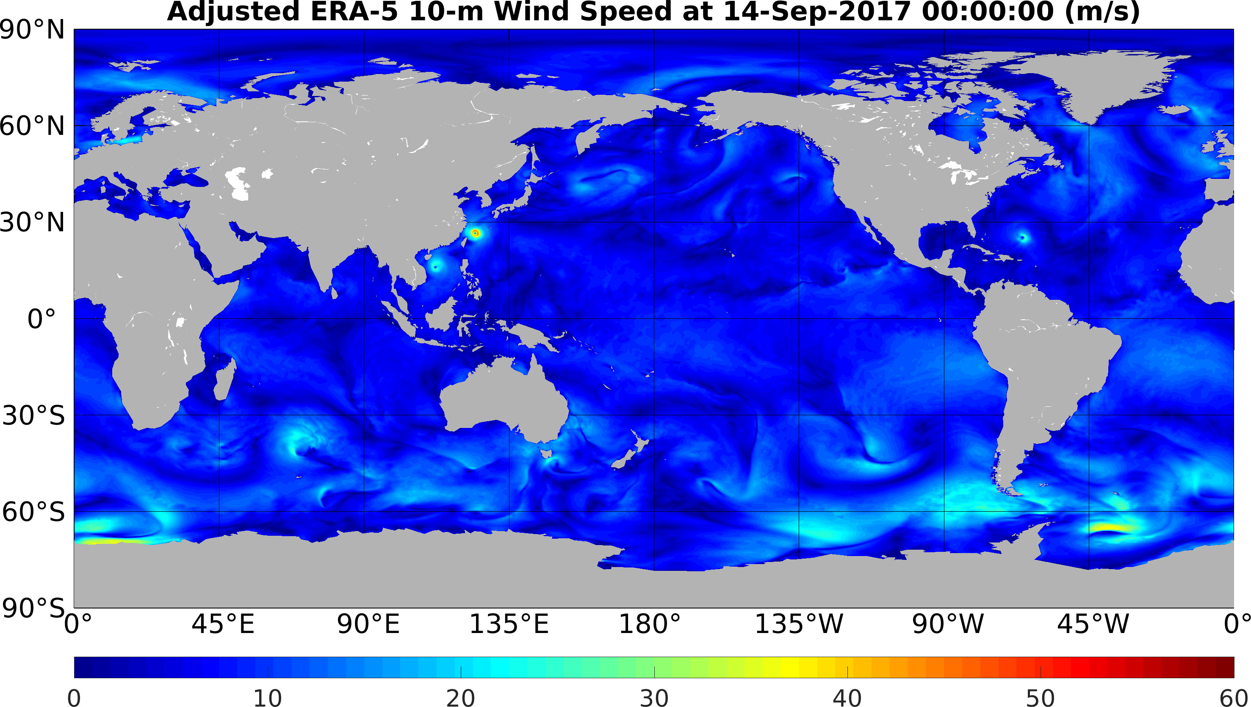
EXAMPLE: ERA5 VS BLENDED WIND SPEED
ERA5 hourly wind fields are first rescaled and then used as the background for the blended wind field calculation:
ADJUSTED ERA5

Slide 24
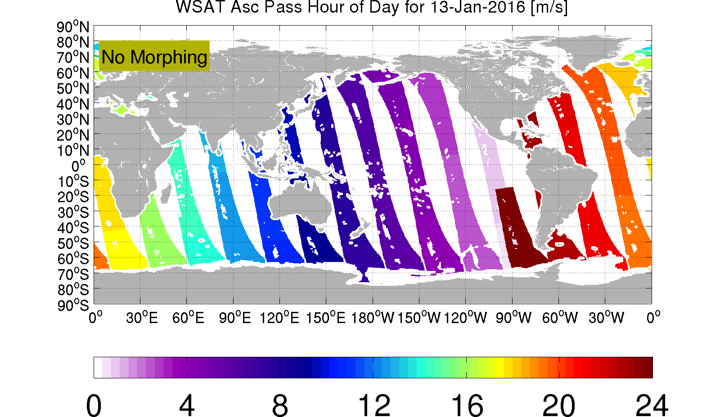

MORPHING-BASED TEMPORAL ADJUSTMENT OF SENSOR WINDS TO ANALYSIS TIME

Slide 25
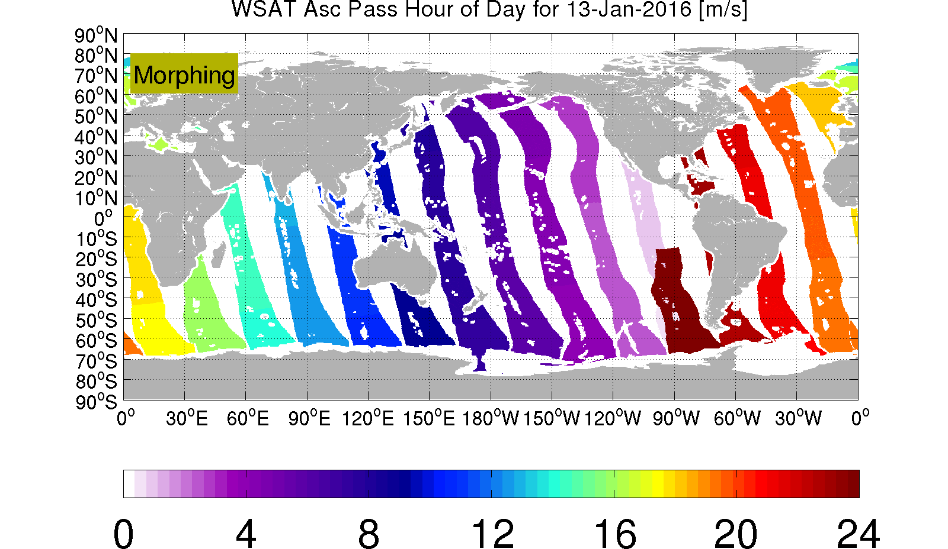
MORPHING-BASED TEMPORAL ADJUSTMENT OF SENSOR WINDS TO ANALYSIS TIME
Example of propagated swaths

Slide 26
EXAMPLE: ERA5 VS BLENDED WIND SPEED
ERA5 hourly wind fields are first rescaled and then used as the background for the blended wind field calculation:
ADJUSTED ERA5

Slide 27
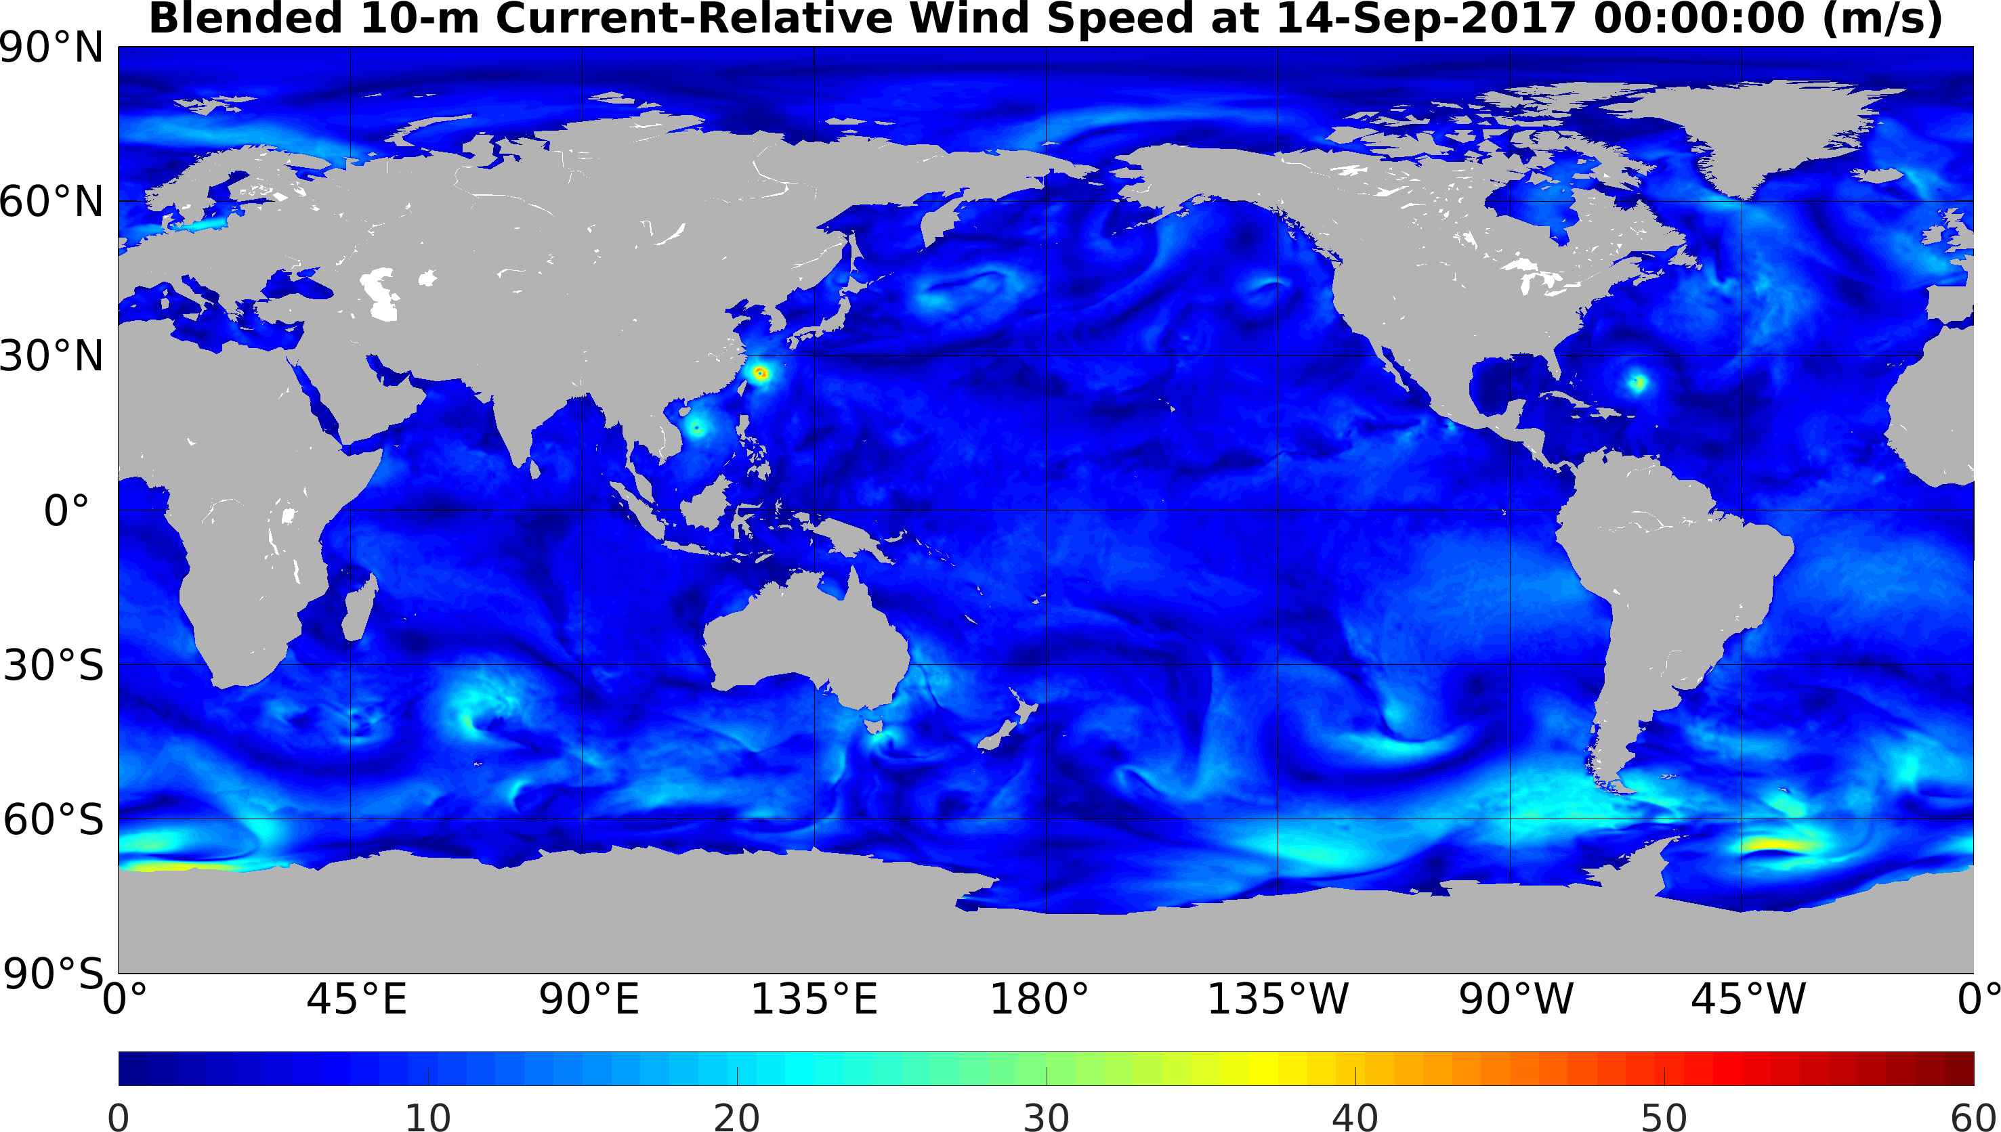
EXAMPLE: ERA5 VS BLENDED WIND SPEED
ERA5 hourly wind fields are first rescaled and then used as the background for the blended wind field calculation:
BLENDED

Slide 28
Triple collocation analysis
The three wind sources are intercalibrated and their measurement errors estimated with the triple collocation analysis:
$x_{i}=a_{i}\left(t+ε_{i}\right)+b_{i}$
Error model: is the wind measured by system =1,2,3; is the true wind signal; is the measurement error for each system; and are the calibration coefficients.
and are the first and second order moments; are the covariances; is the common variance; is the representativeness error.
Stoffelen, 1998; Vogelzang et al., 2021
Calibration coefficients:
Measurement errors:
System 3
r²
$σ_{1}^{2}=\frac{C_{11}}{a_{1}^{2}}−T−r^{2}$
$a_{1}=1;b_{1}=0$
System 2
System 1

Slide 29
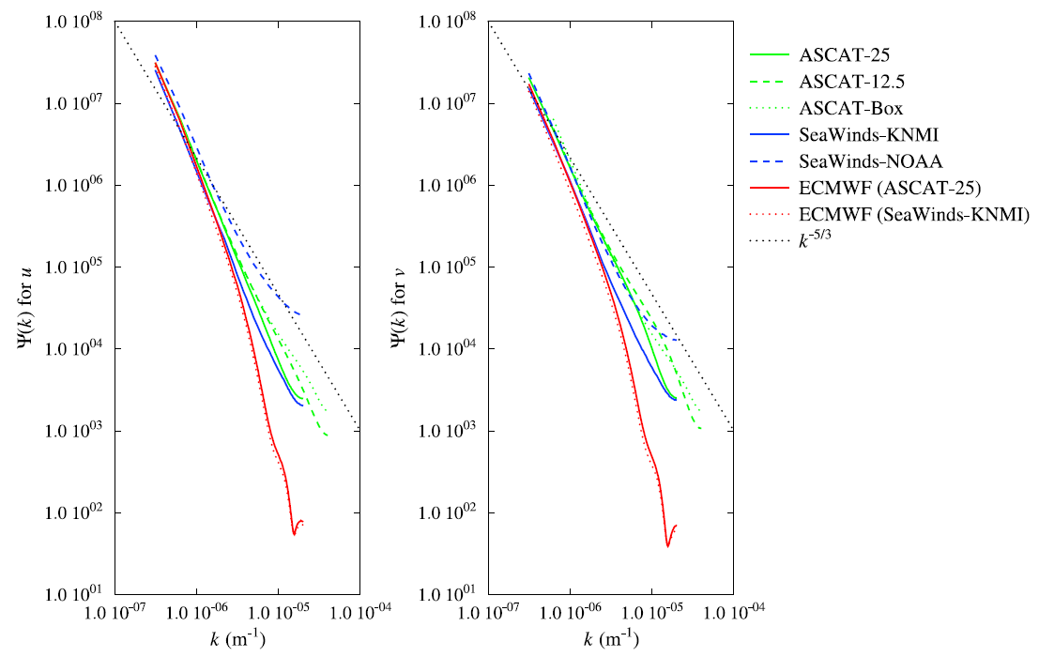
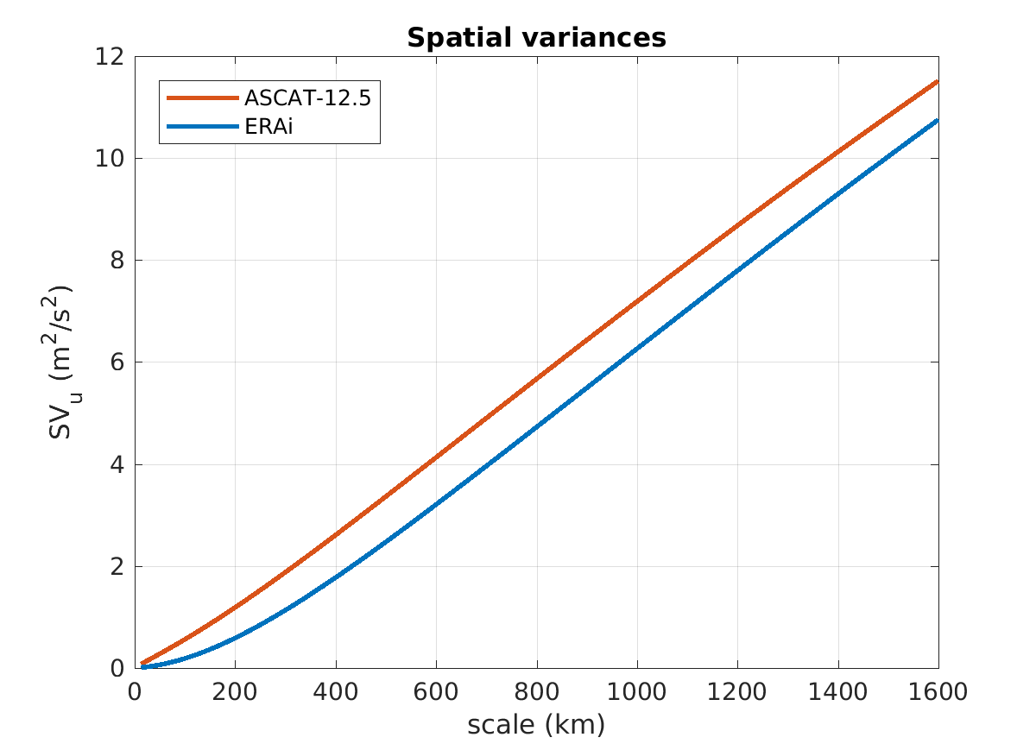
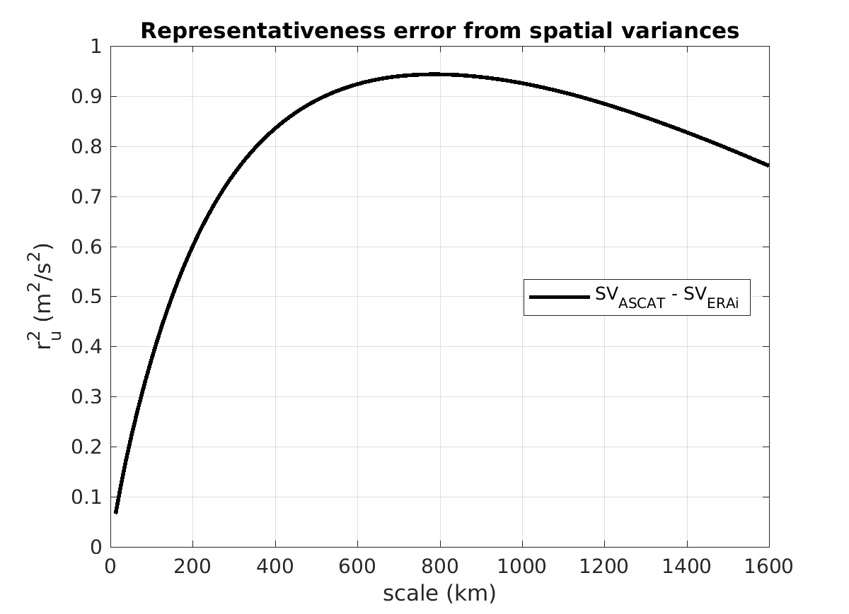
Representativeness error estimation
Power density spectra
Spatial variances
Vogelzang et al., 2011
Vogelzang et al., 2015
Spatial variances are:
                A more reliable measure of the wind variance as a function of scale
                More tolerant to missing points (QC)

Slide 30
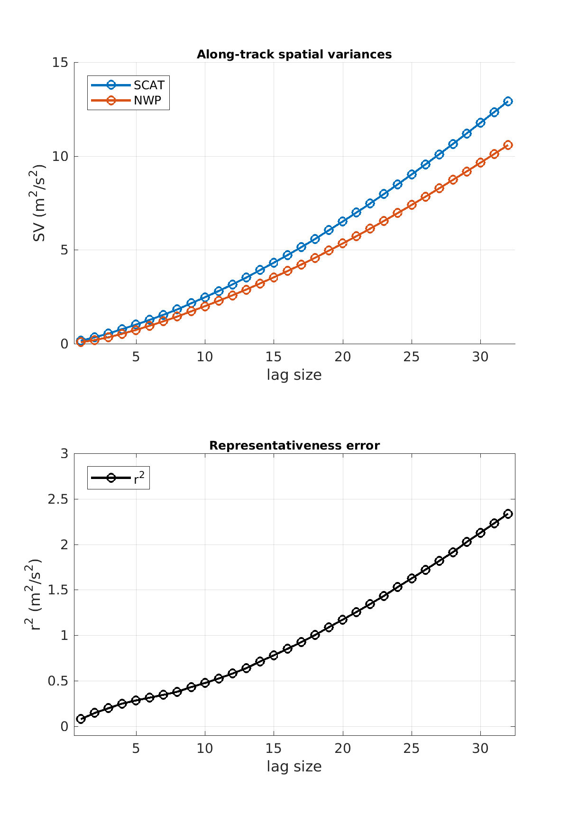
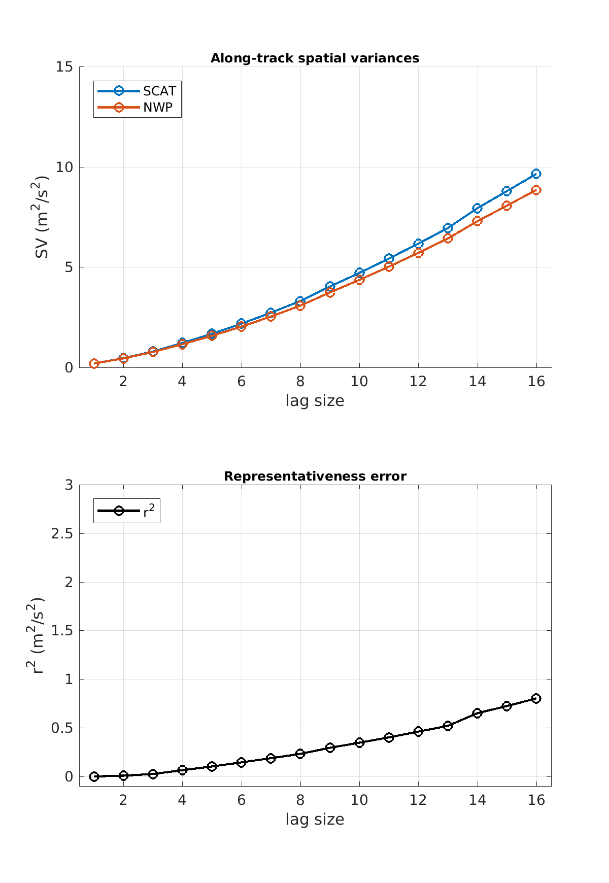
Spatial variance analysis
ASCAT 12.5km – ERA5
r² ~ 0.8m²/s² at 200 km scales
ASCAT 25km – ERA5
r² ~ 0.3m²/s² at 200 km scales

Slide 31
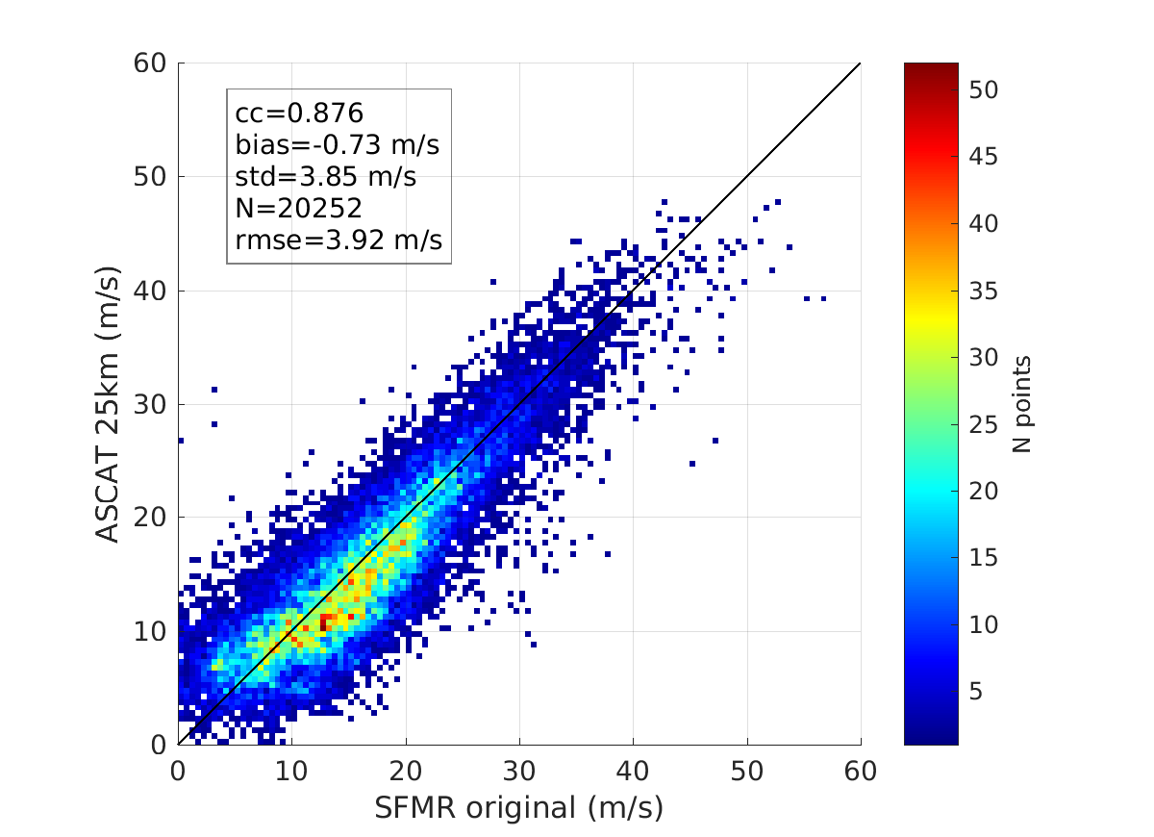
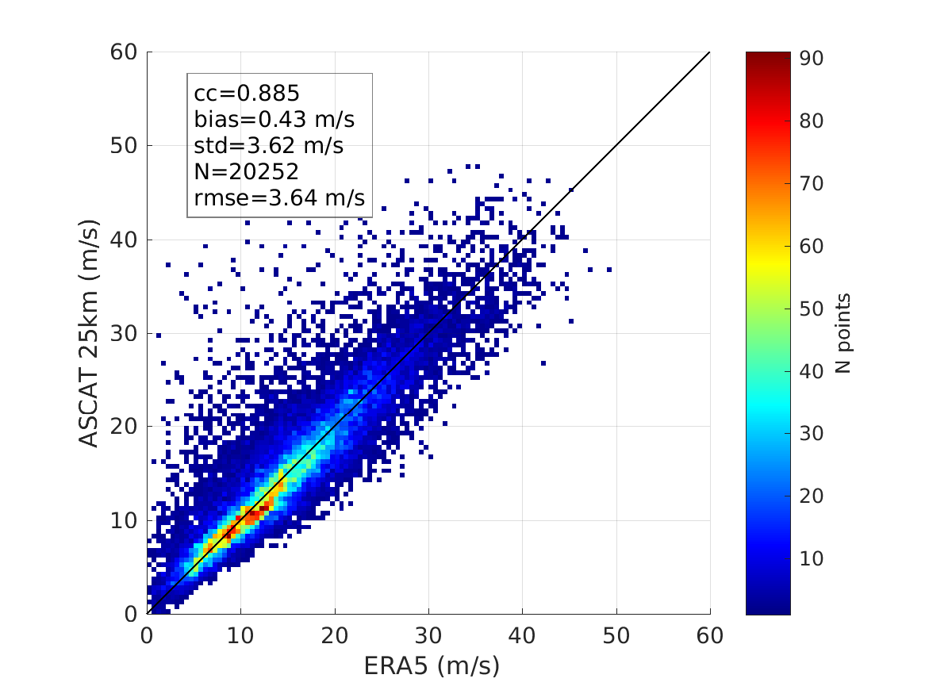
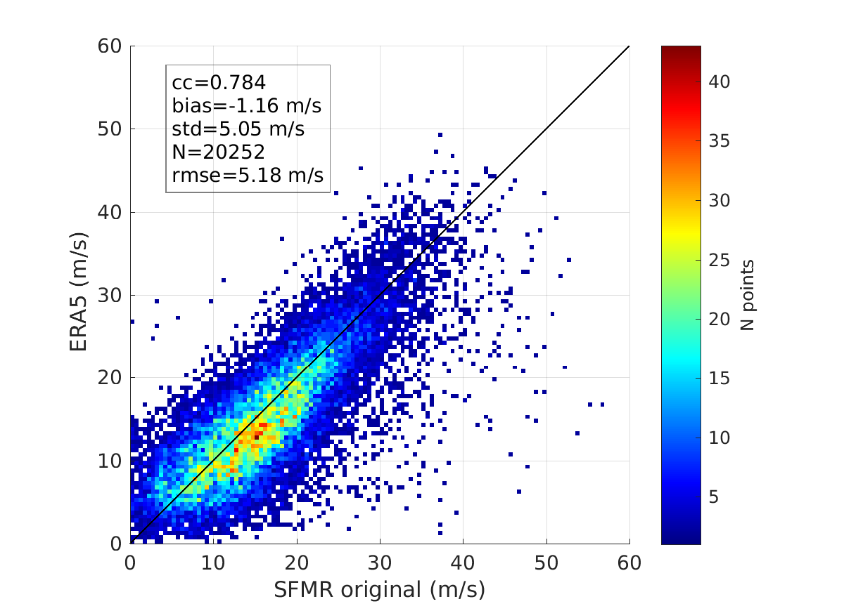
Density plots triple collocation sources
(SFMR-ASCATs-ERA5)
SFMR original winds (100-m sampling)
ERA5 large errors are apparent

Slide 32
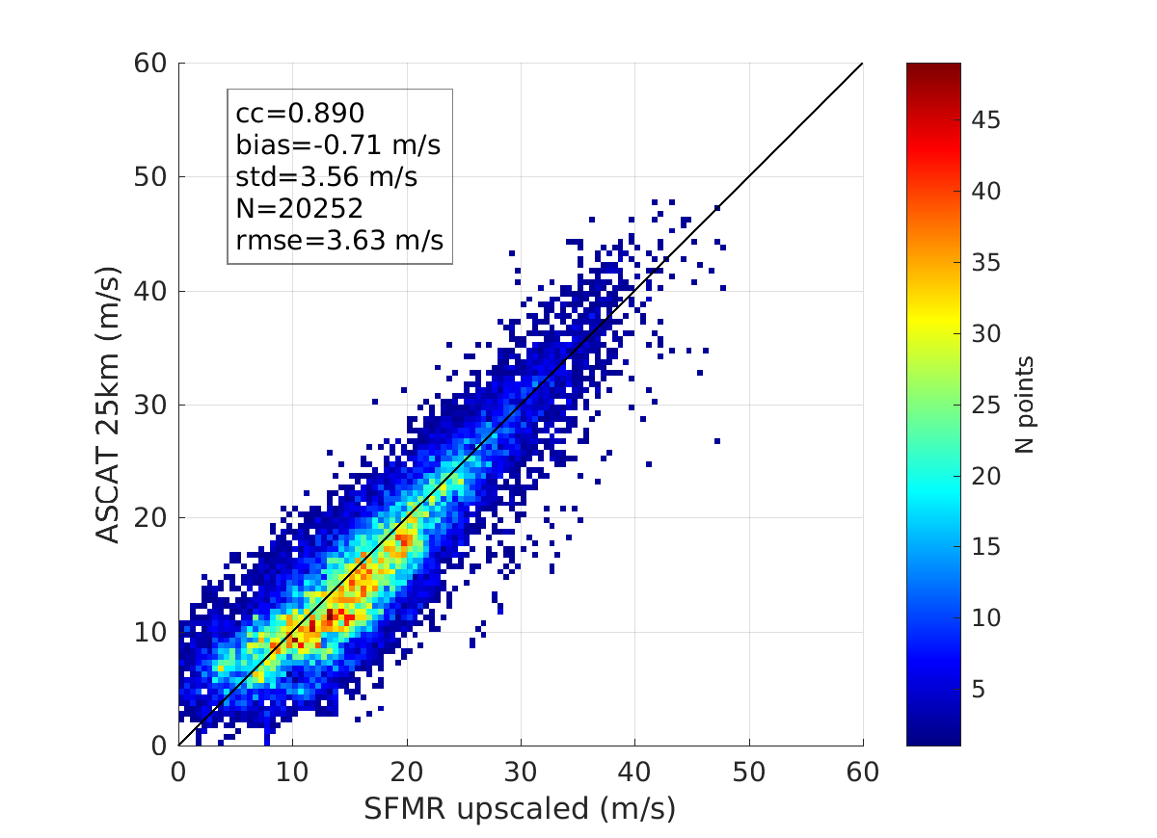
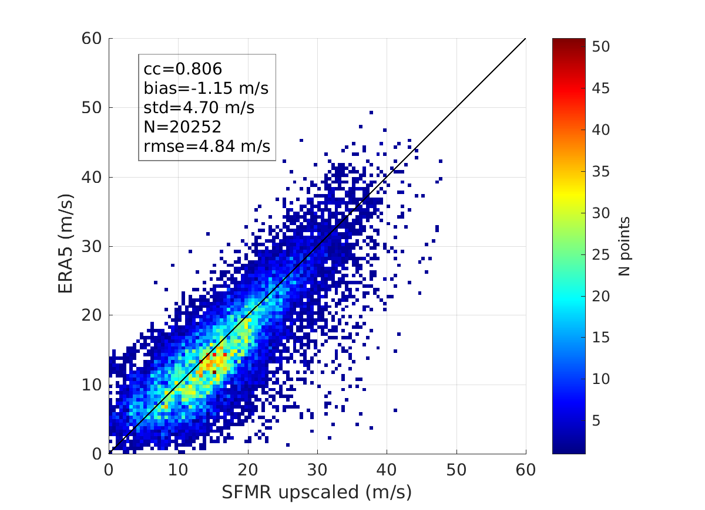
Density plots before triple collocation analysis
(SFMR_{upscaled}-ASCATs-ERA5)
SFMR upscaled winds (80-km along-track averaging)
Reduced scatter on left & right plots due to SFMR upscaling

Slide 33
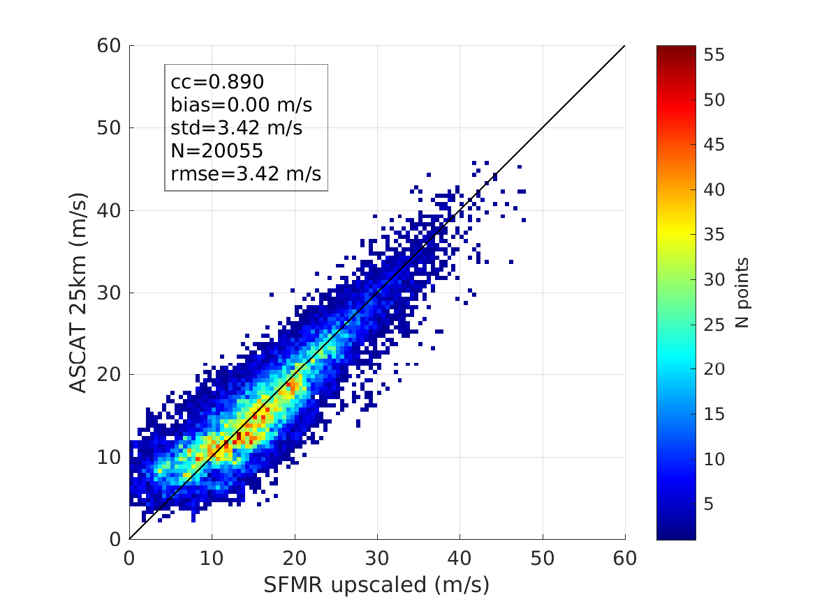
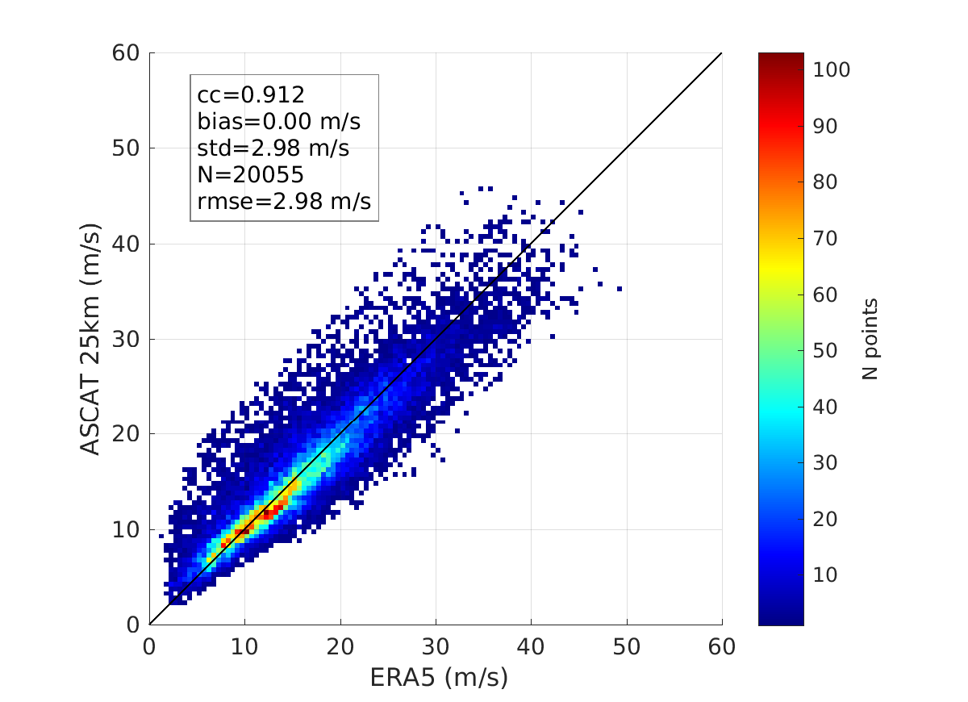
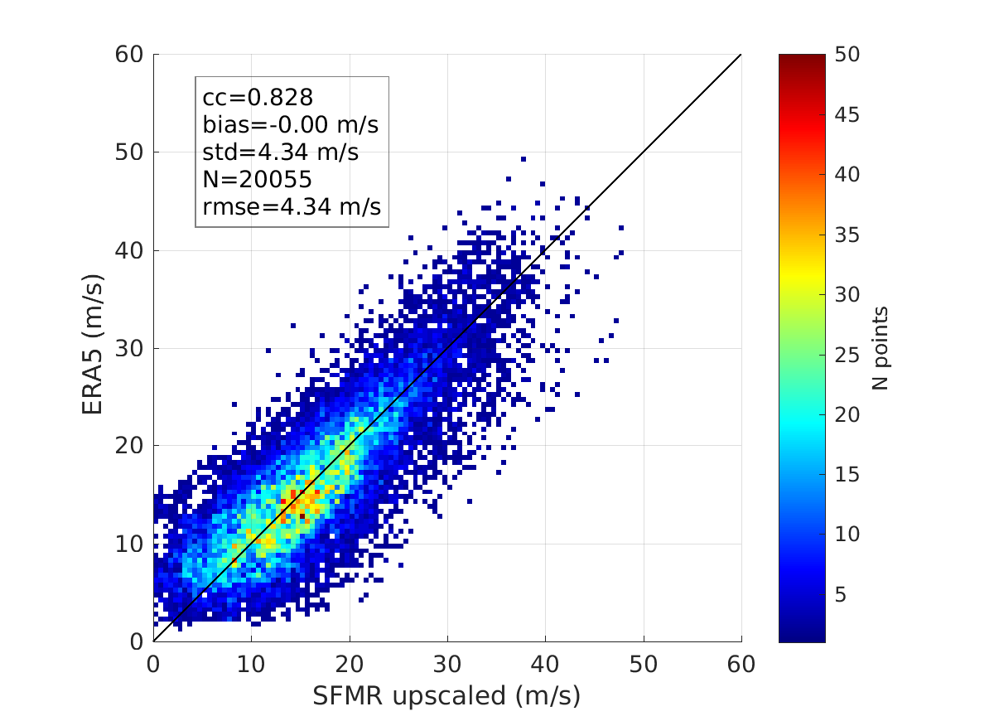
Density plots after triple collocation analysis
(4-sigma test)
SFMR upscaled winds
Triple collocation calibration using 4-sigma test (QC) & r²=0.3 m²/s²
Datasets not well calibrated lead to inaccurate error estimates

Slide 34



Density plots after triple collocation analysis
(2-sigma test)
SFMR upscaled winds
Triple collocation calibration using 2-sigma test (QC) & r²=0.3 m²/s²
Datasets better calibrated, but 2-sigma leads to lower bound error estimates

Slide 35



Density plots triple collocation sources
SFMR upscaled winds
We take calibration coefficients from 2-sigma test and apply them to Triple collocation calibration using 4-sigma test (QC) & r²=0.3 m²/s²

Slide 36
Density plots after triple collocation analysis
(4-sigma test)
SFMR upscaled winds
Triple collocation calibration using 4-sigma test (QC) & r²=0.3 m²/s²
Datasets not well calibrated lead to inaccurate error estimates

Slide 37
Triple collocation analysis
Error estimates (at SCAT spatial scales; r²=0.3 m²/s²)
 | SFMR (m/s) | ASCAT25 (m/s) | ERA5 (m/s)
SFMR original | 3.60 | 0.85 | 2.77
SFMR upscaled | 3.30 | 0.93 | 2.75
Errors computed at scatterometer spatial scales
SFMR errors reduced when upscaled as expected

Slide 38
Triple collocation analysis
Error estimates (at SCAT spatial scales; r²=0.3 m²/s²)
 | SFMR (m/s) | Scatterometer (m/s) | ERA5 (m/s)
RSCAT | 3.50 | 1.55 | 2.56
OSCAT | 3.11 | 2.07 | 2.83
OSCAT-2 | 3.27 | 1.84 | 2.37
HSCAT-A | 2.99 | 1.44 | 2.73
HSCAT-B | 3.26 | 1.47 | 2.00

Slide 39
Summary scatterometer errors
Number of points (after 4-sigma test) for each triple collocated SFMR-Scatterometer-ERA5 set
 | ASCATs (m/s) | RSCAT (m/s) | OSCAT (m/s) | OSCAT-2 (m/s) | HSCAT-A (m/s) | HSCAT-B (m/s)
Number | 20039 | 1513 | 4921 | 10678 | 3041 | 4979
Each SFMR-Scatterometer-ERA5 collocated set samples different weather; some sets contain poor sampling
Mean weighted variance and associated spread for SFMR & ERA5 errors computed
Such spread is used to compute error bars for scatterometer uncertainty estimates

Slide 40
Summary scatterometer errors
Error estimates (at SCAT spatial scales; r²=0.3 m²/s²)
 | ASCATs (m/s) | RSCAT (m/s) | OSCAT (m/s) | OSCAT-2 (m/s) | HSCAT-A (m/s) | HSCAT-B (m/s)
Error SD | 0.93 ± 0.10 | 1.55 ± 0.16 | 2.07 ± 0.22 | 1.84 ± 0.19 | 1.44 ± 0.15 | 1.47 ± 0.16

Slide 41



Density plots before triple collocation analysis
(SFMR_{upscaled}-AMSR2-ERA5)
SFMR upscaled winds (80-km along-track averaging)

Slide 42



Density plots before triple collocation analysis
(SFMR_{upscaled}-SMAP-ERA5)
SFMR upscaled winds (80-km along-track averaging)

Slide 43
Summary radiometer errors
Error estimates (at RAD spatial scales; r²=0.3 m²/s²)
 | AMSR2 (m/s) | Windsat (m/s) | SMAP (m/s) | SMOS (m/s)
Error SD | 2.60 ± 0.16 | 2.87 ± 0.18 | 1.96 ± 0.12 | 2.10 ± 0.13

Slide 44



Density plots before triple collocation analysis
(SFMR_{upscaled}-RSCAT-MM)
Relatively small sampling
RSCAT closer to MM than to SFMR upscaled (QC and/or 2DVar effects?)
MM closer to SFMR upscaled (independent reference) than ERA5

Slide 45


Density plots before triple collocation analysis
(SFMR_{upscaled}-RSCAT-ERA5)
Relatively small sampling
RSCAT closer to ERA5 than to SFMR upscaled (QC and/or 2DVar effects?)
MM closer to SFMR upscaled (independent reference) than ERA5

Slide 46
Triple collocation analysis
Error estimates (at SCAT spatial scales ; r²=0.3 m²/s²)
 | SFMR (m/s) | RSCAT (m/s) | ERA5 (m/s)
SFMR upscaled | 3.50 | 1.55 | 2.56
 | SFMR (m/s) | RSCAT (m/s) | MM (m/s)
SFMR upscaled | 3.39 | 1.67 | 1.64
Substantial reduction in error variance of MM w.r.t. that of ERA5
Uncertainty in the uncertainty estimates non-negligible though

Slide 47
Triple collocation analysis
Error estimates (at SAT spatial scales)
 | SFMR (m/s) | ERA5 (m/s) | Multi-Mission (m/s)
Error SD | 3.41±0.23 | 2.66±0.23 | 1.64±0.17
Errors given at satellite spatial scales
MM random errors substantially smaller than ERA5 errors

Slide 48


Intercomparison RSCAT-ERA5-MM
(Extra-tropical cyclone regions)
No in-situ reference in ETCs; SFMR-based adjustment needs to be removed from all sources
MM closer to RSCAT (independent reference in ETCs) than ERA5
Joint MM/RSCAT variance 23% smaller than that of ERA5/RSCAT

Slide 49

Intercomparison RSCAT-ERA5-MM
(Extra-tropical cyclone regions)
New ERA5 adjustment under TC conditions shows poor agreement with RSCAT for ETC conditions
New ERA5 adjustment based on SFMR upscaled, while old adjustment is the same as used for all scatterometer systems
Storm phase shift effects? ERA5 poorly resolved physical processes under TC conditions?

Slide 50
Extreme wind inter-calibration
Adjustment of scatterometers & radiometers high & extreme winds using SFMR/dropsondes (2010-2020)
  OSI SAF: ASCAT-A, -B & -C, Rapidscat, OSCAT, OSCAT2, HY-2A & HY-2B
  REMSS: Windsat (v7), AMSR-2 (v8), SMAP (v1)
  Ifremer: SMOS (v2)
Accounting for spatial representativeness and QC effects
Addressing SFMR calibration variations
Ensuring inter-calibration among all satellite systems
The L2 adjusted wind products are available on the ESA MAXSS study webpage (https://www.maxss.org/Products/MAXSS-Product-Catalogue)
ASCAT operational wind field over Hurricane Dorian using buoy winds as calibration reference
ASCAT adjusted wind field over Hurricane Dorian
using SFMR winds as calibration reference

Slide 51
Extreme wind validation
Triple collocation analysis for the following
  SFMR-Scatterometer-ERA5
  SFMR-Radiometer-ERA5
  SFMR-RapidSCAT-ERA5/MM
Estimation of spatial representativeness errors using spatial variance analysis
ASCAT winds have the lowest errors
Ku-band winds are higher, although some rain contamination is present
Radiometer winds contain the highest errors in general, with SMAP wind quality comparable to the noisiest scatterometers (OSCATs)
The Multi-Mission (MM) wind quality is substantially higher than that of ERA5, and comparable to that of Ku-band winds (also under ETC conditions)
ERA5
Multi-Mission
 | ASCATs (m/s) | RSCAT (m/s) | OSCAT (m/s) | OSCAT-2 (m/s) | HSCAT-A (m/s) | HSCAT-B (m/s)
Error | 0.93±0.10 | 1.55±0.16 | 2.07±0.22 | 1.84±0.19 | 1.44±0.15 | 1.47±0.16
 | AMSR2 (m/s) | Windsat (m/s) | SMAP (m/s) | SMOS (m/s)
Error | 2.60±0.16 | 2.87±0.18 | 1.96±0.12 | 2.10±0.13
 | SFMR (m/s) | ERA5 (m/s) | Multi-Mission (m/s)
Error | 3.41±0.23 | 2.66±0.23 | 1.64±0.17

Slide 52
Future work
Improve wind adjustment for Ku-band systems by revising QC effects
Apply extreme wind adjustment to new scatterometer systems after 2020 (HY-2C, HY-2D, OSCAT3, WindRAD)
Apply storm translation onto ERA5 to match scatterometer & radiometer storm centres
Repeat triple collocation analysis SFMR-RSCAT-ERA5 for ERA5 used in MM generation
Improve wind adjustment for ERA5; contribute to wind “unadjustment” of MM under ETC conditions
Improve spatial variance analysis under TC conditions
Spatial analysis on adjusted scatt & rad fields: wind radii, derivatives (divergence, curl)
IWRAP data exploitation to analyze the consistency between sea surface wind fields (scatt, rad, ERA5, MM) and those aloft (IWRAP)

Slide 53


Can we reconcile dropsonde and buoy measurements?
Dropsondes
Buoys
ASCAT wind speed (m/s)
Buoy wind speed (m/s)
ASCAT nominal winds calibrated against buoys
Dropsonde & buoy scales increasingly differ above 10 m/s
Which one should we trust?
Strong deceleration close to the Surface
Height assignment errors
Sampling frequency
Work well up to 25 m/s
Few measurements under TC conditions
Wave effects?

Slide 54
Scatterometer data availability (2010-2020)
Scatterometer systems | FORMAT | PERIOD | SOURCE | FREQUENCY
ASCAT-A | BUFR/NetCDF | Full period | OSI SAF | C-band
ASCAT-B | BUFR/NetCDF | 11/2012 – 12/2020 | OSI SAF | C-band
ASCAT-C | BUFR/NetCDF | 01/2019 – 12/2020 | OSI SAF | C-band
OceanSat-2 | BUFR/NetCDF | 01/2010 - 02/2014 | OSI SAF | Ku-band
RapidScat | BUFR/NetCDF | 11/2014 - 08/2016 | OSI SAF | Ku-band
Scatsat-1 | BUFR/NetCDF | 01/2017 – 12/2020 | OSI SAF | Ku-band
HY-2A | BUFR/NetCDF | 06/2012 - 04/2015 | OSI SAF | Ku-band
HY-2B | BUFR/NetCDF | 01/2019 – 12/2020 | OSI SAF | Ku-band
HY-2C | BUFR/NetCDF | 11/2020 – 12/2020 | OSI SAF | Ku-band
CFOSAT | BUFR/NetCDF | 01/2019 – 12/2020 | OSI SAF | Ku-band

Slide 55
Radiometer data availability (2010-2020)
Radiometers | FORMAT | PERIOD | SOURCE | FREQUENCY
SMOS | NetCDF-4 | Full period | IFREMER | L-band
SMAP | Bytemap | 04/2015 – 12/2020 | REMSS | L-band
WindSat | Bytemap | 01/2010 – 10/2020 | REMSS | Channels (GHz): 6.8; 10.7; 18.7; 23.8; 37.0
AMSR2 | Bytemap | 07/2012 – 12/2020 | REMSS | Channels (GHz): 6.93; 7.3; 10.65; 18.7; 23.8; 36.5; 89.0
SSMI / SSMIS | Bytemap | Full period | REMSS | Channels (GHz): 19.35; 23.235; 37.0; 85.5
GMI | Bytemap | 03/2014 – 12/2020 | REMSS | Channels (GHz): 10.65; 18.7; 23.8; 36.5; 89.0; 165.5; 183.31
TMI | Bytemap | 01/2010 – 12/2014 | REMSS | Channels (GHz): 10.65; 19.35; 21.3; 37.0; 85.5
AMSRE | Bytemap | 01/2010 - 10/2011 | REMSS | Channels (GHz): 6.93; 10.65; 18.7; 23.8; 36.5; 89.0

