Slide 1
Zero Current Equivalent Wind (U_{zc}): Adjusting ERA5 Windspeeds for Currents
Gopal Sundaram, University of Michigan, CLaSP
Chris Ruf, University of Michigan, CLaSP

Slide 2
Summary of Presentation & Some Questions
Radiometers, scatterometers and bistatic radars (GNSS-R) are all sensitive to the relative motion between water and air (i.e. the stress equivalent wind)
Reanalysis and forecast models report “true” wind (i.e. air motion relative to an Earth-fixed coordinate system)
True winds are used to
Tune empirical forward models used by remote sensing retrieval algorithms
Assessment performance of remotely sensed winds
A zero current equivalent wind (U_{zc)} is considered as a proxy for the stress equivalent wind
The bias in remotely sensed winds is reduced if with respect to U_{zc}
QUESTIONS:
Should forward models be tuned to U_{zc} instead?
Should retrievals include a current correction to convert retrieved wind to true wind?

Slide 3
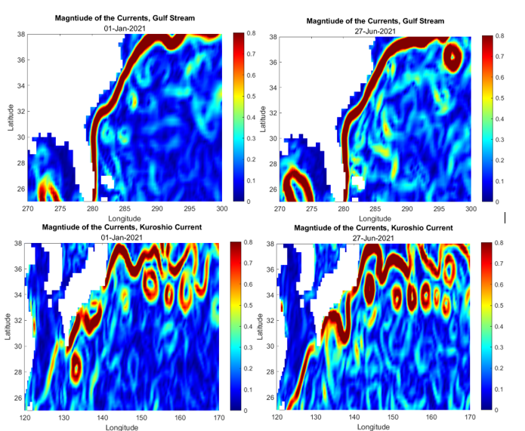
Ocean Currents Affect Air/Sea Relative Motion
Gulf Stream and Kuroshio Currents are shown for January (left) and June (right)
Western Boundary Current (WBC) for North Atlantic (Gulf Stream) and North Pacific (Kurushio)
Gulf Stream alignment is consistent between winter and summer
Kurushio has significant variability between seasons
Other major currents associated with the ITCZ are the North and South Equator Currents (EC)
01 Jan 2021
27 Jun 2021

Slide 4
Remotely Sensed Wind Speed Products Considered
Sensor/Satellite | Start Op. | Active or Passive | Product details | Instrument type
DDMI/CYGNSS | 2017 | Active | L3 Gridded, Daily | GNSS-R Receiver
ASCAT/MetOP | 2007 | Active | L3 Gridded, Daily | Scatterometer
GMI/GPM | 2014 | Passive | L3 Gridded, Daily | Microwave Radiometer

Slide 5
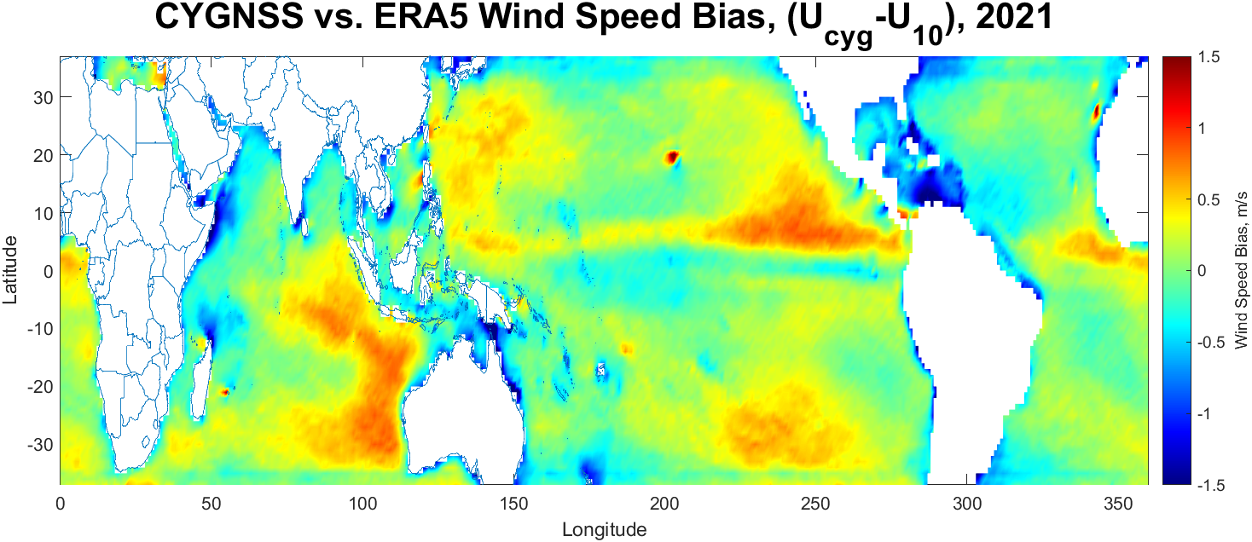
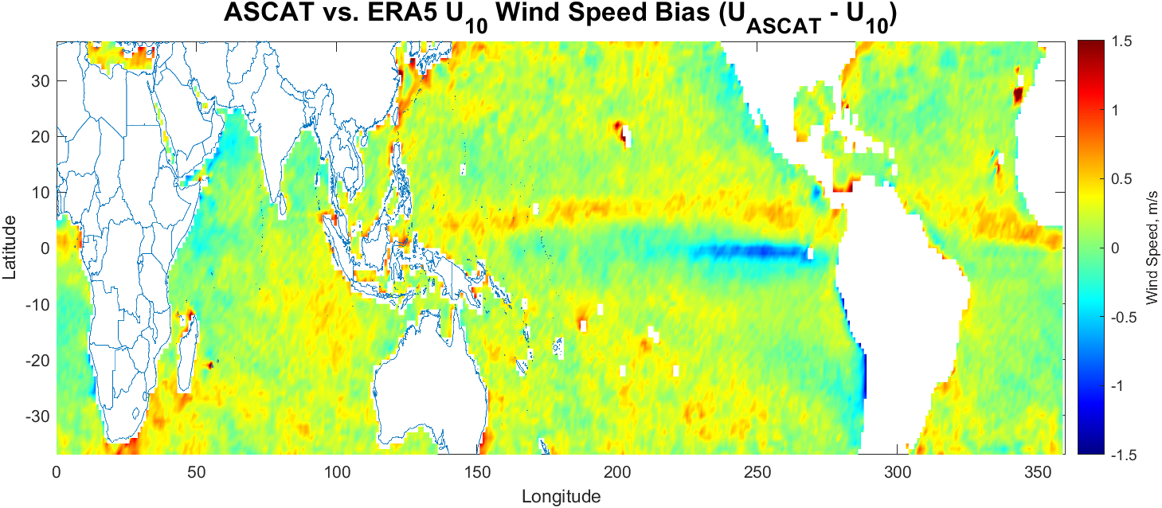
Examples of Apparent Wind Speed Bias
Mean annual difference between CYGNSS or ASCAT and ERA5 U₁₀ shown

Slide 6
Examples of Apparent Wind Speed Bias (2)
CYGNSS has areas of high wind speed bias around the Gulf Stream, Eastern Pacific ITCZ & East African Current
ASCAT displays high wind speed bias around the Pacific and Atlantic ITCZ, Kuroshio Current and the Gulf Stream

Slide 7
Zero Current Equivalent Wind, U_{zc}
U_{zc} is a modification made to ERA5 reanalysis data to account for the surface currents, (Wind-Current = Relative motion)
Subtraction is done vector-wise
$$U_{zc}=|U_{ERA5} −U_{OSCAR}|$$
U_{ERA5} represents the uncorrected ERA5 Neutral Wind Speed (NWS) at 10-meter height, and U_{OSCAR} is the Ocean Current Vector from the Ocean Surface Current Analysis Real-Time (OSCAR) database

Slide 8
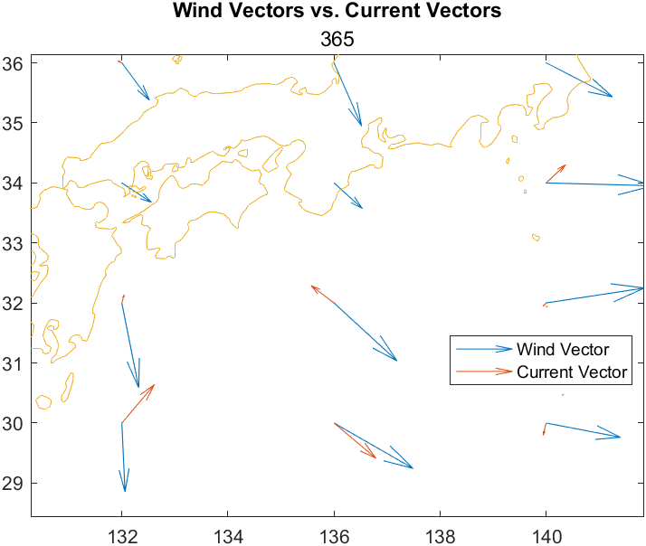
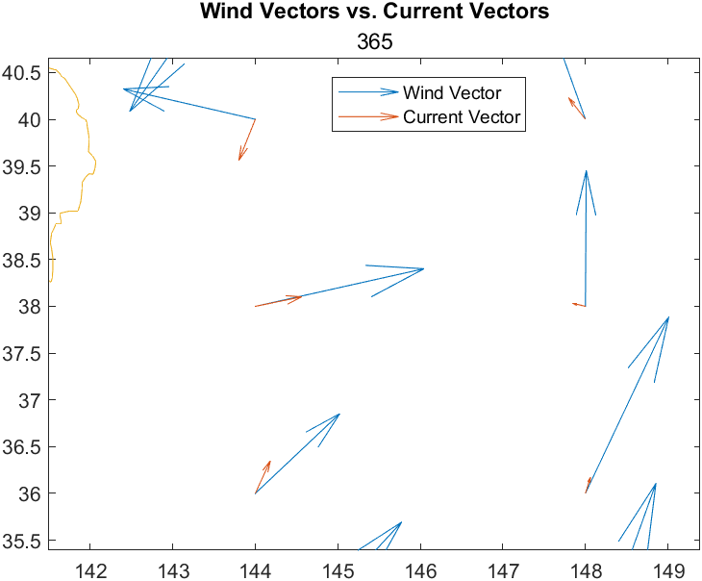
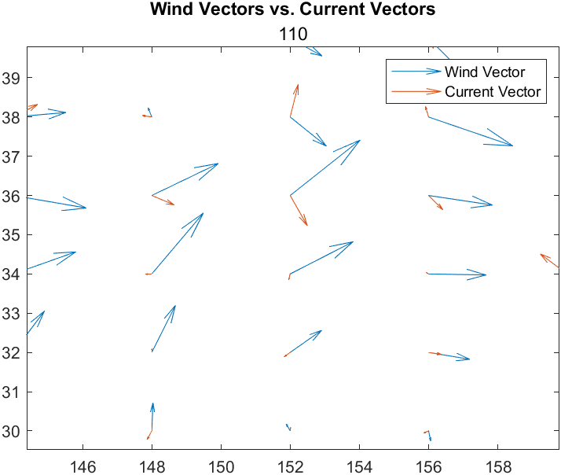
Wind Speed vs. Current Vectors
Antiparallel wind and current vectors
Parallel wind and current vectors
Orthogonal Wind and Current Vectors
Visual Representation of the vector subtraction
Angle between wind and water plays an important role in determining strength of correction
Orthogonality does not mean zero effect, that is at ~60 degrees
Angle with zero difference will vary with relative magnitudes of U_{ERA5} and U_{OSCAR}

Slide 9
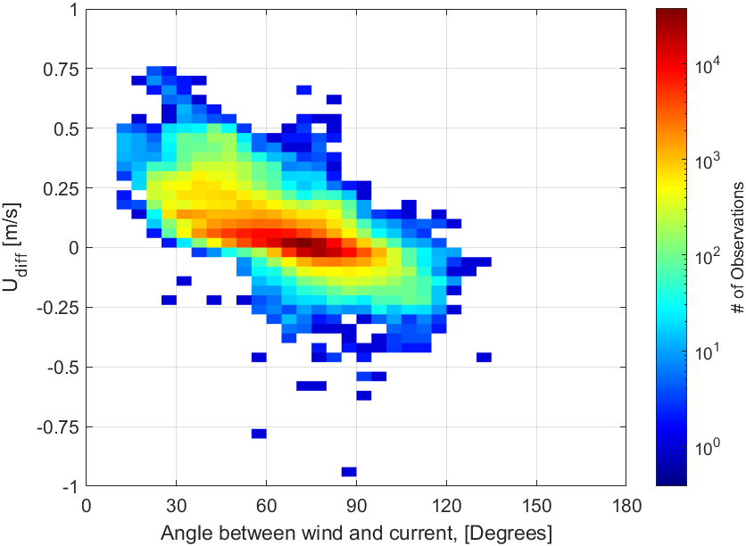
Effect of Angle Between Wind and Current
Udiff = U₁₀ – U_{zc}, the difference in the wind speeds
Density scatterplot of Udiff vs. Angle globally for all of 2021
Max positive difference when wind and current are parallel
Max negative difference when wind and current are anti-parallel
Zero difference when wind and current are ~30-90 deg apart

Slide 10
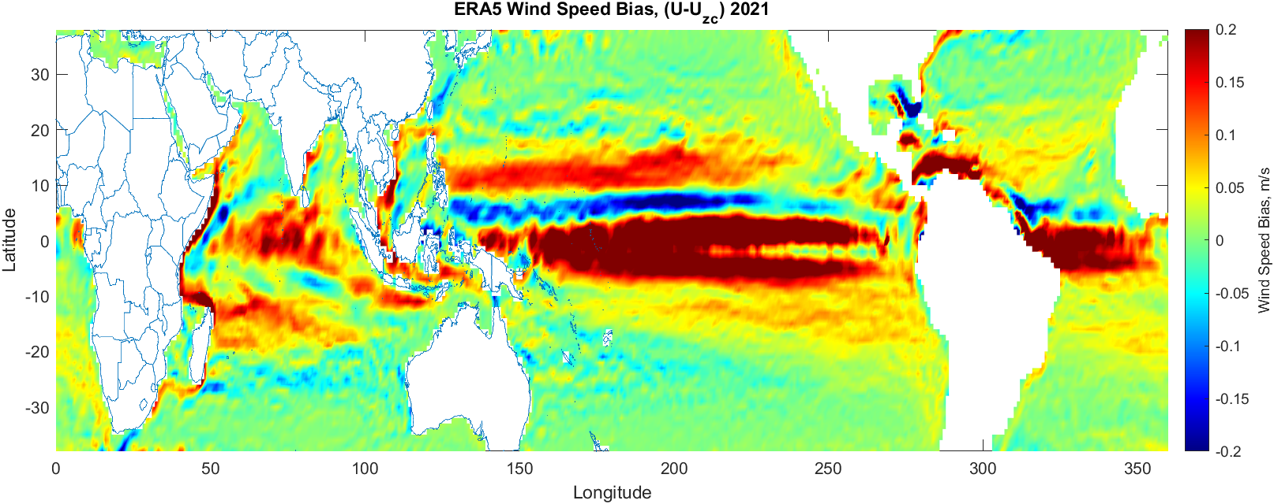
Annual Average (2021) U_{diff} = U₁₀ - U_{zc}
Wind Speed Difference between the ERA5 U₁₀ and the ERA5 Current Corrected U_{zc}
WSD tracks the Equatorial Currents, but is not consistent with other large currents
Gulf Stream and East African Current are present, but not the Kuroshio
Currents are not the only factor, but the angle between the wind and the current also affects magnitude of difference

Slide 11
Wind Speed Difference Zoom In, Kuroshio

Slide 12
Wind Speed Difference Zoom In, Kuroshio

Slide 13
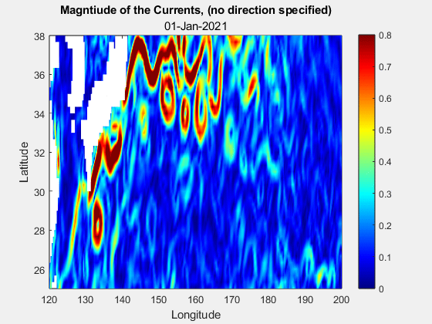
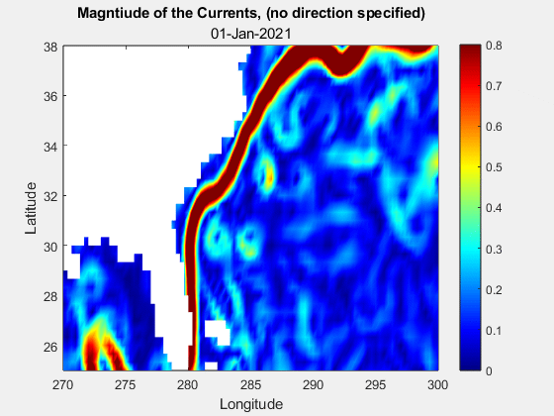
Consistency is Key

Slide 14
Statistical Comparison
Many satellite wind products are tuned to ERA5 winds, so doing a direct wind speed bias comparison will lead to results that show the standard ERA5 as the less biased product in any circumstance
Instead of using pure wind speed bias, Absolute Wind Speed Bias Anomaly (AWSBA) is used to show where the biases diverge apart from the tuning
AWSBA is helpful, plots will further demonstrate where the changes from U₁₀ to U_{zc} are the most prominent
$${|U}_{AWSBA}|=\left|U_{bias} −{mean(U}_{bias}\right)|$$

Slide 15
U_{zc} vs. U Absolute Bias Anomaly, 2021 CYGNSS
CYGNSS vs. ERA5 Current Corrected (bottom) and CYGNSS vs. ERA5 NWS (top)
Improvements in bias anomaly can be seen in the central Pacific, and there’s very few area where bias anomaly increases from NWS to U_{zc}

Slide 16
U_{zc} vs. U Absolute Bias Anomaly, 2021 CYGNSS
CYGNSS vs. ERA5 Current Corrected (bottom) and CYGNSS vs. ERA5 NWS (top)
Improvements in bias anomaly can be seen in the central Pacific, and there’s very few area where bias anomaly increases from NWS to U_{zc}
AWSBA improves from 0.28 m/s to 0.27 m/s

Slide 17
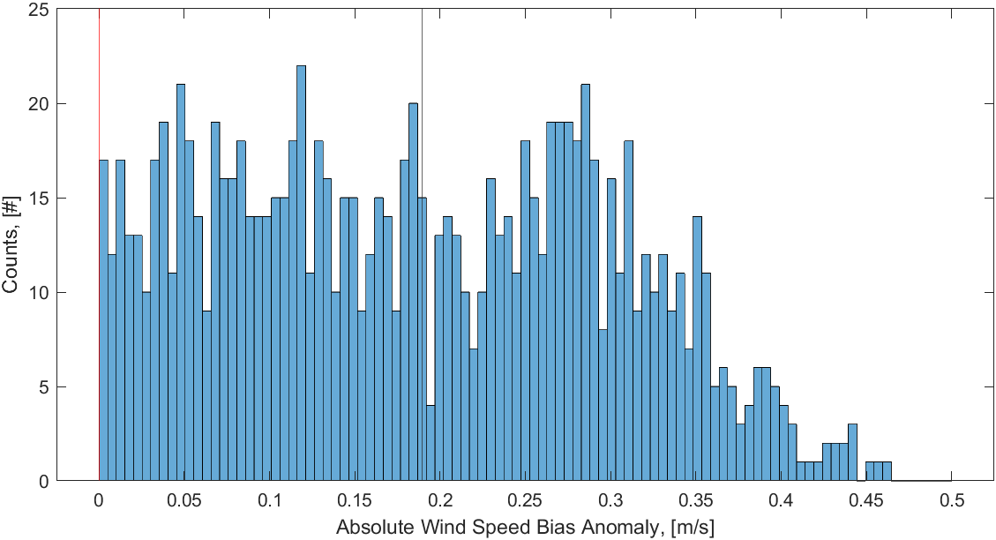
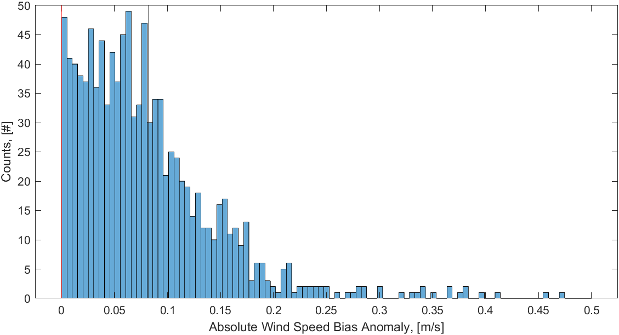
U_{zc} vs. U Absolute Bias Anomaly, 2021 CYGNSS
CYGNSS vs. ERA5 Current Corrected (bottom) and CYGNSS vs. ERA5 NWS (top)
Improvements in bias anomaly can be seen in the central Pacific, and there’s very few area where bias anomaly increases from NWS to U_{zc}
AWSBA improves from 0.28 m/s to 0.27 m/s

Slide 18
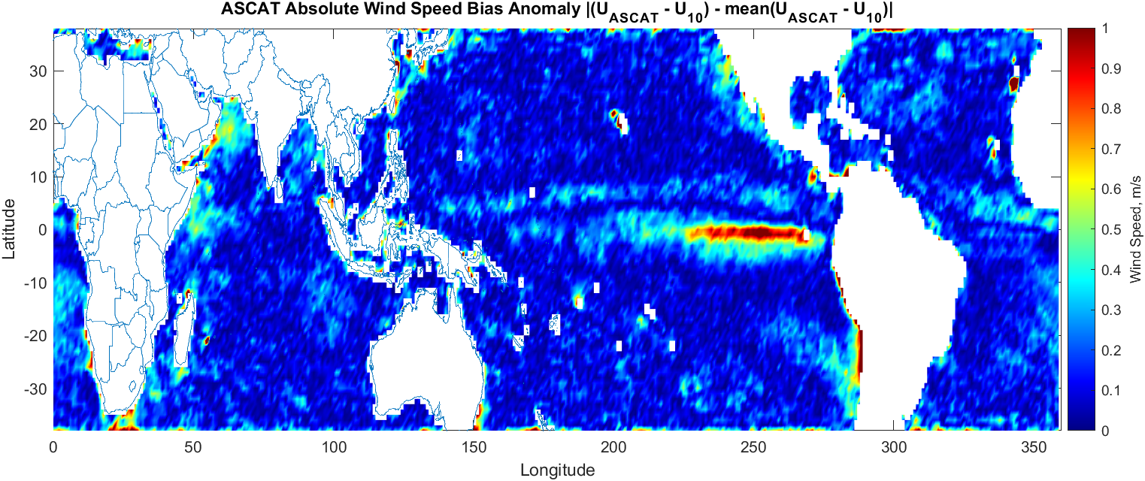
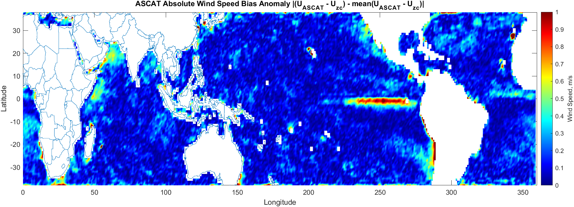
U_{zc} vs. U Bias Anomaly, 2021, ASCAT
ASCAT vs. ERA5 NWS (top) and GMI vs. ERA5 Uzc (bottom)
Extremely low Absolute Bias Anomaly which indicates that the wind speed is finely tuned to ERA5 model data
AWSBA improves from 0.21 m/s to 0.19 m/s

Slide 19
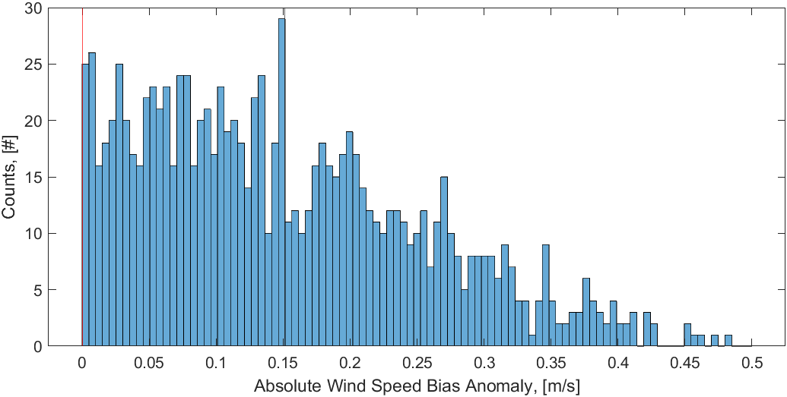
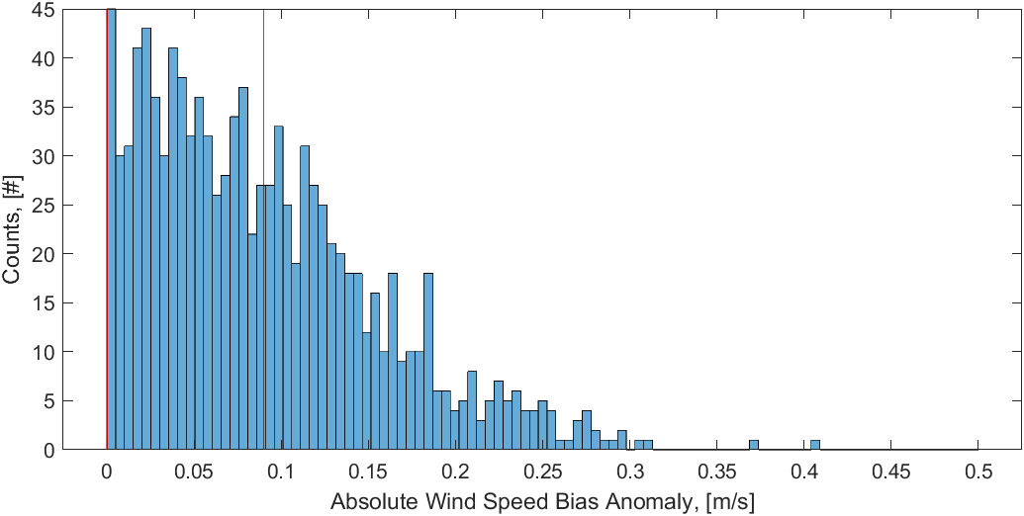
U_{zc} vs. U Bias Anomaly, 2021, ASCAT
ASCAT vs. ERA5 NWS (top) and GMI vs. ERA5 Uzc (bottom)
Extremely low Absolute Bias Anomaly which indicates that the wind speed is finely tuned to ERA5 model data
AWSBA improves from 0.21 m/s to 0.19 m/s
Notes:
Add pop-up histograms for the two circled regions to emphasize the improvement

Slide 20
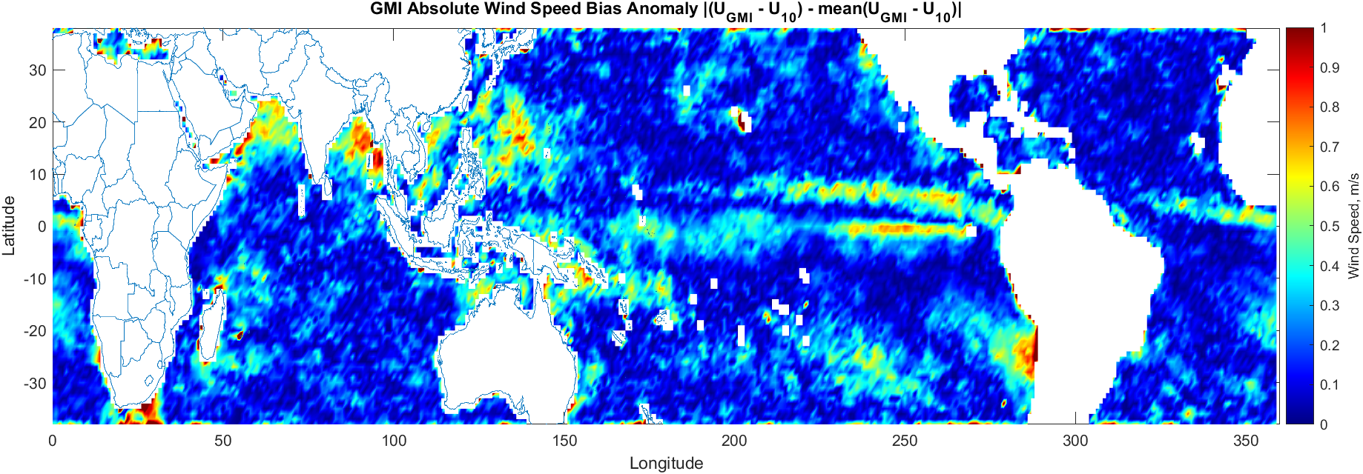
U_{zc} vs. U Absolute Bias Anomaly, 2021 GMI
GMI vs. ERA5 NWS (top) and GMI vs. ERA5 Uzc (bottom)
Improvements in bias anomaly can be seen in the central Pacific, and there’s minimal areas where bias anomaly increases from NWS to U_{zc}
AWSBA improves from 0.26 m/s to 0.25 m/s
High impact region goes from 0.5 m/s to 0.1 m/s
Notes:
Add pop-up histograms for the two circled regions to emphasize the improvement

Slide 21
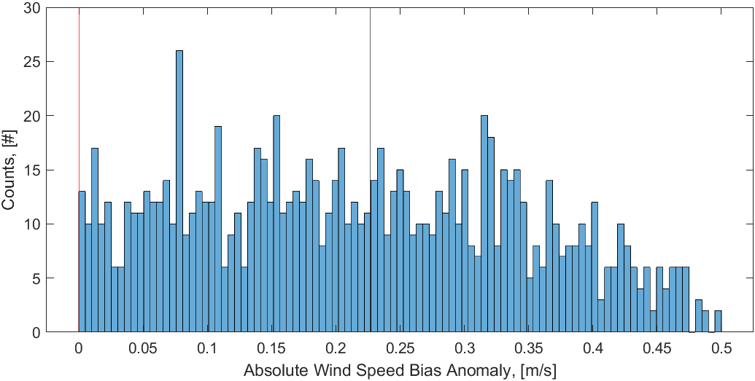
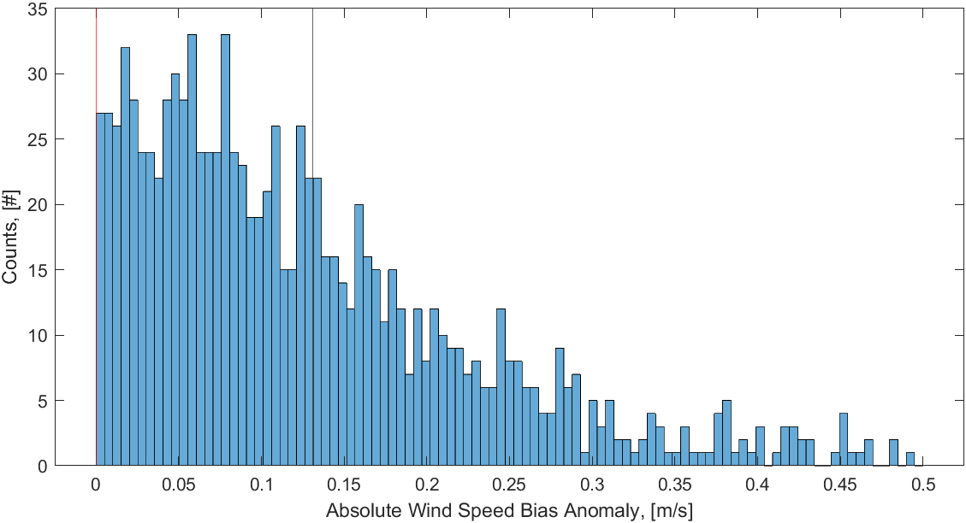
U_{zc} vs. U Absolute Bias Anomaly, 2021 GMI
GMI vs. ERA5 NWS (top) and GMI vs. ERA5 Uzc (bottom)
Improvements in bias anomaly can be seen in the central Pacific, and there’s minimal areas where bias anomaly increases from NWS to U_{zc}
AWSBA improves from 0.26 m/s to 0.25 m/s
High impact region goes from 0.5 m/s to 0.1 m/s
Notes:
Add pop-up histograms for the two circled regions to emphasize the improvement

Slide 22
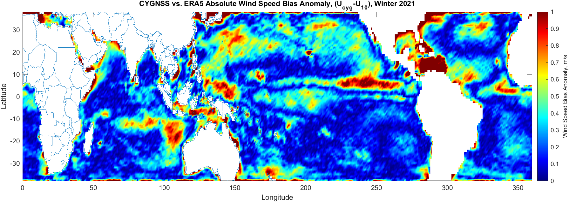
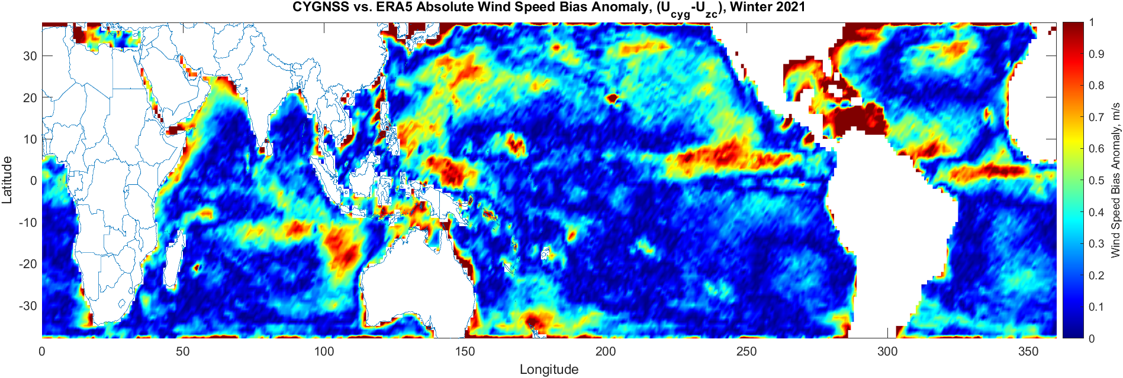
U_{zc} vs. U Absolute Bias Anomaly, 2021 Winter, CYGNSS
CYGNSS vs. ERA5 Current Corrected (top) and CYGNSS vs. ERA5 NWS (bottom)
Improvements in bias anomaly can be seen in the central Pacific, and there’s no area where bias anomaly increases from NWS to U_{zc}

Slide 23
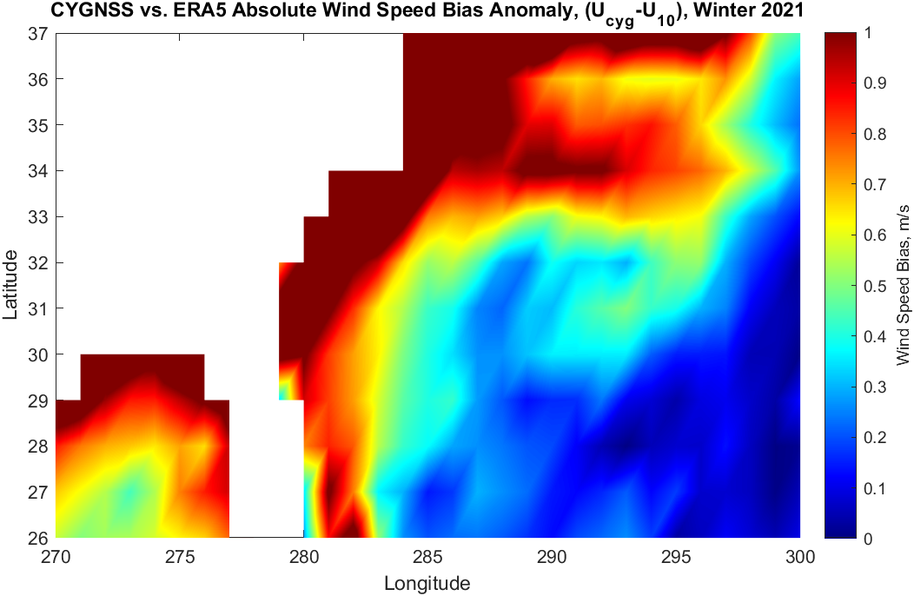
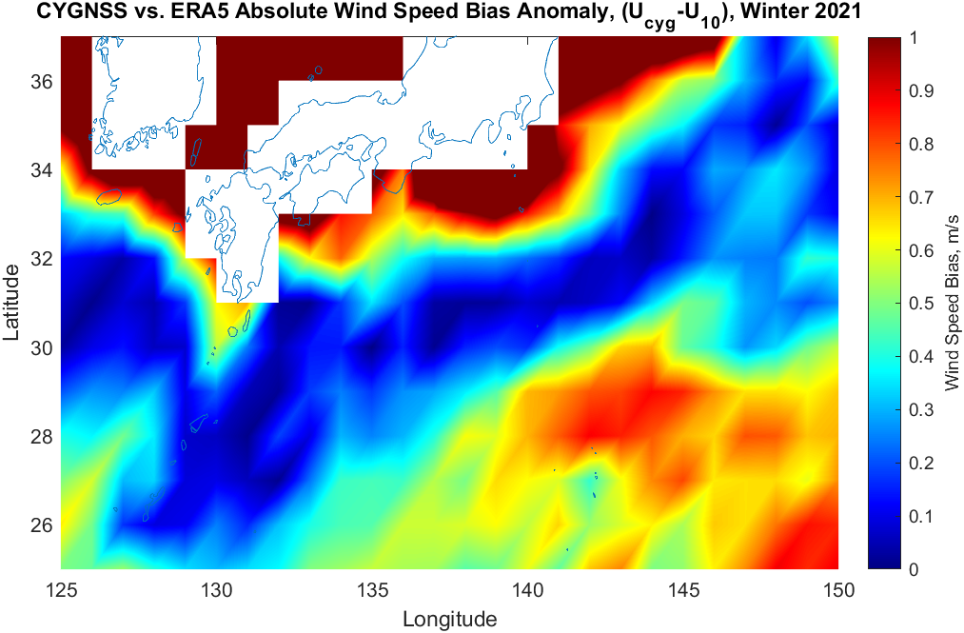
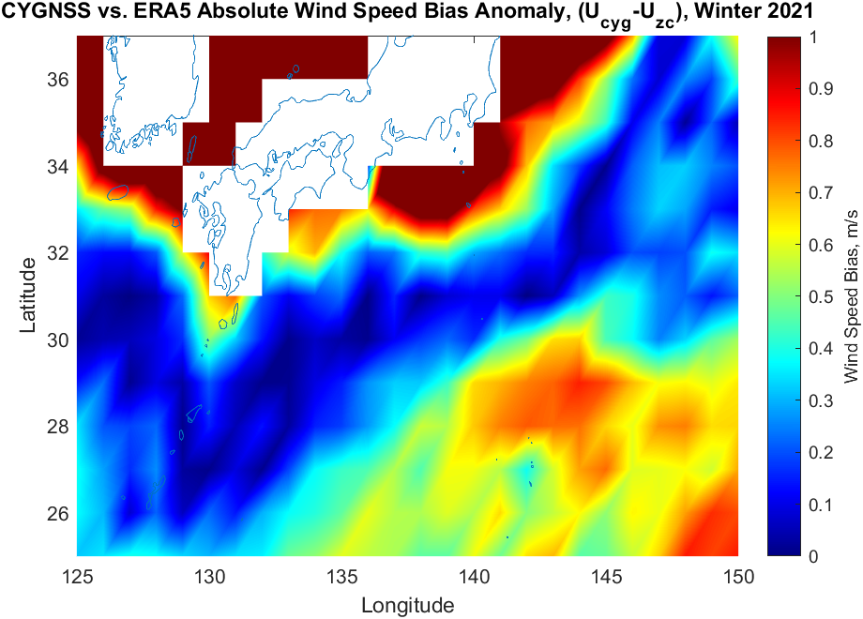
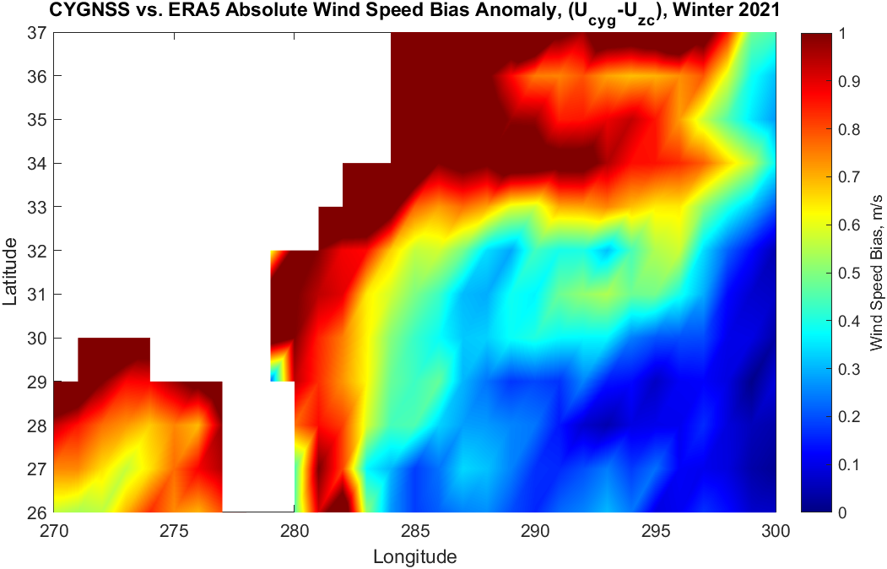
CYGNSS Zoom In on Kuroshio and Gulf Stream

Slide 24
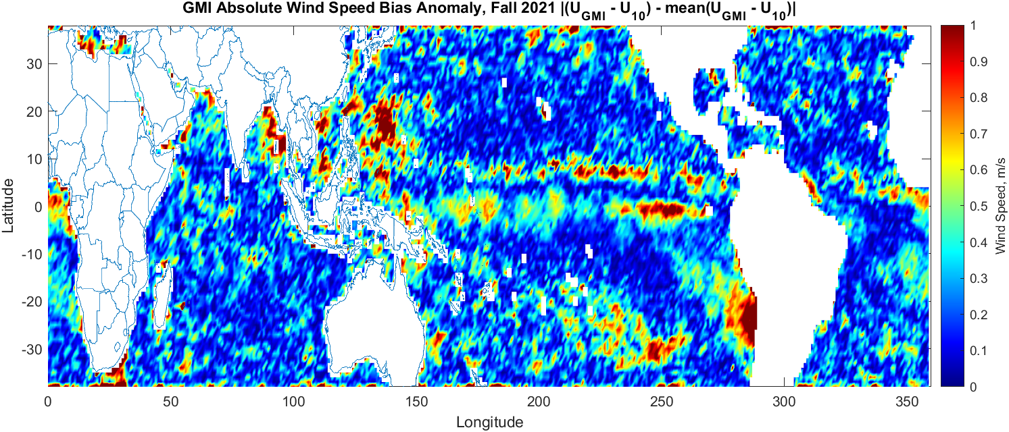
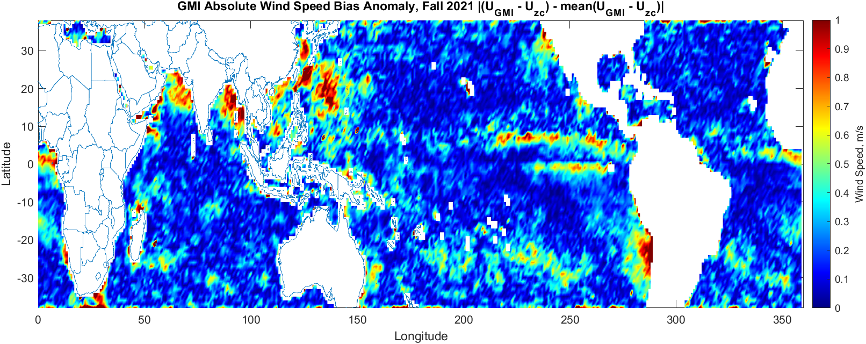
U_{zc} vs. U Absolute Bias Anomaly, 2021 Fall, GMI
GMI vs. ERA5 NWS (top) and GMI vs. ERA5 Uzc (bottom)
Improvements in bias anomaly can be seen in the central Pacific, and there’s no area where bias anomaly increases from NWS to U_{zc}

Slide 25
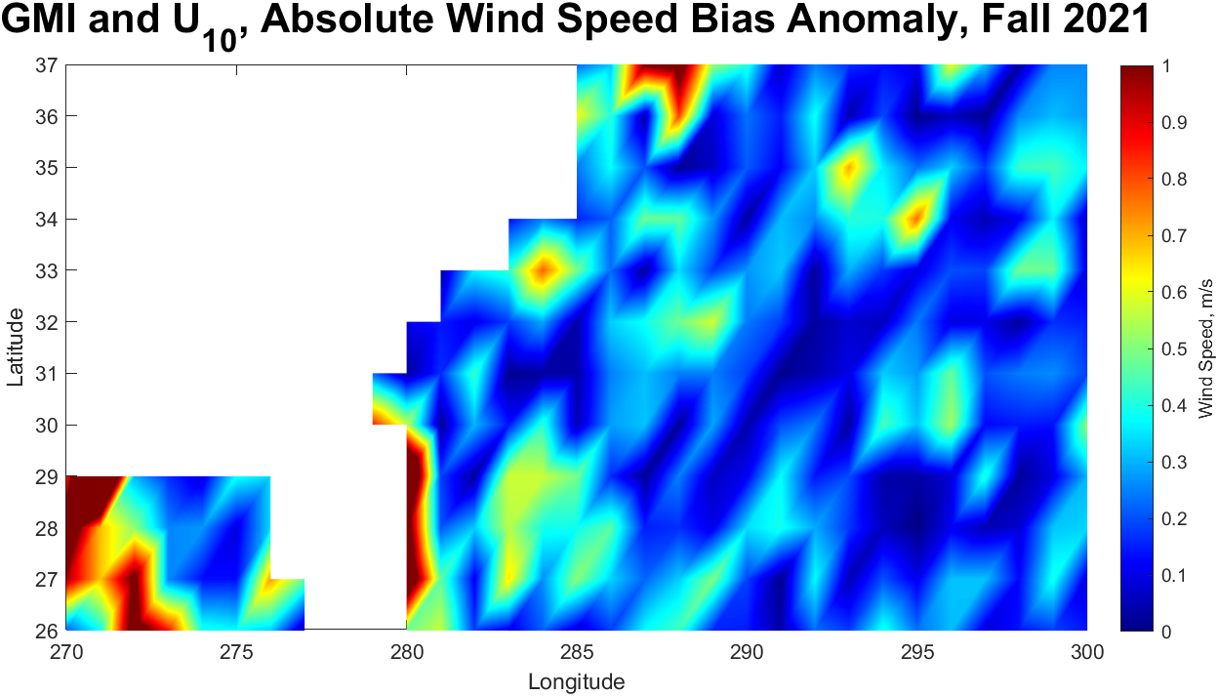
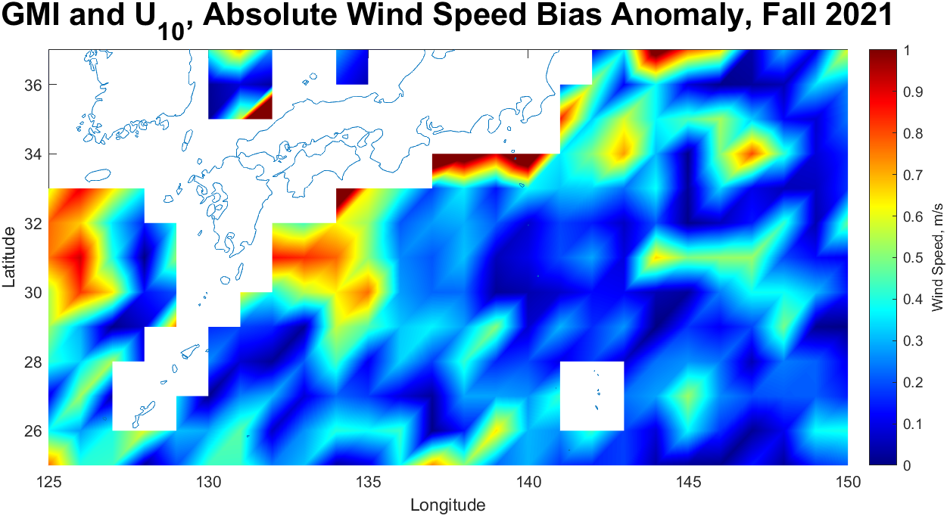
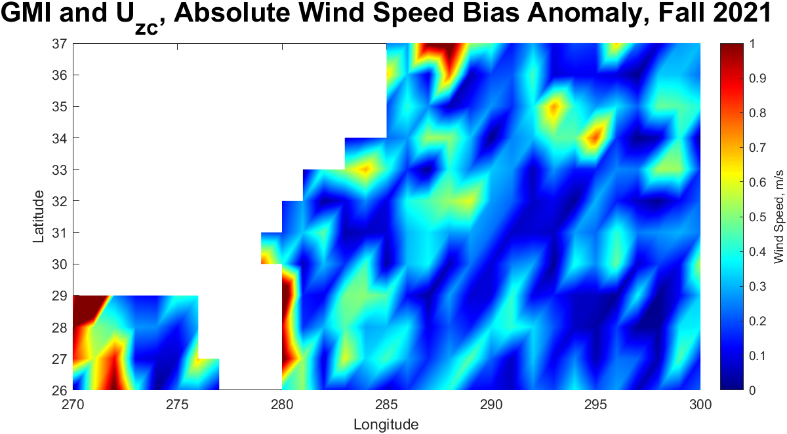
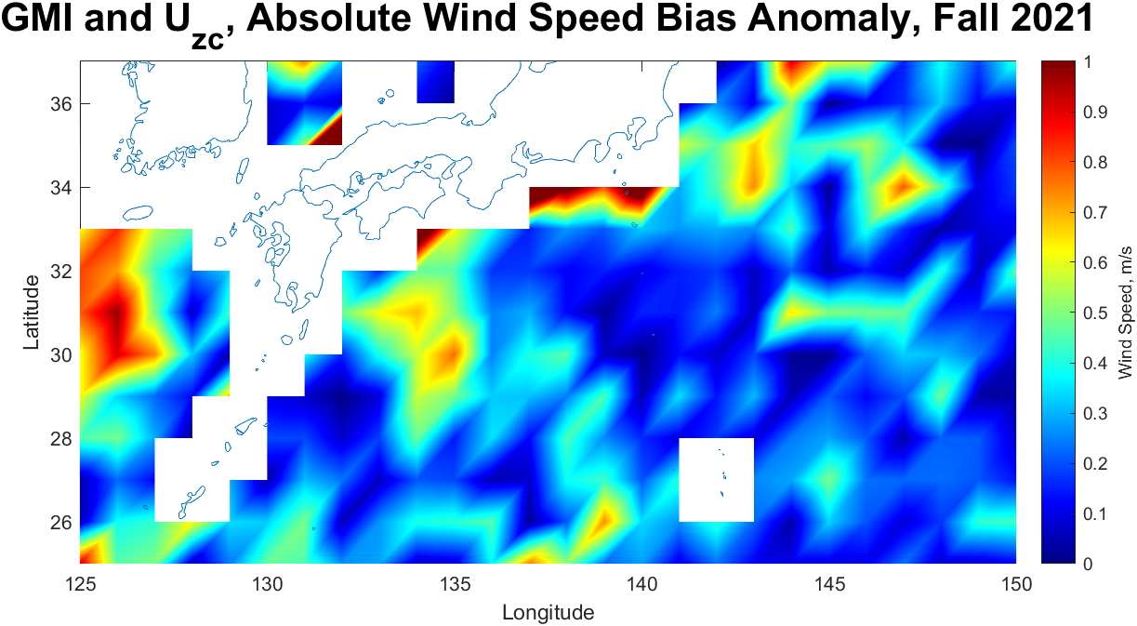
GMI Zoom In on Kuroshio and Gulf Stream

Slide 26
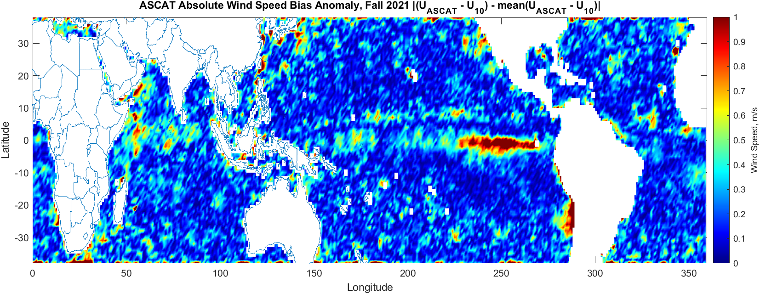
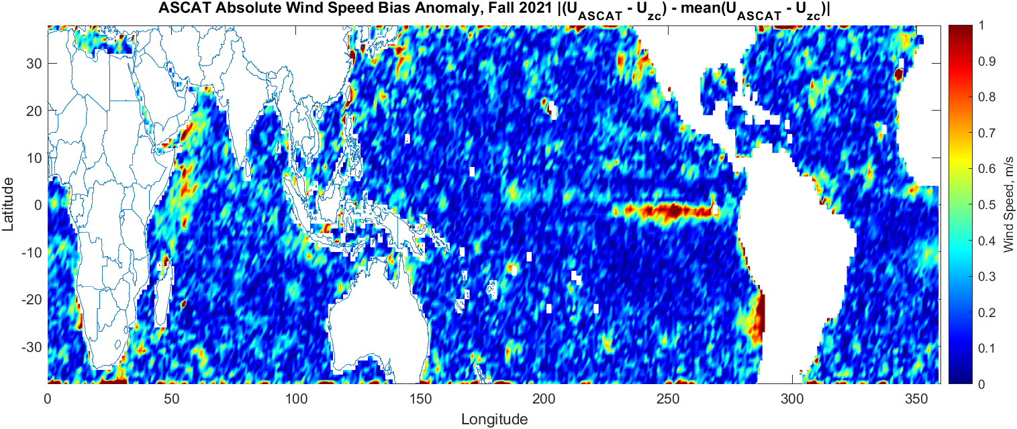
U_{zc} vs. U Absolute Bias Anomaly, 2021 Fall, ASCAT
ASCAT vs. ERA5 NWS (top) and ASCAT vs. ERA5 Uzc (bottom)
Improvements in bias anomaly can be seen in the central Pacific, and there’s no area where bias anomaly increases from NWS to U_{zc}

Slide 27
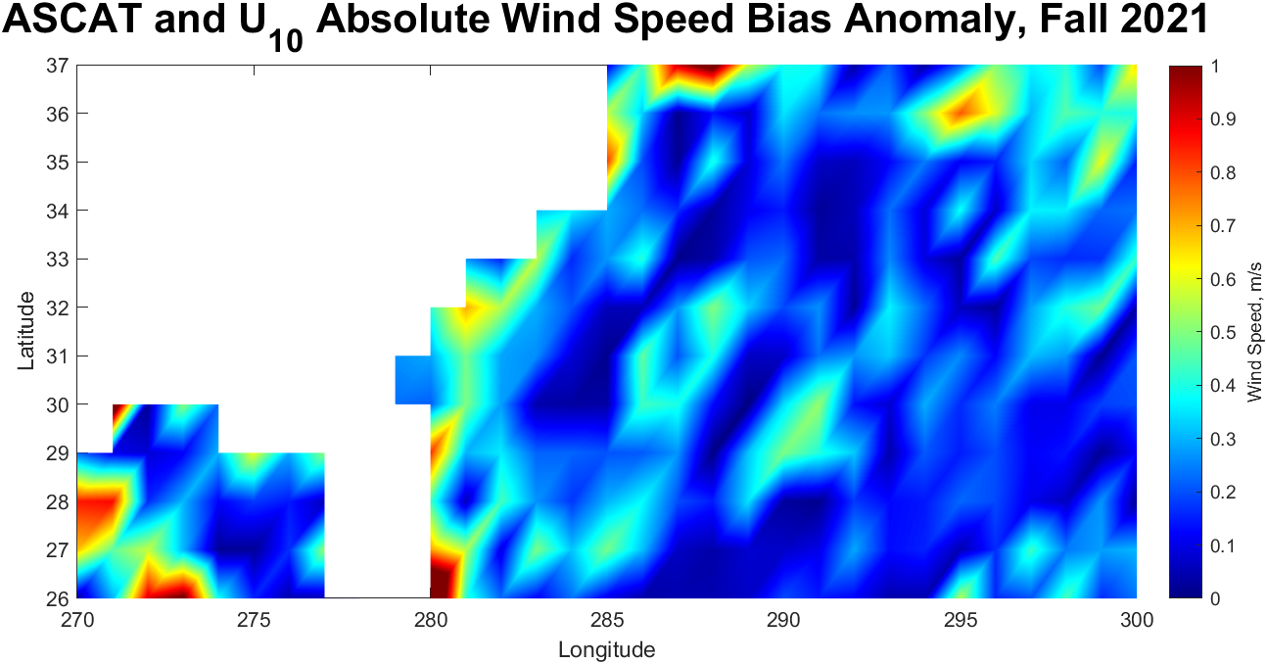
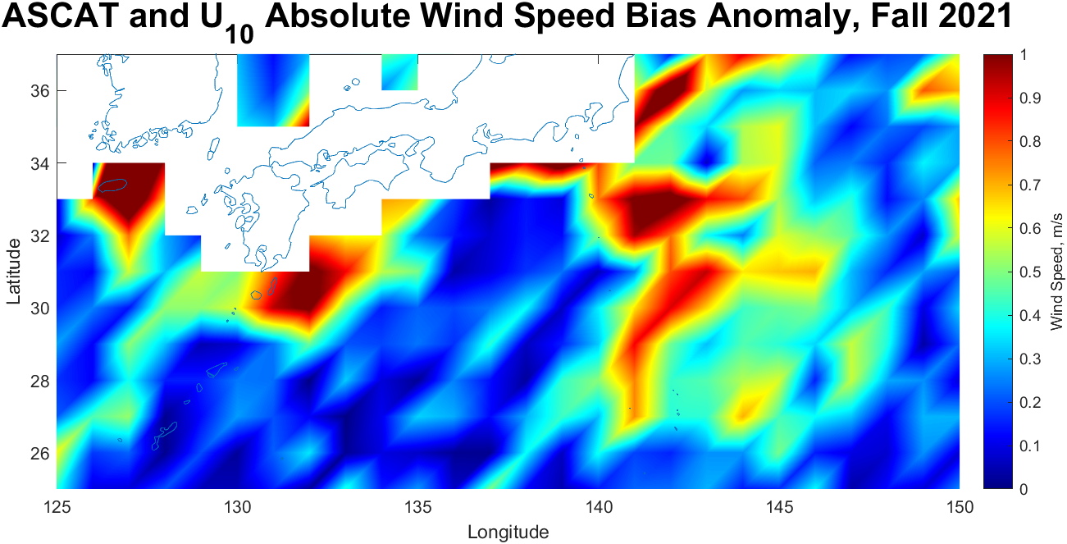
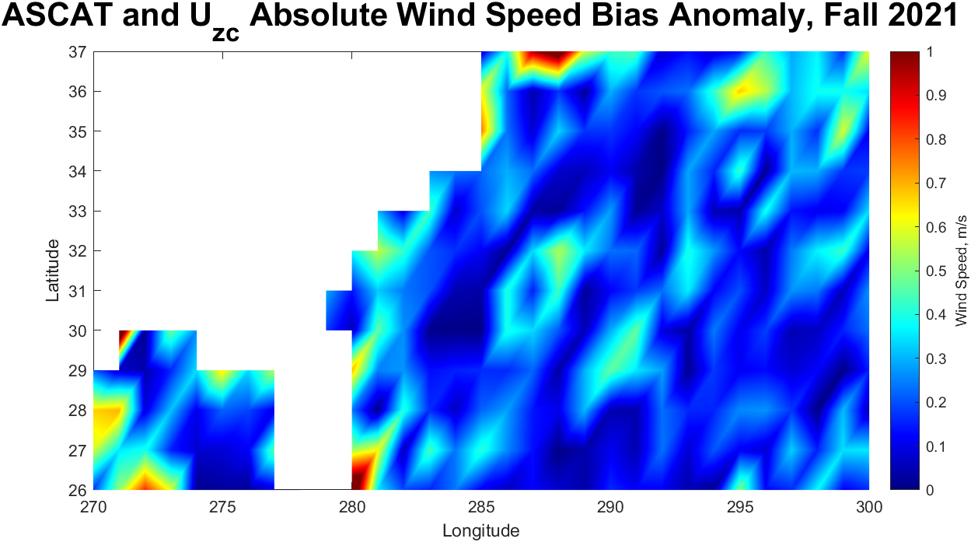
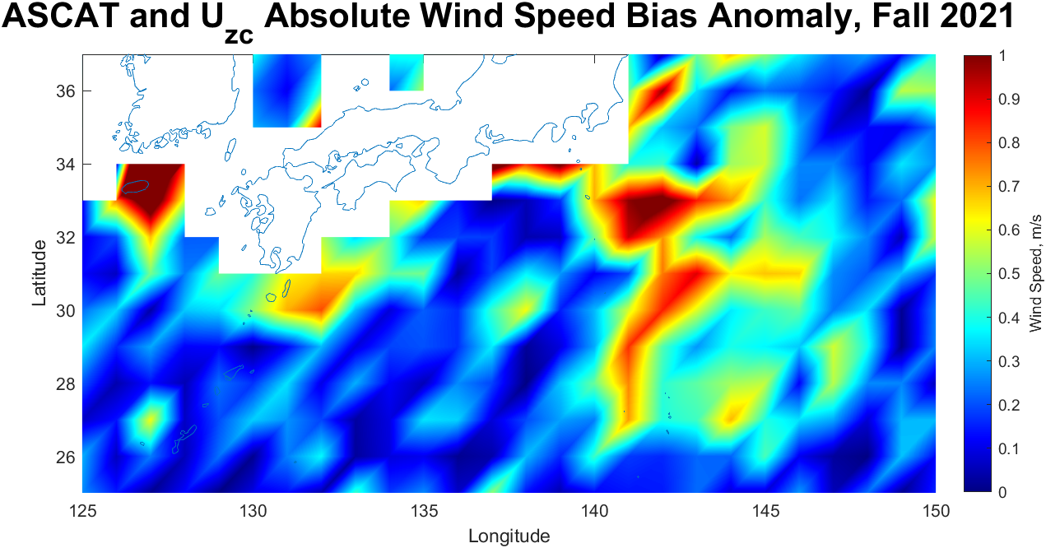
ASCAT Zoom In on Kuroshio and Gulf Stream

Slide 28
Conclusions & Questions
Satellite wind speed products show a decrease in wind speed bias anomaly from the standard ERA5 neutral wind speed product to the modified zero current equivalent wind product.
Matters most in West Pacific ITCZ
Even though the change in wind speed is relatively small (order of 0.1 m/s), this can influence other geophysical parameters that use wind speed, such as Latent Heat Flux.
QUESTIONS:
Should forward models be tuned to U_{zc} instead?
Should retrievals include a current correction to convert retrieved wind to true wind?

