Slide 1
Surfactant effects on parasitic capillary wave dynamics
2024 IOVWST Meeting (Salt Lake City)
Zehua Liu¹, Palas Kumar Farsoiya^{1,*}, Stephane Popinet³ and Luc Deike^{1,2}
Department of Mechanical and Aerospace Engineering, Princeton University, US.
High Meadows Environmental Institute, Princeton University, US.
CNRS, Institut Jean Le Rond d'Alembert - Sorbonne Université, France.
* Current affiliation: Indian Institute of Technology, Roorkee, Uttarakhand, India

Slide 2
Motivation
Kurata, N., Vella, K., Hamilton, B., Shivji, M., Soloviev, A., Matt, S., Tartar, A., & Perrie, W. (2016). Surfactant-associated bacteria in the near-surface layer of the ocean. Scientific Reports, 6.
Sea surface is smoother in surfactant-concentrated area
Surfactants influence the data collected by a scatterometer and its interpretation
Goal: understand how surfactants influence the small-scale waves
Remote sensing
Smoother surface
Notes:
Ocean Surface Smoothness:
In areas where surfactants (like oils) are concentrated, the sea surface tends to be smoother. This is because surfactants reduce the surface tension of water.
Role of Scatterometers:
Scatterometers are devices used to measure the roughness of the ocean's surface. They work by sending radar waves towards the ocean and measuring the intensity of the waves that bounce back (backscattering).
Influence of Surfactants:
Surfactants affect the readings taken by scatterometers. Because surfactants make the sea surface smoother, the radar waves reflect differently compared to rougher, surfactant-free areas.
Research Goal:
The main goal is to understand how these surfactants influence the formation and behavior of small-scale waves on the sea surface. This knowledge helps improve the accuracy of scatterometer data interpretation.

Slide 3
What are surfactants?
Compounds that lower the surface tension between two substances
Unique molecular structures with hydrophilic head and hydrophobic tail
Surfactants come from
active biological production in the sea surface microlayer
human-made pollution
Reduced surface tension
Pollution
Production
Decomposition
Biological activities

Slide 4
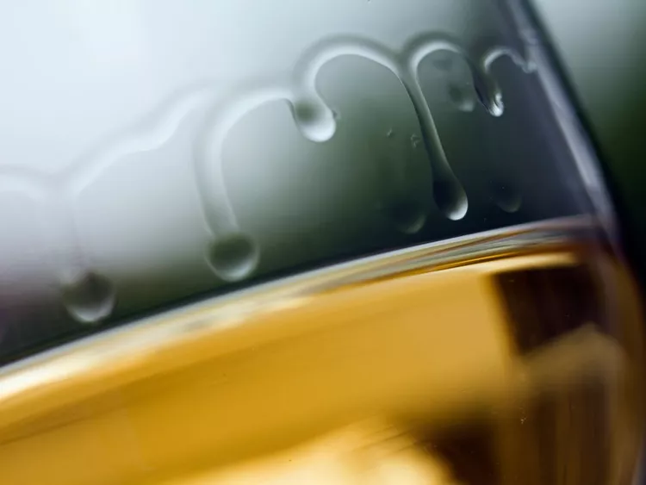
Dynamic effects of surfactants
Tears of wine
Marangoni flow
Water (pepper on it)
Soapy solution
PHOTO: SLOW IMAGES/GETTY IMAGES
Credit: Jubobroff
Surfactants distribution cause gradients in surface tension along the interface
Marangoni stresses that move fluids from area of many surfactants to fewer surfactants

Slide 5
Problem set-up: first without the surfactant
Deike, L., Popinet, S., & Melville, W. K. (2015). Capillary effects on wave breaking. Journal of Fluid Mechanics, 769, 541–569.
$$a$$
Wave amplitude
$$ν$$
Liquid viscosity
$$σ_{0}$$
Surface tension
$$k=2π/λ$$
Wavenumber
Reynolds number fixed
Controlling parameters:
Initial condition:
3rd order stokes wave
Wave steepness
Bond number

Slide 6
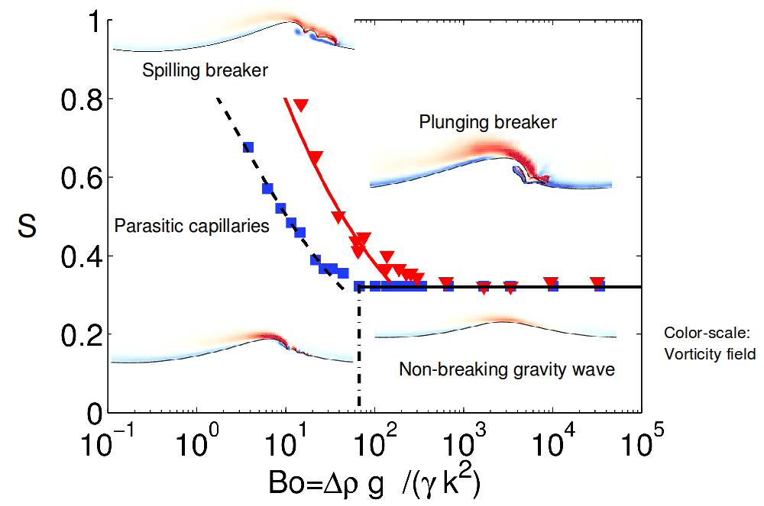
Slope and Bond number control the wave shape
$$Wave slope= \frac{Wave amplitude}{Wavelength}$$
Modification of wave patterns by surfactant?
Current results
main wave is O(0.1-0.5m) capillaries are mm-cm
Deike, L., Popinet, S., & Melville, W. K. (2015). Capillary effects on wave breaking. Journal of Fluid Mechanics, 769, 541–569.

Slide 7
Problem set-up: with surfactant
Surfactant isotherm
$$a$$
wave amplitude
$$k=2π/λ$$
wavenumber
Controlling parameters:
Initial condition:
Uniform distribution of surfactants $Γ\left(x,t\right)=Γ_{0}$
Wave steepness
Bond number
$β$ reflects how surfactants change surface tension

Slide 8
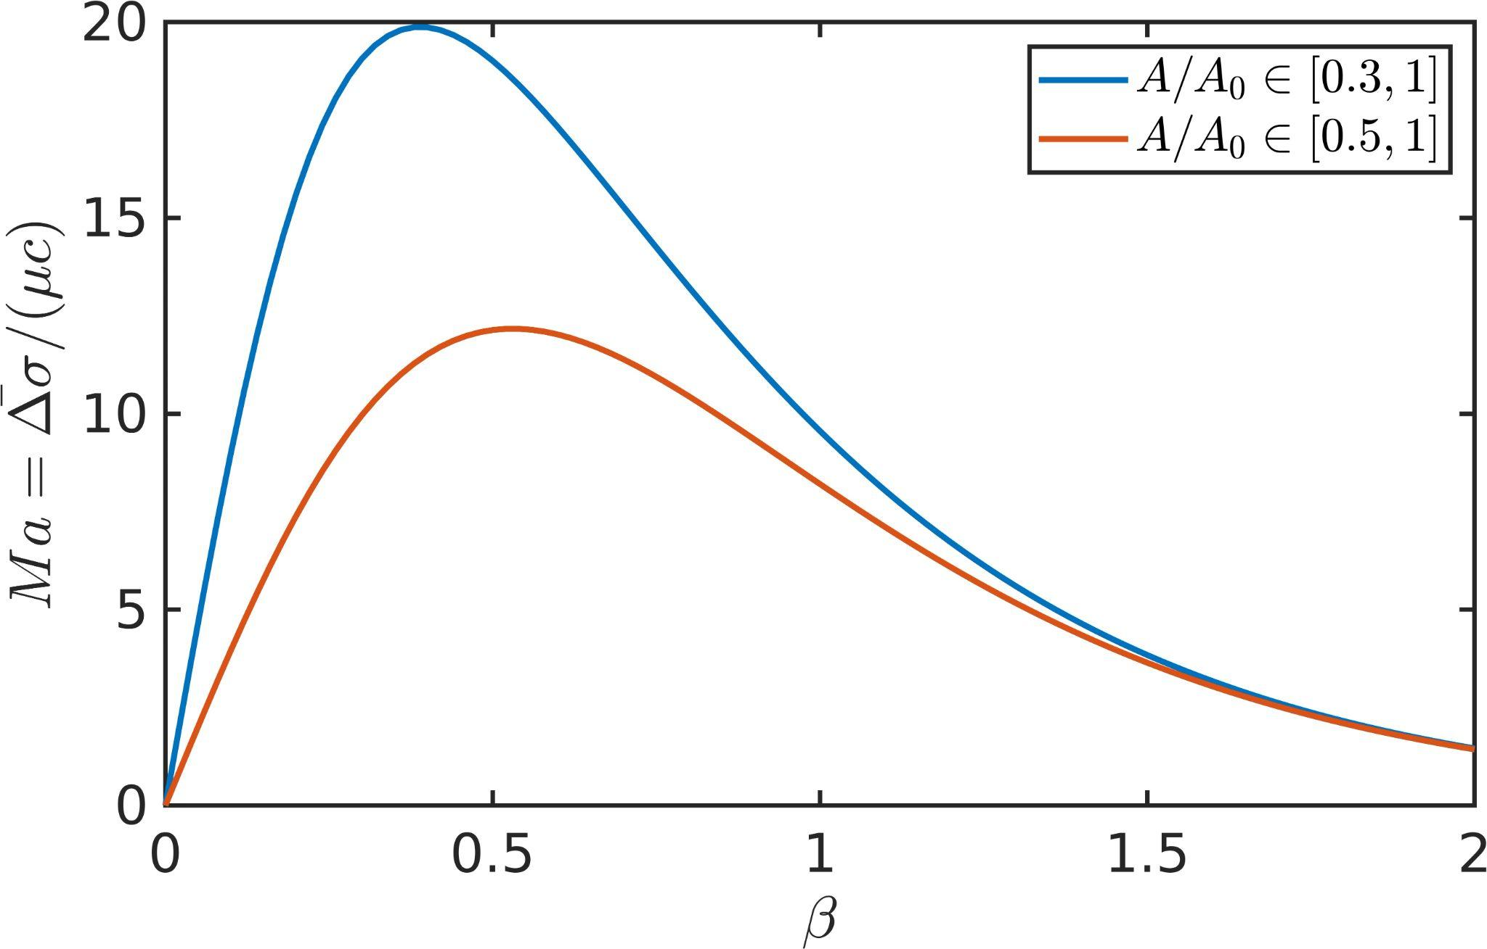
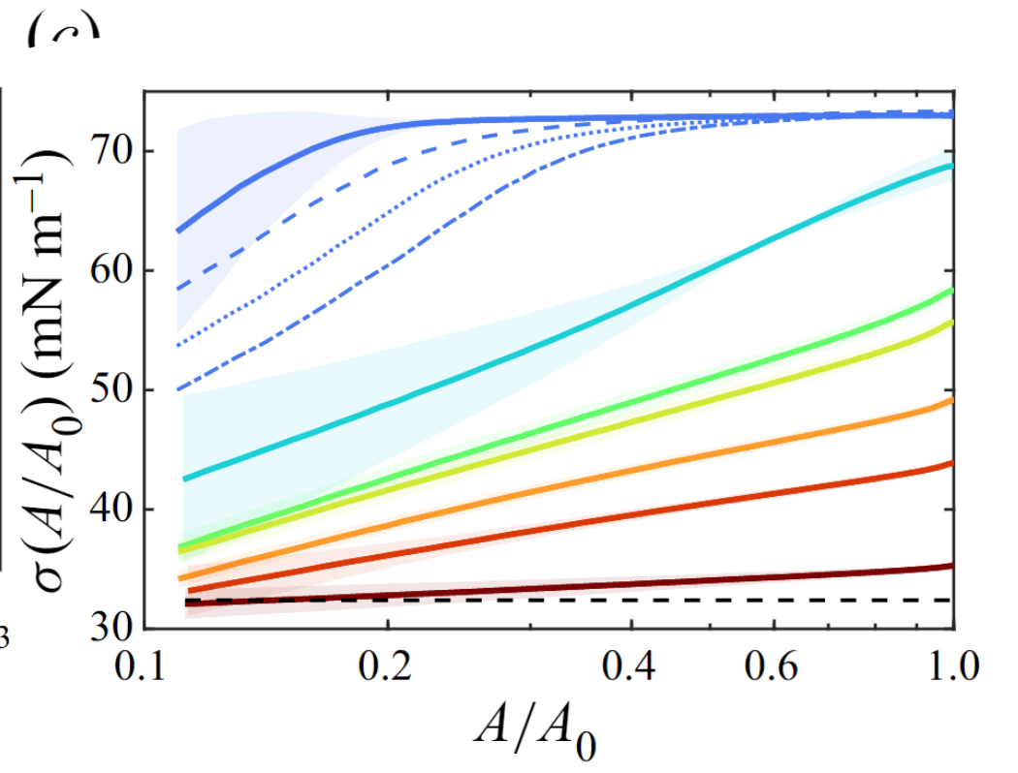
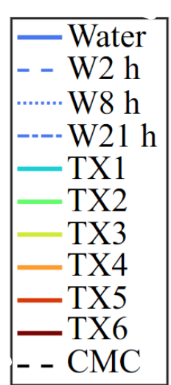
Erinin, M. A., Liu, C., Liu, X., Mostert, W., Deike, L., & Duncan, J. H. (2023). The effects of surfactants on plunging breakers. Journal of Fluid Mechanics, 972.
Surface tension change when compress interface
Effective Marangoni stress due to the surface tension gradient
$$ΓA=Γ_{0}A_{0}$$
Increasing $β$
Small $β\sim 0.01$: clean water, small Marangoni stresses
Intermediate $β\sim 0.3$: TX1, maximal Marangoni stresses
Large $β\sim 2$: TX6, small Marangoni stresses
TX: Triton X (one type of surfactant used in the lab)

Slide 9
Approach: direct numerical simulations
Two phase Navier-Stokes equation:
Marangoni stresses
Surface tension
Volume of fluid method to resolve interface:
Advection-diffusion equation for surfactant transport:
(Advection dominated)
Basilisk, Partial Differential Equations solver
Farsoiya, P.K., Popinet, S., Stone, H.A. and Deike, L., 2024. A coupled Volume of Fluid-Phase Field method for direct numerical simulation of insoluble surfactant-laden interfacial flows and application to rising bubbles.
Popinet, S. (2009) J. Comput. Phys.

Slide 10
Results
No/little surfactants (SB)
Many surfactants (PB)
Surfactant concentration color-coded
Surfactants shift SB to PB
Notes:
Capillary length in water: 2.7mm

Slide 11
Results
No/little surfactants (PCW)
No Marangoni stresses
Color-coded the surfactant concentration
Surfactants transported purely by waves (surface compression)
Surfactants concentrated on wave crest
Small-scale capillary waves
Notes:
Capillary length in water: 2.7mm

Slide 12
Results
No/little surfactants (PCW)
Moderate surfactants (NB)
Surfactants transported
By waves (more concentrated)
By Marangoni-induced flow (more even)
High Marangoni stresses distribute surfactants more evenly
Marangoni stress damp capillary waves
Notes:
Capillary length in water: 2.7mm

Slide 13
Results
Low Marangoni stresses
No/little surfactants (PCW)
High Marangoni stresses
Moderate surfactants (NB)
Low Marangoni stresses
Many surfactants (NB)
Surfactants damp PCW
Notes:
Capillary length in water: 2.7mm

Slide 14
Conclusions
Surfactants change the wave shape: shift SB to PB and damp parasitic capillary waves
Surfactants influence wave dynamics through Marangoni stresses (surface tension variation) and reduced surface tension
Understand how surfactant influence the surface profile will help interpret the scatterometer data
Ocean roughness
Scatteromemter
Better interpretation
Surfactants distribution
For wind speed, direction, sea state etc.
Optical Sensors
Notes:
Capillary length in water: 2.7mm

Slide 15
Results
No/little surfactants (SB)
Many surfactants (PB)
Surfactant concentration color-coded
Surfactants damp PCW
Notes:
Capillary length in water: 2.7mm

Slide 16
Dynamic features (surface tension)
Normalized by the static surface (when $Γ=Γ_{0}$) $σ_{s}=σ_{0}(1−tanh⁡(β))$
$$ak$$
$$0.3$$
PCW
PCW
GW
GW
GW
$$0.01$$
$$0.06$$
$$0.3$$
$$1$$
$$2$$
$$β$$
Note that $β=2$ seems to have huge relative variation, but $σ_{s}$ is smallest, so Marangoni stress is low
$@ Bo=25$ (L10)
$$Ma=0,4,20,10,1$$

Slide 17
Dynamic features (Marangoni stresses)
$$ak$$
$$0.3$$
PCW
PCW
GW
GW
GW
$$0.01$$
$$0.06$$
$$0.3$$
$$1$$
$$2$$
$$β$$
$@ Bo=25$ (L10)
$$Ma=0,4,20,10,1$$

Slide 18
1. Reduced Backscatter Signal. Surfactants dampen the small capillary waves on the ocean surface, the radar pulses sent by the scatterometer will have a weaker backscatter signal because a smoother surface reflects less energy. 2. Altered Wind Speed Measurements. Scatterometers estimate wind speed based on the roughness of the ocean surface, a surfactant-dampened surface can lead to an underestimation of wind speed. The scatterometer might interpret the smoother surface caused by surfactants as a sign of lighter winds. 3. Impacted Wind Direction Data. Similarly, the pattern of waves is used to determine wind direction. If surfactants alter the wave patterns, this could also affect the accuracy of the measured wind direction. 4. Misinterpretation of Sea State. Researchers using scatterometer data need to account for the presence of surfactants. If they're not considered, the sea state could be misinterpreted.
More about how surfactants influence scatterometer measurements

Slide 19
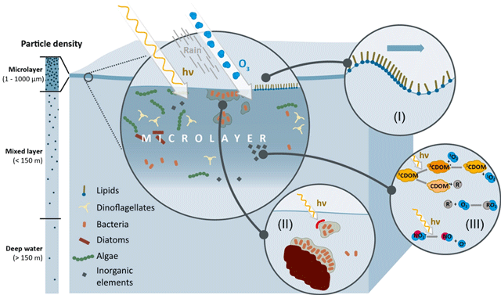
More about sea surface microlayer (SML)
SML is the boundary between atmosphere and ocean; thickness 1$μm$ to 1mm;
Chemical Composition: The SML often contains higher concentrations of organic compounds
Biological Activity: This layer is rich in microbial life and serves as a habitat for bacteria, viruses, and phytoplankton.
Environmental Interactions: The SML plays a pivotal role in the exchange of gases (like carbon dioxide and oxygen), heat, and momentum between the ocean and the atmosphere.
Pollutant Accumulation: The SML has been observed to accumulate pollutants, including heavy metals, organic pollutants, and microplastics.

Slide 20
Parasitic capillary wave
Small ripples (~cm) that ride on the crests of larger gravity waves
Parasitic: they derive energy from larger waves instead of direct interaction with wind
Reason for the choice
See how large-scale waves transport surfactants
Find out how surfactants influence the small-scale wave patterns
Add scales here, showing main wave is O(0.1-0.5m) and capillaries are mm-cm
Gravity waves
Parasitic capillary wave
Notes:
~cm

Slide 21
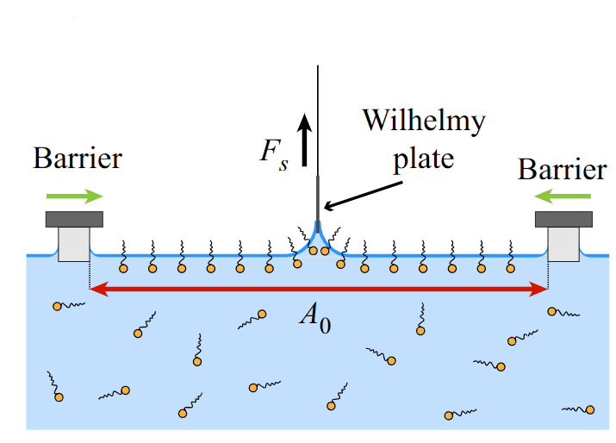
Erinin, M. A., Liu, C., Liu, X., Mostert, W., Deike, L., & Duncan, J. H. (2023). The effects of surfactants on plunging breakers. Journal of Fluid Mechanics, 972.
Understand $β$
Increasing $β$
$$ΓA=Γ_{0}A_{0}$$
Surface tension change when compress interface
Experimental setup
TX: Triton X (one type of surfactant used in the lab)

Slide 22
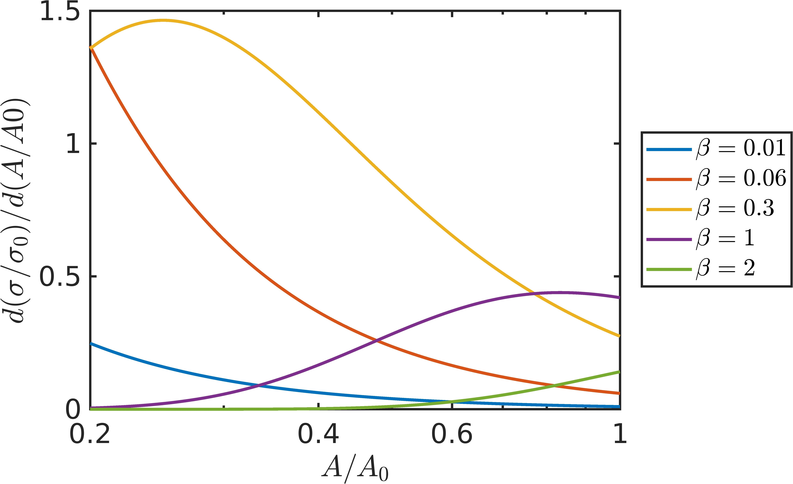
Erinin, M. A., Liu, C., Liu, X., Mostert, W., Deike, L., & Duncan, J. H. (2023). The effects of surfactants on plunging breakers. Journal of Fluid Mechanics, 972.
Understand $β$
Increasing $β$
Surface tension change when compress interface
How fast the surface tension change when compress interface (derivative of the left)

Slide 23
More about the meaning of Marangoni number
Transport speed due to surface tension gradient/Advective transport speed
Estimating the Marangoni Number for a Simple Liquid
Viscosity of Liquid: 𝜇
Change in Surface Tension: Δ𝛾
Characteristic Length (Distance over which surface tension changes): 𝐿
Assumption:
The liquid depth is at least 𝐿, with 𝐿 being the only length scale in the problem.
Transport Rate Estimation:
Using Stokes Flow Equations: Fluid velocity is derived by balancing the stress gradient against viscous dissipation.
Surface Tension as Force per Unit Length: Stress from surface tension change scales as Δ𝛾/𝐿​.
Viscous Stress Scaling: Scales as 𝜇𝑢/L​ where 𝑢 is the speed of the Marangoni flow.
Equation for Flow Speed: 𝑢=Δγ/​μ

Slide 24
Understand $β$: surface tension variation when compress interface
TX: Triton X (one type of surfactant used in the lab)
Small $β\sim 0.01$: clean water, small Marangoni stresses
Intermediate $β\sim 0.3$: TX1, maximal Marangoni stresses
Large $β\sim 2$: TX6, small Marangoni stresses
Experimental measurements can be modeled by:
Erinin, M. A., Liu, C., Liu, X., Mostert, W., Deike, L., & Duncan, J. H. (2023). The effects of surfactants on plunging breakers. Journal of Fluid Mechanics, 972.
$$ΓA=Γ_{0}A_{0}$$

