Slide 1
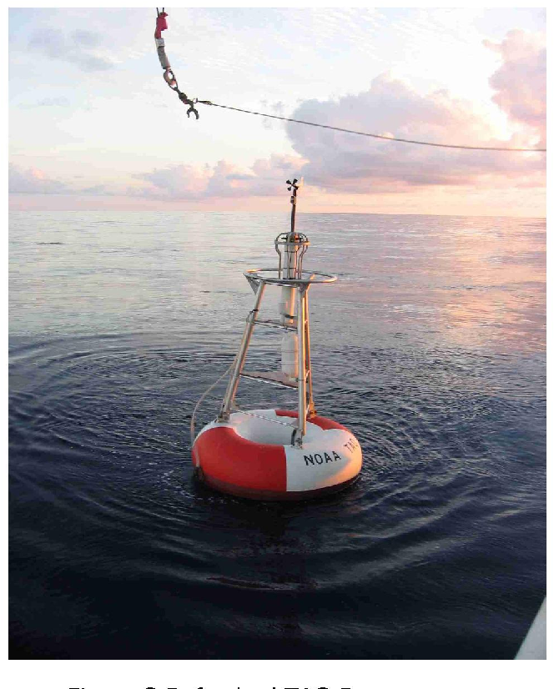
Investigation of Calibration Change in Ocean Surface Wind Measurements from the TAO Buoy Array
Lucrezia Ricciardulli, Andrew Manaster, Richard Lindsley
Remote Sensing Systems, Santa Rosa, CA, USA
This study is supported by NASA OVWST
IOVWST meeting, May 29-31, 2024, Salt Lake City

Slide 2
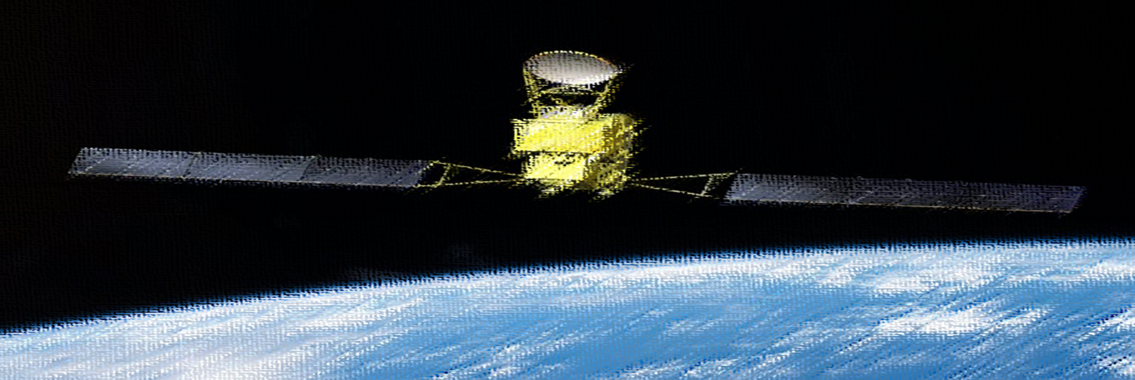
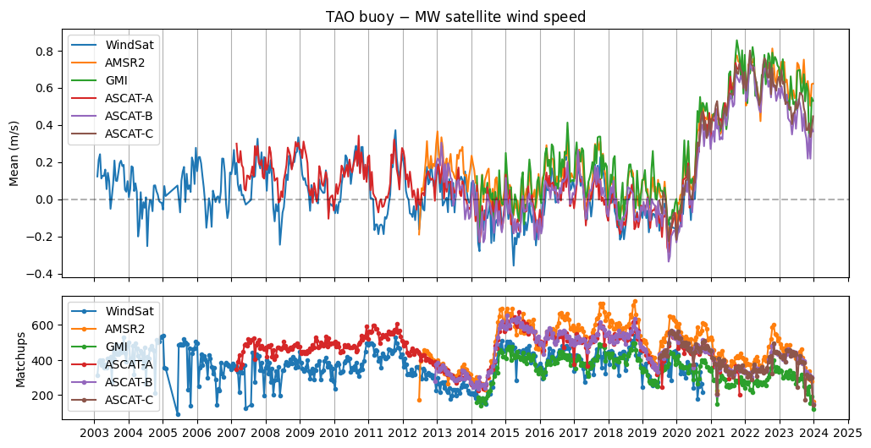
Comparison TAO Buoy Wind speeds vs Satellites
During routine analyses of satellite winds’ stability, a large sudden temporal instability in the TAO buoy wind timeseries has been detected: 0.5-0.8 m/s (10%) since mid-2020

Slide 3
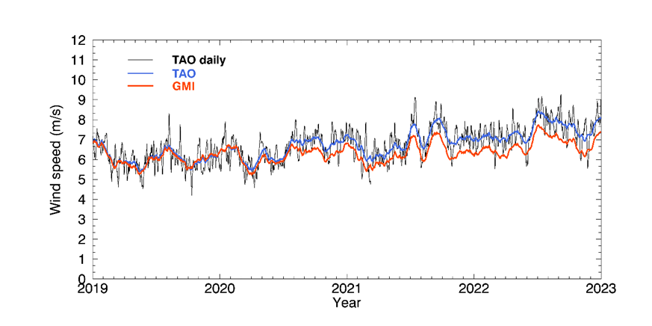
TAO Wind Sudden Change after Buoy Were Serviced
Average over all TAO buoys: incremental change
The timing of the buoys’ wind change corresponds to a period when the TAO buoys were serviced, starting from mid-2020, for the following 2 years
We informed NDBC in 2022: they confirmed a change in calibration coefficients in the new anemometers, still under investigation as of 2024
30-min; 25 km matchups
Example for sample buoy:
Sudden change

Slide 4
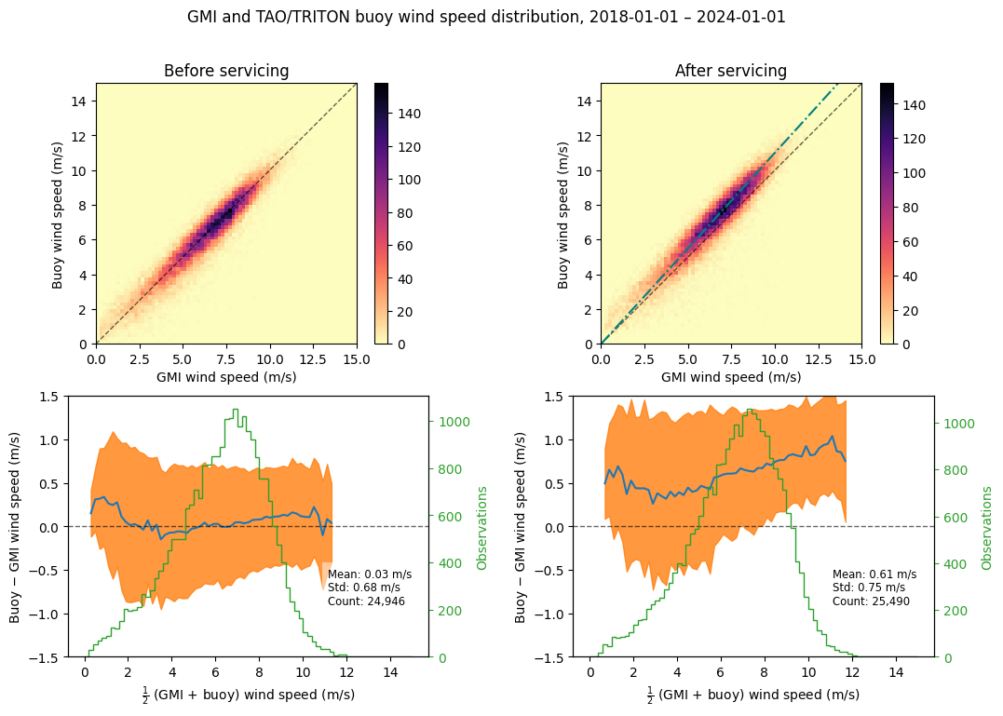
TAO Wind Sudden Change is Proportional to Wind Speed
The change is not a simple shift, rather it seems proportional to wind speed
Present in both components
Estimated ~10% increase
Consistent with the estimated change in calibration coefficients of the anemometers
(Steve DiNapoli, NDBC, personal communication)
10% increase
1-1 line

Slide 5
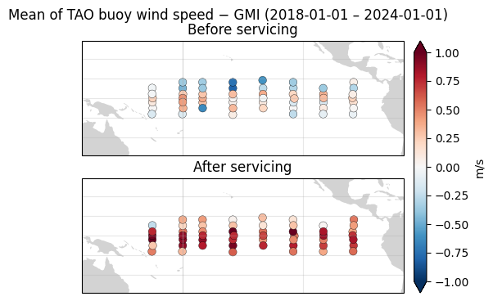
All TAO Buoys Are Affected

Slide 6
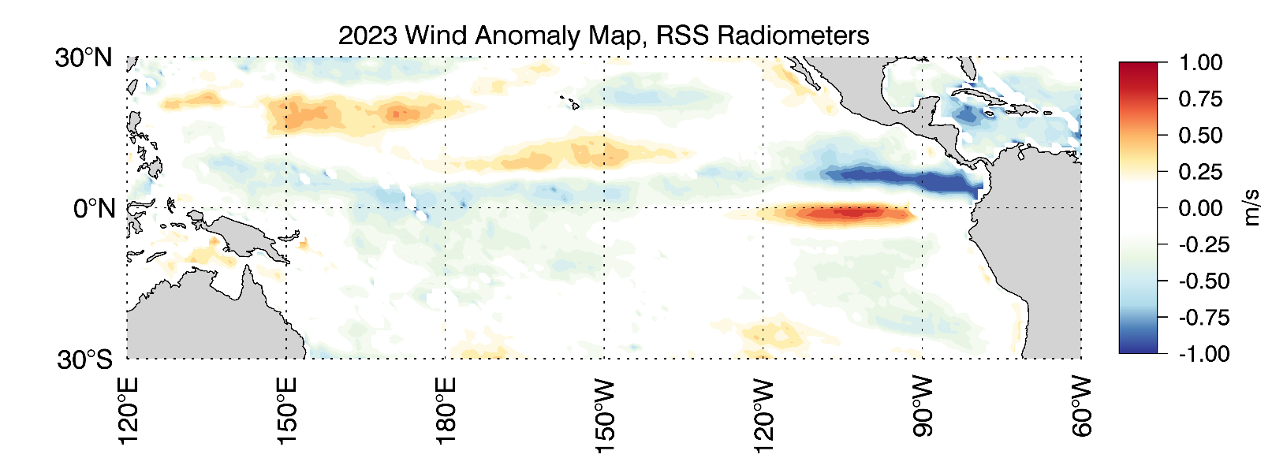
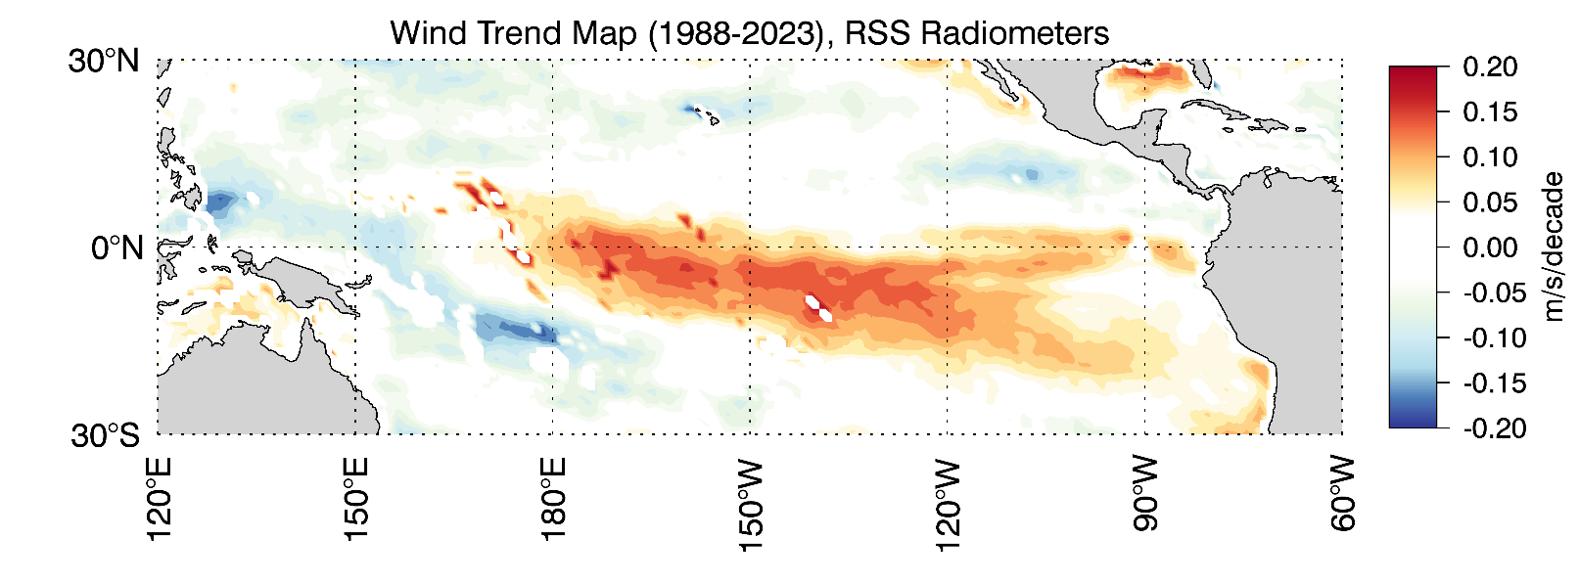
Is the TAO wind sudden change significant?
TAO wind change is larger than climate signals
In the Tropical Pacific
Wind anomaly
Typically < 0.8 m/s
(except intense ENSO events)
Wind trend
< 0.2 m/s

Slide 7
Impact on Users
Misalignment with other buoy arrays: What is the “ground truth”?
Any other observationally-based method using buoys for verification
(i.e. Saildrones, CCMP)
Satellite calibration/validation
Climate Data Record developers
Data assimilation in NWP
Surface Heat Fluxes: dataset development and verification
Tropical climate variability analyses → need to account for spurious signal

Slide 8
Summary and Topics for Discussion
Large sudden temporal instability in the TAO buoy wind timeseries has been detected: 0.5-0.8 m/s (10%) since mid-2020
Cross-calibrated satellite data proved very useful for detecting this change
Changes are of the order or larger than climate signals
No official statement from NDBC whether this is temporary or permanent
Users need to be aware and decide how to deal with it
Manuscript to be submitted to BAMS in June
Use satellite data to develop near real time monitoring of buoy quality
Ask NDBC to provide clear communication and guidance to users.
Ask NDBC to coordinate any such major changes at the global level with other observing systems in the future
Discard TAO buoys for new satellite verification (post-2020) until the mismatch with other buoy arrays is resolved
Suggestions for future course of action:

Slide 9
Extra figures
Number
Of matchups

Slide 10
Buoy-GMI
Bias as function of wind speed,
Before (L) and after service (R)

