Slide 1
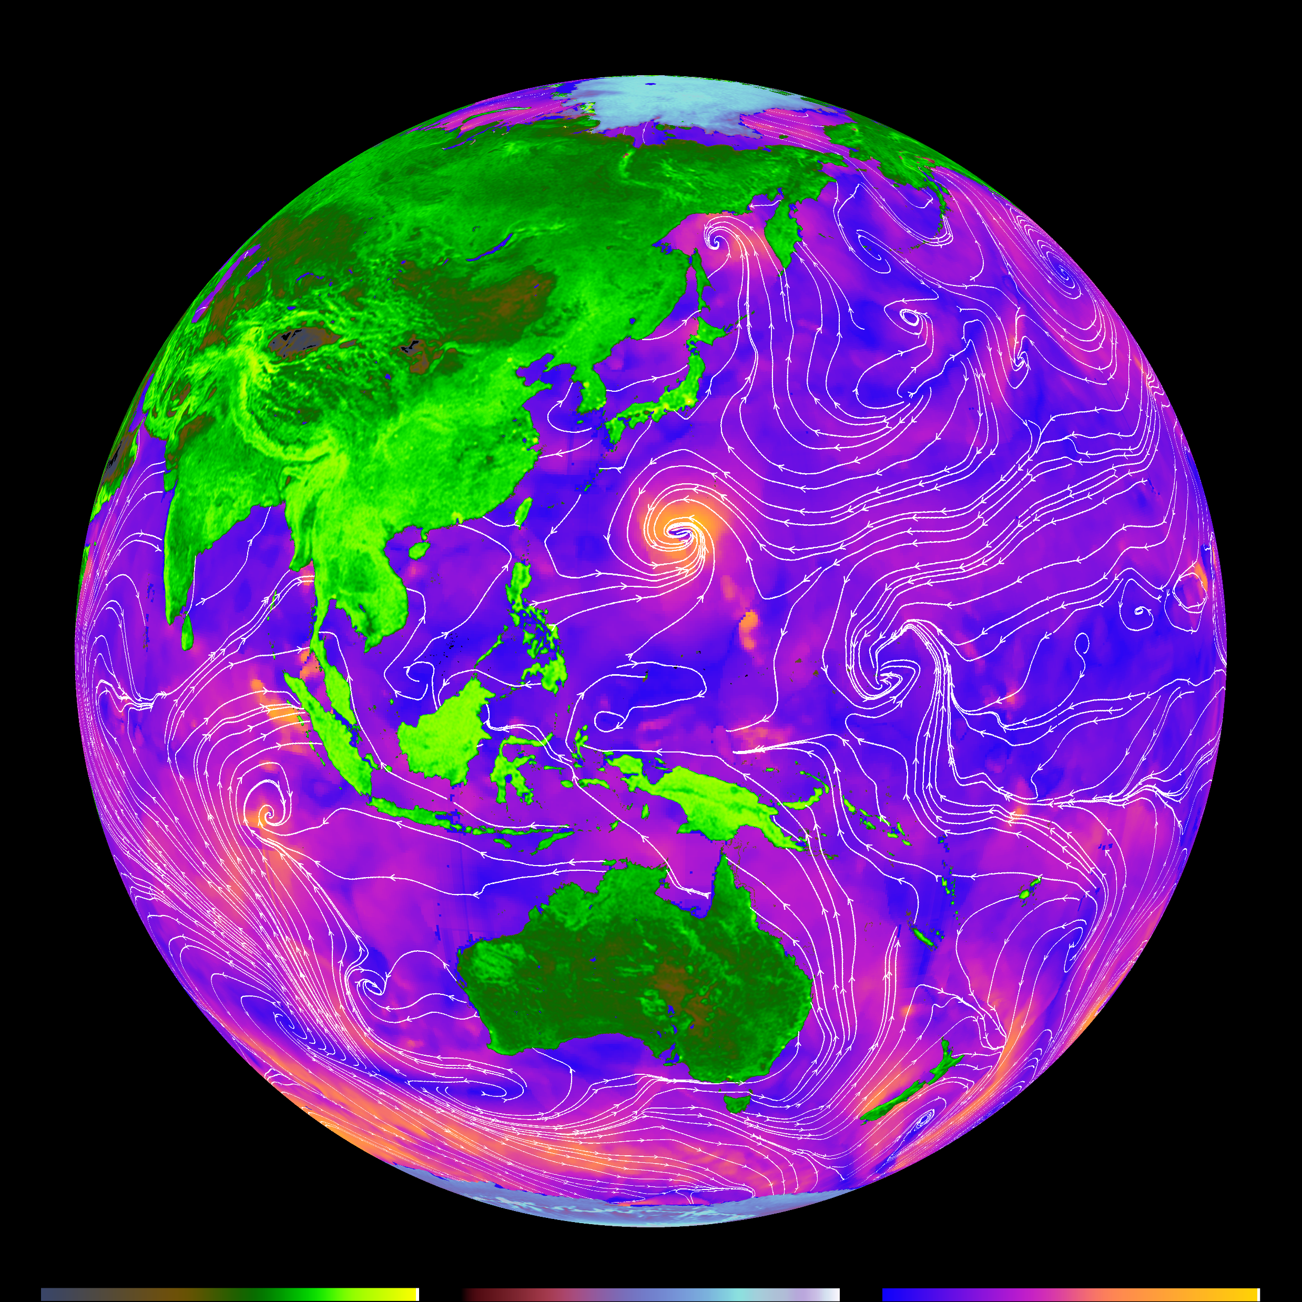
Introduction to Scatterometry
International Ocean Vector Wind
Science Team (IOVWST) Meeting
29 May 2024
Prof. David Long
long@ee.byu.edu
Brigham Young University

Slide 2


Microwave Remote Sensing
Radar
T/R switch or
circulator
Radiometer
Transmit
signal
generator
Frequency
reference
Frequency
reference
Antenna
Antenna
Signal
receive
chain
Signal
receive
chain
Sensor Classes
Processing
Processing
Active (radar)
Passive (radiometers)
Real Aperture
Synthetic Aperture
Real Aperture
Synthetic Aperture
Scatterometer
SAR
Radiometer
SA radiometer
Altimeter
Sounder
Interferometer
Side-looking radar
Interferometric
SAR
Weather radar
Note: Current scatterometers only measure power. Future ‘Doppler scatterometers’ will use EM phase information to estimate surface current.

Slide 3
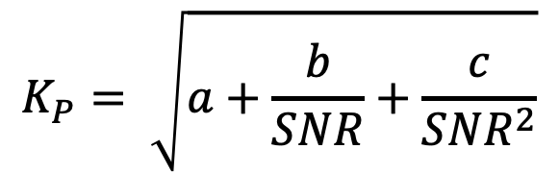

Key Scatterometer Equations
Radar Equation:
where
    is the received power
    is the transmitted power
    is the antenna gain
    is the transmit wavelength
    is the resolution cell area
    is the slant range
    is the normalized surface backscatter
Noise Equation:
where
    is the noise power
    Boltzman’s constant (1.38e-21)
    is the system noise temperature
    is the receiver bandwidth
Kp Equation: (radiometric accuracy)
$$K_{P}=\frac{\sqrt{var(σ^{o})}}{σ^{o}}$$
where a, b, c are constants that depend on the instrument and WVC
$$K_{P}= \sqrt{a+\frac{b}{SNR}+\frac{c}{{SNR}^{2}}}$$
SNR = P_{R} / P_{N}
Note: “Noise” (P_{N}) is the ‘signal’ in radiometry. $σ^{o}$ is the ‘signal’ in scatterometry.

Slide 4
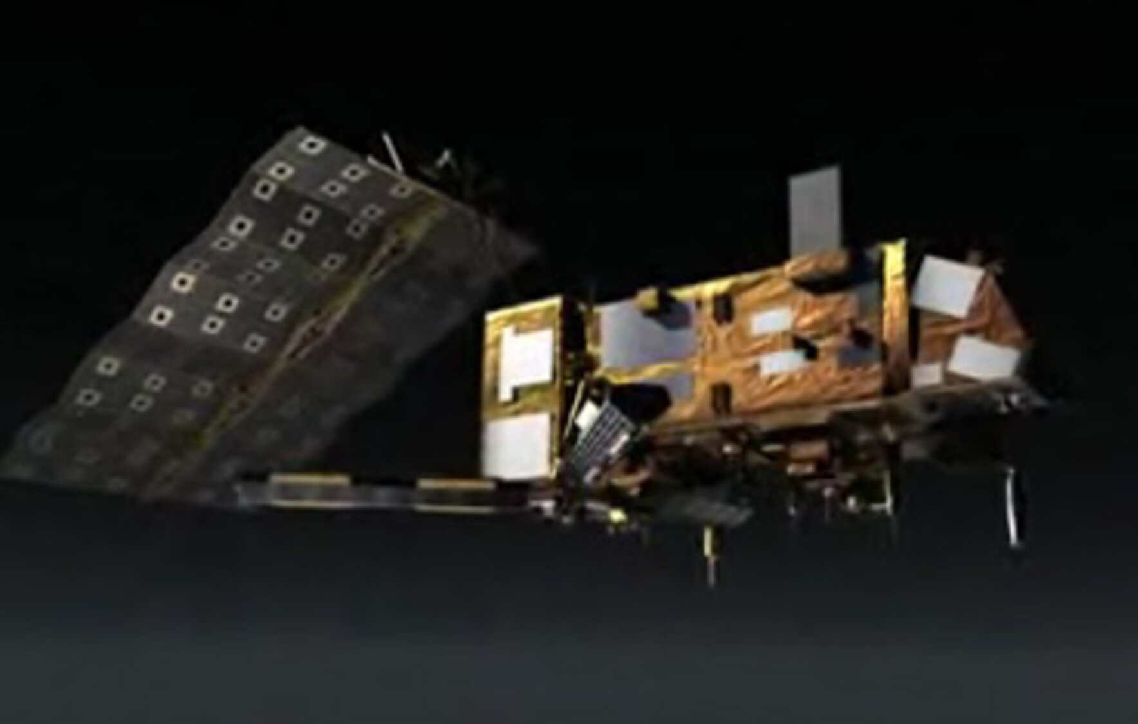
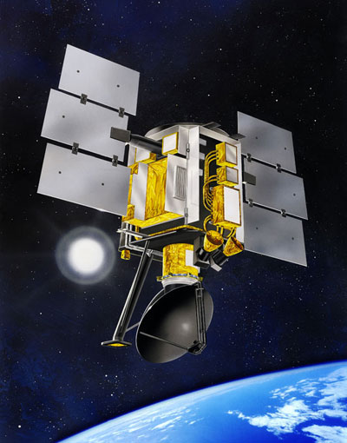
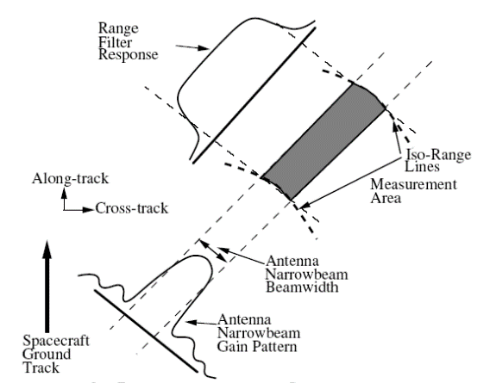
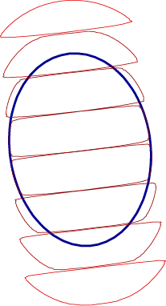
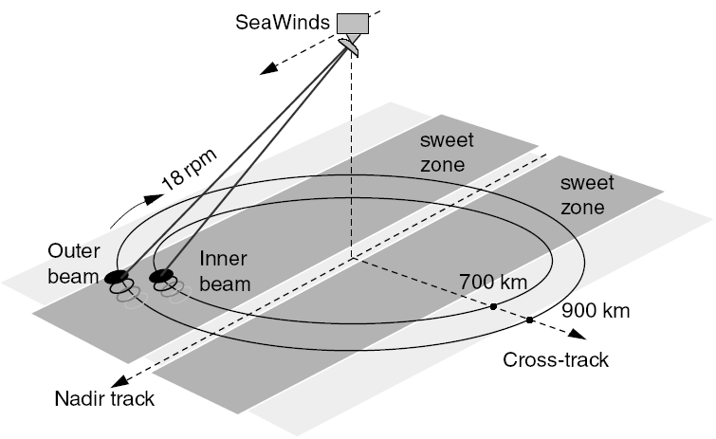
Fan-beam vs Scanning Scatterometers
Fan-beam
Conically Scanning
SASS/ERS/NSCAT/ASCAT resolution defined by beamwidth and Doppler or range gating in along-beam
SeaWinds/QuikSCAT/OSCAT/HY resolution defined by beamwidth with range/Doppler processing to create “slices”
Nadir Track
˚
45°
45°
90°
90°
45°
45°
Extended
Swath
~100 km
~100 km
550 km
672 km
550 km
Left Wind
Swath
Nadir
gap
Right Wind
Swath

Slide 5
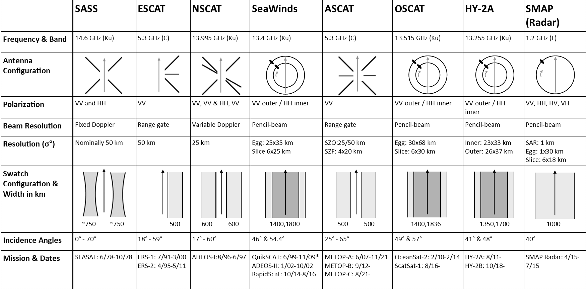
Wind Scatterometers- Past and present

Slide 6
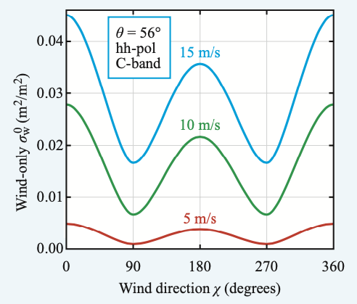
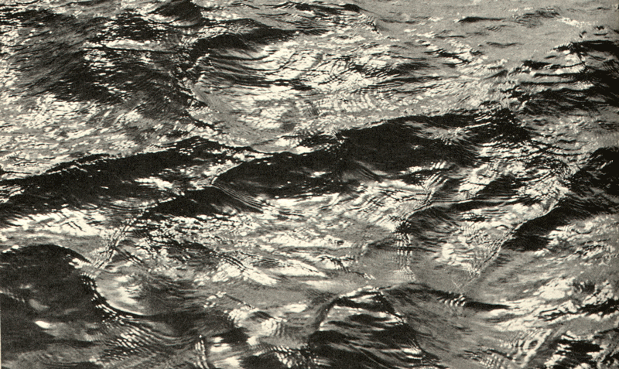
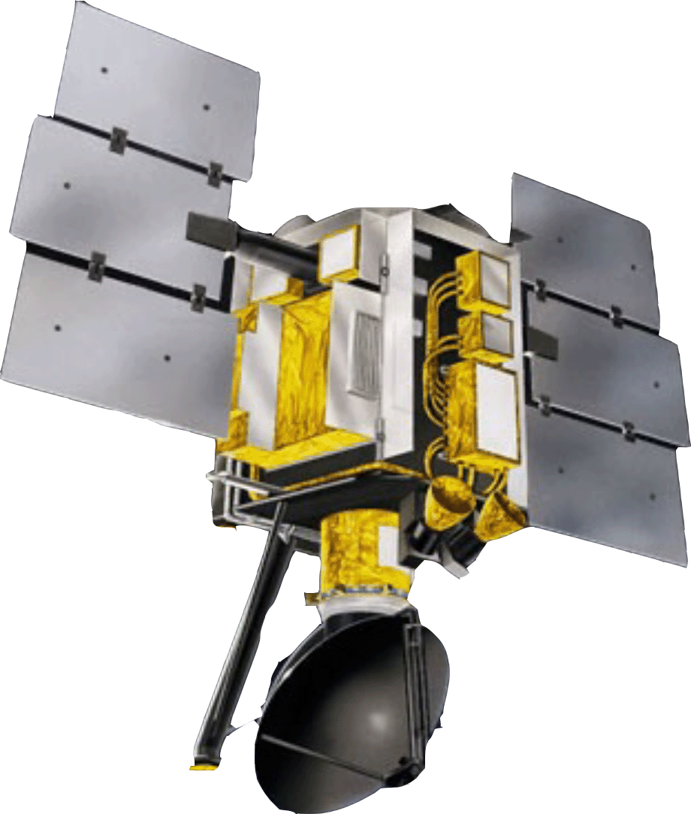
Geophysical Model Function (GMF)
Wind Scatterometry Theory
• Winds over the ocean create small capillary-gravity waves (“cat’s paws”) which roughen surface
- Roughness is related to wind speed and direction
• A scatterometer measures surface roughness via measurements of the normalized radar cross-section (NRCS or sigma-0)
- Sigma-0 measured at multiple azimuth angles
• Wind estimated (”retrieved”) from sigma-0 with aid of geophysical model function (GMF)
D.Long 6
Notes:
Radar scatterometers were originally designed to measure winds over the ocean from space. (This is what I used to do when I worked for NASA – design satellite radars.) The animation shows scatterometer-measured winds blowing around a hurricane off the East Coast. In the picture, colors over the ocean are wind speed, while the lines are the wind direction. Red and yellows denote high wind speeds, while blue shows calmer winds. [pause] Scatterometers measure the wind by measuring small ocean waves called “cat’s paws”. Cat’s paws are the small waves you see when a gust of wind blows over the water and roughens up the surface. From the roughness measurements made by the scatterometer, the wind speed and direction can be estimated. [pause] The scatterometer also collects data over land. My engineering students and I have developed computer techniques to make radar pictures from the scatterometer data. These pictures have proven remarkably useful in studying the Earth. (slow down)

Slide 7
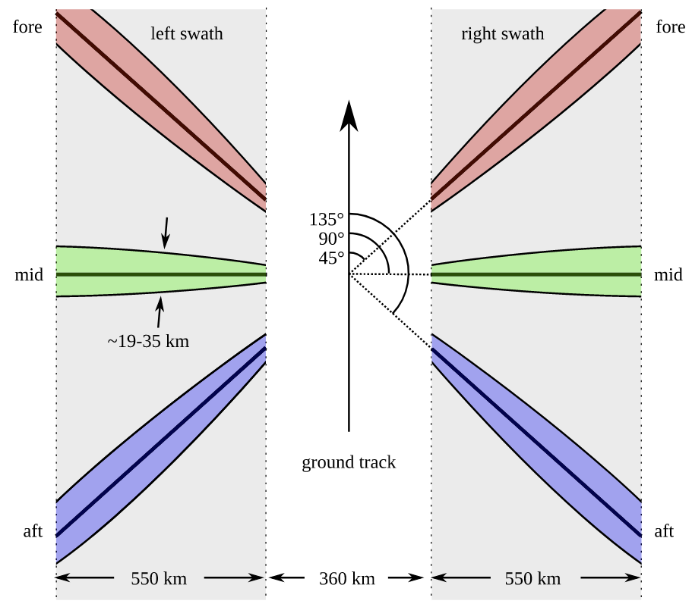
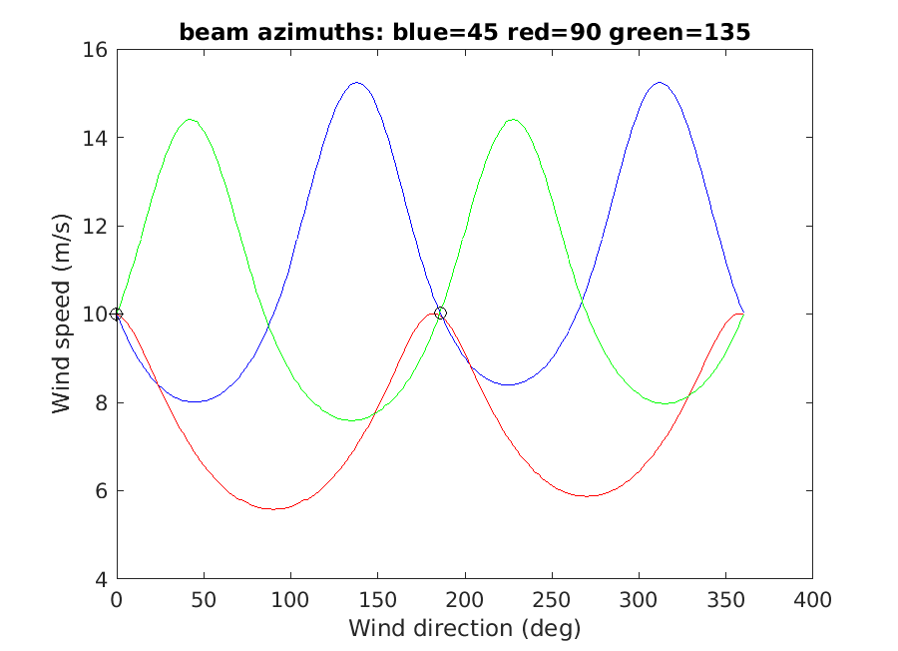
How does scatterometer wind retrieval work?
(a simplified illustration for ASCAT)
ASCAT collects 3 sigma-0 measurements at different azimuth angles
GMF gives wind/speed curve for each
Wind estimate is where curves intersect
  Determine by minimizing an “objective function”
Multiple solutions called “ambiguities”
  Typically, 1-4 ambiguities
  Rank by “closeness” (1st, etc.)
  First two about 180° deg apart, similar speeds
Selection of unique wind uses nearby estimates (“Ambiguity selection”)
7

Slide 8
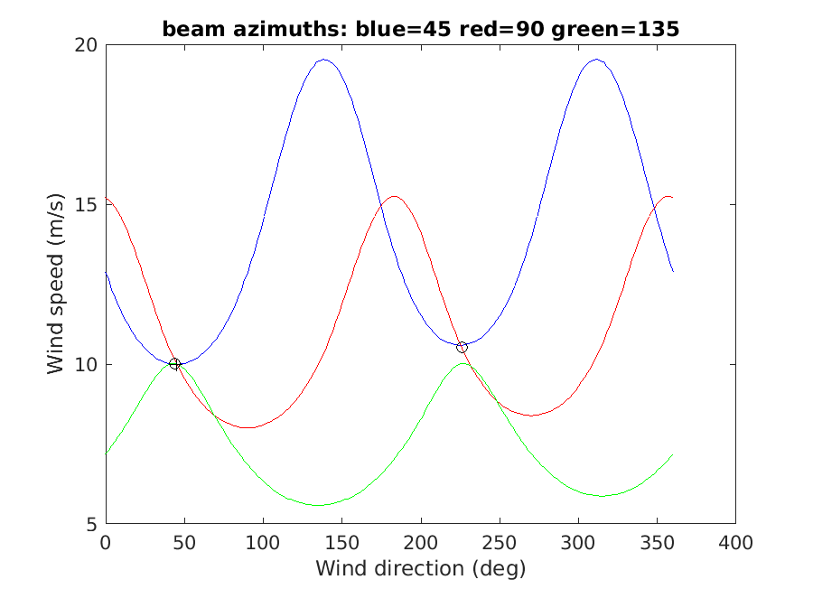
How does scatterometer wind retrieval work?
(a simplified illustration for ASCAT)
ASCAT collects 3 sigma-0 measurements at different azimuth angles
GMF gives wind/speed curve for each
Wind estimate is where curves intersect
  Determine by minimizing an “objective function”
Multiple solutions called “ambiguities”
  Typically, 1-4 ambiguities
  Rank by “closeness” (1st, etc.)
  First two about 180° deg apart, similar speeds
Selection of unique wind uses nearby estimates (“Ambiguity selection”)
8

Slide 9
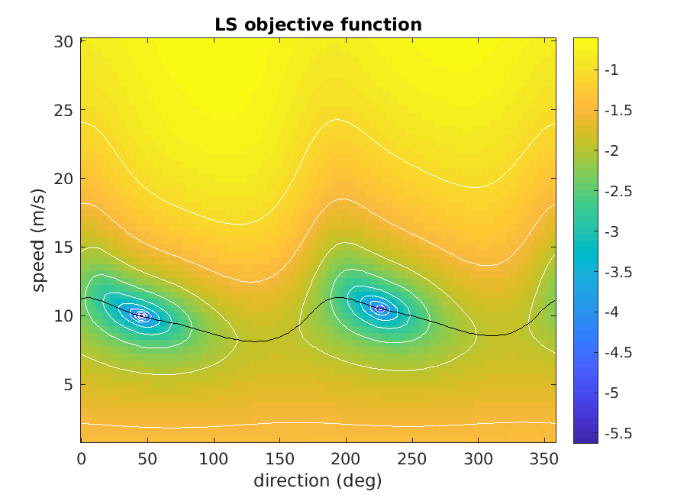
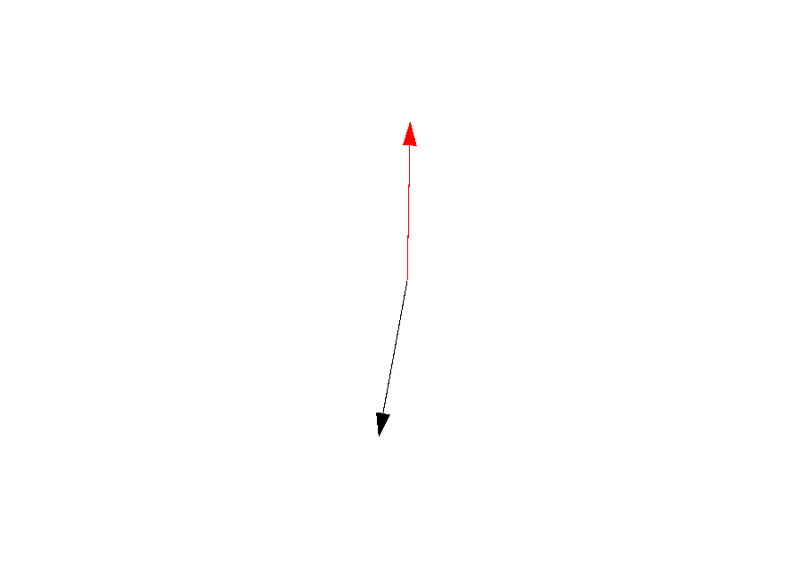
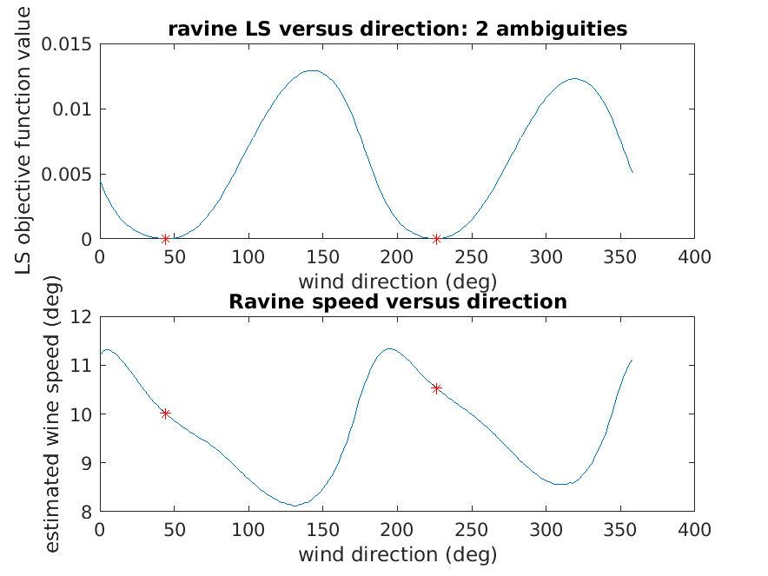
Objective function:
Maximum Likelihood (MLE)
Maximum Aposteriori (MAP)
Least Squares, etc.
N
Wind ambiguity vectors

Slide 10
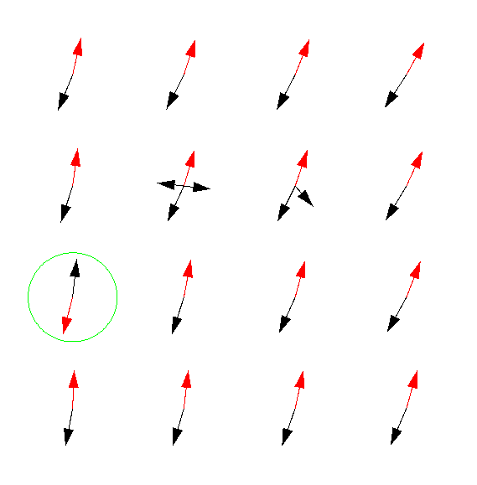
Ambiguity Selection
Ambiguities generally have similar speeds
  First and second differ by ~180°
  Mostly 2, sometimes 3 or 4
Many different methods to select unique vector at each WVC
One: Median filter-based
  Start with 1st ambiguities
  Compute median of nearby area
  Choose ambiguity closest to median
WIND RETRIEVAL
MEASURE
SIGMA-0 AT
SEVERAL
AZIMUTH
ANGLES
AMBUGUITY
SELECTION
(Removal)
INVERT
MODEL
FUNCTION
Red: First-ranked (most likely) ambiguity
Black: Other ambiguities
WIND
VECTORS

Slide 11
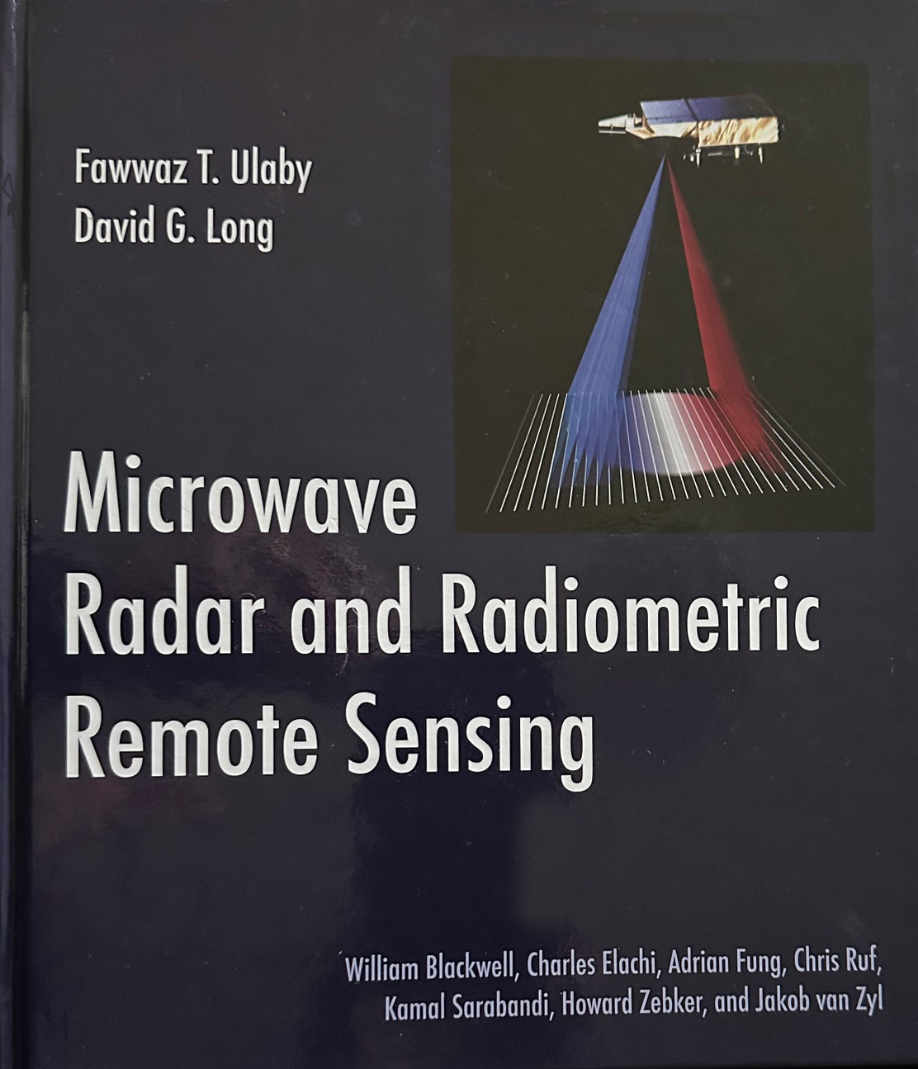
More information
F.T. Ulaby and D.G. Long, Microwave Radar and Radiometric Remote Sensing, University of Michigan Press, 2014.
https://us.artechhouse.com/Microwave-Radar-And-Radiometric-Remote-Sensing-P1738.aspx
https://www.amazon.com/Microwave-Radar-Radiometric-Remote-Sensing/dp/0472119354
David Long long@ee.byu.edu
11 D.Long

Slide 12
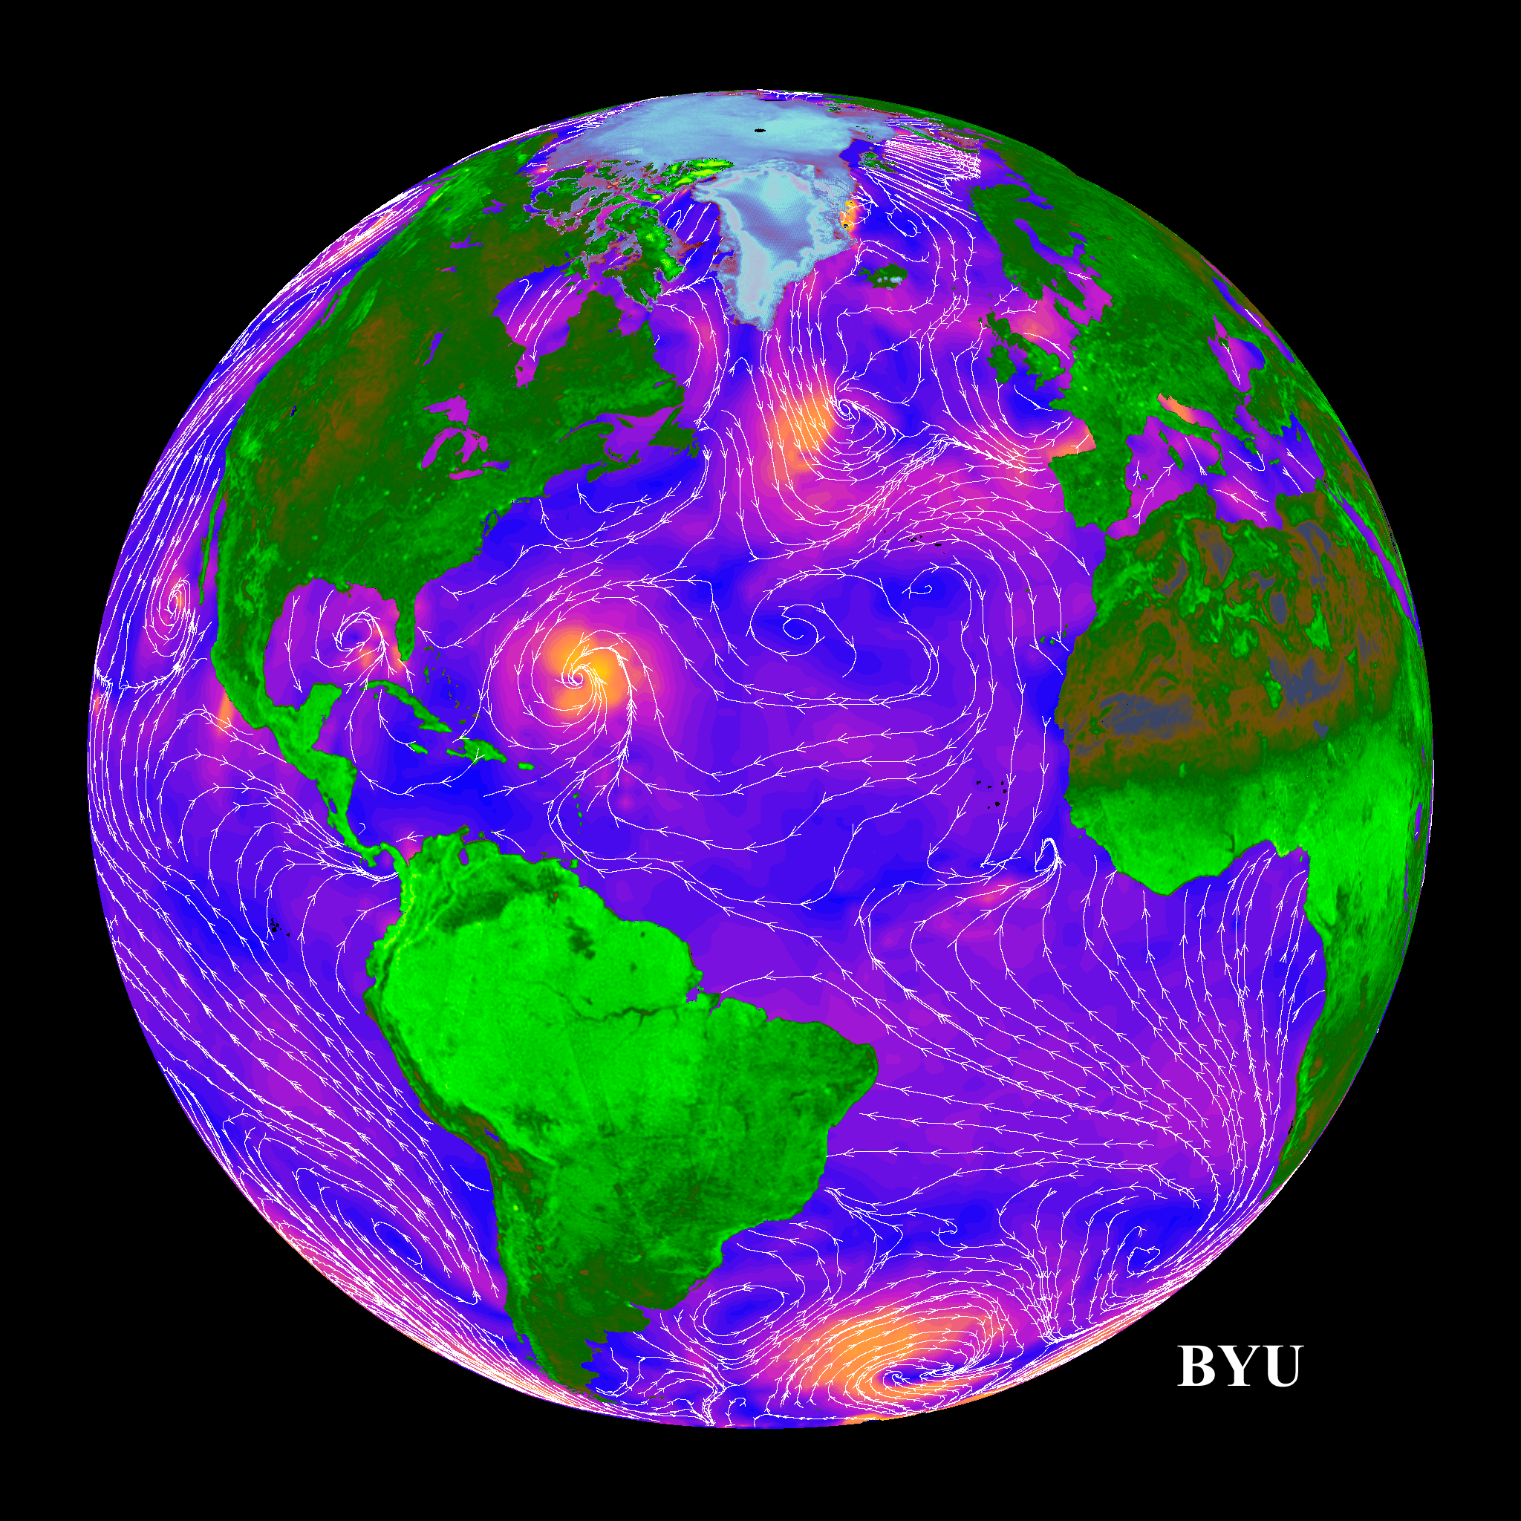
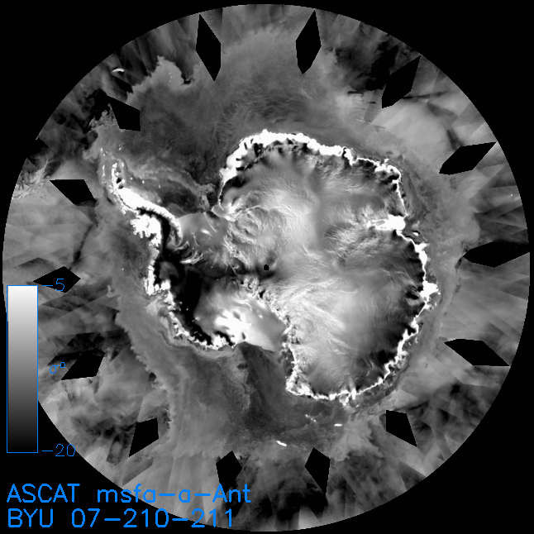
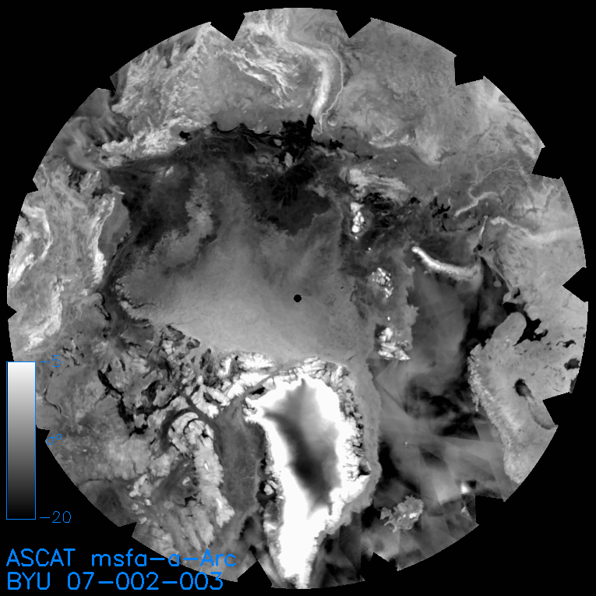
Non-Wind Scatterometer Applications
Key advantages of scatterometry:
- Frequent global coverage
- Multiple azimuth angles and polarizations
Sea ice extent, age
Freeze/Thaw conditions
Flooding
Oil spills
Vegetation mapping
Urban growth
“Land/ice winds” (via sand and snow dunes)
Greenland & Antarctica accumulation and melt
12 D.Long
8

Slide 13
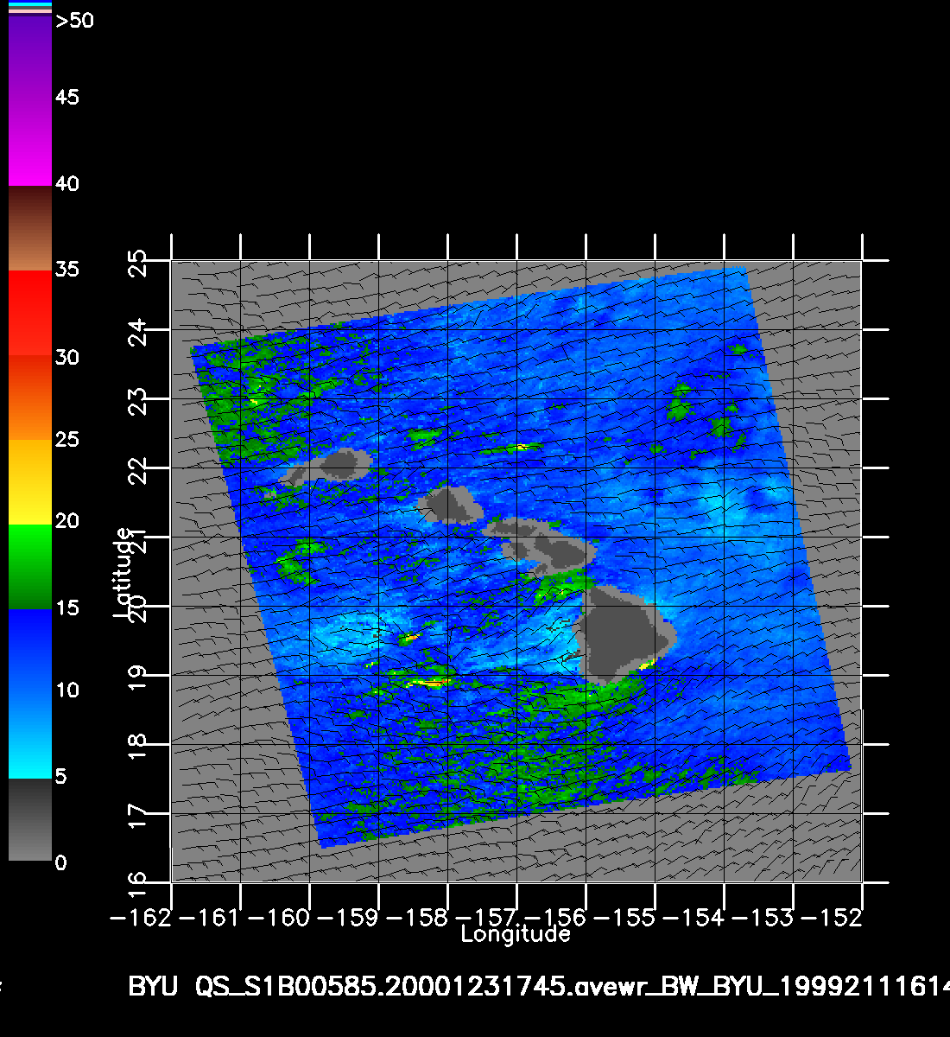
Hawaiian Winds & Rain
UHR
(2.5 km)
wind
speed
25 km
barbs
Thunder
storms
13 D.Long

Slide 14
Bragg (Resonant) Scattering
Bragg scattering can occur for periodic surfaces
  Samples wave spectrum
Reflections from peaks reinforce each other at particular incidence angles and cancel at other angles
  Enhanced scattering in particular directions
  Scattering is incidence and azimuth angle dependent
Resonance condition
Incident direction
θ
nλ/2
surface
14 D.Long
d

Slide 15
Multiscale Rough Surface Scattering
Scales of roughness
Scattering pattern
Flat facets or swell
Slightly rough surface
Composite surface
15 D.Long

Slide 16
General Rough Surface Backscatter
Specular
scattering
General scattering may be a combination of surface and volume scattering, which have a combination of specular and rough scattering characteristics
Details depend on surface characteristics
Rough scattering
σ^{ο}
0º
Incidence angle
90º
16 D.Long

Slide 17
Surface Scattering
Incidence
angle
Incident
wave
“Bistatic scattering” is the scattering in one direction when the illumination is from another direction
“Backscatter” is the return back toward the source
  Special case of bistatic scattering
  is the normalized backscatter = backscatter/target area
Definition of incidence angle
Smooth surface (specular)
Intermediate roughness
σ^{ο}
Very rough
σ^{ο}
0º
Incidence angle
90º

