Slide 1



Surface currents and relative-wind stress in coupled ocean-atmosphere simulations of the northern California Current System*
R. M. Samelson, S. M. Durski, D. B. Chelton, E. D. Skyllingstad, P. L. Barbour
roger.samelson@oregonstate.edu
https://rsamelson.ceoas.oregonstate.edu/
IOVWST Meeting - 31 May 2024
*MWR, in revision
Notes:
The dependence of the model ocean response on the definition of surface current for the relative wind is examined in coupled ocean-atmosphere numerical simulations of the northern California Current System (nCCS) during March through October 2009. The model response is analyzed for wind stress computed from relative wind for six different choices of effective model surface velocity. Simulations without surface-current coupling are also considered. Various ocean model response processes and characteristics are examined, including relative-wind damping of mesoscale kinetic energy, near-surface wind-drift response, patterns and amplitudes of total and geostrophic wind-work, effective wind-work based on the relative-wind surface-current, and the dependence of relative-wind damping on the choice of atmospheric-model planetary boundary layer parameterization.

Slide 2
Coupled ocean-atmosphere simulations
Goal: Examine model response to different surface-current coupling and atmospheric-model planetary boundary layer (PBL) turbulence schemes.
COAWST system: WRF atmosphere (12 km & 36 km), ROMS ocean (2 km)
ROMS: Hydrostatic, free-surface, primitive equations in terrain-following vertical
coordinate (40 levels); Mellor-Yamada 2.5 turbulence scheme; regional
domain nested in HYCOM output.
WRF: Compressible, nonhydrostatic primitive equations in terrain-following
vertical coordinate (51 levels); two nested regional domains, outer nested in
NCEP FNL operational analysis, inner coupled to ROMS ocean model.
Ocean simulation initialized from interpolated HYCOM analysis in October 2008; coupled model simulations begin 7 March 2009 and end 15 October 2009.
SST-stress coupling and fog & low-level stratus previously analyzed in subsets of these simulations.
The modifications to the ROMS-WRF-COAWST modeling system necessary to enable these surface-current-coupled simulations were made by Scott Durski. Modified code is being made available on GitHub by Scott.

Slide 3
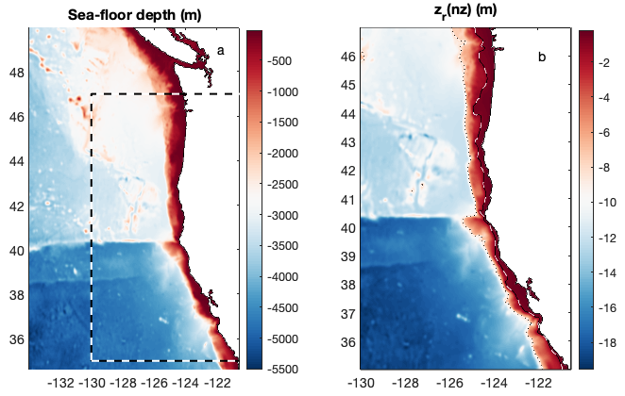
Ocean model and analysis domains
Uppermost model grid-level depth (m)

Slide 4
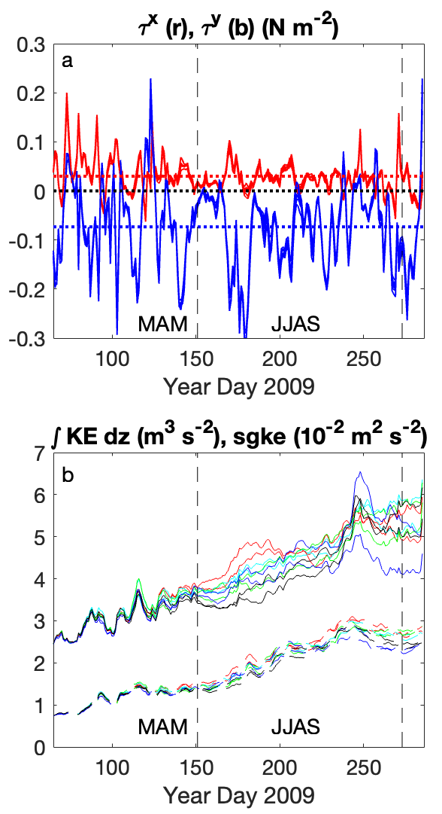
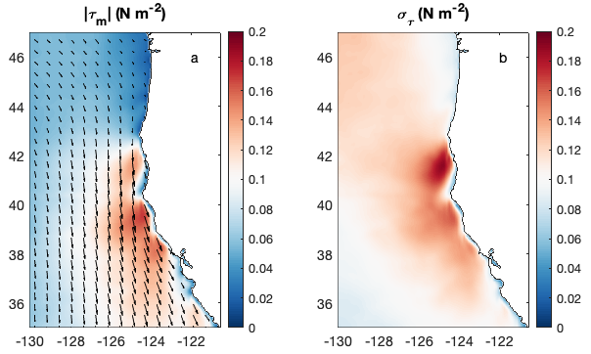
Wind forcing and KE response with SST coupling only
Mar-Oct mean stress
magnitude std dev
Time series
E & N stress
τ^{y} mean -0.07 N m⁻²
JJAS
2005-2010
surface
geostrophic KE
KE depth scale
(total/sfc-geo)
total KE
total KE
surface
geostrophic KE

Slide 5
Coupled ocean-atmosphere simulations
Total of 45 ensemble members:

Slide 6
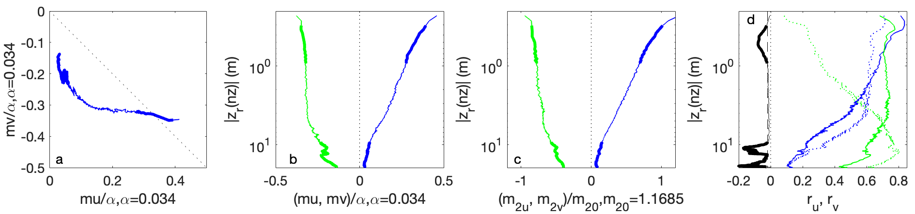
Model wind drift response
Mean regressions of ageostrophic uppermost grid-level velocity against 10-m wind or stress binned by grid-level depth
Near-surface (above 1-m depth): Log-layer response, proportional to wind speed (M-Y scheme limit)
At depth (10-20 m): Slab Ekman response, proportional to wind stress
correlation coefficients
10-m wind regression
stress regression
Solid: 10-m wind
Dotted: stress
Cross-wind
Cross-wind
Cross-wind
Downwind
Cross-wind
Downwind
Downwind
Downwind
Black: Histogram of uppermost
grid-level depths

Slide 7
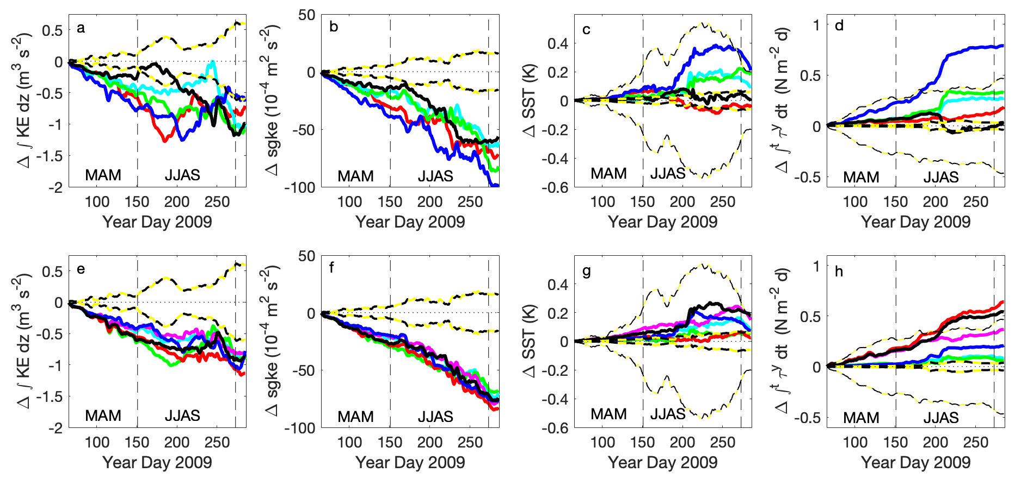
Relative-wind (surface-current) damping of kinetic energy: differences with-minus-without surface-current coupling
Depth-integrated kinetic energy
Time-integrated mean meridional wind stress
Surface geostrophic
kinetic energy
SST
Grouped by PBL
scheme
Grouped by surface-current
for coupling
Reduced stress for wind-drift-corrected cases

Slide 8
Relative-wind (surface-current) damping of kinetic energy: differences with-minus-without surface-current coupling
Surface geostrophic
kinetic energy
Depth-integrated kinetic energy
Grouped by PBL
scheme
Grouped by surface-current
for coupling
Consistent increase in kinetic energy damping with PBL scheme during MAM, when SST fluctuations are small, for PBL schemes ordered as:
MYNN2, UW, GBM, YSU, MYJ
This is opposite to the ordering for increased SST-stress coupling found in previous analysis
(MYJ , YSU , GBM , UW, MYNN2)
(NB: We use MYJ with sfclay=1)
Time-integrated mean meridional wind stress
Depth-integrated kinetic energy
Time-integrated mean meridional wind stress
Surface geostrophic
kinetic energy
SST
SST
Grouped by PBL
scheme
Grouped by surface-current
for coupling

Slide 9
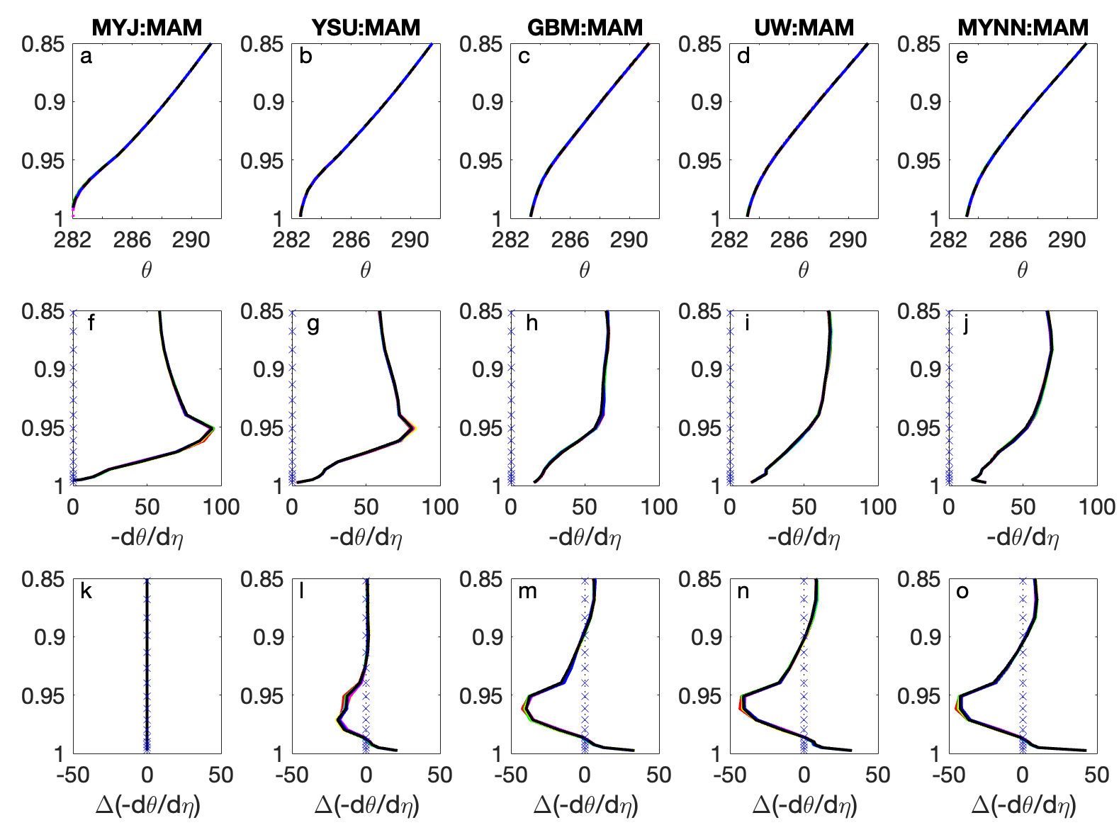
Mean atmospheric boundary layer stability (March-April-May) vs. normalized pressure level for each PBL scheme
Decreasing stability, Increasing vertical mixing, Decreasing KE damping
Potential temperature
Potential temperature
gradient
Difference of gradient relative to MYJ-scheme gradient
MYJ YSU GBM UW MYNN2

Slide 10
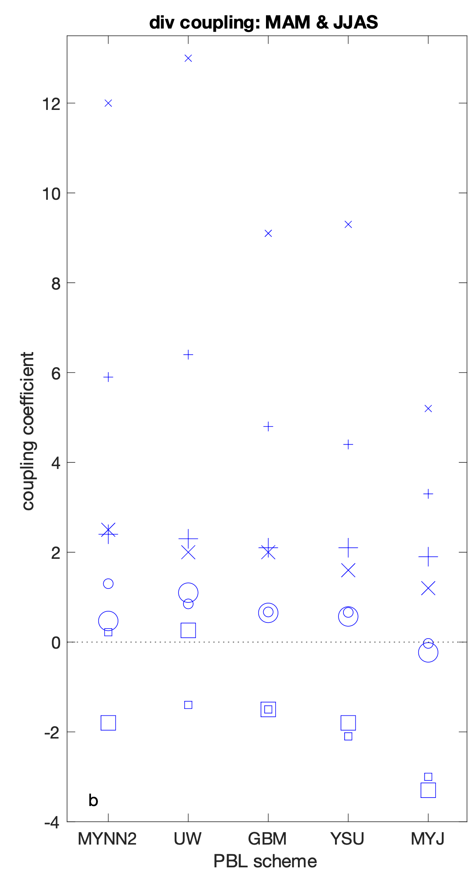
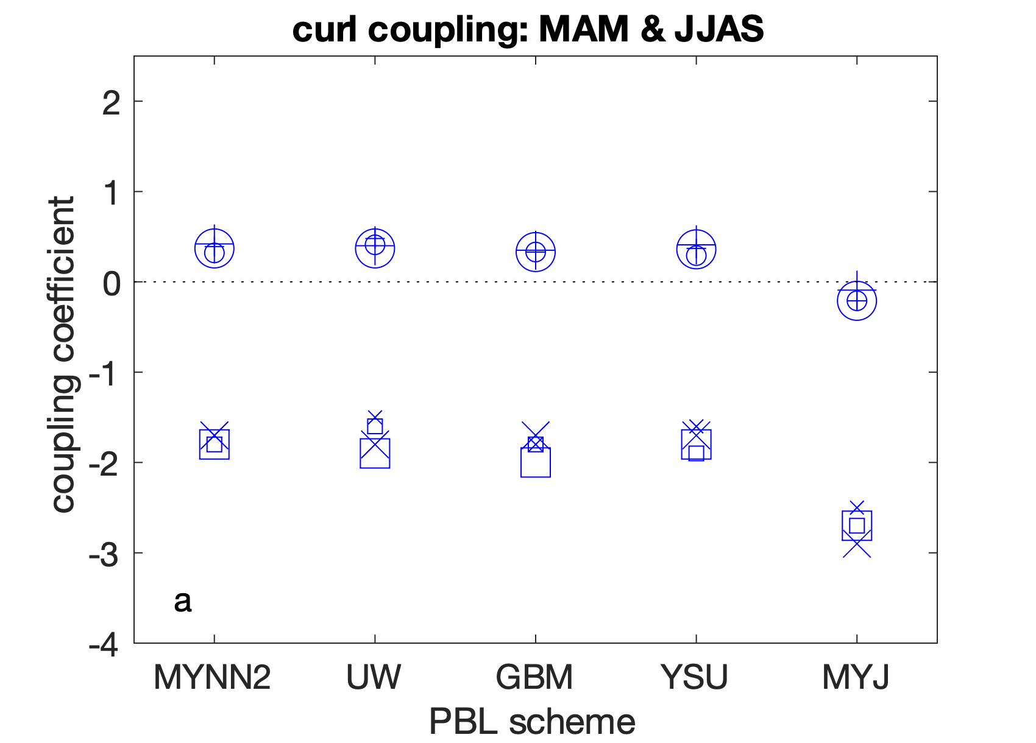
Coupling coefficients:
10-m wind (o,+) and stress ( ,x) curl/divergence vs. coupling-surface-current relative-vorticity/divergence for March-April-May (large symbols) and June-July-August-September (small symbols) for 10-m or geostrophic ( ,o) and wind-drift-corrected (x,+) surface currents
wind-drift response
to SST-driven
10-m-wind divergence
(large during JJAS when SST fluctuations are large)
stress
wind-drift-corrected
divergence
:
divergence
curl
:
relative
vorticity
wind
wind
stress
stress
wind
stress
MYNN2 UW GBM YSU MYJ
Decreasing stability, Increasing vertical mixing, Decreasing KE damping
10-m or geostrophic
MYNN2 UW GBM YSU MYJ
Notes:
MAM (large symbols) and JJAS (small symbols), for stress curl and divergence units of $10^{-7}$ N m$^{-3}$ and wind or current relative vorticity and divergence units of $10^{-5}$ s$^{-1}$. Coefficients are shown for surface stress ($\Box, \times$) and surface wind ($\circ, +$) quantities vs.~ocean surface-current (a) relative vorticity and (b) divergence, for the simulations with 10-m and geostrophic ($\Box,\circ$) and wind-drift-corrected ($\times, +$) surface-current coupling

Slide 11
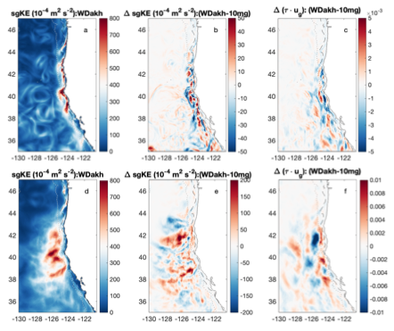
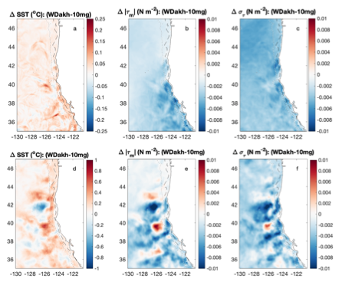
Differences: wind-drift-corrected vs.
10-m or geostrophic surface current coupling
Surface geostrophic KE
Geostrophic wind-work difference
SST
difference
Stress mean
magnitude difference
Stress std dev
difference
Wind-drift-corrected
Difference
March-April-May
June-July-August-September
KE increases where large, decreases where small (?)
Warming, reduced stress;
SST-stress coupling during JJAS

Slide 12
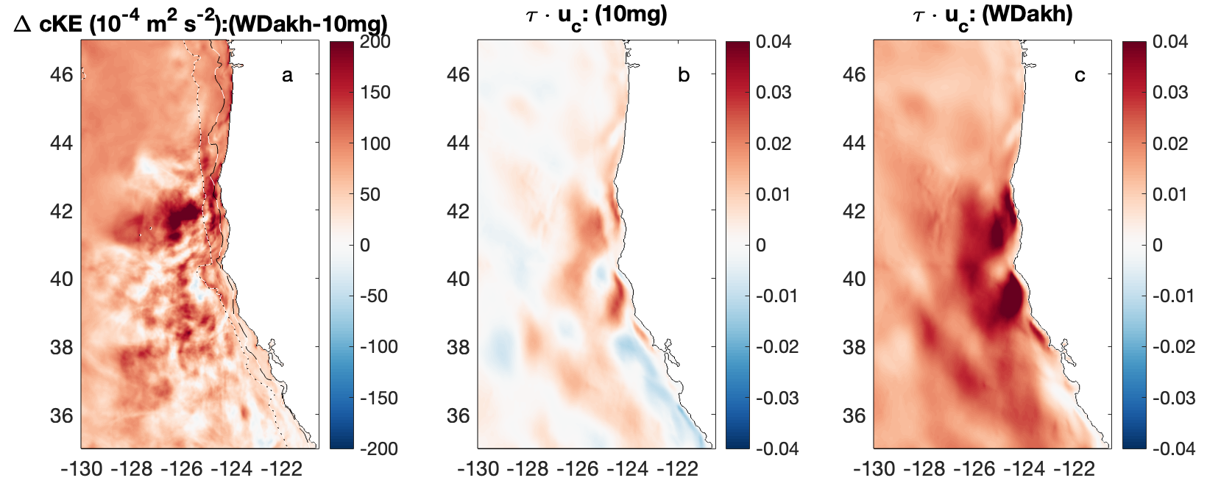
Effective wind-work for 10-m or geostrophic vs. wind-drift-corrected surface currents
Effective wind work: (mean) product of stress and coupling surface current
KE of coupling surface current
10-m or geostrophic
wind-drift-corrected
Effective wind-work is much larger for wind-drift-corrected coupling surface current
(large downwind current component)

Slide 13
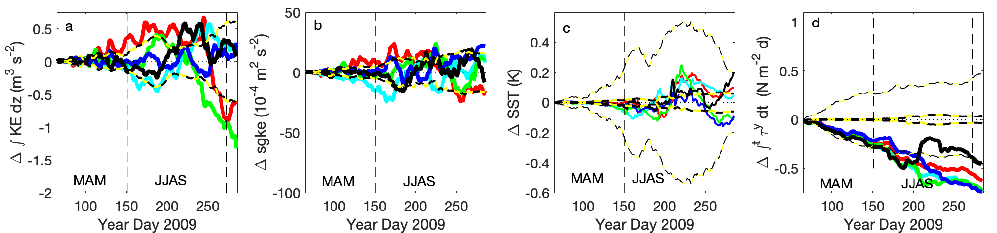
Wind-drift-corrected coupling surface-current with drag coefficient (instantaneous stress) increased by 5%
Motivation: compensate for effective reduction from “3% of wind” surface current
depth-integrated
KE difference
surface geostrophic
KE difference
time-integrated mean
meridional stress difference
SST difference
No systematic change in KE or mean SST!
Systematic 5% increase in mean integrated upwelling forcing (meridional stress)
Quasi-equilibrium balance between forcing and damping (both proportional to stress, with damping also proportional to circulation)?
-0.75/220 = -0.0034
-0.0034/-0.07 = 0.05 = 5%

Slide 14
Summary
Uppermost grid-level velocity has wind-drift component with log-layer structure above 1-m depth;
Surface-current damping depends more strongly on atmospheric PBL scheme than on surface-current formulation: weaker PBL mixing gives stronger damping;
Coupling coefficients computed relative to wind-drift-corrected surface velocities can show large apparent values, arising from wind-drift response;
Wind-drift-corrected surface-current formulations result in large changes in the effective wind-work based on the product of stress and relative-wind surface current but in only small changes in the kinetic energy of the circulation;
Effective change in drag coefficient from wind-drift correction has proportional effect on mean stress but not on kinetic energy, suggesting a quasi-equilibrium balance between forcing and damping.
Mean geostrophic wind work is concentrated in the shelf and slope regions during MAM and in the offshore region during JJAS;
During MAM, changes in kinetic energy and geostrophic wind-work in the shelf and slope regions are spatially correlated, while during JJAS, changes in geostrophic wind-work are strongly modulated by SST-stress coupling;
Damping is stronger in the less energetic, offshore region than in the more energetic, coastal region.

Slide 16
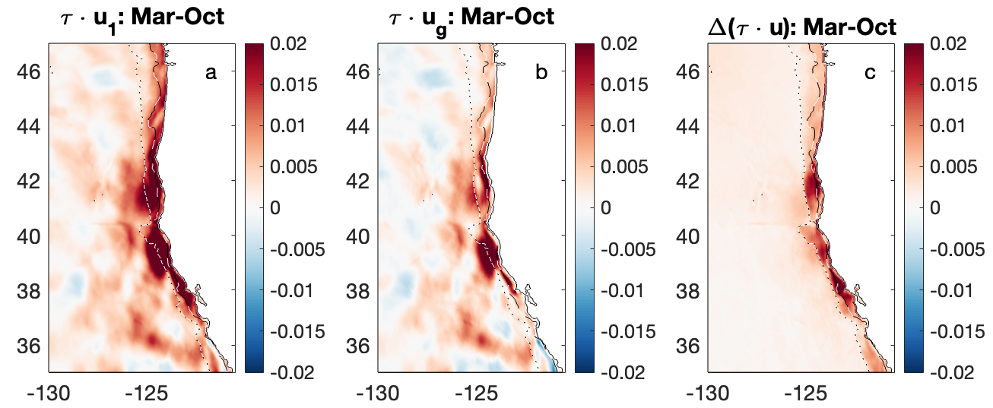
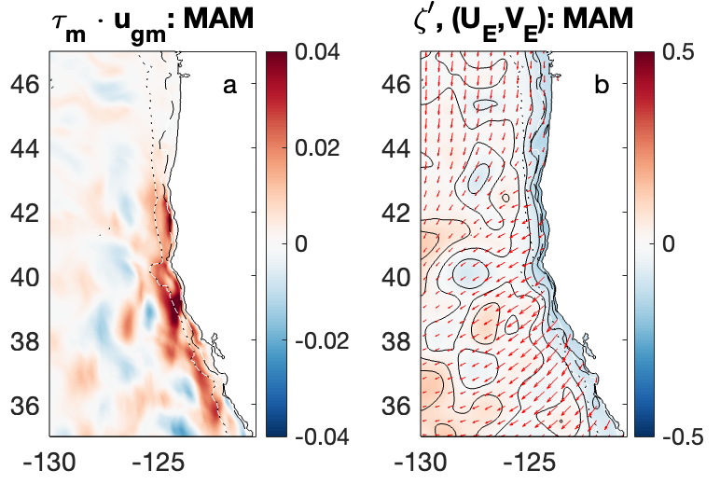
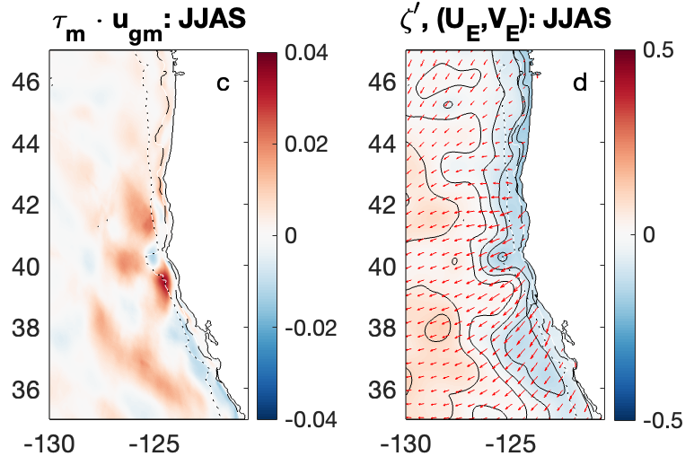
Mean total and geostrophic wind work
Difference over shelf arises from stronger wind-drift response over shelf
(numerical artifact)
Wind work from seasonal mean stress and surface geostrophic velocity (Ekman transport up sea-surface pressure gradient)
Mean geostrophic wind work concentrated over shelf and slope during MAM
Mean geostrophic
wind work stronger offshore
during JJAS
March-April-May
June-July-August-September

Slide 17
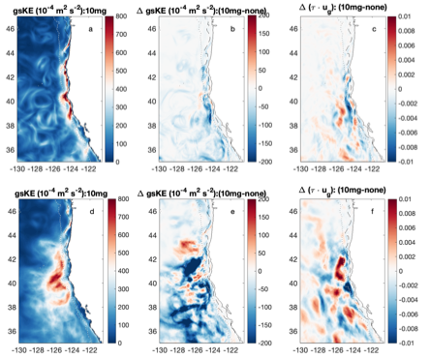
Spatial patterns of geostrophic KE and wind work
Spatial correlation during MAM suggests direct effect of wind-work on local KE
March-April-May
Lack of correlation during JJAS consisten with large SST-stress coupling effects
June-July-August-September

Slide 18
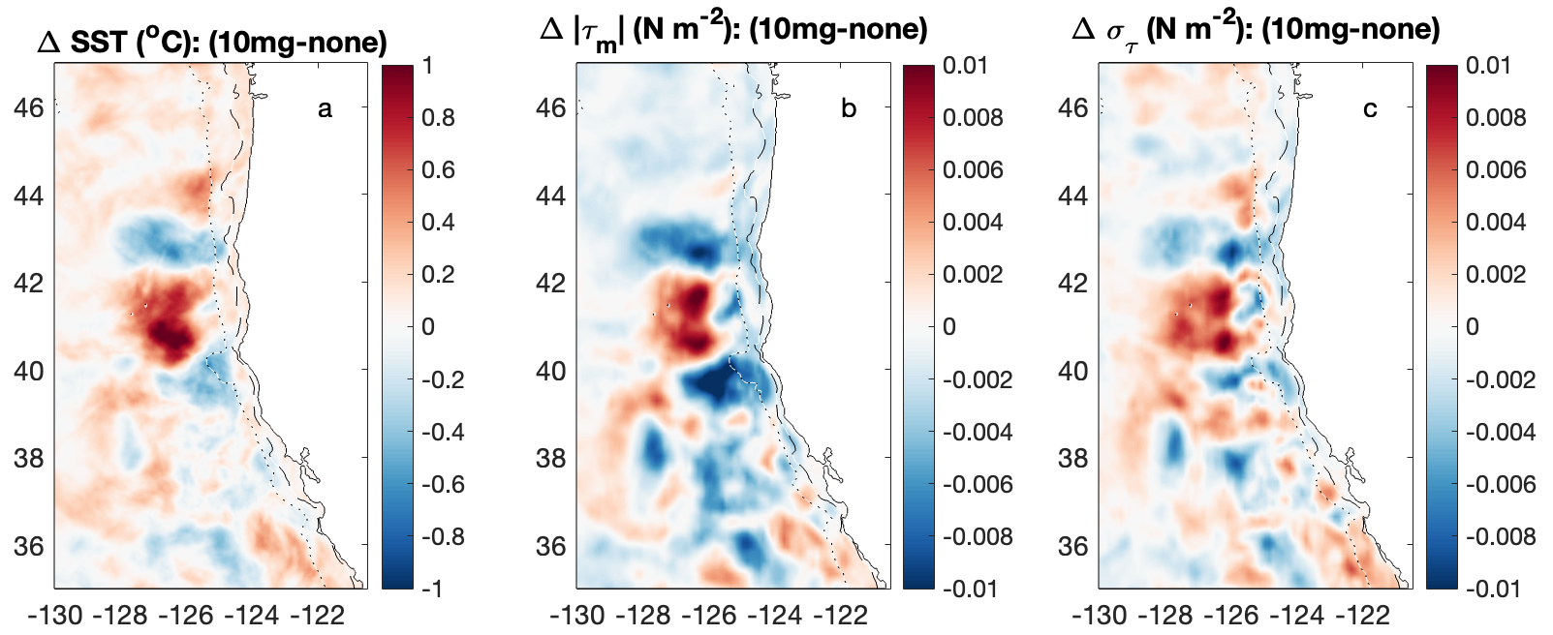
SST-stress coupling during JJAS
Differences for 10-m or geostrophic coupling vs. SST-coupling only
SST
Mean stress magnitude
Stress standard deviation

