Slide 1
Using SAR to Diagnose the Boundary Layer Structure of Hurricane Larry, 7 Sep 2021
Ralph Foster¹, Zorana Jelenak², Joe Sapp²,
Paul S. Chang² Alexis Mouche³, Bertrand Chapron³
¹ APL, University of Washington
² NOAA NESDES
³ Ifremer, FR
Thanks to NASA OVWST (80NSSC19K0060)

Slide 2
Take-Home Messages
Using only SAR images of TCs, derive:
Reasonable mean wind profiles in the TC PBL
TC PBL roll characteristics (scale, orientation & magnitude)
TC PBL characteristics are sensitive & independent test of $K\left(z\right)$ formulations used in numerical models
Validation against IWRAP horizontal winds
~150 x 30 m “pixels”
IWRAP detects TC PBL rolls
Confirms they are Shear-Driven and NOT CONVECTIVE
First observational test of Foster (2005)

Slide 3
Larry 7 Sep, 2021
S-1 Ascending (~18:00 local) Overpass at 21:46 UTC
NOAA N43 P-3 flight with:
IWRAP
SFMR
TDR
4 drop sondes (near storm center)
$∆t$= -3 to +1.5 hours of S-1 (21:46)
NOAA G-IV flight
7 drop sondes in-image within P-3 time window
Environment soundings, far from center

Slide 4
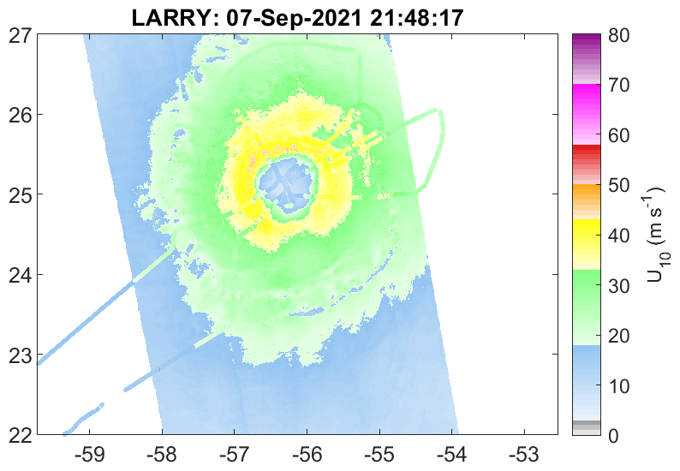
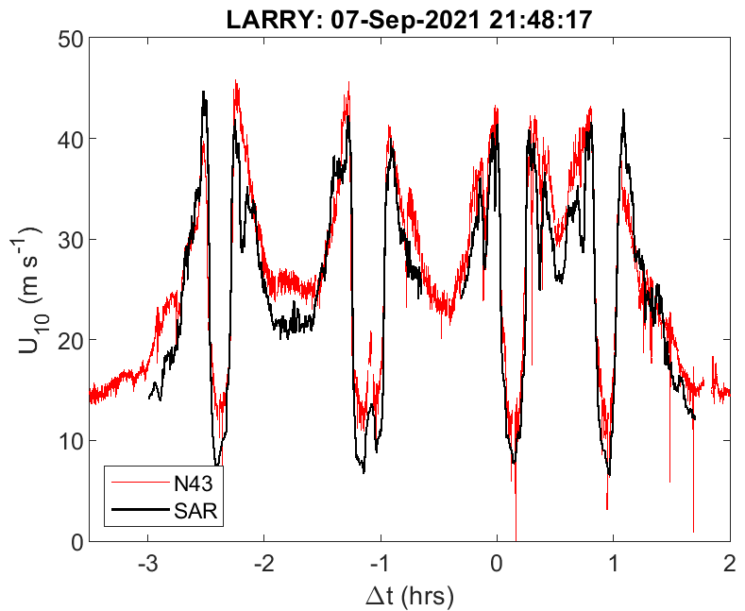
Storm track (P-3 navigation to SAR image) determined by matching SFMR & SAR U10
RMS ~ 4 (m/s) (within 150 km)
S-1 GMF trained against SFMR

Slide 5
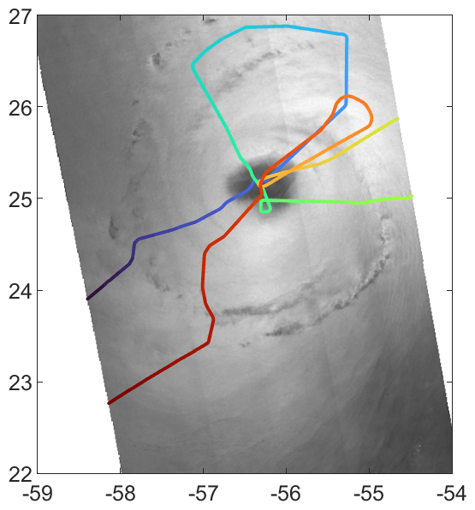
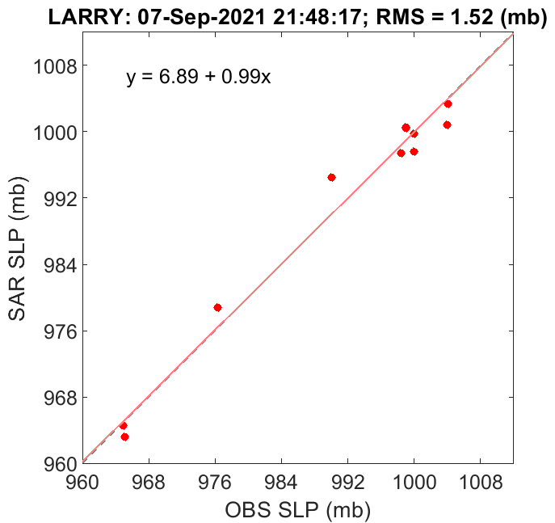
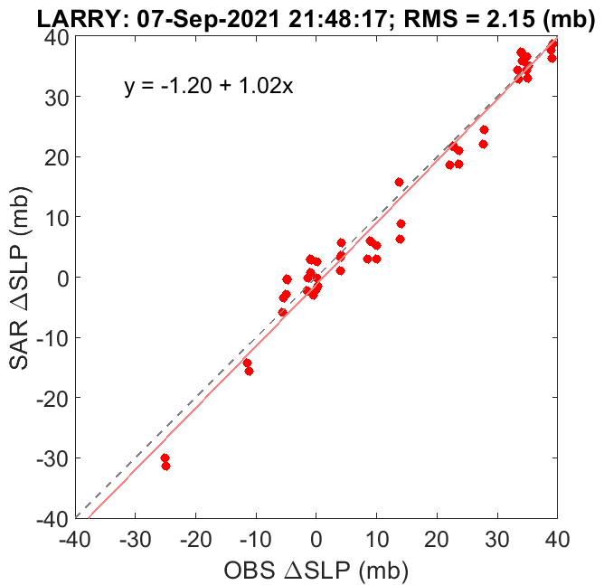
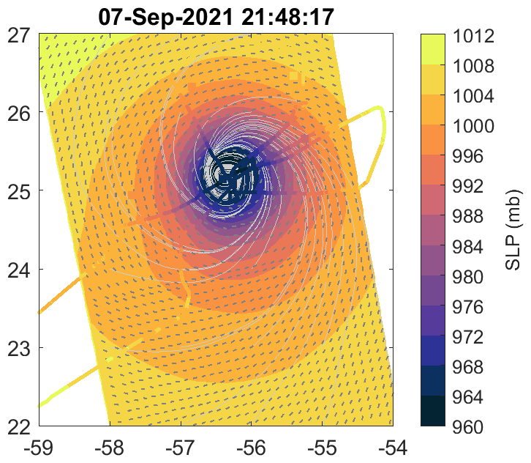
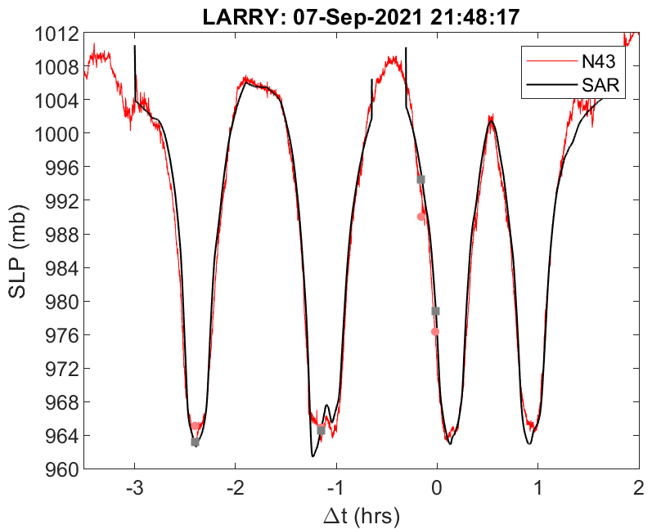
SLP Retrieval
Scatterplots ~along 1:1 line
Total-least-squares
4 sondes from P-3
7 sondes from G-IV
$\frac{N\left(N−1\right)}{2}$ $∆P$ from Sondes
RMS 2.2 mb
Good agreement with P3 SLP
Ref: Foster, 2017

Slide 6
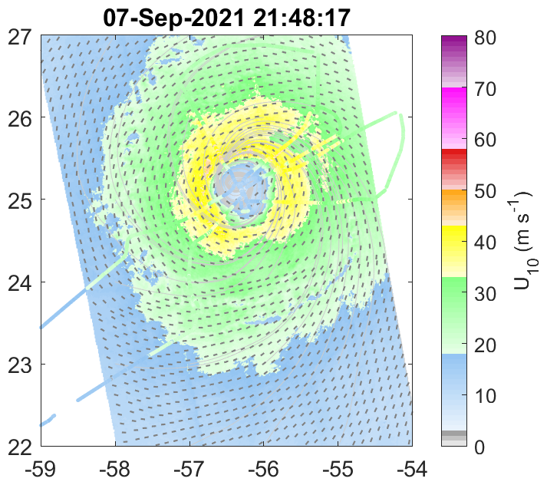
PBL rolls throughout storm
Surface wind streamlines (light gray)
Roll orientations (thick gray bars)
Note: rolls detected throughout SAR image
Agrees with prediction of Foster (2005)
PBL Roll Direction
Spectral analysis 20 km NRCS blocks
Rolls are close to wind direction
Roll signature throughout images

Slide 7
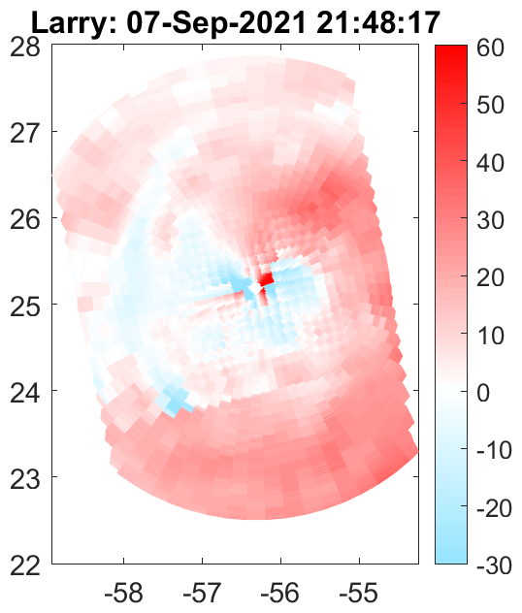
TCBL rolls “Inflow” Angle
Positive Angle: rolls point toward low pressure

Slide 8
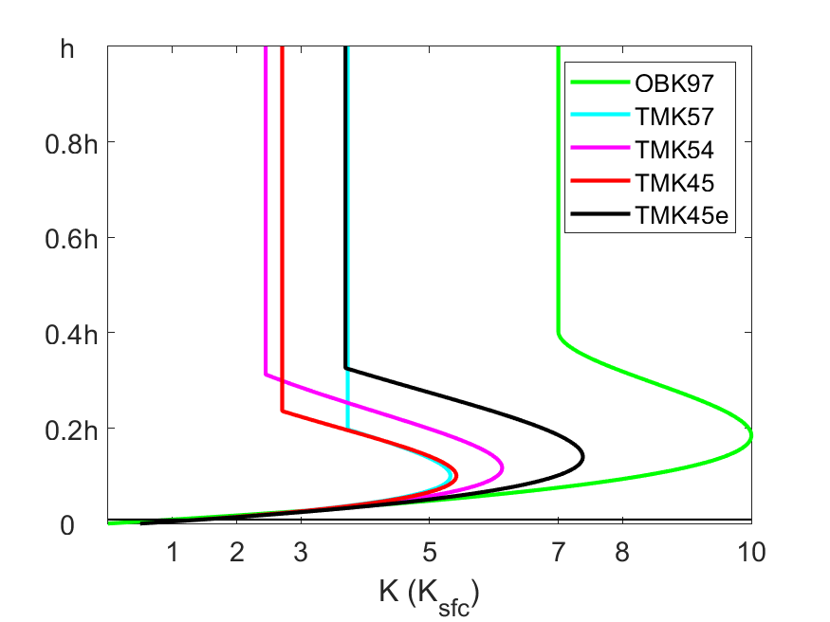
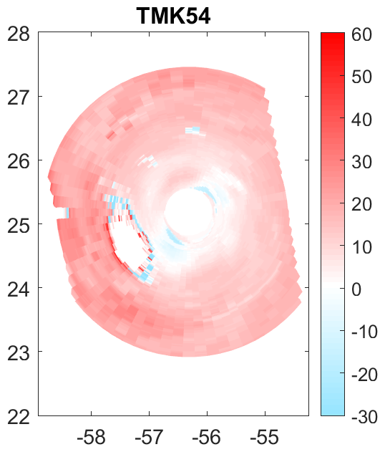
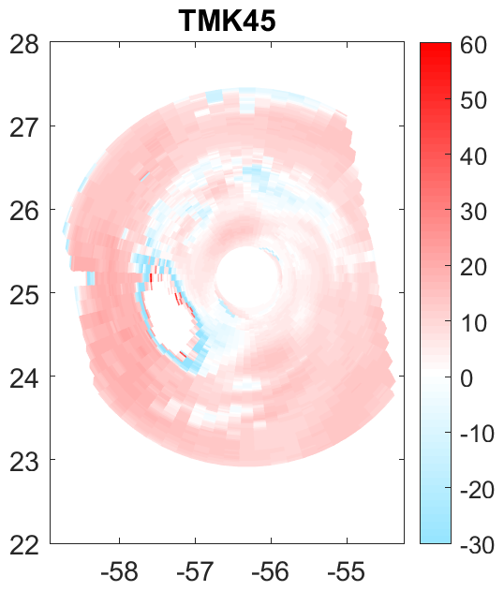
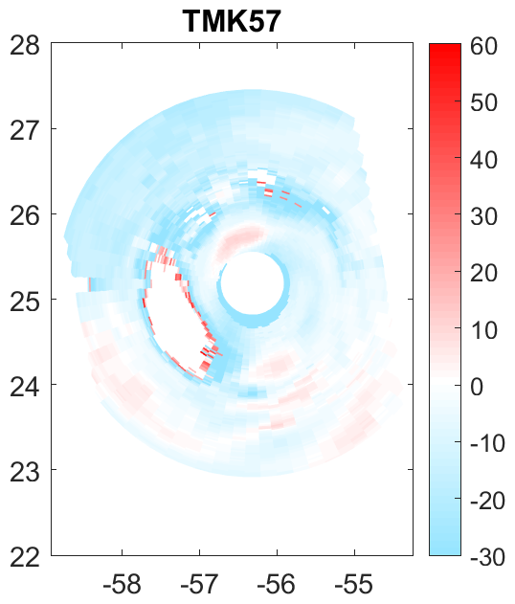
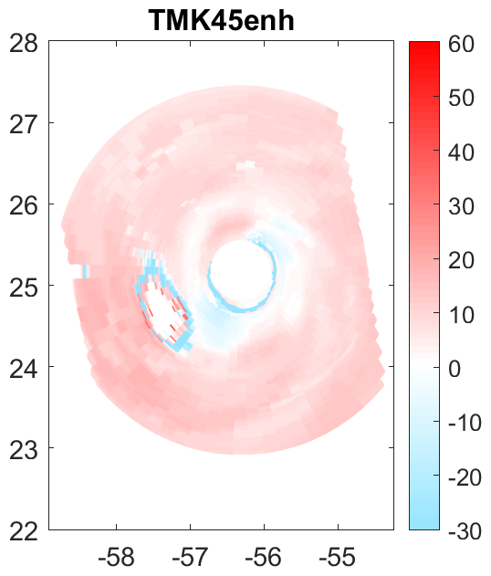
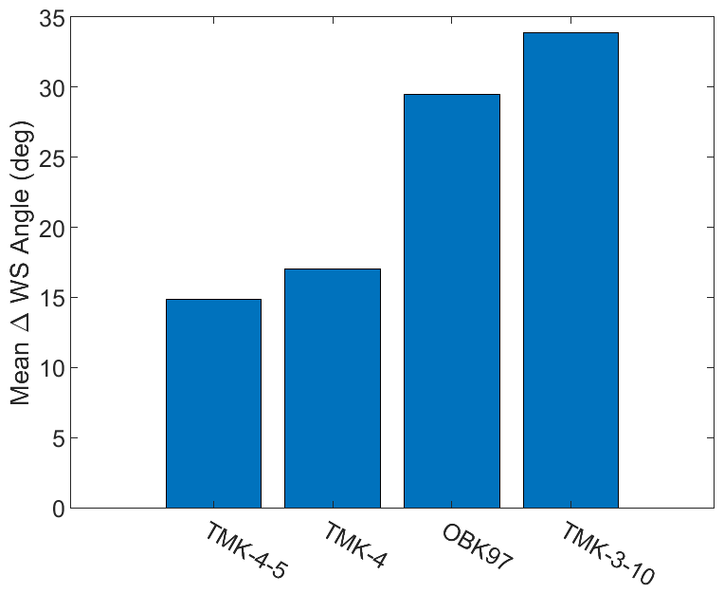
Orientation of TCBL rolls
Assumptions:
Roll orientation primarily determined by TCBL mean shear profiles
SAR-estimated mean shear profiles primarily determined by assumed K(z)
Seek best agreement with OBS
Insight into TCBL roll dynamics
Insight into K(z) distributions (small-scale turbulence)
Various predicted roll orientations
Calculated using Foster (2005; 2009)

Slide 9
IWRAP Winds
Repeat legs near SAR Overpass time

Slide 10
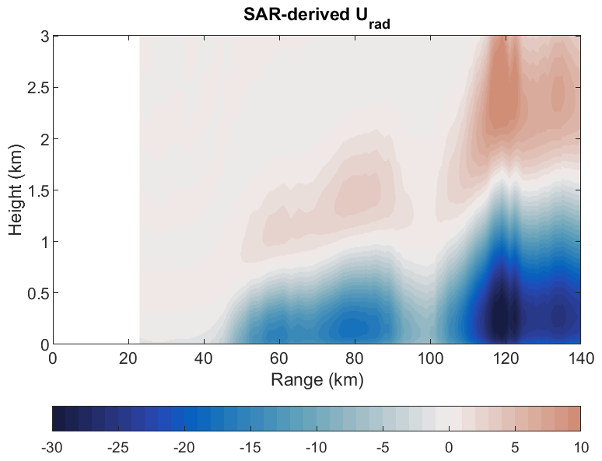
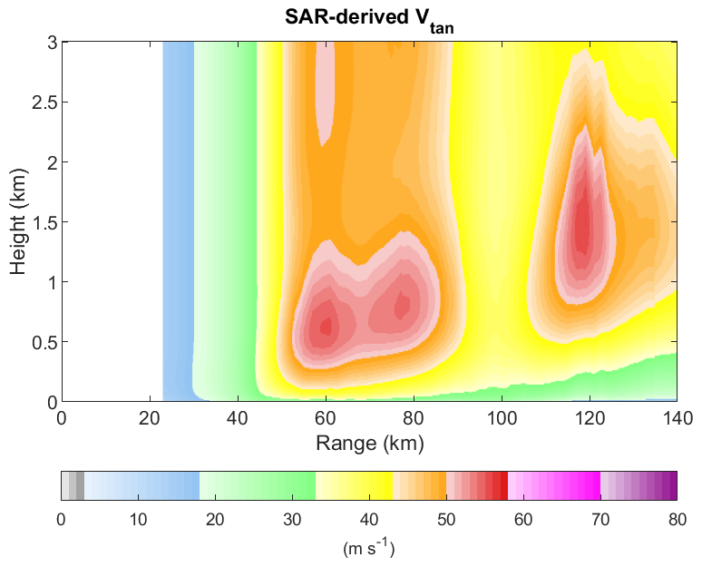
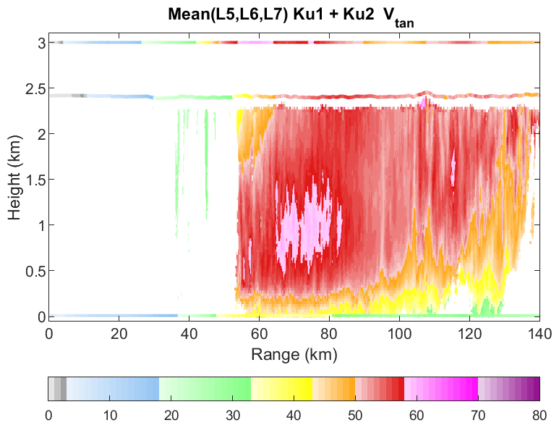
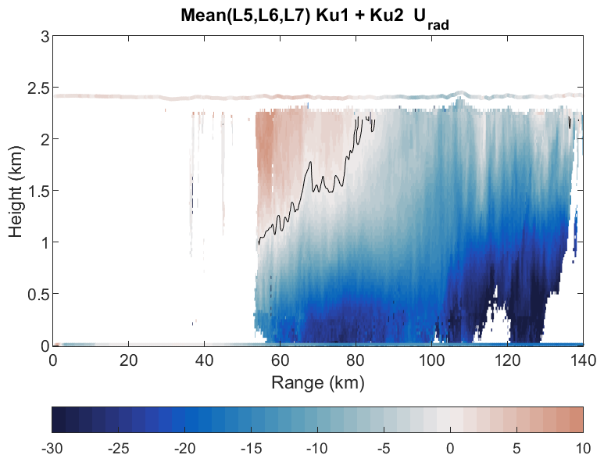
SAR-derived wind profiles have no additional data input
PBL depth a bit shallow
K(z) a bit diffusive
Circulation a bit weak.
Note the periodic modulation in IWRAP winds

Slide 11
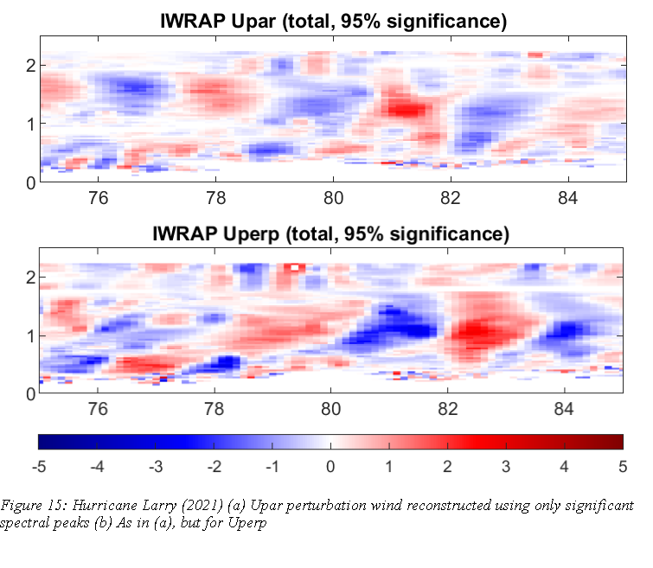
Wavelet-filtered IWRAP winds
r = 65 - 95 km (RMW = 65)
Use SAR to rotate into local roll frame
Perturbation from 5-km running mean
Wavelet spectra for each z
Reconstruct input:
95% Confidence spectral peaks
Spectra: broad peaks $1.5<λ<4$km
Upper: Upar: horizontal component of overturning flow (nearly radial)
Lower: Uperp: horizontal along-roll flow (in/out of page; nearly azimuthal)

Slide 12
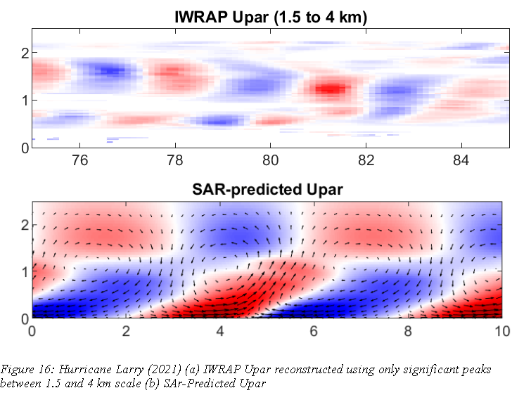
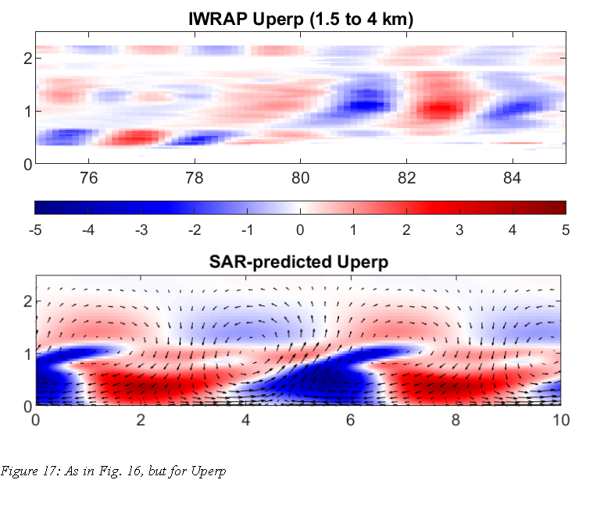
Upper: IWRAP filtered to $1.5<λ<4km$
Lower: SAR-predicted (nonlinear) roll circulation
These are NOT convective rolls!
Roll circulations “lean into mean shear” (neutral stratification)
Uperp largest in lower PBL, “stretches-around” above
Similar phasing in theory and IWRAP
Structures are asymmetric → enhance fluxes

Slide 13
Extra Slides

Slide 14
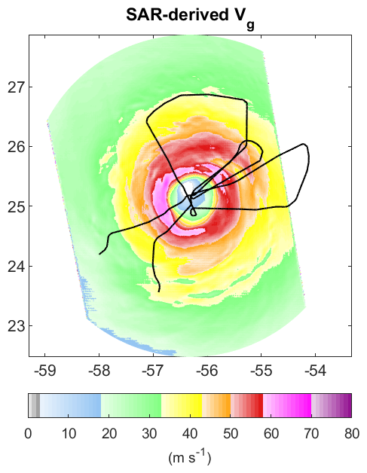
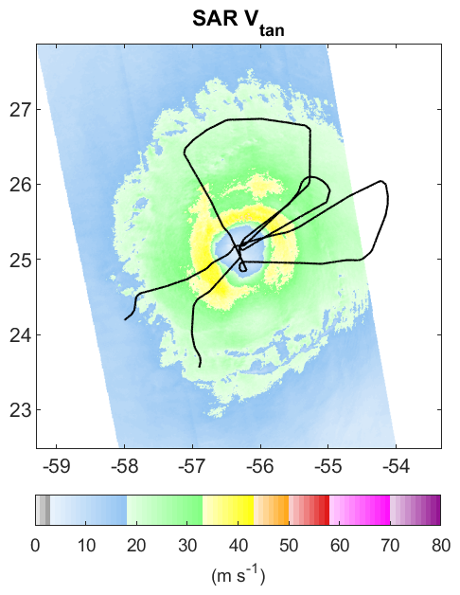
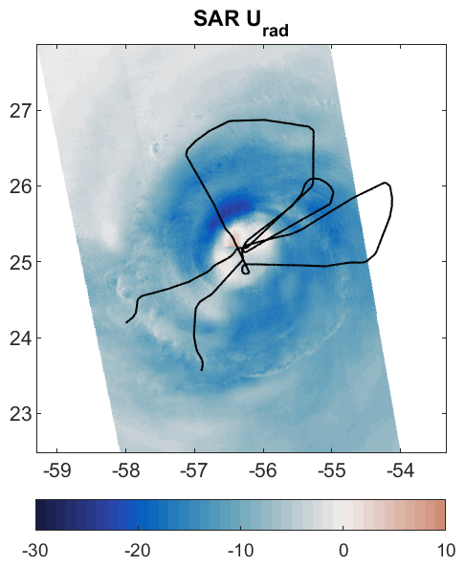
Boundary conditions for Foster (2009) TCBL similarity model for mean wind profiles

Slide 15
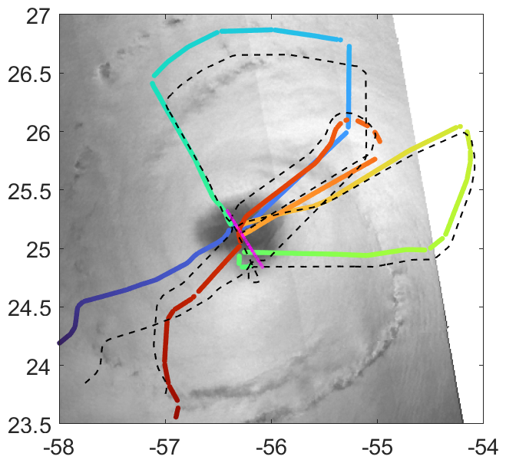
Approximate center fixes
Four NHC 6-hourly locations
First-guess SAR surface wind circulation center
Minimize RMS between SAR - SFMR U₁₀
Do not require track to match any of the center fixes
Smooth path, keep within 10 km of NHC and 4 km of SAR
Optimization cost function restricted to ~150 km of storm center
RMS:
Initial ~6.5 m/s
Final ~4 m/s
$$∆t (hours)$$
Dashed: Actual P-3 flight track
Colored: P-3 adjusted to SAR overpass time
Magenta: Storm track
This is the most difficult aspect of analyzing SAR data
and contributes the most to RMS!

Slide 16
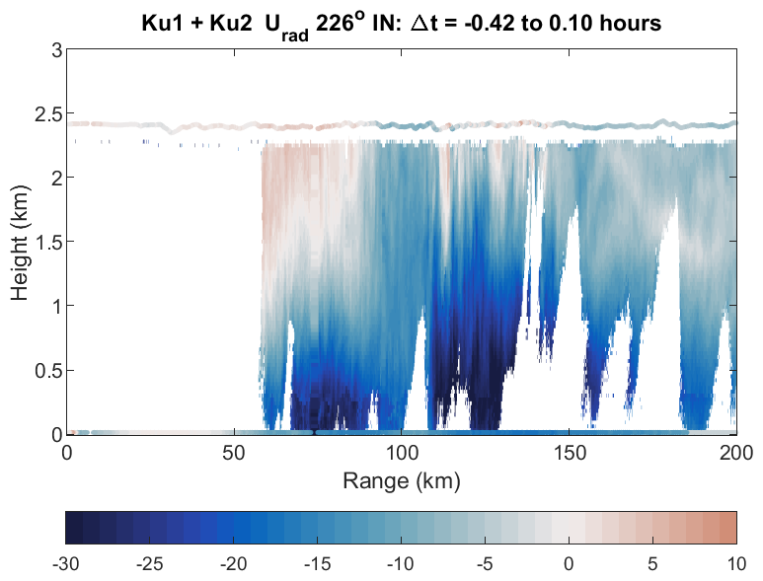
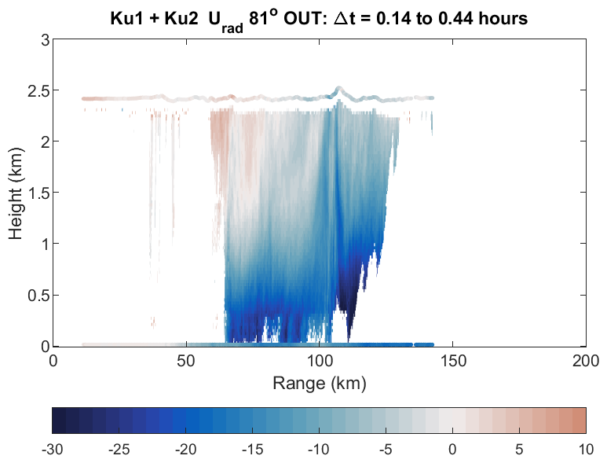
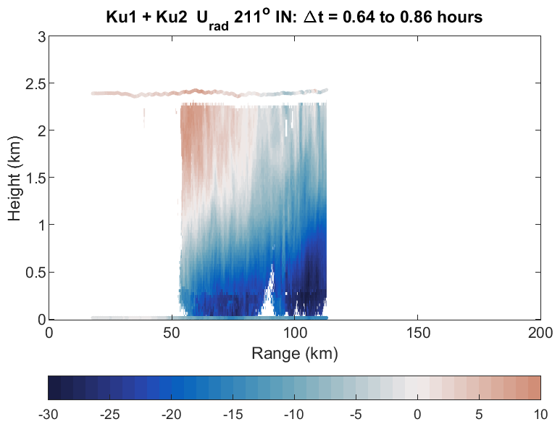
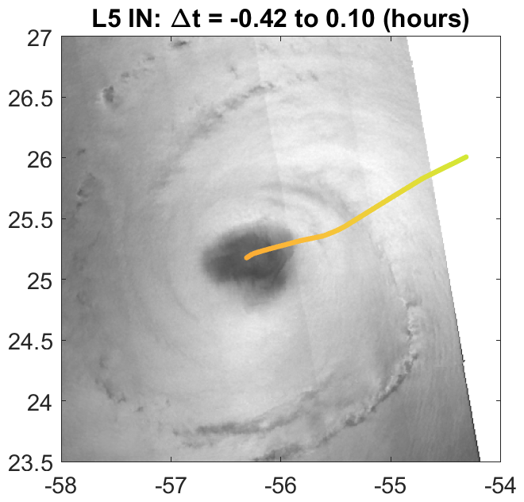
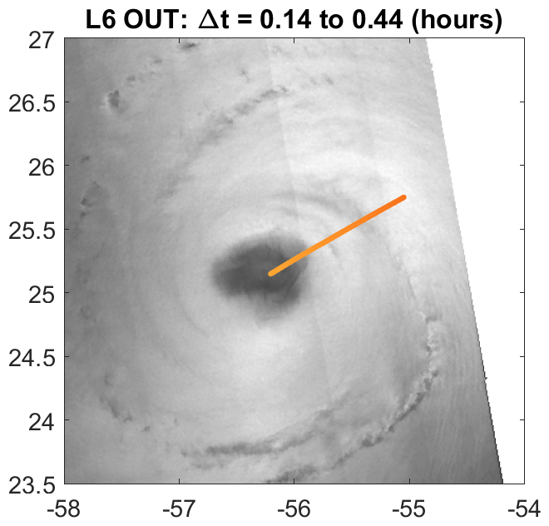
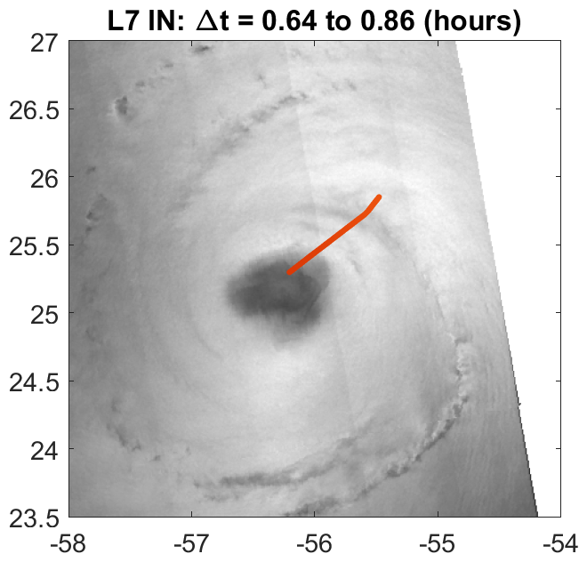
Note inflow/outflow transition clear & consistent in IWRAP and FL
Similar to Leg 2 ($∆t=$ -2.41 to -2.1)
Repeat tracks near S-1 overpass

Slide 17
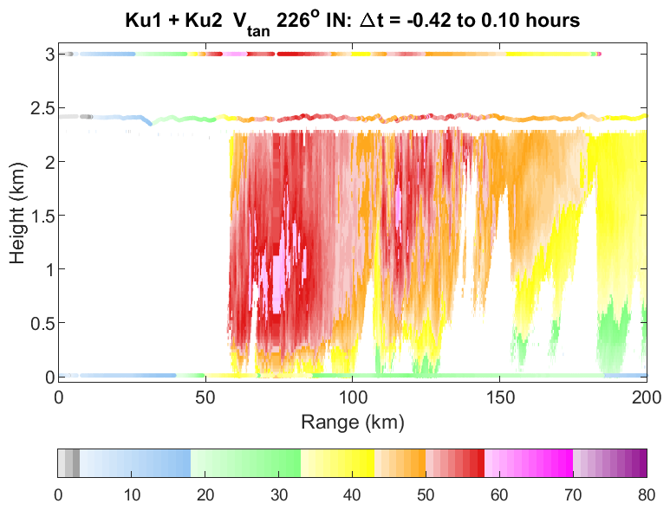
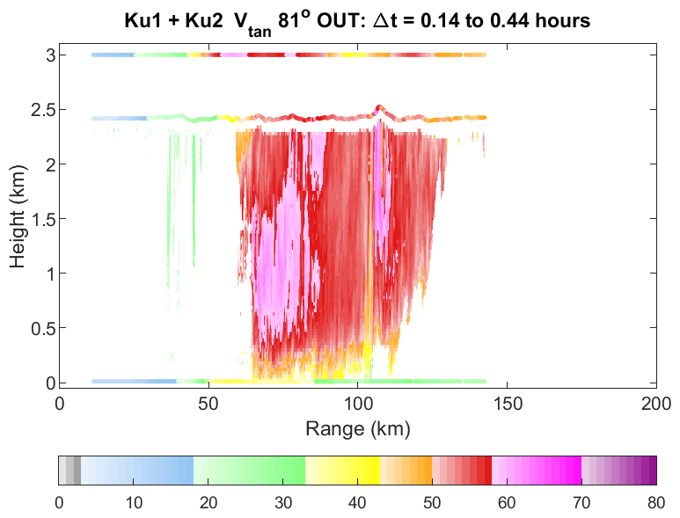
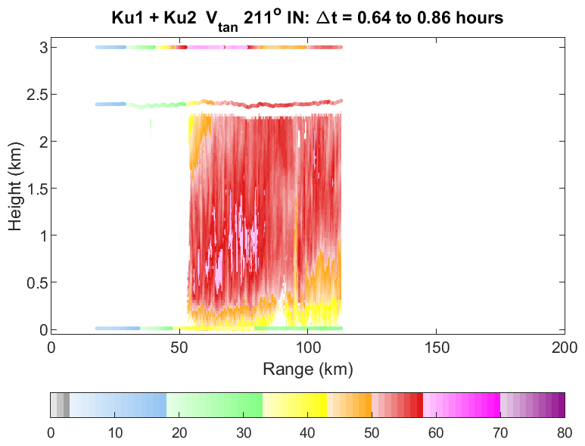
Deep layer of strong azimuthal winds
Similar to Leg 2 ($∆t=$ -2.41 to -2.1)
FL & V_{G} are comparable
Repeat tracks near S-1 overpass

Slide 18
SAR-observed TCBL Roll Orientation
Each TC image is divided into ~20 km² roll detection blocks
Within each block, $σ_{0}$ is analyzed for WS signature
Typically 2 to 4 km-scale wavelengths
Orientation is close to wind direction
SAR Roll signatures are ubiquitous
Foster (2005) conclusions:
TCBL rolls are essentially normal PBL rolls
Stronger because scaling wind speed is stronger
TCBL is paradigm environment for rolls
Neutral to stable stratification ↔ Shear production dominates
Closely aligned to wind direction, but
Orientation is sensitive to TCBL mean shear profiles, especially radial component
Large-scale cross-stream instabilities tend to equilibrate
Streamwise instabilities tend to generate turbulence
TCBL results consistent with global WV analysis

