Slide 1





How do we define wind speed for hurricane force winds?
Mark A. Bourassa¹ and Renee Richardson^{1,2}
The Florida State University
NOAA

Slide 2
Extreme winds in Tropical Cyclones are Believed to be Modified by Sea Spray
Observations from hurricane environment (Powell et al. 2023; Holthuijsen et al. 2012) show that the drag coefficient, the proportionality between kinematic stress and wind speed squared, peaks around 30 m/s and decreases as wind speed increases for greater wind speeds.
  This deviates from the older stress parameterizations based on wind speeds up to 20 m/s, which have a drag coefficient that increases linearly with increasing wind speed.
  Keep in mind that stress (τ ) is proportional to the drag coefficient times wind speed squared
    A saturated drag coefficient does not mean that stress saturates
    This is important because wind sensors are thought of as sensitive to stress.
We will discuss modeling the
impacts of spray and sea state on
a log-wind profile
That profile can then be used to
determine equivalent neutral winds
in a tropical cyclone environment.

Slide 3
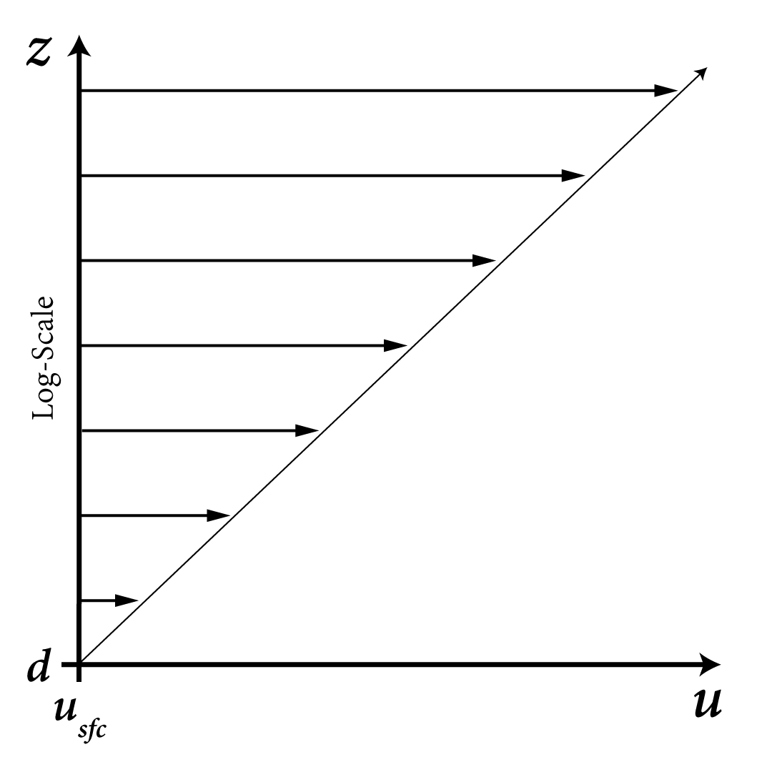

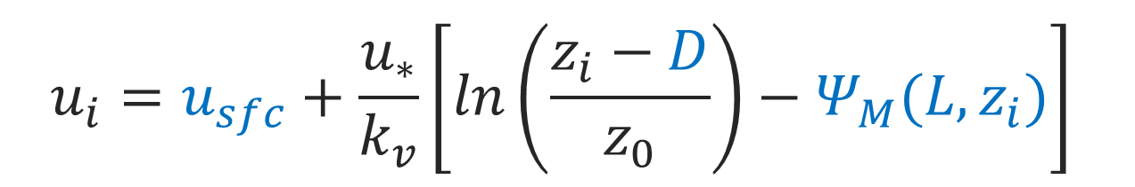
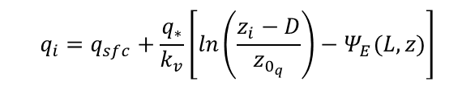
The Log-Profile of Wind Speed
d = displacement height
Speed of Surface Current
Friction Velocity
Height Above Surface
D = d – z₀
D ≈ d
$$u_{i}=u_{sfc}+\frac{u_{∗}}{k_{v}}\left[\ln\left(\frac{z_{i}−D}{z_{0}}\right)−Ψ_{M}(L,z_{i})\right]$$
Mean Wind Speed
Von Kármán Constant
( ≈ 0.4 ± 0.01 )
Roughness Length
Stability Term
(a function of u*, q*, and θ*)
Equivalent neutral winds can be determined
using the u* and z0 from the show equation
Setting the blue terms to zero
Similarly structured profiles
exist for potential temperature (θ)
and specific humidity (q)
$$θ_{i}=θ_{sfc}+\frac{θ_{∗}}{k_{v}}\left[\ln\left(\frac{z_{i}−D}{z_{0_{θ}}}\right)−Ψ_{H}(L,z)\right]$$
$$q_{i}=q_{sfc}+\frac{q_{∗}}{k_{v}}\left[\ln\left(\frac{z_{i}−D}{z_{0_{q}}}\right)−Ψ_{E}(L,z)\right]$$
Stress = ρ|u∗| u∗ Sensible heat flux = -ρ C_{p}|u∗| θ∗ Latent heat flux = -ρ L_{v}|u∗| q∗

Slide 4


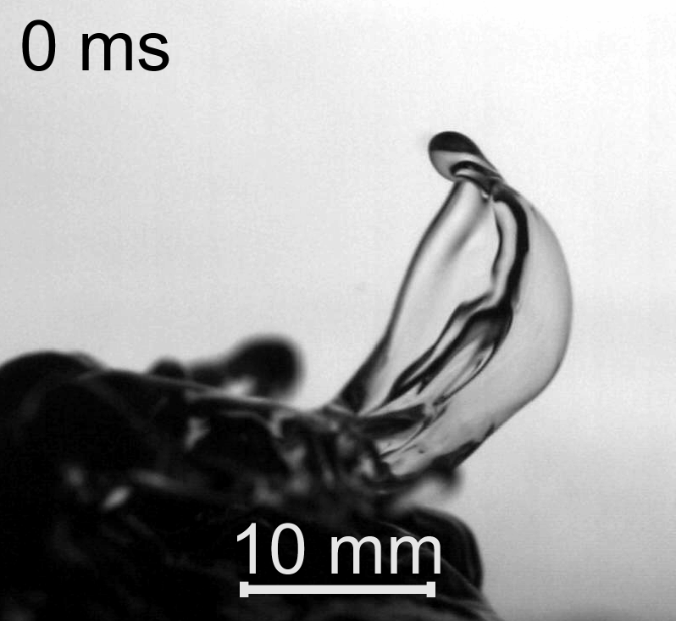
Extraction (Reduction) of Stress due to Spray
Veron et al. (2012, GRL) observed a specific spume generation mechanism in a high wind, wave tank study, which had only been observed in previous fluid dynamics studies.
  Stated that this mechanism may need to be accounted for in estimates of sea spray generation in “hurricane or strongly forced wave conditions.”
Troitskaya et al. (2017, SR) not only observed the bag-breakup mechanism in a high wind, wave tank study, but also parameterized the spray generation mechanism.
  Extraction of atmospheric stress due to ‘Bags’ and ‘droplets.’
Notes:
Previous fluid dynamics studies have observed a spume generation mechanism when observing liquid fragmentation in gaseous flow and termed it as the bag break up mode. This has also been observed in wave tank studies.
Troitskaya et al. 2017 observed the bag breakup mechanism in their high wind, wave tank study as well. They used a high speed camera to capture what was happening at the surface to obtain these high quality images below.
When high winds blow across the surface, you get an elevation of the water surface, as the wind continues to blow over the surface, the ”projection” inflates creating this microsail bordered by a thick rim. The microsail ruptures releasing many smaller spray droplets and the rim fragments into larger droplets.
Before getting into the next slides, it should be pointed out that this parameterization is based off of wave tank results, not the open ocean. Fine tuning of the parameterization will be performed to eliminate these issues. These issues will be shown in the upcoming slides.

Slide 5
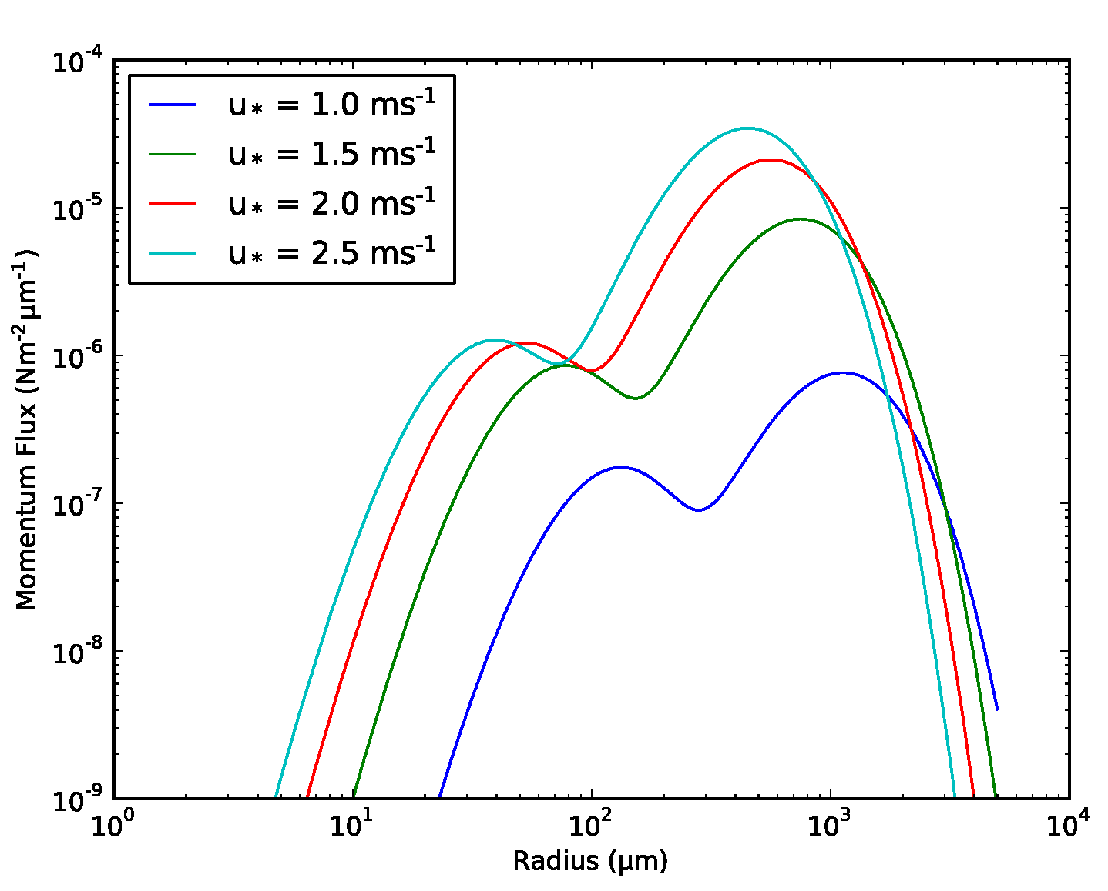

Surface Stress Model – Spray Contribution
Troitskaya et al. (2017, SR) parameterized the contribution of this sea spray generation mechanism to the total turbulent stress into two separate parts:
10⁻⁴
$$20ms^{−1}≤U_{10}≤40ms^{−1}$$
10⁻⁵
10⁻⁶
Drag of surface waves
‘Bag’ stress, or the airflow resistance to the microsails
The droplet stress, or the momentum acquired during the droplet production
Spray Momentum Flux (Nm⁻²𝜇m⁻¹)
10⁻⁷
10⁻⁸
10⁻⁹
10
Radius (𝜇m)
1
100
1000
10000
Notes:
Normally model stress as form drag of surface waves, nothing else
Waves providing resistance to the above air flow
The droplet stress is the term where the previously shown SSGF comes into play
These extra terms are specifically for high wind conditions and are not activated until wind speeds reach 22.5 m/s
momentum flux from the sea spray on the y axis and radius of the spray droplets on the x axis. Each line represents momentum flux at a different friction velocity. This friction velocity range is equivalent to u 10 range of 20 m/s to 40 m/s. That being said, we see with higher winds, more spray is generated meaning for an increase in momentum transfer by the spray.
** Surface stress is the momentum flux through the air-sea interface. A common interpretation is the vertical transfer of horizontal momentum through the interface, per unit area

Slide 6
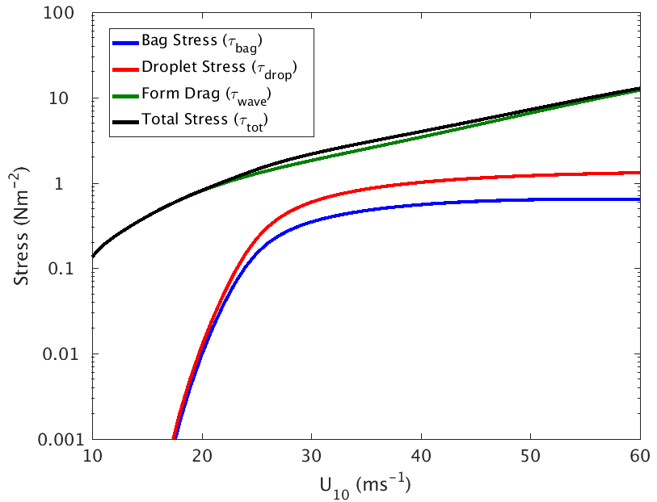

Flux Model – Stress Components
Can momentum extracted by spray account for the observed reduction in the drag coefficient?
  Tested with a surface flux model that would otherwise have a drag coefficient that increases linearly with wind speed
  An iterative, air-sea coupling model, the Modularized Flux Testbed (MFT) is used (Bourassa 2006, AOI).
The waves ’feel’ the reduced stress,
  Which reduces the roughness length
  Further reducing the stress
  Countered by a reduction in spray production and its impact on stress
$τ_{tot}=τ_{wave}+τ_{bag}+τ_{drop}$
Notes:
For the development of our drag coefficient parameterization we use an iterative, air-sea coupling model. The aforementioned surface stress model from Troitskaya et al is implemented into this model with a few modifications. 1 being that we base our form drag off of a different study Zheng et al (2013). 2nd, since this model is iterative, the drag coefficient is modified by the sea spray, making it internally consistent throughout calculations.
By taking into account the two spray terms (droplet and bag stresses), we see a reduction in the form drag. The presence of spray in the hurricane boundary layer reduces the momentum felt by the surface.
In the wave tank results, we do see less of an increase in stress at high winds due to leveling off of the drag coefficient by spray. but, as the circle points out, field observations contradict this so the model needs to be fine tuned.
-why do we see the decrease in Cd?
1. the winds reach such a high speed and the surface is less rough i.e. relatively smoother, due to spray and foam
- the storm feels the total stress.
- spray related stress reduces momentum felt by the surface. Sea spray is still a part of the momentum flux but doesn’t contribute to wave growth. When falls back into the ocean, transferred to ocean currents.
- the ocean feels the wave related stress
2. including roughness due to spray reduces the stress on the surface which reduces the wave-related roughness i.e. form drag
For a given fetch, significant wave height is proportional to the stress (form drag), which is reduced by the presence of spray in the boundary layer.
In other words, fetch provides a cap on the SWH for a given wind speed and the spray further reduces this cap

Slide 7
Flux Model: Spray vs. No Spray
There is an obvious reduction in the stress and drag coefficient due to to spray effects. The black line is the model without spray, blue is the atmospheric value with spray, and red is the oceanic value
The drag coefficient levels off early than previous literature reports. Also, there is an unexpected increase in the coefficient at wind speeds greater than 35 ms⁻¹
Stress
Drag Coefficient
Notes:
Spray modification does not give consistent results in comparison to observations (Powell 2003). Implies that some arbitrary tuning may be off in the flux model and spray terms.
Next portion of the project is to continue fine tuning the model
Way to tune it, stuff with wave dependency →

Slide 8
Profiles from Dropsonde Observations
d = displacement height
Speed of Surface Current
Friction Velocity
Height Above Surface
D = d – z₀
D ≈ d
$$u_{i}=u_{sfc}+\frac{u_{∗}}{k_{v}}\left[\ln\left(\frac{z_{i}−D}{z_{0}}\right)−Ψ_{M}(L,z_{i})\right]$$
Mean Wind Speed
Von Kármán Constant
( ≈ 0.4 ± 0.01 )
Roughness Length
Stability Term
(a function of u*, q*, and θ*)
Observations of wind speed, air temperature, and humidity at different heights in a log-layer can be used to solve these three equations
Similarly structured profiles
exist for potential temperature (θ)
and specific humidity (q)
$$θ_{i}=θ_{sfc}+\frac{θ_{∗}}{k_{v}}\left[\ln\left(\frac{z_{i}−D}{z_{0_{θ}}}\right)−Ψ_{H}(L,z)\right]$$
$$q_{i}=q_{sfc}+\frac{q_{∗}}{k_{v}}\left[\ln\left(\frac{z_{i}−D}{z_{0_{q}}}\right)−Ψ_{E}(L,z)\right]$$
Stress = ρ|u∗| u∗ Sensible heat flux = -ρ C_{p}|u∗| θ∗ Latent heat flux = -ρ L_{v}|u∗| q∗

Slide 9
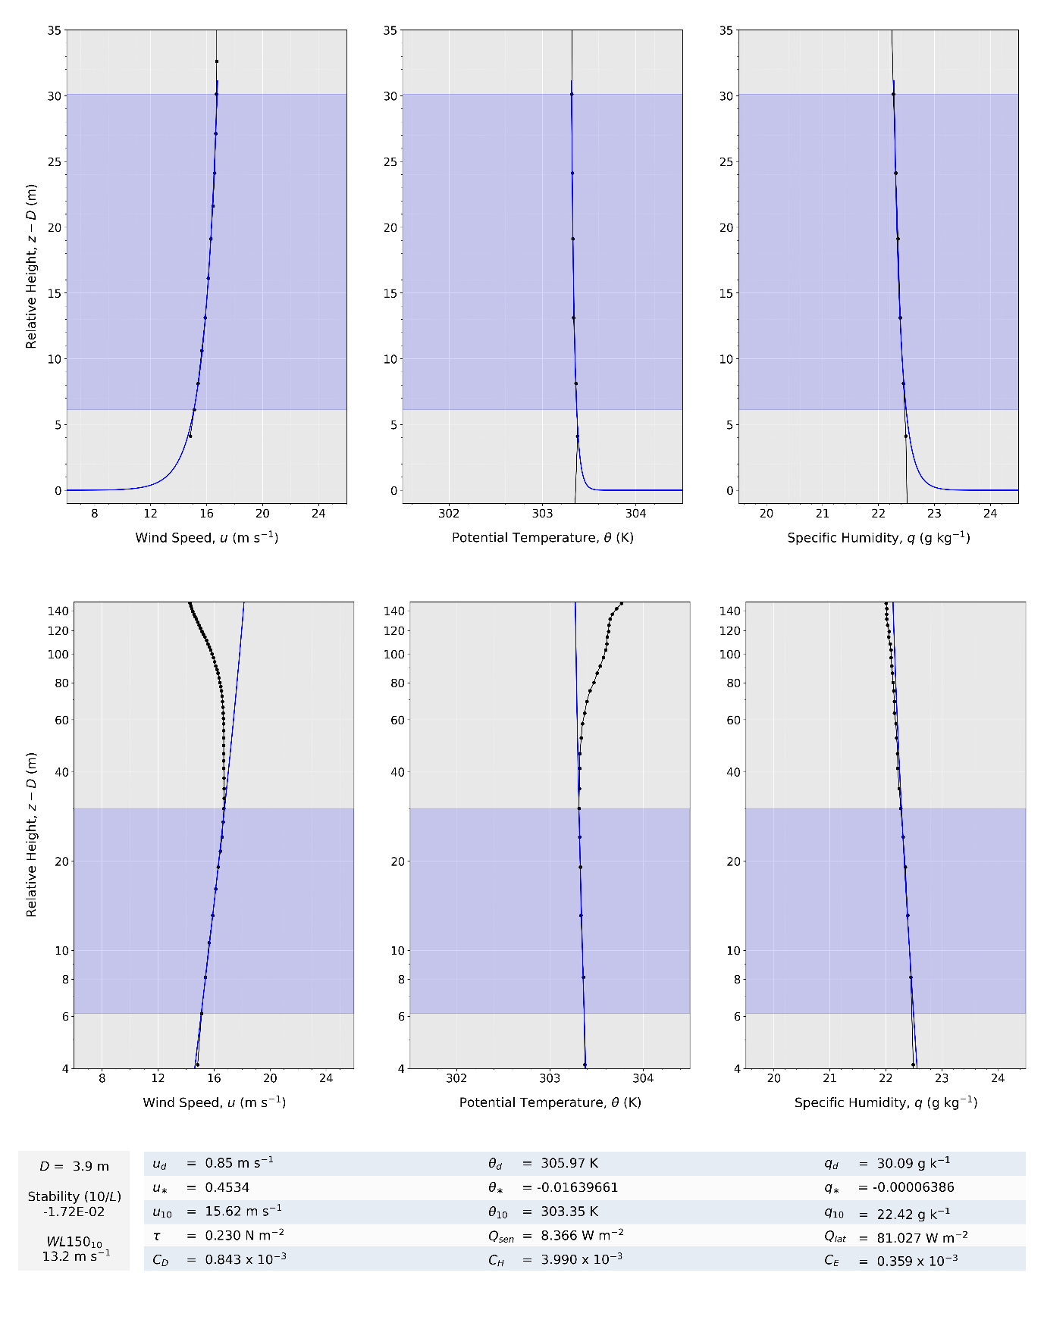
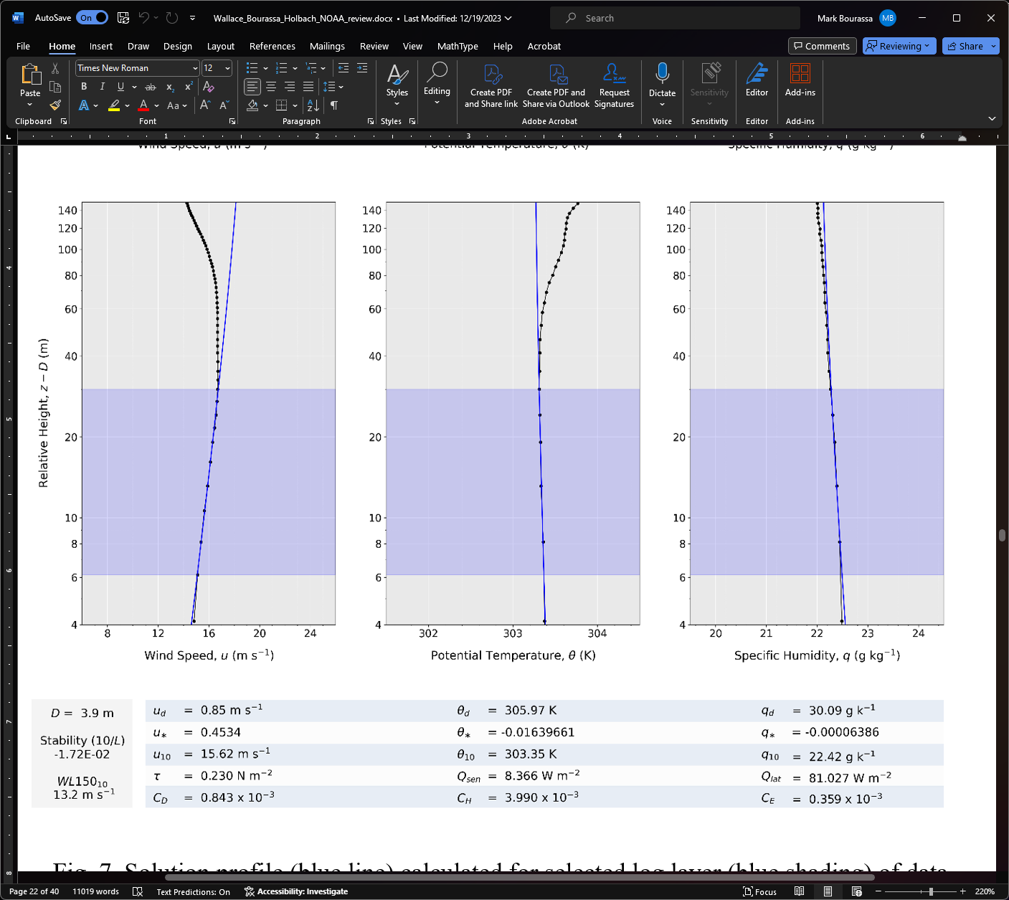
Output
Able to find solution profiles for u, θ, and q
Calculate fluxes
Interpolate solutions to produce estimated 10m wind that factors in displacement height and follows expected physics
Here, our u₁₀ is close to the estimate using NOAA’s WL150 method

Slide 10
Able to find solution profiles for u, θ, and q
Calculate fluxes
Extrapolate solutions to produce estimated 10m wind that factors in displacement height and follows expected physics
Here, our u₁₀ is close to the estimate using NOAA’s WL150 method

Slide 11
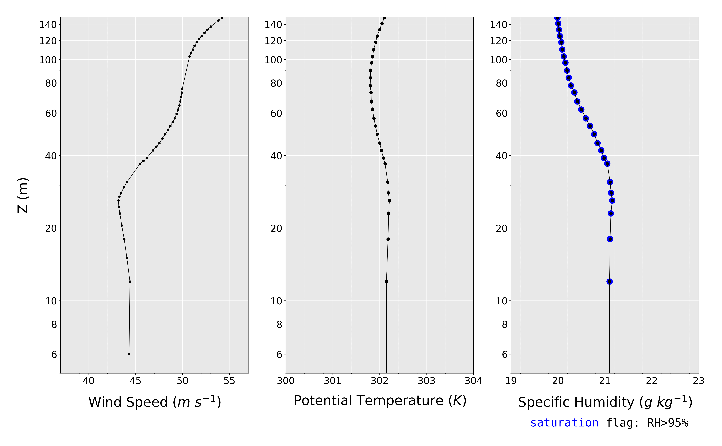
Dynamic Shift in Wind
Isothermal
(Well-Mixed)
RH Flag + Vertical Moisture Profile
This spray layer seems to be associated with a displacement height

Slide 12
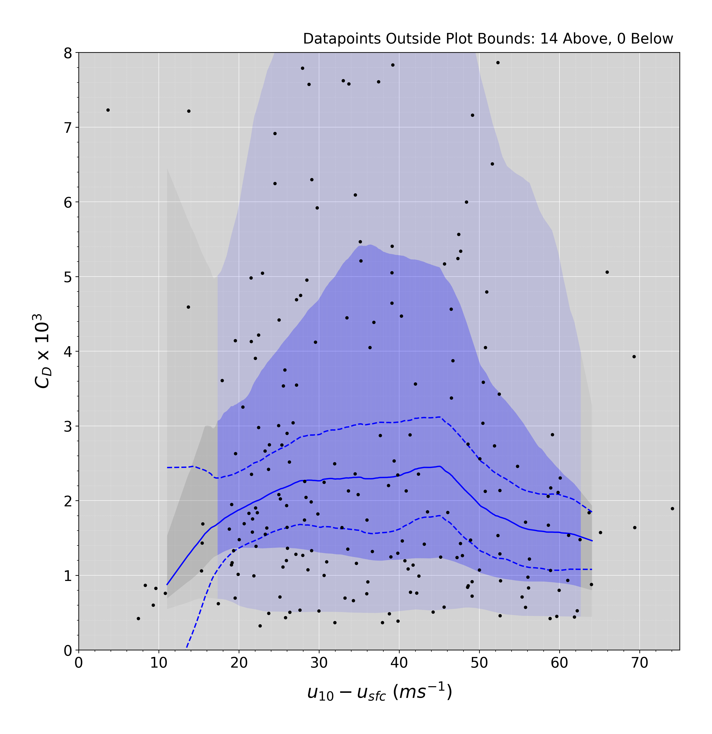
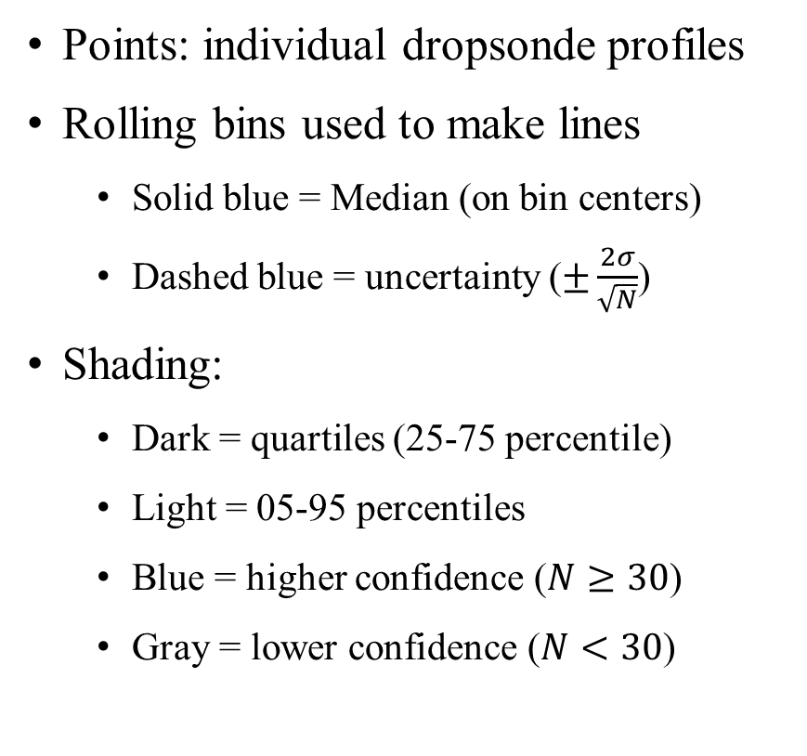
Plot Explanation
Points: individual dropsonde profiles
Rolling bins used to make lines
  Solid blue = Median (on bin centers)
  Dashed blue = uncertainty ($±\frac{2σ}{\sqrt{N}}$)
Shading:
  Dark = quartiles (25-75 percentile)
  Light = 05-95 percentiles
  Blue = higher confidence ($N≥30$)
  Gray = lower confidence ($N<30$)

Slide 13
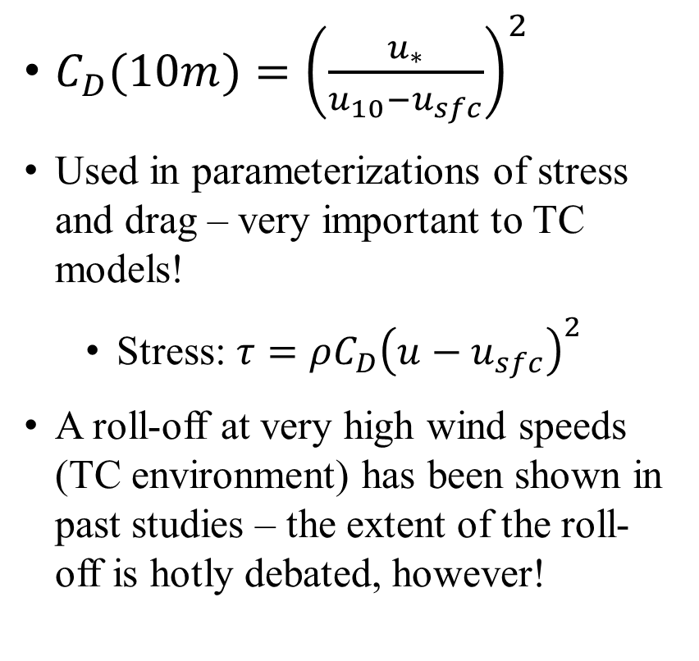
Drag Coefficient (C_{D})
$C_{D}(10m)={\left(\frac{u_{∗}}{u_{10}−u_{sfc}}\right)}^{2}$
Used in parameterizations of stress and drag – very important to TC models!
  Stress: $τ=ρC_{D}{\left(u−u_{sfc}\right)}^{2}$
A roll-off at very high wind speeds (TC environment) has been shown in past studies – the extent of the roll-off is hotly debated, however!

Slide 14
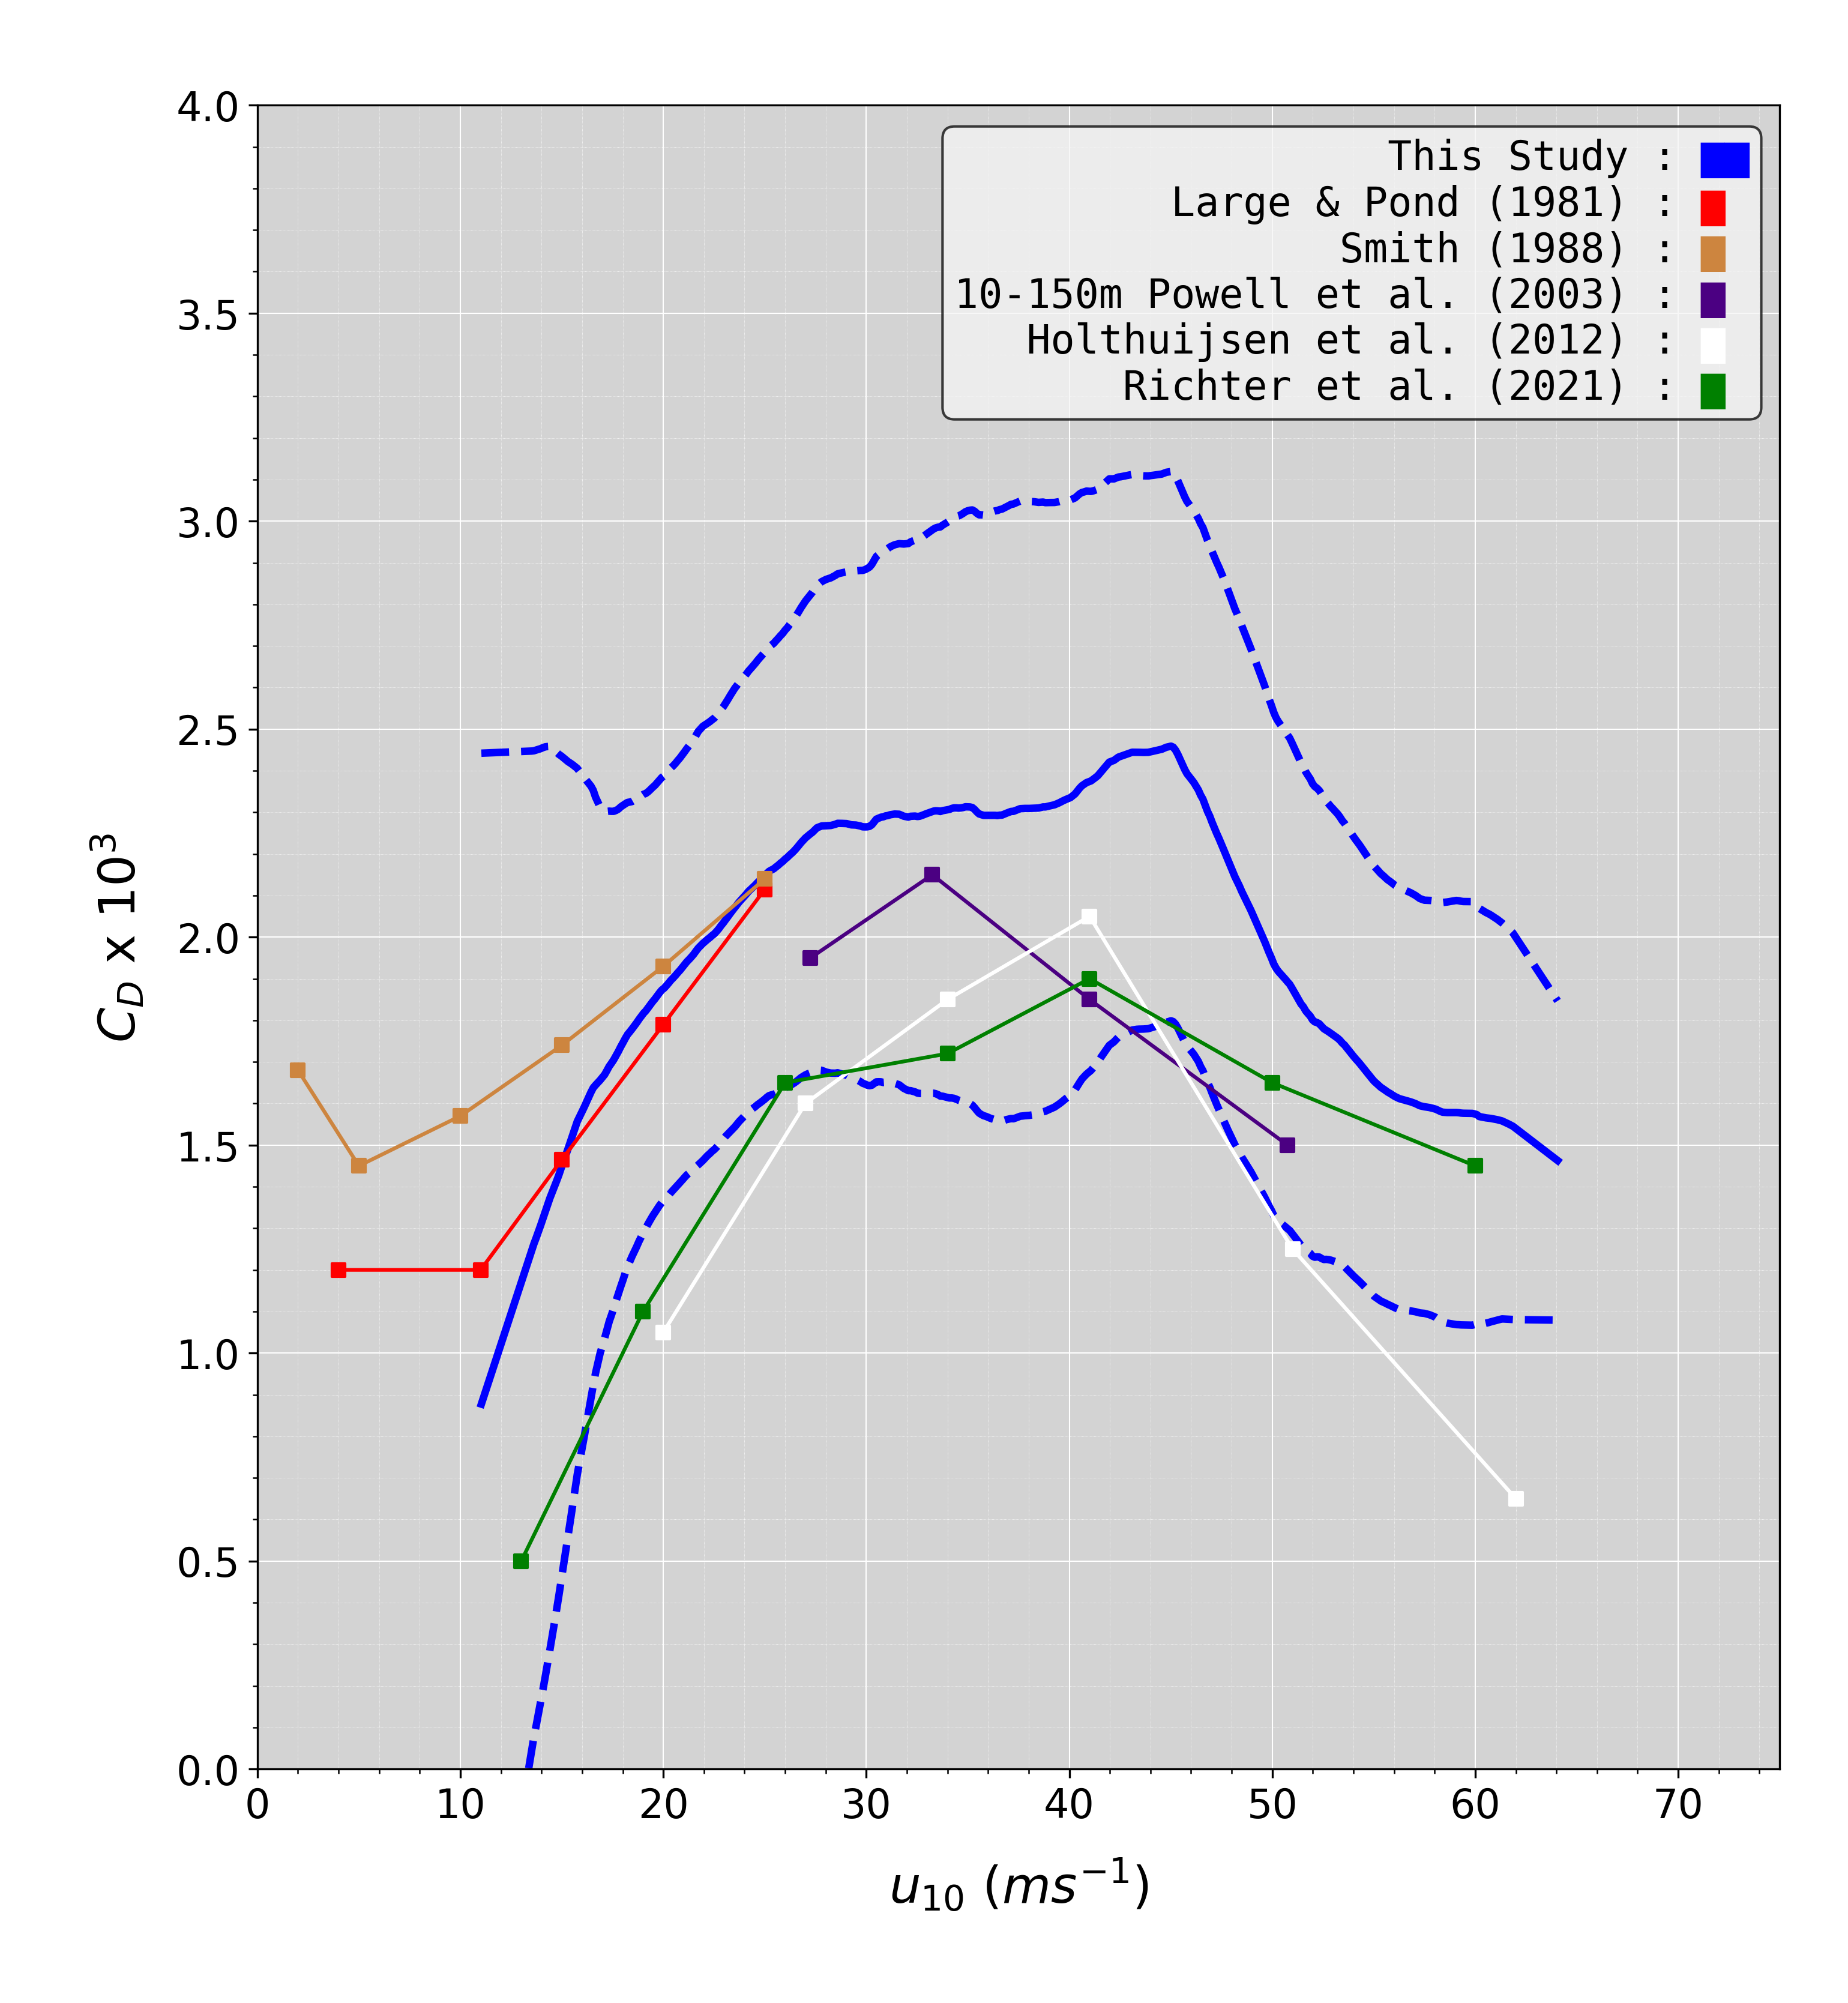
C_{D} vs. Past Work
Most previous studies within bounds of uncertainty
Fairly good agreement in the mean
  Large & Pond 1981 and Smith 1988 parameterizations are ship-based observations – only meant to be used up to at most 25 ms⁻¹
    However, being close to them is a good sign
  Powell et al. 2003, Holthuijsen et al. 2012, and Richter et al. 2021 are all hurricane studies
    Aggregate dropsonde profiles are used in these (many sondes averaged together)

Slide 15
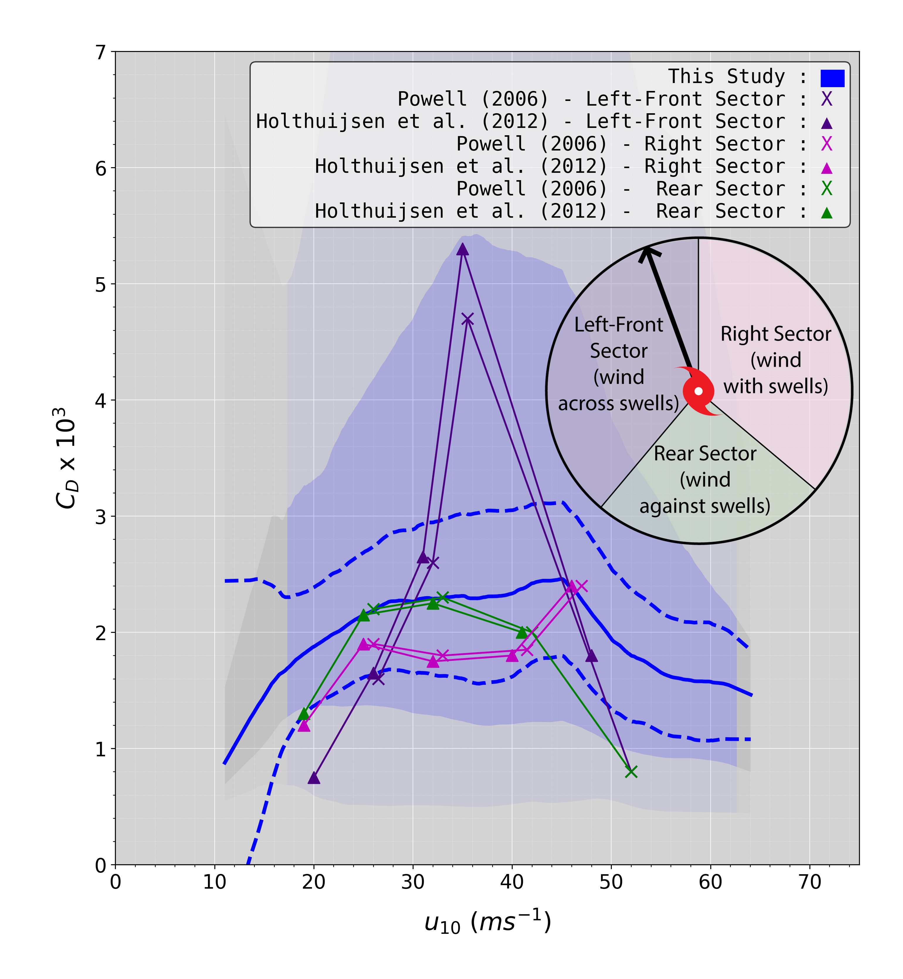
C_{D} vs. Past Work
(split by storm sector)
Two prior studies show large spike in drag for cross-swell (Left-Front sector) dropsondes
  Powell (2006)
  Holthuijsen et al. (2012)
Lines up well with our quartiles
The sea state is very different in these sectors
Strongly suggests that increased drag is due to a different process – possibly sea state modifying roughness

Slide 16
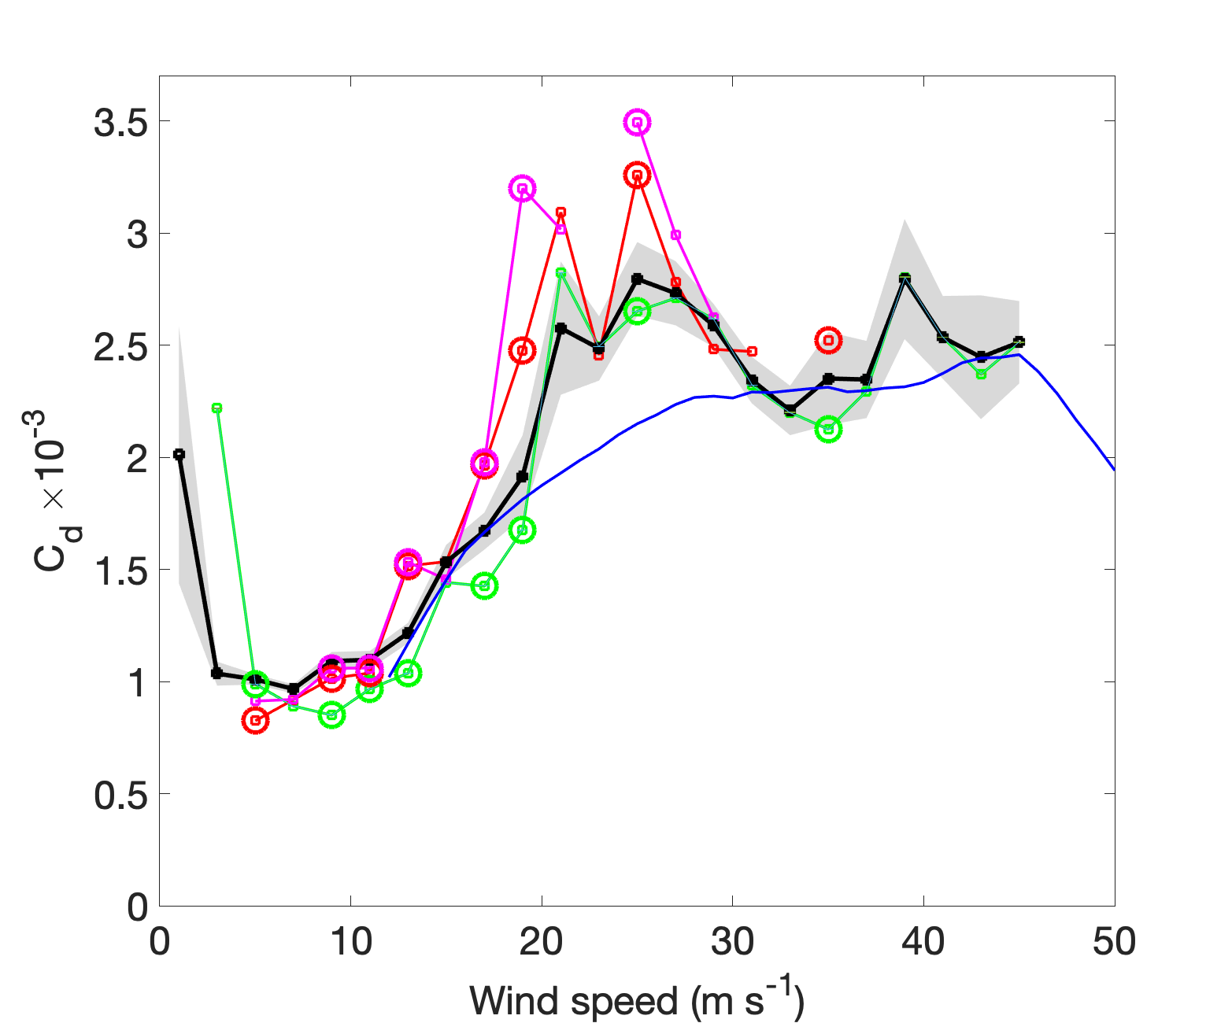
Mean C_{d} binned based on wind speed
Wind-wave > 60º
All cases
Wind-wave > 45º
Dropsondes (median)
(Wallace Holbach and Bourassa)
SailDrone C_{D} are remarkably consistent with dropsonde results
Except for 20 to 30 m/s
Graphic from Greg Foltz
Wind-wave < 45º

Slide 17
Summary and Conclusions
A sea spray model can (with some adjustment) can explain the drop in observed stress and drag coefficients dependencies are a function of wind speed. (some tuning is required)
Dropsonde data suggest that spray causes a non-negligible displacement height for wind speeds greater than about 30 m/s.
  SailDrone drag coefficients are remarkably similar to dropsonde drag coefficients.
  However, that implies that the extraction of stress due to spray either
    Happens at height below the height of the SailDrone anemometer (about 2 m), or
    Some other process is responsible for the reduction in drag dependency on wind speed.
Observations are pretty consistent that another process is coming in to play for wind speeds from about 20 to 30 m/s that is increasing the stress.
For calculating equivalent neutral winds:
  The displacement height is important for determining the correct value of friction velocity.
  The roughness length probably depends on sea state for winds in the 20 to 30 m/s range.
    The actual dependency is far from clear.

Slide 18
How do we define wind speed for hurricane force winds?
Mark A. Bourassa¹ and Renee Richardson^{1,2}
The Florida State University
NOAA

Slide 19
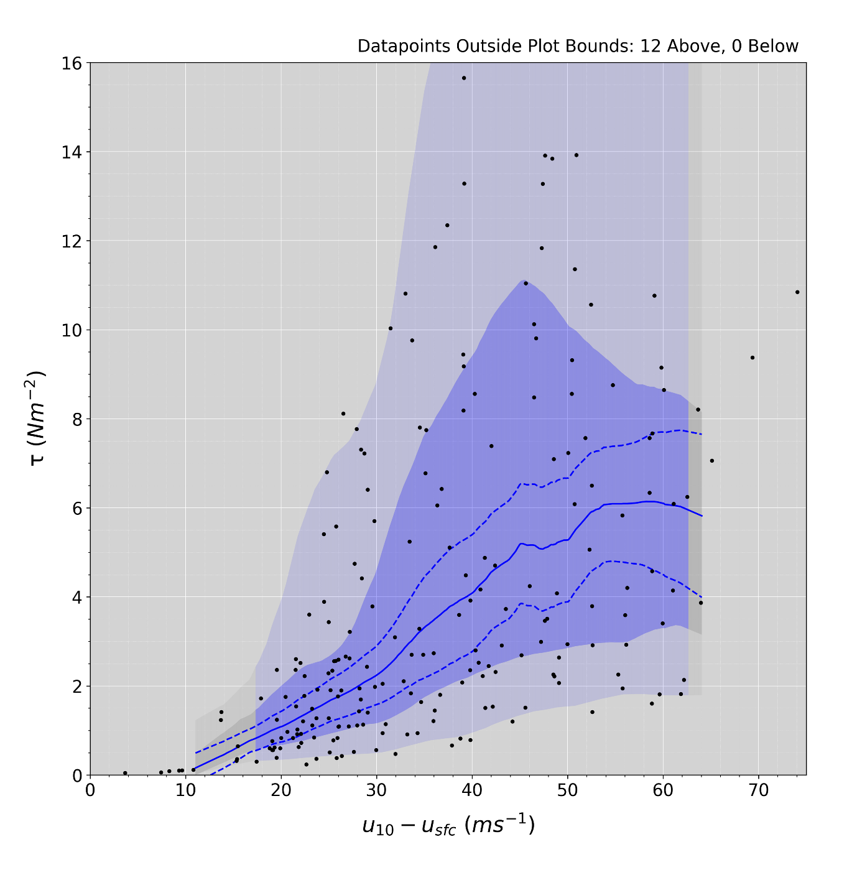
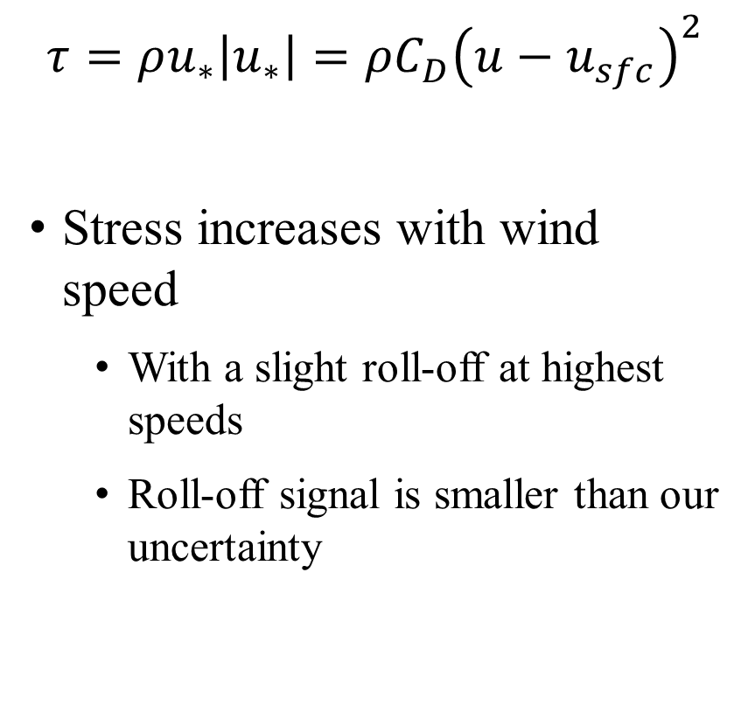
Momentum Flux (Stress)
$$τ=ρu_{∗}\left|u_{∗}\right|=ρC_{D}{\left(u−u_{sfc}\right)}^{2}$$
Stress increases with wind speed
  With a slight roll-off at highest speeds
  Roll-off signal is smaller than our uncertainty
Notes:
FOR SHF – Evaporative cooling of the atmosphere due to spray – NOT from surface

Slide 20
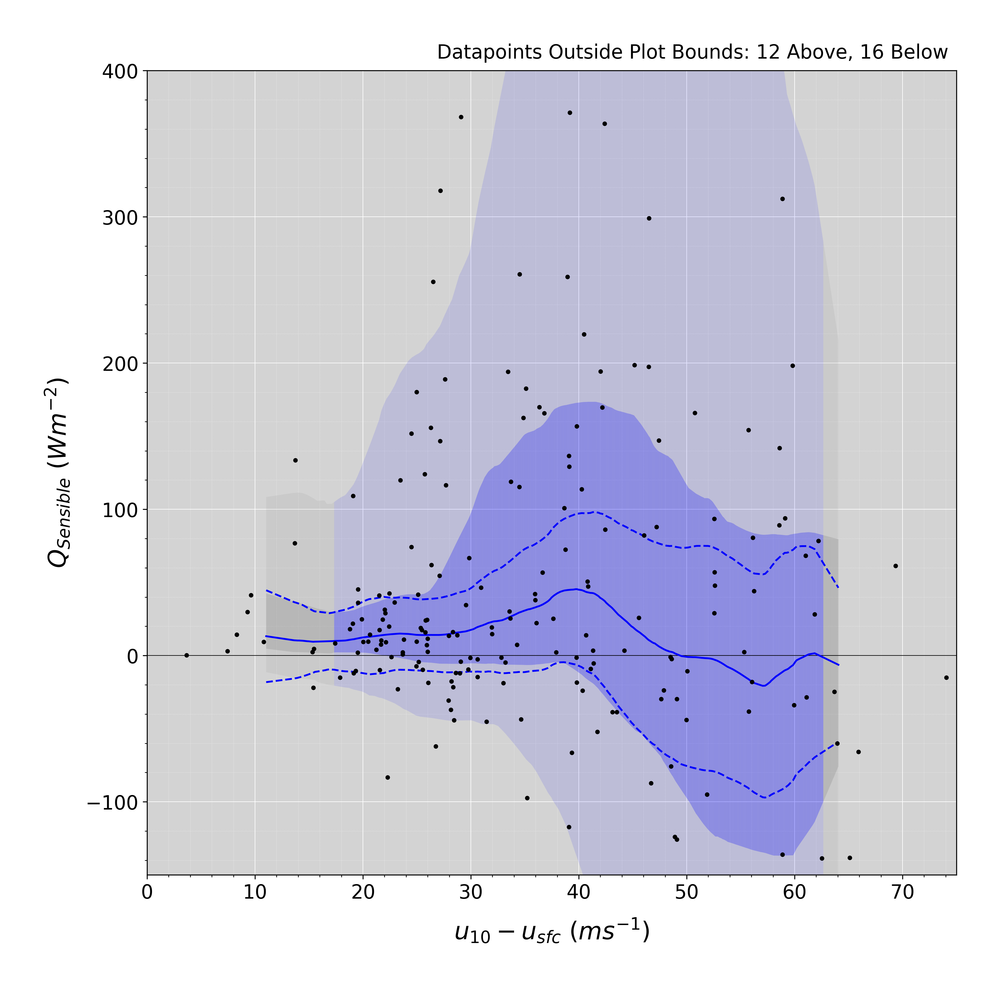
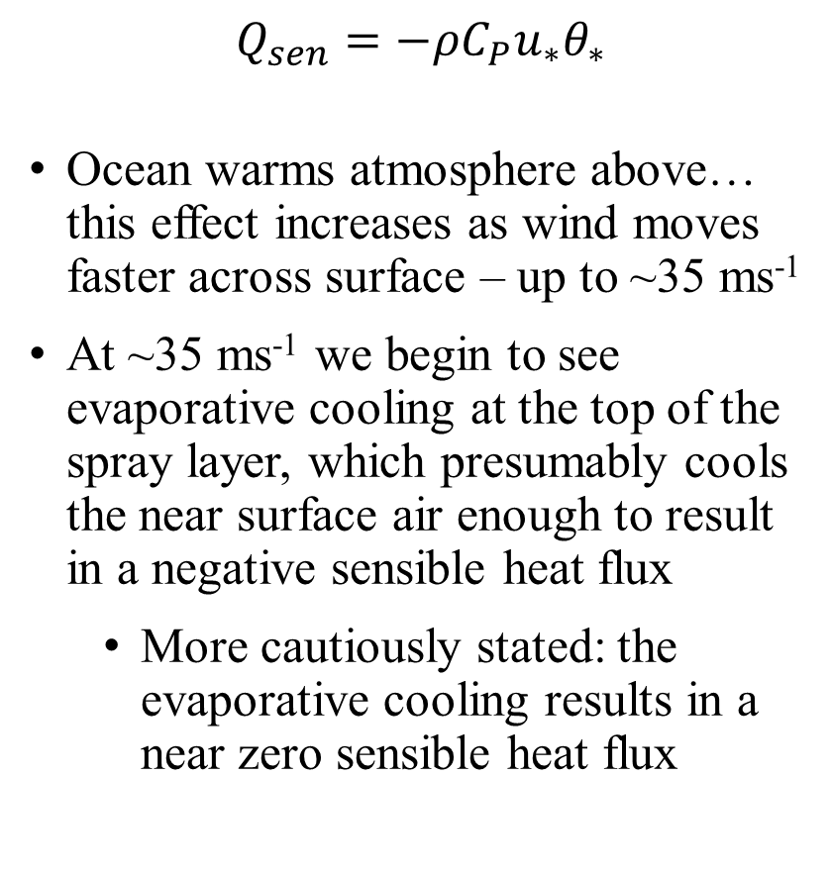
Sensible Heat Flux
$$Q_{sen}=−ρC_{P}u_{∗}θ_{∗}$$
Ocean warms atmosphere above… this effect increases as wind moves faster across surface – up to ~35 ms⁻¹
At ~35 ms⁻¹ we begin to see evaporative cooling at the top of the spray layer, which presumably cools the near surface air enough to result in a negative sensible heat flux
  More cautiously stated: the evaporative cooling results in a near zero sensible heat flux
Notes:
FOR SHF – Evaporative cooling of the atmosphere due to spray – NOT from surface

Slide 21
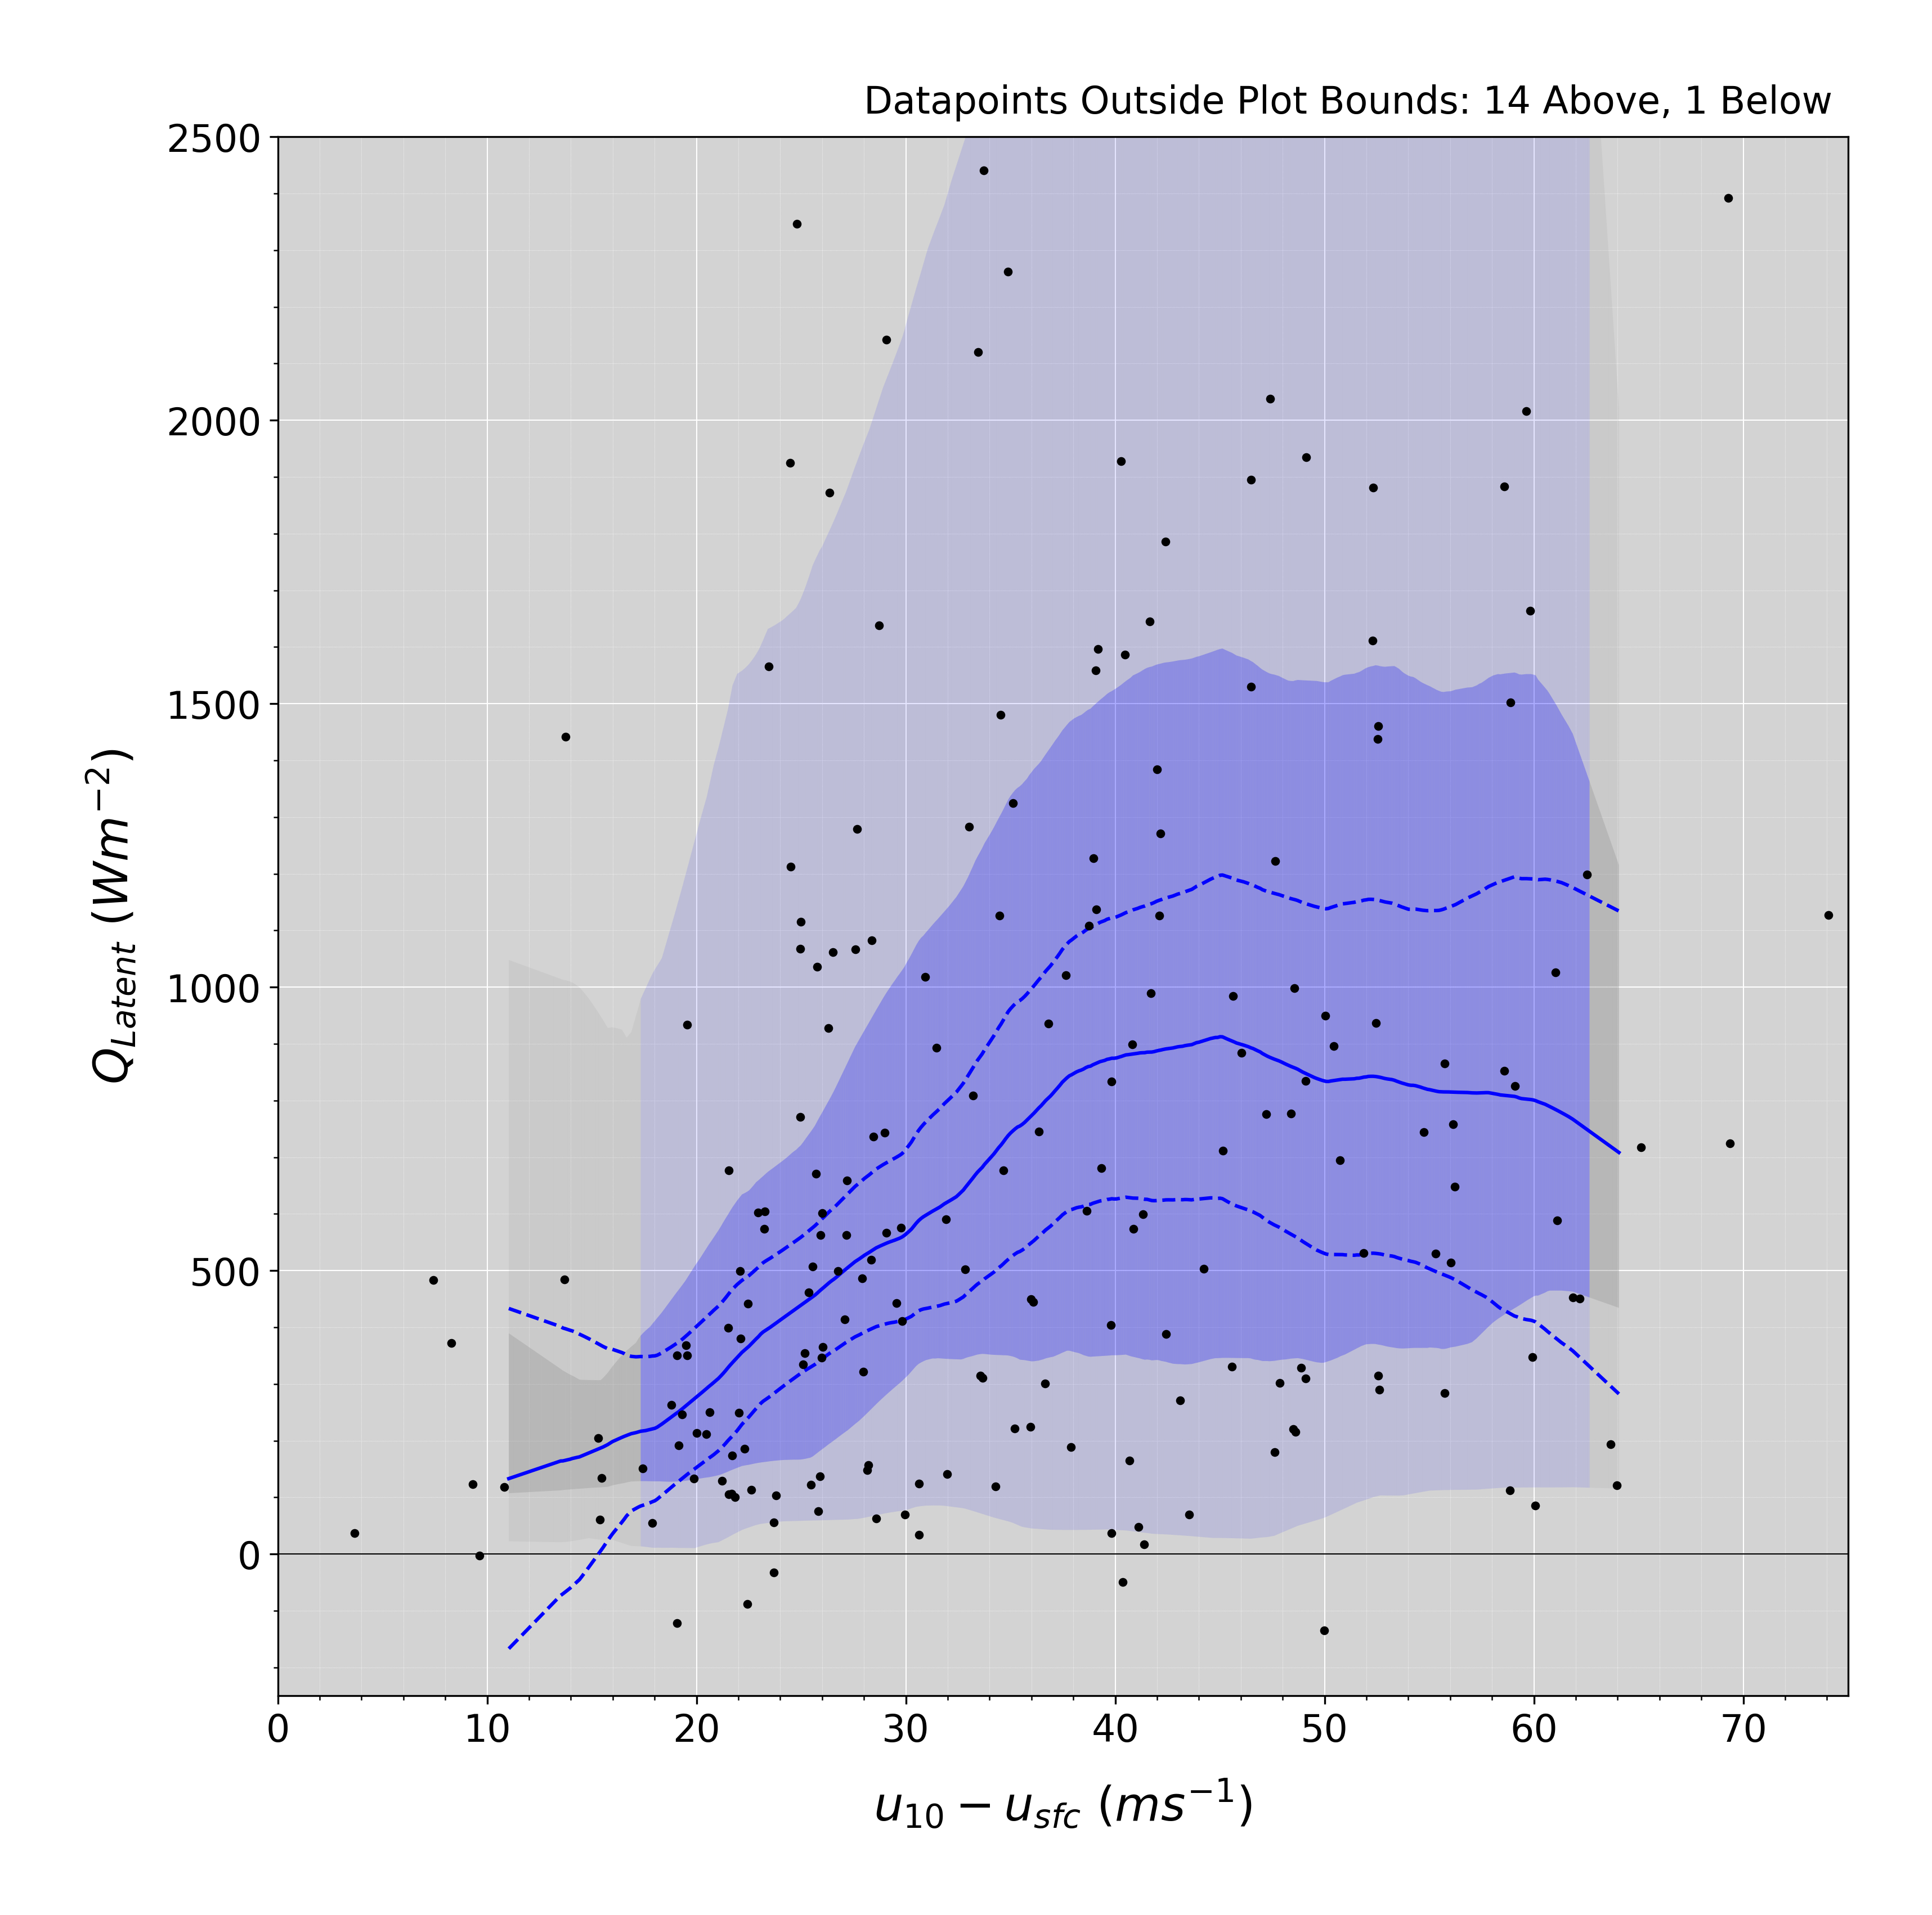
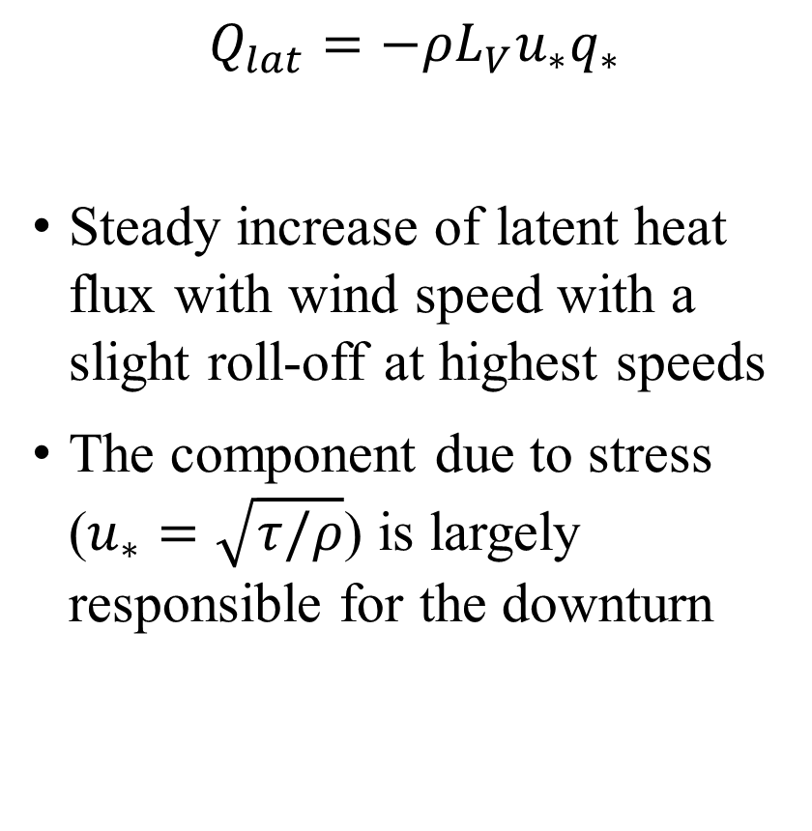
Latent Heat Flux
$$Q_{lat}=−ρL_{V}u_{∗}q_{∗}$$
Steady increase of latent heat flux with wind speed with a slight roll-off at highest speeds
The component due to stress ($u_{∗}=\sqrt{τ/ρ}$) is largely responsible for the downturn
Notes:
FOR SHF – Evaporative cooling of the atmosphere due to spray – NOT from surface

