Slide 1
A multi-satellite, multi-scale investigation of marine atmospheric boundary layer impacts on low-level cloud variability
Justin Stopa
Ocean Resources and Engineering, SOEST, The University of Hawaiʻi at Mānoa
Ralph Foster
Applied Physics Laboratory, The University of Washington
Hauke Schulz and Ryan Eastman
The University of Washington
Doug Vandemark
Ocean Processes Analysis Laboratory, The University of New Hampshire
Alexis Mouche and Bertrand Chapron
Ocean and space physics (LOPS), IFREMER, UBO, CNRS, IRD
Peter Sadowski, Yannik Glaser
Information & Computer Sciences, Mathematics, The University of Hawaiʻi at Mānoa
Salt Lake City, Utah, IOVWST 2024 31 May 2024

Slide 2
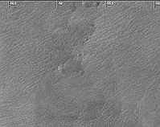
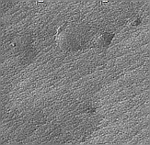
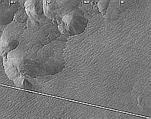
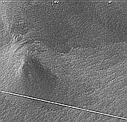
Gravel
19°N
Explore Connections between PBL Clouds & Coherent Structures
Aqua - Modis
True Color
Flowers
63°W
36°W
Modis clouds: PBL cloud Classes
Sugar, Gravel, Fish, Flowers
S-1 SAR
ERA5 U10
7°N
S-1 SAR: PBL CS classes & related stratification regimes
MODIS - Gravel
Wide-swath SAR
Zoomed SAR
A
Hypothesis
PBL cloud classes & PBL CS change states due to changes within the same stratification regime
Changes in CS classes can induce profound differences in the fluxes across the PBL (more so than surface fluxes)
Expect: Cloud patterns are affected by the CS.
Motivation: Cloud-Radiative Feedback
A
Rolls
Cells/Rolls
Cold Pools
200 km
200 km
40 km
MODIS - Flowers
Gust Front
Rolls

Slide 3
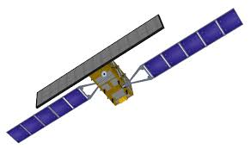
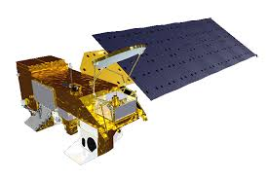
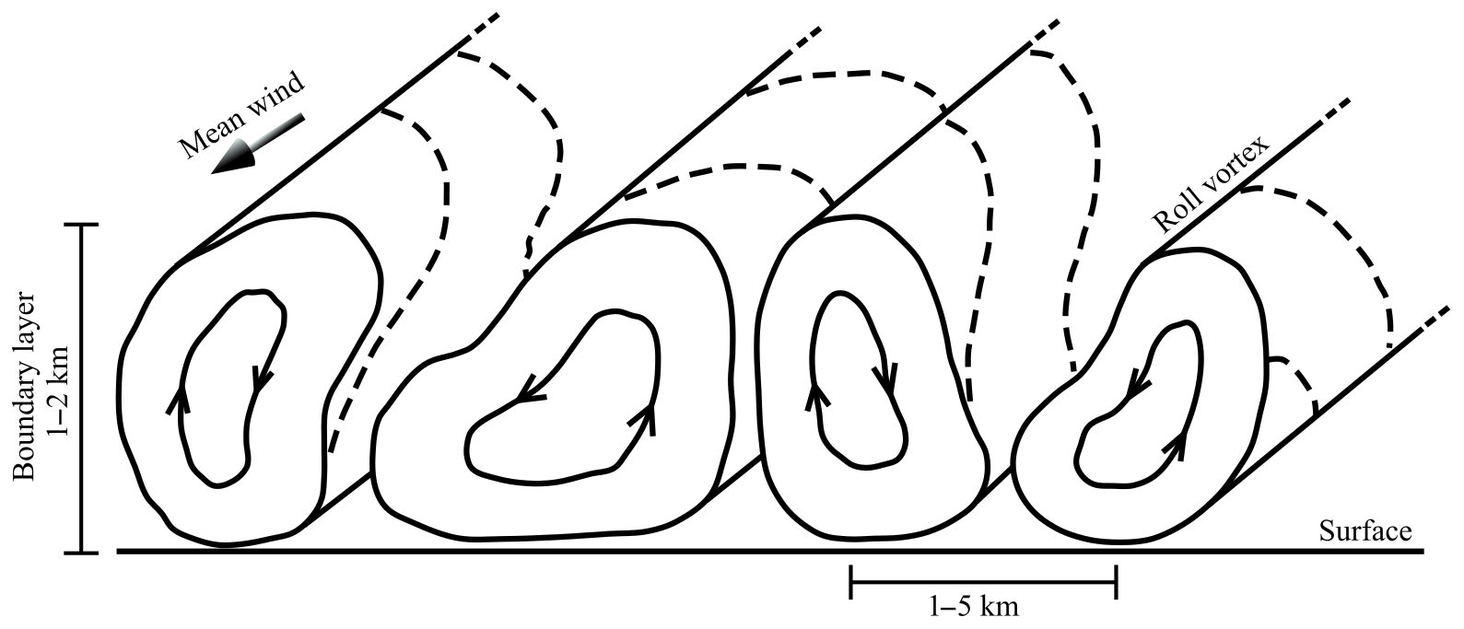
Outline
Marine Atmospheric Boundary Layer - MABL
Introduction
Clouds patterns - top of MABL
SAR surface textures - bottom of MABL
MABL sandwich
Results - trade wind boundary layer of the NW Atlantic
MABL bifurcation - a continuum of cells and rolls
Cloud type vs SAR classes
Outlook
Coherent Structures leave imprint in SAR images

Slide 4
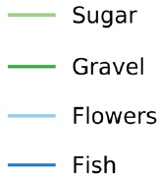
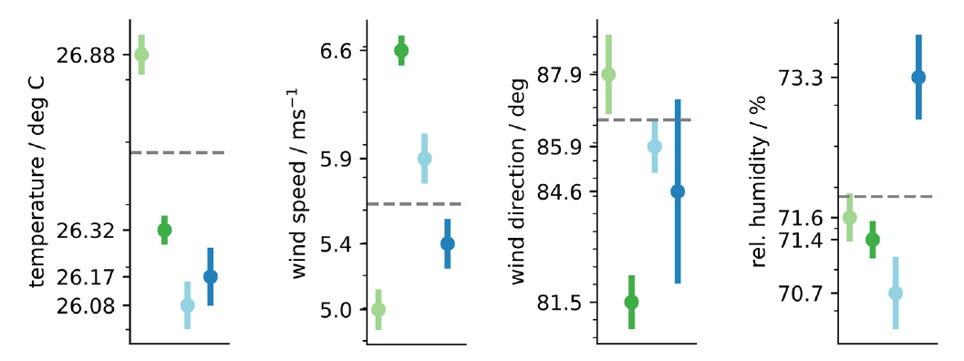
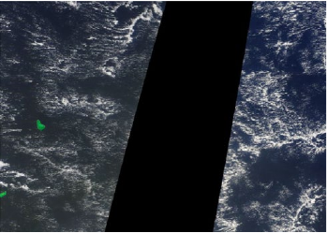
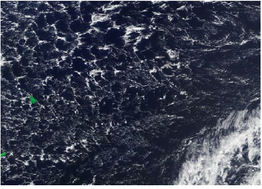
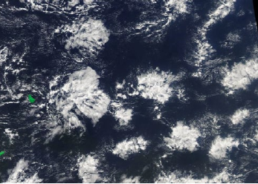
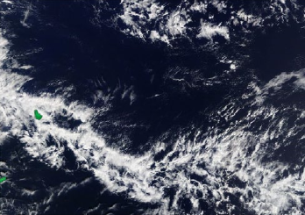
Cloud classes - top of MABL
Mean States Associated with PBL Cloud Types
Schulz et al., JGR 2021
●Clouds patterns strongly relate to wind speeds and directions
●Sugar->Fish->Flowers->Gravel
Low to high wind speed
E to NE wind direction
●Changes in temperature and moisture
sugar
gravel
fish
flower
Sugar
Gravel
Flowers
Fish

Slide 5
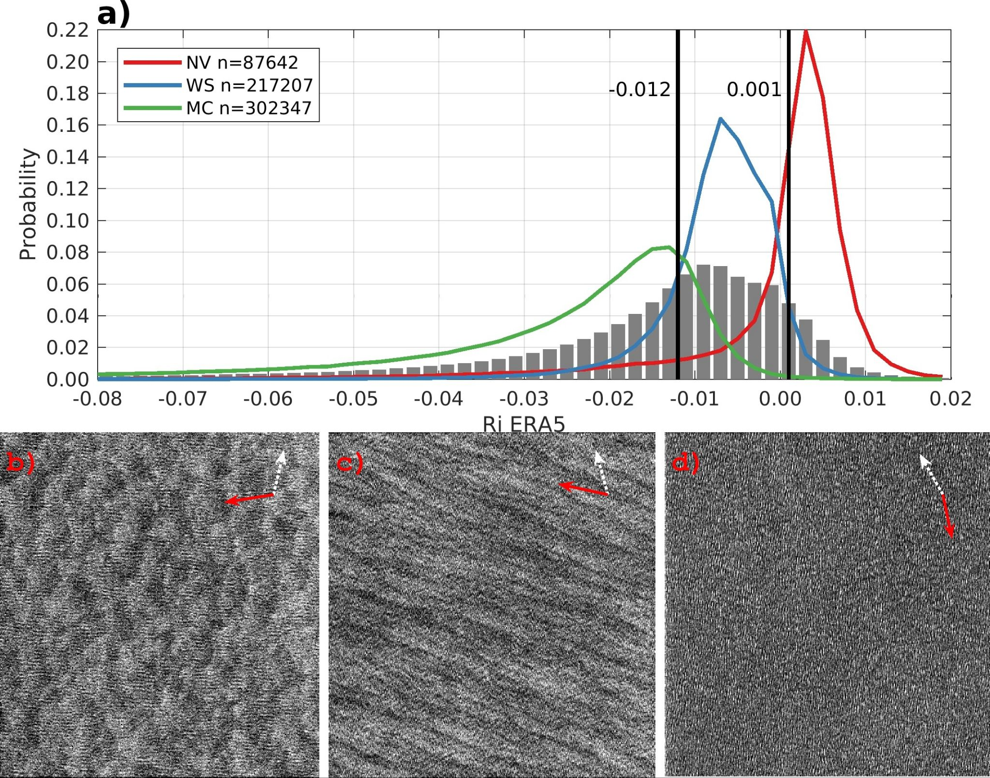
SAR textures and stratification - bottom of MABL
●2016-2019 Sentinel-1A/B SAR images
●CNN classifies the SAR textures:
Microscale Convection (MC) - unstable (UBL)
Cells - convection
Wind Streaks (WS) - near neutral (NNBL)
Rolls - forced convection
Negligible Variability (NV) - stable (SBL)
No PBL variability
SAR Textures map to Ri (from ERA5)
●Based on PDFs, implicit coherent structure bands
1) UBL: Ri<-0.012
2) NNBL: -0.012≤Ri<0.001
3) SBL: Ri ≥0.001
Unstable
MC Ri=-0.032
Near-neutral
WS Ri=-0.006
Stable
NV Ri=+0.005
Stopa et al., GRL 2022

Slide 6
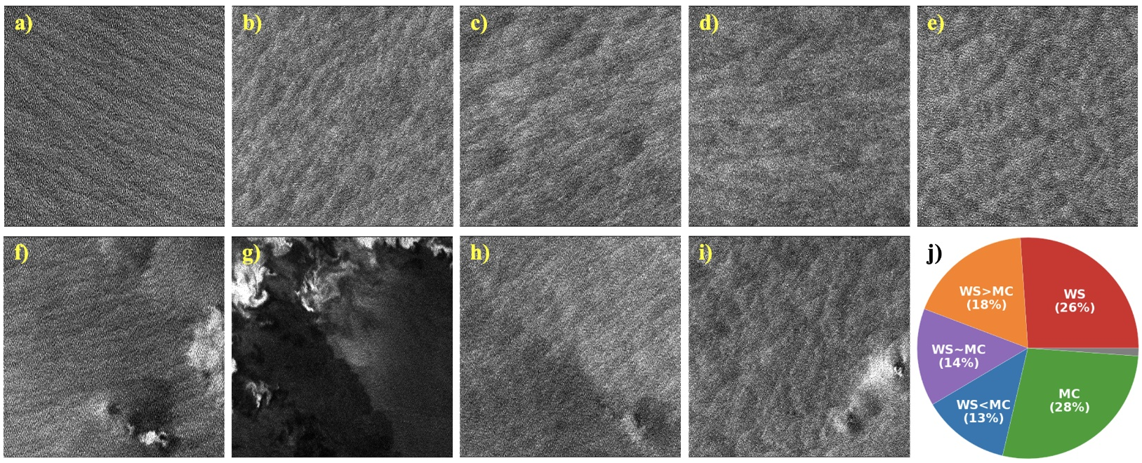
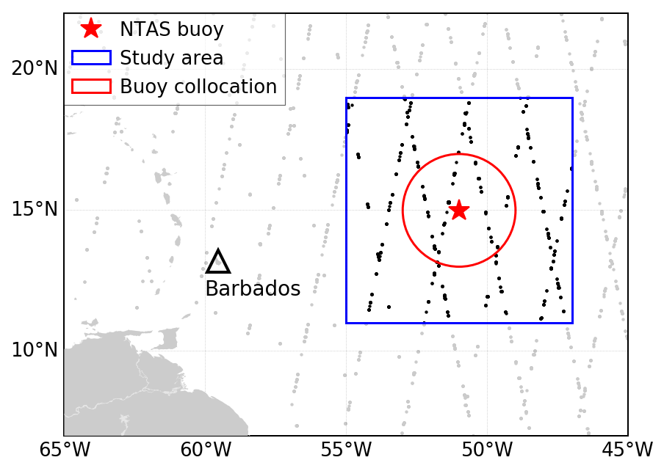
Morphology of trade wind boundary layer observed by SAR
●Hand-tagged SAR images - 8° box centered at NTAS
●4200 images or 350 images/month
●Results are independent of “voting” strategy and expert
●Region is an ideal place for study of the MABL - consistent winds across large regions minimal changes in SST
● 99% have rolls or cells
Classes
WS = Wind Streaks: only rolls
WS>MC: WS dominate over MC
WS~MC: WS and MC are present w/ equal strength
WS<MC: MC dominate over WS
MC = Micro-scale convection: - only cells
Figure 1. Sampling of WV2 images. (a)-(e) Examples of MABL CS classes. In order: WS, WS>MC, WS~MC, WS<MC and MC. (f) WS with RC and CP in lower portion. (g) No CS with RC and possible large CP (h) CS transformation across GF, WS upper right, WS > MC lower left. CP in lower right corner. (i) MC > WS with CP in lower right corner (j) Populations fractions of these five MABL CS classes.

Slide 7
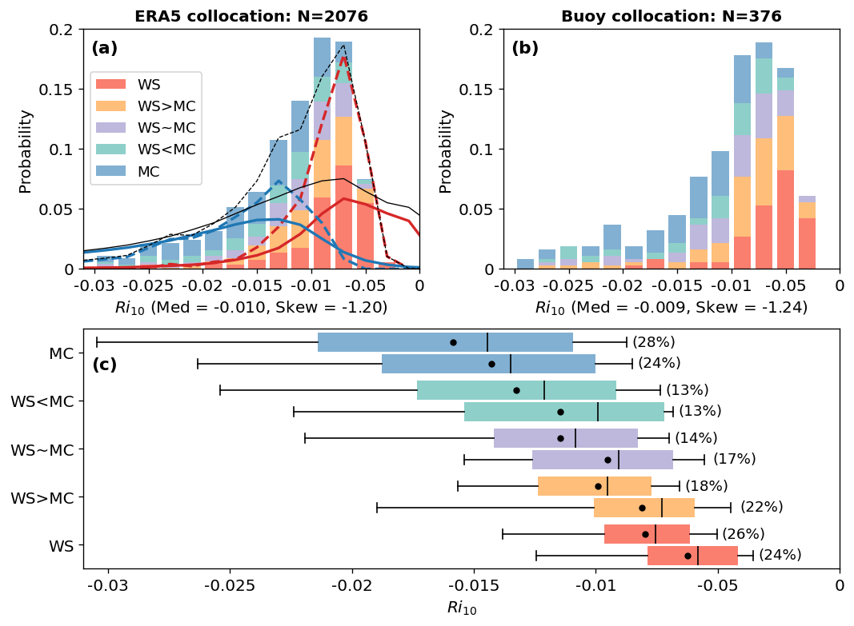
Morphology related to stratification
Note that the near-neutral (PBL rolls) regime is ~twice as likely in this region (dashed) as it is globally (solid, curves from slide 2)
Note that the convective regime (PBL cells) regime is comparable to global averages (solid, curves from slide 2)
WS→MC: Ri becomes more negative (more unstable)
MC→WS: Ri becomes more positive (more stable)
Confirm Grossman, (1982) BOMEX
Differences between NTAS and ERA5 …

Slide 8
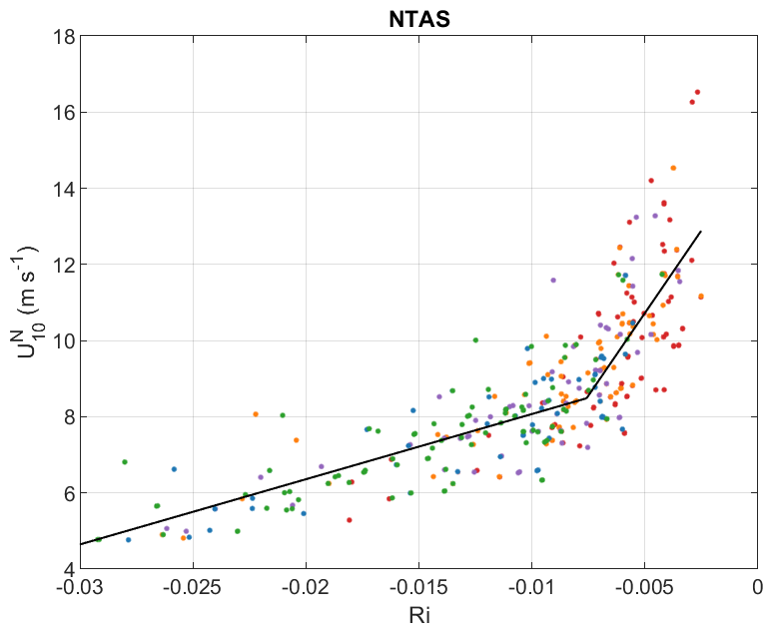
PBL Classes and Buoy Data
Piecewise bilinear fit
Transition when roll signature appears:
Ri_{crit} = -0.0075 for both Stress & Qflux (latent heat flux)
Determined by the fit
U10N controls stratification
Moderate/Weak relationship with moisture flux
Water vapor is a trace gas, follows eddies. Mesoscale & temporal variability in q_{air}
No relationship with buoyancy flux
Temperature is property of the fluid and can adjust independently of eddies
Hypothesis:
Natural variability in U10 tends to neutralize PBL, shifting mean state toward rolls.
Rolls induce non-gradient momentum flux in addition to homogeneous Reynolds Stress
Changes slope of U10(Ri)
U10N (~𝜏)
$$R^{2}=0.70$$
Color Scheme

Slide 9
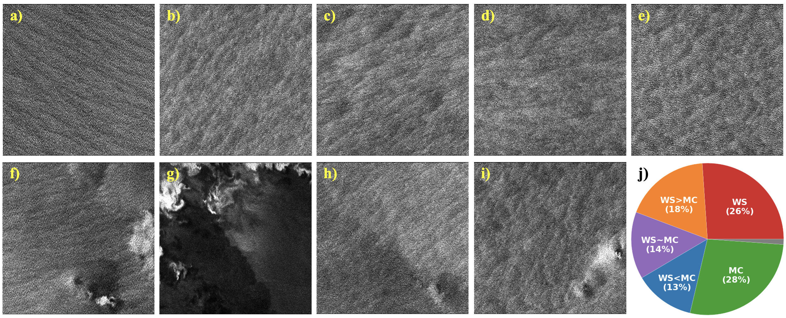
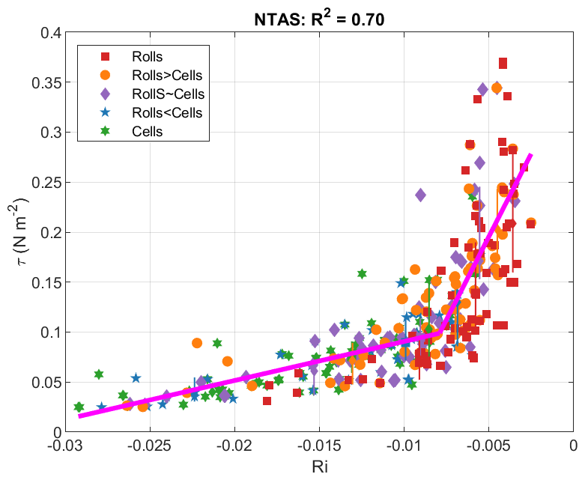
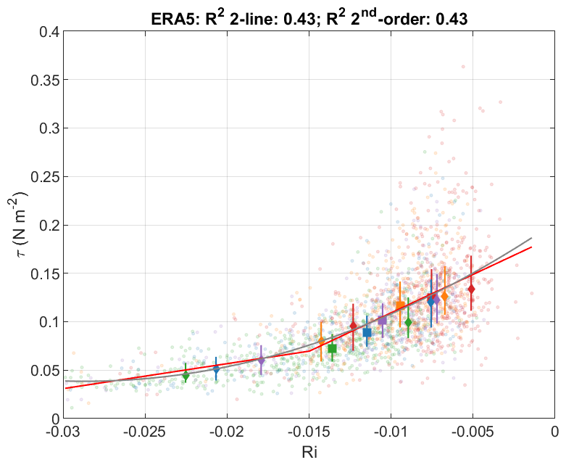
Sharp increase in stress when rolls emerge
Flux Buoy Data
ERA5
No sharp increase in stress when rolls emerge
Scattered outliers
Mass of data is here
2nd-order fit is equivalent to bilinear fit
Atlantic Trade Winds Region Upwind of Bermuda

Slide 10
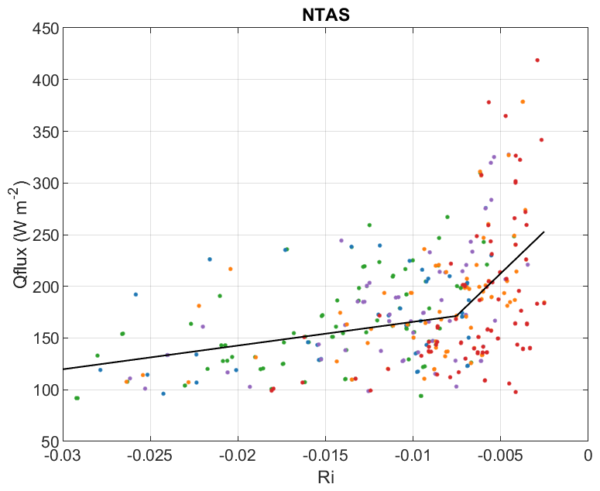
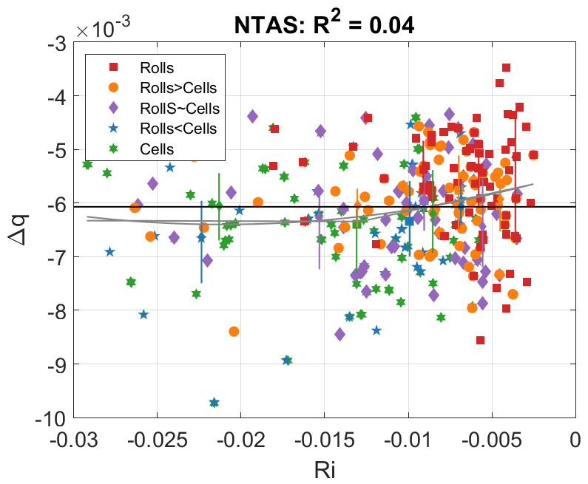
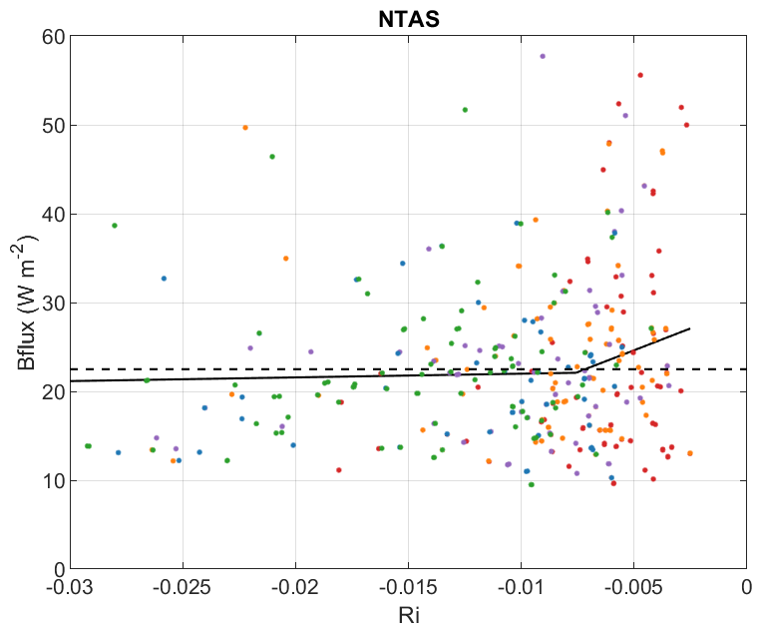
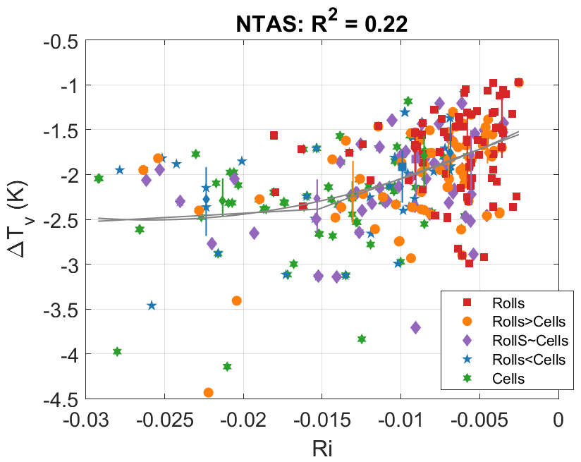
Cautionary Note on Direct Surface Flux Retrievals Using SAR Texture
Stratification is primary control on CS
Frequently U10 controls stratification
Latent Heat Flux
$∆q$ has large variance
mesoscale & temporal variability
$∆q$ uncorrelated with Ri
Ri (hence CS) has lower predictability
$R^{2}=0.26$
Speed effect “blurred”
Buoyancy Flux (~sensible heat flux)
$\left|∆T_{v}\right|$ anticorrelates with Ri
Unknown (to us) reason
Nets to NO predictability with RI (CS)
$R^{2} \sim 0$
Speed effect neutralized
Latent Heat Flux
$$R^{2}=0.26$$
Buoyancy Flux
$$R^{2}\sim 0$$
NTAS Buoy
Of course: High predictability of stratification (Ri) & Stress/Wind

Slide 11
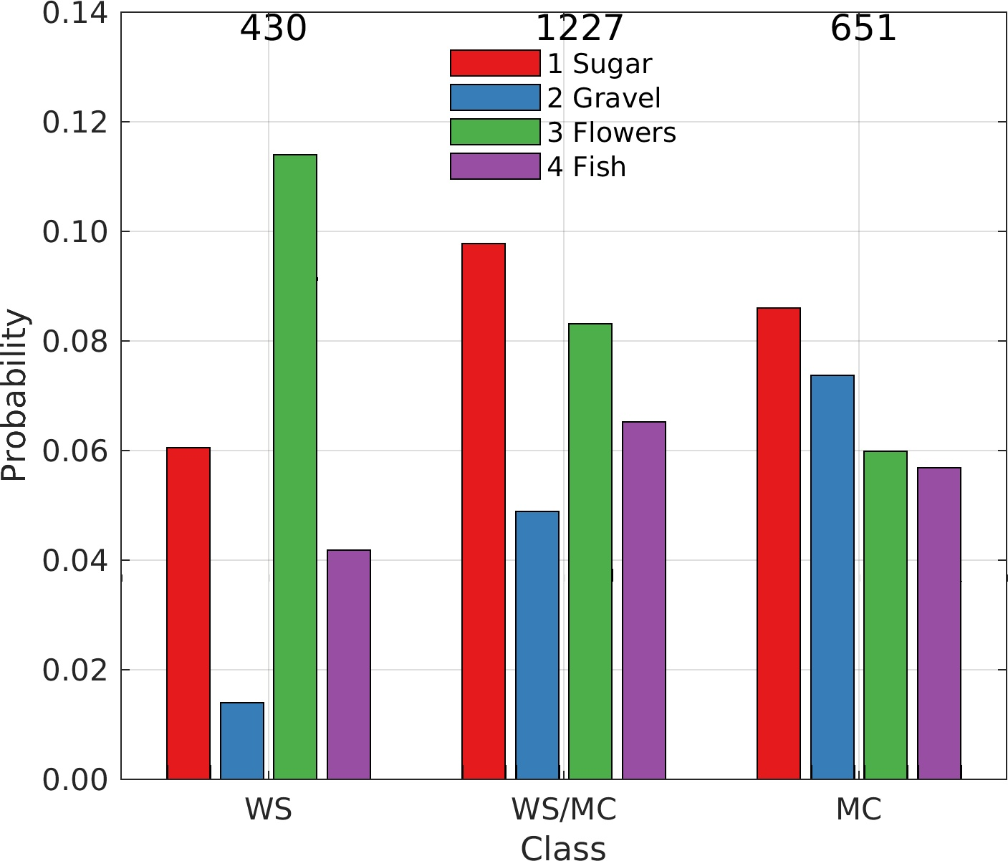
Cloud Type Vs SAR classes
● Hand-tagged database near NTAS
● Simplified to uniform images & 3 classes: WS, WS/MC, MC
Note:
● WS→WS/MC→MC: increasing gravel & fish & sugar
● WS→WS/MC→MC: decreasing flowers
Next up:
● WindSAT and/or COWVR moisture flux convergence
● Examine ASCAT wind MLE (cone-distance)
Sugar
Gravel
Flowers
Fish
Notes:
hand-tagged SAR images - 8° box centered at NTAS
●4200 images = 350 images/month 175 ASC/DSC
●WS, WS/MC, MC no overlap
↳RC, CP, AB overlap w/ WS, WS/MC, MC
●Closest point in x,y,t to 0.5° daily cloud classes
●Hauke - class 1,2,3,4 = sugar, gravel, flowers, fish?
●Figure is 98% of database excluding LW/BS images
Interpretation…
●RC 3X likely to coincide with flowers/fish
●CP strongest relationship w/ gravel
●AB/WS - strongest relationship with flowers
↳Does this make sense? (Gravel largest U10)
●Too many hits with sugar?
●WS, WS/MC, MC → increase in gravel & fish
●WS, WS/MC, MC → decrease in flowers
gravel - stronger boundary layer cooling

Slide 12
OVW/SAR
Aqua - Modis
True Color
S-1 SAR
Combination of scales and technologies for 20 Jan. 2019 showing the regional scales from Modis Aqua visual cloud imagery 17:30 UTC, mesoscale surface wind vectors from ASCAT at 13:12 UTC, and localized fine-scale turbulence in the MABL from SAR WV images at 09:26 UTC. SAR images have N at the top of the image.
WS>MC
Sugar
Gust Front
WS~MC
Flowers
S-1 SAR
WS~MC
Cold Pool
or Gust Front
ASCATOVW
ASCAT Wind Divergence
ASCAT Wind MLE
WS>MC

Slide 13
Summary
Start of new OVWST project
Regular meetings with UW (CICOS & Atmos. Sci.) PBL Cloud experts (Shulz & Eastman)
Established data sharing & preliminary dataset explorations & combinations
Begun exploration of Eurec4 data
New SAR classification model completed, will soon have much improved/longer SAR dataset & ERA5 collocations

