Slide 1



International Ocean Vector Wind Science Team Meeting
Salt Lake City, UT
29-31 May 2024
CYGNSS Improved Wind Speed Product over Tropical Cyclones
Chris Ruf¹, Mohammad Al-Khaldi², Raji Balasubramaniam¹,
Dani Pascual³, April Warnock⁴
(1) University of Michigan, Ann Arbor, MI USA
(2) Ohio State University, Columbus, OH USA
(3) Deimos Space UK Ltd., Harwell, Oxfordshire UK
(4) SRI International, Ann Arbor, MI USA

Slide 2
CYGNSS Mission Overview
Flight Segment Design
  Eight satellites in low earth orbit at 35º inclination
  Bistatic radar receiver measures GPS signals scattered from the ocean surface
  Retrieve ocean surface wind speed, similar to ocean scatterometer (only speed, not direction)
Mission Timeline
  Launch 15 Dec 2016
  Science Phase E since Mar 2017
  One of eight satellites lost Nov 2022
  Currently in extended Phase E with 7 of 8 operating nominally

Slide 3
CYGNSS Ocean Data Products
(available at NASA PO.DAAC)
Level 1 Engineering Data Products
  Scattering Cross Section of the ocean and land for incoherent scattering from rough surfaces
Level 2 Science Data Products
  Ocean surface wind speed (10 m ref height)
    Fully Developed Seas (FDS), Young Seas/Limited Fetch (YSLF)
  Ocean surface heat flux (latent and sensible)
Level 3 Science Data Products
  Hourly 0.2 deg lat/lon gridded versions of L2 products
  6-hourly 0.1 deg lat/lon merged FDS+YSLF wind speed for tropical cyclone overpasses with storm-centric YSLF regridding

Slide 4
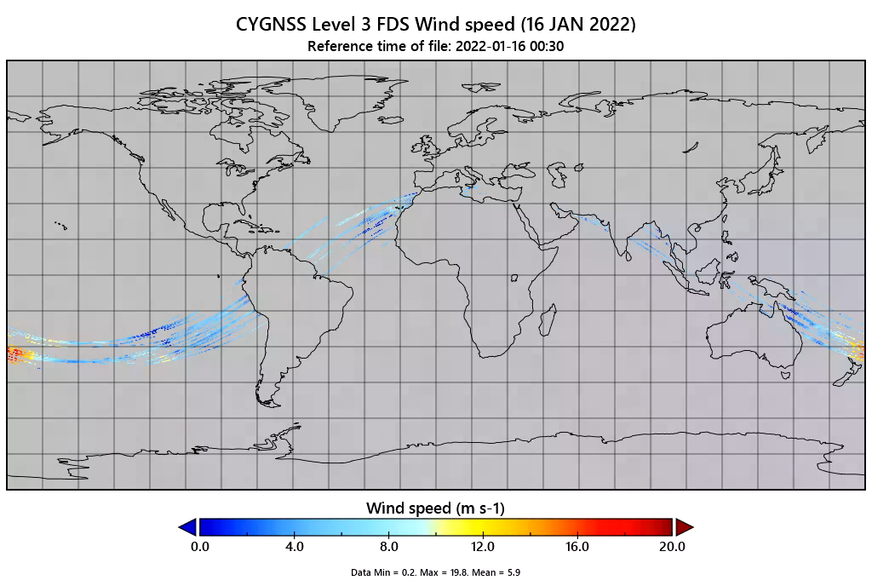
CYGNSS Global Wind Speed Product
Typical 24 hours of v3.1 L3 Winds

Slide 5
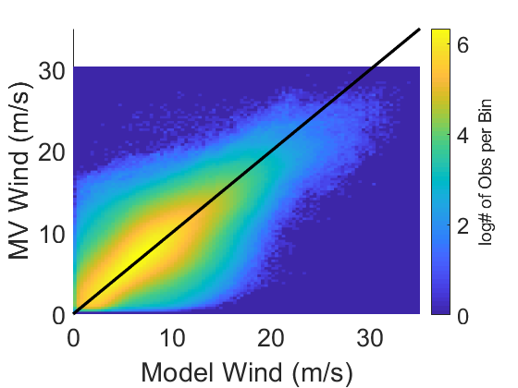
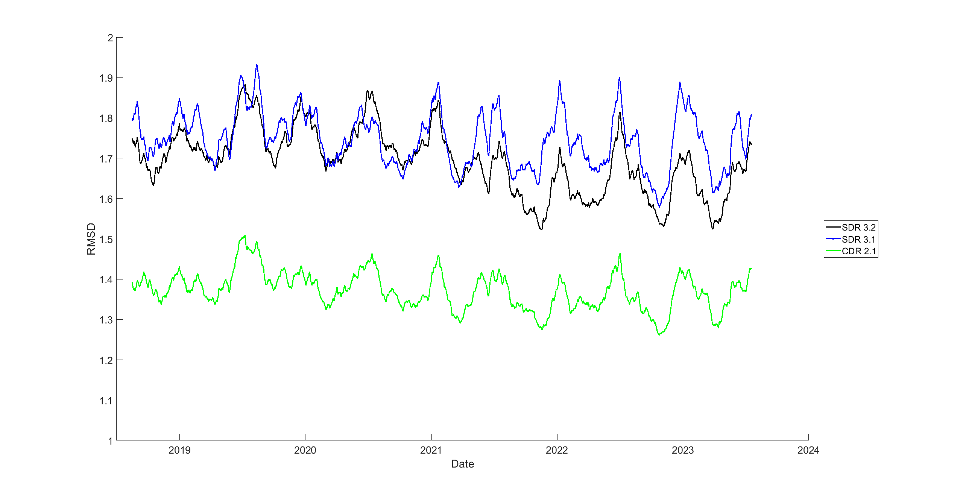
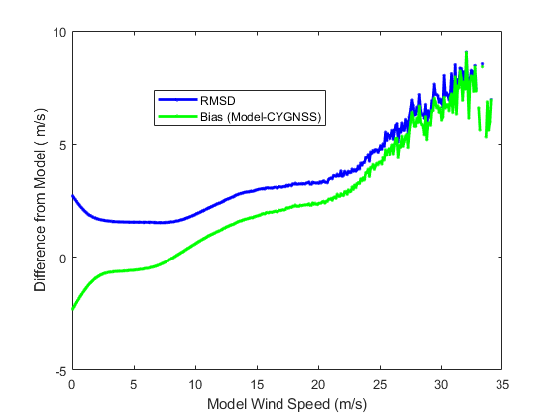
CYGNSS Global Wind Speed
Performance w.r.t. ERA5
CYG SDR v3.2 (m/s)
ERA5 (m/s)

Slide 6
CYGNSS Global Wind Triple Colocation
Performance Assessment
Use triplets selected from 4 possible wind speed sources
  CYGNSS (Project FDS v3.2 and NOAA v1.2)
  ERA5 (u₁₀ neutral stability)
  ASCAT (scatterometer)
  GMI (radiometer)
 |  | RMSE [m/s]
 |  | FDS | NOAA | ERA5 | ASCAT | GMI LF
Triplet used to estimate RMSE | FDS, ERA5, ASCAT | 1.39 | - | 0.71 | 0.42 | -
 | FDS, ERA5, GMI LF | 1.32 | - | 0.85 | - | 0.41
 | FDS, ASCAT, GMI LF | 1.34 | - | - | 0.57 | 0.31
 | NOAA, ERA5, ASCAT | - | 1.00 | 0.66 | 0.49 | -
 | NOAA, ERA5, GMI LF | - | 0.93 | 0.74 | - | 0.59
 | NOAA, ASCAT, GMI LF | - | 1.02 | - | 0.46 | 0.45
 | ERA5, ASCAT, GMI LF | - | - | 0.76 | 0.31 | 0.57
Avg. |  | 1.35 | 0.98 | 0.74 | 0.45 | 0.47

Slide 7
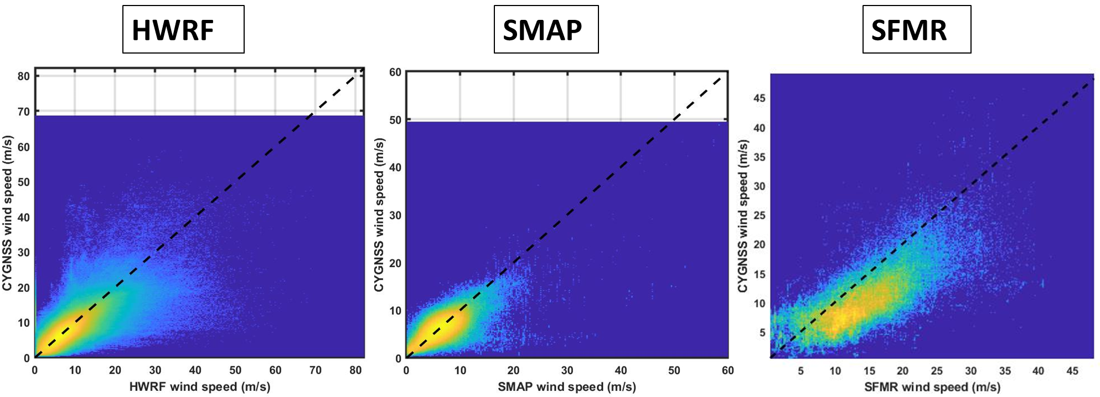
CYGNSS TC Wind Triple Colocation
Performance Assessment
Use triplets selected from 4 possible wind speed sources
  Test System: CYGNSS (L Band reflectometer)
  HWRF (Model re-analysis product)
  SMAP (Spaceborne L Band radiometer)
  SFMR (Airborne 4.6 -7.2 GHz radiometer)

Slide 8
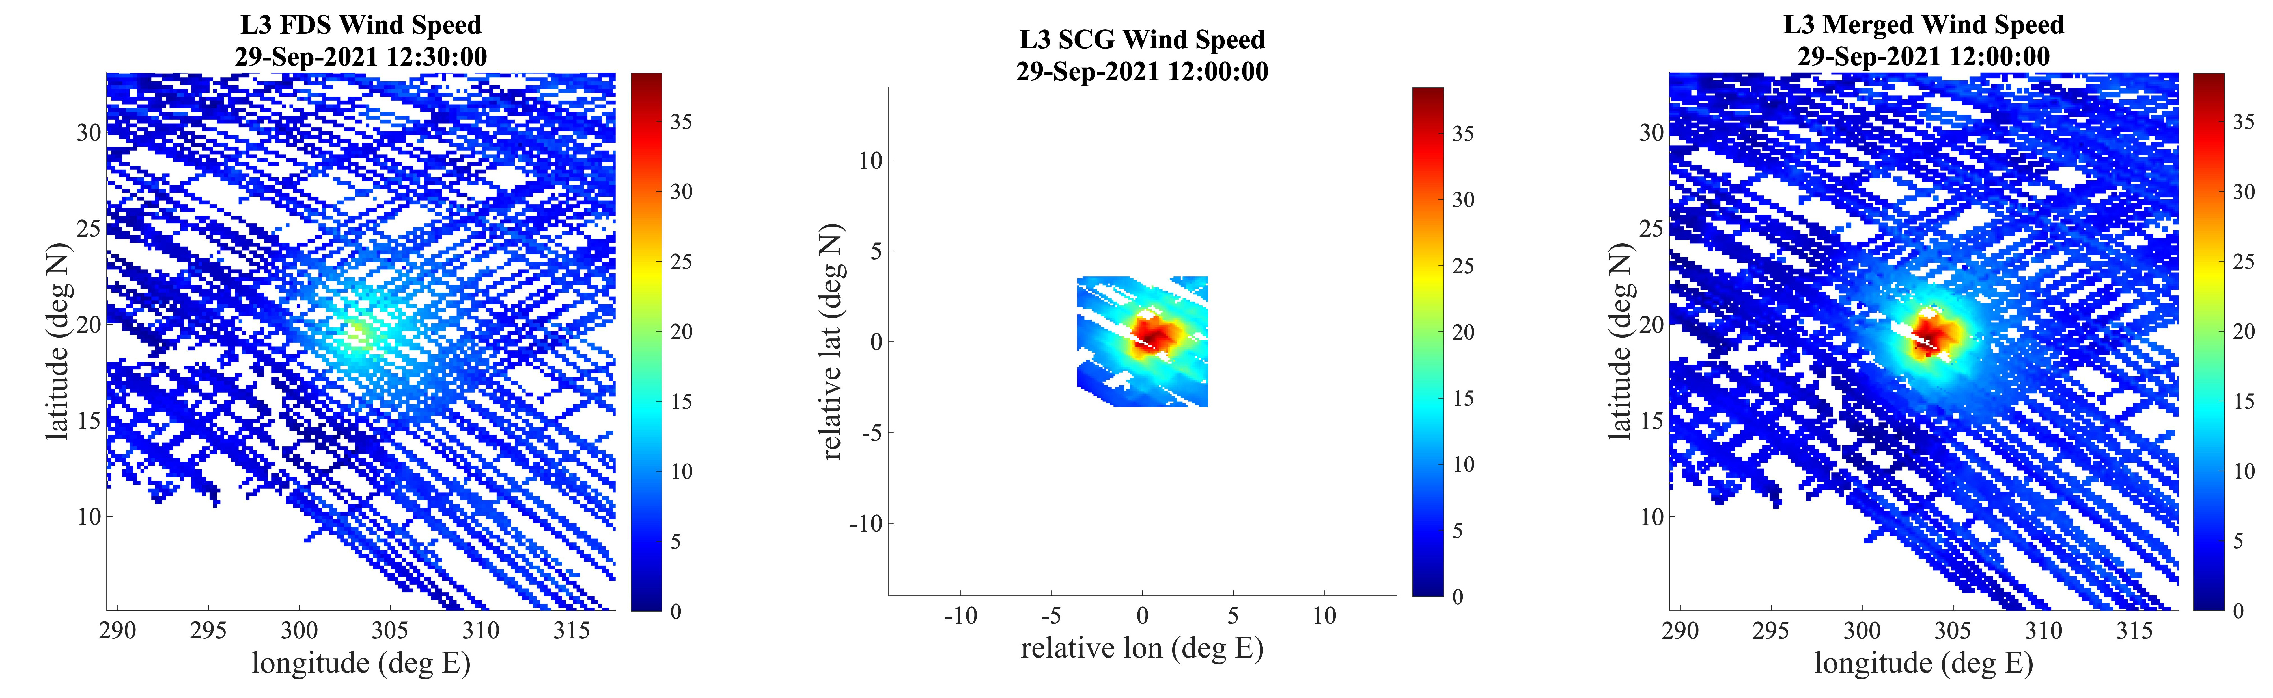
CYGNSS L3 Merged Wind Speed
L3 FDS winds
  0.2 x 0.2 deg grid; 1 hour averaging window
  Global coverage
L3 YSLF winds
  0.1 x 0.1 deg storm-centric grid; +/- 6 hour averaging window
  Spatial coverage +/- 3.6 deg about storm center
Tapered transition from YSLF to FDS at 34 knot wind radius
Warnock et al. (2024). CYGNSS Level 3 Merged Wind Speed Data Product for Storm Force and Surrounding Environmental Winds. J. Selected Topics Appl. Earth Obs., doi: 10.1109/JSTARS.2024.3379934.

Slide 9
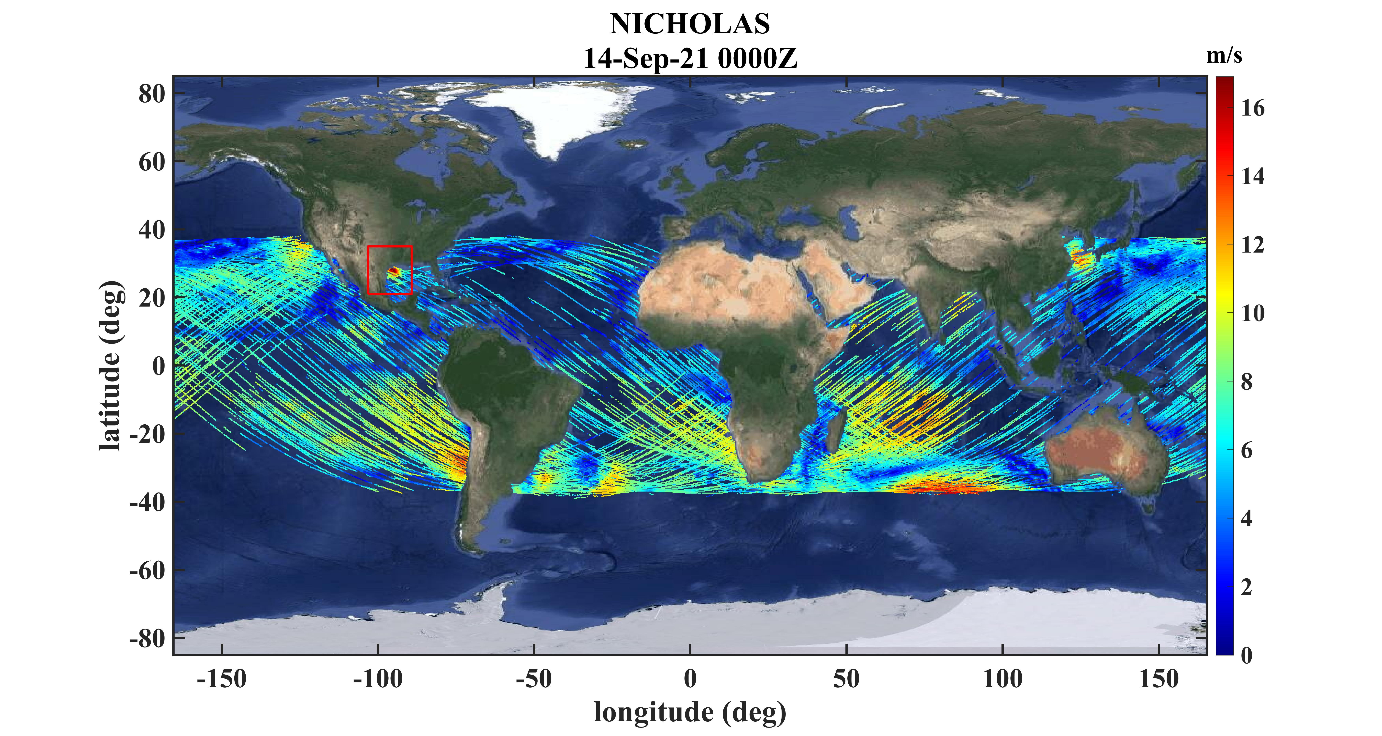
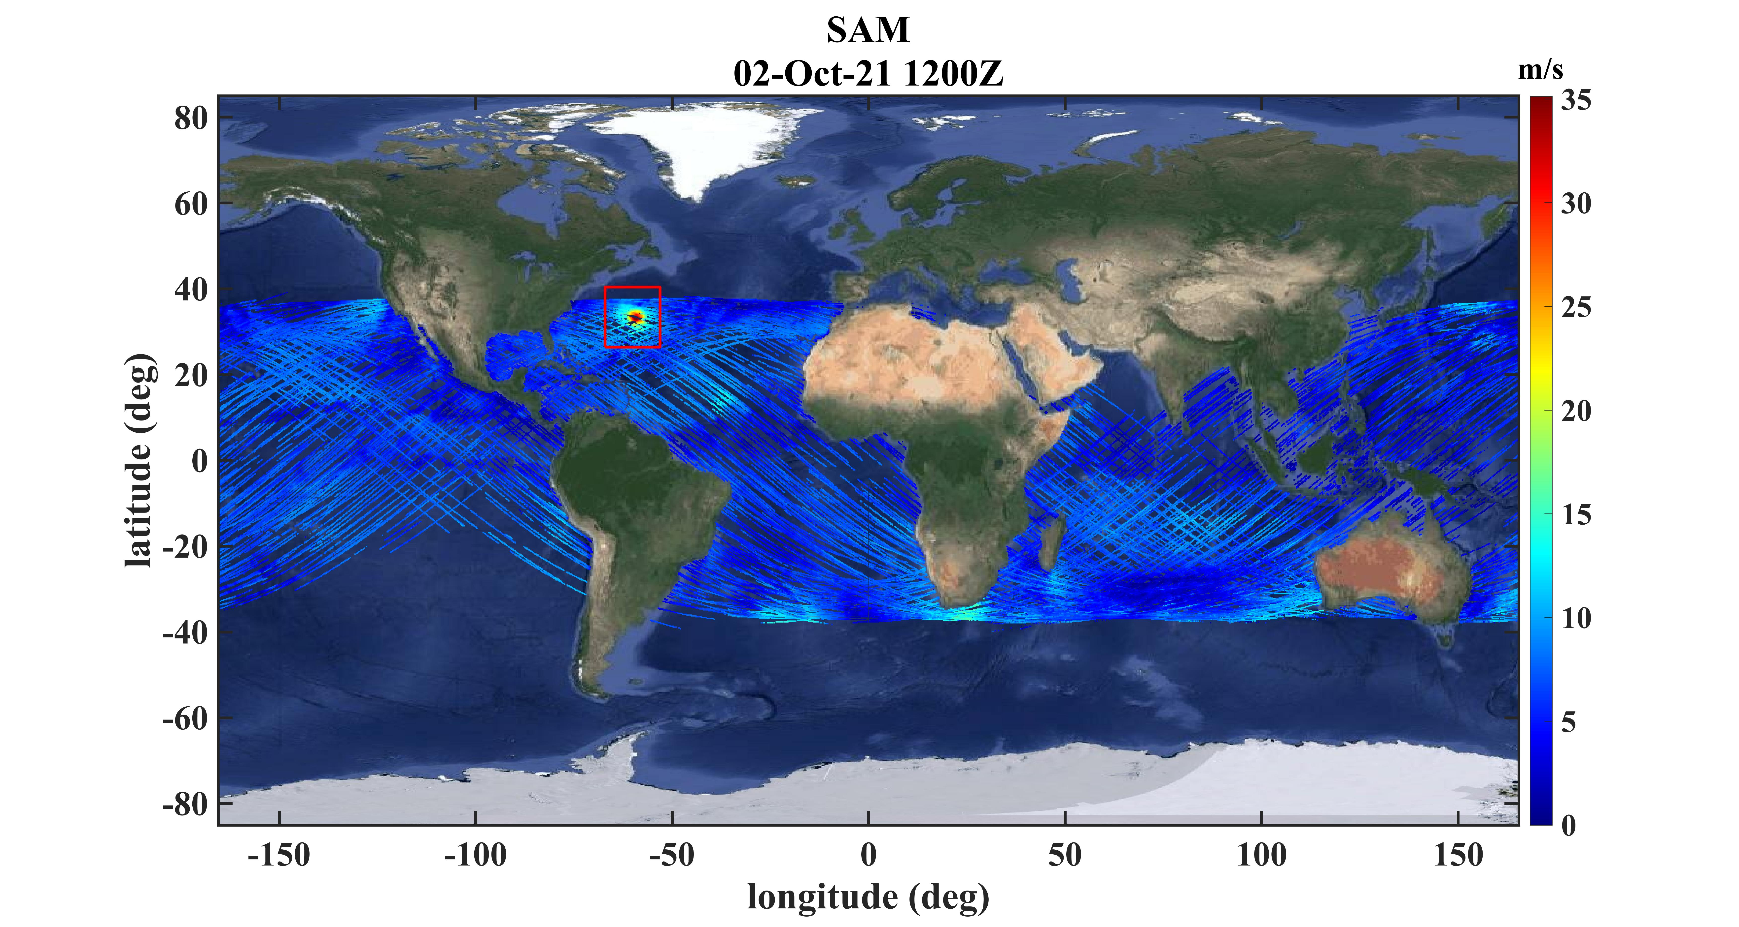
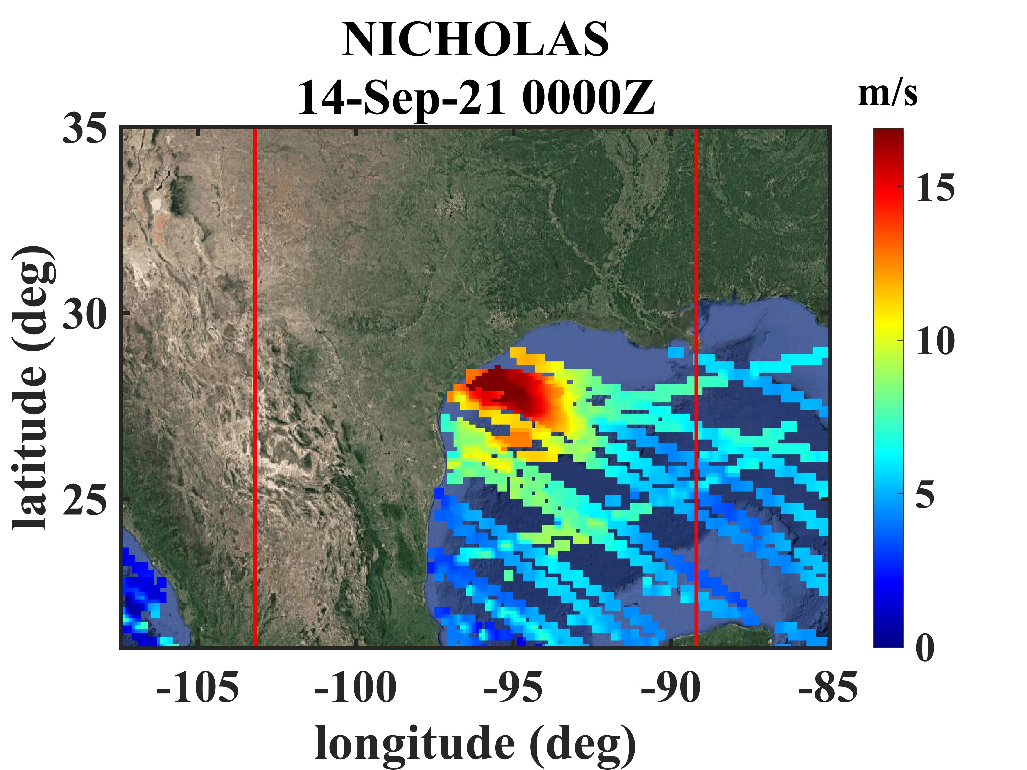
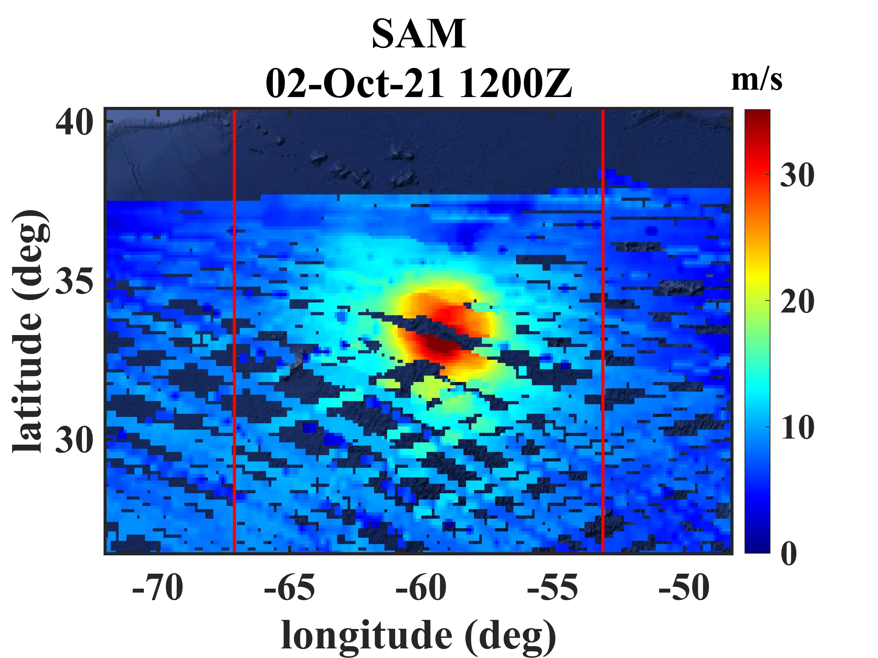
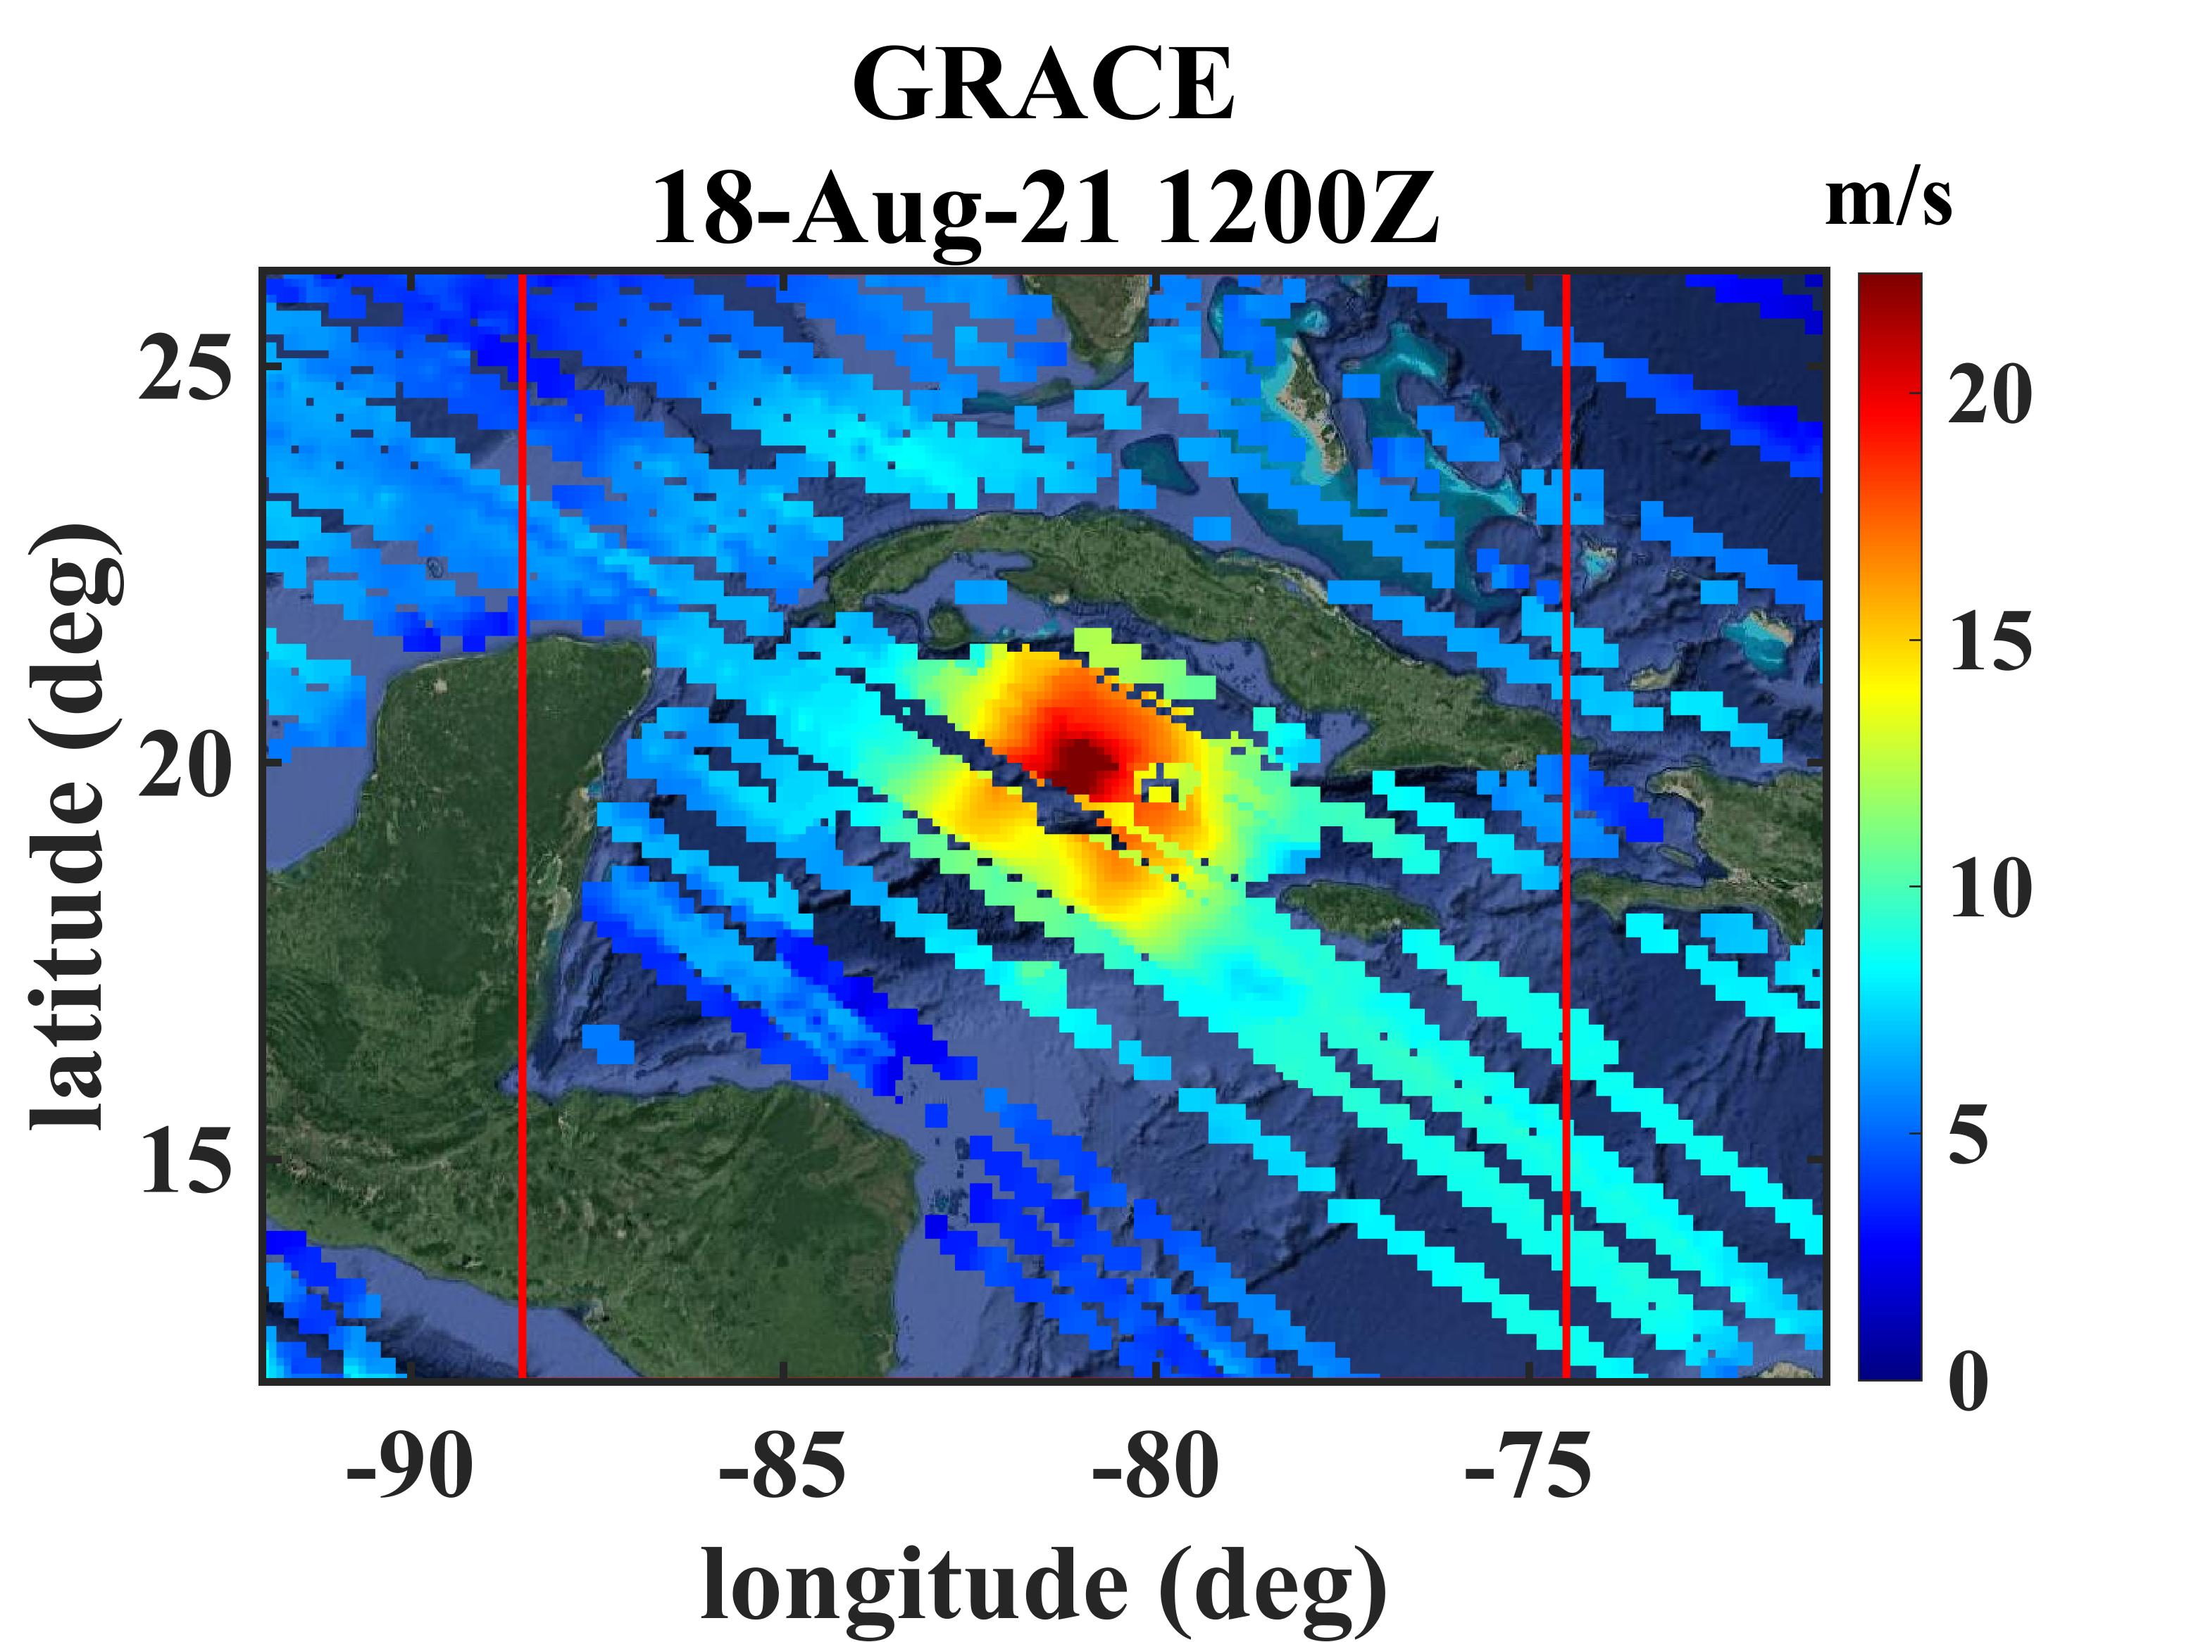
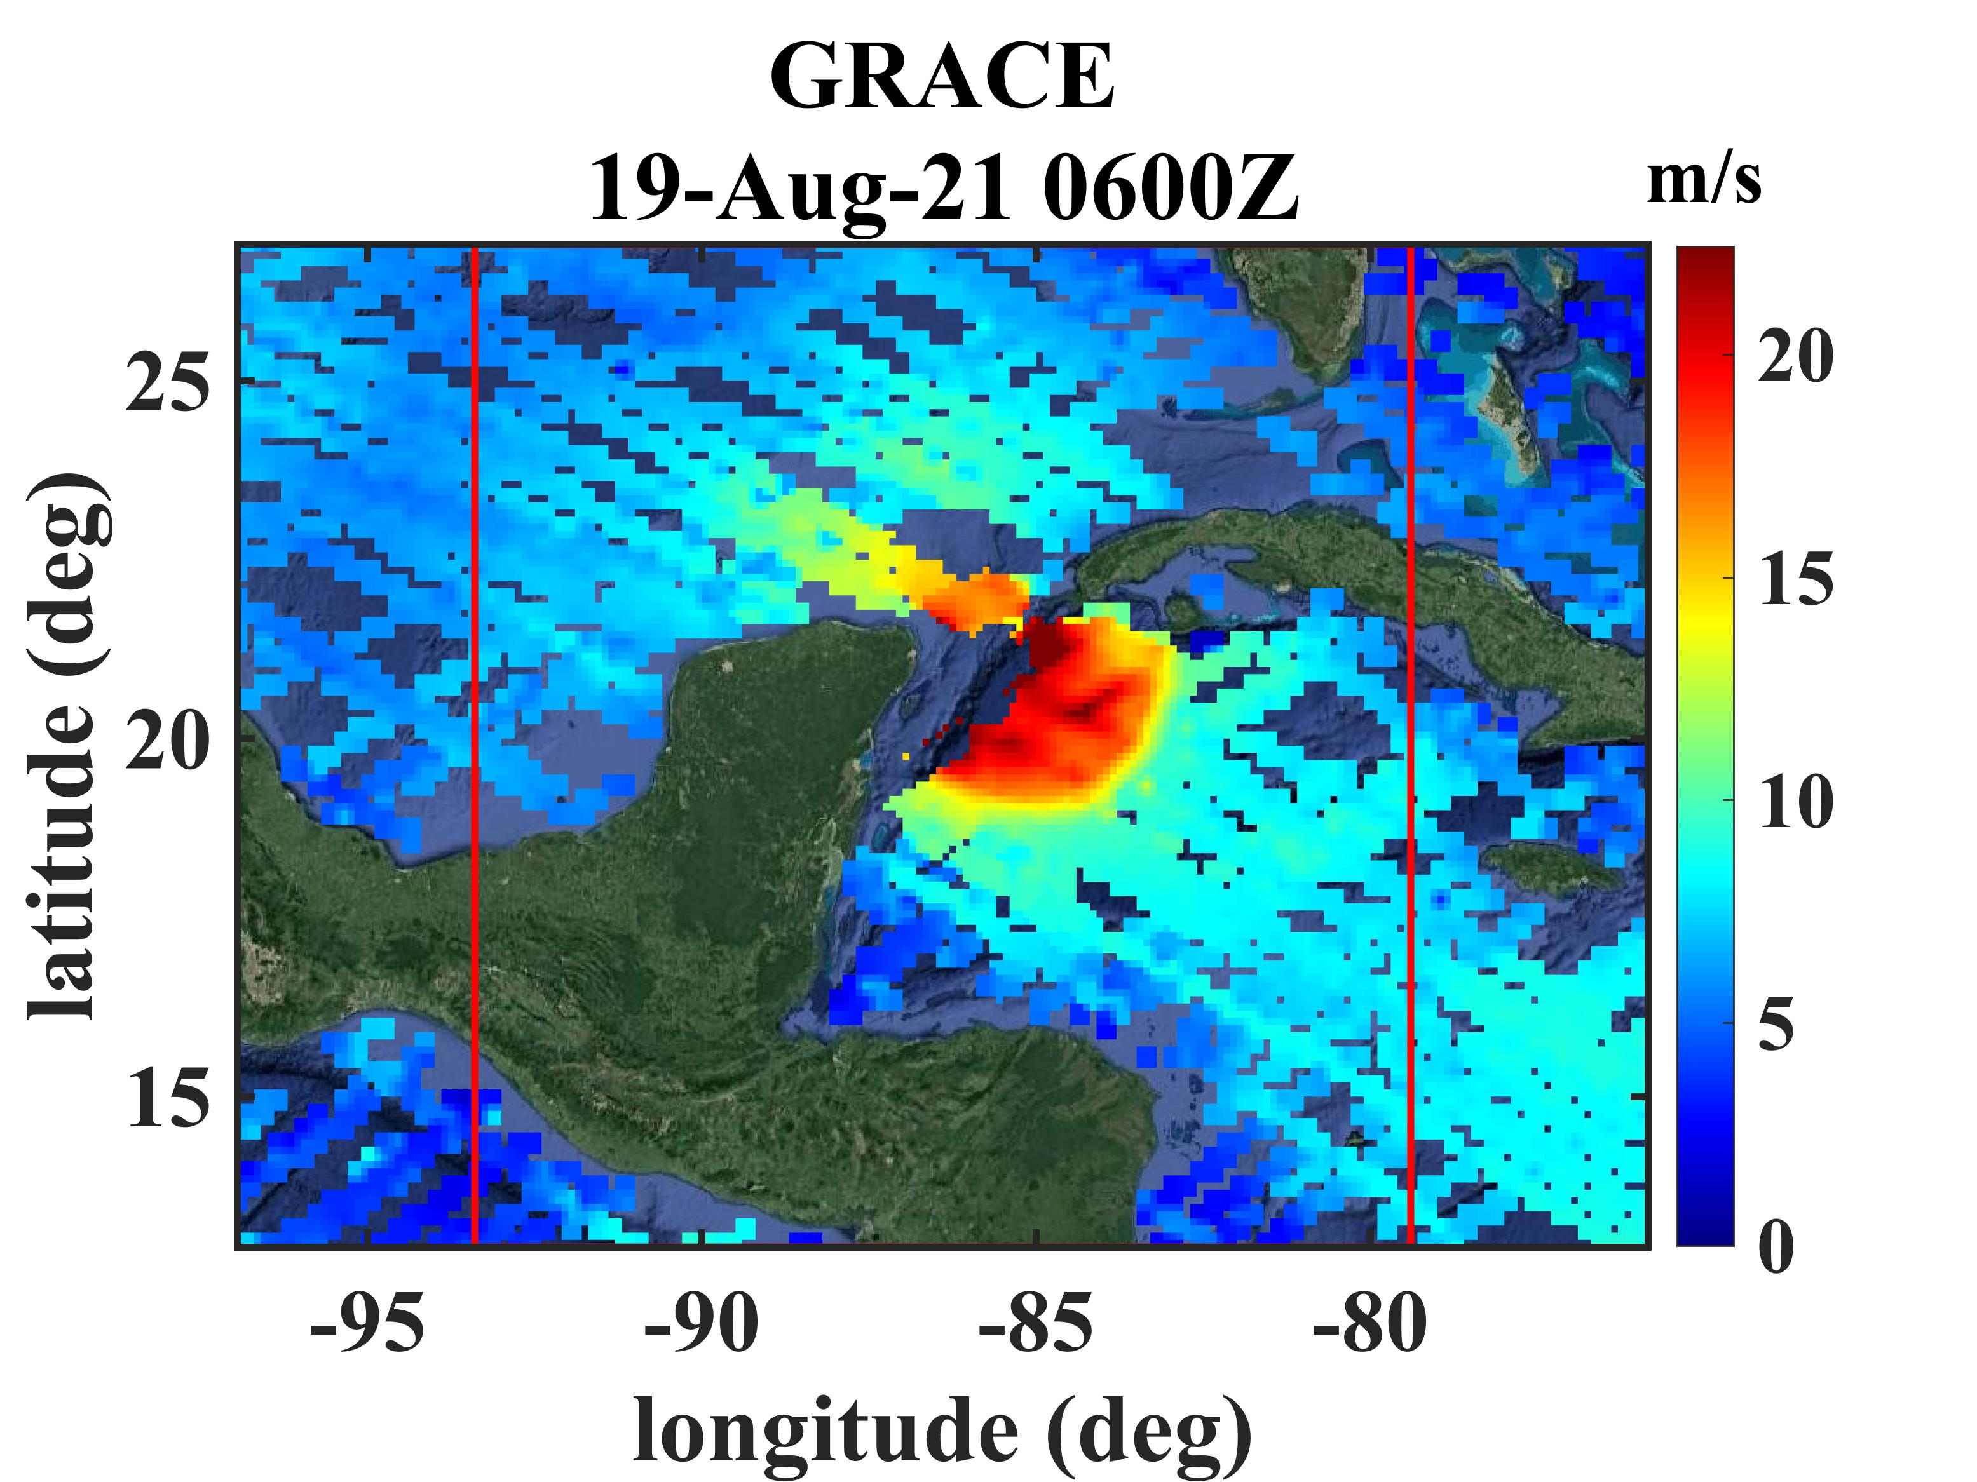
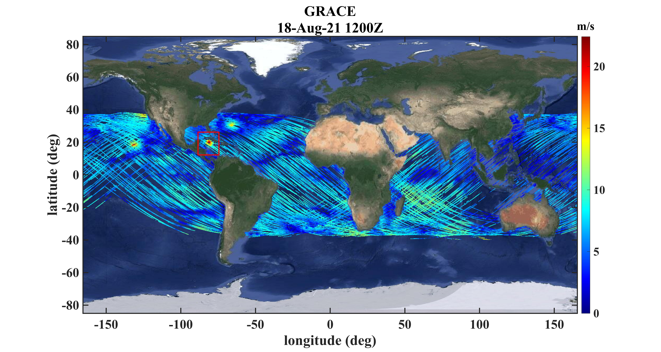
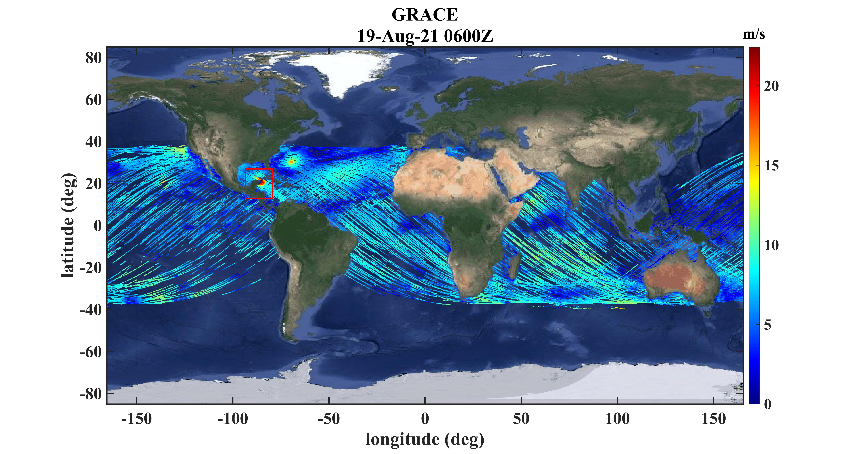
CYGNSS L3 Merged Wind Speed
Global Coverage Examples
TCs Nicholas, Sam and Grace

Slide 10
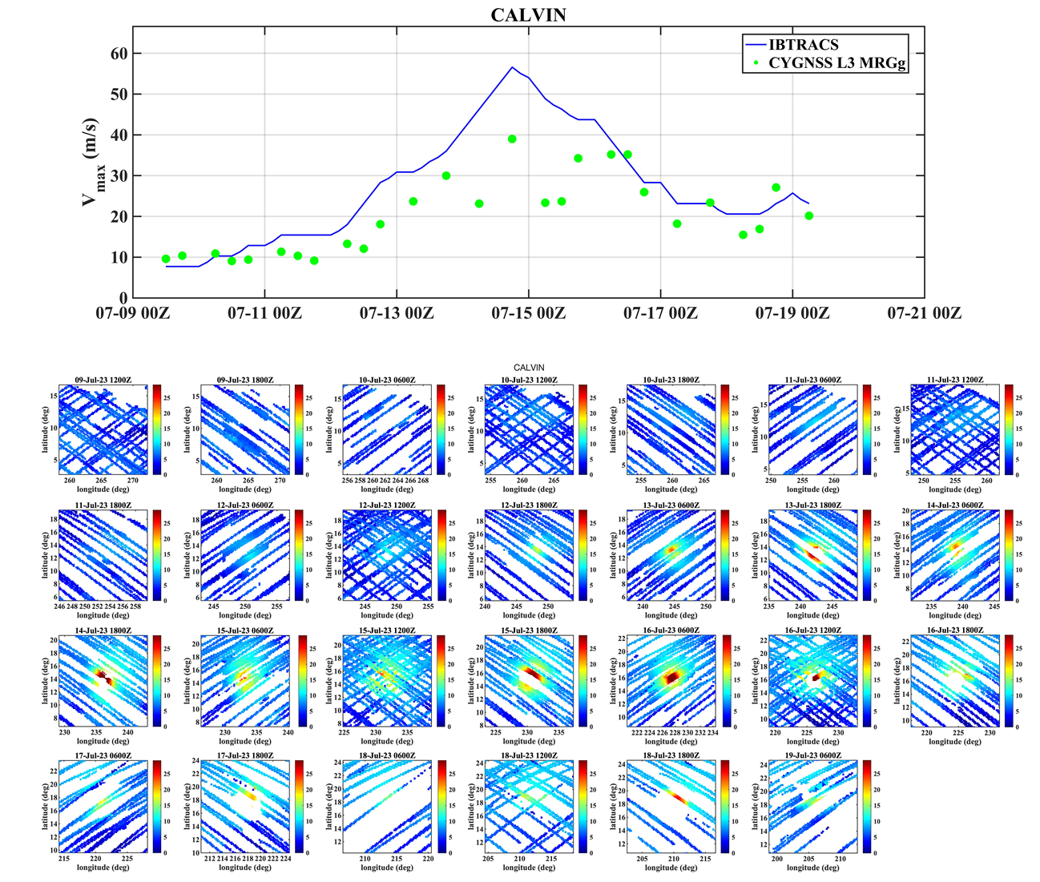
Time Series of L3 MRG and Vmax
Hurricane Calvin, July 2023
Frequent overpasses track day-to-day storm development
Decrease in sensitivity at higher (>40 m/s) wind speeds
Development of storm structure tracked

Slide 11
CYGNSS TC Wind Triple Colocation
Performance Assessment
Use triplets selected from 4 possible wind speed sources
  Test System: CYGNSS (L Band reflectometer)
  HWRF (Model re-analysis product)
  SMAP (Spaceborne L Band radiometer)
  SFMR (Airborne 4.6 -7.2 GHz radiometer)

Slide 12
Triple Colocation Validation of TC Winds
4 different triplets of matchups
  A = [CYGNSS, SMAP, SFMR]
  B = [CYGNSS, SMAP, HWRF]
  C = [CYGNSS, SFMR, HWRF]
  D = [SMAP, SFMR, HWRF]
Data Set: All 2018-2022 TC Winds
Triplet | Individual RMS Errors (m/s)
 | CYGNSS | SMAP | SFMR | HWRF
A | 5.1 | 5.9 | 3.5
B | 5.2 | 5.7 |  | 8.9
C | 5.2 |  | 2.9 | 8.9
D |  | 6.1 | 3.3 | 8.3

Slide 13
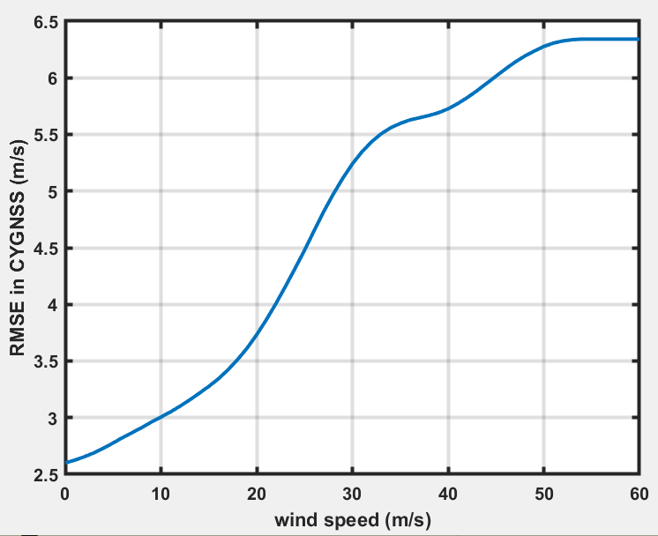
CYGNSS RMSE vs. Wind Speed
CYGNSS 5.2 m/s RMSE includes all wind speeds in matchup dataset
Partition storm matchup data into +/- 5 m/s wind speed bins and repeatedly perform triple colocation analysis

Slide 14
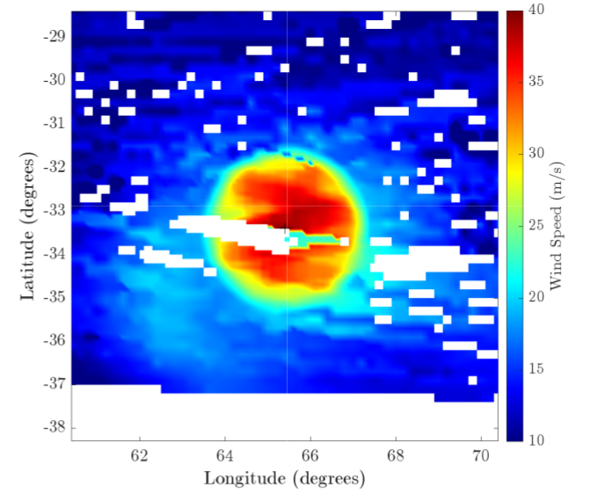
CYGNSS L3 MRG 34 knot Wind Radius
Start with a 6-hourly wind speed field
Azimuthally average over each quadrant and select radius @ 34 knots (~17.5 m/s)
TC Calvinia, 01Jan2020 0600Z

Slide 15
R34 Triple Collocation
Performance Assessment
4 different triplets of R34 matchups selected from
  CYGNSS
  Best Track
  ASCAT-B
  SMAP
RMSE (km) | BT | ASCAT-B | CYGNSS | SMAP
Case 1 | 46.85 | 36.82 | 58.33
Case 2 | 45.57 |  | 49.47 | 53.64
Case 3 | 40.05 | 43.32 |  | 43.48
Case 4 |  | 34.73 | 55.23 | 48.80
AVERAGE | 44.2 | 38.3 | 54.3 | 48.6

Slide 16
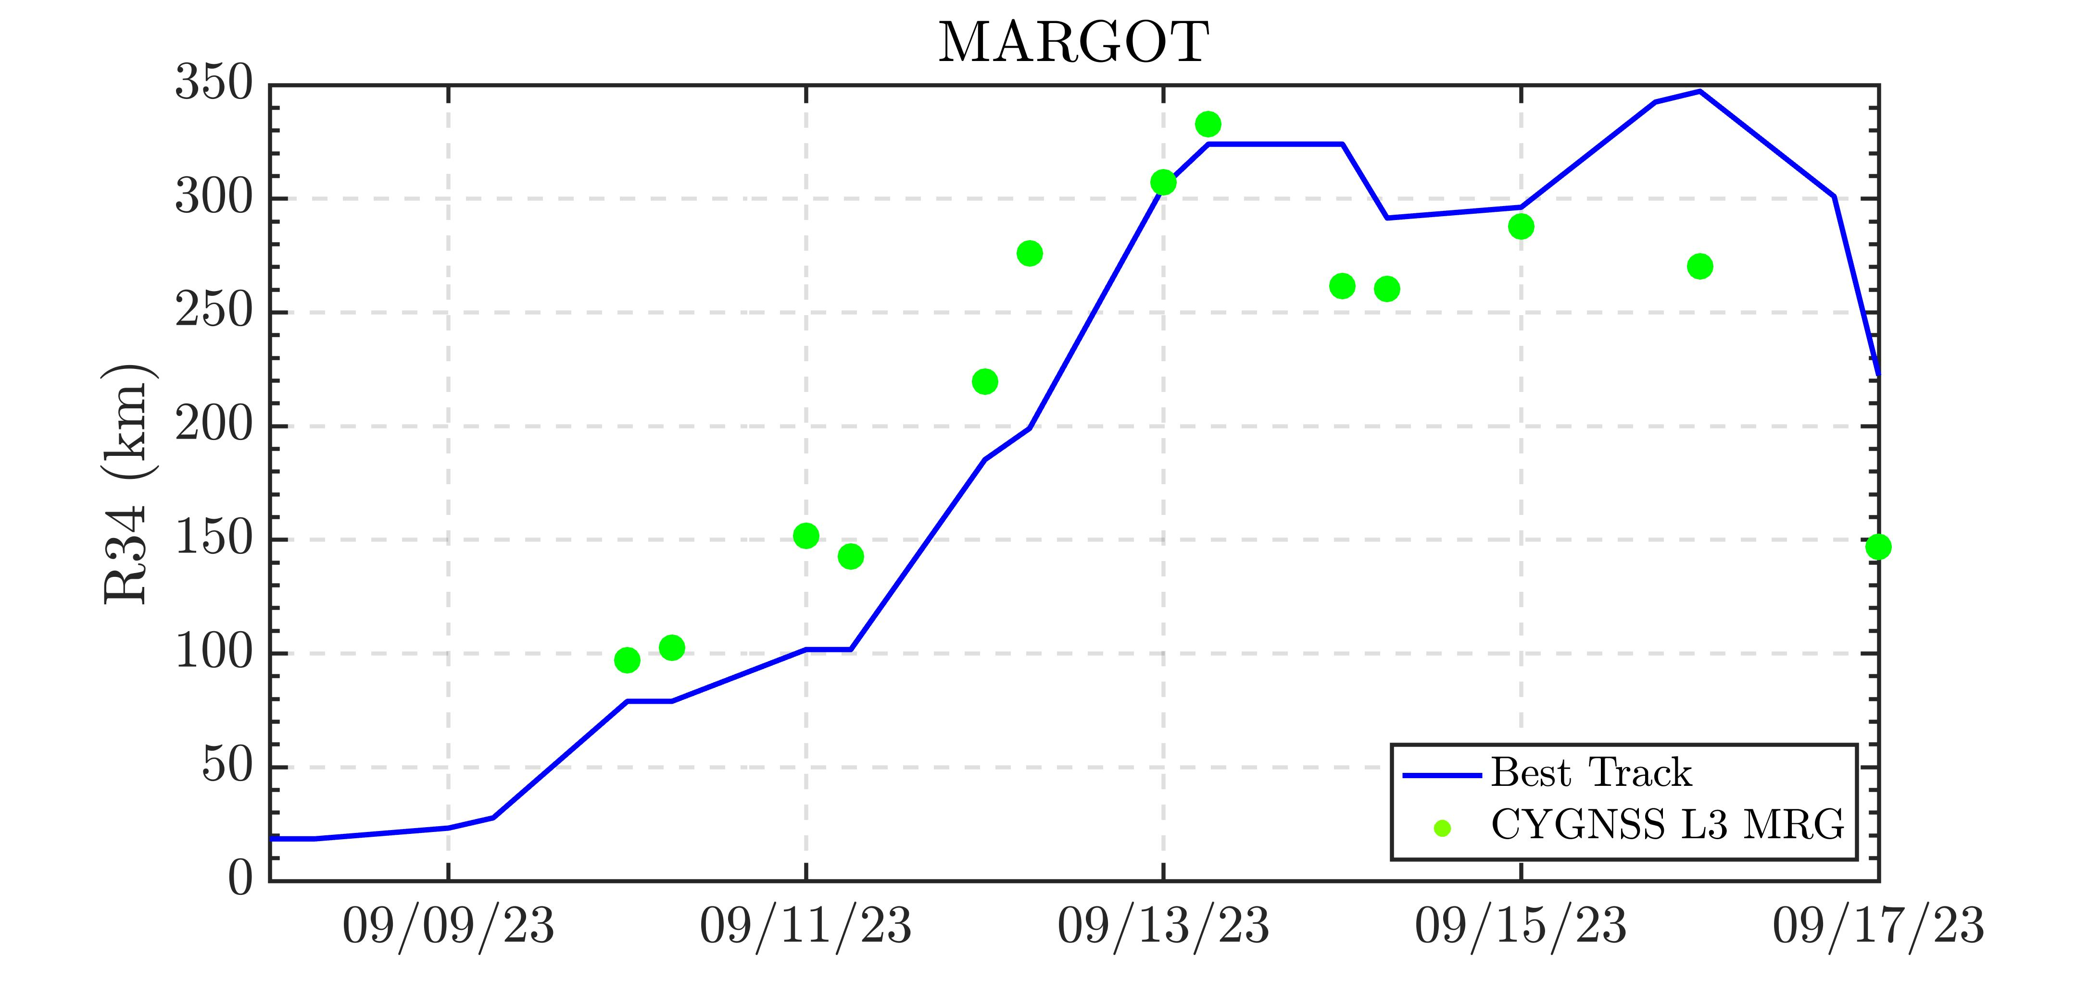
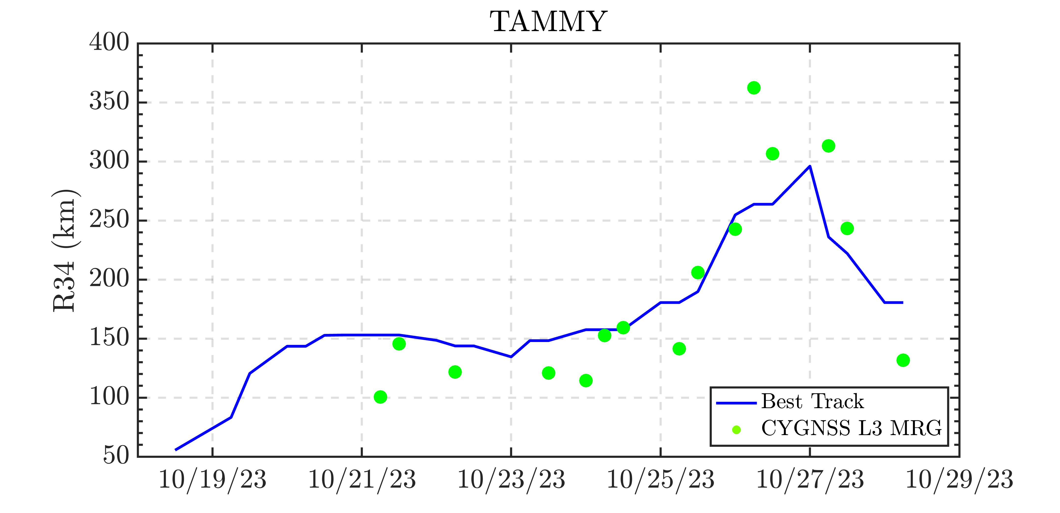
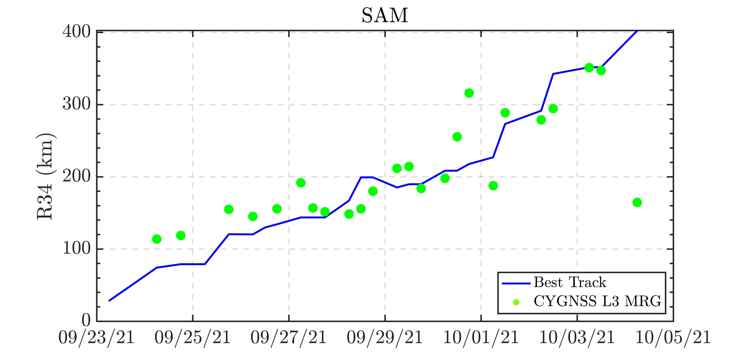
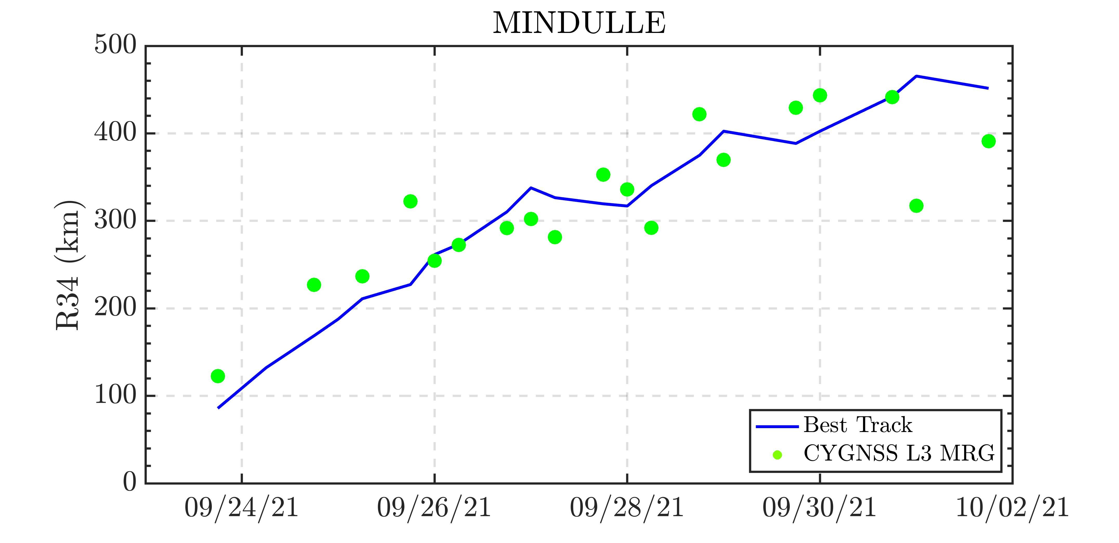
Time series storm-by-storm comparison to Best Track
Average R34 over all reported quadrants

Slide 17
R34 Spatial & Temporal Sampling
Percent of wind fields where quadrant-specific 34-knot wind radii are available
 | TD | TS | Ty/Hu
wind fields with no R34 values reported | 89% | 71% | 31%
wind fields with any R34 values reported that report 1 quadrant | 30% | 17% | 9%
wind fields with any R34 values reported that report 2 quadrants | 32% | 21% | 11%
wind fields with any R34 values reported that report 3 quadrants | 23% | 24% | 18%
wind fields with any R34 values reported that report 4 quadrants | 15% | 38% | 62%
Based on all storms from Aug 2018 through Nov 2023
Generally better sampling with higher intensity storms

Slide 18
Summary
CYGNSS ocean surface wind speed products provide 2-3 samples per day over +/- 38 deg latitude
Negligible impact from precipitation at L-Band
  Study diurnal patterns of tropical convection and precip
RMSE performance 1.0-1.4 m/s over 0-20 m/s
Performance degraded at higher winds, with RMSE approximately 10% of wind speed
R34 wind radii by quadrant resolved at 6 hr intervals
  69% of all 6 hr intervals sampled through TC life cycles
  62% of cases sample all 4 quadrant, 18% (3 quadrants), 11% (2 quadrants), 9% (1 quadrant)

