Slide 1
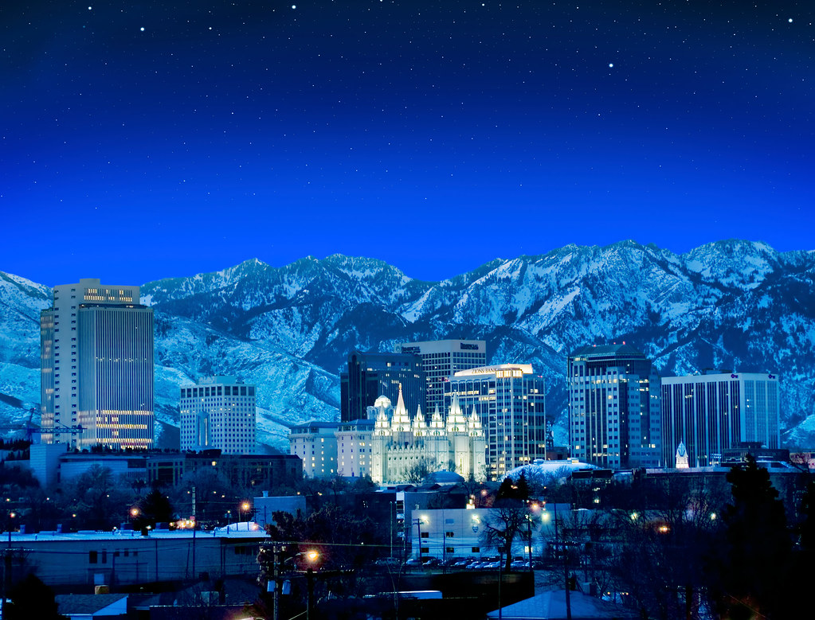
Welcome to Salt Lake City
International Ocean Vector Wind Science Team (IOVWST) Meeting
29 May 2024
Prof. David Long
Brigham Young University
long@ee.byu.edu
801-367-3661
Utah, the greatest snow on Earth!

Slide 2
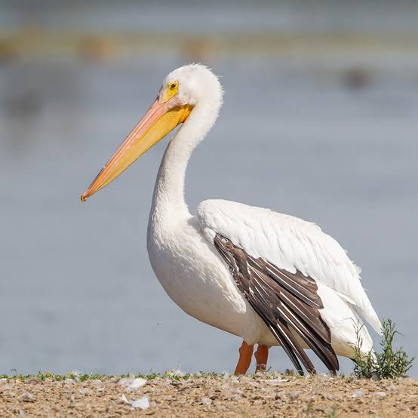
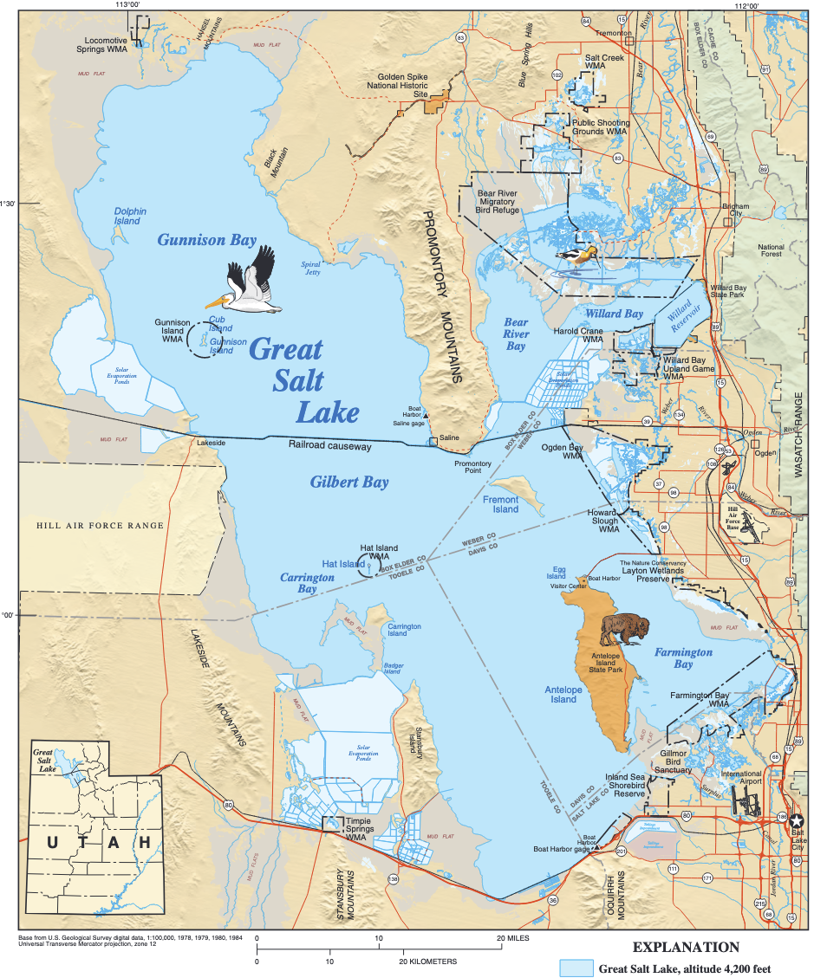
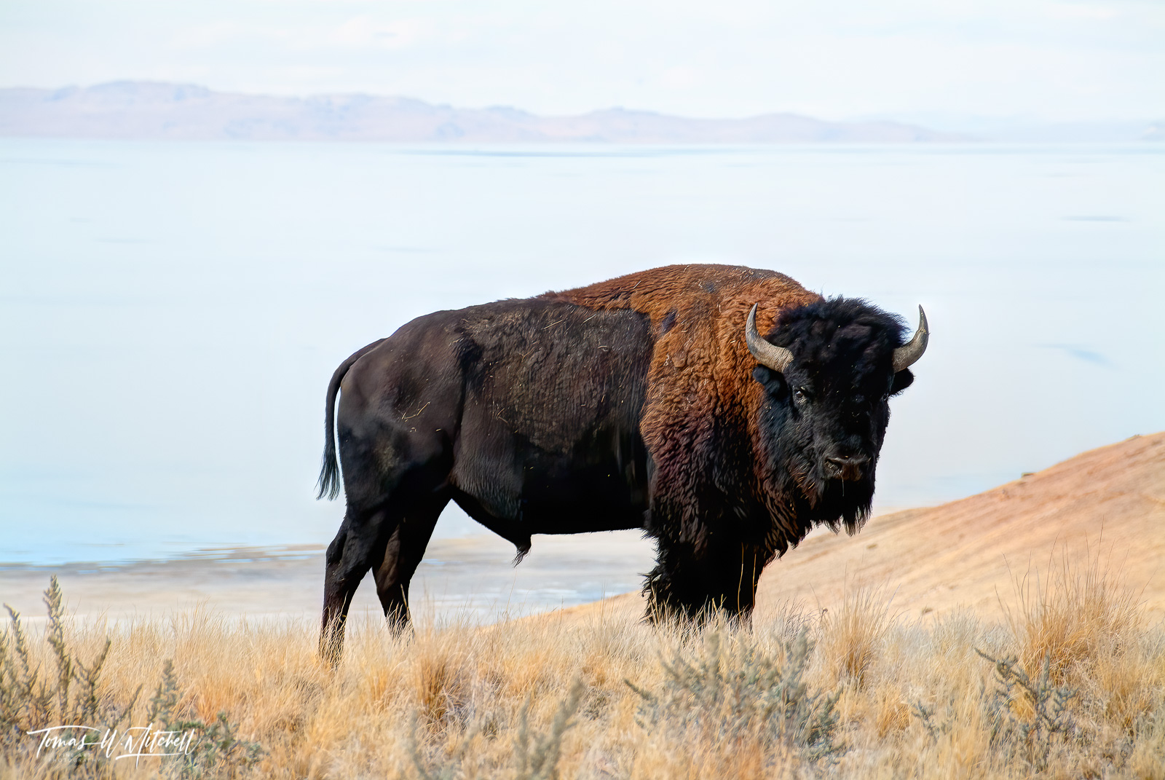
The Great Salt Lake
Salt Lake City is named after the Great Salt Lake
Surface at 4200’ (1280 m)
Remanent of Lake Bonneville that disappeared 16,000 yrs ago
Great Salt Lake overs 950-3300 sq miles (2500-8500 sq km) and is max 11 m deep
Salinity: 8—28% (2-7 times saltier than ocean)
Surrounding wetlands critical habitat for shore & migrating birds
Salt Flats

Slide 3
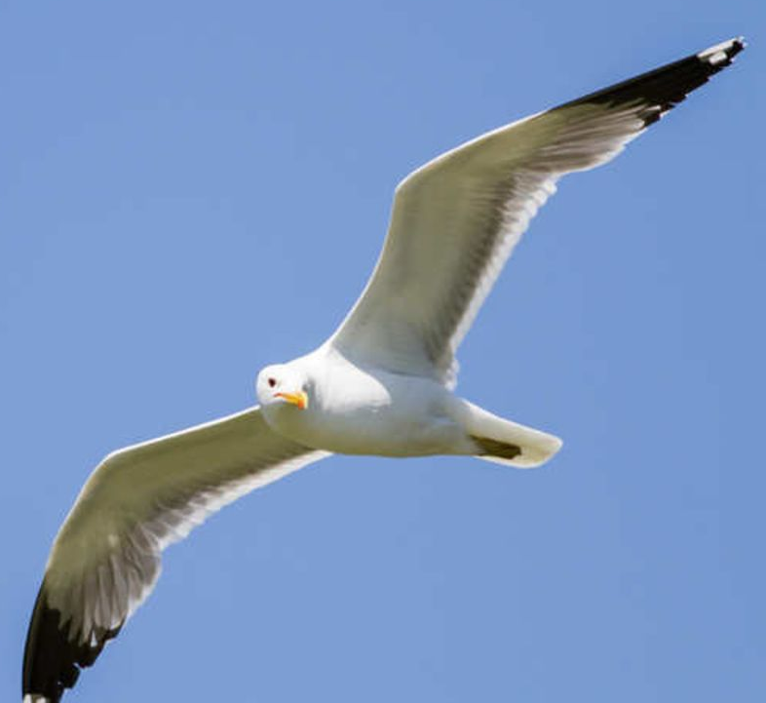
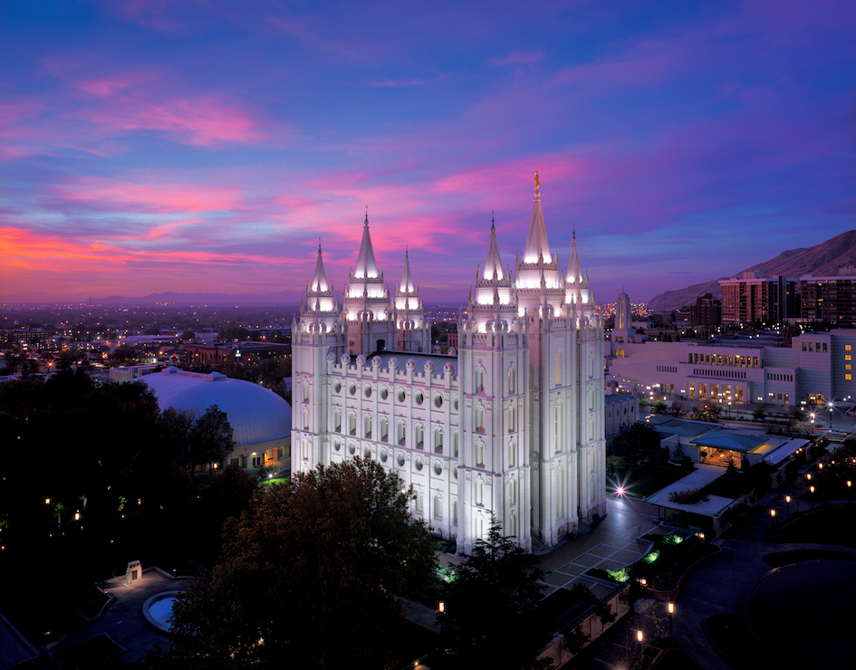
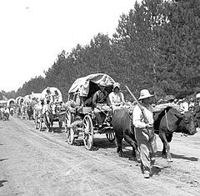
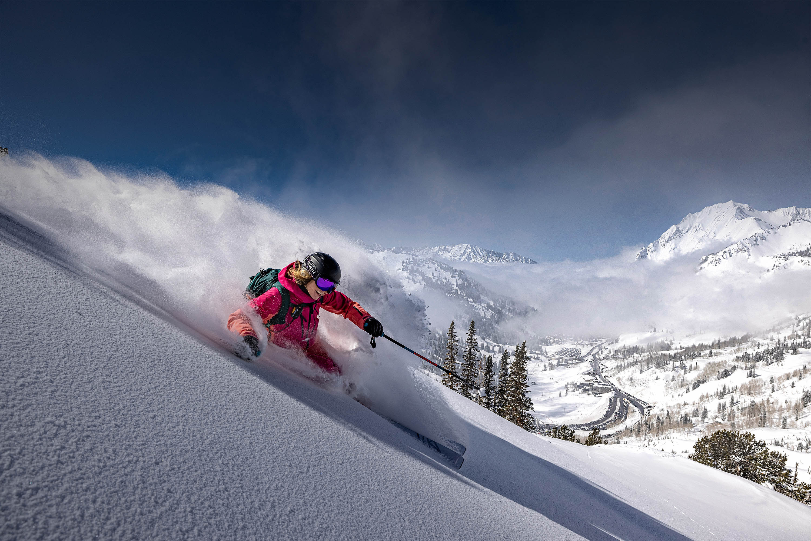
Local History
Indigenous people: Paiutes and Utes
Early Mormon pioneer settlers first came here in 1847
Utah state bird is Seagull
Monument in Temple Square
Utah State Bird: Seagull
Hosted 2002 Olympics
Home of JAZZ basketball
Farming, mining, skiing
Headquarters of the Church of Jesus Christ of Latter-day Saints
Pioneer wagon train
Utah, the greatest snow on Earth!

Slide 4
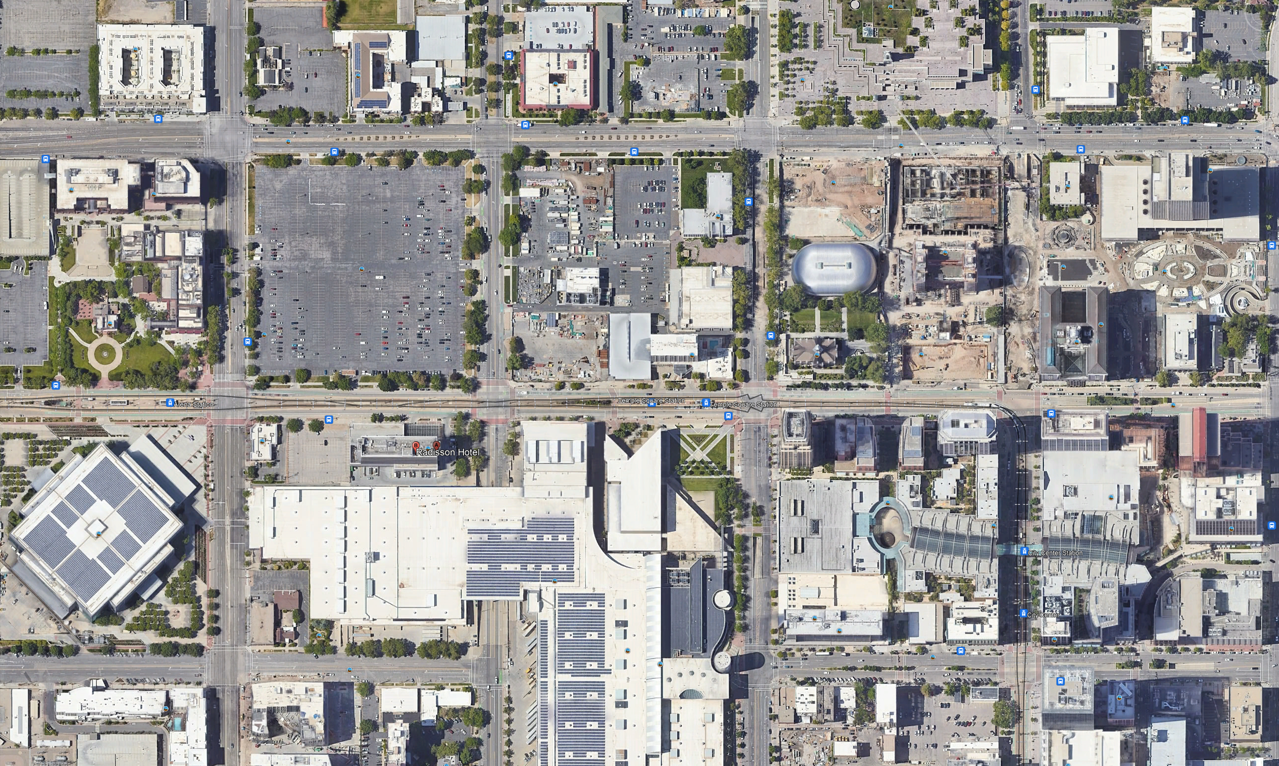
qe
Conference Center
N
Local Map
History
Museum
werqw
Family
History
Center
Temple Square
Radison Hotel
TRAX stations
Delta
Center
Arena
Symphony
Hall
City Creek Center Mall
Salt Palace Convention Center
Food
160 m

Slide 5
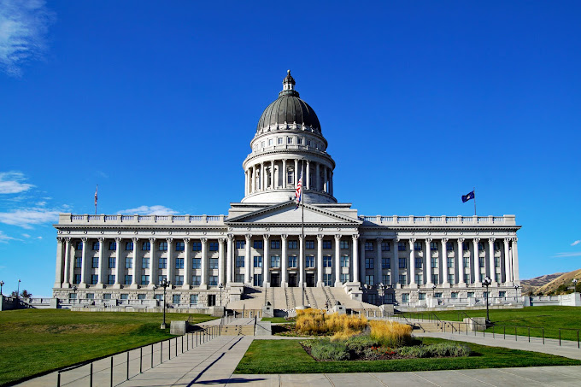
Free Nearby Local Activities
Temple Square, Tabernacle, Conference Center (Start in Conference Center)
Guided tours every 30 mins 9 a.m. - 8 p.m.
Self-guided tours
Tabernacle Choir rehearsal (open to the public) Thursday 7:30-9:30 p.m. in the Conference Center. You are invited.
Family history center—help find your ancestors
History museum
Pioneer, City Creek, and Liberty Parks
Utah Capitol building

Slide 6
Other Local Activities
Clark Planetarium 10 am - 7 pm $10 admission
Tracy Aviary & Botanical Garden (oldest aviary in U.S.) closed for hatching
Lagoon amusement park in Farmington
Thanksgiving point Natural History Museum, botanical gardens, farm
Great Salt Lake (day trip). Drive to Antelope Island or take guided tours
Birding

Slide 7
Welcome to Salt Lake City
International Ocean Vector Wind Science Team (IOVWST) Meeting
29 May 2024
Prof. David Long
Brigham Young University
long@ee.byu.edu
801-367-3661
Utah, the greatest snow on Earth!

