Slide 1
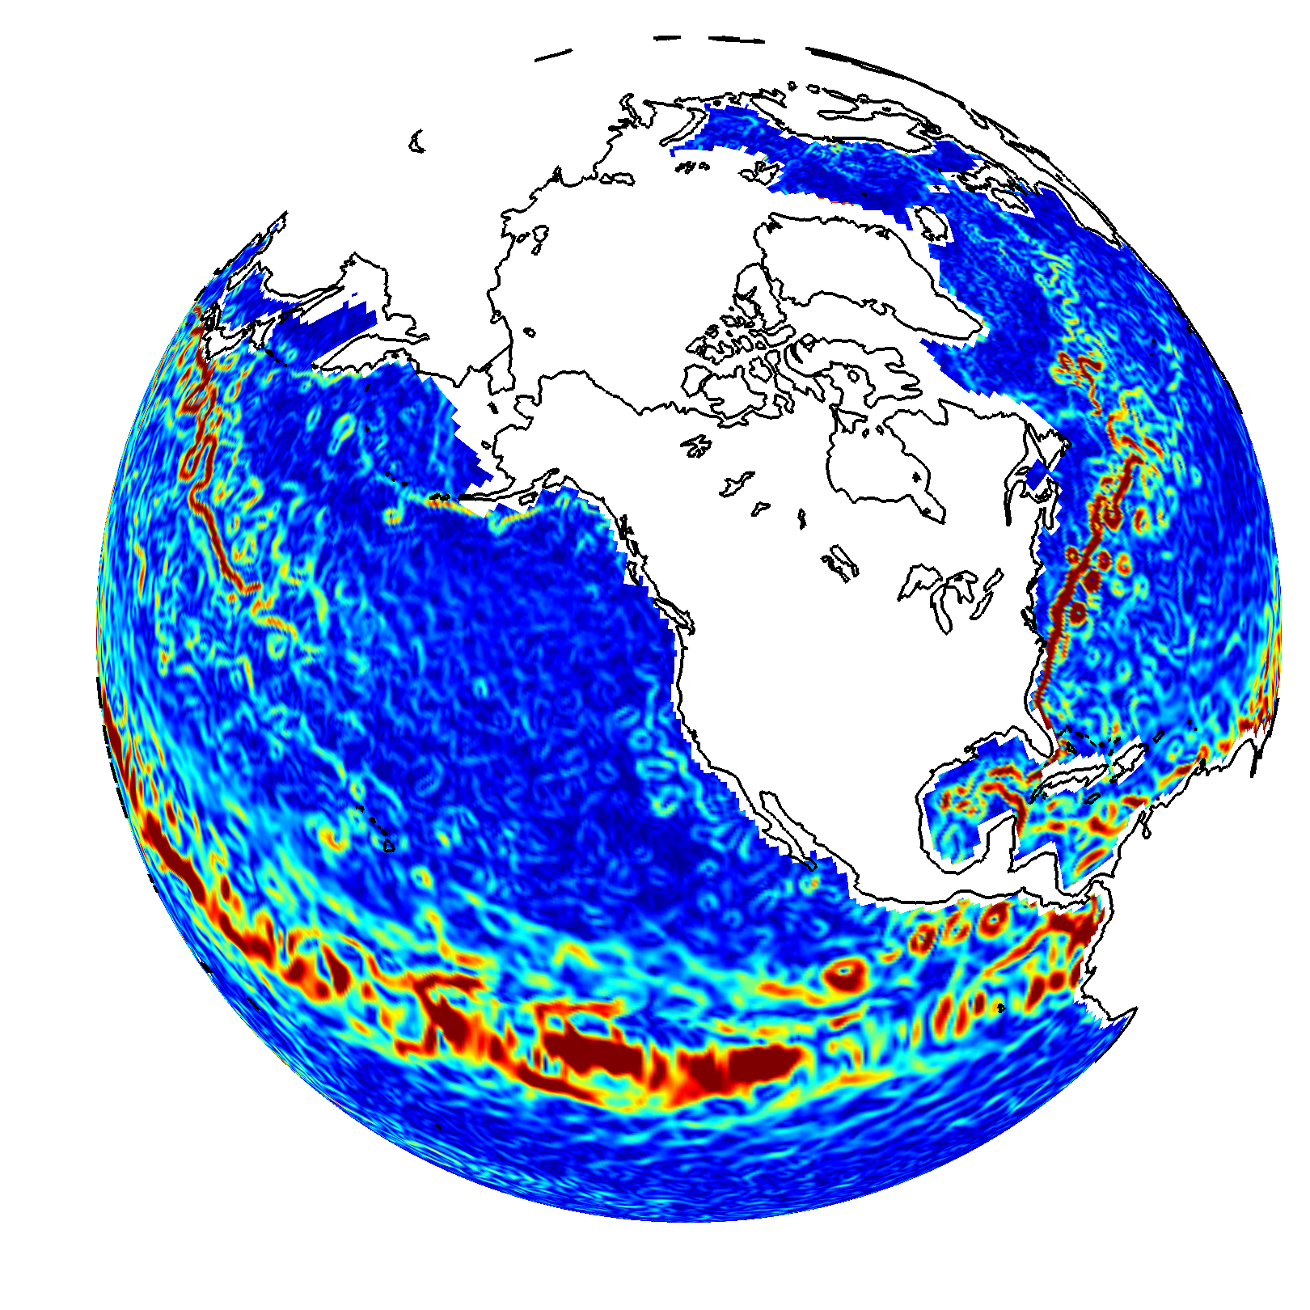
Wind and Current Matchup: Evaluating the Performance of Ekman Theory in OSCAR
Kathleen Dohan
Earth & Space Research, Seattle, WA
Ocean Surface Currents Analyses-Realtime (OSCAR) is a satellite-derived global surface current product provided in near-real time based on geostrophy, Ekman dynamics, and thermal wind

Slide 2
OSCAR product description (very brief)
Ocean Surface Currents Analyses-Realtime (OSCAR) is a satellite-derived global surface current product provided in near-real time based on geostrophy, Ekman dynamics, and thermal wind. Uses CMEMS SSH, ERA5 or NCEP winds, and GHRSST CMC SST
V2.0
Daily files, complete metadata, three quality levels: final, interim, and near-real-time (NRT)
https://podaac.jpl.nasa.gov/dataset/OSCAR_L4_OC_FINAL_V2.0
https://podaac.jpl.nasa.gov/dataset/OSCAR_L4_OC_INTERIM_V2.0
https://podaac.jpl.nasa.gov/dataset/OSCAR_L4_OC_NRT_V2.0
Working on V2.1 to be released this summer. Fixing some minor issues and now will be providing all components: ug, uw, ub
Stopping production of 1/3 and 1 degree legacy products this month

Slide 3
IOWVST project (brief)
Motivation: To better understand and model the coupling between ocean vector winds and the upper ocean mixed layer.
The key scientific questions are:
Where does Ekman theory break down in the global ocean and why?
How much do wind-driven currents depend on the scales of the satellite wind measurements?
How can we connect top surface current data to mixed layer currents in a simple global model?
Main tasks:
Systematic match-up between wind datasets and statistics with in situ data
Model development:
Development of a Stokes-Coriolis term within the OSCAR model
Calculation of small-scale currents using swath data
Assessment and possible inclusion of Langmuir turbulence in OSCAR
Investigation of vertical variation through the generalized Ekman model
This talk: As I work on the model development, need to choose small test areas wisely before applying changes to global ocean, and need to understand how to assess the performance. Today: challenges in a Ekman currents assessments.

Slide 4
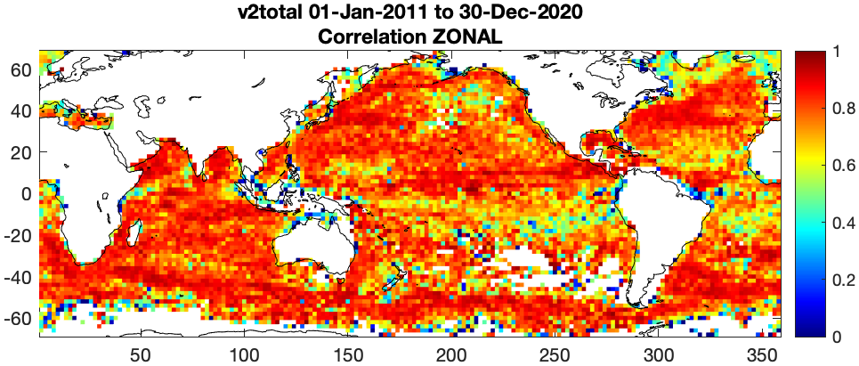
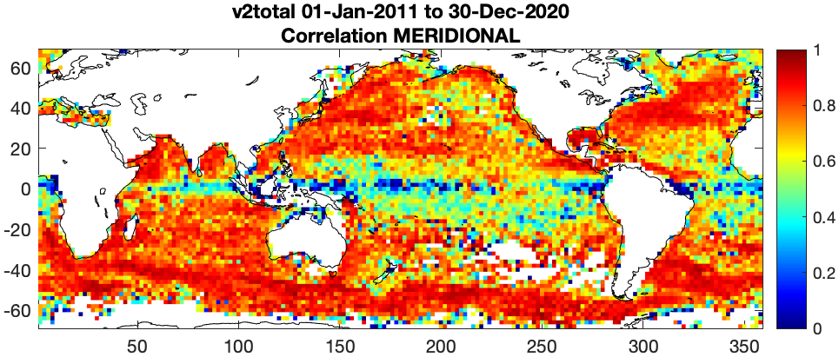
This talk: Tackling evaluation of Ekman currents from drifting buoys
Traditionally, have used drifting buoys to evaluate the global performance of OSCAR. To assess wind-driven model performance, we need to understand the relative contributions from geostrophic, Ekman, other (temperature gradients, nonlinear processes, filaments, upwelling, etc)?
Correlation of OSCAR v2.0 final with drifters, from 2011:2020. Drifter velocities and locations are daily binned. OSCAR velocities are interpolated to the drifter locations, and correlations are made between zonal and meridional components. Upper Left: zonal correlation coefficient binned to 2º boxes. Right: meridional correlation coefficients. Loer right: scatter plots of all the data at once.

Slide 5
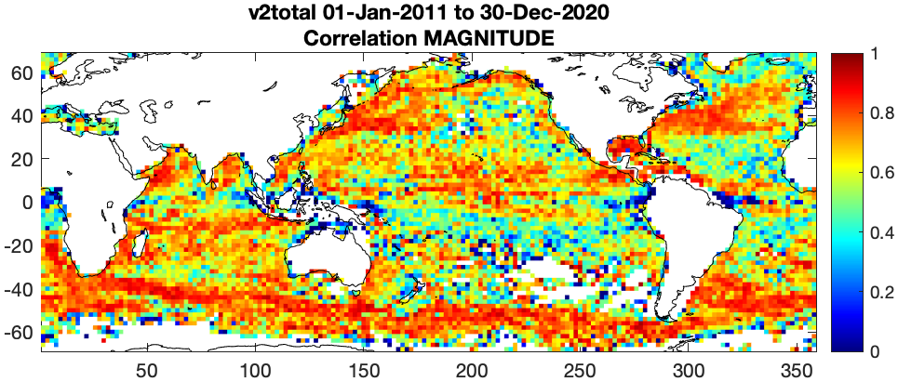
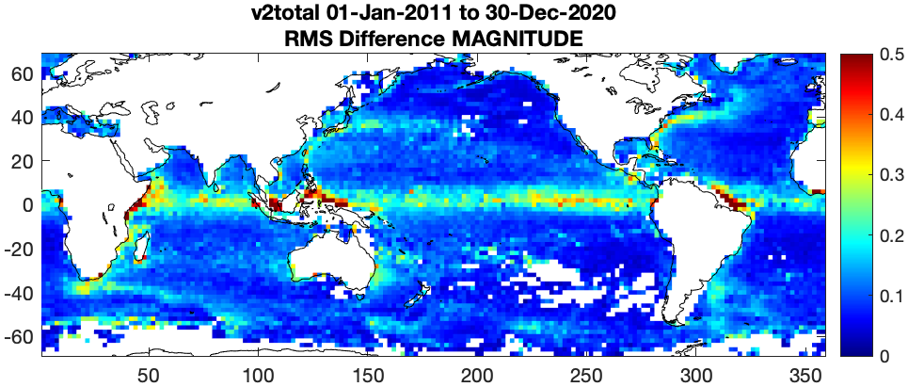
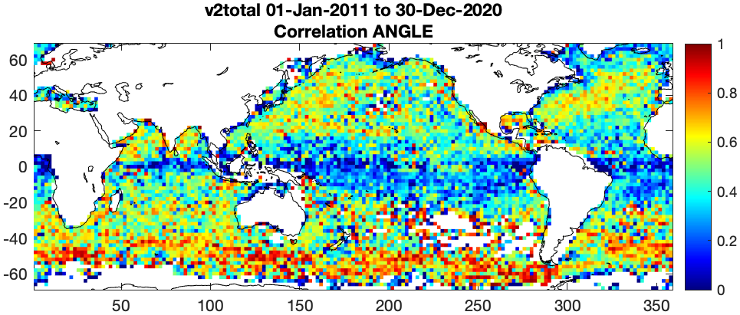
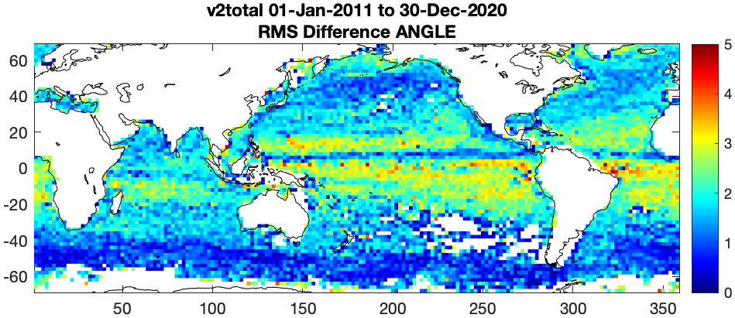
OSCAR evaluation using drifter velocities: Magnitude and angle
Because many currents are often zonally aligned, have traditionally done u,v correlations. Here, the angle and magnitude of the velocity vector

Slide 6
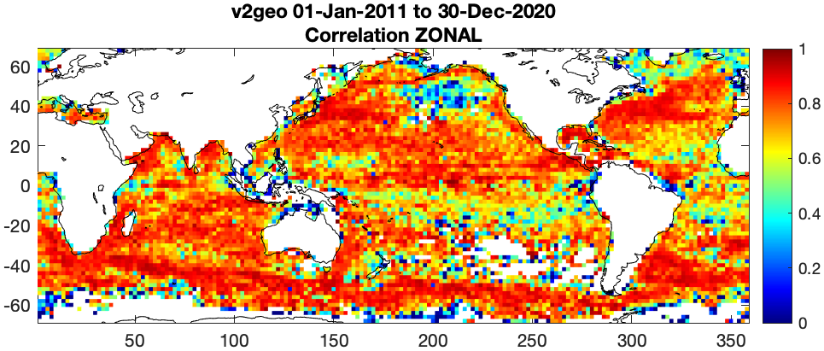
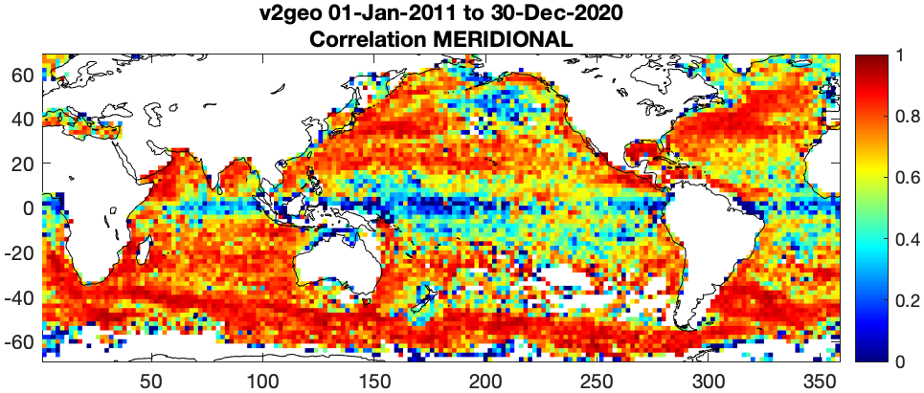
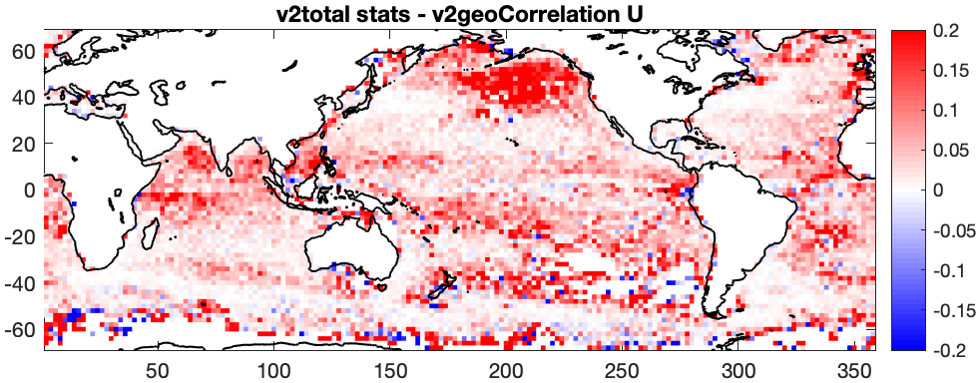
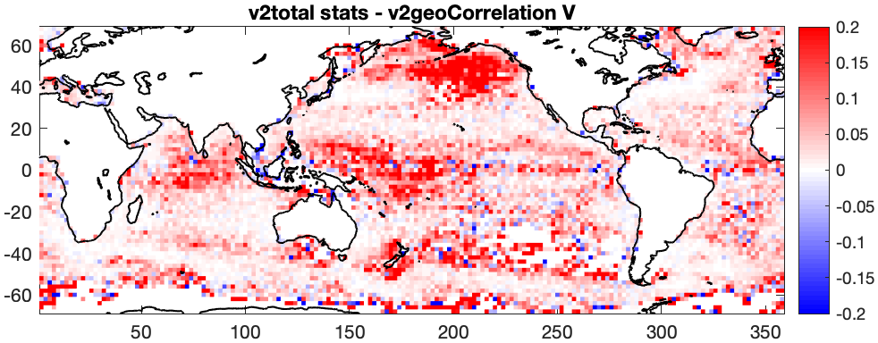
OSCAR correlation with drifter velocities GEOSTROPHIC ONLY
Many areas have strong signals from the geostrophic component. All areas are improved with total currents.

Slide 7
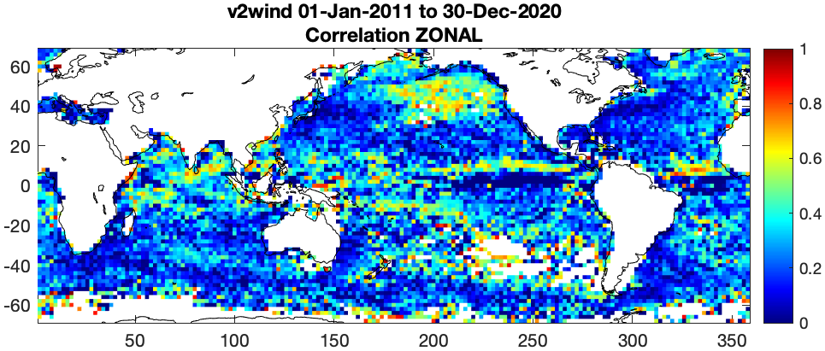
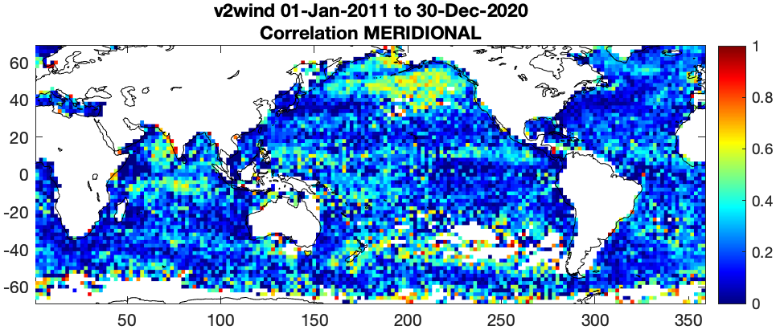
OSCAR correlation with drifter velocities WIND COMPONENT
Some areas of high correlation with wind component

Slide 8
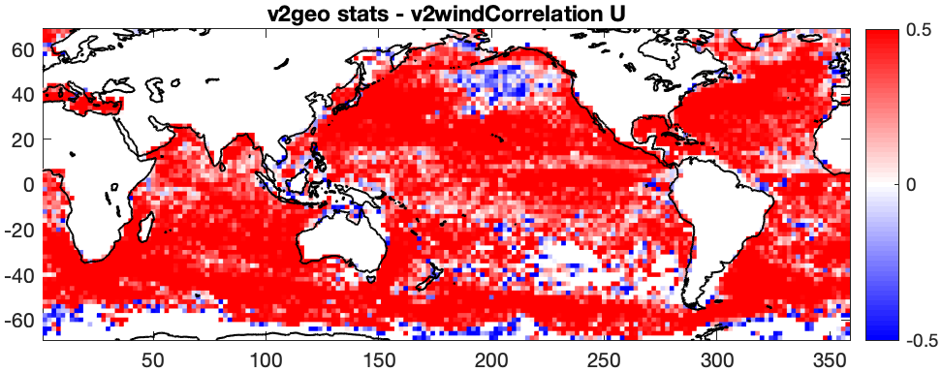
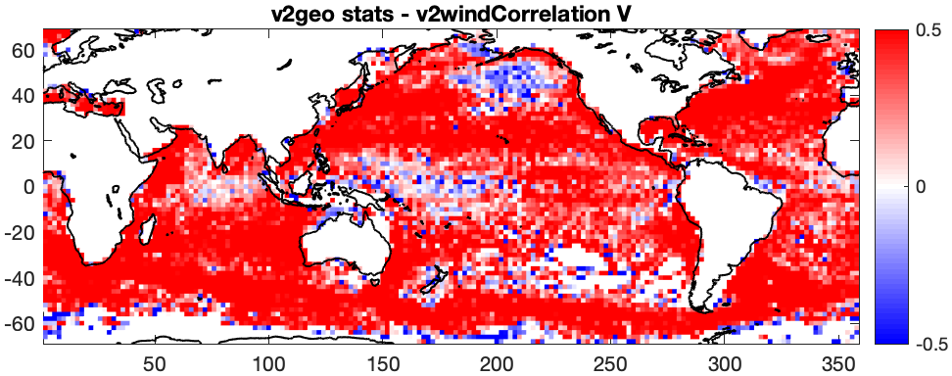
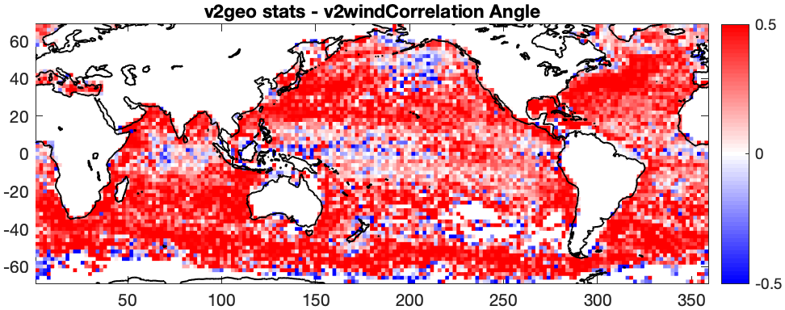
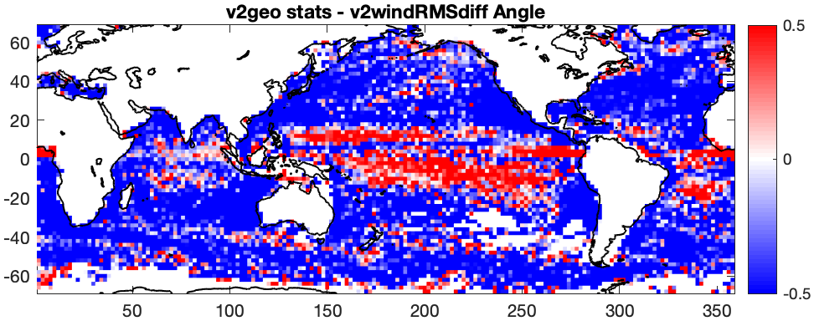
OSCAR correlation with drifter velocities DIFFERENCE between geo and wind components

Slide 9
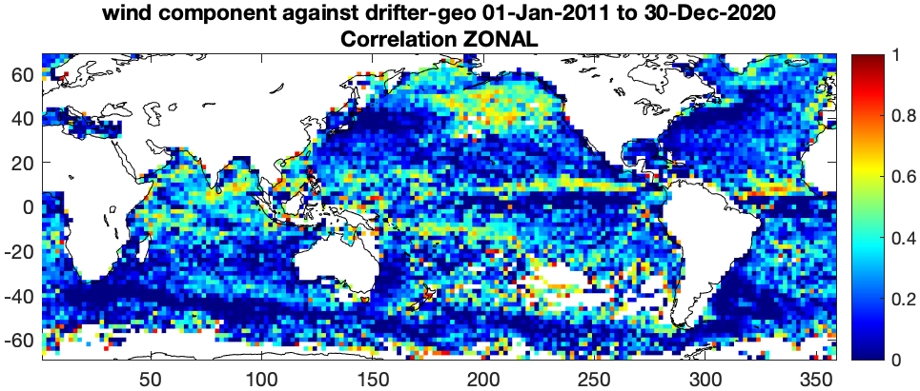
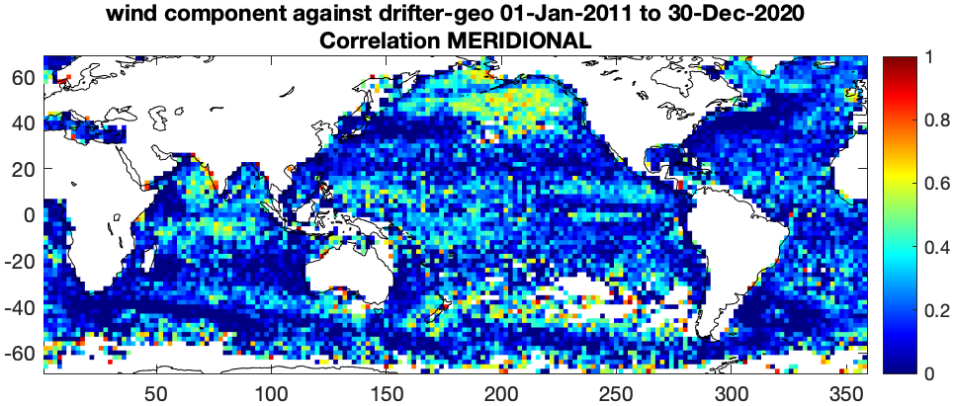
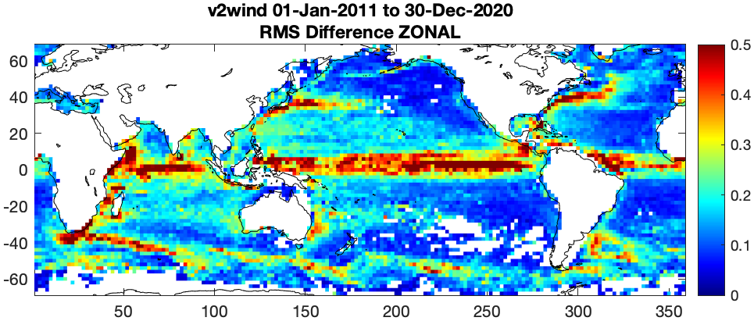
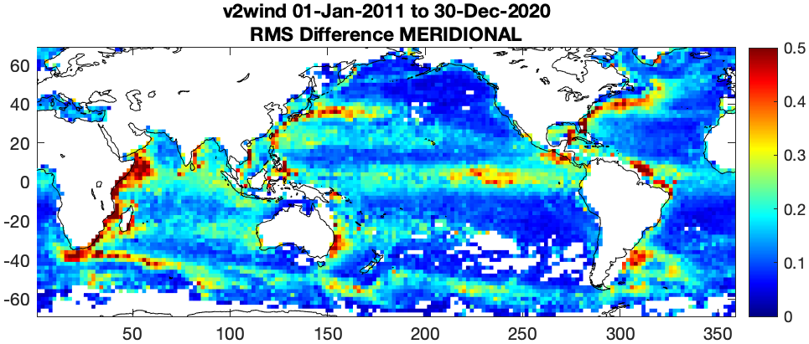
OSCAR correlation with drifter velocities: WIND COMPONENT vs DRIFT-GEO
Subtract out geostrophic signal from drifters, see improvement, but still see strong geostrophic signal. Not just from errors in geostrophic component (and interpolation), but also from interactions with those strong currents

Slide 10
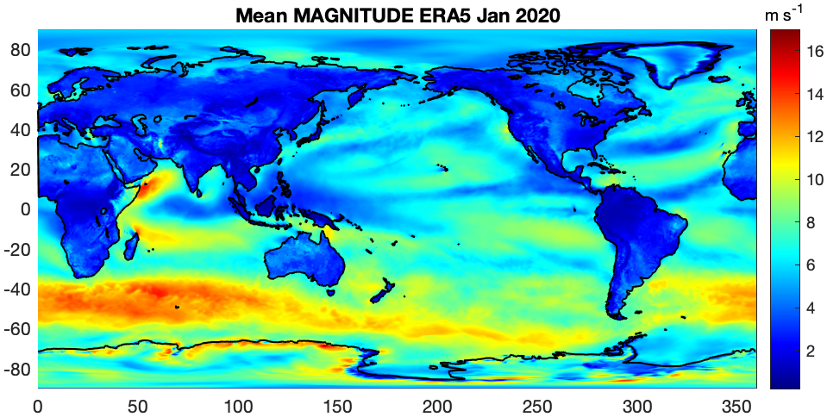
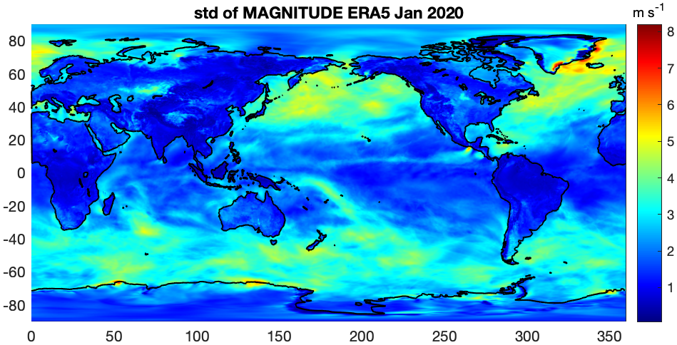
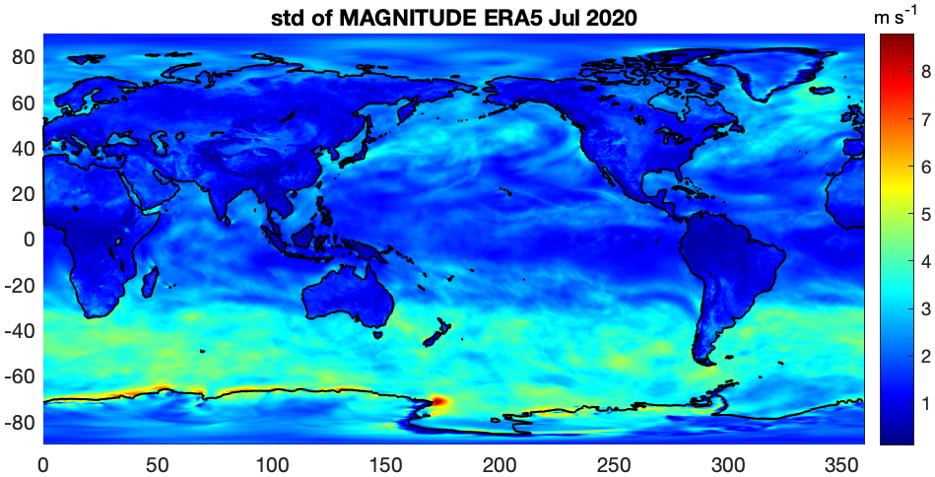
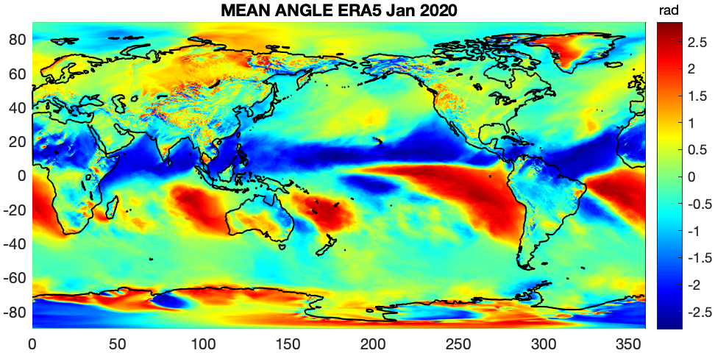
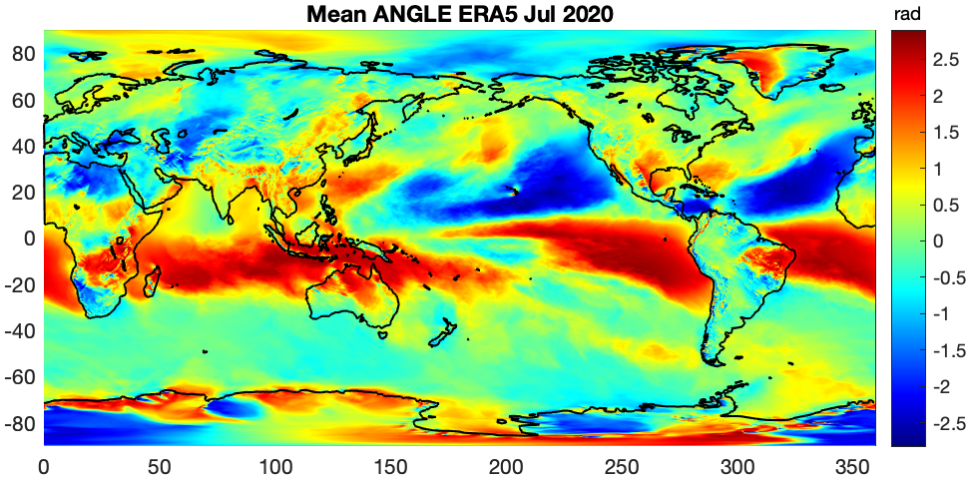
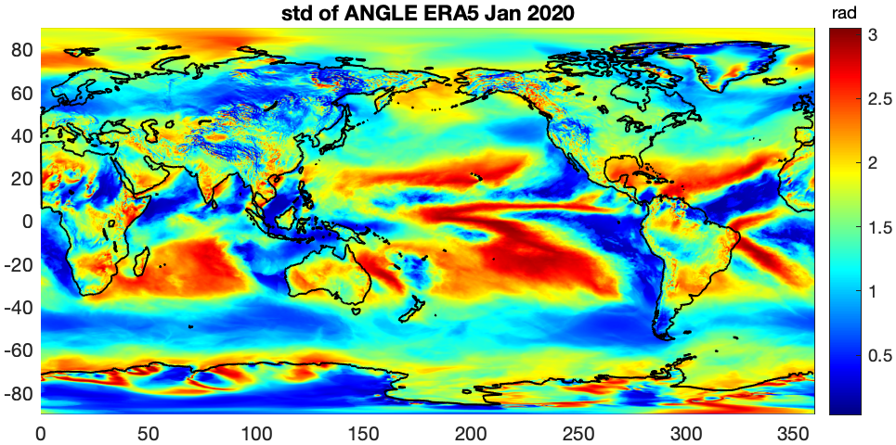
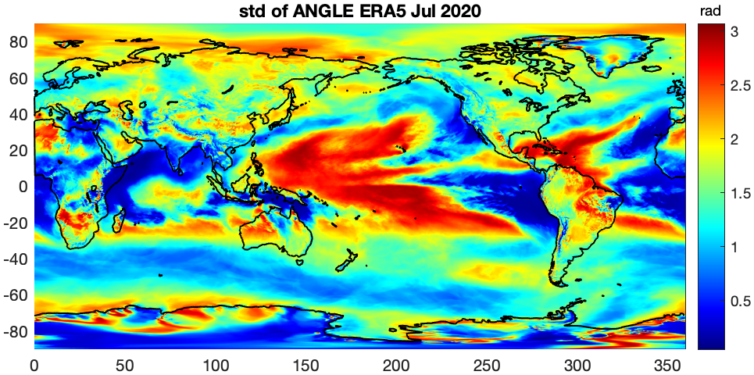
WIND CONDITIONS: Geographical differences and possible effect on Ekman currents
Not all areas with low geostrophic currents signal had the same degrees of correlation with drifter velocities
Can quickly look at ERA 5 winds to see general trends – the idea that very erratic winds will not be appropriate for a steady Ekman model.
One obvious point, very seasonally dependent. General 10-year correlation plots are not adequate to describe the situation. Need spatially and temporally local data.

Slide 11
WIND STATS MATCHUPS
To test upper ocean models in local areas with swath data and smaller scales, I will need local assessments of conditions.
Matchups with winds. For each drifter point in the record, have selected a radius and time period to calculate statistics on the winds at each point.
Used ERA5 hourly winds as a starting point, for a general look
Looking at swath winds in key areas
Areas with lower relative geostrophic currents
Areas with higher correlations with buoys vs areas with lower correlations with buoys
Testing the time/space area to include in the statistics
Refine the statistics (e.g. add dominant length scale calculation)
Here, 50 km radius using hourly ERA5 winds in a day surrounding the drifter data point.
Calculate mean and standard deviation for the wind vector magnitudes and angles.

Slide 12
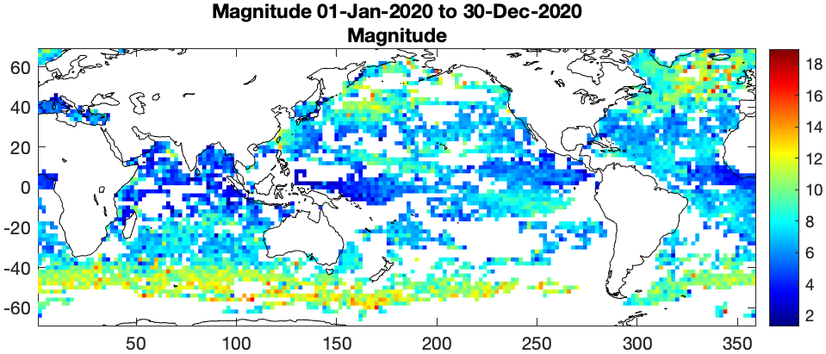
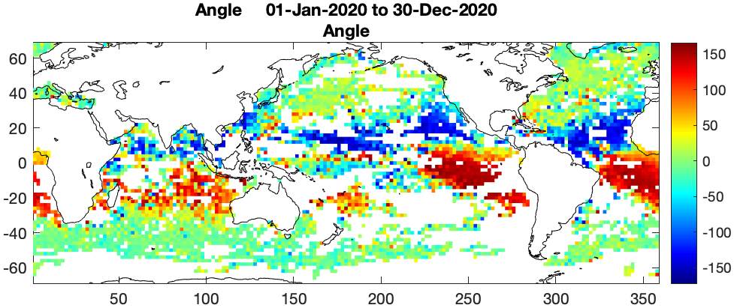
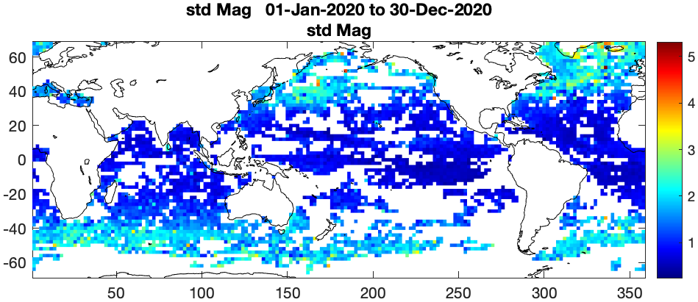
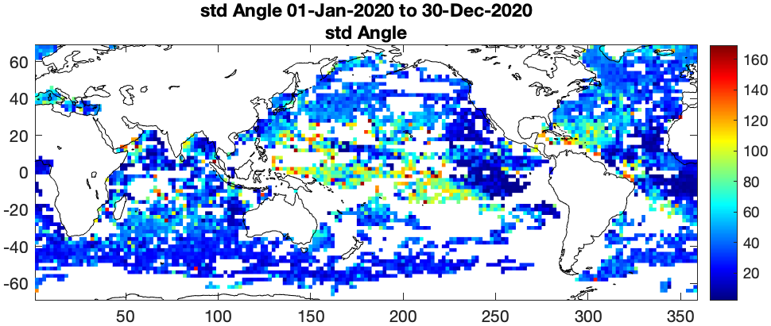
WIND STATS MATCHUPS ERA5

Slide 13
FINAL NOTE
Do an OSCAR test run using scatterometer winds
Focus on North Pacific for model development
Development of Coriolis-Stokes term highest priority in order to add to the OSCAR product as soon as possible

