Slide 1



Near-surface wind and wave drift currents in the coupled air-sea boundary layer
R. M. Samelson
CEOAS, Oregon State University
roger.samelson@oregonstate.edu
https://rsamelson.ceoas.oregonstate.edu/
IOVWST Meeting - 31 May 2024

Slide 2
Initial project goals:
Compute and analyze global statistics of near-surface wind and wave drift from recently proposed equilibrium-sea model (Samelson 2022, JPO) .
MERRA-2 reanalysis winds.
Motivation: Contribute to risk reduction for ODYSEA satellite Doppler scatterometer by improving quantitative characterization and physical understanding of near-surface currents driven by wind and waves.
Future work:
Test equilibrium-sea drift model (e.g., drogued/undrogued buoys).
Extend coupled modeling (talk #2)

Slide 3
History….
DopplerScatt: Bragg scattering from capillary waves (cm) initially suggested DS would measure cm-depth surface currents [now: surface to 1.6 m depth mean]
=> What is the wind (“Ekman”) drift at cm-depth scales?
Keulegan (1951), van Dorn (1953),…, O’Brien (1985),…Zelenke et al. (2012),.…:
  Surface wind drift is 3% of (10-m) wind speed at 15º to the right (NH) of wind…but why?
  Turbulent universality theory gives first-order explanation (Samelson 2020) but neglects wave effects that are surely not negligible on ocean side of interface.
  What about waves and wave drift?

Slide 4
What about waves and wave (Stokes) drift?
Wave momentum (Stokes drift) of equilibrium-sea wave field is part of wind (“Ekman”) drift.
Wave momentum is captured in full-depth Eulerian means:
  Fixed-depth Eulerian mean places wave momentum above wave troughs.
  Mass-weighted surface-conforming mean gives Eulerian mean profile equivalent to Stokes drift profile.
Green line:
Fixed-depth Eulerian mean
Blue line:
Lagrangian mean (Stokes drift)
or
Mass-weighted spatial average in surface-conforming coordinates

Slide 5
Equilibrium-sea wind (and wave) drift model:
Wind drift model for the mass-weighted, surface-conforming mean current implicitly incorporates wave (Stokes) drift from the equilibrium wave field.
Homogeneous, equlibrium balance: Coriolis force vs. stress divergence.
How to model turbulent stress near the surface?
  Ocean roughness length dependent on 10-m wind speed.
  Wave-effect parameter dependent on 10-m wind speed, which – by analogy to Monin-Obukhov similarity theory – effectively modifies the classical wall-boundary value of the von Kármán constant.

Slide 6
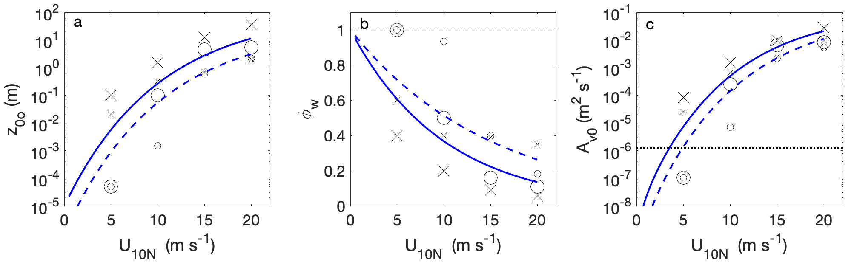
(at z=0)
10 m
Surface eddy viscosity
Roughness length*
Wave-effect parameter
*Roughness length can be interpreted in terms of wave-breaking turbulence.

Slide 7
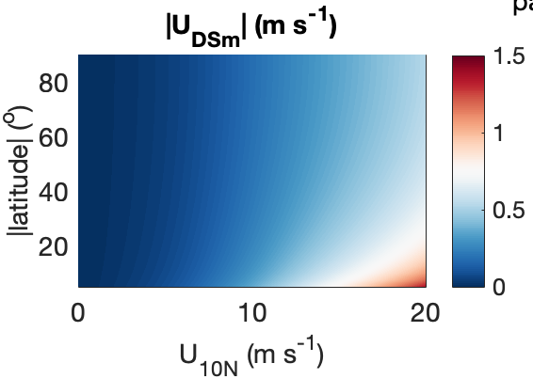
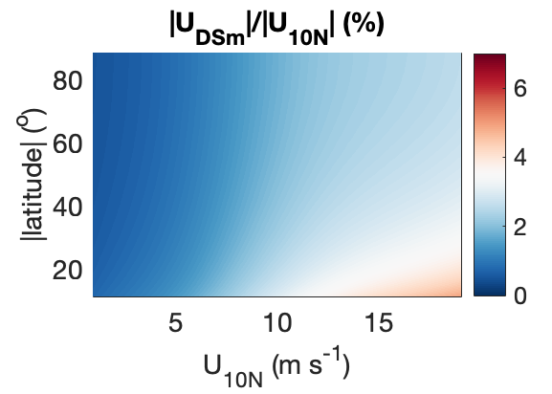
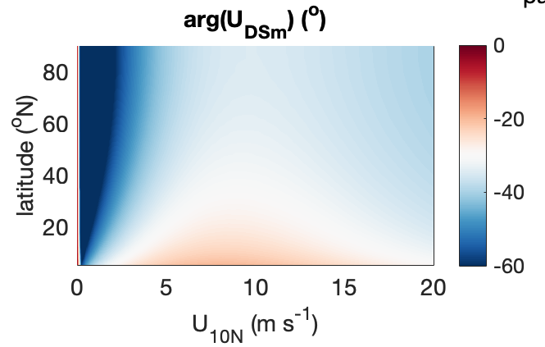
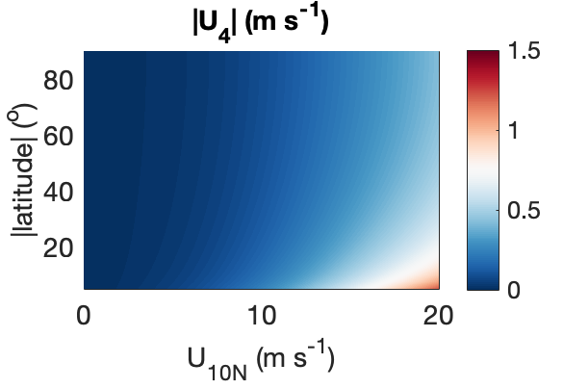
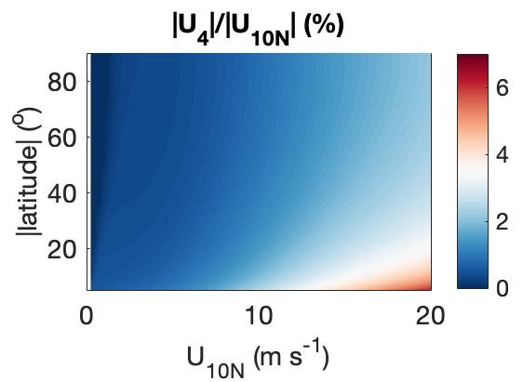
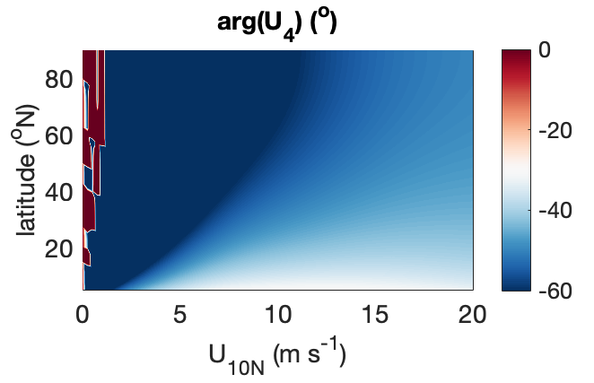
Model wind drift vs. 10-m wind speed and latitude
Drift speed
Fraction of 10-m wind speed
Wind-relative angle (NH)
”DopplerScatt mean”
0-1.6 m depth
4-m depth
[nominal DopplerScatt calibration depth]

Slide 8
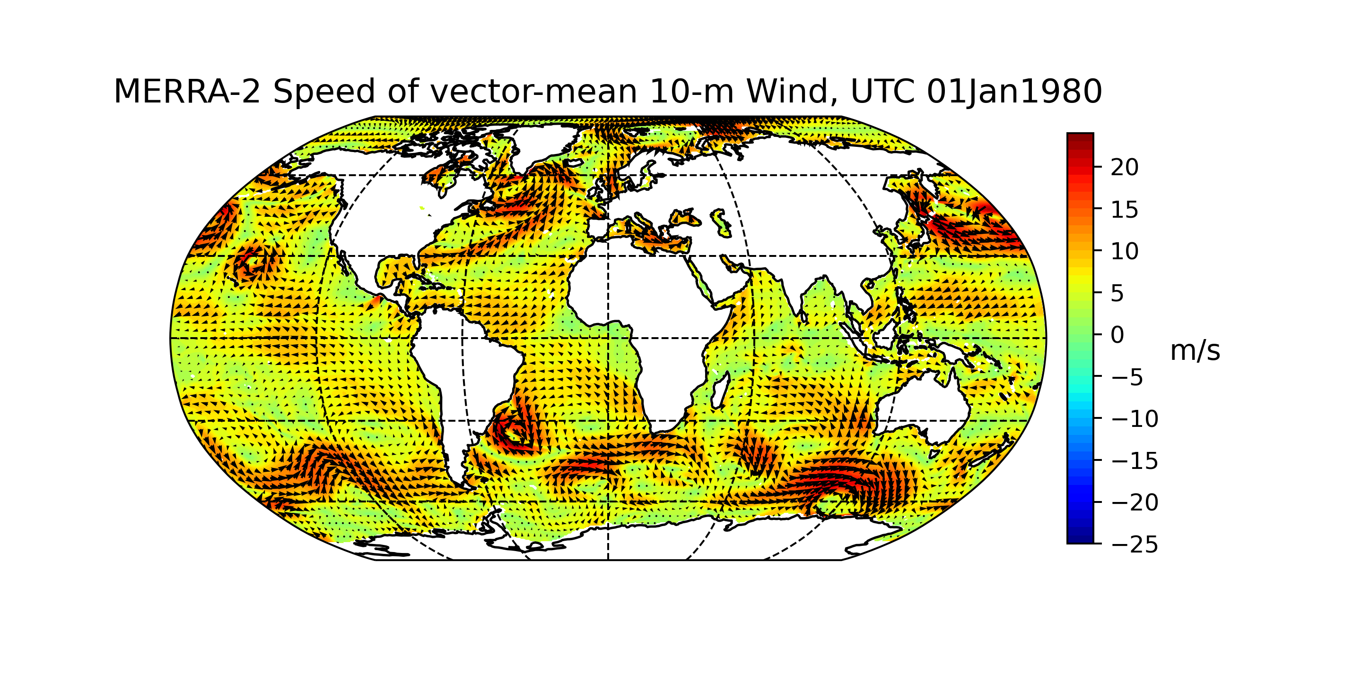
MERRA-2 winds: 01 Jan 1980 vector-mean of hourly fields

Slide 9
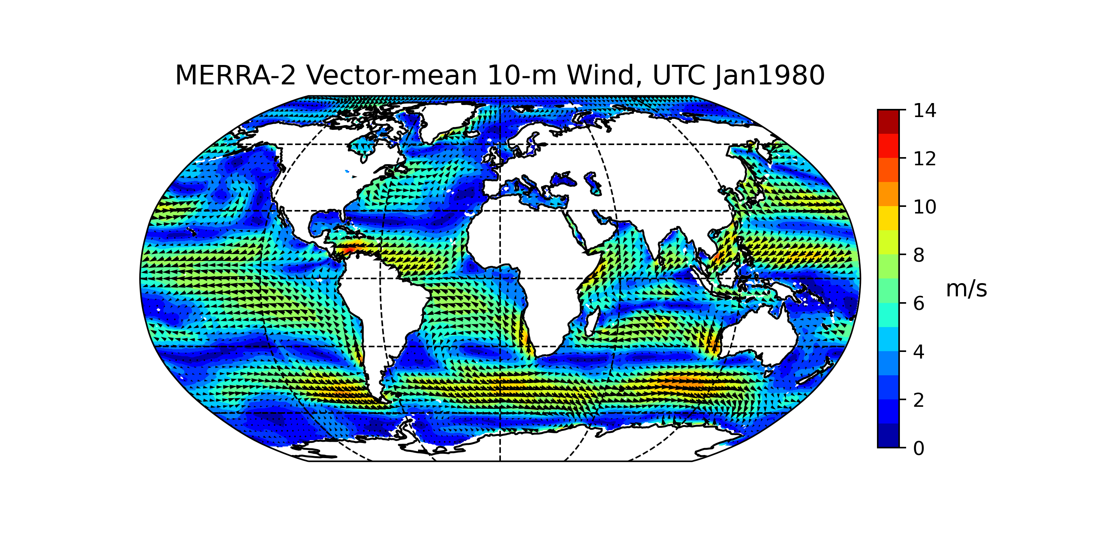
MERRA-2 winds: Jan 1980 monthly vector-mean

Slide 10
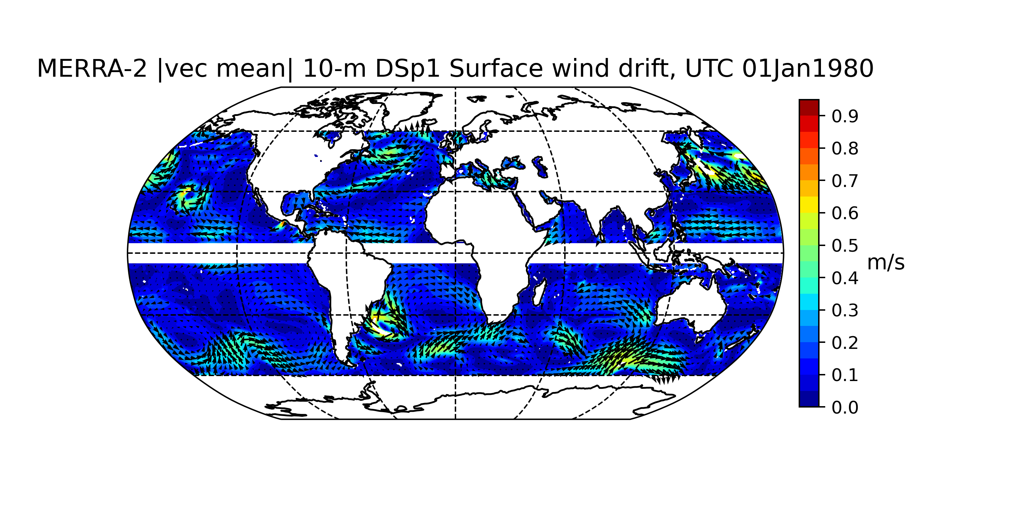
“DopplerScatt mean” wind drift: 01 Jan 1980 vector-mean

Slide 11
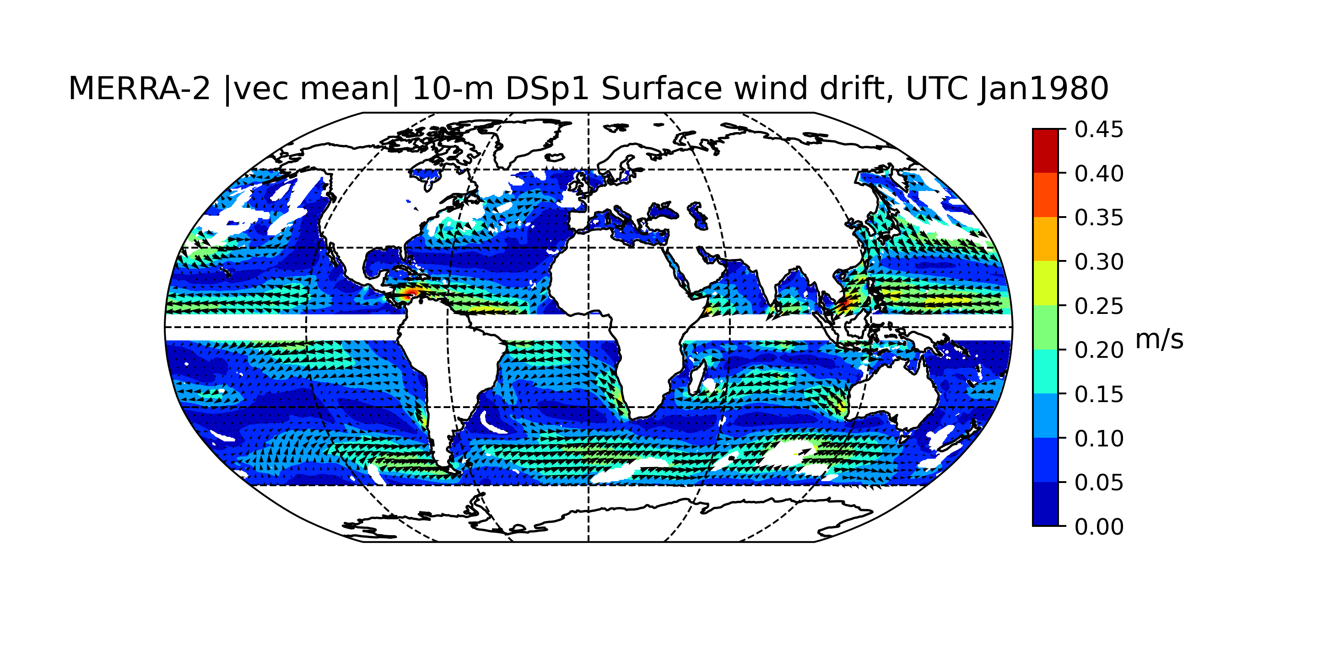
“DopplerScatt mean” wind drift: Jan 1980 vector-mean

Slide 12
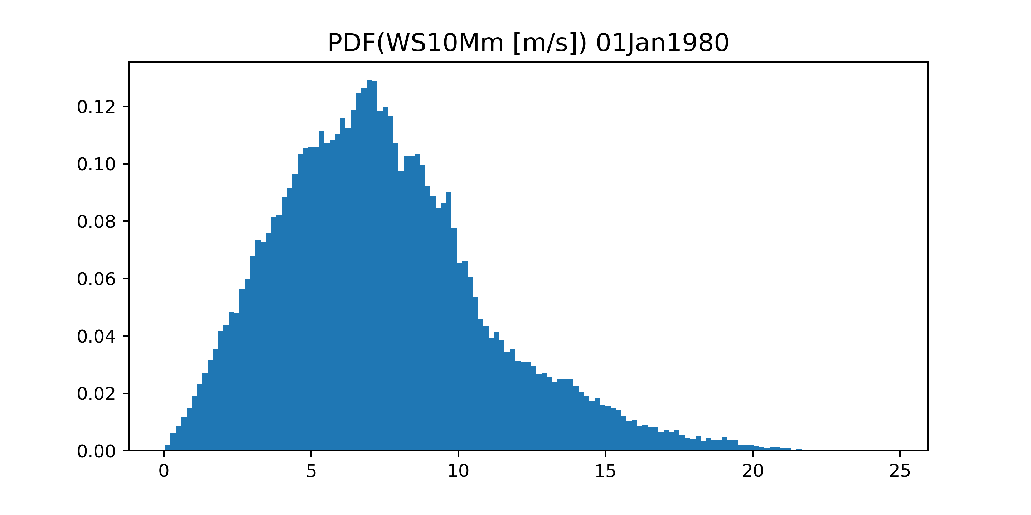
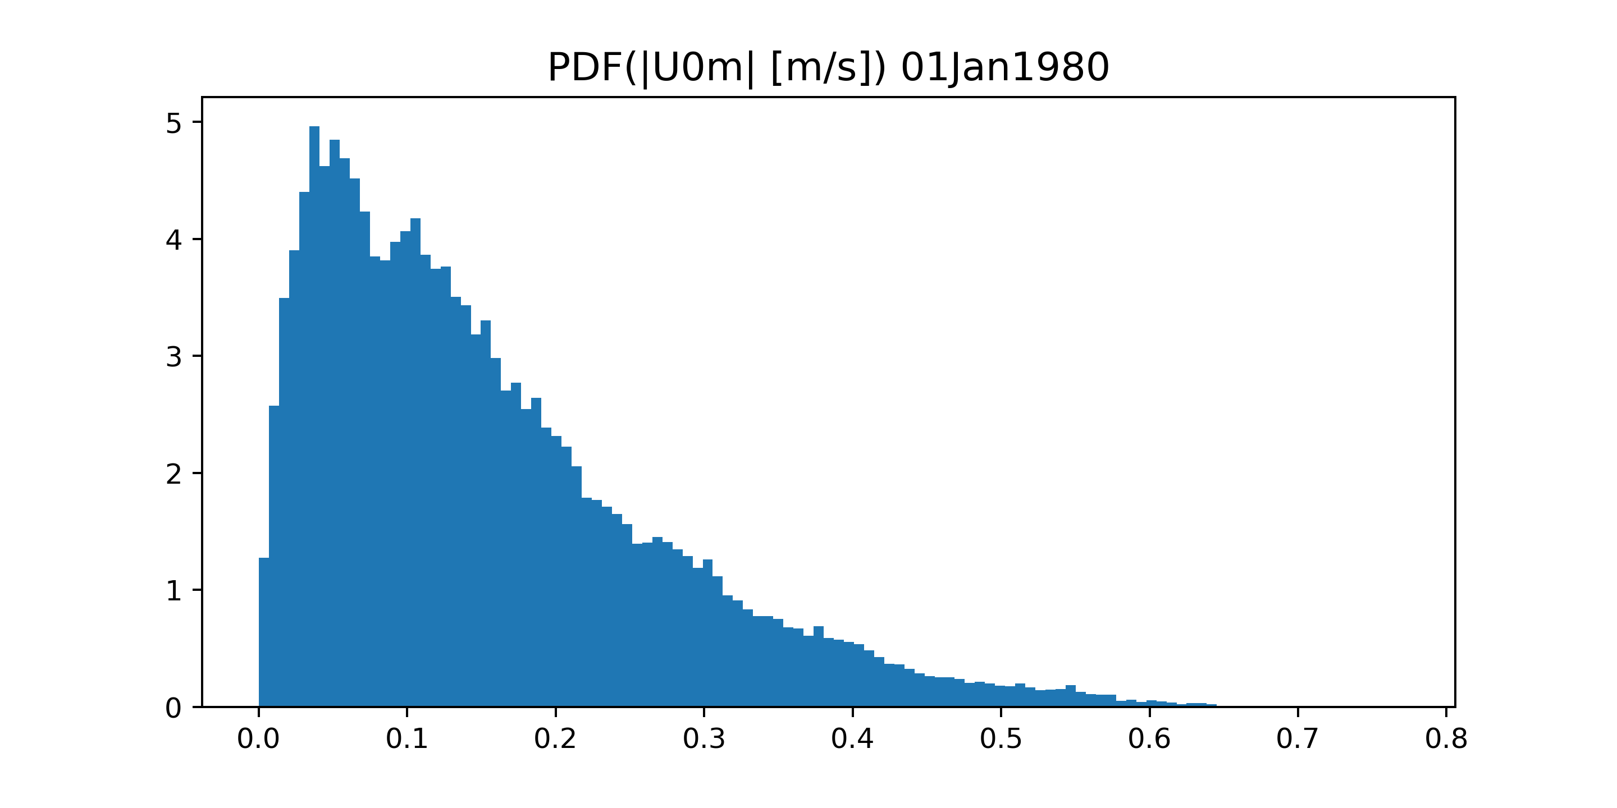
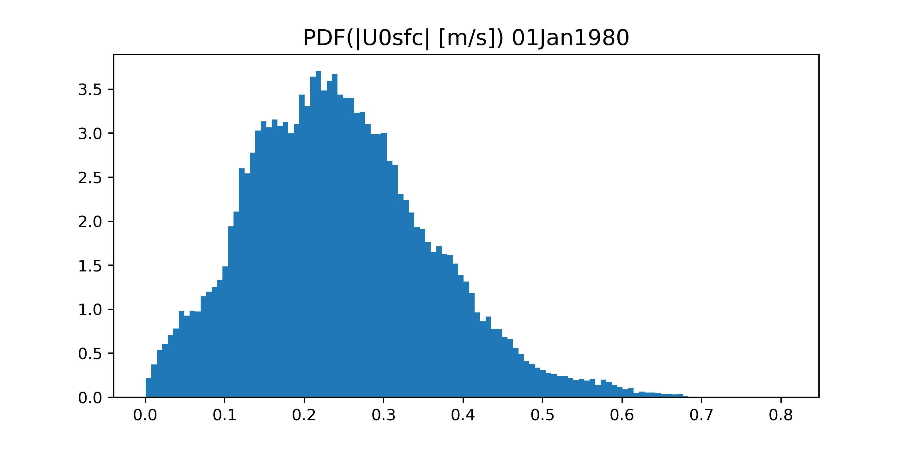
Wind and drift pdfs – 01 Jan 1980
“DopplerScatt mean”
10 m s⁻¹
0.3 m s⁻¹
Drift at air-sea interface
0.3 m s⁻¹

Slide 13
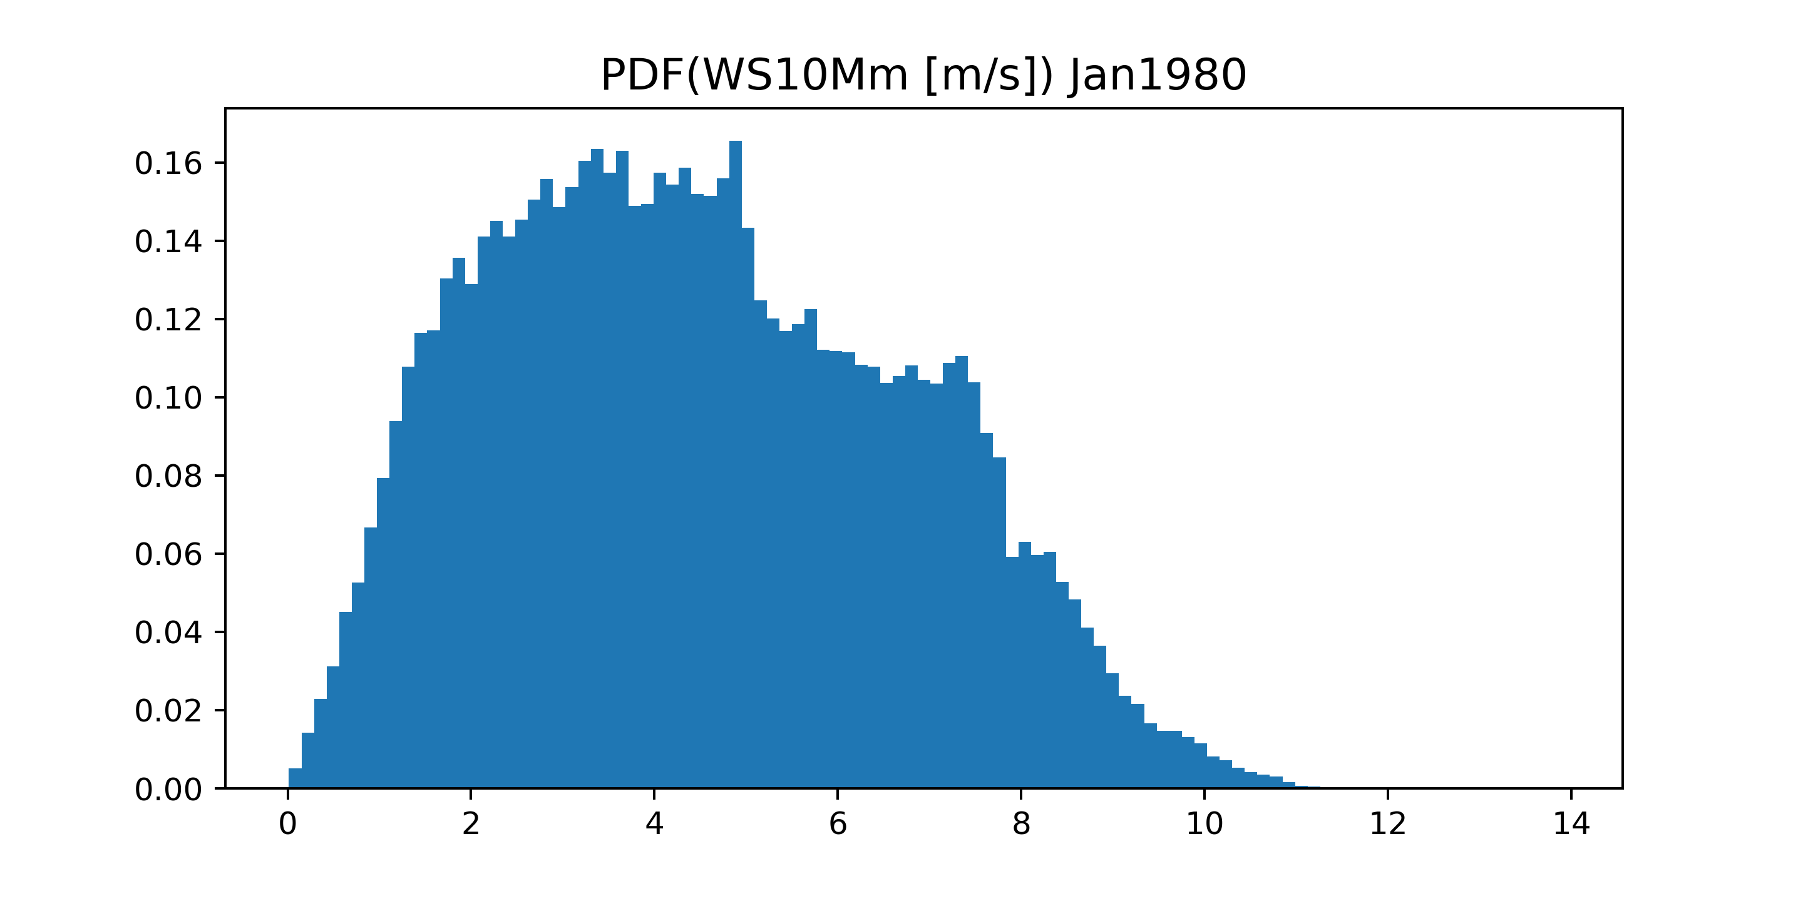
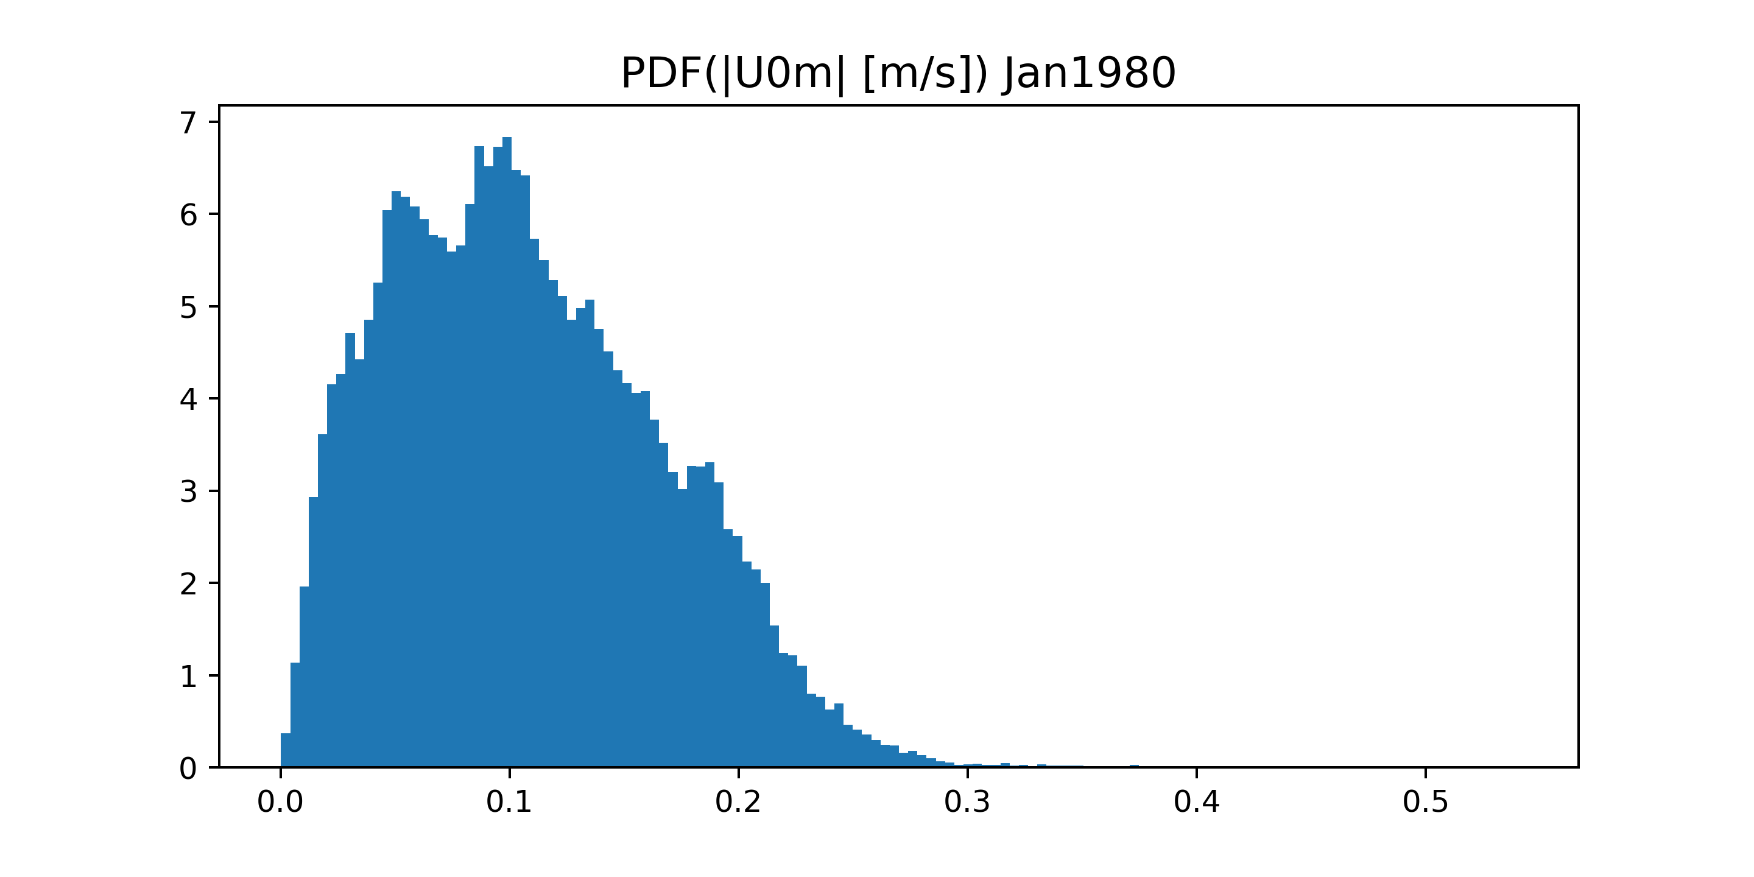
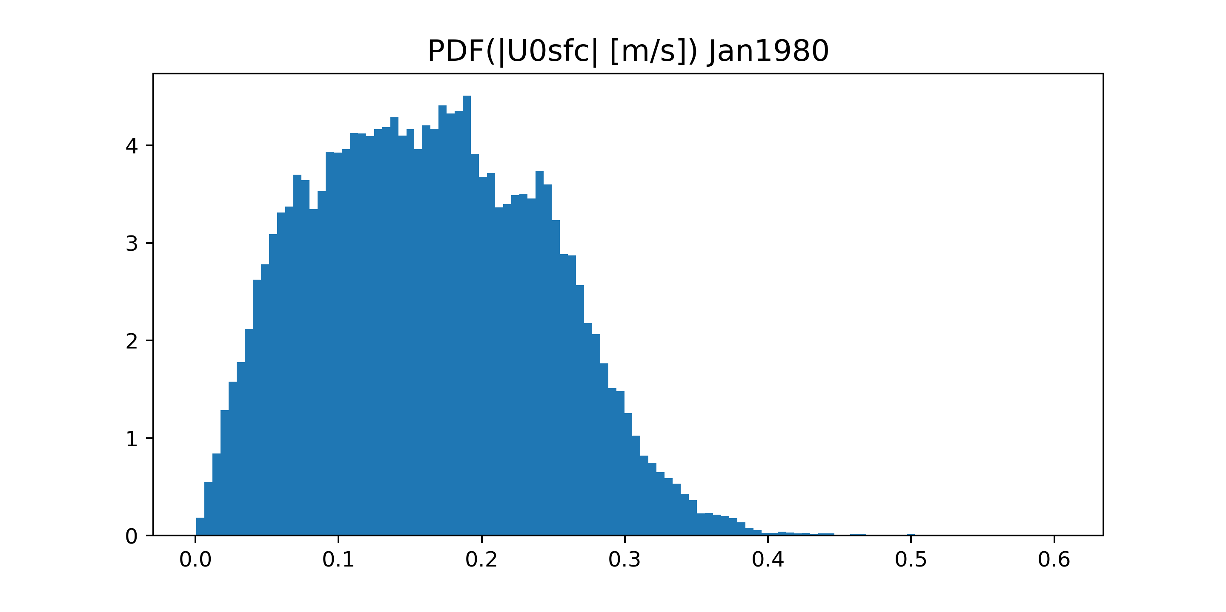
Wind and drift pdfs – Jan 1980
“DopplerScatt mean”
10 m s⁻¹
0.3 m s⁻¹
Drift at air-sea interface
0.3 m s⁻¹

Slide 14
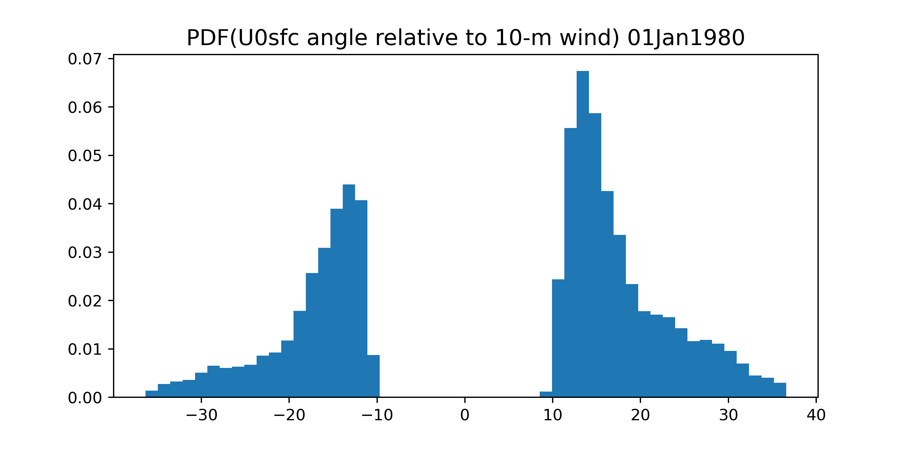
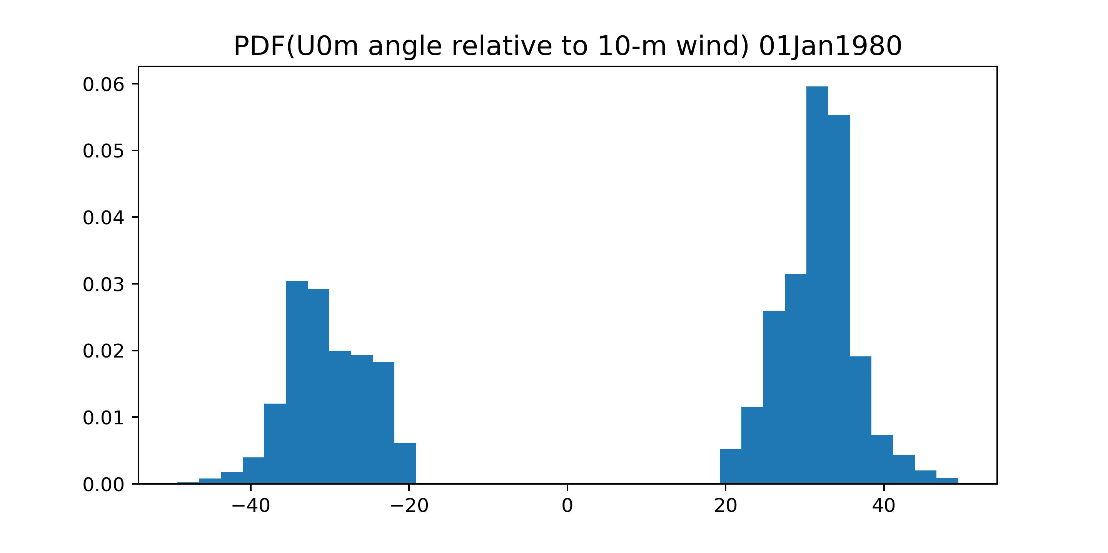
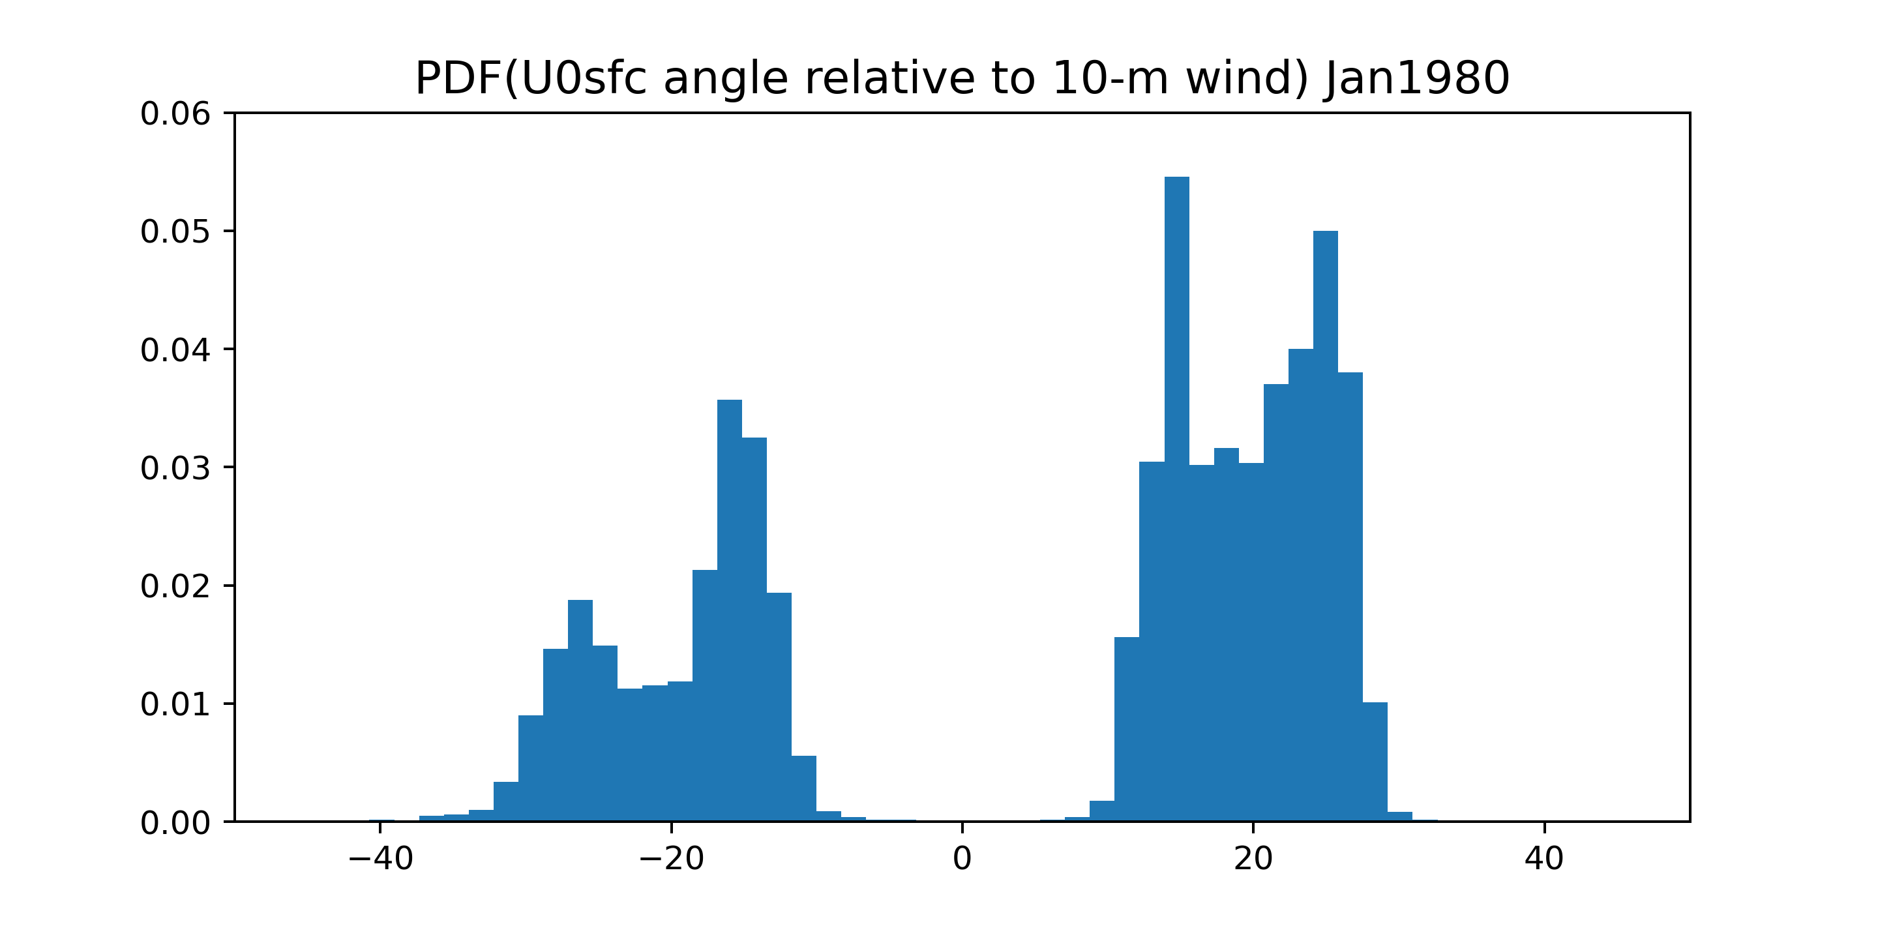
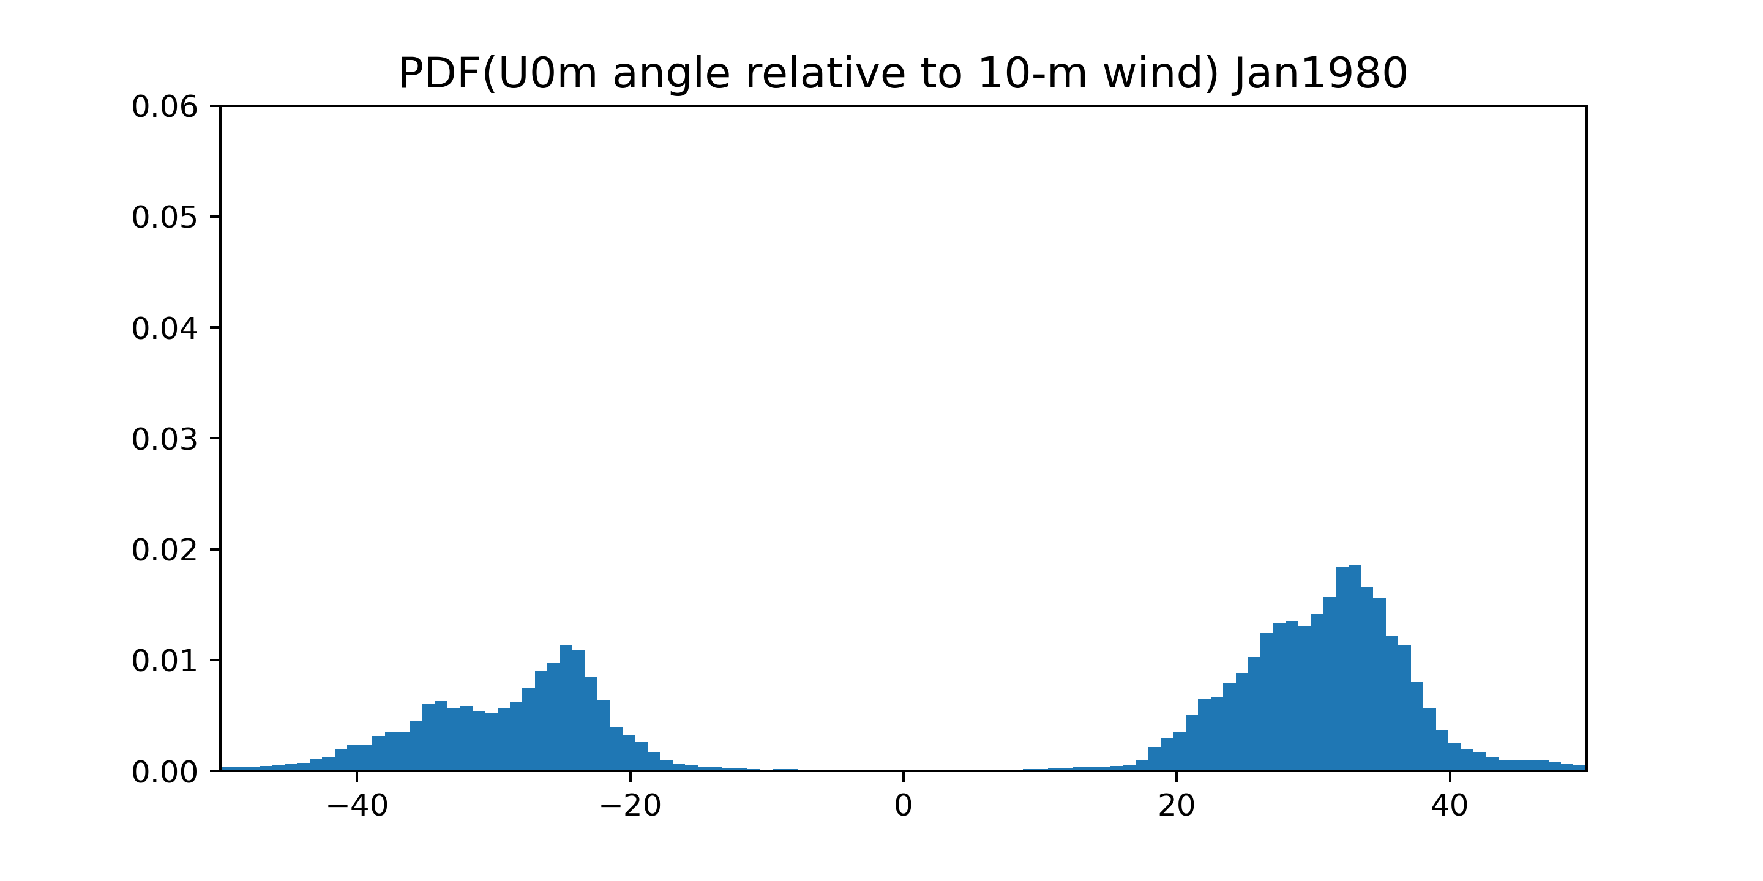
Relative drift-angle pdfs
Air-sea interface drift
“DopplerScatt mean”
01 Jan 1980
Jan 1980

Slide 15
Summary
Analysis in progress of global statistics of near-surface wind and wave drift from recently proposed equilibrium-sea model (MERRA-2 reanalysis winds; ODYSEA risk reduction).
Typical values of “DopplerScatt” 1-day mean drift are 0.1-0.2 m s⁻¹ and can exceed 0.5 m s⁻¹.
Typical values of “DopplerScatt” monthly mean drift are 0.05-0.15 m s⁻¹ and can exceed 0.25 m s⁻¹.
Transient mid-latitude winds give relatively large vector-mean drift at mid-latitudes on daily timescales.
Quasi-steady low-latitude winds give relatively large vector-mean drift at low latitudes on monthly time scales.

Slide 17
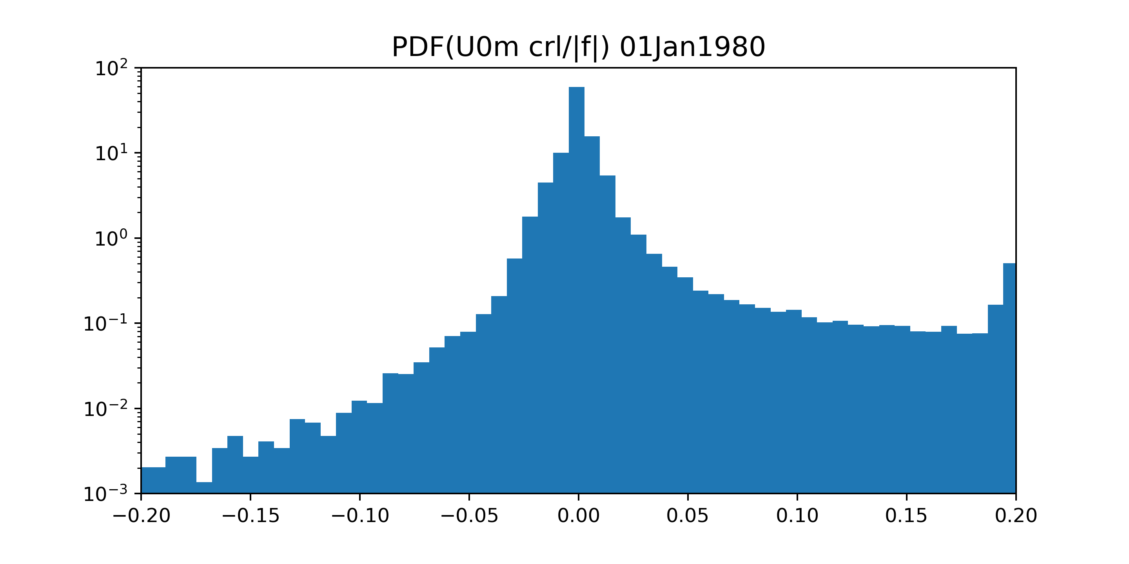
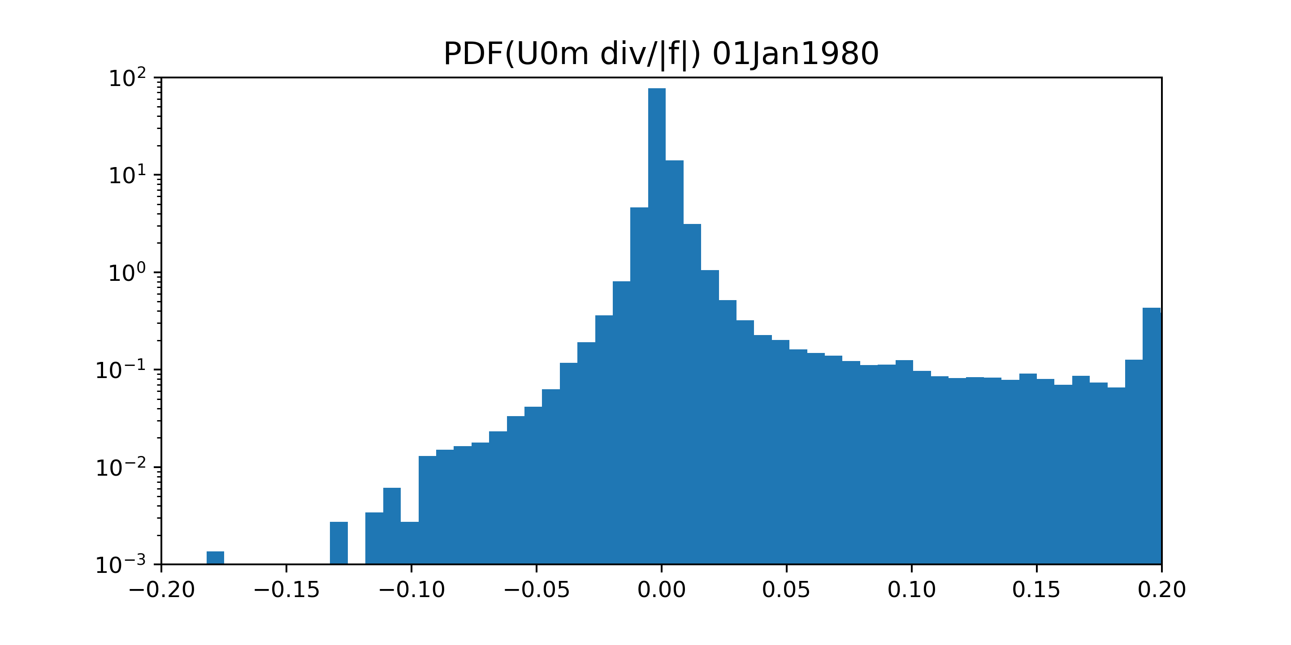
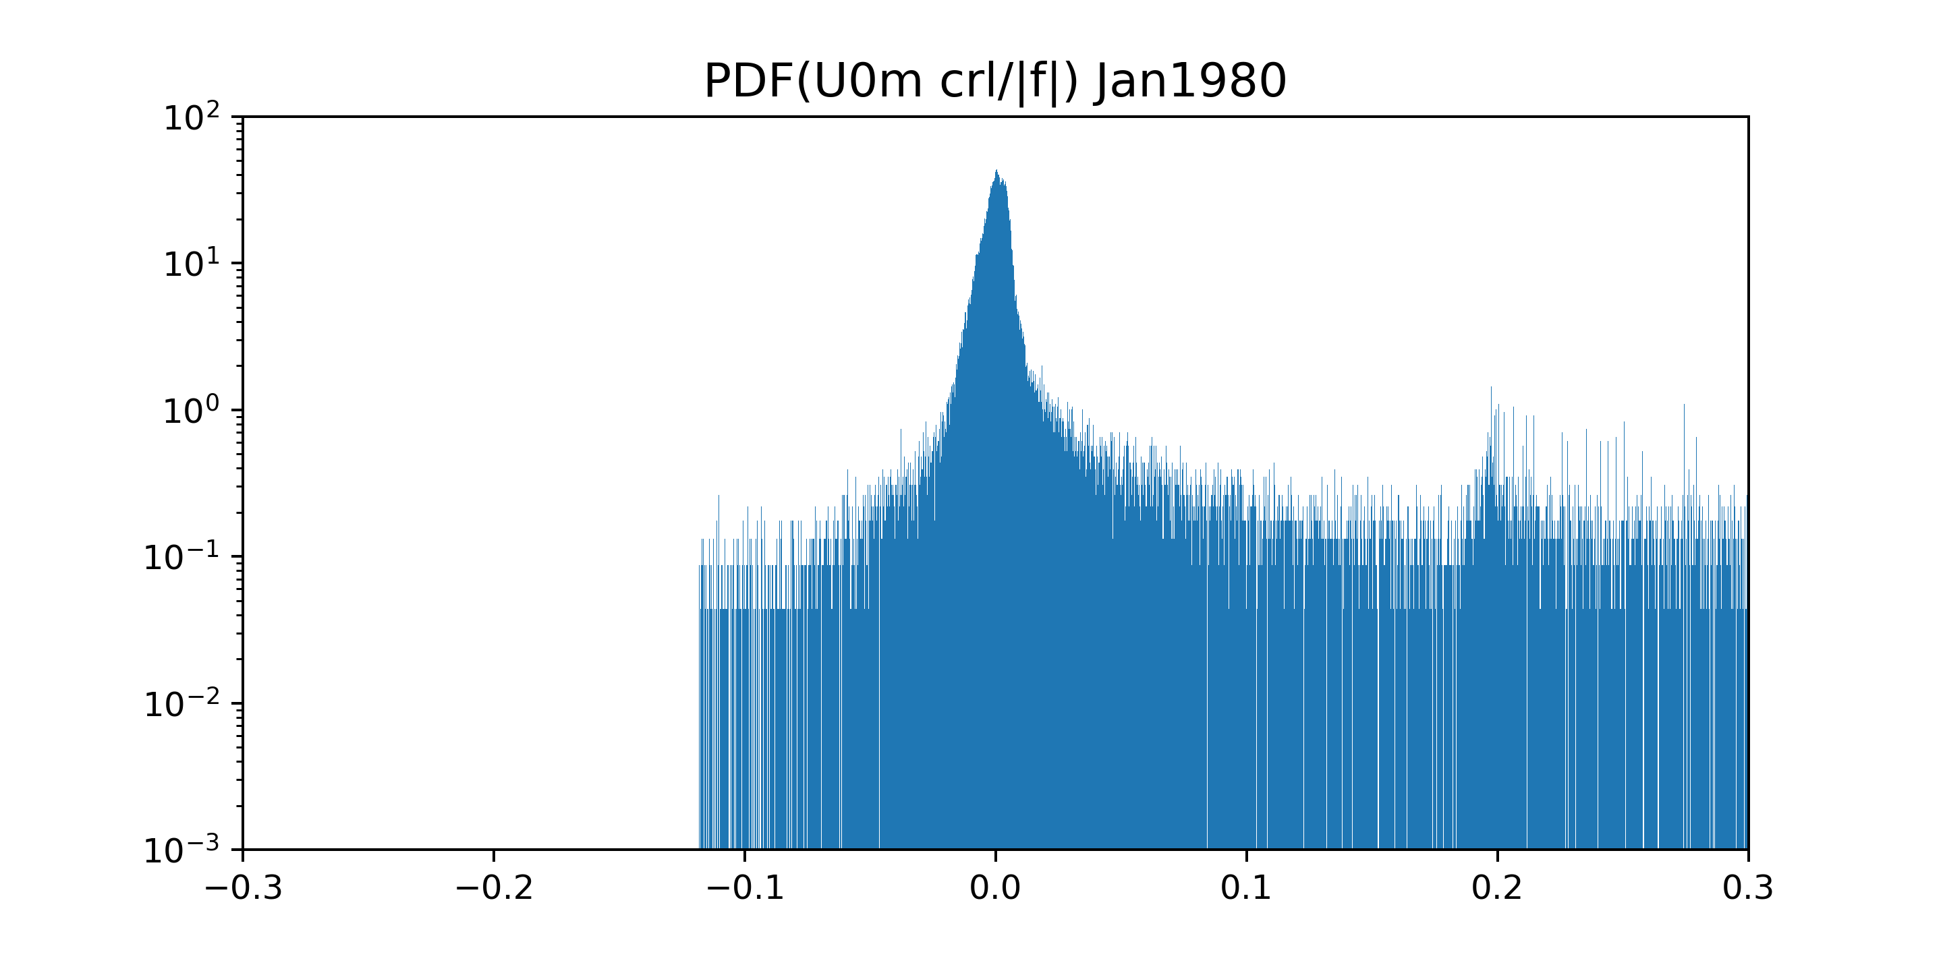
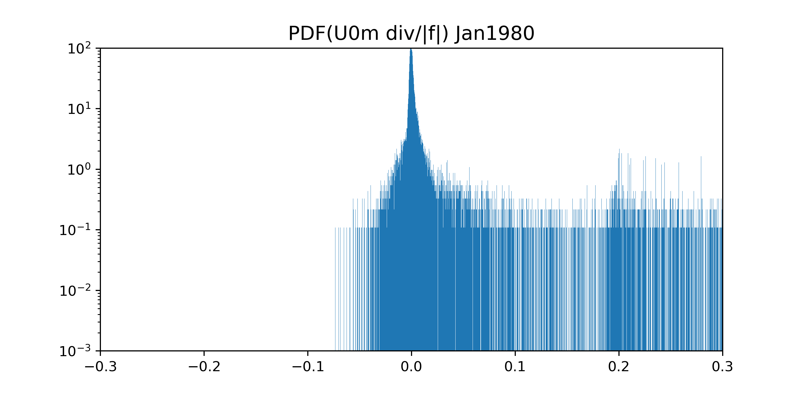
Drift curl and divergence pdfs

