Slide 1
Review of Equivalent Neutral Winds and Stress Equivalent Winds
Mark A. Bourassa¹ and Ad Stoffelen²
The Florida State University
KNMI

Slide 2
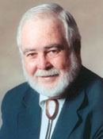
Why Calibrate to ‘Winds’ Rather than Stress
Radar backscatter was observed to be dependent on wind speed and/or wave height in the 1950s.
In 1963 Dick Moore had the idea that backscatter could be used to estimate oceanic variables.
The NASA Sea Surface Stress (S³) report indicated that scatterometers probably did respond to stress rather than wind.
The number of stress observations available for calibration was approximately zero. Therefore, it was desirable to calibrate to wind, for which the collocated observations would be plentiful.
Willard Pierson, Vince Cardone and colleagues found that wind speed could be adjusted to be more consistent with surface stress.
Equivalent neutral wind
But there was a questionable assumption which brings us to stress equivalent winds

Slide 3
Qualitative Description of Earth-Relative Winds and Equivalent Neutral Winds and Stress Equivalent Winds
Earth relative winds are wind speeds measured relative to the ‘fixed’ earth
Earth relative winds are the standard for almost all atmospheric applications:
Operational meteorology (forecasts and analyses)
Hurricane and marine cyclone analyses
Most meteorologists think in terms of earth relative winds
Equivalent neutral winds are used to determine (or as a proxy for) surface turbulent stress.
They have been designed for very simple conversion to stress.
They assume an average (of some sort) air density, which causes systematic errors when converting from a stress to a wind and a friction velocity
Air density is about 1.1 kg m⁻³ in the tropics outside of strong cyclones
Air density can be 1.4 kg m⁻³ in the in extremely cold air outside of strong cyclones
Stress Equivalent winds correct for this problem, defining a satellite wind speed that does take account of the local air density
Which implies that for comparison air density must be used to determine stress-equivalent winds

Slide 4
Stress – Parameterization with a Drag Coefficient
The surface turbulent stress (momentum flux density) is usually parameterized as
This form can be more accurately written as
It can be further improved in terms of surface relative wind vectors:
Does a scatterometer respond to U₁₀ or to U₁₀ − U_{sfc}?
Cornillon and Park (2001, GRL), Kelly et al. (2001, GRL), and Chelton et al. (2004, Science) showed that scatterometer winds were relative to surface currents.
Bentamy et al. (2001, JTech) indicate there is also a dependence on wave characteristics.
Bourassa (2006, WIT Press) showed that wave dependency can be parameterized as a change in U_{sfc} for wind and waves moving in the same direction.
Hence, empirical GMFs tuned to U_{sfc} incorporate wave (motion) dependency Portabella et al. (2009, JAOT)

Slide 5
Equivalent Neutral wind speed minus Earth Relative wind speed for U₁₀ = 6 ms⁻¹
For equal and opposite air/sea temperature differences, the change is greater for the stable conditions
These results require a roughness length that is dependent on friction velocity. Otherwise, it can change a lot

Slide 6
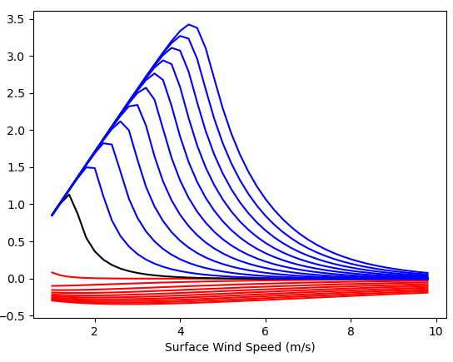
How To Calculate Equivalent Neutral Winds & Common Errors
Correct Approach
Calculate the friction velocity (or stress)
accounting for atmospheric boundary-layer stability, and
And using a stress depending roughness length.
Use these friction velocity and roughness length to determine a wind speed at 10 m height (z=10) with zero additional impact from atmospheric stability.
Common errors: #1 Neutral winds
Stable
U₁₀EN – U₁₀_Neutral (ms⁻¹)
Unstable
#2 Kara et al. (200xx) found that application of a constant roughness length or a roughness length without a dependency on stress (a Charnock like roughness length results in systematic errors in equivalent neutral winds

Slide 7
What If Scatterometers Respond to Stress?
If scatterometers respond in a manner consistent with equivalent neutral winds, then they respond to changes in friction velocity (u∗).
τ = ρ_{air} u∗²
Replace u* in the traditional definition of equivalent neutral winds – write in terms of τ
If scatterometers respond to stress, then it responds to changes in air density and change in friction velocity!
If scatterometers respond to stress, then calibrations to stress equivalent winds will not depend on actual air mass density (de Kloe et al., 2017, JSTARS)
⟨ ⟩
10S

Slide 8
Review of Equivalent Neutral Winds and Stress Equivalent Winds
Mark A. Bourassa¹ and Ad Stoffelen²
The Florida State University
KNMI

