Slide 1
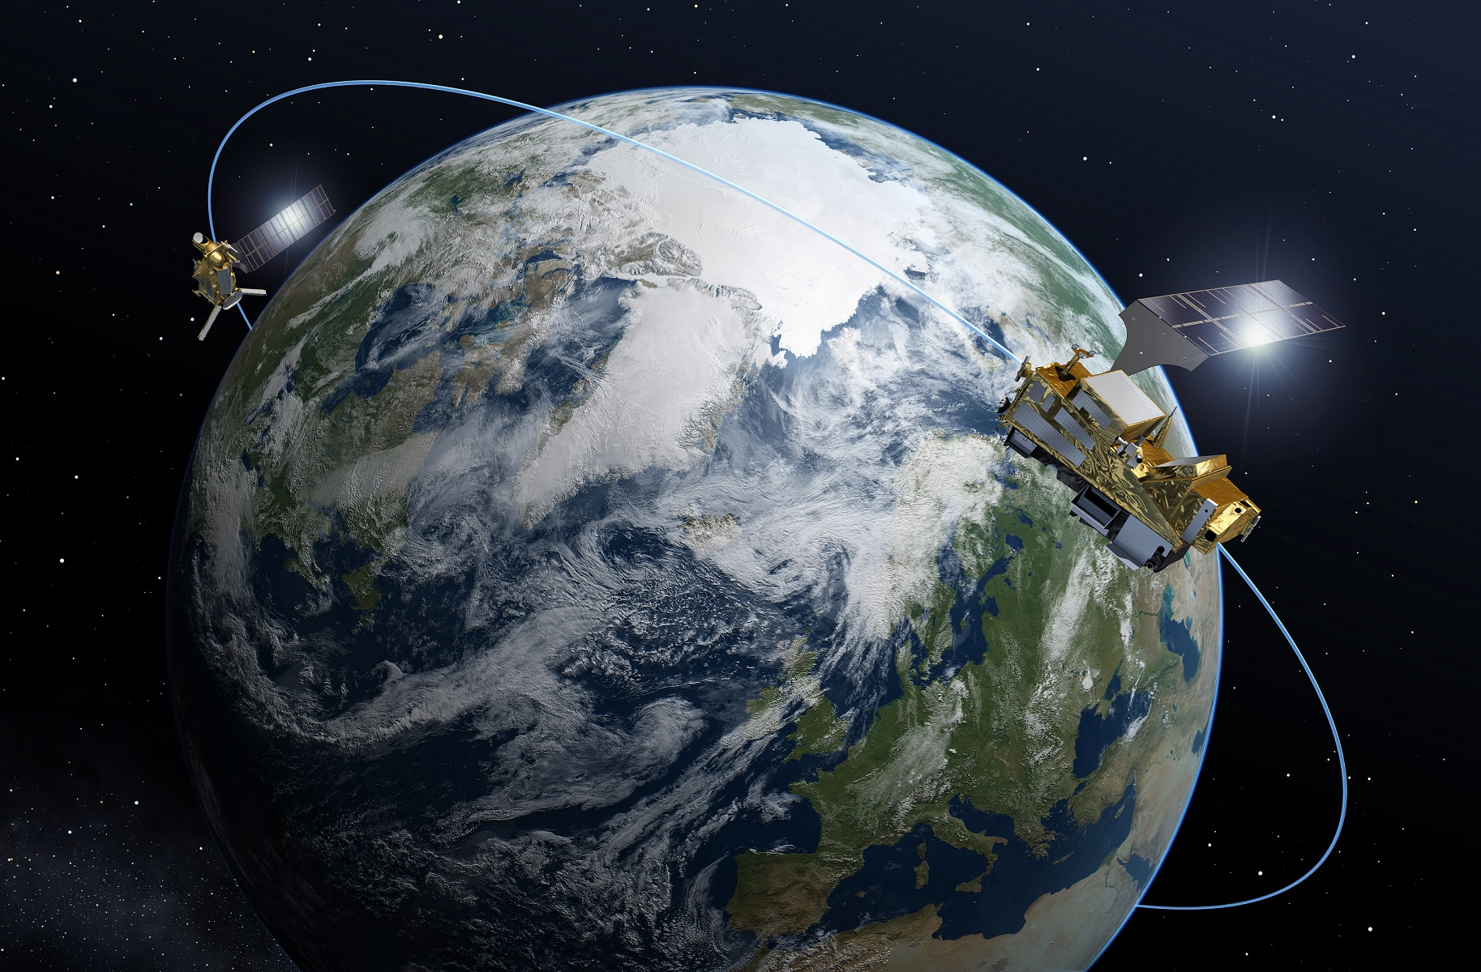





CORRECTION OF NWP OCEAN SURFACE WIND BIASES WITH MACHINE LEARNING AND SCATTEROMETER DATA
2024 International OVWST Meeting May 29 - 31
Evgeniia Makarova, Marcos Portabella, Ad Stoffelen, Ana Trindade, Giuseppe Grieco

Slide 2
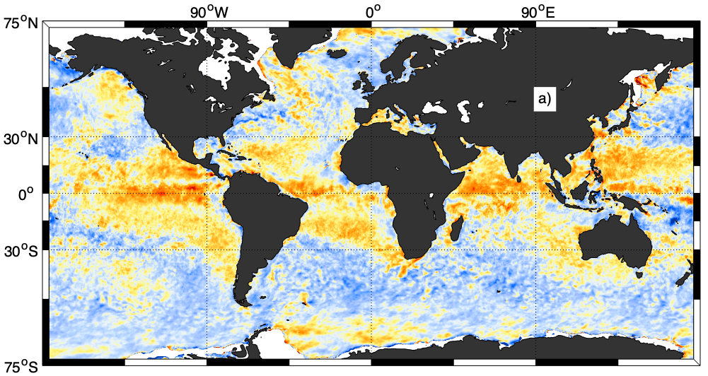
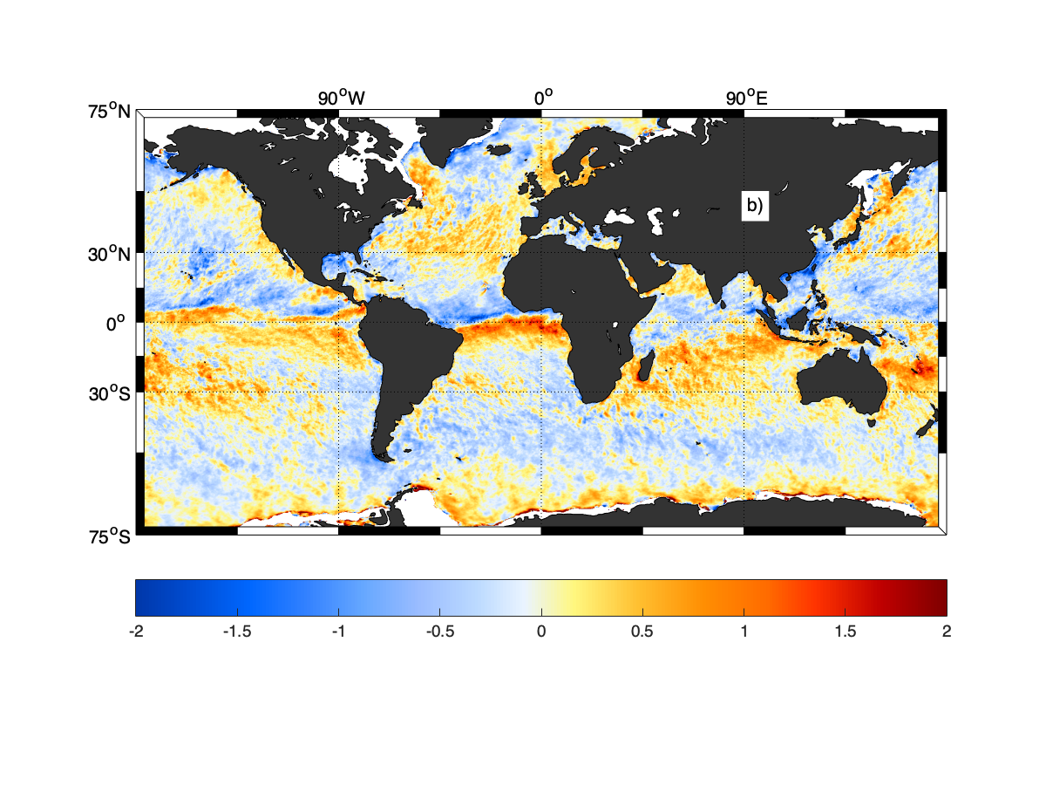
Systematic differences between NWP and scatterometer
COLLOCATIONS
ASCAT-A/B/C – ERA5 u10S
30-d Temporal Window
Zonal component (v10S)

Slide 3
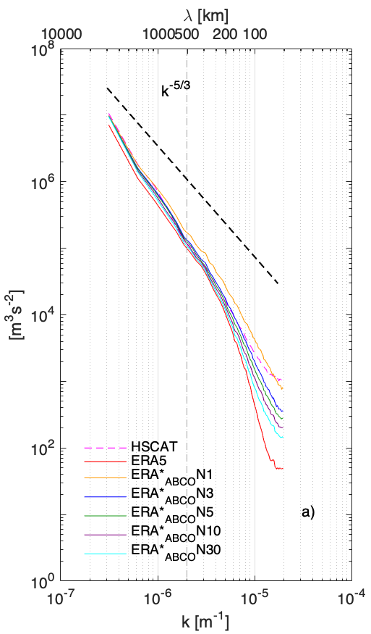
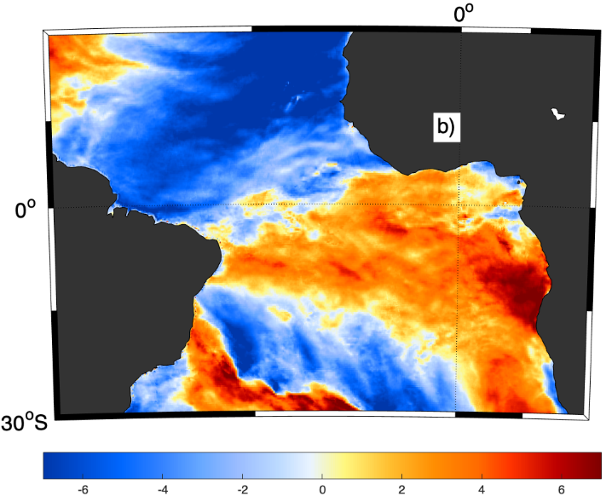
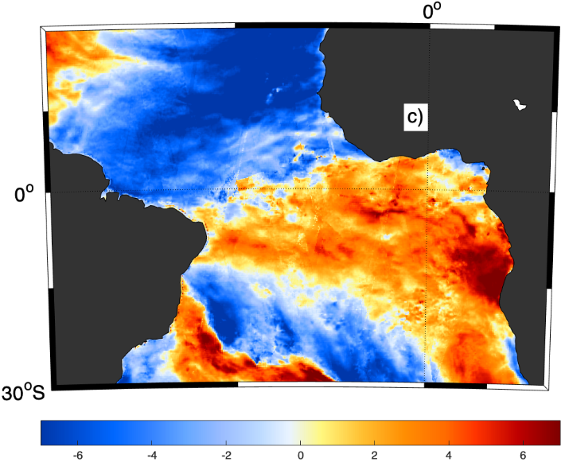
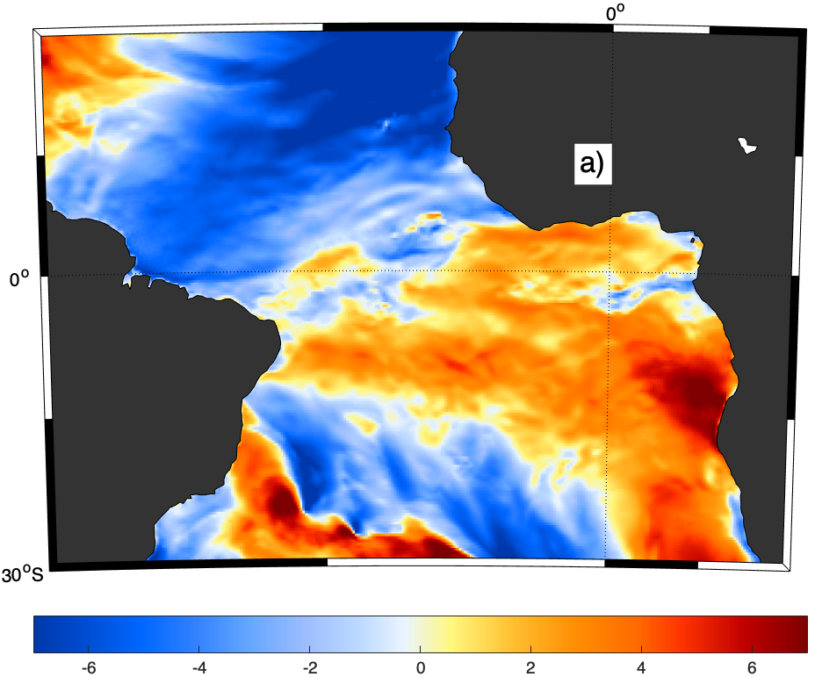
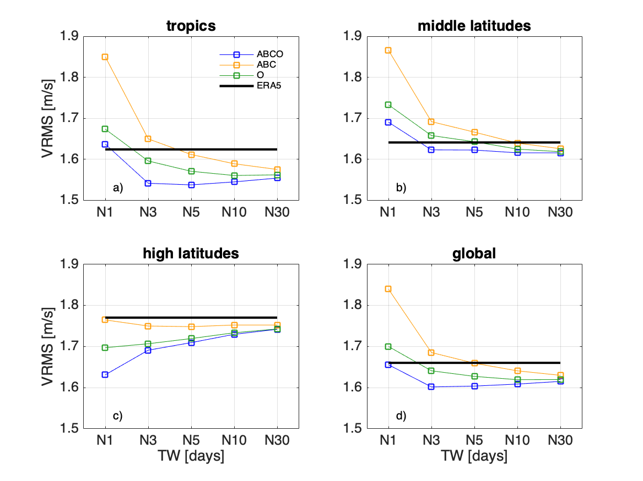
ERA* wind & stress product
ERA* wind & stress product
Development of ERA*:
1. Scatterometer-based corrections:
2. ERA5-corrected stress-equivalent winds (ERA5*):
COLLOCATIONS
ASCAT-A – NWP u10S
30-d Temporal Window
$SC\left(i,j,t_{f}\right)=\frac{1}{M}\sum_{t=1}^{M}{\left(u_{10s}^{{SCAT}_{k}}\left(i,j,t\right) | | −u_{10s}^{ERA5}\left(i,j,t\right)\right)}$
N length of the temporal window (d);
k Scatterometer combinations
M is the number of scatt. and ERA collocations
Applied at every forecast time
Meridional wind component (v)
$u_{10s}^{{ERA5}^{∗}}\left(i,j,t_{f}\right)=u_{10s}^{ERA5}\left(i,j,t_{f}\right)+SC\left(i,j,t_{f}\right)$
ERA* corrects for large-scale circulation errors and adds small-scale true wind variability, due to oceanic features such as wind changes over SST gradients and ocean currents.
ERA* error variance (w.r.t. HSCAT-B) is 9% lower than that of ERA5
m.s⁻¹

Slide 4
ERA* wind & stress product
Scatterometer constellation in 2010-2020 (only C-band & Ku-band with global, continuous coverage)
  2010-2012: ASCAT-A & OSCAT
  2013: ASCAT-A, ASCAT-B & OSCAT
  2014-2016: ASCAT-A, ASCAT-B
  2017-2018: ASCAT-A, ASCAT-B & OSCAT2
  2019-2020: ASCAT-A, ASCAT-B, ASCAT-C & OSCAT2, HSCAT-B
HSCAT-A and RapidSCAT don’t have full coverage and/or continuous coverage, therefore used for verification purposes only
The 2019 period is used as testbed for ERA* optimization over the entire period since it contains all the possible combinations of C-band and Ku-band scatterometer sampling
Validation against buoys is added to independent scatterometer verification

Slide 5
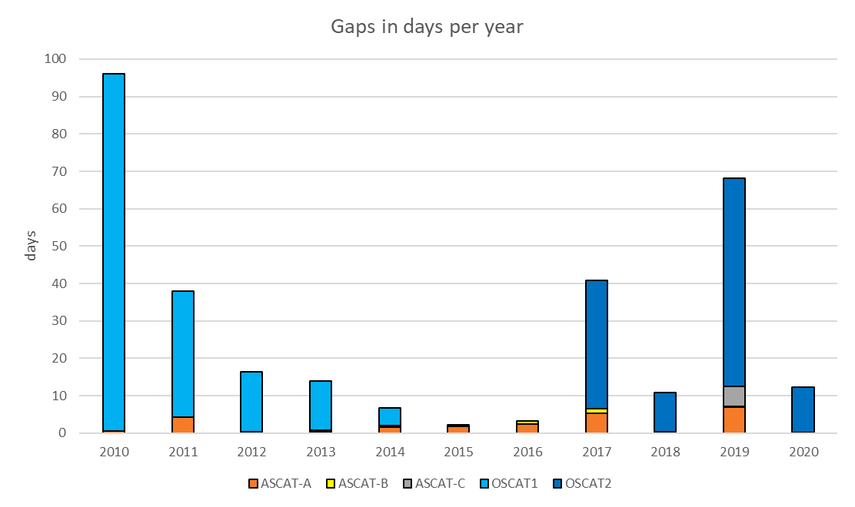

ERA* wind & stress product
Scatterometer constellation
AO AO AO ABO AB AB AB ABO ABO ABCO ABCO
Large data gaps in Ku-band systems!

Slide 6
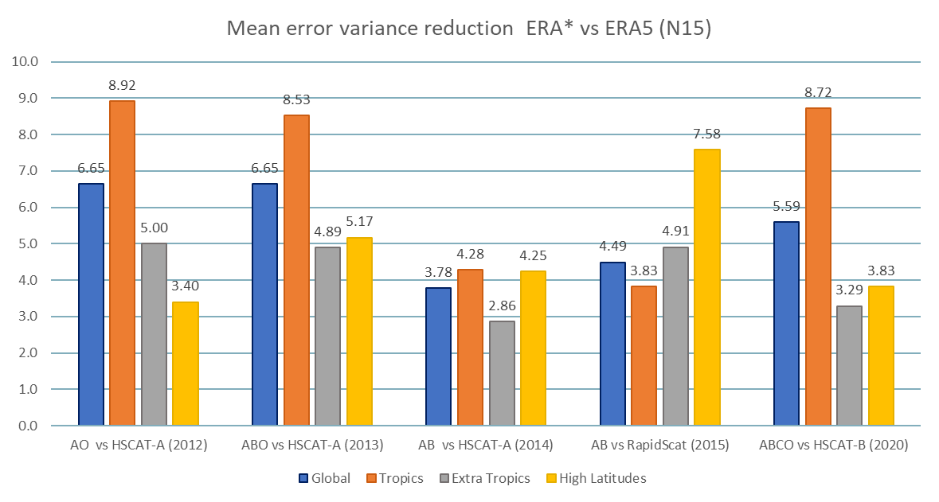
Previous approach: ERA*
ERA* dataset (2010 – 2020)
Previous attempt to correct persistent ERA5 U10S biases
Based on mean scatterometer – NWP differences accumulated over a certain time window
Default configuration:
15-day time window
Best performance in the tropics (reduction up to 8.9% error variance)
Globally 3.8 – 6.7% error variance reduction, depending on the available constellation
Portabella et al., 2022

Slide 7
Previous approach: ERA*
Limitations:
Only corrects local biases persistent over several days
Very sensitive to scatterometer sampling, especially over shorter time windows
Doesn’t directly show NWP error dependence on both atmospheric and ocean state conditions
Has limitations in operational use: computationally expensive and need to shift temporal window (which in turn degrades performance)

Slide 8
Objectives
Create a preliminary ML model to predict NWP stress-equivalent wind (U10S) biases
Fit a regression that finds functional relationship between several NWP parameters and U10S biases
Location (lon, lat)
u-component bias
Atmospheric (T, msl, q)
ML MODEL
Oceanic
(SST gradients, currents)
v-component bias
Wind derivatives
Check the viability of the approach and compare performance of models based on different ML algorithms and libraries
Train and validate models over a relatively small subset of data

Slide 9
Datasets: Inputs
ERA5 reanalysis:
U10S components, wind speed and direction
Mean sea level pressure
Air temperature
Specific humidity
SST, SST gradients
$U10S=U10N\sqrt{\frac{ρ_{air}}{ρ_{air}>}}$
$ρ_{air}>\text{1.225 }{\text{kg}}/{m^{3}}$
Currents: Global Total Surface Current from CMEMS (MULTIOBS_GLO_PHY_MYNRT_015_003)
Daily mean surface velocities components (uo, vo)
Derivatives: ERA5 wind curl, divergence

Slide 10
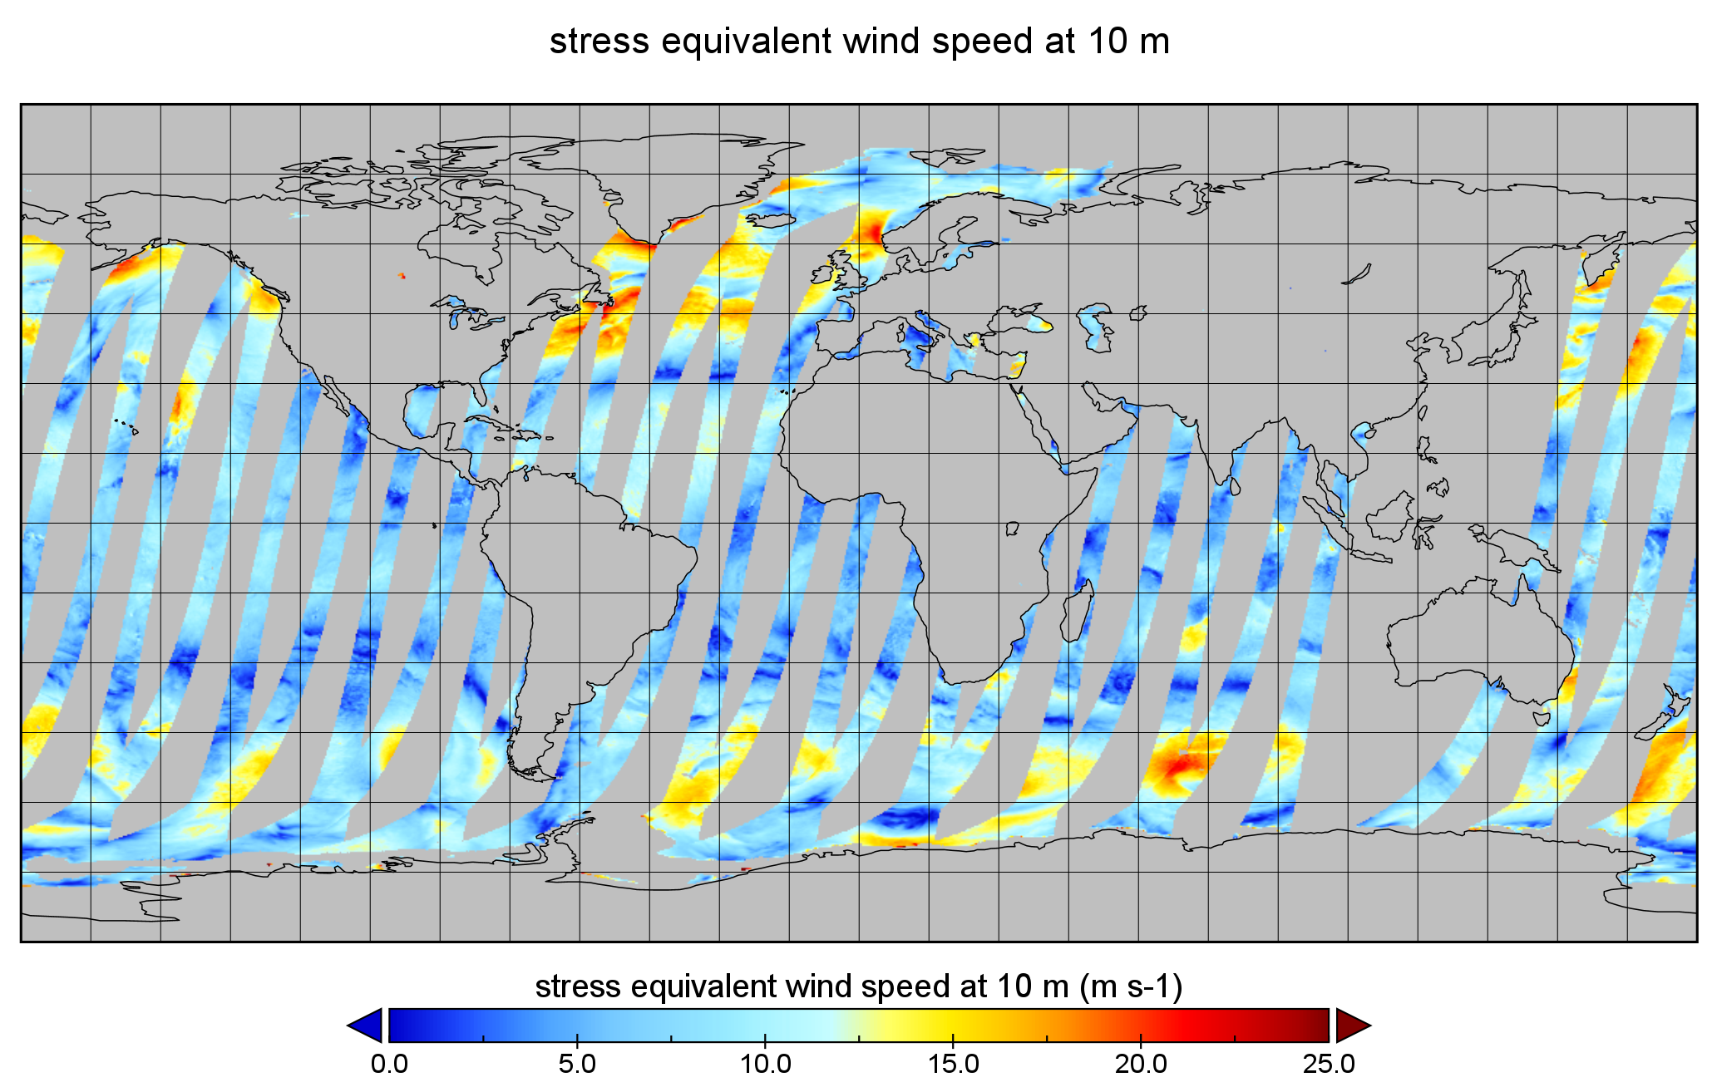
Datasets: Target
Model target: Individual differences between ASCAT-A and ERA5 U10S
(components, at each grid point)
$target=\left\{\begin{aligned}u_{ascat}−u_{ERA5} \\ v_{ascat}−v_{ERA5}\end{aligned}\right.$
OSI SAF ASCAT-A 12.5 km U10S data
Periods used:
02/01/2020 – 01/05/2020
(split into train/validation and test periods)
01/02/2019 – 30/04/2019
(additional test period)
ASCAT-A descending swaths for February 8th, 2020

Slide 11
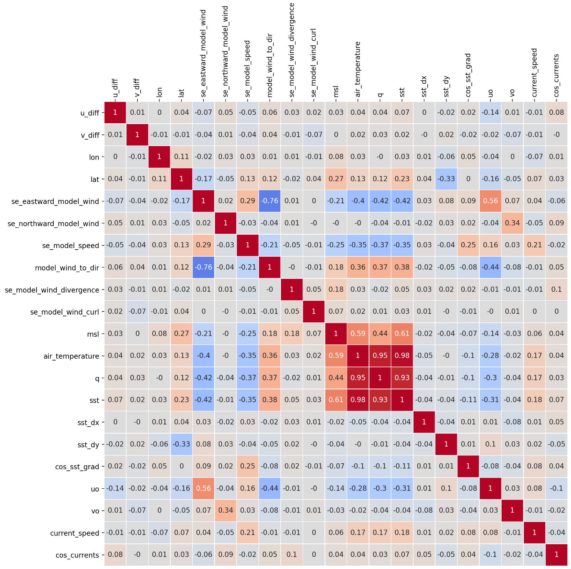
Datasets: Preliminary analysis
High correlations:
Air temperature
Relative humidity
Sea surface temperature (SST)
Mean sea level pressure (msl)
Correlated with latitude:
SST
SST meridional gradient
MSL
Zonal wind component
Zonal oceanic velocity
Temperature
Humidity
Currents correlated with stress-equivalent wind

Slide 12
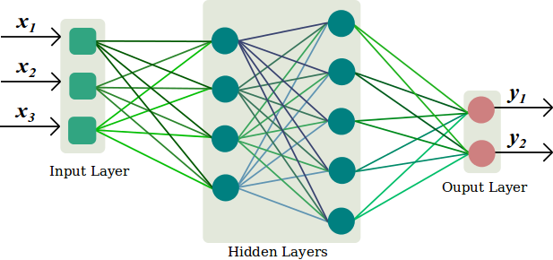
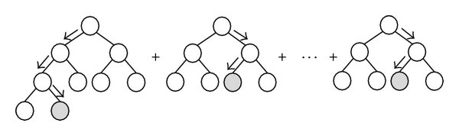


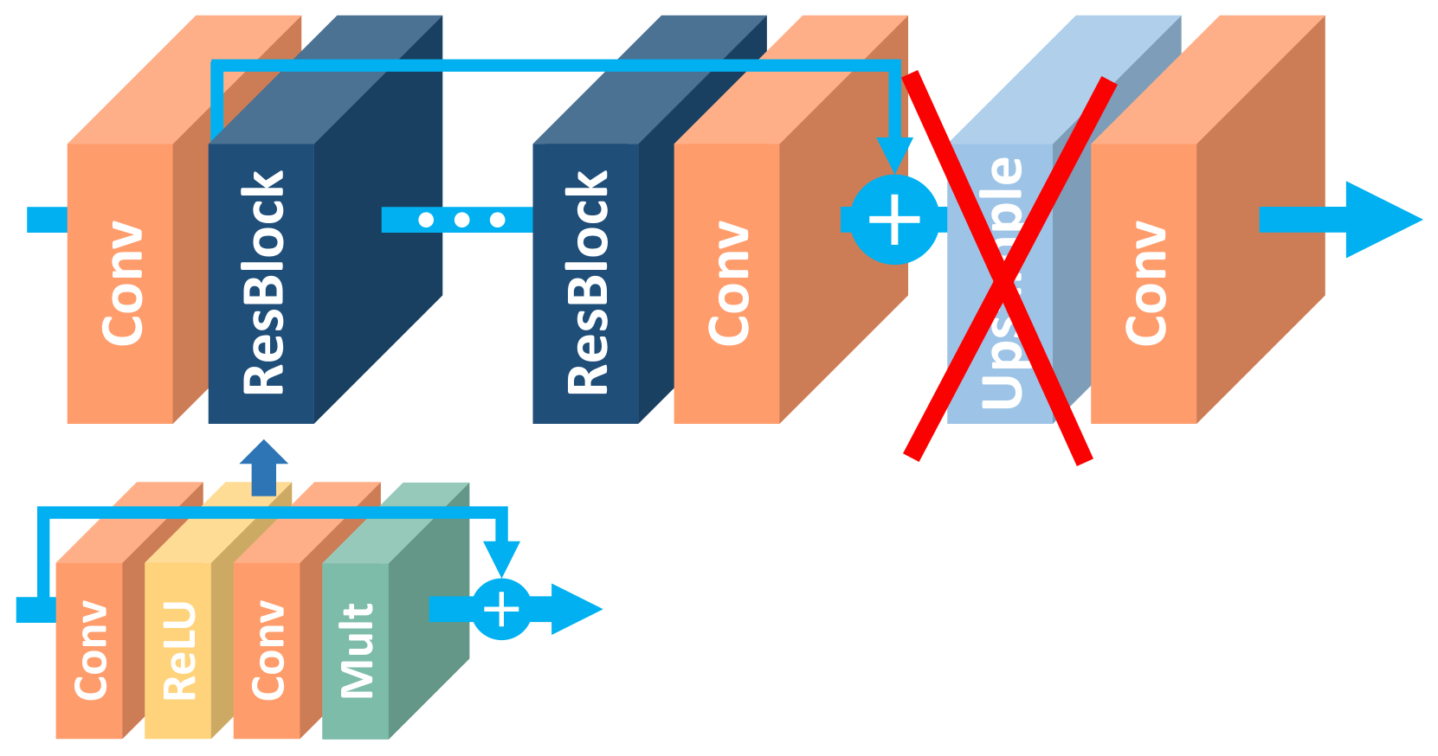
ML Models
Gradient-boosted decision trees (GBDT)
Fully-connected feed forward neural networks
(currently)
2nd stage (future development):
Convolutional neural networks for super-resolution adapted to regression/generative networks
Modified EDSR network (arXiv:1707.02921)

Slide 13
Data preparation
Collocation in space and time of 3 datasets
Calculation of the derivatives
Normalization for NN models
Dataset is split into train, validation and test subsets
Train
Verification
Test
02/01/2020 - 06/03/2020
07/03/2020 - 09/03/2020
10/03/2020 - 01/05/2020
Random down-sampling of the training dataset to 10% to reduce training time

Slide 14
Methodology: Validation
Metrics:
Vector Root Mean Square Difference
$VRMS=\sqrt{\frac{1}{N}\sum_{i}{{\left(u_{i}^{scat}−u_{i}^{model}\right)}^{2}+{\left(v_{i}^{scat}−v_{i}^{model}\right)}^{2}}}$
$relativeerrorvariancereduction\left(\text{\%}\right)=\frac{VRMS_{ERA5}^{2}−VRMS_{ML}^{2}}{VRMS_{ERA5}^{2}}∗100$
(Train dataset: 02/01 - 09/03/2020)
Test dataset: 10/03 - 01/05/2020
vs ASCAT-A:
Complete ASCAT-A swaths, no reduction
Same ground truth instrument as in training
Validation at same local times
vs HSCAT-B:
Predictions are generated for complete ERA5 forecasts for this period
Corrected forecasts are collocated with HSCAT-B
Local times 3.5 hours apart from training times
Additional validation metrics for 01/02/2019 – 30/04/2019 vs HSCAT-B & ASCAT-A
Covers train* and test months but the period is independent
* January not included as HSCAT-B data is only available from 16/01/2019

Slide 15
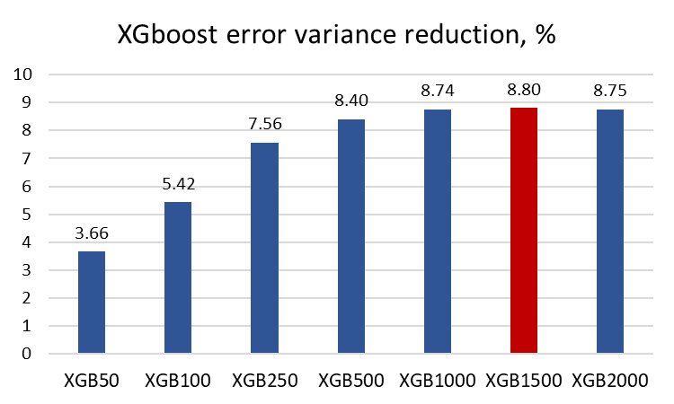
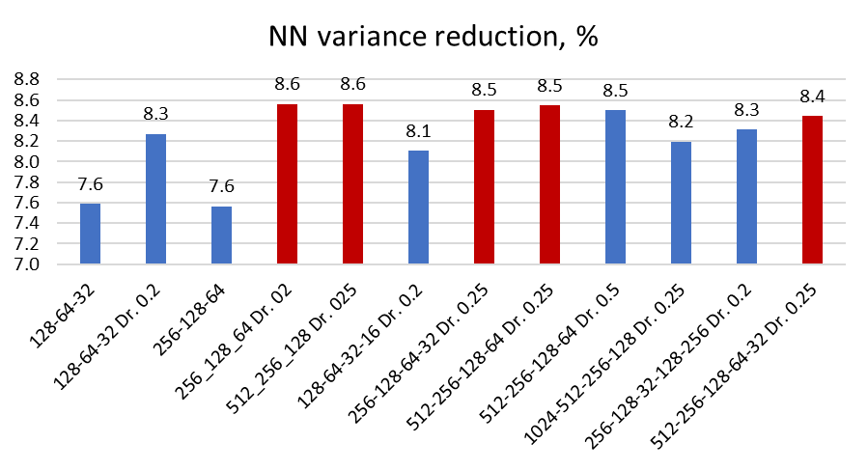
Performance on test subset (vs ASCAT-A) globally
10/03/2020 – 01/05/2020
XGBoost Regressor with different number of estimators
Feed-forward neural networks
*Models marked in red are evaluated against HSCAT-B and in 2019 test period against ASCAT-A/HSCAT-B

Slide 16
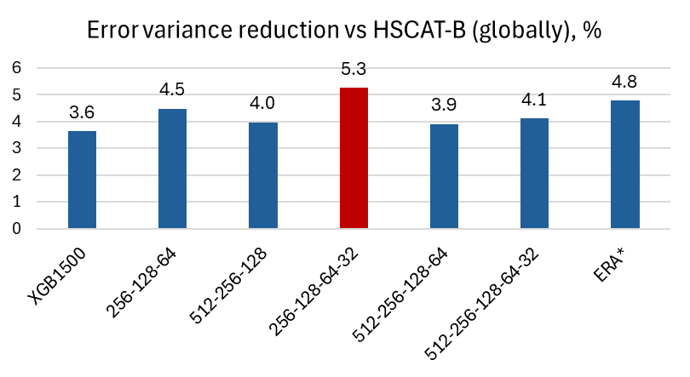
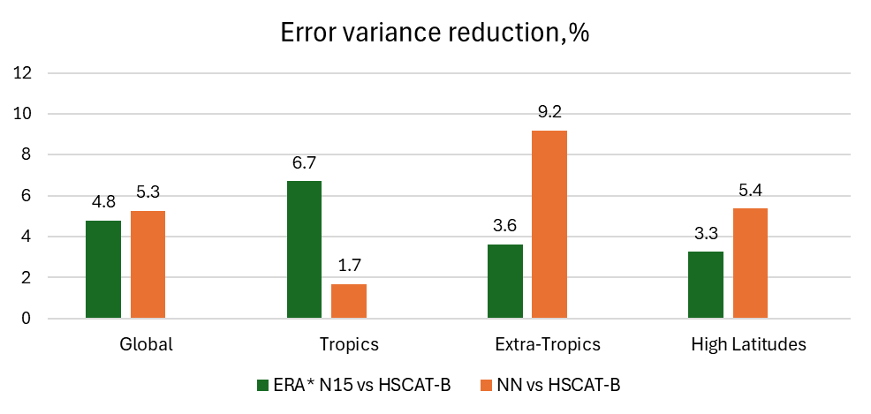
2020 test period
10/03/2020 - 01/05/2020
Regional metrics for NN 256-128-64-32
ERA5 VRMS
ERA5 | ASCAT-A | HSCAT-B
Global | 2.053 | 1.631
Tropics | 2.023 | 1.545
Extra-Tropics | 2.027 | 1.604
High Lats | 2.177 | 1.888

Slide 17
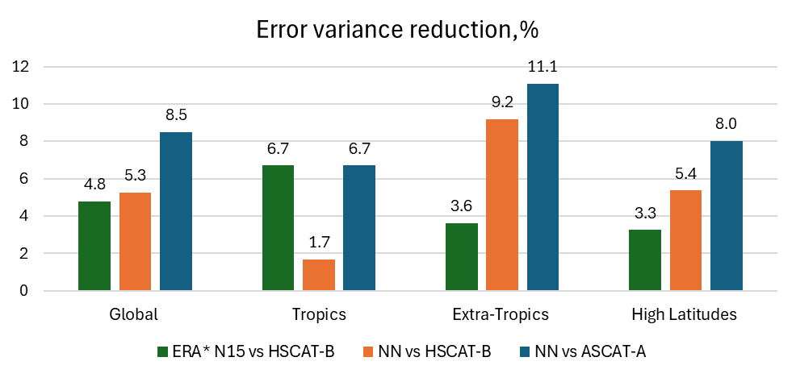
2020 test period against HSCAT-B
10/03/2020 - 01/05/2020
Regional metrics for NN 256-128-64-32
ERA5 VRMS
ERA5 | ASCAT-A | HSCAT-B
Global | 2.053 | 1.631
Tropics | 2.023 | 1.545
Extra-Tropics | 2.027 | 1.604
High Lats | 2.177 | 1.888

Slide 18
2020 test period against HSCAT-B
10/03/2020 - 01/05/2020
Regional metrics for NN 256-128-64-32
ERA5 VRMS
ERA5 | ASCAT-A | HSCAT-B
Global | 2.053 | 1.631
Tropics | 2.023 | 1.545
Extra-Tropics | 2.027 | 1.604
High Lats | 2.177 | 1.888

Slide 19
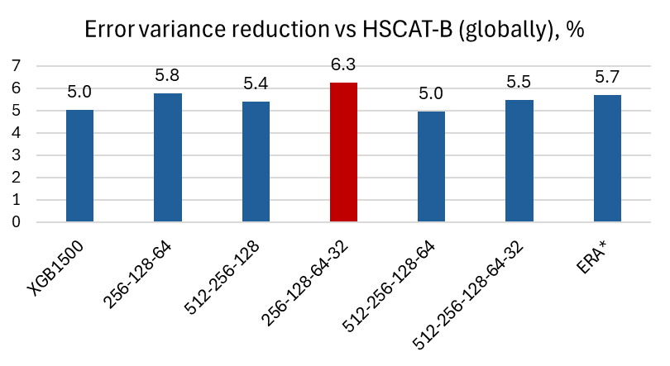
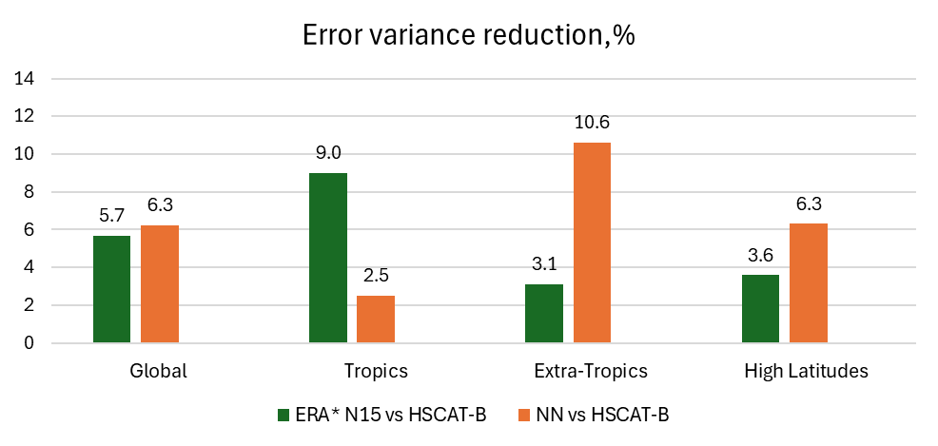
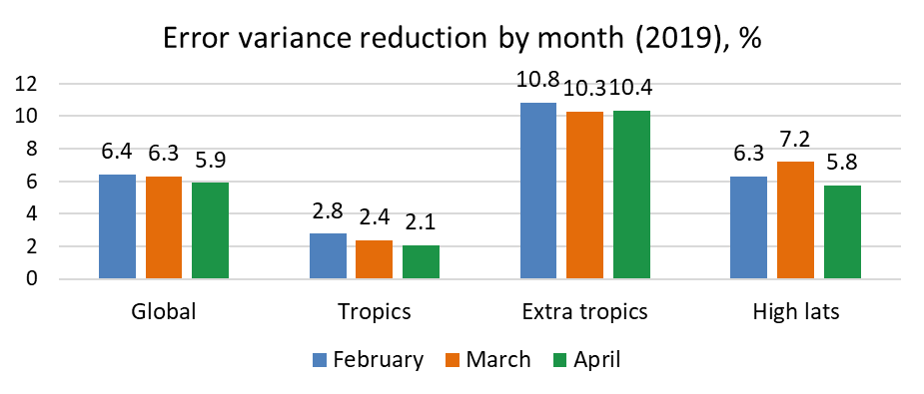
2019 test period
01/02 – 30/04 2019
ERA5 VRMS
Better metrics for months seen in training but applied to another year -> seasonal models?
ERA5 | ASCAT-A | HSCAT-B
Global | 2.082 | 1.647
Tropics | 2.056 | 1.602
Extra-Tropics | 2.047 | 1.622
High Lats | 2.2 | 1.794

Slide 20
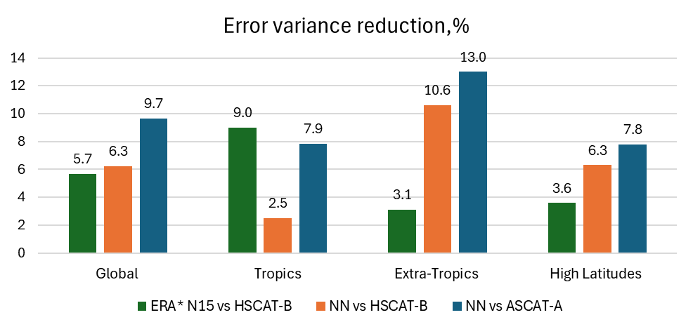
2019 test period
01/02 – 30/04 2019
ERA5 VRMS
Better metrics for months seen in training but applied to another year -> seasonal models?
ERA5 | ASCAT-A | HSCAT-B
Global | 2.082 | 1.647
Tropics | 2.056 | 1.602
Extra-Tropics | 2.047 | 1.622
High Lats | 2.2 | 1.794

Slide 21
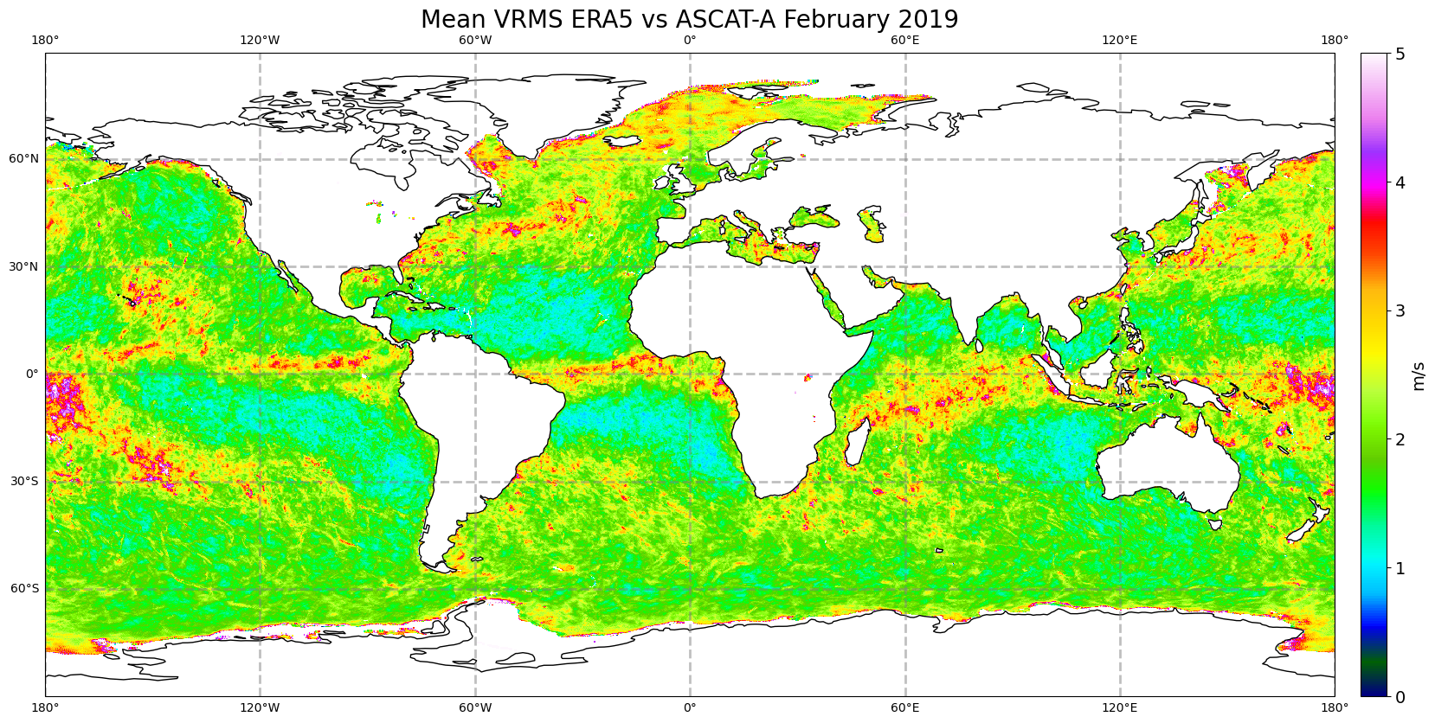
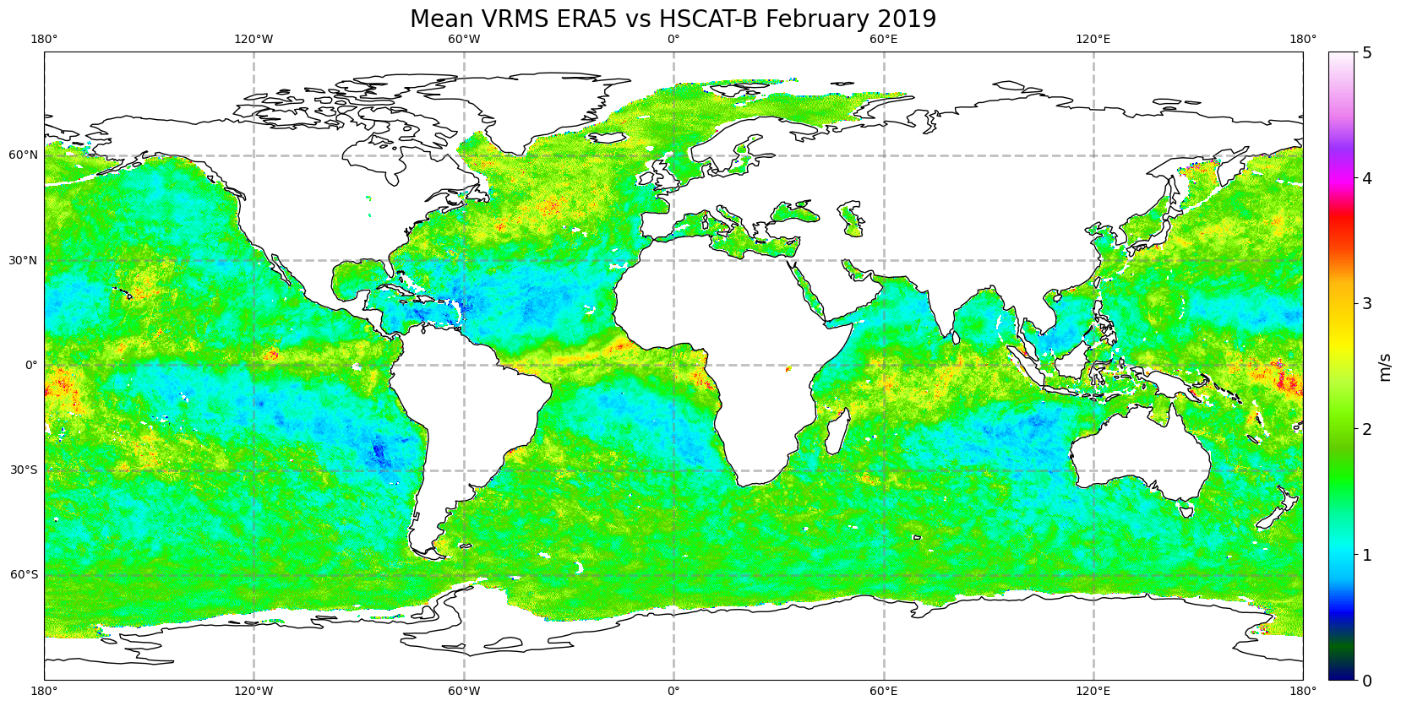
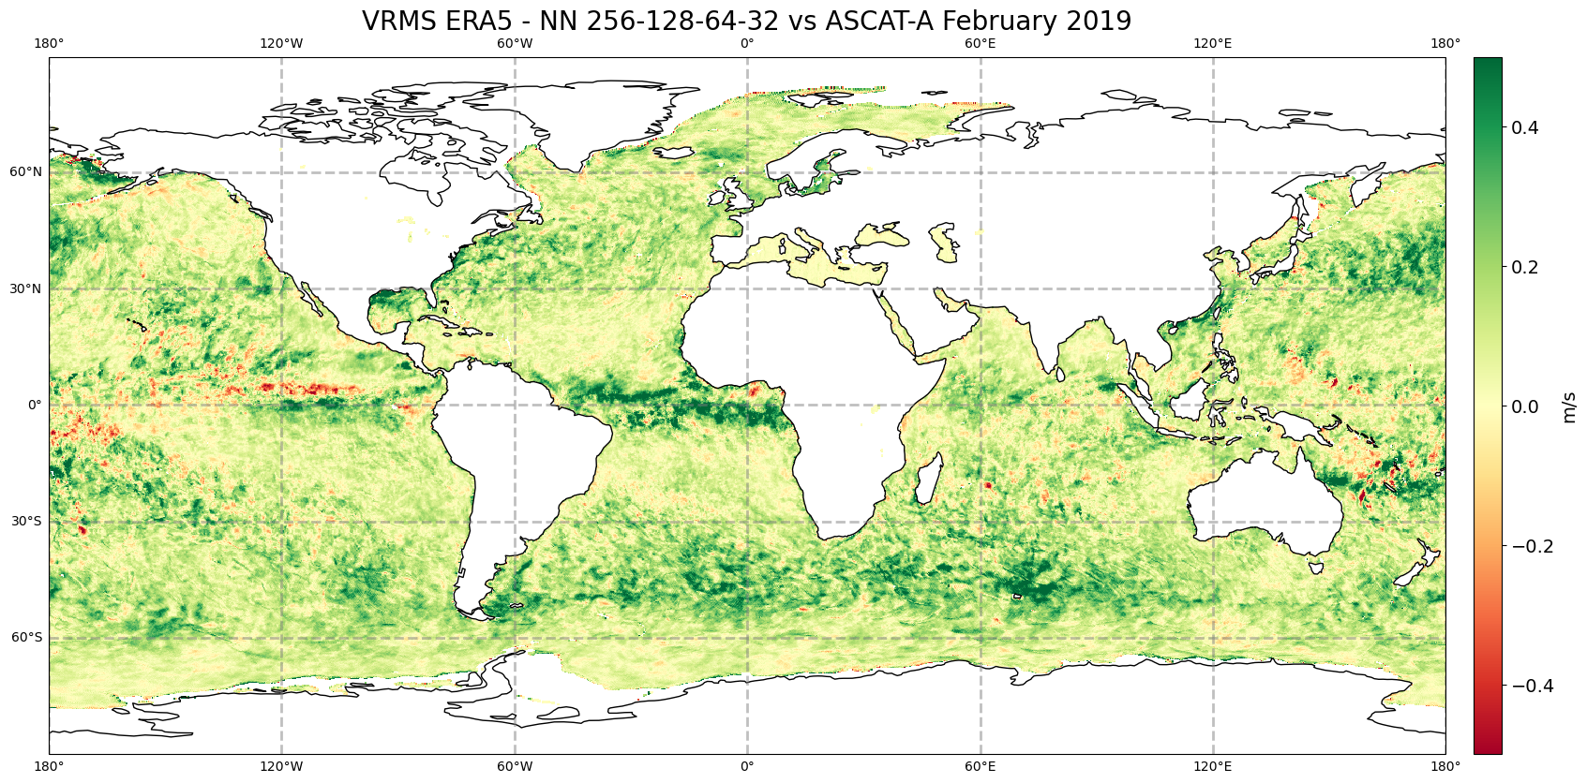
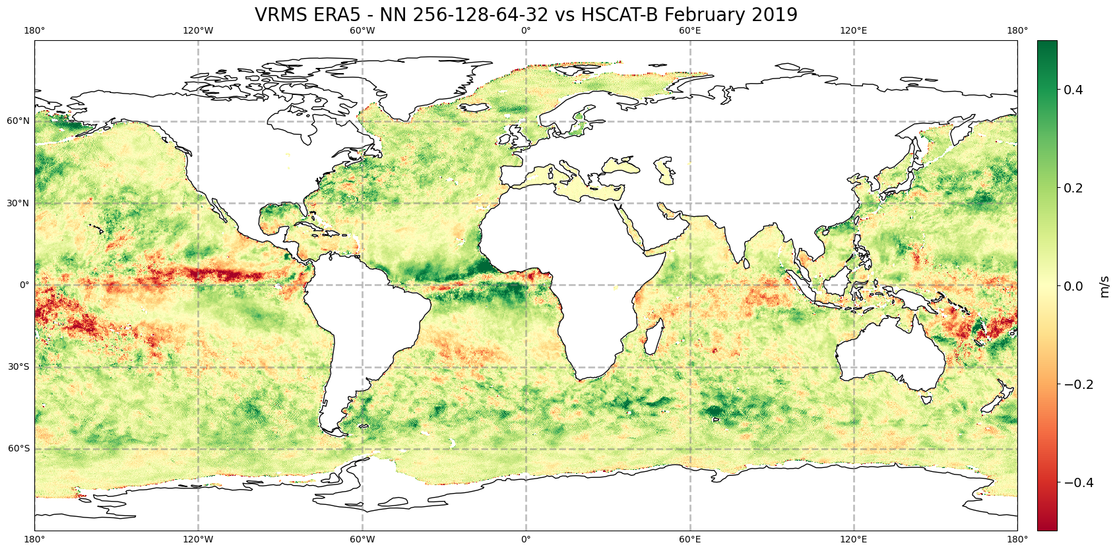
Spatial distribution of VRMS vs ASCAT-A and HSCAT-B
Notes:
Comparison between HSCAT-B and ASCAT-A errors (all flags applied). The beneficial impact of NN if compared vs ASCAT is higher than compared vs HSCAT, especially in the tropics.

Slide 22
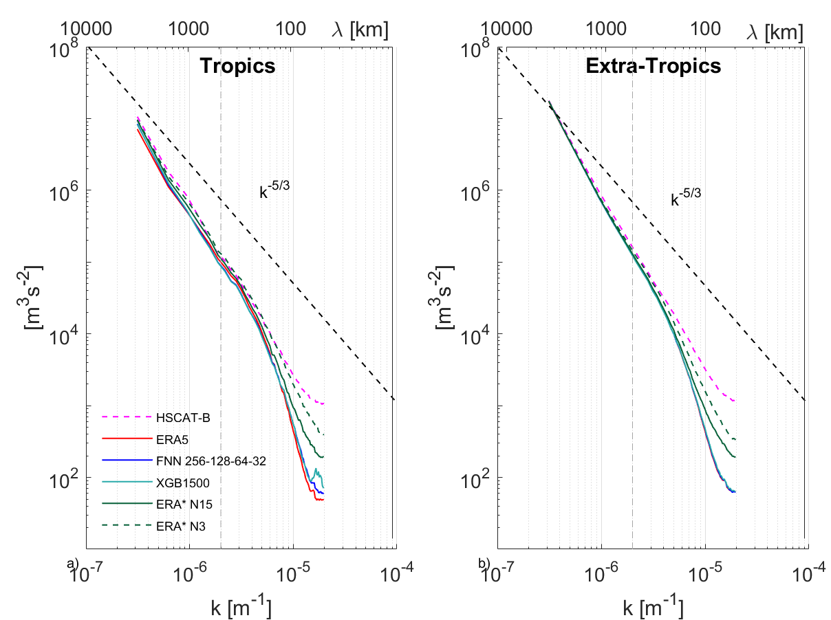
Spectral density
v-component
February 2019
Collocations vs HSCAT-B
Lower variance at 500-km scale in tropics compared to ERA5
Corrections are smoothing the abrupt changes in the forecast fields
Possibly due to the RMSE target loss function

Slide 23
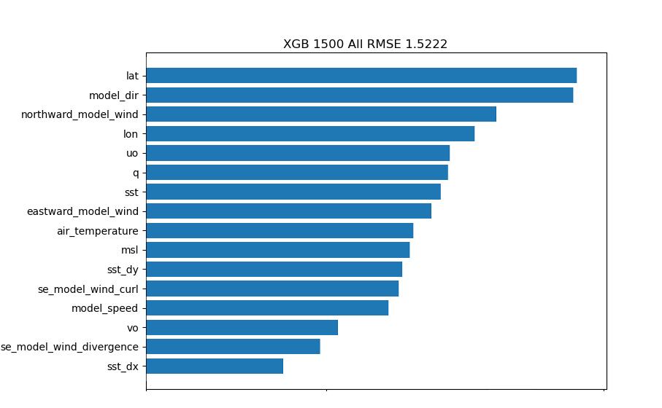
XGBoost or neural networks?
XGBoost:
Almost 10 times faster during training
  Can be used to test different input feature combinations
Shows slightly better results against ASCAT-A
Allows to see feature importance
Input feature importance
Neural networks:
Better performance against HSCAT-B
  Better generalization?
Only the basic fully-connected architecture was evaluated, more complex yet to be tested
Feature elimination showed that all of the input variables had some added value, even the highly correlated ones.

Slide 24
Conclusions
Preliminary ML models show that it is possible to predict ERA5 NWP biases using other NWP variables as input
With FNN models 6.3% error variance reduction achieved globally and 10.6% in the extra-tropics (vs HSCAT-B, February – April 2019).
Error reduction significantly larger, when verified against ASCAT-A (9.7% globally, 13% in the tropics). Does LTAN play a role?
Models trained on a larger dataset can be used for operational purposes
Model corrections for the training period can be used to enhance reanalysis products (as well as applied to the past periods with no scatterometer data assimilation)

Slide 25
Future Work
Create seasonal models
Generate and validate the corrections for several years, incl. validation against inclined orbit HY-2C & -2D to assess daily cycle effects.
Interpretation of the resulting model to assess in which conditions ERA5 is prone to errors
Try more complex algorithms including convolutional neural networks (CNNs) and generative AI (generative adversarial networks, diffusion models)
Acknowledgement: This work has been funded by the EUMETSAT OSI SAF through the OSI_VSA22_01 and OSI_VSA24_01 studies

Slide 26
Additional slides

Slide 27
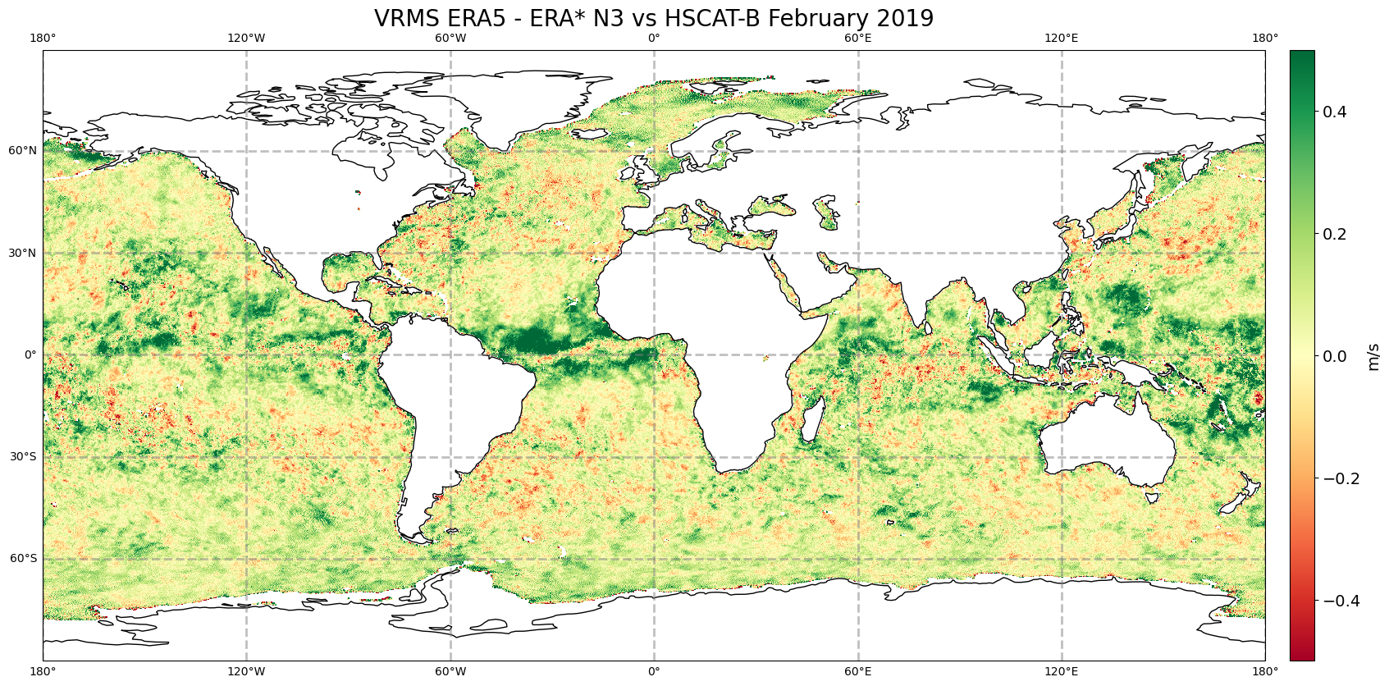
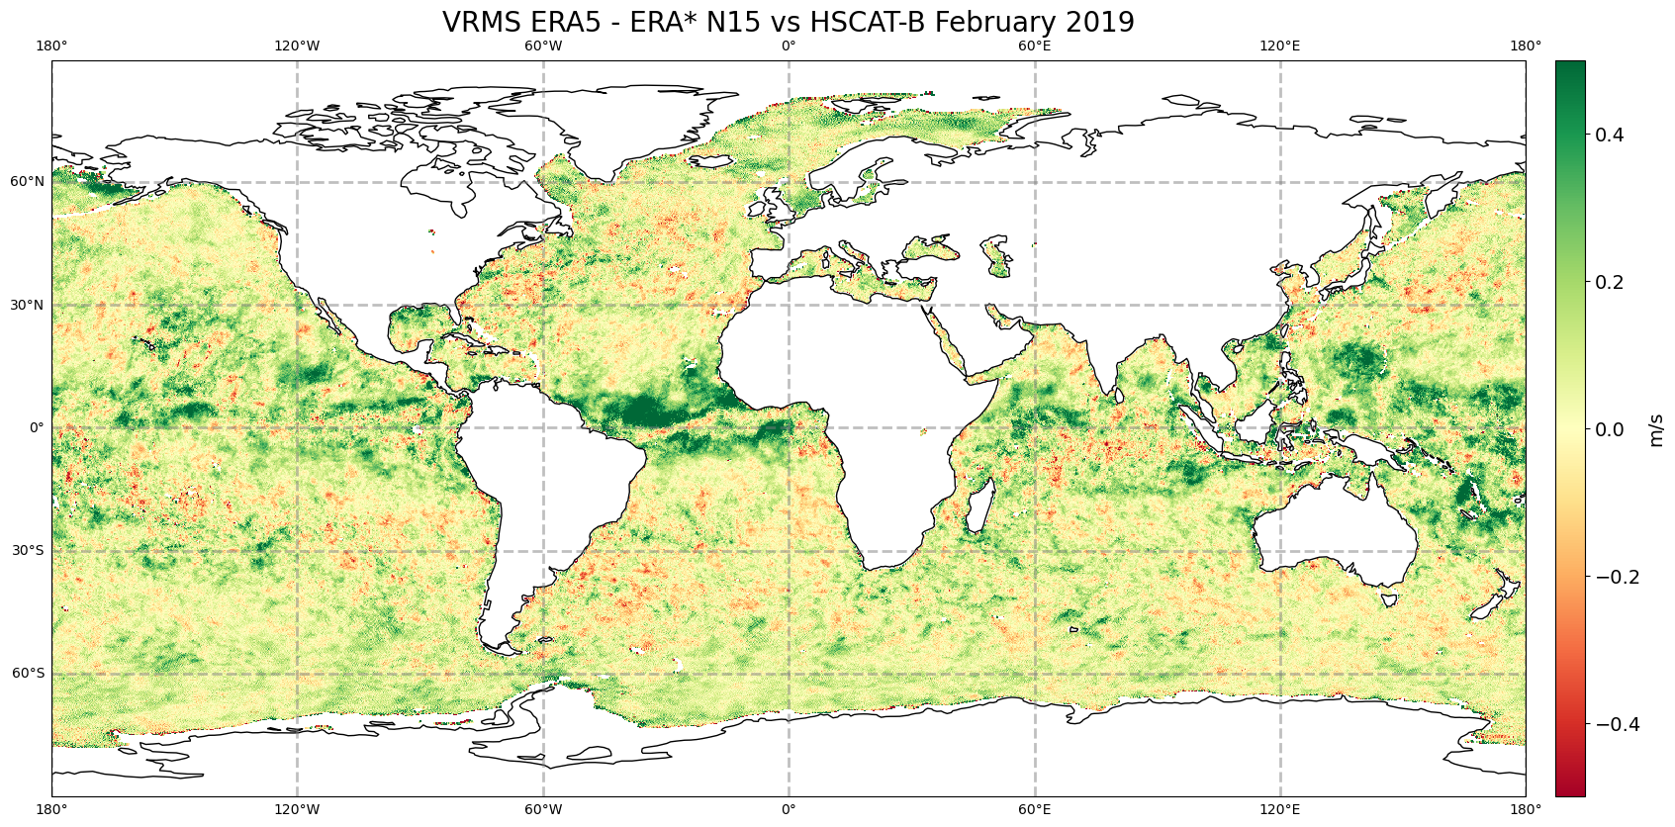
Spatial distribution of VRMS vs HSCAT-B (2019)
knmi+var+land qc + prodmon
Notes:
XGBoost has very similar distribution as NN, not shown for not being repetitive. The validation is done against HSCAT-B with QC applied. The metrics are shown for 2019, year not used in training but covering the month of February, seen by the model in 2020. This is how the operational model will work.

Slide 28
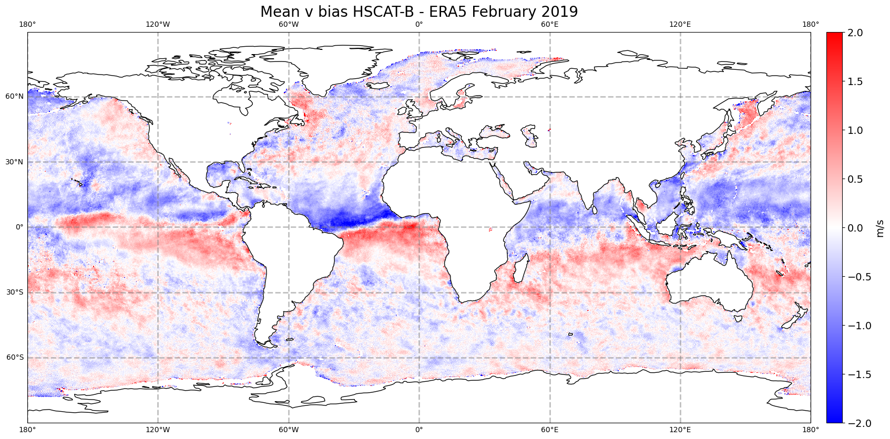
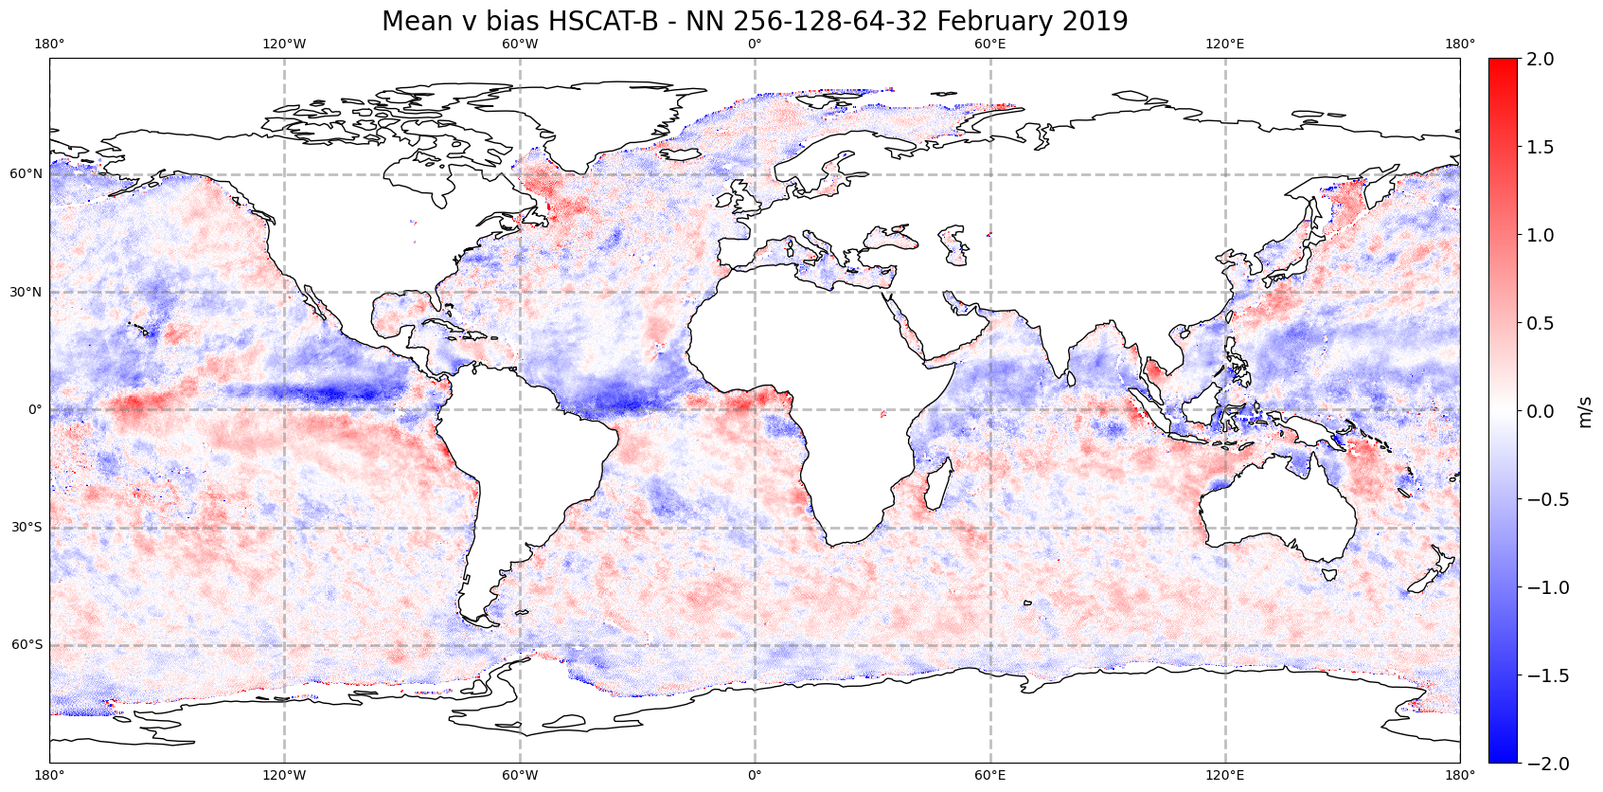
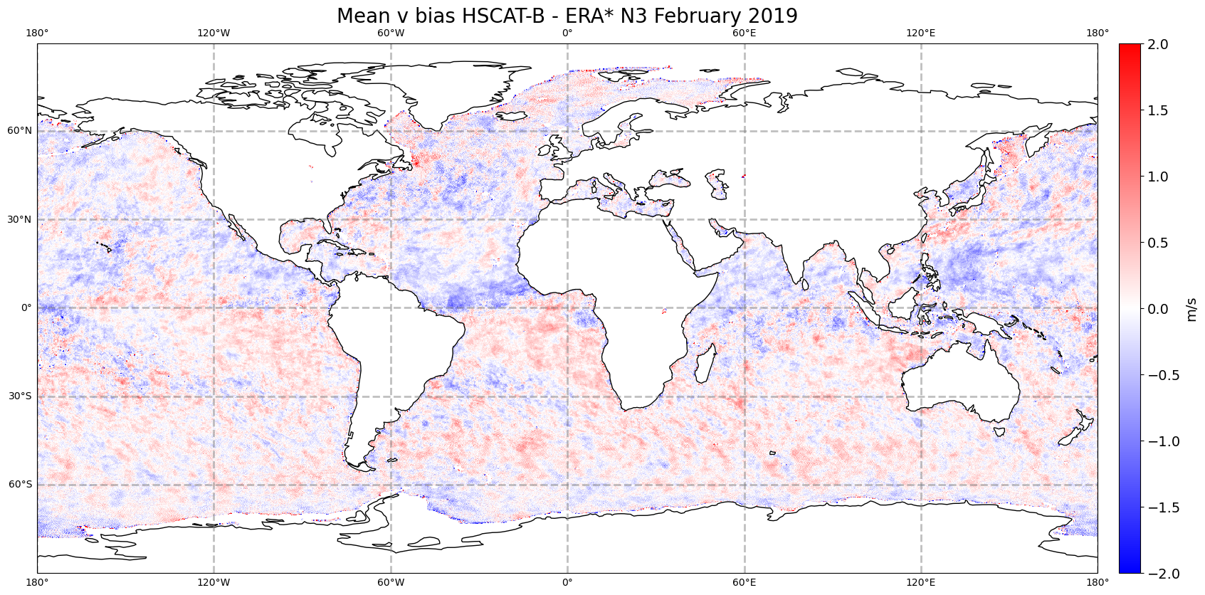

v bias vs HSCAT-B

Slide 29
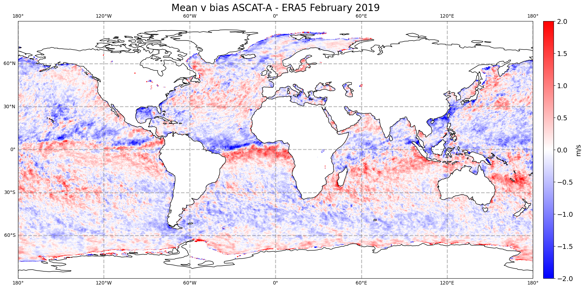
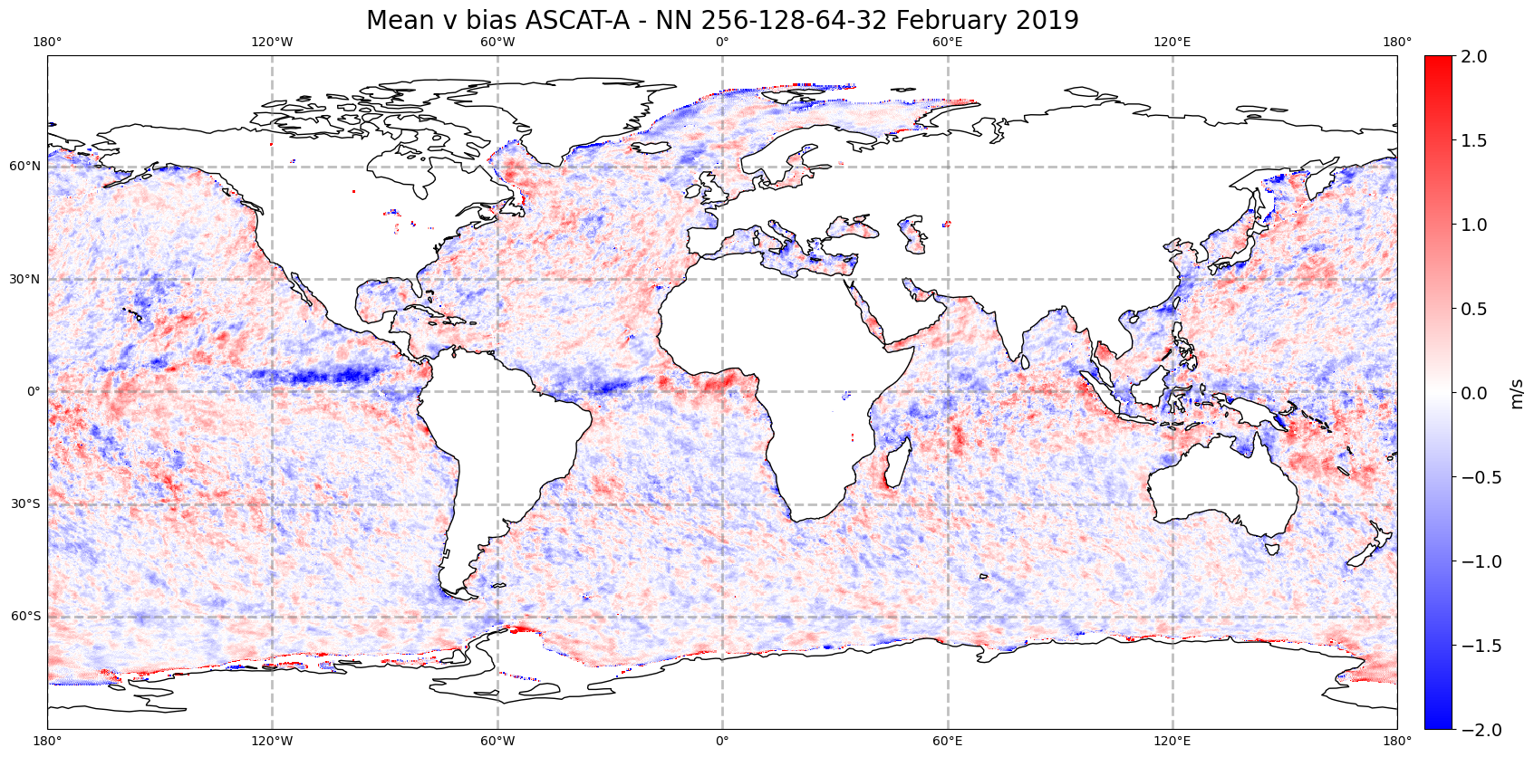
v bias vs ASCAT-A and HSCAT-B

Slide 30
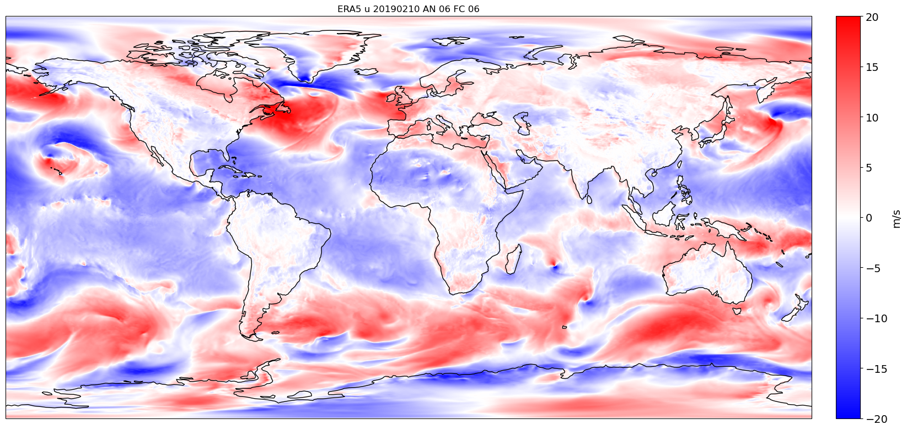
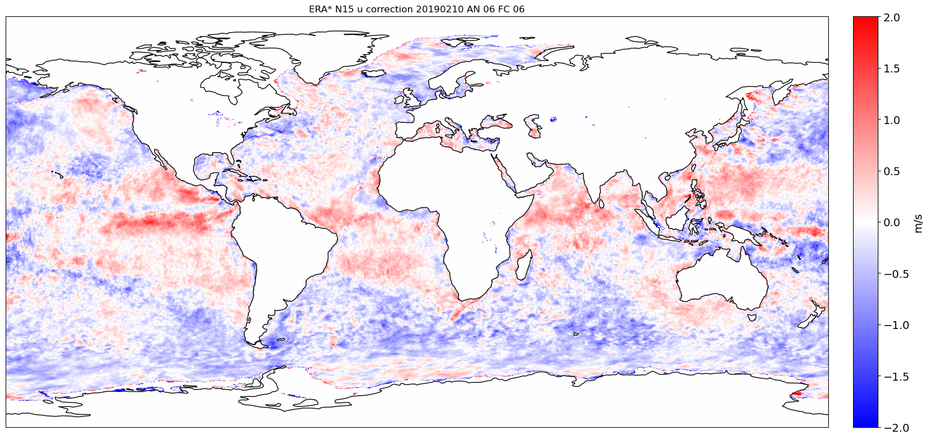
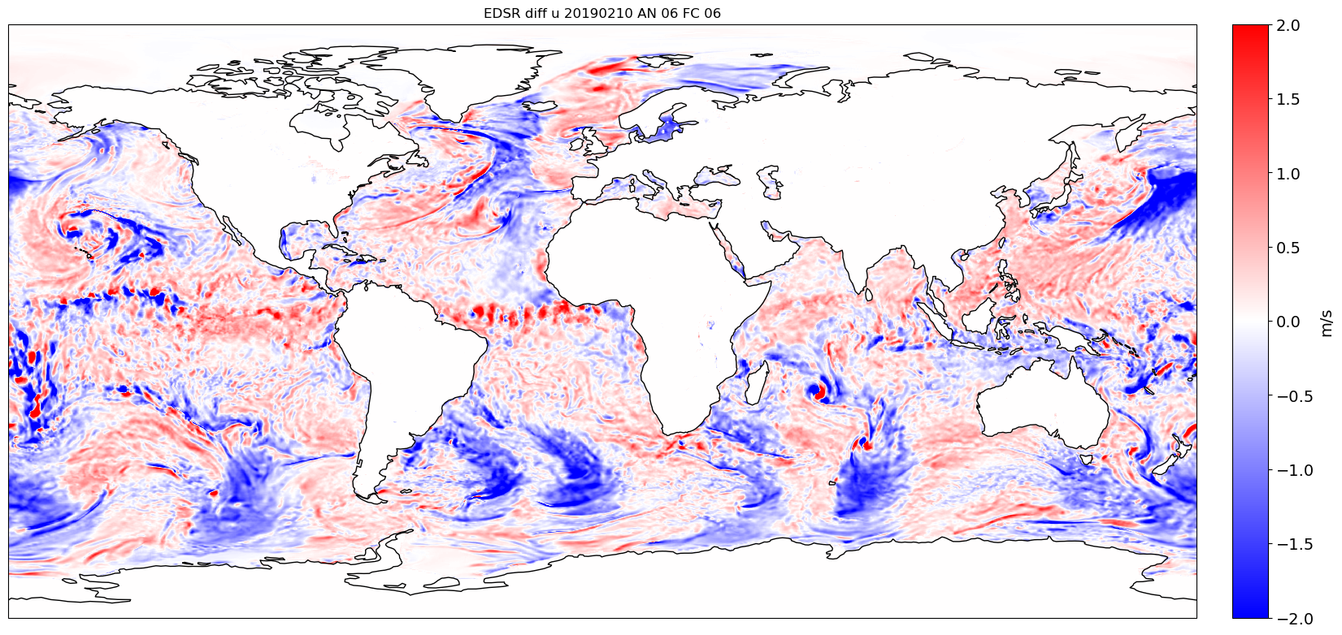
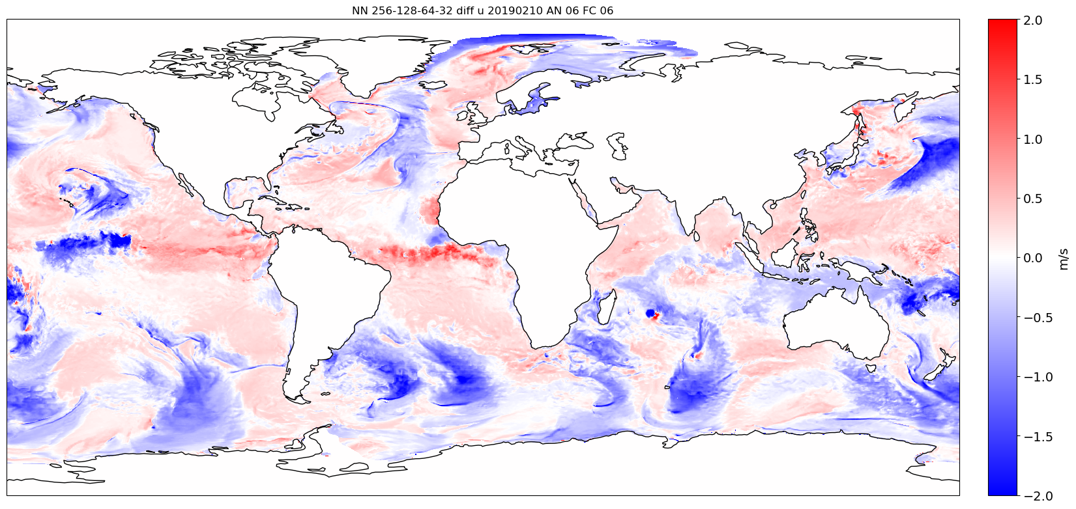
Corrections for u-component
ERA5 u10s
ERA* N15 u10s corrections
EDSR-based model
FNN point-per-point

Slide 31
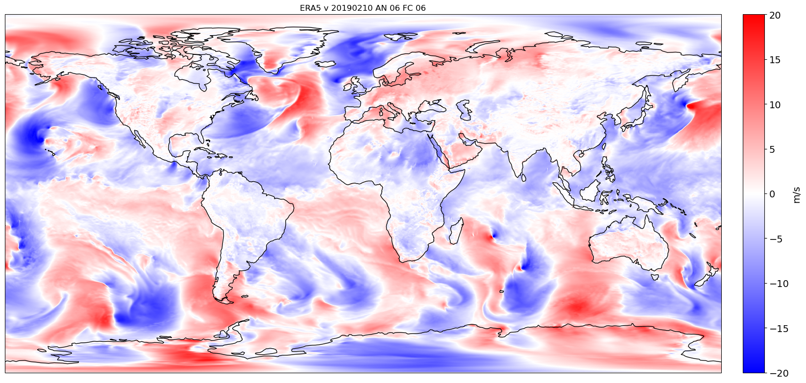
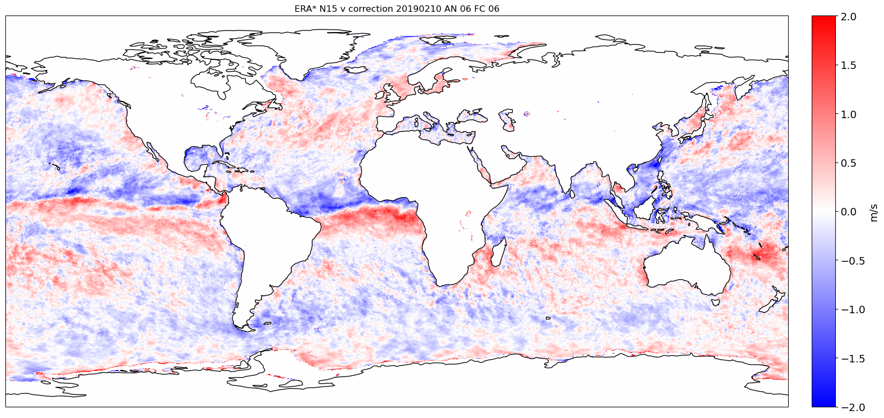
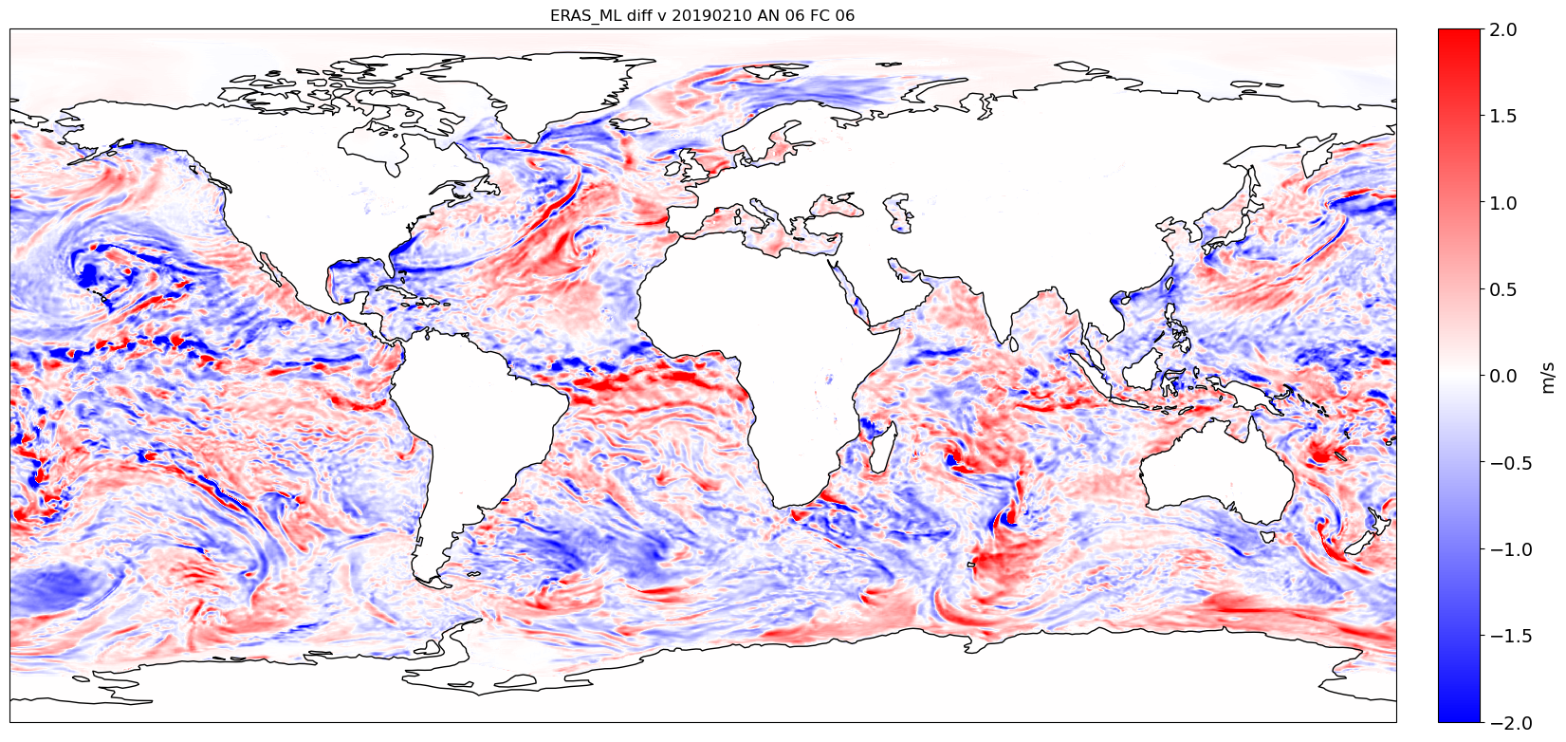
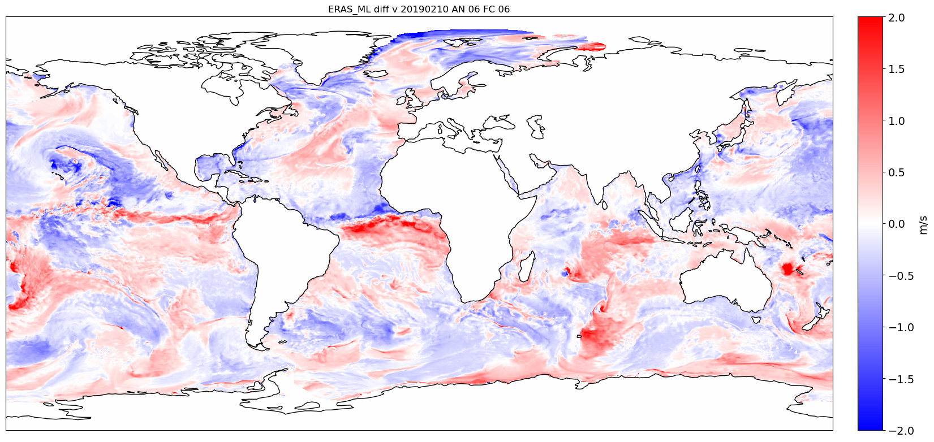
Corrections for v-component
ERA5 v10s
ERA* N15 v10s corrections
EDSR-based model
FNN point-per-point

Slide 32
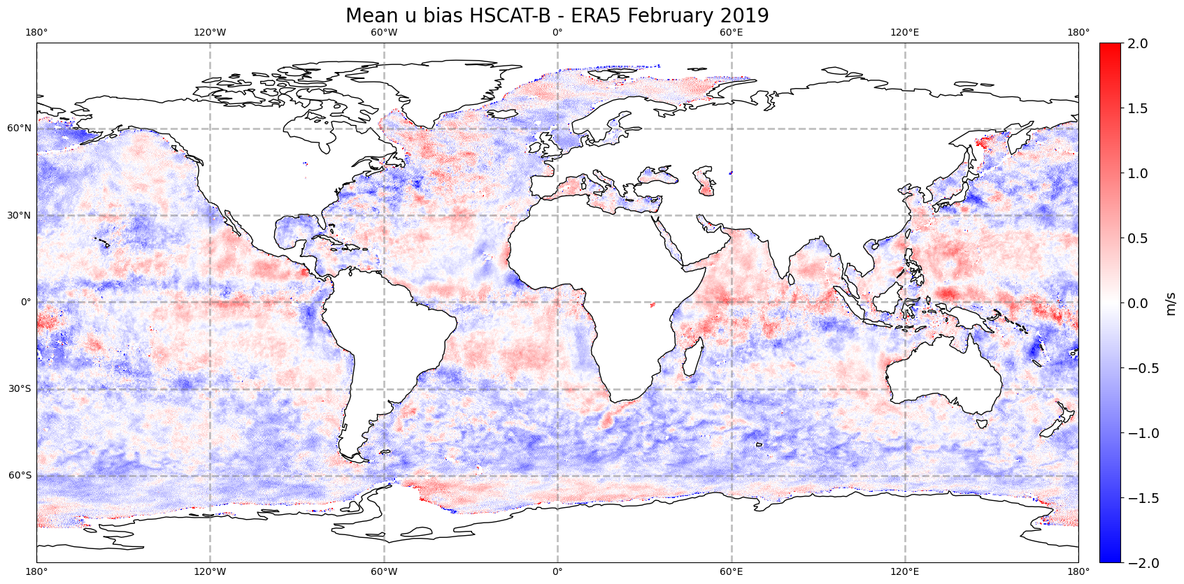
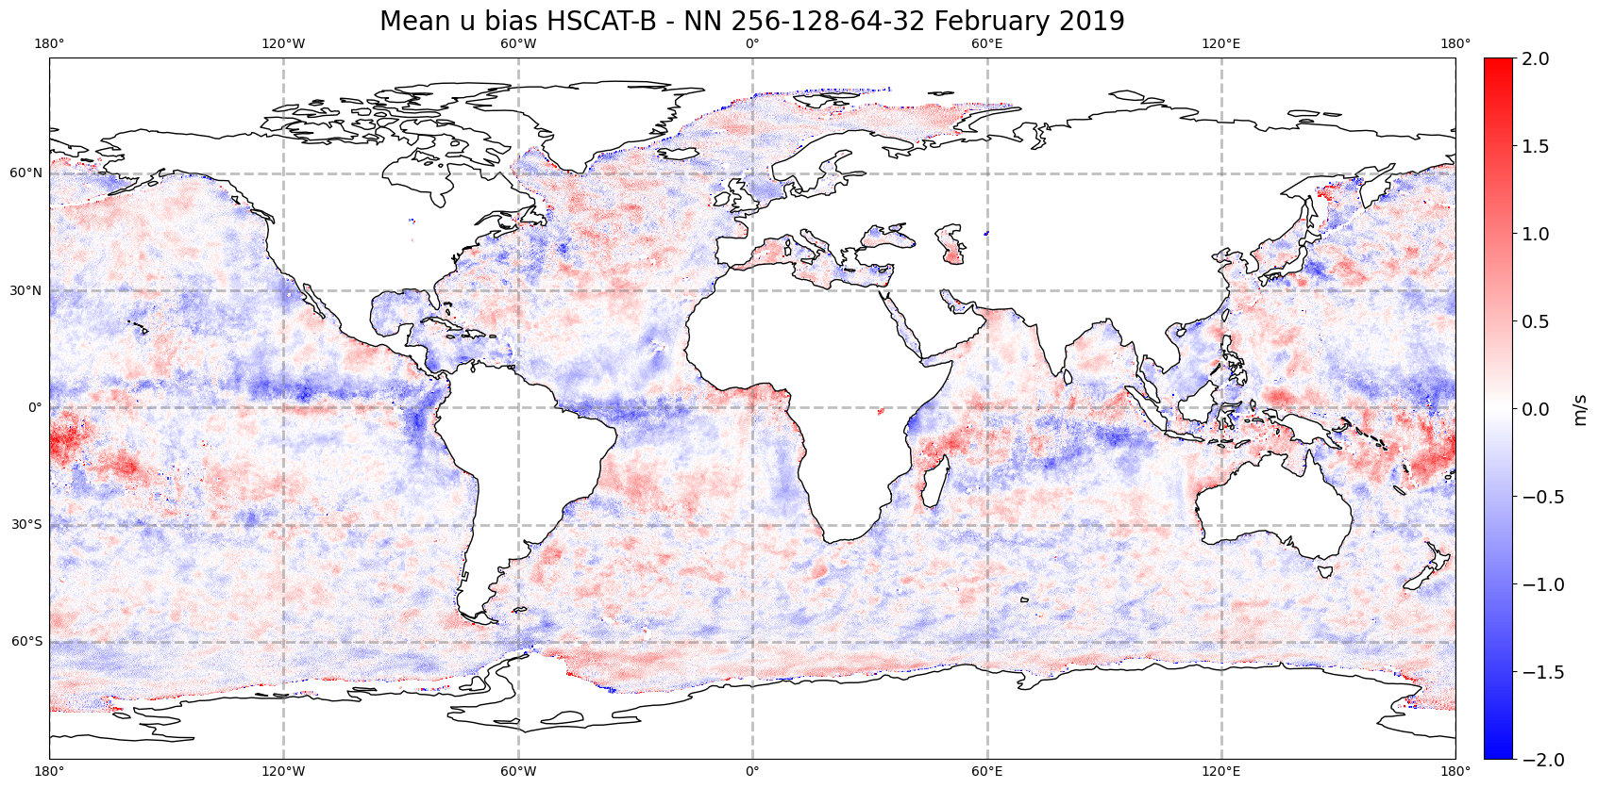
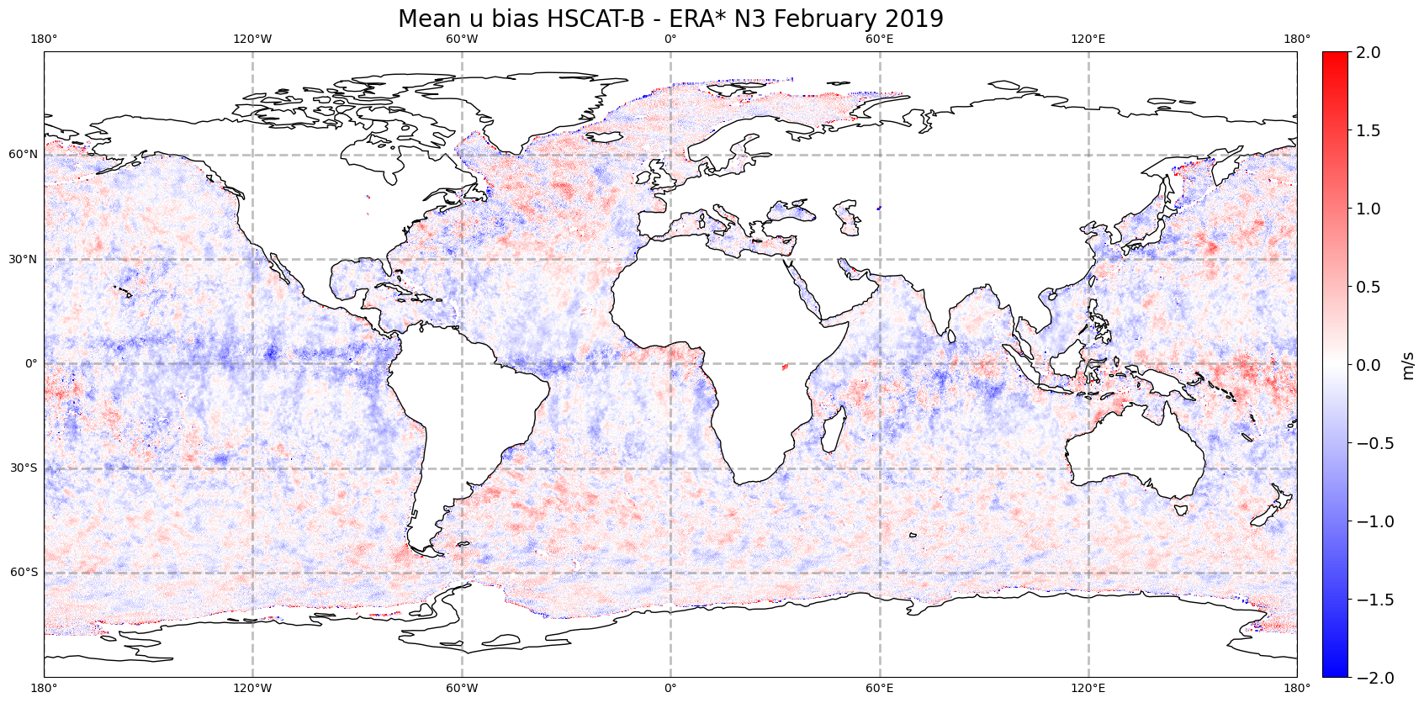

u bias vs HSCAT-B

Slide 33
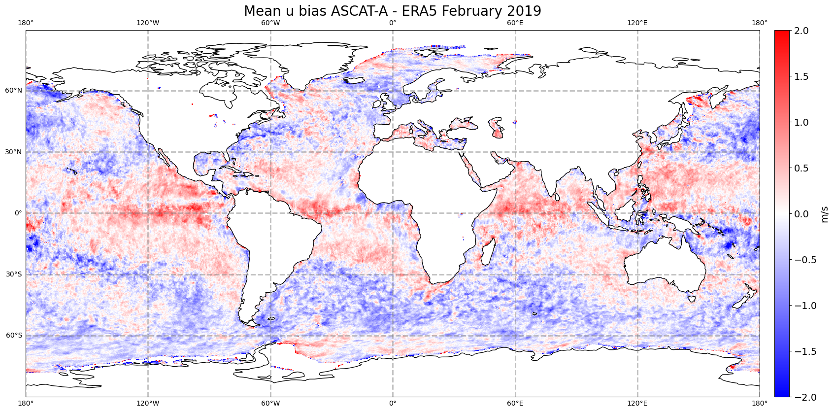
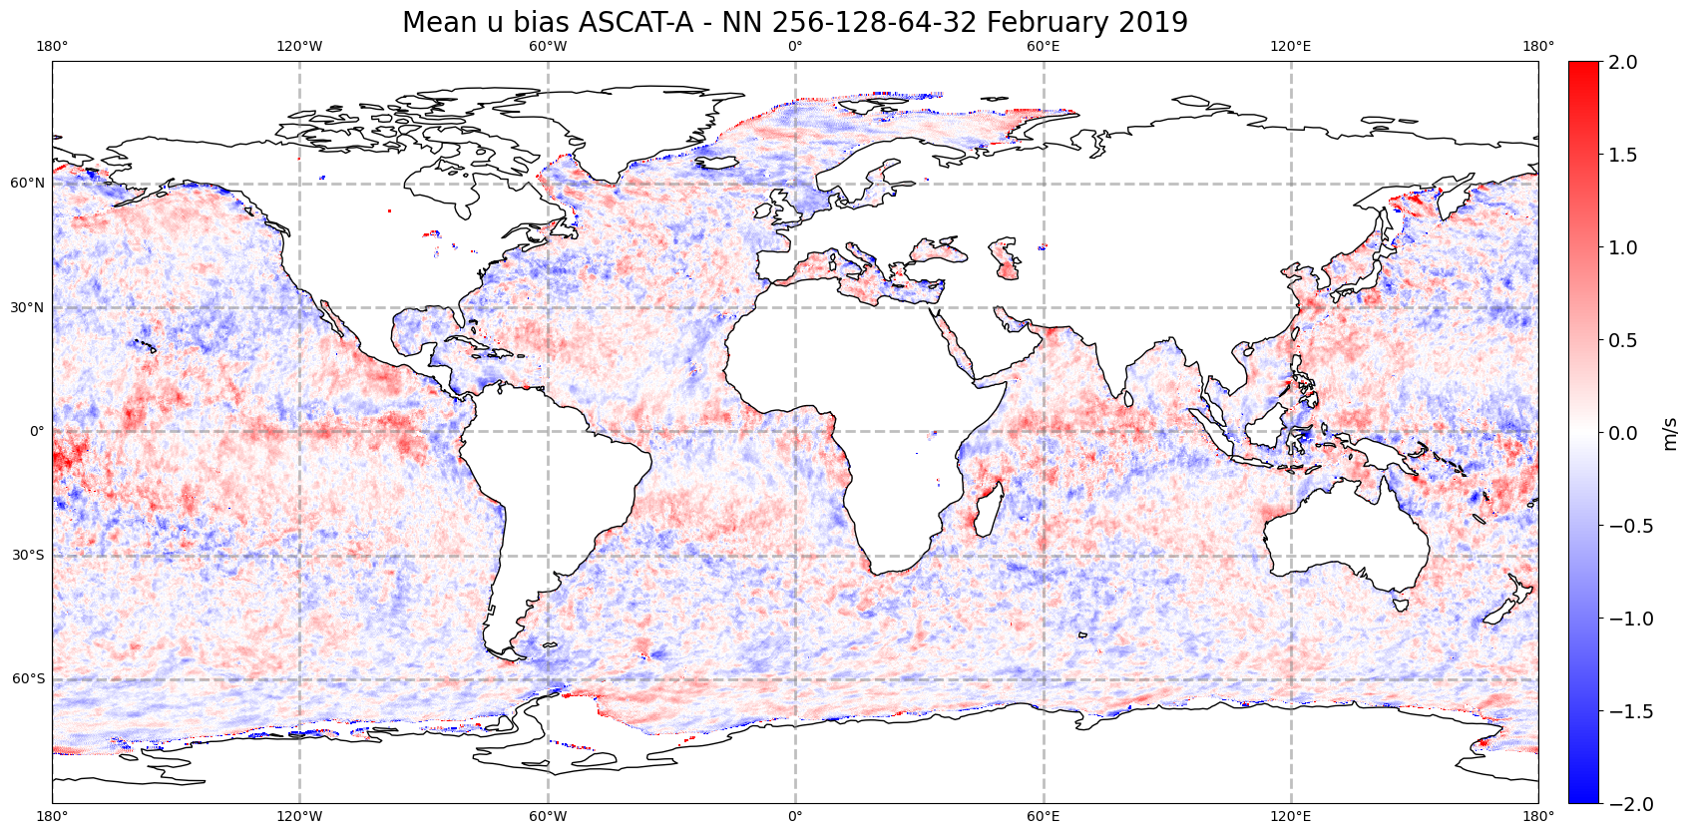
u bias vs ASCAT-A and HSCAT-B

Slide 34




u bias vs HSCAT-B

Slide 35


u bias vs ASCAT-A and HSCAT-B

Slide 36




v bias vs HSCAT-B

Slide 37


v bias vs ASCAT-A and HSCAT-B

Slide 38




Spatial distribution of VRMS vs HSCAT-B (2019)
knmi+var+land qc + prodmon
Notes:
XGBoost has very similar distribution as NN, not shown for not being repetitive. The validation is done against HSCAT-B with QC applied. The metrics are shown for 2019, year not used in training but covering the month of February, seen by the model in 2020. This is how the operational model will work.

Slide 39


Spatial distribution of VRMS vs ASCAT-A and HSCAT-B
Notes:
Comparison between HSCAT-B and ASCAT-A errors (all flags applied). The beneficial impact of NN if compared vs ASCAT is higher than compared vs HSCAT, especially in the tropics.

