Slide 1
An Overview of the Aircraft TC Measurement: From Present Capabilities to Future Needs
¹Zorana Jelenak, ¹Paul Chang, ²Ralph Foster,
³Heather Holbach, and ³Mark Bourassa
NOAA/NESDIS/STAR
²APL
³FSU

Slide 2
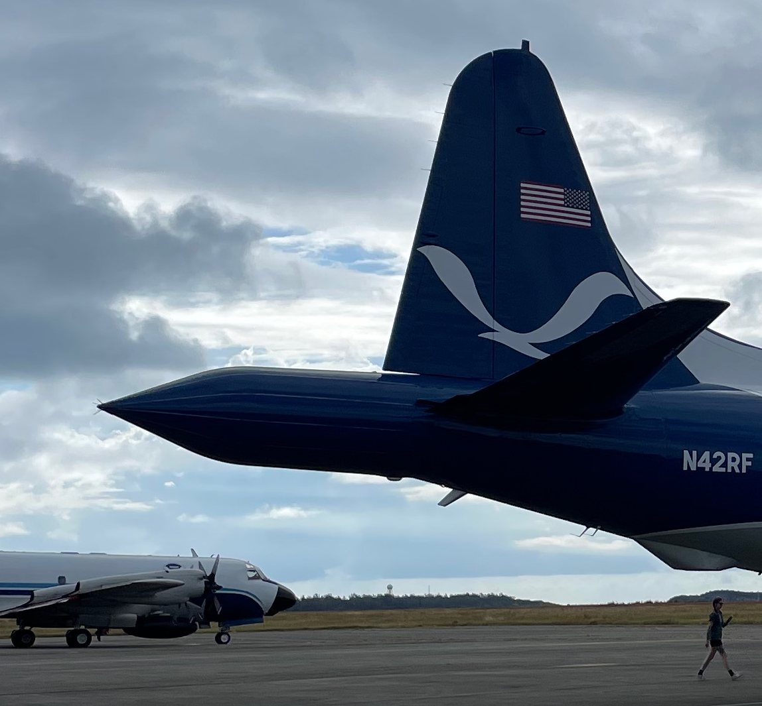
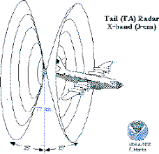
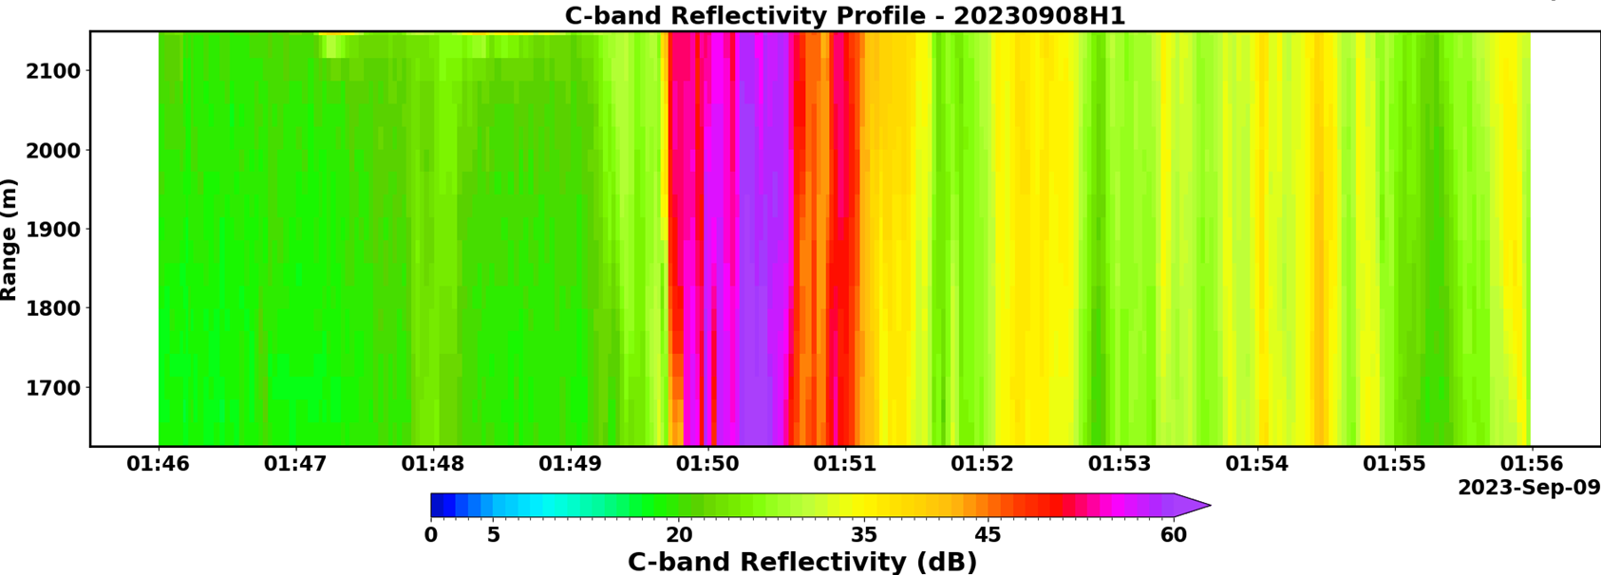
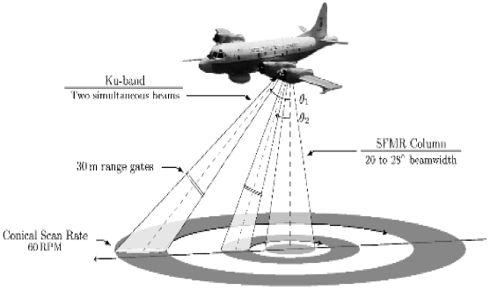
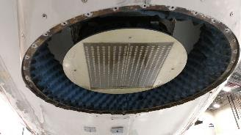
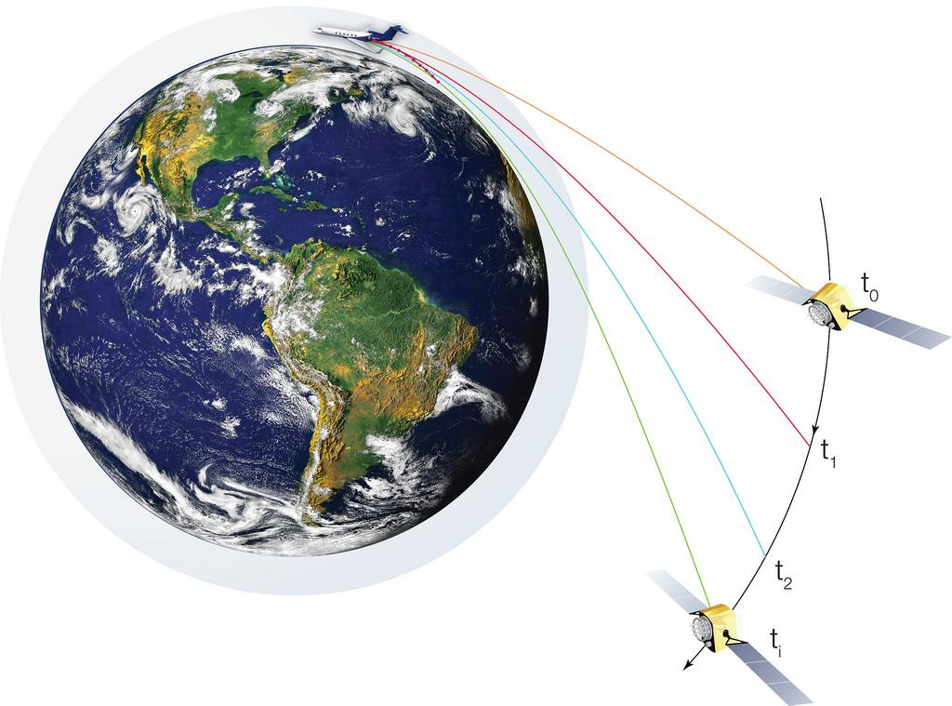
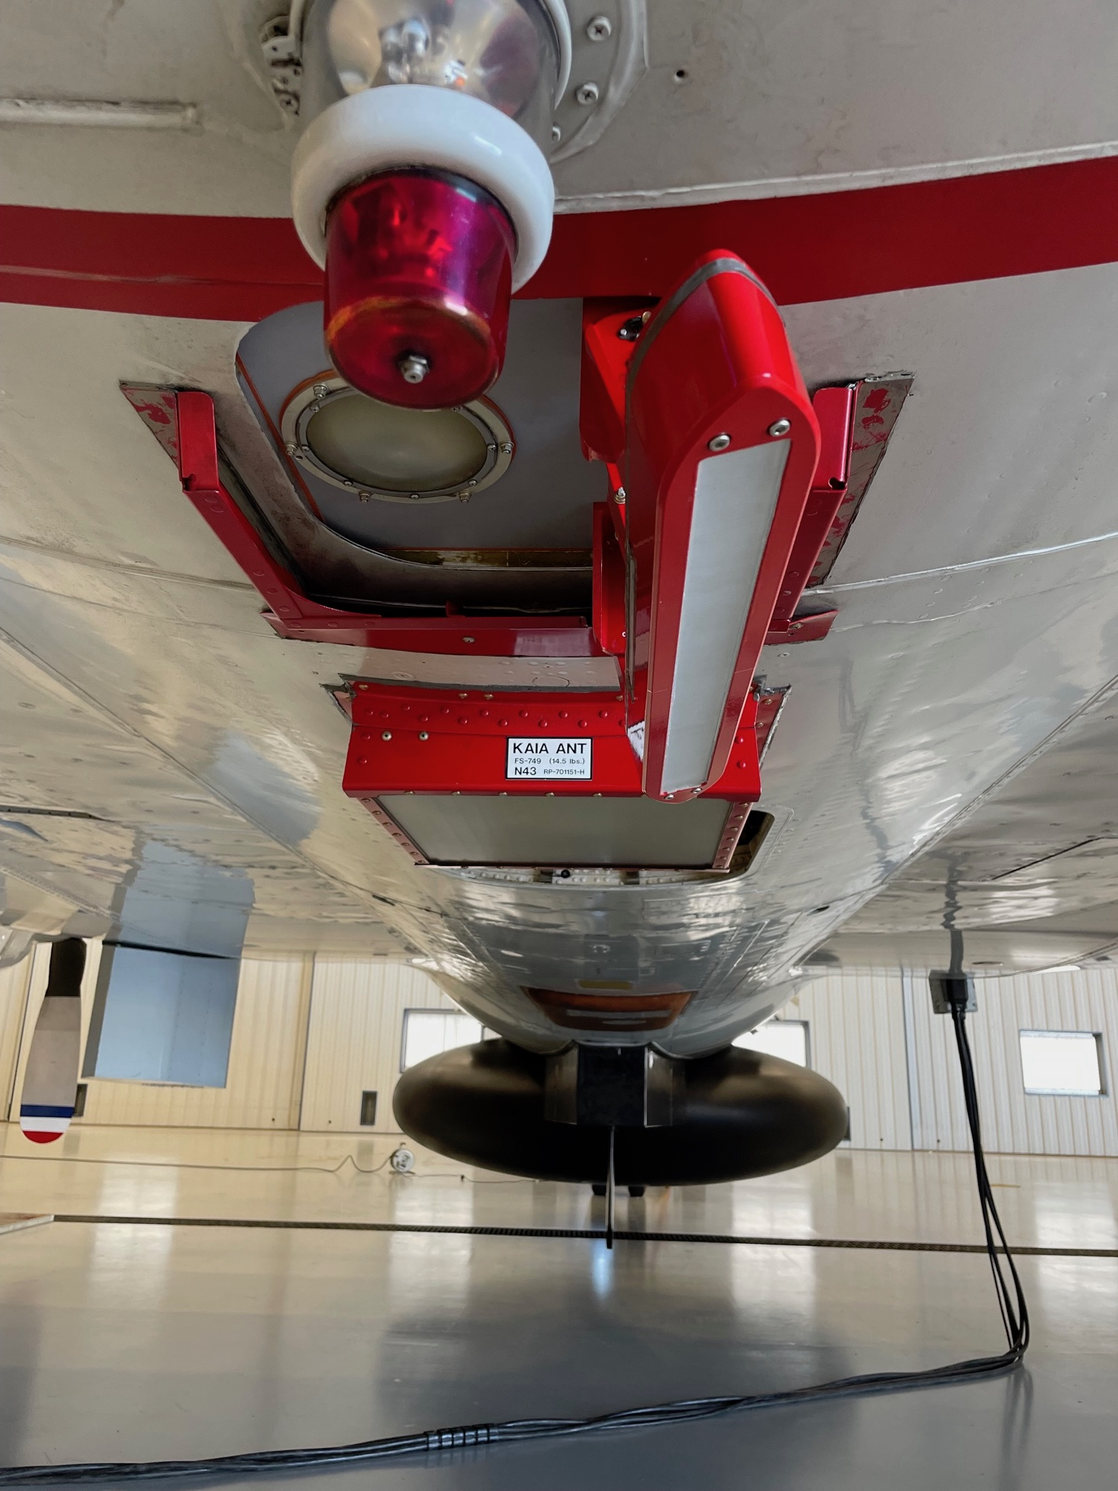
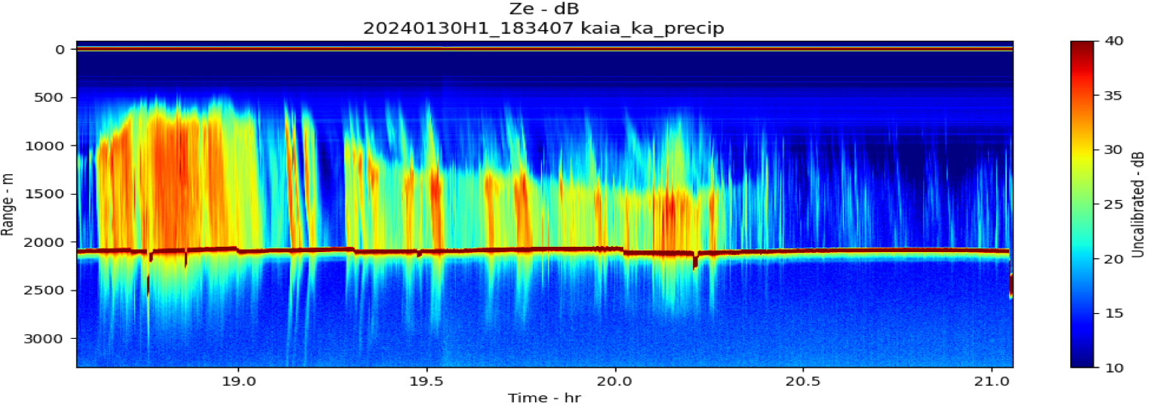
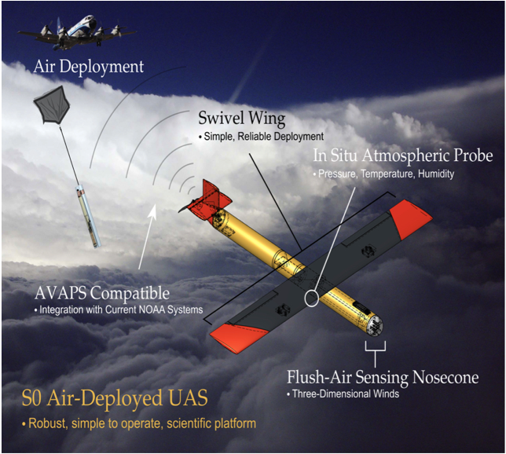
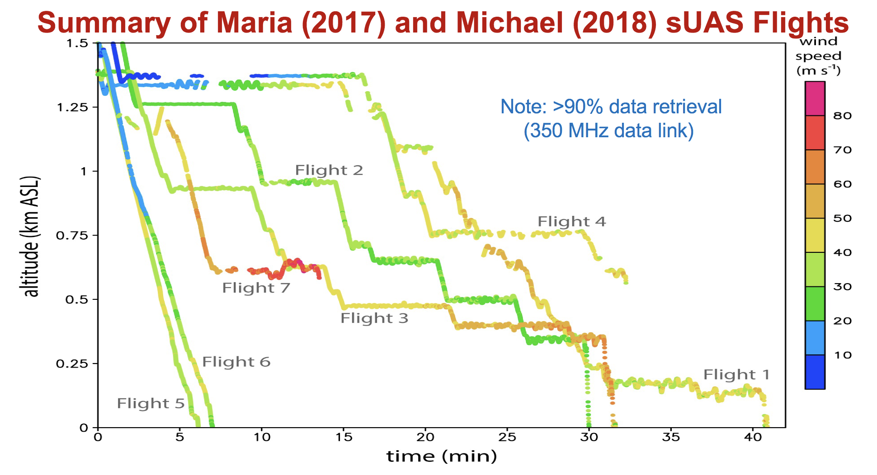
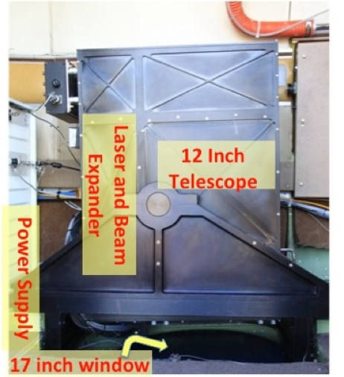
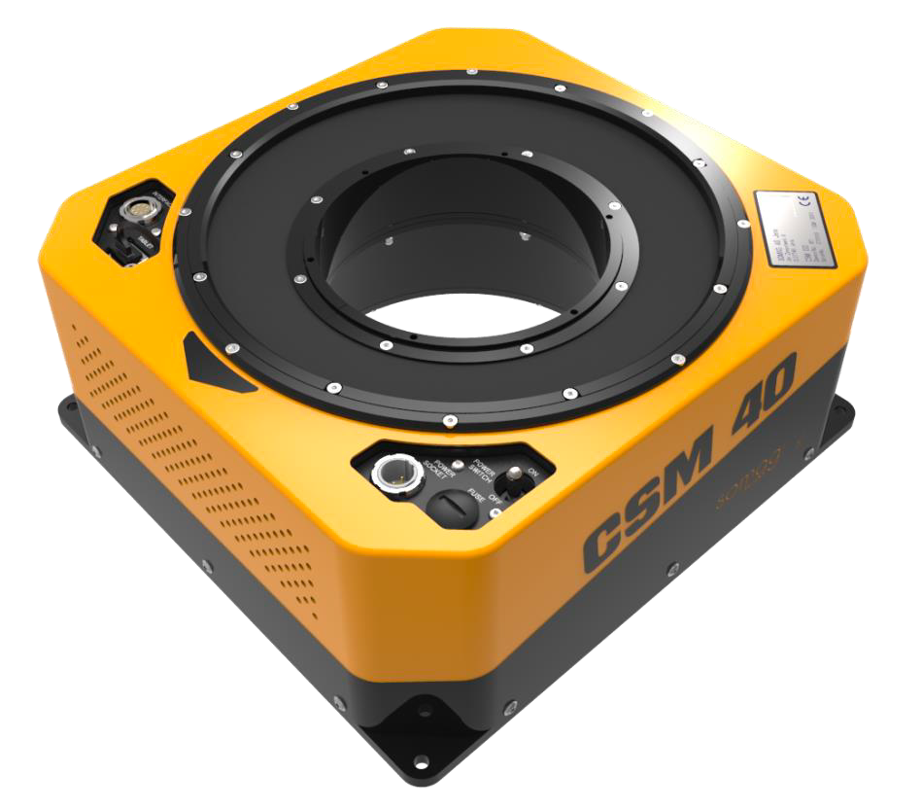
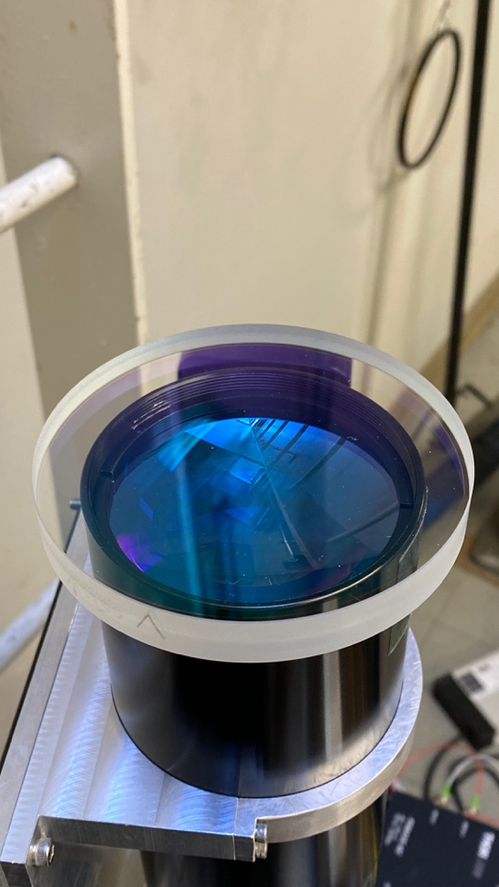
X-band
Tail Doppler Radar
Atmospheric Profiling
C-band
IWRAP
Ku-band
Radio Occultation
KaIA
Altius-600
Black Swift S0
Ka-band
W-band
W-Band
antenna
Lidar
Compact Ramen Lidar
Wind Lidar

Slide 3
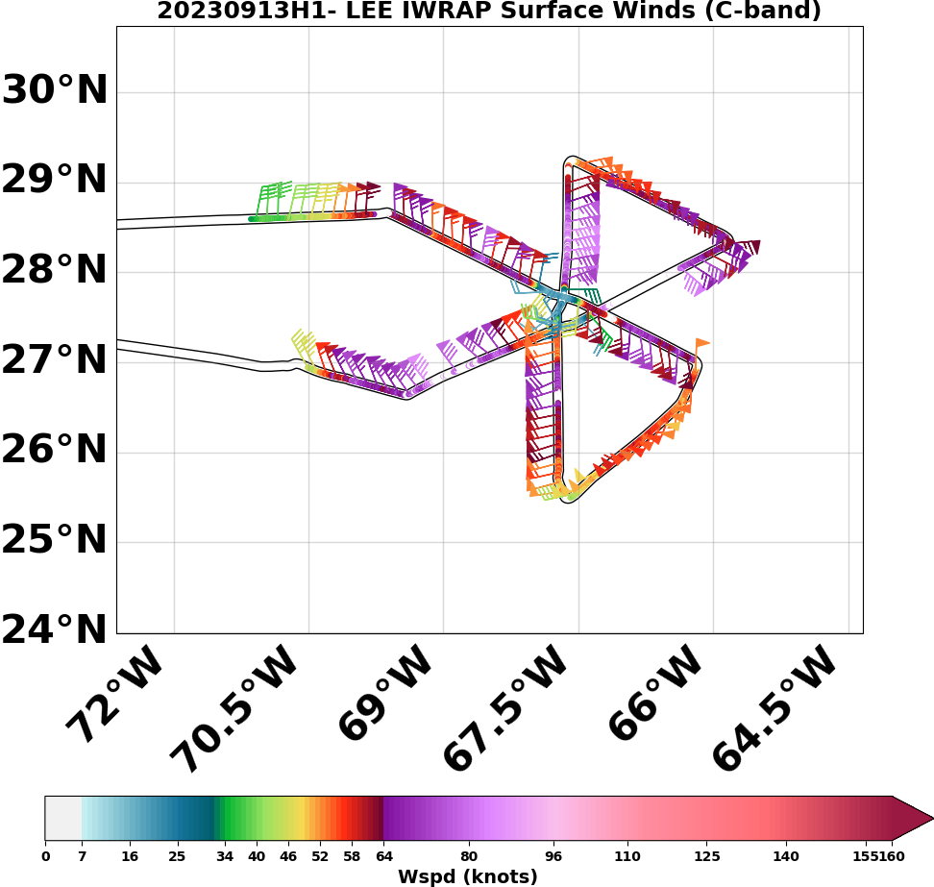
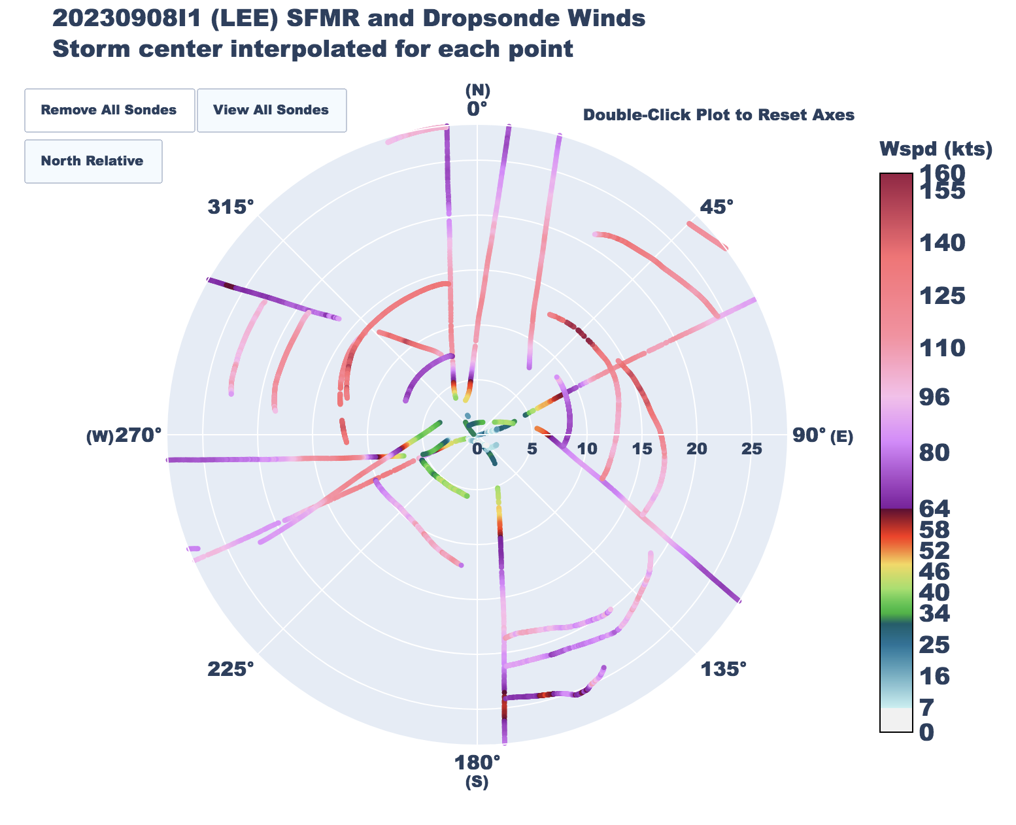
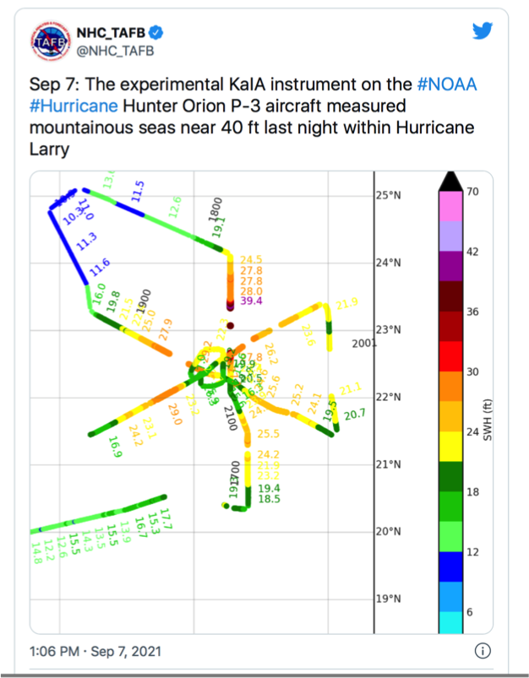
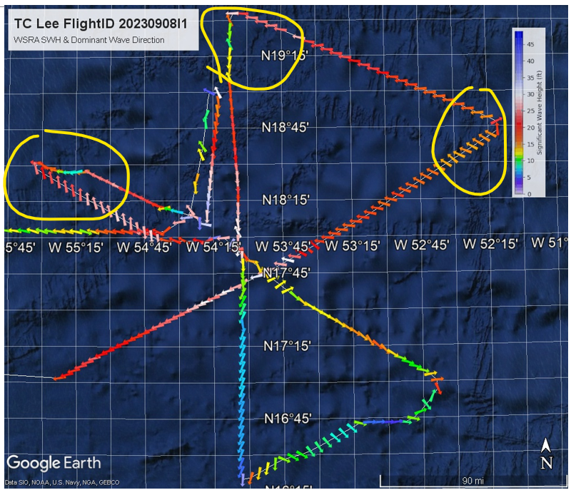
Surface Wind Measurements
Aircraft Instrumentation
Instrument | Aircraft | Measurements
GPS Dropsondes | C130, P3, G-IV | Atmospheric wind, temperature and humidity profiles
Stepped Frequency Microwave Radiometer | C130, P3, G-IV | C-band, nadir looking, Surface wind speed, rain rate
Imaging Wind and Rain Airborne Profiler (IWRAP) | P3 | Ocean Surface Vector Winds, (scatterometry) C, Ku, VV, HH, VH
Ka-band Interferometric Altimeter (KaIA) | P3 | Significant wave height, relative ocean height, & wind speed (lower speed regimes), precip profiles at Ka & Ku
Wide Swath Radar Altimeter (WSRA) | P3 | Significant wave height and directional wave spectra, wind speed (lower speed regimes), rain rate, Ku-band
IWRAP
OSVW
KaIA
SWH
WSRA
SWH + Wave Spectra
Dropsonde+SFMR
Notes:
Microphysics Spirals
Idalia - 20230829I1 - 1 spiral
Tammy - 20231019I1 - 1 spiral
Tammy - 20231021I1 - 1 spiral
Tammy - 20231022I1 - 2 spirals

Slide 4
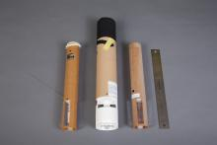
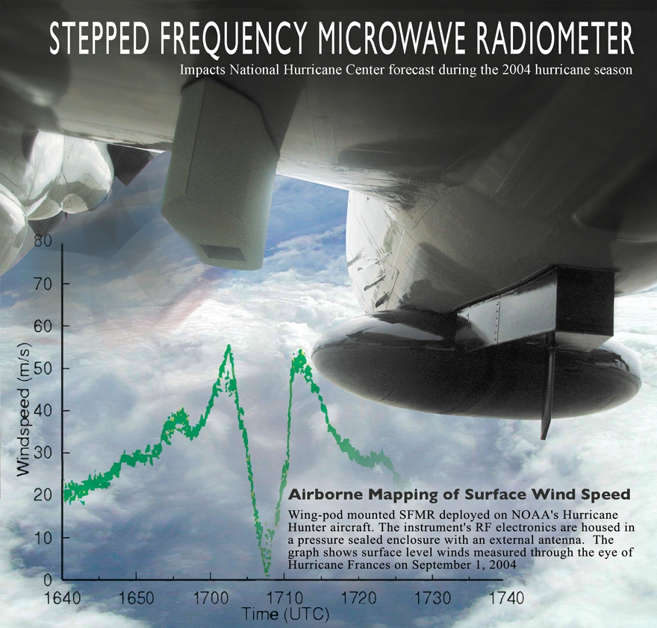
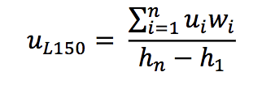
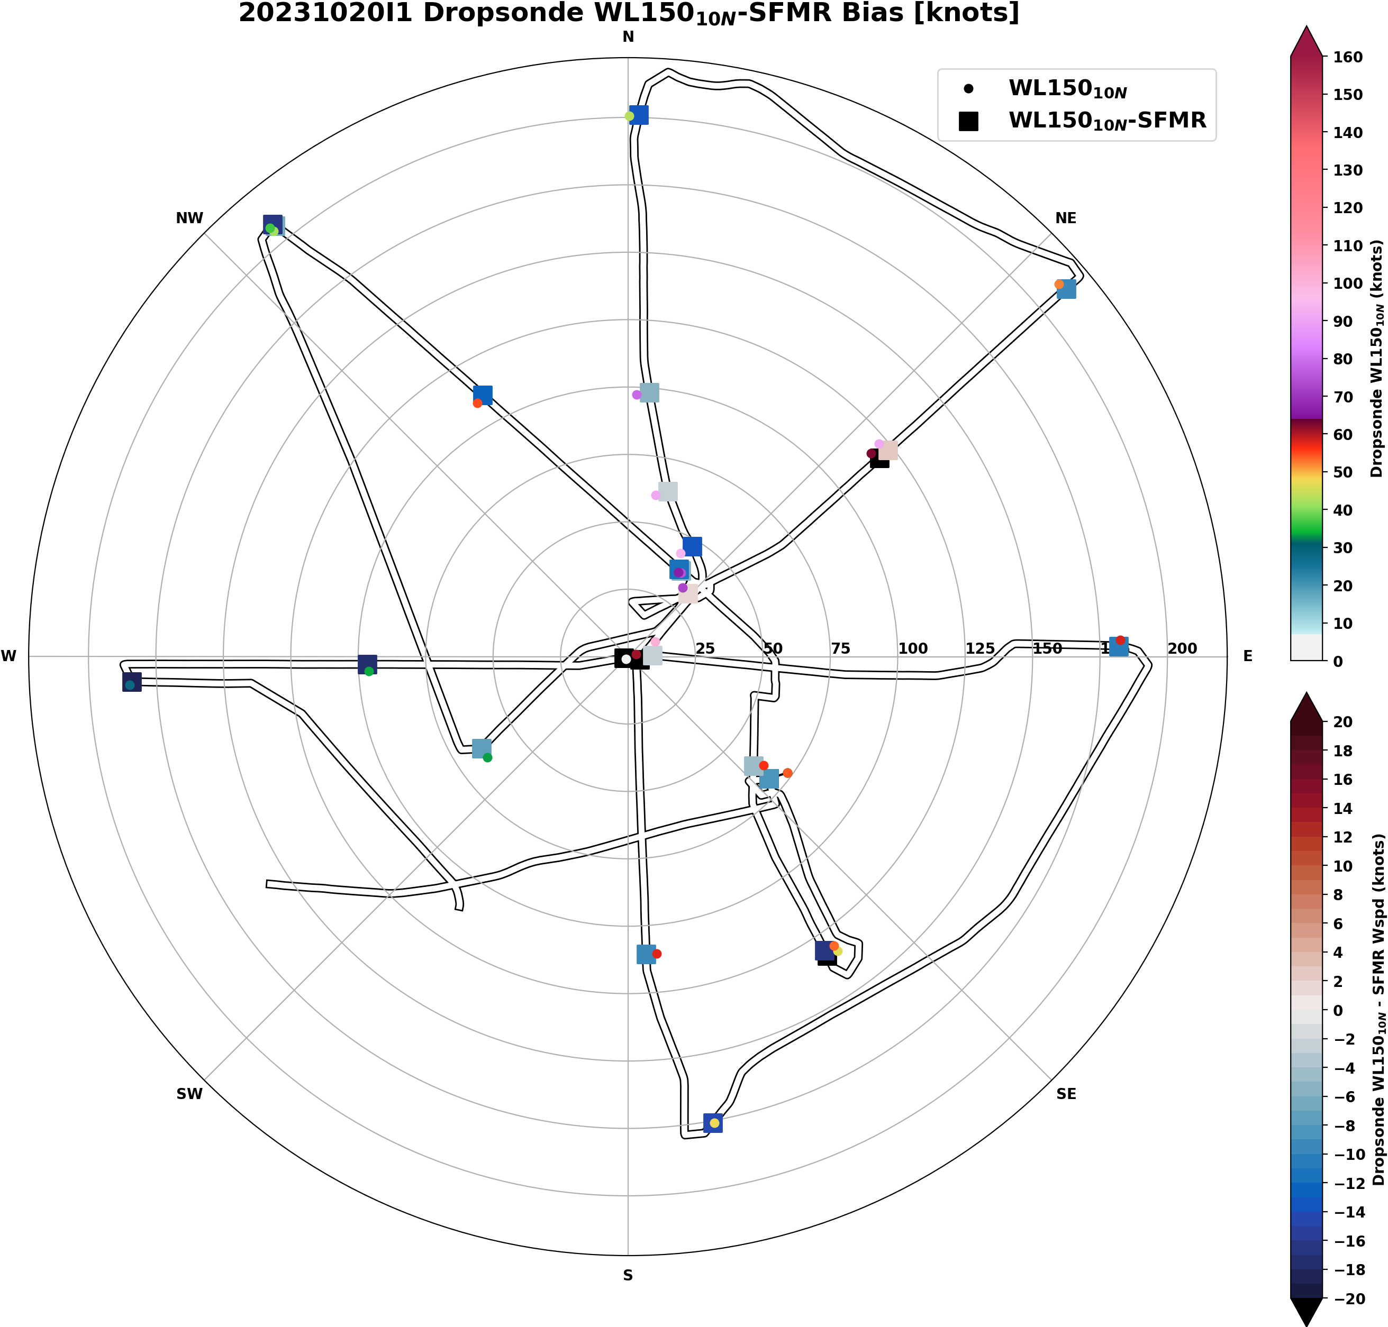
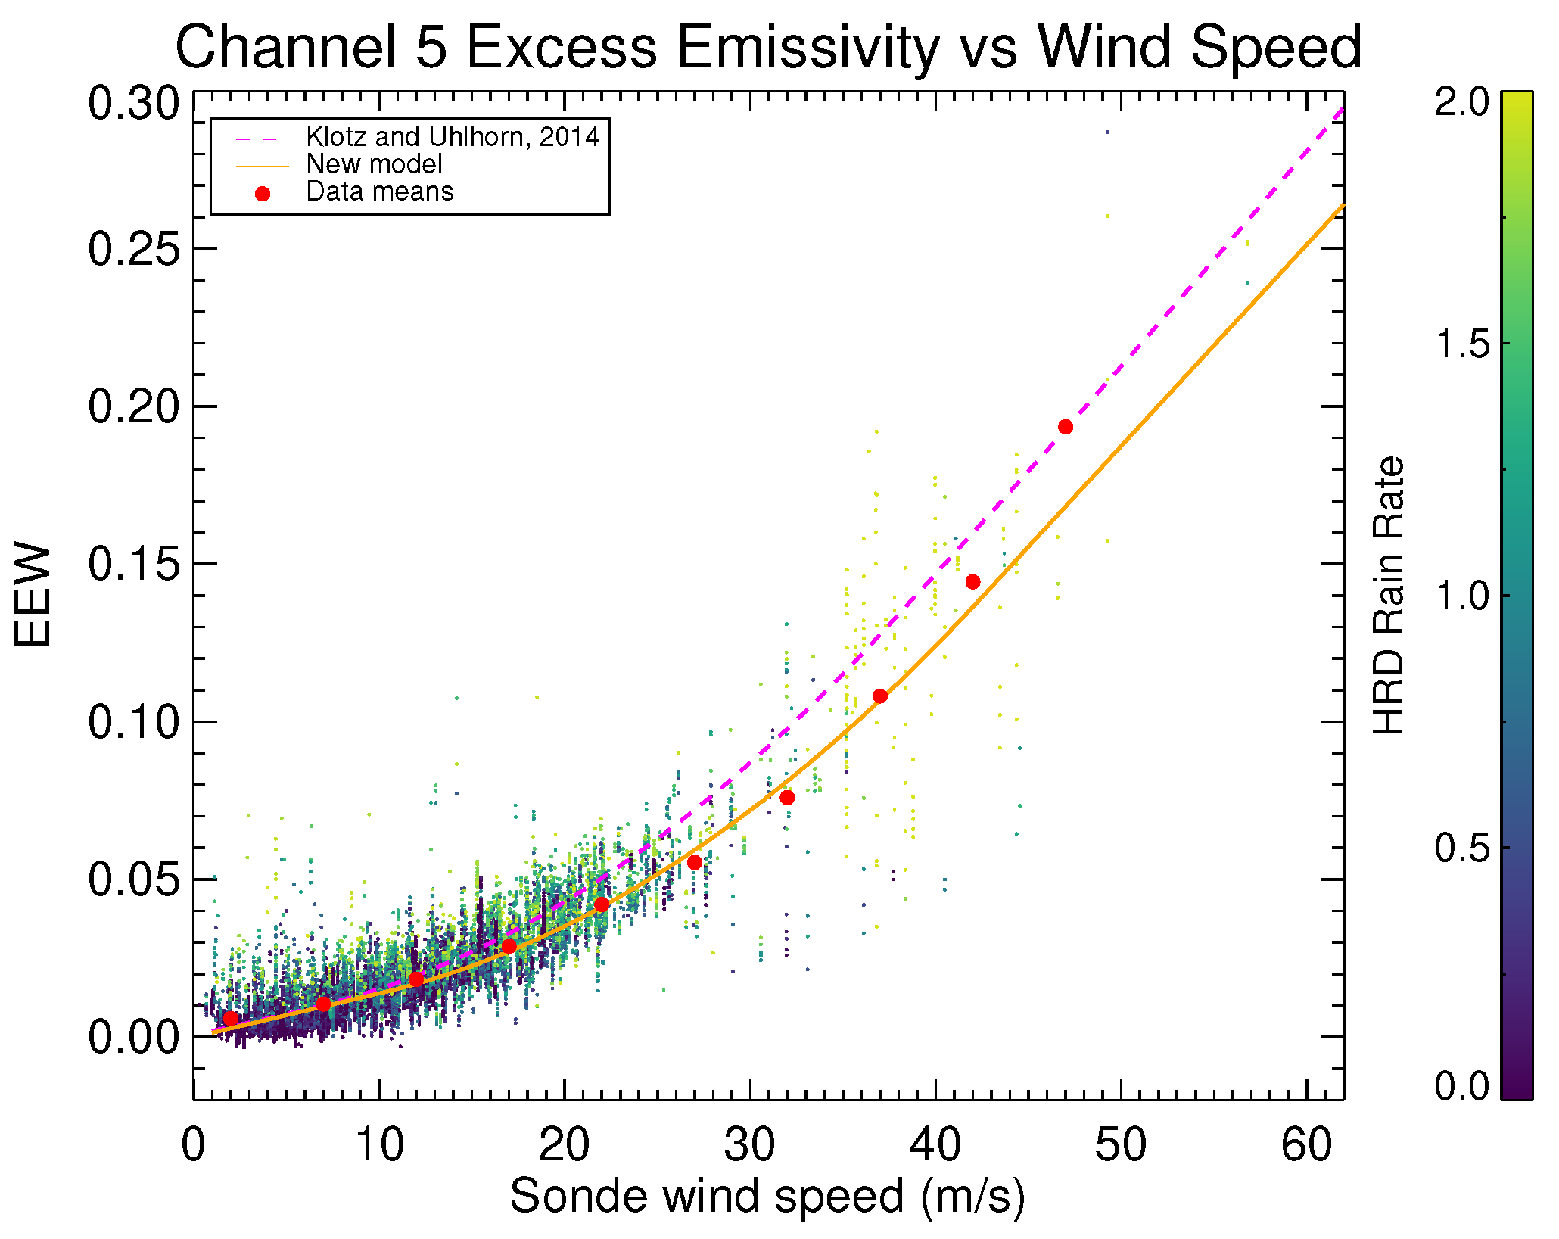
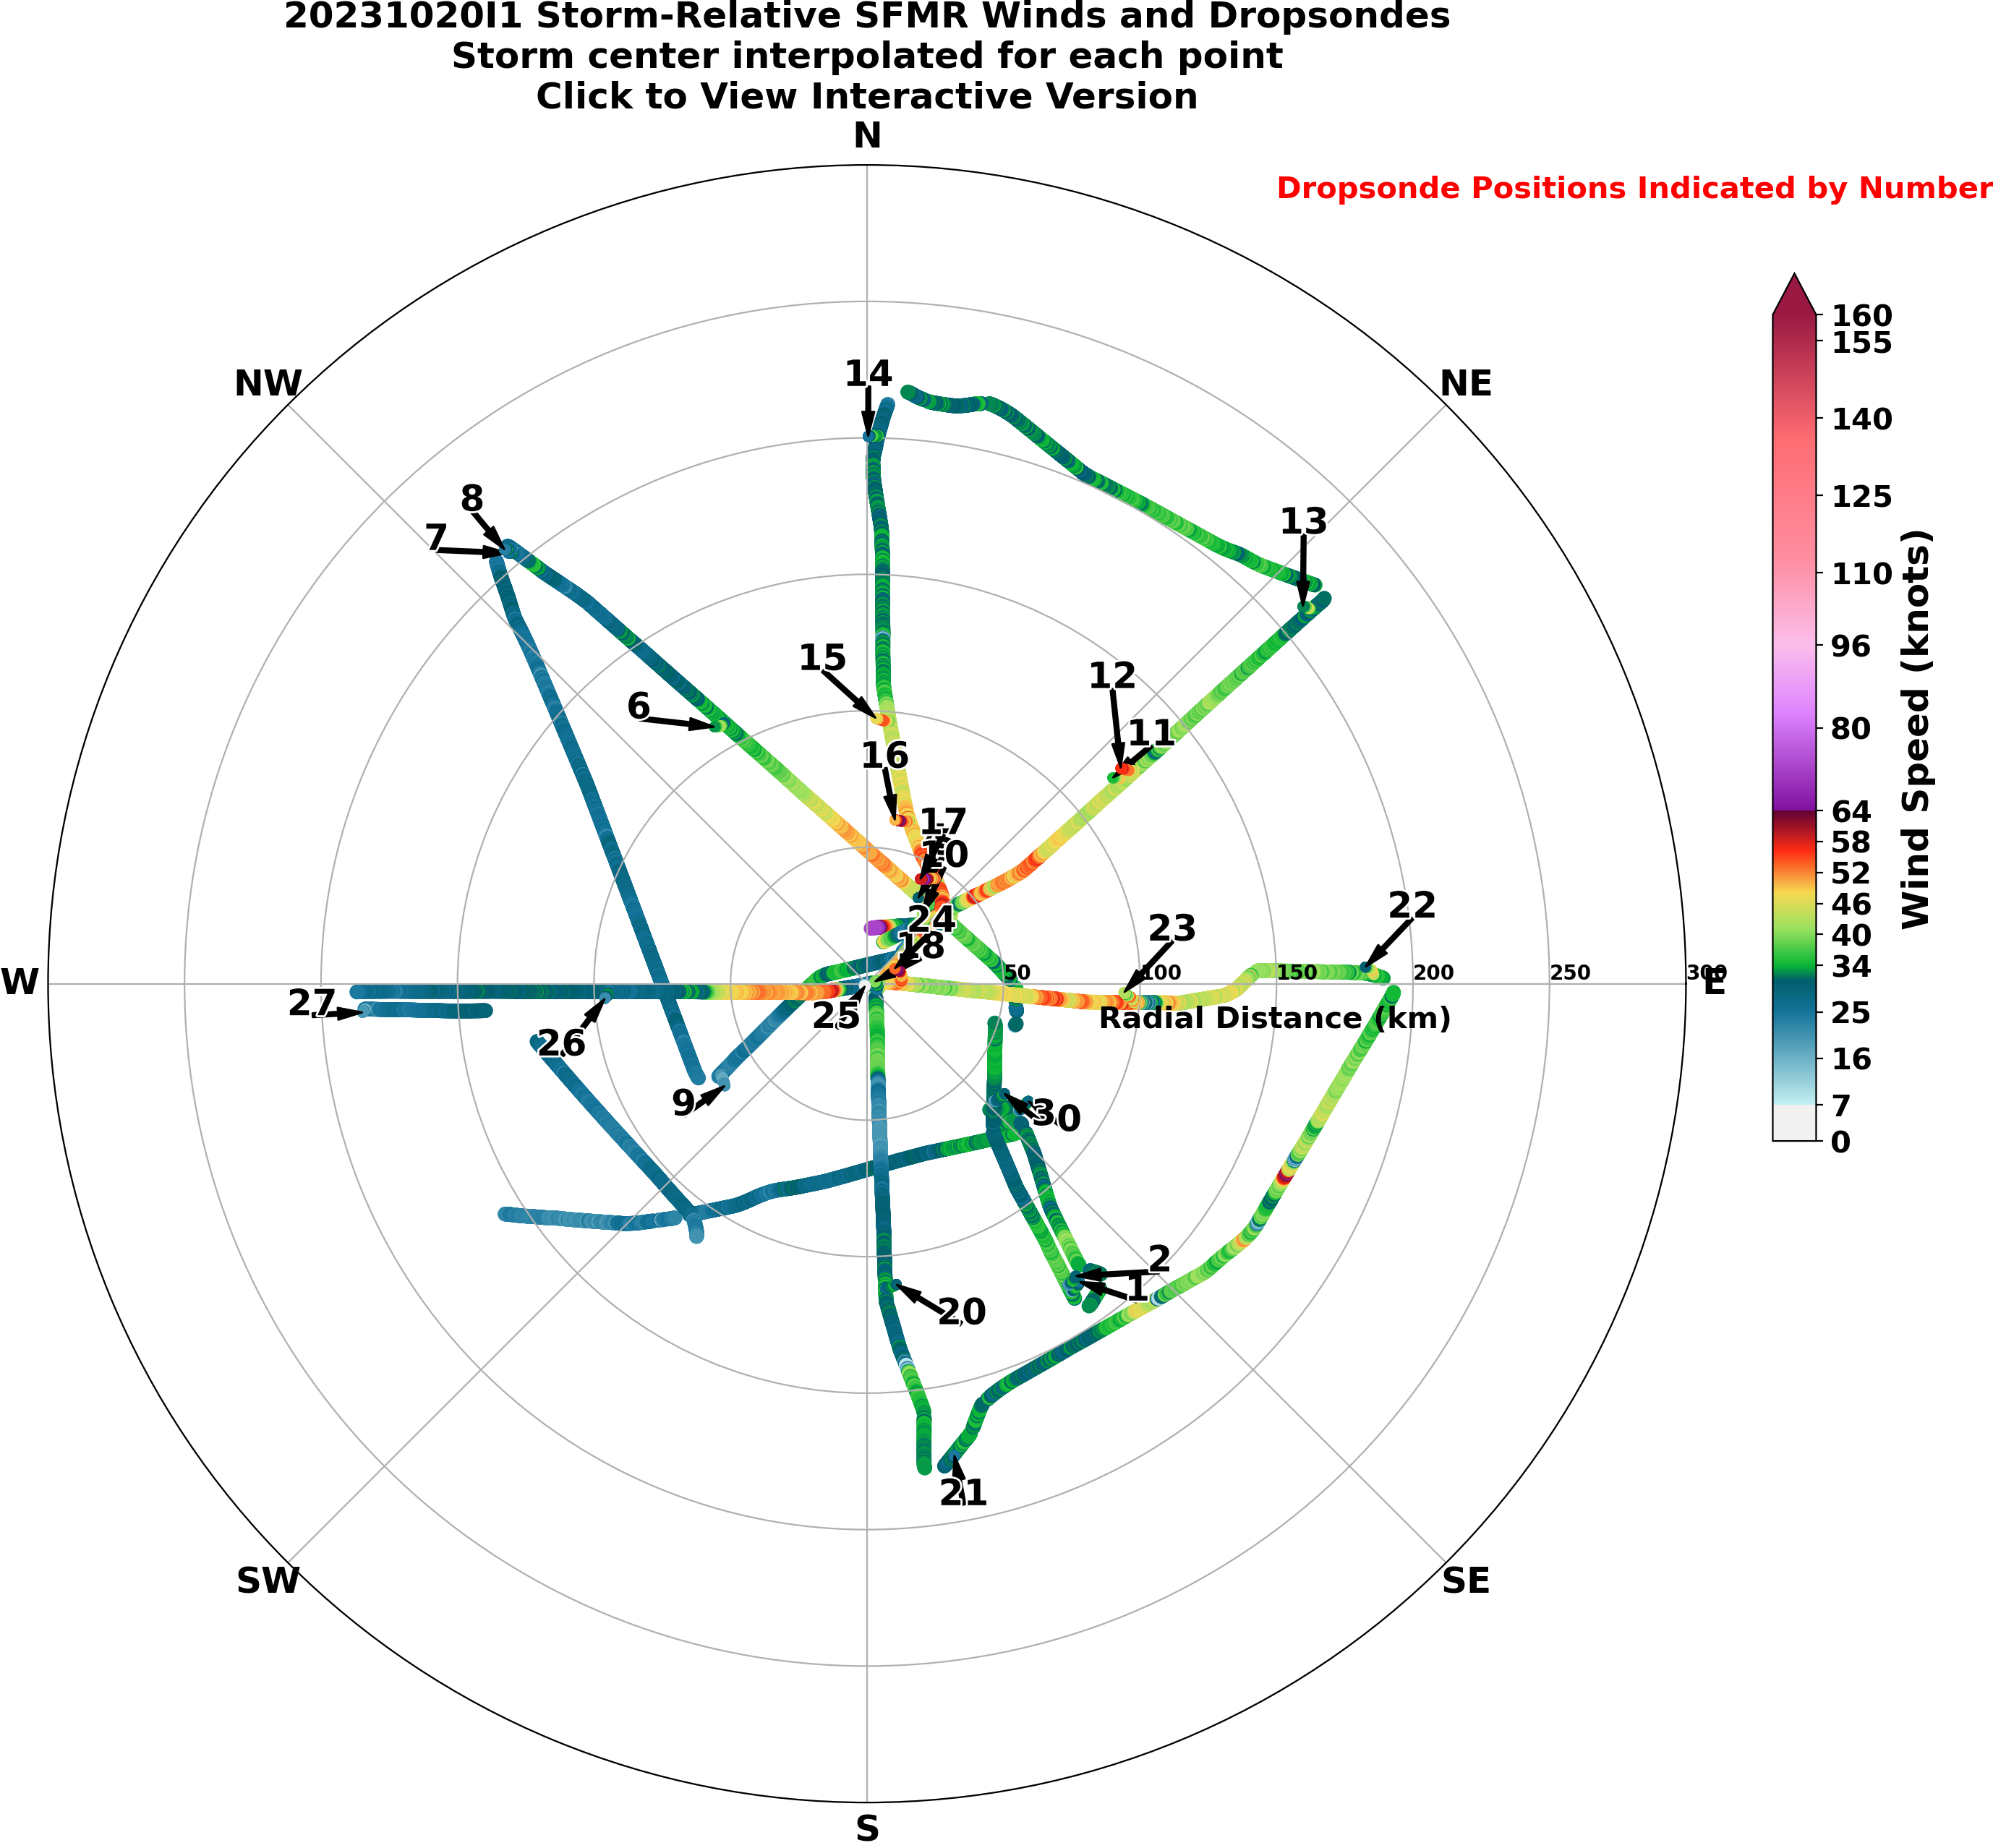
First Extreme Surface Wind Measurements
Franklin at al 2003:
10m Surface Wind: WL150
1981/2005-present
1997
Klotz (2014)
Sapp (2019)

Slide 5
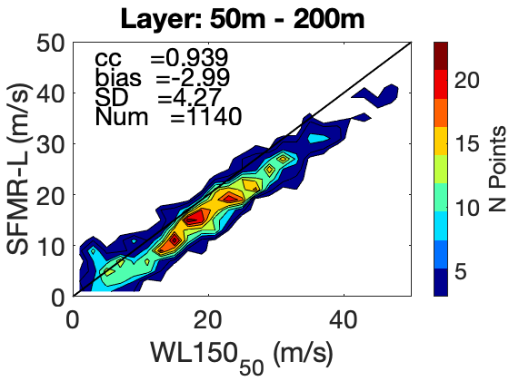
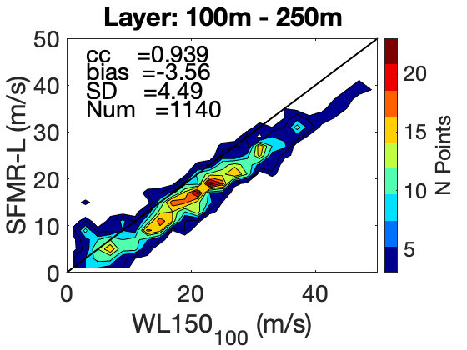
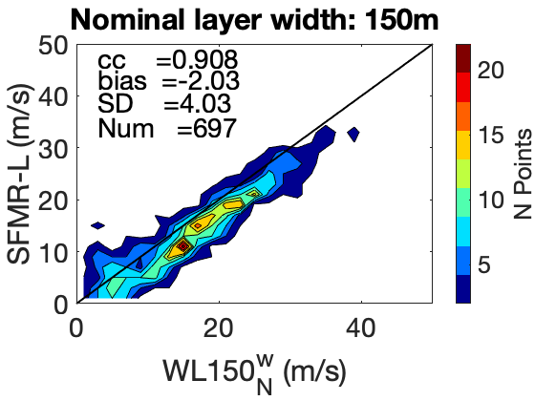
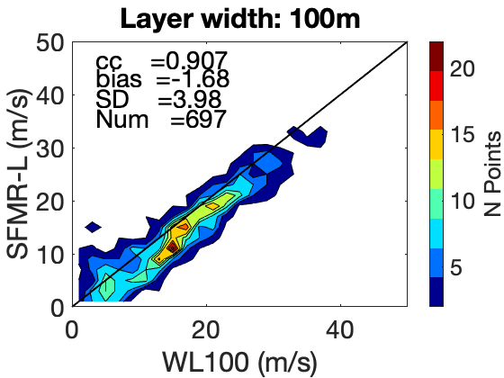
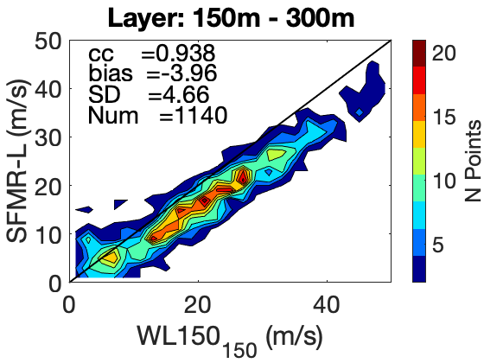
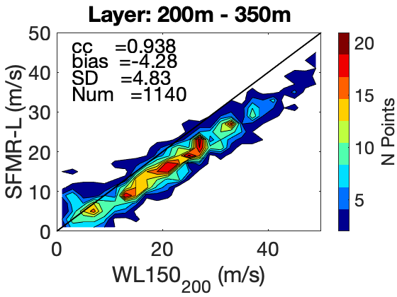
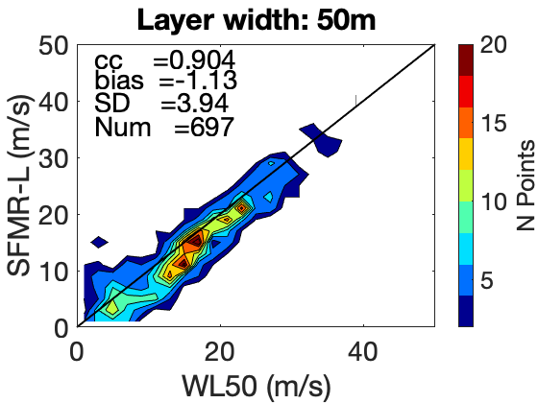
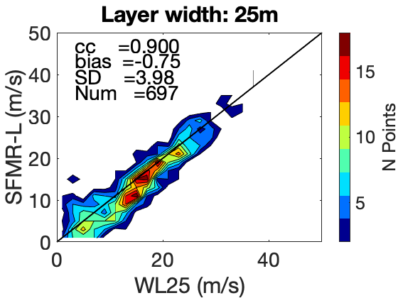
On dropsonde surface-adjusted winds and their use for the SFMR wind speed calibration
Polverari at al 2022
Comparison between SFMR and dropsonde WL wind computed from the WL150 algorithm using different layer height
Comparison between SFMR and dropsonde WL wind computed from the WL150 algorithm using different layer width
Bias and SD increase when averaging the dropsonde readings over a layer at mean altitudes higher than the nominal 85 m. The WL150 scaling factor should be function of the mean layer height
Bias and SD are significantly reduced when averaging the dropsonde readings over a layer thinner than the nominal 150-m layer. The dropsonde winds averaged over a 25-m-layer are more representative of the 10-m winds
Take away: The dropsonde WL150 winds can introduce noise and biases when converted into 10-m surface winds. The dropsonde surface winds estimated from the WL150 algorithm should be used with caution for cal/val [Polverari et al., IEEE TGRS, 2022]

Slide 6
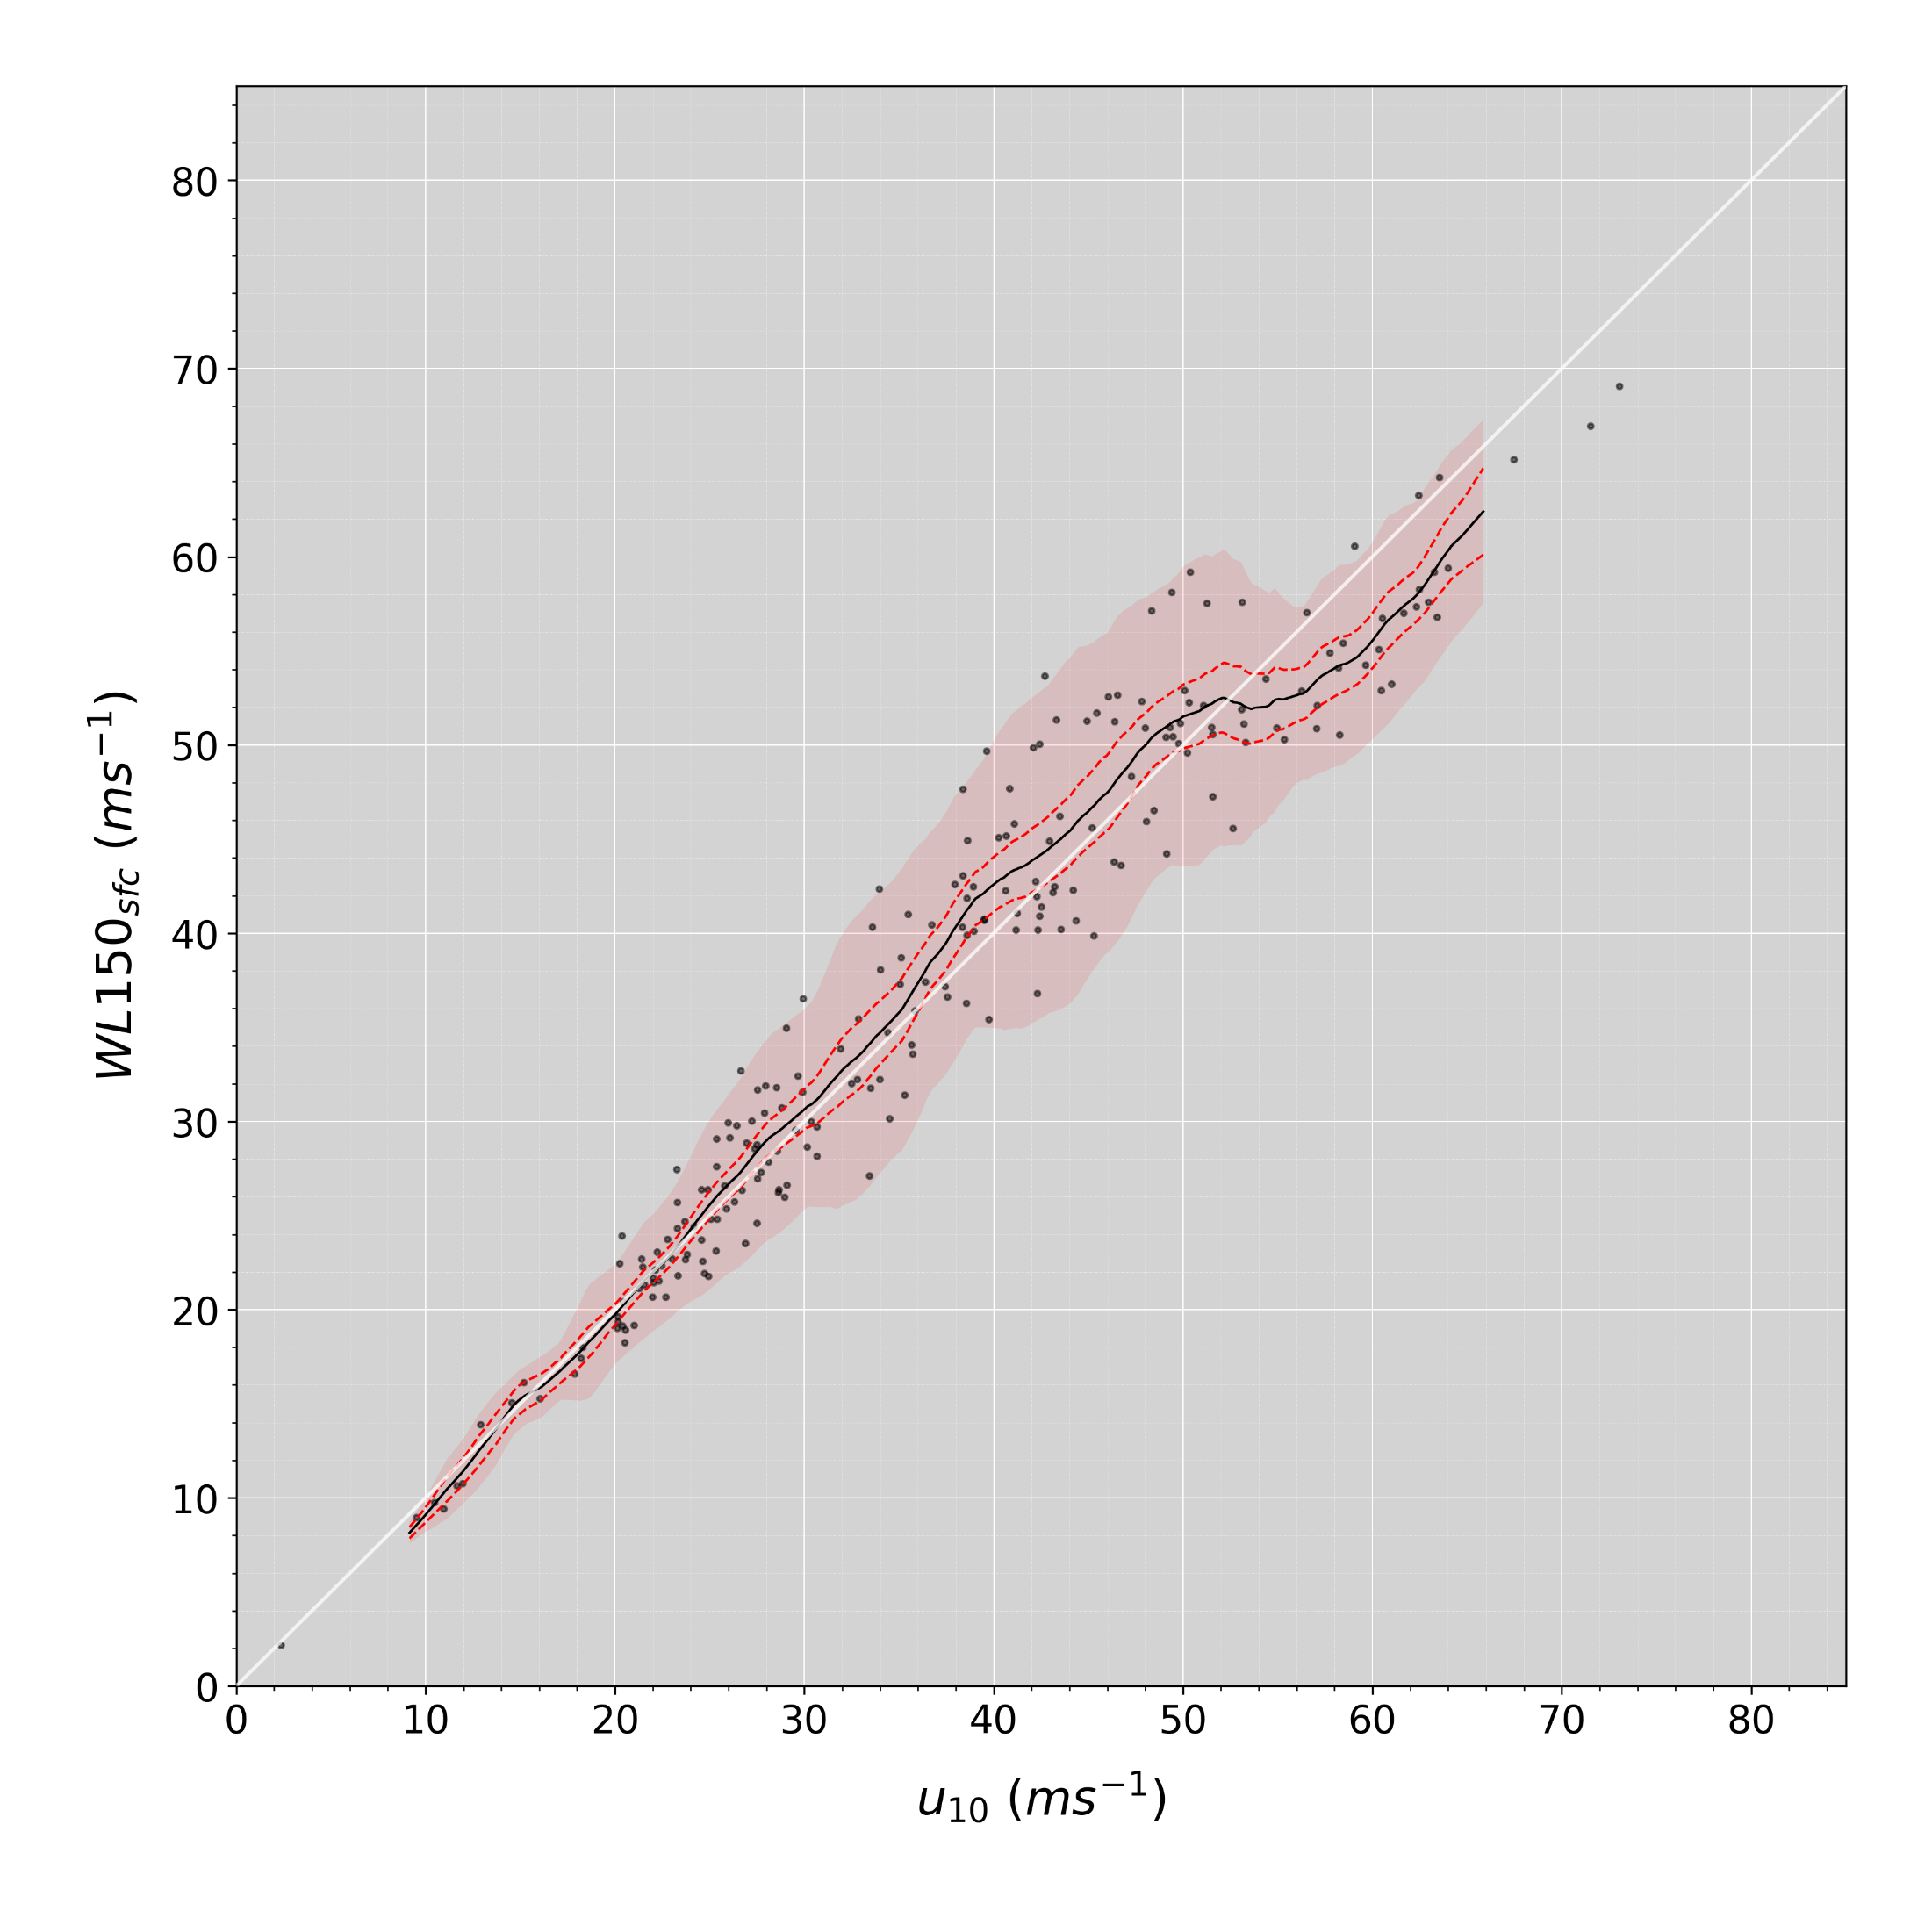
Holbach and Bourassa 2023 U₁₀ vs WL150
This comparison is restricted to conditions when we can find a log profile, which are conditions that favor a good comparison to WL150 winds.
Variability increases as some function of wind speed
Which is expected
Good agreement at lower speeds
15 < u₁₀ < 35 ms⁻¹
WL150 is biased slightly high from ~35-50 ms⁻¹ compared to our log-profile u₁₀
WL150 significantly low biased above ~55 ms⁻¹ compared to our log-profile u₁₀

Slide 7
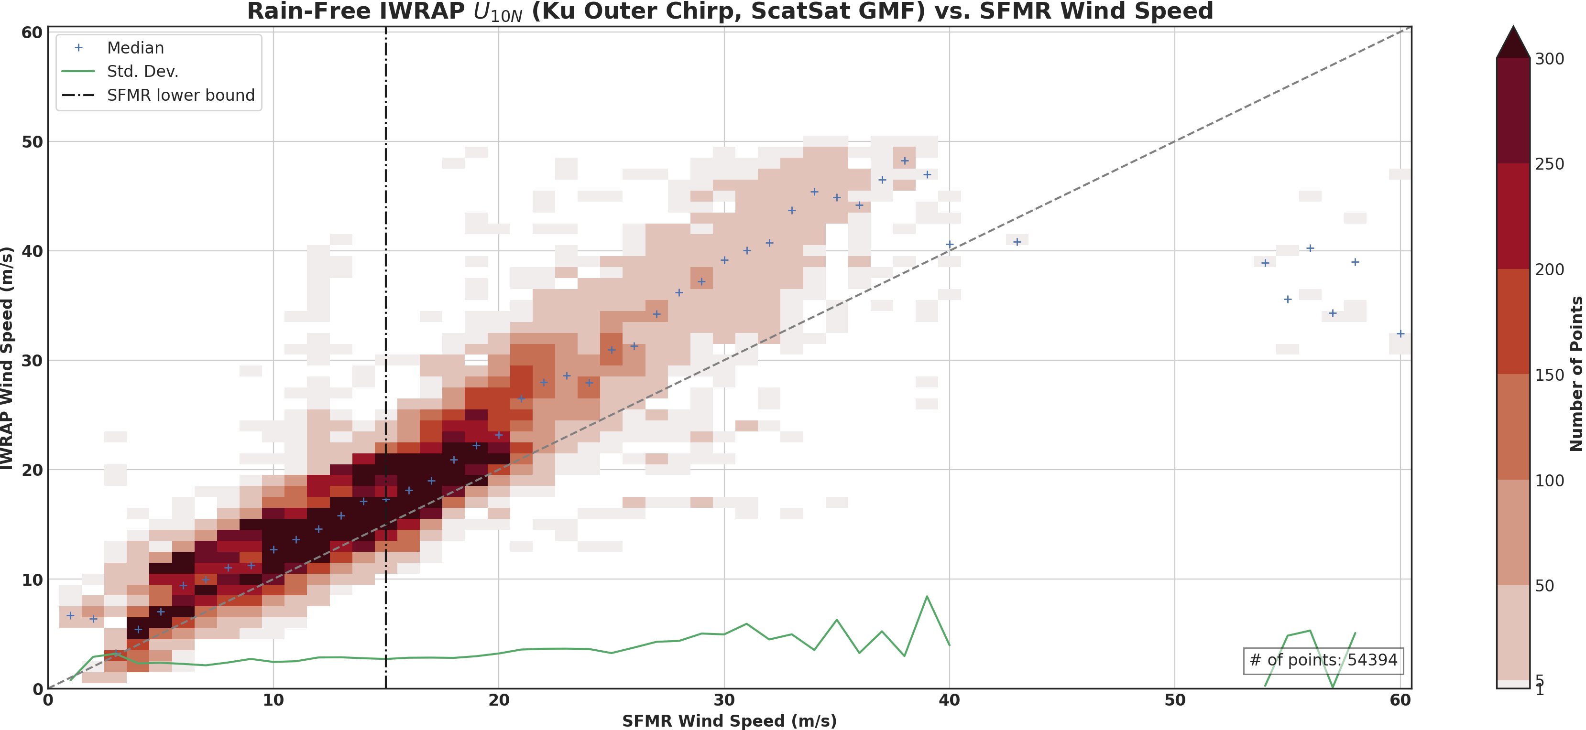
ScatSat GMF – IWRAP Ku@50° Klotz 2014 RTM - SFMR

Slide 8
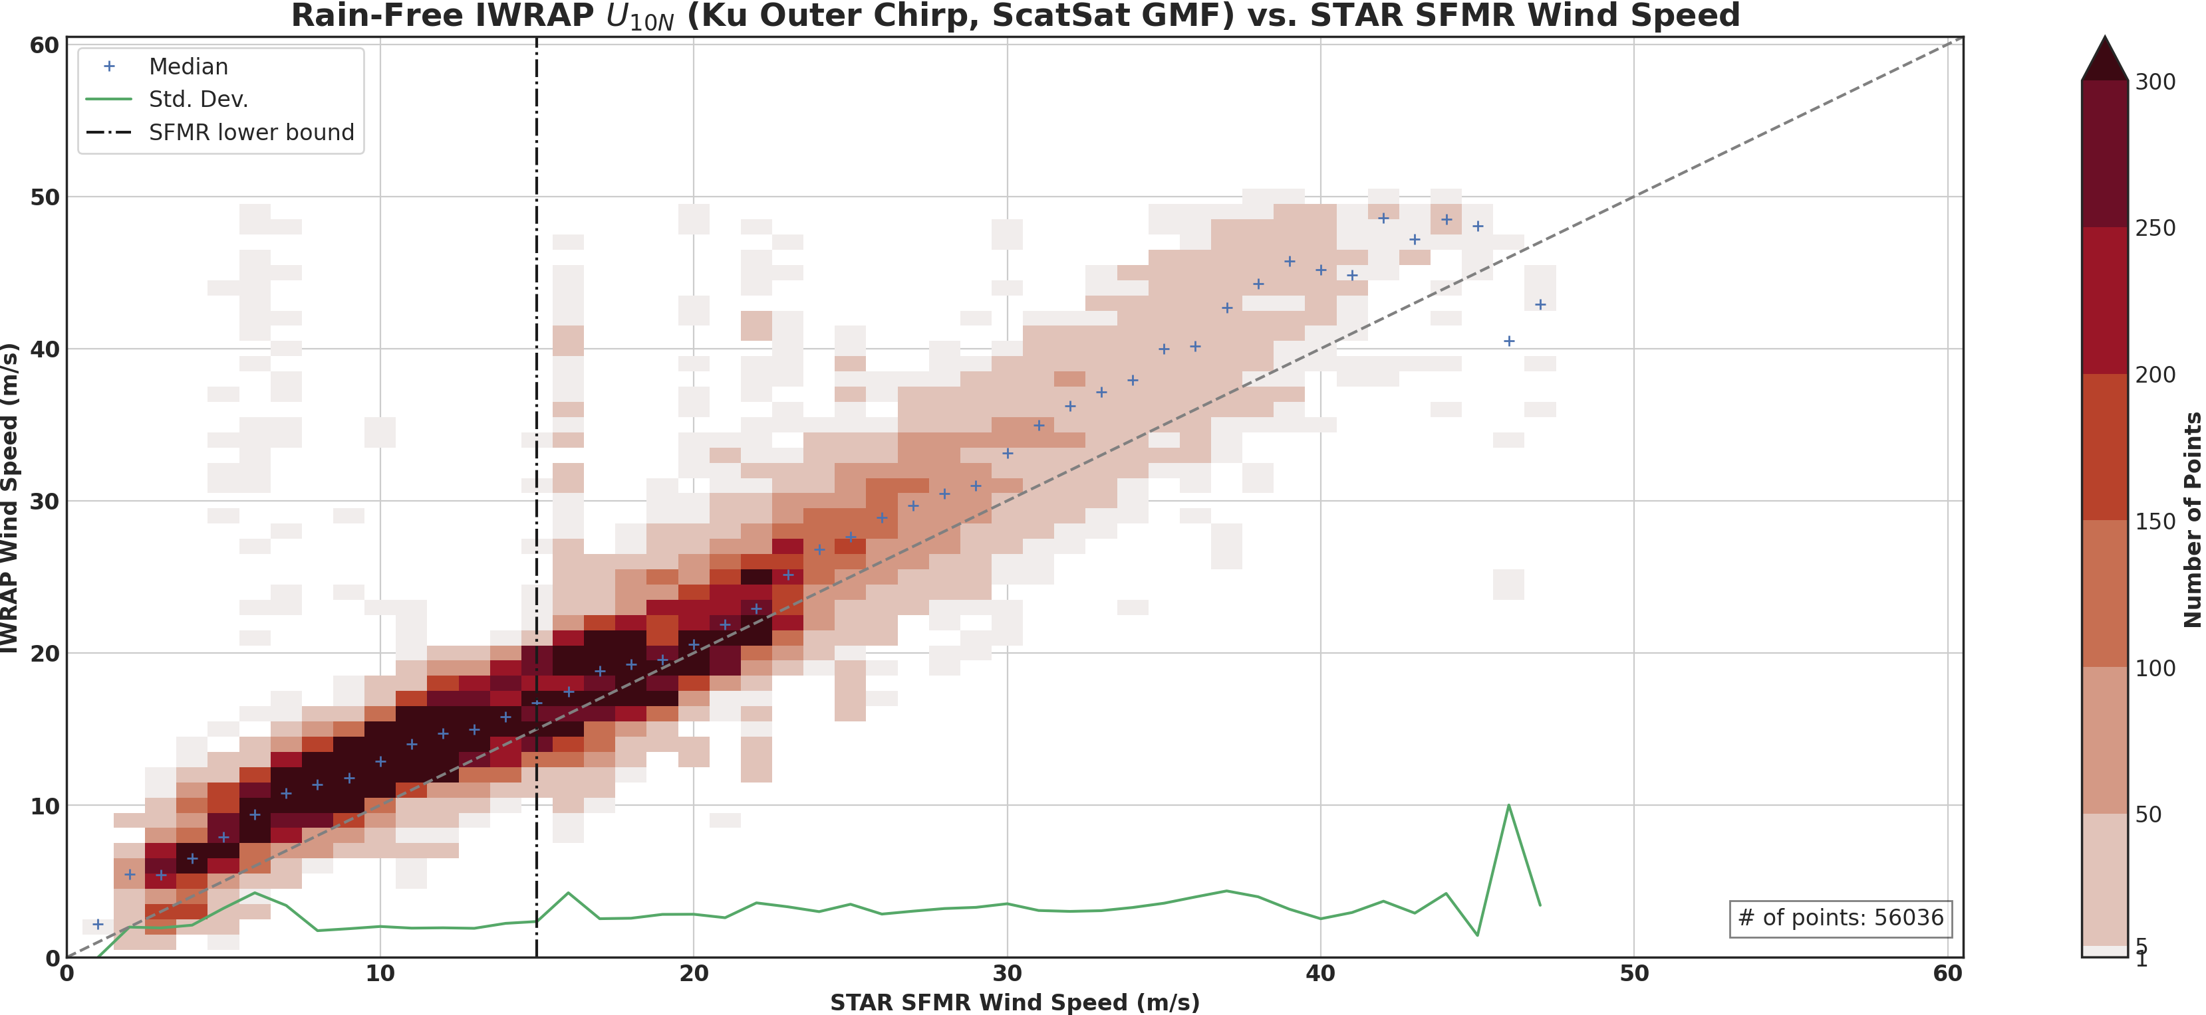
ScatSat GMF – IWRAP Ku@50° Sapp 2019 RTM - SFMR

Slide 9
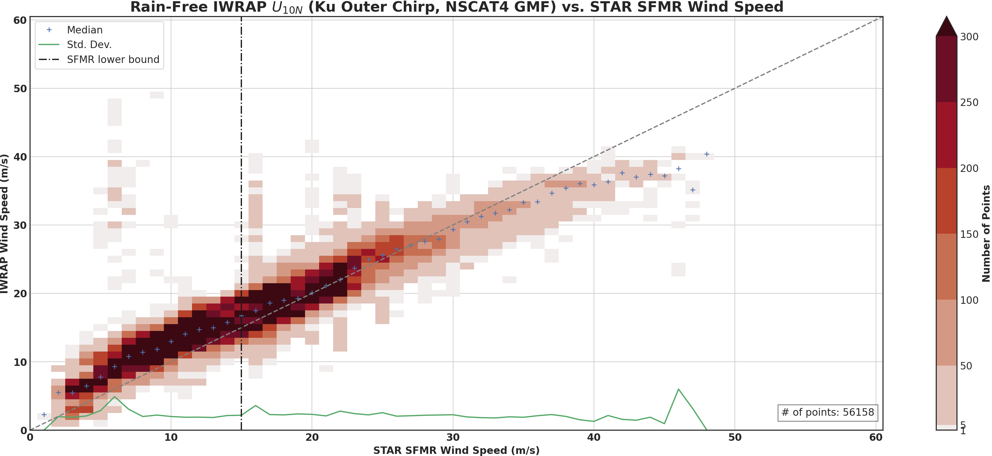
NSCAT4 GMF –IWRAP Ku@50° Sapp 2019 RTM - SFMR

Slide 10
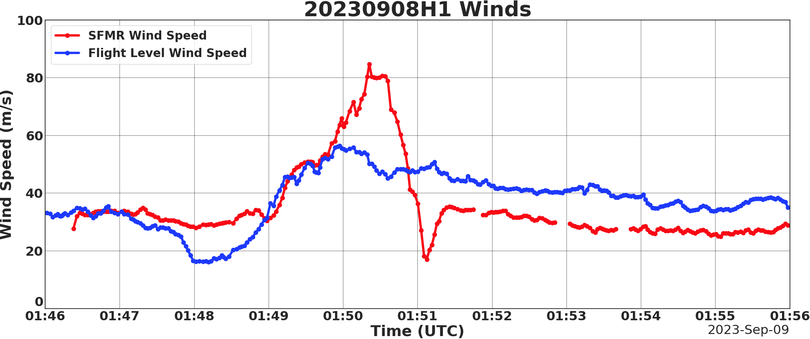
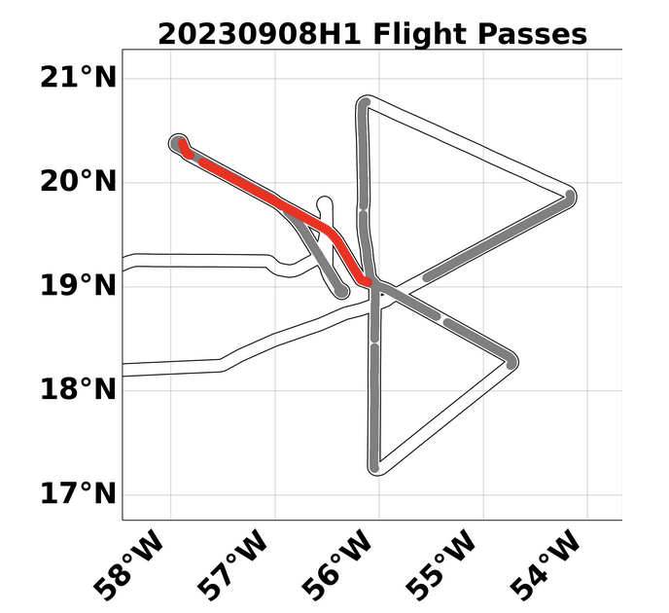
Case of Hurricane Lee Sep 8th, 2023 NE Eyewall Winds: Cat 5 or 2-3?
SFMR surface wind measurements: Physical or Artificial?
Flight path along storm motion – highest waves – wave impact on Tb’s?
Storm just underwent RI was there extreme momentum transfer to the surface?
GMF?
To answer cases like Lee we really need to know what was happening above the surface

Slide 11
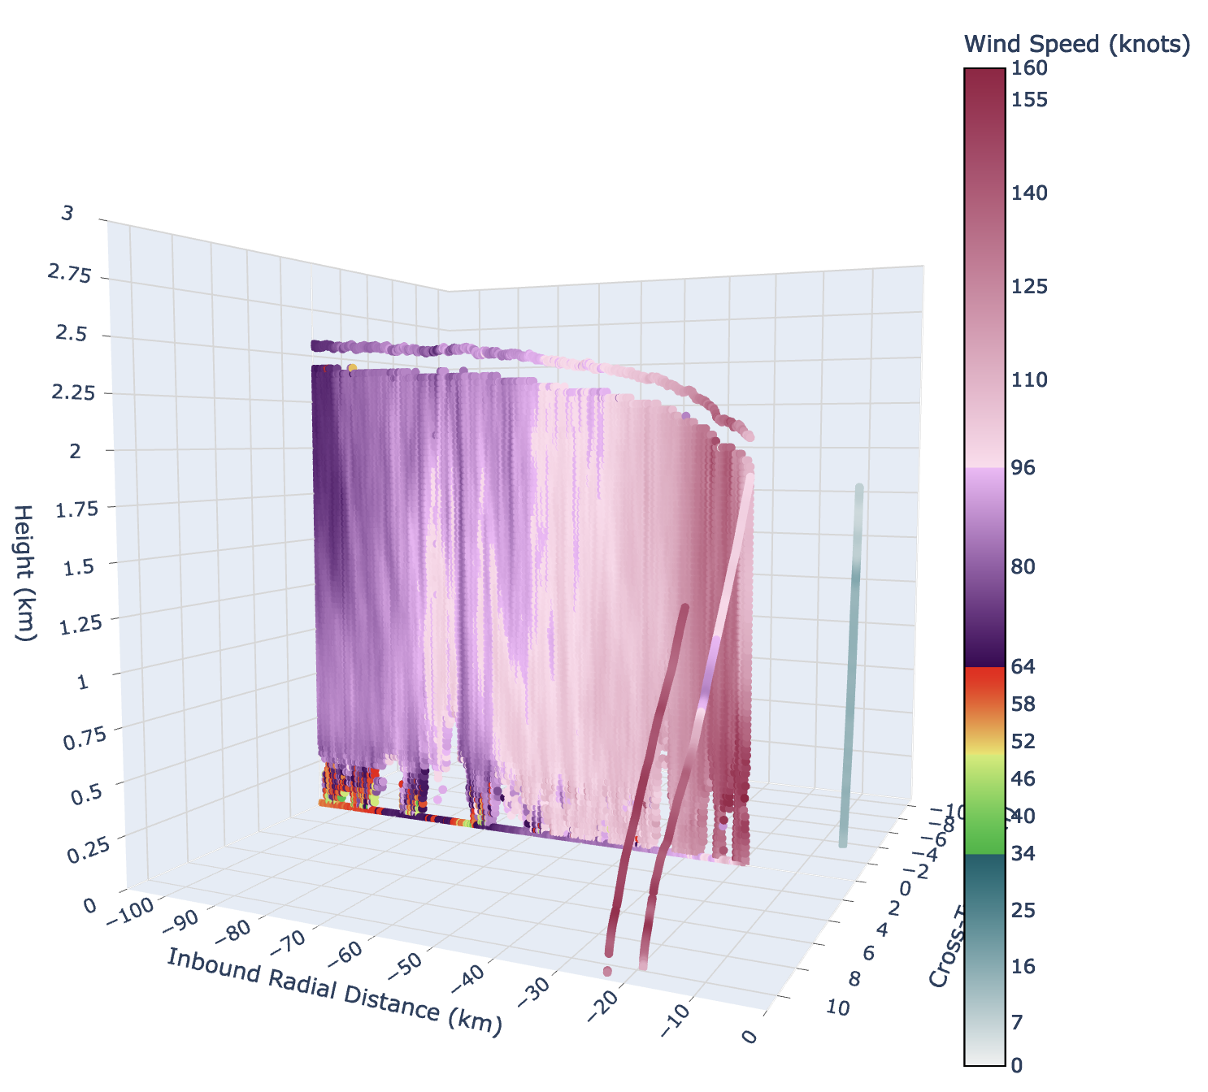
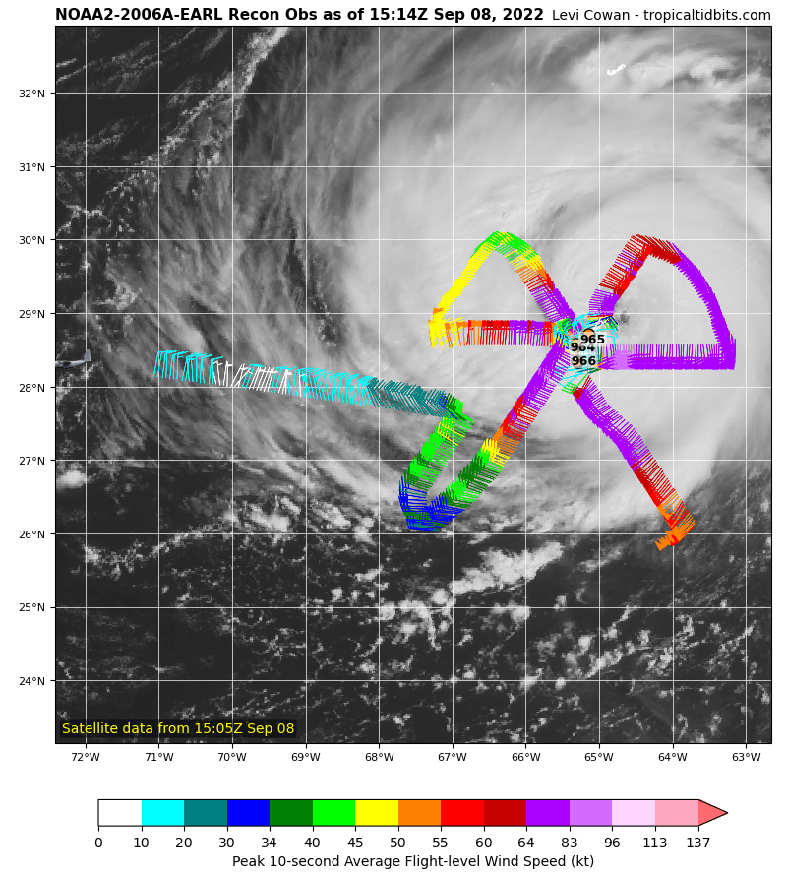
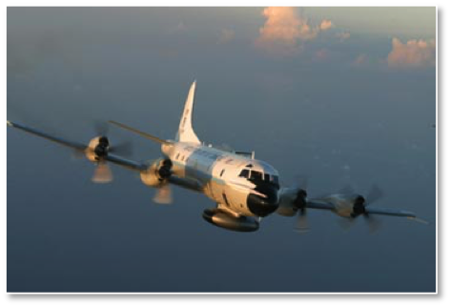
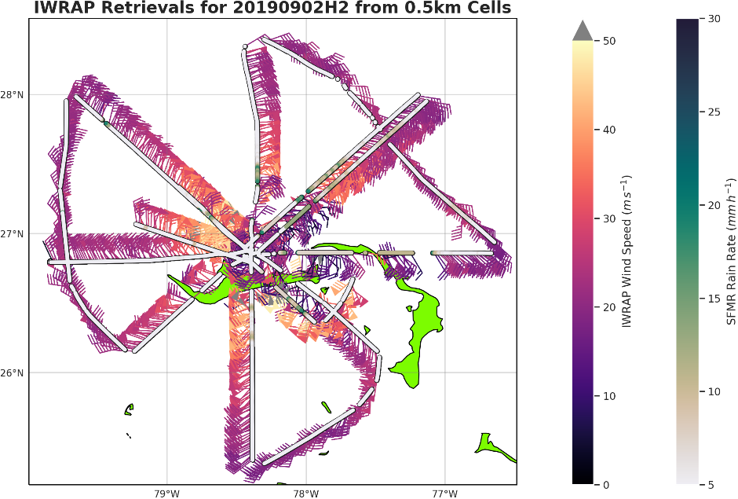
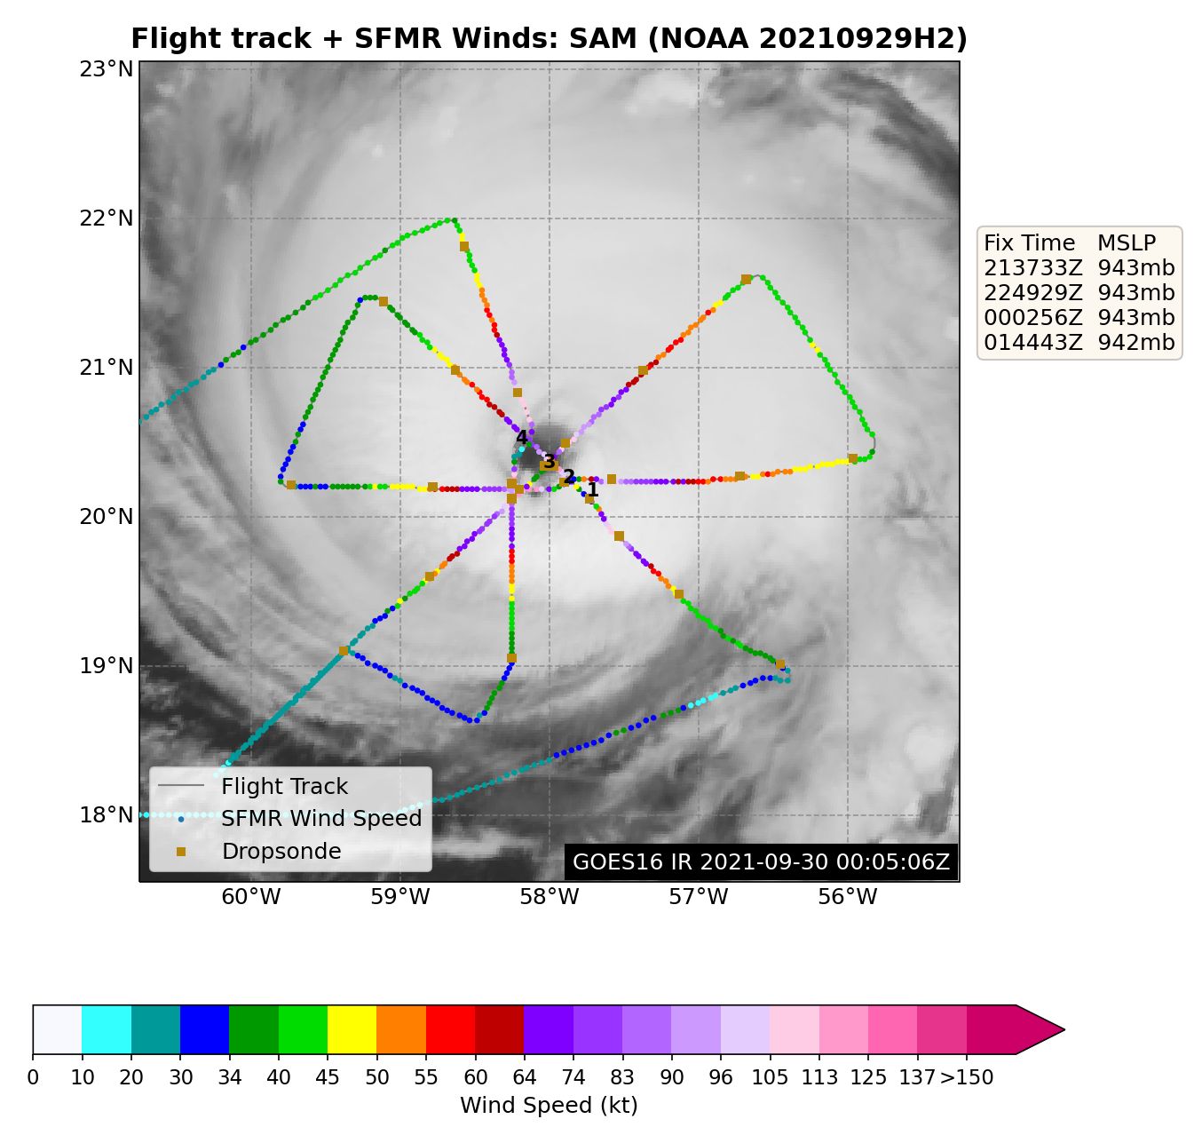
To understand Surface Winds Means We need to Understand What is happening within HBL
TDR
Reflectivity
IWRAP-Imaging Wind and Rain Airborn Profiler (UMASS/NESDIS)
Providing continuous real-time ocean surface winds and fine resolution real-time Doppler velocity and reflectivity profiles below the aircraft to just above the surface
Connecting flight level, surface SFMR and sonde observations
Providing new insite in physical processes of the HBL from very fine resolution measurements that will hopefully lead to better model parametarization
SFMR

Slide 12
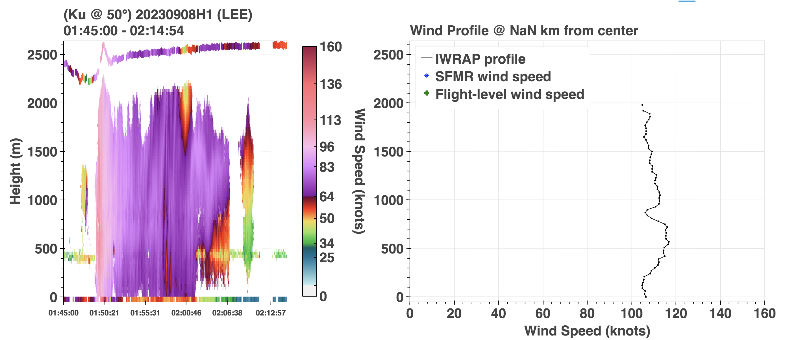
Case of large wind overestimation

Slide 13
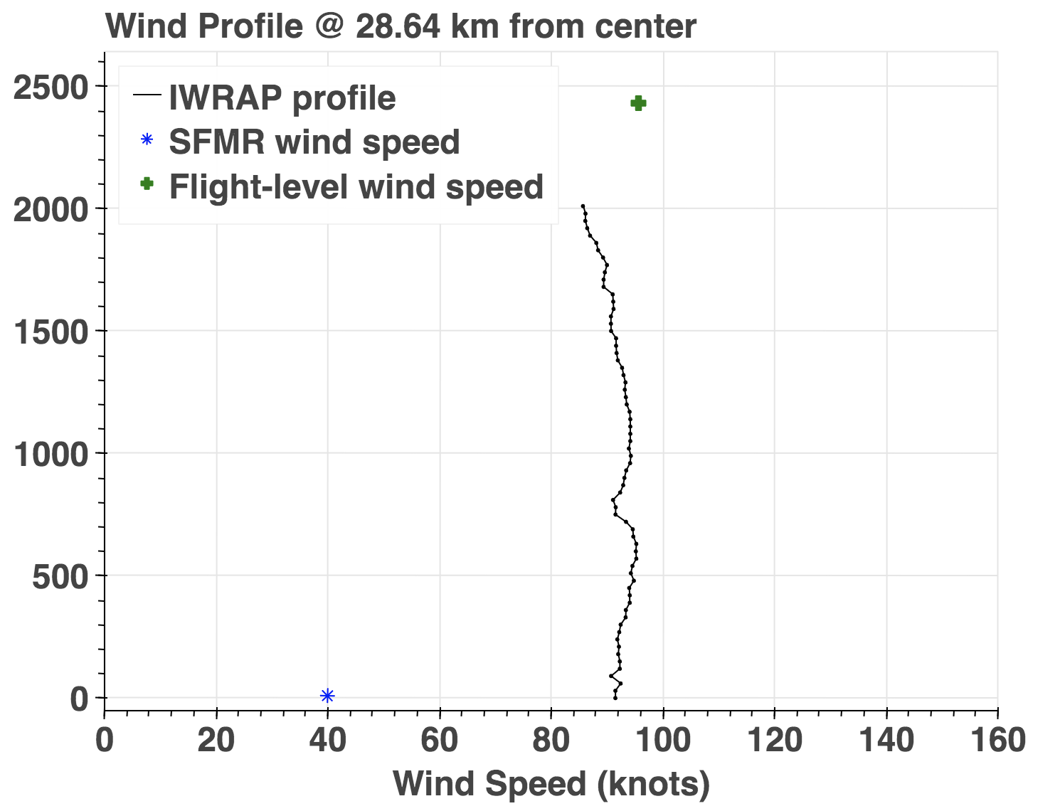
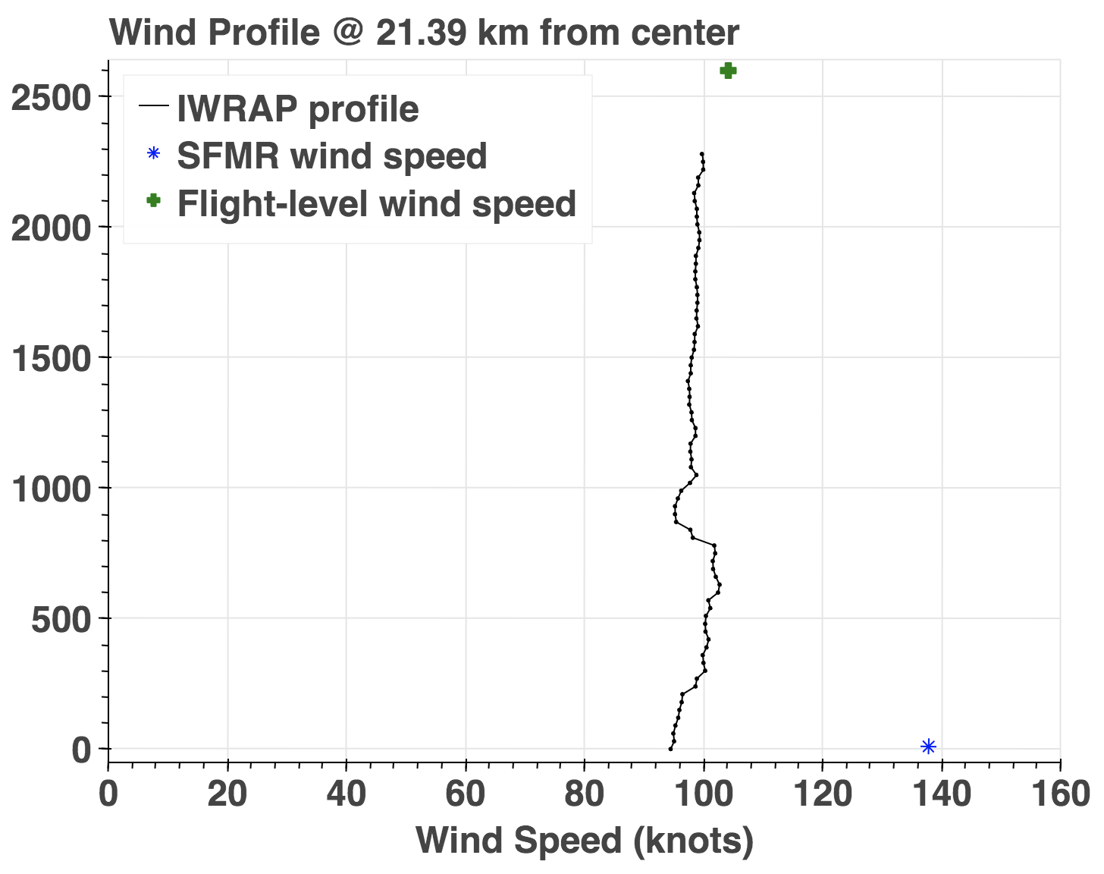
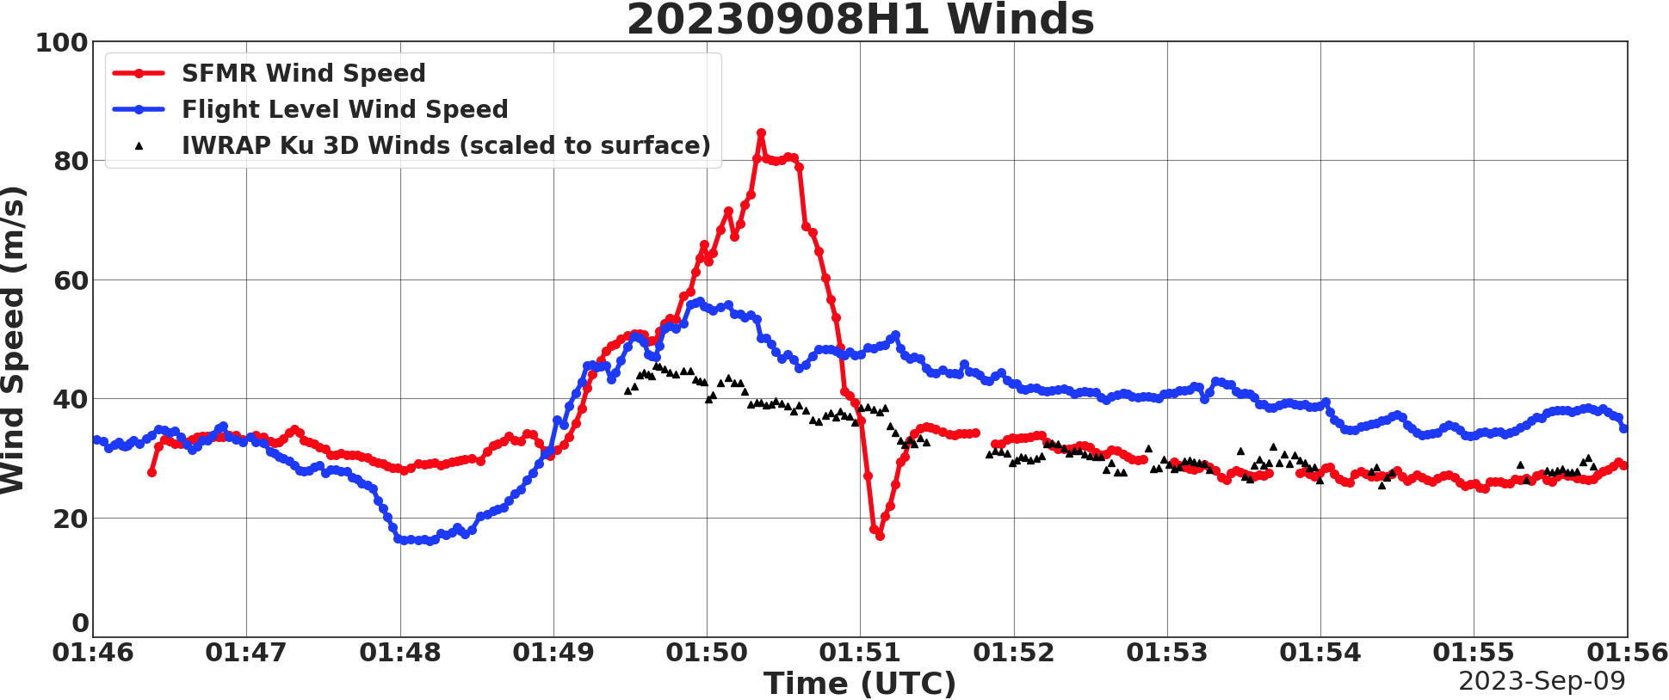
Case of large wind overestimation

Slide 14
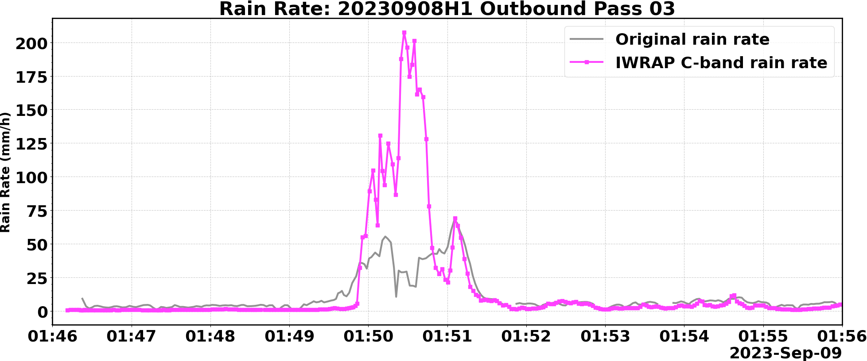
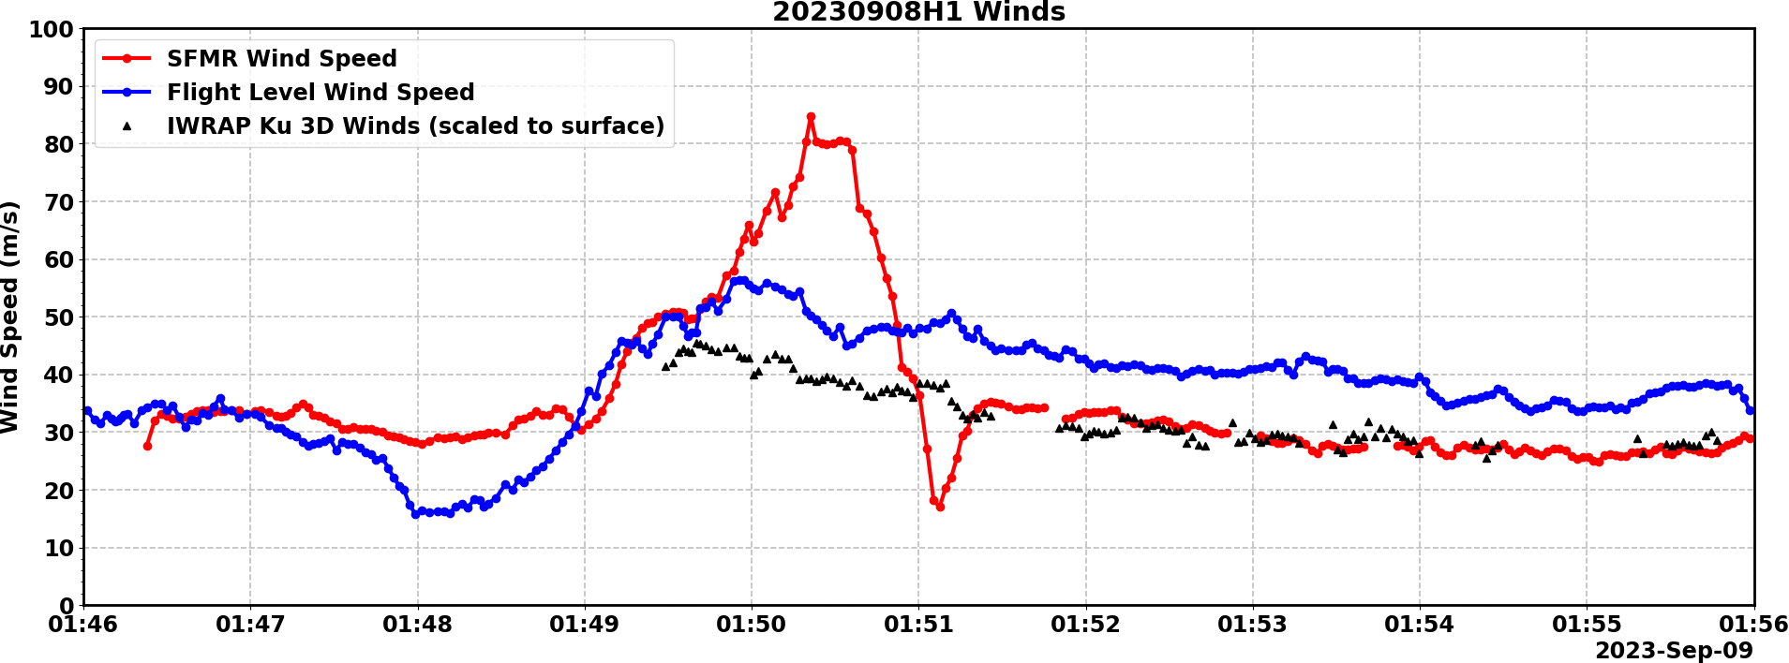
Case of large wind overestimation

Slide 15
Goal for datasets:
Consistent physics in remote sensing and boundary-layer modeling

Slide 16
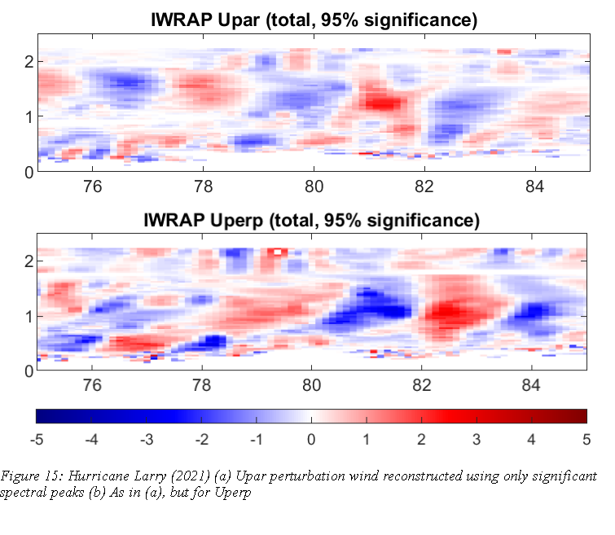
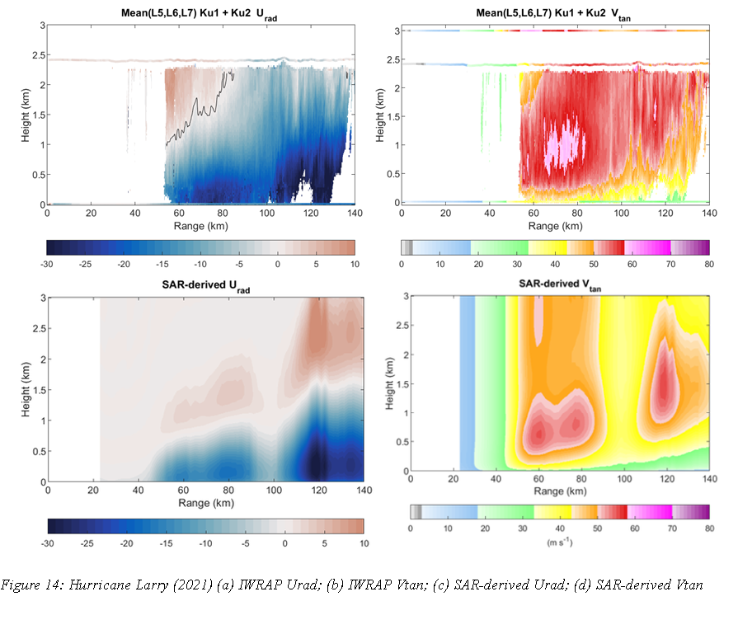
Look at TCBL Rolls with IWRAP and SAR Ralph Foster 2024
Urad
Vtan
Significant Perturbation wind (r-z slice)
Upper: Upar: horizontal component of overturning flow (nearly radial)
Lower: Uperp: horizontal along-roll flow (in/out of page; nearly azimuthal)
Upper: IWRAP
Lower: SAR-derived
Hurricane Larry (2021) Coincident IWRAP and SAR

Slide 17
Look at TCBL Rolls with IWRAP and SAR Ralph Foster 2024
Upper: IWRAP filtered to $1.5<λ<4km$
Lower: SAR-predicted (nonlinear) roll circulation
Note:
Roll circulations “lean into mean shear” (neutral stratification)
Uperp largest in lower PBL, “stretches-around” above
Similar phasing in theory and IWRAP
Structures are asymmetric → enhance fluxes

Slide 18
Look at TCBL Rolls with sUAS and Saildrone J. Zhang 2024 preliminary results
sUAS
Saildrone
Narrow spectral peaks indicate boundary-layer rolls in a similar manner to those detected by P3 aircraft in Hurricane Isidore (J. Zhang et al. 2008)

Slide 19
Sharp increase in stress when rolls emerge
Flux Buoy Data
ERA5
No sharp increase in stress when rolls emerge
Scattered outliers
Mass of data is here
Atlantic Trade Winds Region Upwind of Bermuda

Slide 20
Wind Wave Growth in Hurricanes from KaIA and Measurements SFMR
15
10
5
40
30
20
10
0
10
20
30
40
Kaia Significant Wave Height [m]
5
10
15
SFMR Wind Speed [m/s]
Jelenak at al 2024 AMS
Storm motion speed

Slide 21
Wind Wave Growth in Hurricanes from IFREMER WW3
Jelenak at al 2024 AMS
15
10
5
40
30
20
10
0
10
20
30
40
Kaia Significant Wave Height [m]
5
10
15
Model wave growth parameterization far from observations
WW3 Wind Speed [m/s]
Storm motion speed

Slide 22
C130 P3 G4
Operational
Quasi-Operational
Research
Flight Level TDR MMR
ADWL
W-Radar
UAS
ARO
Microphysics Probes
IWRAP
Flight Level
TDR
Reflectivity
OSVW
Rain Rate
3D Winds
3D Reflectivity
MMR
X-Band Radar
Surface winds
Rain Rate
3D Winds
3D Reflectivity
GPS Sonde + SFMR
KaIA WSRA
3D winds in clear sky
KaIA
WSRA SWH
Surface waves

Slide 23
Future
NOAA is moving away from the P-3 platform by 2030
We need recommendations from community regarding next generation aircraft instruments
What measurements should be sustained
No plans for replacement of any operational instruments
TDR replacement plan is still uncertain
What research measurements would be good to transition to operations
There is transition plan for WSRA instrument
What new measurements are needed?

