Slide 1
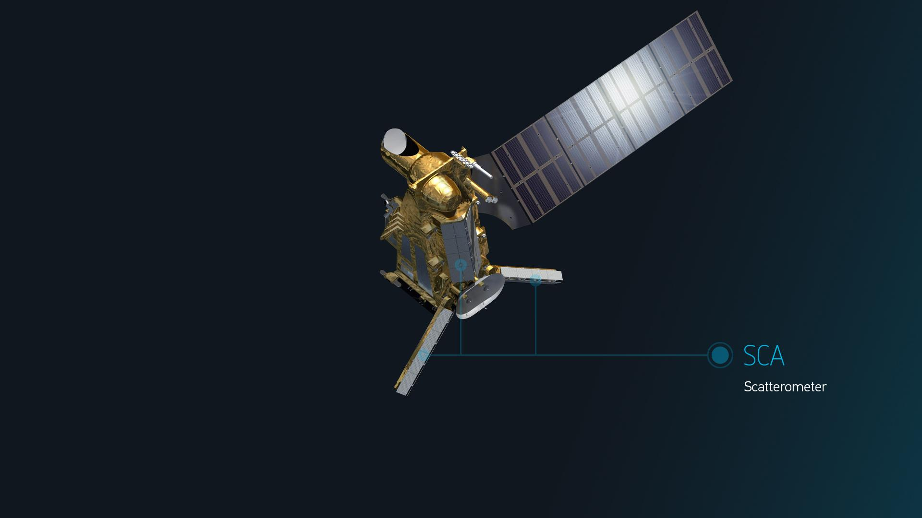
DopSCA
ESA
MOMS
Ad.Stoffelen@knmi.nl
Alexandre Payez
Paco Lopez-Dekker
Owen O’Driscoll
29 May 2024

Slide 2
Earlier DopSCA
The high-quality scatterometer SCA is an excellent starting point for observing ocean motion, as accurate wind input is needed for Stokes drift knowledge
The digital signal transmitter allows DopSCA waveforms (chirps)
Pointing knowledge may be proven adequate (TBC on ASCAT)
First simulation studies now provide a feasible concept on SCA with marginal, but potentially useful accuracy, e.g., in hurricane wind conditions or for monthly climatologies
DopSCA campaign(s) may be envisaged?
ESA and EUMETSAT DopSCA studies in preparation

Slide 3
DopSCA simulation
Peter Hoogeboom, Emeritus TU Delft
Dual chirp of approximately 0.115 ms, separated by approximately 0.011 ms
Echo cancellation
The result shows that it should be possible to obtain 0.5 m/s precision
on the surface for a single 50 x 50 km WVC
SCA will be 15 km spatial resolution and other space-time averages are feasible
Time delay between transmit pulses in ms | Precision in m/s Combined pulse responses | Precision in m/s Echo cancelled pulse responses | Precision in m/s Echo cancelled pulse responses, 50 x50 km WVC
0.115 | 1,23 | 0,80 | 0,39
0.1265 | 1,09 | 0,67 | 0,34
0.138 | 1,02 | 0,72 | 0,37
0.1495 | 1,03 | 0,73 | 0,36
0.161 | 1,04 | 0,84 | 0,42

Slide 4
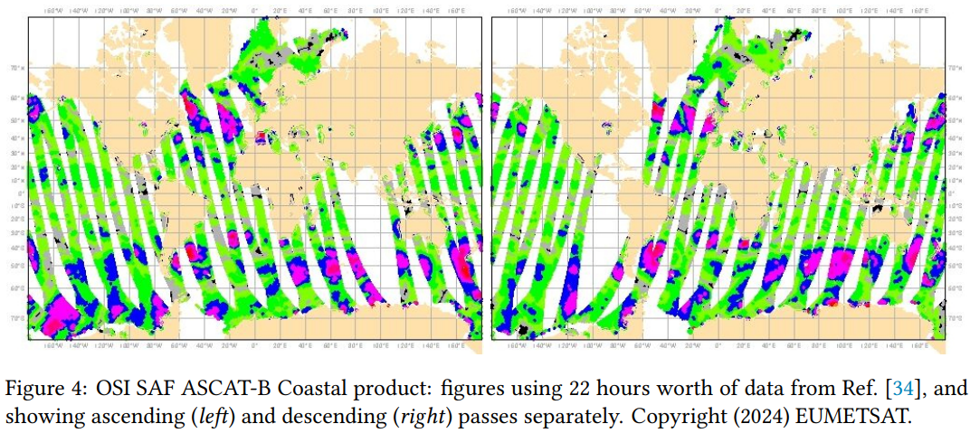
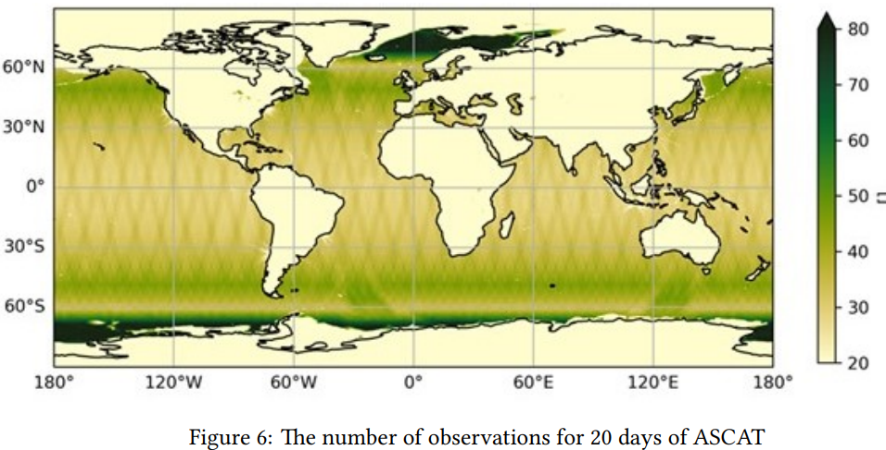
From ASCAT coverage
Other space-time averages are feasible
SCA has 10% more coverage
If wave motion is taken out instantaneously by a wind proxy, then in 20 days, currents with SCA can be determined with 6 times smaller SDE
(0.25 deg.)

Slide 5
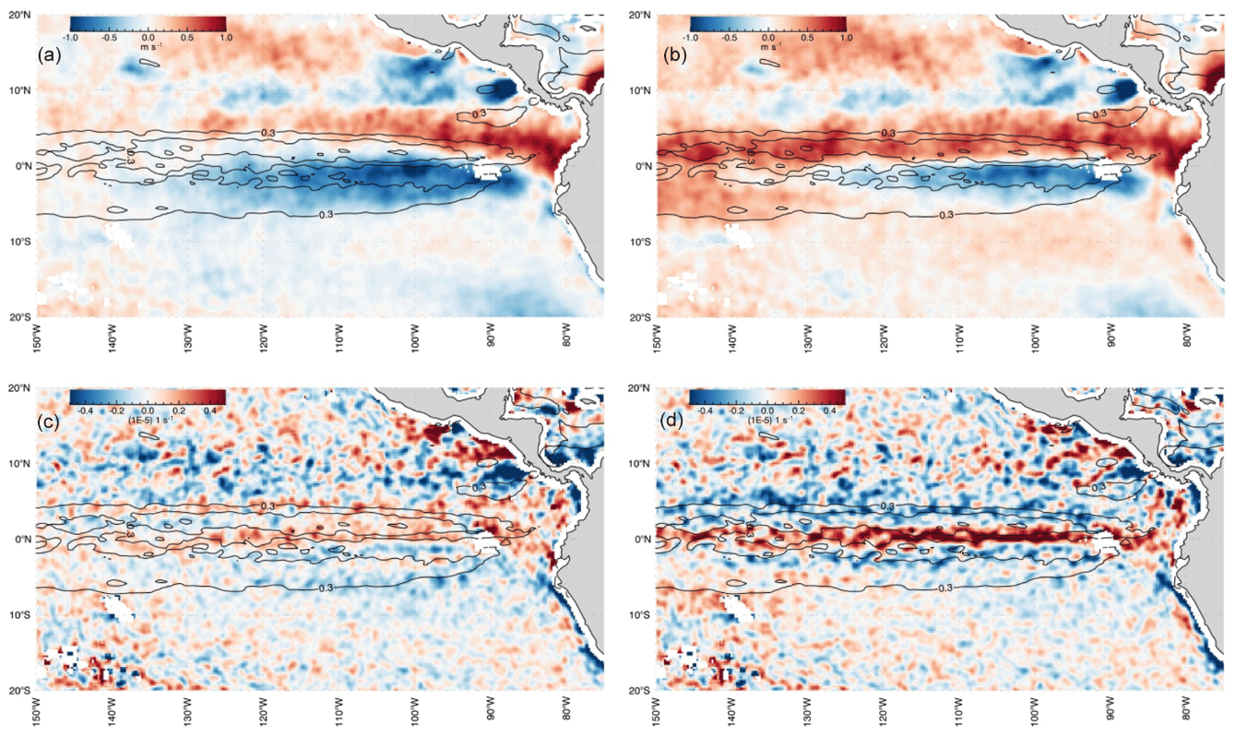
What do we really know about OSC?
Corrected with CMEMS currents
Errors increase after correction, while they appear closer associated with the currents
Variances on m/s level, not cm/s
Δf before correction
Δf after correction
2016
Δ∇xτ before correction
Δ∇xτ after correction
Belmonte Rivas and Stoffelen (2019)

Slide 6
We really know very little about OSC
No direct current measurement system exist yet
Geostrophic measurements appear unable to inform small-scale currents
Much ocean motion is generated by the wind and associated waves, which change rather fast, hence collocated measurements of wind and current are very beneficial
Seeing only large-scale currents will be useful to correct coupled atmosphere-ocean models on a timescale of months to years
Requirements appear more based on goals than on thresholds or breakthroughs
With support from the ocean current community (references) we will provide thresholds and breakthroughs

Slide 7
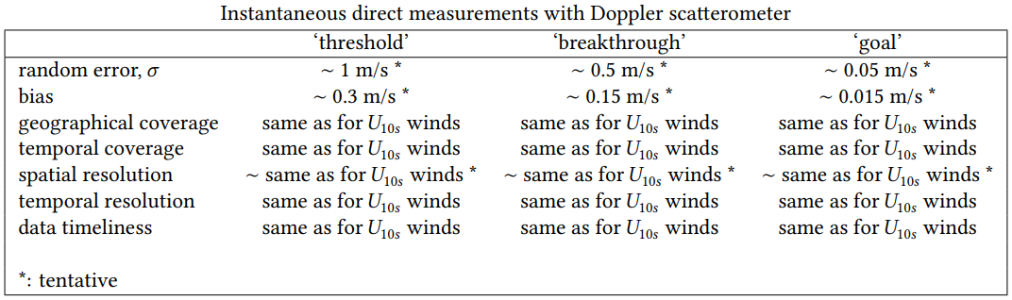
WVC Doppler requirements
SCA exists and will not be changed; DopSCA is a “no-cost” opportunity
IOVWST feedback is much appreciated!
Contact me for MOMS TNs on requirements and specifications

Slide 8
Other Doppler missions
SCA follow-on in the 2050 time frame
SeaStar Earth Explorer, not selected by ESA
NASA/CNES Odysea, proposed (how likely?)
Harmony Earth Explorer selected by ESA
OSCOM approved, CFOSAT follow-on
Limitations
Synergy between approved missions

Slide 9
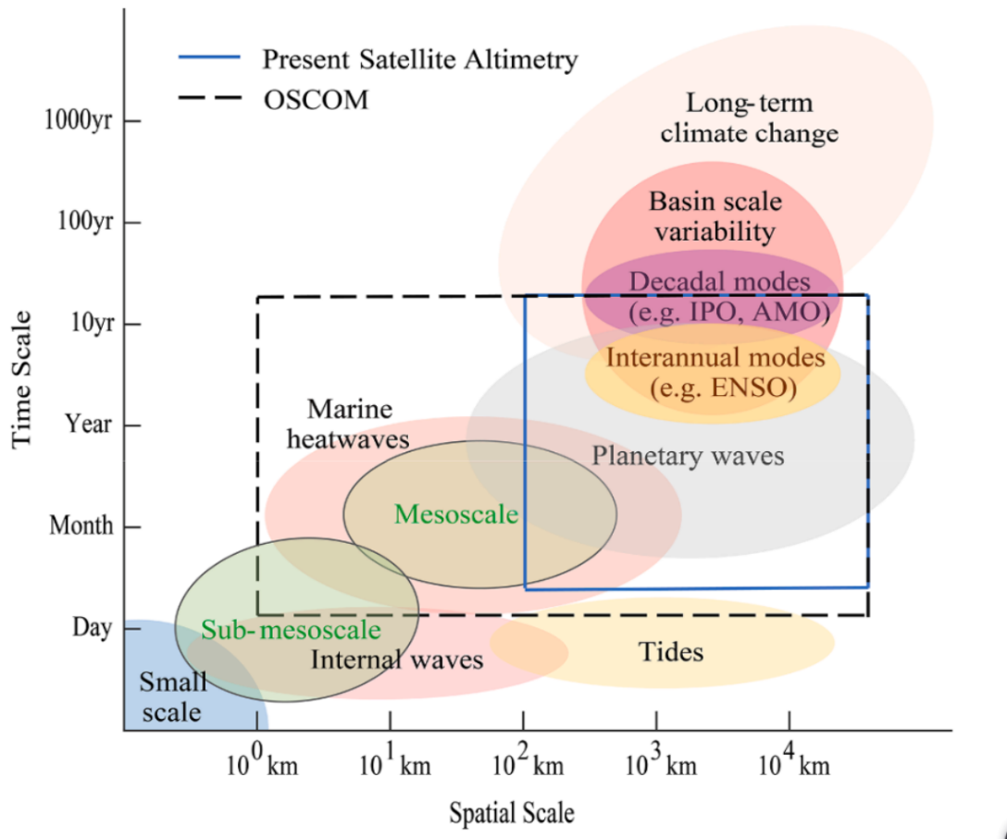
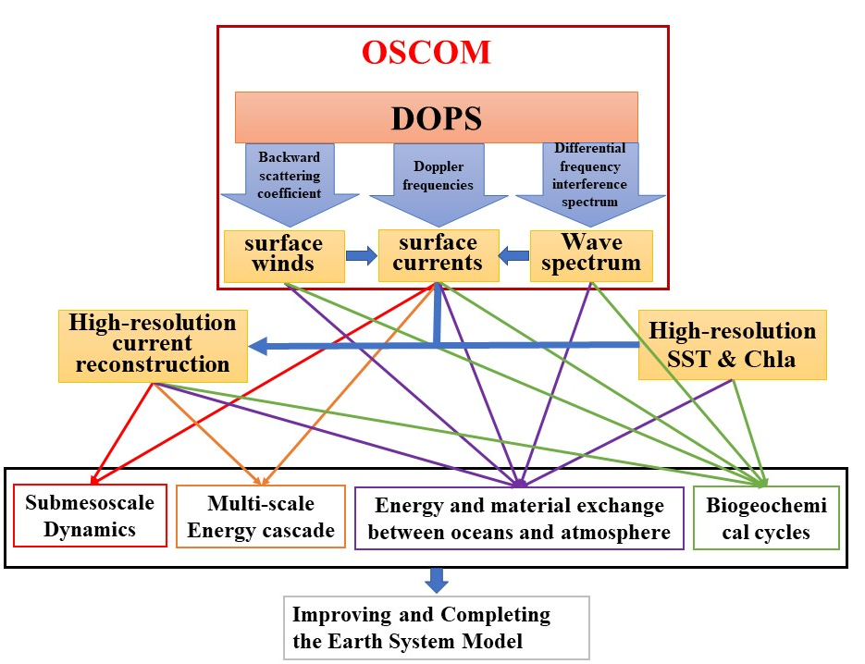
Ocean Surface Current multiscale Observation Mission (OSCOM)
Requirement and Achievement
OSCOM will directly measure ocean surface currents with a very high horizontal resolution of 5–10 km and a 3-day global coverage. The accuracy of currents is 0.1m/s in speed and 15° in direction.
Du et al., 2021 doi.org/10.1016/j.pocean.2021.102531
duyan@scsio.ac.cn & dongxiaolong@mirslab.cn
Chinese Academy of Sciences

Slide 10
Complementarity with SCA
OSCOM (perhaps Odysea, CFOSAT FO)
More accumulation over a given period
SCA works in rainy regions
OSCOM may be a SCA reference for OSVC
Harmony
Not a global mission, an explorer
Scenes with high resolution for underlying ocean km-scale processes
SCA is reference for calibration and vector winds

Slide 11
SCA opportunities under study
Commissioning
More dual-chirp pulses by more beams over a few days?
Dual pulse shape and power optimization?
Pulse sequences?
Processing chain
  Wind use for Doppler?
  Doppler use for winds?
  . . .
Operations
Continuity of the SCA wind mission!
Explore further use of pulses and prove (much) loss of wind quality
Discuss possible technical trade-offs with SCA SAG and SCA experts at EUMETSAT, ESA

Slide 12
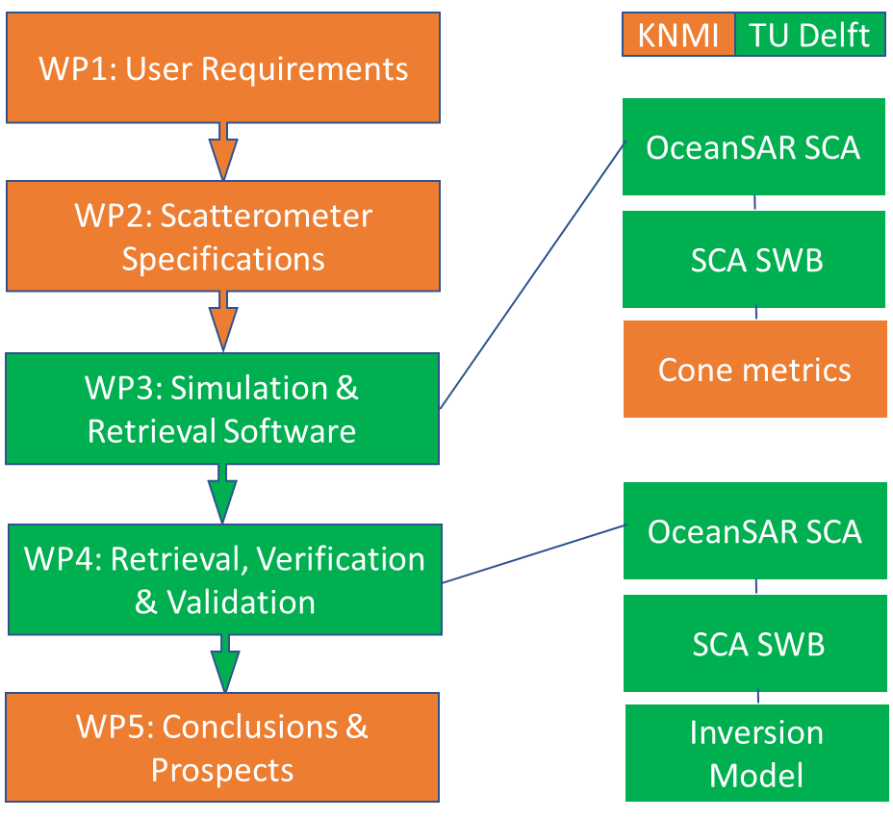
MOMS WP overview

Slide 13
Backup slides

Slide 14
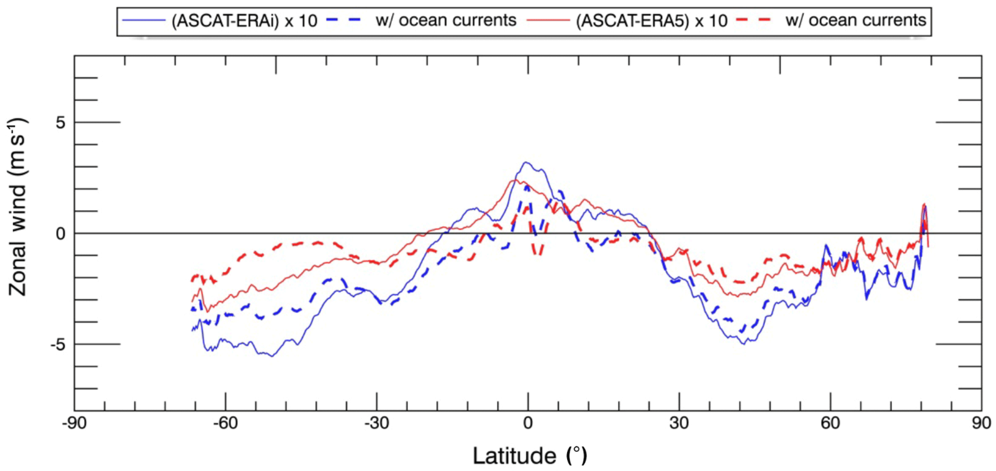
What do we really know?
Copernicus Marine Service mean ocean currents typically reach 0.2 m/s
Basin-scale biases are (only) partially removed
Belmonte Rivas and Stoffelen (2019)

Slide 15
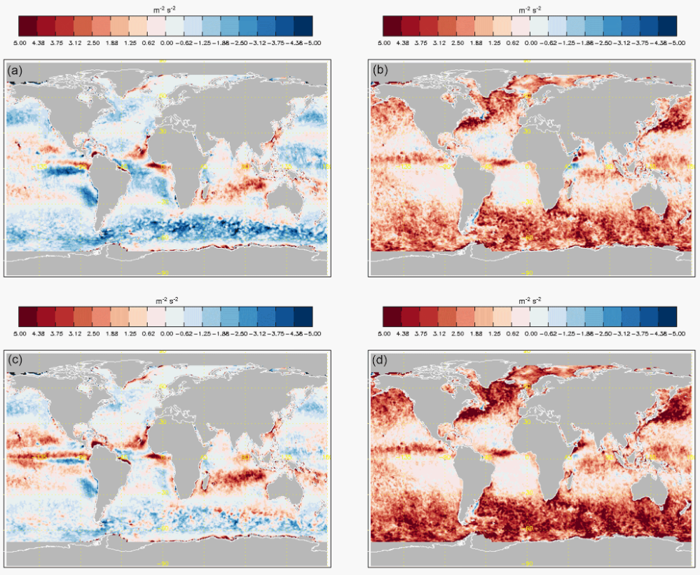
What do we really know about OSC?
These currents generally deteriorate the deterministic differences between scatterometer and ERA5 model
Variances on m/s level, not cm/s
MKE before correction
EKE before correction
MKE after correction
EKE after correction
Belmonte Rivas and Stoffelen (2019)
2016

Slide 16
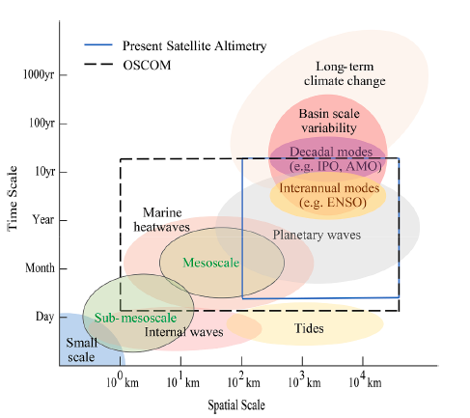
Ocean Surface Current multiscale Observation Mission (OSCOM)
Scientific issues: ① Multi-scale dynamical process interaction and energy cascades
Spatial-scale [km]
Sub-mesoscale ~10km
Mesoscale
~100km
Large-scale
~1000km
Small-scale
~100m
90% Kinetic Energy
Kinetic density
Reverse cascading
Forward cascading
Wave number [cpkm]
D'Asaro et al., 2011, Science
How to separate multi-scale processes in the global ocean surface total currents?
What constitute the unbalanced ocean dynamic processes?
How do mesoscale and sub-mesoscale processes in the ocean interact with each other and transform energy?
How does the energy of surface wind input and convert to ocean currents and waves?

Slide 17
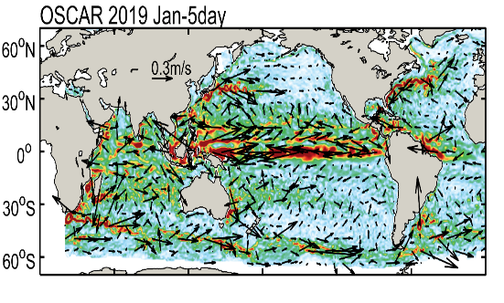
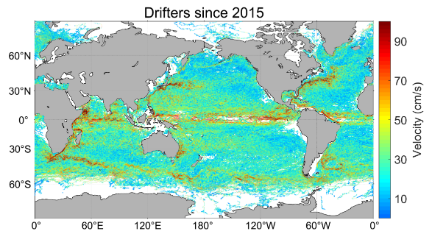
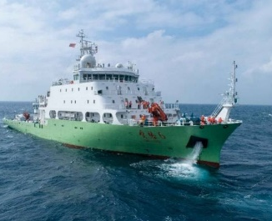
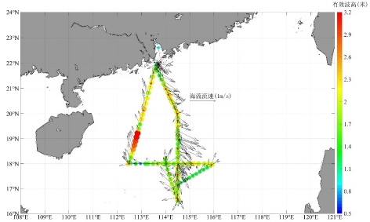
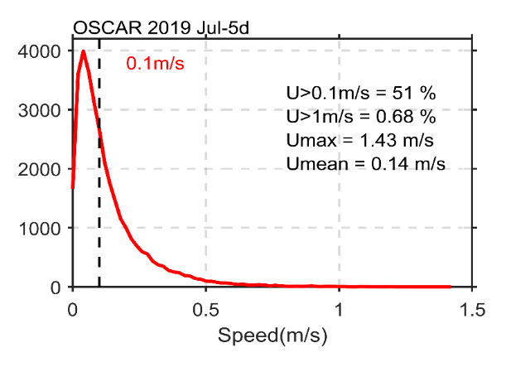
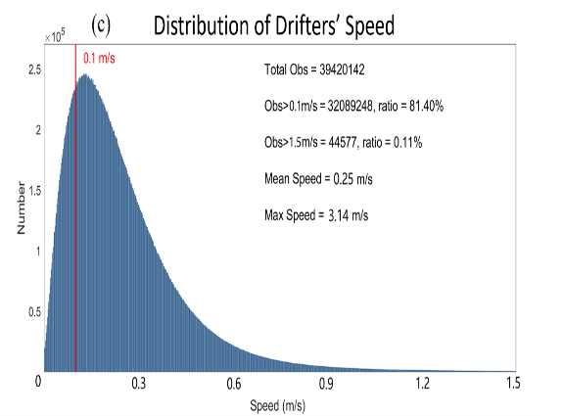
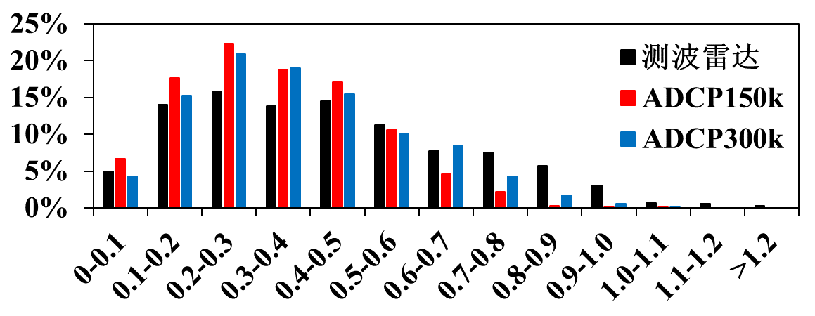
Ocean Surface Current multiscale Observation Mission (OSCOM)
Global ocean surface velocity: OSCAR, Argos, ADCP, Radar
5-day mean OSCAR currents: Currents with speed ≥0.1m/s account for 51% of the global currents
6-hour mean Argos currents: Currents with speed ≥0.1m/s account for 81% of the global currents
In-situ observed currents (2021): Currents with speed ≥0.1m/s account for 95% of the currents
>0.1m/s

Slide 18
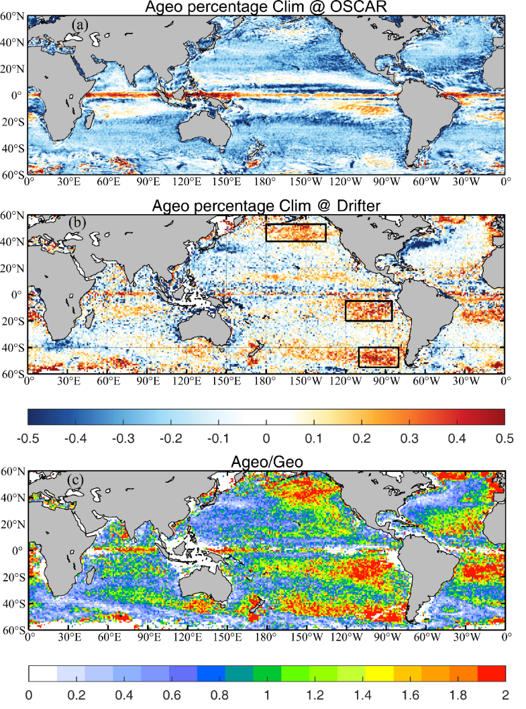
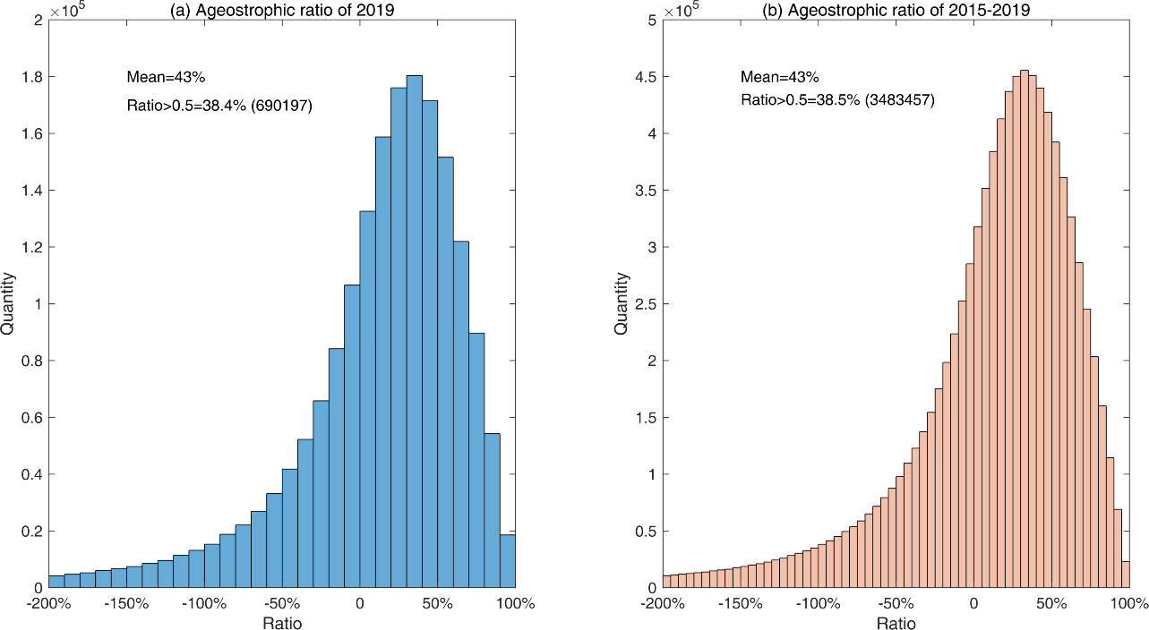

Ocean Surface Current multiscale Observation Mission (OSCOM)
Importance of the non-geostrophic currents
The non-geostrophic currents determine the directions of the total currents in the near-equatorial trade winds and mid-latitude westerly winds prevailing regions, where the maximum non-geostrophic speed can reach twice the geostrophic speed and exceed 60% of the total current.
The OSCAR data cannot reveal the non-geostrophic processes in these regions and underestimate the weakening effect of the non-geostrophic process in the strong western boundary currents and the Antarctic Circumpolar Current.
The non-geostrophic currents in the global ocean account for ~43% of the total current

Slide 19
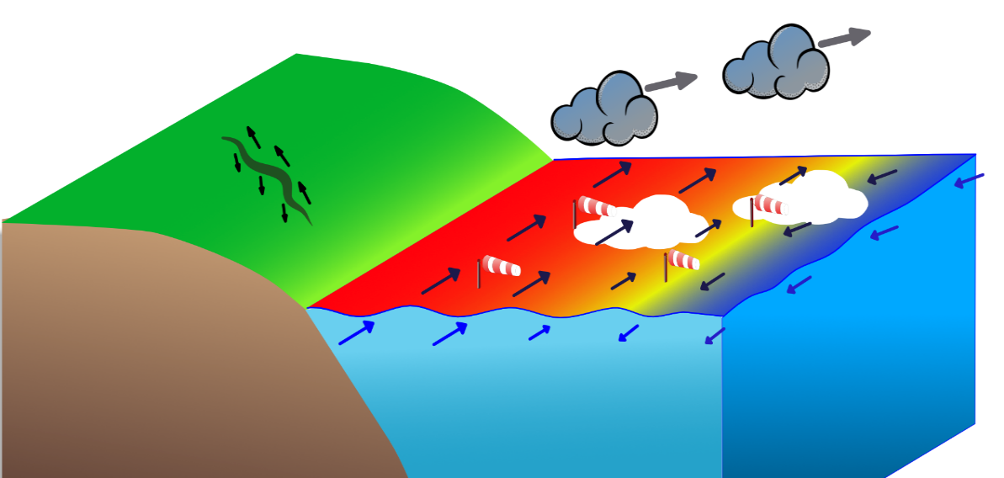
EE10 HARMONY observation concept: stereo phase
Exploit Sentinel-1
Add tandem satellites
Line-of-sight diversity for high resolution (km)
Ocean surface vector motion (Doppler)
Surface vector winds (scatterometry)
Improved directional surface wave spectra
Sea Surface (skin) Temperature (SST)
Cloud-top motion (TIR time-lapse) and
height (TIR parallax)
Sea Ice / cryosphere application
3-D surface deformation (DInSAR)
Approved for 2029
Focus on km-scale processes
Regional explorer mission
Limited calibration for NRCS/Doppler

Slide 20
Ocean Surface Current multiscale Observation Mission (OSCOM)
Configurations and measurement principles
Payload: Doppler Scatterometer (DOPS )
Variables:
Ocean surface currents (OSC)，
Ocean surface vector winds (OSVW),
Ocean surface wave spectrums (OSWS)
Parameter | Values
Wave band | Ka+Ku
Polarization mode | Ka：VV Ku：HH、VV
Swath | ＞1000km
Resolution | 5km（OSC, OSVW） 10km（OSWS）
Accuracy | 0.1m/s（OSC） 1.5m/s（OSVW） 15°（OSC，OSVW）
Rotating speed | ~15rpm
Antenna diameter | 1.5m
Ku
Ka
Direction
View

Slide 21
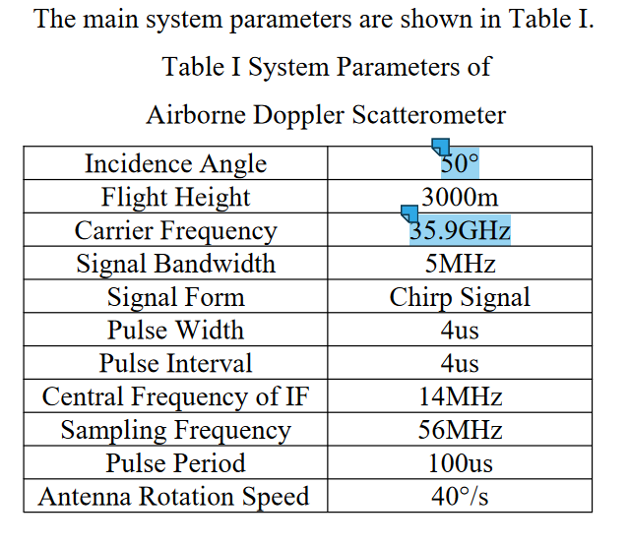
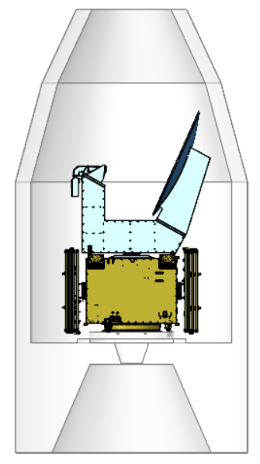
Ocean Surface Current multiscale Observation Mission (OSCOM)
Ka & Ku Dual Frequency Doppler Scat onboard OSCOM
Payload | Payload Parameter | Technical Indicator
Ka+Ku DOPS | Dual Band：Ka+Ku; incidence: 46°-49°; Polarization: Ka-band: VV, Ku-band: HH & VV; | Resolution ： 5 km (OSC, OSVW) Swath：>1000 km Accuracy: 0.1m/s (OSC) ≤15° (OSC, OSVW)
Burst

Slide 22
CFOSAT follow-on DopSCAT proposal
Ku band Doppler Scat onboard Wind-Wave Satellite
Payload | Payload Parameter | Technical Indicator
Ku-DOPS | Frequency：13.256GHz (Ku); incidence: 46°-49°; Polarization: HH &VV; | Resolution ： 12.5 km (OSC, OSVW) Swath：>1000 km Accuracy: 0.2m/s (OSC) 1.5m/s (OSVW) ≤15° (OSC, OSVW)
CFOSAT SCAT transmit/receive was thermally unstable
Wind-wave Satellite is the follow-on missions of CFOSAT.
The Scatterometer will upgrade to Ku band Multi-beam Doppler Scatterometer for the Ocean Surface Current observation.
Ocean Surface Current accuracy: 0.2m/s
Resolution, Wind vector accuracy will be improved

Slide 23
Odysea (previously WaCM)
Pencil beam scatterometers
  Ku-band (10 km nominal resolution; provided by ISRO)
  Doppler Ka-band (5 km nominal resolution for winds; JPL)
Ocean current measurements
  Spatial resolution: <25 km
  Temporal resolution: <10 days
  Vector velocity accuracy: 5 cm/s – 10 cm/s
Limitations
- Not yet approved
- High noise at low winds (tropics)
- Cloud and rain Doppler problem for, e.g., cold pool ocean dynamics
- 10 days averaging

Slide 24
