Slide 1
Outstanding issues in calibration for routine conditions
IOVWST meeting
Day 3, talk 2
Co-leads: Zhen Li (KNMI), Ad Stoffelen (KNMI), Richard Lindsley (RSS)
15 Nov, 2023

Slide 2
Some notions on scatterometer NRCS calibration
The NRCS is a geophysical quantity and does NOT depend on instrument
Hence, instruments may be intercalibrated to provide consistent NRCS
Transponder calibration is difficult, hence ancillary methods are used
Using collocated scatterometers, calibration and GMFs are being made consistent for Ku and C bands and different polarizations
Thermo-elastic wave guide effects make antenna beam pattern gain specifications in space inaccurate and linear correction (a dB value) is needed per incidence angle
Antenna noise floor corrections are critical for low NRCS calibration
Rotating scatterometers may suffer from poor azimuth-angle effect compensation
A posteriori calibration corrections are worse than the associated improvements in instrumentation and processing (though work quite well)

Slide 3
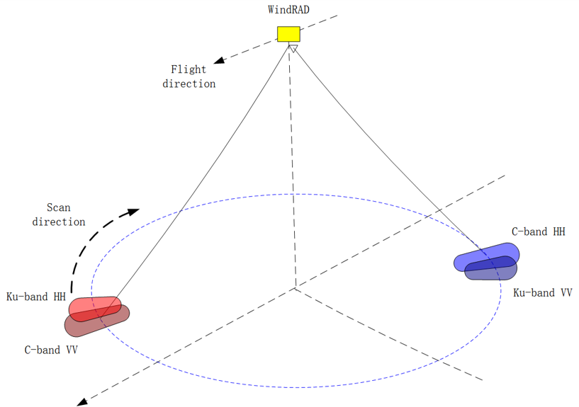
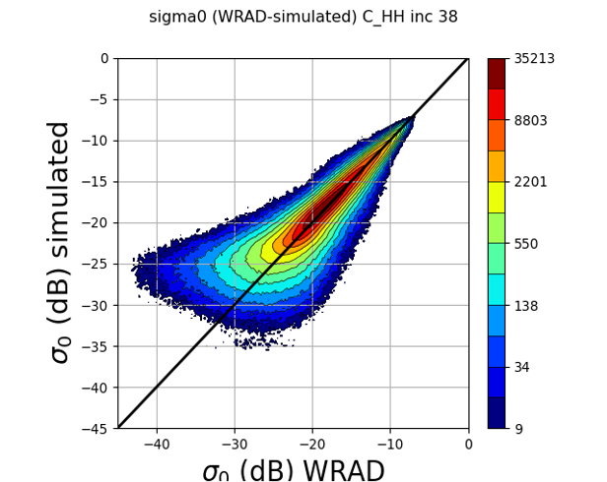
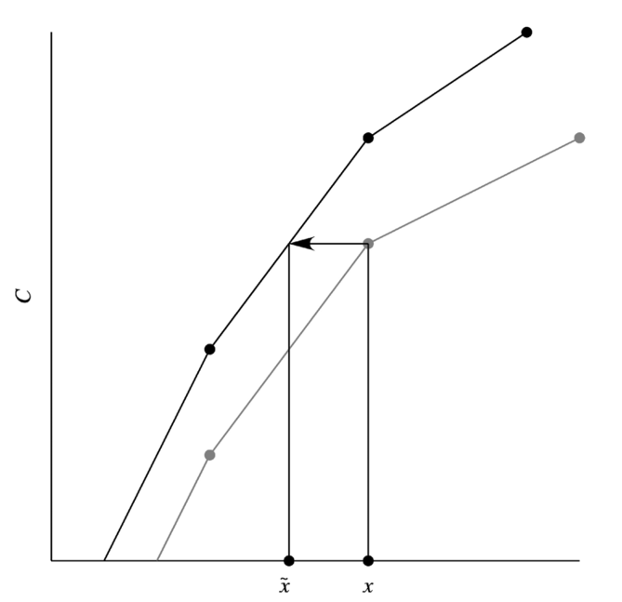
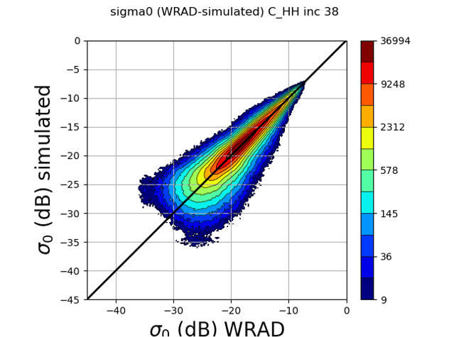
Higher Order Calibration (HOC) for non-linear distribution in Sigma0s
Zhen Li¹, Ad Stoffelen¹, Anton Verhoef¹, Zhixiong Wang², Jian Shang³, Honggang Yin³
KNMI¹, NUIST², CMA³
Link to poster
It employs CDF matching technique to calibrate the non-linearity in the sigma0 distribution
There are two issues in needed of calibration:
The ridge off the diagonal, usually => NOC
The non-linearity at the low sigma0 values => HOC
NOTE:
HOC can remove the incidence angle dependency, which is NOC as a function of incidence angle and the non-linearity.
HOC cannot remove the azimuth angle dependency, which is introduced by rotating and level-0 processing.

Slide 4
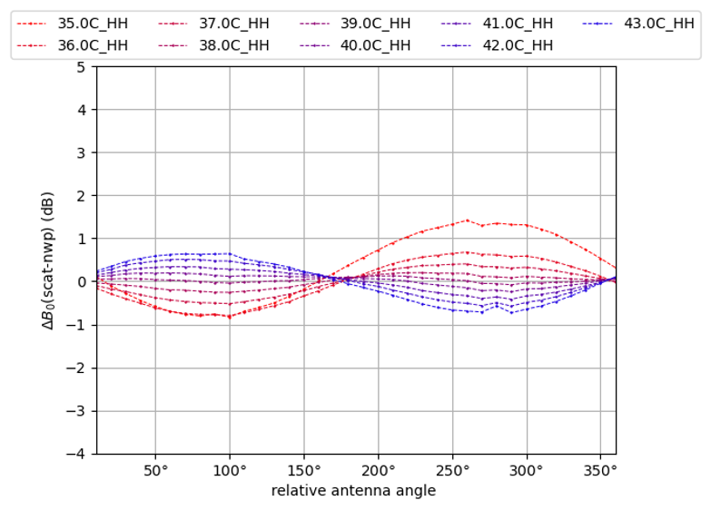
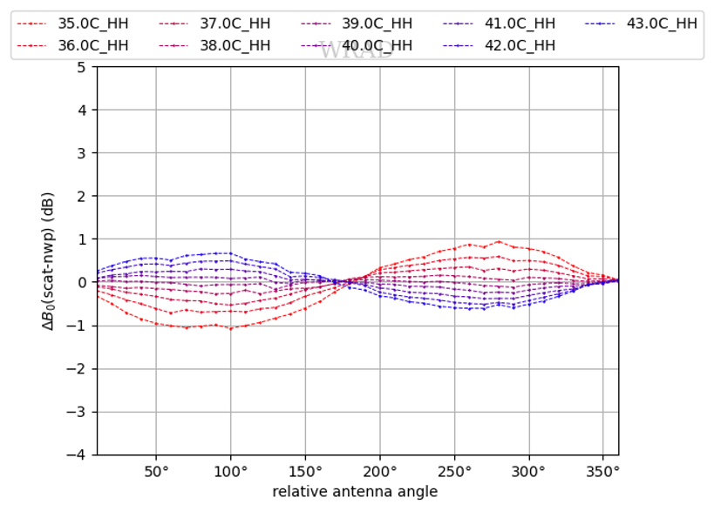
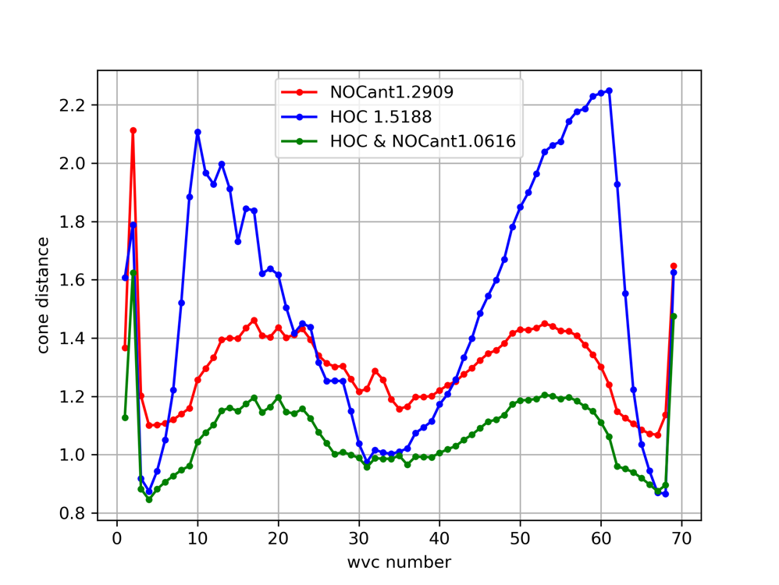
HOC calibrated NOCant
NOCant: NOC as a function of incidence angle and relative azimuth angle.
Use the combination of HOC&NOCant can remove the non-linearity, incidence angle dependency and azimuth angle dependency => achieve optimal wind result.
The MLE (cone distance) is a metric to measure the quality of the retrieval. It reveals how well the measurements fit the GMF (Geophysical Model Function), the lower the better. The combination of HOC&NOCant gives the best fit to the GMF. ​
*Li, Z.; Stoffelen, A.; Verhoef, A.; Wang, Z.; Shang, J.; Yin, H. Atmospheric Measurement Techniques, (2023), 4769-4783, 16(20)

Slide 5
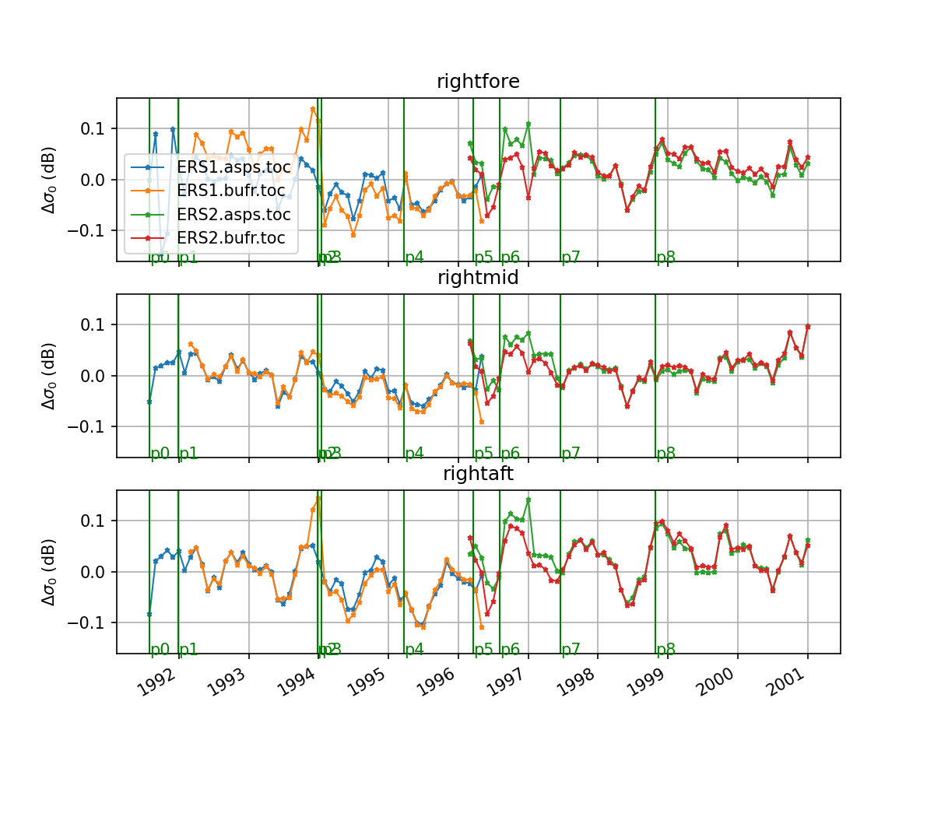
Calibration of the ERS scatterometer wind product with NOC and Cone Metrics KNMI Jeroen Verspeek, Ad Stoffelen, Anton Verhoef
Link to poster
The ERS1/ERS2 wind product will be reprocessed over their entire life span
Two datasets for ERS are available, ASPS and BUFR operational data. They mostly overlap and partly complement each other.
NOC/cone metrics beam pattern corrections were applied for level1b (operational BUFR data), noise floor, offset.
The quality of both derived wind products are compared and assessed.
NWP ocean calibration (NOC) is used for NRCS monitoring and cone metrics as “absolute” NRCS calibration method.
Time series show daily and seasonal variations in the wind speed bias, but they appear to be very stable over the long term.

Slide 6
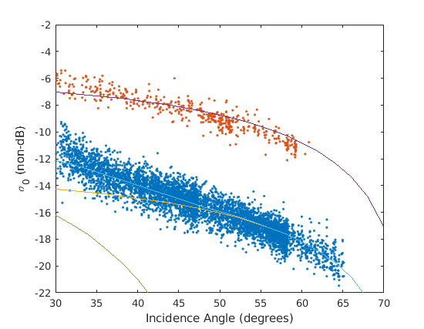
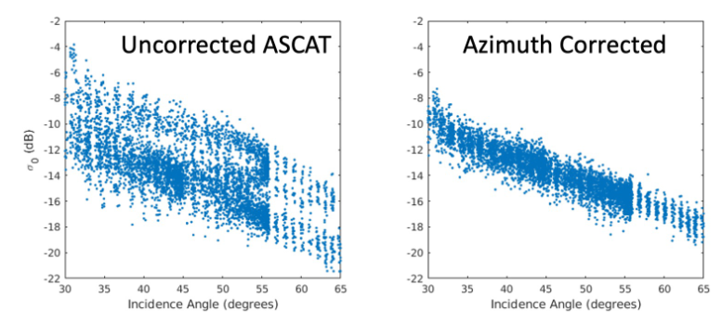
Cross-Calibration Modeling
The idea behind the cross-calibration model is that on the calibration area, the difference in reported σ₀ from two scatterometers can be represented reasonably well by
σ_{Scatt1} - σ_{Scatt2} = C_{Calibration} + C_{Area}
The goal of the model is to predict C_{Area} so that C_{Calibration} can be isolated.
Using formulas for volume backscattering, we model calibration offset due to the physical properties of the area using the predicted σ₀ values given by
σ₀(θ_{i},f) = V(θ_{i}, p, v_{i}) + S(θ_{i}, H_{RMS}, L_{Corr}) + A(θ_{a}).
The formula has volume, surface, and azimuth components, each calculated using parameters including incidence and azimuth angle, particle radius, ice volume fraction, and surface RMS height and correlation length.
σ₀ (dB)
Figure 1. Plot of ASCAT (blue) and NSCAT (red) data points with the modeled NSCAT (purple) and ASCAT (light blue) fit lines. ASCAT surface (green) and volume (yellow) components are also depicted

Slide 7
Model Sensitivity
Figure 2. shows the sensitivity of the model. Because the units for each parameter differ, we define the sensitivity of the model with respect to a parameter as the derivative of modeled σ₀ with respect to the standard deviation of that parameter. Shown in the figure are the sensitivity values up to ±1 standard deviation away from the estimated value for the parameter.
The values used in the model for each of these parameters are estimates, so this sensitivity analysis is an important tool for evaluating the model’s accuracy.

Slide 8
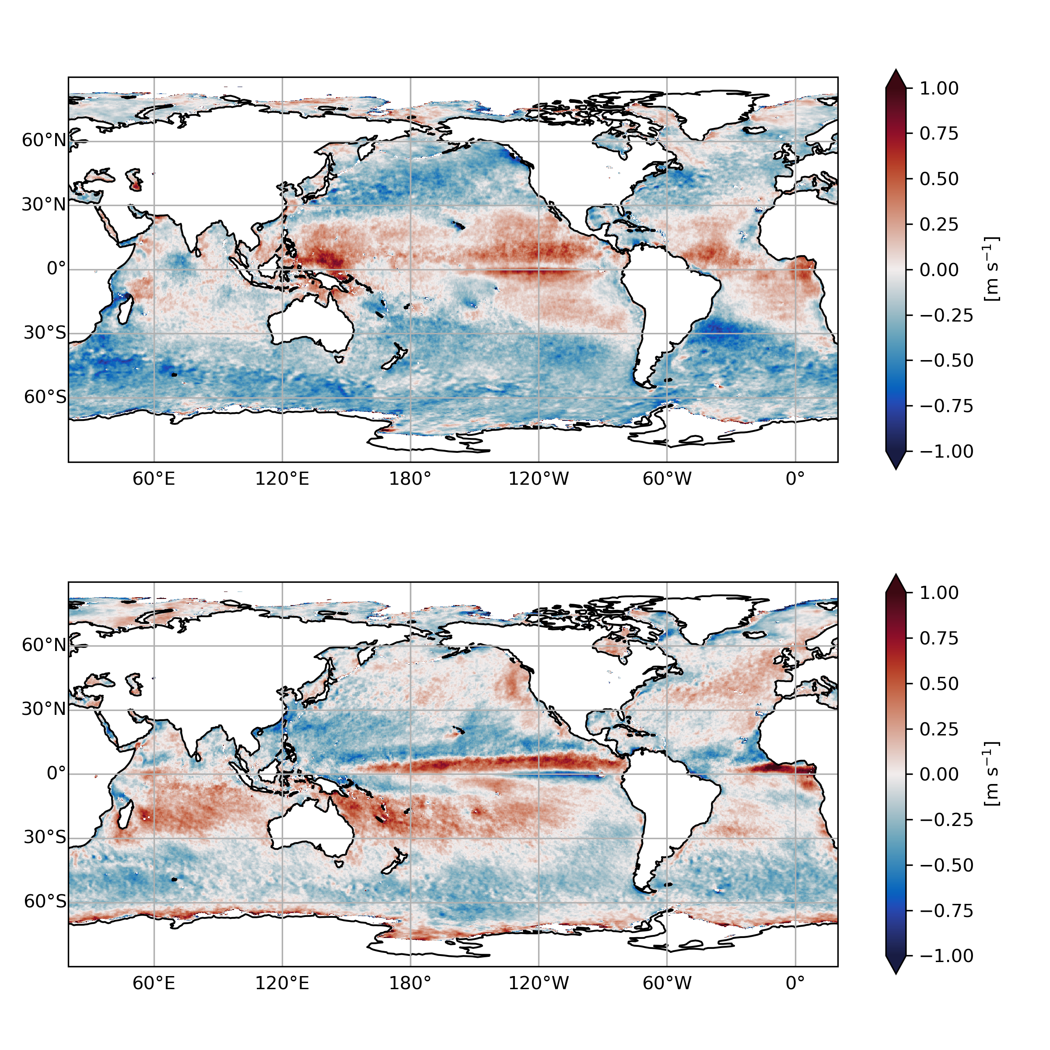
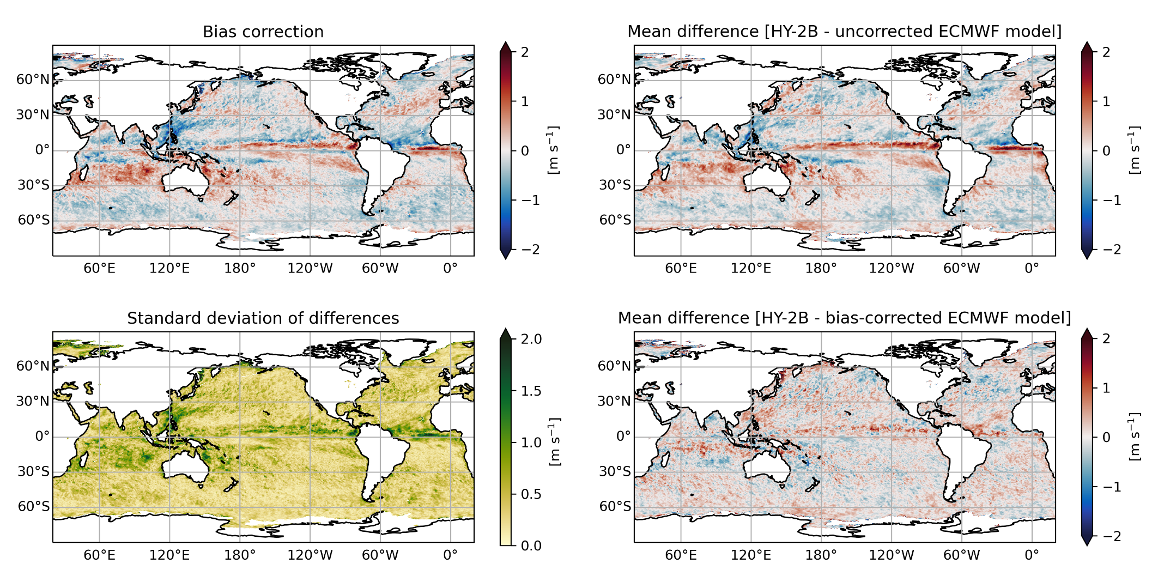
Using scatterometer observations to correct for persistent biases in modelled ocean surface winds
Link to poster
Rianne Giesen, Ad Stoffelen, Ana Trindade, Marcos Portabella and Anton Verhoef
Metop-B ASCAT – ECMWF OPS [2022]
20-day bias correction (Metop-B/C ASCAT – ECMWF ERA5)
Zonal wind bias
Meridional wind bias
Meridional wind bias
We use 20-day averaged scatterometer-model differences to produce corrected hourly ECMWF model fields
Comparison with independent HY-2B HSCAT (different time of day) shows that biases are removed effectively
Annually averaged scatterometer-model differences display substantial systematic biases
Belmonte Rivas, M. and A. Stoffelen (2019): Characterizing ERA-Interim and ERA5 surface wind biases using ASCAT, Ocean Sci., 15, 831–852, doi: 10.5194/os-15-831-2019.
Global ocean hourly reprocessed sea surface wind and stress from scatterometer and model. E.U. Copernicus Marine Service Information (CMEMS). Marine Data Store (MDS). DOI: 10.48670/moi-00185
Notes:
- It has been shown that differences between scatterometer observations and collocated numerical weather prediction model winds are highly persistent, with annual mean magnitudes around 1 m/s in some regions, particularly the tropics.
- These biases can be used to correct NWP model winds, which are most used to force ocean models. For instance, 20-day biases computed from scatterometer observations are used to produce corrected hourly ECMWF model fields that are publicly available through the Copernicus Marine Service.
- A comparison with HY-2B HSCAT observations that were not used in the calculation of the bias corrections show that this method also effectively removed scatterometer-model biases at other times of day. The largest residuals are found in regions with large variability in the scatterometer-model differences.
- Instead of correcting the model winds in a postprocessing step, the bias corrections can also be used to nudge the scatterometer observations towards the model state during data assimilation, promoting effective assimilation of the scatterometer winds. This is currently under investigation in an experiment together with ECMWF.

Slide 9
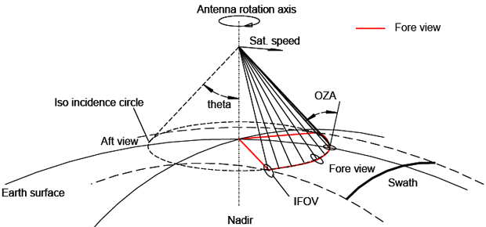
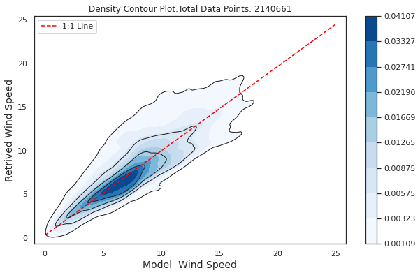
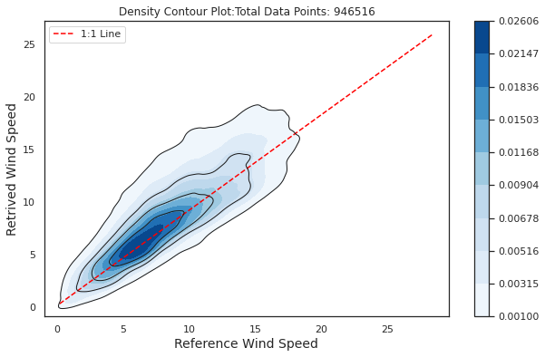
Radiometric Wind Retrieval for MWI
Sisma Samuel, Anton Verhoef, Ad Stoffelen (KNMI)
Retrieval based on data from SSMIS-F16, F17, F18
Comparison with ERA5 wind speed
conically scanning MWI- viewing geometry
MWI frequency 18GHz – 183GHz (26 channels)
Retrieval of wind speed for future Microwave Wind Imager.
Currently using SSMIS Brightness temperature from channels-19V&H,22V, 37V&H GHz
Work is in progress……
Wind speed collocated with RapidScat

Slide 10
Discussion points for outstanding issues in calibration for routine conditions:
Consistency of different GMFs: e.g. NSCAT-4DS, NSCAT-4HY2, what is the optimal reference ?
Calibration methods: NOC (incidence or/and azimuth dependency, cone metric), HOC (non-linearity).
Instruments have their own attributes, which need to be treated differently and carefully.
Using scatterometer observations to correct for persistent biases in modelled ocean surface winds
(Rianne, day 1 talk 1).
Intercalibration: the differences between remotely sensed wind products and NWP wind products (day 2 talk 3)
Rain quality control: MLE, Joss (Xu et al., 2020), Bayesian methods, possibly also ML method (Xu et al., 2021).
Triple, quadruple, quintuple collocation analysis for the consistency of all scatterometers, giving confidence of the wind data quality (Vogelzang et al., 2021 and 2022).
Intercalibration with passive winds: e.g., SSMI, WindSat, MWI (Microwave Imager) or CIMR winds (Dinnat et al., 2023).
Cone metrics for Ku-band pencil-beam scatterometers?

