Slide 1
Wind Coupling with Other Geophysical Variables
2023 IOVWST Meeting
Day 3
November 15, 2023
Bia Villas Bôas, Luc Deike, Luc Lenain, Marcos Portabella, Aneesh Subramanian, Ernesto Rodríguez

Slide 2
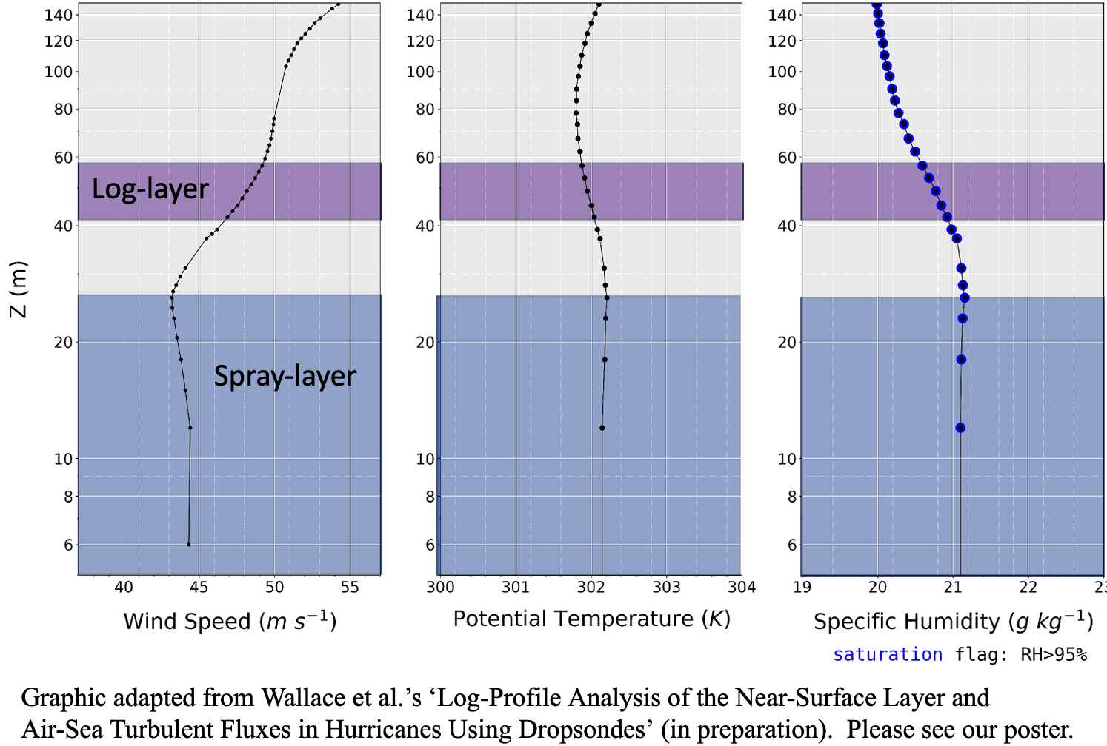
Sea Spray in Hurricanes Influences Profiles of Wind, Potential Temperature, and Moisture
Link to Poster
Danny Wallace, Heather Holbach, Mark Bourassa
Due to limited time, this material could not be included but you can find the presentation here:
https://docs.google.com/presentation/d/1wY3pikDvO7l2tslGRQmILBZUriB0EWqS/edit?usp=sharing&ouid=101155798790393408482&rtpof=true&sd=true

Slide 3
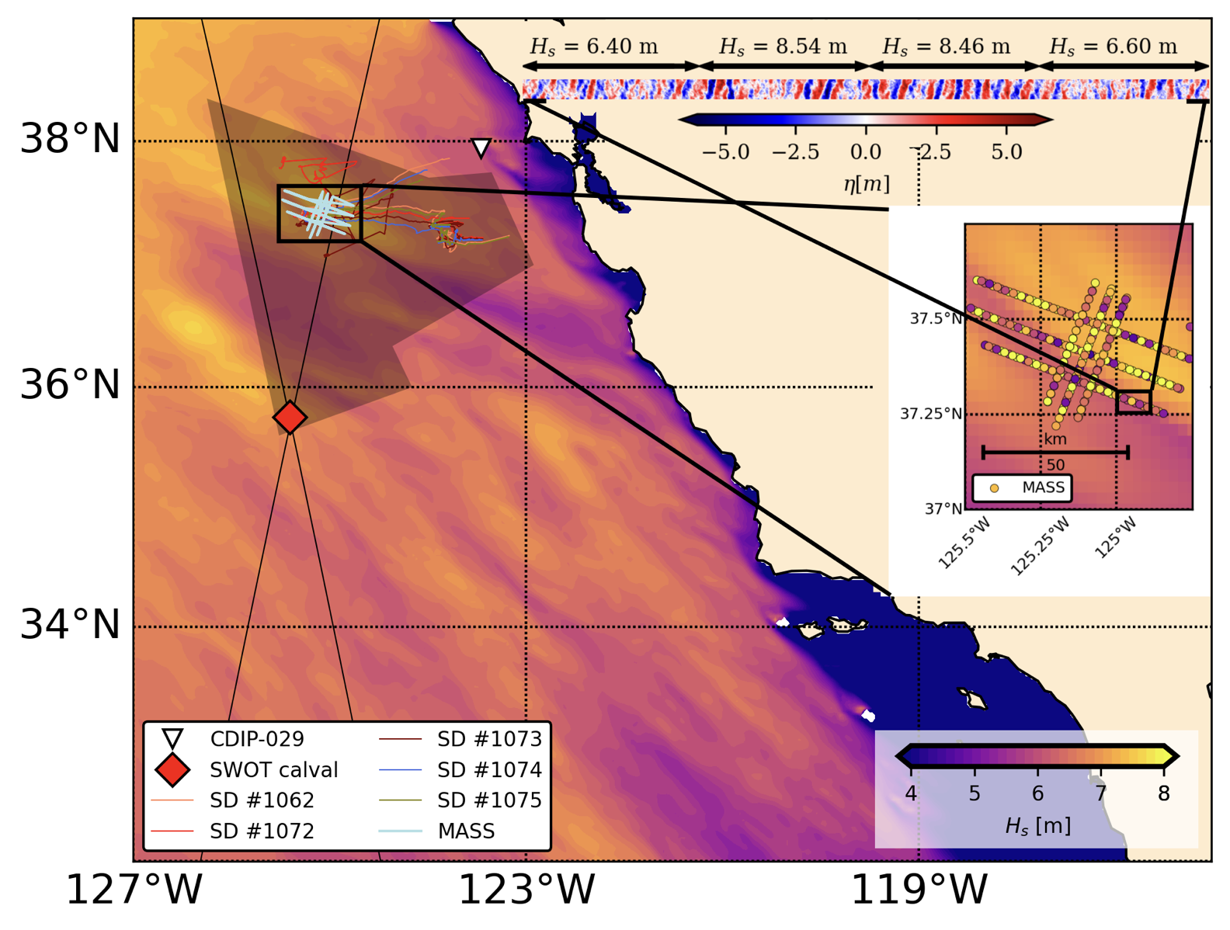
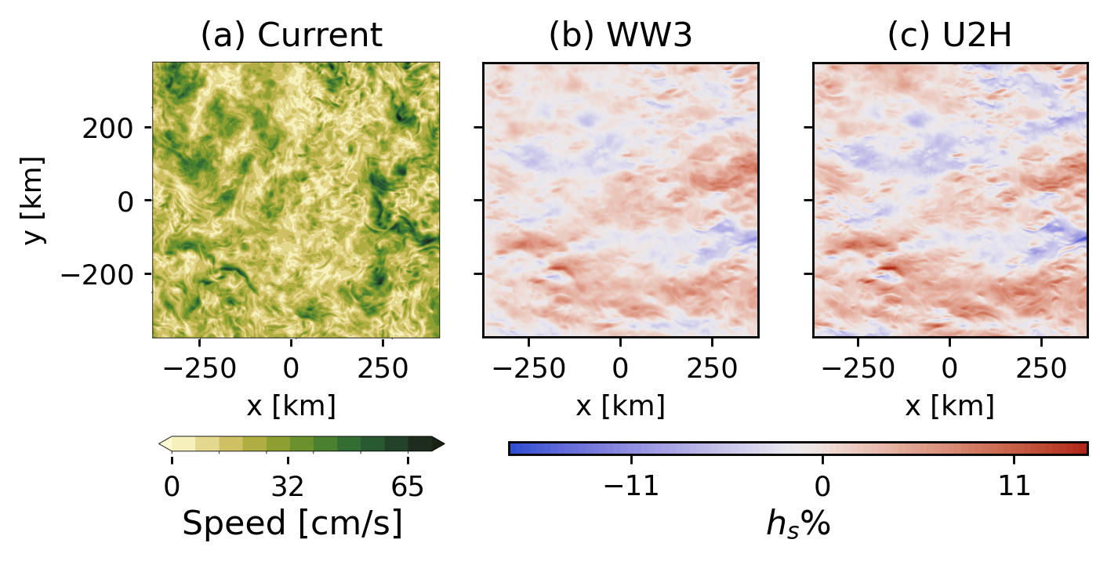
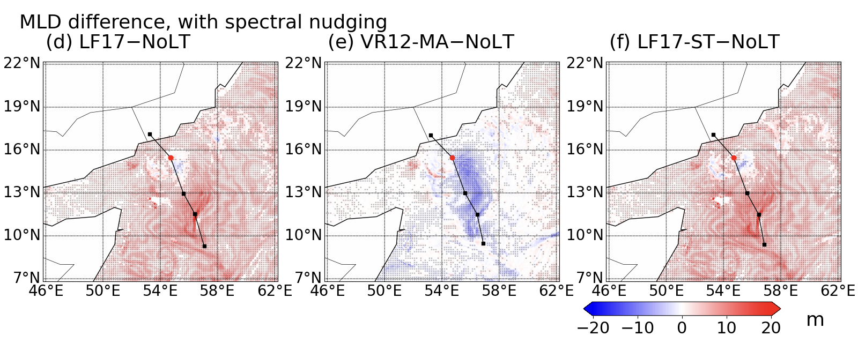
A coupled framework for quantifying interactions between winds, currents, and waves.
Bia Villas Bôas, Gwendal Marechal, Matt Mazloff, and Rui Sun
SKRIPS is a model framework developed by our team that couples the MITgcm, WRF, and WaveWatch III.
Modeling and theory suggest a scale dependence between currents and surface wave gradients
More on Marechal et al poster
See Wang et al. (2023)
Our main goal is to quantify the contribution of surface waves to air-sea fluxes, ocean mixing and upper-ocean budgets.
We are leveraging observations from S-MODE and SWOT cal/val to better understand sea state gradients and their impact on how we sense winds, currents, and SSH.
The spatial variability of Stokes drift results from a combined response to wind forcing and amplitude/frequency modulation due to wave-current interactions (Marechal, Villas Bôas, Pizzo, and Lenain – in prep).
Sensitivity of the mixed layer depth to different Langmuir turbulence parameterization schemes. See Sun et al (2023) for details.

Slide 4
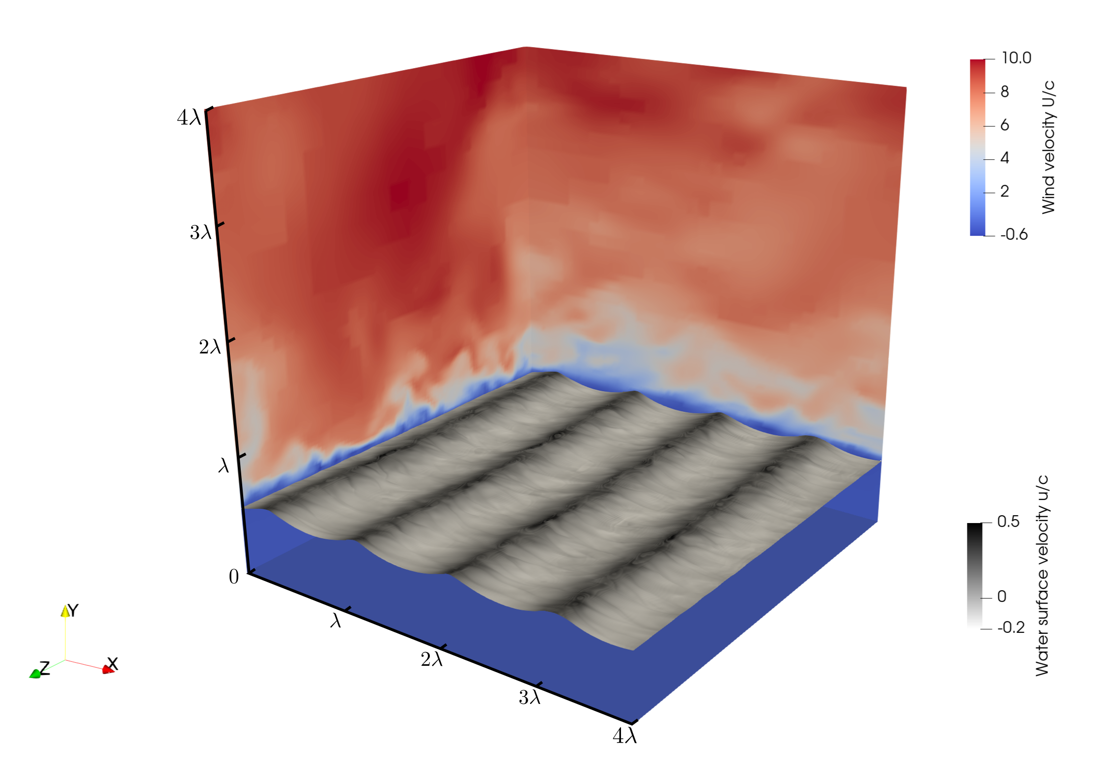
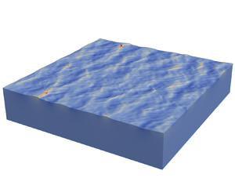
NASA Project High fidelity modeling of parasitic capillary wave dynamics for remote sensing
Jiarong Wu, and Luc Deike.
Stephane Popinet (Sorbonne University), Bertrand Chapron (Ifremer),
Ernesto Rodriguez (NASA-JPL), Tom Farrar (WHOI)
Link to Poster
Scope and approach: high fidelity modeling of small scale surface waves coupled with atmospheric and oceanic turbulent boundary layers
Direct numerical simulations of wind-wave-current coupling; including breaking and parasitic capillary waves
Multi-layer modeling for broad banded wave dynamics coupled with boundary layer processes, including statistics of breaking waves
Wu, Popinet and Deike, 2022, J. Fluid Mech.
Wu, Popinet and Deike, 2023, J. Fluid Mech.
From individual dynamics (scales from mm to meters)
To statistics (scales from meters to km)

Slide 5
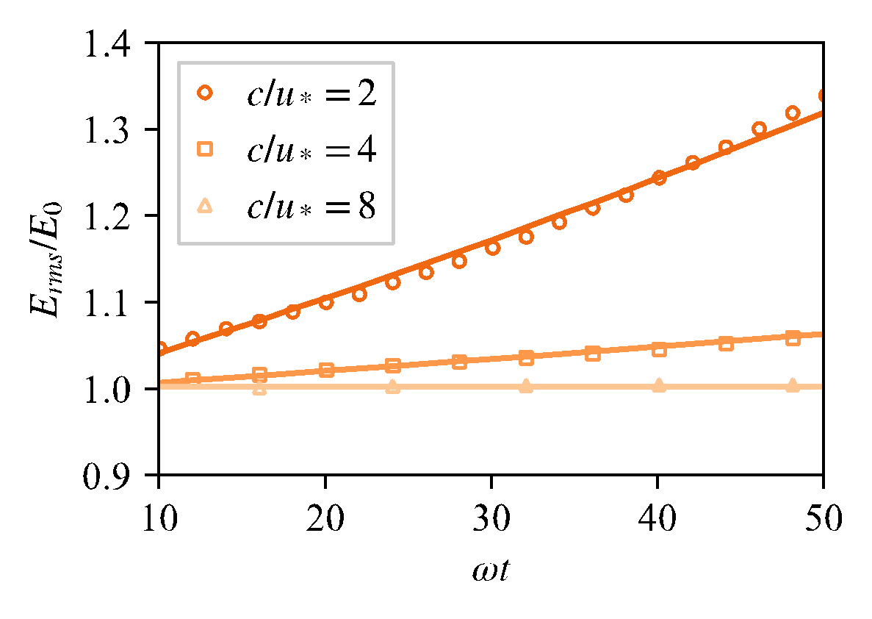
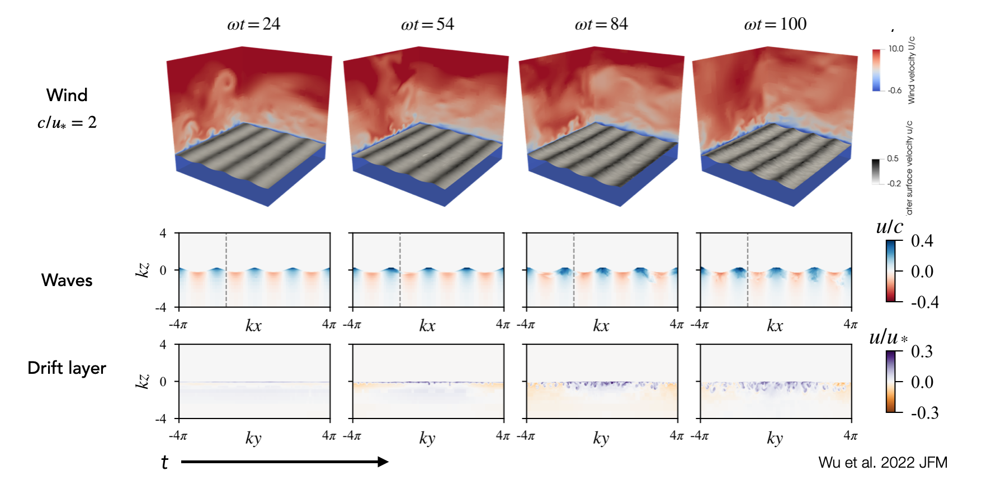
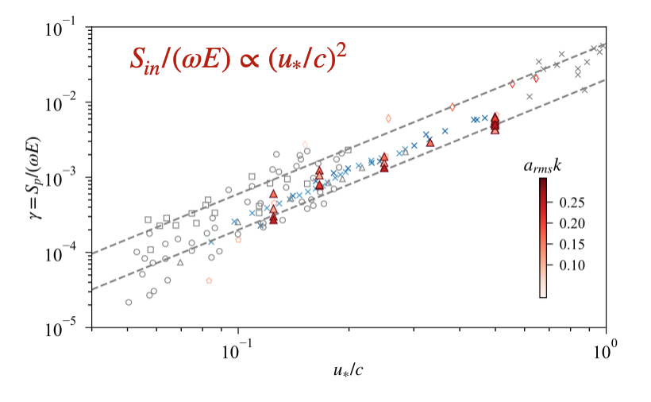
NASA Project High fidelity modeling of parasitic capillary wave dynamics for remote sensing
Jiarong Wu, and Luc Deike, Stephane Popinet (Sorbonne University), Bertrand Chapron (Ifremer),
Ernesto Rodriguez (NASA-JPL), Tom Farrar (WHOI)
Link to Poster
Fully coupled simulations of wind-wave-current coupling; including breaking and parasitic capillary waves

Slide 6
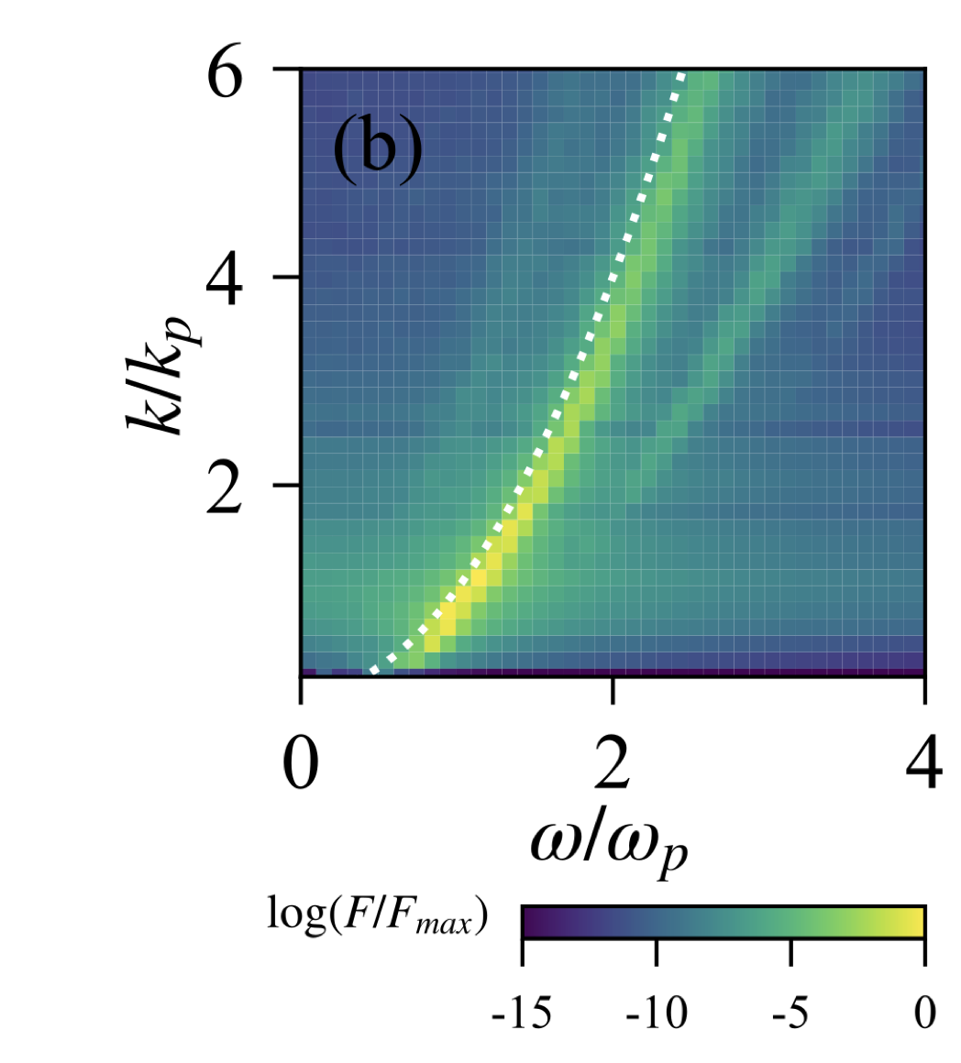
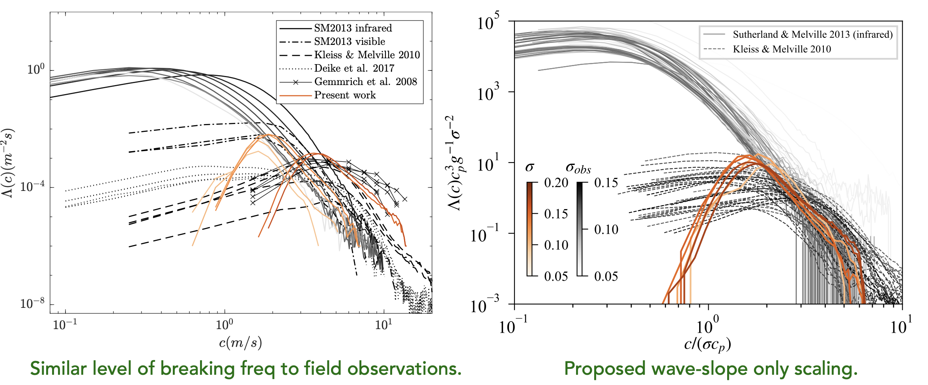
NASA Project High fidelity modeling of parasitic capillary wave dynamics for remote sensing
Jiarong Wu, and Luc Deike.
Stephane Popinet (Sorbonne University), Bertrand Chapron (Ifremer),
Ernesto Rodriguez (NASA-JPL), Tom Farrar (WHOI)
Link to Poster
Multi-layer modeling for wave dynamics coupled with upper ocean, including breaking waves

Slide 7
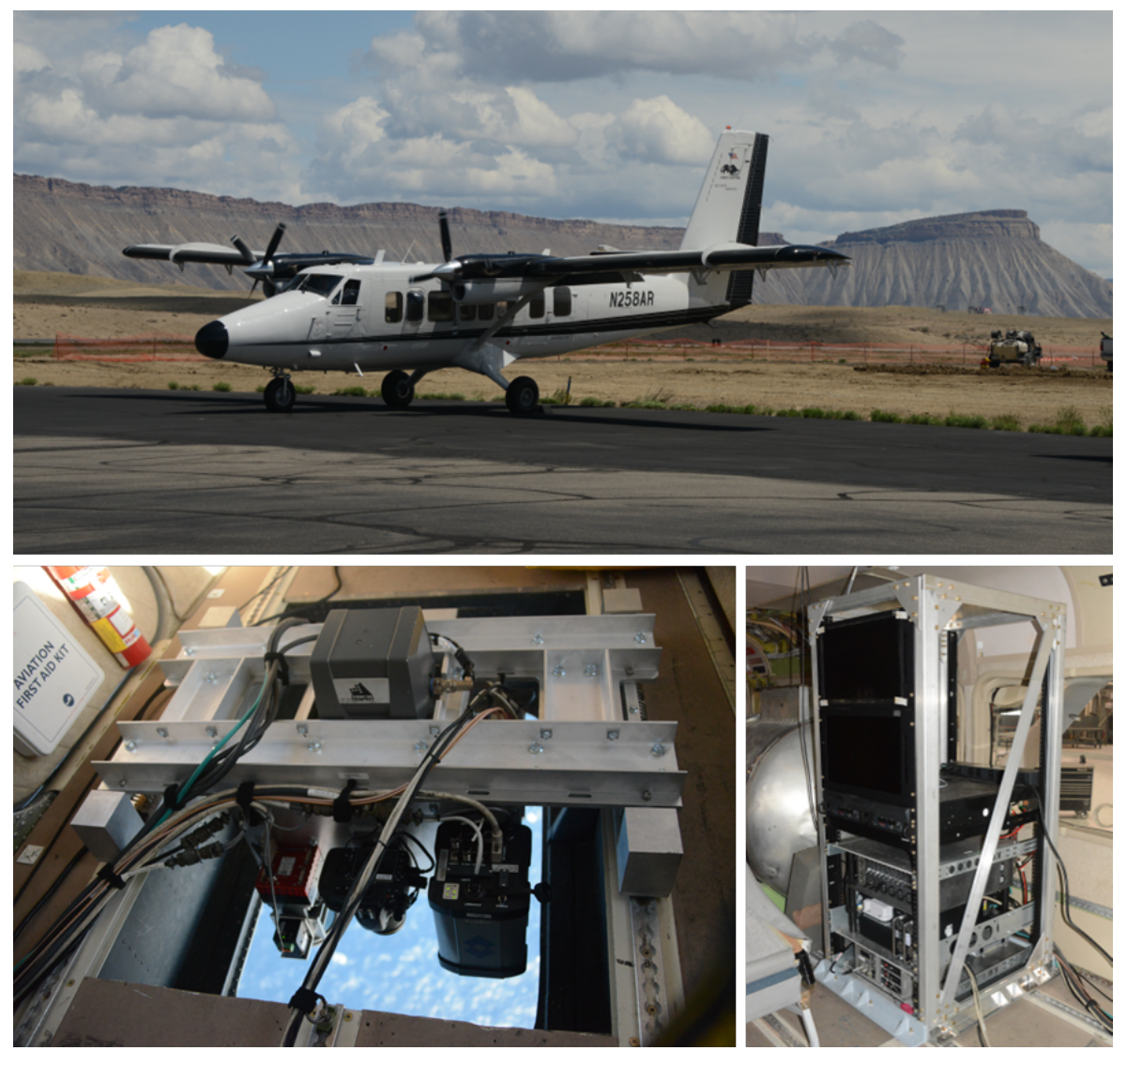
Coupling between the ocean and the atmosphere from meso to submesoscales Luc Lenain (SIO), Nick Pizzo (URI) and Mara Freilich (Brown)
SIO Modular Aerial Sensing System (MASS)
SIO MASS is an airborne instrument to simultaneously collect observations of sea surface temperature, ocean color, winds and mean-square slope, surface waves, wave breaking statistics, ocean topography, and currents and upper-ocean shear at horizontal scales ranging from submeter to mesoscales.

Slide 8
Coupling between the ocean and the atmosphere from meso to submesoscales Luc Lenain (SIO), Nick Pizzo (URI) and Mara Freilich (Brown)
DoppVis Currents
SIO MASS is an airborne instrument to simultaneously collect observations of sea surface temperature, ocean color, winds and mean-square slope, surface waves, wave breaking statistics, ocean topography, and currents and upper-ocean shear at horizontal scales ranging from submeter to mesoscales.
Co-located observations of wind, waves, and currents are necessary to understand air-sea interactions.

Slide 9
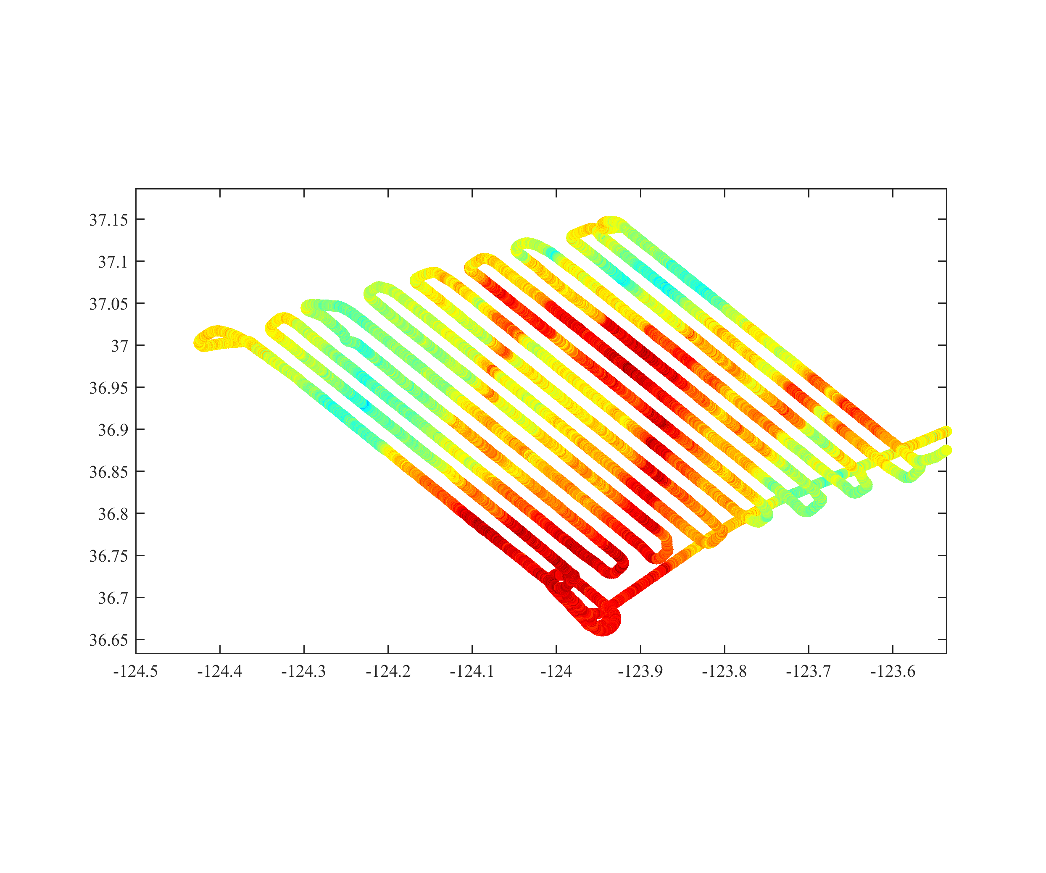
Coupling between the ocean and the atmosphere from meso to submesoscales Luc Lenain (SIO), Nick Pizzo (URI) and Mara Freilich (Brown)
Significant synergy with the S-MODE and SWOT programs
S-MODE IOP2 pencil-beam SST from MASS (April 19 2023)

Slide 10
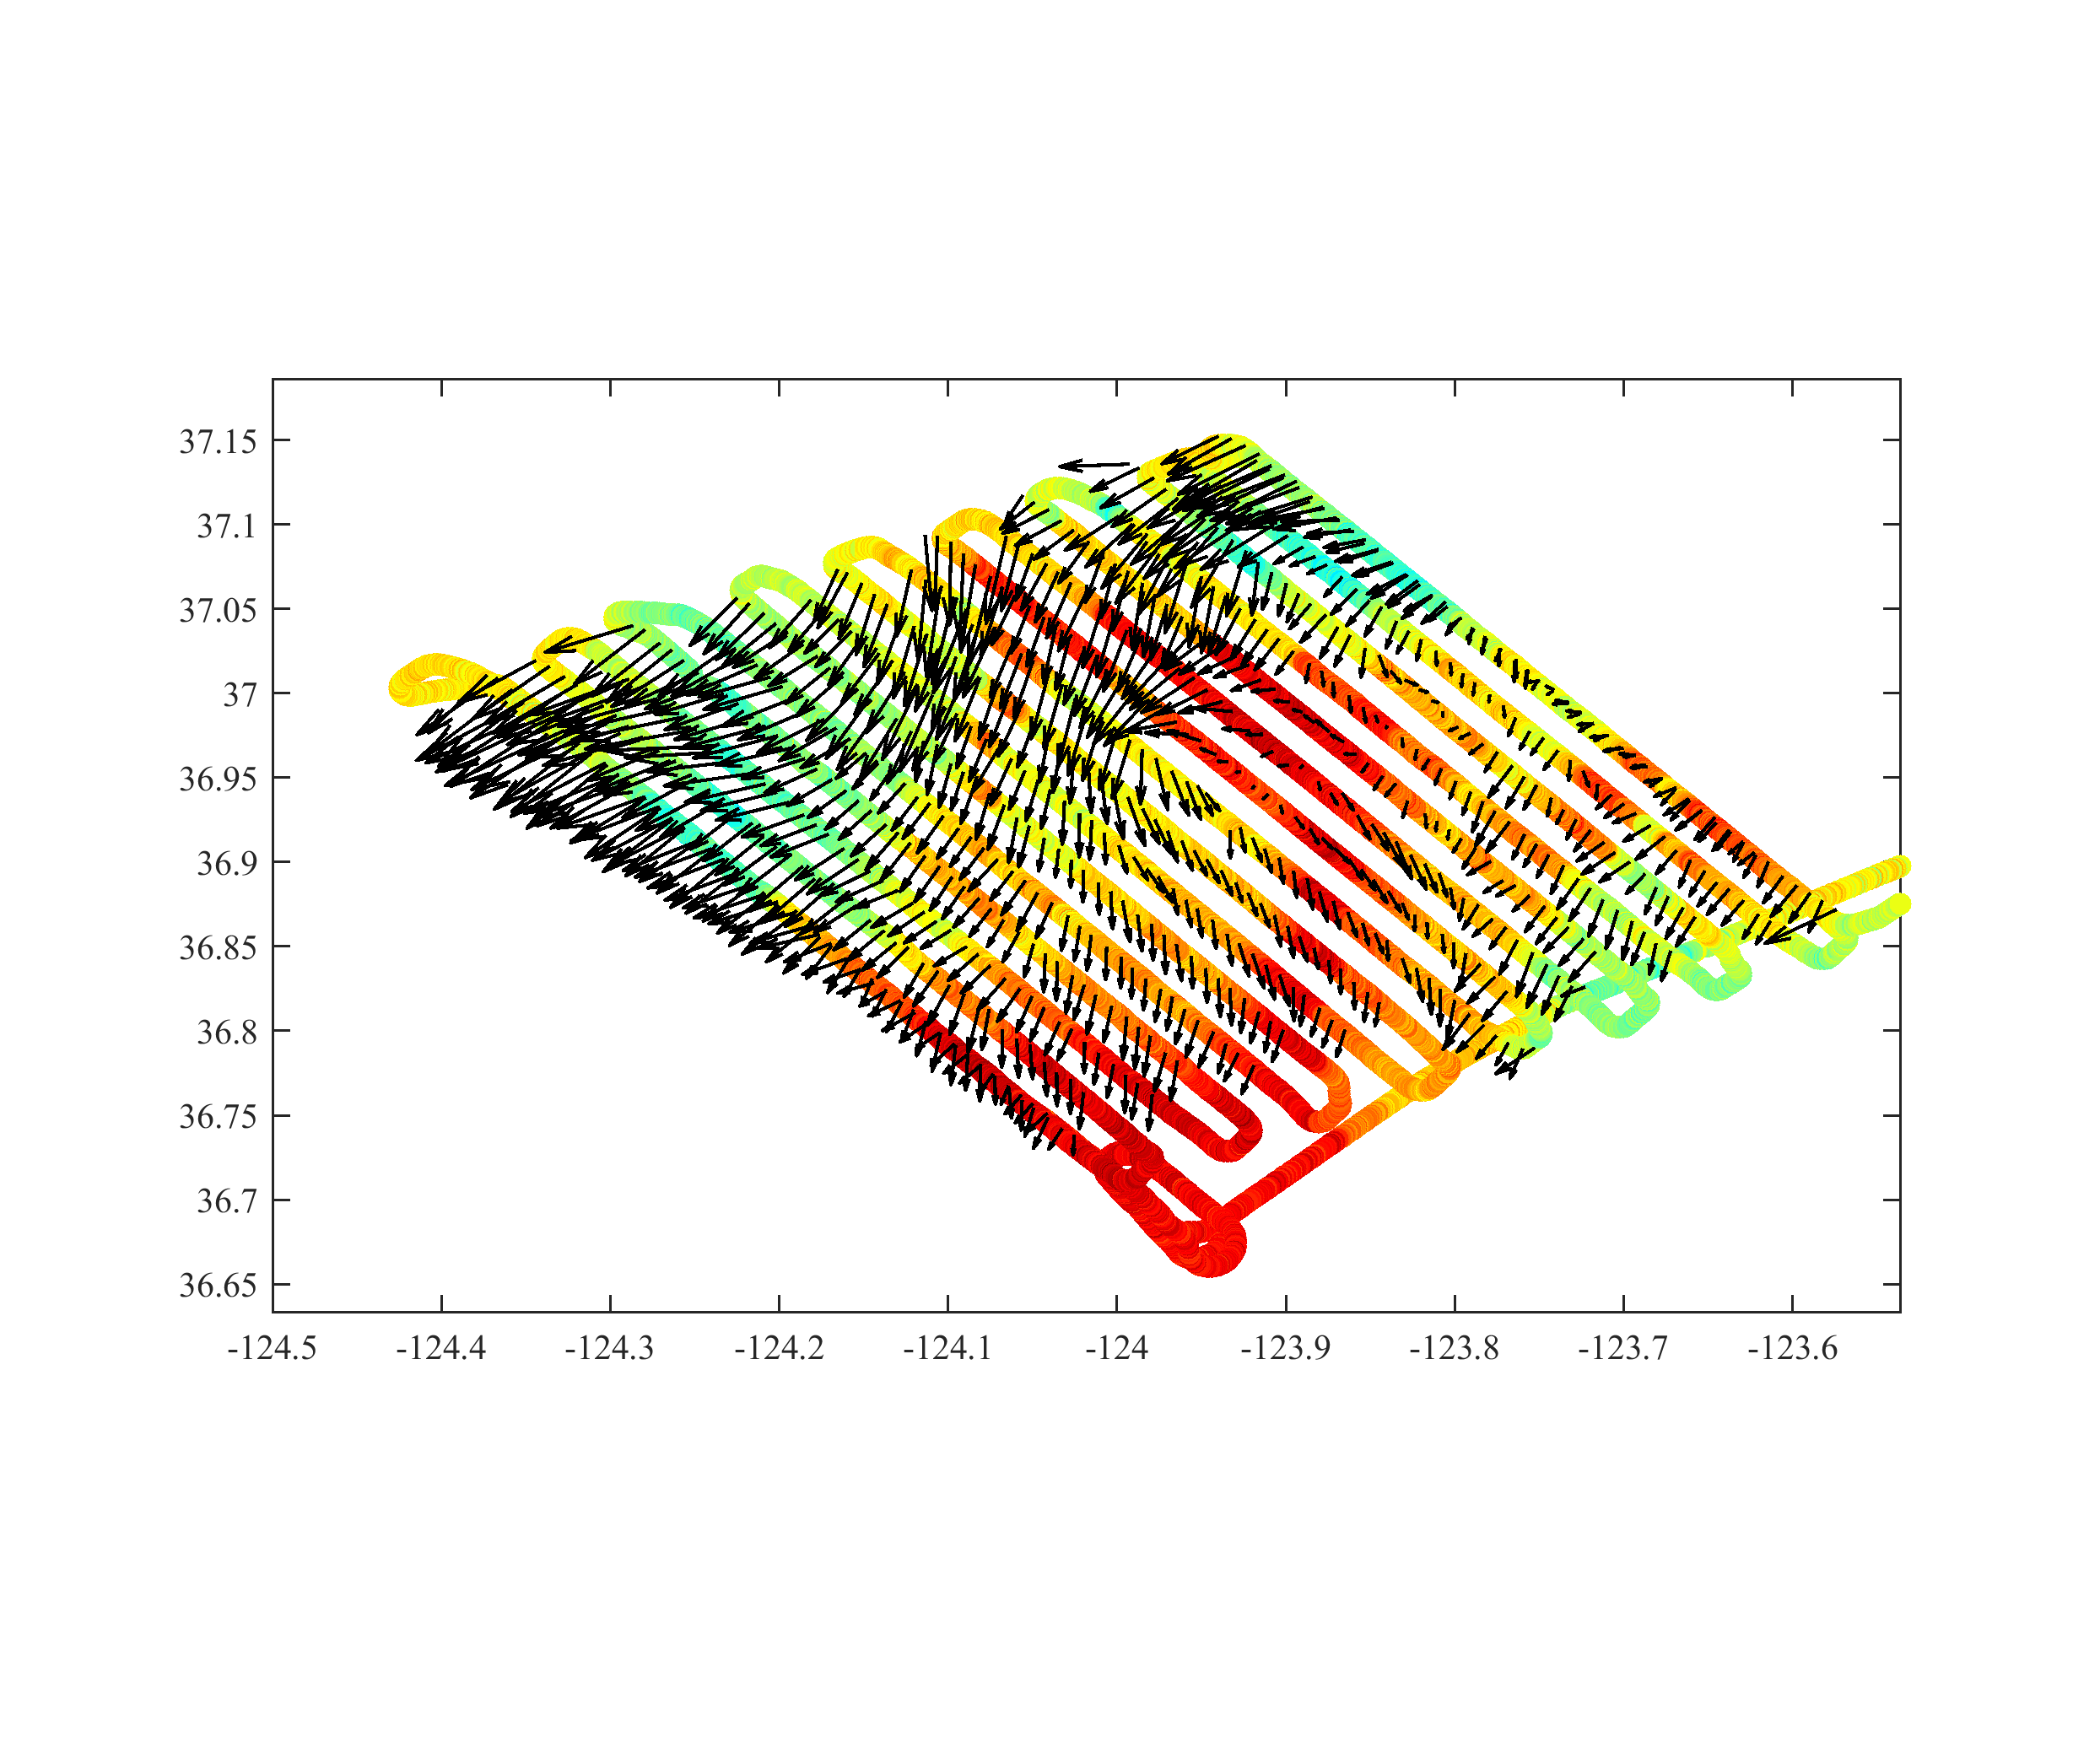
Coupling between the ocean and the atmosphere from meso to submesoscales Luc Lenain (SIO), Nick Pizzo (URI) and Mara Freilich (Brown)
Significant synergy with the S-MODE and SWOT programs
S-MODE IOP2 pencil-beam SST from MASS (April 19 2023)
With 1km surface currents products added (MASS DoppVis)

Slide 11
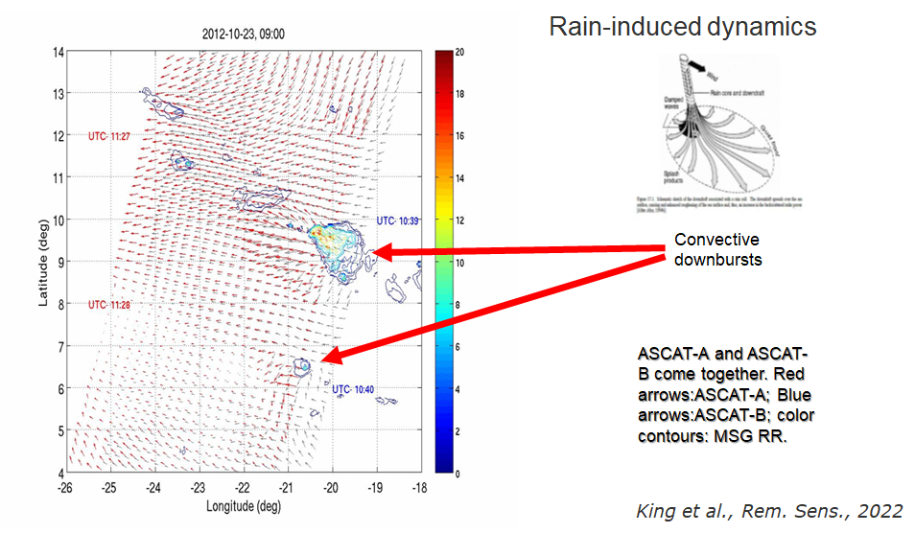
Wind & rain coupling

Slide 12
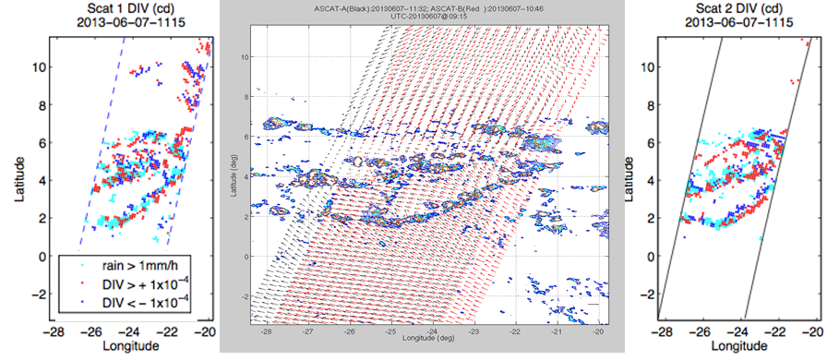
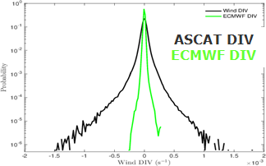
Analysis of scatterometer wind derivatives under moist convection

Slide 13
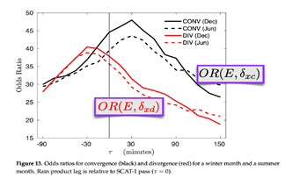
Analysis of scatterometer wind derivatives under moist convection

Slide 14
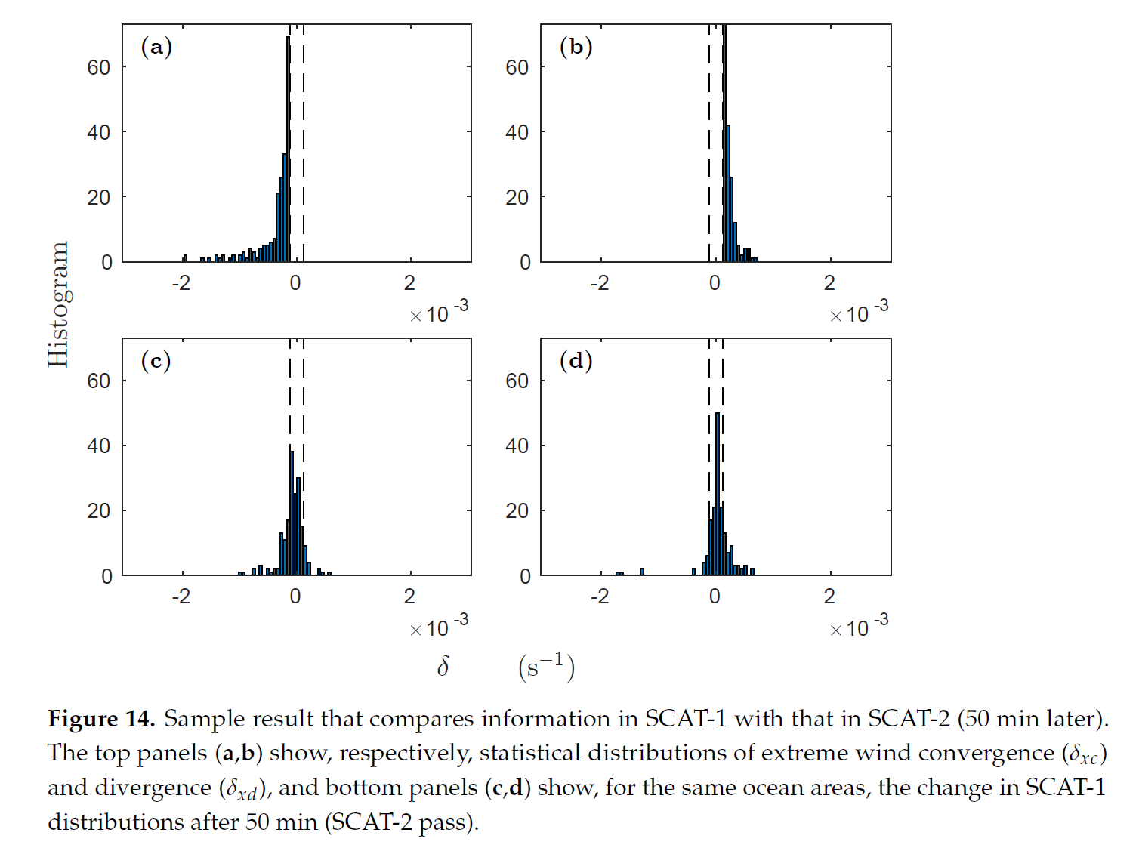
Analysis of scatterometer wind derivatives under moist convection
Rain-induced dynamics produce rapid changes (within 50 min) in the wind field (again, not captured by NWP)
Implications on air-sea interactions?

Slide 15
Additional Wind-Rain at the Poster Session
Rain Detection and Wind Retrieval Using U-NET on ASCAT Measurements. McKinney & Long
https://drive.google.com/file/d/1gOgI11DGbQi5Kd6x_3yDCXBwgPxUfGyZ/view?usp=sharing
Simultaneous Wind Rain Retrieval Using OSCAT. Fogg & Long
https://drive.google.com/file/d/1jleL_WTJmgVHhhDHRmT0HpAQ4-7LJvPj/view?usp=sharing
Link to Poster
Link to Poster

Slide 16
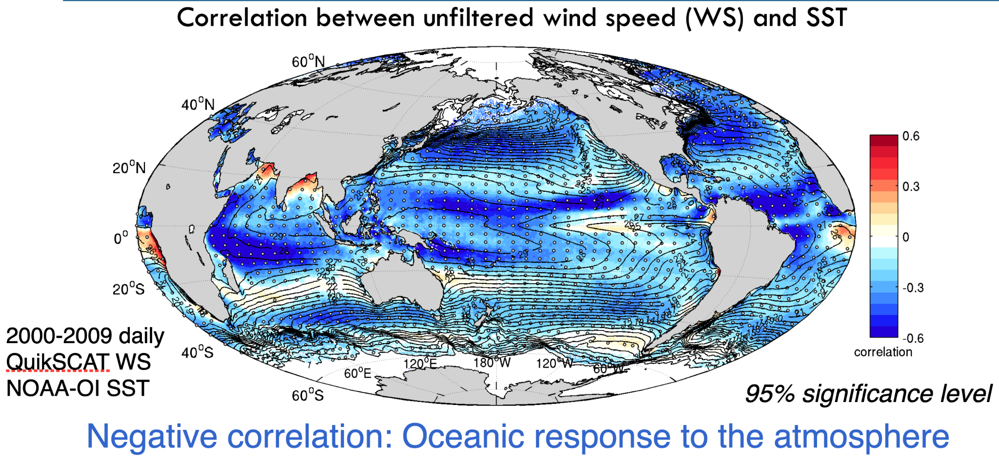
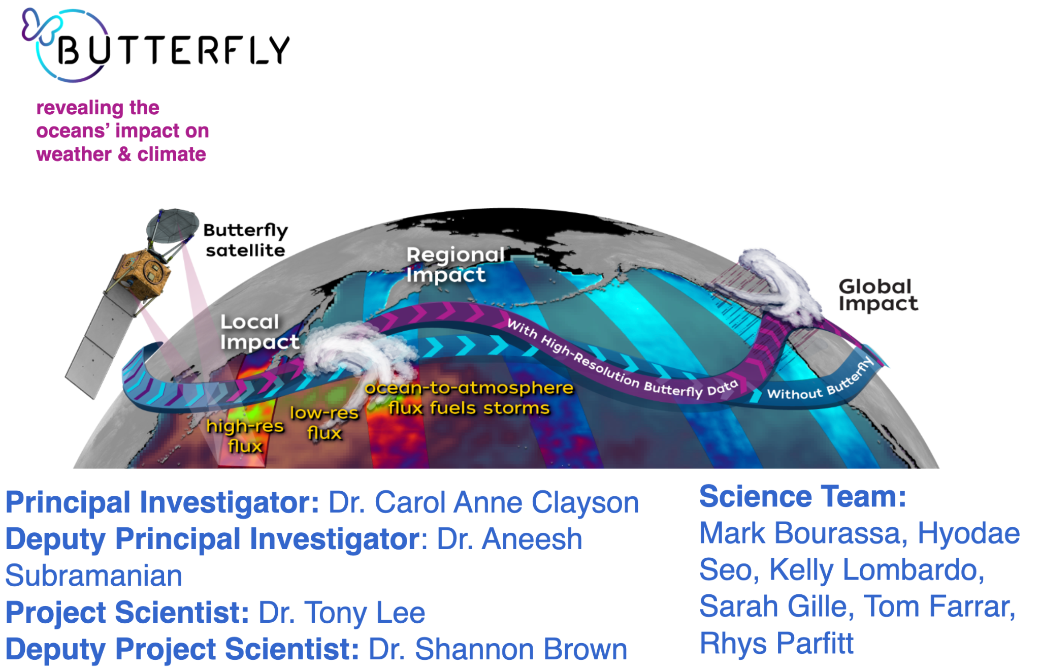
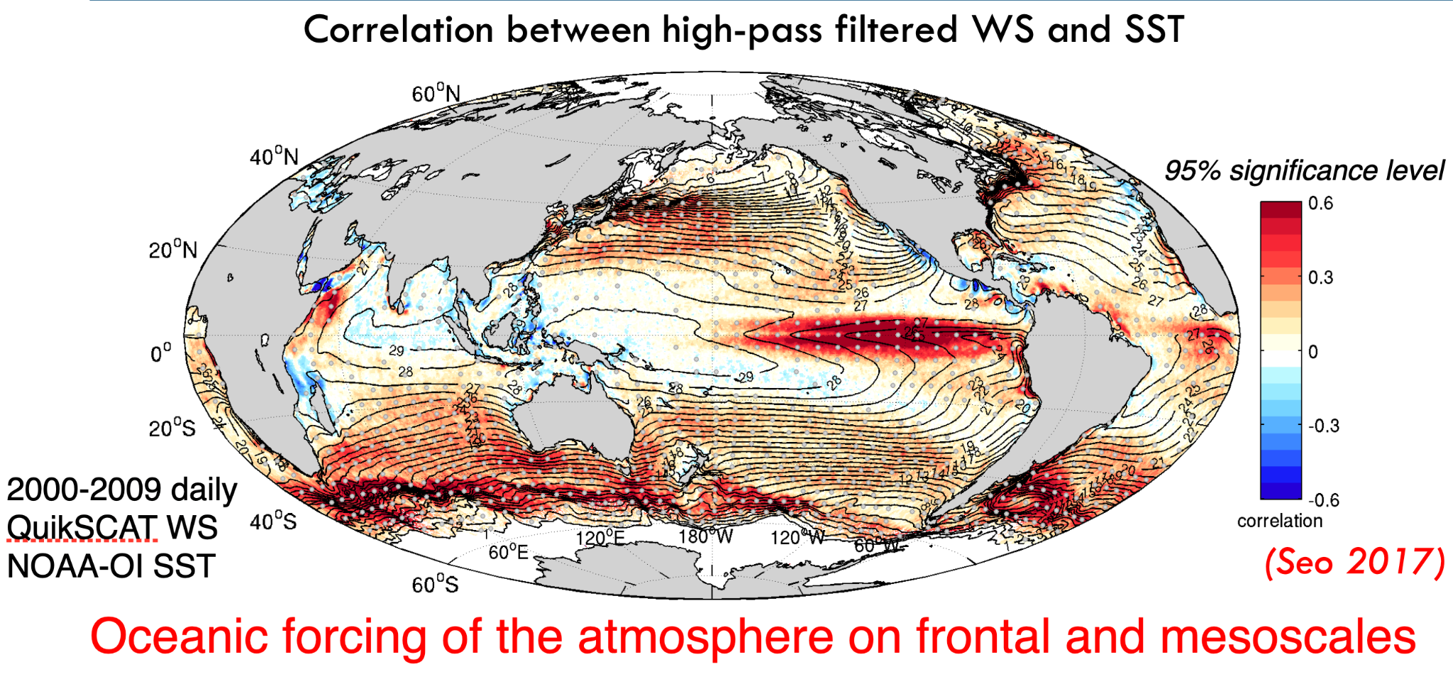
Link to Poster

Slide 17
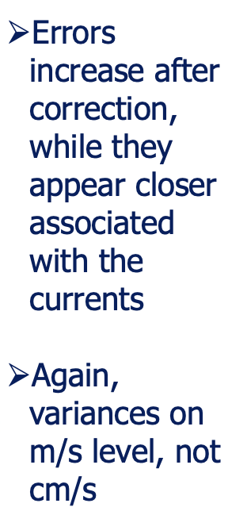
Impact of currents on winds: ERA5 vs scatterometer
Courtesy Ad Stoffelen

Slide 18
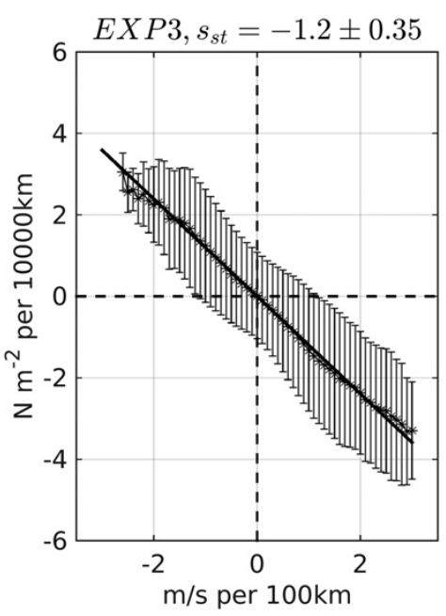
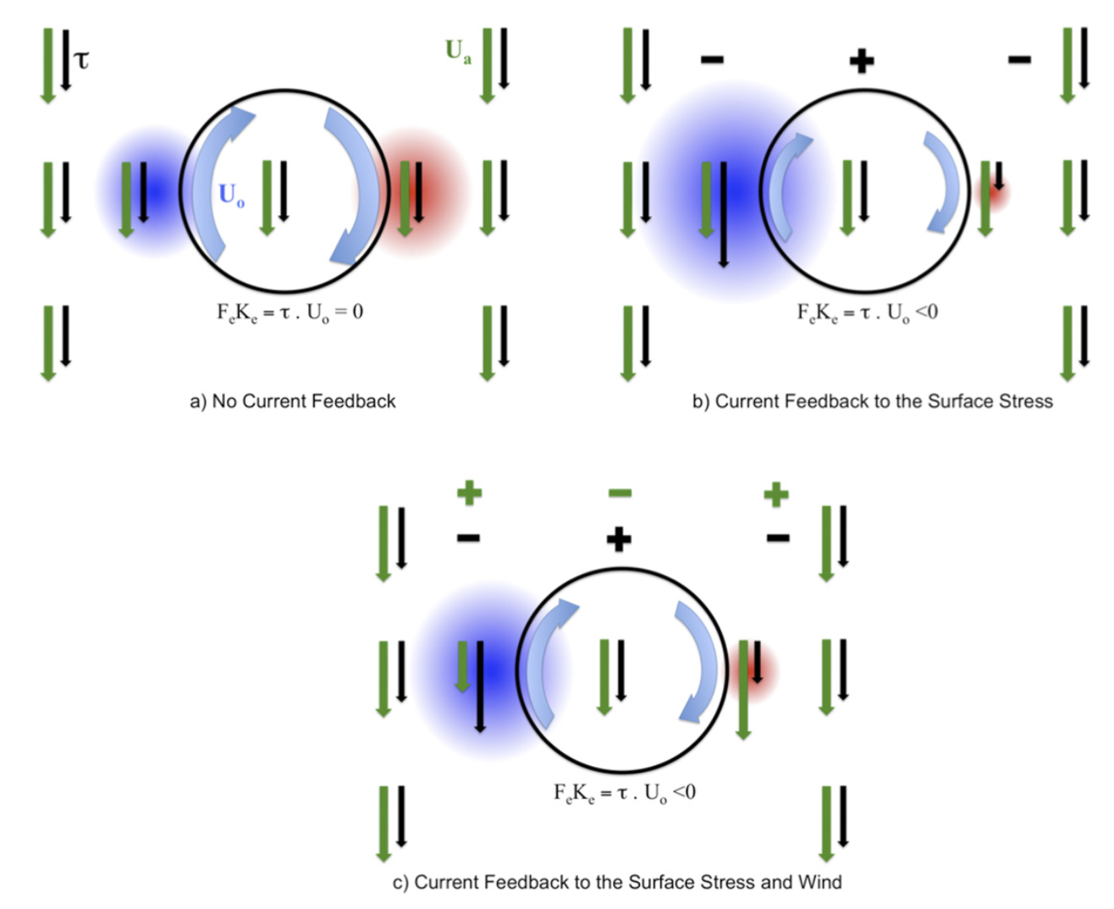
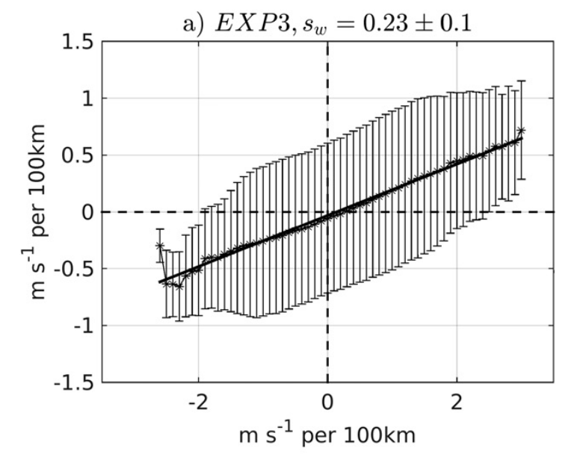
Wind-Current Coupling Mechanism
Relative Vorticity - Wind stress curl
Renault, L., Molemaker, J. M., Gula, J., Masson, S., & McWilliams, J. C. (2016). Control and Stabilization of the Gulf Stream by Oceanic Current Interaction with the Atmosphere. Journal of Physical Oceanography. https://doi.org/10.1175/jpo-d-16-0115.1
Relative Vorticity -
curl atmospheric wind

Slide 19
DopplerScatt S-MODE, current-wind derivative correlation
Rodriguez, Wineteer et al 2023

Slide 20
Wind Stress & Atmospheric Wind Coupling Coefficients (1km)
Rodriguez, Wineteer et al 2023

Slide 21
For more details regarding the S-MODE results, see…
Email ernesto.rodriguez@jpl.nasa.gov for questions, comments
Paper to be submitted shortly…
The S-MODE data are available in PODAAC
https://docs.google.com/presentation/d/1374rGTH9UGjCp9_XhPrAb7VF1n7hwSlE/edit?usp=sharing&ouid=101155798790393408482&rtpof=true&sd=true

Slide 22
Additional Posters not Covered in Overview
Exploring PBL coastal transitions and ocean surface properties with an Airborne Doppler Wind Lidar. Emmitt & Greco
Link to Poster

