Slide 1
Using >25 Years Ocean Surface Wind Record
for Science and Applications
Svetla Hristova-Veleva (JPL/Caltech), Lisan Yu (WHOI), G. King, M. Bourassa (FSU)
F. Wentz (RSS), L. Ricciardulli (RSS), A. Stoffelen (KNMI), M. Portabella (CSIC)
With additional input from:
S. Gille, A. Verhoef, A. Wineteer, B. Stiles, E. Wright, J. Knaff, J. Sienkiewicz, C. Mears, T. Lee and several others
IOVWST meeting 2023, November 1st
Part of the research was carried out at the Jet Propulsion Laboratory, California Institute of Technology, under a contract with the National Aeronautics and Space Administration (80NM0018D0004).
© 2023 California Institute of Technology.

Slide 2
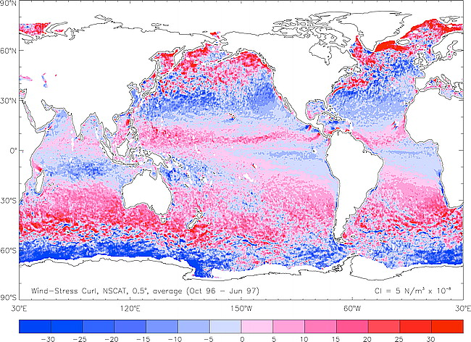
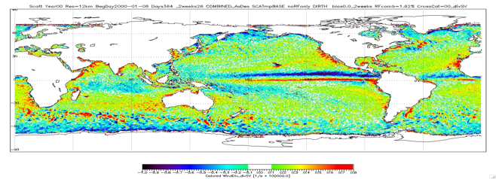
Ocean surface winds are one of the key components of the Earth system. Indeed, the ocean surface winds and stress are Essential Climate Variables (ECV) identified by the Global Climate Observing System (GCOS) [GCOS-200, 2016; and again by GCOS, 2021 ].
They represent a unique measurement at the interface of two fluids – the ocean and the atmosphere. As such, they reflect the interactions at this interface and modify the boundary layers in each one of them.
They are a major driver of
the ocean circulation through the surface stress curl
affect the air-sea interactions
provide fuel to the weather systems by modulating the sensible and latent heat fluxes.
modify the turbulent mixing in the upper levels of the ocean
drive the atmospheric convection by providing dynamical forcing through the convergence of the near-surface winds
Understanding these interactions is critical for improving ocean modeling and weather forecasting on a variety of spatial and temporal scales.
Wind Stress Curl
Wind Divergence/Convergence

Slide 3
Part 1. Climate Data Records (CDRs) and Earth Science Data Records (ESDR) Overview

Slide 4
1.A Climate Data Records (CDRs) of single instrument ocean surface winds Level 2 and Level 3 products
L2 and L3 products are provided either on
- the observational grid (L2 products)
- a regularly spaced grid (L3 products, could be averaged over time to provide some level of completeness)
They do not use models to: - provide interpolation in time
- to fill the space gaps between orbits
As such, the single-instrument CDRs
- do not depend on temporally varying external data (such as e.g., ERA5, radiometers, other scatterometers)
- can assure stability of the CDRs of the ocean surface winds
- would need to be intercalibrated with other single-instrument CDRs (during overlaps) to extend the Earth Science Data Record (ESDR)

Slide 5
1.A CDRs of single-instrument ocean surface winds – goals & motivation
Goal: long-term efforts by the IOVWST to provide stable and well-intercalibrated records of the ocean surface winds
Motivation: existing difference in operational estimates from different wind missions and different institutions

Slide 6
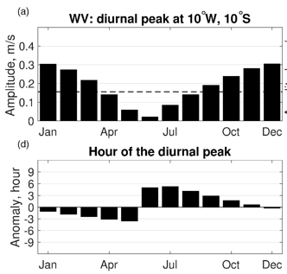
1.A CDRs of single-instrument ocean surface winds – goals & motivation
Goal: long-term efforts by the IOVWST to provide stable and well-intercalibrated records of the ocean surface winds
Motivation: existing difference in operational estimates from different wind missions and different institutions
Main Sources of Uncertainty
Diurnal variability of the winds
Not well-known magnitude and geographic variability of the diurnal signal, to allow properly isolating its contribution to the differences in the wind estimates from missions observing at different Local Times of Day.
Differences in the active observing systems
frequency of the observations (Ku vs C band), with possible differences in the physics of the relationship between the observations (σ⁰) and the underlying winds; Also having different sensitivity to
atmospheric parameters (most importantly rain)
ocean surface parameters such as wind speed, sea surface temperature (SST) and sea state.
instrument design and geometry (push-broom vs pencil beam, variable incidence angles of the observations);
Retrieval algorithms and assumptions - inconsistencies remain in the different components of the different retrieval schemes.
CDR Challenge: Seasonal changes in diurnal winds
Strength and timing of diurnal wind cycles vary seasonally.
Donata Giglio, Sarah Gille et al

Slide 7
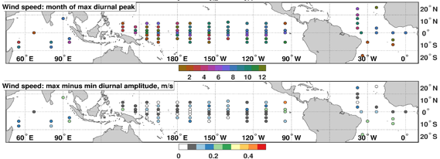
1.A CDRs of single-instrument ocean surface winds – goals & motivation
Goal: long-term efforts by the IOVWST to provide stable and well-intercalibrated records of the ocean surface winds
Motivation: existing difference in operational estimates from different wind missions and different institutions
Main Sources of Uncertainty
Diurnal variability of the winds
Not well-known magnitude and geographic variability of the diurnal signal, to allow properly isolating its contribution to the differences in the wind estimates from missions observing at different Local Times of Day.
Differences in the active observing systems
frequency of the observations (Ku vs C band), with possible differences in the physics of the relationship between the observations (σ⁰) and the underlying winds; Also having different sensitivity to
atmospheric parameters (most importantly rain)
ocean surface parameters such as wind speed, sea surface temperature (SST) and sea state.
instrument design and geometry (push-broom vs pencil beam, variable incidence angles of the observations);
Retrieval algorithms and assumptions - inconsistencies remain in the different components of the different retrieval schemes.
CDR Challenge: Seasonal changes in diurnal winds
Strength and timing of diurnal wind cycles vary seasonally.
Patterns vary geographically.
Donata Giglio, Sarah Gille et al

Slide 8
1.A CDRs of single-instrument ocean surface winds – goals & motivation
Goal: long-term efforts by the IOVWST to provide stable and well-intercalibrated records of the ocean surface winds
Motivation: existing difference in operational estimates from different wind missions and different institutions
Main Sources of Uncertainty
Diurnal variability of the winds
Not well-known magnitude and geographic variability of the diurnal signal, to allow properly isolating its contribution to the differences in the wind estimates from missions observing at different Local Times of Day.
Differences in the active observing systems
frequency of the observations (Ku vs C band), with possible differences in the physics of the relationship between the observations (σ⁰) and the underlying winds; Also having different sensitivity to
atmospheric parameters (most importantly rain)
ocean surface parameters such as wind speed, sea surface temperature (SST) and sea state.
instrument design and geometry (push-broom vs pencil beam, variable incidence angles of the observations);
Retrieval algorithms and assumptions - inconsistencies remain in the different components of the different retrieval schemes.
CDR Challenge: Seasonal changes in diurnal winds
Strength and timing of diurnal wind cycles vary seasonally.
Patterns vary geographically.
Donata Giglio, Sarah Gille et al
Annual signal can be aliased by sampling (ISS)
Multiple satellites, or well-coordinated orbits are needed to distinguish diurnal signal from other variability

Slide 9
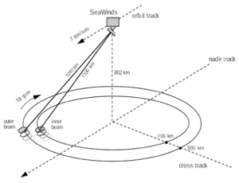
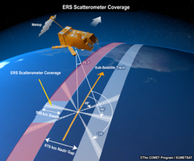
1.A CDRs of single-instrument ocean surface winds – goals & motivation
Goal: long-term efforts by the IOVWST to provide stable and well-intercalibrated records of the ocean surface winds
Motivation: existing difference in operational estimates from different wind missions and different institutions
Main Sources of Uncertainty
Diurnal variability of the winds
Not well-known magnitude and geographic variability of the diurnal signal, to allow properly isolating its contribution to the differences in the wind estimates from missions observing at different Local Times of Day.
Differences in the active observing systems
frequency of the observations (Ku vs C band), with possible differences in the physics of the relationship between the observations (σ⁰) and the underlying winds; Also having different sensitivity to
atmospheric parameters (most importantly rain)
ocean surface parameters such as wind speed, sea surface temperature (SST) and sea state.
instrument design and geometry (push-broom vs pencil beam, variable incidence angles of the observations);
Retrieval algorithms and assumptions - inconsistencies remain in the different components of the different retrieval schemes.
CDR Challenge: Seasonal changes in diurnal winds
Strength and timing of diurnal wind cycles vary seasonally.
Patterns vary geographically.
Donata Giglio, Sarah Gille et al
Annual signal can be aliased by sampling (ISS)
Multiple satellites, or well-coordinated orbits are needed to distinguish diurnal signal from other variability
Schematic of the observation geometry for the two different observing systems: the rotating pencil beam of the Ku-band scatterometers (left) and the push-broom fan beam sampling by the C-band scatterometers (right)

Slide 10
1.A CDRs of single-instrument ocean surface winds – goals & motivation
Goal: long-term efforts by the IOVWST to provide stable and well-intercalibrated records of the ocean surface winds
Motivation: existing difference in operational estimates from different wind missions and different institutions
Main Sources of Uncertainty
Diurnal variability of the winds
Not well-known magnitude and geographic variability of the diurnal signal, to allow properly isolating its contribution to the differences in the wind estimates from missions observing at different Local Times of Day.
Differences in the active observing systems
frequency of the observations (Ku vs C band), with possible differences in the physics of the relationship between the observations (σ⁰) and the underlying winds; Also having different sensitivity to
atmospheric parameters (most importantly rain)
ocean surface parameters such as wind speed, sea surface temperature (SST) and sea state.
instrument design and geometry (push-broom vs pencil beam, variable incidence angles of the observations);
Retrieval algorithms and assumptions - inconsistencies remain in the different components of the different retrieval schemes.
CDR Challenge: Seasonal changes in diurnal winds
Strength and timing of diurnal wind cycles vary seasonally.
Patterns vary geographically.
Donata Giglio, Sarah Gille et al
Annual signal can be aliased by sampling (ISS)
Multiple satellites, or well-coordinated orbits are needed to distinguish diurnal signal from other variability
Schematic of the observation geometry for the two different observing systems: the rotating pencil beam of the Ku-band scatterometers (left) and the push-broom fan beam sampling by the C-band scatterometers (right)

Slide 11
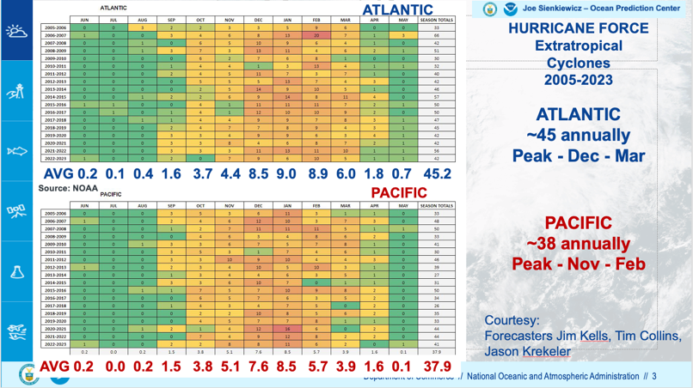
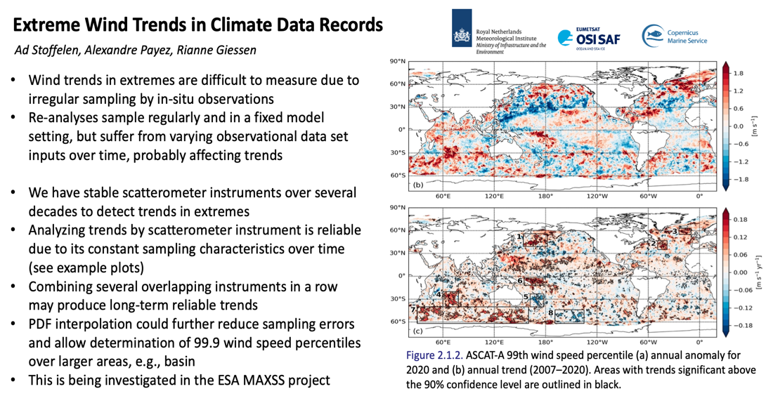
1.A CDRs of the ocean surface winds – driving desire for the single-instrument products
The Driving desire of a number of ocean wind estimate producers is to create observations-only depiction of the interface between the atmosphere and the ocean.
To study trends and variability in the Earth System.
To validate models.

Slide 12
1.A CDRs of the single instrument ocean surface winds from different providers
There is a number of Climate Data Records (CDRs) being developed at different institutions, having slightly different designs an targets
Here are the examples we will explore further:
EUMETSATs OSI SAF by KNMI - https://scatterometer.knmi.nl/archived_prod/
RSS - https://www.remss.com/announcement/ASCAT-ABC-ocean-surface-wind-CDR/
JPL - https://wow.jpl.nasa.gov/ - Look under the Data Tab on the menu in the upper right
Each of the CDRs uses
different retrieval algorithms
different C-band Geophysical Model Function (GMF)
different nudge fields (NCEP versus ECMWF)
Why do we need more than one CDR
Only through analyses of a number of different CDRs we can obtain a better understanding of the uncertainties associated with the retrieval approaches and the creation of the climate-quality CDRs.
Such understanding is critically needed when analyzing the CDRs to establish climate trends and variability, and to understand the processes and the evolution of the large-scale phenomena such as the MJO, ENSO and the Hadley Cell. Even the depiction of the diurnal variability of the winds might be affected by the uncertainties associated with the different retrieval approaches.

Slide 13
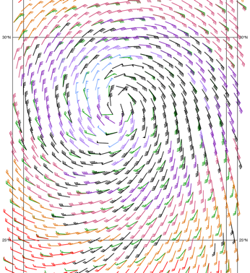
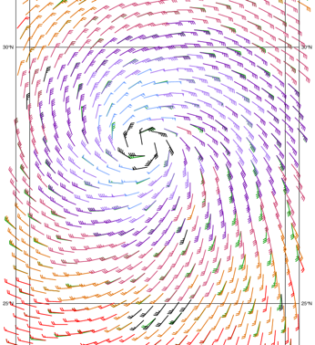
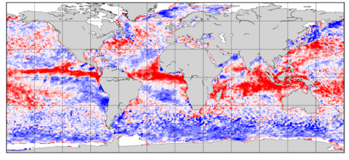
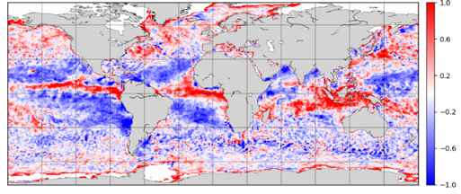
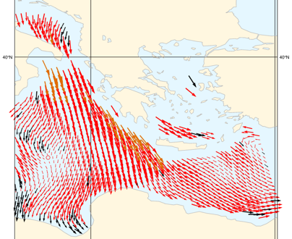
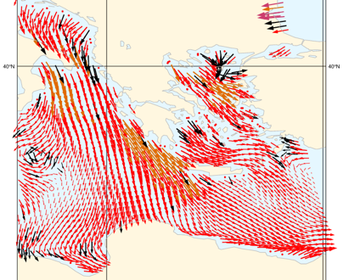
1.A New Ku-band scatterometer Climate Data Records by OSI SAF/KNMI
Ad Stoffelen, Anton Verhoef (KNMI)
We have reprocessed the data records from QuikSCAT, Oceansat-2, and RapidScat to obtain a uniform ocean wind dataset from 1999 to 2016
The datasets will become available soon in the EUMETSAT Data Centre (level 2 swath data) and on the Copernicus Marine Service portal (level 3 gridded data)
As compared to our previous datasets (released in 2016-2017), RapidScat was included, and several product improvements have been implemented, see the images showing new vs. old
The ECMWF ERA5 reanalysis winds are used instead of ERA Interim winds to include in the products and to initialize the ambiguity removal step
A new quality control rejects less winds and has a better skill than the old QC. Two flags are included now: one for use in visualization and one for use in NWP applications
Furthermore, the data are now processed closer to the coast and systematic wind speed and direction biases have been reduced
Improved quality control (less black (flagged) barbs in right hand side)
Corrections for SST lead to smaller systematic wind speed biases (right hand side)
Coastal processing in new datasets (right hand side)
GMF and calibration improvements lead to smaller direction biases (right hand side)

Slide 14
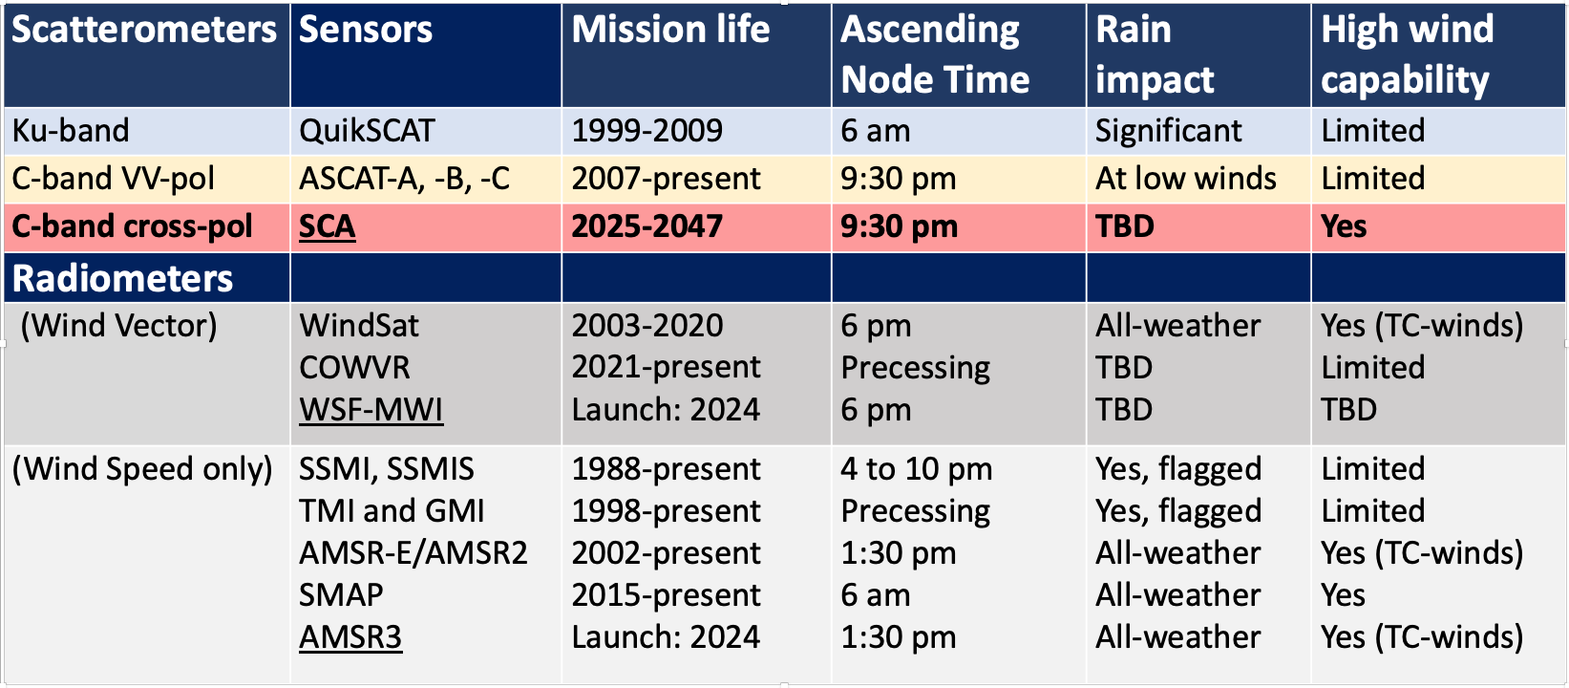
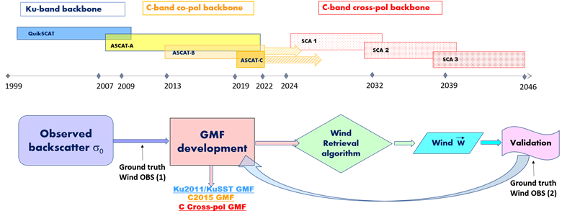
Lucrezia Ricciardulli, Andrew Manaster, Thomas Meissner, Carl Mears Remote Sensing Systems (RSS), Santa Rosa, California, USA
1.A Scatterometers and Radiometers in RSS WIND CDR:
Objective: Consistency among past, present and future scatterometer and radiometer missions
Link to poster
Scatterometer cross-calibration methodology
Ku-band, C- _{VV-pol} and C-_{cross-pol} Geophysical Model Functions (GFM) developed using radiometers as calibration target (OBS 1)
In-situ winds (buoys, Saildrones) used for validation (OBS 2)
Non-sun-synchronous radiometers (TMI/GMI) used for transferring calibration to different times of day [e.g.: QSCAT (6 am/pm) 🡪 ASCAT(9:30 am/pm) ]
Wind-speed differences of colocated scatterometers/radiometers
Consistency within 0.1 m/s

Slide 15
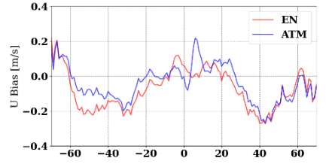
1.A The JPL MEaSUREs-funded CDRs: Goals
Hristova-Veleva, Stiles , Fore , Wineteer , Moroni ,
Bourassa, Vandemark, O'Neill , Polverari, Wright, Asharaf
1. New: Real Winds
Wineteer’s poster
Compared to ERA5, global bias and STD is reduced by ~0.1 m/s relative to the EN winds.
:
Creation of a consistent long-term Earth Science Data Records (ESDR) that includes observations from different scatterometer missions while eliminating inconsistencies between them. Note: QuikSCAT-based homogenization.
Development of the dynamically-significant derived products, including the surface wind stress, and the curl and divergence of the surface wind and stress. These products are generated at the highest possible resolution of the observations (i.e. at the swath - Level 2);
Development of scatterometer-only user-friendly gridded products (Level 3 products) of the wind, stress, curl and divergence of the wind and the stress. These ocean wind L3 products will complement existing L4 products, which have their own roles.
Regionally, biases are reduced substantially by up to 1-2 m/s.
Almost completely removed large scale biases in the Southern Ocean; Equatorial biases remain due to poor Equatorial surface currents
2. New: Providing estimation of the uncertainty for each wind retrieval cell.
3. New: Improved Rain Flagging for Ku-band scatterometers – Stiles’ poster
4. New: Simplified Quality Flag Indicator (0 to 4) to help users navigate the maze of traditional existing flags (also provided) – Hristova’s poster
5. New: Stress estimation – Hristova’s poster
6. New: Derivatives of the wind and the stress – Wright’s poster
and Hristova’s poster
7. New: ERA-5 overlays Hristova’s poster

Slide 16
1.B Combined multiple platform ocean surface winds to create a long-term Earth Science Data Record (ESDR)
Winds from observations reflect the state of the atmosphere, however science and applications suffer from the irregular sampling by the satellites
Model winds on the other end provide regular sampling but suffer from model biases
Combining observations from multiple instruments (with or without the use of models) is, thus, a goal for the IOVWST:
To provide a long-term Earth Science Data Record (ESDR) with regular sampling and removed biases
To combine ocean surface winds with other atmospheric and ocean variable to facilitate studies of processes in the Earth System

Slide 17
1.B Combined multiple platform ocean surface winds – Level 4 products
L4 products require the use of multiple platforms (either combining observations from multiple instruments and/or using models):
- to provide interpolation in time - only because we have insufficient temporal resolution of the observed wind field from a single instrument
- to fill the space gaps between orbits
- to assign direction to wind speed retrievals produced by passive radiometers
- could provide different derived products that involve the use of observations from more than one instrument, to facilitate studies of the Earth System.
The L4 products, by their nature, design, and goal to combine data from multiple instruments inevitably would have somewhat variable characteristics over time, simply because different instruments/missions come to play through different periods of the Earth Science Data Record (ESDR), and hence their different instrument characteristics, retrieval algorithms, and different sampling through the diurnal cycle would have to influence the long-term stability of the L4 products.

Slide 18
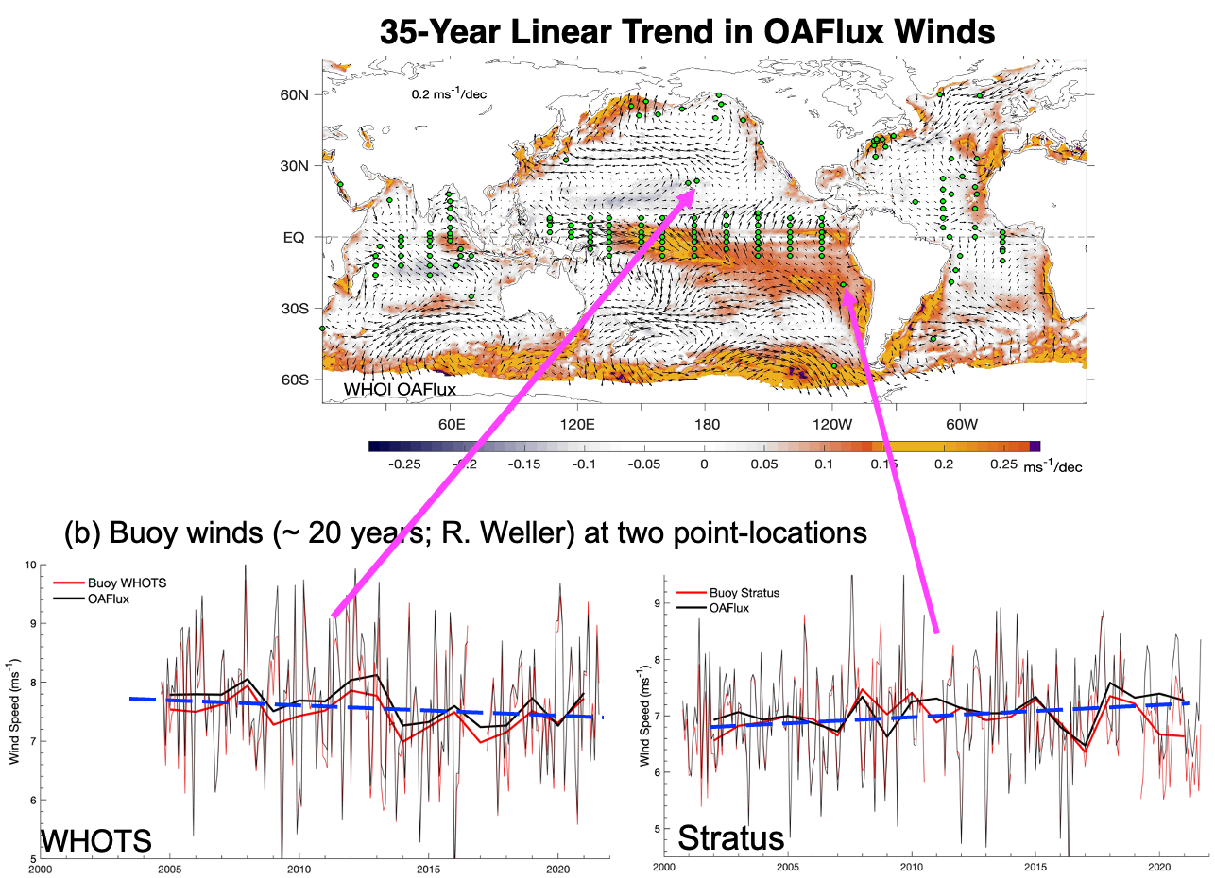
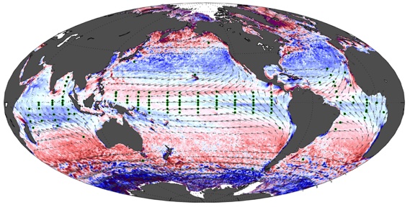
1.B MEaSUREs at WHOI OAFlux
Air-Sea Flux ESDRs
PI: Lisan Yu
Satellite climate data record
Winds: integrated from 19 satellite sensors (12 microwave radiometers and 7 scatterometers)
Heat and moisture fluxes: derived from 13 sensors (9 microwave radiometers and 4 sounders).
2. Over 35 years of 0.25°,daily datasets
The data records span from 1988 to the present, providing a long-term perspective on climate trends and patterns.
3. Robust validation using 151 Buoys including archived and active research buoys as well as selected NDBC buoys.
OAFlux 0.25° (1988-2022)
Mean Wind Stress and Curl

Slide 19
1.B ESDRs - Combined Multiple Observations/Models CCMP 3.1 Cross-Calibrated Multi-Platform Vector Wind Analysis Carl Mears, Lucrezia Ricciardulli, Frank Wentz (RSS) Tong Lee (JPL), Xiaochun Wang (UCLA)
CCMP uses a variational analysis to combine satellite winds with a background field from Numerical Weather Prediction (in this case, ERA5). The algorithm is designed to produce winds that agree with QSCAT and ASCAT winds from RSS (particularly important at high wind speed) by performing adjustments to the background field and radiometer wind retrievals before the variational analysis is performed.
Status:
Data available every 6 hours from Jan 1993 thru July 2023.
V3.1 released, now includes ASCAT-B.
ASCAT-C is excluded from V3.1 so it can be used as a validation source.
Updates are possible in “near real time”, when time and available effort permit.
In process with the PO.DAAC to archive CCMP 3.1 there.
Available at: https://www.remss.com/measurements/ccmp/

Slide 20
1.B ESDRs - Combined Multiple Observations/Models Surface Wind Thematic Assembly Center (Wind TAC)
The Surface Wind TAC is responsible for the collection, processing, qualification and distribution of surface winds data products derived scatterometers satellite missions. It is in charge of the near-real time (NRT) and delayed mode (REP) processing of Wind observations (globally), required for Copernicus Marine Service modelling and data assimilation and for applications.
The Surface Wind TAC develops wind and wind stress vector products, but also their derivative curl and divergence fields at both L3 and L4 from scatterometers and radiometers.
EXAMPLE: Global Ocean Monthly Mean Sea Surface Wind and Stress from Scatterometer and Model
For the Global Ocean - The product contains monthly Level-4 sea surface wind and stress fields at 0.25 degrees horizontal spatial resolution. The monthly averaged wind and stress fields are based on monthly average ECMWF ERA5 reanalysis fields, corrected for persistent biases using all available Level-3 scatterometer observations from the Metop-A, Metop-B and Metop-C ASCAT, QuikSCAT SeaWinds, ERS-1 and ERS-2 SCAT satellite instruments. The product provides monthly mean stress-equivalent wind and stress variables as well as their standard deviation. The number of observations used to calculate the monthly averages are included in the product.

Slide 21
Part 2. Science questions that could be addressed from the CDRs/ESDRs of ocean surface winds

Slide 22
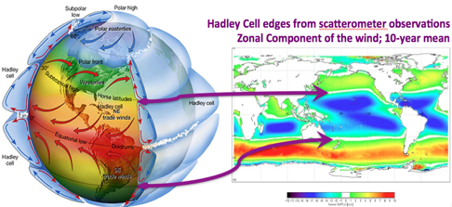
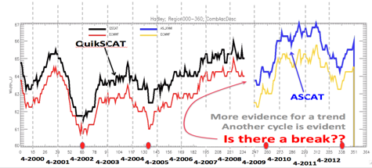
2. Science questions that could be addressed from the CDRs of ocean surface winds
Trends and variability in the global circulation:
Hadley cell
MJO and ENSO
Climate indices
Trends and variability in extremes
Coupling of tropical convection with surface wind convergence and flux convergence
Scale of the tropical convective systems
Winds and currents: effects on the ocean dynamics
Marine heat waves
The value of the speed-only CDRs from radiometers: coincident observations of the surface winds, the precipitation and thermodynamics of the environment (in terms of the Total Precipitable Water - TPW)
- Are the tropics expanding as an atmospheric response to the observed tropical ocean warming trend? If so, this widening of the Hadley cell could have a substantial impact on water resources and the ecology of the sub-tropics.
- Until now, the understanding of the mechanisms that govern the changing width of the tropics has been confined to models and proxies because of the unavailability of systematic observations of the large-scale circulation.
- Ocean surface vector winds, derived from scatterometer observations, provide for the first time an accurate depiction of the large-scale circulation and allow the study of the Hadley cell evolution through analysis of its surface branch.
- In a 2015 study we determine the extent of the Hadley cell as defined by the subtropical zero-crossing of the zonally-averaged zonal wind component, determined from QuikSCAT observations (Fig. 1) - (Hristova-Veleva et al., 2015).
To investigate the consistency in the trends and variability when determined by different scatterometers, we performed similar analysis of the Hadley cell using the wind estimates from ASCAT. We found an apparent discontinuity in the signal when the data source changes from one observing system to another (Fig. 2). What is the reason? Diurnal signal or retrieval inconsistencies?
Fig. 1. Schematic of the large-scale circulation (left panel) and the zonal component of the surface wind as determined from QuikSCAT (right panel).
Fig. 2. Time evolution of the width of the combined Hadley cell as determined from the zero crossing of the mean zonal wind (from 1-year running averages)
.
In a 2015 study we determine the extent of the Hadley cell as defined by the subtropical zero-crossing of the zonally-averaged zonal wind component, determined from QuikSCAT observations (Fig. 1) - (Hristova-Veleva et al., 2015).
To investigate the consistency in the trends and variability when determined by different scatterometers, we performed similar analysis of the Hadley cell using the wind estimates from ASCAT. We found an apparent discontinuity in the signal when the data source changes from one observing system to another (Fig. 2). What is the reason? Diurnal signal or retrieval inconsistencies?

Slide 23
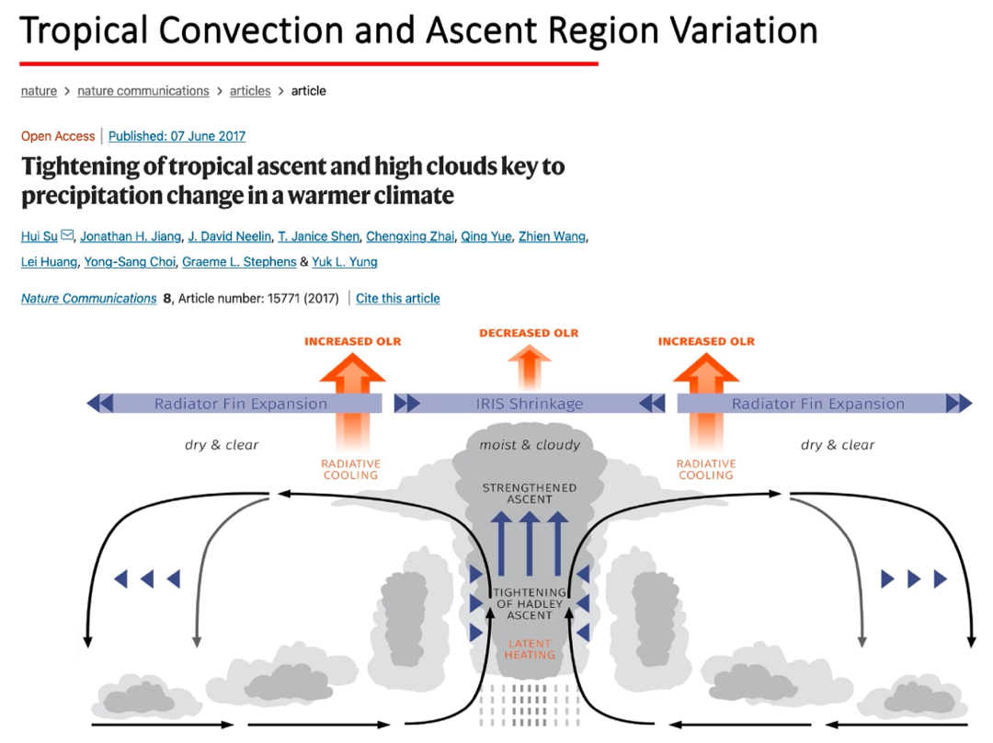
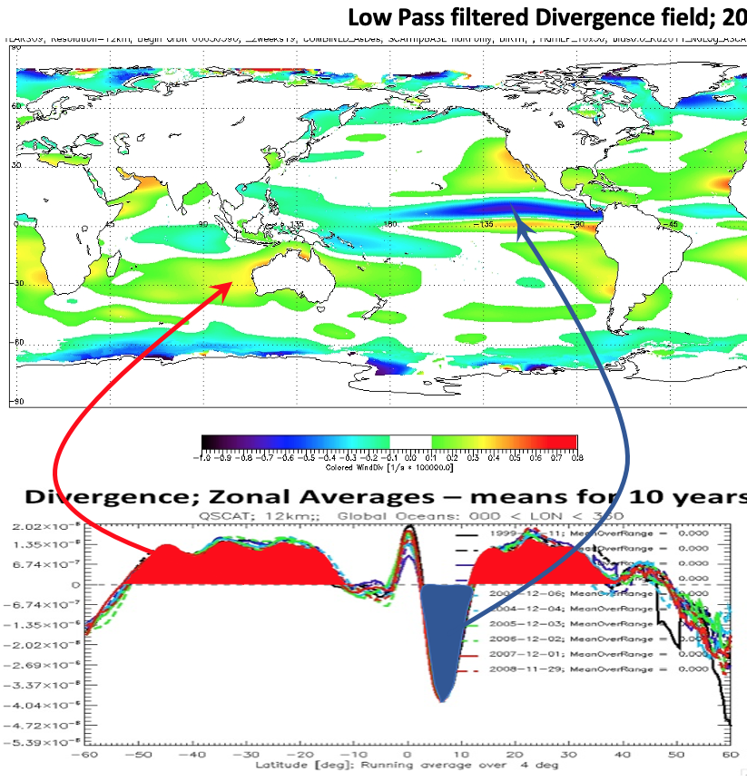
2. Science questions that could be addressed from the CDRs/ESDRs of ocean surface winds
Trends and variability in the global circulation:
Hadley cell and ITCZ
MJO and ENSO
Climate indices
Trends and variability in extremes
Coupling of tropical convection with surface wind convergence and flux convergence
Scale of the tropical convective systems
Winds and currents: effects on the ocean dynamics
Marine heat waves
The value of the speed-only CDRs from radiometers: coincident observations of the surface winds, the precipitation and thermodynamics of the environment (in terms of the Total Precipitable Water - TPW)

Slide 24
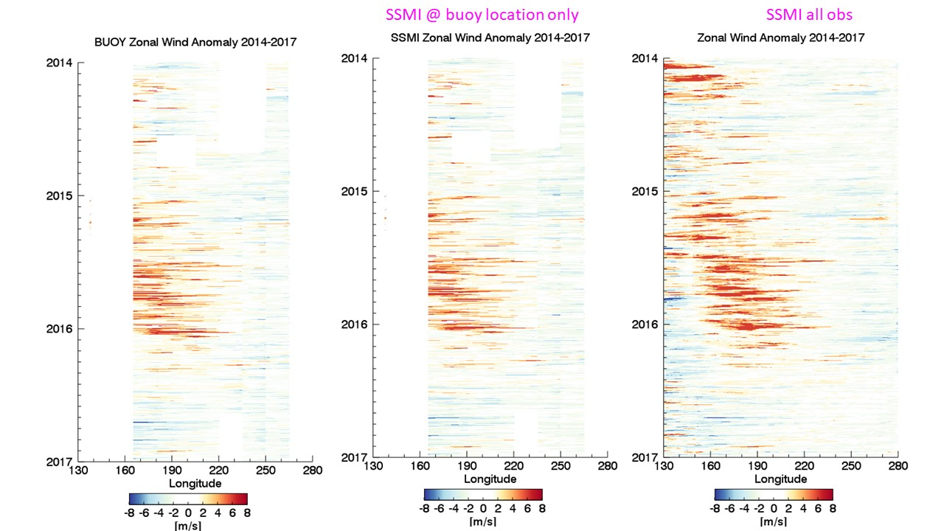
2. Science questions that could be addressed from the CDRs/ESDRs of ocean surface winds
WWB as depicted by the Zonal Wind Anomaly from Buoy and SSMI
Trends and variability in the global circulation:
Hadley cell and ITCZ
MJO and ENSO
Climate indices
Trends and variability in extremes
Coupling of tropical convection with surface wind convergence and flux convergence
Scale of the tropical convective systems
Winds and currents: effects on the ocean dynamics
Marine heat waves
The value of the speed-only CDRs from radiometers: coincident observations of the surface winds, the precipitation and thermodynamics of the environment (in terms of the Total Precipitable Water - TPW)
Lucrezia Ricciardulli
The Westerly Wind Bursts (WWB) for ENSO 97/98 as seen by the buoys only, by SSMI at the buoy locations, or by all SSMI (SSMI’s wind direction is from CCMP).
When taken only at the buoy locations, SSMI gives exactly the same figure as the buoys only.
But if we use all SSMI (all pacific 5N-5S) for the selected longitudes, we have a much better picture of the zonal wind anomalies that define a WWB.
Note: features in the East side that are not covered by the buoys (some tiny negative anomalies at the end of the ENSO event).

Slide 25
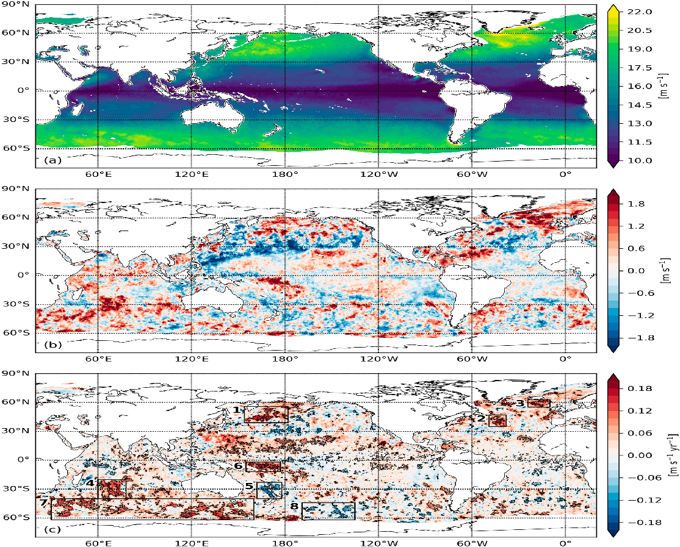
2. Science questions that could be addressed from the single-instrument CDRs of ocean surface winds
Extreme Wind Trends in Climate Data Records
Trends and variability in the global circulation:
Hadley cell and ITCZ
MJO and ENSO
Climate indices
Trends and variability in extremes
Coupling of tropical convection with surface wind convergence and flux convergence
Scale of the tropical convective systems
Winds and currents: effects on the ocean dynamics
Marine heat waves
The value of the speed-only CDRs from radiometers: coincident observations of the surface winds, the precipitation and thermodynamics of the environment (in terms of the Total Precipitable Water - TPW)
Ad Stoffelen, Alexandre Payez, Rianne Giessen
Wind trends in extremes are difficult to measure due to irregular sampling by in-situ observations
Re-analyses sample regularly and in a fixed model setting, but suffer from varying observational data set inputs over time, probably affecting trends
We have stable scatterometer instruments over several decades to detect trends in extremes
Analyzing trends by scatterometer instrument is reliable due to its constant sampling characteristics over time
Combining several overlapping instruments in a row may produce long-term reliable trends
PDF interpolation could further reduce sampling errors and allow determination of 99.9 wind speed percentiles over larger areas, e.g., basin (all this is being investigated in the ESA MAXSS project)
Figure 2.1.2. ASCAT-A 99th wind speed percentile (a) annual anomaly for 2020 and (b) annual trend (2007–2020). Areas with trends significant above the 90% confidence level are outlined in black.

Slide 26
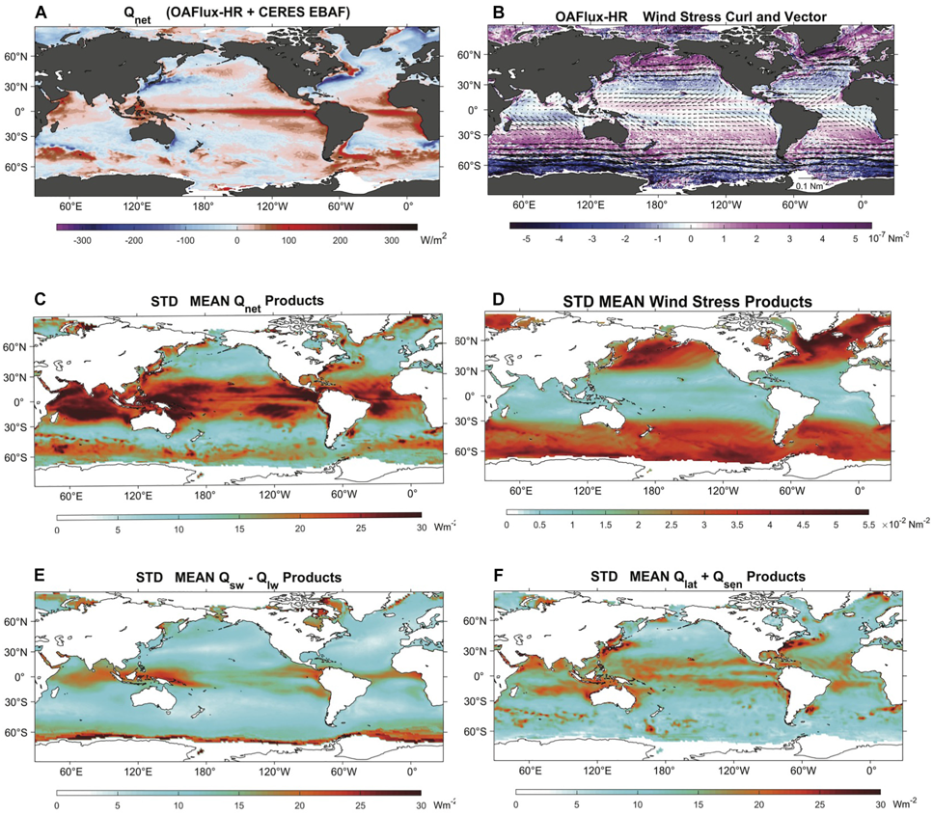
2. Science questions that could be addressed from the multi-platform ESDRs of ocean surface winds
OAFlux
Trends and variability in the global circulation:
Hadley cell and ITCZ
MJO and ENSO
Climate indices
Trends and variability in extremes
Coupling of tropical convection with surface wind convergence and flux convergence
Scale of the tropical convective systems
Winds and currents: effects on the ocean dynamics
Marine heat waves
The value of the speed-only CDRs from radiometers: coincident observations of the surface winds, the precipitation and thermodynamics of the environment (in terms of the Total Precipitable Water - TPW)
FIGURE 1 | (A) Annual mean net surface heat flux (Qnet) for 2016 from the OAFlux-HR + CERES EBAFv4.0 product. (B) Annual mean wind stress curl and wind stress vectors for 2016 from the OAFlux-HR. (C) Standard deviation of annual-mean Qnet from 12 products. (D) Standard deviation of annual mean of surface wind stress magnitude from 12 products. (E) Standard deviation of annual-mean surface shortwave and longwave (Qsw – Qlw) from 10 products. (F) Standard deviation of annual-mean turbulent latent and sensible heat flux (Qlat + Qsen) from 11 products. Based on Yu (2019).

Slide 27
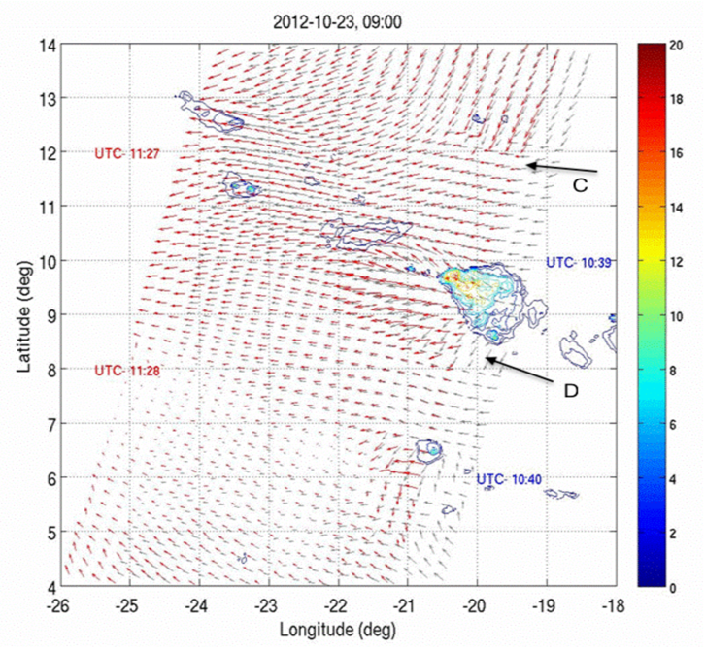
2. Science questions that could be addressed from the single-instrument CDRs of ocean surface winds
Correlating Extremes in Wind Divergence with Extremes in Rain over the Tropical Atlantic
Trends and variability in the global circulation:
Hadley cell and ITCZ
MJO and ENSO
Climate indices
Trends and variability in extremes
Coupling of tropical convection with surface wind convergence and flux convergence
Relating winds and precipitation in tropical convective systems
Winds and currents: effects on the ocean dynamics
Marine heat waves
The value of the speed-only CDRs from radiometers: coincident observations of the surface winds, the precipitation and thermodynamics of the environment (in terms of the Total Precipitable Water - TPW)
King GP, Portabella M, Lin W, Stoffelen A. Correlating Extremes in Wind Divergence with Extremes in Rain over the Tropical Atlantic. Remote Sensing. 2022; 14(5):1147. https://doi.org/10.3390/rs14051147
Figure 2. A satellite view of interaction of rain and ocean winds in Atlantic Inter-Tropical Convergence Zone in an area a few degrees north of equator to west of coast of Africa.
Figure shows superposition of wind vectors from ASCAT-A (black) and ASCAT-B (red) with contours of Meteosat Second Generation (MSG) rain at time corresponding to pass of ASCAT-A.
Colorbar shows rain rate in mmh−1−1. Note convective rain cells (>10 mmh−1−1) and nearby areas of strong wind convergence (C) and divergence (D).
Air–sea fluxes are greatly enhanced by the winds and vertical exchanges generated by mesoscale convective systems (MCSs). In contrast to global numerical weather prediction models, space-borne scatterometers are able to resolve the small-scale wind variability in and near MCSs at the ocean surface.
Downbursts of heavy rain in MCSs produce strong gusts and large divergence and vorticity in surface winds.
In this paper, 12.5 km wind fields from the ASCAT-A and ASCAT-B tandem mission, collocated with short time series of Meteosat Second Generation 3 km rain fields, are used to quantify correlations between wind divergence and rain in the Inter-Tropical Convergence Zone (ITCZ) of the Atlantic Ocean.
We show that when there is extreme rain, there is extreme convergence/divergence in the vicinity.
The divergence time lag is close to zero, while it is 30 min for the convergence peak, implying that extreme rain generally appears after (lags) extreme convergence.
The temporal scale of moist convection is thus determined by the slower updraft process, as expected.

Slide 28
2. Science questions that could be addressed from the CDRs/ESDRs of ocean surface winds
Trends and variability in the global circulation:
Hadley cell and ITCZ
MJO and ENSO
Climate indices
Trends and variability in extremes
Coupling of tropical convection with surface wind convergence and flux convergence
Relating winds and precipitation in tropical convective systems
Winds and currents: effects on the ocean dynamics
Marine heat waves
The value of the speed-only CDRs from radiometers: coincident observations of the surface winds, the precipitation and thermodynamics of the environment (in terms of the Total Precipitable Water - TPW)

Slide 29
2. Science questions that could be addressed from the CDRs/ESDRs of ocean surface winds
Trends and variability in the global circulation:
Hadley cell and ITCZ
MJO and ENSO
Climate indices
Trends and variability in extremes
Coupling of tropical convection with surface wind convergence and flux convergence
Relating winds and precipitation in tropical convective systems
Winds and currents: effects on the ocean dynamics
Marine heat waves
The value of the speed-only CDRs from radiometers: coincident observations of the surface winds, the precipitation and thermodynamics of the environment (in terms of the Total Precipitable Water - TPW)

Slide 30
Part 3. Application-focused uses of the CDRs

Slide 31
3. Application-focused uses of the CDRs
Guiding question: Would we get the same conclusion in our science investigations depending on whether we are using models or observations?
Very important consideration: Account for sampling issues – spatial, and, maybe more importantly, temporal (i.e. account for the diurnal component that is hidden (aliased) in the observational CDR).
Model validation across spatial and temporal scales
Types of model validations
Verify whether re-analyses are:
consistent with observations
stable – meaning the difference from observations do not show trend
Determine:
Geographical (regional) model biases, and their trends
Biases in spatial wind variability (convergence and vorticity; scale wind/stress spectral analyses)
Model’s ability to capture temporal variability: diurnal, seasonal, and intraseasonal signals
Determine model’s ability to capture important phenomena in the:
Global atmospheric circulation
WWB and El-Nino evolution
MJO phases
Hadley cell structure and trends: in width of the cell; in intensity and width of the ITCZ
Air-sea interactions: e.g. SST-wind coupling; fluxes and flux convergence; Also, their trends and variability
Vertical exchanges due to moist convection (rather poorly represented in all models)
Which models
Operational – coupled and uncoupled
Re-analyses
Climate

Slide 32
Part 1, 2, 3 Background and Additional Contributions
Note:
Some repetition of information in earlier slides as the following slides come to support or complement the earlier discussions.

Slide 33
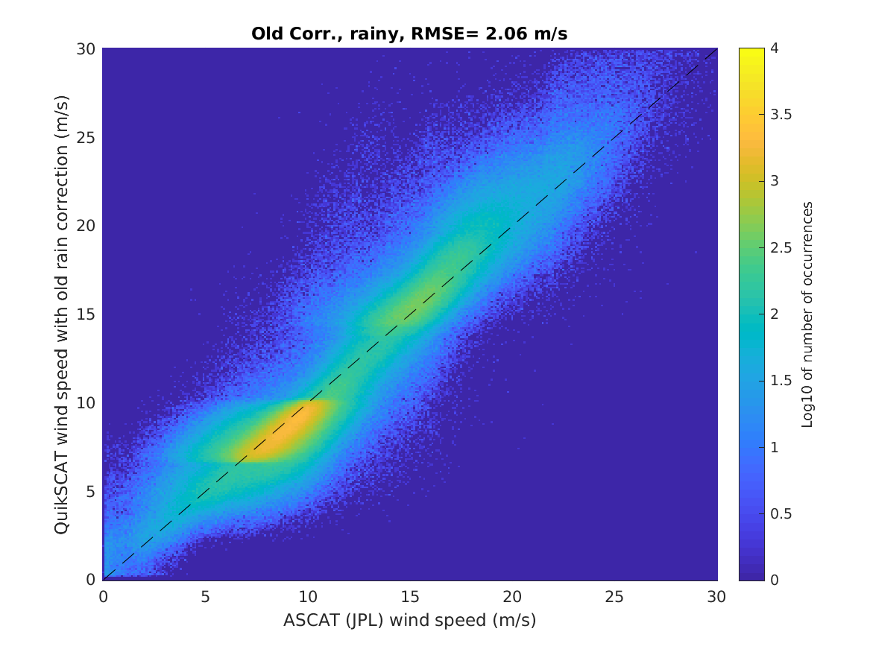
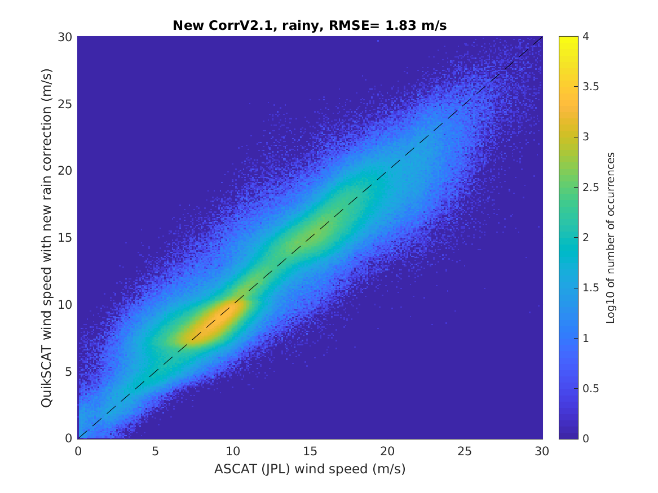
Flowchart of Ku/C-band rain correction and harmonization work- Bryan Stiles et al. (Green – completed in past years, Blue – completed this year, Orange – nearing completion, Gray – Future work described in poster.)
Modify C-band (ASCAT) GMF to match QuikSCAT wind speeds in rainfree conditions
Recalibrate ScatSAT to remove nonilinearity in calibration w.r.t QuikSCAT using ASCAT-B data
Develop neural network to correct ScatSAT wind speeds in rain to match ASCAT-B data
Remove step functions in time of a few tenths of a m/s in ASCAT/ScatSAT calibration
Current QuikSCAT rain correction
Utilize the serendipitous improvement in near-ice winds due to ScatSAT-trained rain correction neural network to improve detection and where possible correction of sea-ice contaminated wind data for ScatSAT, ASCAT, and QuikScat.
(See Stiles et al poster)
2-D ASCAT/ScatSAT joint histogram in rain with 90 minute colocation
Use ScatSAT-trained neural network to improve QuikSCAT rain correction. Histogram matching is used to transform QuikSCAT brightness temperature and backscatter inputs into ScatSAT distribution
New QuikSCAT rain correction
RMS diff (m/s) | Rainy (m/s) | Rain free (m/s)
Current | 2.06 | 1.22
New | 1.83 | 1.20

Slide 34
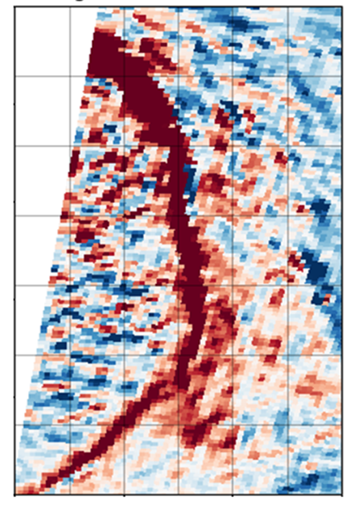
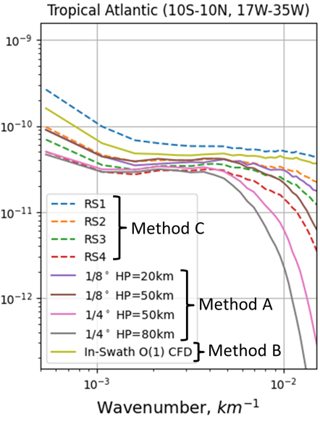
Comparing Wind Derivative Calculation Methods from Orbital Swath Winds
Link to poster
Ethan Wright and Mark Bourassa, COAPS Florida State University
How do the noise characteristics of wind divergence and vorticity change with common methods of calculation and preprocessing of orbital (L2) wind data?
Derivative Calculation Methods
Finite differencing on a uniform grid
Finite differencing on the orbital swath grid
Circulation about a central point using a line integral of surrounding wind cells
Power Spectra Comparisons

Slide 35
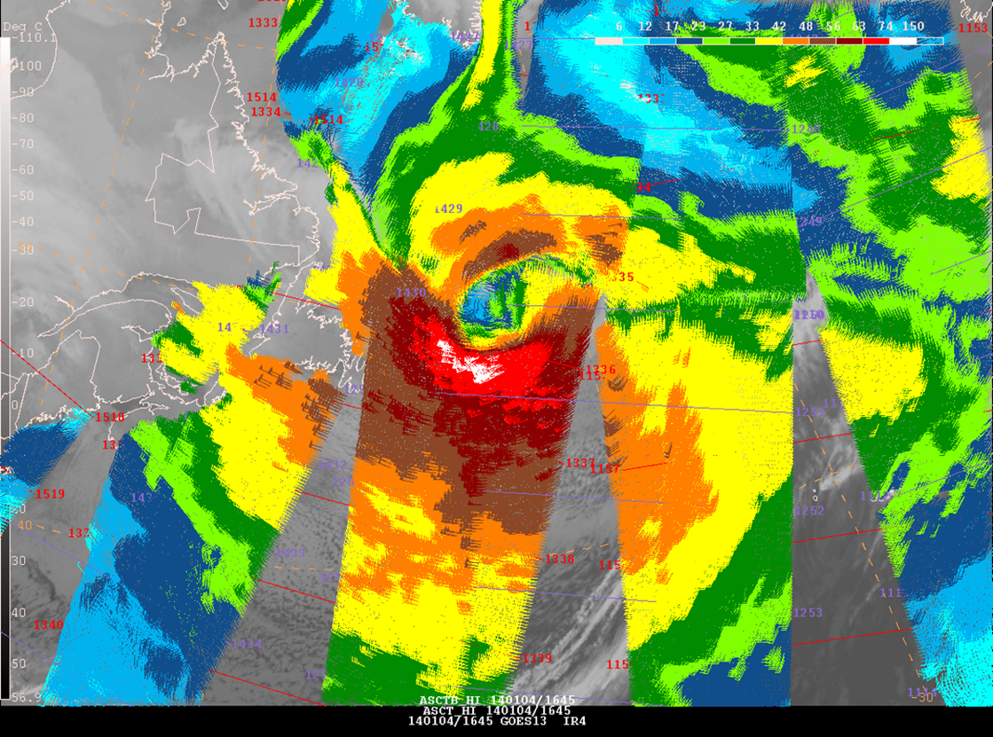
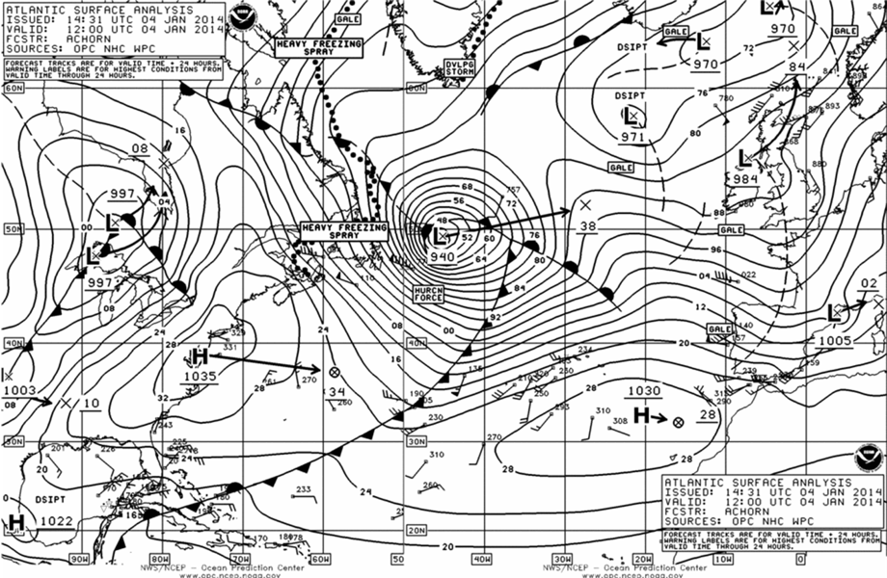
Marine Weather Warnings
Introduced Hurricane Force – 2000
Ability to observe winds
confirm warnings
Validate NWP guidance
Observe wind structures/evolution
QuikSCAT, ASCAT A-C, OSCAT, RapidScat
Improved algorithms – high winds, coastal
Wind Speed
Knots
34 – 41
42 – 47
48 – 56
56-63
64-74
75 - >
Source: NOAA
Joe Sienkiewicz – Ocean Prediction Center

Slide 36
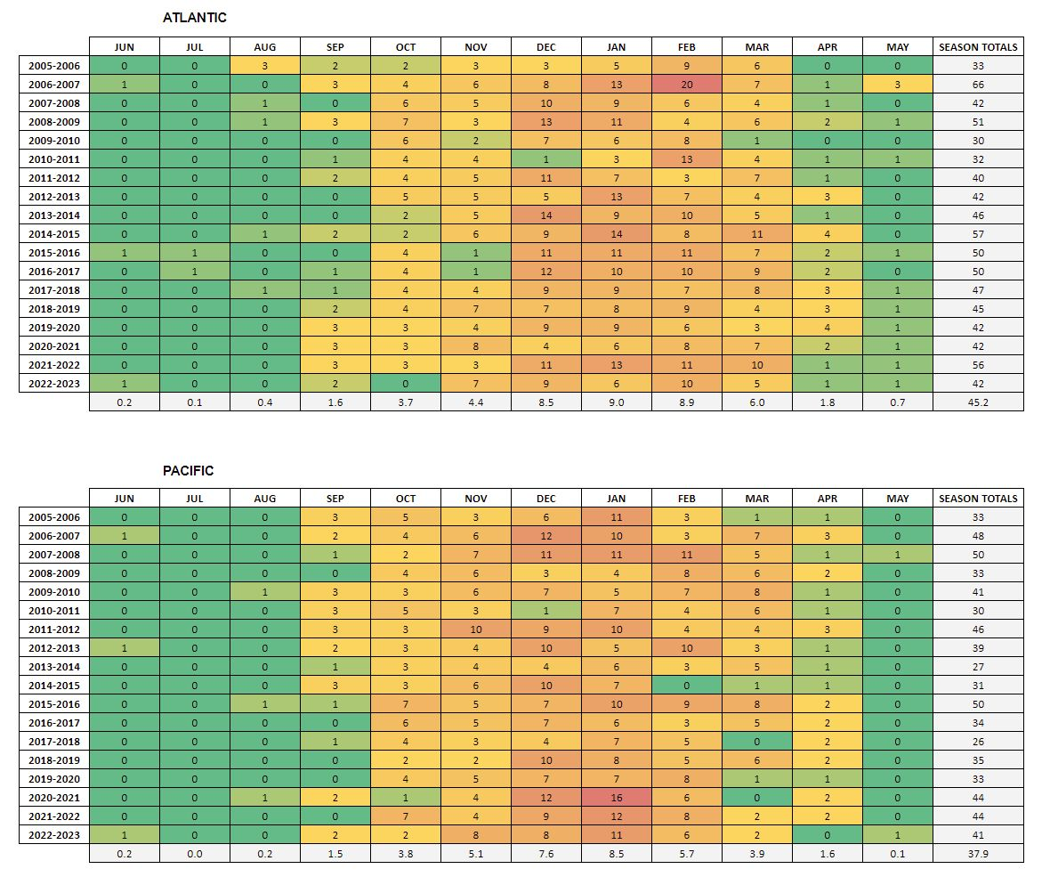
ATLANTIC
HURRICANE FORCE
Extratropical
Cyclones
2005-2023
ATLANTIC ~45 annually
Peak - Dec - Mar
PACIFIC
~38 annually
Peak - Nov - Feb
AVG 0.2 0.1 0.4 1.6 3.7 4.4 8.5 9.0 8.9 6.0 1.8 0.7 45.2
Source: NOAA
PACIFIC
Courtesy:
Forecasters Jim Kells, Tim Collins, Jason Krekeler
AVG 0.2 0.0 0.2 1.5 3.8 5.1 7.6 8.5 5.7 3.9 1.6 0.1 37.9

Slide 37
Discussion Slides from
John Knaff

Slide 38
We work to estimate operational TC wind metrics
John Knaff
All existing satellite data has shortcomings
We work to get estimates in front of forecasters
Provide guidance on use
The following slides proved an overview of availability, shortcomings, and resulting best track/operational use
These were taken from Knaff et al. (2021)
Knaff, J.A., C. R. Sampson, M. Kucas, C. J. Slocum, M. J. Brennan, T. Meissner, L. Ricciardulli, A. Mouche, N. Reul, M. Morris, G. Chirokova, and P. Caroff, 2021: A practical guide to estimating tropical cyclone surface winds: History, current status, emerging technologies, and a look to the future. Tropical Cyclone Research and Review, 10(3), 125-150, https://doi.org/10.1016/j.tcrr.2021.09.002.

Slide 39
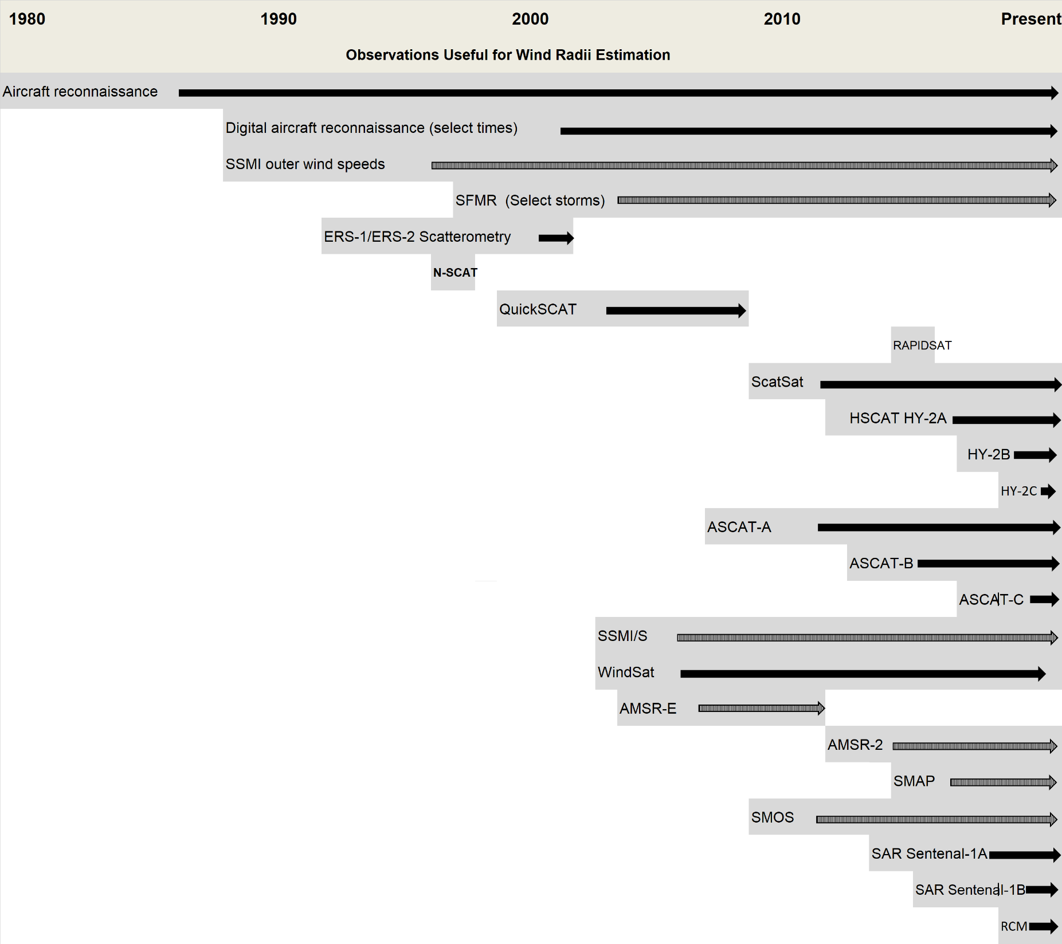
John Knaff

Slide 40
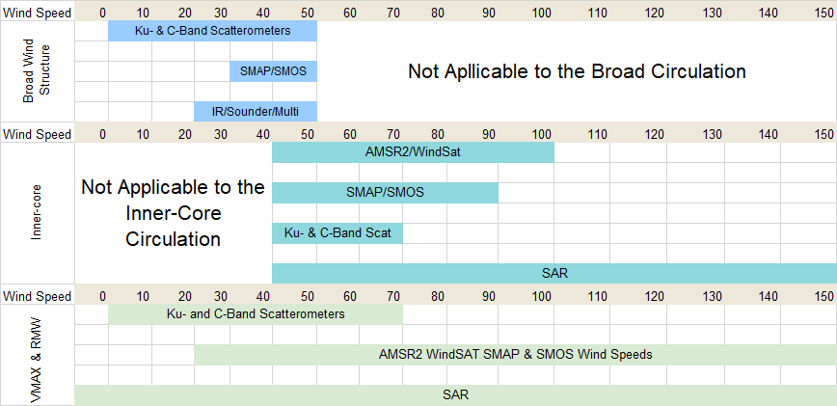
John Knaff

Slide 41
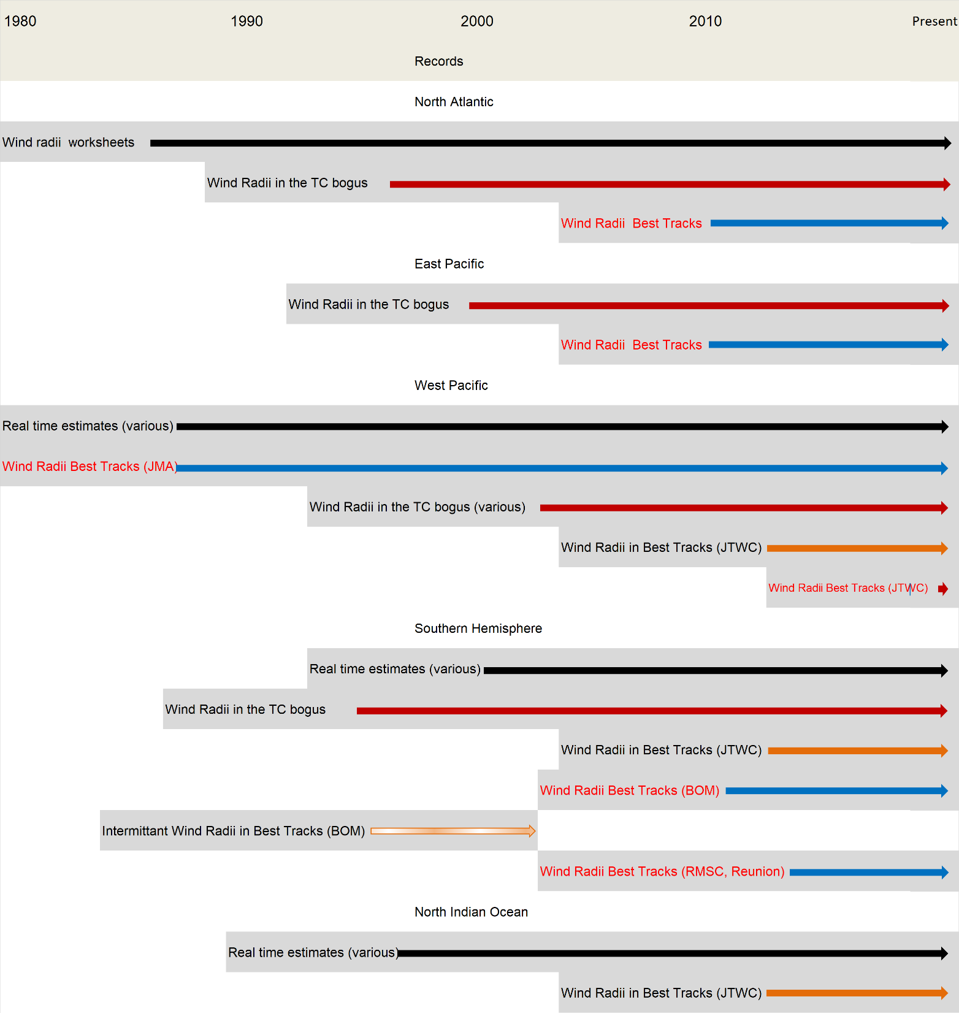
John Knaff

Slide 42
What are the needs
John Knaff
surface wind data coverage from a combination of sources should cover an area extending at least 600 n mi (1100 km) from TC centers with a horizontal resolution on the order of 2 km in the inner-core region, and be available at least every six hours.
planning for research and experimental observational capabilities (e.g., for surface wind estimation) should incorporate adequate funding for instrument design and ground station capabilities so that near real-time digital data are provided for forecasting applications and critical evaluation during real-time weather events.

Slide 43
Extreme Wind Trends in Climate Data Records
Ad Stoffelen, Alexandre Payez, Rianne Giessen
Wind trends in extremes are difficult to measure due to irregular sampling by in-situ observations
Re-analyses sample regularly and in a fixed model setting, but suffer from varying observational data set inputs over time, probably affecting trends
We have stable scatterometer instruments over several decades to detect trends in extremes
Analyzing trends by scatterometer instrument is reliable due to its constant sampling characteristics over time (see example plots)
Combining several overlapping instruments in a row may produce long-term reliable trends
PDF interpolation could further reduce sampling errors and allow determination of 99.9 wind speed percentiles over larger areas, e.g., basin
This is being investigated in the ESA MAXSS project
Figure 2.1.2. ASCAT-A 99th wind speed percentile (a) annual anomaly for 2020 and (b) annual trend (2007–2020). Areas with trends significant above the 90% confidence level are outlined in black.

Slide 44
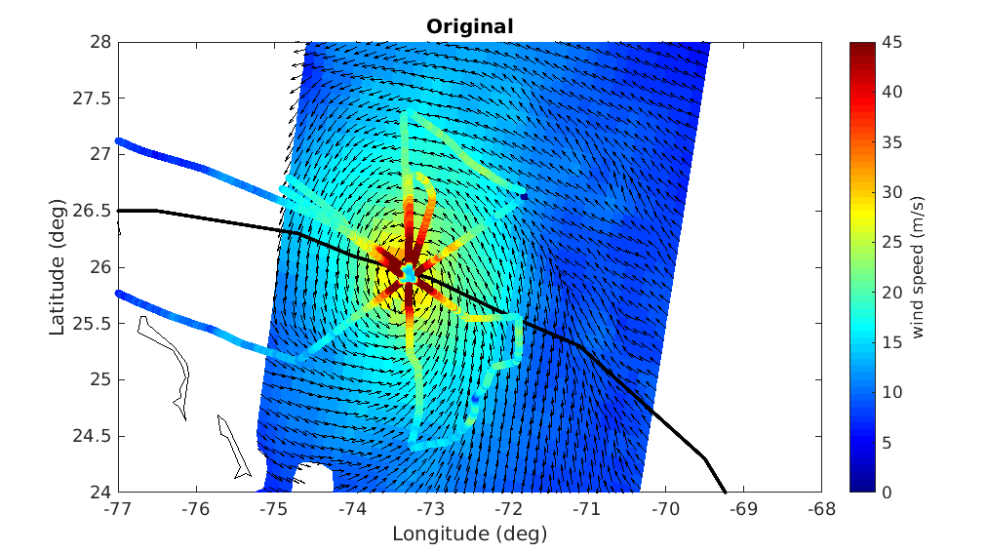
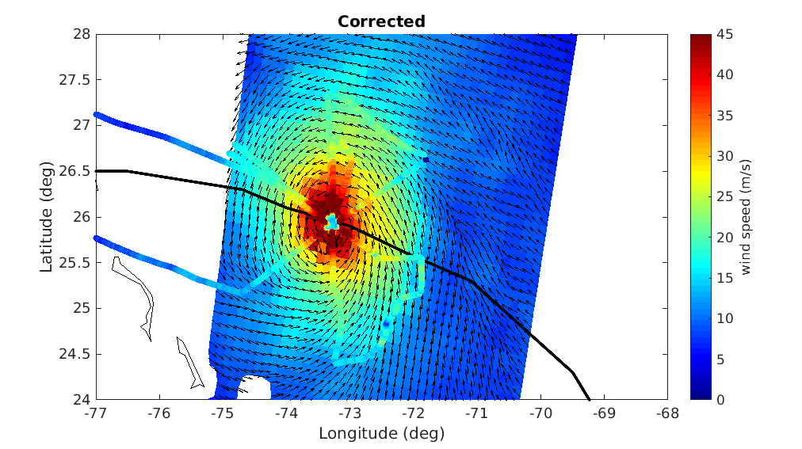
Extreme wind inter-calibration & validation
Adjustment of radiometers & scatterometers high & extreme winds using SFMR (2010-2020)
OSI SAF: ASCAT-A, -B & -C, Rapidscat, OSCAT, OSCAT2, HY-2A & HY-2B
REMSS: Windsat (v7), AMSR-2 (v8), SMAP (v1)
Ifremer: SMOS (v2)
Accounting for spatial representativeness and QC effects
Addressing SFMR calibration variations
Ensuring inter-calibration among all satellite systems
The L2 adjusted products are available on the ESA MAXSS study webpage (https://www.maxss.org/Products/MAXSS-Product-Catalogue)
ASCAT operational wind field over Hurricane Dorian using buoy winds as calibration reference
ASCAT adjusted wind field over Hurricane Dorian
using SFMR winds as calibration reference

Slide 45
CDR Challenge: Seasonal changes in diurnal winds Donata Giglio, Sarah Gille et al
Strength and timing of diurnal wind cycles vary seasonally.
Patterns vary geographically.
Annual signal can be aliased by sampling (e.g. from ISS)
Multiple satellites, or well-coordinated orbits needed to distinguish diurnal signal from other variability
Giglio et al, Remote Sensing, 2022

Slide 46
ERA* High-resolution ocean forcing product (2010-2020)
ERA* aims at correcting NWP local wind biases with geolocated scatterometer-NWP differences accumulated over several days
ERA* corrects for large-scale circulation errors and adds small-scale true wind variability, due to oceanic features such as wind changes over SST gradients and ocean currents
A 10-year dataset of ERA5-corrected ERA* wind & stress has been developed in the context of the ESA WOC study
ERA* product resolution: 0.125º & hourly (https://www.worldoceancirculation.org/Products)
Zonal component (v10S)
COLLOCATIONS
ASCAT-A/B/C – ERA5 u10S
30-d Temporal Window

Slide 47
Does it matter if the scatterometer retrievals are consistent?
Recent evidence suggests that the tropics have expanded over the last few decades by a very rough 1º latitude per decade, considered to be an atmospheric response to the observed tropical ocean warming trend. If continued, the expansion of the tropics (the widening of the Hadley cell) could have a substantial impact on water resources and the ecology of the sub-tropics.
Until now, the understanding of the mechanisms that govern the changing width of the tropics has been confined to models and proxies because of the unavailability of systematic observations of the large-scale circulation.
Ocean surface vector winds, derived from scatterometer observations, provide for the first time an accurate depiction of the large-scale circulation and allow the study of the Hadley cell evolution through analysis of its surface branch.
In a 2015 study we determine the extent of the Hadley cell as defined by the subtropical zero-crossing of the zonally-averaged zonal wind component, determined from QuikSCAT observations (Fig. 1) - (Hristova-Veleva et al., 2015). We found:
The first half of the 10-year record shows two distinct cycles in the width of the Hadley cell while the latter part of the record shows a steady increase in the width, as has been shown by others (~1º/decade, both south and north, for a total of about 2º / decade);
The two cycles in the 1999-2004 time period are likely a reflection of the modulation of the Hadley cell by the La Nina (1999) /El Nino (2002) events that dominated this period;
To investigate the consistency in the trends and variability when determined by different scatterometers, we performed similar analysis of the Hadley cell using the wind estimates from ASCAT. We found an apparent discontinuity in the signal when the data source changes from one observing system to another (Fig. 2). What is the reason? Diurnal signal or retrieval inconsistencies?
Fig. 1. Schematic of the large-scale circulation (left panel) and the zonal component of the surface wind as determined from QuikSCAT (right panel).
Fig. 2. Time evolution of the width of the combined Hadley cell as determined from the zero crossing of the mean zonal wind (from 1-year running averages)
.

Slide 48
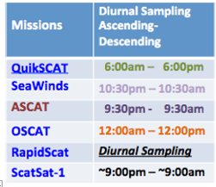
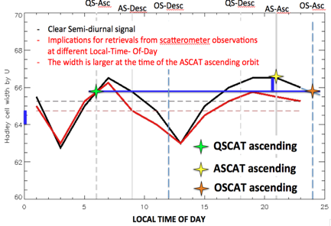
CDRs of single-instrument ocean surface winds – goals & motivation
Goal: long-term efforts by the IOVWST to provide stable and well-intercalibrated records of the ocean surface winds
Motivation: existing difference in operational estimates from different wind missions and different institutions
Main Sources of Uncertainty
Diurnal variability of the winds
Not well-known magnitude and geographic variability of the diurnal signal, to allow properly isolating its contribution to the differences in the wind estimates from missions observing at different Local Times of Day.
Differences in the active observing systems
frequency of the observations (Ku vs C band), with possible differences in the physics of the relationship between the observations (σ⁰) and the underlying winds; Also having different sensitivity to
atmospheric parameters (most importantly rain)
ocean surface parameters such as wind speed, sea surface temperature (SST) and sea state.
instrument design and geometry (push-broom vs pencil beam, variable incidence angles of the observations);
Retrieval algorithms and assumptions - inconsistencies remain in the different components of the different retrieval schemes.
Hadley Cell Width from RapidScat
NASA’s ISS-RapidScat provided unique opportunity to help reveal the impact of the diurnal signal.
Our analyses showed the presence of a clear semidiurnal signal in the width of the Hadley cell.
Schematic of the observation geometry for the two different observing systems: the rotating pencil beam of the Ku-band scatterometers (left) and the push-broom fan beam sampling by the C-band scatterometers (right)

Slide 49
PART 4: CDRs/ESDRs – Collaborative Studies

Slide 50
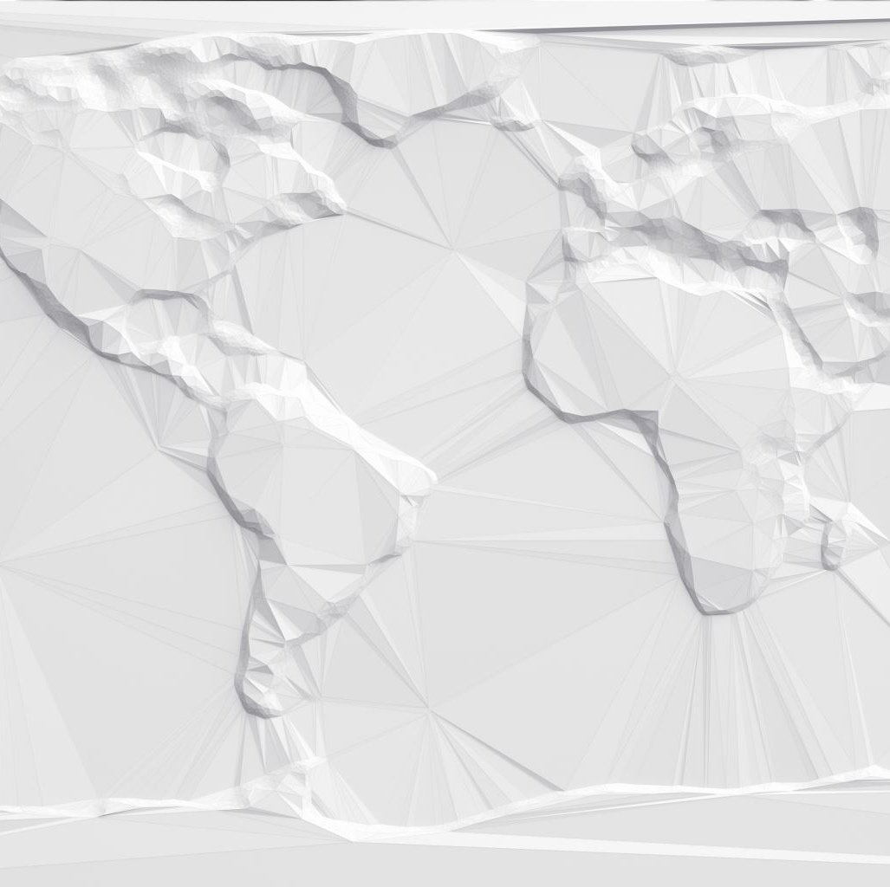
4.1.CDRs: Limitations A Deep Dive into Outstanding Technical Issues
Lisan Yu (WHOI), Svetla Hristova-Veleva (JPL/Caltech),
Mark Bourassa (FSU), Greg King
CDRs/ESDRs are merged from multiple sensors. There are differences in retrievals, algorithms, and merging approaches.
Every CDR/ESDR has limitations, and none is perfect.
One CDR/ESDR cannot meet every need.
Proposed Action:
Intercomparison of CDRs/ESDRs is necessary
to assess their accuracy, reliability, and consistency across different datasets and sources.
To provide clear guidance to the use of CDRs/ESDRs
Temporal resolution:
- How is it determined?
Missing data gaps:
- Whether and how are they filled?
Extreme winds:
- How do we convey our interpretation
of extreme winds?
- How does a lack of clarity impact trends
in extreme winds?
Ice edge:
- How accurate are scatterometer retrievals
near the ice edge?

Slide 51
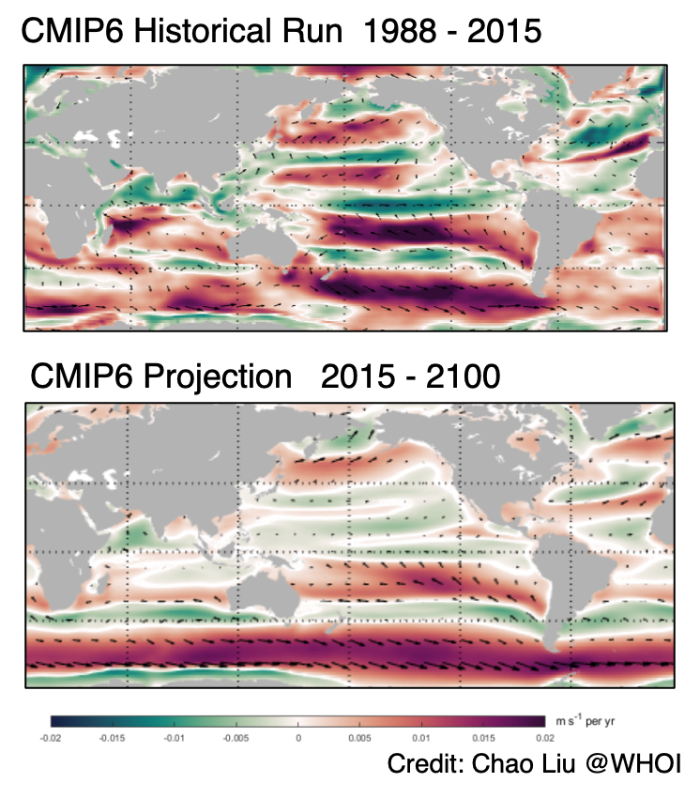
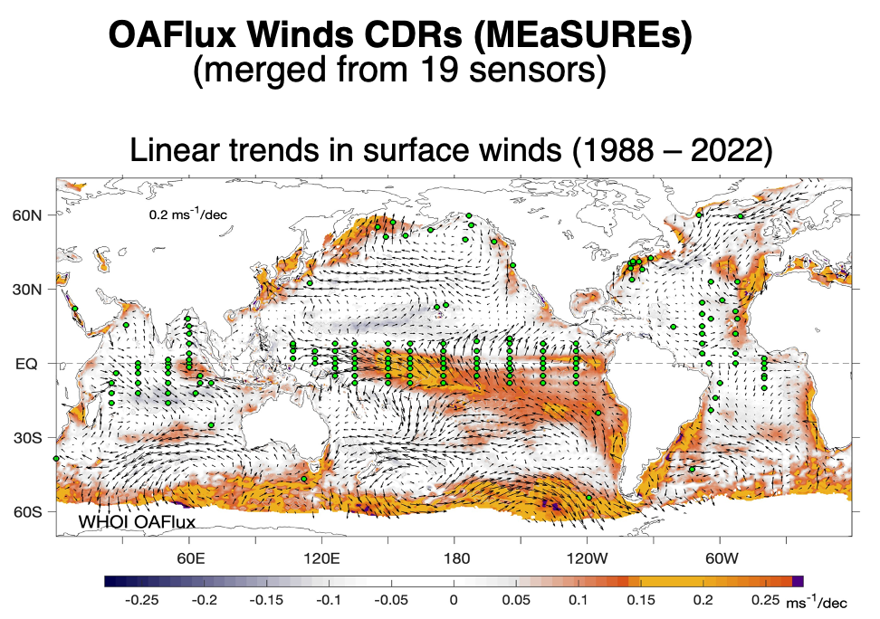
4.2 CDRs/ESDRs for climate studies
WMO: 30-year period is considered a minimum timeframe to distinguish long-term climate trends from shorter-term weather variability
Wind CDRs/ESDRs of 30+ years: Potential Role in improving climate simulation & projection
Proposed action:
Reaching out to climate model communities to foster collaborations.
Unlike OAFlux-1deg, it is NOT a model/sat combination

Slide 52
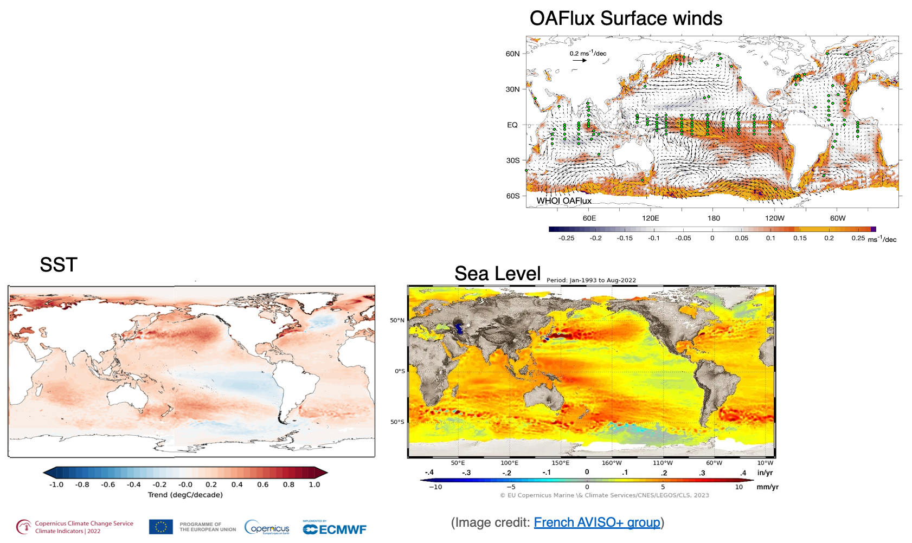
4.3. Climate Trends
across Key Climate Indicators
Winds are a key driver of ocean climate change and variability (sea level, the water cycle, SSS,..)
Winds interacts with SST, precipitation, ...
Proposed action:
fostering collaborations across teams

Slide 53
Three collaborative research focus areas
CDRs/ESDRs: Limitations
Proposed Action: Intercomparison studies
Climate Trends across ECVs
Proposed Action: Fostering collaboration across teams
CDRs for climate studies
Proposed Action: Reaching out to climate model communities

