Slide 1
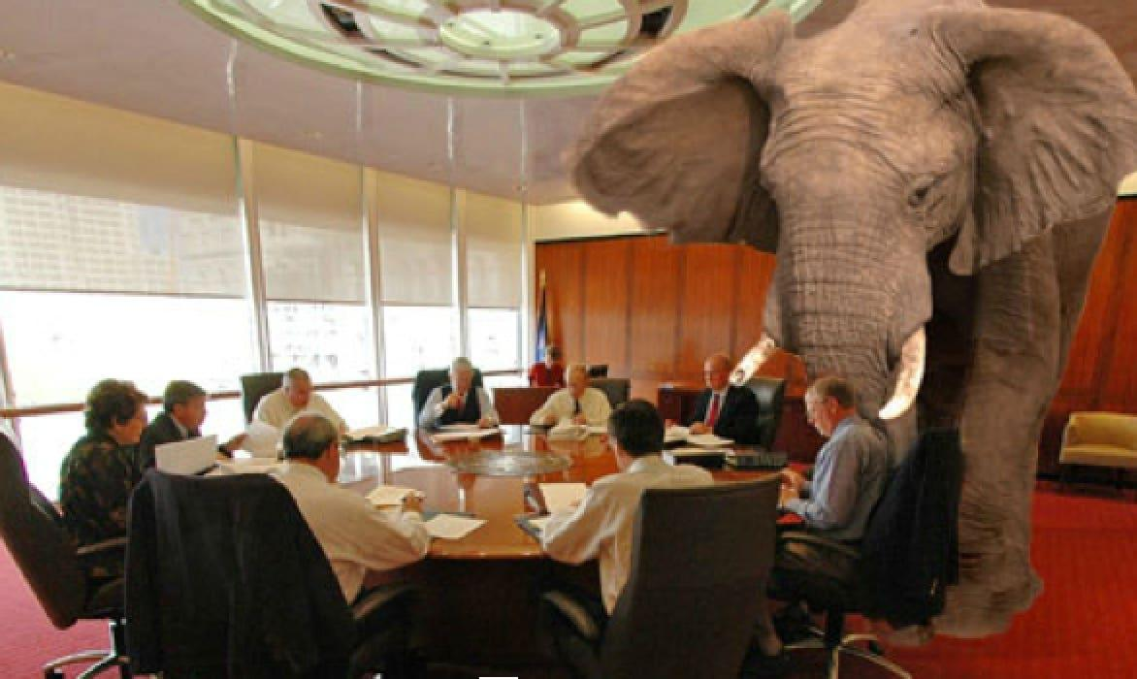
How to live with model biases ?
Ad.Stoffelen@knmi.nl
Zhixiong Wang, NUIST
Giovanna De Chiara, ECMWF
and several others . . .

Slide 2
Golden age of Scatterometry (WMO OSCAR)
Source: https://space.oscar.wmo.int/gapanalyses?mission=12
Past C-band missions : Past Ku-band missions :
ERS-1,2/ESCAT 10:30 desc. 1992-1996, 1995-2000 SeaWinds/QuikScat 6:00 desc. 1999-2009
MetOp-A/ASCAT 9:30 desc. 2007-2021 RapidScat/ISS 52 * 2014-2016
OceanSat-2/OSCAT-1 0:00 desc. 2009-2014
ScatSat-1/OSCAT-2 8:45 desc. 2016-2021
Prepare ourselves for many scatterometers ☺
~15% forecast error reduction?

Slide 3
Quintuple collocation analysis
(C-band)
(C-band)
(Ku-band)
Scatterometers winds and stresses are unbiased with respect to moored buoys and have the smallest random error among in-situ and NWP winds
Consolidated several methodologies to solve collocation error equations
Added better ability to approximate the errors of the errors
Confirms the excellent accuracy of scatterometer winds
Stress-equivalent 10-m winds
Jur Vogelzang and Ad Stoffelen, 2022a, 2022b, 2021

Slide 4
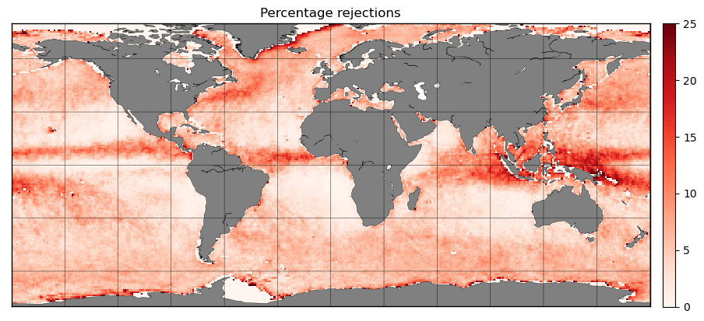
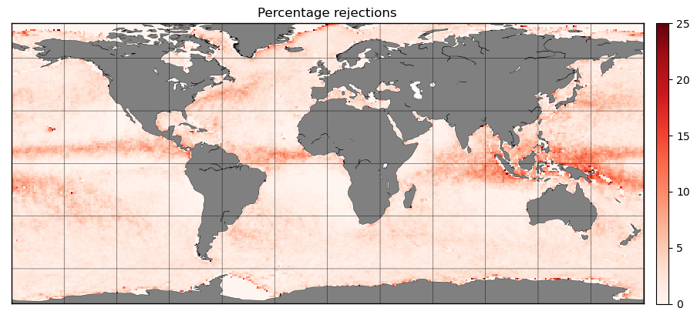
Quality Control and ocean winds
EUMETSAT OSI SAF continuously improves quality control (QC)
For Ku-band scatterometers we need to control rain events (=>)
Develop algorithms to correct for remaining observational sampling biases
We compare geographical biases between rain-insentitive (ASCAT) and rain-sensitive (Ku-band) scatterometers and collocated ECMWF winds
This allows correction of the satellite sampling biases using ECMWF
It allows to estimate the bias due to the systematic removal of about 10% of the Ku-band winds in moist convection
We work on Ku-band rain correction methods using Bayesian estimation
Zhao et al., 2023
King et al., 2022
Xu and Stoffelen, 2021, 2019
Trindade et al., 2020, 2023
Belmonte and Stoffelen, 2019
Old
New

Slide 5
Hi-res radiosonde shear much larger than in NWP model
The ECMWF model is the best global NWP model available ☺
Collocation data base
ECMWF wind PDFs agree very well
Shear in ECMWF model 2-3 times lower, however
Tropical tropopause strongly variable
Shear determines mixing of air, cloud forming, ..
Houchi et al. 2010
Tropics
RAOB
RAOB
ECMWF
ECMWF

Slide 6
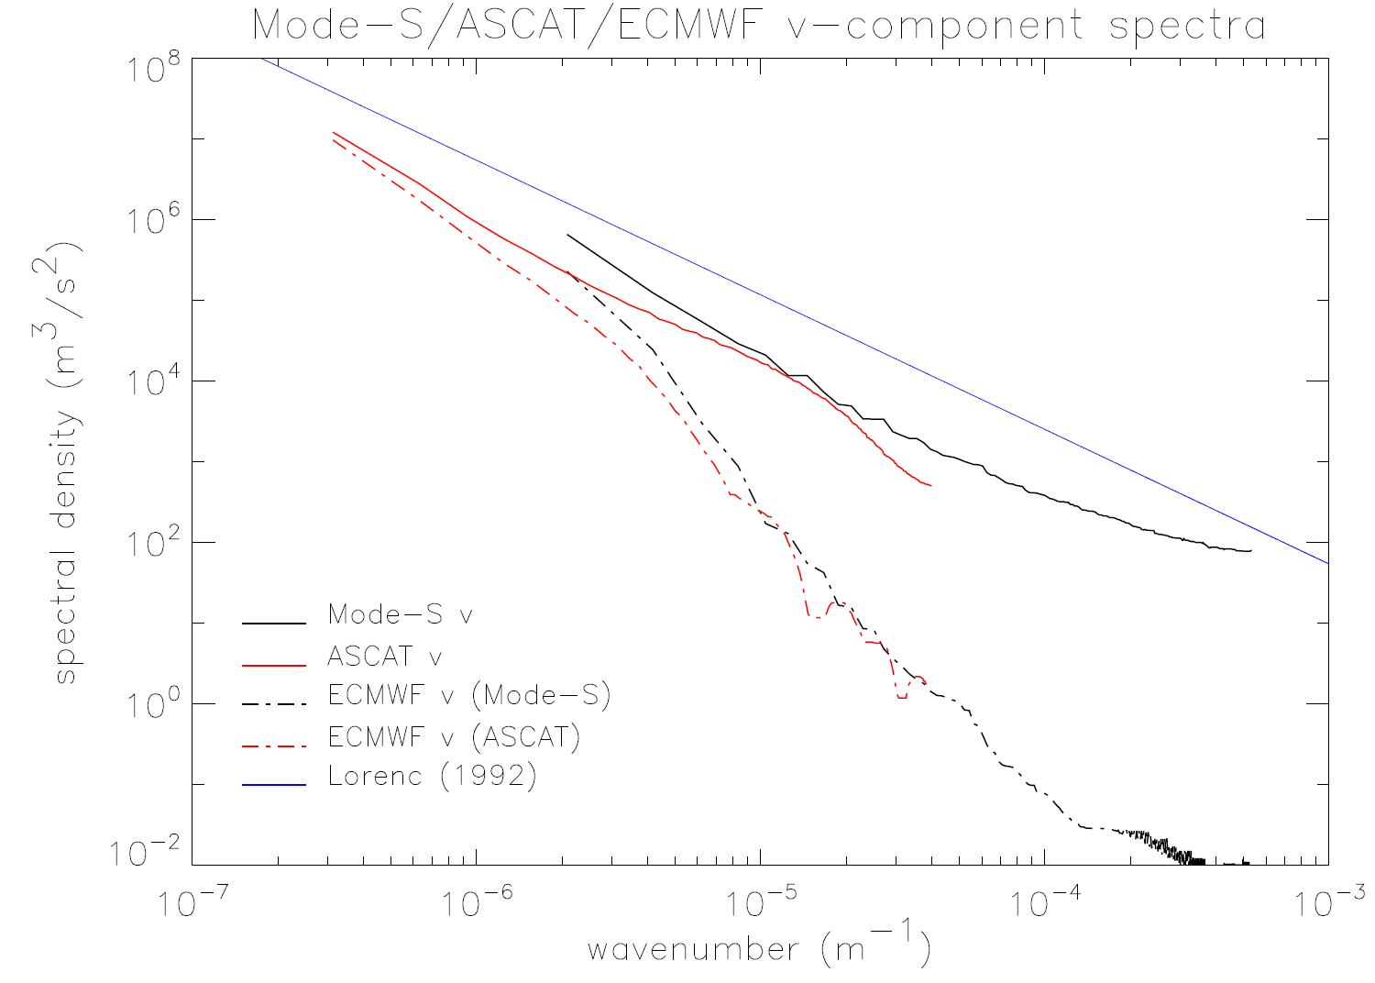
Global NWP gap for small scales
Collocation observations and ECMWF (same sample)
Below 500-km scales 3D turbulence dictates k^{-5/3} spectrum
This is followed by the observations
In the upper air and at the ocean surface, ECMWF misses small-scale processes
Wind variability is associated with mesoscale dynamics, mixing, coupled to sea surface conditions
500 km
k^{-5/3}
ModeS at 10 km height
ASCAT
Collocated
ECMWF (ODB)
2014
≡ ERA5

Slide 7
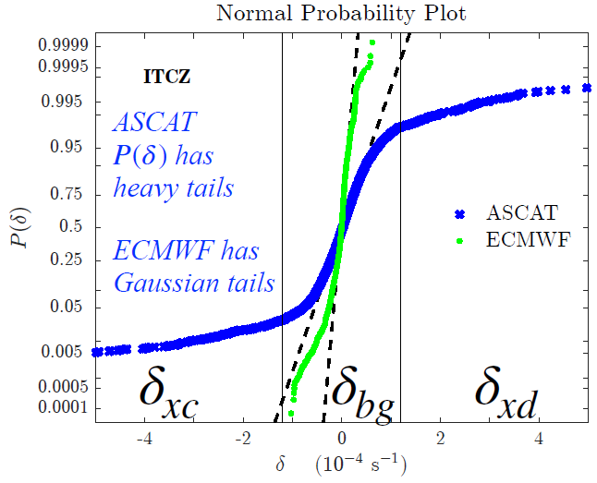
Spatial derivatives of wind and stress fields
Notes:
PDF of wind divergence (King et al., 2022)

Slide 8
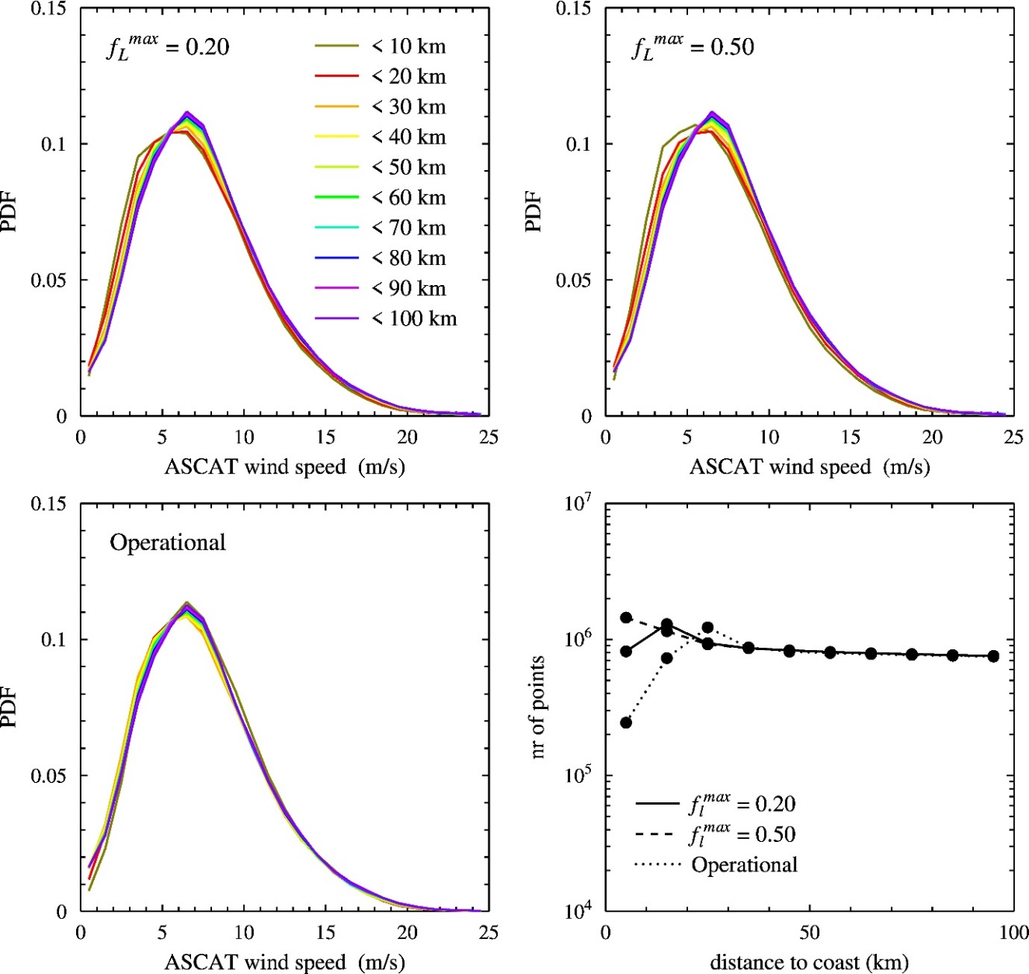
NWP model coastal winds are too low
PDFs of collocated coastal winds
ECMWF u10s decreases faster towards the coast for < 30 km
Probably caused by diffusion operator?
Consistent with downscaling studies with km-scale grids
While these still reduce the winds before they reach the coast!
This is problematic for coastal model studies
Vogelzang & Stoffelen, 2022

Slide 9
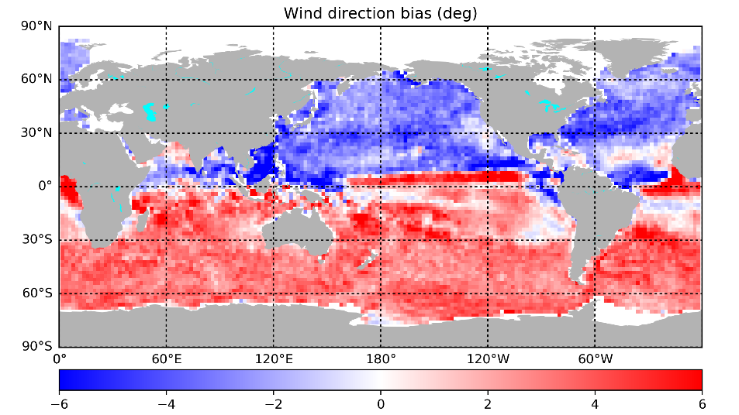
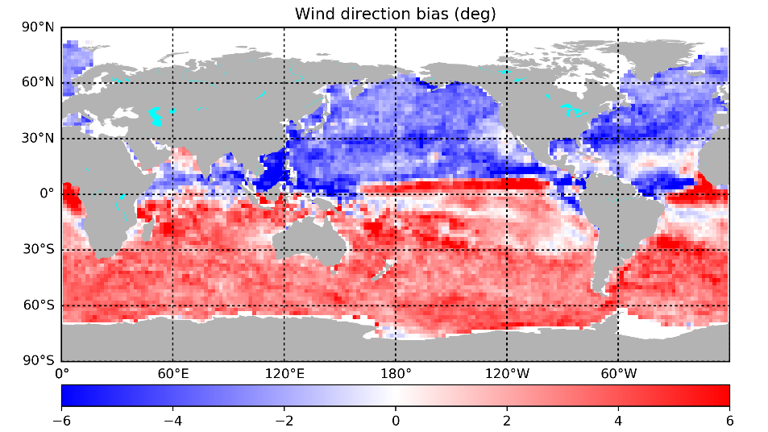
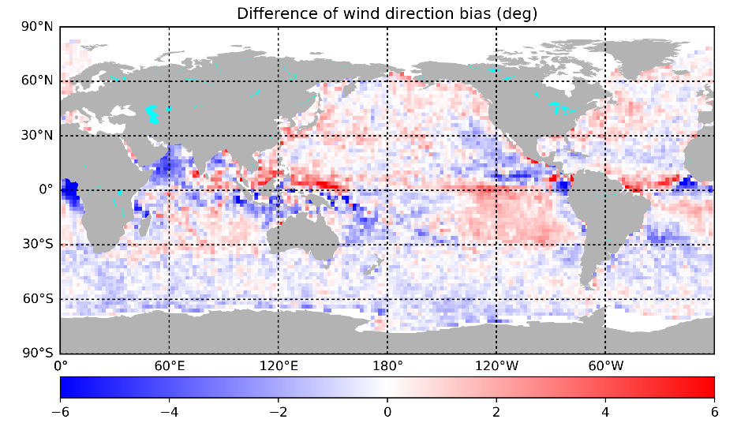
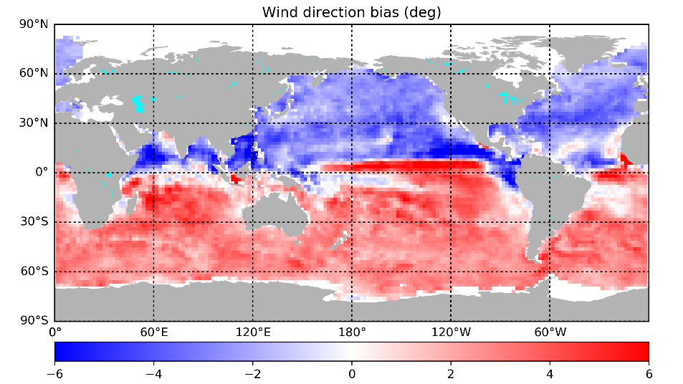
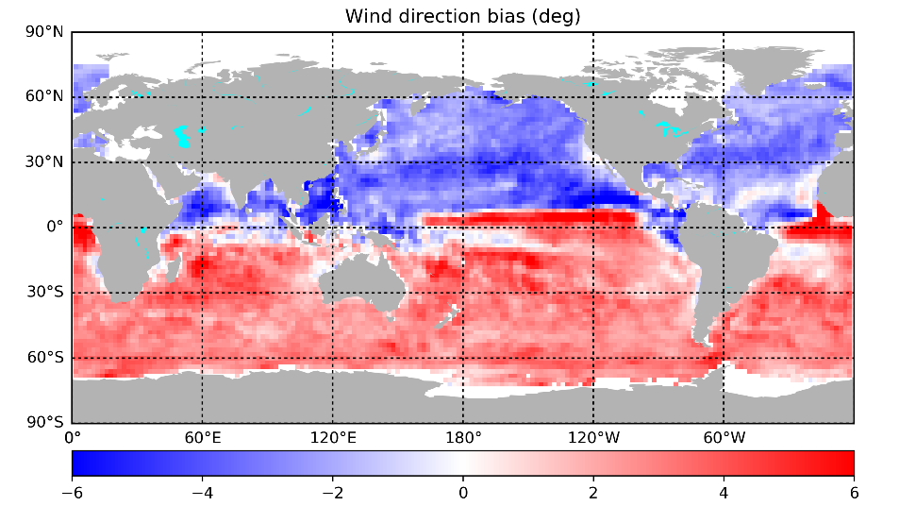
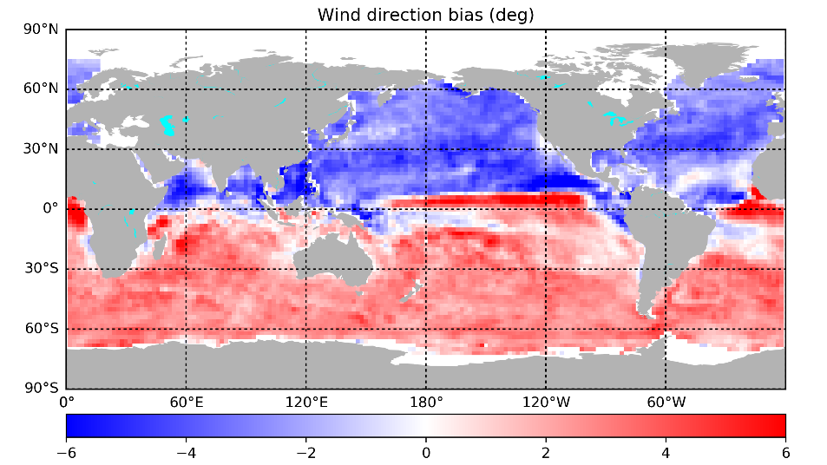
Wind direction biases of SCA - NWP
Pattern could be diurnal cycle error
ASCAT-B NRT
ASCAT-C NRT
ASCAT-B/NRT – HSCAT-B/Rep02
HSCAT-B Rep02
HSCAT-C Rep02
HSCAT-D Rep02
www.ecmwf.int/sites/default/files/elibrary/2020/19545-causes-systematic-forecast-biases-near-surface-wind-direction-over-oceans.pdf

Slide 10
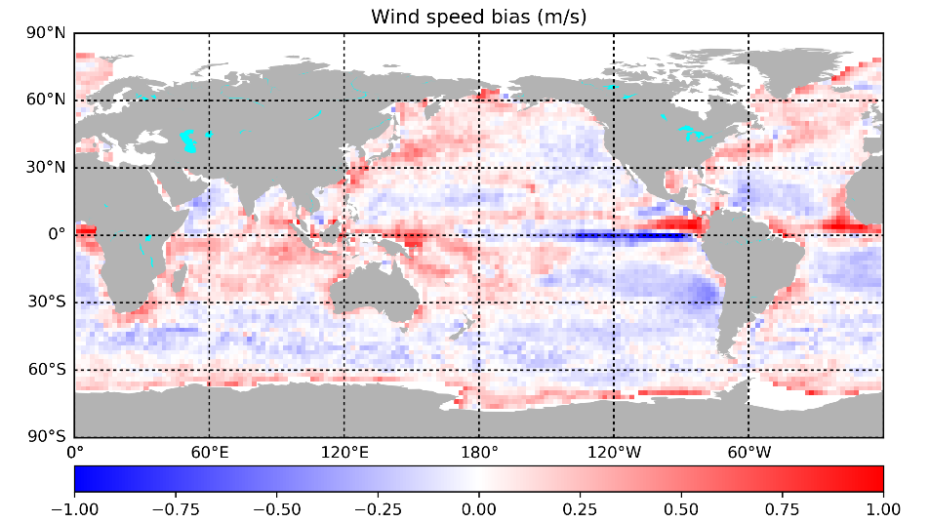
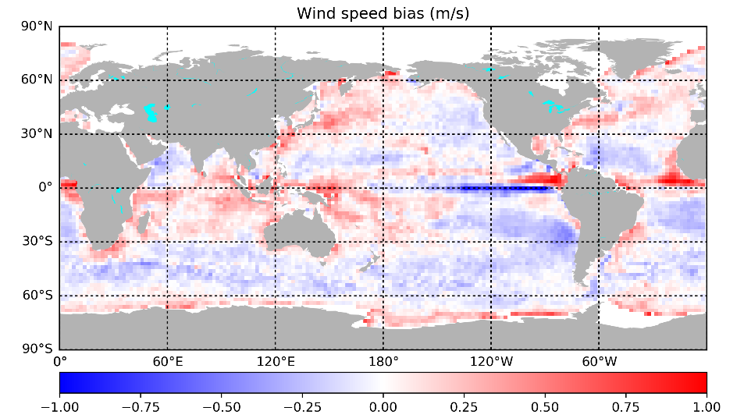
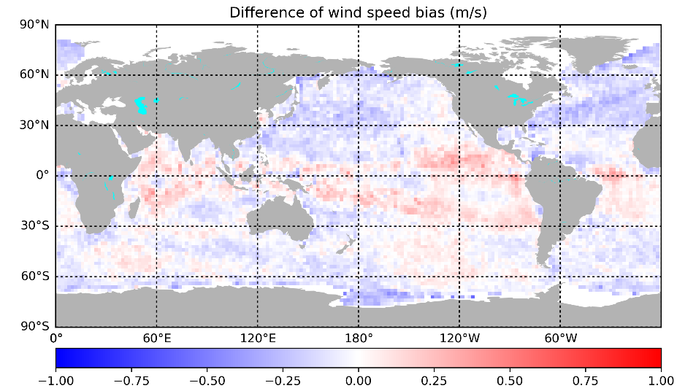
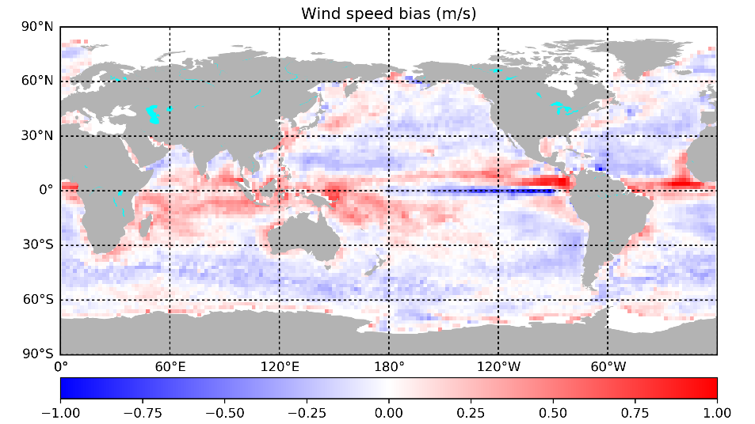
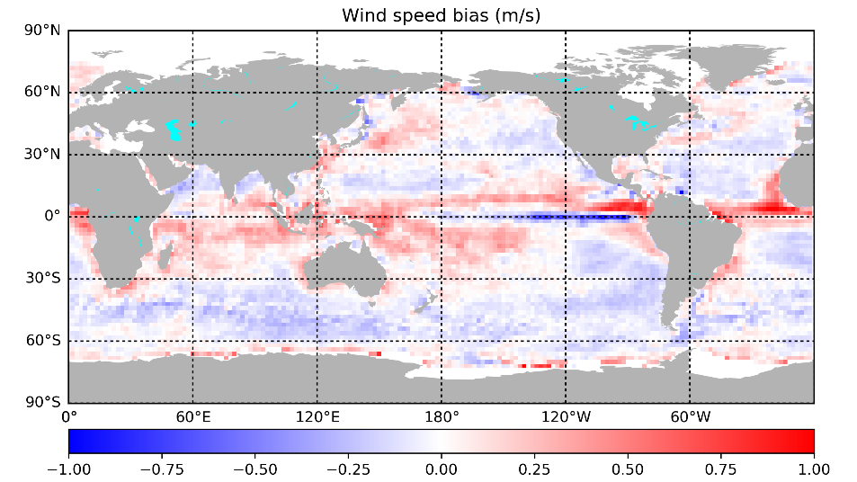
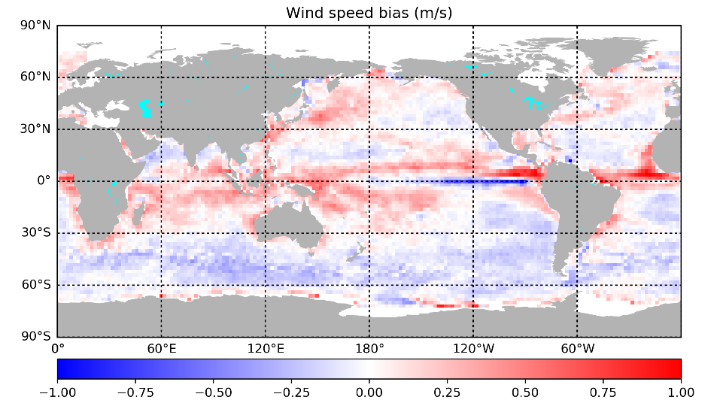
Wind speed biases of SCA - NWP
Pattern could be diurnal cycle error
ASCAT-B NRT
ASCAT-C NRT
ASCAT-B/NRT – HSCAT-B/Rep02
HSCAT-B Rep02
HSCAT-C Rep02
HSCAT-D Rep02

Slide 11
What can we fix?
Adjust observations to the model biases to make NWP data assimilation more effective, i.e., take profit of the full innovation vector to initialize mesoscale dynamics
Correct ERA5 and OPS model background U_{10S} for the biases observed by scatterometer (hourly) (we cannot correct the ERA5 U10S analyses, as its errors are too complicated because of their scatterometer dependency)
Use ML to learn the biases, such that they can be applied in coupled forecasts (ICM)
Link the biases in mean and variance to coupled-model physical parameters (EUMETSAT fellow)
Test the impact of the proposed changes on (coupled) ocean and weather forecasts
Improve the physical coupled model, based on what we learned
SCA mission science plan, 2019

Slide 12
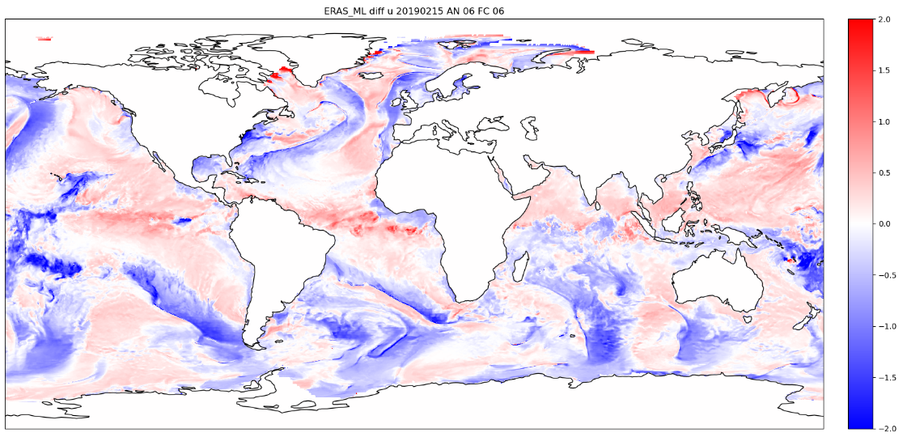
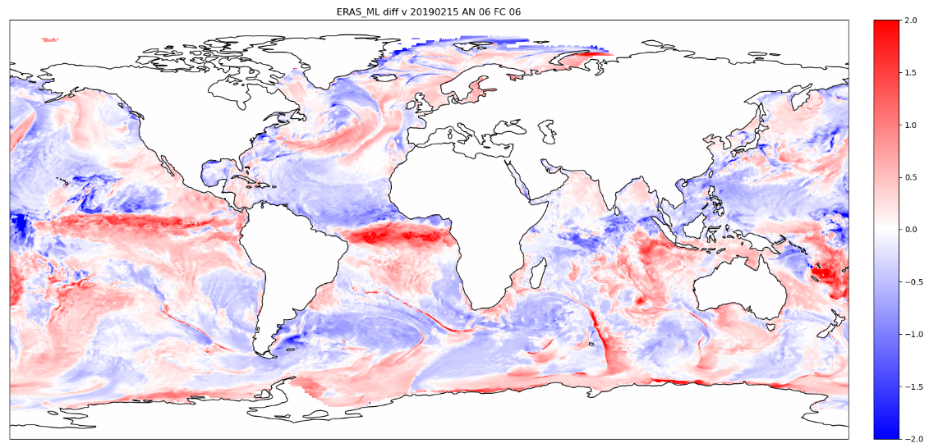
On the use of machine learning to correct NWP model sea surface wind forecasts with scatterometer data input
Eugenia Makarova (makarova@icm.csic.es), Marcos Portabella, Ad Stoffelen, Ana Trindade
Link to poster
Machine learning (ML) model for correcting the ECMWF ERA5 reanalysis stress-equivalent local wind biases.
Ocean surface and atmospheric related NWP parameters used as inputs.
Algorithms evaluated:
XGBoost (Extreme Gradient Boosting)
Feed-forward neural networks (4 hidden layers)
Preliminary model was trained on a small subset of data (70 days in 2020, 5% subsample).
Corrections generated for u (top) and v (bottom) ERA5 stress-equivalent wind components by a feed-forward neural network for 15th February 2019 AN 6 FC 6 forecast
Error variance reduction compared to ERA5, validated against HSCAT-B

Slide 13
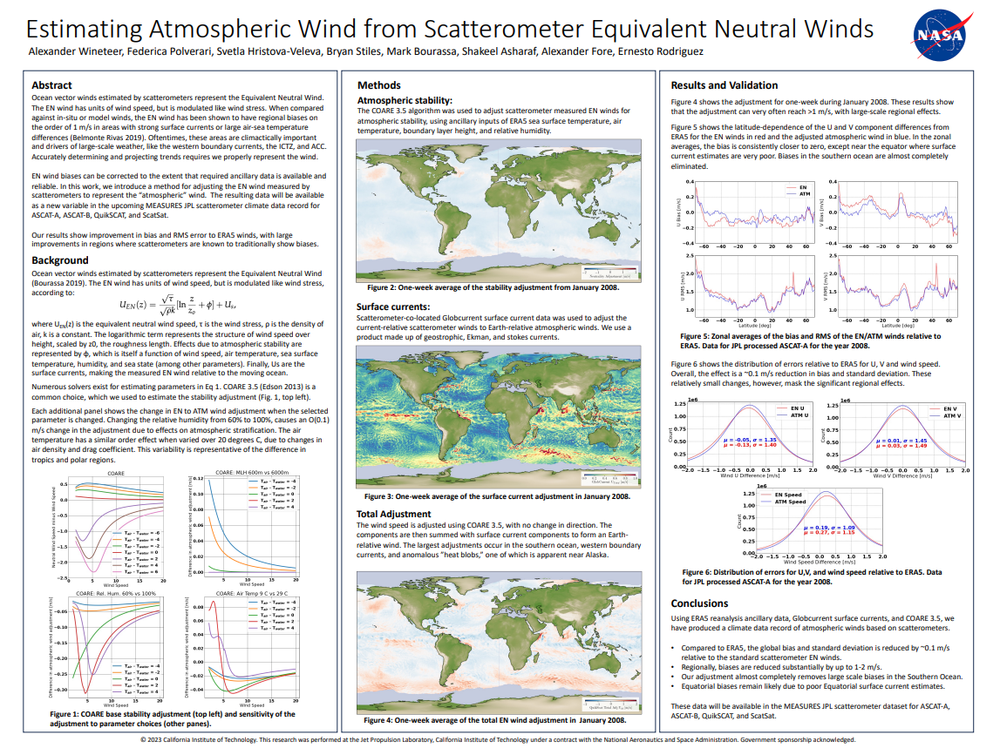
Link to poster

Slide 14
Suggested topics for discussion
Are 10-m stress-equivalent winds the most ideal for ocean forcing?
Are mean current effects easily corrected by observed scatterometer bias corrections?
Do empirical GMFs fit the Stokes drift as part of the local wind?
What causes the stability of the spatial U_{10S} model biases in mean and variance over a month?
What do (coupled) NWP models miss that can explain these biases?
Are ECMWF NWP model biases the smallest among other global NWP models?
Oceanographers should be concerned with the noted biases in spatial derivatives and transient variability for the implied ocean forcing errors?
How to correct variability errors in fluxes and forcing? SDD U_{10S} /τ and spatial derivatives
U_{10S} biases in mean and variance affect ocean forcing and hence air-sea coupling and earth system dynamics (ocean is 70% of the earths’ surface); are climate projections biased too?
How much do biases prevent effective data assimilation (cf. BLUE paradigm)?
Each scatterometer now typically contributes a few % in the reduction of the forecast errors. Can we reach with 7 complementary scatterometers and bias adjustment 15% NWP forecast error reduction? That would be spectacular!
Note: only 15 minutes discussion time ☹

Slide 15
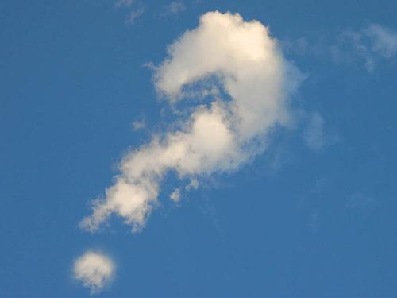

Slide 16
Backup slides

Slide 17
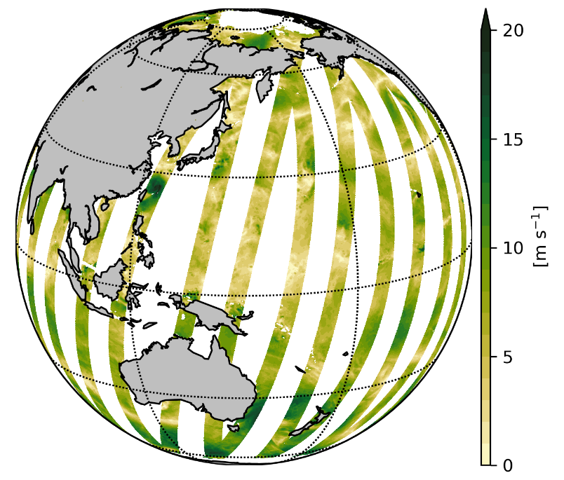
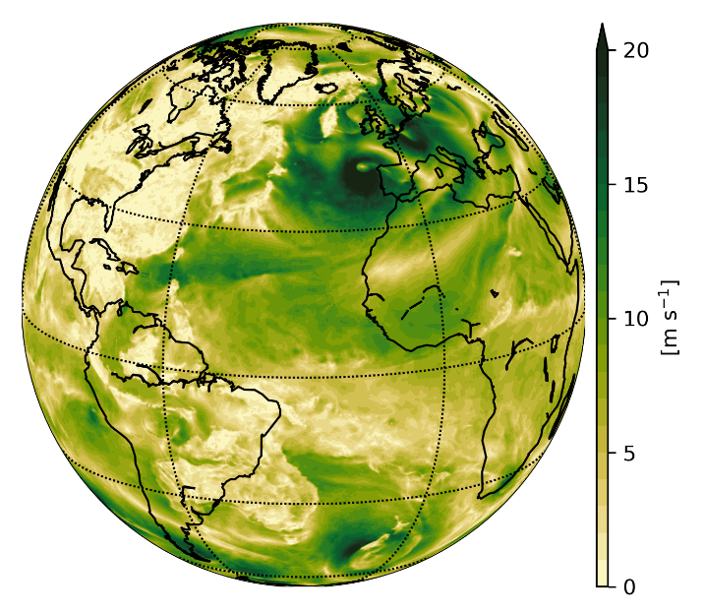
Rationale to bias observations
U10 Model biases are locally rather high compared to innovation, violating Best Linear Unbiased Estimate paradigm in data assimilation
A few decades of model improvement have not solved this problem, though one is still trying actively (Sandu, 2019); it is a problem for ocean forcing too; this is, the water is forced in the wrong direction
ECMWF provided a reference run without scatterometers for which NUIST and KNMI computed model biases, averaging over 20 days (like for the Copernicus L4 product)
NUIST applied these biases to obtain adjusted SCAT BUFR products
ECMWF will run a SCAT* OSE and compare it to reference OSEs with (SCAT OSE) and without (noSCAT OSE) scatterometer data assimilation
EUMETSAT MIDAS project result on scatterometer OSEs with the HARMONIE model also points to a very similar bias problem
Geographically unbiased EU Copernicus Marine Service L4 OPS and ERA5 U10S hourly and monthly winds/stress are available
L3 daily Copernicus Marine Service
L4 hourly Copernicus Marine Service

Slide 18
Meridional (v) model bias adjustment
SCATs assimilated
No SCAT assimilated
SCAT and FG differences
FG
FG
FG
FG
FG
Top: large v first guess biases, both in runs with (OPS) / without (OSE1) ASCATs and HY2B used
Bottom: ASCATB_SC is adjusted to OSE1 and not to ECMWF_OPS, while with small biases
Top: large v first guess biases, both in runs with/without ASCATs and HYB assimilated
Bottom: ASCATB_SC is well adjusted to OSE1
Top: large v biases in ASCAT-B_SC as expected
Bottom: ECMWF_OPS minus OSE1 is complement of ASCAT-B_SC minus OPS (on left)
OPS FG biases adjust only a little to the scatterometers

Slide 19
Zonal (u) model bias adjustment
SCATs assimilated
No SCAT assimilated
SCAT and FG differences
FG
FG
FG
FG
FG
Top: large u first guess biases, both in runs with (OPS) / without (OSE1) ASCATs and HY2B
Bottom: ASCATB_SC is adjusted to OSE1 and not to ECMWF_OPS, while with small biases
Top: large u first guess biases, both in model runs with/without ASCATs and HYB
Bottom: ASCATB_SC is well adjusted to OSE1
Top: large u biases in ASCAT-B_SC as expected
Bottom: ECMWF_OPS minus OSE1 is complement of ASCAT-B_SC minus OPS (on left)
OPS FG biases adjust only a little to the scatterometers

Slide 20
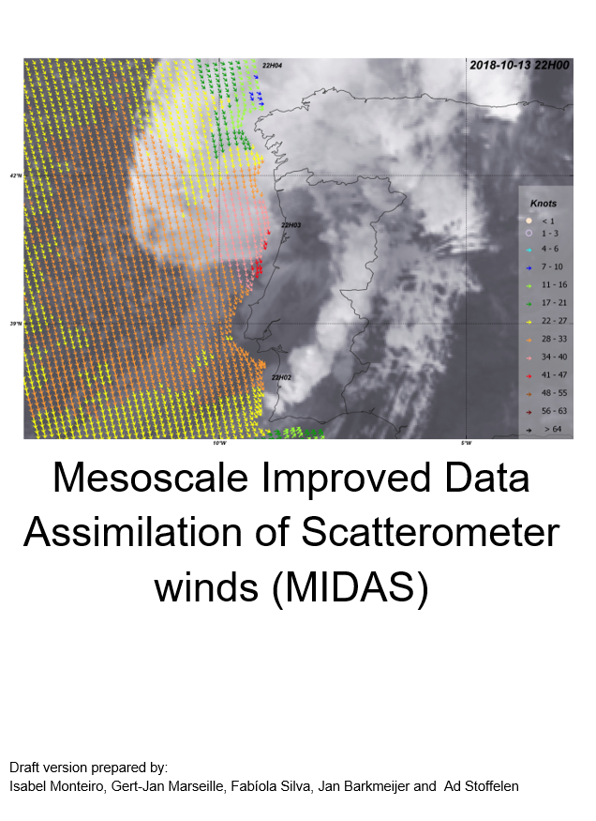
MIDAS conclusions
HARMONIE 3-hour 4D-Var better than the widely used 3D-Var
ASCAT improves the forecast skill both in 3D- and 4D-Var
Tested data thinning distances, superobbing and observation error inflation
Particular effects on the v component
Error inflation at full density similar to superobbing statistically (as expected in Stoffelen et al., 2020)
Local model biases are substantial with respect to the innovations and violate the data assimilation BLUE paradigm
Scatterometer winds are not effectively used to initialise dynamical weather features and model biases need to be accounted for to better exploit scatterometer winds in HARMONIE
This was a EUMETSAT study

Slide 21
MIDAS conclusions
7 Feb – 15 Mar 2020
Median OSCAT – noSCAT FG
3-hour 4D-Var better than the widely used 3D-Var
ASCAT improves the forecast skill both in 3D- and 4D-Var
Tested data thinning distances, superobbing and observation error inflation
Particular effects on the v component
Error inflation at full density similar to superobbing statistically
Local model biases are substantial with respect to the innovations and violate the BLUE paradigm data assimilation.
Scatterometer winds are not effective to initialise dynamical weather features and model biases need to be accounted for to better exploit scatterometer winds in HARMONIE
u10
u10
3Dvar
4Dvar
v10
v10
3Dvar
4Dvar

Slide 22
Conclusions
Model biases of 10-m stress-equivalent wind (U10s) are substantial with respect to observations; corrected hourly ERA5 and OPS L4 winds are available in the Copernicus Marine Service
Scatterometers can map out the rather stable spatial surface model biases in mean and variance well
Biases prevent effective data assimilation (cf. BLUE paradigm)
Experiment with ECMWF o-b bias correction in progress by adjusting scatterometer BUFR data
Biases also prevent effective scatterometer data assimilation in HARMONIE (EUMETSAT MIDAS)
U10s biases in mean and variance affect ocean forcing and hence air-sea coupling and earth system dynamics (ocean is 70% of the earths’ surface)
EUMETSAT awarded a fellow position at KNMI/ICM/ECMWF to address data assimilation, ocean forcing and physical causation of biases
EUMETSAT OSI SAF visiting scientist Evgenia Makarova at ICM employs Machine Learning based on model parameters to predict the biases (MOS), which then can be used in forecast mode
Each scatterometer may contribute a few % in the reduction of the forecast errors and with 6-7 complementary scatterometers, it may be a worthwhile investment to improve their assimilation by addressing remaining problems, of which model biases is a prominent one
Furthermore, scatterometers can be well exploited to (much?) improve the coupled model dynamics at the air-sea interface

