Slide 1
Ocean Vector Winds: science and data needs in coastal regions
Bourassa M, Fewings M, Grieco G, Han W (alphabetic)
Two parts:
I. Recent science results
II. Need & methods for improving coastal winds
Nov 1st, 2023, IOVWST meeting, virtual

Slide 2
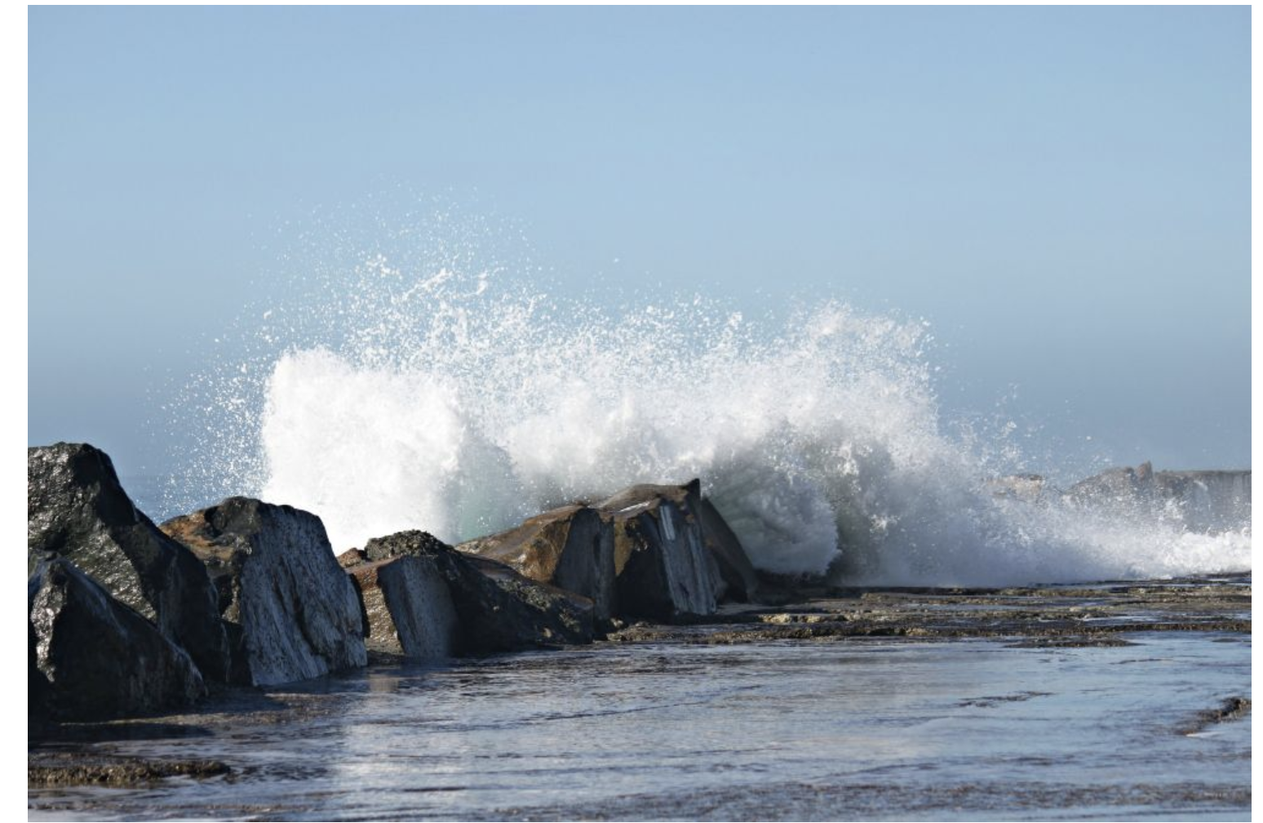
Motivation
Coastal Ocean:
Coastal upwelling is important for biological productivity, marine ecosystems and fishery
Coastal sea level rise and sea surface Height EXtreme (HEX) events cause flooding & damage, disrupting human society and marine ecosystems
Both local winds near coasts and remote winds from open ocean are crucial for determining coastal ocean processes
Improving the accuracy of ocean vector wind product, especially in coastal ocean where land contamination occurs, is important for scientific community

Slide 3
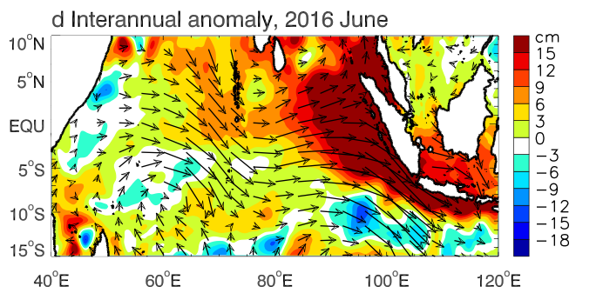
I. Climate-driven extreme sea level events in coastal Indonesia during recent decades
W. Han, W. Kamp and coauthors
Indian Ocean
Remote EQ wind;
Local longshore wind
Indonesian islands
Sea level anomaly (SLA): satellite & Java tide gauge
90th
Sea surface Height EXtreme (HEX) events: daily satellite sea level anomalies (SLA) > 90th percentile
Notes:
.

Slide 4
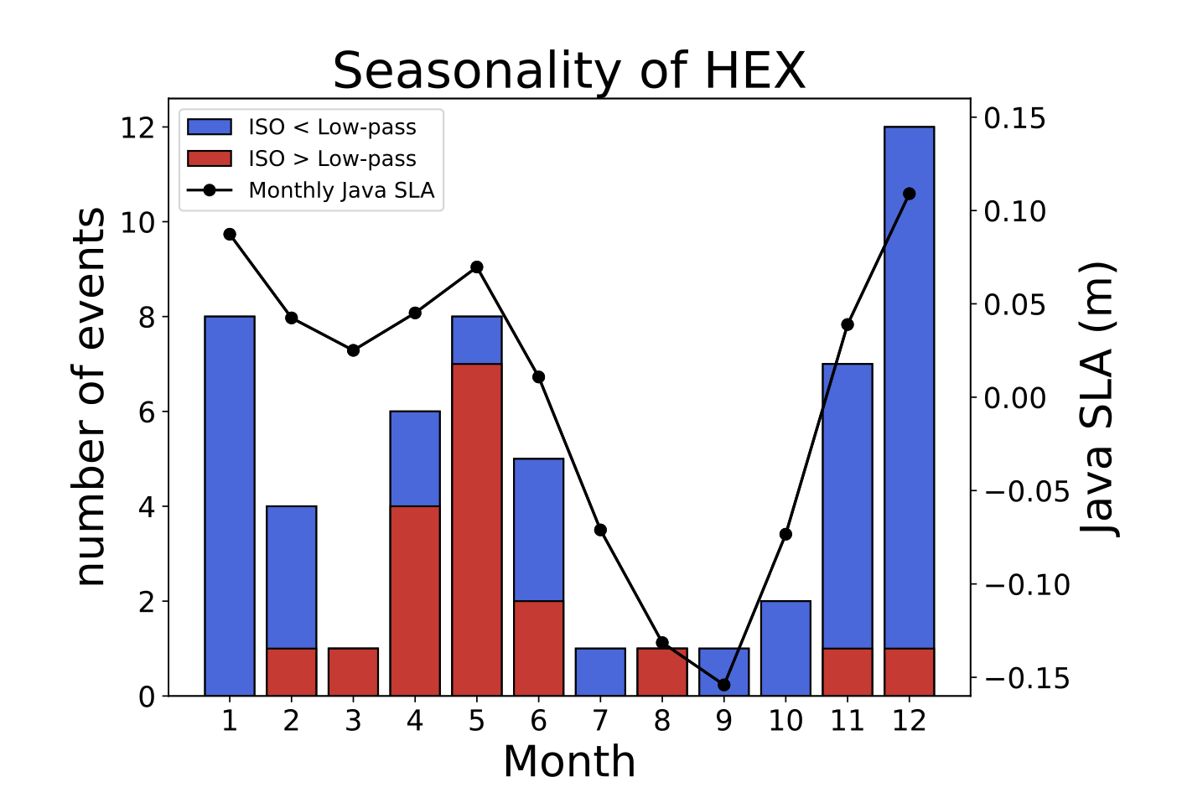
N. Winter: 105d lowpassed (LP)
N. spring: ISO
The number of HEX events for each month (bar graph), together with the monthly mean SLA climatology for the 1993-2021 period (black curve). The HEX events are divided into two categories The first with ISO signals (105-day highpass filtered SLA) < 105-day low-passed (LP) signals (blue) and the second with ISO signals > LP signals (red).

Slide 5
(a) Northern winter: LP (seasonal & interannual dominate) dominate
Westerly & northwesterly wind anomalies associated with Australian-Indonesian monsoon, exacerbated by -IOD & La Nina,
causing LP dominance of HEX.
(b) Spring: Why do ISO (mainly MJO) contribute more to HEX?
Spring MJO:
stronger EQ westerlies & stronger HEX
Winter MJO: shift south of EQ, weaker EQ westerlies
Notes:
Supplementary Table 1. Peak amplitude and corresponding time of the Compound Height-Heat EXtremes (CHHEXs; supplementary Table 1a) and Height EXtremes (HEXs) alone (supplementary Table 1b) during 1993-2018 identified from Fig 1, using the 90th percentile of monthly mean satellite sea level anomalies (SLA) of 0.21m as the threshold, together with satellite sea surface temperature anomalies (SSTA) near the Cilacap B tide gauge location at Java coast for CHHEX events, with the 90th percentile of SSTA (1.11ºC) as the threshold. Tide gauge SLA values are shown in parentheses. We choose to retain the mean seasonal cycle in the SLA and SSTA (see text for discussion), and the SSTA is relative to the 1989-2018 mean of 28.5ºC. Note that for the 2016 and 2010 CHHEX events the SSTA peaks lead the SLA peaks, but the SSTA remains above (close to) the 90th percentile during the SLA peak for 2016 (2010), and the SSTAs shown in supplementary Table 1a are their peak values. Occurrence of the two dominant interannual climate modes over the Indo-Pacific Ocean, the El Niño-Southern Oscillation (ENSO) and Indian Ocean Dipole (IOD), are shown in the bottom row. El Niño (La Niña) is positive (negative) phase of ENSO, and nIOD (pIOD) denotes negative (positive) phase of IOD. “Mons” denotes either Indian monsoon or Australian-Indonesian monsoon. Note that the correlations for ENSO-Indian monsoon is -0.44 and for ENSO-Australian monsoon is -0.3 for 1993-2018, with both >95% significance.

Slide 6
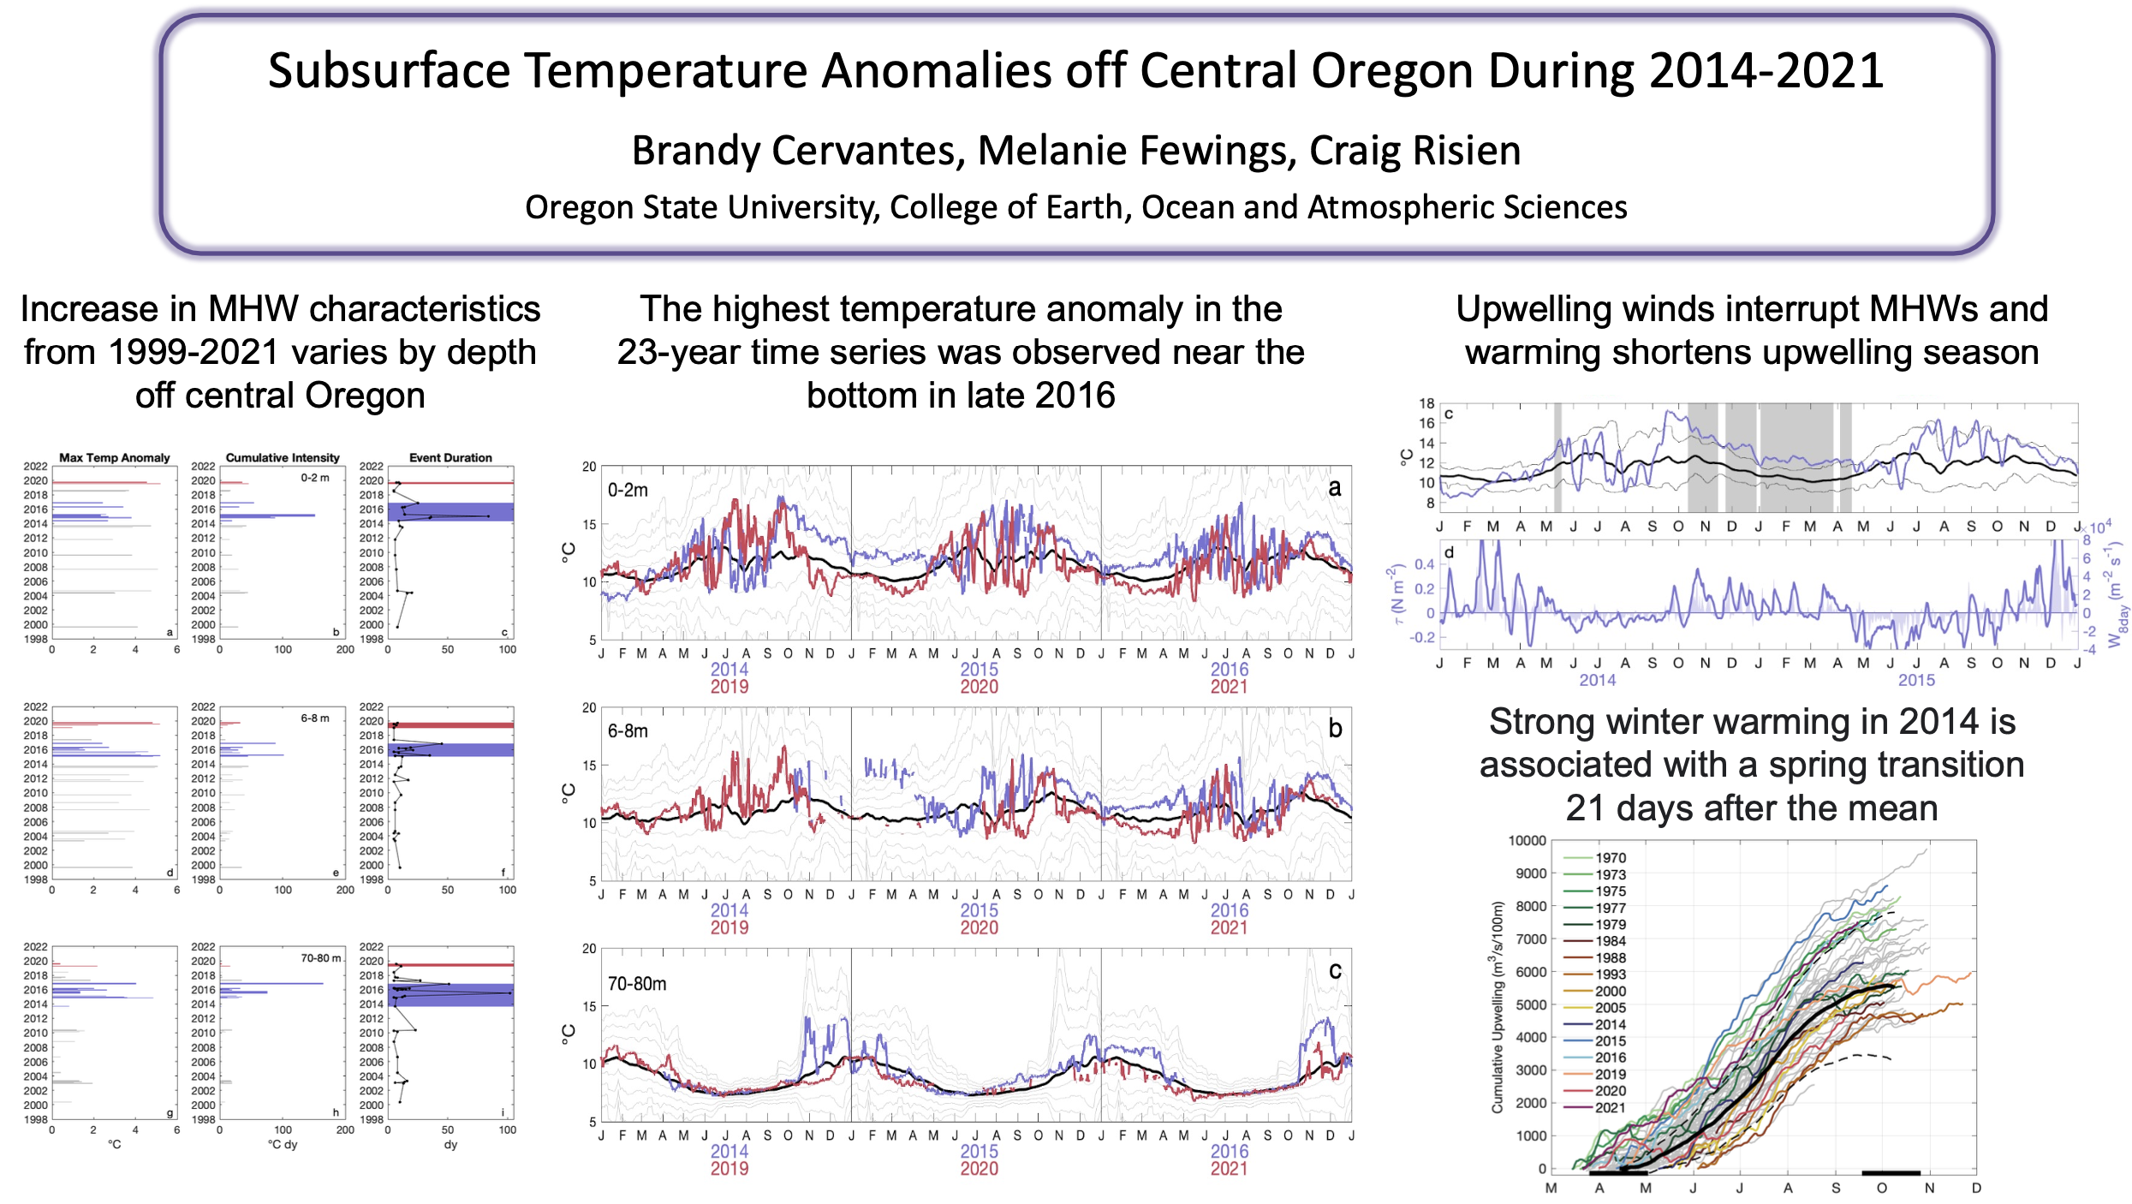
Poster: Coastal Marine heatwaves (MHW) off Central Oregon
B. Cervantes, M. Fewings, C. Risien (OSU)
Link to poster
Observed increase in MHW from 1999-2021
Highest temperature anomaly near the bottom
Upwelling winds interrupt MHWs & warming shortens upwelling season
Please visit the poster for more details

Slide 7
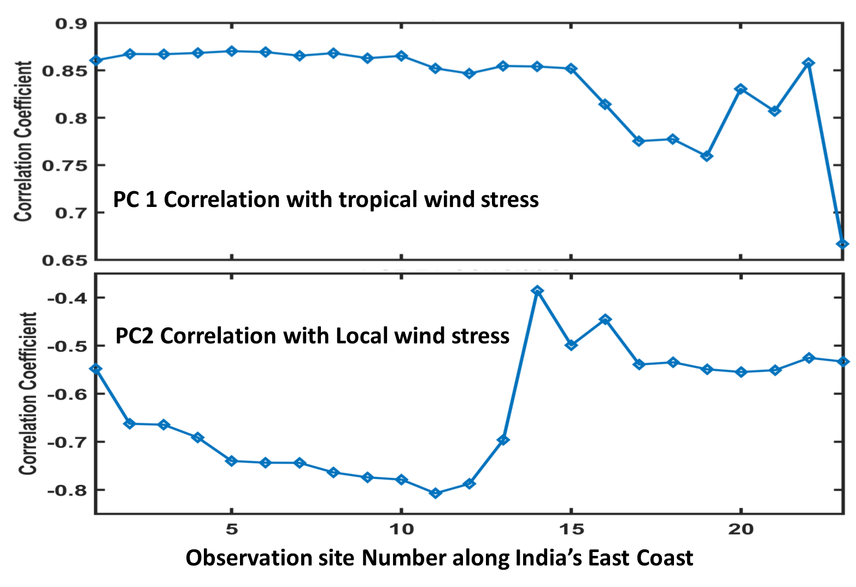
Coastal Upwelling in the Western Bay of Bengal: Role of Local and Remote Windstress
Sthitapragya Ray, Debadatta Swain, Meer M. Ali and Mark A. Bourassa
Link to poster
Research Gap: Relative contribution of Ekman Transport and Kelvin waves to coastal upwelling along India’s eastern coast (western Bay of Bengal).
Motivation: Coastal upwelling is the most important physical process determining the biological productivity of coastal oceans.
Principal Component Analysis of a coastal sea surface height anomalies results in two main modes of variability:
PC1 is associated with coastal Kelvin waves
PC2 is associated with local Ekman forcing
Conclusions:
Coastal SST cooling coincides with alongshore winds in the south, while the cooling precedes the winds in the north.
SSHA along the northern section is influenced by Mode 1 which is correlated with equatorial zonal winds.
SSHA along the south is driven by Mode 2 which is correlated with local winds.

Slide 8
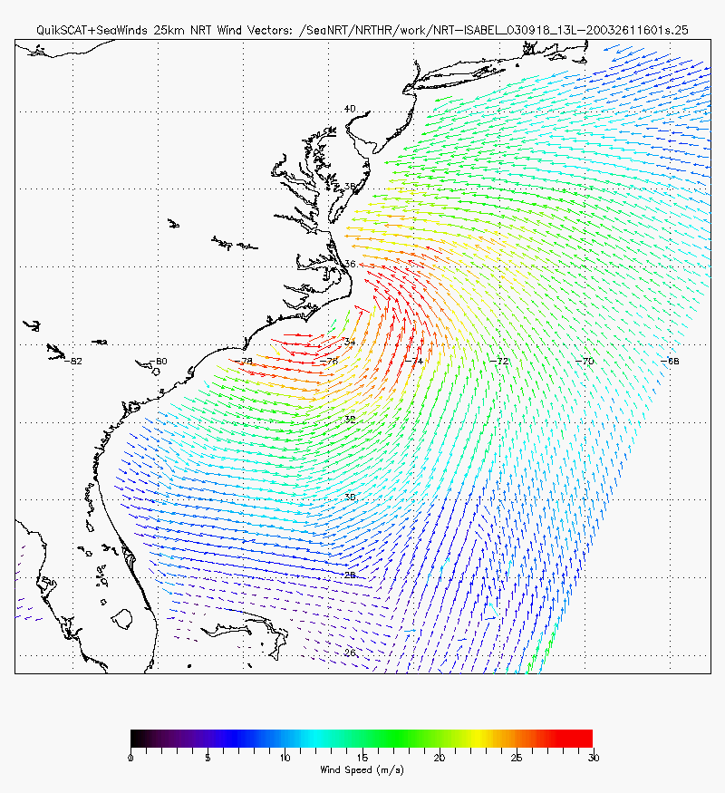
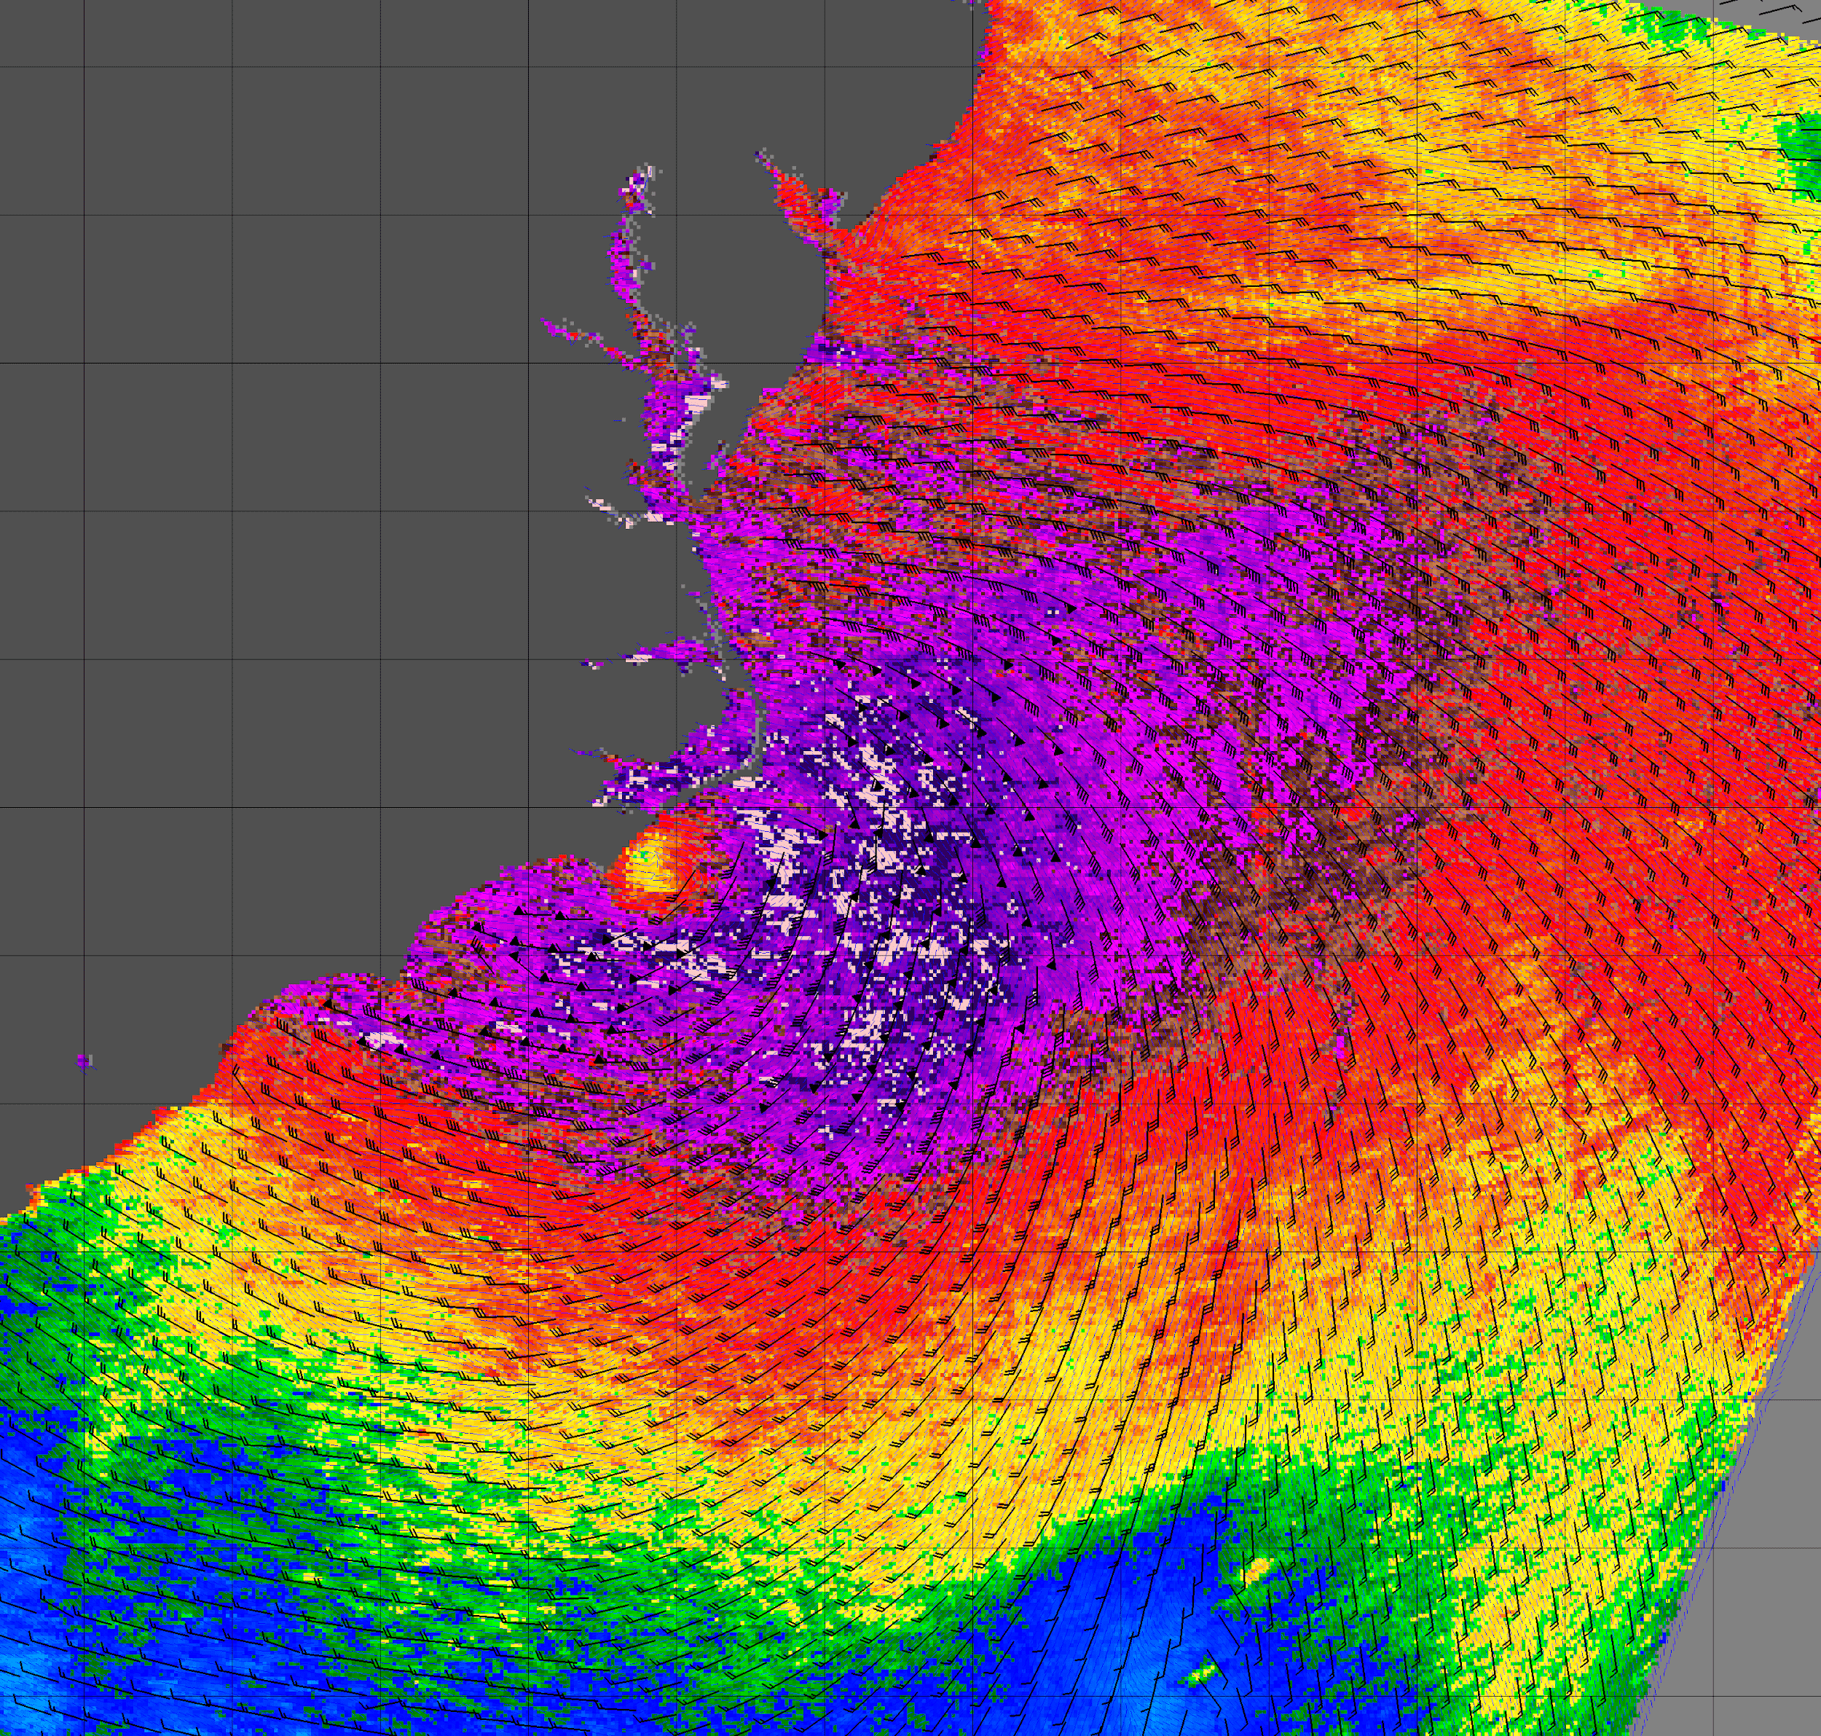
Hurricane Isabel – Conventional vs UHR winds QuikSCAT
II. Need & methods for improving coastal winds
Hurricane
Eye
QuikSCAT
Satellite
Conventional 25 km resolution wind vectors
2.5 km UHR winds overlaid with 25 km barbs
Provided by D. Long

Slide 9
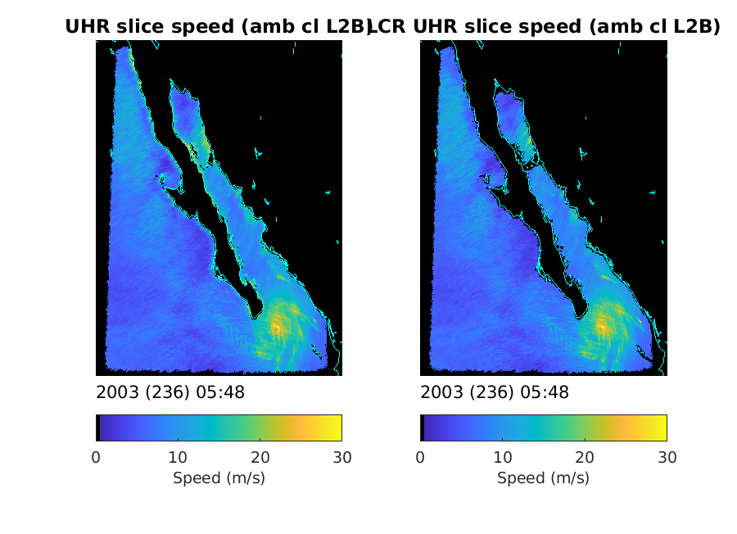
QuikSCAT Near-Coastal Wind Land Contamination Correction Example
Note land-contaminated
high winds along
coast are removed
using LCR method
High resolution
Tropical Storm
Provided by D. Long

Slide 10
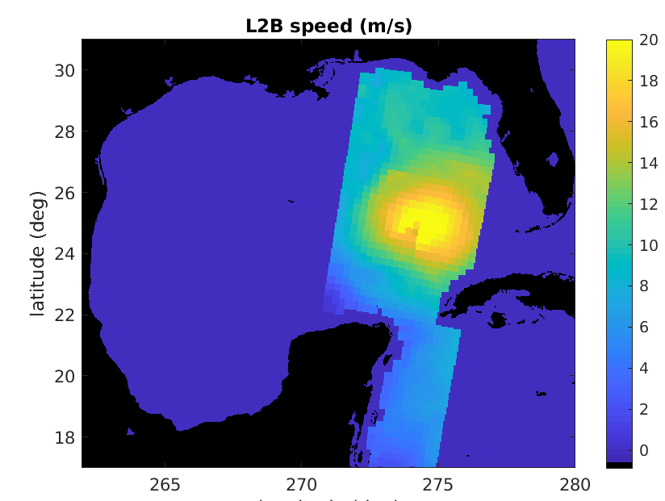
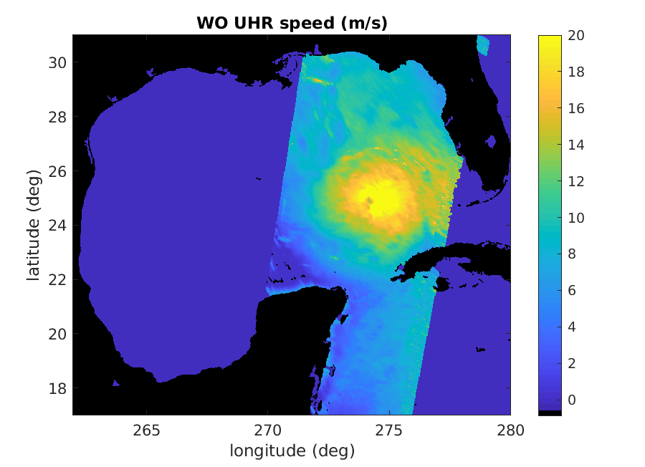
ASCAT Enhanced Resolution Example: Hurricane Ida
Conventional
Conventional (25 km)
BYU Ultra-High Resolution Retrieval (2.5 km*)
* Posted resolution. Effective resolution ~8 km.
Provided by D. Long

Slide 11
Coastal wind retrievals from QuikSCAT-corrected σ₀s
σ₀s are corrected with noise regularization
It consists in projection land-contaminated σ₀s onto the pdf of non-contaminated σ₀s
Good performance. Cannot deal with negative σ₀s (<3%) but no impact on retrievals
Link to poster
Fig. 1: σ₀ in linear units (LU) before correction
Fig. 2: σ₀ in LU after correction. outliers: fill values
Fig. 3: Blue arrows: QC winds @ 12.5 km. Yellow arrows: MLE-flagged winds. Magenta arrows: varQC-flagged winds. Red arrows: MLE and varQC-flagged winds
G. Grieco

Slide 12
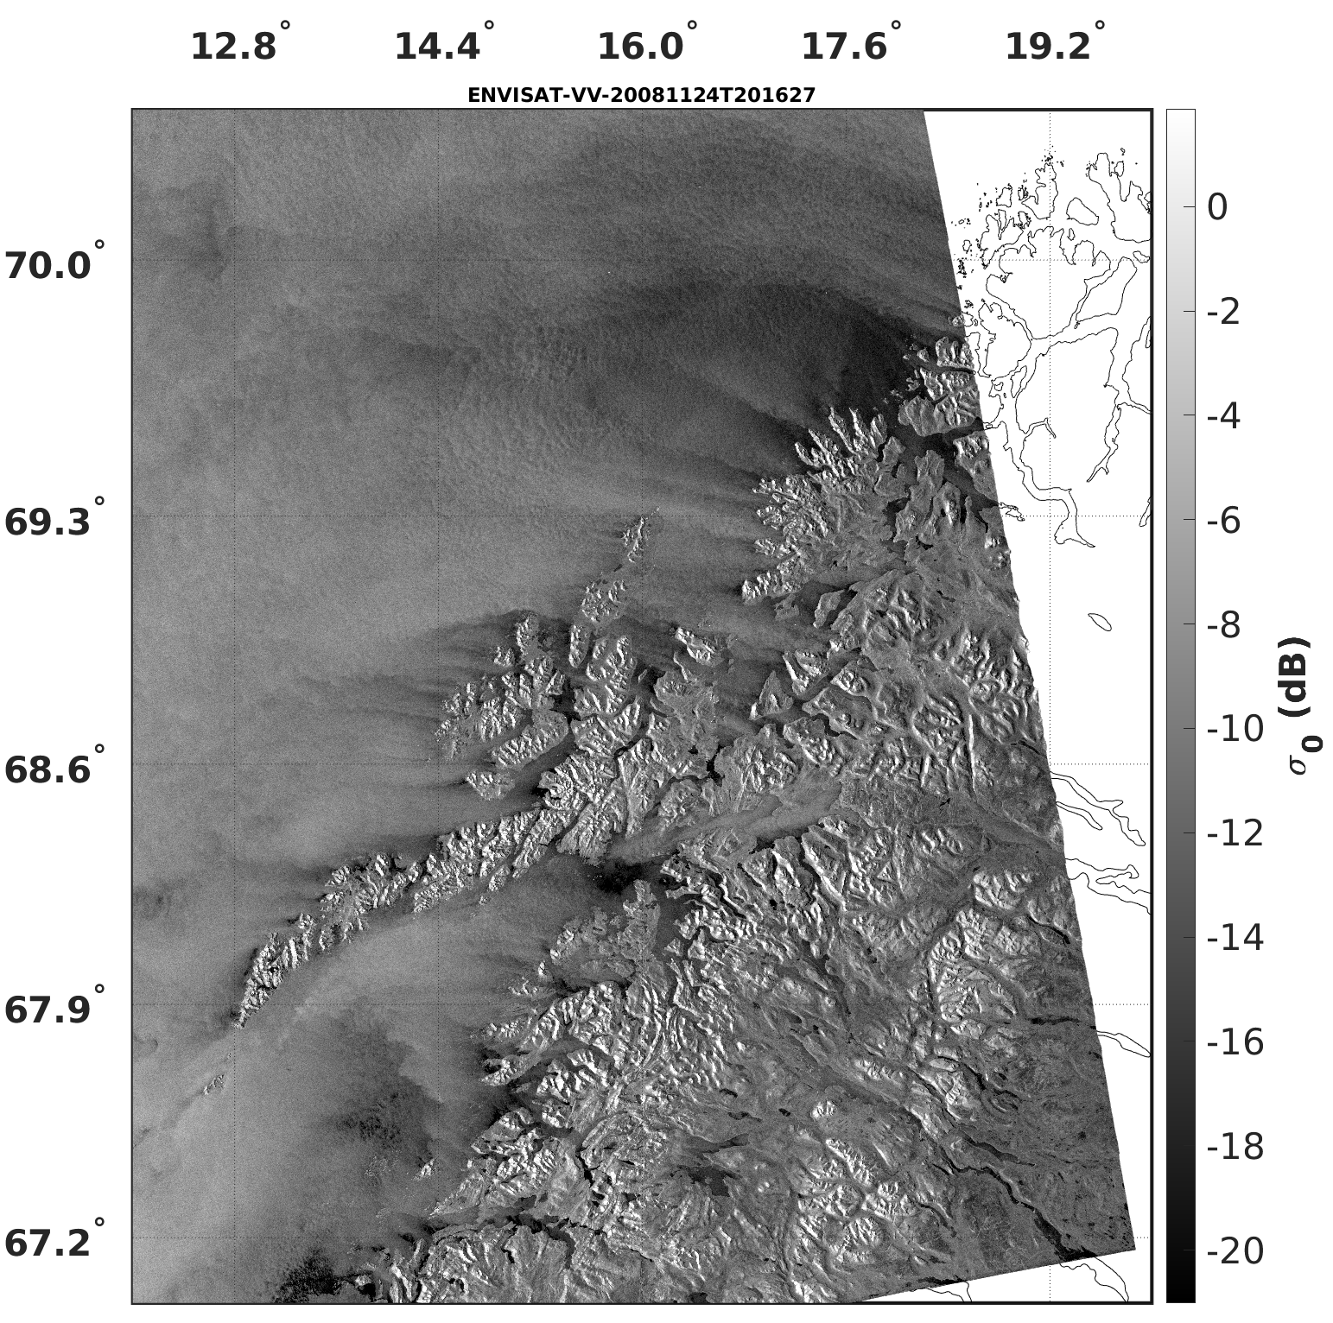
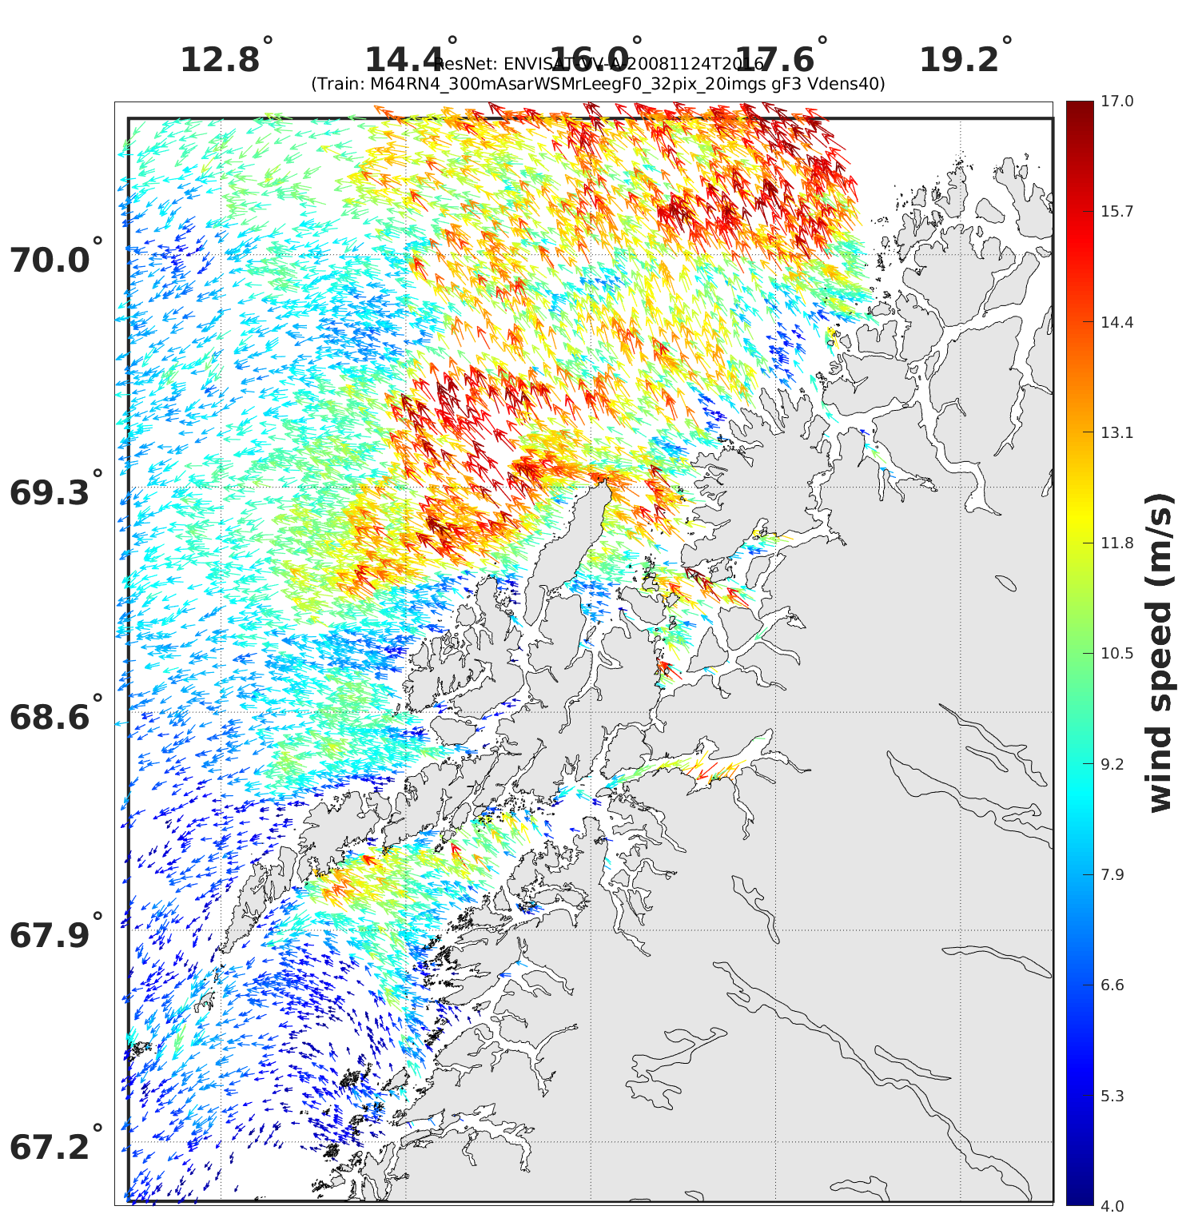
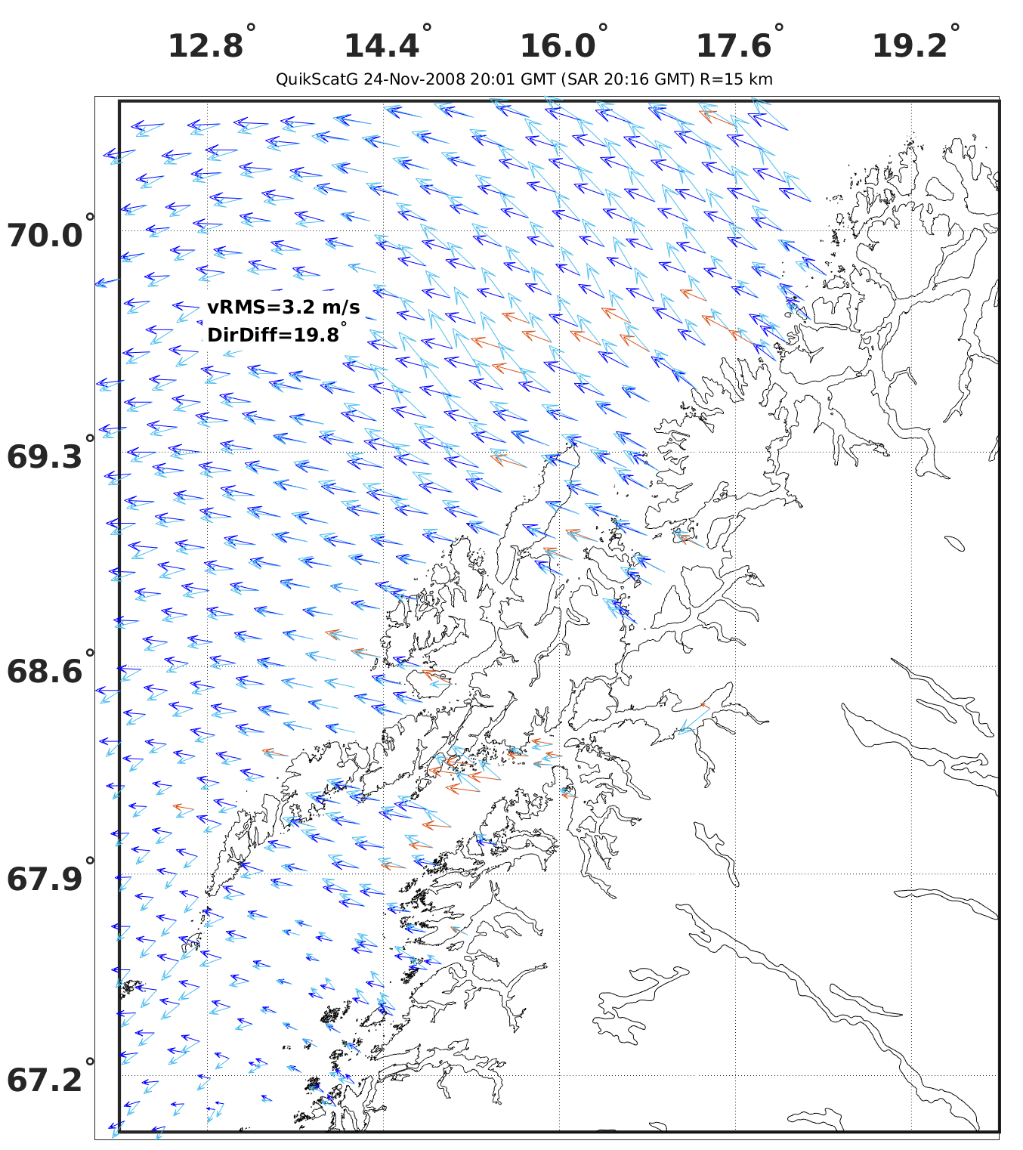
Validation of scat-derived coastal winds: is SAR suitable?
How can we validate scat-derived coastal winds?
Is SAR mature for this purpose? If not, how can we improve it?
Can scat-derived winds be used to validate SAR winds? How?
ASAR σ₀^{VV} in dB
ASAR-derived winds with a 2-step procedure: ResNet (direction) + CMOD7 (speed). Grid spacing is 900 m
Light blue (dark blue) arrows: ASAR (QuikSCAT)-derived winds on the QuikSCAT WVC grid @ 12.5 km. Orange arrows: rainy WVCs
G. Grieco

Slide 13
Issues and discussion
Needs: Good ways to calculate (wind curls & Ekman pumping velocity): there will be a poster on Day 3 on this topic
Needs: Reduce averaging in coastal winds

