Slide 1
Future and Proposed Vector Wind Missions
Shannon Brown¹, Paco Lopez Dekker², Alex Wineteer¹
With inputs from across the Ocean Winds Community
International Ocean Vector Winds Science Team 2023
¹Jet Propulsion Laboratory, California Institute of Technology
²Delft University of Technology
© 2023 California Institute of Technology. Government sponsorship acknowledged.
This document has been reviewed and determined not to contain export controlled technical data.

Slide 2
23
24
25
26
27
28
29
30
31
32
33
34
35
36
Current and upcoming ocean vector wind missions; not including wind speed magnitude instruments.
Good continuity of measurements through 2030s, but non-optimal distribution of equatorial crossing times.
Poor sampling of 12 AM-6 AM winds.
Data from WMO https://space.oscar.wmo.int/gapanalyses?mission=12
00:00
01:00
02:00
Meteor-MP N1
03:00
04:00
ODYSEA
05:00
CFOSAT
HY-2L
SEASTAR
06:00
CIMR
WindRad FY-3E
WindRad FY-3J
Node crossing time
HY-2B
HY-2E
Harmony
07:00
08:00
Metop-B/C
09:00
Metop-SG / SCA
Meteor-MP N2
10:00
11:00
12:00
OSCAT-3
OSCAT-3A
COVWR
Operational
Drifting
HY-2C/D
HY-2F
Approved
HY-2S
Proposed

Slide 3
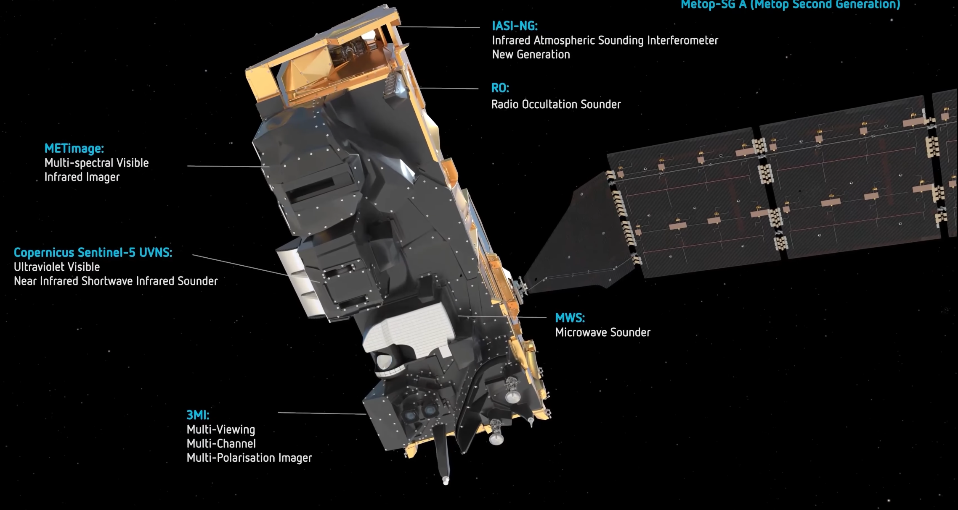
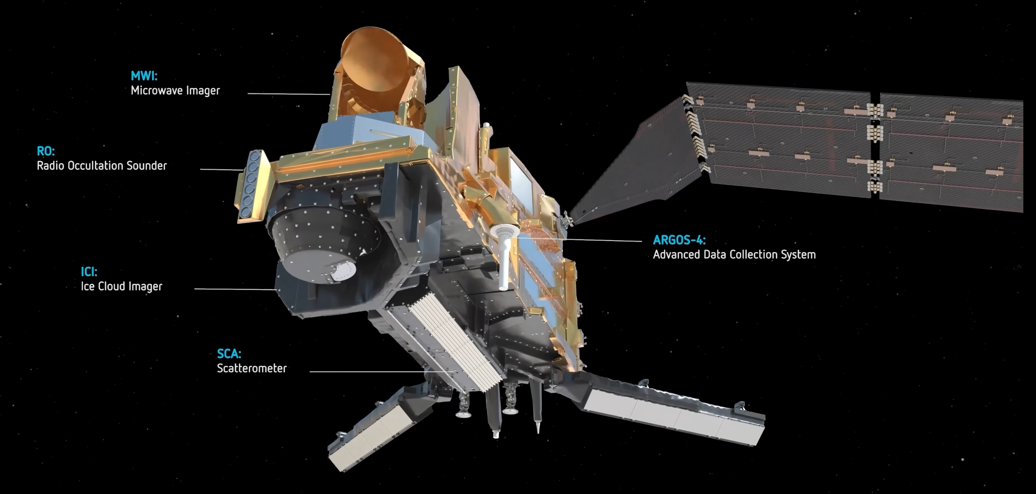
MetOP-SG
Metop-SG A
Second generation of MetOP satellites, carrying many instruments including the SCA C-band scatterometer.
Two satellites; B carries SCA
Two 660-km swaths separated by a 525-km gap along-track. 3 looks each pixel (45, 90 and 135° azimuth)
25 km with sampling at 12.5 km intervals. High-resolution mode: 15-20 km with sampling at 6.25 km intervals.
Metop-SG B
Satellite | Launch
Metop-SG-A/B1 | 2024-11-30
Metop-SG-A/B2 | 2031-11-30
Metop-SG-A/B3 | 2038-11-30
Source: Ad Stofflen and WMO

Slide 4
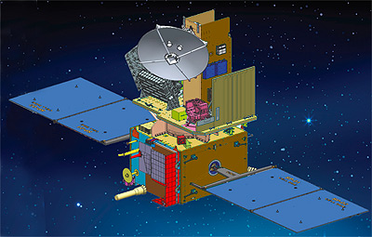
Oceansat-3A
Continuity for Oceansat-3
OSCAT-3: Ku-band ocean vector wind scatterometer
Conical scanning, two beams; incidence angles: 48.9° and 57.6°; swath 1440 km
12.5 km resolution
Launch expected in 2025
Source: WMO

Slide 5
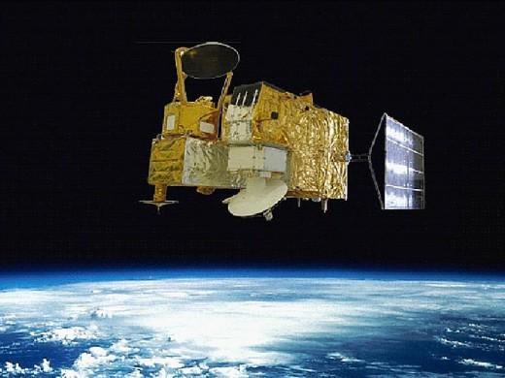
Haiyang-2 Series
HY-2 A, B, C, D, E, F carry the HSCAT Ku-band scatterometer
1,300 km swath with 25-50 km resolution
Continuity 2011-2030+
HY-2 L carries CSCAT rotating fan-beam Ku-band scatterometer
1,000 km swath with 50 km resolution
Under consideration
HY-2 S carries a L-band scatterometer
Under consideration
Operational data available from KNMI
Source: Ad Stofflen and WMO

Slide 6
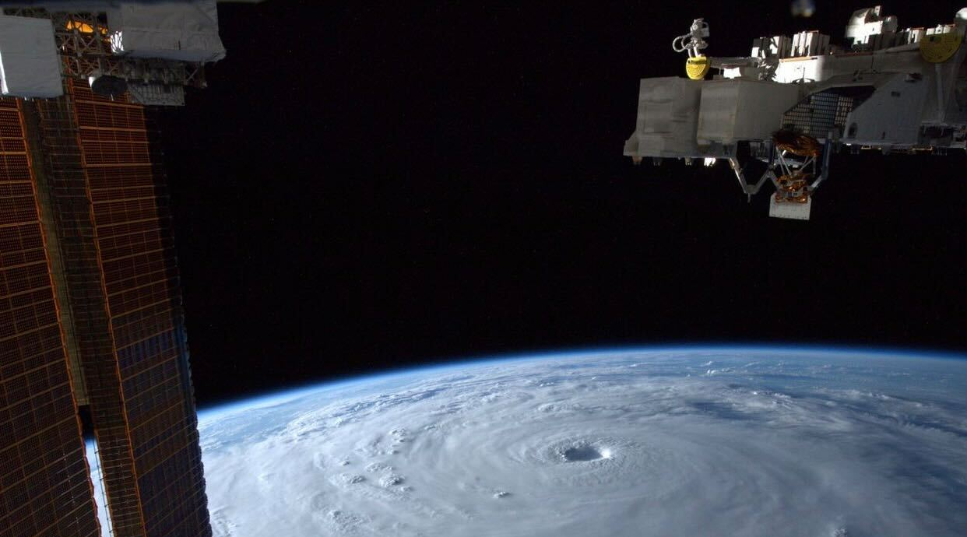
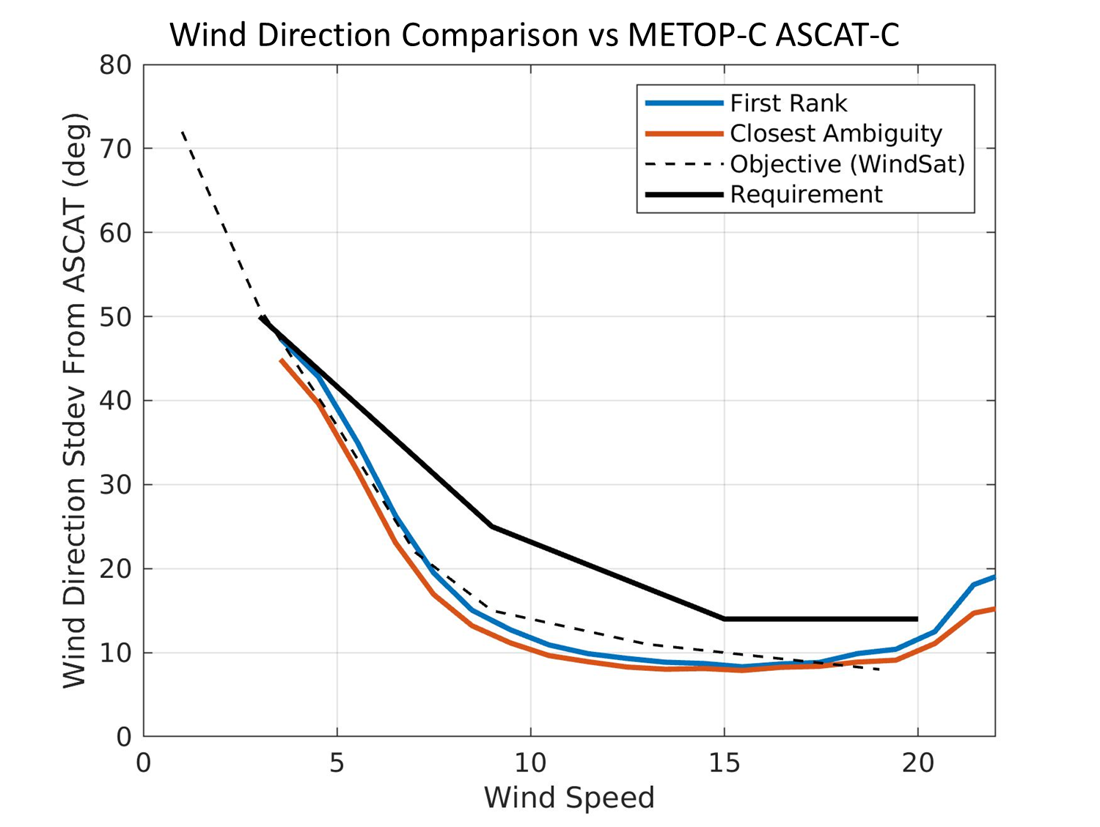
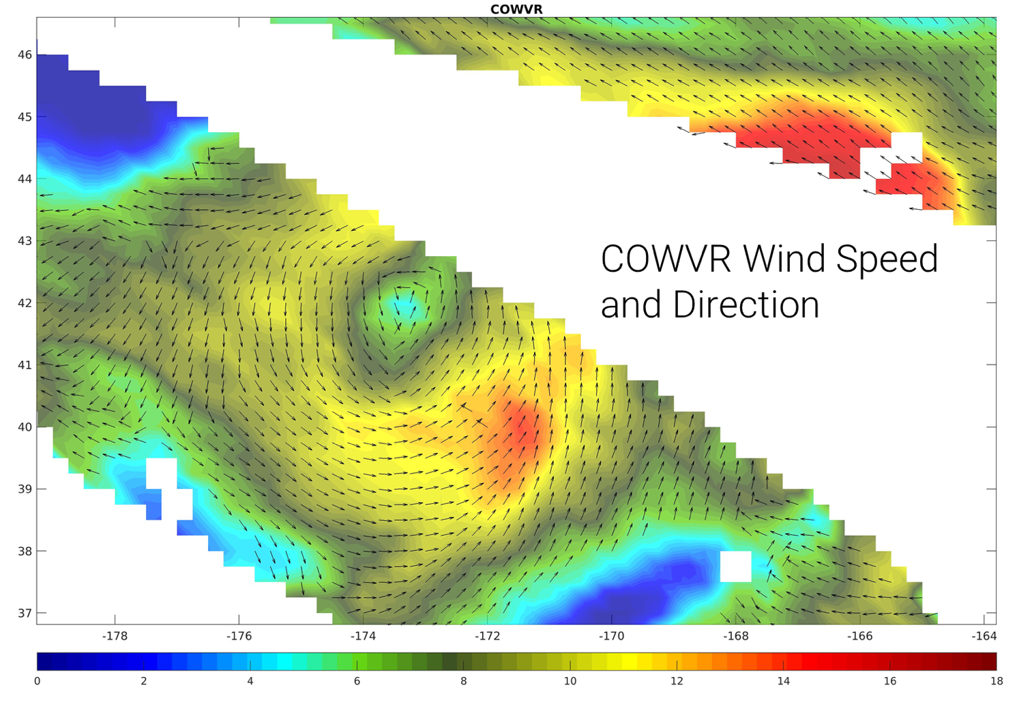
Compact Ocean Wind Vector Radiometer Demonstrated
COWVR demonstrated wind vector performance matching and exceeding WindSat
Low-cost sensor architecture that can be deployed as part of a constellation to more frequently observe ocean vector winds
Source: Shannon Brown

Slide 7
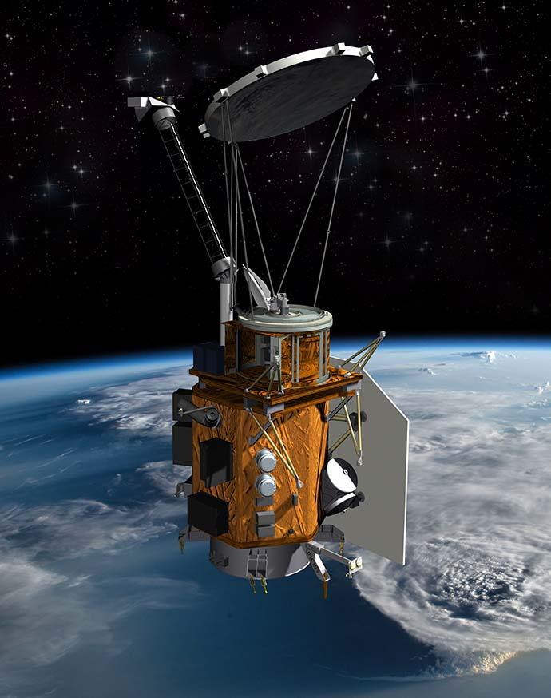
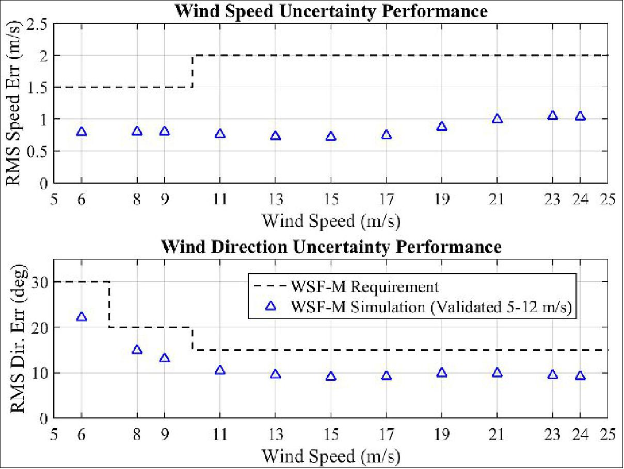
Weather Satellite Follow-on – Microwave (WSF-M)
US Space Force Mission, sensor built by Ball Aerospace
10-90 GHz conical imaging radiometer with polarimetric channels for ocean vector winds at ~25km resolution
Launch: NET 23 March 2024
Data available through NOAA shared processing agreement after cal/val phase (nominally 6 months)
Source: Shannon Brown
Credit: Ball Aerospace
https://www.eoportal.org/satellite-missions/wsf-m#spacecraft

Slide 8
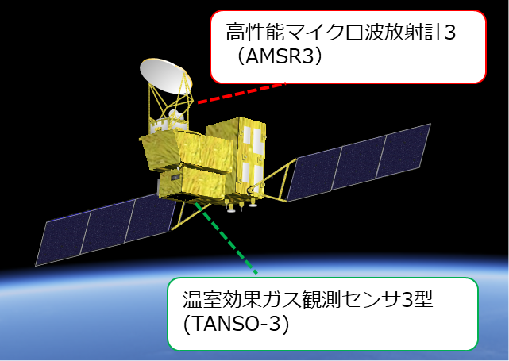
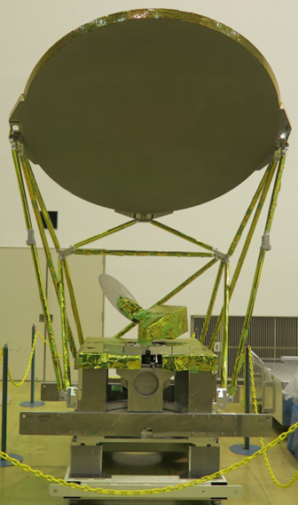
AMSR3 on GOSAT-GW (Global Observation SATellite for Greenhouse gases and Water cycle)
AMSR3: Advanced Microwave Scanning Radiometer 3, conical scanning passive microwave radiometer succeeding GCOM-W/ AMSR2
GOSAT-GW will carry two instruments, AMSR3 & TANSO-3
AMSR3, developed by JAXA, will succeed AMSR series observations adding new high-frequency channels for solid precipitation retrievals and water vapor analysis in NWP.
TANSO-3, developed by JAXA under contract with Japanese Ministry of the Environment (MOE), will improve observation capability of greenhouse gases from GOSAT-2/TANSO-2 by choosing grating spectrometer to enable spatially detailed observation.
Target launch is JFY2024 (Apr. 2024 - Mar. 2025)
AMSR3
Link to poster
AMSR3
AMSR3 Channel Sets
Center frequency [GHz] | Polari-zation | Band width ［MHz］ | NEDT (1σ) | Beam width (spatial resolution)
6.925/7.3 | H/V | 350 | < 0.34 K | 1.8°(34km x 58km)
10.25 | H/V | 500 | < 0.34 K | 1.2°(22km x 39km)
10.65 | H/V | 100 | < 0.70 K | 1.2°(22km x 39km)
18.7 | H/V | 200 | < 0.70 K | 0.65°(12km x 21km)
23.8 | H/V | 400 | < 0.60 K | 0.75°(14km x 24km)
36.42 | H/V | 840 | < 0.70 K | 0.35°(7km x 11km)
89.0 A/B | H/V | 3000 | < 1.20 K | 0.15° (3km x 5km)
165.5 | V | 4000 | < 1.50 K | AZ=0.23°/ EL=0.30° (4km x 9km)
183.31±7 | V | 2000×2 | < 1.50 K | AZ=0.23°/ EL=0.27° (4km x 8km)
183.31±3 | V | 2000×2 | < 1.50 K | AZ=0.23°/ EL=0.27° (4km x 8km)
TANSO-3
TANSO-3: Total Anthropogenic and Natural emissions mapping SpectrOmeter-3, grating imaging spectrometer replacing the Fourier transform spectroscopy used in GOSAT-2/TANSO-FTS-2
Source: Nato Ebuchi

Slide 9
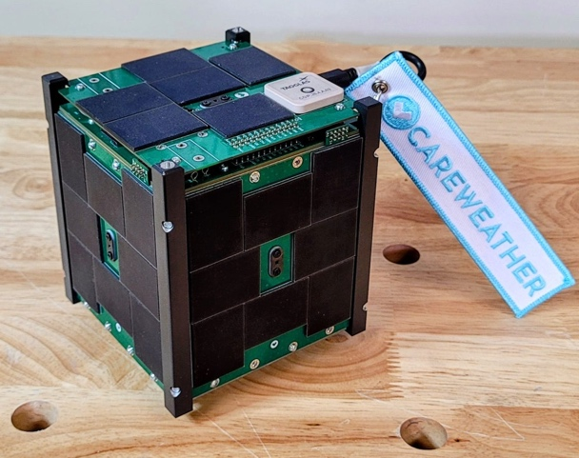
Veery—The Small Scatterometer
Source: Patrick Walton
10-satellite stack
Body-spun flat rotating fan-beam scatterometer.
Heritage performance at 3 orders of magnitude lower cost.
30 W, C-band, LFM-ICW signal. 1-meter x 15 cm array antenna.
Aerodynamic at low altitude, large solar, antenna, radiative area.
Designed for hourly, global OSVW constellation.
8-12 satellites required for 3-hourly. About 30 for hourly.
Flat satellite stacking for extremely low aggregate launch cost.
Radar pathfinder (v0.3) launching Feb. 2024
C-band radar backend and frontend test.
In-house components supporting low cost and tight, vertical integration.
Seeking funding for 2026-H1 v1.0 mission.
Link to poster
SpaceX ½ Plate Rideshare Slot
```
```
10x50x100 cm Body
Veery v1.0
```
```
2-5 yr Orbital Life
Worst Case Measurement Error
8-satellite Constellation
400 km
1.5
12
Average Hits/day
25 km spatial resolution
reprocessed to 6 km.
±1.5 m/s, ±20° (3 - 30 m/s)
RMS Speed Error (m/s)
8
1200 km
GROUND SWATH
1
0.5
4
FOOTPRINT
0
0
90
450 km
0
180
360
0
45
25 km
True Direction (deg)
Latitude (deg)
DESIGN V1.0.3
Acknowledgments - This material is based upon work supported by National Science Foundation Grant No. 2304609 and Air Force contract FA864921P0620.

Slide 10
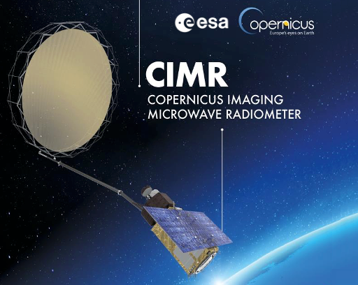
Copernicus Imaging Microwave Radiometer (CIMR)
ESA Copernicus Sentinel expansion mission
High-resolution 1.4-36 GHz conical imaging radiometer with polarimetric channels for ocean vector winds
Features rotating 8m mesh reflector
Wind requirement: <2m/s and 20º at 40km resolution (CIMR MRD)
Good for winds in rain and extreme events
Launch: >2025
Data available through ESA
Credit: ESA
Source: Craig Dalton

Slide 11
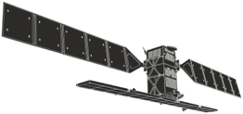
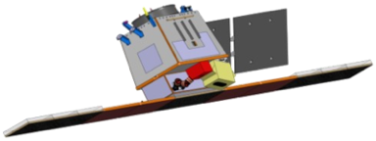
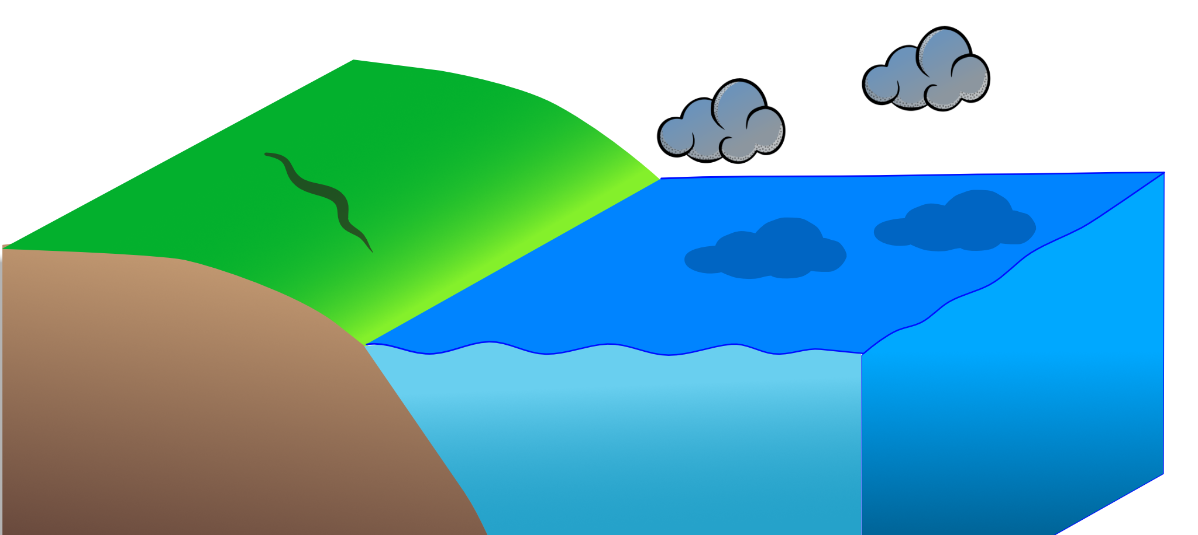
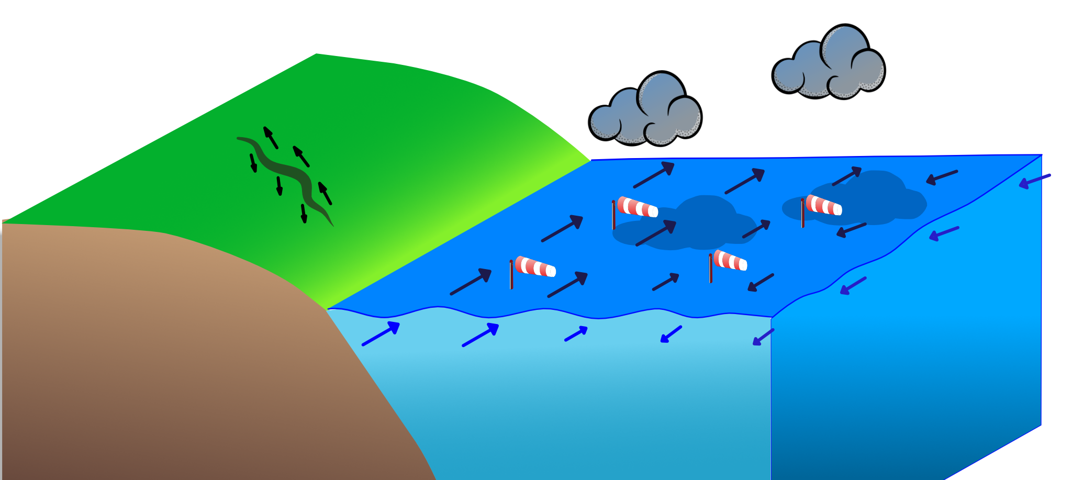
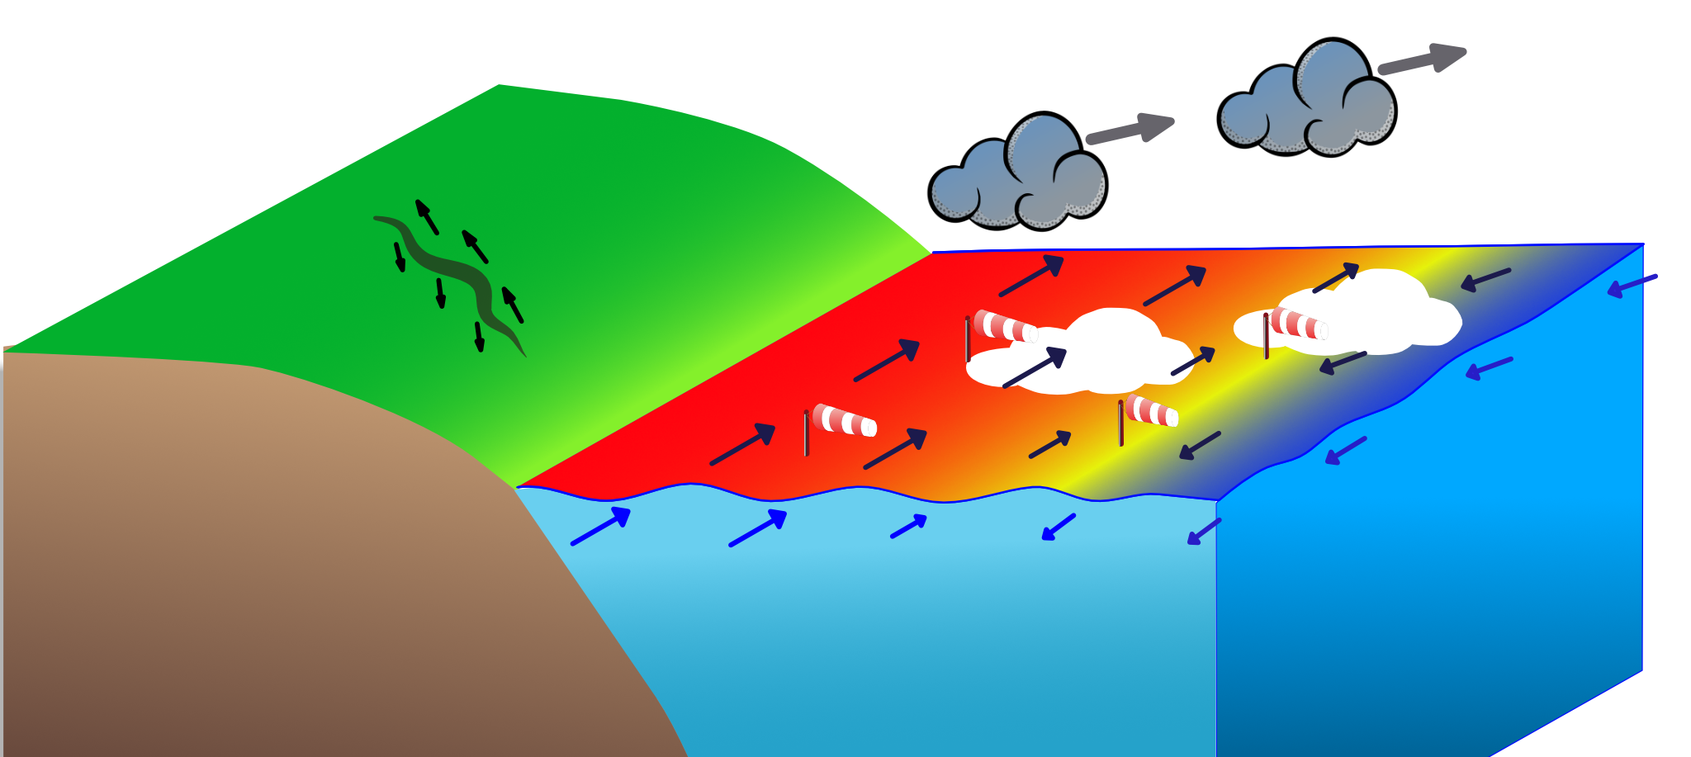
EE10 HARMONY observation concept: stereo phase
Approved for 2029
Exploit Sentinel-1
Add tandem satellites
Line-of-sight diversity for high resolution (km)
Ocean surface vector motion (Doppler)
Surface vector winds (scatterometry)
Improved directional surface wave spectra
Sea Surface (skin) Temperature (SST)
Cloud-top motion (TIR time-lapse) and height (TIR parallax)
Sea Ice / cryosphere application
3-D surface deformation (DInSAR)
Source: Paco Lopez-Decker and Ad Stofflen

Slide 12
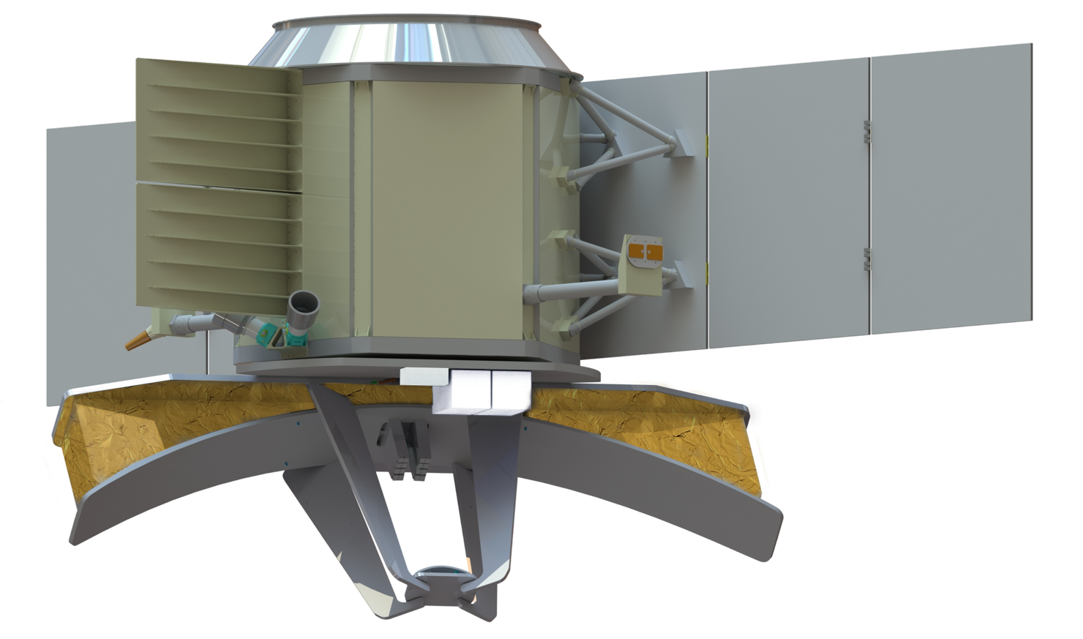
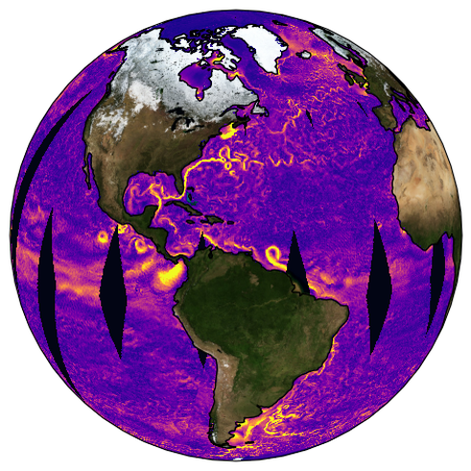
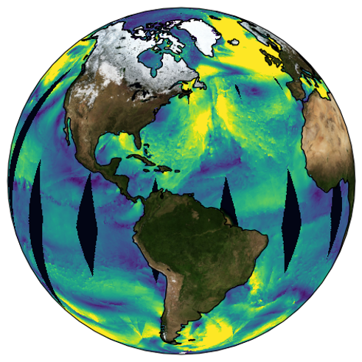
Ocean Dynamics and Surface Exchange with the Atmosphere
Simultaneous measurements of ocean vector winds and currents with daily global coverage.
Single instrument: Ka-band Doppler Scatterometer
5 km posting vector winds and currents
1,700 km wide swath
<50 cm/s current vector error
<1.5 m/s wind speed error, < 20 deg direction
3-year mission
Drifting 4:30 AM/PM orbit
Latency: winds <3h; currents <6h
Coverage within 3 km of coasts
Measures 86% of ice-free ocean, daily
Launch in 2030 if selected
Link to poster
Proposed to the NASA Earth System Explorer call. Step 1 selection will be in April 2024.
A partnership between NASA/JPL, CNES, and Ball Aerospace, led by PI Sarah Gille, UCSD SIO

Slide 13
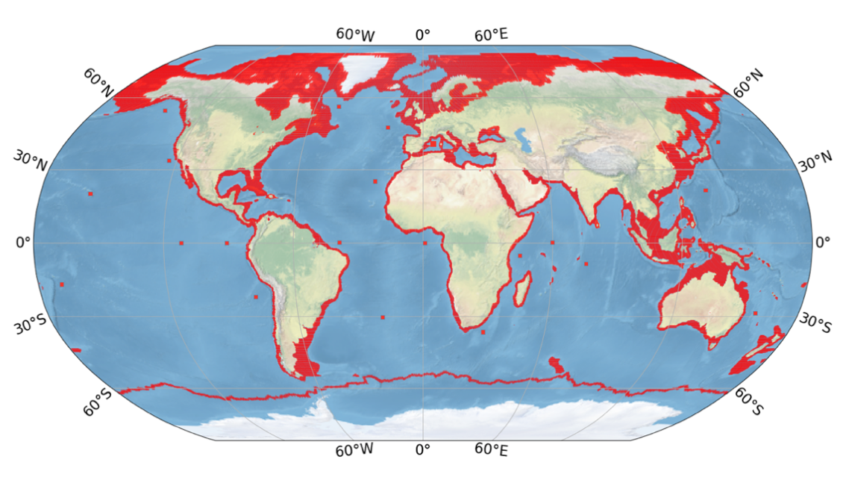
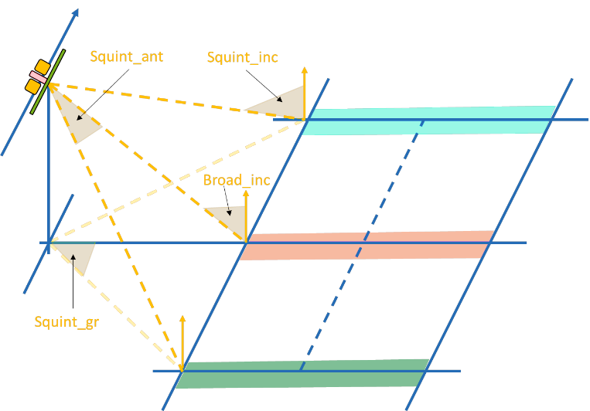
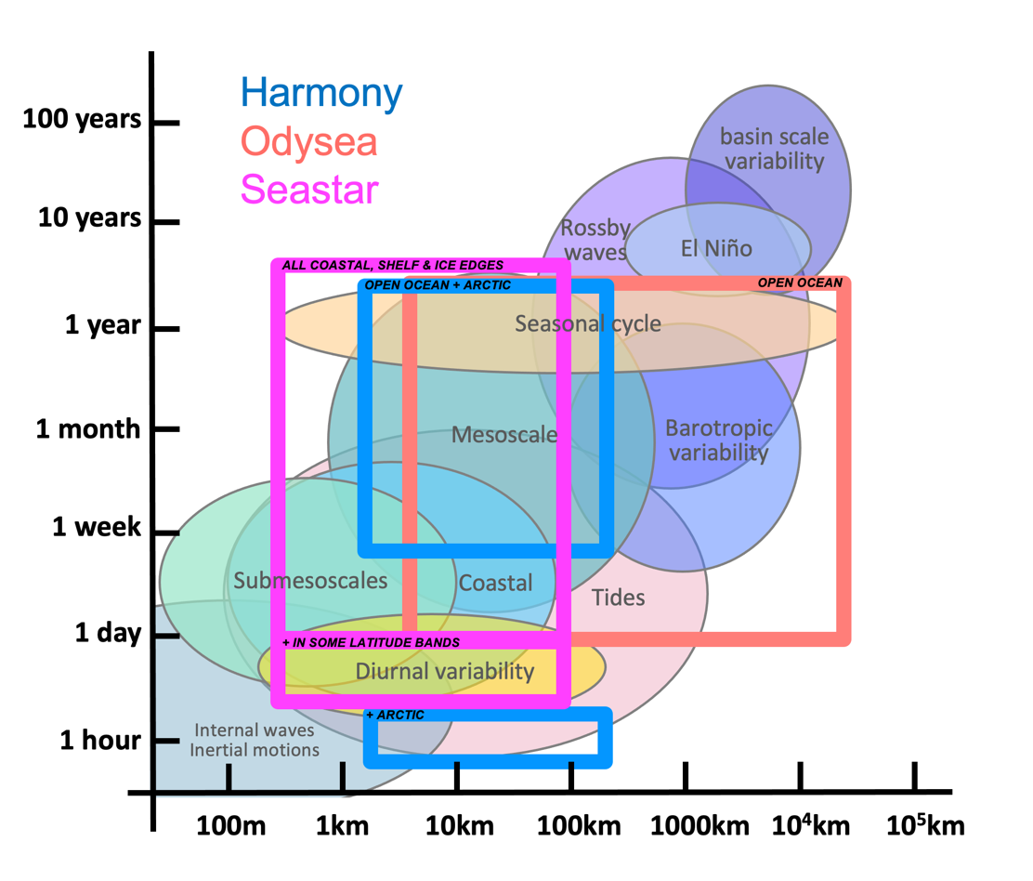
EE11 SEASTAR
Baltic Sea alga blooms revealing submesoscales -Sentinel-2, July 2019
COVERAGE: All coastal seas, shelf seas, Marginal Ice Zones + some open-ocean sites
Seastar is a candidate mission for ESA Earth Explorer 11 to observe fast-evolving (1-day) small-scale (1km or finer) ocean surface dynamics in coastal and shelf seas and marginal ice zones.
SAMPLING: 1-day revisit
+ sub-daily at some latitudes
+ in-flight orbit switch between:
1-day exact repeat
Drifting 1-day ~91 days repeat
Drifting 1-day ~271 days repeat
10 km
Primary Products
Total Surface Current Vector
 | One continuous swath: ~100 km
 | Horizontal posting (resolution): ≤ 1 km
 | TSCV RMSE @ 1km resolution: ≤ 0.1 m/s
Ocean Surface Vector Wind
 | Same swath and posting as TSCV
 | OSVW RMSE: ≤ 1 m/s
Directional Ocean Wave Spectrum
Secondary Products
 | Sea Ice Drift Vector
 | Full directional wave spectrum
 | Estuarine River Flow
Launch (if selected) 2031/32
The payload is a Ku-band high-squint along-track SAR interferometer with three azimuth lines-of-sight (45 deg fore/aft and broadside) for simultaneous retrieval of surface current and wind vectors
https://atpi.eventsair.com/ucm2023/
Contact: Christine Gommenginger cg1@noc.ac.uk
Notes:
SeaSTAR shall provide measurements over Coastal seas, Shelf seas and Marginal Ice Zones (CoSMIZ) and selected Ocean Regions of Special Scientific Interest (ORSSI).
Note 1: The CoSMIZ is defined by the SeaSTAR mask provided as an input to the Phase 0 Industry study at KO.
The CoSMIZ covers all ocean areas within 80km of the Coastline Boundary (CB), within 80km of the Sea Ice Boundary on the ocean side and over Shelf Seas (corresponding to areas where bathymetric depth ≤ 1000 metres. The resulting mask can be seen in the image below.
Note 2: The Coastline Boundary (CB) and the Sea Ice Boundary (SIB) are defined in Error! Reference source not found.. The sea ice edge is defined as 5% sea ice concentration in the SIB. The SIB will be updated fortnightly (every 2 weeks) in line with best practice from other missions (e.g. CRISTAL).

Slide 14
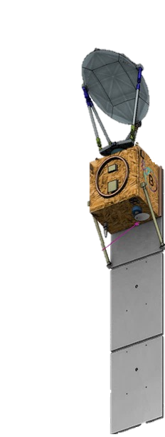
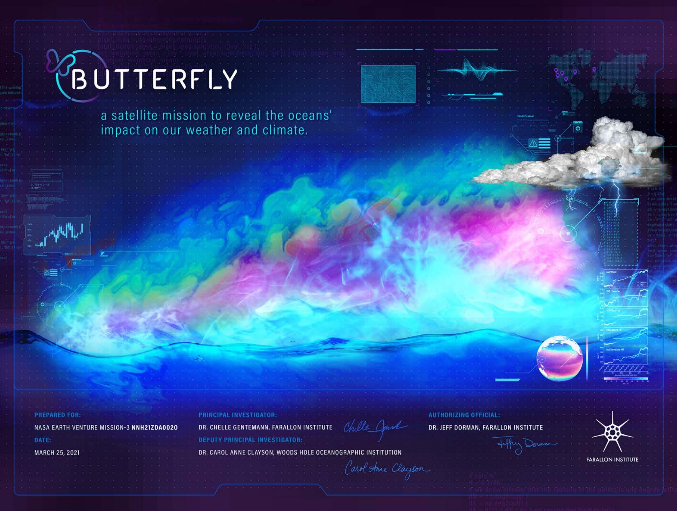
Measures air-sea sensible and latent heat flux over ocean with uncertainty <15W/m² at 15km resolution
A new mission to measure air-sea heat exchange from space
6-200 GHz high-resolution polarimetric imager
NASA Earth Ventures
Source: Shannon Brown
https://nasa-butterfly.github.io/

Slide 15
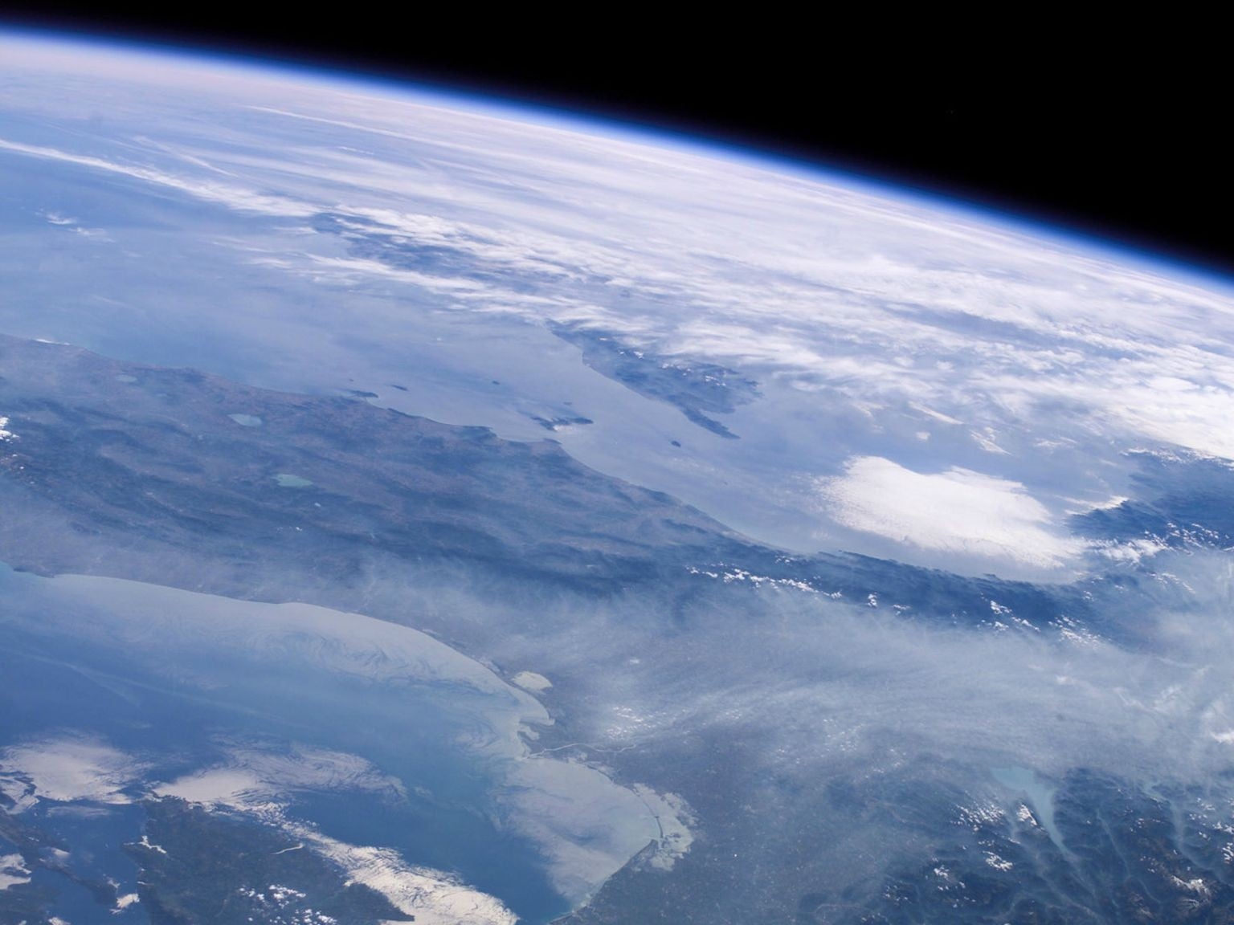
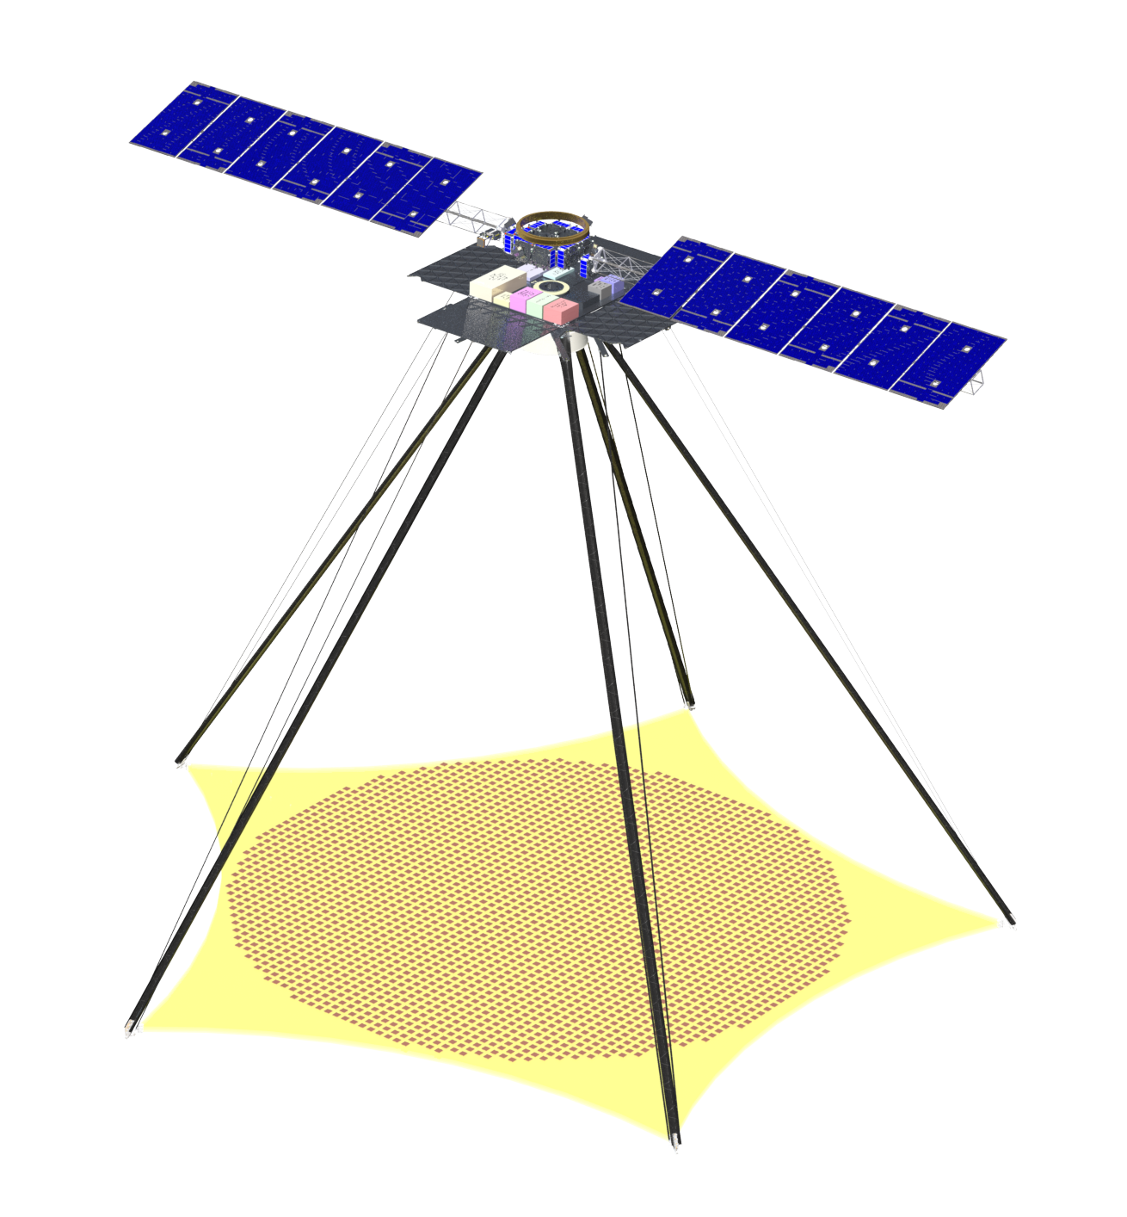
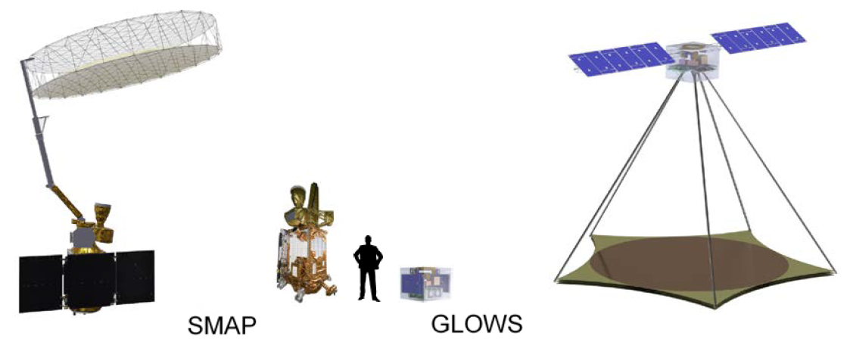
IGARSS 2022
High Resolution L-band Wind Speeds from the Global L-band Observatory for Water Cycle Studies (GLOWS) – a SMAP Continuity Mission
Link to poster
David G. Long, Rajat Bindlish, Jeffrey Piepmeier, and Mark Bailey
2023
GLOWS will carry L-band polarimetric radar and radiometers
Will measure:
- Surface wind speed at 5 km resolution
- Sea surface salinity at 50 km
- Sea ice, Soil moisture, etc.
Source: David Long

Slide 16
Backup

Slide 17
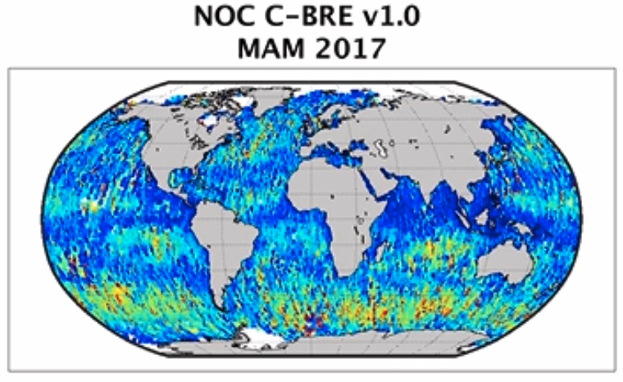
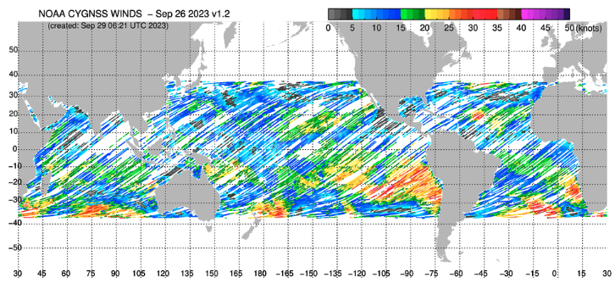
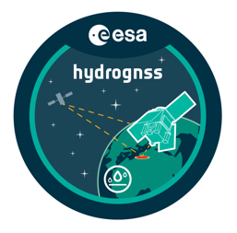
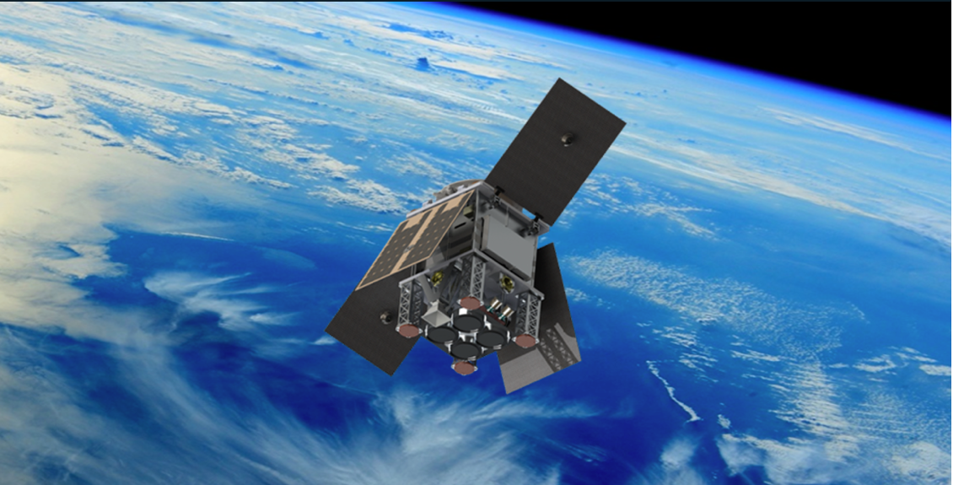
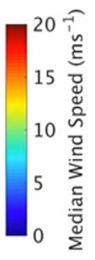
GNSS-R Ocean winds
Past, present and future missions
UK TDS-1
2014-2018
NASA CyGNSS
2016-present
ESA HydroGNSS
Launch 2024
Global
1 sat, GPS, single pol, single freq
NOC v1.0 winds shown
No ancillary data in inversion
U10 RMSD vs ECMWF ∼ 2 m/s
38S - 38N
8 sats, GPS, single pol, single freq
NOAA v1.2 winds shown
Ancillary data in inversion: WW3 Hs
U10 RMSD vs ECMWF ∼ 1.2m/s
Global
2 sats, GPS + Galileo, dual pol, dual freq
Higher spatio-temporal sampling
Wider range / higher sensitivity (TBD)
NOC leading wind and sea ice processing
Contact: Giuseppe Foti, National Oceanography Centre, g.foti@noc.ac.uk

