Slide 1
International Ocean Vector Winds Science Team Meeting Oct 4, 2023 Wind-Related Ocean Processes Overview Kathleen Dohan (ESR), Luc Lenain (UCSD), Roger Samelson (OSU)

Slide 2
Ocean processes at play on the coupling between ocean and atmosphere
Ocean-Wind Coupling/ Air-Sea Interaction
Mesoscale
Submesoscale
Near-surface shear and wave dynamics
Wind drift and wave drift
Stokes-drift from wave state and Stokes-Coriolis
equilibrium-sea momentum balance
Wave-state dependence
Kinetic energy balance of the surface layer
Coupling in Extreme Weather
Upwelling Processes
Relative-Wind Coupling Damping Effect of the ABL
Requirements of the constellation to capture surface currents
Long-term shifts in circulation patters and long-term wind trends

Slide 3
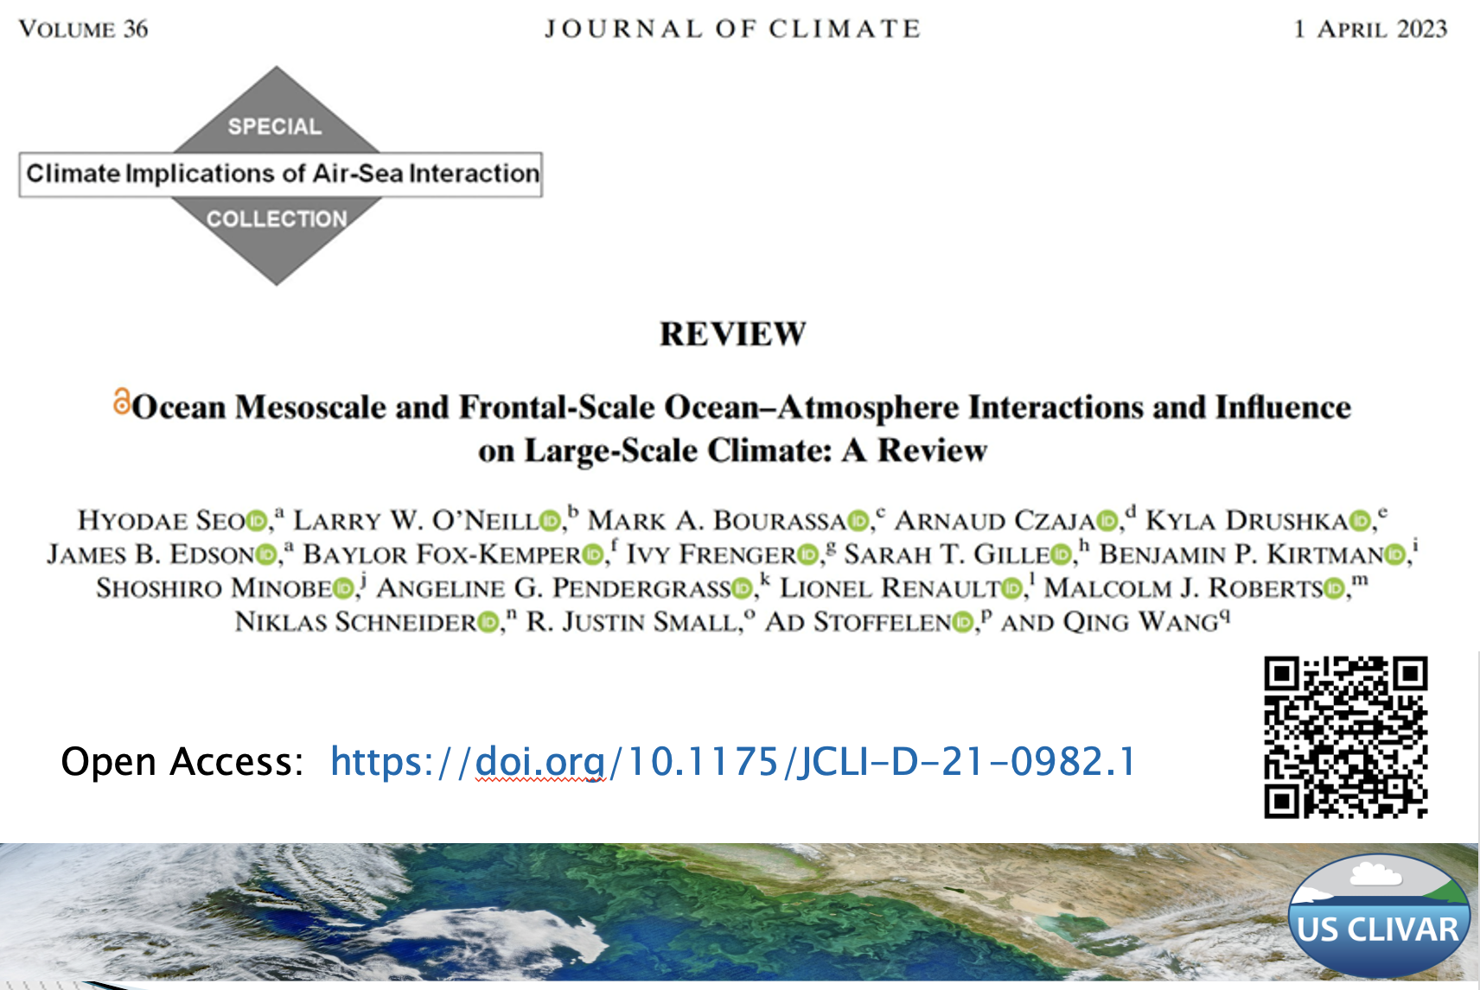
Wind-Related Coupling on the Mesoscale
Mesoscale and Frontal-Scale Air-Sea Interactions Workshop (US CLIVAR March 2023, leads: Seo & O’Neill)
Overarching goal US CLIVAR Working Group: Formulate and coordinate observational and modeling efforts to quantify oceanic mesoscale and frontal-scale air-sea coupled processes and evaluate their integrated impacts on Earth’s climate and hydrological cycle
Seo et al. 2023 Review of current understanding and demonstrated influence of air-sea coupling on a wide variety of high-level processes in Earth’s climate system
Focused on coupling processes on scales of 10-1000km and weather to climate timescales

Slide 4
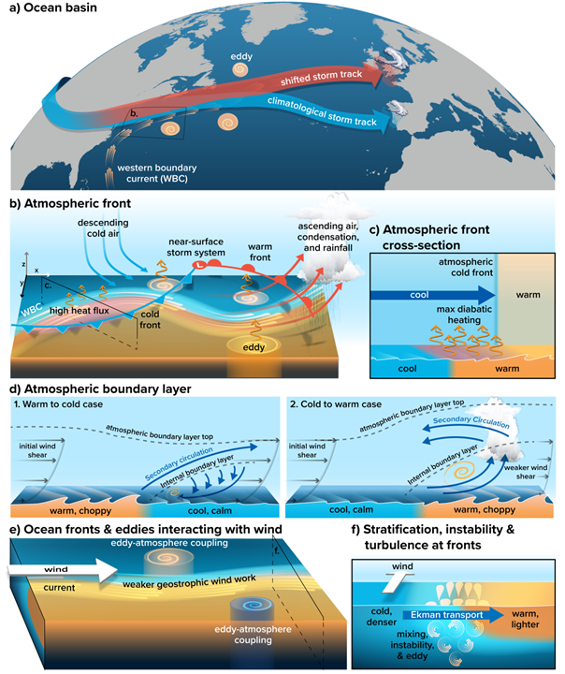
Wind-Related Coupling on the Mesoscale
Wind-Related Ocean Processes Overview in the Northern Atmosphere
Seo at al. (2023) review paper
Shifted storm track by WBC leads to downstream rainfall
Cold and warm fronts in a low pressure system traversing SST front, asymmetric diabatic heating, precipitation
Cold front crossing over SST front close up
MABL processes with cross-frontal winds: warm-to-cold, cold-to-warm. Vertical mixing, shear, drag different regimes
Meandering currents and eddies under wind: mechanical and thermal feedback, adjusted wind-stress curl and up/downwelling
Ekman transport at fronts

Slide 5
Wind-Related Coupling on the Mesoscale
Reading materials
Strub, P.T. and C. James (2022), Evaluation of Nearshore QuikSCAT 4.1 and ERA-5 Wind Stress and Wind Stress Curl Fields over Eastern Boundary Currents. Remote Sensing, 14(9), 2251, doi:10.3390/rs14092251
Chacko, N., M. M. Ali, and M. A. Bourassa, 2022: Impact of Ocean Currents on Wind Stress in the Tropical Indian Ocean. Remote Sensing, 14, 2547. https://doi.org/10.3390/rs14071547
Poster in this session: Jackie May and Bourassa
The upper ocean response to coupling surface currents to wind stress using high-resolution coupled atmosphere-ocean models over the Gulf Stream. Looking at the ocean mixed layer vorticity response and its impact on the submesoscale vertical heat flux.
Link to poster

Slide 6
Wind-Related Coupling on the Submesoscale
Reading materials and recent workshops
Lorentz Center workshop on Air-sea Interaction at the (Sub)mesoscale (held last week).
Chen, X., W. Dewar, E. Chassignet, M. Bourassa, S. Morey, and G. Gopalakrishnan, 2022: On the Feedback Between Air-Sea Turbulent Momentum Flux and Oceanic Submesoscale Processes. J. Geophys. Res. Oceans, 127(10), e2022JC018767
Poster in this session: Mara Freilich et al.
Characterization of the transition to
submesoscale dynamics
Observations at edges of upwelling filaments:
kinetic energy flux at fronts
Cross-scale interactions at fronts and filaments
Link to poster

Slide 7
Near-Surface Shear and Wave Dynamics
Reading materials and recent developments
A major goal of the NASA EVS-3 S-MODE project
Pizzo et al. 2023 - The role of Lagrangian drift in the geometry, kinematics and dynamics of surface waves. Inferring currents from the wave field is a central aim of remote sensing instruments. What current are we measuring?
Dispersion relationship using remote sensing techniques to observe near-surface shear (DoppVis, Lenain et al. 2023) DoppVis enables airborne remote sensing of near surface current profiles from few 10's of cm below the surface down to few meters, using georeferenced video of the ocean surface to capture the wave dispersion relationship and invert for current as a function of depth.
Wave-state dependence: e.g. Sauvage et al.
Kinetic energy balance of the surface layer
Partitioning of wind-work is necessary for understanding surface-layer KE balance e.g. Zippel et al
"Stokes wind-work" and turbulence in the surface layer
Physical meaning of “Stokes wind-work” (product of stress and surface Stokes drift) that appears in LES (WAB) KE balance (e.g., Skyllingstad et al doi: 10.1175/JPO-D-22-0150.1)
Lenain et al. 2023
An example of current profile collected from DoppVis (figure 1 of Lenain et al. 2023), along with deeper observations from collocated Wave Glider ADCPs

Slide 8
Near-Surface Shear and Wave Dynamics
Poster in this session: Dohan
Adding Stokes-Coriolis term and vertical variation to OSCAR
Poster in this session: Samelson
Equilibrium wind-drift model to improve understanding of wind-drift and wave-drift currents in the upper few meters of the water column and their coupling across the air-sea interface to the ABL. The equilibrium wind-drift model incorporates a novel, wind-speed-dependent wave-effect parameter, which allows wave effects on momentum transport. Model, coupled numerical simulations, in-situ analysis.
Link to poster
Link to poster

Slide 9
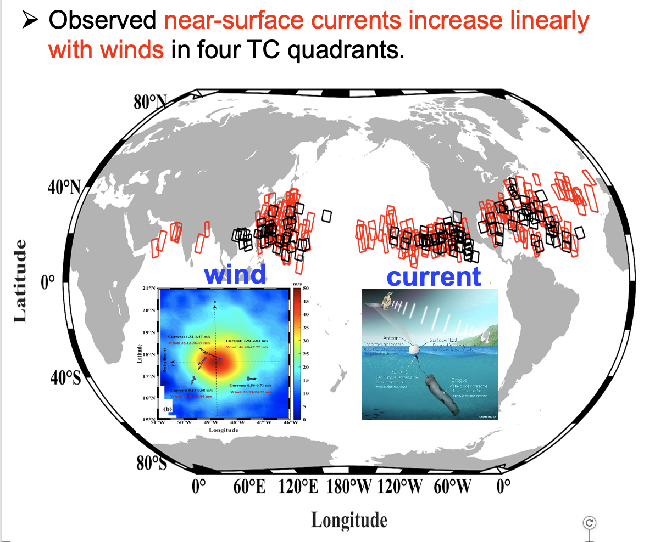
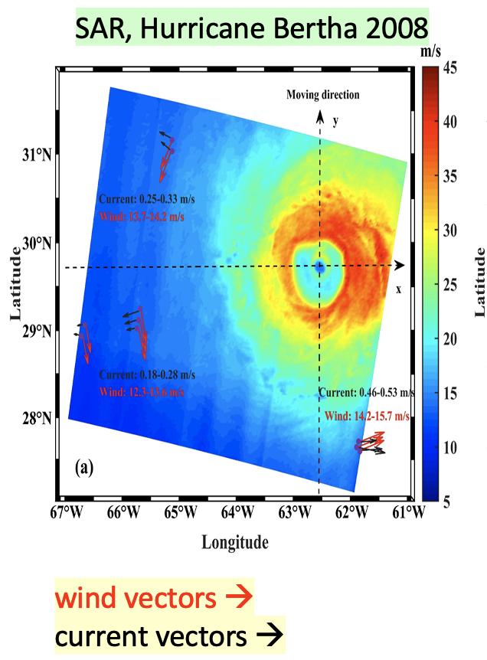
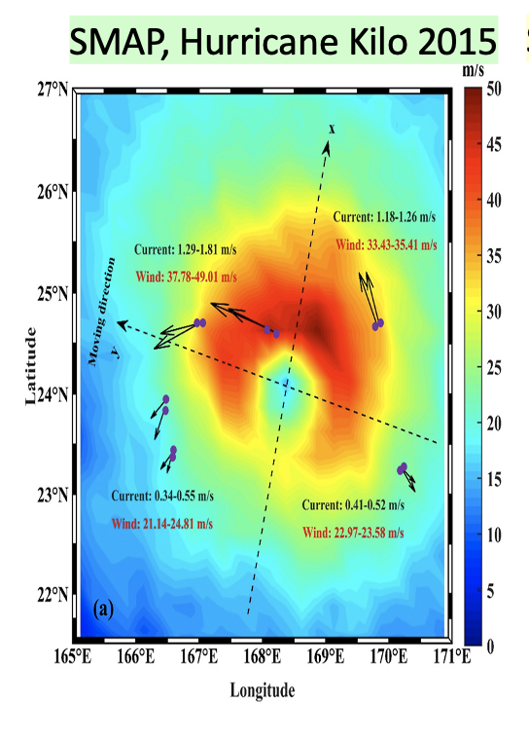
Relative-Wind Coupling in Extreme Weather
Will Perrie & Biao Zhang, Bedford Institute of Oceanography, Canada
Work on marine winds and ocean processes derived from SAR, tropical cyclone remote sensing, wind and current observations under extreme weather
Observed near-surface currents increase linearly with winds in four TC quadrants but satellite + drifting buoy observations show TC surface winds and currents have asymmetric characteristics with the wind direction alignment with current directions dependent on the quadrants.
Fan, Zhang, Perrie, Mouche. 2022, Observed Ocean Surface Winds and Mixed Layer Currents Under TCs etc. …JGR

Slide 10
Upwelling Processes
Development of Multi-Metric Satellite-Based Coastal Upwelling Indices
Steven Morey – Florida A&M University
MODIS AQUA Chl a
Extension of traditional upwelling index metrics based on
Winds (along-coast component of stress and Ekman transport)
SST
Ocean Color
Individual variables are related differently to coastal upwelling at different locations
Local winds are not always good indicators of upwelling near complex coastlines.
SST is also influenced by air-sea heat exchange.
Ocean Color is not a good indicator near regions of riverine input.
Wind-Derived indices are related to instantaneous vertical motions whereas SST and Ocean Color are related to time integrated vertical motion.
Using model and satellite analyses, statistical and machine learning methods are trained to produce multi-metric indices for coastal upwelling that are better indicators of coastal upwelling than indices based on individual variables.
SST
CCMP Offshore
Ekman Transport

Slide 11
Dependence of Relative-Wind Damping Effect on ABL turbulence

Slide 12
Requirements of the constellation to capture surface currents
Long-term shifts in large-scale circulation patterns and long-term wind trends
Dohan Poster in this session
Shifting circulation patterns observed over decades of satellite data: OSCAR zonal velocity climatology from 1993:2020 – climatology from 1993:2010. Meridional shifts of currents are the most noticeable, seen as the banded blue/yellow lines.
Importance of small scales and the vector wind constellation: Demonstration of difference in Ekman current calculated from differently measured and sampled winds

Slide 13
Closing remarks
Discussion Point:
Did we miss anyone? (We are sure we did)
2 dominant research areas, although not independent:
Coupled ocean atmosphere dynamics, namely mesoscale and fronts
Wind/wave upper ocean dynamics. Contact us if you’re interested in keeping in touch
Etc.
Posters:
M. Freilich, L. Lenain, S. Gille – Dynamics of transition to submesoscale
J. May and M. Bourassa – Coupling surface currents to wind stress over Gulf Stream
K. Dohan – Adding Stokes-Coriolis and vertical variation to OSCAR surface currents
R. Samelson – Modeling near-surface wind and wave drift currents

