Slide 1
Impact of Boundary Layer on Biomass Burning Aerosol Transportation in Coastal Regions within Tropics
Georgios Priftis¹, Udaysankar Nair¹ and Timothy J. Lang²
¹University of Alabama in Huntsville
²NASA Marshall Space Flight Center
IOVWST Meeting May 3, 2022

Slide 2
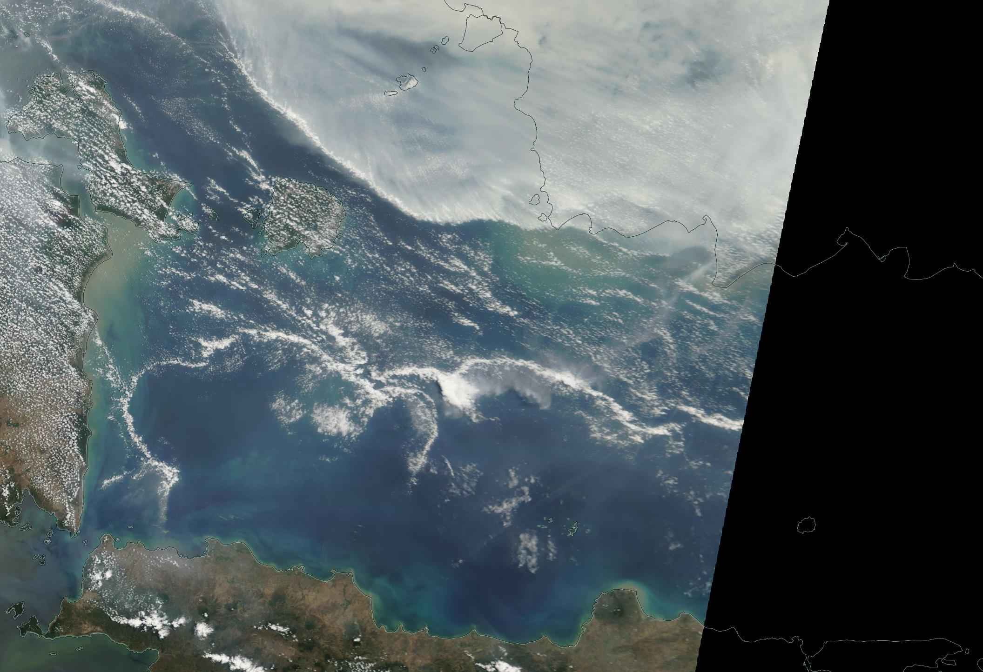
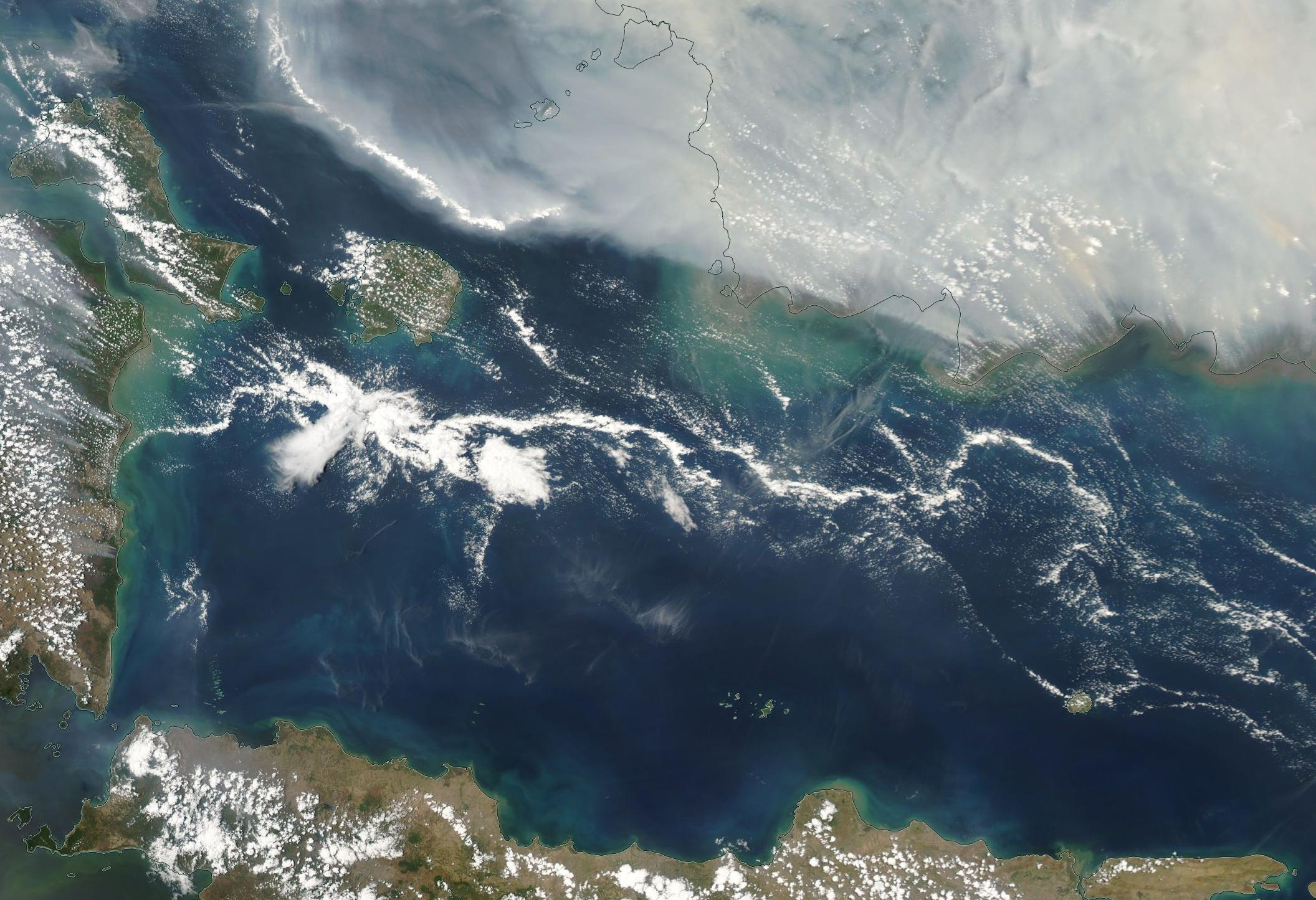
Background and Motivation
Aggregation of shallow convection over the ocean is the first step in upscale growth of organized convective structures
Under maritime conditions, mesoscale circulations driven by land-ocean contrasts contribute substantially to vertical moisture transport and latent heating.
Land breeze front can propagate long distances offshore
Land breeze circulation provides trigger for such upscale growth through mesoscale convergence
How does the land breeze affect the transport of smoke within the marine planetary boundary layer?
10-13-2016 MODIS

Slide 3
Area of study

Slide 4
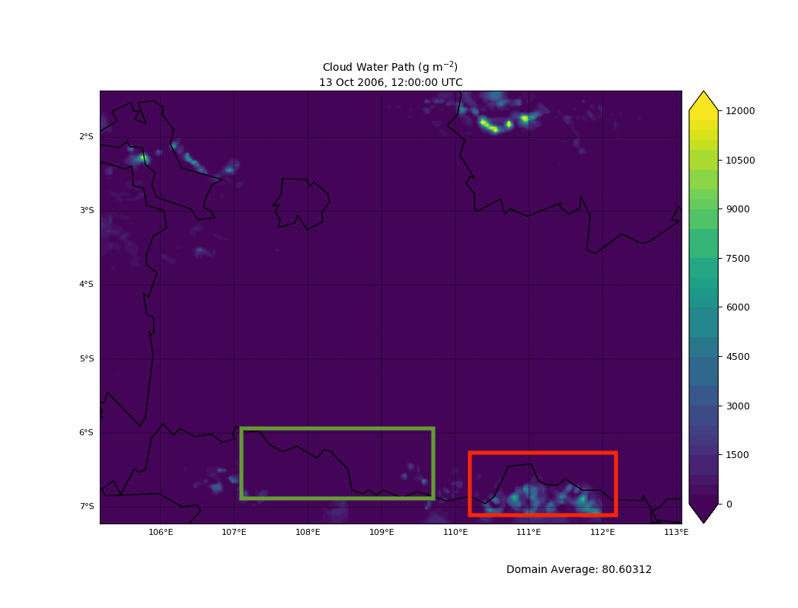
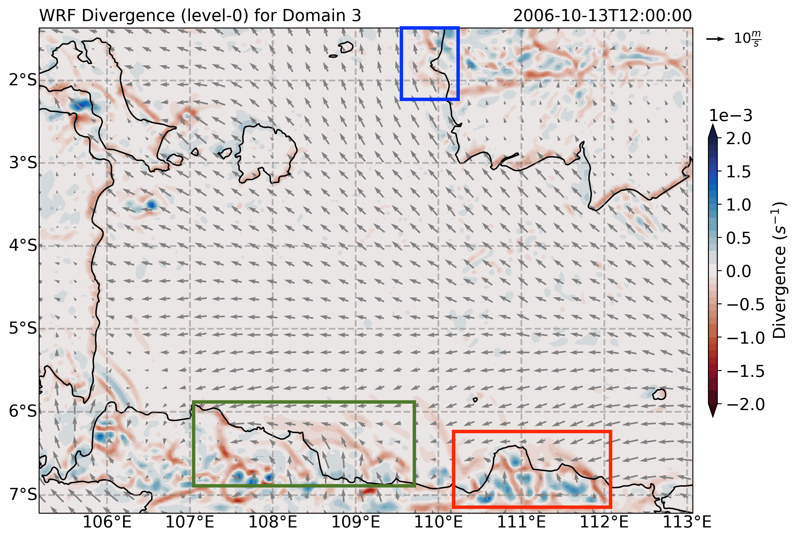
Results
Land breeze propagation:
With smoke
Convective clouds
No-convection

Slide 5
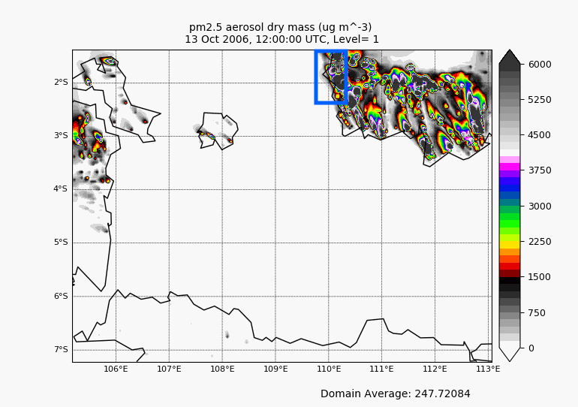
High concentration of smoke along the land breeze front

Slide 6
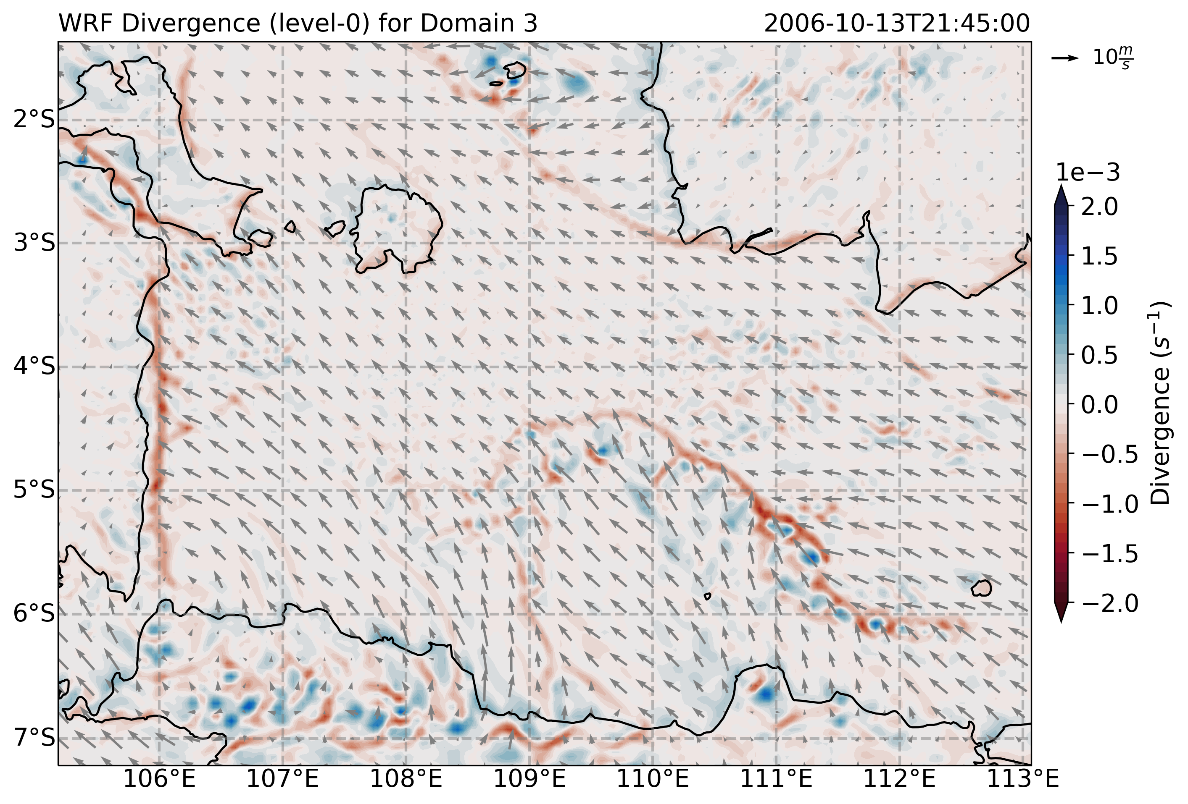
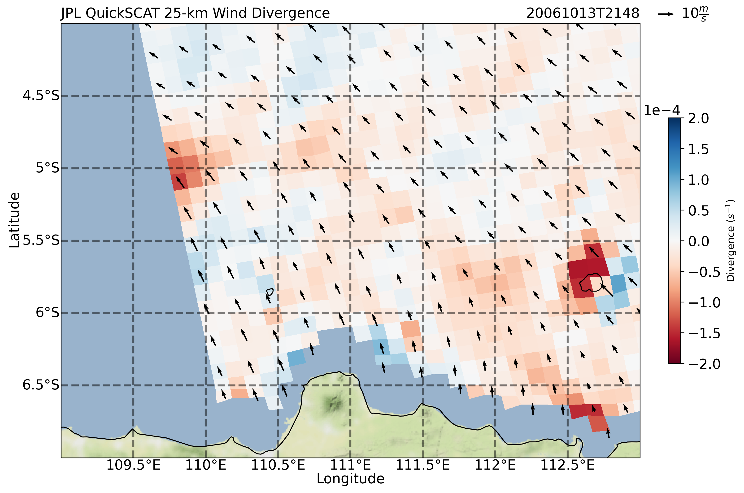
Agreement between Quickscat wind retrievals and WRF wind vectors at the lowest level
Potentially retrieval degradation near the edge of the swath and precipitation

Slide 7
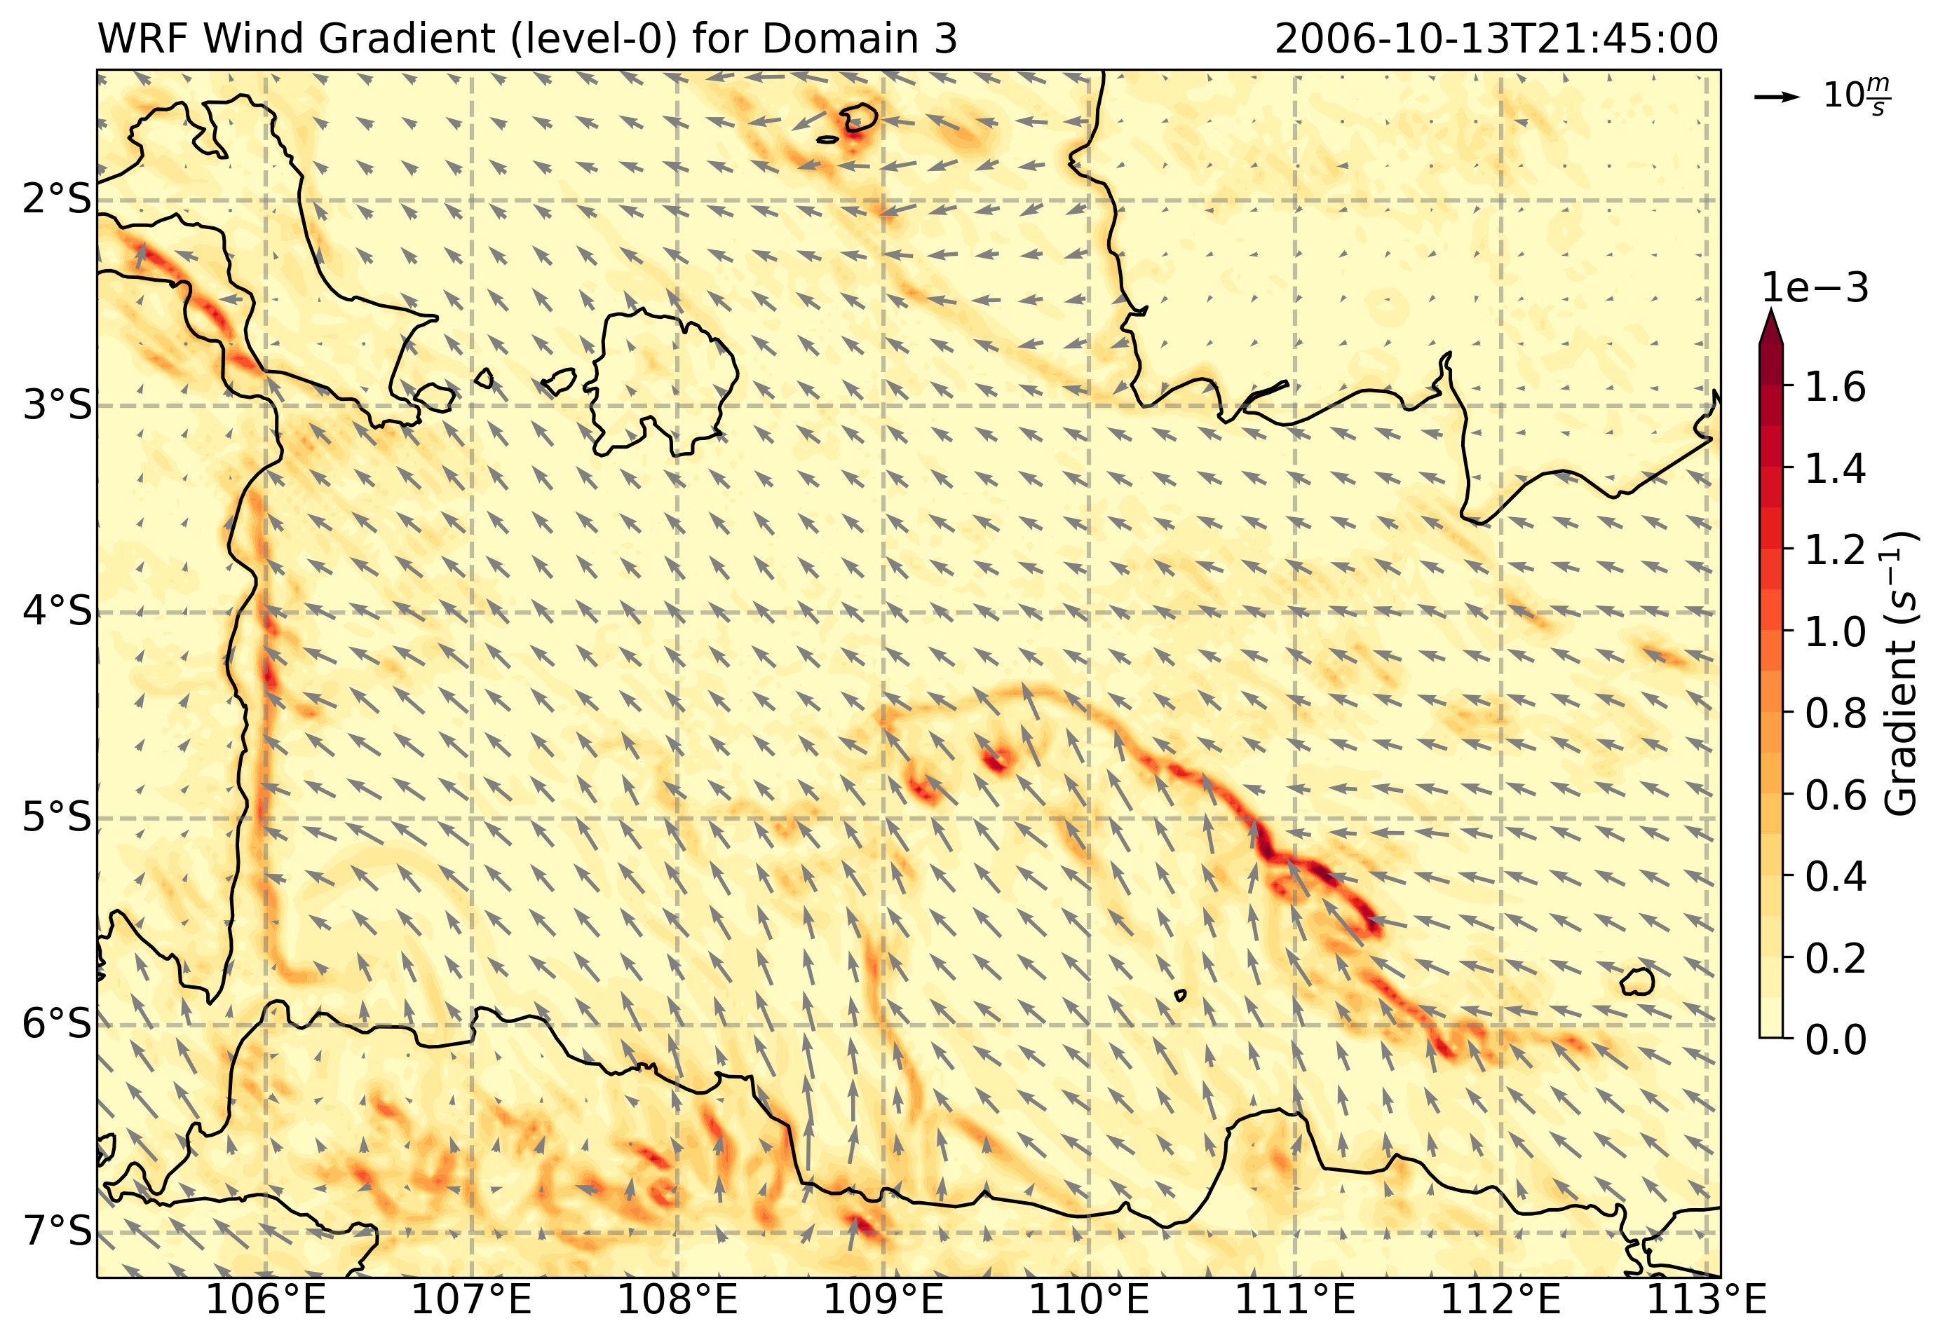
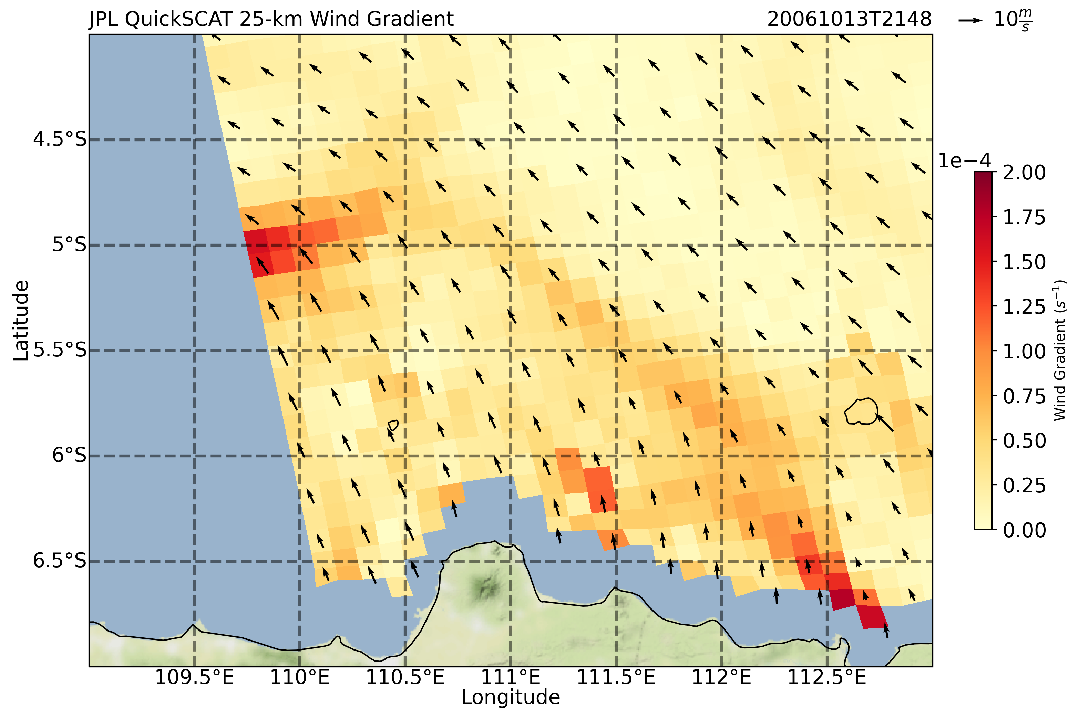

Slide 8
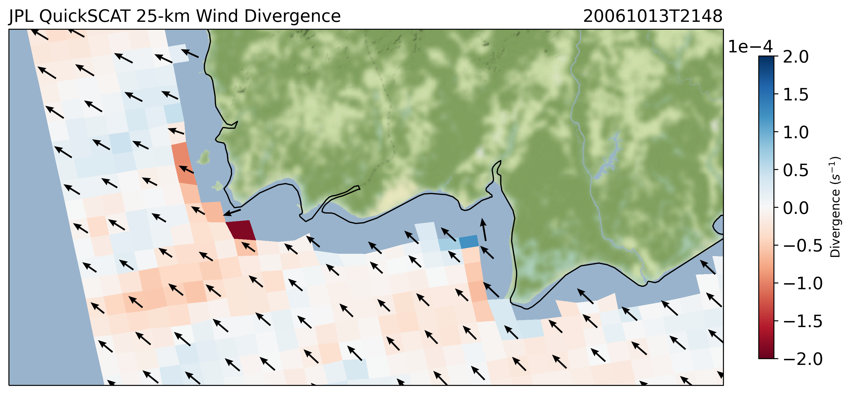
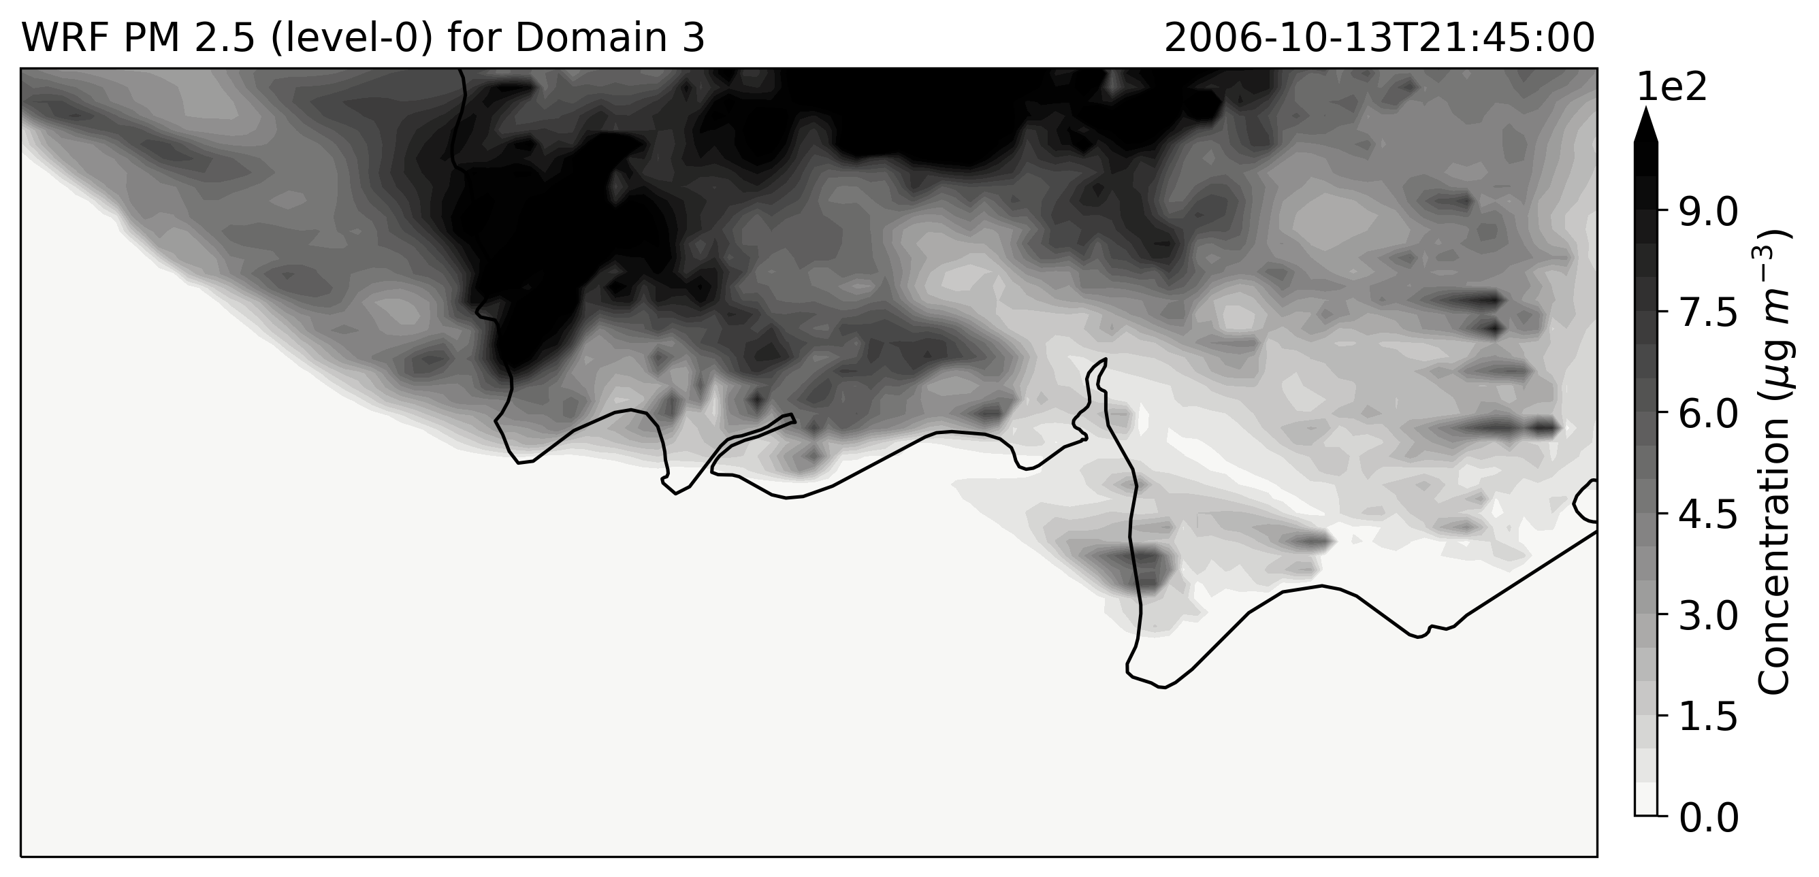
Agreement between Quickscat wind retrievals and WRF wind vectors at the lowest level
Increased concentration of smoke along the front of the land breeze

Slide 9
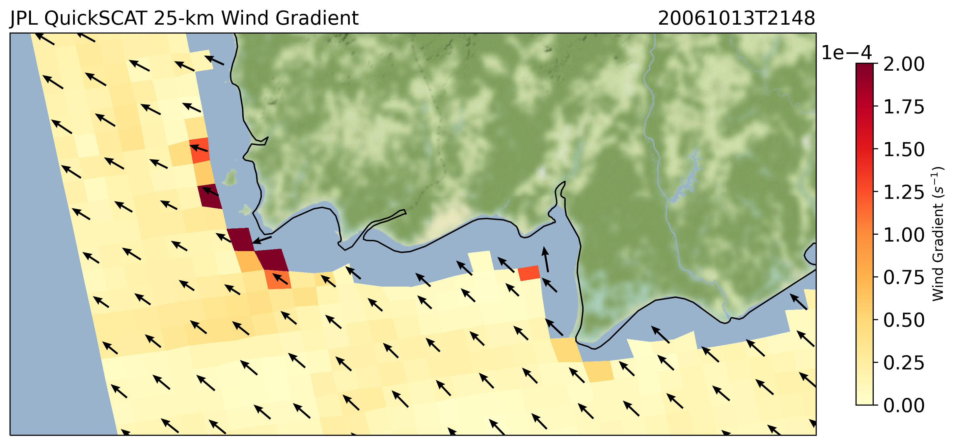
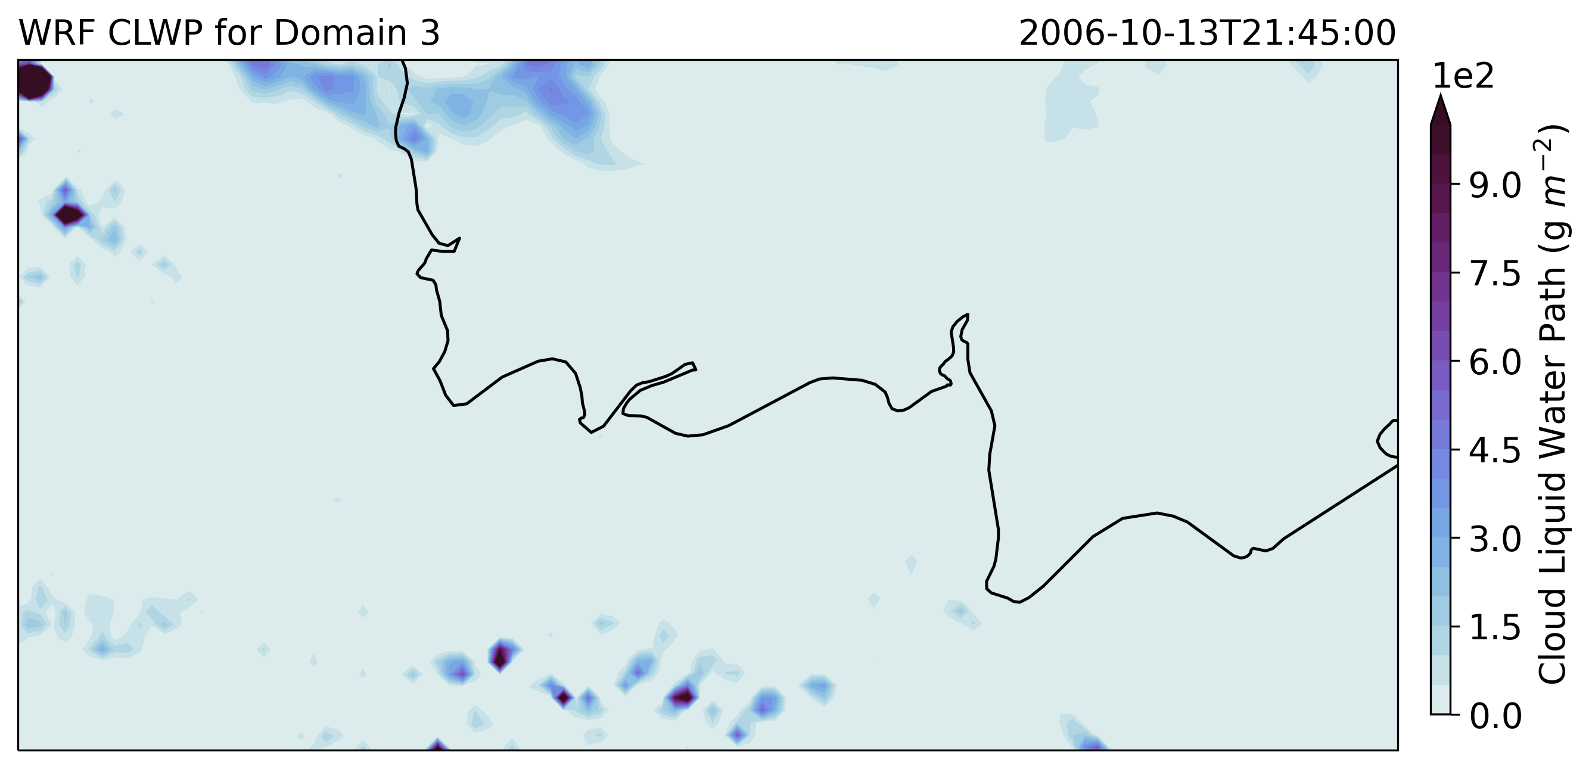
Land breeze is not always associated with precipitation

