Slide 1
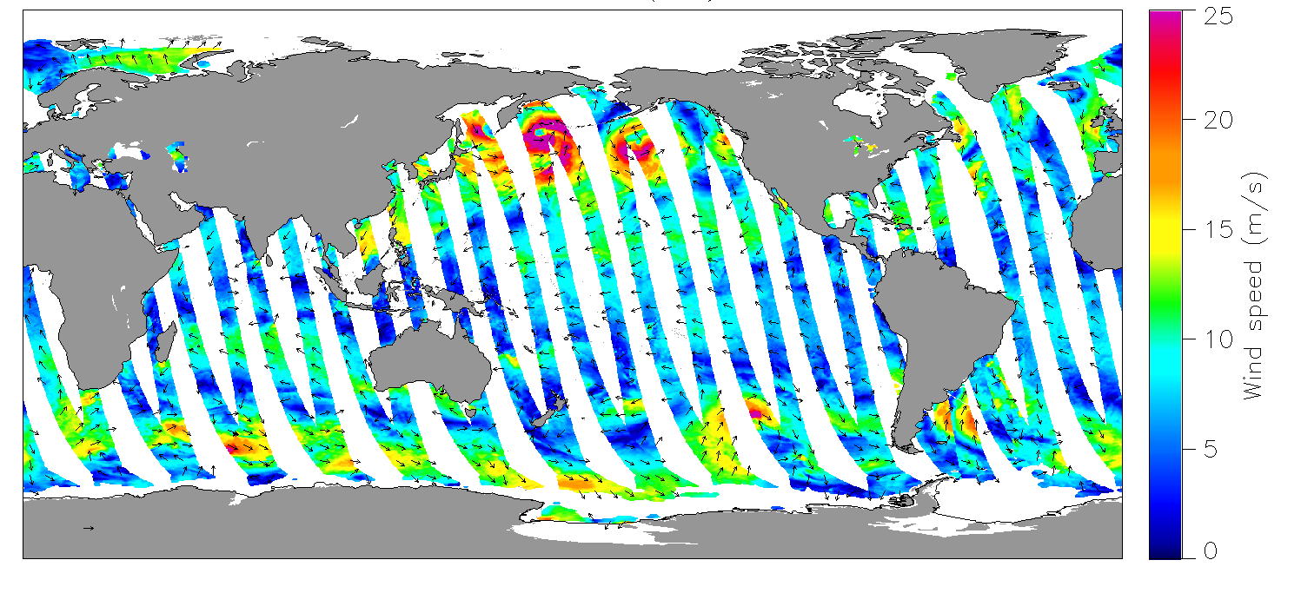
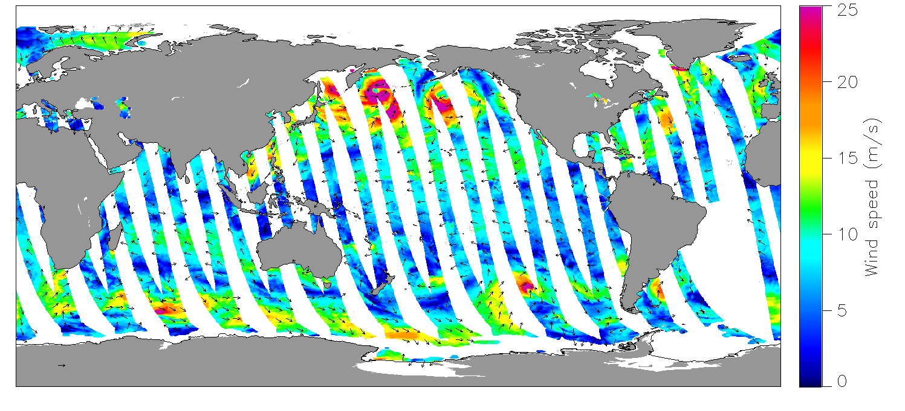
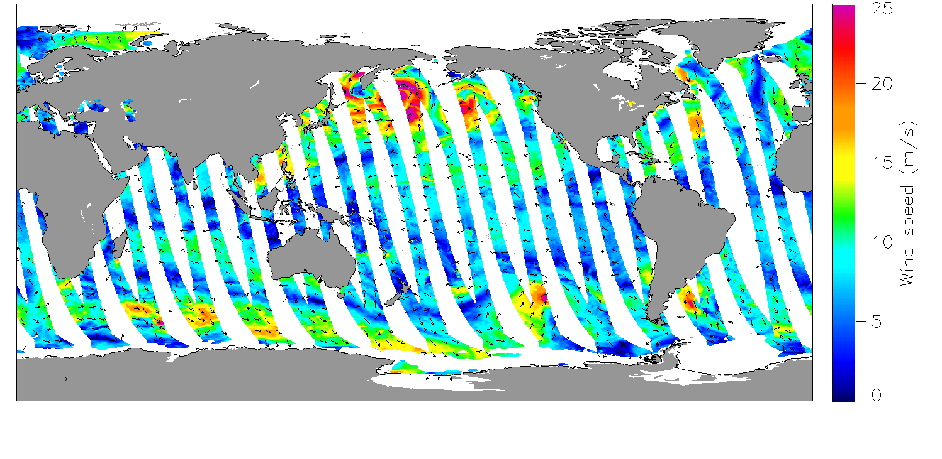
INTERCALIBRATION OF
ASCAT SCATTEROMETERS ON
METOP-A, -B, AND -C FOR A STABLE
WIND CLIMATE DATA RECORD
12-31-2020 (Asc.)
Lucrezia Ricciardulli and Frank Wentz
Remote Sensing Systems, Santa Rosa, CA, USA
ASCAT-A
ASCAT-B
CDR Strategy
Absolute calibration
Cross-calibration
Wind timeseries stability
Future work
ASCAT-C
Acknowledgements: This work is supported by the NASA OVWST
IOVWST Virtual Meeting, March 2021

Slide 2
STRATEGY FOR OVW CLIMATE DATA RECORD
Ku-band backbone
C-band backbone
QuikSCAT
ASCAT-A
ASCAT-B
ASCAT-C
1999
2007
2009
2013
2019
2021
NWP w,φ
Reynolds SST
Calibrated σ₀
_{(EUMETSAT L1B)}
Wind
Retrieval algorithm
ASCAT-A
GMF
(w, φ_{R}, θ, SST*)
Wind w_{A}
ASCAT-B
Wind w_{B}
ASCAT-C
Wind w_{C}
KuSST GMF: Ku2011 GMF+ incidence angle dependency+ *SST dependency
Ocean Calibration
Post-hoc corrections
C2015 GMF: incidence angle dependency but no *SST dependency

Slide 3
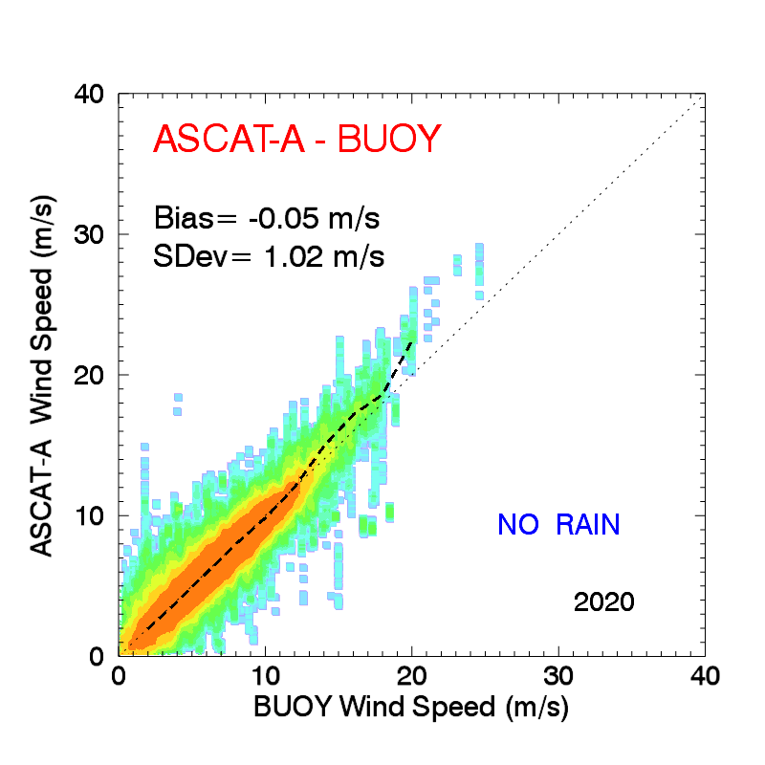
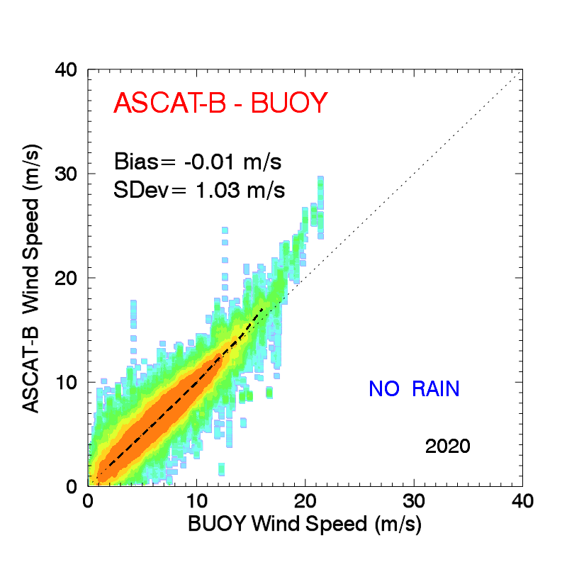
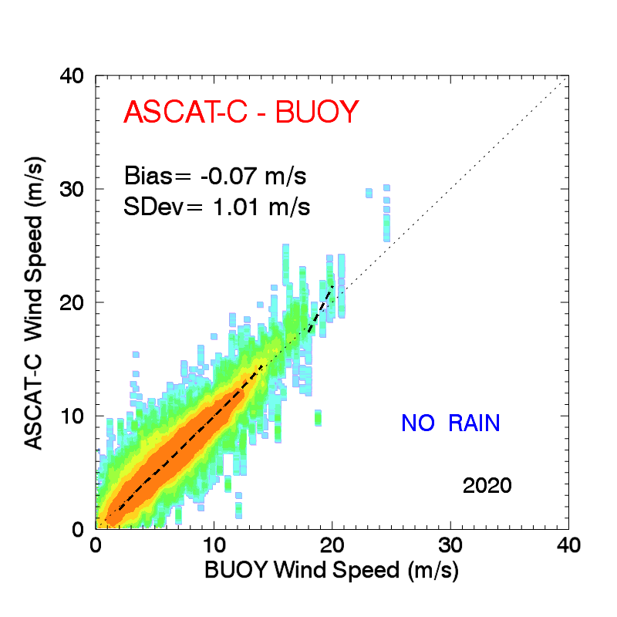
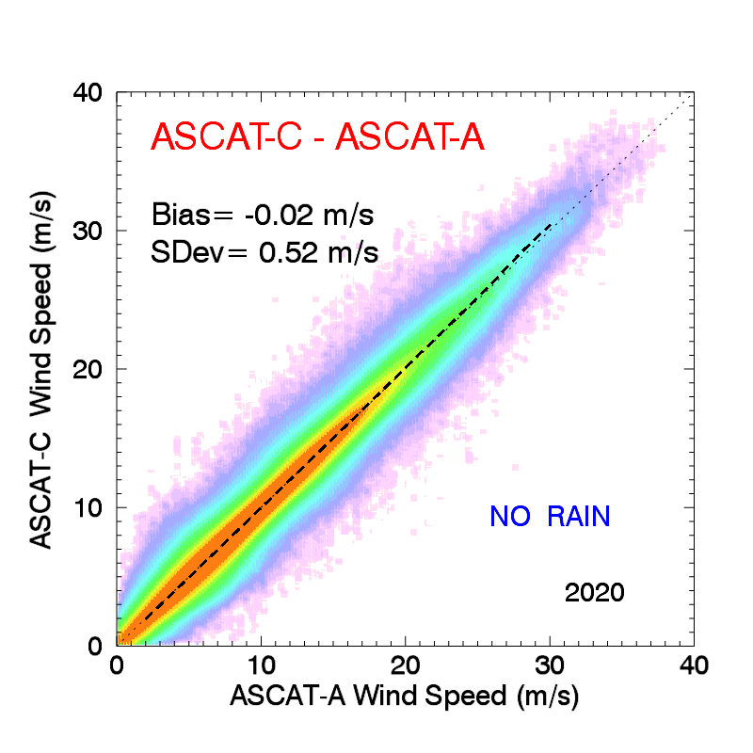
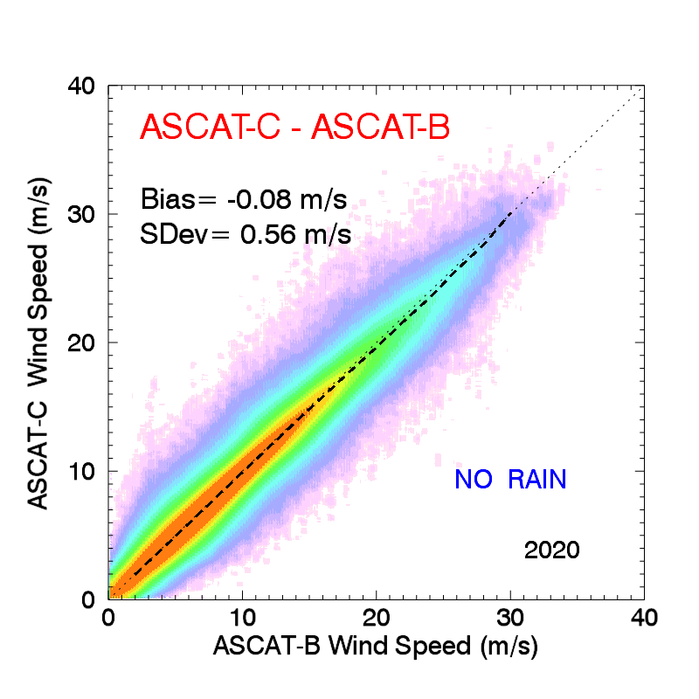
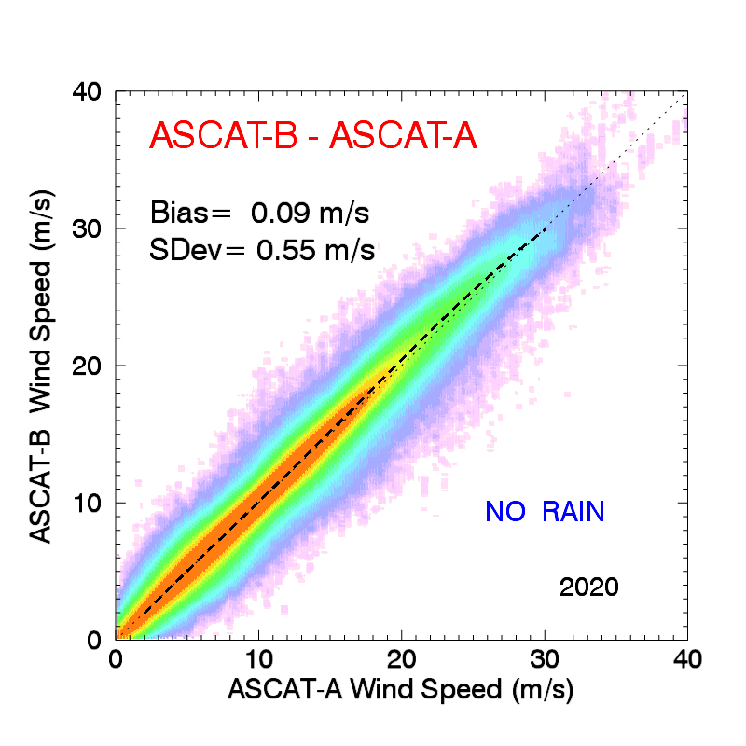
ABSOLUTE AND CROSS-CALIBRATION (2020)
Absolute calibration vs BUOYS
 | Bias (m/s) | StDev (m/s)
ASCAT-A | -0.05 | 1.0
ASCAT-B | -0.01 | 1.0
ASCAT-C | -0.07 | 1.0
Cross-calibration
 | Bias (m/s) | StDev (m/s)
ASCAT-C vs A | -0.02 | 0.52
ASCAT-C vs B | -0.06 | 0.56
ASCAT-B vs A | 0.09 | 0.55

Slide 4
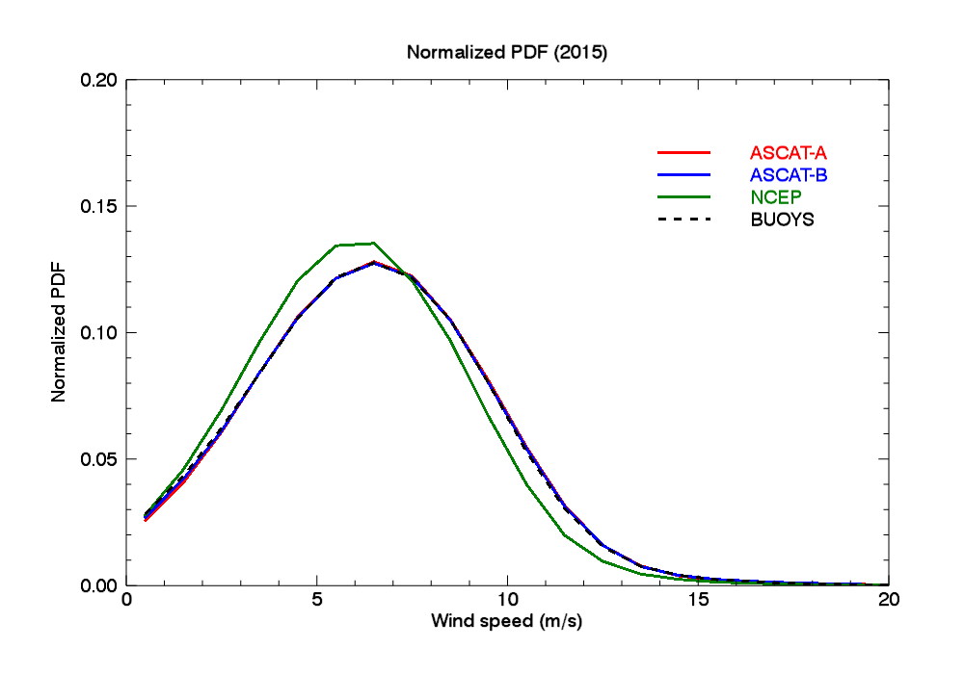
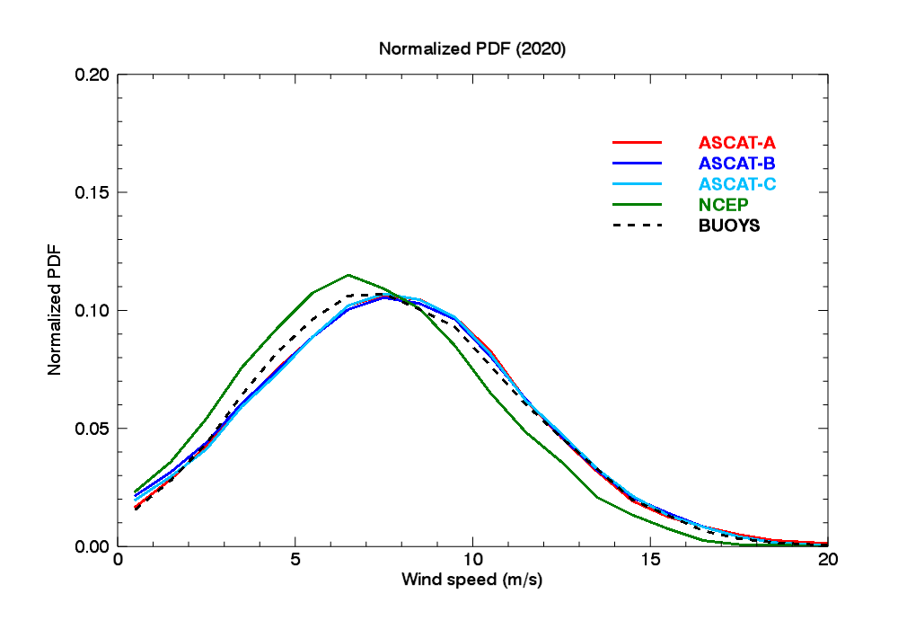
QUADRUPLE/QUINTUPLE COLOCATION WITH BUOYS
2015
2020
73500 quadruple Colocations
2500 quintuple Colocations
ASCAT-B (L2) 30 min with buoy, 60 min with L3 ASCAT-A, -C, 25 km
Excellent alignment ASCAT-A,-B,-C
Well-aligned PDFs ASCAT vs BUOYS (2015-2019)
2020 has much less colocations because ASCAT-C was added → quintuple colocations (ASCATs 60 min)
No post-hoc wind speed adjustment; these results are from well-defined GMF developed from radiometers, buoys not used

Slide 5
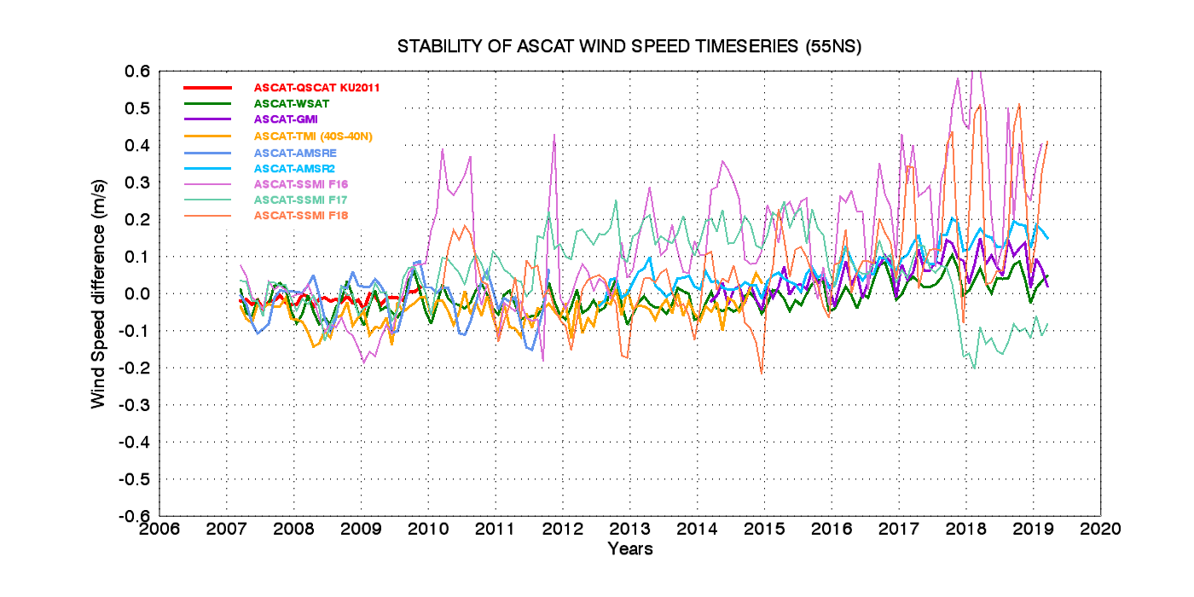
2018-2019 OVWST: ASCAT-A CALIBRATION ANALYSIS
From GLOBAL comparisons between ASCAT-A wind differences with all other sensors
Small ASCAT-A drift?

Slide 6
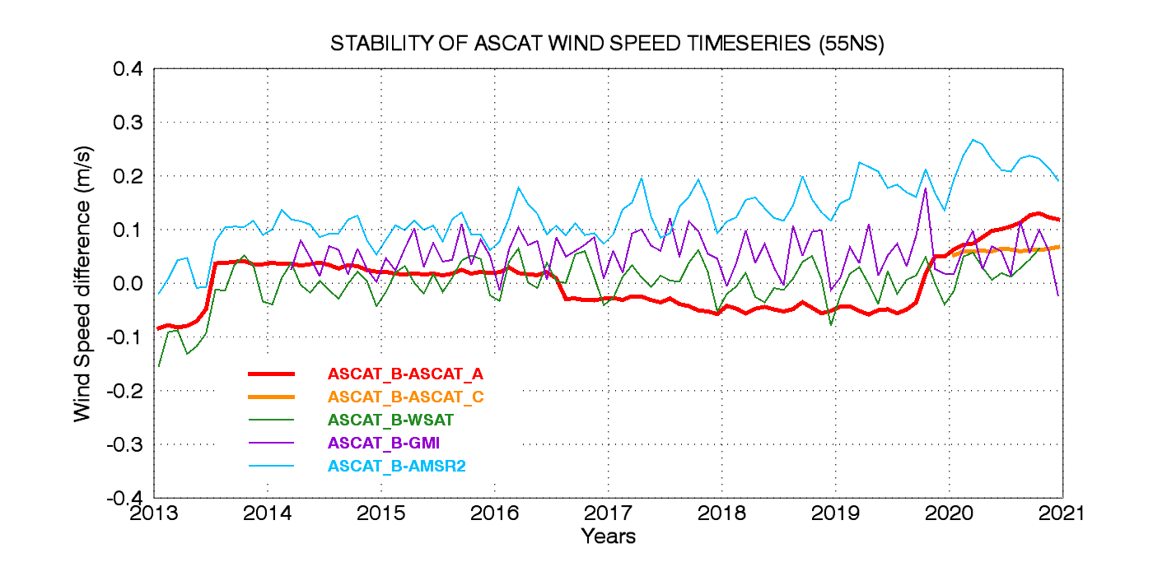
ASCAT CDR STABILITY
From GLOBAL comparisons between ASCAT-B vs –A, -C and radiometer winds
AMSR-2 ~-0.1 m/s drift
B unstable
beginning
~0.05 m/s B-A drift
Stable B-C
~0.05 m/s bias
~0.05 m/s B-A drop
Extremely Stable
-B vs GMI, WindSat,
unbiased
~0.08 m/s B-A jump

Slide 7
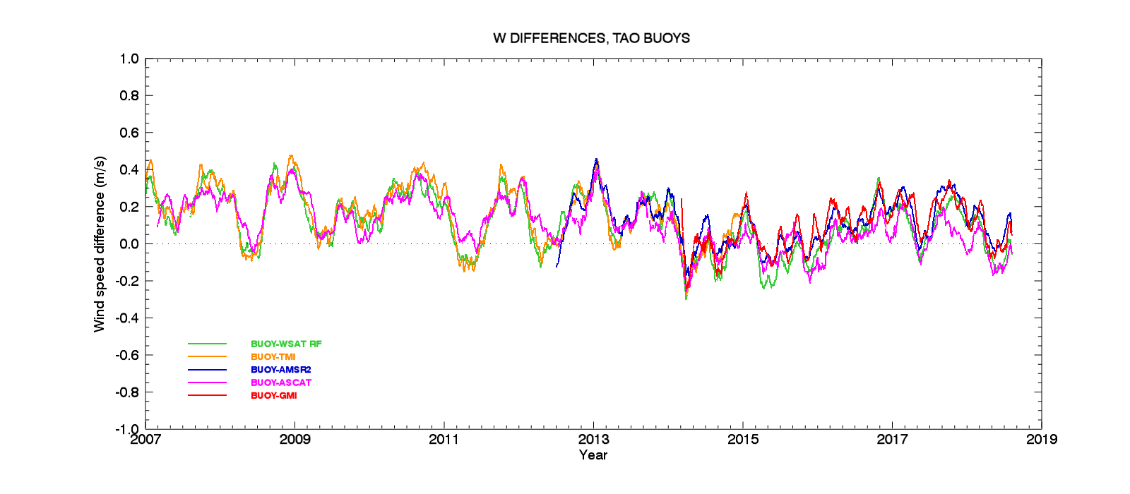
CAN WE USE BUOYS TO DETECT ASCAT DRIFTS/JUMPS?
ASCAT-A and radiometers vs TAO BUOYS: due to limited colocations and noise,
it is extremely challenging to detect ASCAT calibration jumps < 0.1 m/s just from buoys

Slide 8
SUMMARY
ASCAT –A, -B, -C cross-calibration is very good, at all winds (matching PDFs); within ~ 0.1 m/s
ASCAT-B extremely stable over 2014-2021; some instability the first 6 months.
ASCAT-B absolute calibration is excellent: winds unbiased versus buoys
ASCAT-A very stable until 2016, some jumps/drift later
1. Small jump ~ 0.05 m/s (~0.05 dB) in mid 2016;
2. Small drop ~ -0.08 m/s (~-0.08 dB) in fall 2019
3. Steady negative drift after Fall 2019, additional ~-0.05 m/s bias
ASCAT-C extremely stable mid 2019-present; small bias compared to ASCAT-B (-0.05 m/s)
These biases were determined with cross-examination among different ASCATs (60 min col)
Buoys are used for determining overall biases over long periods. Not efficient for determining small jumps/drifts < 0.1 m/s
For small drifts/jump, in the absence of overlapping ASCATs, having multiple radiometers proved to be more useful
FUTURE WORK
Reprocess final ASCAT-A at the end of the mission (end 2021): apply small σ₀ corrections
Apply small correction to ASCAT-C to match –B?
Check Ku-/C-band Cross-calibration at very high winds
Release KuSST reprocessed QuikSCAT
Manuscript on CDR
Apply methodology/KuSST to process/cross-calibrate ScatSat

Slide 9
EXTRA SLIDES

Slide 10
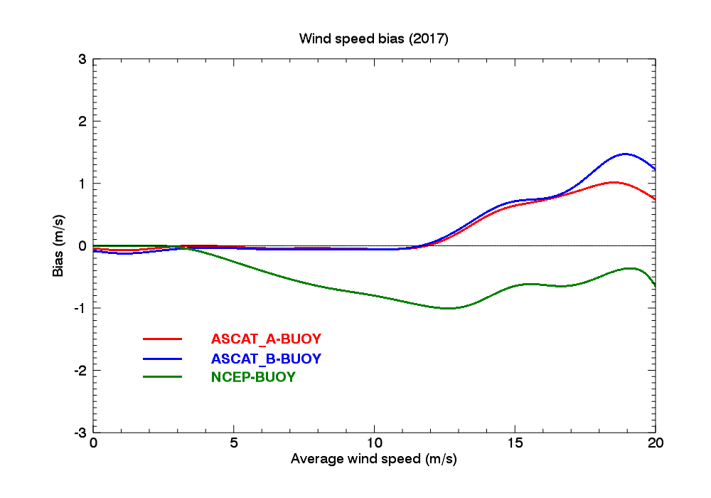
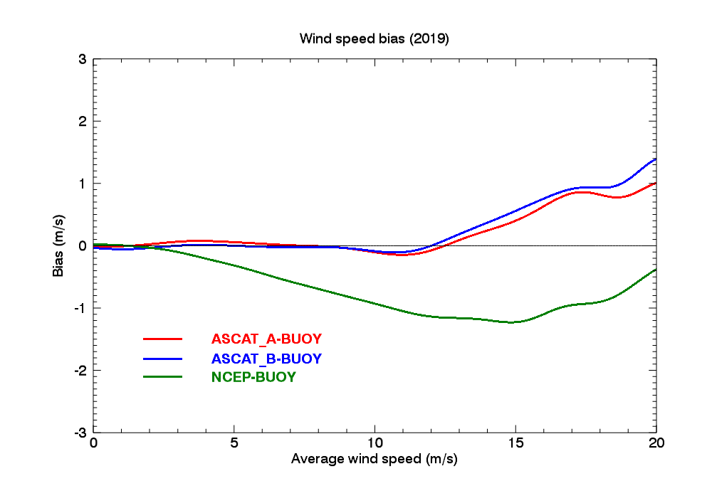
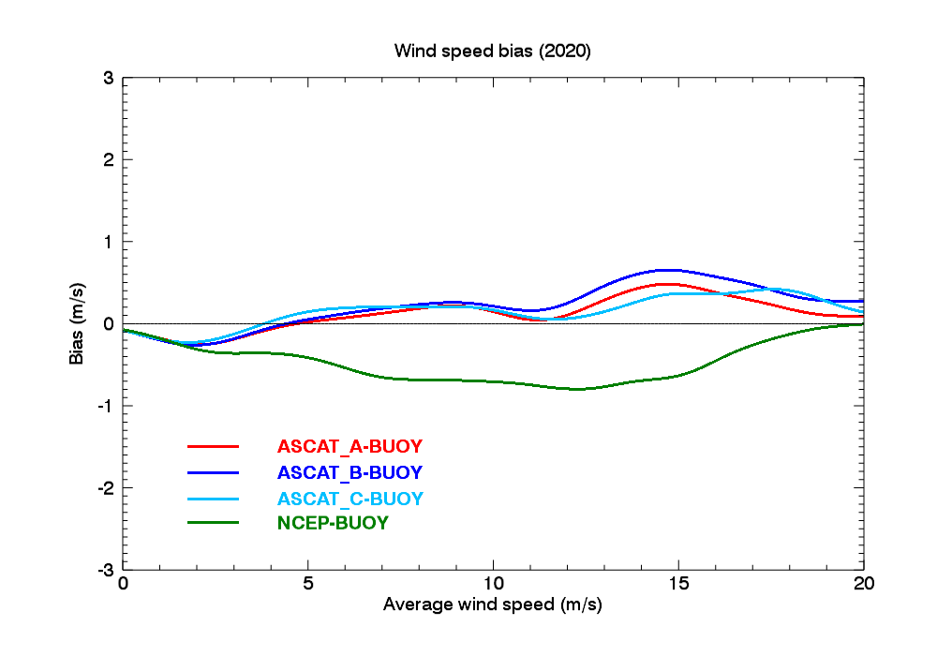
ASCAT-BUOY BIAS AS A FUNCTION OF WIND SPEED
2017
2019
70000+ quadruple Colocations/year
~2500 quintuple Colocations

Slide 11
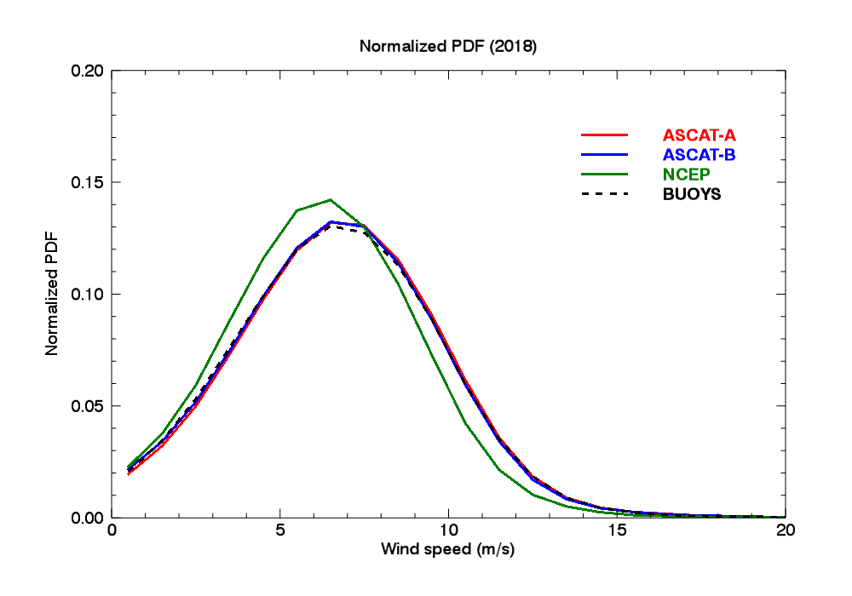
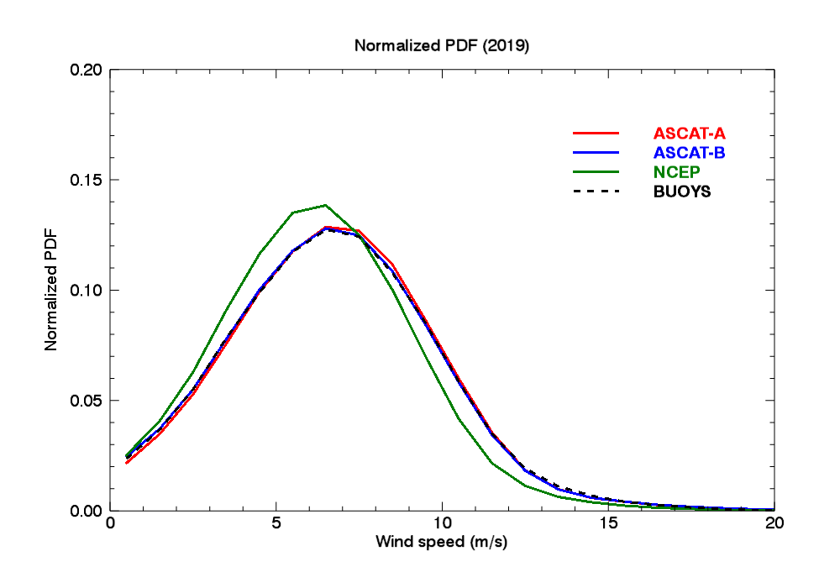
Additional colocated ASCAT/BUOY PDFs for 2018-2019
2018
2019

Slide 12
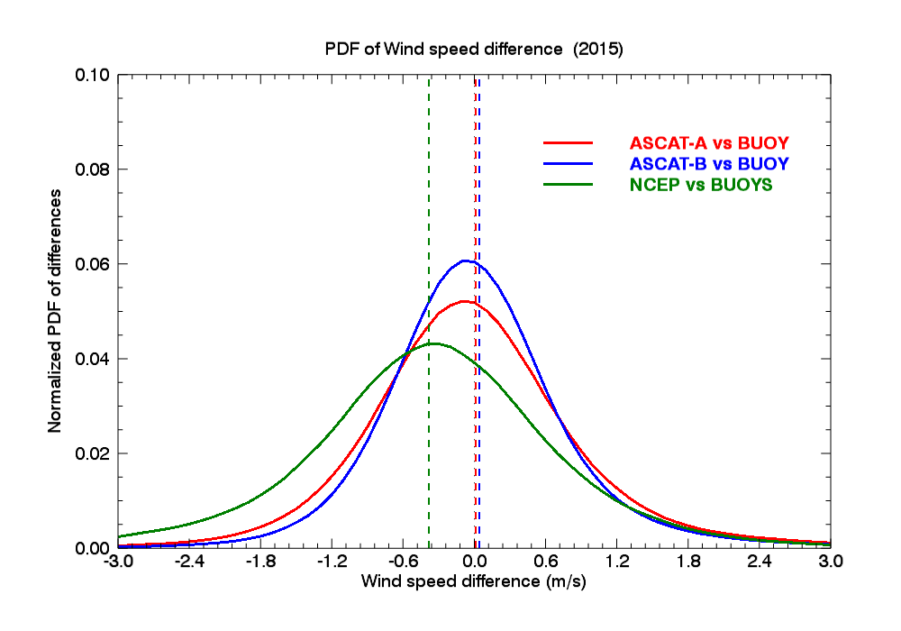
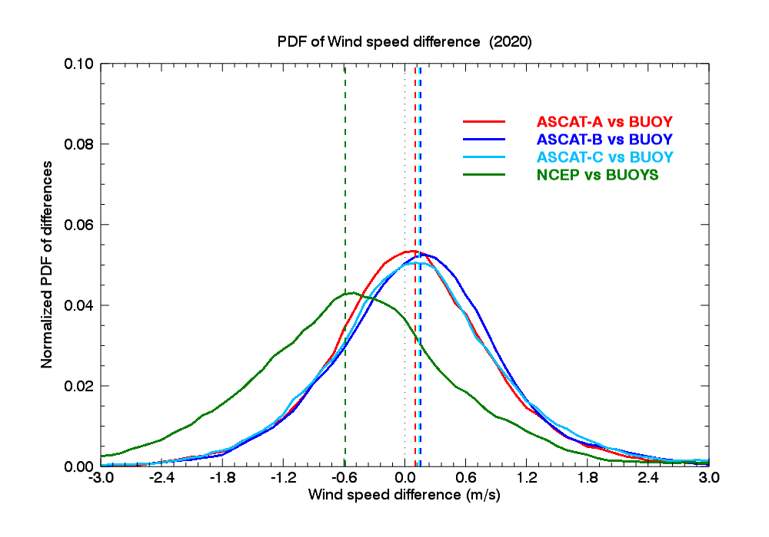
PDF of the differences ASCAT-BUOY
2015
2020
Quadruple colocations
Quintuple colocations

Slide 13
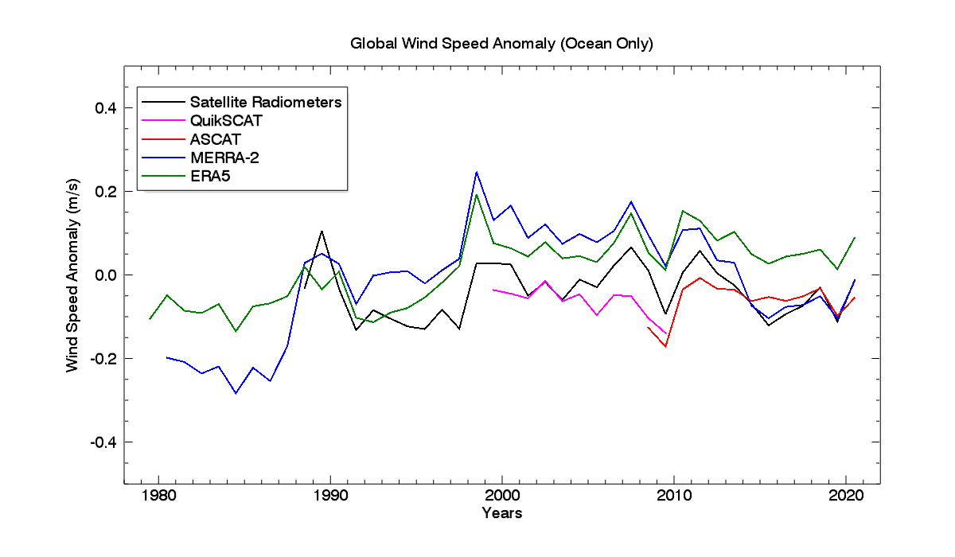
USE OF SCATTEROMETERS CDR FOR STATE OF THE CLIMATE REPORT : WIND ANOMALY TIMESERIES 1988-2020
Global ocean wind anomaly timeseries for the AMS 2020 State of the Climate report (to be published July 2021)
ASCAT-A and -B
QSCAT
Radiometers

